Slide 1

10 REASONS BEHIND FINLAND’S HAPPINESS
Photo: Aleksi Poutanen, Helsinki Partners, 2021
Notes:
1

Slide 2

Finland is the happiest country in the world
10 REASONS BEHIND FINLAND’S HAPPINESS
1
2
3
4
5
6
7
8
9
10
1
Photo: Svante Gullichsen, Helsinki Partners, 2024
Finland is
the happiest country in the world.
Finland has ranked at the top of the World Happiness Report since 2018.
Source: World Happiness Report
Notes:
2

Slide 3
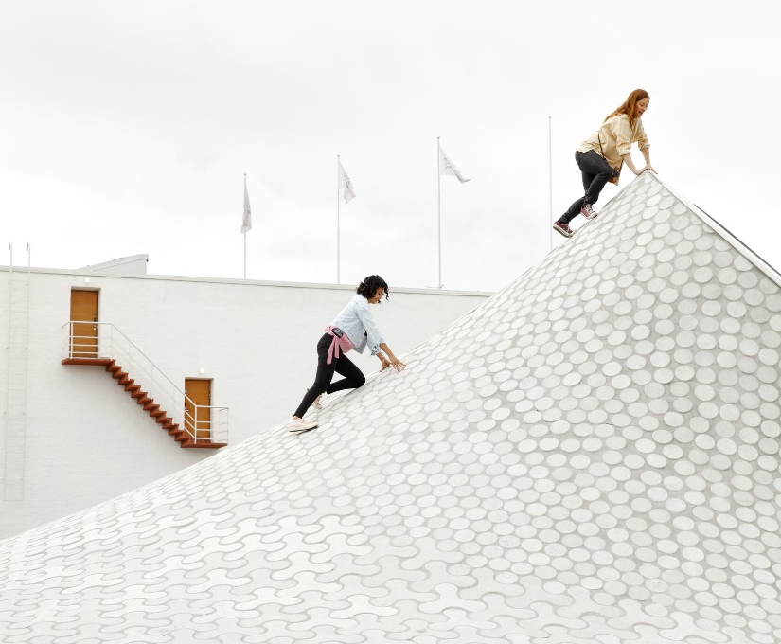
Finland is the happiest country in the world
10 REASONS BEHIND FINLAND’S HAPPINESS
1
2
3
4
5
6
7
8
9
10
1
Photo: Karoliina Bärlund, Helsinki Partners, 2021
In Finland,
happiness doesn’t just happen.
Finnish happiness reflects the strong social systems and culture of well-being that has been built over the past 100 years.
Notes:
3

Slide 4
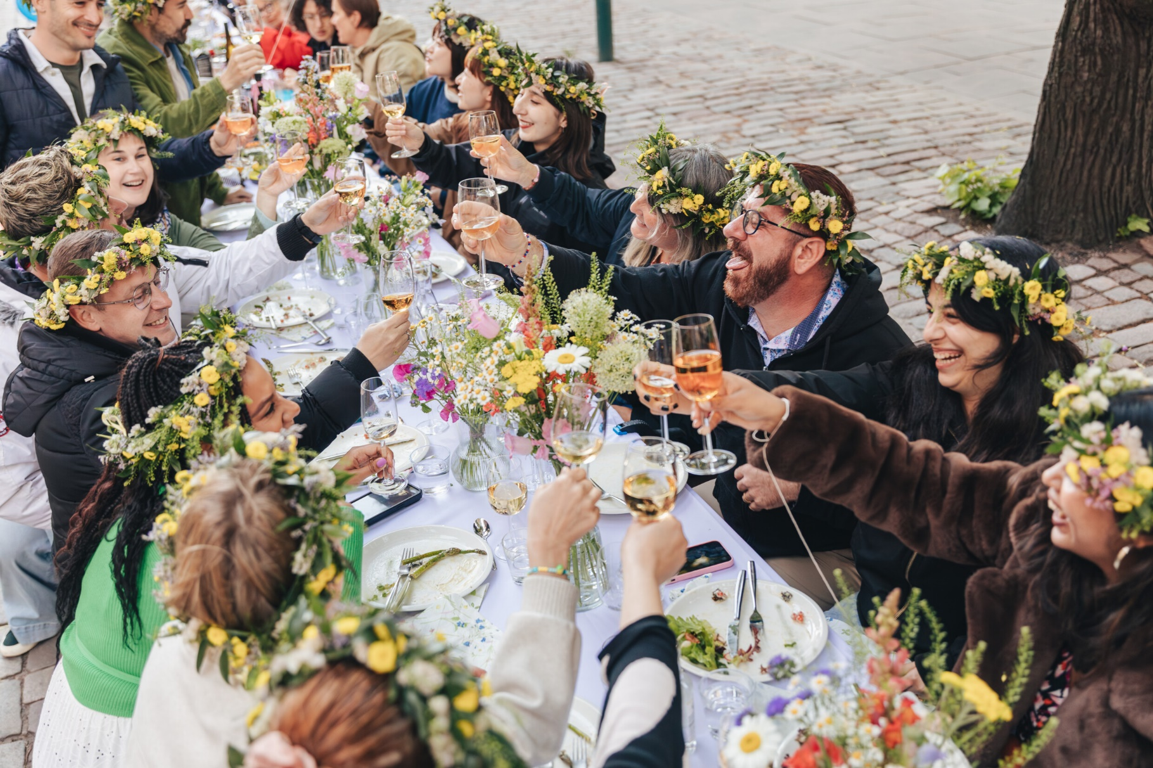
Finland is the happiest country in the world
10 REASONS BEHIND FINLAND’S HAPPINESS
1
2
3
4
5
6
7
8
9
10
1
Photo: Svante Gullichsen, Helsinki Partners, 2024
We call it an
infrastructure of happiness.
But what is it about Finnish society and way of life that
supports personal happiness?
Notes:
4

Slide 5
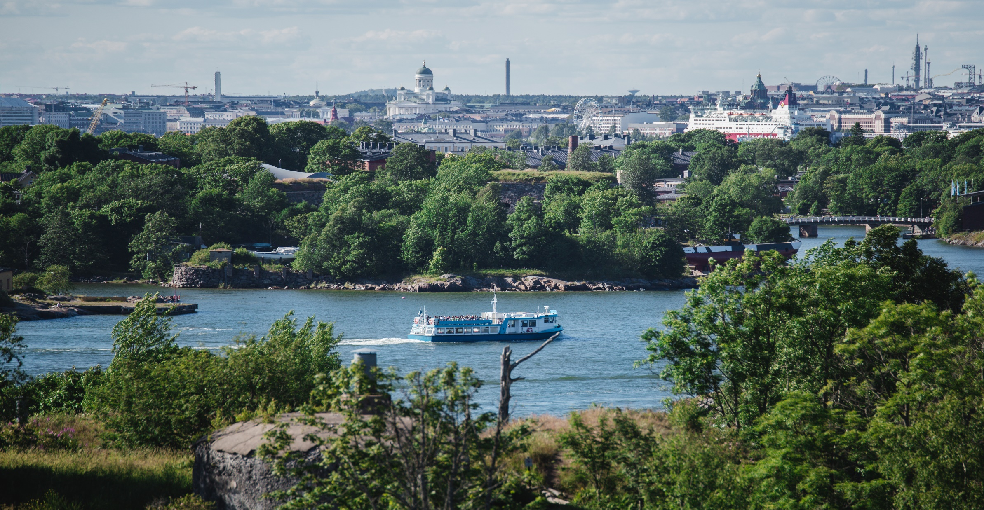
Why is Finland so happy?
Photo: Julia Kivelä, Visit Finland, 2017
Notes:
5

Slide 6

Why is Finland so happy?
10 REASONS BEHIND FINLAND’S HAPPINESS
1
2
3
4
5
6
7
8
9
10
Photo: Karoliina Bärlund, Helsinki Partners, 2021
1. Trust as foundation
Trust is a cornerstone of Finnish society and plays a vital role in fostering happiness. In Finland, trust extends beyond personal relationships to include public institutions, governance, and even strangers.
Notes:
6

Slide 7
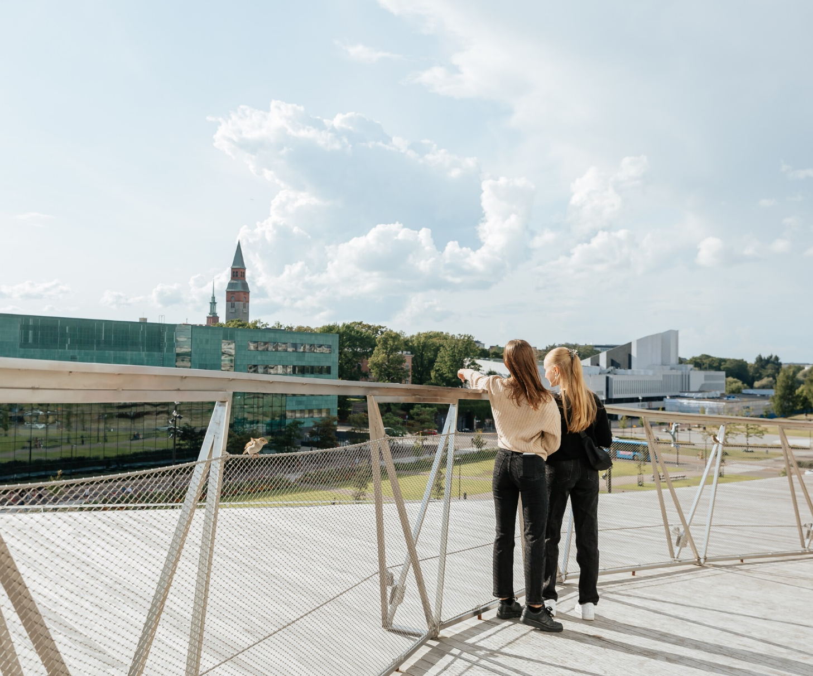
Why is Finland so happy?
10 REASONS BEHIND FINLAND’S HAPPINESS
1
2
3
4
5
6
7
8
9
10
Photo: Ida Laukkanen, Boksi, 2021
2. Good governance
Finnish happiness rests on good governance and a political system that is transparent, accountable, and a committed to the rule of law.
Notes:
7

Slide 8

Why is Finland so happy?
10 REASONS BEHIND FINLAND’S HAPPINESS
1
2
3
4
5
6
7
8
9
10
Photo: Julia Kivelä, Helsinki Partners, 2024
3. Framework of support
Finland offers a societal framework that combines stability and safety nets, creating an environment where individuals can make life choices without fear of failure.
Notes:
8

Slide 9

Why is Finland so happy?
10 REASONS BEHIND FINLAND’S HAPPINESS
1
2
3
4
5
6
7
8
9
10
1
Photo: Tuukka Koski, City of Helsinki, 2024
4. Shared responsibility
Finns’ strong sense of shared responsibility, with over 90% considering paying taxes an important civic duty, strengthens social cohesion and promotes a fair and just society, central to happiness.
Notes:
9

Slide 10
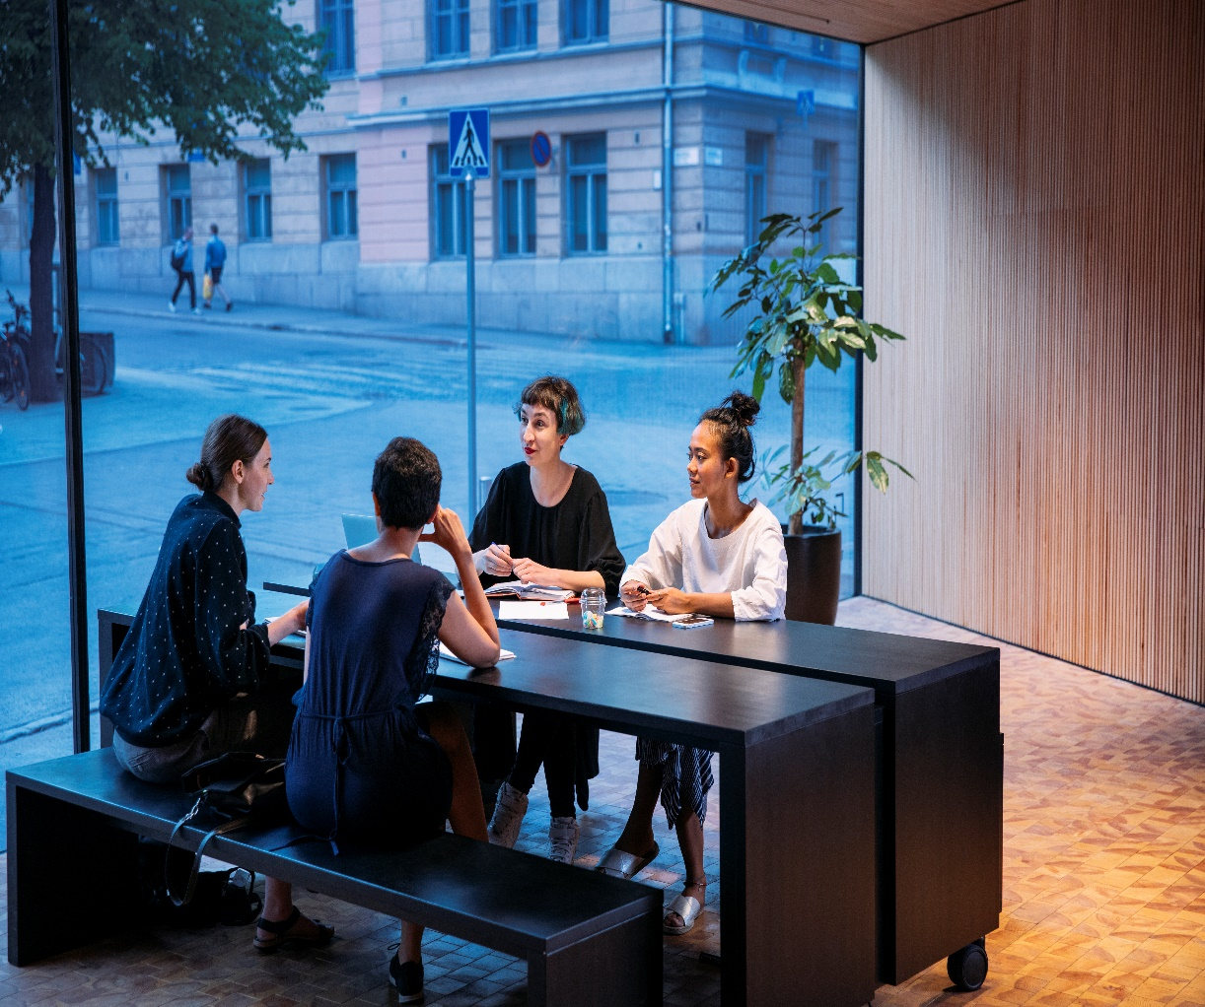
Why is Finland so happy?
10 REASONS BEHIND FINLAND’S HAPPINESS
1
2
3
4
5
6
7
8
9
10
Photo: Jussi Hellsten, City of Helsinki, 2018
5. Participation and dialogue
The Finnish system encourages active participation and open dialogue between the public and authorities, fostering inclusion and empowerment. The protection of freedom of expression allows Finns to share their views freely, promoting transparency and a thriving democracy that supports happiness.
Notes:
10

Slide 11
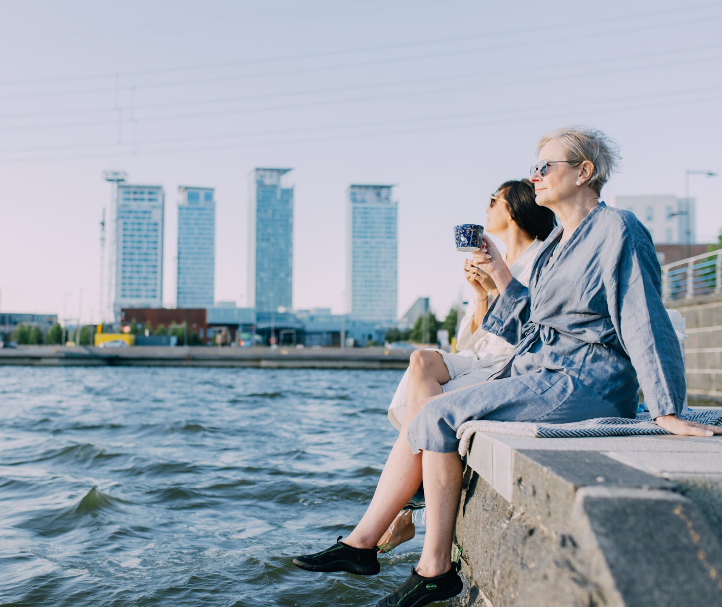
Why is Finland so happy?
10 REASONS BEHIND FINLAND’S HAPPINESS
1
2
3
4
5
6
7
8
9
10
1
Photo: Julia Kivelä, Helsinki Partners, 2023
6. Equality and social justice
Finland’s commitment to equality, including gender equality and strong protections for minorities, fosters a socially inclusive environment that contributes to overall happiness.
Notes:
11

Slide 12
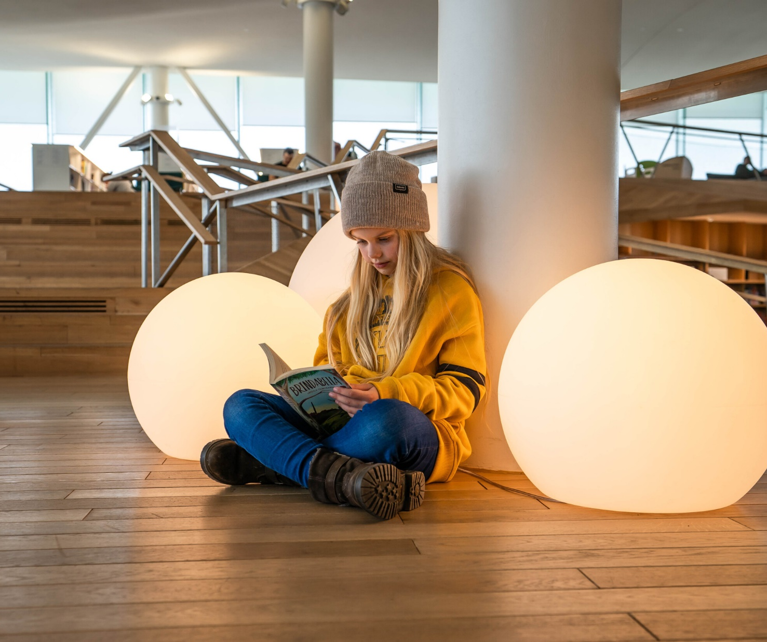
Why is Finland so happy?
10 REASONS BEHIND FINLAND’S HAPPINESS
1
2
3
4
5
6
7
8
9
10
Photo: Laura Dove, Helsinki Partners, 2022
7. Education and information
Finland’s world-class education system ensures equal access to high-quality learning, empowering individuals to succeed. Combined with strong press freedom and a focus on media literacy, which enables citizens to navigate information critically, these pillars create an informed and engaged society.
Notes:
12

Slide 13

Why is Finland so happy?
10 REASONS BEHIND FINLAND’S HAPPINESS
1
2
3
4
5
6
7
8
9
10
Photo: Natura Viva, 2018
8. Connection to nature
In Finland, the bond between people and nature is an essential part of daily life and well-being. The Finns’ immersion in nature promotes calmness, reduces stress, and fosters a sense of contentment. Finland's accessibility to nature, combined with the cultural value placed on it, serves as a vital source of happiness.
Notes:
13

Slide 14
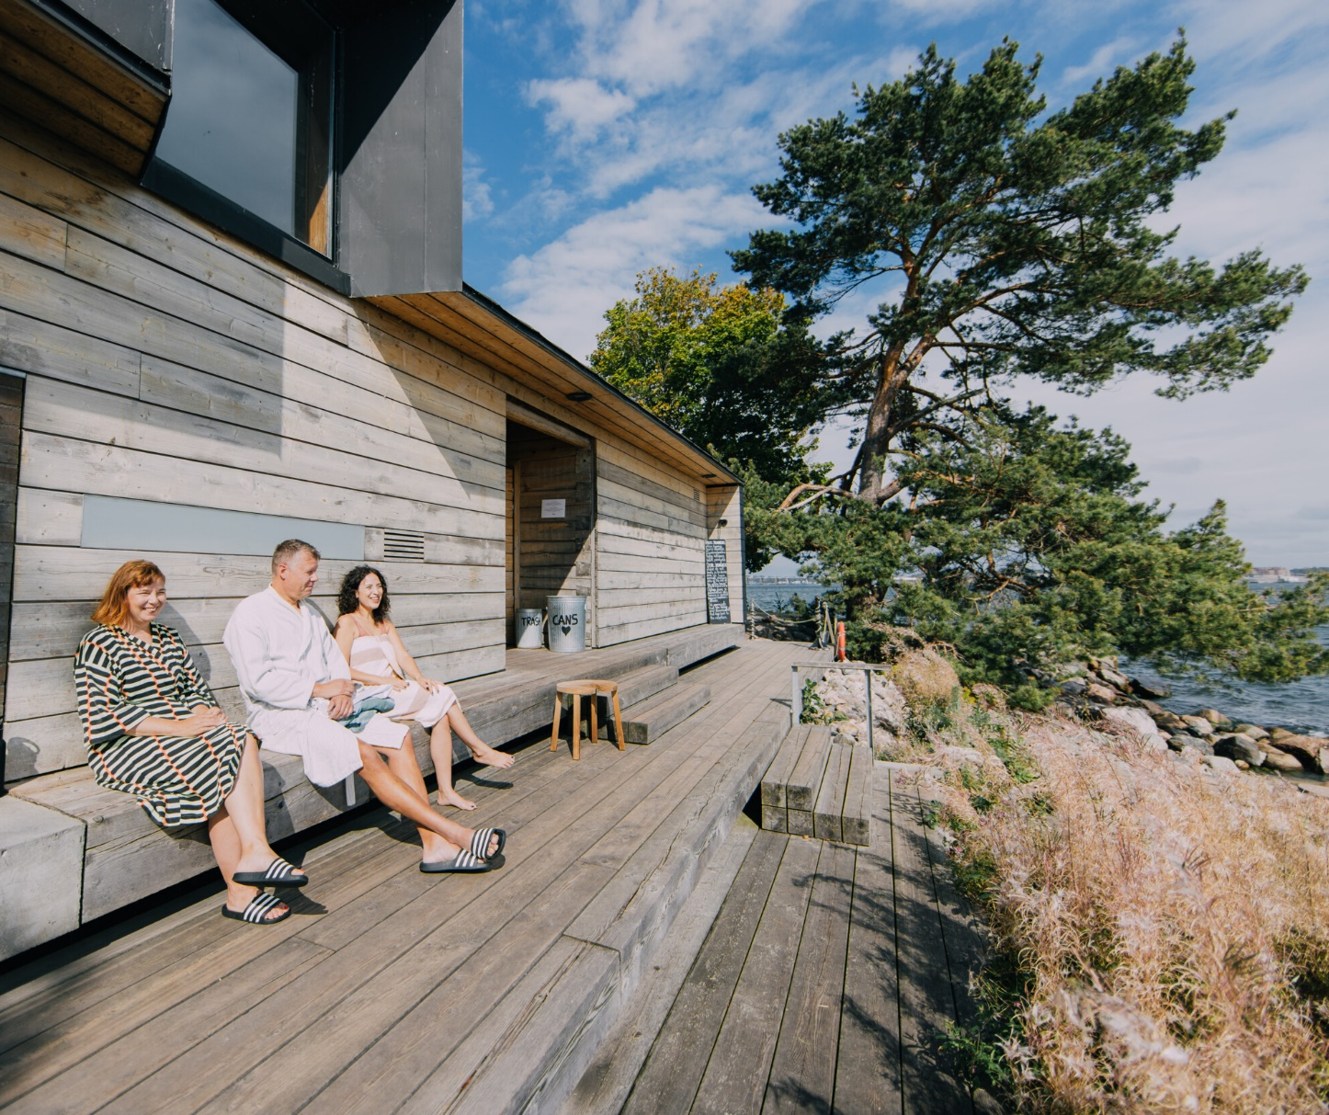
Why is Finland so happy?
10 REASONS BEHIND FINLAND’S HAPPINESS
1
2
3
4
5
6
7
8
9
10
Photo: Julia Kivelä, Helsinki Partners, 2023
9. Simplicity and sauna
Finnish culture is deeply rooted in an appreciation for simplicity, functionality, and the importance of life's small moments. At the heart of this is the sauna, a space where Finns unwind, disconnect from daily pressures, and reconnect with themselves and others in a meaningful way.
Notes:
14

Slide 15

Why is Finland so happy?
10 REASONS BEHIND FINLAND’S HAPPINESS
1
2
3
4
5
6
7
8
9
10
Photo: Jussi Hellsten, Helsinki Partners, 2020
10. Balance
in life
Finnish society is built to support a balanced life, where personal well-being is prioritized alongside professional commitments. The systems in place, from work policies to social structures, create an environment where individuals can harmonize their responsibilities, fostering a lifestyle that promotes both productivity and personal fulfillment.
Notes:
15

Slide 16
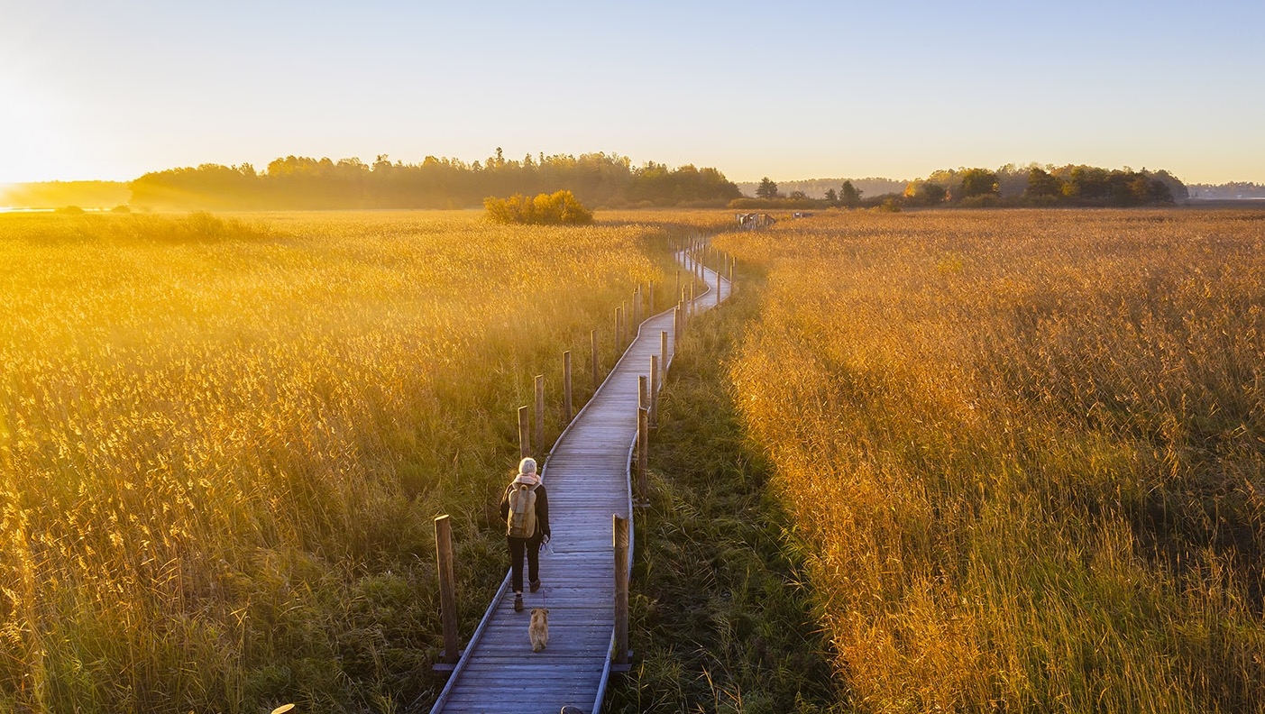
In a well-functioning, safe, fair, and ‘error-friendly’ society, people can worry less and focus more on living their lives, enjoying the freedom to be happy.
Photo: Mika Huisman, 2018
Notes:
16

Slide 17
Making happiness happen.
FINLAND
Notes:
17

