Slide 2
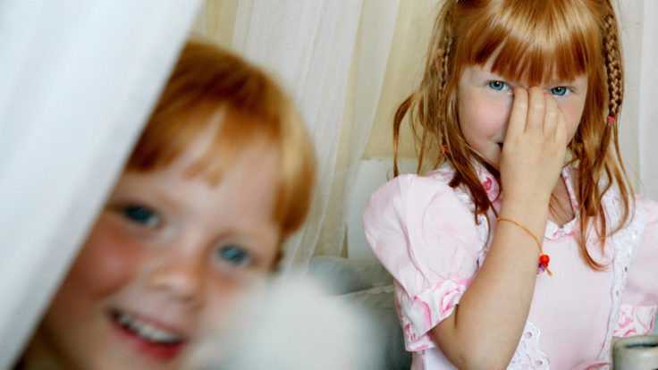
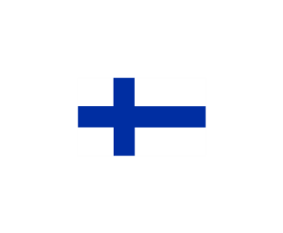
FINLAND:
THE HAPPIEST
COUNTRY IN
THE WORLD
Notes:
Visit Finland Image Bank / G73487.jpg

Slide 3
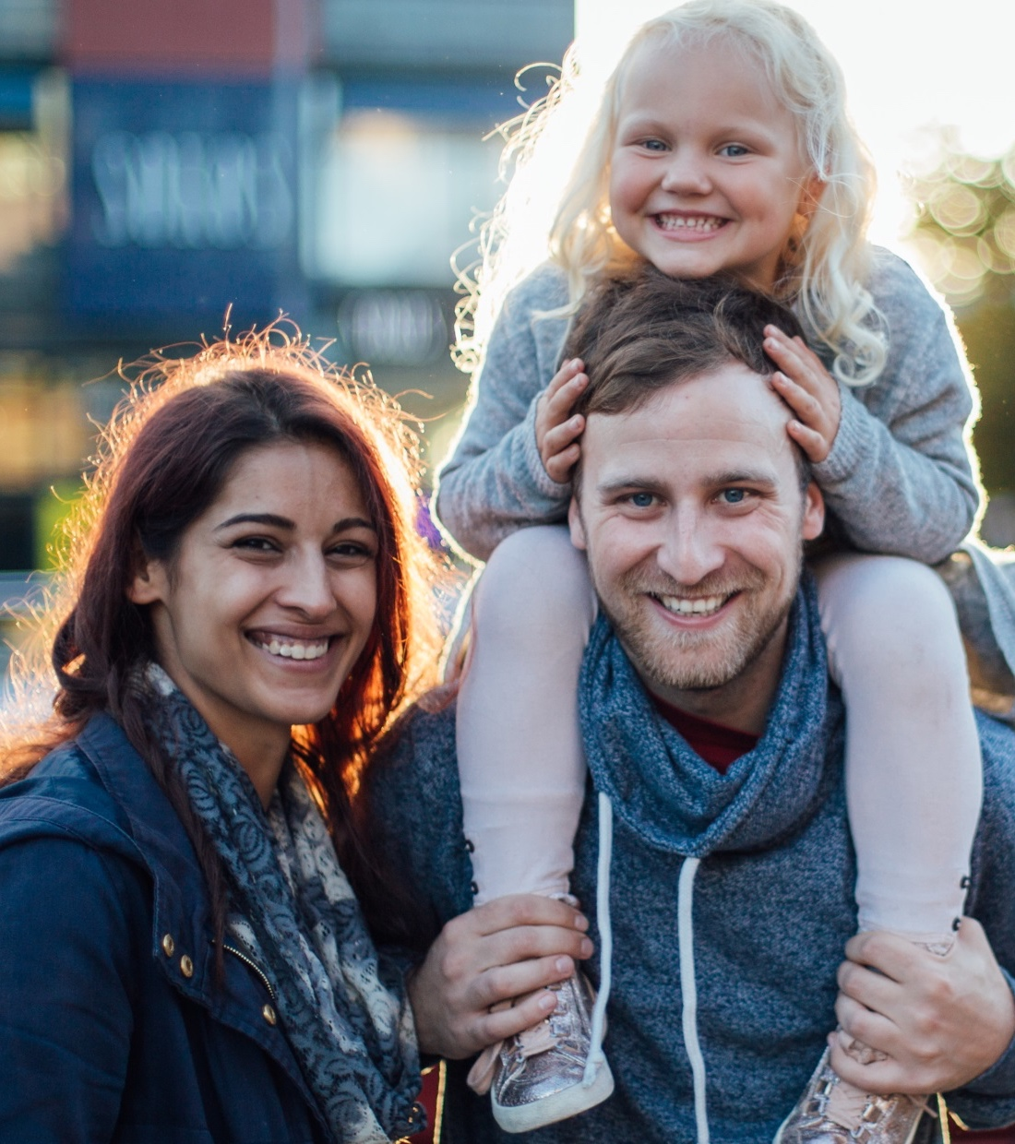
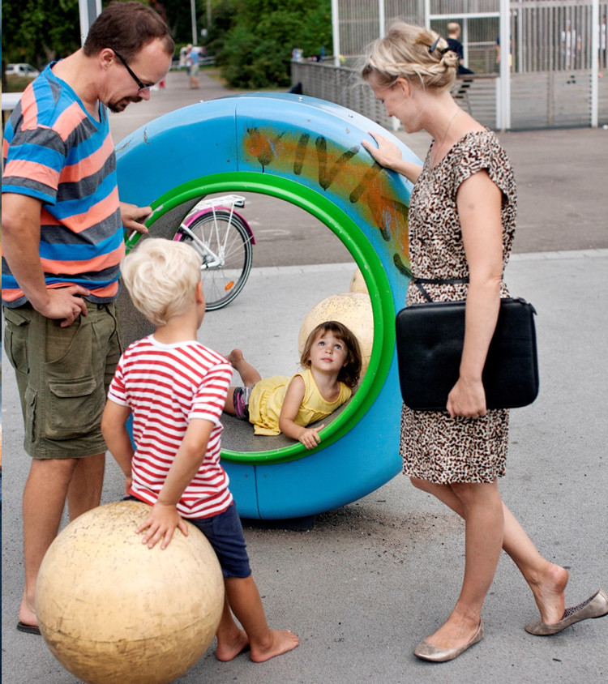

For the fifth year in a row, Finland ranks as the happiest country in the world in the UN World Happiness Report.
1
ST
HAPPIEST
COUNTRY
For the fifth year in a row, Finland is the happiest nation in the World Happiness Report, which ranks 156 countries by how happy their citizens perceive themselves to be.

Slide 4
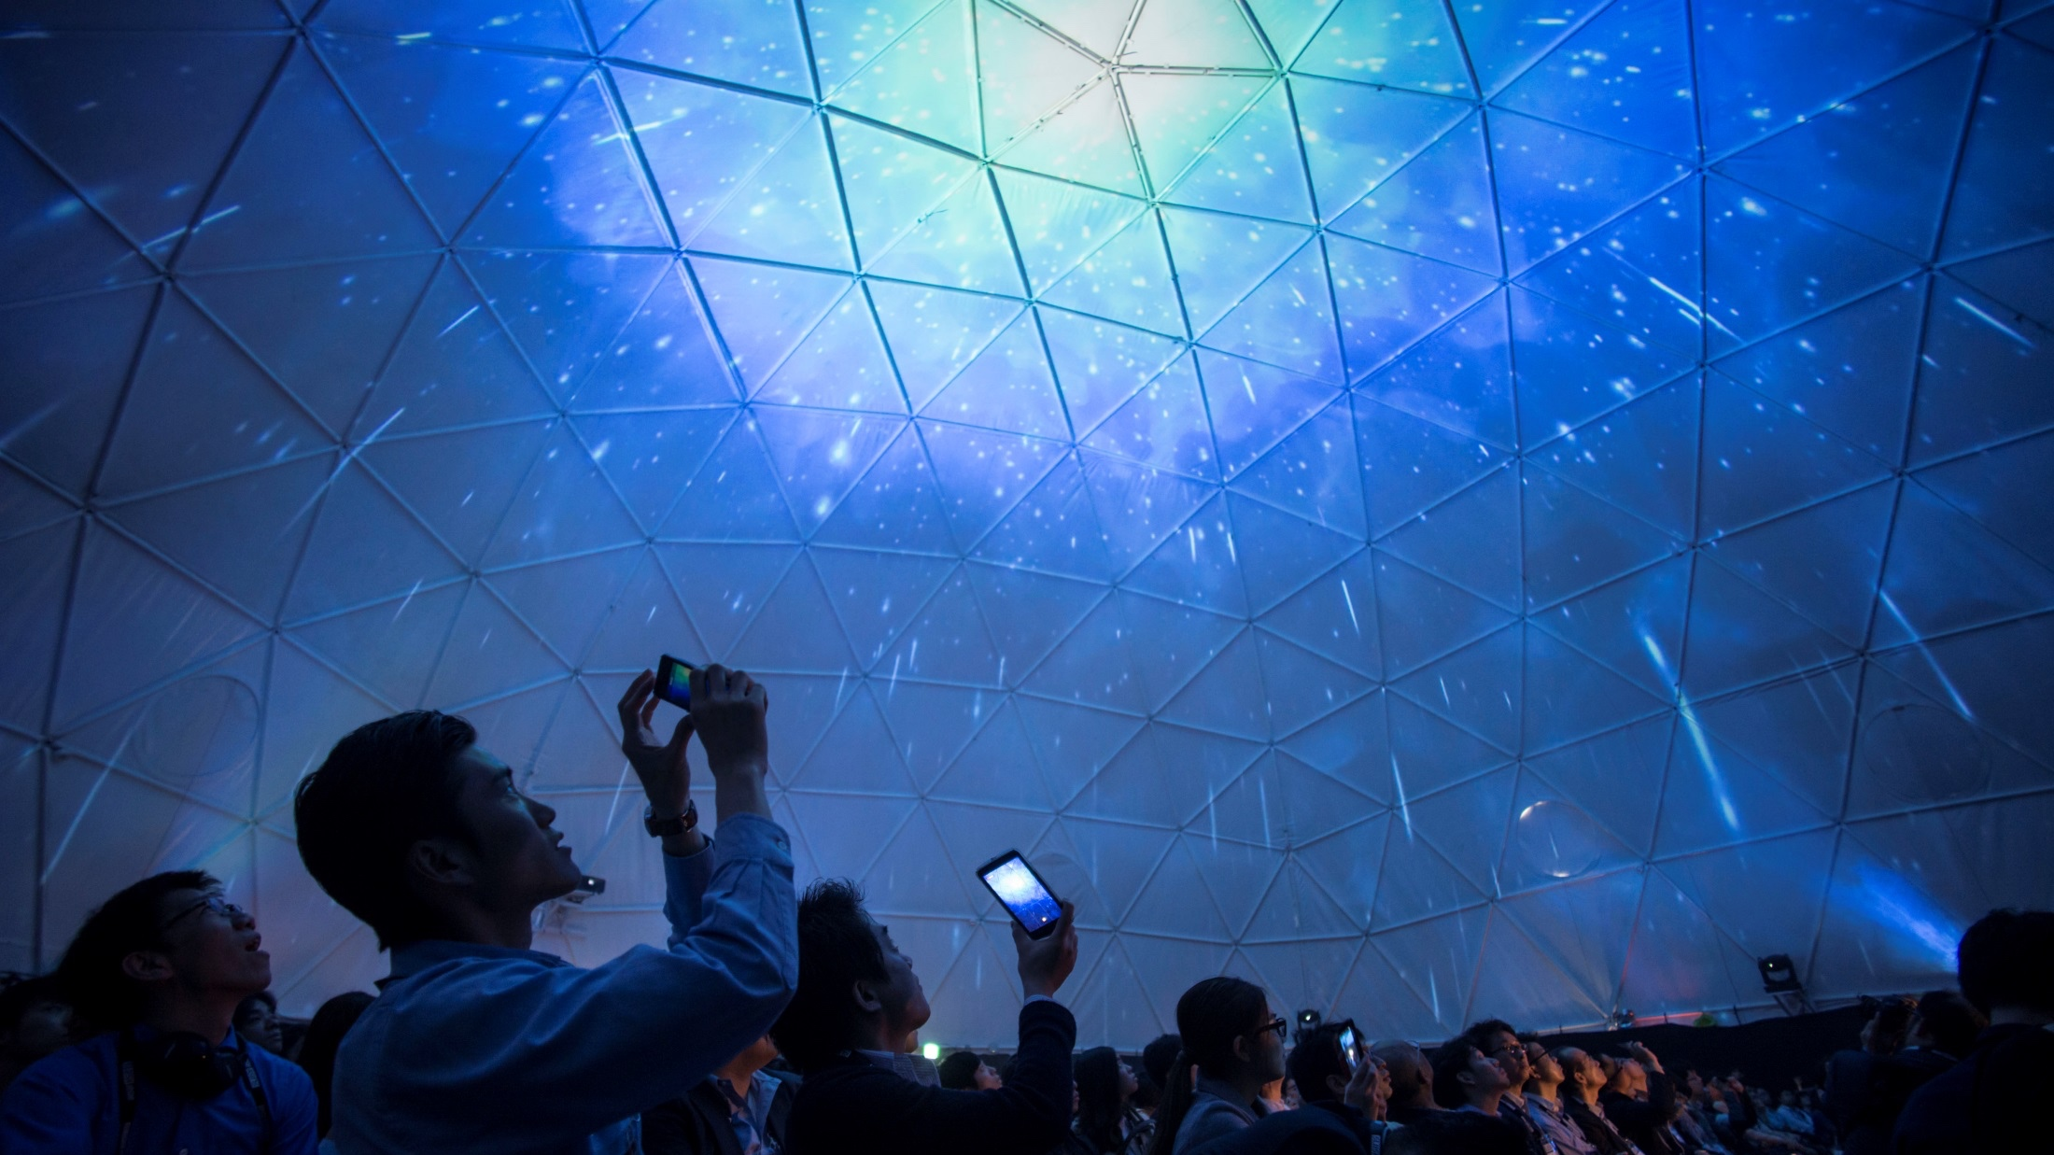

What is the World
Happiness Report?
The UN World Happiness Report ranks 156 countries by their happiness levels.
People in each country are asked to rate their life on a 10-step ladder from the best possible to the worst possible life for them.
Notes:
FINLAND IMAGE BANK: Slush Japan 2015 Slush_Japan_2015 (5).jpg Petri Artturi Asikainen/Team Finland/Finland Promotion Board

Slide 5
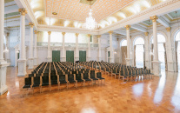
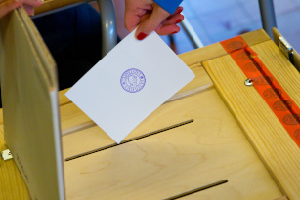
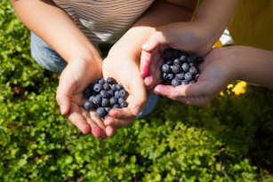
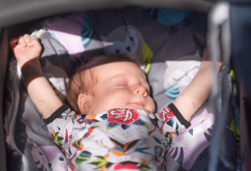
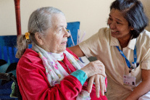


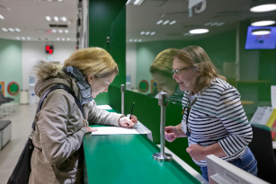
Although the World Happiness Report measures subjective happiness, the study also attempts to explain each country’s score by referring to a range of factors.
CONFIDENCE IN
GOVERNMENT
QUALITY OF
DEMOCRACY
GDP
PER CAPITA
HEALTHY
LIFE EXPECTANCY
AVAILABLE
SOCIAL SUPPORT
FREEDOM TO
MAKE DECISIONS
GENEROSITY
IN SOCIETY
ABSENCE OF
CORRUPTION

Slide 6
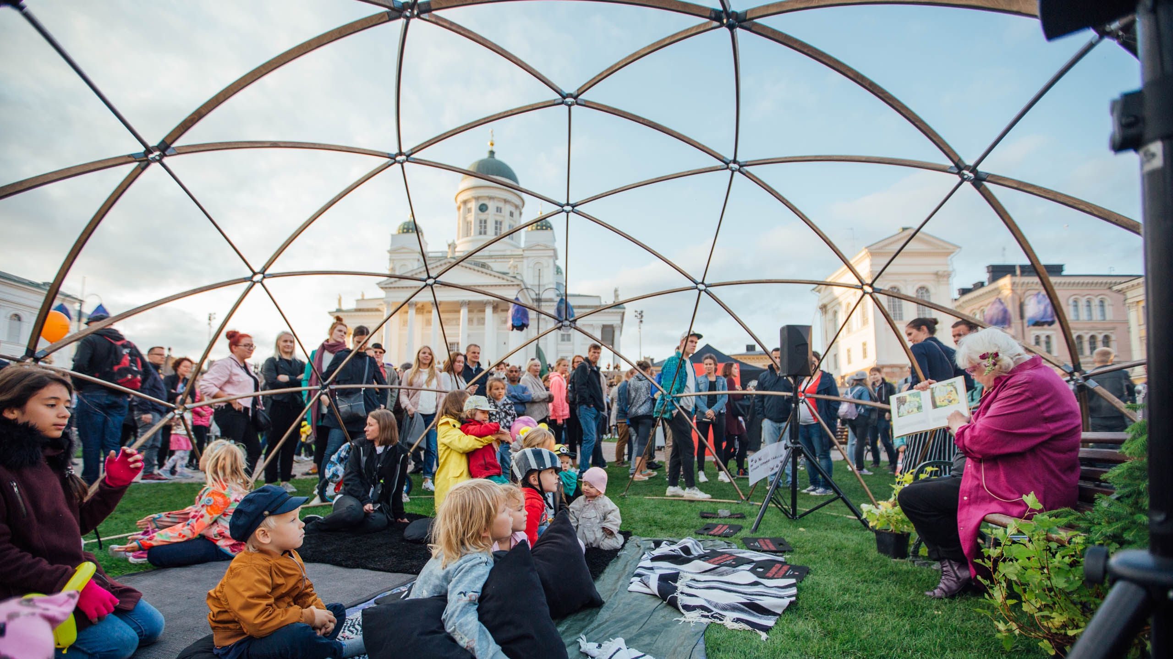
Why are Finns so happy?
Notes:
VISIT FINLAND IMAGE BANK: Finland_Helsinki_events_Juhlaviikot_TheNightOfArts_web_byJuliaKivela__MG_1317.jpg Julia Kivelä

Slide 7
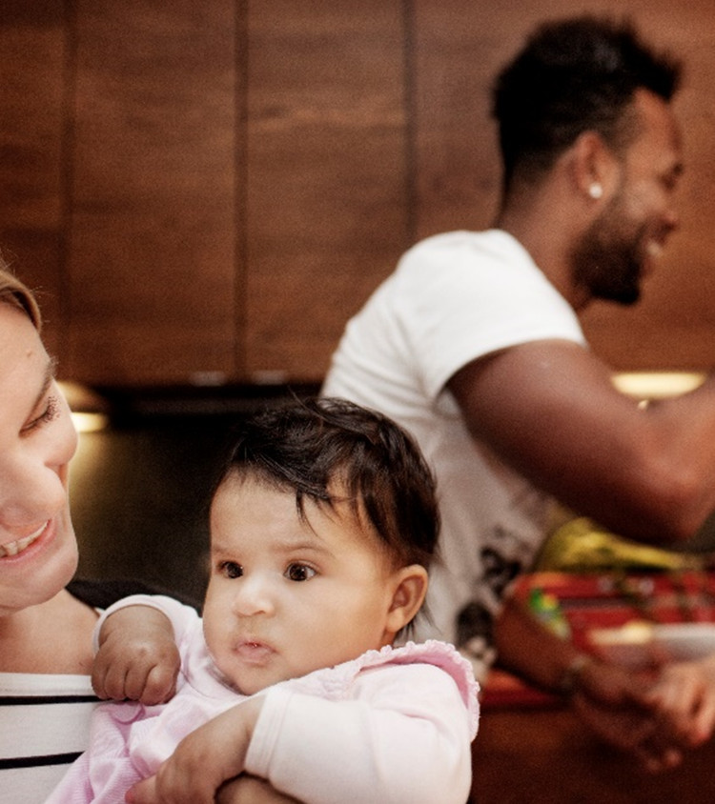
Finland has the best governance in the world as measured by voter turnout, legislative independence and the number of women in Parliament.
Finland is also the most stable nation in the world.
1
ST
BEST
GOVERNANCE
IN THE
WORLD
Finland has the best governance in the world as measured by voter turnout, legislative independence and
the number of women in Parliament.
Source: The Legatum Prosperity Index 2021, Fund for Peace 2021
Notes:
Source: The Legatum Prosperity Index 2021 (Best Governance)
Source: Fund for Peace 2021 (Most stable nation)

Slide 8
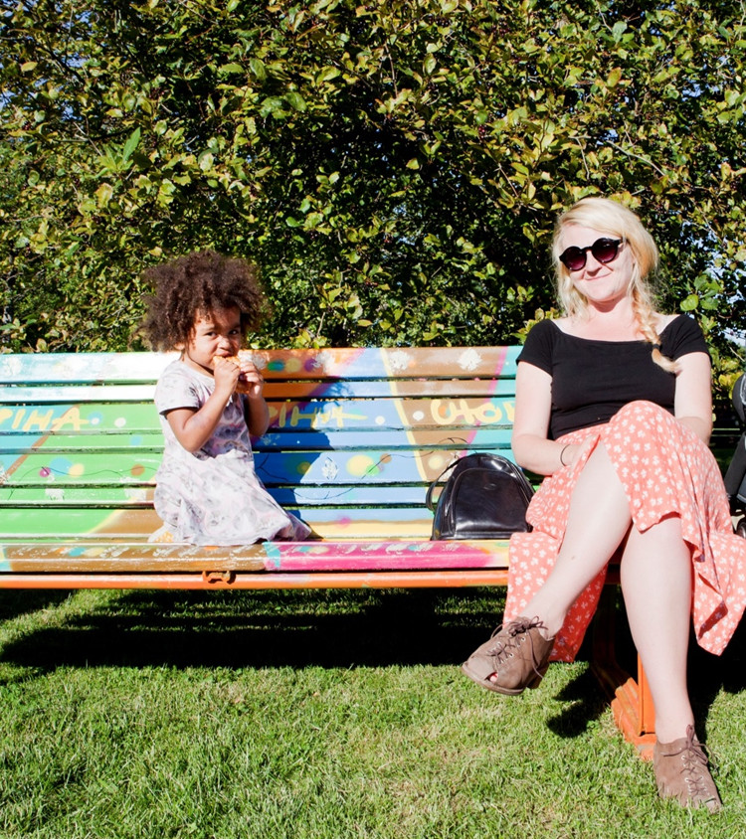
1
st
LEAST
CORRUPT
COUNTRY
Finns can trust the system and each other.
Finland is one of the least corrupt countries in the world, and 85% of Finns agree or strongly agree that they can trust most of their fellow citizens. That is the highest percentage in the EU.
In the 2021 Corruption Perceptions Index (CPI), Finland rankis in the shared first place with Denmark and New Zealand.
Source: Transparency International 2021, Eurobarometer 471, 2018
Notes:
Source: Transparency International 2018 (Corruption)
Source: Eurobarometer 471 – April 2018 (Trust)

Slide 9
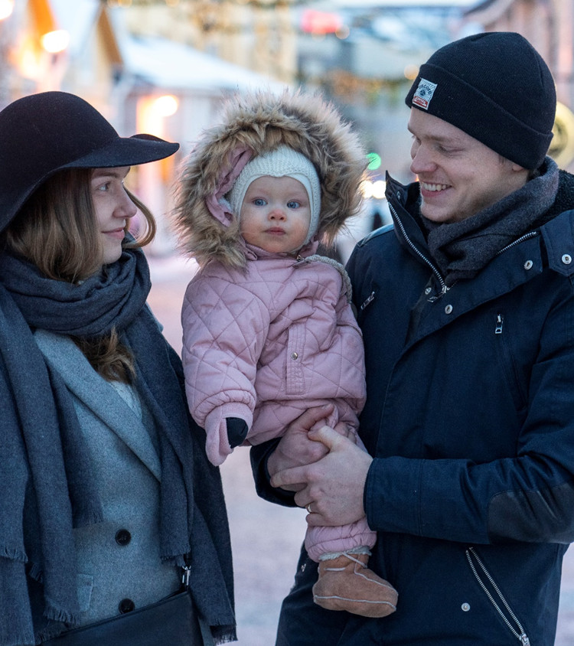

1
ST
MOST
POLITICAL AND civil
FREEDOM
Finns truly have the freedom to make decisions.
Finland ranks first among countries with the most political and civil freedom. Finns are also in the global top three when it comes to opportunities available to a nation’s citizens.
Finland ranks 1st among countries with the most political and civil freedom. The index uses indicators such as status of freedom, political rights and civil liberties.
Source: Freedom House 2021, The Legatum Prosperity Index 2021
Notes:
Source: Freedom House 2021 (Freedom)
Source: The Legatum Prosperity Index 2021 (Opportunities)

Slide 10
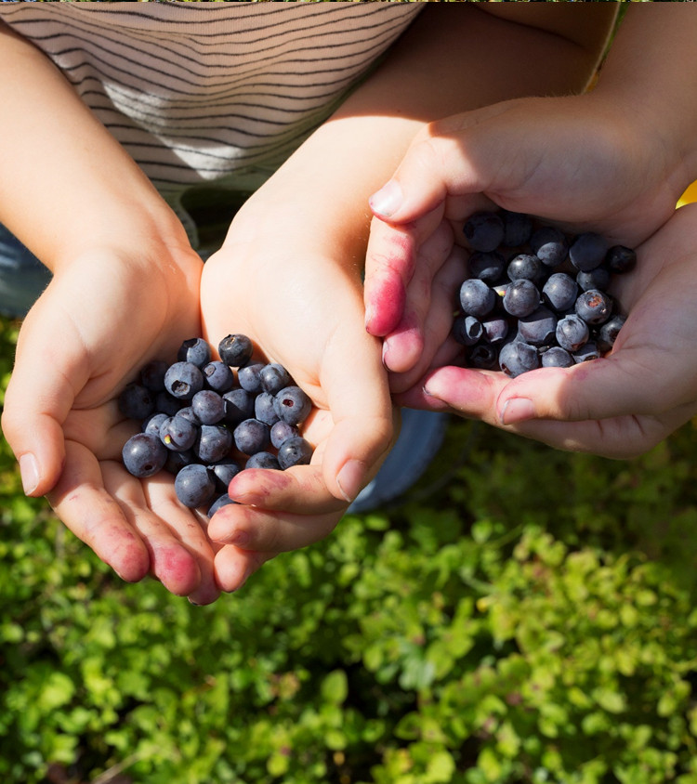
4
Wealth and wellbeing play a part in Finns’ happiness. Finland ranks high in prosperity when measuring economic growth, quality of life and other related categories.
Finland also ranks in the top ten when ranked according to innovations and business environment.
th
GLOBAL
PROSPERITY
Finland ranks third in the Global Prosperity Index, which measures wealth, economic growth, wellbeing, life opportunities and quality of life, among other things.
Source: The Legatum Prosperity Index 2021, Bloomberg Innovation Index 2021
Notes:
Source: The Legatum Prosperity Index 2021 (Global prosperity)
Source: Bloomberg Innovation Index 2021 and The Consumer Technology Association 2019 (Innovations)
Source: Global Innovation Index 2018 (Business environment)

Slide 11
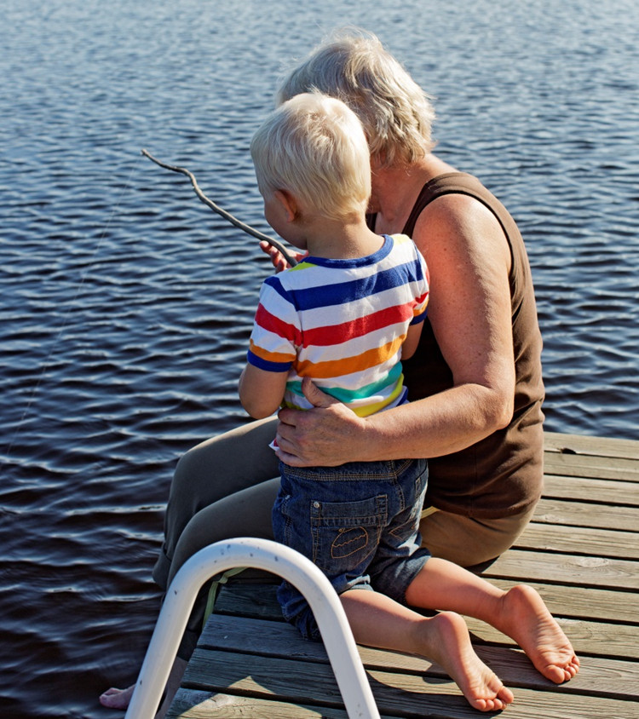

3
RD
MOST
SOCIALLY
JUST
Healthcare and income security are guaranteed for everyone in Finland.
This means a better chance at happiness for all. It is no coincidence that Finland ranks as one of the most socially just countries in the world.
Finland ranks as the 3rd most socially just country in the EU, measured according to poverty prevention, equitable education, labour market access, health and other factors.
Source: Bertelsmann Stiftung 2017
Notes:
Source: Bertelsmann Stiftung 2017 (Socially just)

Slide 12
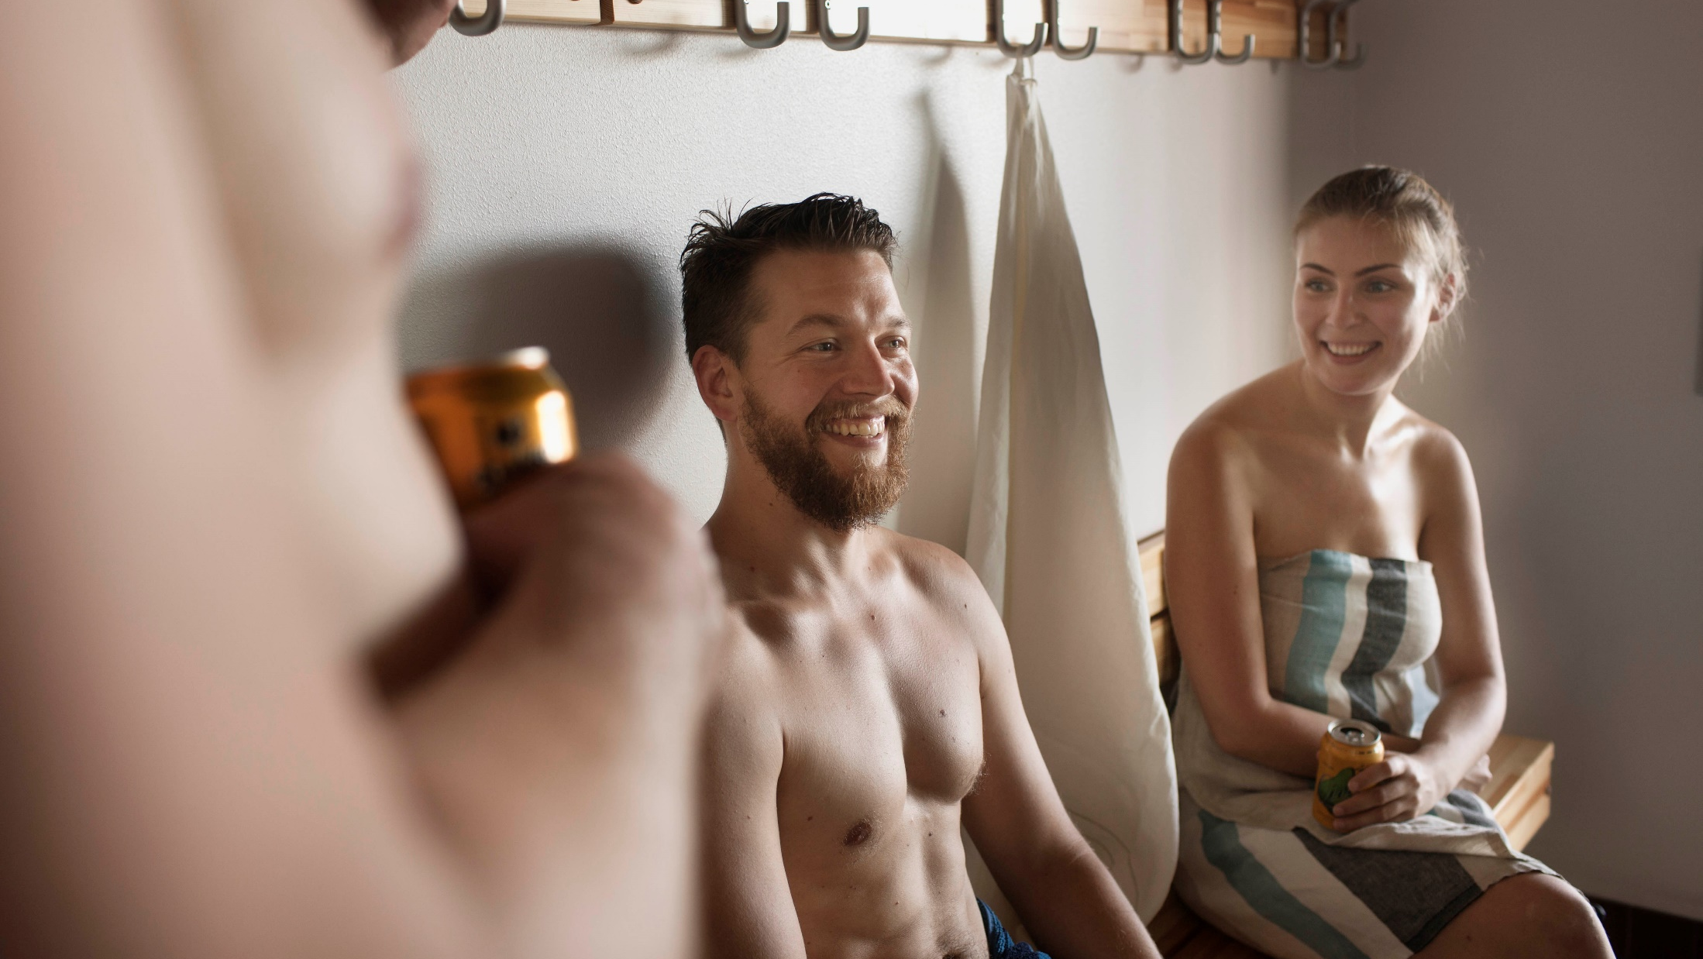
FINLAND IS ALSO
A HIGHLY EQUAL SOCIETY

Slide 13
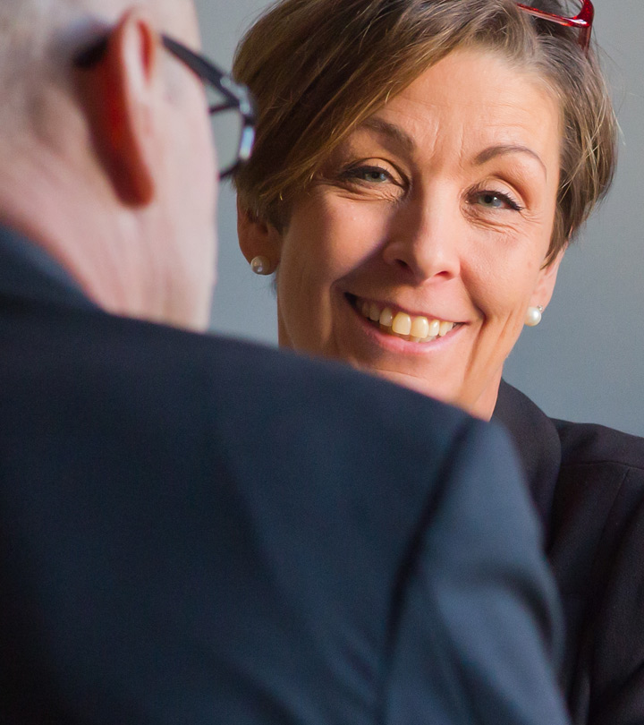

2
Gender equality is one of the core values of Finnish society.
Finland would not be one of the most advanced – and happiest – countries in the world had it not been for its strong commitment to equality.
nd
Global
Gender
Gap INDEX
Finland is one of the best countries in the world for gender equality, according to the World Economic Forum’s Global Gender Gap Report 2021.
Source: Global Gender Gap Report 2021
Notes:
Source: Global Gender Gap Report 2021

Slide 14
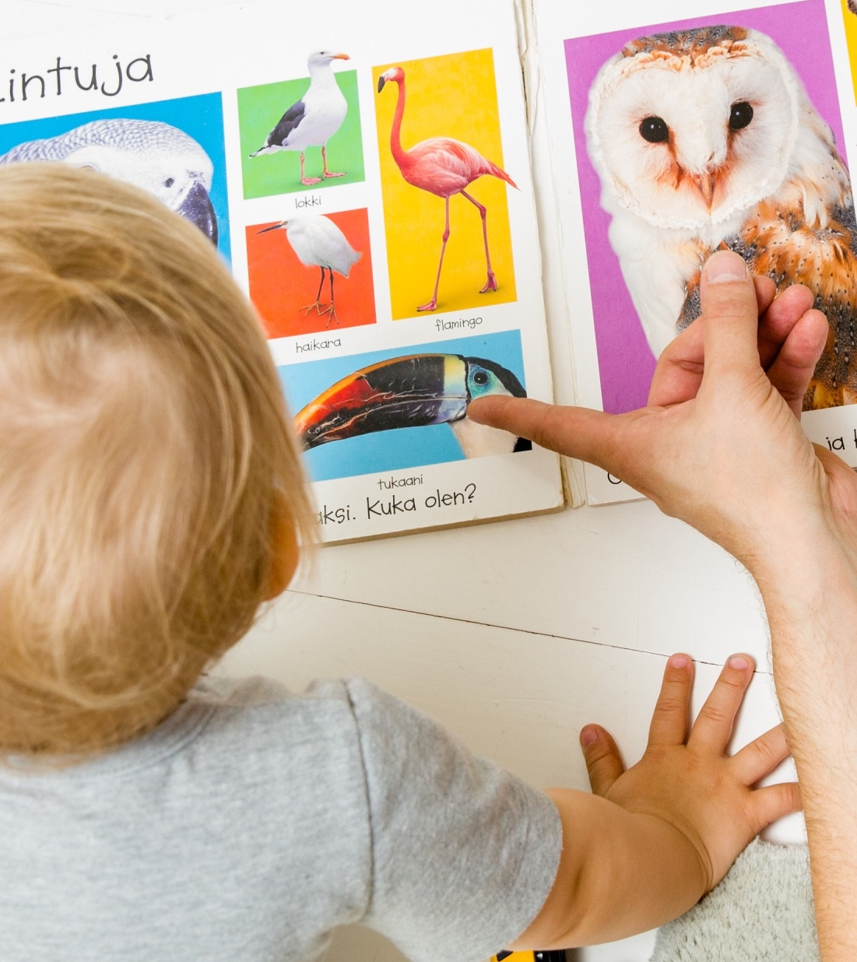

1
Women and men are equal – both at work and at home.
Finland is the only country in the developed world where fathers spend more time with school-aged children than mothers do.
Also, 80% of dads go on paid paternity leave.
ST
For time dads spend with children
Finland is the only country in the developed world
where dads spend
more time with
school-aged children than mothers do.
Source: OECD 2018
Notes:
Source: OECD 2018

Slide 15

Everyone gets an equal start in Finland.

Slide 16
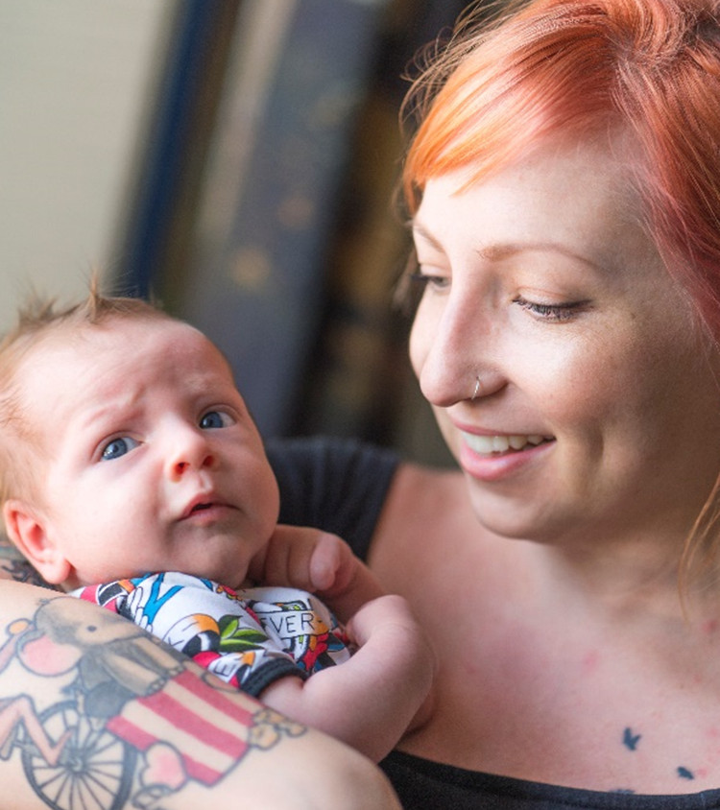

2
Finland is one of the fairest countries in the world for children.
To guarantee a more equal start to life, every Finnish child is welcomed into the world by a maternity package containing clothing and
baby-care products.
ND
FAIREST
COUNTRY FOR
CHILDREN
Finland ranks second when observing how fair a country is for all children and their wellbeing. Each country is ranked by inequality of income distribution; education; health; and life satisfaction.
Source: UNICEF 2016
Notes:
Source: UNICEF Office of Research 2016 (Fairest Country)

Slide 17
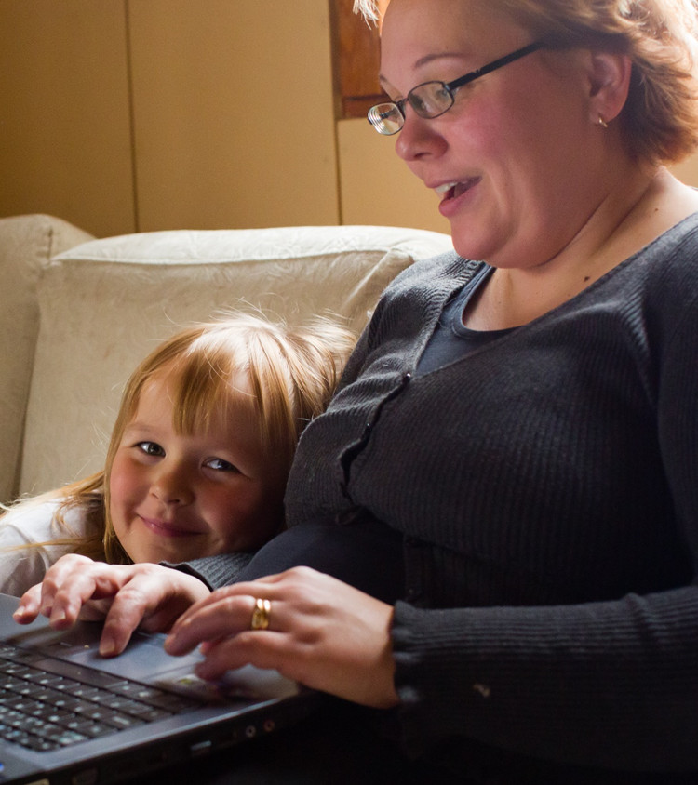
2
An equal start for everyone requires healthy and happy mothers. Finland offers free prenatal care for mothers and nearly a year of paid maternity leave when the child is born.
Affordable child care makes it easy for mothers to combine work and family life.
ND
BEST
COUNTRY TO
BE A MOTHER
UNICEF compiles statistics on the health of mothers and children and uses them to produce rankings showing where mothers fare best and where they face the greatest hardships.
Source: UNICEF 2016
Notes:
Source: UNICEF Office of Research 2015 State of The World’s Mothers Report

Slide 18
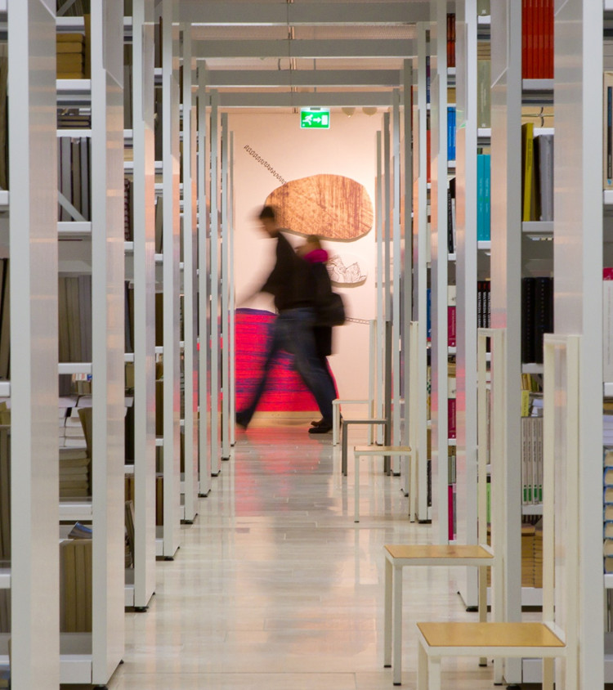

Equality also means equal access to education.
Education is free for everyone from preschool to higher education. This means that every Finn has a right to go to university tuition-free.
Everyone’s potential is utilised.
4
th
EDUCATION
Finland ranks number four in education out of 167 countries. The Legatum Prosperity Index measures access to education; quality of education; and human capital.
Source: Legatum Prosperity Index 2021
Notes:
Source: The Legatum Prosperity Index 2021

Slide 19
Finland:
The Happiest Country
in the World.

