Slide 2
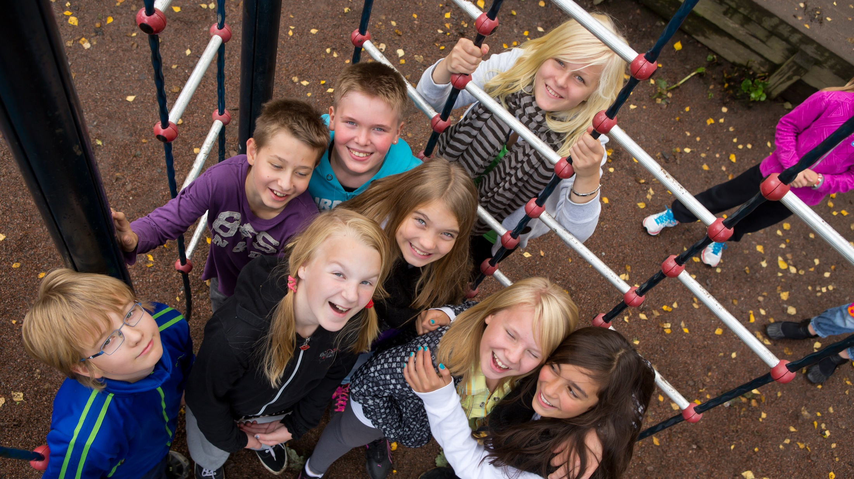
Future Skills with FINLAND
Notes:
Photo: Riitta Supperi/Keksi/Finland Promotion Board

Slide 3
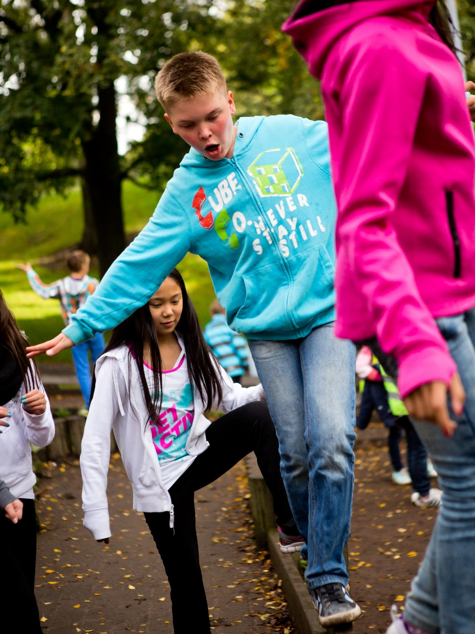
Education system
The Finnish education system has been built on the belief that a nation can only fulfill its human and economic potential if every citizen has an equal opportunity to fulfill their personal potential.
Notes:
That has meant that education should be available to everyone regardless of their gender or socioeconomic background.
Photo: Riitta Supperi/Keksi/Finland Promotion Board

Slide 4
World famous education
Today, the Finnish education system is world famous, and Finland consistently ranks at or near the top in
international comparisons of students’ academic results.
Notes:
Photo: Riitta Supperi/Keksi/Finland Promotion Board

Slide 5
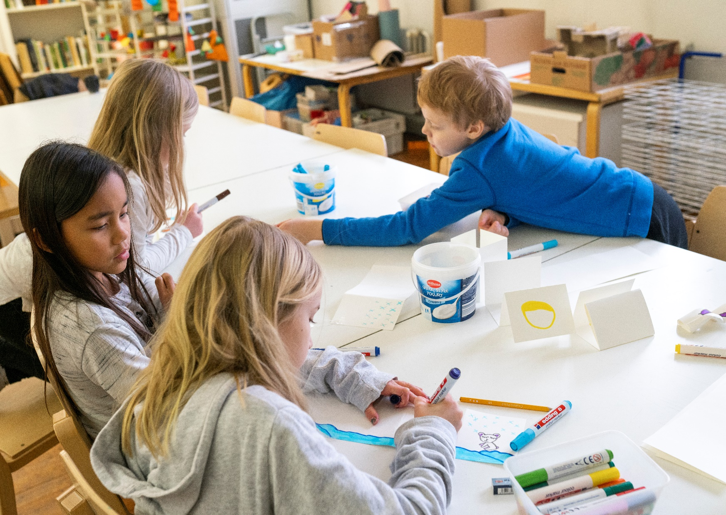
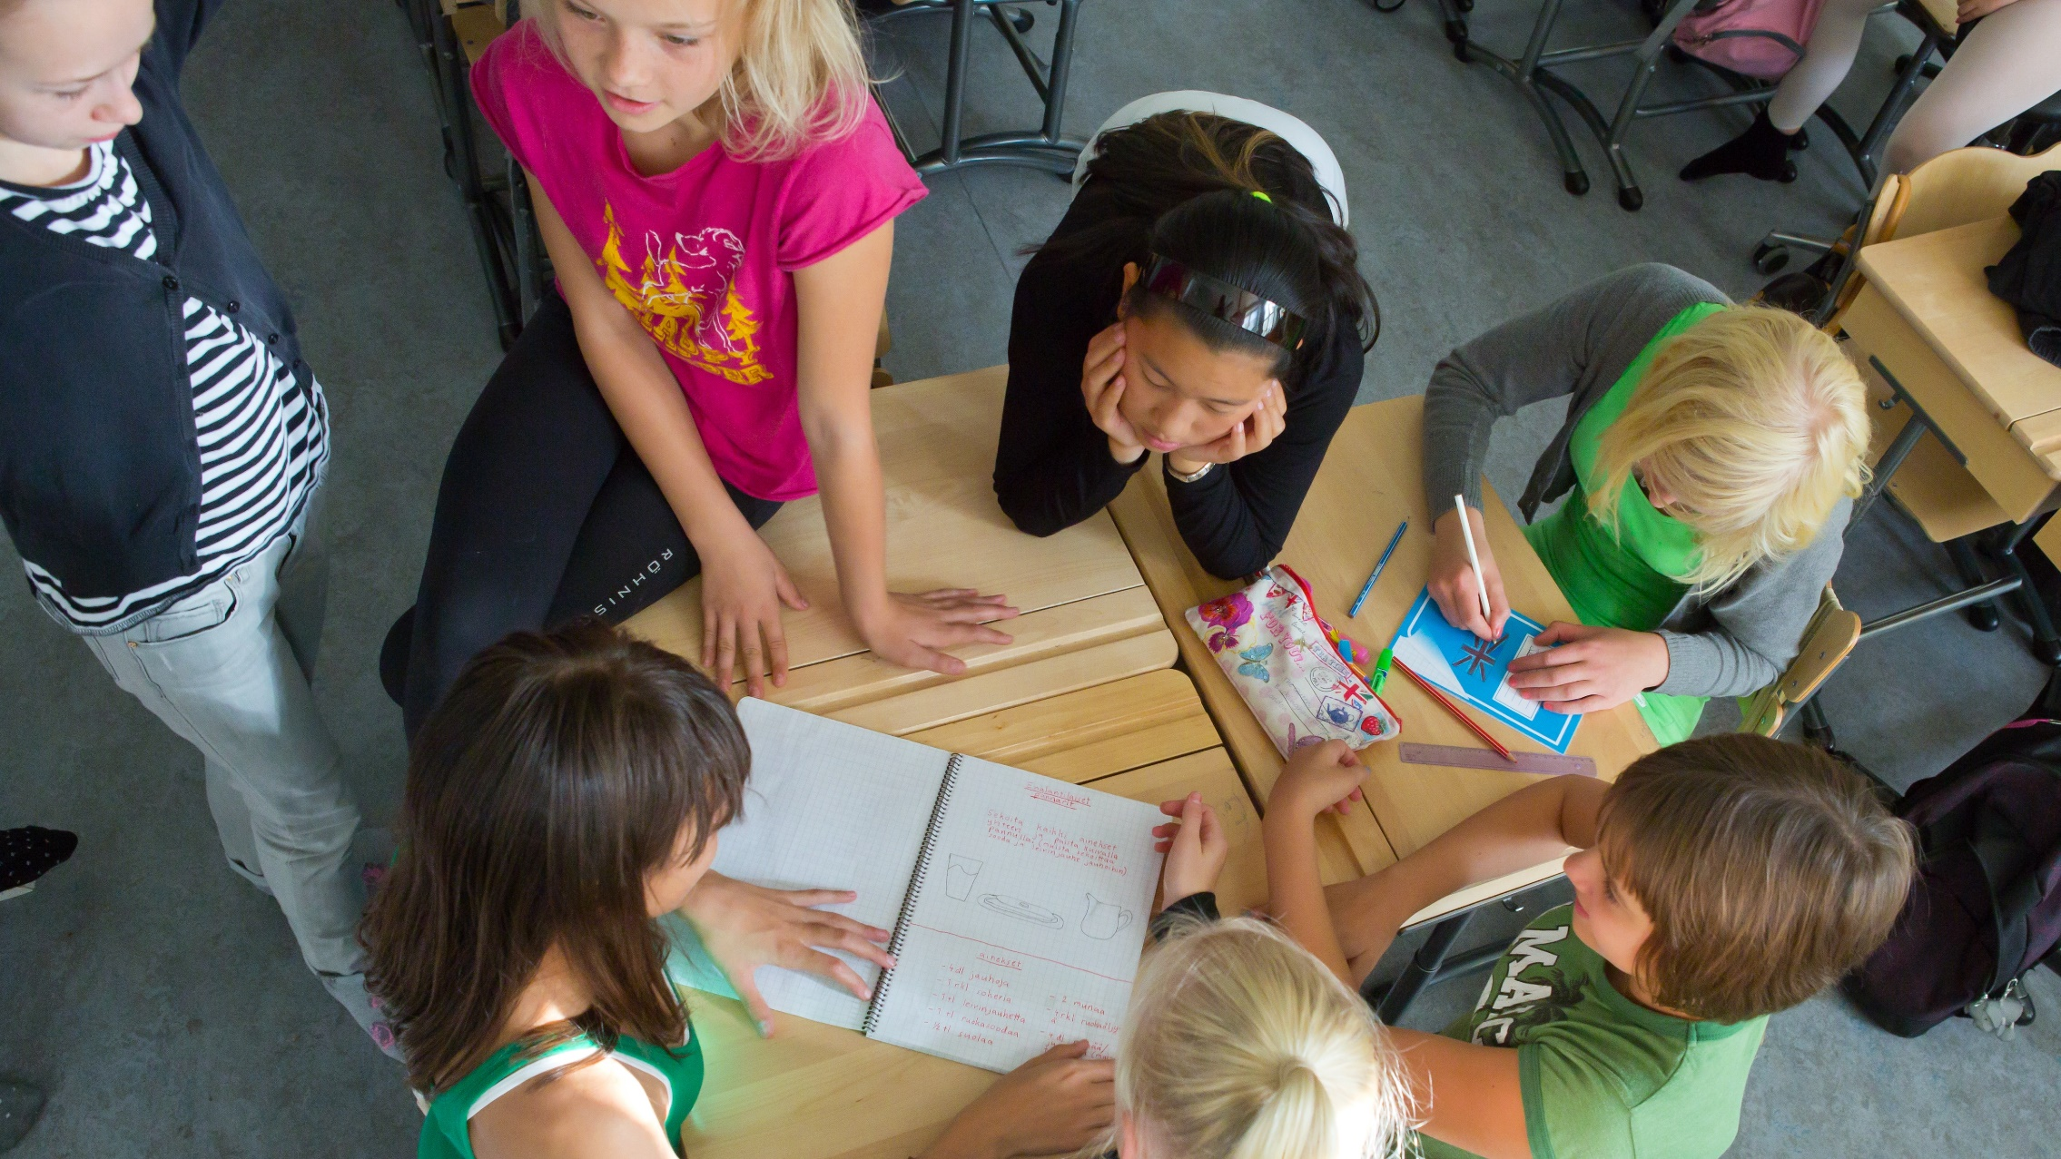
Finnish education has been
ranked second best in the world.
(Legatum Prosperity Index, 2023)
Notes:
In Finnish thinking, learning environments should encourage innovation, make room for creativity and allow the various abilities of individuals to flourish. That means equality, creativity and competitiveness are all very much intertwined.
Photo: Riitta Supperi/Keksi/Finland Promotion Board

Slide 6
Happiest country
Finland – in six consecutive years ranked the happiest nation in the world – is one of the few countries in the world to combine high educational achievement with high life satisfaction.

Slide 7
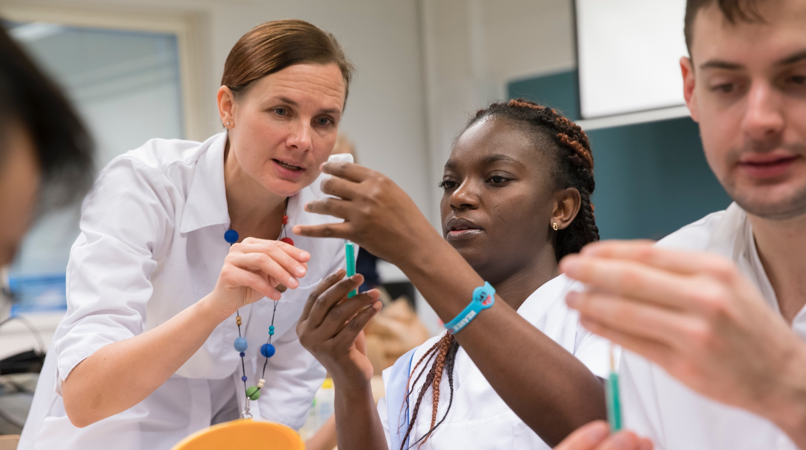
Highly educated and motivated workforce
is the backbone of the Finnish economy.
Notes:
Photo: Velhot Photography Oy/ Riku Isohella

Slide 8
Education for all
All education from preschool to universities is free of charge for Finnish and EU citizens.
Institutions of adult education as well as informal programs and online courses promote the important principle of lifelong learning.
Notes:
Photo: Velhot Photography Oy/ Riku Isohella

Slide 9
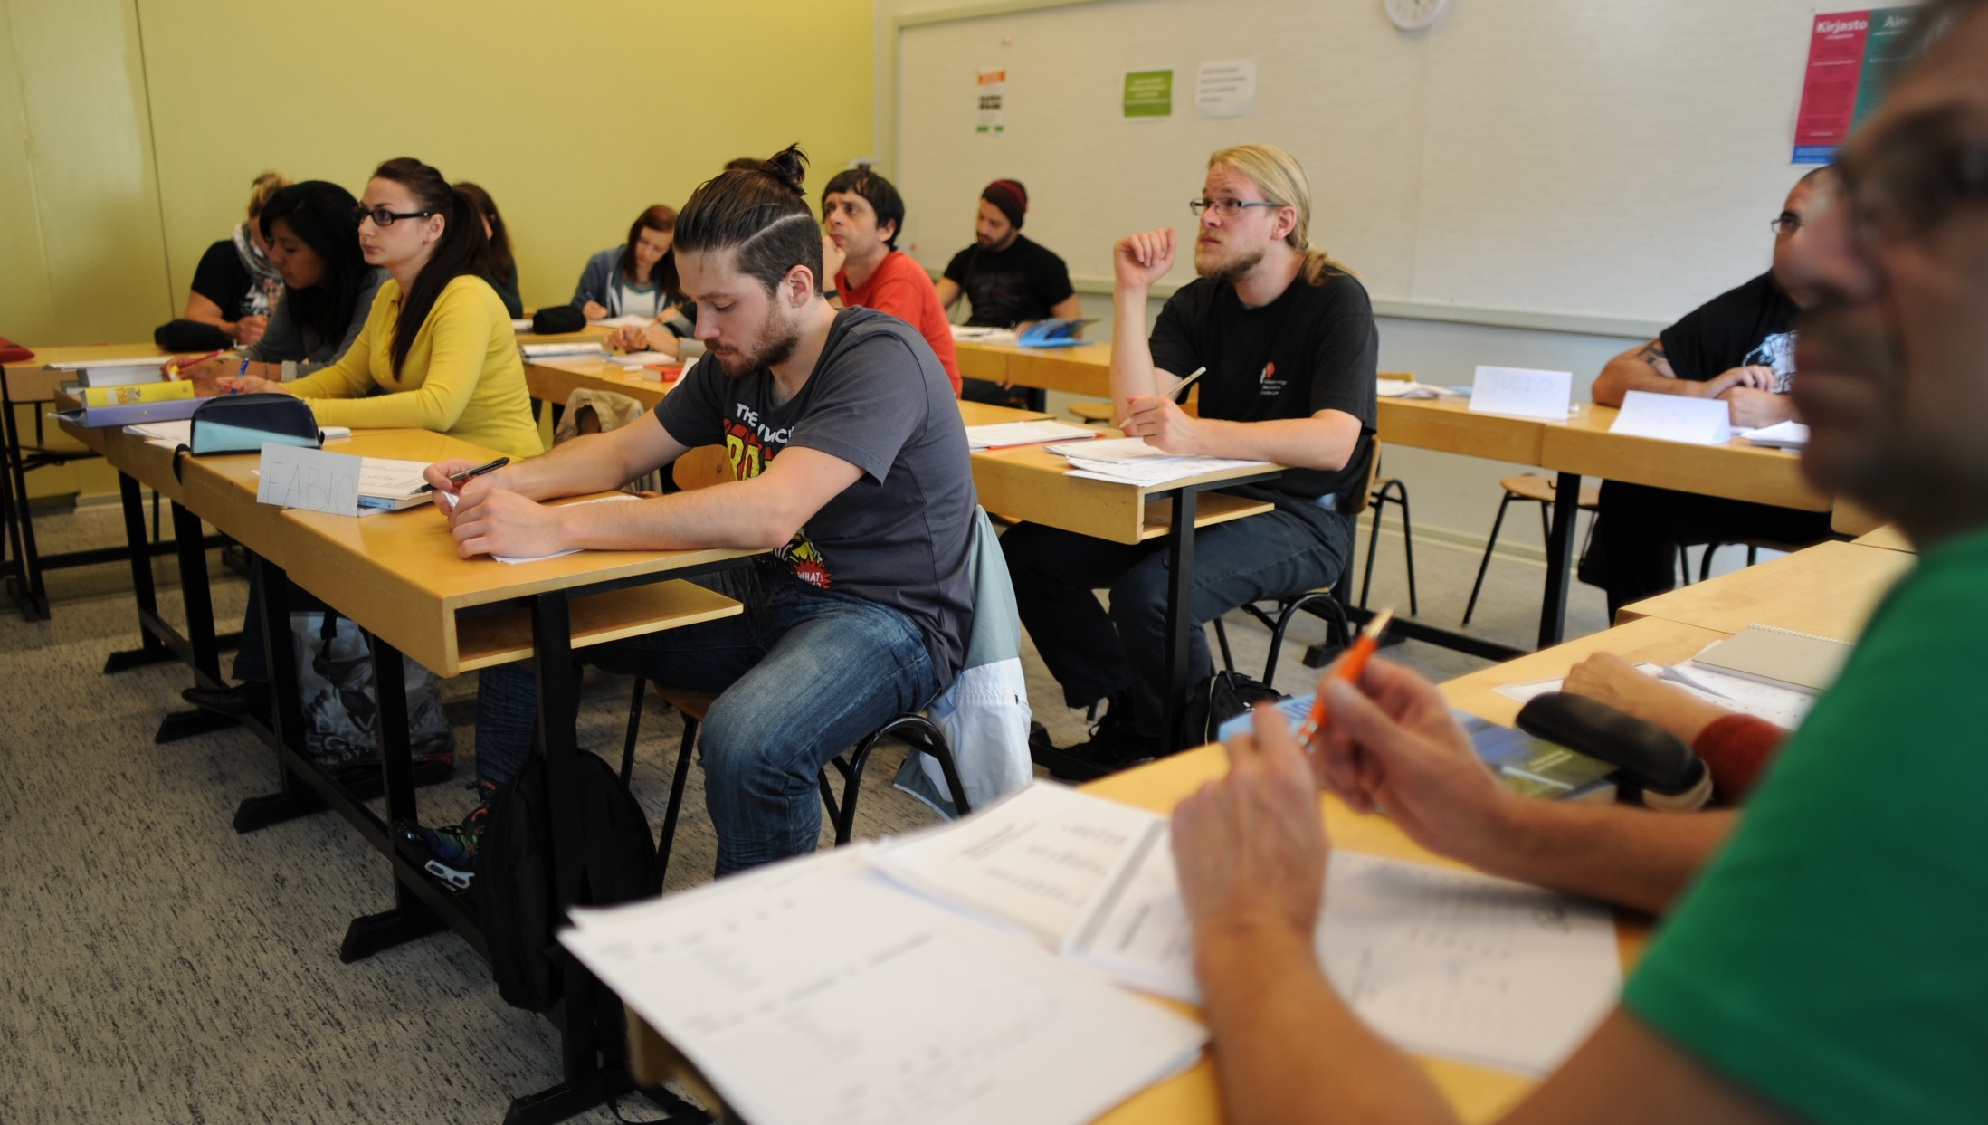
In Finland, the participation rate
in adult education and training ranks as second in the EU.
(Eurostat 2021)
Notes:
Photo: Emilia Kangasluoma

Slide 10
Autonomous teachers
Teachers are highly respected in Finland. All teachers are university-educated.
Teachers also work independently and have significant autonomy to choose teaching methods, study materials, and many other matters.
Notes:
Photo: Riitta Supperi/Keksi/Finland Promotion Board

Slide 11
Student-centred approach
Finnish pupils spend less time in classrooms than most of their counterparts around the world.
In basic education, the average class size is 20 students.
Notes:
Photo: Riitta Supperi/Keksi/Finland Promotion Board

Slide 12
While new technologies can benefit learning in many ways,
it is recognised that they need to be used in a pedagogically meaningful way to be effective.
Notes:
Photo: Riku Isohella

Slide 13
Equal opportunities
Regional and
socioeconomic differences in learning outcomes are very modest. The Finnish system is based on providing every child with a neighborhood school that is just as good as any other school in the country.
Notes:
Thanks to this policy and an emphasis on support to children with learning difficulties, Finnish education results are impressively equal.
Photo: Sakari Piippo

Slide 14
Joy of learning
Schooldays are relatively short, and there is no standardised testing.
Finnish schools focus on creating a motivating environment in the classroom, support for those who need it, and on a holistic perspective on children’s well-being.
Notes:
But as seriously as Finns take education, they are also serious about the joy of learning. Play and creativity are an especially important part of early childhood education, while music, arts and physical education continue to be a vital part of the curriculum in primary and secondary schools.
At upper secondary school the aim is to develop the pupils’ transversal competences. These contain skills in life management and responsible involvement, not only boosting lifelong learning but also helping pupils to grow into balanced, enlightened humans and citizens.
Photo: Pasi Markkanen

Slide 15
High academic performance and high life satisfaction
Finland has consistently ranked high on the Programme for International Student Assessment (PISA), a comparison testing the skills and knowledge of 15-year-old students in different countries.
Finnish students are also placed high in the assessment of life satisfaction, making Finland the only country in the PISA study combining high academic performance with high life satisfaction.

Slide 16
One of the factors behind Finland’s PISA results is the fact that low-achieving students perform better than in most other countries.
Notes:
Photo: Riku Isohella

Slide 17
Investing in education
Finland is investing in its universities and other institutions of higher learning.
By 2030, Finland plans to invest 4% of its GDP in Research and Development.
Notes:
All this makes Finland uniquely positioned to adapt to a world transformed by digitalisation, automation, Artificial Intelligence and other new technologies, where traditional tasks and occupations will change or even disappear, and others emerge in their place
Photo: Elina Manninen

Slide 18
Skills for the future
Finland's strengths lie in excellent, relatively equal learning outcomes, a high education level, a healthy work-life balance, and flexibility of the education system, making it possible to rapidly adapt to new technologies.
Notes:
The Finnish system is also open to public-private partnerships as well as enterprise and research cooperation.
Photo: Elina Manninen

Slide 19
Evolving education system
As the world changes, educational systems must evolve to continue providing citizens with the skills needed in the future.
Embedded in Finnish culture are an open-mindedness for science and technology and a commitment to knowledge-based growth and prosperity.
Notes:
Continuous investment in education, research and lifelong learning is an investment in equal opportunities.
Photo: ulkoministeriö

Slide 20
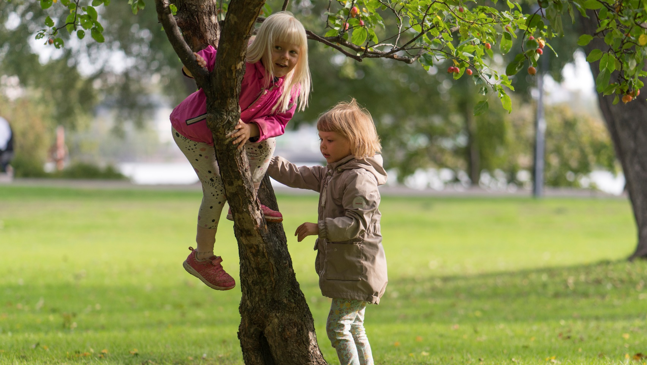
Just like in the 1800s, the best way to achieve sustainable economic growth and well-being in the future is to mobilise everyone’s competence and talents.
Notes:
Continuous investment in education, research and lifelong learning is an investment in equal opportunities.
Photo: Pasi Markkanen

