Slide 2
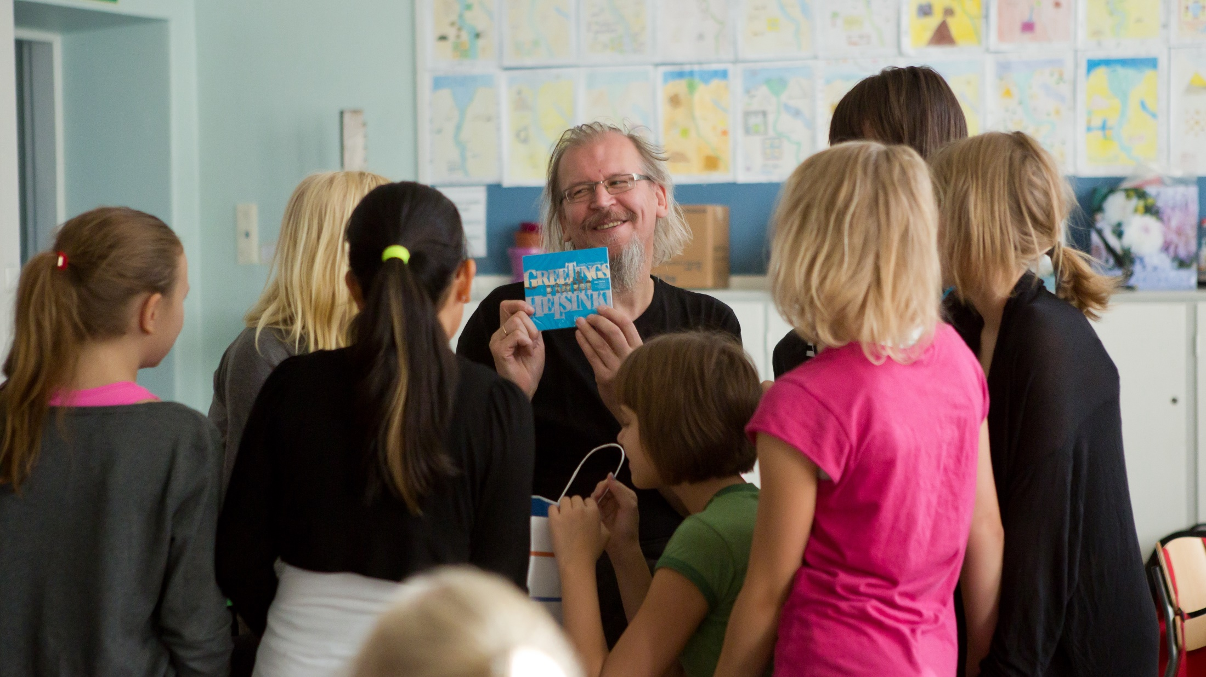
Teachers in Finland trusted and respected professionals
Notes:
Photo: Riitta Supperi

Slide 3
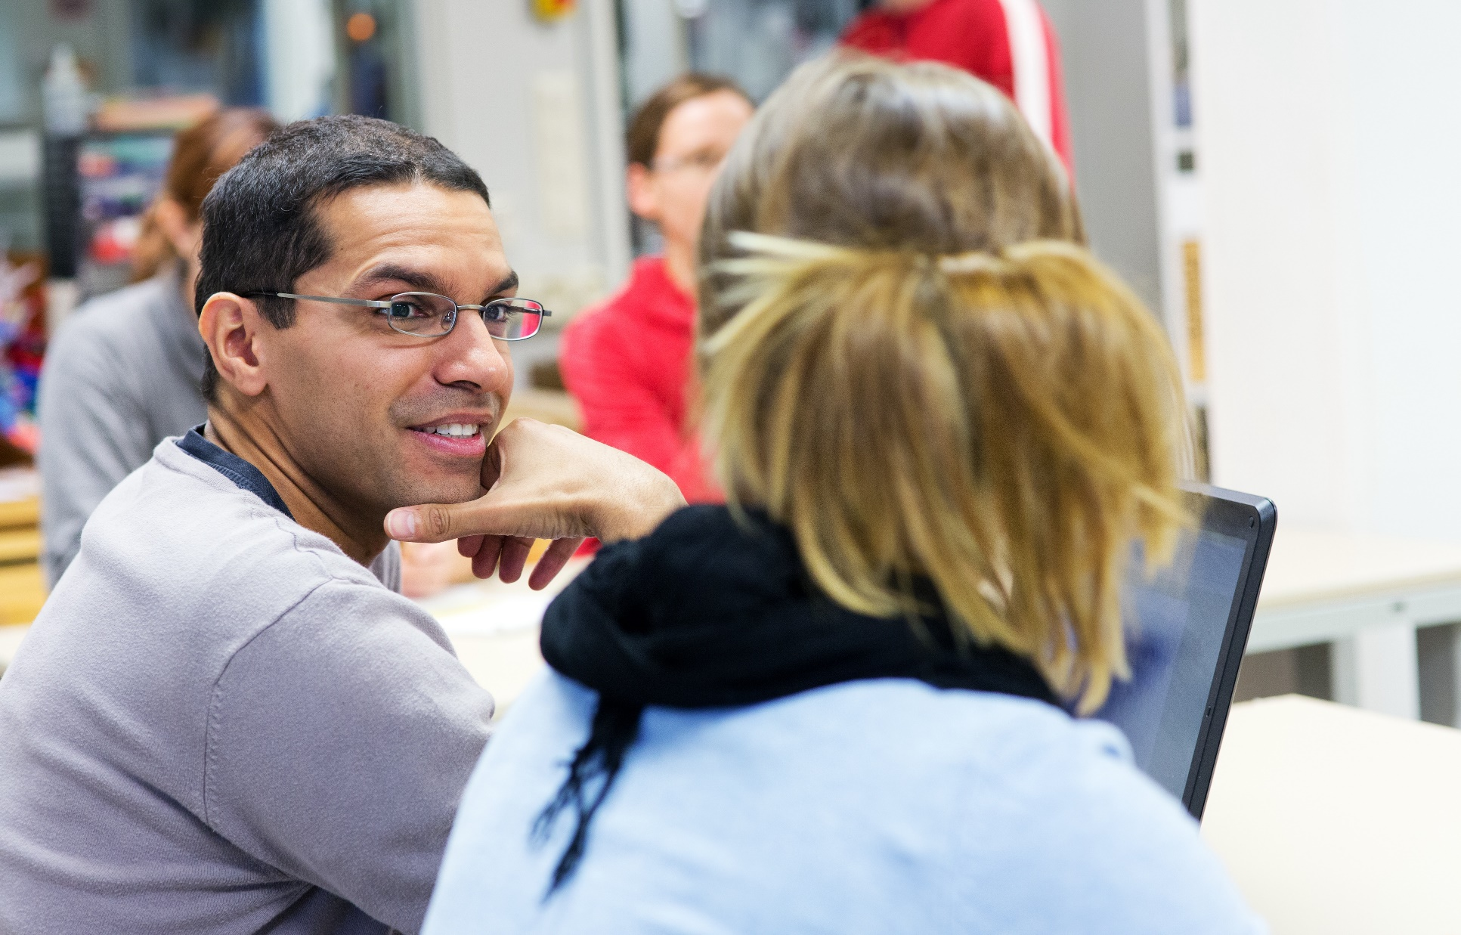
Finland’s high level of education and expertise is based on high-quality teacher education. Finnish teachers must hold a master’s degree in education, or in their specific field..
Notes:
Photo: Riitta Supperi

Slide 4
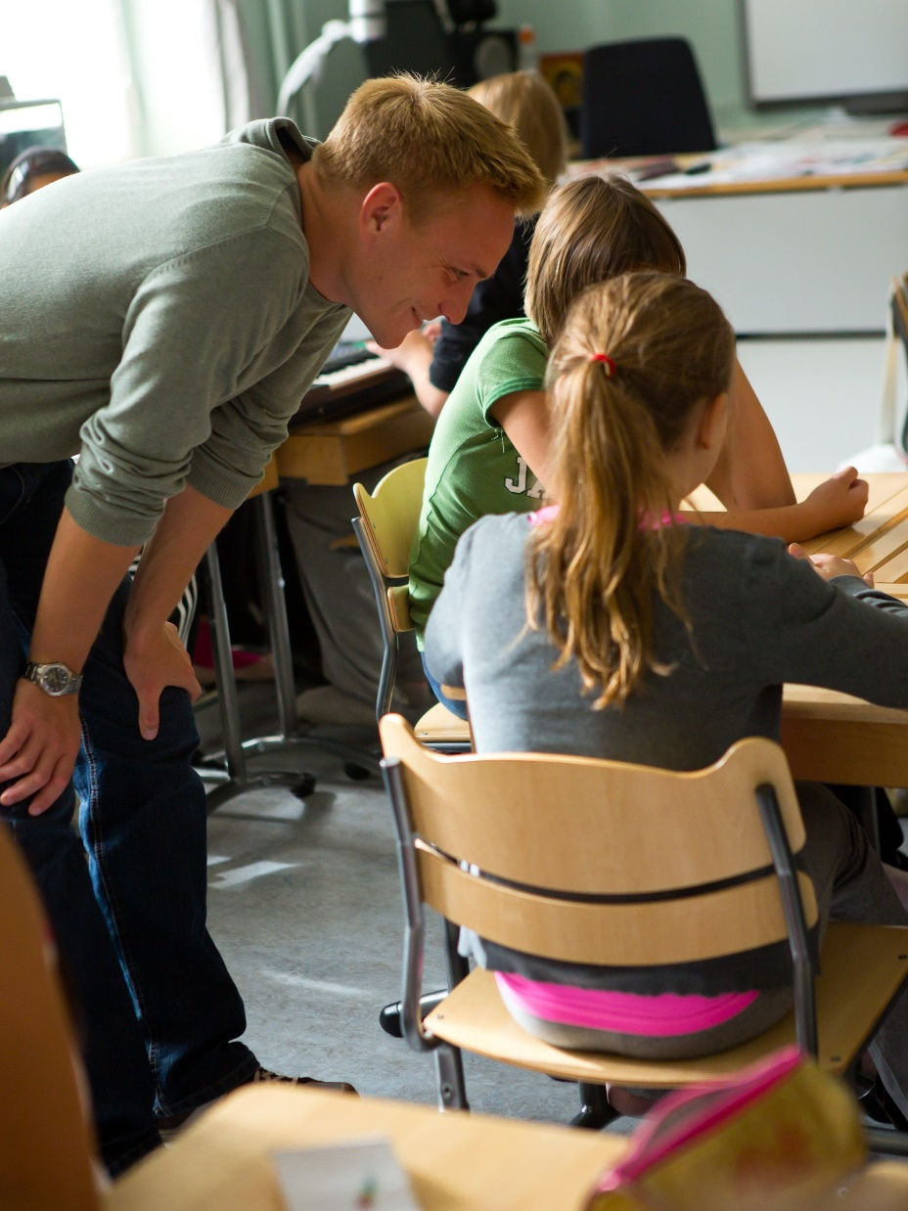
Pedagogical studies and practical training
Teacher education does not only consist of academic studies but also involves pedagogical studies and guided teaching practice. The education is research-based and aims to equip the future teachers with all relevant skills.
Notes:
Photo: Riitta Supperi

Slide 5
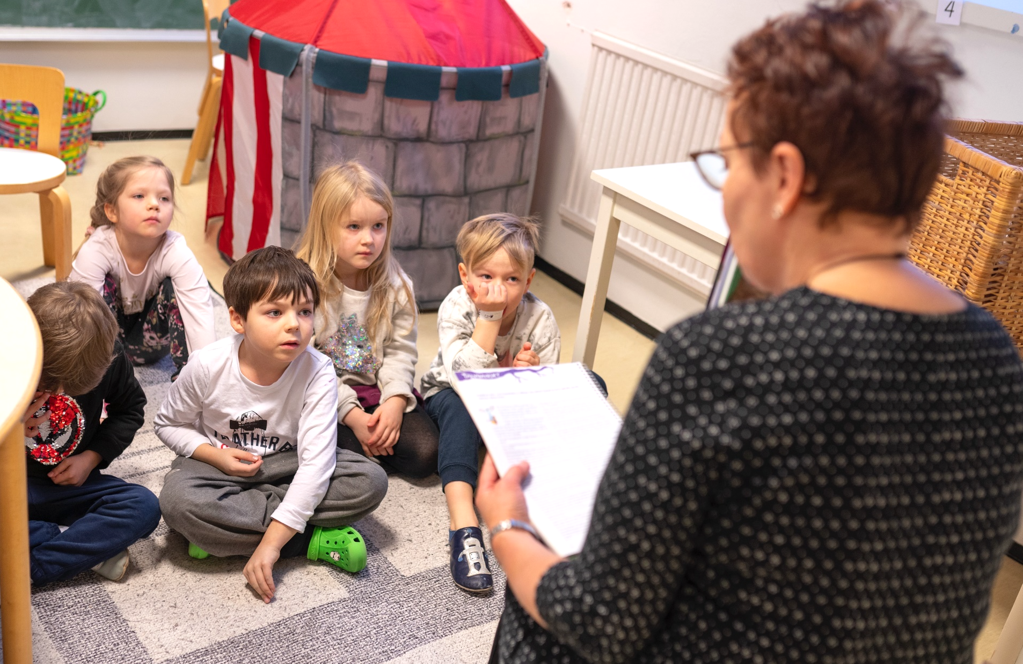
The content of teacher education develops constantly. Teachers are encouraged to explore new approaches in their work.
Notes:
Photo: Pasi Markkanen

Slide 6
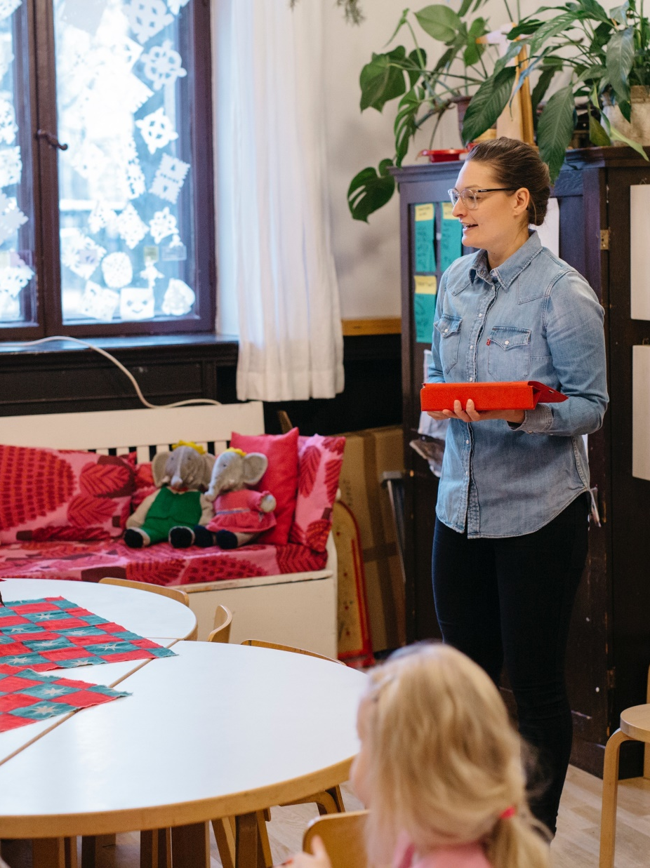
Autonomous professionals
The objective of the teacher education is to produce teachers who are capable of independent problem solving. Finnish teachers are autonomous professionals, with a great deal of freedom.
Notes:
Photo: Elina Manninen

Slide 7
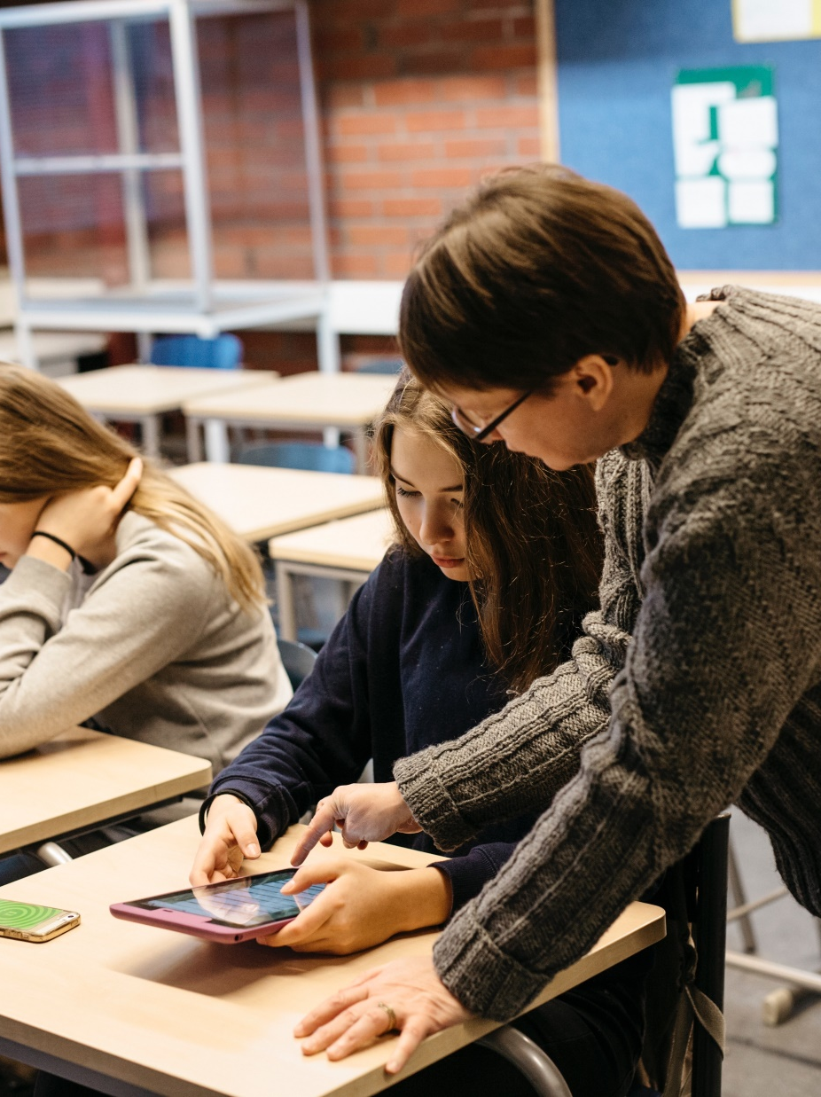
No standardised testing
Because there are no mandatory national standardized tests in basic education, teachers are responsible for the assessment of their respective subjects.
Notes:
Photo: Elina Manninen

Slide 8
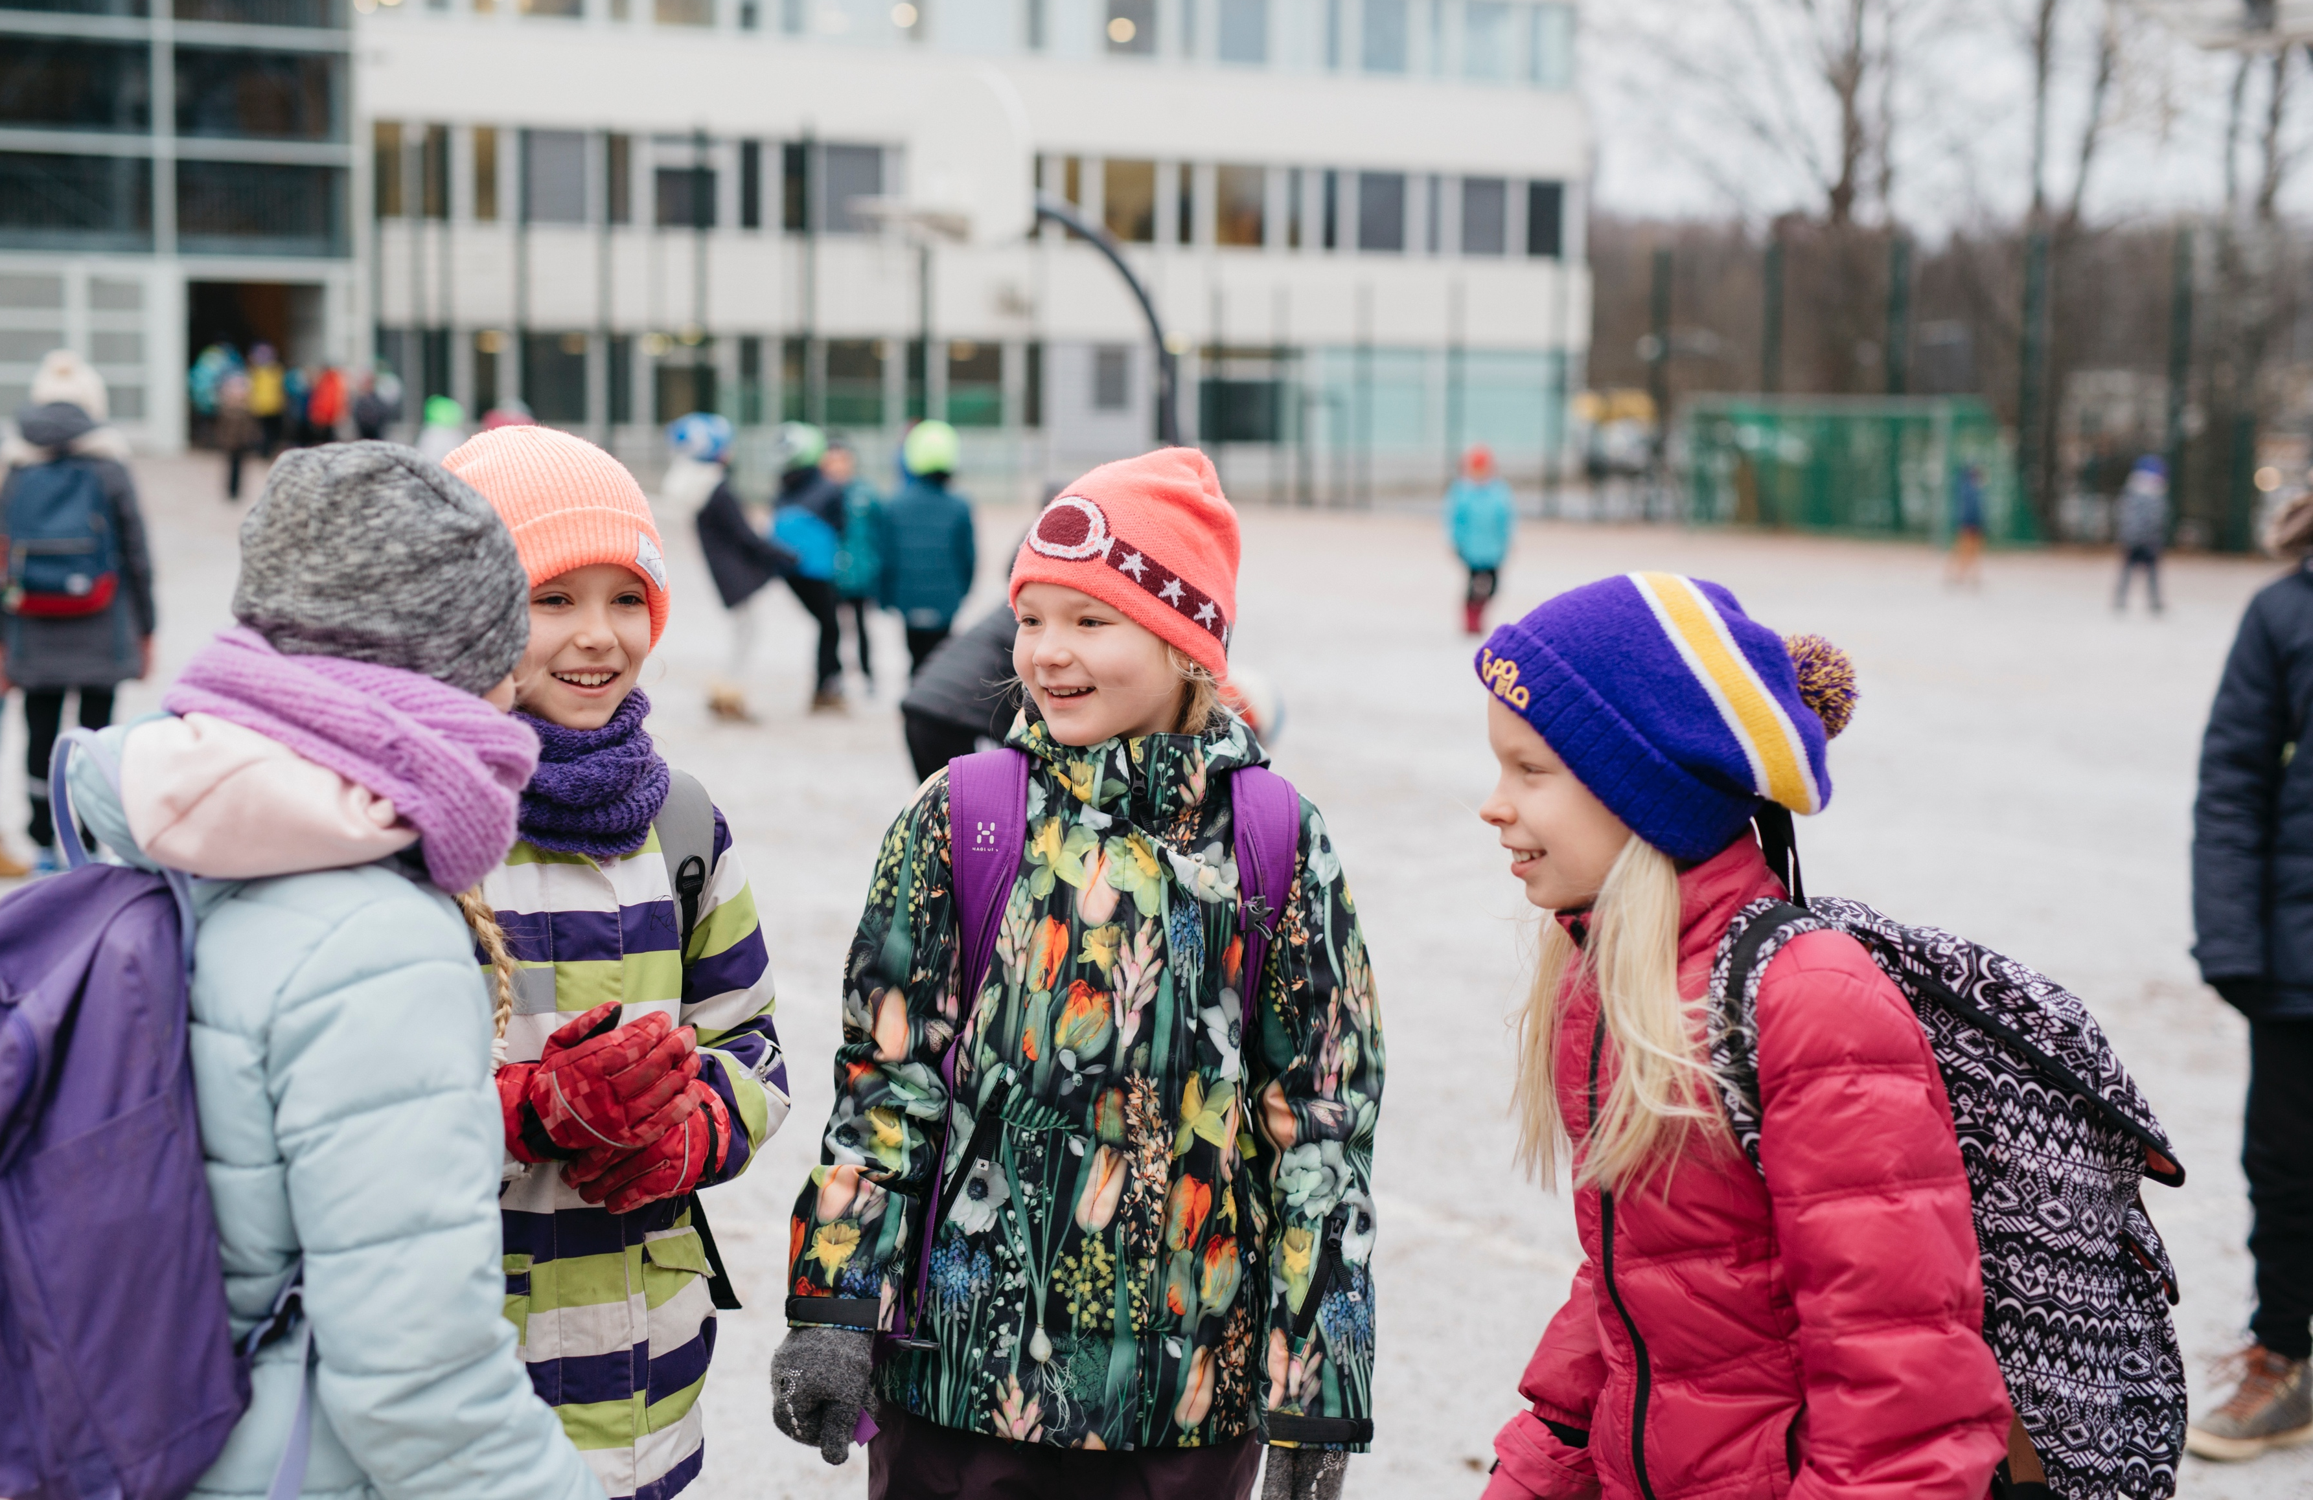
Finnish pupils spend less time in a classroom than most of their OECD counterparts.
Notes:
Photo: Elina Manninen

Slide 9
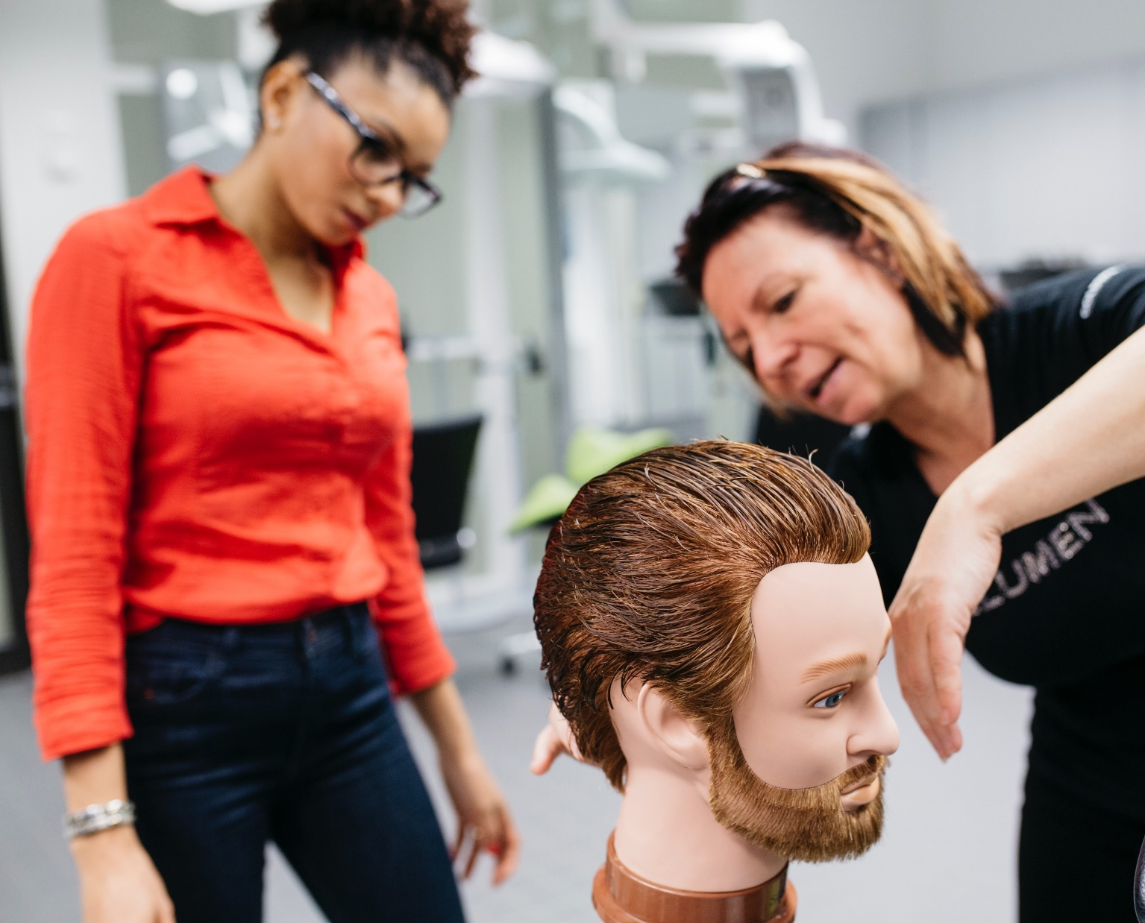
Lifelong learning is an important part of the Finnish education system and a natural part of working life.
Notes:
Photo: Elina Manninen

Slide 10
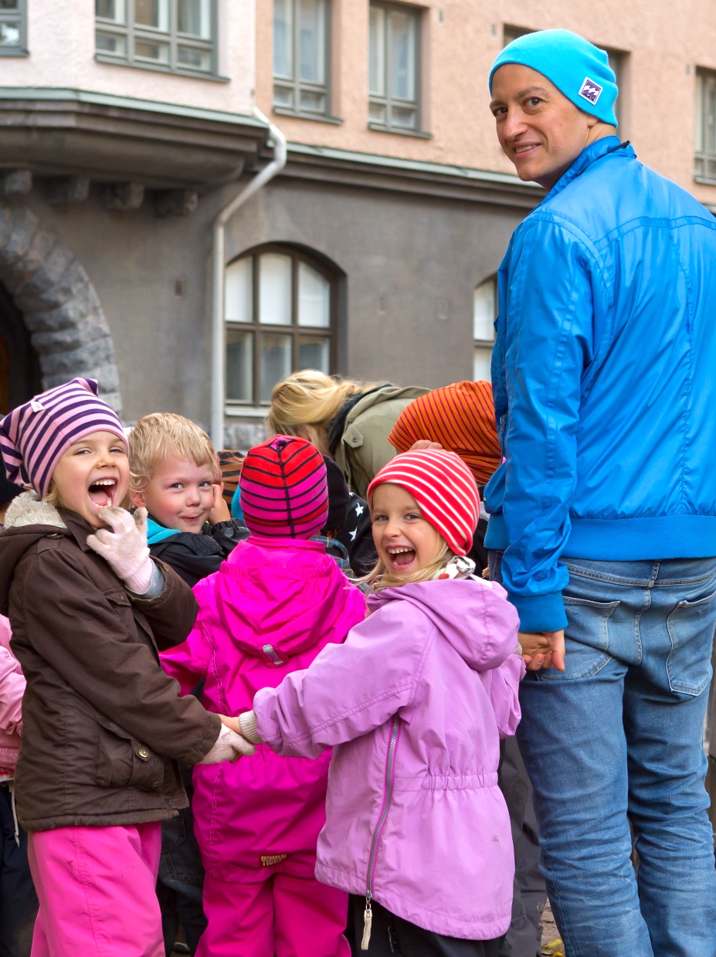
Student-centered approach
The average class size in Finnish schools is around 20 students, and a student-centered approach lies at the heart of all learning.
Notes:
Photo: Riitta Supperi

Slide 11
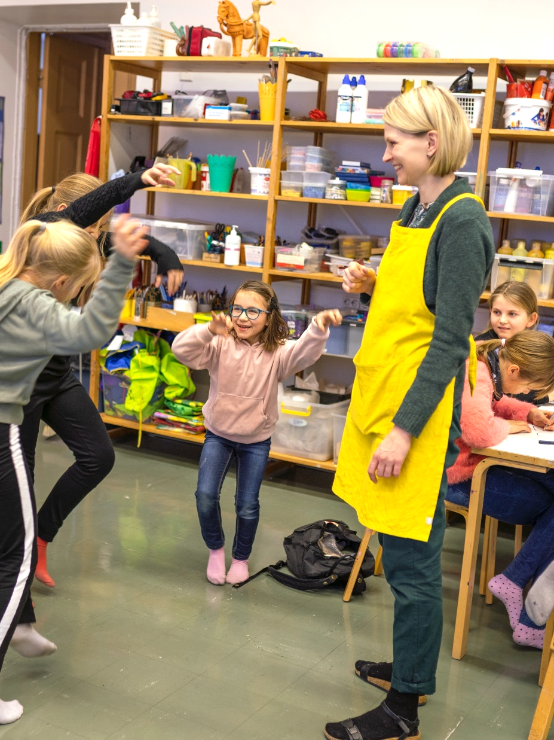
Creative environment
The open atmosphere in Finnish schools supports independence, creativity, and innovation. Playing and physical activities promote the joy of learning and an active role in learning increases motivation.
Notes:
Photo: Pasi Markkanen

Slide 12
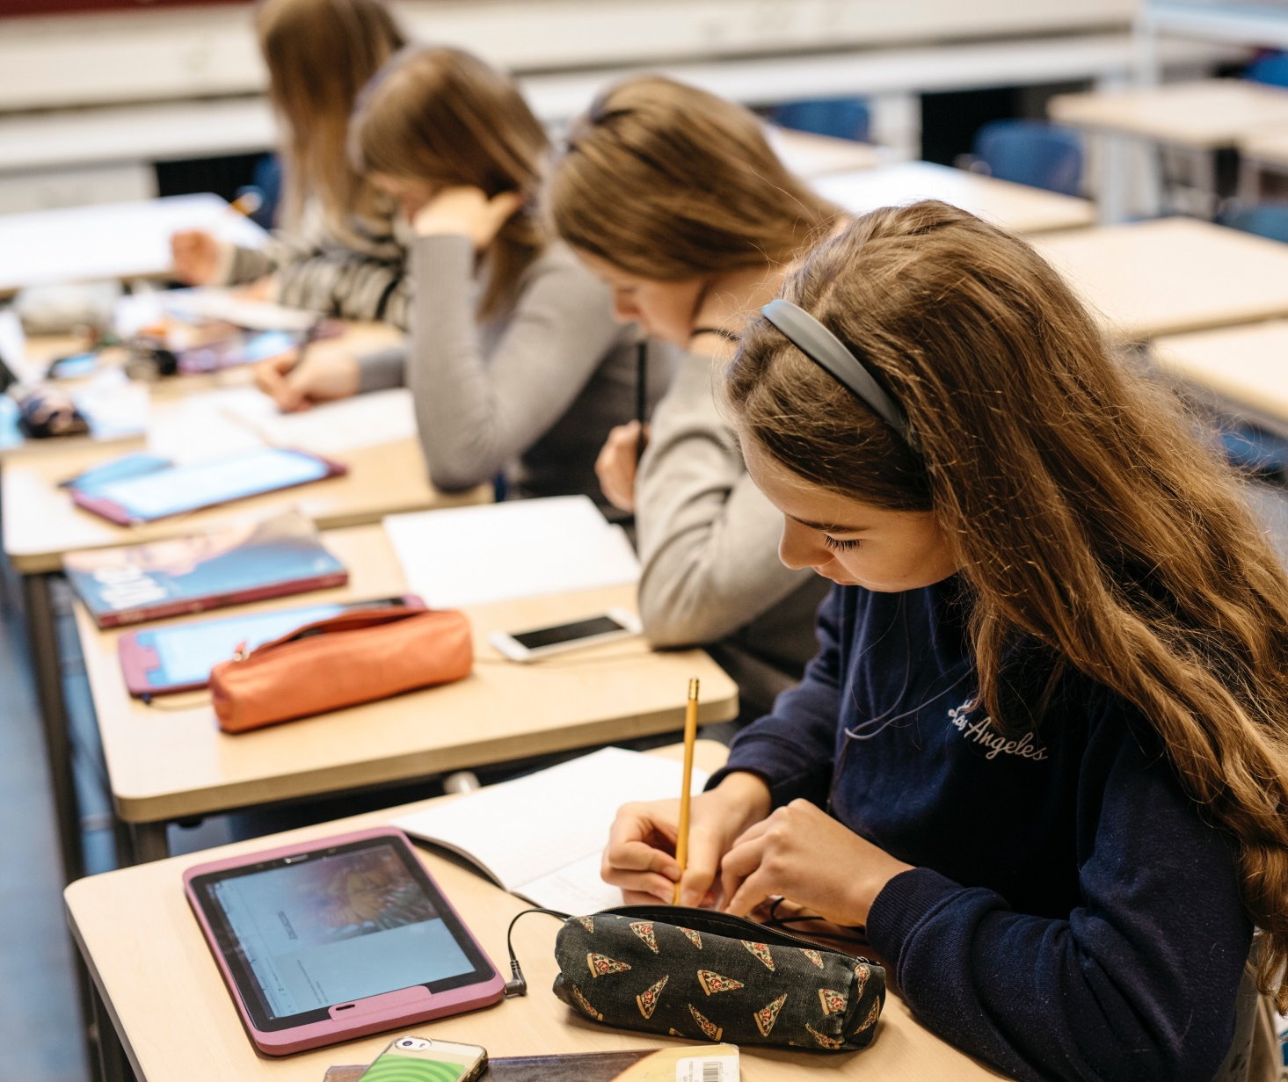
Teachers aim to ensure a balance between theoretical, arts, crafts, and science subjects. Technology is used as one tool to support learning.
Notes:
Photo: Elina Manninen

Slide 13
Learn more about Finnish teachers
Ministry of Education and Culture
www.okm.fi
Finnish National Agency for Education
www.oph.fi
Trade Union of Education
www.oaj.fi

