Slide 1
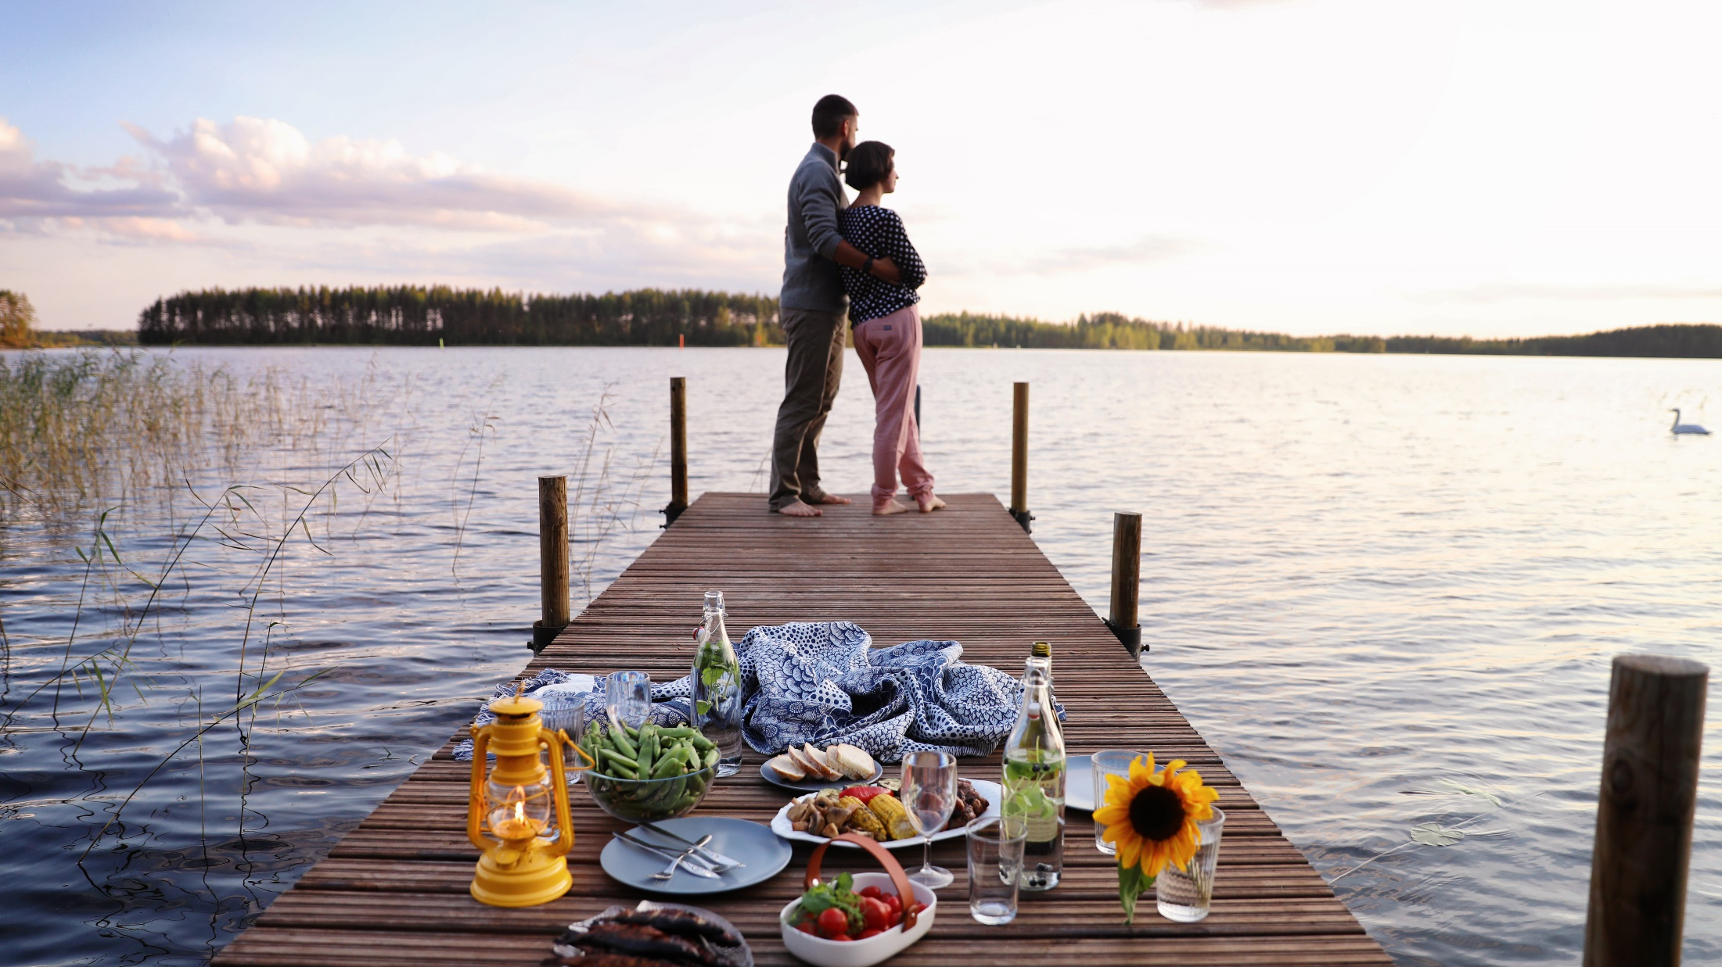
The smart taste of nature
Sustainable food from generation to generation
Photo: VisitKarelia/Harri Tarvainen
Notes:
For the speaker:
This presentation is about Finnish food, which has successfully combined thousands of years of Nordic cuisine with modern ingenuity. This gives us healthy, natural food, which is produced with minimum impact on the environment. And, we can’t forget, it tastes great!
(This is an opportune moment to share a personal anecdote about food from your past or present. It’s a good idea to kick the presentation off by building relatability with the audience.
Do you often cook food as a family? Do you remember a specific recipe from your childhood? Or are you serving some Finnish delicacy tonight?
Or, you can notice the traditional Finnish ingredients in the picture.)

Slide 2
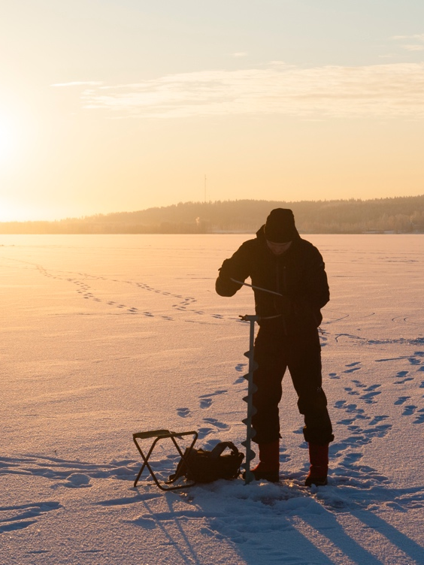
The four distinct seasons, with long winters and an intense summer growing period, provide a unique way of producing food.
Photo: Katri Lehtola
Notes:
Our four very different seasons are a major asset for Finland.
Our growing season is intense. Summer days could have 20 hours of daylight or more – in Lapland the sun
doesn’t even set. Plants thrive with this abundance of light and grow pure and super-tasty ingredients that
Finns value very highly and handle with pride.
Our long winters with temperatures well below zero reduce plant diseases and pests. Therefore, our use of
pesticides is among the lowest in the Europe.
In addition to our unique seasons, Finnish nature is known for its pureness. Finland has famously clean air,
water and soil.
These conditions provide the foundations that have shaped our food production for generations.

Slide 3
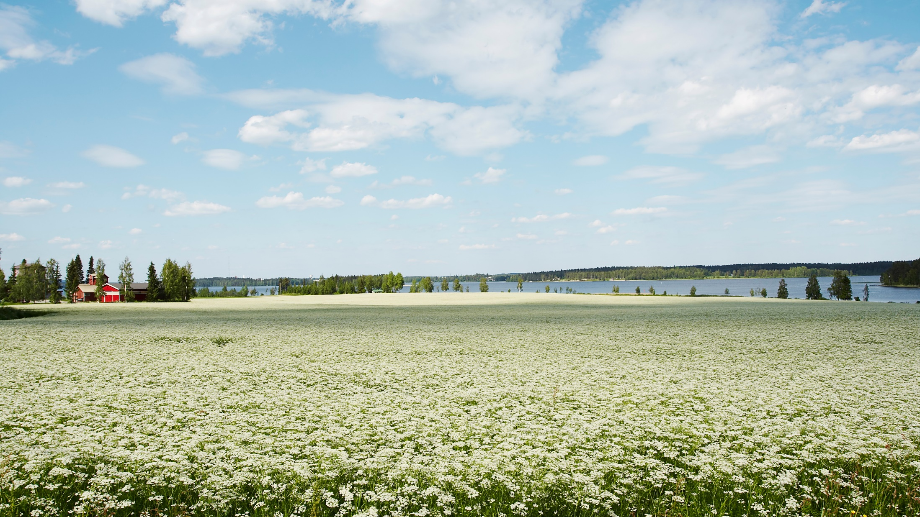
Plants thrive with abundance of light and grow pure and tasty ingredients.
Photo: Adobe Stock
Notes:
The caraway fields in Finland enjoy the sun that shines day and night in the summer. It ripens the seeds particularly aromatic and rich in essential oil. The cool climate in Finland helps to reduce the need for pesticides.

Slide 4
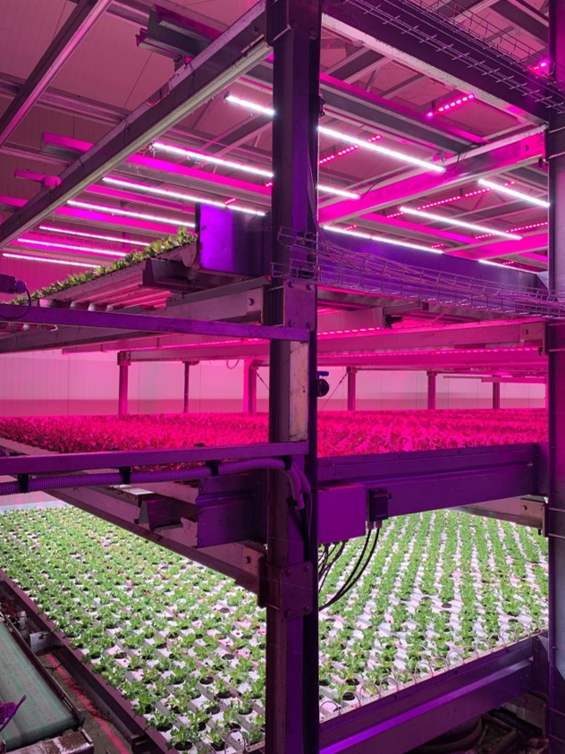
Sustainable innovations are at the heart of Finnish food production.
Today this innovativeness can be seen in vertical farming under LED lights and in new foods such as plant-based products. .
Photo: Robbes Lilla Trädgård
Notes:
Seasonal, high-quality raw materials have been a source of innovation for Finns for generations. For example, the Nobel Prize in Chemistry was awarded to Finnish professor A.I. Virtanen in 1945 for his revolutionary method to preserve fodder.
Today this innovativeness can be seen in vertical farming under LED lights, as well as in new foods such as plant-based and ’free from’ food products. Finnish oats and fava beans are a source of new plant-protein innovations and other tasty and healthy food products. All this is made possible by the fact that Finnish food industry invests heavily in R&D.

Slide 5
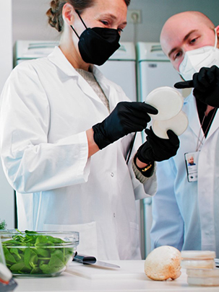
Finnish food innovations are an important part of Finland’s contribution to a sustainable future for the planet.
Finland aims for the most transparent, responsible and safe food chain in the world.
Photo: Sherpa
Notes:
The respect we feel for food and our appreciation of sustainability are even more prominent today as the climate is changing and biodiversity is threatened.
We have also a number of programmes, such as “Catch the carbon” to develop and introduce climate change resilient practices, and the flagship “Climate Food programme” to minimise the climate footprint of food and improve people’s understanding of how food is produced.
Animal welfare and environmental issues are at the core of our food production. We never compromise on food safety. Traceability is a priority for us.
We aim for the most transparent, safe and responsible food chain in the world.
We are highly motivated to continually develop more sustainable and inventive food products.
This is our promise to you.

Slide 6
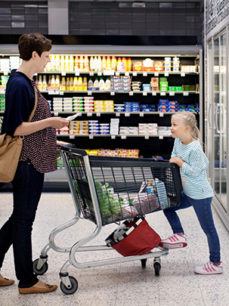
Examples of pioneering work
Use of antibiotics in food production is among the lowest in the world.
Salmonella in food is virtually non-existent due to Finland’s unique control programme.
Notes:
We have a long tradition of producing food with a minimum use of antibiotics. The aim is to maintain the welfare and health of animals through good production conditions and care – not medication. Antibiotics are not used preventatively and no antibiotics have been used for poultry since 2009.
Our salmonella situation is excellent and, highly exceptional internationally. Thanks to our long-standing and strict salmonella control programme, salmonella in food is virtually non-existent.

Slide 7
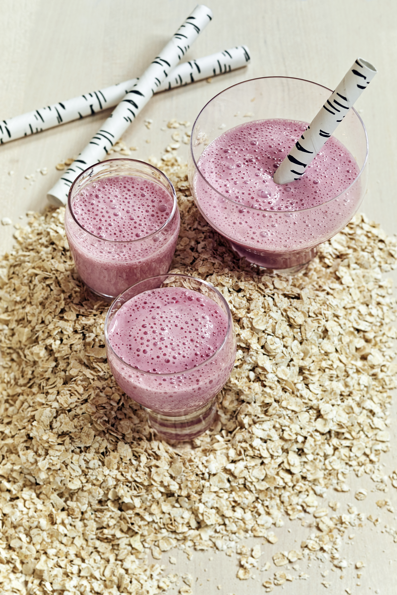
Finns have created tasty lactose-free and gluten-free products.
Finns are also constantly searching for new ways to increase sustainability.
Photo: Laura Riihelä/Business Finland
Notes:
Finnish companies are trailblazers in developing lactose-free dairy products and gluten-free foods. Finnish oats are perfect raw material for many gluten-free products.
We keep working to increase sustainability and to minimise the burden on our planet. The Finnish food industry strives for carbon neutrality and aims to reduce greenhouse gas emissions by 75 per cent by 2035.

Slide 8
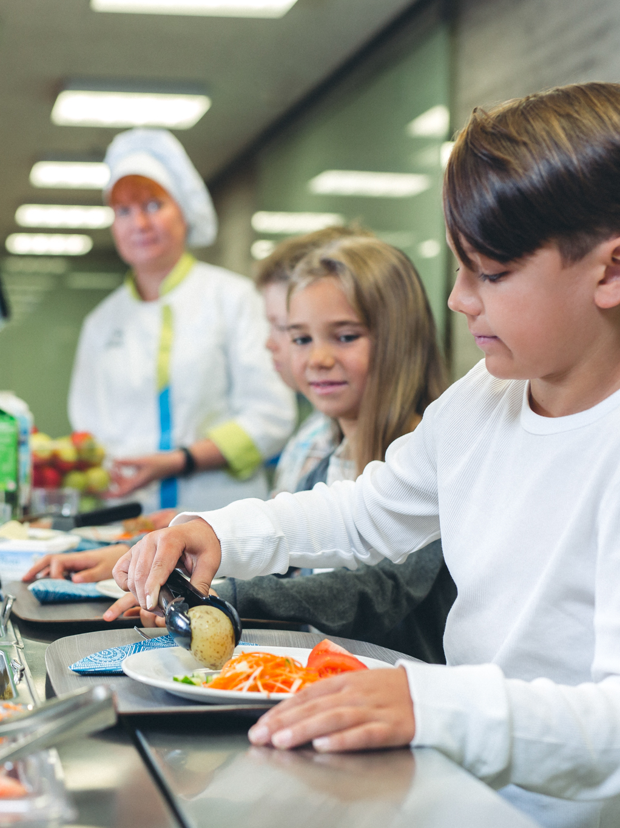
Free school meals are a social innovation first introduced to the world by Finland in 1948.
Photo: MMM/Viestintävalkea Oy
Notes:
Free school meals is a social innovation first introduced to the world by Finland in 1948. Menus are set with the participation of students as they learn about food production. The food is chosen for its health-related, educational, social and cultural significance.

Slide 9
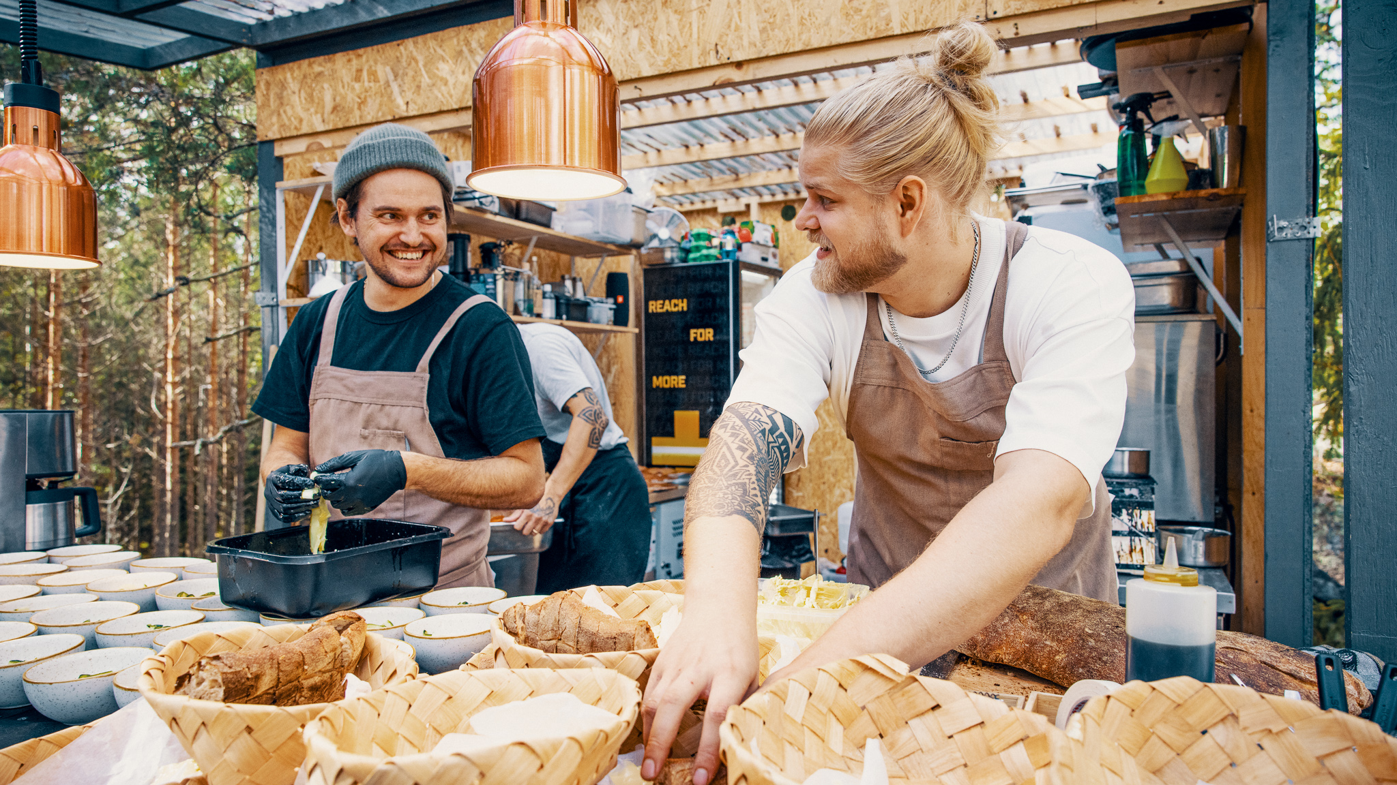
From a creative restaurant culture to adventurous home kitchens, new ideas grow from Finland’s northern fields, forests, lakes and the sea.
Photo: Haaga-Helia AMK / Jamo Katila
Notes:
The Finnish food culture has its roots deep in our own northern fields, forests, lakes and the sea, but they do not restrict us. You can taste the Finnish passion and bold experiments in our creative restaurant culture and adventurous home kitchens.
A few years ago Italian Prime Minister Silvio Berlusconi made a joke about Finnish cuisine. As a light-hearted rebuttal, a Finnish pizza chain created a pizza with Finnish rye bread crust and reindeer as a topping. Named the Berlusconi, it won first place at an international competition and remains a popular pizza today.
We want to solve global problems with innovations, technologies, safety and security. But, and I’m sure we can all agree, that food must not taste like technology.

Slide 10
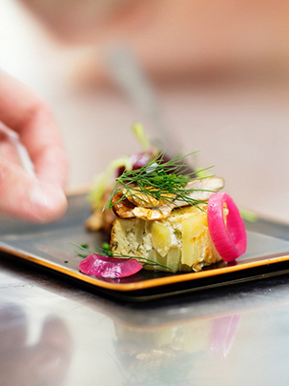
Finland focuses on sustainability and minimising the environmental impact – but Finns never compromise on taste.
Photo: Pia Inberg
Notes:
The roots of the Finnish food tradition lie in pure, down to earth and honest foods. And this is what we are still producing - from plant proteins to functional food products - in a way that is sustainable and minimises the environmental impact.

Slide 11
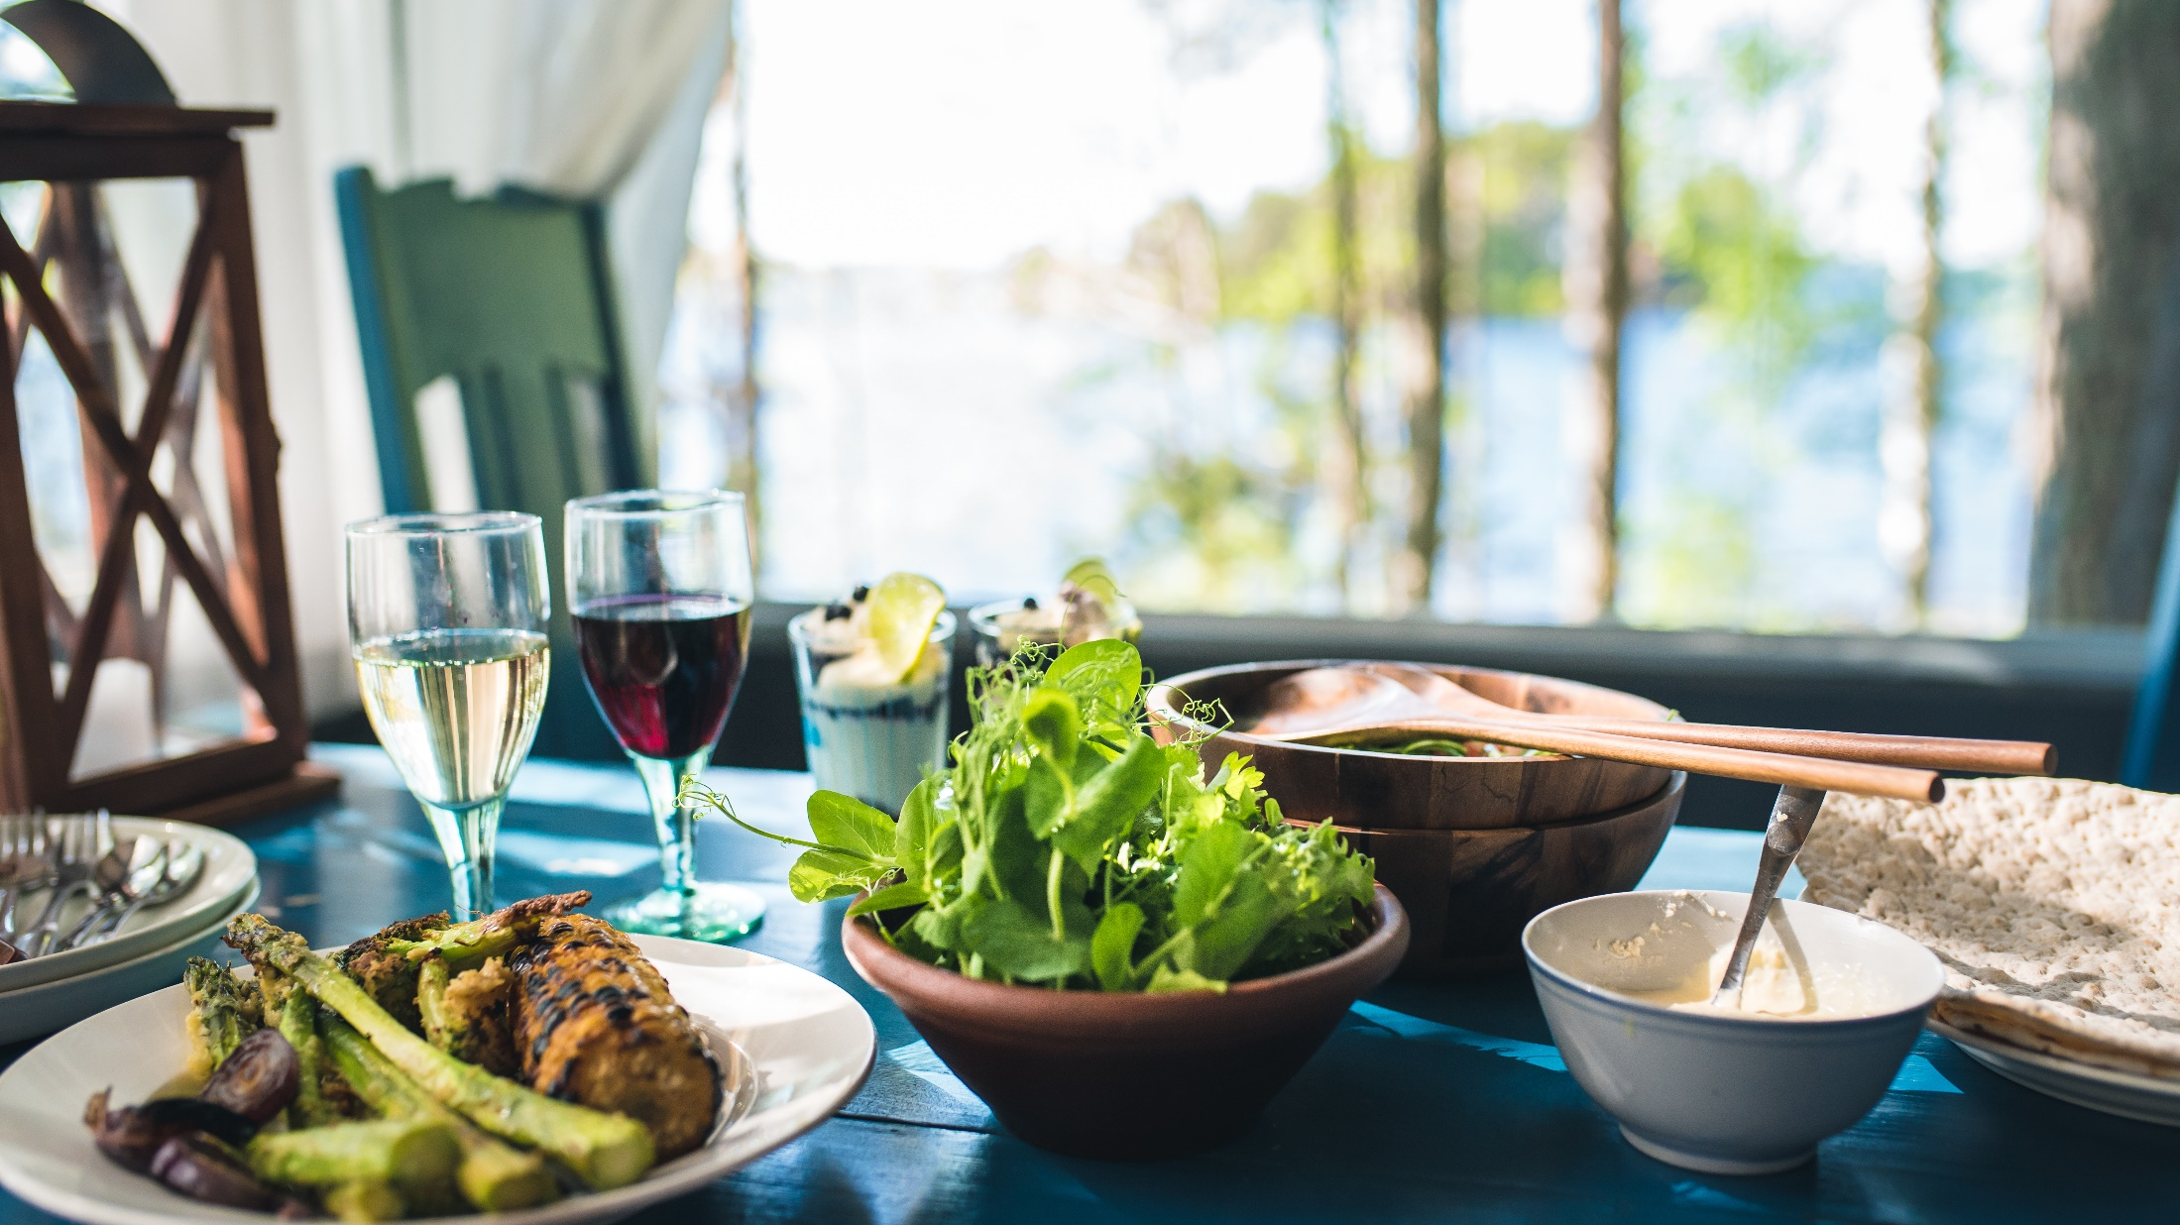
For Finns food is a great show of love with heritage and clever new ideas as special ingredients.
Photo: Adobe Stock
Notes:
Thank you so much for your time. I hope you see how passionate even us Finns can be about food! To us it’s a great show of love, not just among our families but to our global community as well.

