Slide 1
GENDER EQUALITY
  Finland taking the lead and getting recognition
Käyttö rajoitettu.
Team Finland sisäinen, ei julkinen esitys

Slide 2
Thinking about gender equality? Thinking about its’ importance in building healthy & successful societies? What countries come to your mind?
-> Is that a segment/image Finland wants to “own”?

Slide 3
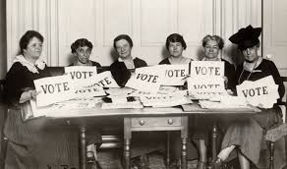
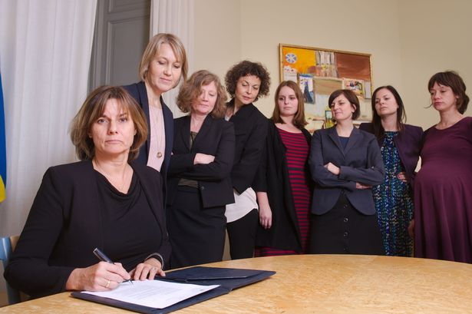
The usual images are from New Zealand and Sweden

Slide 4

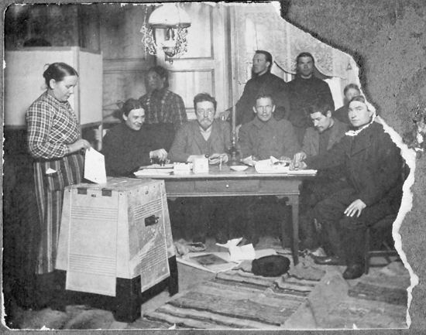

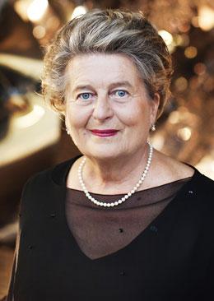
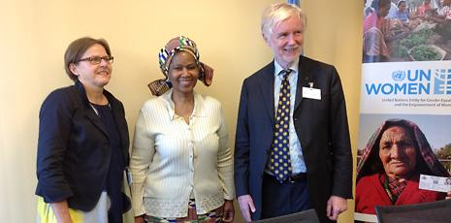
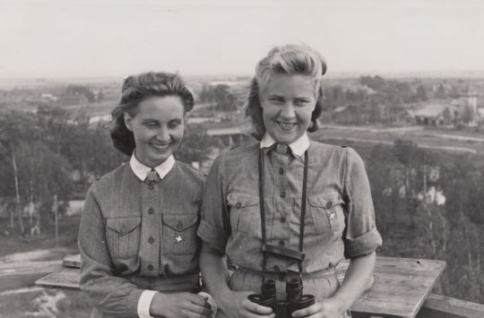
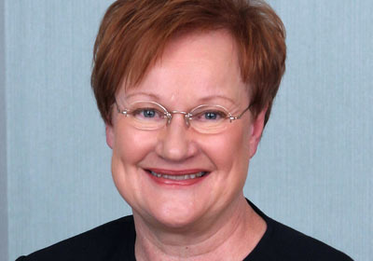
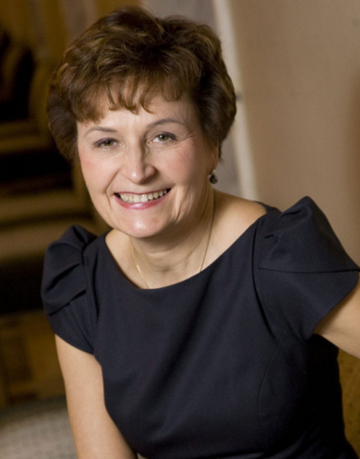
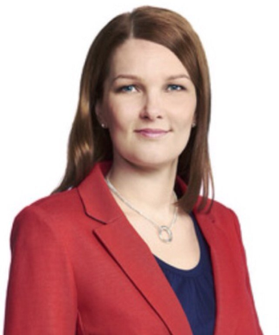
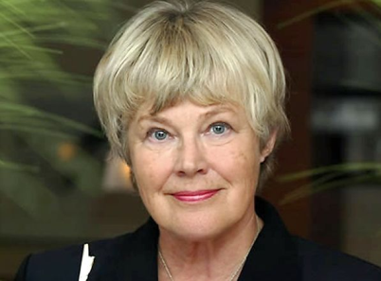
The full picture would include Finland

Slide 5
Finland will soon publish the first big gender equality award in the world.
This gives us a chance to overall strengthen the image of Finland and to:
Redefine the concept of leading gender equality countries in the world.
Spotlight Finland’s expertise, social innovations and global commitment.
Position Finland as a leading country in gender issues and as a cooperation oriented actor in complex issues related to gender.

Slide 6
The Story of Gender Equality and Finland v. 1
Finland has reinvented itself in just one short century – and we’re still at it. We believe in gender equality and that has boosted us to the top of all kinds of country rankings from quality of life to best countries in the world for women and girls. Women usually work full-time and enjoy equal access to education and healthcare. Finland is The Country where women are most likely able to participate fully in political and economic life.
Finland was the first country in the world to extend the right to vote and stand for elections to all women, in 1906, and thus had the first women in Parliament. The share of women MPs is at a steady 40 % level. The success of Finland is closely linked to improvements in gender equality. Due to affordable, good-quality child care, and other social policies, women can participate equally. Finland is famous for the way it cares for expectant mothers and its maternity package. Gender based discrimination is prohibited by law.
Promotion of the rights of women and girls is one of the key priorities in Finland’s development policy. We support women’s participation in decision-making, business and in conflict prevention. Human rights of women and girls, in particular rights to sexual and reproductive health, are key to a successful society.
Areas for improvement always exist, both in Finland and globally, and we are committed to finding the solutions that work.

Slide 7
Message Map (TB designed)
Finland: First in the world to give full political rights, first in the world to grant a big international gender equality award.
Countries where women have strong roles in society are the most sustainable financially, socially and ecologically.
We are one of the leading countries in the world because the entire talent of our small country – not only 50% of it – is fully utilized.
Finland is amongst the best countries to be a mother and a girl: 2nd according to Save the Children in 2016.
Thanks to our world-class expertise, education system and research, we find joyful and practical solutions to both local and global challenges
Finland is the best-performing
country in the world when
it comes to human capital
potential, according to
the World Economic Forum, 2016.

Slide 8
Core message to be embedded everywhere in country image communications:
Finland: First in the world to give full political rights, first in the world to grant a big international gender equality award.

