Slide 2
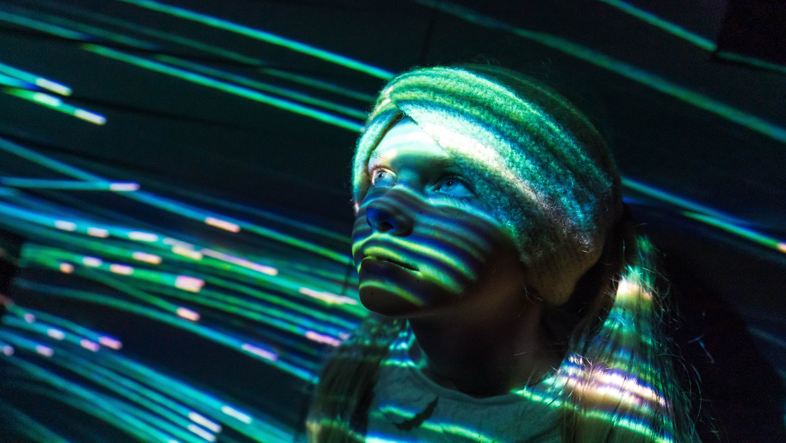

FINLAND: TEACHING MEDIA LITERACY
FOR THE FUTURE
Notes:
Photo: Laura Dove

Slide 3
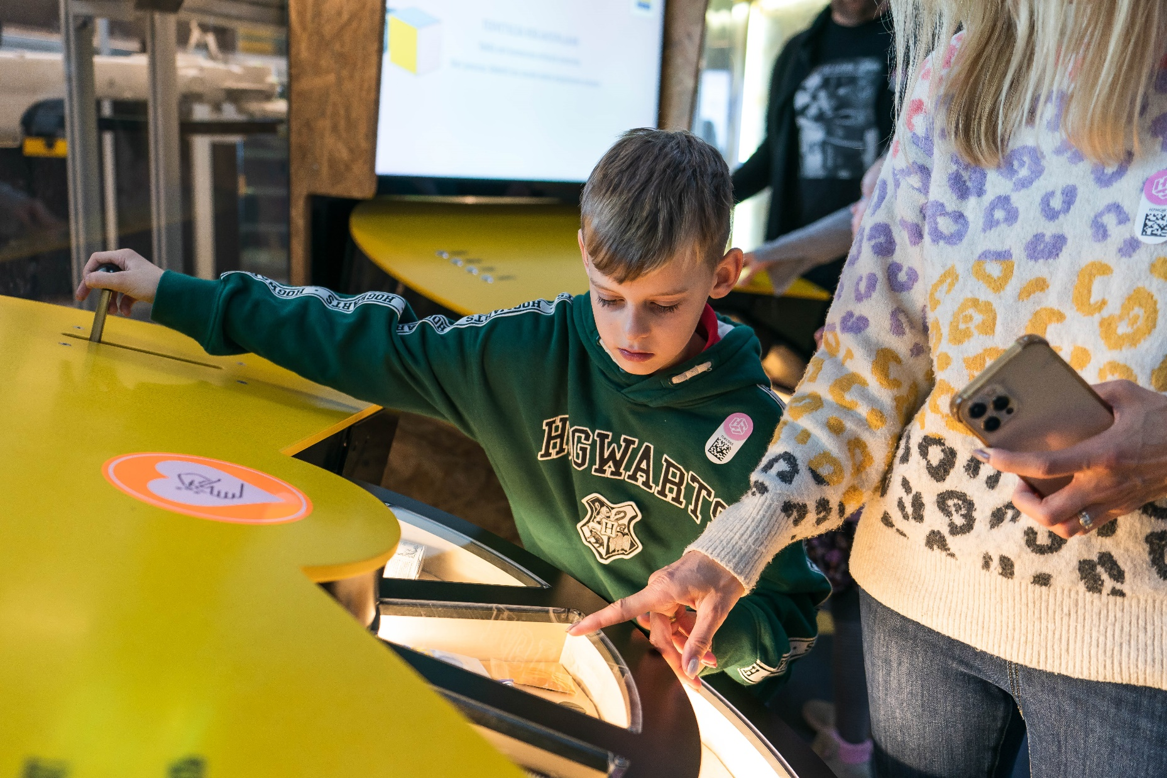
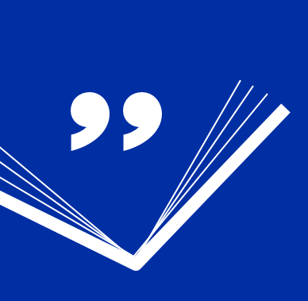
1
ST
MEDIA
LITERACY
Finland has placed first in the Media Literacy Index since it was first published in 2017.
The index ranks European countries according to their resilience potential to disinformation.
Media Literacy Index
2017–2022
Notes:
Photo:

Slide 4
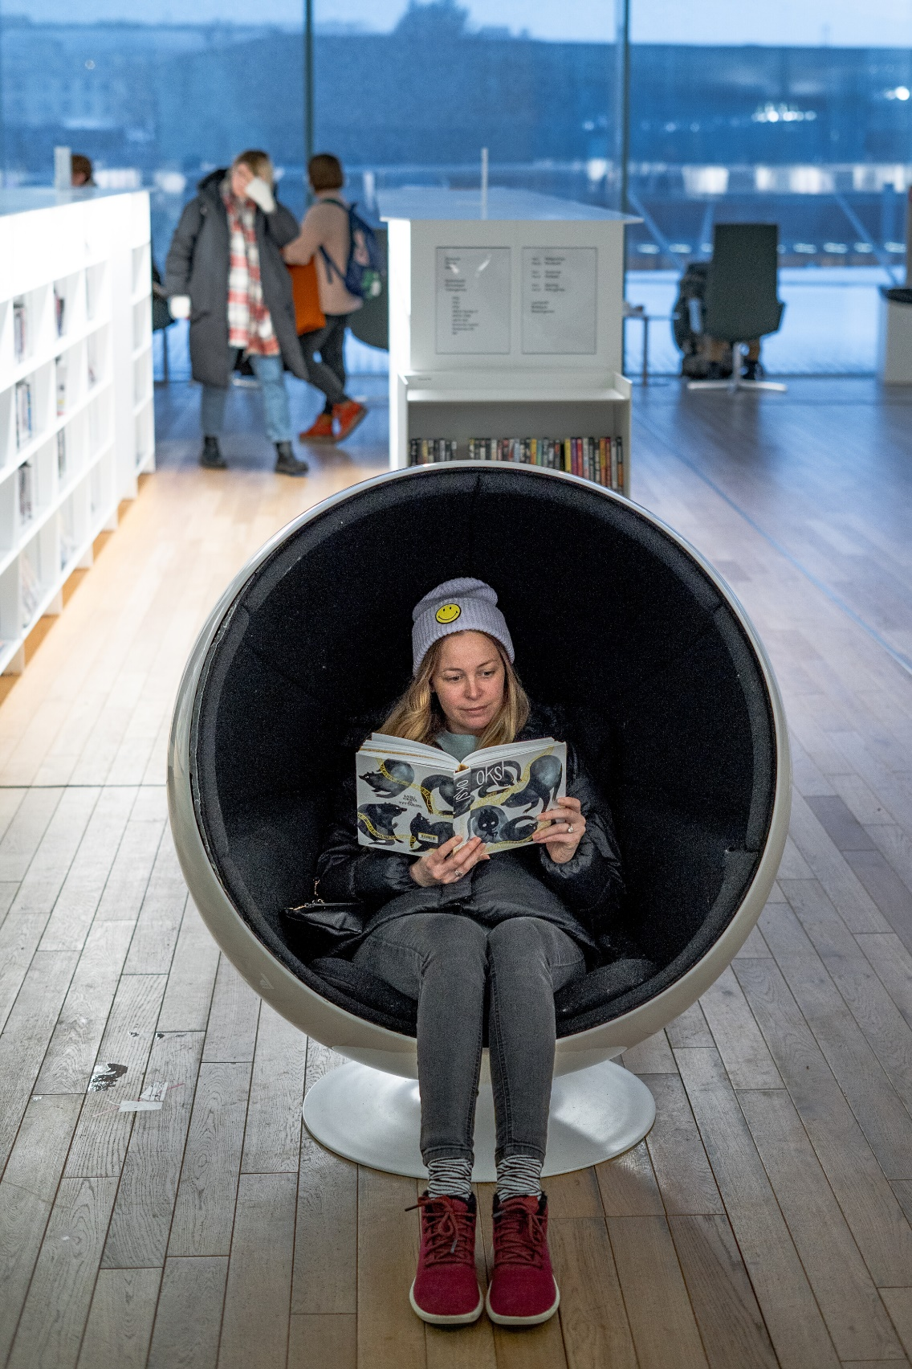
What makes Finland special in terms of media literacy?
In Finland, media literacy is viewed as an essential competence throughout the educational system, from early childhood education to non-formal education.
Notes:
Photo: Jules Hatfield & Christine Williams , Jules Hatfield & Christine Williams
Woman reading in Oodi library

Slide 5
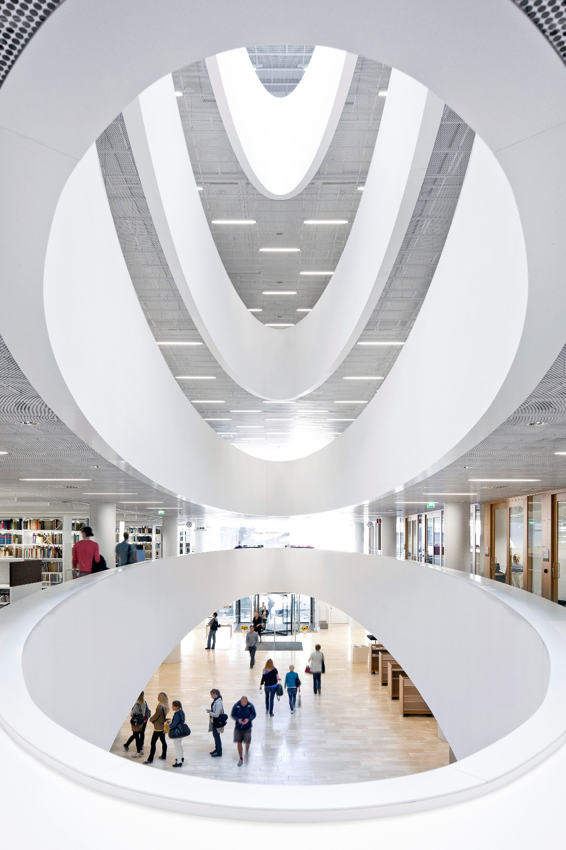
The secret behind Finland’s success is a cross-sector approach to providing citizens of all ages with good media skills. A large number of organisations work together, coming from different perspectives, but with a common goal.
Notes:
Photo: Tuomas Uusheimo
Kaisa House

Slide 6
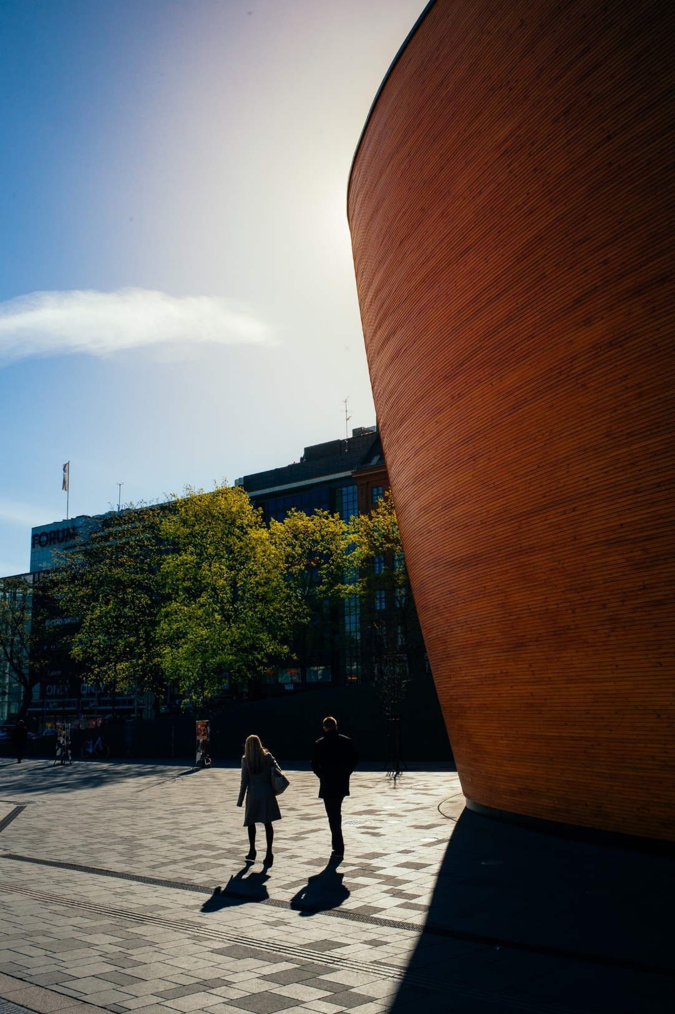
ST
Finland’s media literacy is strengthened by the society and social model, such as a free and independent press and a high degree of trust in individuals and institutions.
Notes:
Photo: Karoliina Bärlund / Helsinki Partners

Slide 7
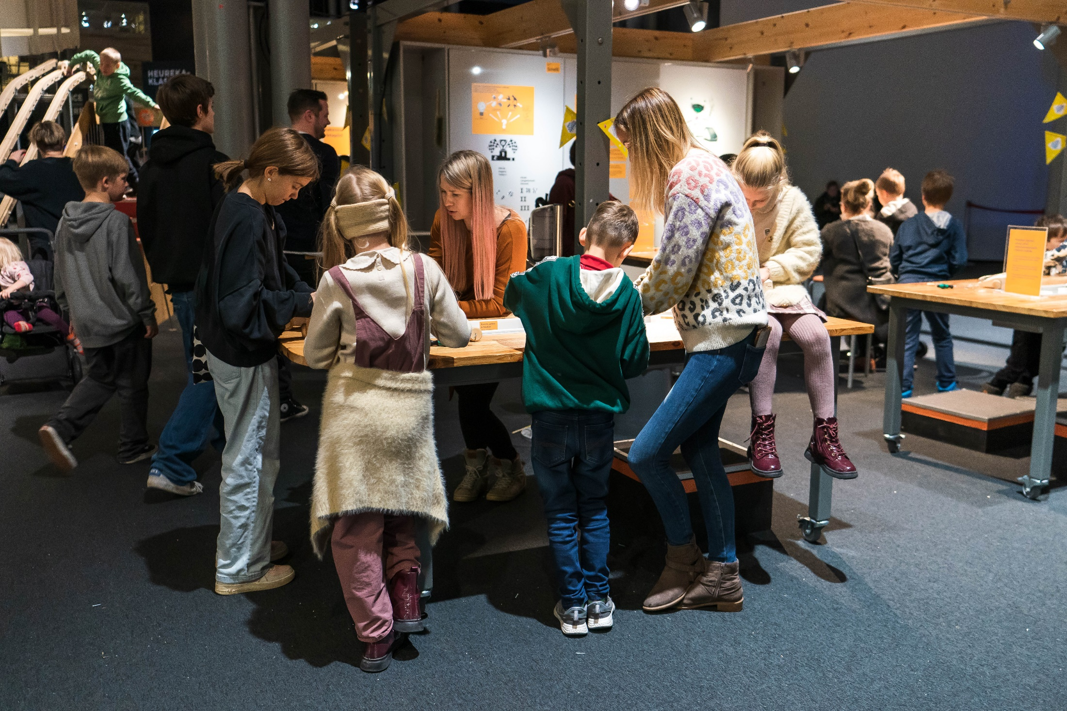
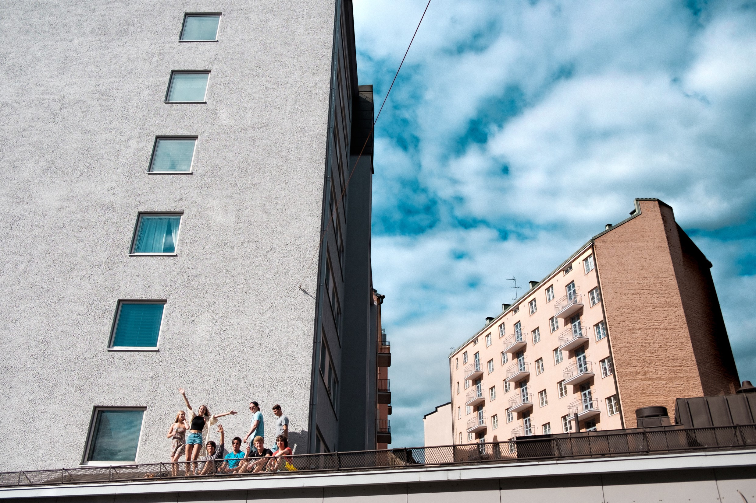
LET’S TAKE A LOOK
Notes:
Photo: Laura Dove

Slide 8
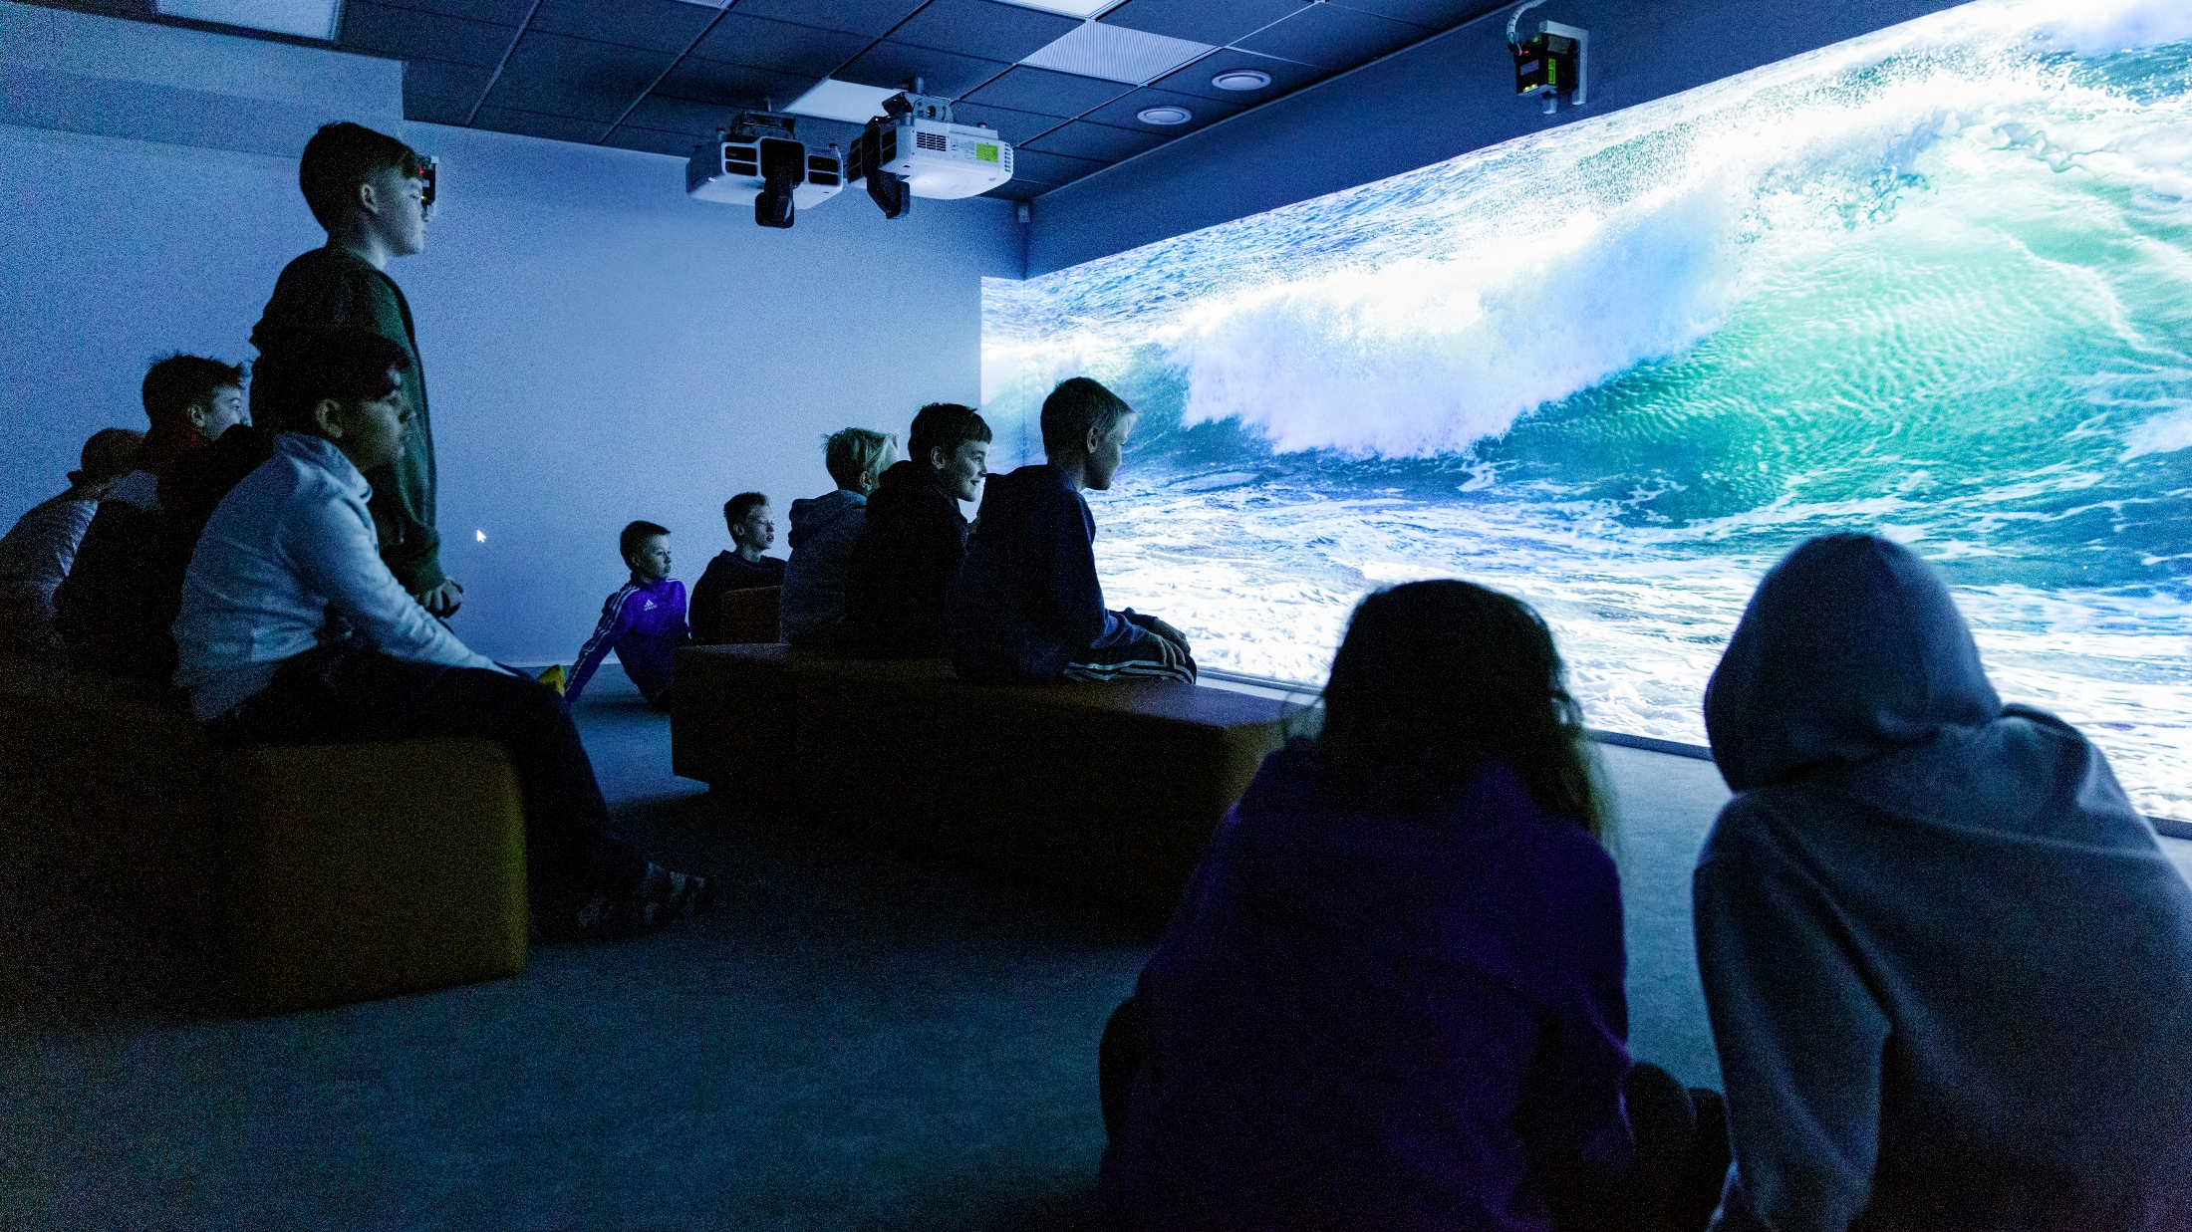
What is media literacy?
“Media literacy” refers to the ability to use, understand and evaluate media content – as well as well the ability to produce it.
Media literacy encompasses a wide range of skills.
Notes:
Hiidenkivi school is a contemporary community school for children and young people in its district. It has some interactive class rooms.
Photo: Maija Astikainen / City of Helsinki

Slide 9
Media literacy is:
ST
Understanding media representation
Analysing messages and their sources and credibility
Understanding underlying biases, interests and motivations
Creating media for communication
Media literacy is needed to critically analyse and digest information, and to build views based on evidence. It’s also a key tool in combatting hate speech and disinformation.
Notes:
Photo: Karoliina Bärlund / Helsinki Partners

Slide 10
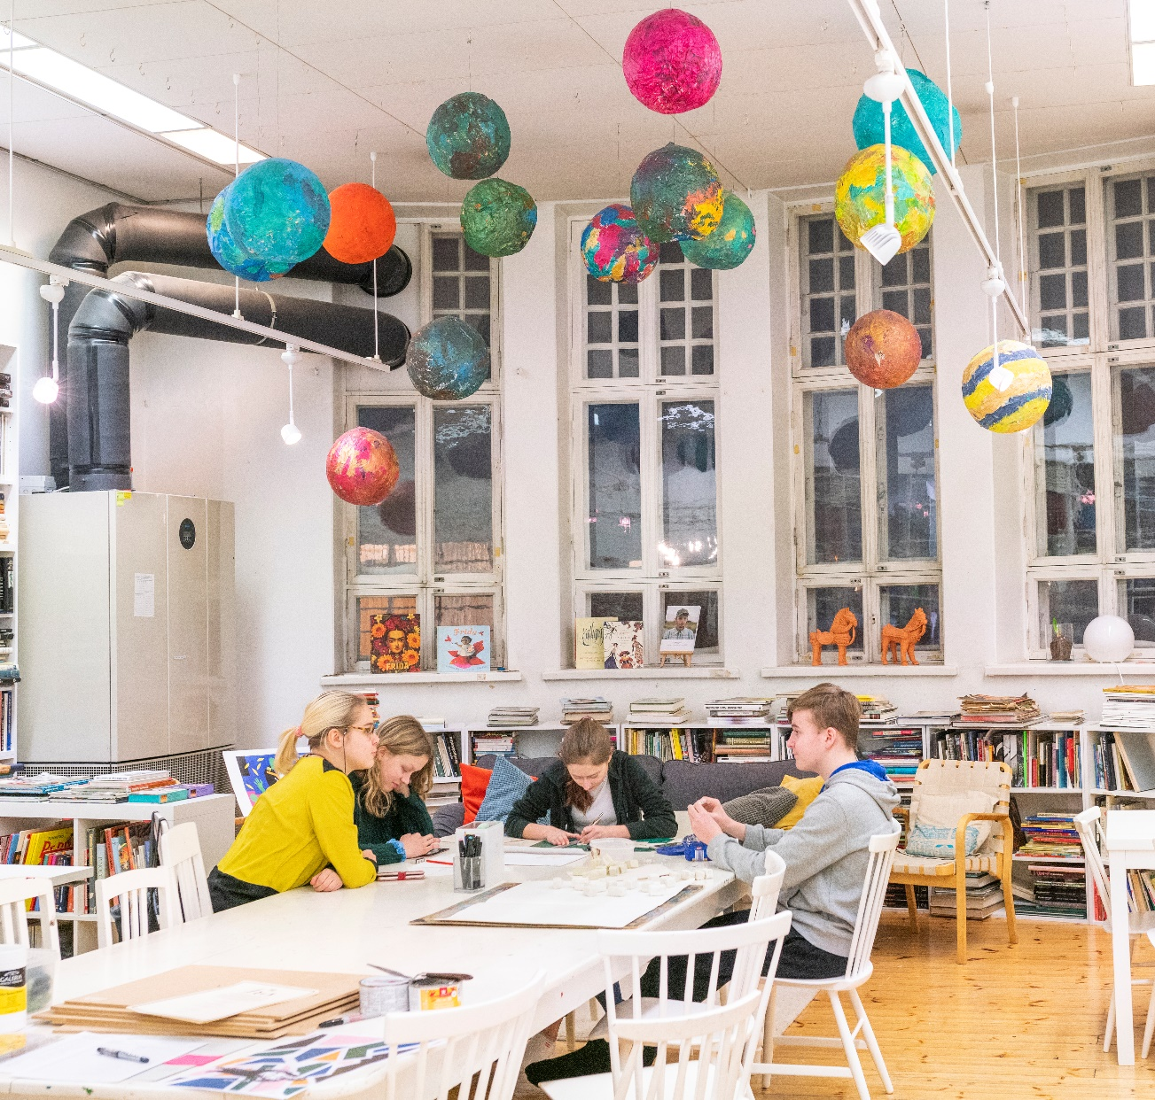
Media education is not new in Finland. Content related to media literacy has been part of formal education since the 1970s. It has evolved as media education has adapted to a changing media culture.
Notes:
Photo: Pasi Markkanen

Slide 11
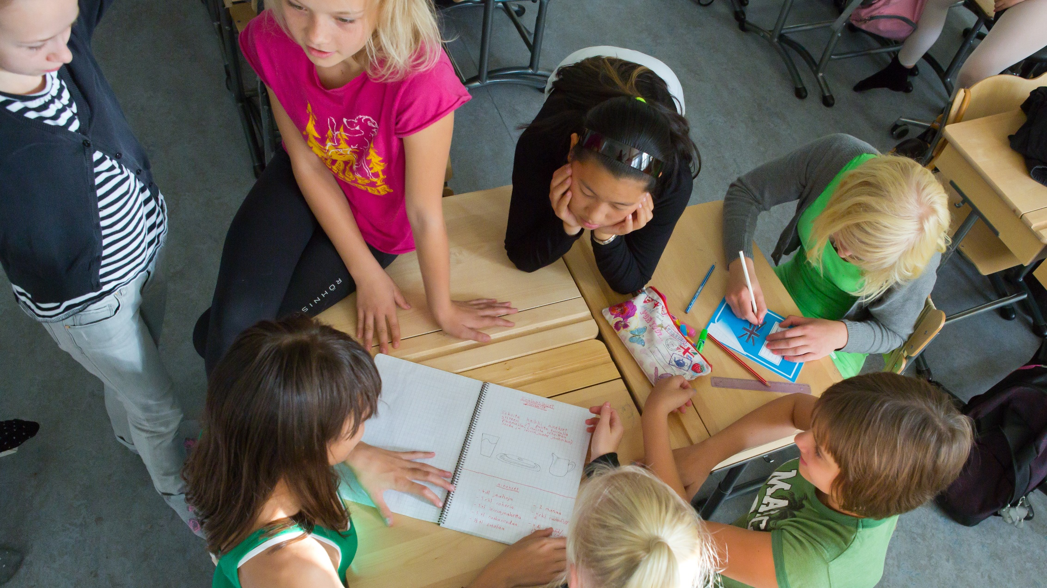
In 2019, Finland prepared a National Policy for Media Literacy, working together with a large number of stakeholders.
The policy created a common basis for continuing to develop media literacy, and includes a vision for future work.
Notes:
Photo: Riitta Supperi / Kuvatoimisto Keksi / Finland Image Bank

Slide 12
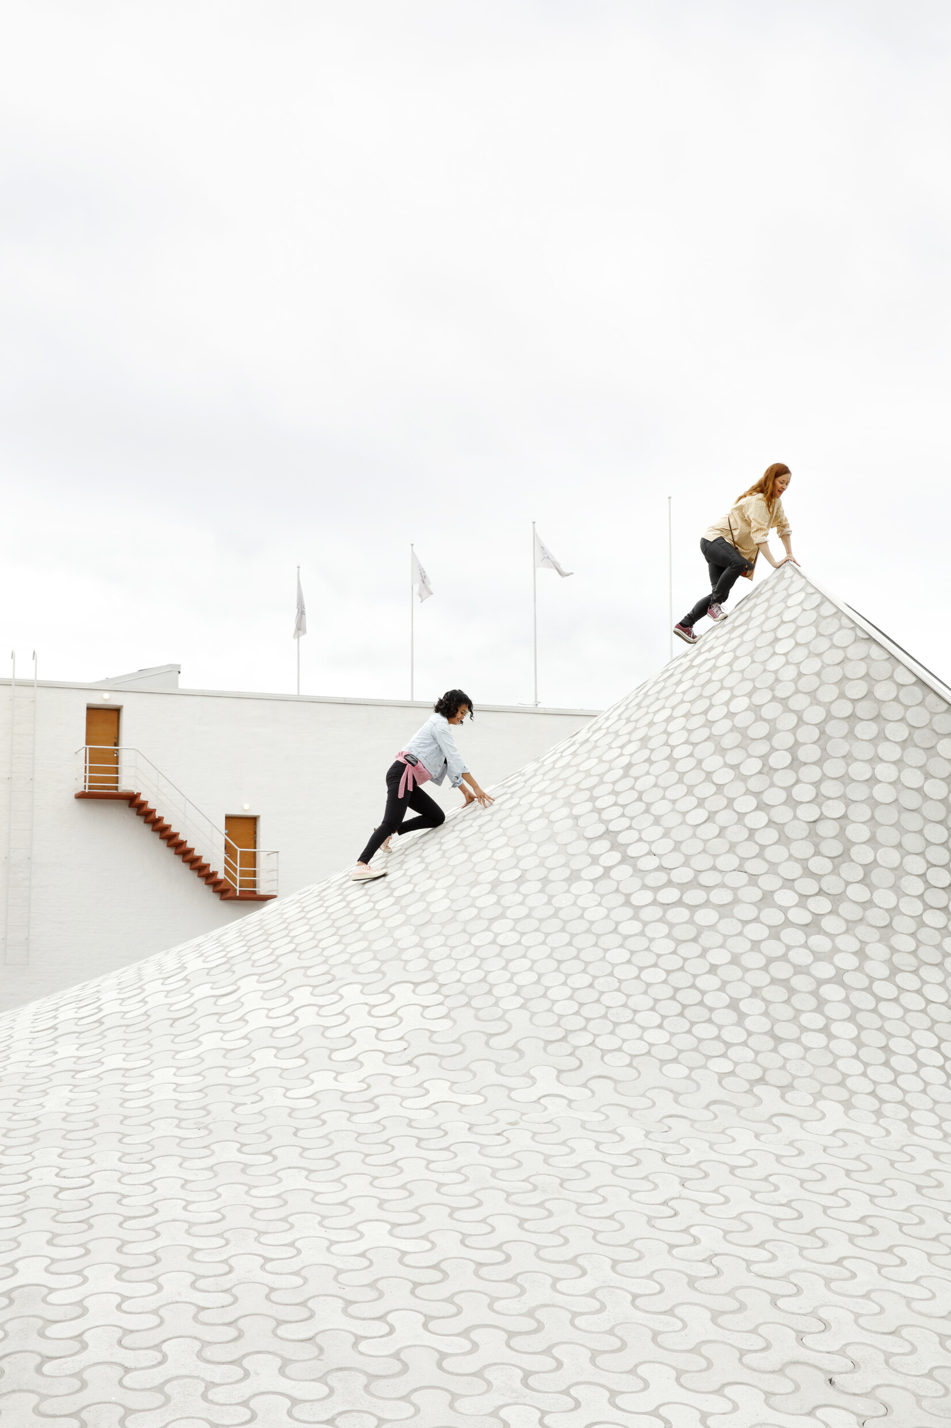
Finland’s Media Literacy vision has three objectives:
ST
Media education needs to be comprehensive in
terms of its content, perspectives, target groups and geographic distribution.
Media education must be high-quality, meaningful and non-discriminatory. The quality of media education is assessed and developed based on research.
Media education has to be systematic and consistent in all parts of Finland.
Notes:
Photo: Karoliina Bärlund / Helsinki Partners

Slide 13
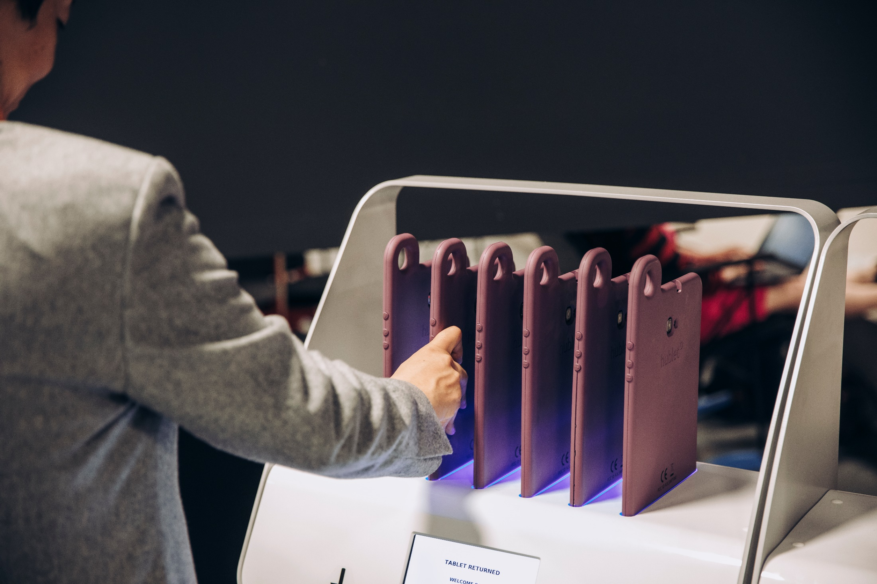
FINLAND’S CROSS-SECTOR APPROACH
Notes:
Tablet rental at Oodi
Oodi is Helsinki's new Central Library and a living meeting place in the city centre on the Kansalaistori Square. Oodi is a venue for events, a house of reading and a diverse urban experience. It will provide its users with knowledge, new skills and stories, and will be an easy place to access for learning, story immersion, work and relaxation. Oodi is a library of a new era, a living and functional meeting place open for all.
Photo: Aleksi Poutanen / Helsinki Partners

Slide 14
ST
The Ministry of Education and Culture has supported media education in Finland for decades. The Ministry promotes media literacy by allocating resources, disseminating relevant information and developing legislation. This takes place not only through education, but also through cultural, youth and art policies.
Notes:
Photo: Karoliina Bärlund / Helsinki Partners

Slide 15
ST
The National Audiovisual Institute,
a subordinate agency of the ministry, is responsible for developing and coordinating media education around the country. They do so in close cooperation with stakeholders in the field.
Notes:
Photo: Karoliina Bärlund / Helsinki Partners

Slide 16
ST
The formal education system forms the foundation and backbone of Finnish media education. Media literacy is integrated into the national core curricula at all levels of education, and it is embedded in the day-to-day activities of schools and classrooms across the country.
Notes:
Photo: Karoliina Bärlund / Helsinki Partners

Slide 17
ST
Informal media education occurs in places like libraries and museums, and it is also integrated into youth work. Governmental organisations, civil society actors, NGOs and media outlets all play a role.
Notes:
Photo: Karoliina Bärlund / Helsinki Partners

Slide 18
NEW LITERACIES
Notes:
Photo: Laura Dove

Slide 19
ST
The New Literacies Programme, launched in 2020, is Finland’s latest developmental programme for media education. From early childhood education to upper secondary level, it aims to strengthen children’s and young people’s media literacy, programming skills and competence in information and communications technology.
Notes:
Photo: Karoliina Bärlund / Helsinki Partners

Slide 20
New Literacies:
Early childhood education
ST
Ages 0–4: Media education is approached through curious experimentation and play. Children get to know everyday media, devices and content. They empathise with stories and process them by means of personal expression and creativity. Together with other children, they examine information about issues that interest them.

Slide 21
New Literacies:
Pre-primary education
ST
Ages 5–6: Children take a more active role as media users and producers. At the same time, they begin learning how to understand what is fiction and what is true.

Slide 22
New Literacies:
Elementary school I
ST
Ages 7–15: Students examine and produce stories and learn how to use media safely and understand its role in society. They use creativity and imagination to produce stories with the help of media devices, both independently and in groups. In higher grades, pupils make initiatives, generate ideas and experiment with media. They use media to express their own thoughts and opinions.

Slide 23
New Literacies:
Elementary school II
ST
Teenage students develop their narrative methods and technical skills, and they get to produce media content aimed at influencing others. Students learn to evaluate the reliability of social media content as a source of information. They critically examine the various effects that media can have on individuals, groups and society.
Data and privacy protection are also featured.

Slide 24
New Literacies:
General upper secondary education
ST
Ages 15–17: The curriculum includes the cross-cutting themes of Multiliteracy and Media, and Technology and Society. Students practise related competences across different subjects. Multiliteracy highlights the importance of abilities to interpret and to produce different media.

Slide 25
New Literacies:
Vocational upper secondary education
ST
Ages 15–17: Media and information literacy competences are mainly integrated into language arts, information technology, maths and science subjects. Special attention is paid to work-related media competences.

Slide 26
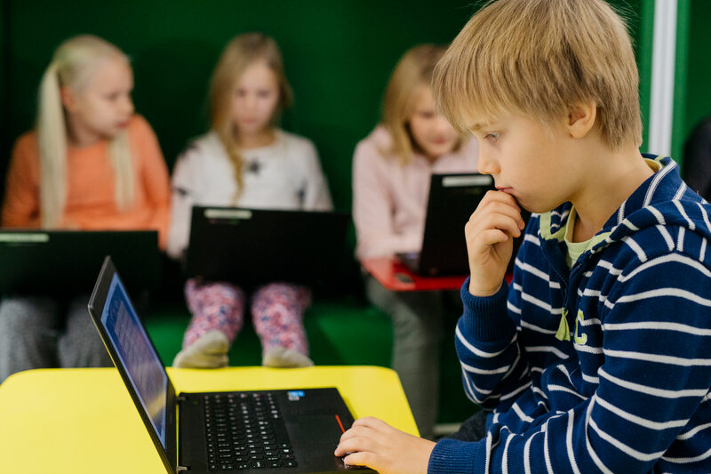
MEDIA EDUCATION
IN THE CLASSROOM
Notes:
Photo: Elina Manninen / Keksi

Slide 27
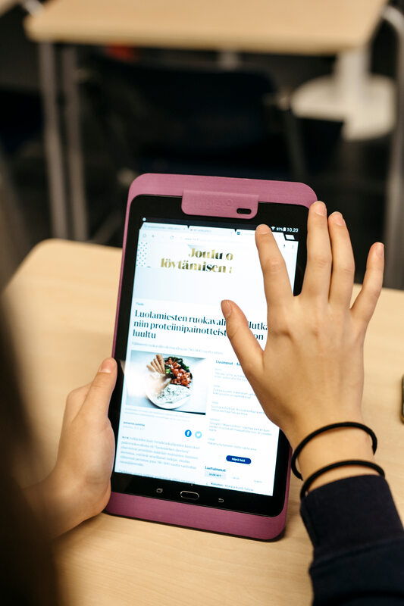
ST
In Finland, teachers are university-educated professionals who are given a great deal of autonomy to plan their teaching based on the needs of their classes. Therefore, there is no single government-mandated way of teaching media literacy.
Notes:
Photo: Elina Manninen / Keksi

Slide 28
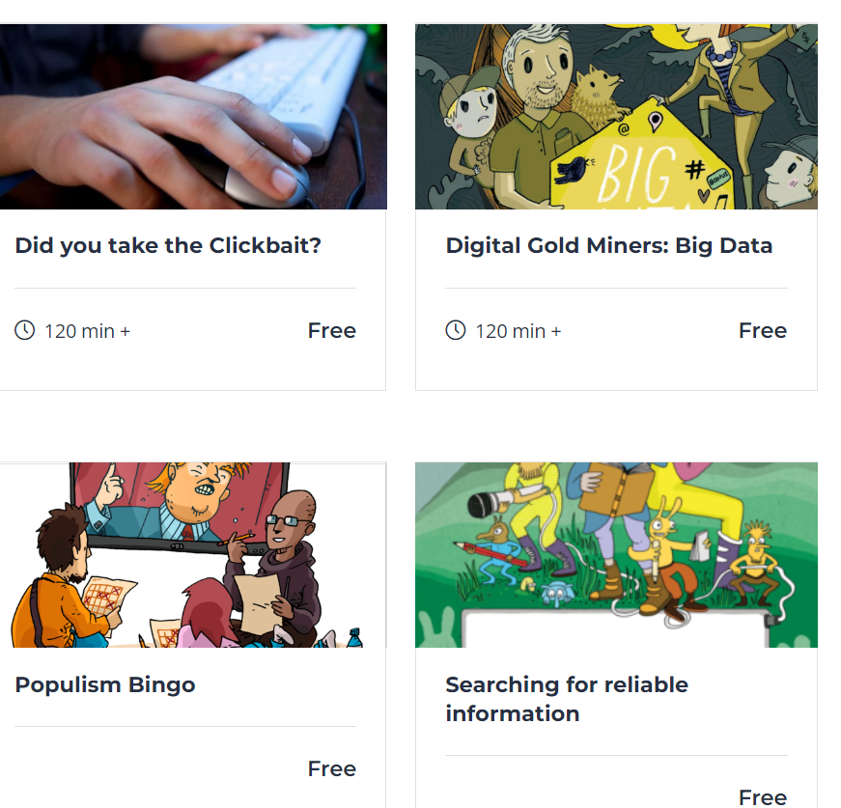

ST
There is a variety of support materials for media education. They are available on a website, Media Literacy School, for teachers to use and share.

Slide 29

Finland celebrates Media Literacy Week annually. Every year, around 30 different campaigns are created in cooperation with more than 50 partner organisations from all sectors of society, such as public institutions, NGOs and private companies. The national theme week encourages local institutions, such as schools, libraries, youth centres, museums and kindergartens, to try new ways of supporting media literacy.
Notes:
Photo: Kansallinen audiovisuaalinen instituutti

Slide 30
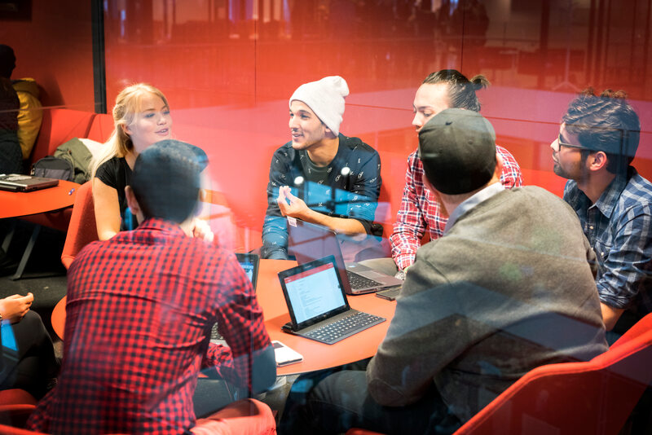
ADULTS AND
MEDIA EDUCATION
Notes:
Photo: Velhot Photography Oy/ Riku Isohella

Slide 31
ST
Adults are a challenging target group. Individual competences and needs vary greatly, and adults cannot be reached as a cohesive group in the same way schoolchildren can. Those working in media education are actively searching for new ways to reach their target audience.

Slide 32
ST
Several different organisations contribute to the development of adult media literacy. Some examples are adult education providers, libraries, different civil society organisations and private companies such as media outlets.

Slide 33
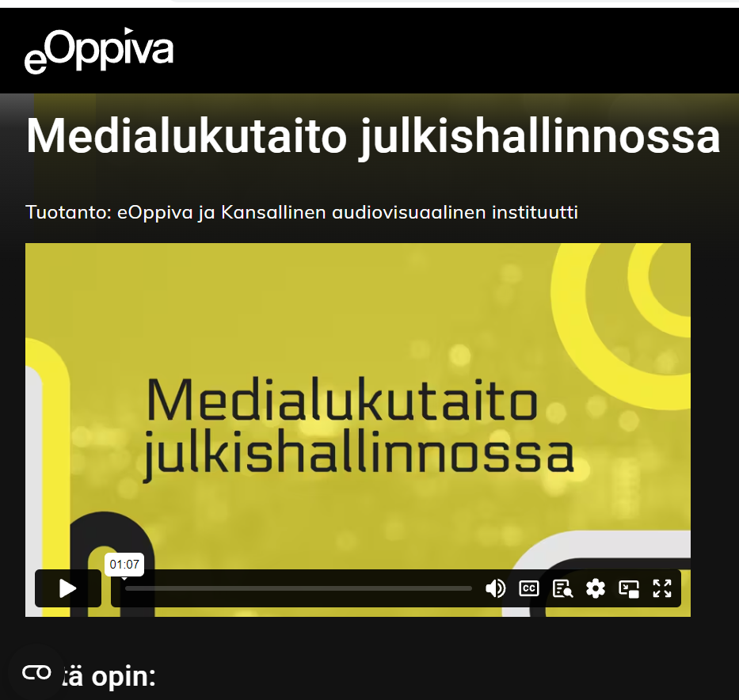

ST
In public administration, employers can encourage the media literacy of their employees with an online training course. The course was published in 2021 and is open to all government employees.

Slide 34
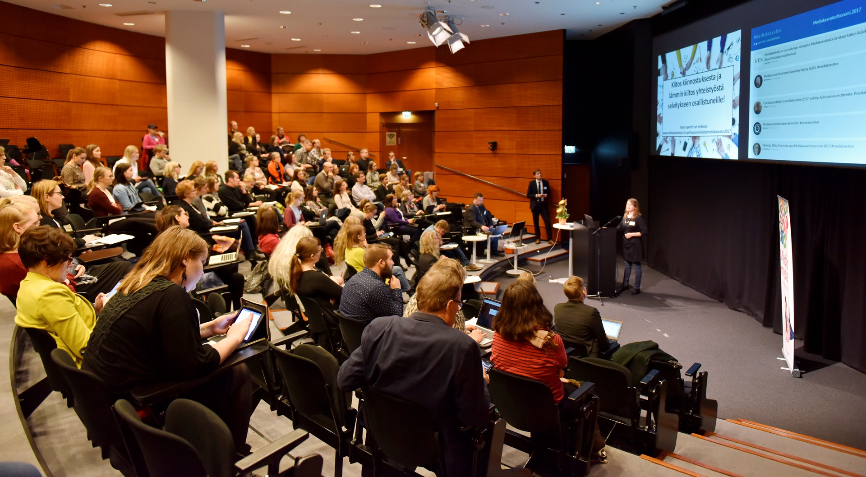
The annual Media Education Forum promotes media education for adults. This free-of-charge seminar provides stakeholders and specialists an opportunity to network and share views and best practices in media literacy for adults.
Notes:
Photo: Matti Pyykkö / N2 Albiino / Helsinki Partners

Slide 35
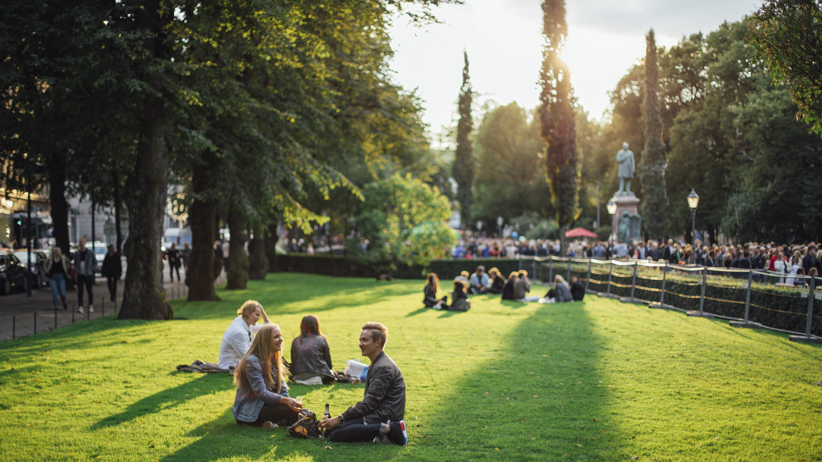
SKILLS AND TOOLS
FOR THE FUTURE
Notes:
Photo: Julia Kivelä / Visit Finland

Slide 36
ST
Critically evaluating and applying information received from various media sources is a vital skill in our modern societies, and it’s only becoming more important as technology continues to evolve.

Slide 37
ST
In recent years, Finland has put more focus on inclusion in media literacy education. Examples of objectives include strengthening the skills, capacities and inclusion of participants; improving accessibility; removing barriers; and preventing exclusion.

Slide 38
Finland:
Teaching media literacy
for the future.

