Slide 1







Careers in Finland – world’s happiest country
Finland is a stable, safe, equitable and high-functioning welfare state
Here, you can enjoy high quality-of-life and combine an interesting career with a thriving personal life. Balancing work and family has been made easy in Finland.
The healthy balance between work and leisure in Finland also gives you plenty of opportunities to enjoy the country's unique nature – which is easy to access even from urban areas.
Finland is home to leading and high-performing companies which offer attractive work opportunities.
Finnish innovation and strong technological expertise is fostered by close cooperation between companies, universities and research institutions.
Finland’s educational system is among the best in the world. ​
Finland is a leading global expert in climate challenges and solutions.

Slide 2

Find your work-life balance
Finns know that happy, well-rested employees
are an organisation's most valuable resource.
Although working hours may vary across industries, the standard is an eight-hour workday.
Employees are entitled to plenty of paid holidays and vacation days and many Finns take four weeks off during the summer months. ​
Family welfare and equality are two values universally upheld by Finnish society – and they're embedded in workplace policies and culture, too.

Slide 3
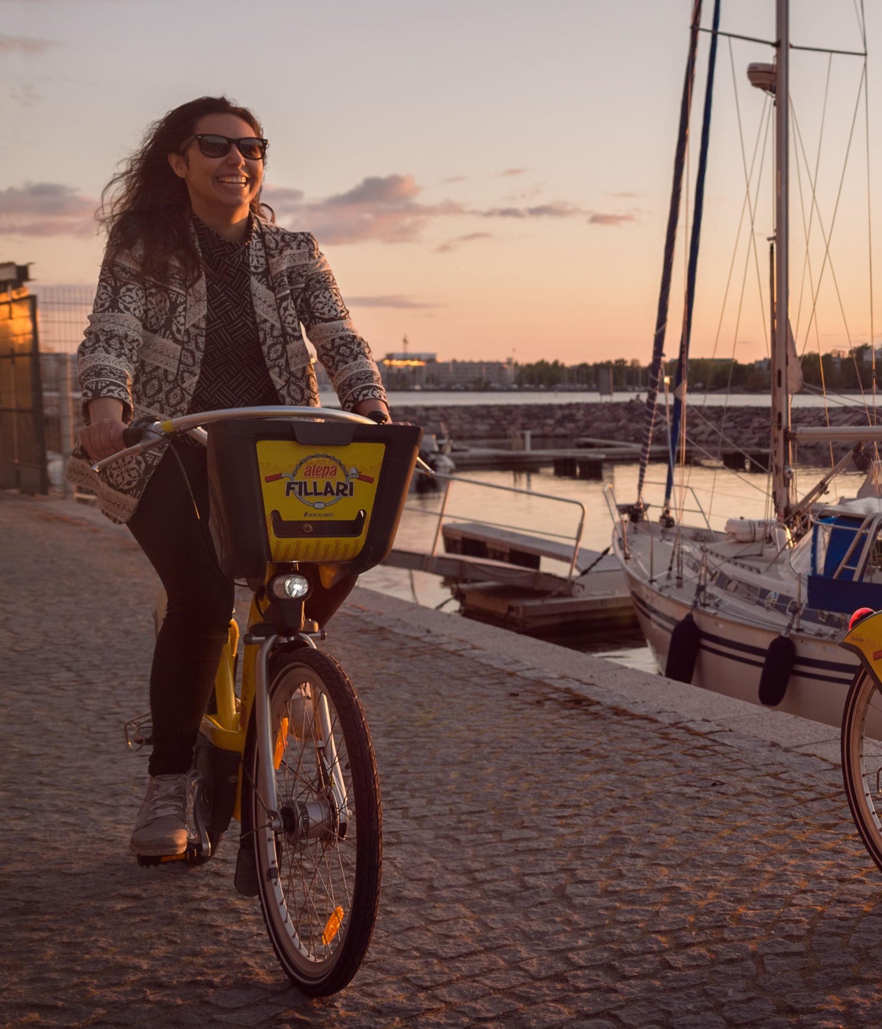

Safety and stability in Finland​
A unique mix of social responsibility, individual freedoms and an equitable society help make Finland the happiest country in the world. And it also helps make it one of the safest. ​
Finland is ranked the world’s most stable country. ​
As a low-hierarchy culture, you might just bump into a head of state dropping their child off at the local public school.​

Slide 4

Opportunities to innovate and develop skills​
​
Finland has a vibrant start-up scene and rapidly growing tech sector, offering exciting opportunities for English-speaking professionals around the world. ​
Flat hierarchies and a national passion for innovation encourages employees across all levels to weigh in on workplace culture, policies and processes. ​
According to studies, Finland offers the best opportunities in Europe for employees who want to develop their professional skills at work.​

Slide 5
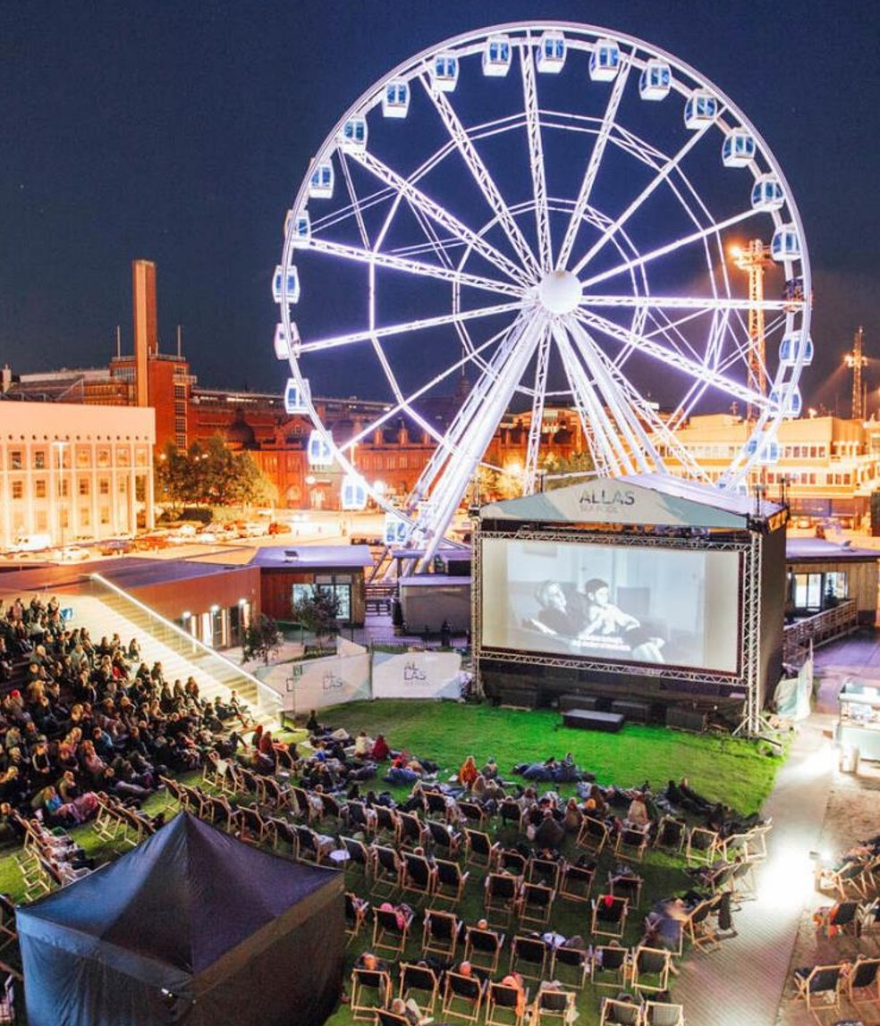
Rich cultural offerings​
Explore Finnish cultural highlights in more detail:
https://www.visitfinland.com/en/things-to-do/
Finland has a vibrant arts and culture scene, boasting diverse music, dance, theatre, cinema, food and art offerings.
Finland has over 300 museums and some of the most exciting new architecture in Northern Europe. You'll also find an array of exciting events and festivals across urban and rural settings, ranging from cool to quirky to just plain crazy.​

Slide 6

workinfinland.com
Open positions:
www.workinfinland.com/en/open-jobs/​
Services offered by cities in Finland, e.g. Spouse program:
www.workinfinland.com/en/why-finland/#cities-and-municipalities​
​Workinfinland.com is the official Finnish website for international talent. ​
This “one-stop shop” website simplifies the recruitment, job search, and relocation process for people seeking work in Finland. ​
Find out everything you need to know about living and working in Finland – with in-depth information about housing, healthcare, social benefits, work-life balance, career development and more​.​

Slide 7

Launch your start-up in Finland​
Find more information:
www.businessfinland.com/establish-your-business/startup-a-business/
Finland has one of the fastest-growing startup scenes in the world. ​
Get everything you need to launch a start-up successfully: ​
A stable business environment for startups.​
A vibrant ecosystem of accelerators, angel investors and VCs, ​
Backed by strong government support.​
An excellent testing ground for new technologies. ​
Highly-educated and tech-savvy people. ​
The best know-how within digital technology.

Slide 8
Study in Finland
Find more information on how to study
in Finland at:
Studyinfinland.fi
Finland's world-leading higher education system offers over 500 English-taught bachelor's and master's degree programmes across 13 universities and 22 universities of applied sciences (UAS).
The universities also offer options for English-taught doctoral degrees.
All universities and universities of applied sciences offer scholarship opportunities to international students.

Slide 9


Learn more on LinkedIn and Youtube
Follow us:
#Finlandworks LinkedIn
Learn more with Youtube videos:
Finland for families​
https://www.youtube.com/watch?v=9X3QUA1Poyg&t=2s​
Enjoy the vibrant city life​
https://www.youtube.com/watch?v=wBgS4AvWHdY​
Grow your career​
https://www.youtube.com/watch?v=UfHXZWttIl0​
Find your work-life balance​
https://www.youtube.com/watch?v=Wn1nf6eSAwg

