Slide 1



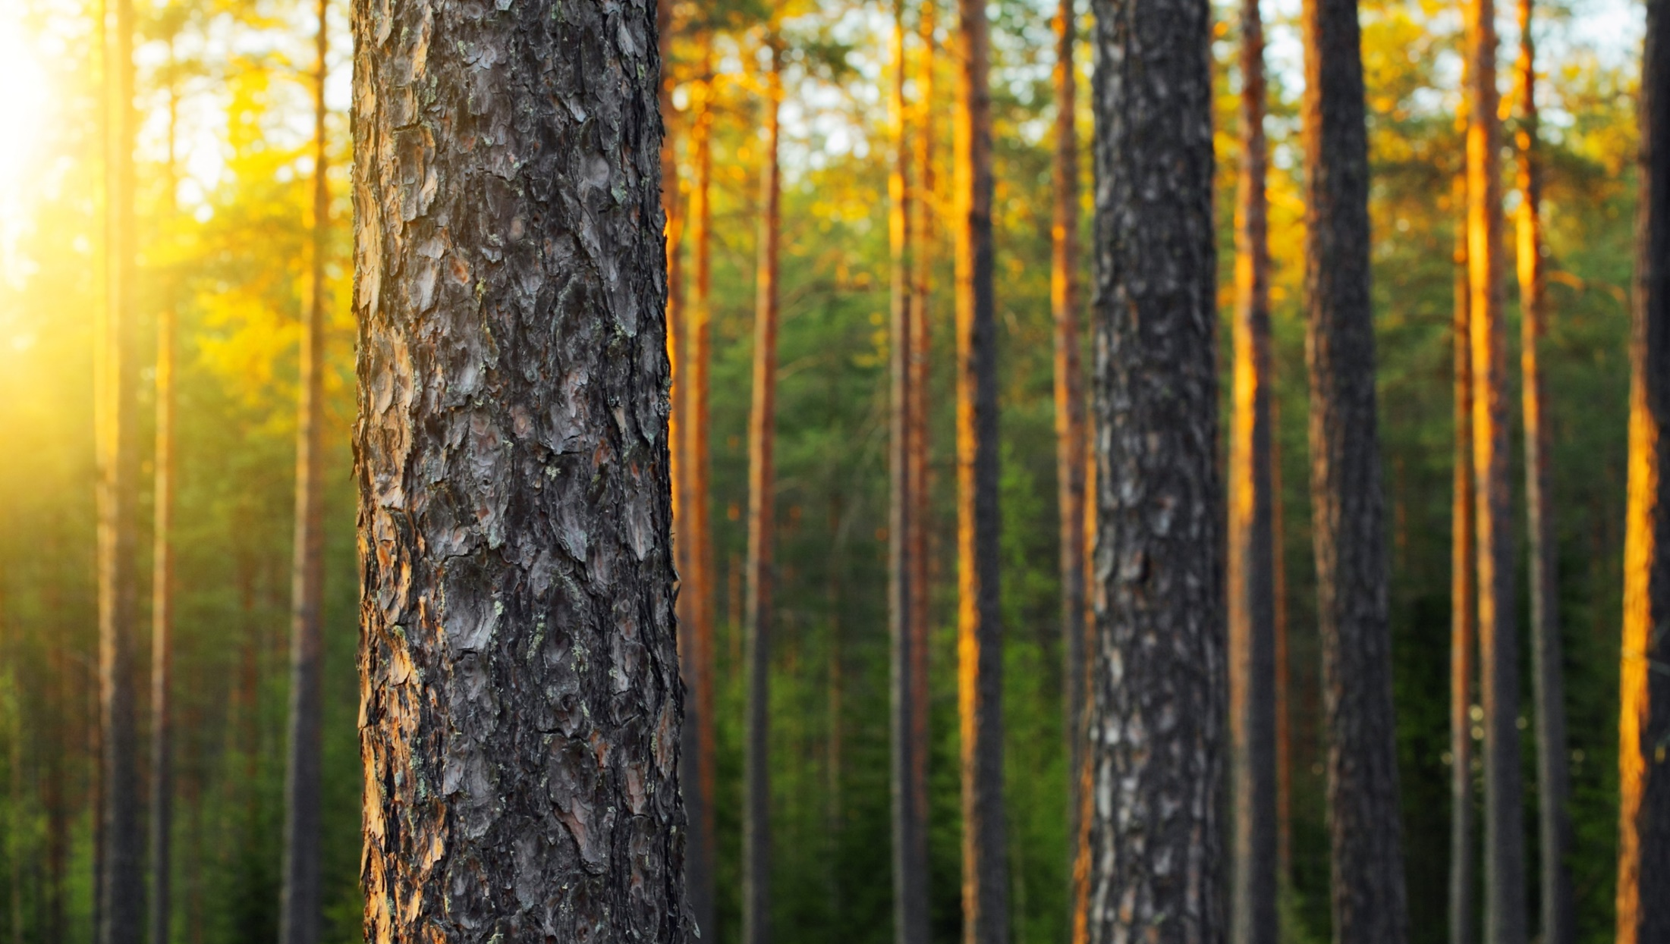


Slide 2
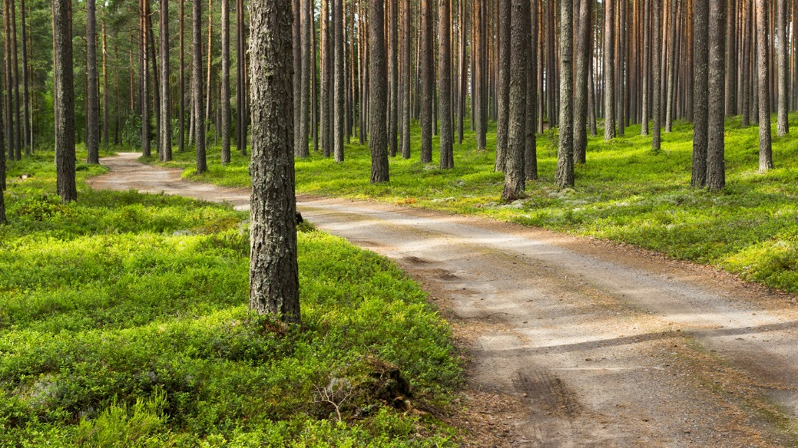

#1 FORESTED COUNTRY
IN EUROPE
75% OF THE
LAND COVERED
IN FORESTS
SUSTAINABLE AND COMPREHENSIVE UTILIZATION
THE NORDIC ENVIRONMENT HAS GIVEN FINNISH WOOD SOME SPECIAL FEATURES
Slowly grown wood is very strong
Beautiful wood for further processing
Notes:
The first forest law to prevent excess harvesting of the trees was issued in Finland already at 1886.
Strong, Slowly Grown
Finnish wood grows slowly and the result is a hard, tough and straight-grained timber with low internal tension and a few cracks.
Sustainable from Certified Forests
95 % of Finland’s forests in commercial use are certified.
Beautiful for Further Processing
Due to its beautiful structure and appearance, Finnish spruce and pine are versatile material for various applications.
Constant, Reliable Deliveries
Finnish sawmills can reliably deliver sawn softwood throughout the whole year and as a result the clients can rely on deliveries and keep their stocks small.
Sources:
http://www.smy.fi/forest-fi/metsatietopaketti/suomen-metsavarat/
http://www.woodfromfinland.fi
http://www.fao.org/forestry/country/57479/en/fin/

Slide 3
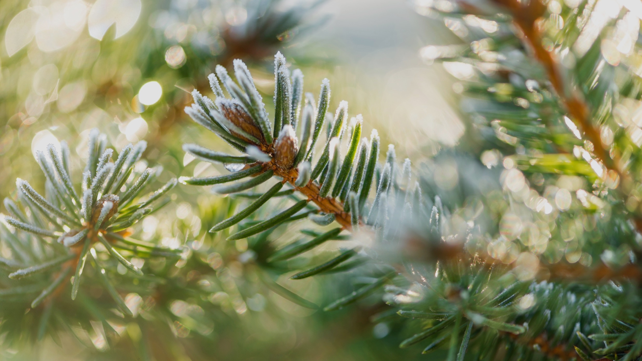
UNIQUE KNOW-HOW OF
FOREST-BASED BUSINESS
GLOBAL GIANTS:
UPM & STORA ENSO ARE TOP PLAYERS IN THE EUROPEAN FOREST INDUSTRY
A PLATFORM
FOR NEW REVOLUTIONARY BIOPRODUCTS
Notes:
The Finnish forest industry is a forerunner that has great opportunities to promote sustainable development. Finland has good chances for retaining its position as a leading production and innovation environment, which allows new forest industry products and services to be developed and competitive advantages to be improved. Forest industry companies have invested approximately EUR 100 million a year in research and development functions in Finland. (Source: Statistics Finland) Finnish forest industry groups are among the world’s biggest forest industry companies.
Measured by 2015 turnover: UPM 10,1 Bn. EUR & Stora Enso 10,0 Bn. EUR
Source: http://www.forestindustries.fi/statistics/industry/10-Forest%20Industry/

Slide 4
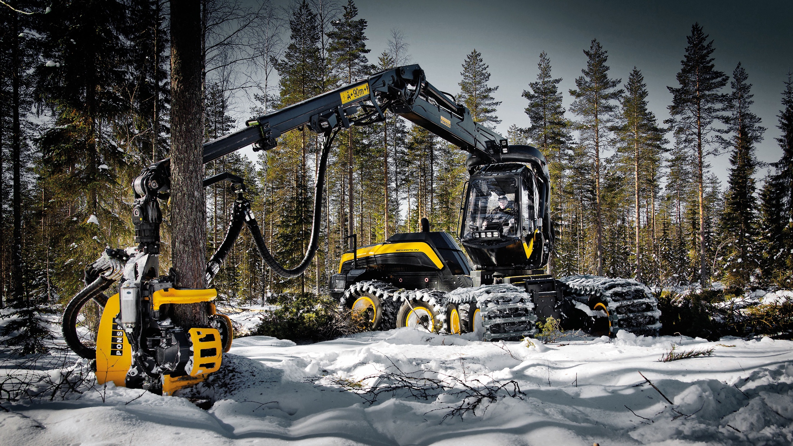
CUTTING EDGE
FOREST HARVESTERS
THE WORLD’S LEADING HARVESTER PROVIDERS
JOHN DEERE & PONSSE HAVE THEIR MAIN FACILITIES IN FINLAND
JOHN DEERE’S JOENSUU FACTORY IS THE WORLD’S LARGEST HARVESTER FACTORY
IN CUT-TO-LENGTH
Notes:
Source: https://www.deere.fi/fi_FI/our_company/news_and_media/press_releases/2012/february/joe_investment/joe_investment.page

Slide 5
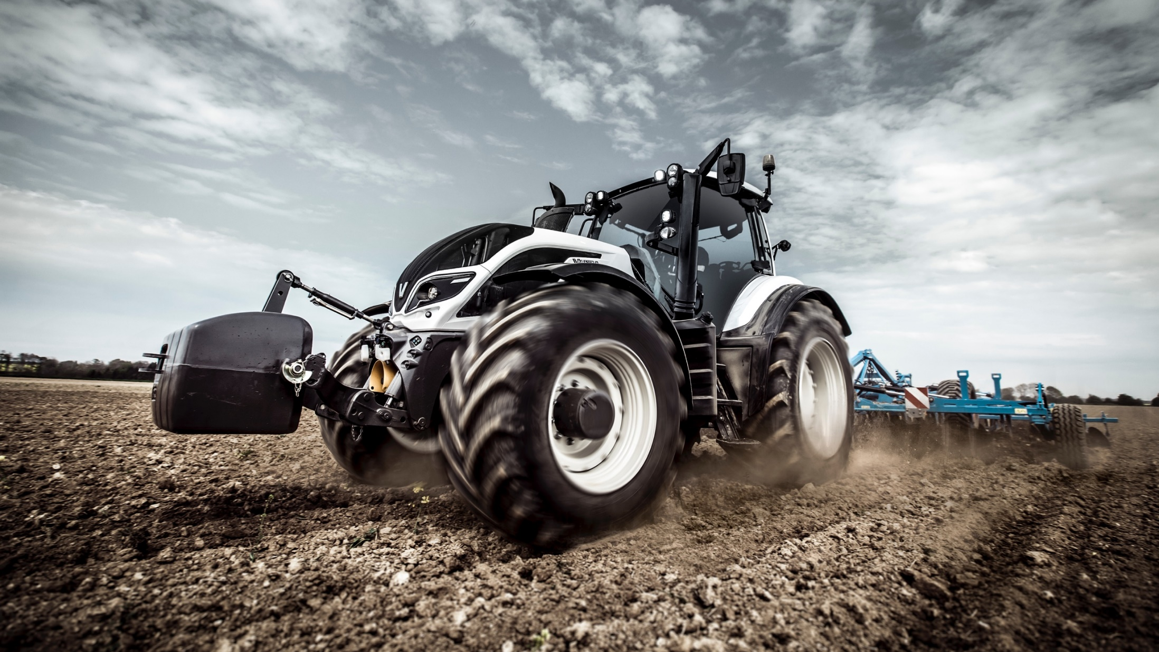
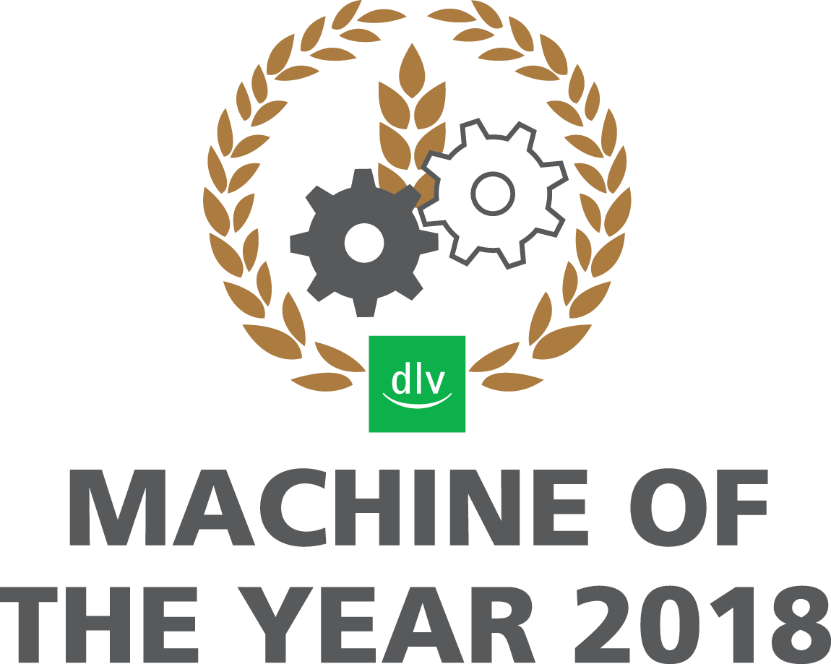
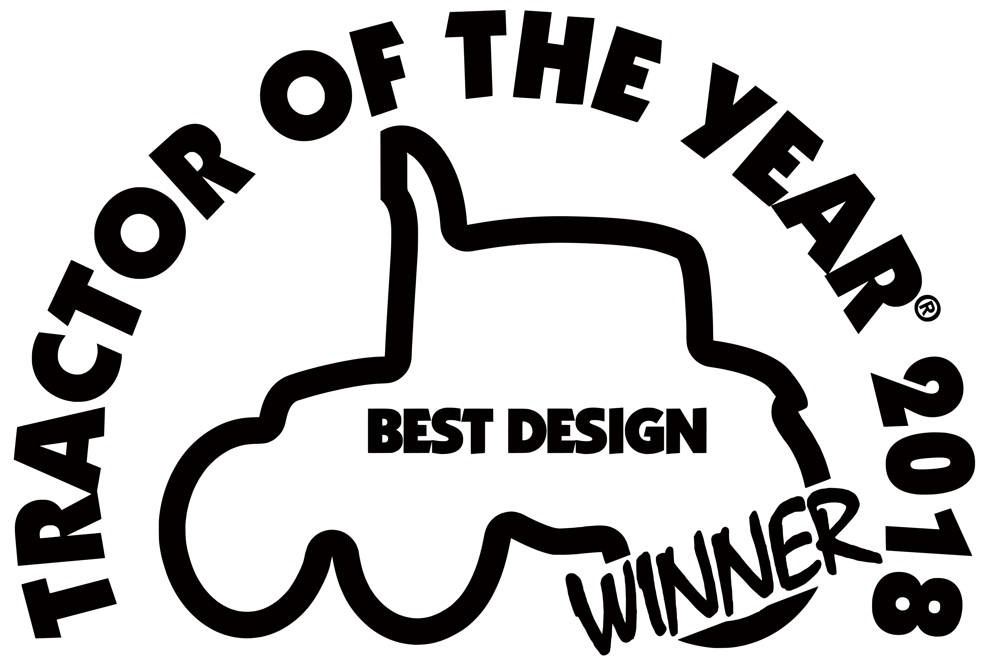

HARSH ARCTIC NATURE REQUIRES
WELL DESIGNED MACHINERY
FINNISH
VALTRA TRACTOR
HAS WON
2016 RED DOT AWARD
MACHINE OF THE YEAR 2018
TRACTOR OF THE YEAR 2018
Notes:
Weatherproof technology: Finland’s weather conditions are exceptionally harsh, with extremely cold winters and short summers. In fact, half of the world's arable land north of 60 degrees latitude is on Finnish soil. Yet despite this – or perhaps because of it – Finland is among the world’s most productive agricultural regions. Built on Nordic know-how, Finnish agricultural machines are tough and easy to maintain. There is no other option. If the harvesting season lasts only 2-3 weeks, your machinery must be weatherproof.
Red dot award: With its origins dating back until 1955, the award is organised by Design Zentrum Nordrhein Westfalen and with more than 17,000 entries each year one of the best-respected design competitions in the world. The sought-after award, the “Red Dot”, is the revered international seal of outstanding design quality. The international jury only awards this sought-after seal of quality to projects that set themselves apart significantly from comparable projects thanks to their excellent design.
Statement of the jury: “Ergonomically well-considered in the interior, the Valtra T4 convinces outwardly with a dynamic appearance which is an expression of its performance and efficiency.”
Source: http://red-dot.de/pd/award/about/?lang=en

Slide 6
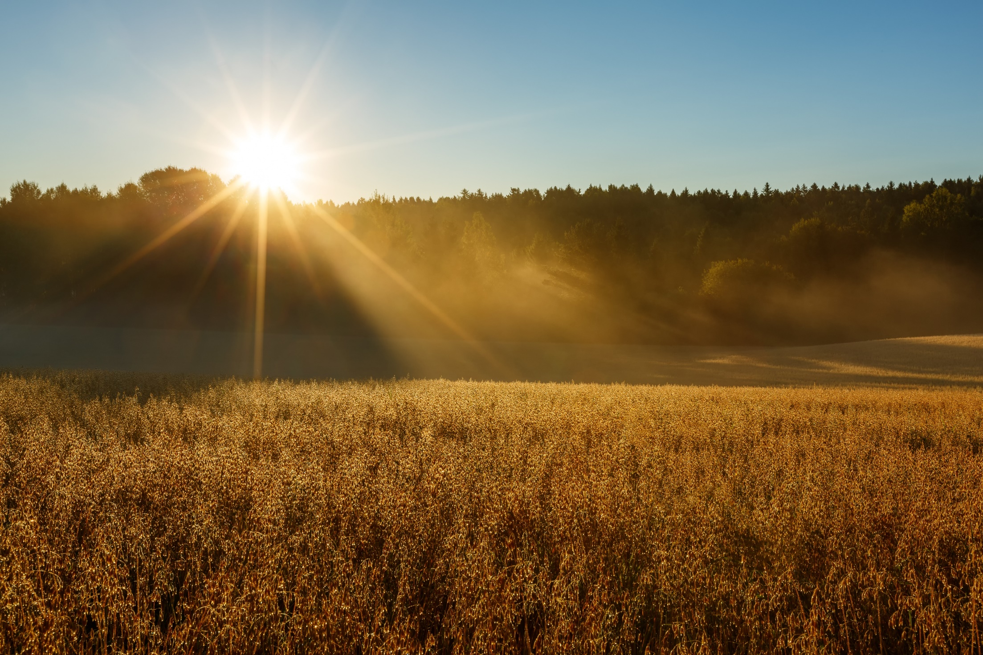
NATURAL AND HEALTHY FOOD
POWERED BY ARCTIC NATURE
COUNTRY IN
OAT RESEARCH
AND INNOVATIONS
OAT EXPORTER
IN THE WORLD
Notes:
Arctic Nature: Located as far north as South Greenland, Alaska and Northern Siberia, Finland is the northernmost country to practice versatile farming and food production techniques. Our long summer days and arctic midnight sun enhance the unique flavour of various grains, vegetables, herbs, berries and other ingredients.
Finnish oat: Finnish oat has excellent quality due to long growing season and cool climate. The European Union accepted two health claims for beta-glucan, the soluble fibre of oats. Beta-glucan helps to control blood cholesterol and attenuates the peaks in blood glucose after a meal. In addition, the insoluble fibres improve the wellbeing of the stomach and gut.

Slide 7
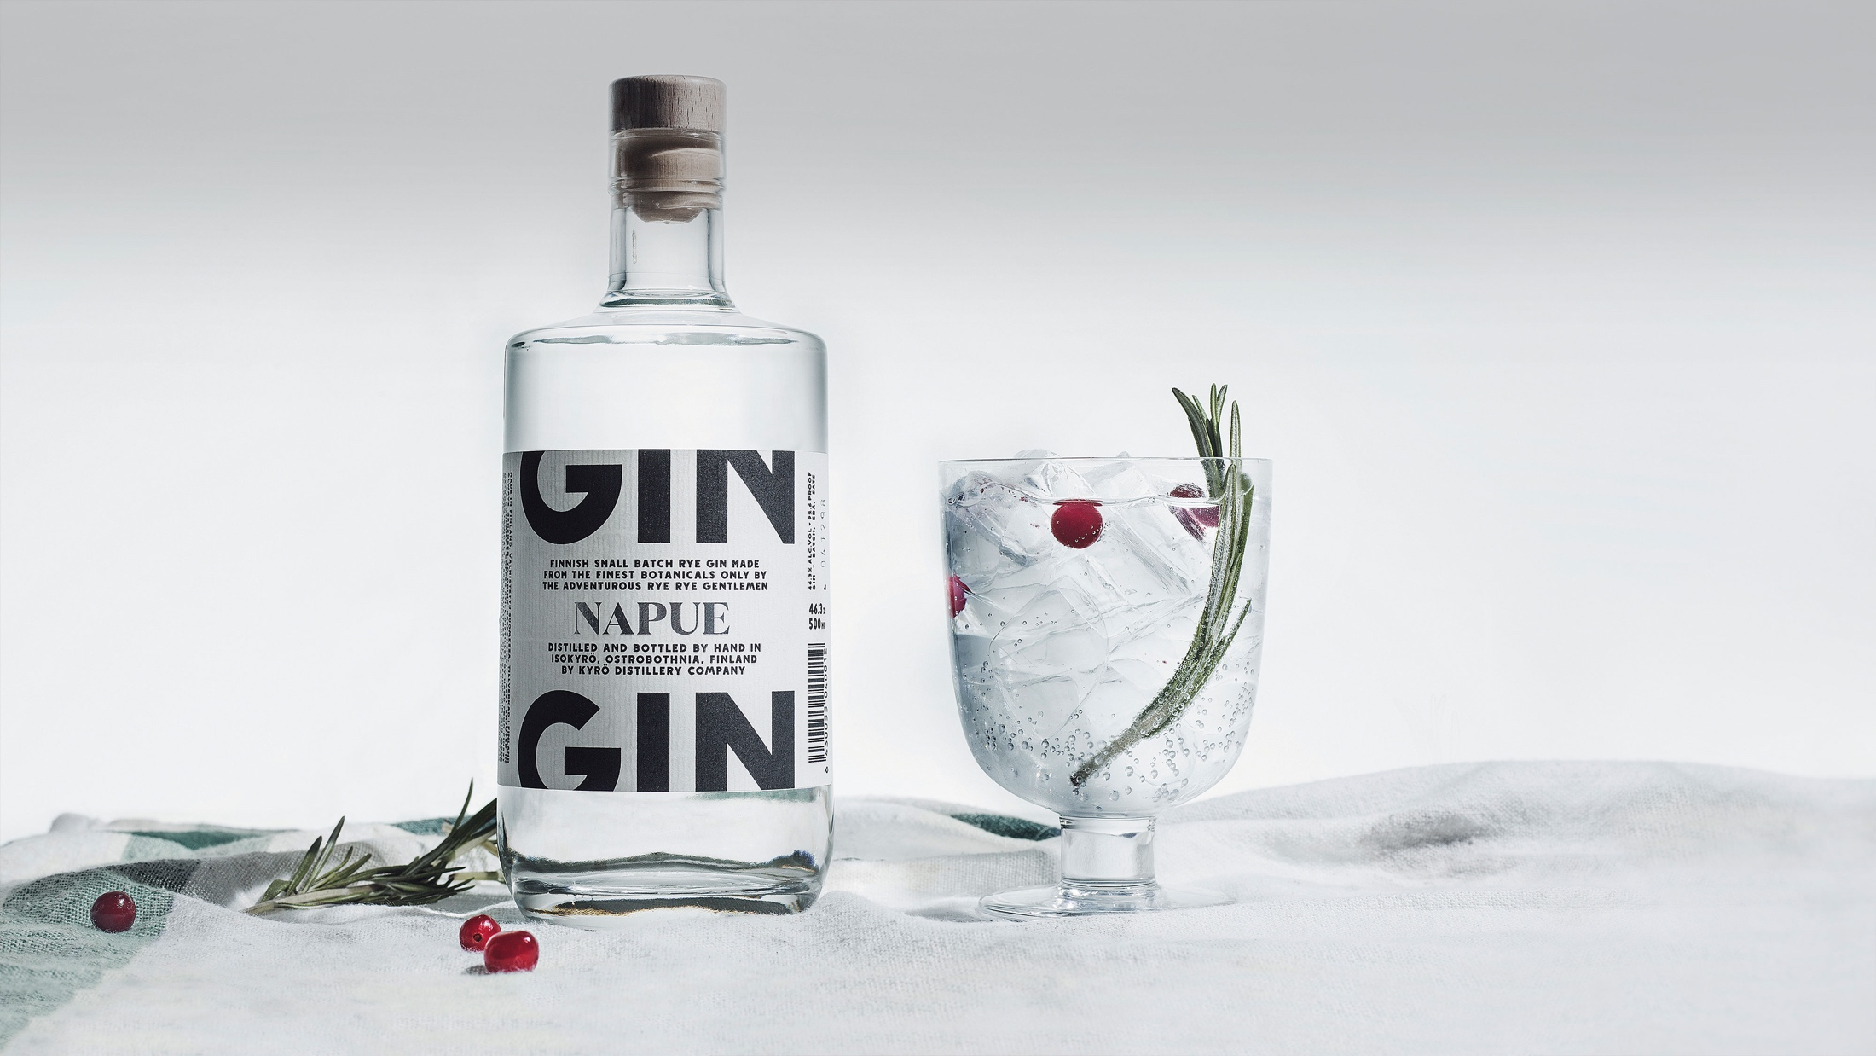
EXCELLENT FLAVOR FROM
THE PURE FINNISH NATURE
THE WORLD’S #1
GIN AND TONIC
IS MADE OF NAPUE GIN,
A FINNISH KYRÖ DISTILLERY COMPANY SPIRIT
Notes:
Please make decision in using this slide considering the culture of target group / market.
Pure raw materials: Finnish food gets is flavour from the pure environment. The Finnish soil, waters and air are the cleanest in Europe, enhancing the taste of the ingredients. Our water is proven to be the purest in the world, and our northern climate and cold winters are practically killing the bugs, allows farmers to use far less chemical pesticides than do their counterparts in other countries.
Napue: The best gin and tonic in the world is made with Napue Gin, a product of the Kyrö Distillery Company in Isokyrö, Finland. The first Finnish whiskey from rye, Napue Gin is produced using rye grain and the finest botanicals which give off a nose rich in meadow sweet, citrus, cumin and juniper. To follow it up, the palate develops subtle leafy and refreshing menthol notes. Napue Gin was the inaugural winner of the IWSC Gin & Tonic Trophy in 2015!

Slide 8
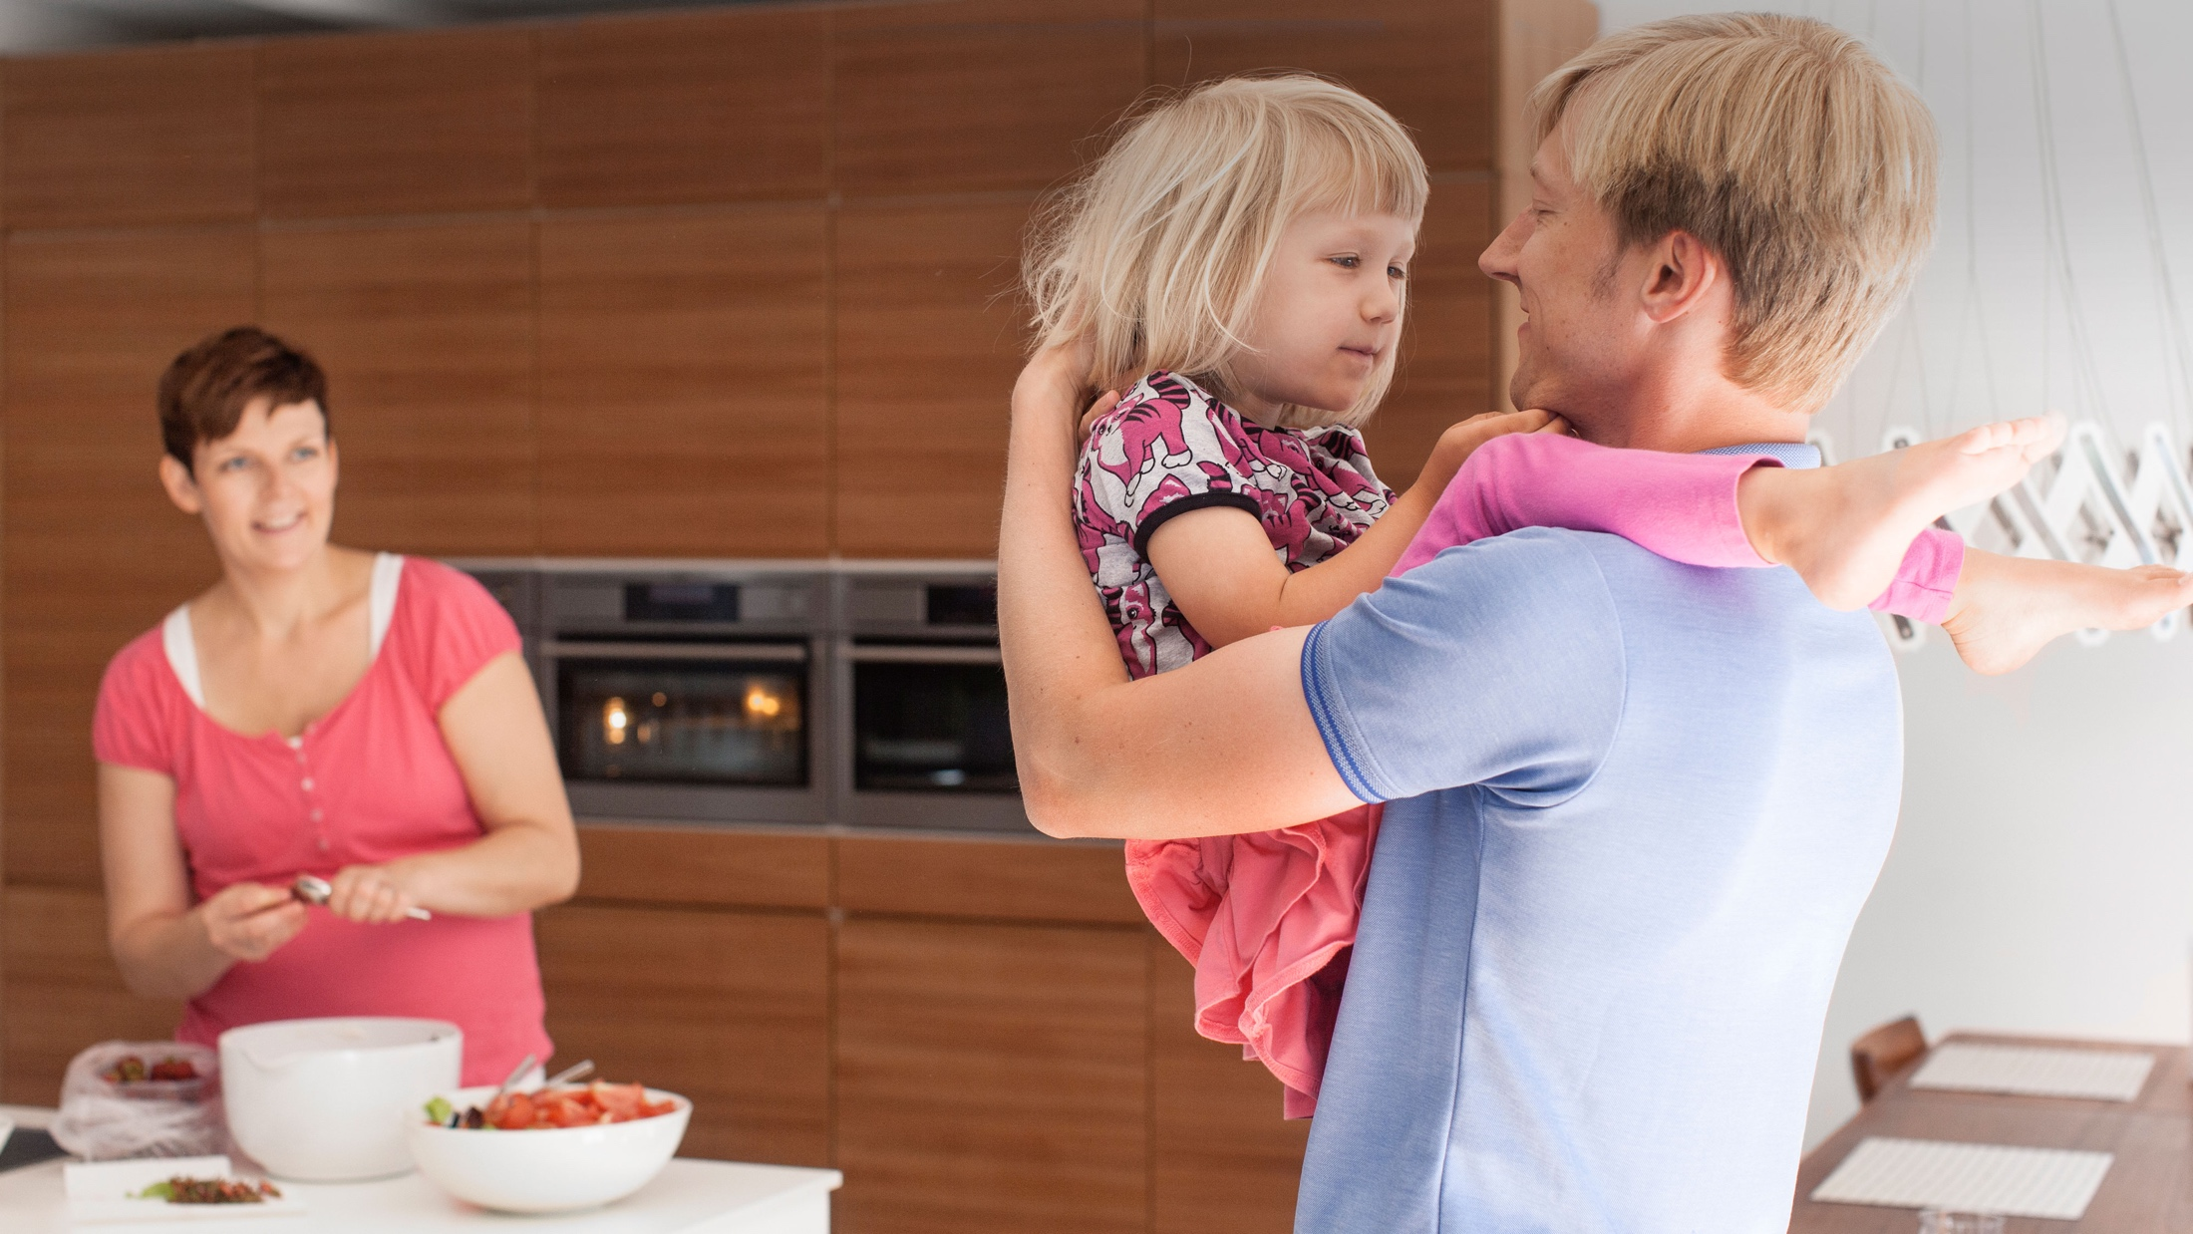
THE HOME OF WORLD-CLASS
FOOD INNOVATIONS
BENECOL
CHOLESTEROL-LOWERING FOOD PRODUCTS
LGG
PROBIOTIC FUNCTIONAL FOOD PRODUCTS
XYLITOL
CAVITY-REDUCING SUGAR
ALTERNATIVE
Notes:
Food innovations: There have been outstanding inventions in the field of healthy nutrition, a result of considerable investment in research. Benecol, Xylitol and Lactobacillius GG (Lactobacillus rhamnosus GG) are the most widely recognized examples of these innovations.
Xylitol: Finland is the undisputed home of xylitol. It makes a great sugar alternative as it not only tastes very similar to sugar but it’s also naturally derived from Finnish birch trees. In the early 1970s, Finnish researchers found out that xylitol can reduce cavities by affecting the bacteria in the mouth that causes decay. Chewing gum was identified as the perfect way to get people to eat xylitol and in 1975, the world’s first xylitol chewing gum was launched in Finland. Xylitol has now become synonymous with both Finland and dental care. Nowadays around 90% of Finnish kindergartens offer xylitol sweets to all children on a daily basis. The Finnish National Institute of Health & Welfare recommends that all 1 to 6 year olds are given xylitol confectionery after meals. The Ministry of Social Affairs and Health also recommends that publicly funded xylitol products are provided to children to improve dental health and to decrease the costs of public dental care.
LGG: Finland's biggest dairy company Valio is a pioneer in researching the health effects of functional foods and its R&D unit is one of the most highly regarded food industry research units in the world. The company has spearheaded research on probiotics, described as beneficial bacteria that combine naturally with the fermented milk products that people consume every day. Starting in the 1990s with the probiotic bacterial strain Lactobacillus GG (LGG®), leading dairy companies continue to adopt new Valio technologies and apply them to their own products. Valio has licensed LGG® in more than 30 countries. It provides an easy route for companies to develop and launch their own probiotic functional food products.
Benecol: Benecol is a brand of cholesterol lowering food products owned by the Finnish company Raisio Group, which owns the trademark. Raisio Group licenses the Benecol brand and sells the ingredient stanol ester to food companies around the world. There are over 70 clinical studies proving that plant stanol ester lowers cholesterol levels. The brand is licensed in more than 30 countries by local food companies such as Kaiku in Spain, Colanta in Colombia, Lotte in Korea and Kalbe Nutritionals in Indonesia.

Slide 9
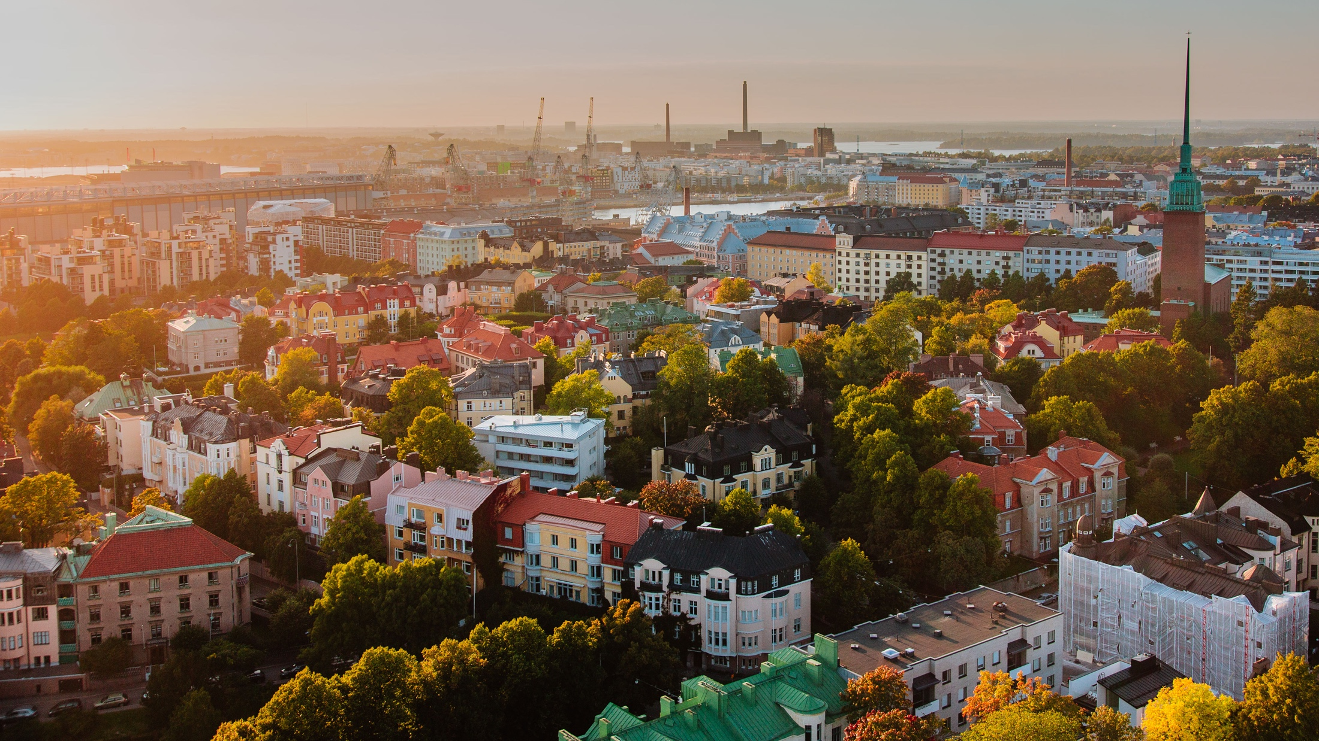
#1 IN COMBINED
HEAT AND POWER
33%
OF ELECTRICITY
IS PRODUCED BY
COMBINED HEAT
AND POWER
EU’S CHP PRODUCTION IS
JUST OVER 10 %
IAE: FINLAND IS THE ”MODEL FOR THE WORLD” IN CHP AND DHC
Notes:
Finland is the leading country in the world in combined heat and power (CHP) generation. Almost 80 per cent of district heat production is based on CHP generation. Correspondingly, one-third of electricity is obtained in CHP generation. No other country has such a great market share of CHP electricity than Finland. In the EU, combined heat and power generation amounts to only just over ten per cent of total electricity production.
Source: http://energia.fi/en/energy-and-environment/district-heat-and-district-cooling/combined-heat-and-power-generation
The International Energy Agency (IEA 2009) has stated that Finland is the 'model for the world' in CHP and DHC (District Heating and Cooling) with high efficiency and environmental performance.

Slide 10
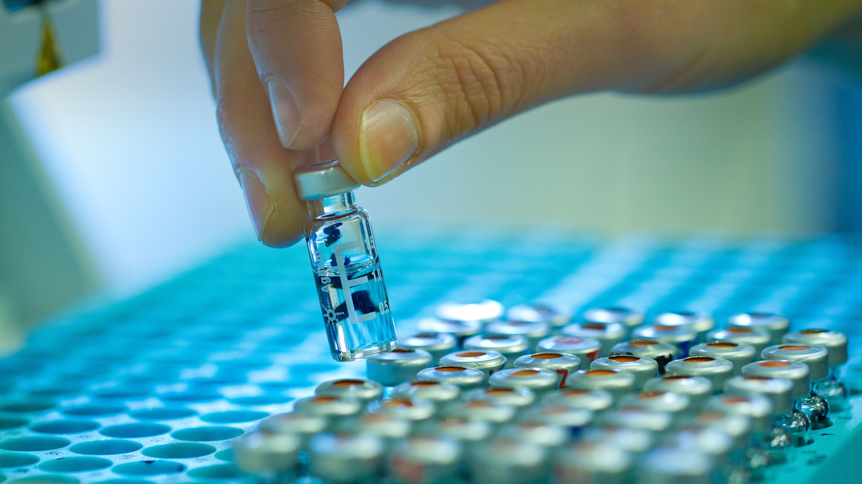
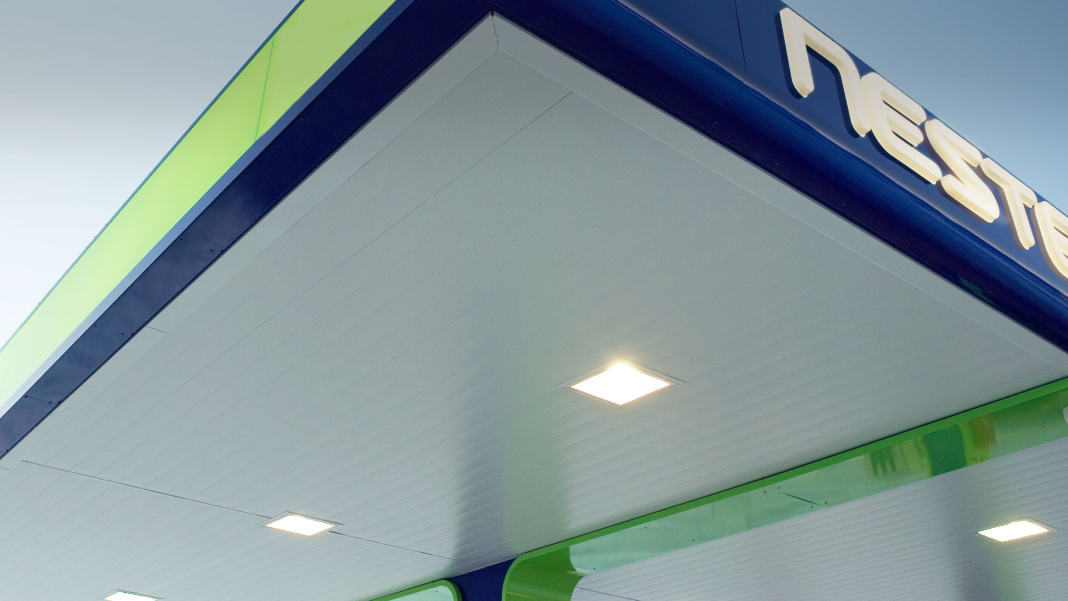
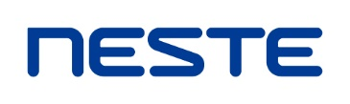
EXCELLENCE IN
RENEWABLE BIOFUELS
NESTE IS THE WORLD’S #1 RENEWABLE DIESEL PRODUCER
THE COMPANY IS ALSO
THE LARGEST WASTE- AND RESIDUE-BASED RENEWABLE FUEL PROVIDER
Notes:
Finnish companies have focused their development on advanced fuel production technologies also from challenging feedstock and hence can offer unique solutions.
Neste: Neste is the leading producer of renewable diesel in the world, with an annual production volume of more than 2 million tons. The company is also the world’s largest producer of renewable fuels from waste and residues.
Source: http://www.biodieselmagazine.com/articles/324835/neste-oil-claims-world-leadership-in-biofuels-from-waste-residue

Slide 11
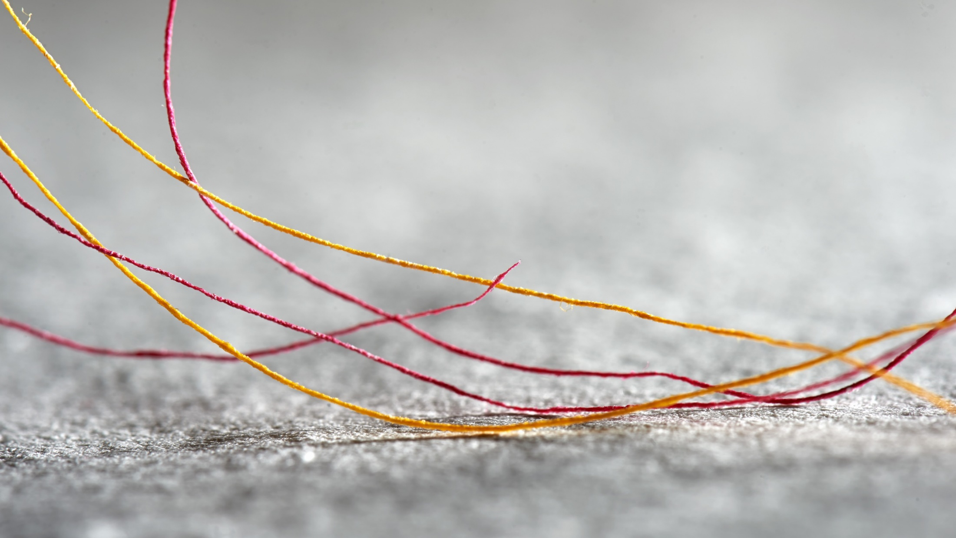

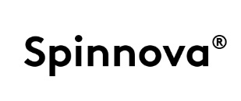
THE HOME OF HIGH-END
BIOBASED INNOVATIONS
ST1
THE WORLD’S #1 PLANT IN PRODUCING BIOETHANOL FROM SAWDUST
SPINNOVA
FIBRE YARN DIRECTLY FROM MARKET PULP
PAPTIC
REPLACING PLASTIC BAGS WITH WOOD FIBRES
Notes:
Finland has world class research in both biomaterials and biochemicals. VTT Technical Research Centre of Finland is one of the largest applied research institutes globally in the field. The cooperation between businesses and research has long traditions in Finland. The mentioned examples are all VTT spin-offs.
Spinnova: Spinnova has patented technology for production of textile yarns directly from wood fibers developing sustainable alternatives for cotton and oil based yarns at very low cost. The technology is environmentally lean containing no extra chemical treatments of pulp fibres. Customer benefits: 99% less water vs. cotton yarn, 80% less energy used vs. cotton yarn, 50% less land used vs. cotton yarn (farmland not used), Sustainable raw material supply, Lower production costs than cotton yarn
ST1: ST1 builds the world first biofuel plant, which produces bioethanol from sawdust. The yearly production capacity is 10 million litres. The raw material supply and initilization phase are estimated to start at the end of 2016.
Paptic: Paptic is a start-up company focusing on technology development and sales of renewable, recyclable and sustainable fibre based materials. Paptic material is a true Finnish innovation with its roots in the art of paper making. Paptic with 80% biobased raw materials, combined with the recyclability and reusability, results in unbeatable combination of strengths of plastic and papers.

Slide 12
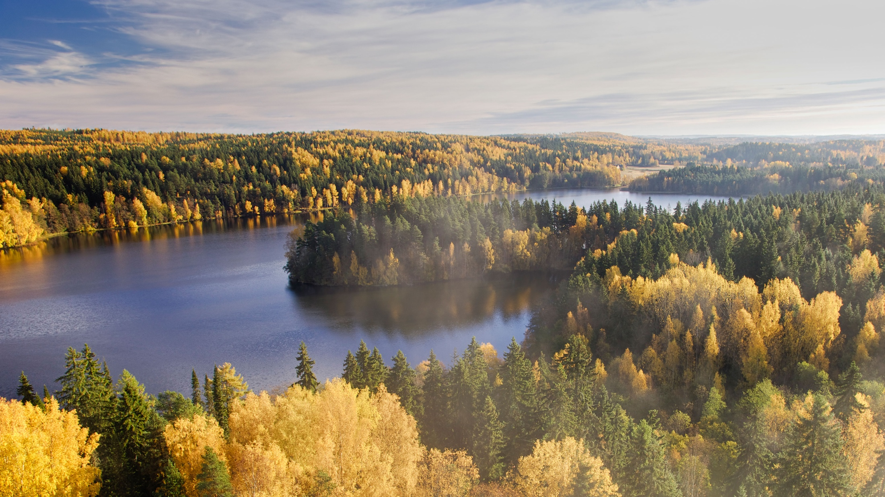
ATTRACTIVE INVESTMENT
TARGET
THE MILL:
100%
USAGE OF RAW MATERIALS AND SIDE STREAMS
THE LARGEST SOFTWOOD BIOPRODUCT MILL IN THE WORLD HAS BEEN BUILT TO ÄÄNEKOSKI
240% ELECTRICITY
SELF-SUFFICIENCY
Notes:
All of the products manufactured at the mill will are bioproducts. In the early stages, 20 per cent of these products will be bioproducts other than pulp. The Metsä Group bioproduct mill will produce high-quality pulp sustainably and resource-efficiently, and it will also produce biomaterials, biochemicals, bioenergy and biofertilisers from production side streams.
The mill will use 100 per cent of the raw materials and side streams to manufacture products and produce energy, and it will not use any fossil fuels whatsoever. All of the energy needed by the mill will be produced from wood. A globally unique bioeconomy ecosystem of companies will develop around its pulp production over time. Electricity self-sufficiency: 240%.
The investment decision was made on 21 April 2015. Excavation work in the mill area began immediately after that, and the letters of intent signed with the key partners were finalised into delivery agreements. The installation of the main equipment began in 2016 and the mill will was completed in the third quarter of 2017. The mill will reach its nominal production rate in summer 2018. Metsä Fibre is owned by Metsäliitto Cooperative (50.2 %), Metsä Board Corporation (24.9 %) and Itochu Corporation (24.9 %).

Slide 13
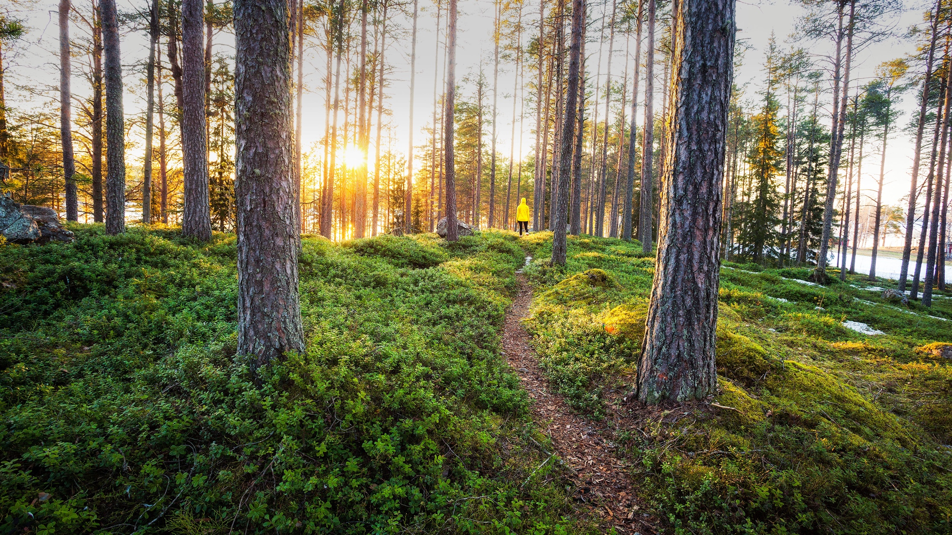
FINLAND – THE UNIQUE BIOBASED ECOSYSTEM TO BOOST YOUR BUSINESS

