Slide 1
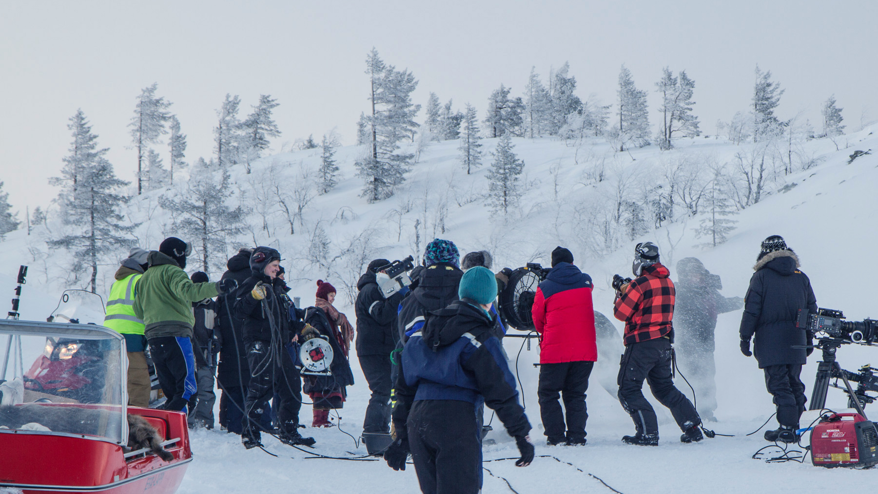
FINLAND – A SURPRISINGLY versatile Filming LOCATION

Slide 2
WHY NOT GIVE IT A SHOT WITH AN ATTRACTIVE 25% CASH REBATE?

Slide 3
Finland is a sought-after location for film crews who want to shoot against snowy, Arctic backdrops. But there is much more to Finland than this.
Filmmakers are offered a huge variety of settings with Finland’s four distinct seasons and multitude of landscapes, that can also double as many places.

Slide 4
Finland is brimming with possibilities
Locations are easily accessible through dependable and stable infrastructure and logistics.
Mobile phone coverage and Internet access are everywhere – even in the wilderness.
Local crews are accustomed to working in international teams and are experts at making films in the extreme natural conditions.
We also happen to be the cheapest of all the Nordic countries to shoot in.

Slide 5
FILM FRIENDLY
WITH LESS RED TAPE

Slide 6
“Everyman’s Right”
= a national law meaning that typically no permits are needed on publicly-owned land, which accounts for much of Finland’s surface area.
Where needed, permit procedures tend to be straightforward compared to other countries.

Slide 7
A network of regional Film Commissions serve productions interested in shooting in the area.
Film Commissions offer help and assistance in finding suitable locations, crew and services in Finland.

Slide 8
FILM INCENTIVES
WHY NOT GIVE IT A SHOT?
Finland’s incentive is a 25% cash rebate for above and below-the-line production expenditure in Finland, with several regional incentives also available on top of the national one.
The cash rebate operates on a first come, first served basis from January of each year, with applications processed in max. 40 days and payments made in max. 3 weeks.
No cultural points tests to worry about, it’s purely about expenditure.

Slide 10
Every year, several international film crews come to shoot in Finland. Recent examples: WAR / a huge budget Indian action-thriller by Siddarth Anand. MASTER CHENG / a Finnish-Chinese co-production by Mika Kaurismäki. SNOW FLOWER / a Japanese feature film by Kojiro Hashimoto. KEEPING UP WITH THE KARDASHIANS / the ever-popular reality show. THE BACHELOR / US reality TV sensation.
FAMOUS PRODUCTIONS

Slide 11
Finland Film Commission Audiovisual Producers Finland Finnish Lapland Film Commission North Finland Film Commission West Finland Film Commission East Finland Film Commission South East Finland Film Commission The Finnish Film Foundation
FILM INDUSTRY CONTACTS

