Slide 1
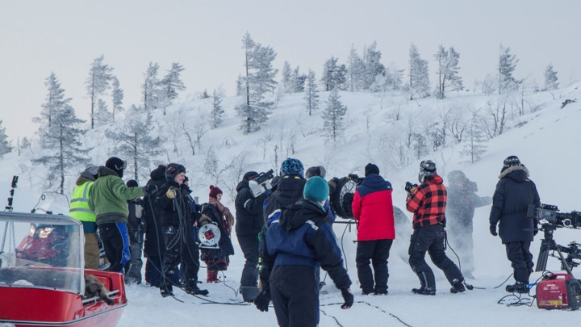
FINLAND – A SURPRISINGLY VERSATILE FILMING LOCATION
Photo: Olli-Pekka Mahrberg, Virtual Works
Peoples’ notion of Finland is a snowy, Arctic landscape, as seen in Joe Wright’s Hanna, or Indian action-thriller War. However, the country’s locations are incredibly diverse, from endless lakes, forests and cabins perfect for any horror flick, to historic towns with castles or Eastern bloc-type urban cityscapes great for dystopian blockbusters. Our bast array of undiscovered locations can double as many places, complemented by our four distinct seasons.
Finland is brimming with possibilities. All of its locations are easily accessible via road. Because the country is a world leader in cutting-edge technology, mobile phone coverage and Internet access are never a problem, even in the backwoods. Finland also boasts five international airports, and Helsinki acts as an important international hub, including as Asia’s gateway to the rest of Europe.
There are direct flights between Helsinki and all the key global production hubs: Los Angeles (10h), New York (8h), London (3h), as well as all the largest cities in Asia: New Delhi (11h), Tokyo (9h), Singapore (13h), and eight direct flights to the biggest cities in China.
Local crews speak English and other languages, are accustomed to working in international teams and are experts at making films in extreme environments. So what’s it like to work with local crews? Punctuality is a trademark of the Finnish people: regardless of the weather and unforeseen circumstances, Finns not only get things done, but get them done on time. We also happen to be the cheapest of the Nordic countries to shoot in.
1

Slide 2
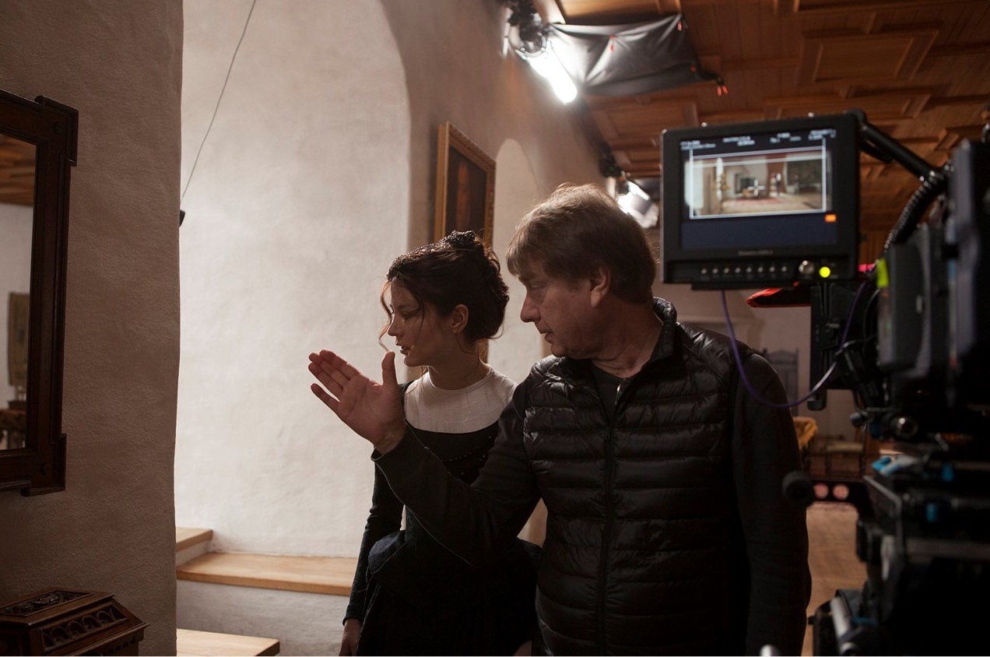
FILM FRIENDLY WITH LESS RED TAPE
A low level of bureaucracy is one of the key aspects of physical production in Finland. A national law known as “Everyman’s Right” means that typically no permits are needed to film on publicly -owned land, which accounts for much of Finland’s surface area. Where needed, permit procedures tend to be fast and straightforward compared to other countries, with your local regional film commission being able to take care of the permits within just a few days.
There is a network of regional Film Commissions that serve productions interested in the area. Film Commissions are public, non-profit organizsations which market the respective area as a filming location and offer help finding suitable locations, cast, crew and services.
Our professional infrastructure of crews and equipment can stretch itself to handle several features and TV series simultaneously. But perhaps its best to think of the entire Nordic and Baltic region as one production hub, where crews and gear moves around easily. Finland is also home to some top full-service post-production houses, as well as pure VFX facilities.
Finns prefer actions to words. We tend to say what we do and do what we say. That’s why Finland is the most functional country in the world, and the Finnish handshake is the most reliable one.
FILM INCENTIVES
Finland’s national production incentive comes in the form of a 25% cash rebate, available for above and below-the-line production expenditure in Finland, including post-production. The best part is that it’s incredibly simple and easy to apply for, with no cultural points system and payments are made in a maximum of only three weeks. It operates on a first come, first served basis and applications open on the first business day in January, are accepted throughout the year, and each application is processed in a maximum of only 40 days. Several regional film commissions offer local incentives on top of the national one, which are also based on local expenditure and come in the form of cash or services.
FAMOUS PRODUCTIONS
Every year international film crews come to shoot in Finland. Recent examples include action-thriller War, the biggest production in India’s cinematic history and directed by Siddarth Anand, Finnish-Chinese co-production Master Cheng directed by Mika Kaurismäki, and Japan’s Snow Flower directed by Kojiro Hashimoto. Finland has also been featured on two of America’s most popular reality TV shows: Keeping Up With the Kardashians and The Bachelor..
Photo: The Girl King, Marianna Films, Triptych Media, Galafilm, Starhaus Filmproduktion, Anagram
2

Slide 3
LEARN MORE ABOUT FINLAND AS A FILMING LOCATION
Filming in Finland:
www.filminginfinland.fi
Audiovisual Producers Finland – APFI ry:
www.apfi.fi/en
Finnish Lapland Film Commission:
www.filmlapland.fi
North Finland Film Commission:
www.nffc.fi
West Finland Film Commission:
www.wffc.fi
East Finland Film Commission:
www.effc.fi
South East Finland Film Commission:
www.seffc.fi/seffc
The Finnish Film Foundation:
https://ses.fi/en/home
3

