Slide 1
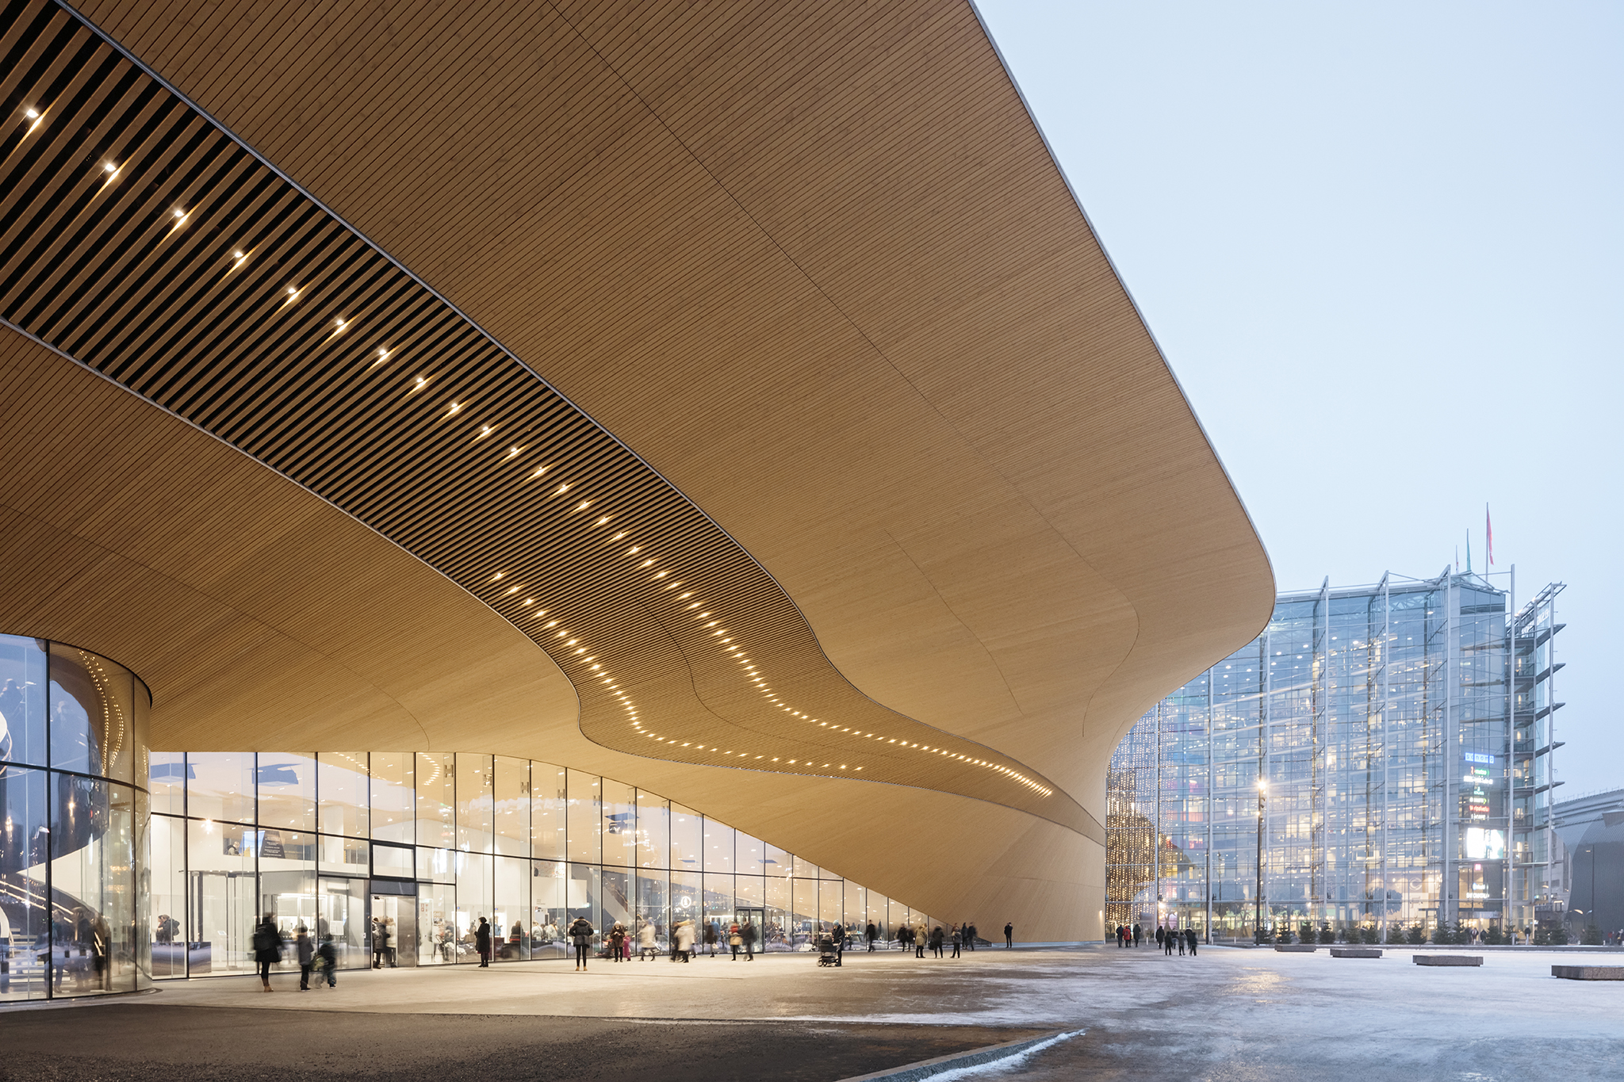
FINLAND,
THE LITTLE BIG COUNTRY OF ARCHITECTURE
Helsinki Central Library Oodi by ALA Architects, 2018. photo: Tuomas Uusheimo

Slide 2
Our high standards of education and a long tradition of architecture competitions ensures that professional knowhow is passed on to the next generation.

Slide 3
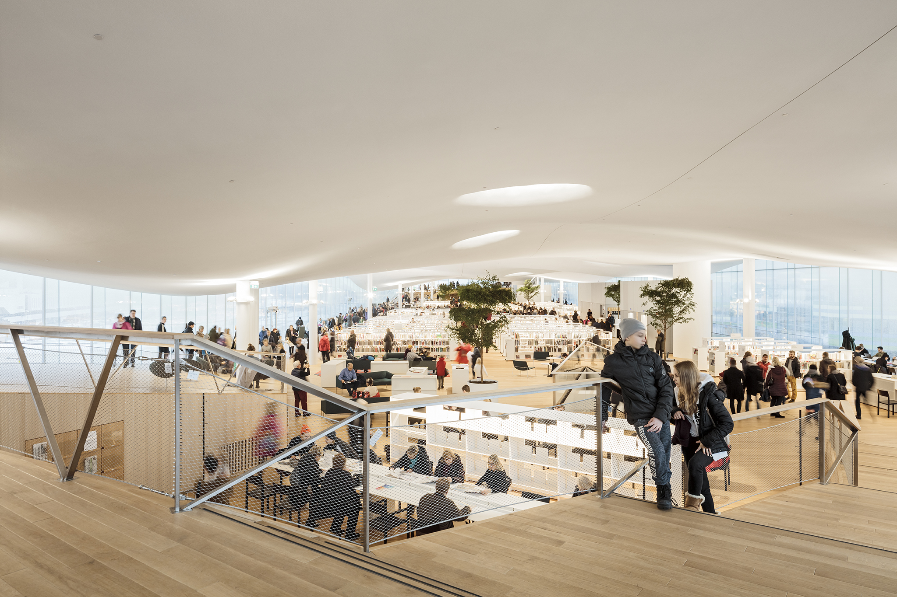
Helsinki Central Library Oodi by ALA Architects, 2018. Photo: Tuomas Uusheimo

Slide 4
WORLD RECOGNITION FOR 1920S–1950S
MODERNISM

Slide 5
High-quality public buildings designed by the best architects have underpinned the development of civic society and formed part of Finland’s national identity from the 19th century to the present.
National Romantic style, inspired by Art Nouveau, brought Finnish architecture and design to international attention, the internationally best known architect of this era being Eliel Saarinen.
Finland is best known for its 20th century architecture, with a strong modernist tradition spearheaded by Alvar Aalto.

Slide 6
FINLAND WAS THE FIRST COUNTRY WHERE WOMEN COULD STUDY TO BE ARCHITECTS.

Slide 7
A SYNTHESIS OF ELEGANCE AND PRAGMATISM
Closeness to nature paired with a strong tradition of modernism.
A simple elegance that combines pragmatism with the highest standards and optimal use of materials.
Internationally known as a pioneer in architectural policy, architectural education for children and conservation of modern architecture.

Slide 8
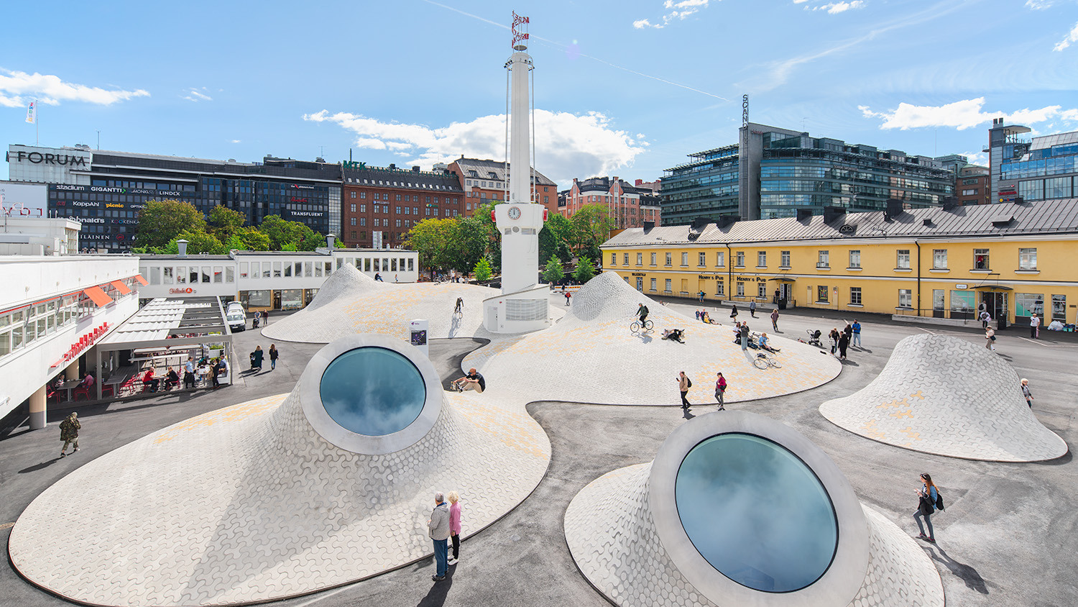
Amos Rex Art Museum, Helsinki, by JKMM Architects, 2018. photo: Mika Huisman

Slide 9
INTEREST ON A GLOBAL BASIS
In 2019, the Alvar Aalto Museum and the Museum of Finnish Architecture ran a total of 18 exhibitions around the globe.
In the same year, close to 135,000 architecture fans visited the museums’ exhibitions and sites in Finland.

Slide 10
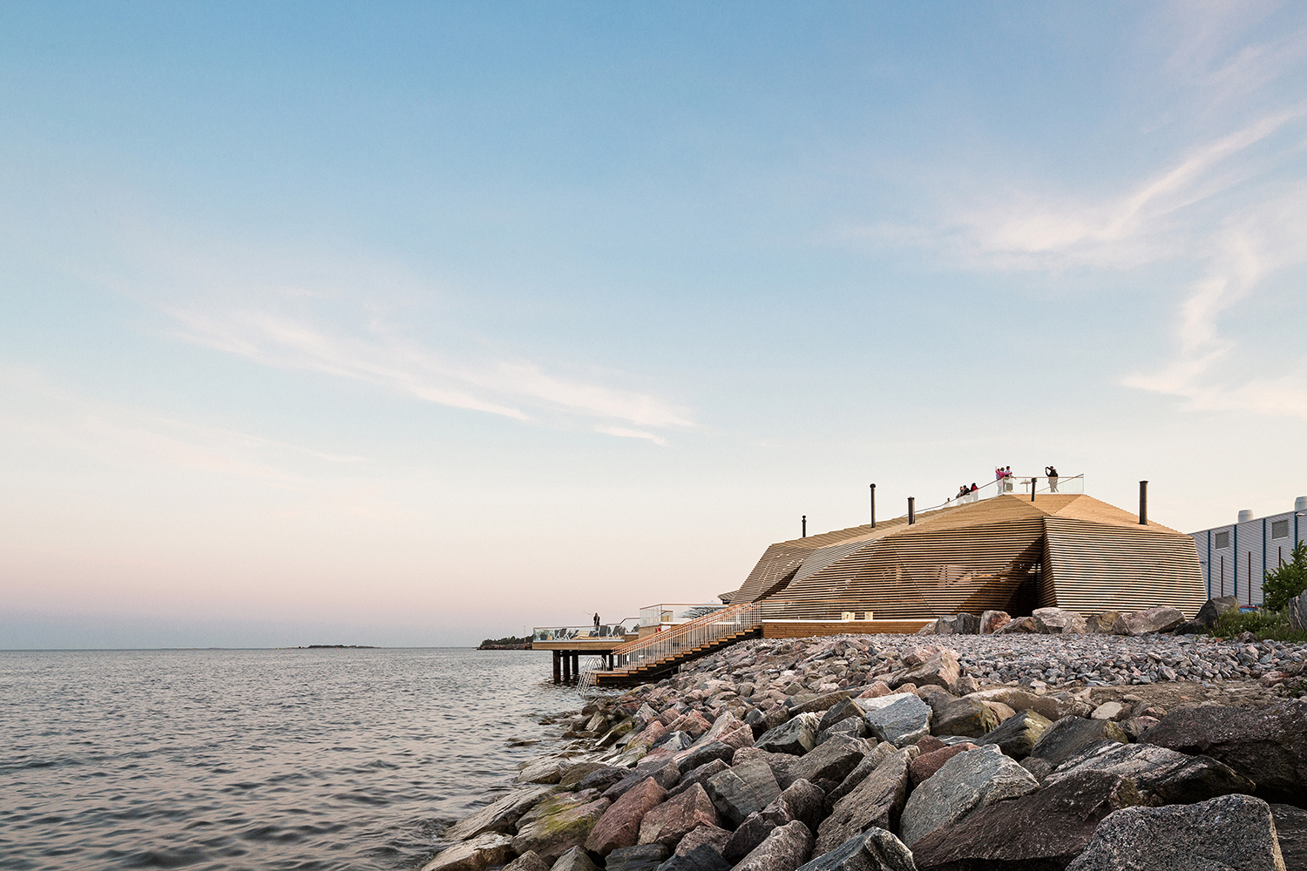
Löyly Sauna and Restaurant, Helsinki, by Avanto Architects, 2016. photo: Kuvio Architectural Photography

Slide 11
A THRIVING INDUSTRY
3,600
9 mil€
Around 3,600 people are employed in Finland's architecture sector with around 600 partners and 2,500 employees working in private companies.
Architecture firms account for around EUR 9 million in exports each year.

Slide 12
Learn more about Finnish architecture
Links to sites:
Archinfo Finland, archinfo.fi/en Museum of Finnish Architecture, mfa.fi/en Alvar Aalto Foundation, alvaraalto.fi/en
Finnish Architecture Navigator, finnisharchitecture.fi

