Slide 1
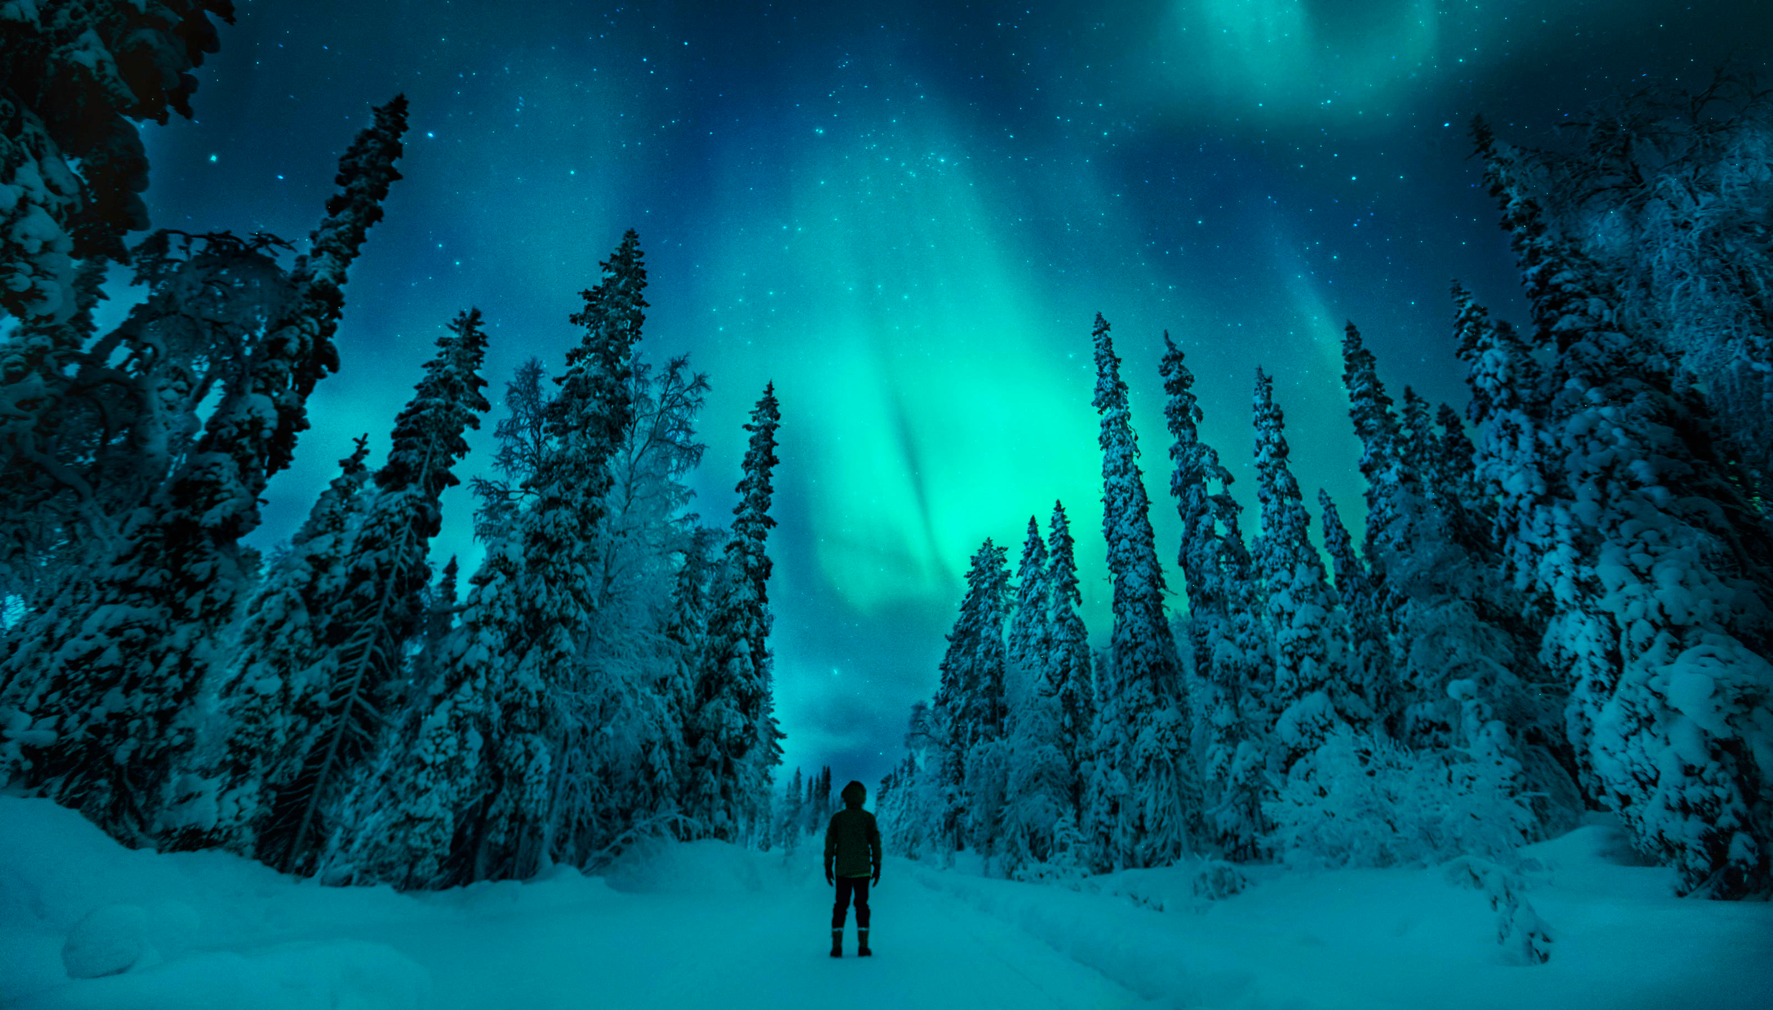
An underrated holiday destination
Credit: Konsta Punkka/Visit Finland mediabank

Slide 2
WHY COME TO FINLAND FOR A HOLIDAY?
Our pure and beautiful natural environment and varying seasons are as amazing to visitors as to us Finns, and are becoming ever more valuable in today’s world.

Slide 3
REASONS WHY YOU’LL LOVE FINLAND
One of the world’s most sparsely populated countries
More forest as a percentage of surface area than anywhere else in Europe
Quiet, undisturbed and clean wilderness
Sheer beauty of our natural landscape
Finland has been named the world’s happiest nation three years running by the UN The World Happiness Report (2018, 2019, 2020)

Slide 4
FINLAND IS DIVIDED INTO FOUR MAIN AREAS,
AND EACH HAVE THEIR OWN UNIQUE STRENGTHS.
LAPLAND
LAKELAND
COAST & ARCHIPELAGO
HELSINKI REGION
Credit: Visit Vuokatti

Slide 5
FINNISH LAPLAND -
AN AREA OF DRAMATIC CONTRASTS
The sun never rises in midwinter but shines around the clock at midsummer.
Natural splendours such as the Northern Lights and the Midnight Sun provide
visitors with a holiday experience that is completely different to standard,
man-made attractions.

Slide 6
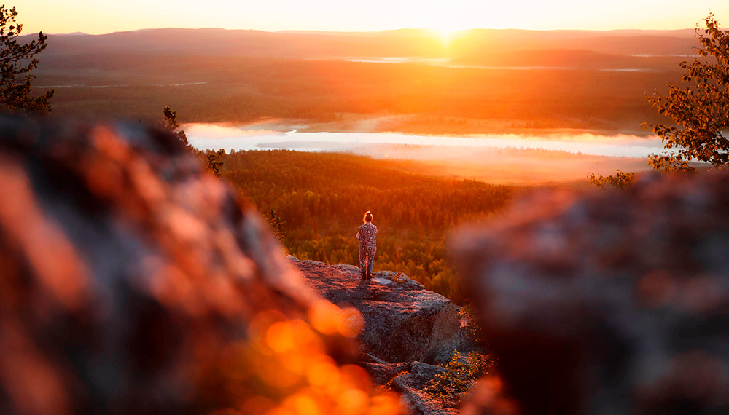
Credit: Harri Tarvainen/Visit Finland mediabank

Slide 7
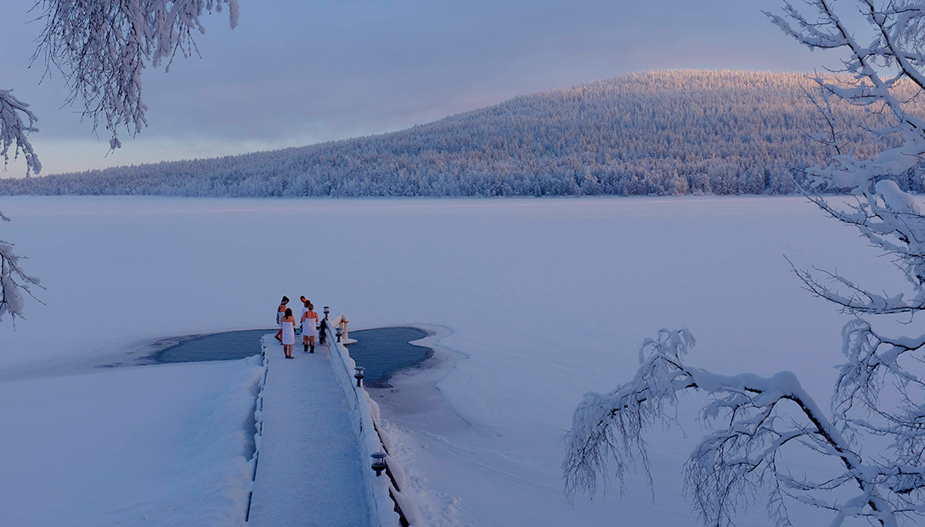
Credit: Olli Oilinki /Visit Finland mediabank

Slide 8
OUR CAPITAL CITY, HELSINKI,
IS KNOWN AS A PEARL OF BALTIC.

Slide 9
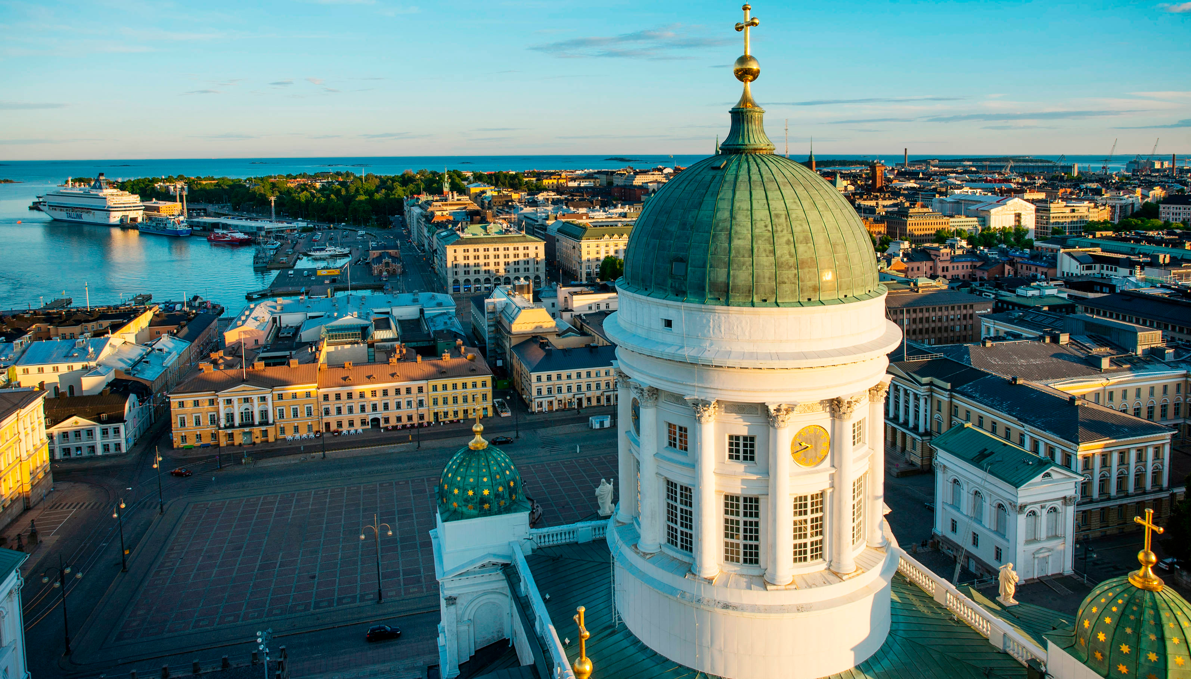
Credit: Lauri Rotko /Helsinki mediabank

Slide 10
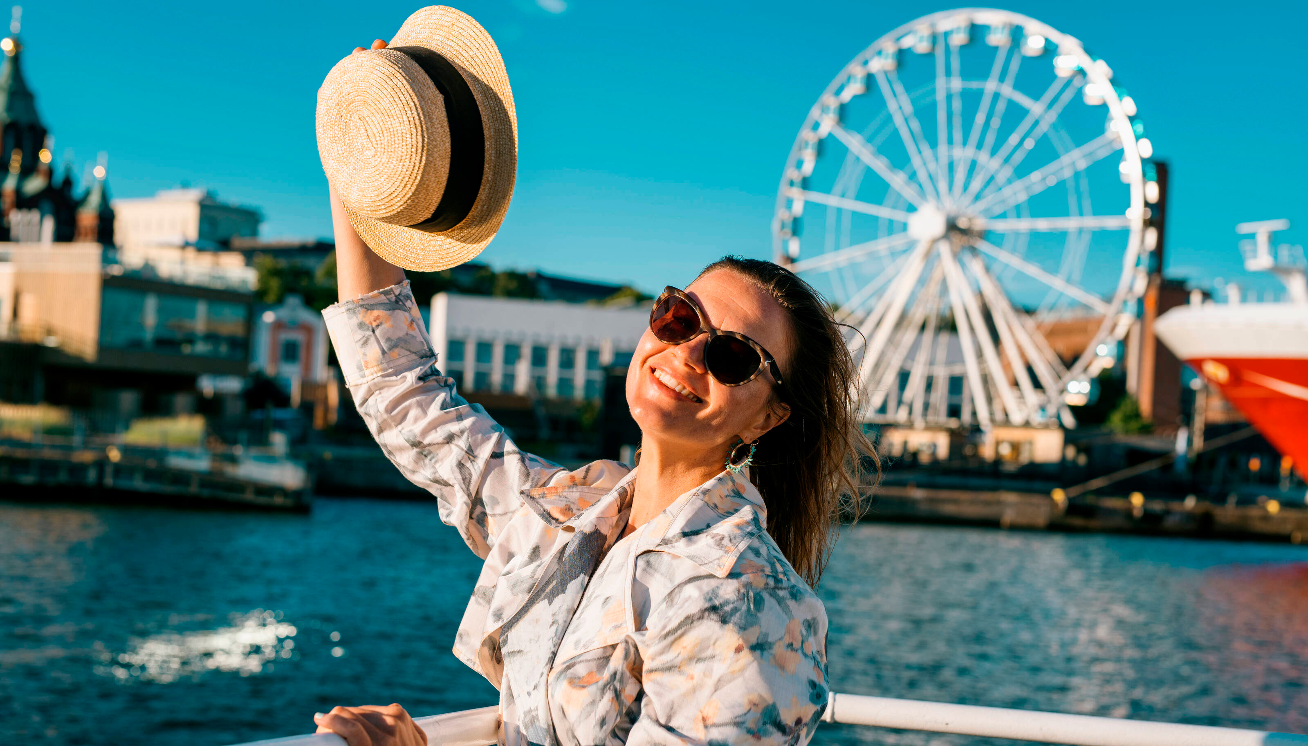
Credit: Mikko Huotari/Visit Finland mediabank

Slide 11
Lakeland – the largest
lake district in Europe
A blue labyrinth of lakes, islands, rivers and canals, interspersed with forest and ridges,
stretching for hundreds of kilometers in a placid and staggeringly beautiful expanse.

Slide 12
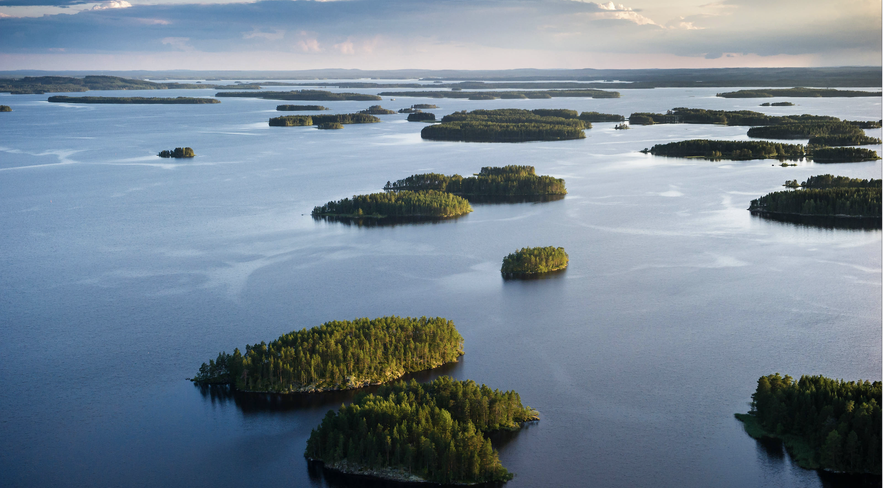
Credit: Juha Määttä /Visit Finland mediabank

Slide 13
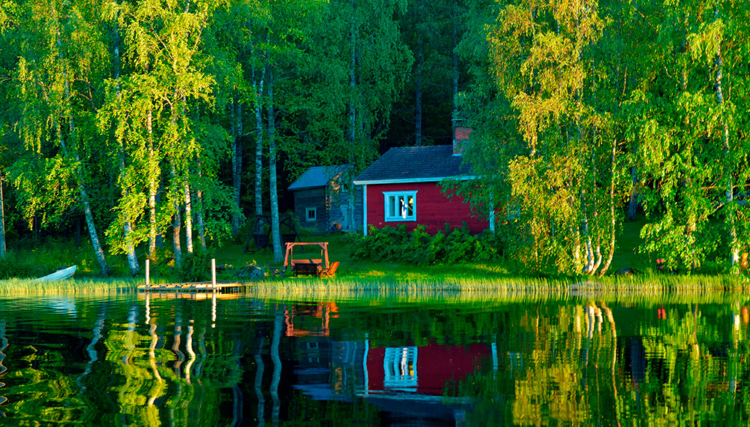
Credit: Jaakko Tähti/Visit Finland mediabank

Slide 14
Coast and Archipelago –
the world’s largest archipelago

Slide 15
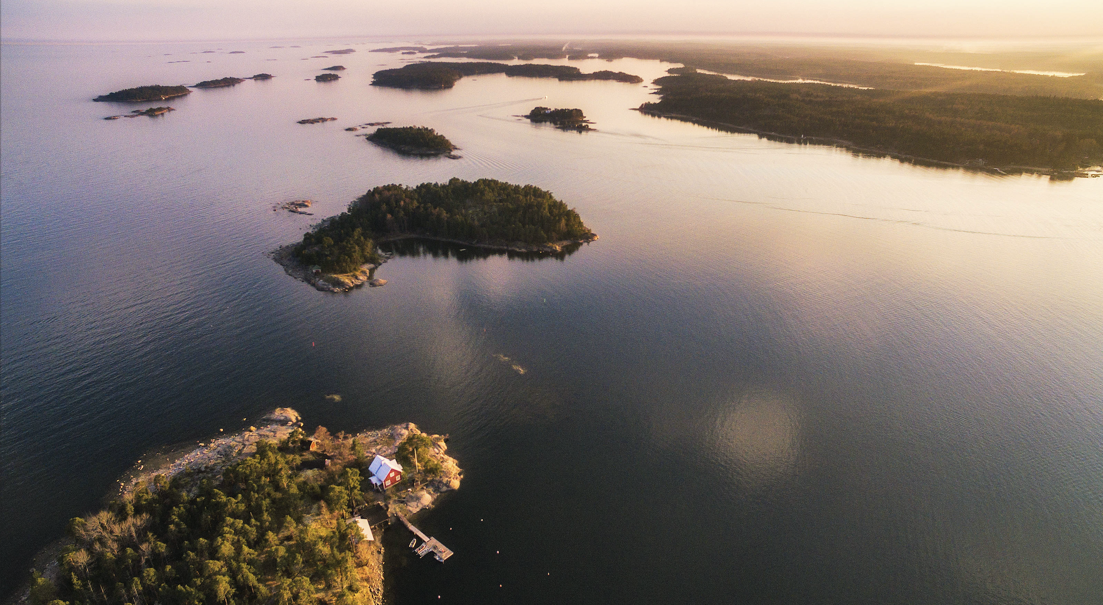
Credit: Michael Matti/Visit Finland mediabank

Slide 16
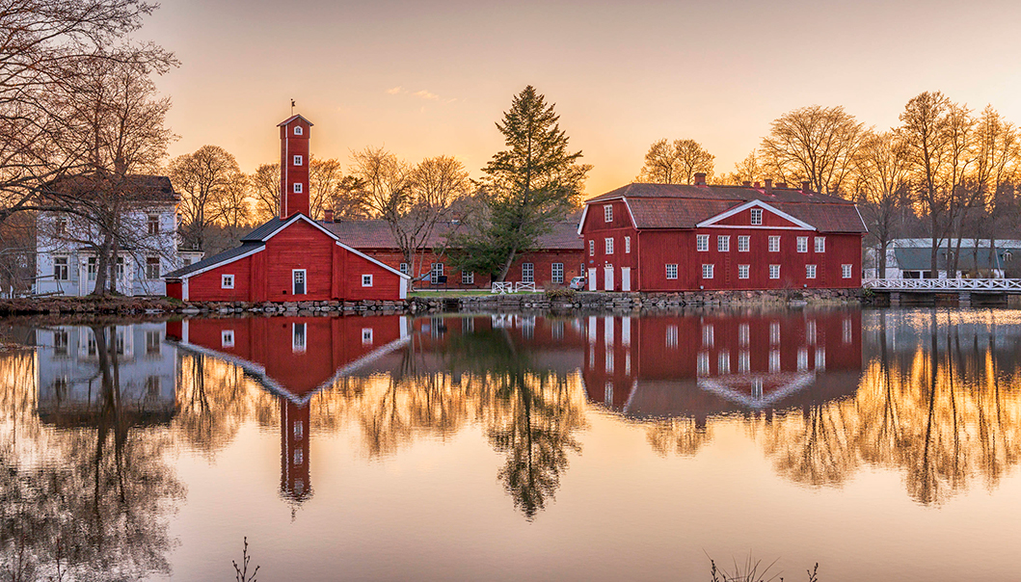
Credit: Niko Laurila /Visit Finland mediabank

Slide 17
Meaningful encounters
Finns have always lived close to the nature, prompting us to create tourist services that are unique around the world.
Sauna, ice swimming, glass igloos and icebreakers are some examples of the offbeat attractions.
Opportunities to do and join in rather than just standing back.
Come to Finland for an experience that won’t blend in with the rest.

Slide 18
Facts and figures
37 national parks
188,000 lakes
Over 3 million saunas
The biggest archipelago in the world
Aurora Borealis can appear on 200 nights a year in Finnish Lapland.
Santa Claus – the one and only – comes from Finland.
Finland hosts some of the world’s craziest summer events such as wife carrying and mobile phone throwing competitions.

Slide 19
Learn more about Finland / Follow us
http://www.visitfinland.com/
https://instagram.com/ourfinland/

