Slide 1
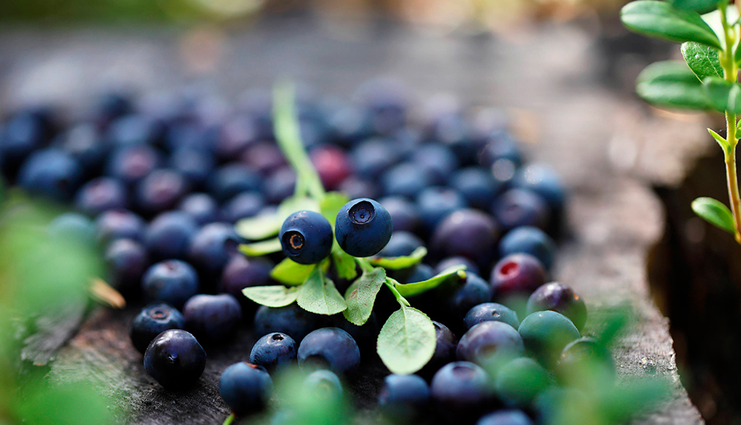
FINLAND
FOR FOOD LOVERS
Photo: Harri Tarvainen/Visit Finland mediabank

Slide 2
Finns love to shock tourists with the exotic, black “delicacies” of salmiakki (salt liquorice), rye bread and mämmi (rye/malt pudding).
The colour black doesn’t actually say much about local cuisine, which comes in all shapes and colours.
Finland’s pure flavours, clean environment and close relationship with nature are in demand all over the world.

Slide 3
A culinary history of multiple influences

Slide 4
Finnish food culture springs from the northern nature but also East and West have had an influence on it.
Finland is a large country whose considerable regional differences can also be seen on the dining table.

Slide 5
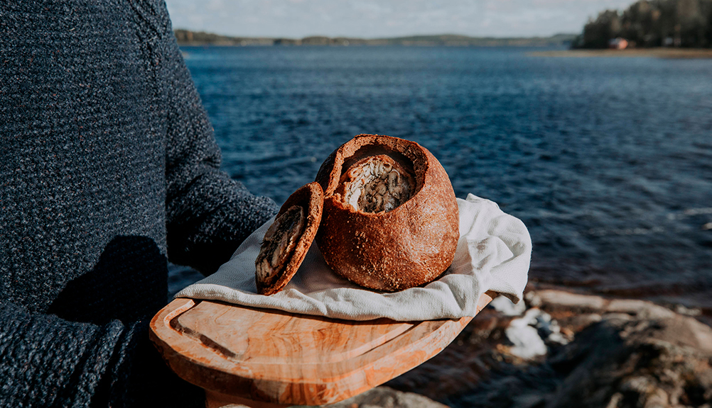
Photo: Julia Kivelä/Visit Finland mediabank

Slide 6
Finnish food is currently enjoying a re-birth as chefs combine old traditions with new influences from around the world.
Food lovers and travellers can enjoy the top chefs’ creations not only in fine restaurants but also at local street food
happenings across the country.

Slide 7
Pure food from untouched nature

Slide 8
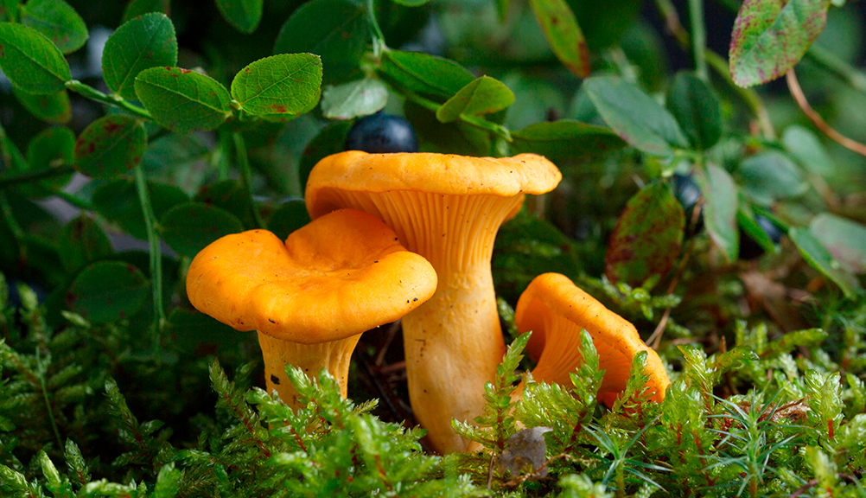
Credit: Julia Kivelä/Visit Finland mediabank
Photo: Visit Finland mediabank

Slide 9
Finnish food is both clean and wild.
Thanks to extreme variations in light and temperature, Finnish flavours are clear, strong and sufficient in themselves.
Enjoying Finnish food is both good for your health and pampering for your taste buds.
Visitors can come exceptionally close to the local origin of their food, whether in the countryside, at sea or in the city.

Slide 10
TOP TASTES TO TRY
Karjalanpiirakka, also known as Karelian pie, is made with rye flour and filled with potato, rice or carrots.
Ruisleipä, rye bread made from sour dough, is a delicious Finnish staple.
Korvapuusti translates into “cuffed ears” in English, but it is essentially a cinnamon bun essentially cinnamon buns.
Mustikkapiirakka, blueberry pie, served with fresh milk is known and loved by all.

Slide 11
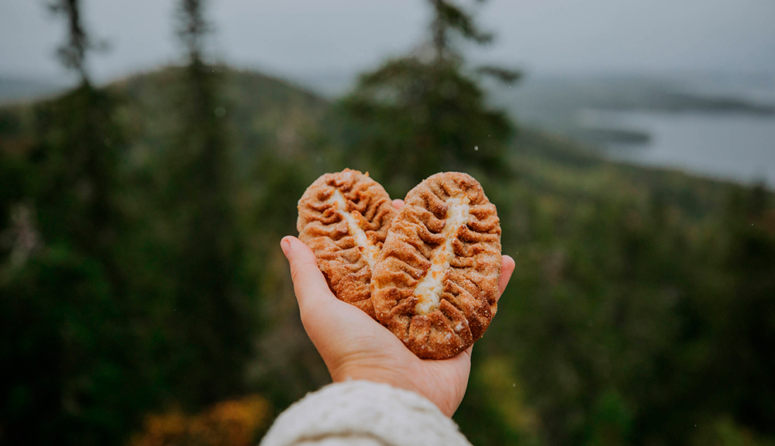
Photo: Julia Kivelä/Visit Finland mediabank

Slide 12
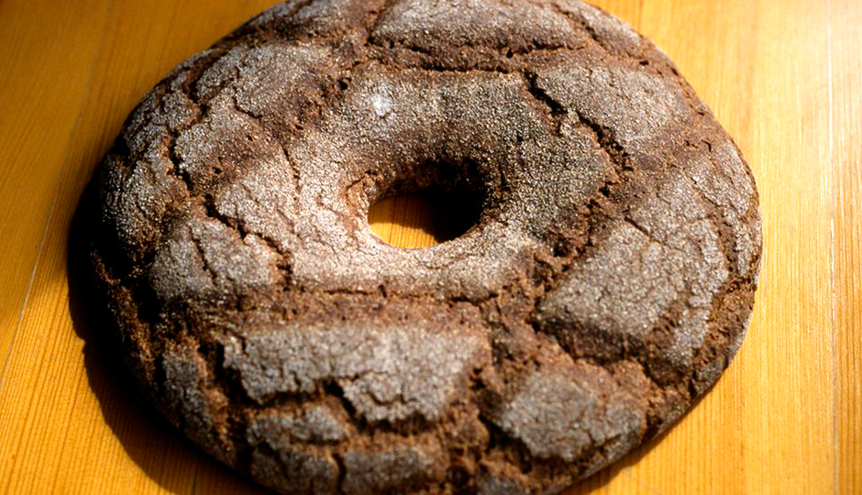
Photo: Visit Finland

Slide 13
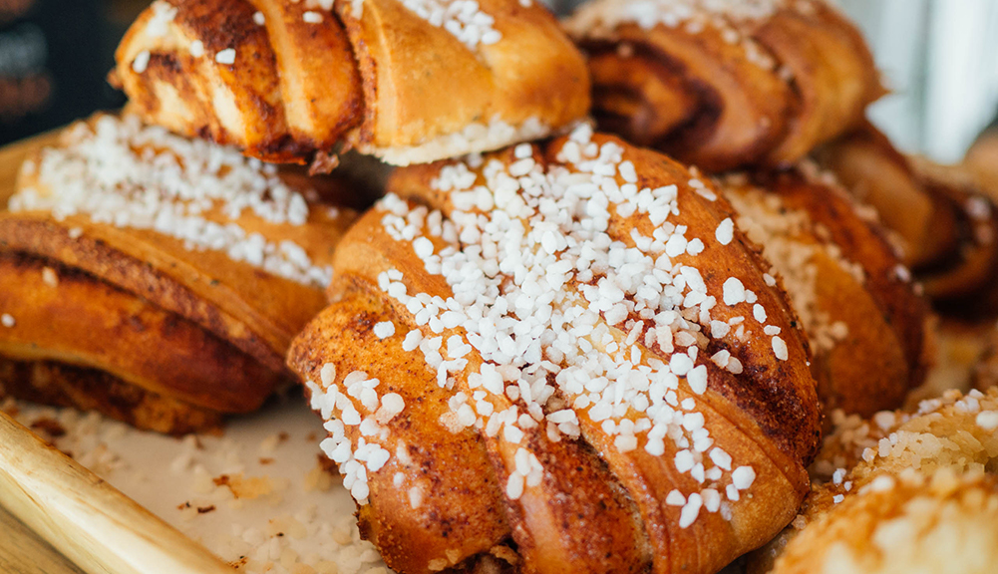
Photo:Julia Kivelä/Visit Finland

Slide 14
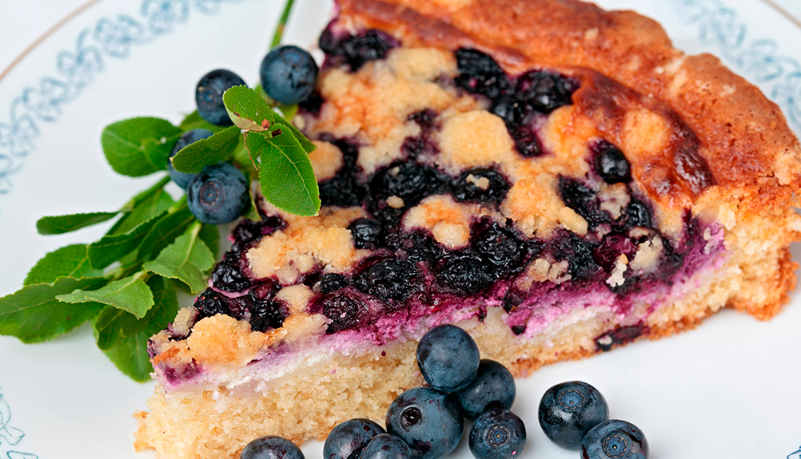
Photo:Pirkko Kanervisto

Slide 16
Uudet perunat & silli, new potatoes with herring. New potatoes begin to appear around midsummer.
Poronkäristys, sautéed reindeer, served with mashed potatoes. Reindeer are found in Finland’s northern province of Lapland.
Leipäjuusto, known in English as “Finnish Squeaky Cheese”, is delicious with cloudberry jam.
Salmiakki, salty liquorice, is a treat which almost all Finns are addicted to – and love to get visitors to try.

Slide 17
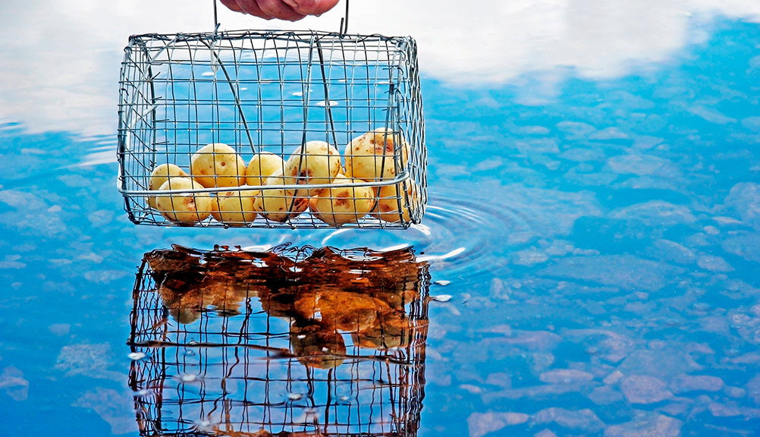
Photo: Tarja Hoikkala/Vastavalo

Slide 18
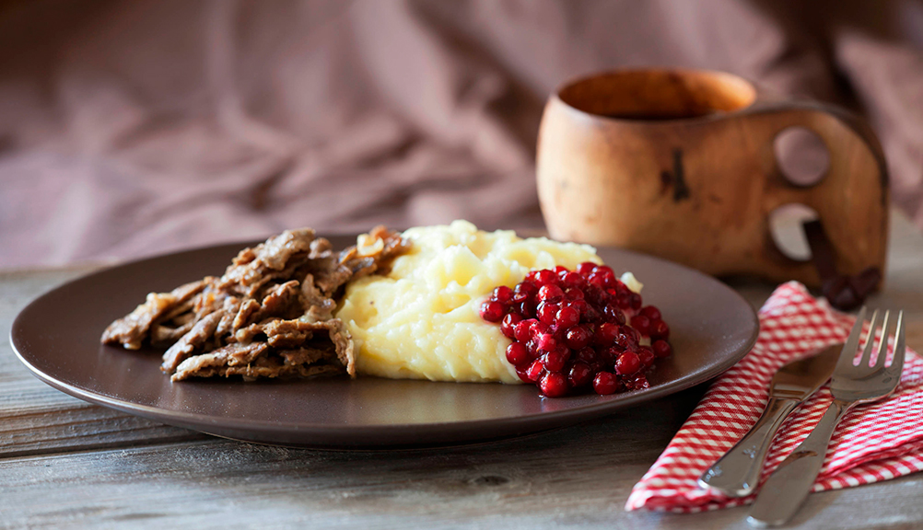
Photo: Soili Jussila/Vastavalo

Slide 19
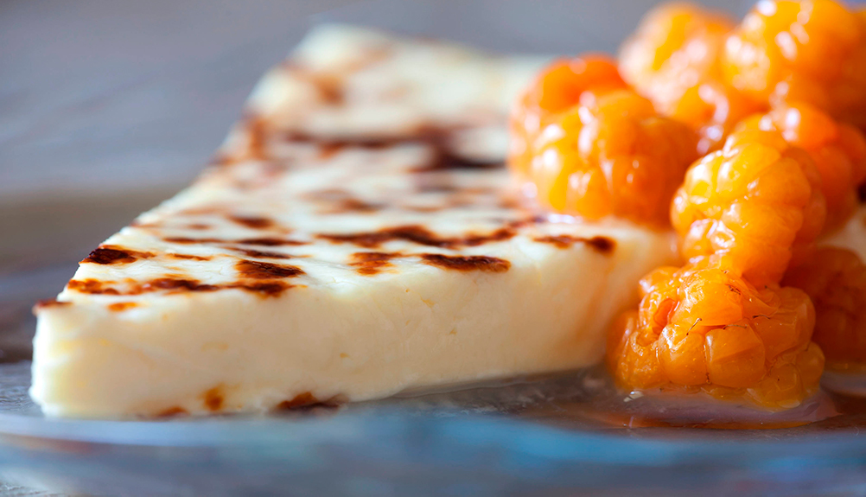
Credit: Harri Tarvainen/Visit Finland mediabank
Photo: Soili Jussila/Vastavalo

Slide 20
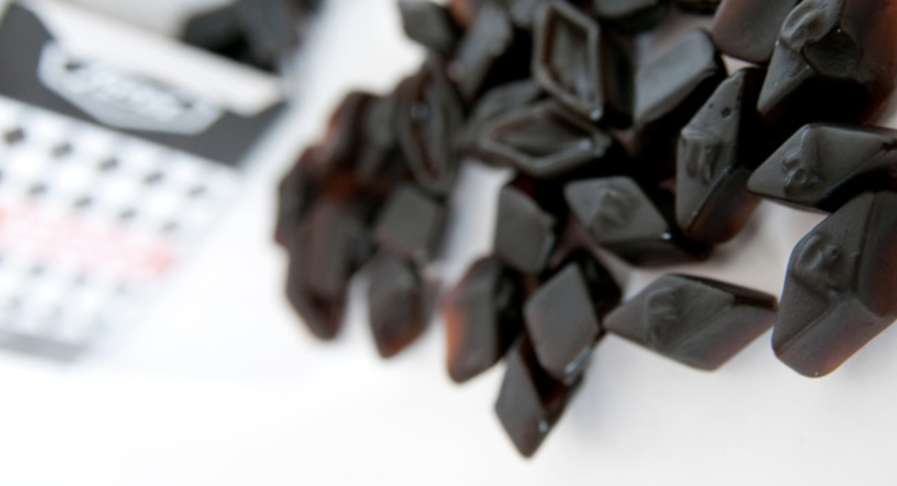
Photo: Vastavalo/Visit Finland

Slide 21
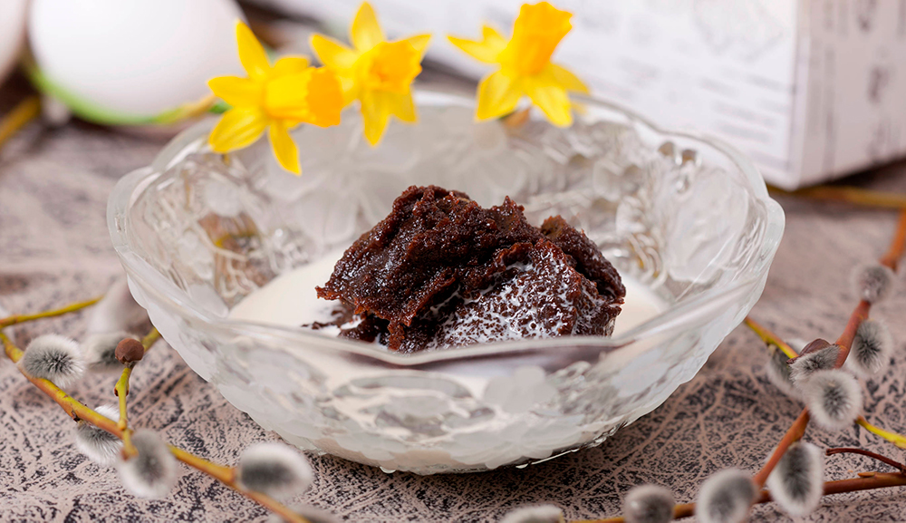
Photo: Soili Jussila/Vastavalo

