Slide 2
Finland – a design country far beyond its size
2020
Tent sauna benches, Mikko Auerniitty, Aalto University

Slide 3
Finnish design combines practicality and functionality, consideration for the users, a solution-focused approach,
and equality.
Planmeca Viso G5
3D imaging unit
Photo: Dino Azinur

Slide 4
The aesthetic starting point is Scandinavian minimalism, enriched by eastern abundance and decorativeness.
These features are shown in both designing objects and designing services, business, customer experience and
other new areas of design.
Hei Schools!
Photo: Kim Öhrling

Slide 5
The design industry has long and distinguished traditions in Finland.
Fiskars clothes
Design: Maria Korkeila
Photo: Alisa Martynova / Fiskars Finland Oy Ab

Slide 6
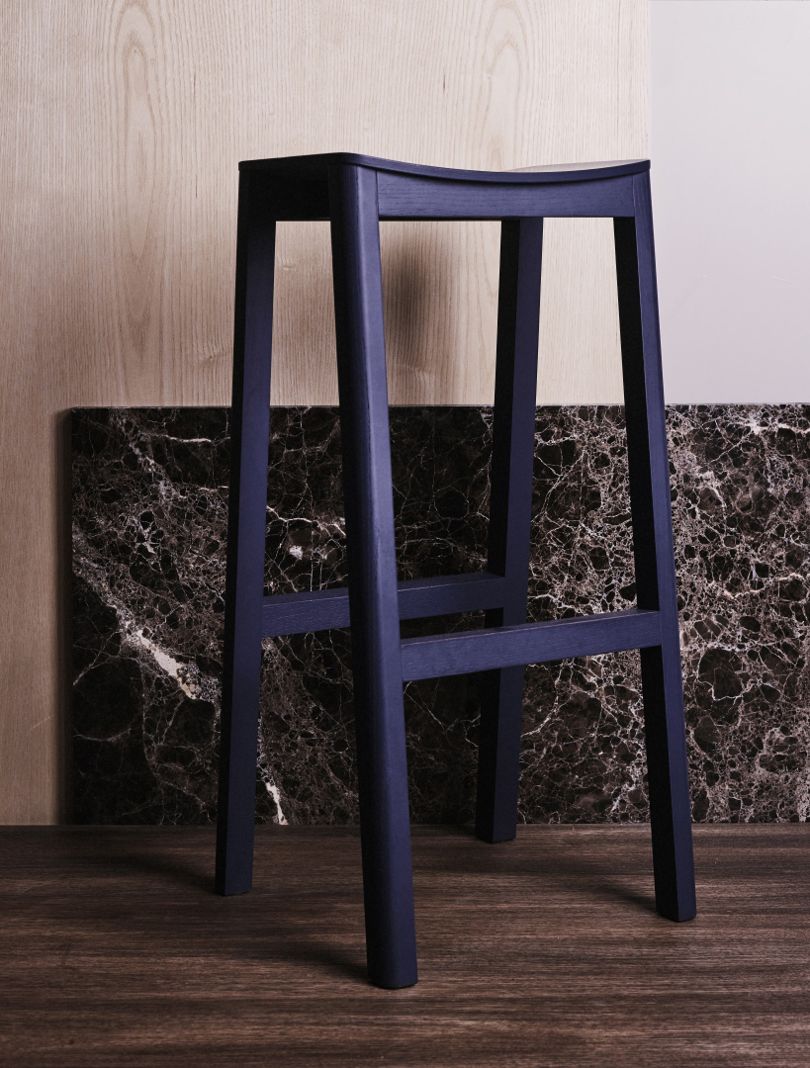
The world fame of Finnish design was born between the 1940s and 1960s partly because of determined promotion work.
The fame was boosted by international design exhibitions such as the Milan Triennials and renowned designers.
Halikko stool
Design: Sebastian Jansson /
Made by Choice

Slide 7
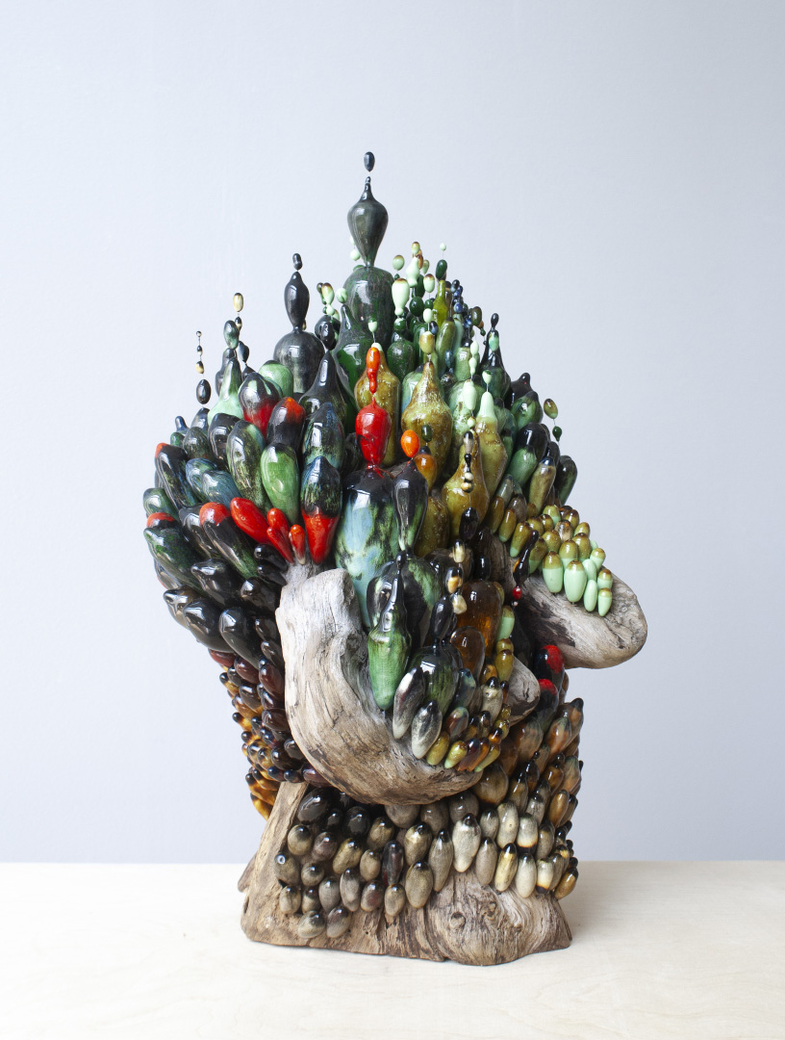
Furniture, glass and ceramics have been traditionally strong areas of Finnish design. Industrial design grew in the 70s and Finland was one of its forerunners.
Volcanic Forest
Wood, ceramic, glass
Design: Matias Liimatainen

Slide 8
Now we are pioneers in
service design and
legal design, among others. Young Finnish fashion designers have also attracted attention.
Vallila x Ervin Latimer
2nd cycle collection by Ervin Latimer
New life for Howard Smith fabrics
Photo: Chris Vidal
Fiskars clothes
Design: Maria Korkeila
Photo: Alisa Martynova / Fiskars Finland Oy Ab

Slide 9
The design sector is a growing industry in Finland.

Slide 10
In 2018, the turnover
of the design sector’s businesses was around €12.3 billion.
Design competence is utilised in almost all areas of business, from services
to heavy industry.
Source: www.ornamo.fi
Sulapac straws
Photo: Sulapac

Slide 11
Design competence regarding circular economy and sustainable development has become particularly topical.
Korvaa, concept headphones
The Korvaa Initiative
Design: Aivan

Slide 12
Another current trend is the design of digital environments.
This is also influenced
by new ways of consuming and behaving such as sharing and leasing.
Hive Helsinki Coding School
Hive Helsinki Foundation
Design / photo: Kuudes

Slide 13
The aim is to increase the use of design competence particularly at businesses’ strategic level, when its influence on business is the
most effective.
Woodio bathtub
Photo: Martti Järvi / Woodio Oy

Slide 14
Design is a part of national decision making.

Slide 15
The first national design policy programme, Muotoilu 2005!, was launched back in 1999, making it the first in the world. The second national design programme, Design Finland, was launched in 2013.
Samples
Omuus
Photo: Simo Viitanen

Slide 16
Design-intensive business, industry and manufacturing is supported by various programs of the state
and public organisations.
Skand electric boat
Jean Munch and Laura Hietala
Aalto University

Slide 17
At the moment, the
focus areas are bio
and circular economy,
smart technologies and
the design related
to them.
Source: www.businessfinland.fi
A robot car
Smart Kalasatama
Photo: Jussi Hellsten / City of Helsinki

Slide 18
ARCHITECTURE AND DESIGN HAVE BEEN CENTRAL ELEMENTS
IN THE DESIGN AND CONSTRUCTION OF HELSINKI,
THE CAPITAL OF FINLAND.
Helsinki Central Library Oodi, ALA Architects, photo: Tuomas Uusheimo

Slide 19
Design is seen in various city operations and details, from library services to public transport.
Helsinki Central Library Oodi
Photo: Jussi Hellsten / Helsinki Marketing

Slide 20
In 2012, Helsinki was the World Design Capital, and in 2014 it was named UNESCO’s City of Design.

Slide 21
In 2016, Helsinki was the first city in the world to employ a Design Director.
Design is a part of Helsinki City Strategy: the objective is to be the world’s best-functioning city by 2021.
Lasipalatsi square
Photo: Aleksi Poutanen / Helsinki Marketing

Slide 22
Design creates tourism.
Flow Festival
Photo: Jussi Hellsten /
City of Helsinki

Slide 23
Design is one of the spearheads in
Finland’s tourism.
Design District Helsinki attracts people interested
in design and urban culture
to the capital with its shops, restaurants, galleries
and design hotels.
Helsinki Design Week
Photo: Aleksi Poutanen

Slide 24
A new joint museum for architecture and design is under planning in Helsinki.
This museum, characterised as “the most attractive museum in the world”,
aims to open its doors to the public in 2025.
Secret Universe
Exhibition at Design Museum by Company: Aamu Song & Johan Olin
Photo: Paavo Lehtonen

Slide 25
The design education in Finland is world class.
AALTO UNIVERSITY’S DEGREE PROGRAMME IN FASHION IS ONE OF THE BEST IN
THE WORLD.
IT RECEIVED THE BEST IN GLOBAL INFLUENCE MENTION IN 2019 IN THE INTERNATIONAL COMPARISON
OF FASHION SCHOOLS.
Source: www.businessoffashion.com
Näytös 19
Amina Saada, Aalto University
Photo: Mikko Raskinen

Slide 26
Aalto University's art and design programmes were ranked by the QS World University Ranking as
the 7th best
in the world in 2020.
Source: www.aalto.fi
Plusminus game
Veera Hokkanen, Thomas Holmes,
Hannu Koivuranta, Antti Sandberg, Helena Sorva and Juuso Toikka
Aalto University

Slide 27
IDBM (International Design Business Management) was one
of the first study
modules in the world
that combined business sciences, engineering sciences and design education.
Future Packaging prototypes
Fold & Sustain, CoCeA, Aalto University
Photo: Anastasia Ivanova

Slide 28
In Finland, design is a part of a good and functional daily life.
Isoisän silta / Granpa’s bridge
Photo: Riku Pihlanto / City of Helsinki

Slide 29
Design is seen in the physical environments
of homes and workplaces, city structures, public
and private services and business operations.
Virtual Aquarium, Helsinki’s New Children’s Hospital
Design: John Lee, Laura Horton, Jukka Eerikäinen
and Sourya Sen, Aalto University
Photo: Sourya Sen

Slide 30
We believe that good design is everybody’s right.

