Slide 1
FINLAND
– SOCIETY COMMITTED TO GENDER EQUALITY

Slide 2
THE SUCCESS OF FINLAND AS A COUNTRY IS TO A GREAT EXTENT LINKED WITH IMPROVEMENTS IN THE STATUS OF WOMEN AND
GENDER EQUALITY.

Slide 3
HISTORY
Finland was the first country in the world to extend the right to vote and stand for elections to all women and men in 1906.
Finland was also the first country to elect women to Parliament in 1907.

Slide 4
OUR STRENGHTS
Women and men are equally represented in the Finnish labour market.
Discrimination based upon gender is prohibited by law.
All Finnish girls and boys study in mixed classrooms for at least 9 years and receive free meals at school.

Slide 5
OUR STRENGHTS
Child health clinics and other services that provide the best possible health and well-being for the whole family.
Finland is famous for its maternity package sent to every expectant mother or family.

Slide 6
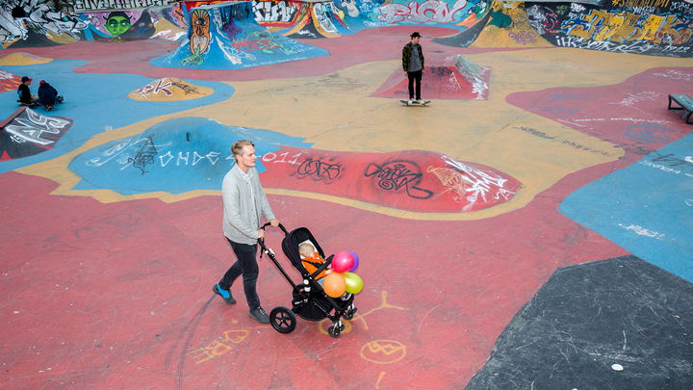

Slide 7
PROMOTION OF THE RIGHTS OF WOMEN AND GIRLS IS ONE OF THE FOUR KEY PRIORITIES OF FINLAND’S NEW DEVELOPMENT POLICY.

Slide 8
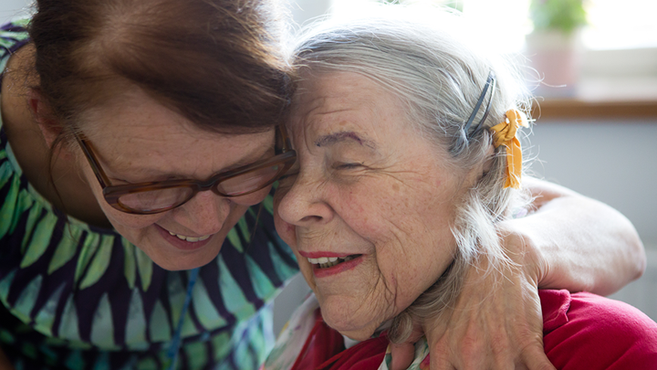

Slide 9
FACTS AND FIGURES
All the highest political positions in Finland have been held by women:
President of the Republic (2000)
Prime Ministers (2003, 2010 and 2019)
Minister of Finance (2011, 2019)
Minister of Foreign Affairs (1995)
Minister of Defence (1990)

Slide 10
Facts and figures POLITICAL
47%
58%
of MPs are women
of Ministers (11 out of 19) in the Government are women

Slide 11
Facts and figures MUNICIPAL
39%
39%
of municipal councilors are women
of municipal council chairpersons are women

Slide 12
Facts and figures BUSINESS
29%
40%
1/3
of the board members in listed companies are women
of state-owned company board members are women
Women account for approximately one-third of Finland’s entrepreneurs, which is a relatively high share in comparison with other EU countries

Slide 13
FAMOUS FINNISH WOMEN
Minna Canth
A Finnish writer and social activist. Minna Canth is the first woman to receive her own flag day in Finland.
Miina Sillanpää
Finland’s first female minister and a key figure in the workers’ movement.
Helvi Sipilä
A promoter of women’s rights. She was appointed as the first-ever female Assistant-Secretary-General of the United Nations in 1972.

Slide 14
FAMOUS FINNISH WOMEN
Elisabeth Rehn
First female Minister of Defence of Finland in 1990. Rehn is known for her international assignments as UN Undersecretary General and as the special rapporteur for Human Rights in Bosnia and Herzegovina.
Tarja Halonen
First female President of Finland. Tarja Halonen has paid close attention to the issues of human rights, democracy, civil society and gender equality.

Slide 15
LEARN MORE ABOUT EQUALITY IN FINLAND
Minister for Nordic Cooperation and Equality
Ministry of Social Affairs and Health: Gender Equality Unit
Council for Gender Equality (TANE)
Ombudsman for Equality

Slide 16
LEARN MORE ABOUT EQUALITY IN FINLAND
National Non-Discrimination and Equality Tribunal
Employment and Equality Committee in the Finnish Parliament
Centre for Gender Equality Information
Statistics Finland: Gender Equality

