Slide 1
FINLAND’S WATER EXPERTISE
IS WORLD CLASS

Slide 2
The water supply system in Finland is robust, reliable and cost-effective. it functions 24 hours a day, 7 days a week even when there is a power cut.

Slide 3
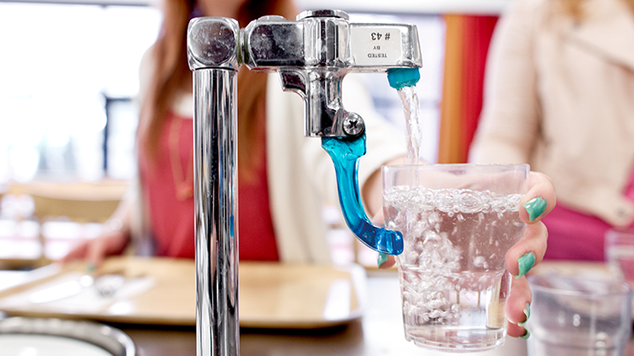
RICH IN WATER, SMART IN WATER KNOWLEDGE

Slide 4
You can swim and fish in any of the 647 rivers and 187,888 lakes.
You can drink water directly from the tap anywhere.
All of Finland has access to improved water sources and sanitation.

Slide 5
Finland’s water sector always ranks high in international comparisons.

Slide 6
Since the early 1900’s the responsibility of water supply is shared.
It has been developed by cooperation between a variety of private and municipal organizations.

Slide 7
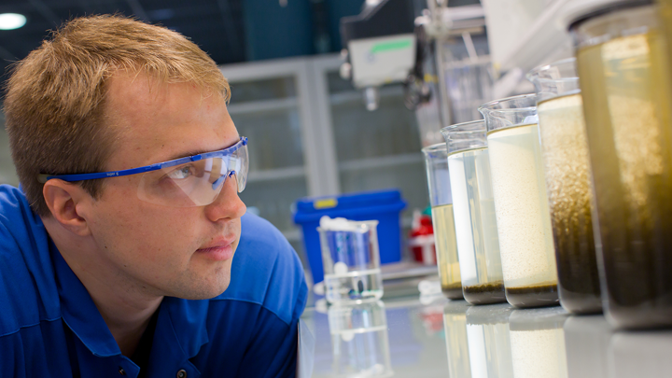
STRENGTH OF THE FINNISH WATER SECTOR

Slide 8
STRENGHT OF THE FINNISH WATER SECTOR
Versatile and international water know-how, world-class excellence.
Appropriate sector legislation and effective administration.
Good cooperation with other sectors and NGOs.
Long tradition of consumer initiative.

Slide 9
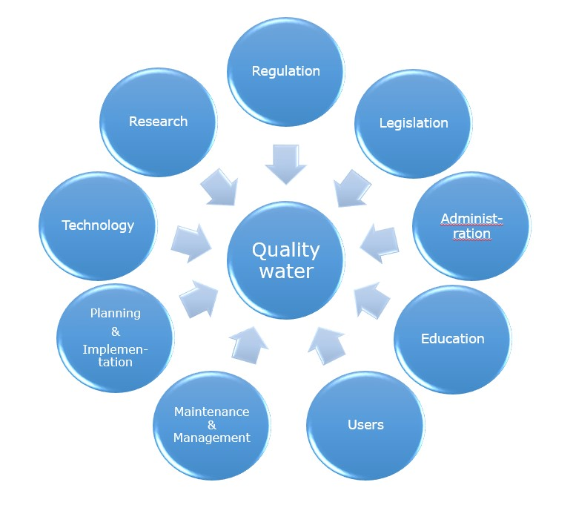

Slide 10
Finland is noted for its good regulation and operation, as well as robust and reliable technology.

Slide 11
Facts and figures
5bil€
5-10%
Finnish companies in the water sector currently have a turnover of around 5 billion euros a year, which is about one-fifth of Finnish cleantech total sales.
The annual growth is 5–10 per cent and the water sector employs 6,000–10,000 people.

Slide 12
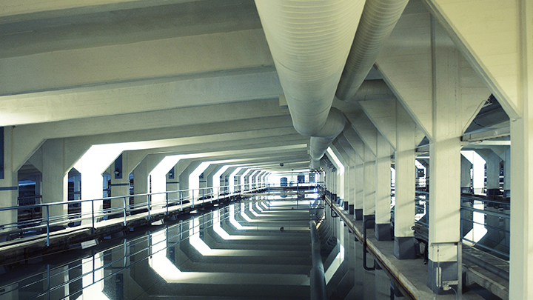

Slide 13
FINNISH COMPANIES IN THE WATER SECTOR
Finnish water expertise covers all aspects of water from research and education to technology, consulting, monitoring and contracting. You can find a detailed list of Finnish water actors at: http://www.finnishwaterforum.fi/wp/en/our-members/

Slide 14
LEARN MORE ABOUT FINLAND’S WATER EXPERTISE
http://www.finnishwaterforum.fi/en/

