Slide 1
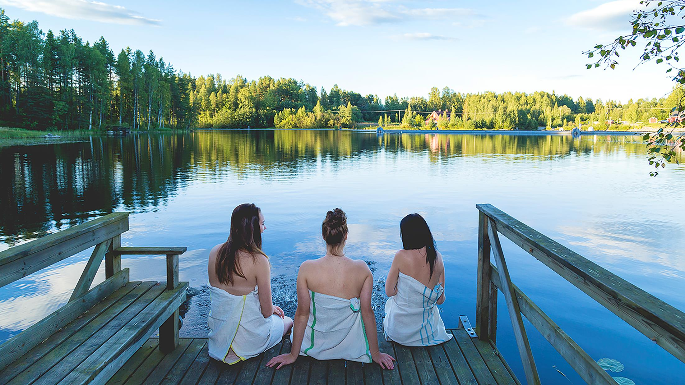
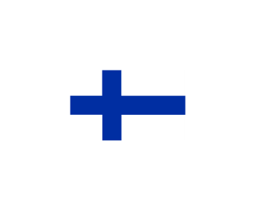
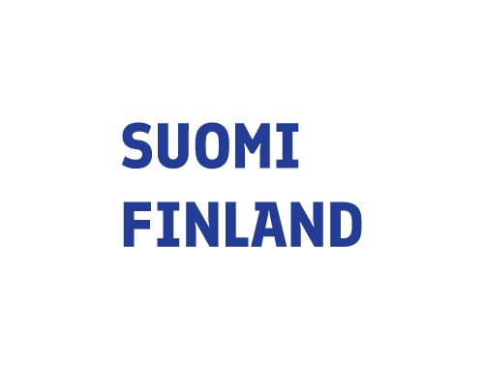
FINLAND
A land of saunas
#SaunafromFinland #AuthenticFinnishSaunaExperience #VisitFinland

Slide 2
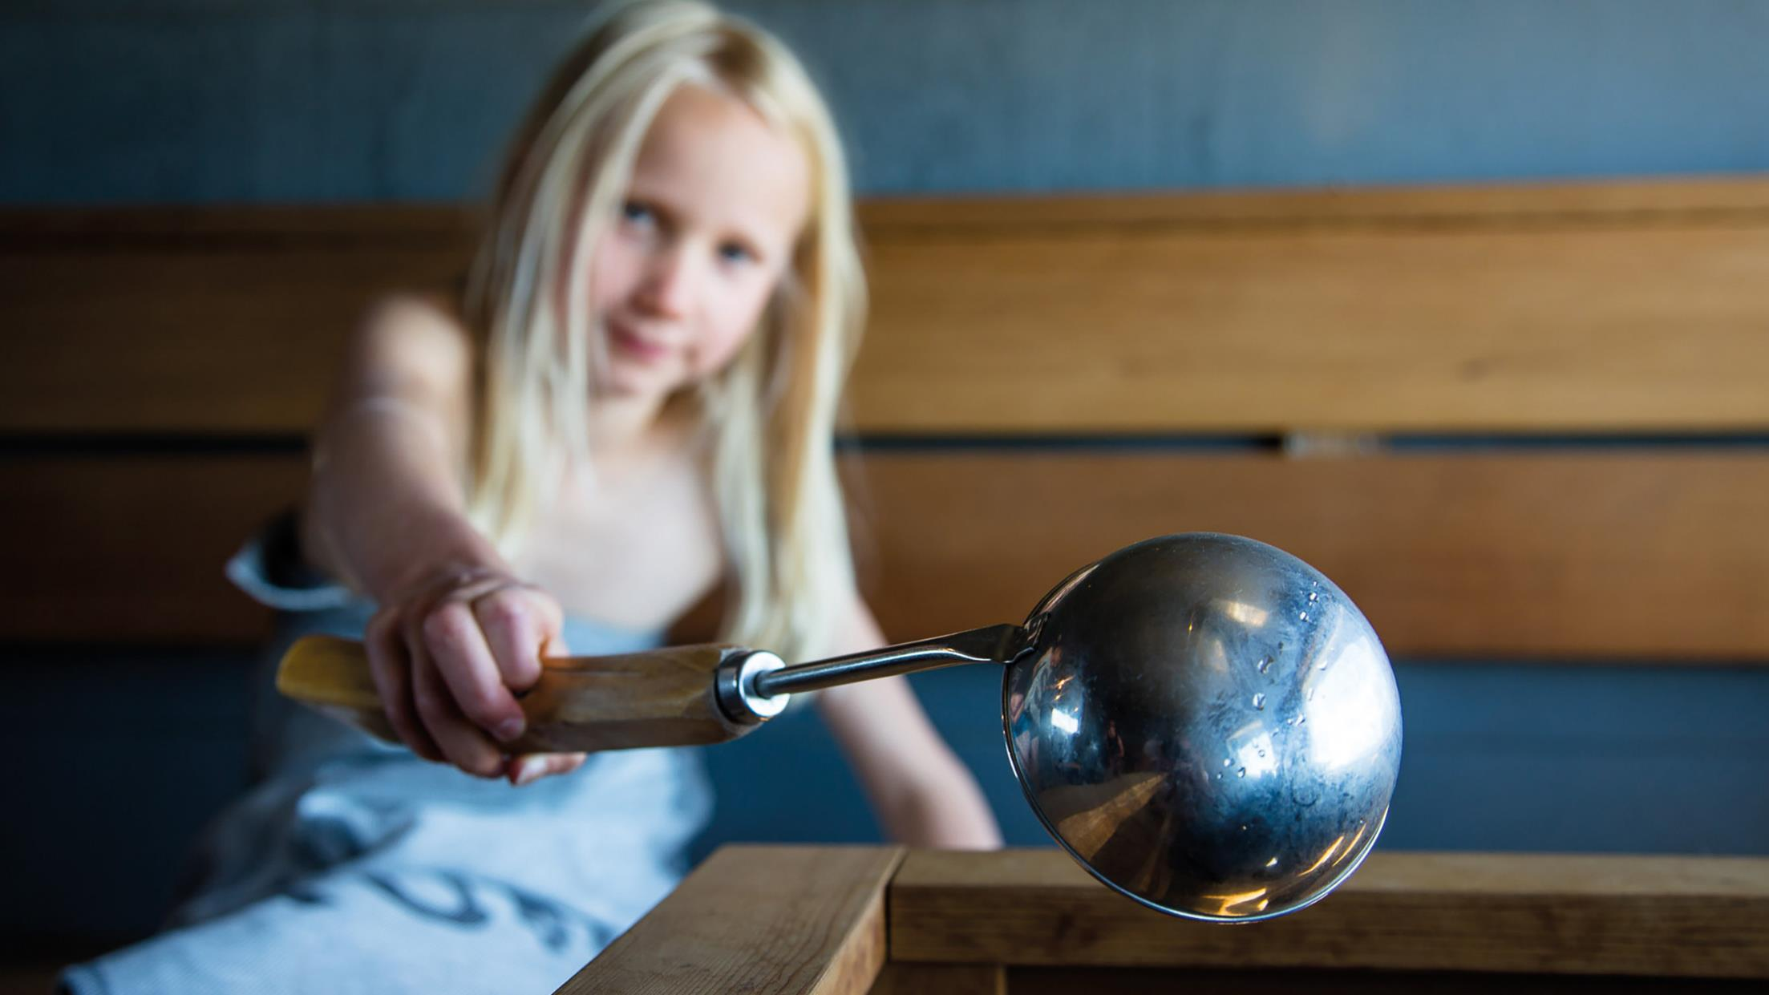
THE FINNISH SAUNA

Slide 3
FINNISH SAUNA – A PLACE FOR JUST BEING
Throwing water on the rocks (“Löyly”)
Scientifically proven health benefits
No specific rules or timing → ultimate relaxation
Natural materials
Temperature higher than in other saunas

Slide 4
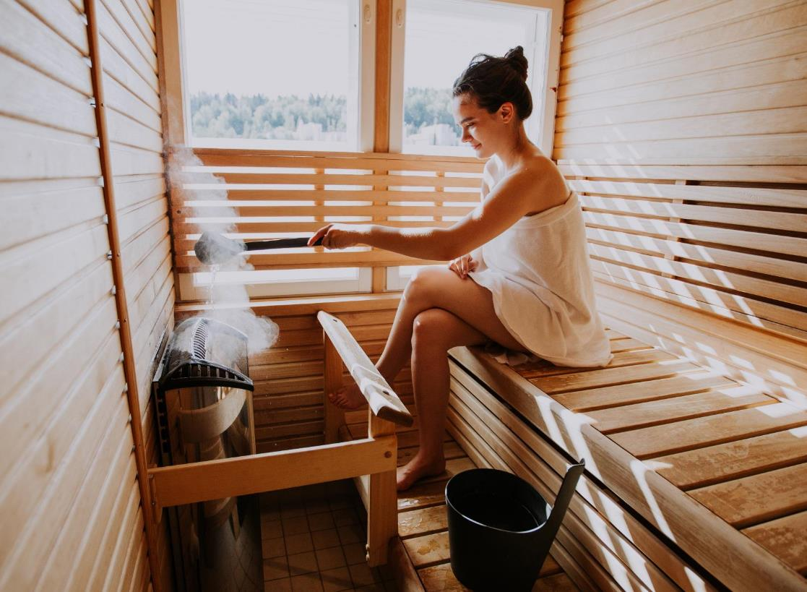
One of differences between Finnish sauna bathing and other sauna cultures is that Finnish sauna habits are flexible. The bather can control the level of heat in the sauna by throwing water on the sauna heater—or “throwing steam,” as we Finns call it.
Photo: Julia Kivelä/ Visit Jyväskylä, Hotel Alba

Slide 5
Many studies have shown that sauna bathing has multiple health benefits, such as decreasing the risk of heart disease and dementia. Scientists have researched the health effects of sauna on the heart, the skin, recovery, and even sleep.
Photo: Hawkhill

Slide 6
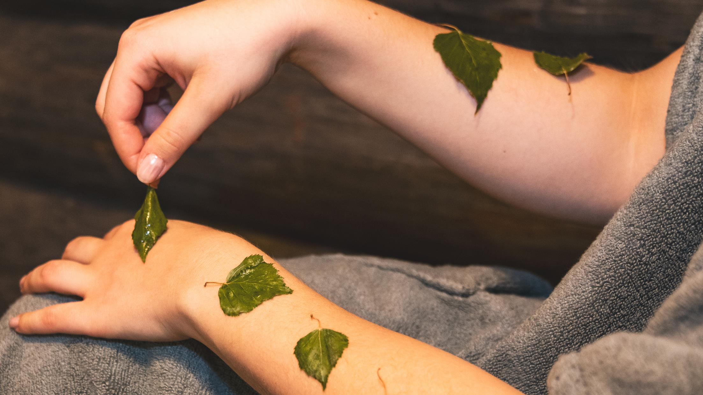
Finnish sauna has been scientifically proven to be good for your health. It’s good for your heart, blood circulation, brain, and respiratory system.
Read more about the most recent research:
Kunutsor et al. (2019)
Kunutsor et al. (2018)
Laukkanen et al. (2018)

Slide 7
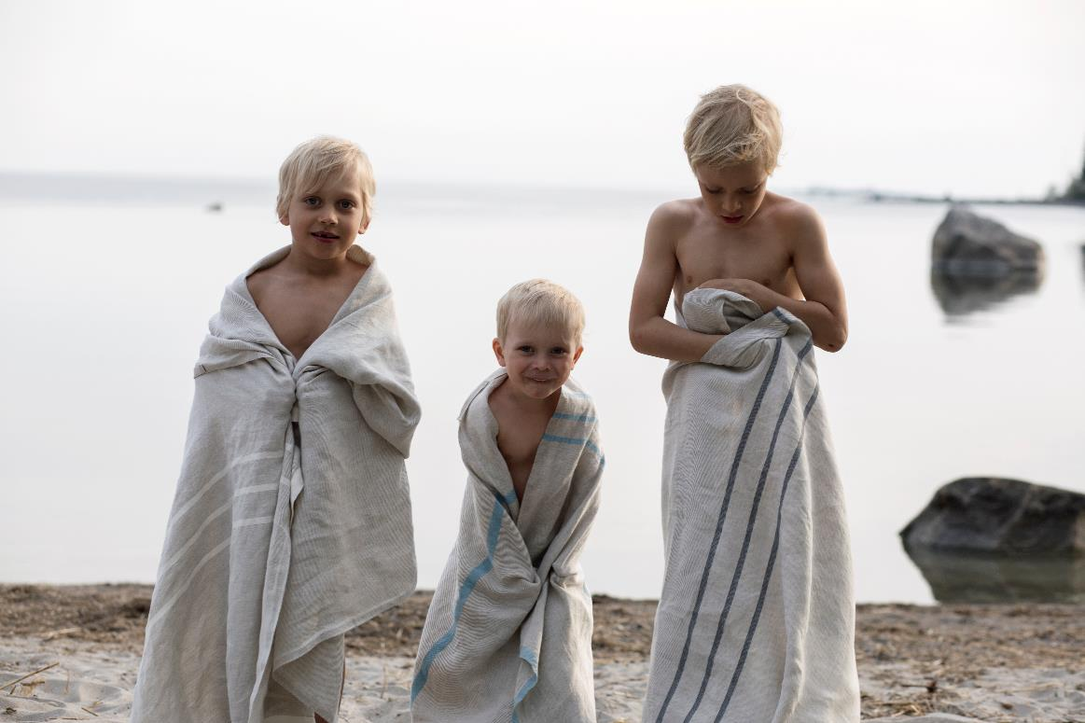
SAUNA – AN ESSENTIAL PART IN THE CULTURAL HISTORY OF FINLAND
Sauna has been one of the key aspects of Finnish culture for centuries - the first saunas were built already during the Stone Age.
Sauna has served as a place to give birth, wash off the dust of hard work and look after one’s health.
Many Finnish folklore songs and stories tell about the spirits and elves of the sauna.
Photo: Lapuan Kankurit Oy

Slide 8
Finland has around 3,2 million saunas for 5,5 million people.
Nearly ninety percent of Finns sauna bathe at least once a week, and forty percent go to sauna several times per week. The sauna is truly an essential part of the Finnish heritage and lifestyle, and one thing that separates Finland clearly from the other Nordic countries.

Slide 9
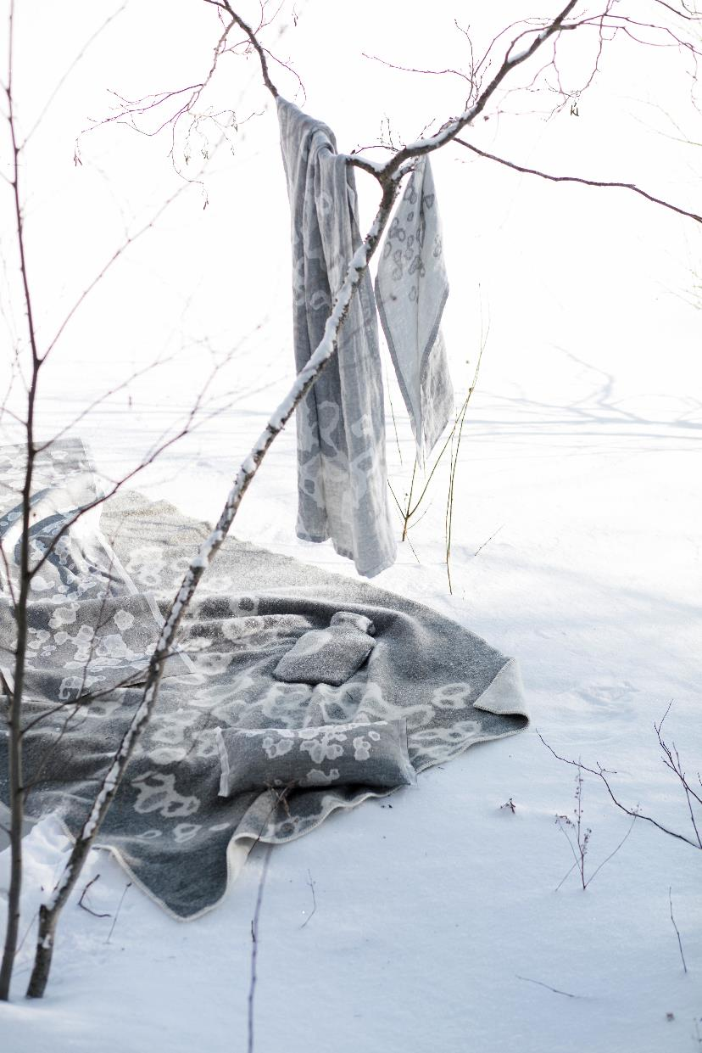
SAUNA BATHING AS CULTURAL HERITAGE
In June 2018, the sauna and sauna bathing was chosen as Finland’s first candidate for the UNESCO Representative List of the Intangible Cultural Heritage of Humanity.
Photo: Lapuan Kankurit Oy

Slide 10
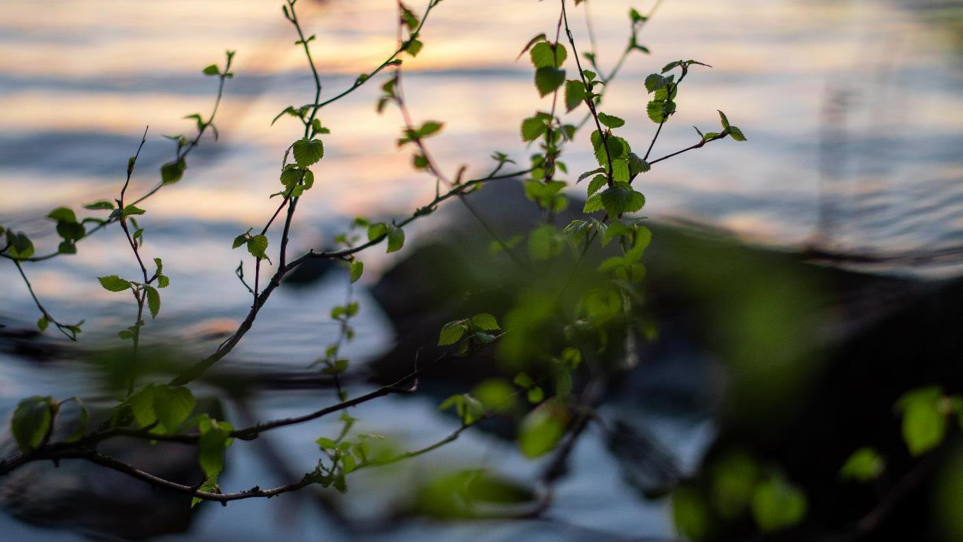
90 %
90% of Finns go to the sauna at least once a week.
40 %
40% of Finns go to the sauna multiple times in a week.

Slide 11
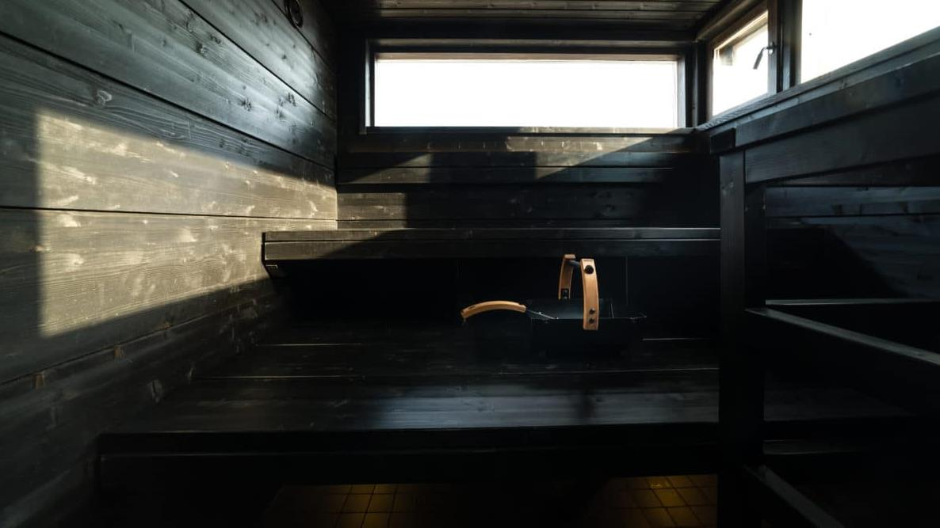
THE AUTHENTIC FINNISH SAUNA EXPERIENCE
Photo: Lapland Hotels Tampere

Slide 12
BEFORE THE SAUNA – PEACEFUL PREPARATION
The preparations for sauna evening often include connecting with nature, for example by cutting and burning wood.
Heating up the sauna and setting the right mood with bench covers, candles, and fresh water for drinking is a great way to calm down for the sauna.

Slide 13
DURING THE SAUNA – PRESENCE IN COMFORT
The ideal temperature depends on the wishes of everyone.
Cooling off between the sauna sessions can be done whenever it feels necessary by taking a cold shower or a swim.

Slide 14
Whether the sauna is private or public, it is an environment where everyone is meant to feel safe. The sauna is a place for equality. Everyone can enjoy themselves, regardless of socioeconomic status. Titles mean nothing when sitting in the sauna.

Slide 15
AFTER THE SAUNA – PROLONGED PLEASURE
Passing time after the sauna is all about enjoying the relaxed state that takes over the body.

Slide 16
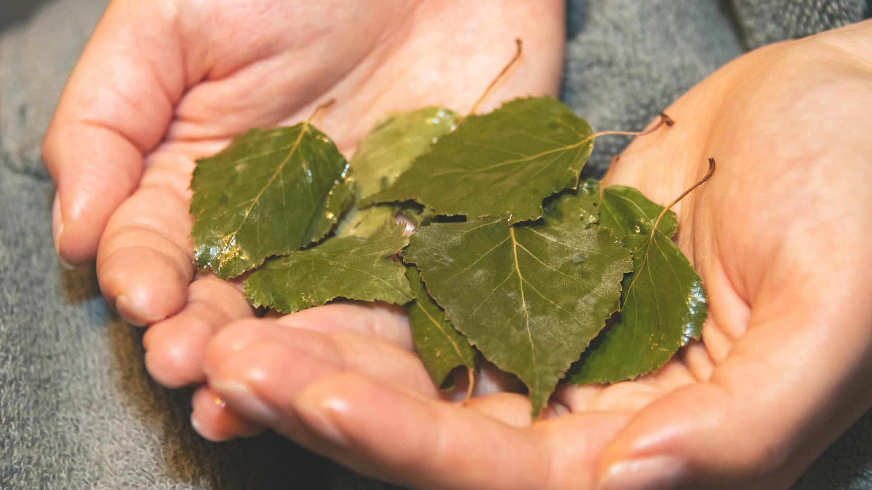
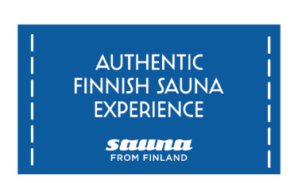
Finnish sauna expertise association Sauna from Finland has defined eight core values for the Finnish sauna experience:
Authenticity
Multisensoriality
Presence & relaxation
Wellbeing & health
Contrast
Cleanliness
Safety
Responsibility

Slide 17
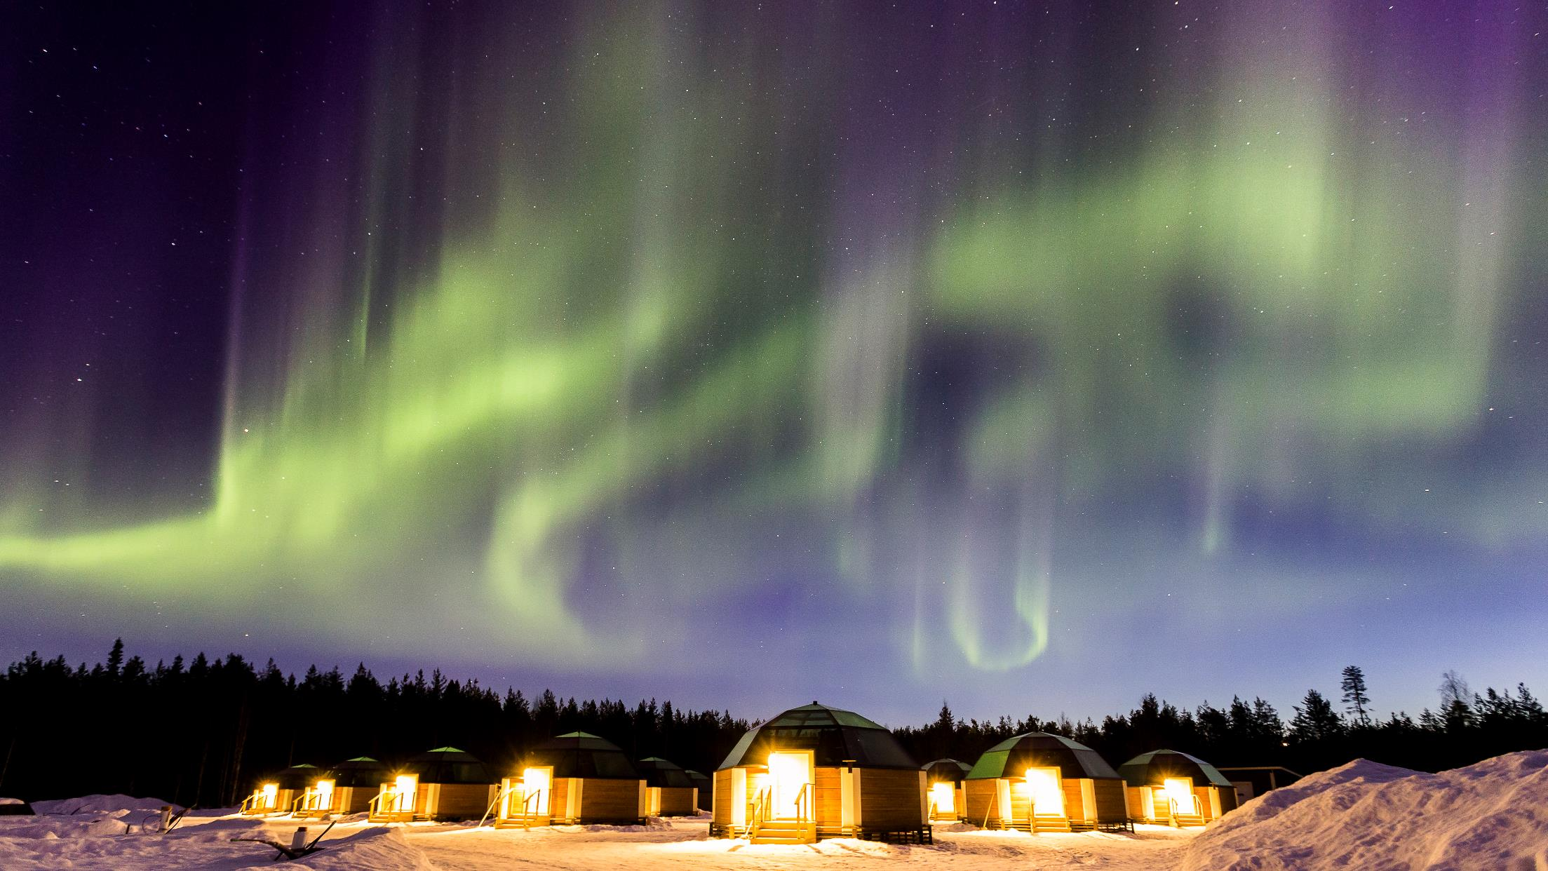
Going to an authentic Finnish sauna is a high-quality experience that creates a long-lasting memory.
Photo: Arctic SnowHotel Glass Igloos

Slide 18
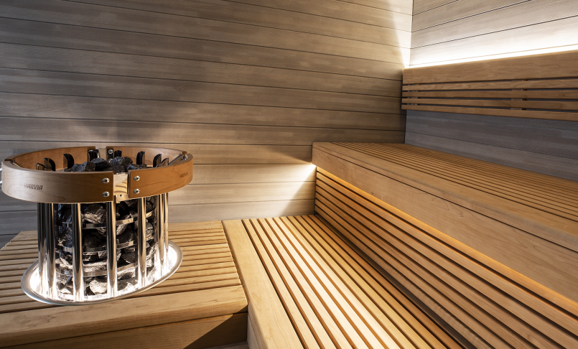
THE FINNISH SAUNA INDUSTRY
Photo: Harvia

Slide 19
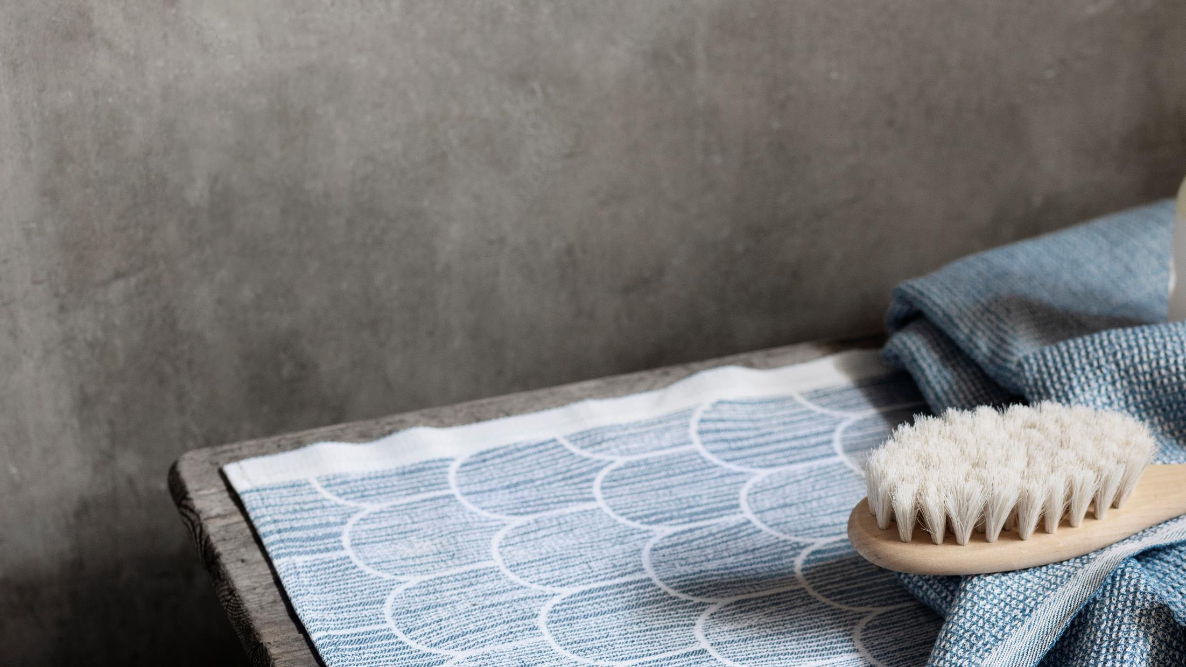
In Finland, there are around 30 sauna construction companies and around 20 companies that manufacture sauna stoves and heaters.
In addition, there are thousands of companies that produce other elements to the Finnish sauna experience.
Photo: Lapuan Kankurit Oy

Slide 20
Source: Sauna from Finland

Slide 21
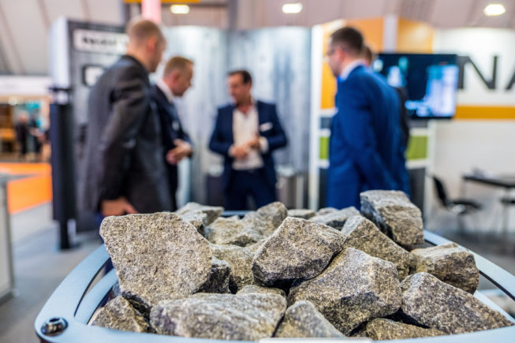
Finland is the leading country in sauna product development because the sauna experience and its impact on wellbeing can be studied in an exceptionally large user base.
The recent development areas and trends focus on:
Sustainability and clean tech
Accessibility
Safety
Remote control
Individualization and custom-made experiences

Slide 22
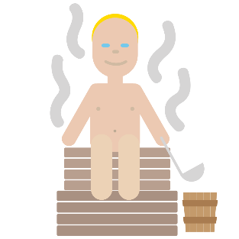
The estimated value of the sauna and sauna heater construction industry is around 1 billion euros but when all the industries producing elements of the sauna experience are considered, the value rises to multiple billions.

Slide 23
The Finnish sauna offers multiple possibilities.
It is a unique wellbeing product that fits in hotels, spas, and health clubs, and as a service of its own.

Slide 24
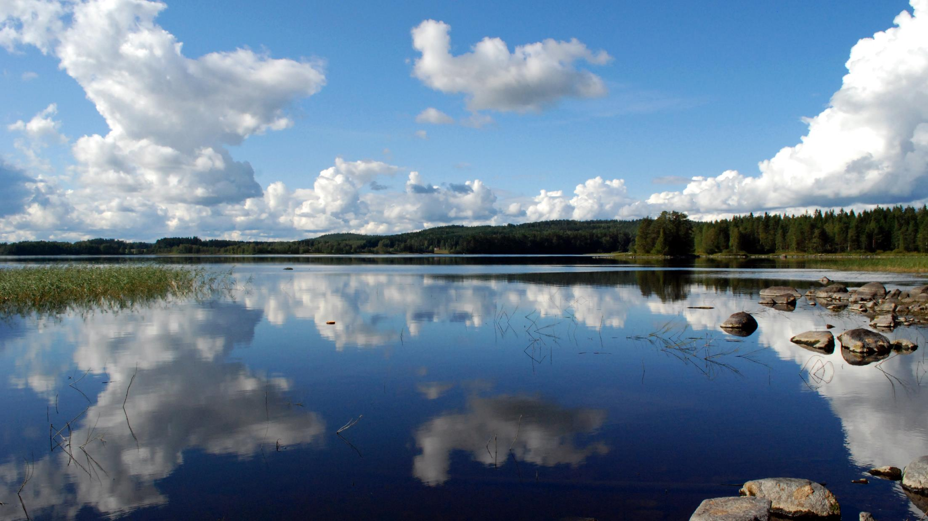
Learn more
www.saunafromfinland.com
www.sauna.fi
Photos:Sauna from Finland

