Slide 1
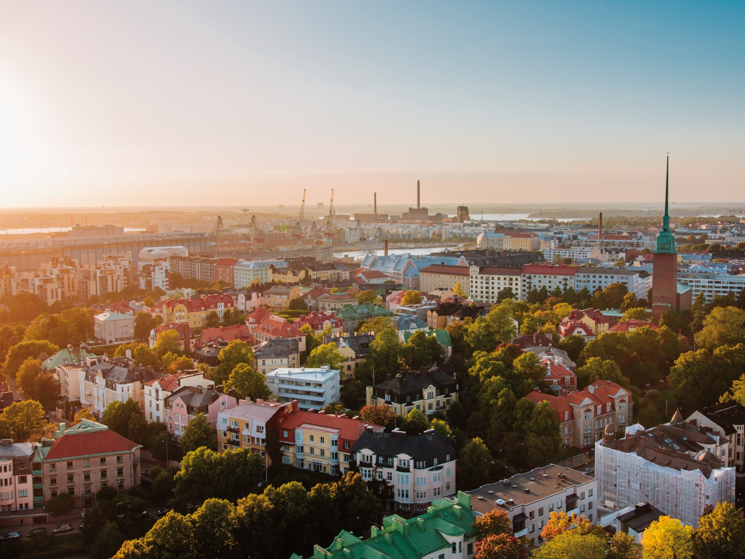

THE STORY OF FINLAND 100

Slide 2
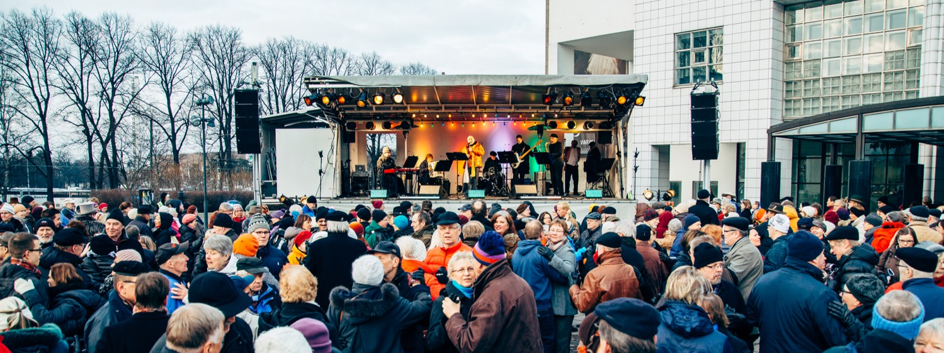
In 2017, Finland celebrates 100 years of independence and more than 100 years of uninterrupted democracy.

Slide 3
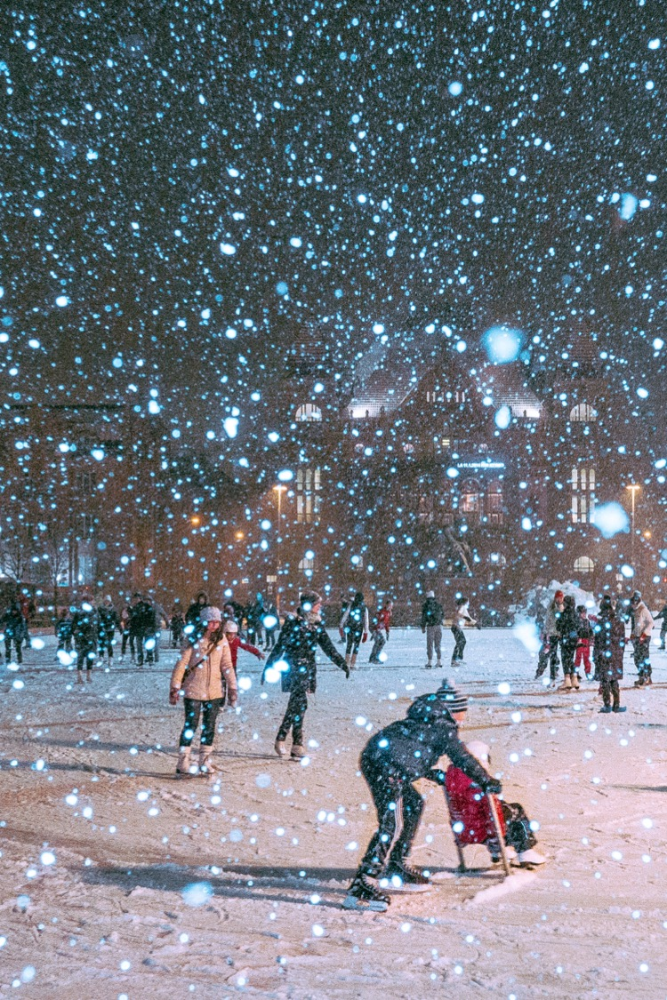
The secret of our success is that we’ve had a lot of practice.

Slide 4
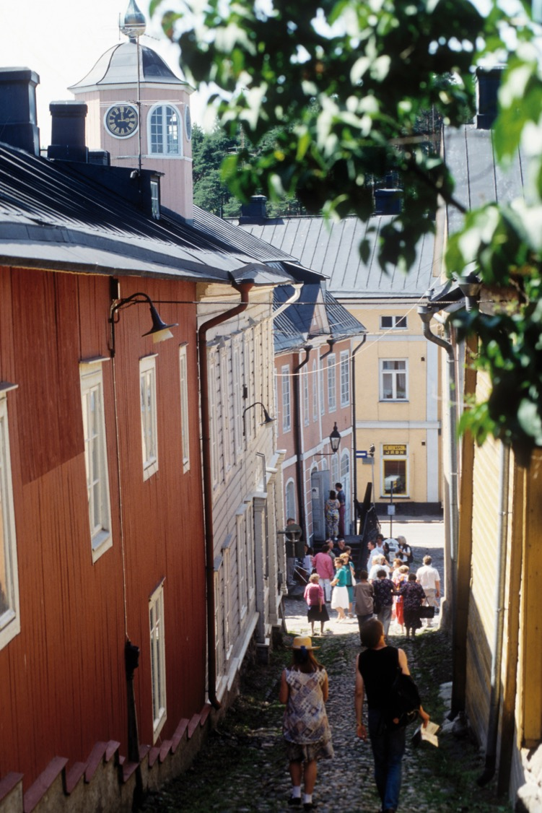
We became autonomous 208 years ago.
Autonomous Grand Duchy of Finland in 1809.

Slide 5
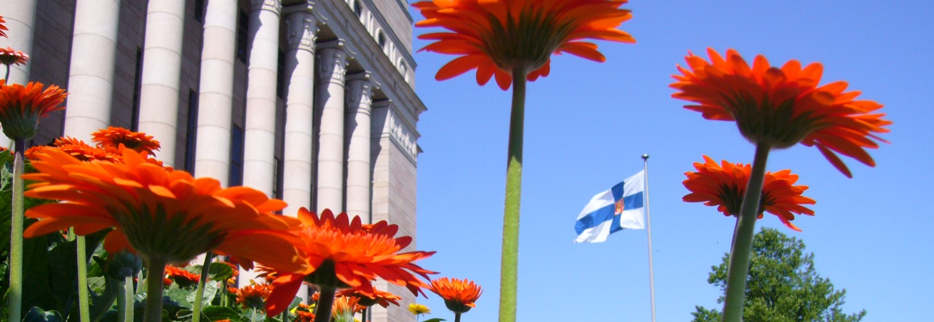
For over 150 years Finland has been built with the help
of representative democracy which has laid the foundations of the Finnish parliament.
Finnish parliament established in 1906.

Slide 6
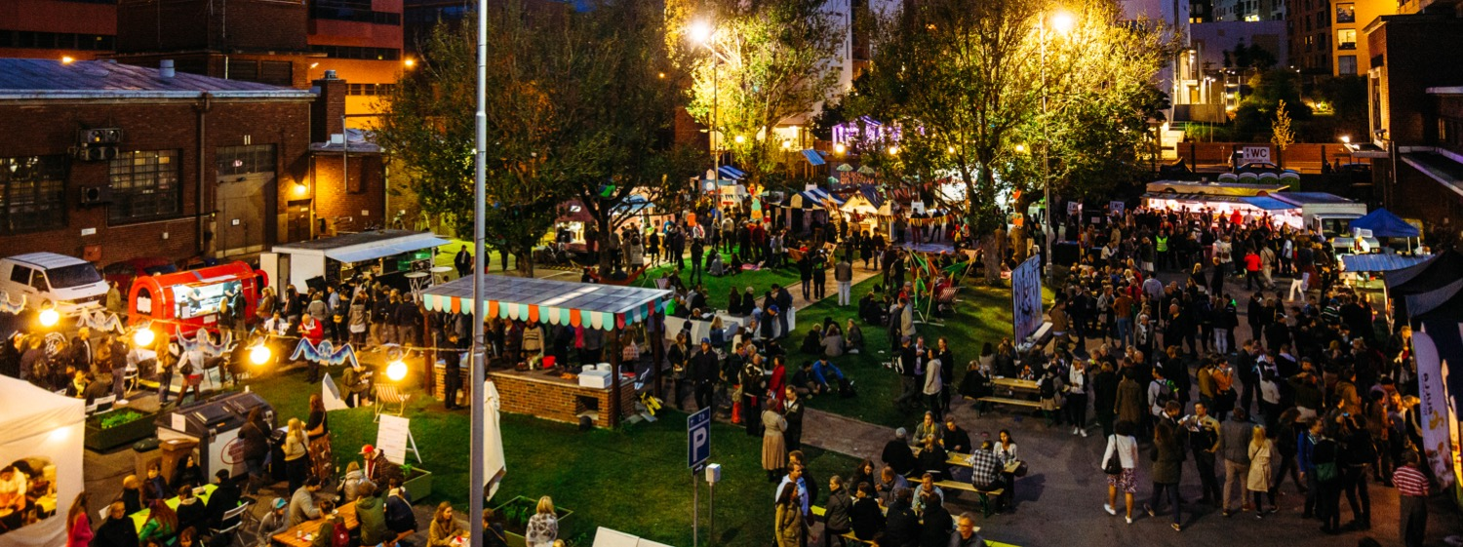
We’ve had democratic elections for 110 years.
First open and free elections in 1907.

Slide 7
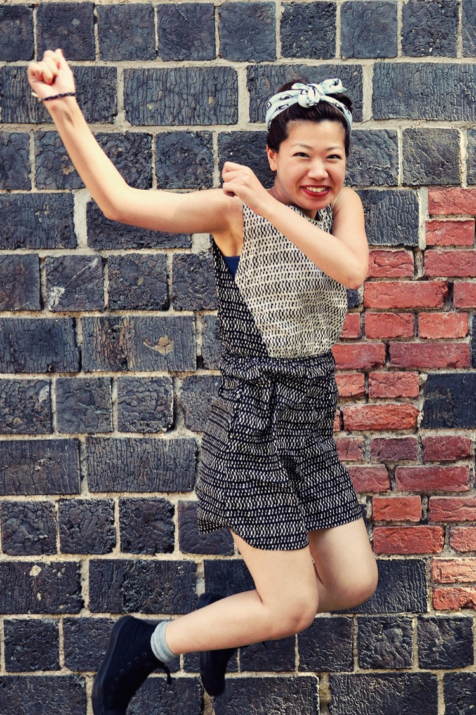
Finland is the first country in the world to grant both women and men full political rights in 1906.
19 out of 200 members of the parliament were women in 1907.

Slide 8
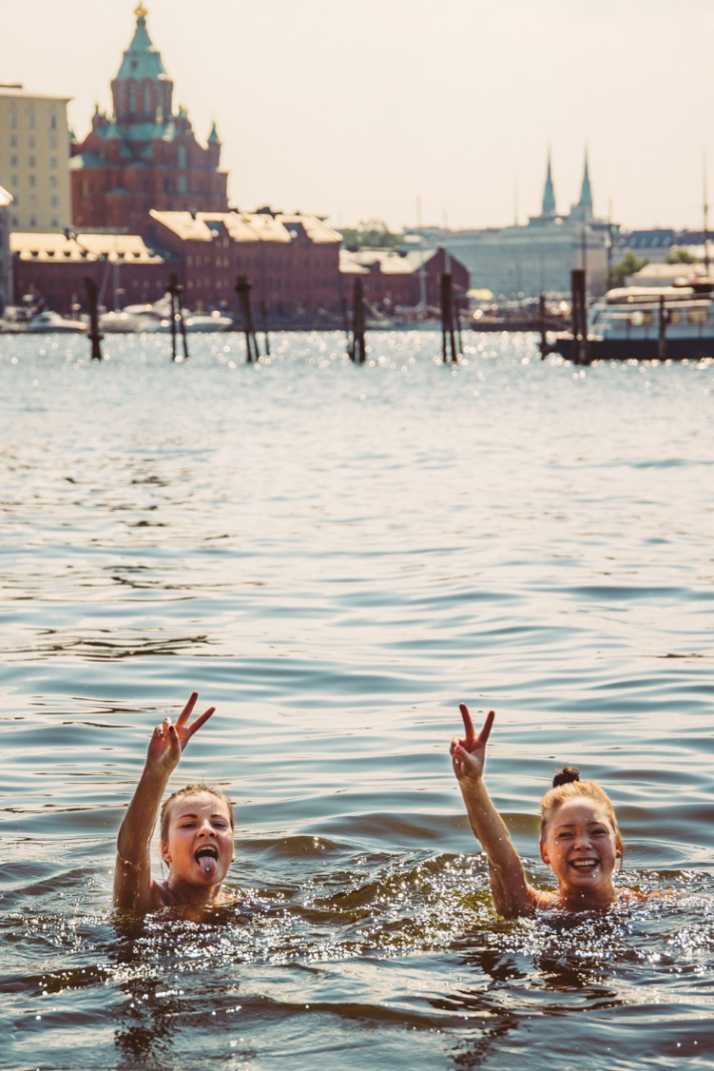
Women’s position has remained strong ever since.
> 3rd Global Gender Gap Report.
> 2nd State of the World’s Mothers Report.

Slide 9
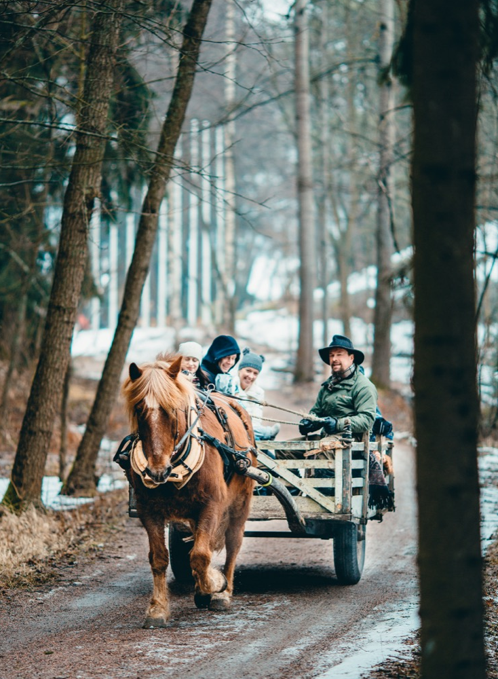
Finland gained independence in 1917 – one hundred years ago.

Slide 10
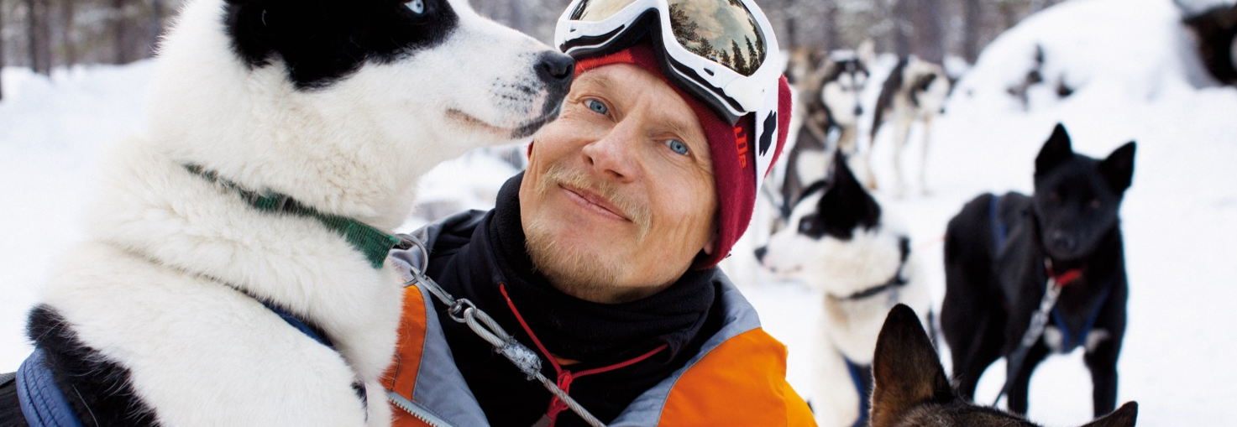
> 2nd Corruption Perceptions Index.
> 1st World Press Freedom Index.
Thanks to long democratic tradition, we are very law abiding.

Slide 11
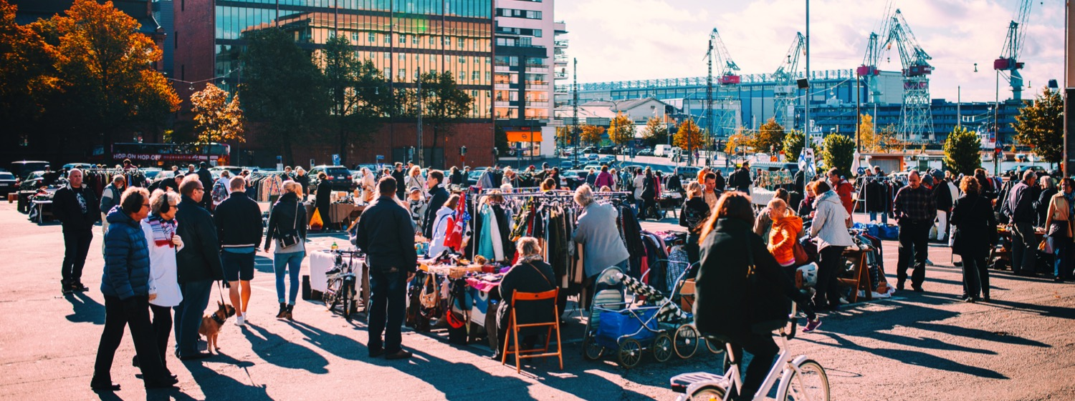
It has made us the most stable country in the world.
Most stable nation in the world: 1st Fragile States Index.

Slide 12
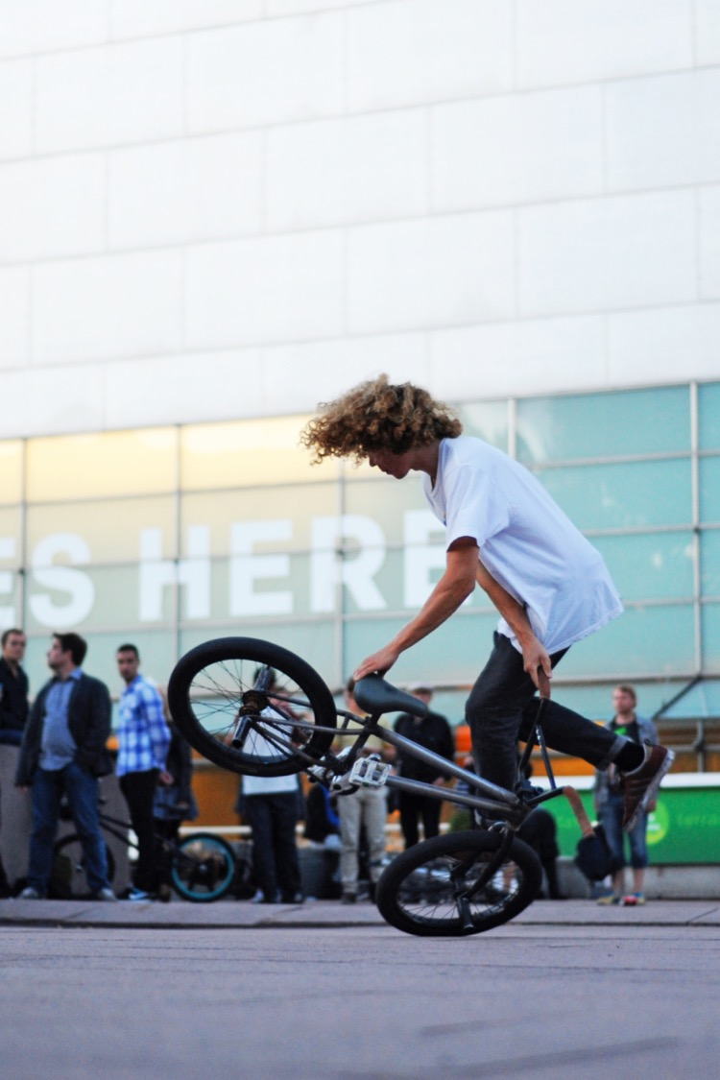
… And helped reach the top of all kinds of country rankings.

Slide 13
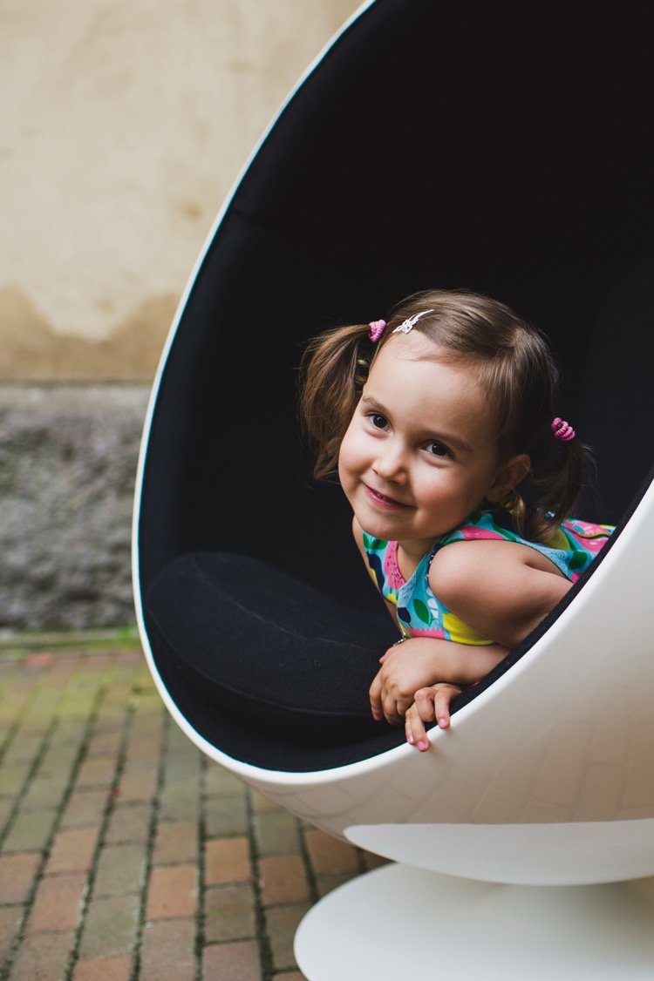
> 2nd Fairest Country for Children.
> Maternity package introduced
> in 1938.
As there are so few of us, we can’t afford to leave anyone behind
– big or small.

Slide 14
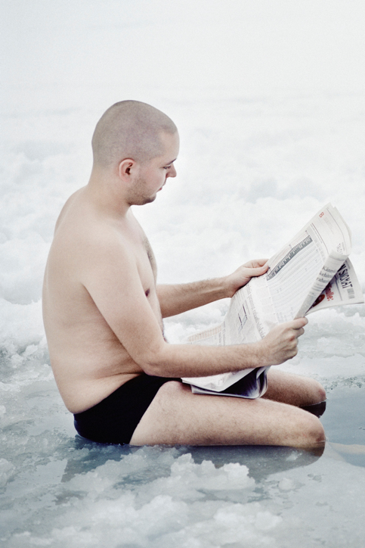
That’s why world-class health-care and education are available for all.
1st World’s Most Literate Nations.

Slide 15
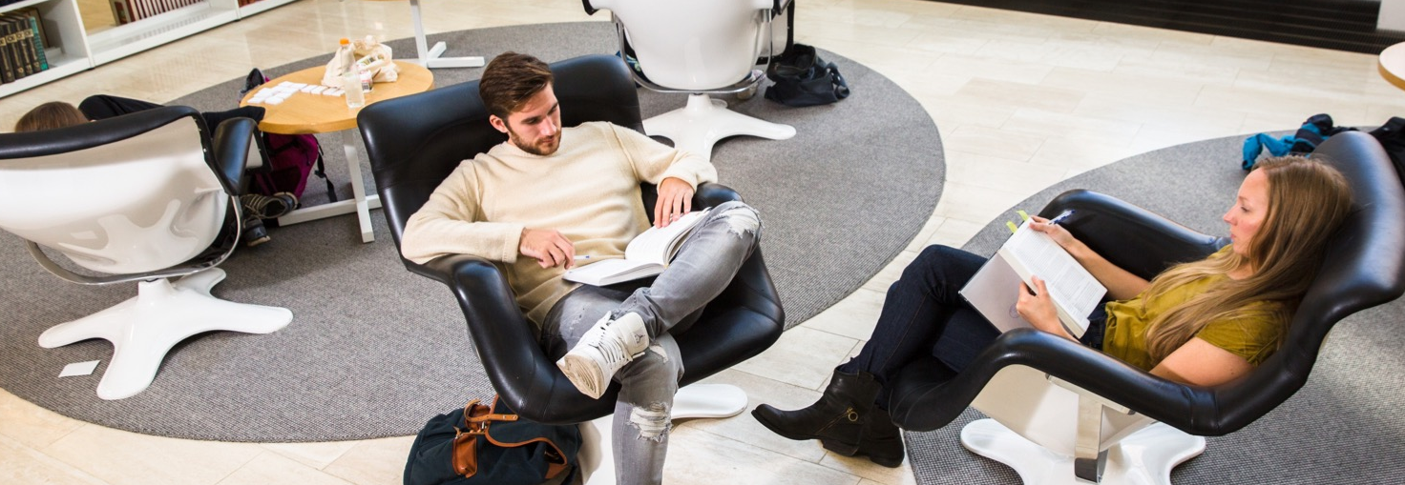
> 87% of Finnish people over the
age of 25 hold at least an upper secondary education certificate.
> Almost 42% hold a higher education degree.
Consequently, our work force is one of the most educated in the world.

Slide 16
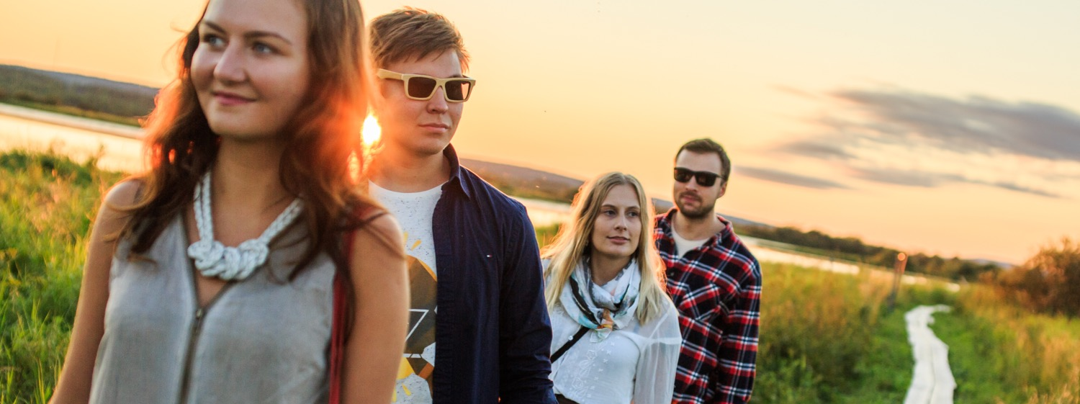

> Over 70% of Finland is forest.
> Biggest archipelago in the world.
> 1st Greenest Country in the World.
Our unique relationship with nature means that sustainable thinking comes naturally to us.

Slide 17
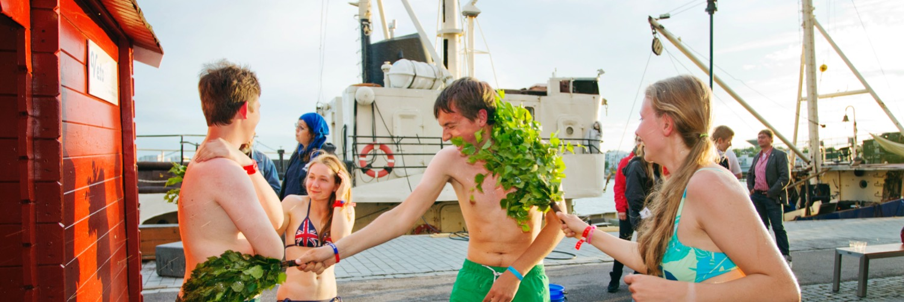
Finland is the cleanest country in the world
– in many ways.
> 188 000 lakes with water good enough to drink.
> 2nd global clean tech index.
> 3rd Cleanest Air in the World
> 3 million saunas.

Slide 18
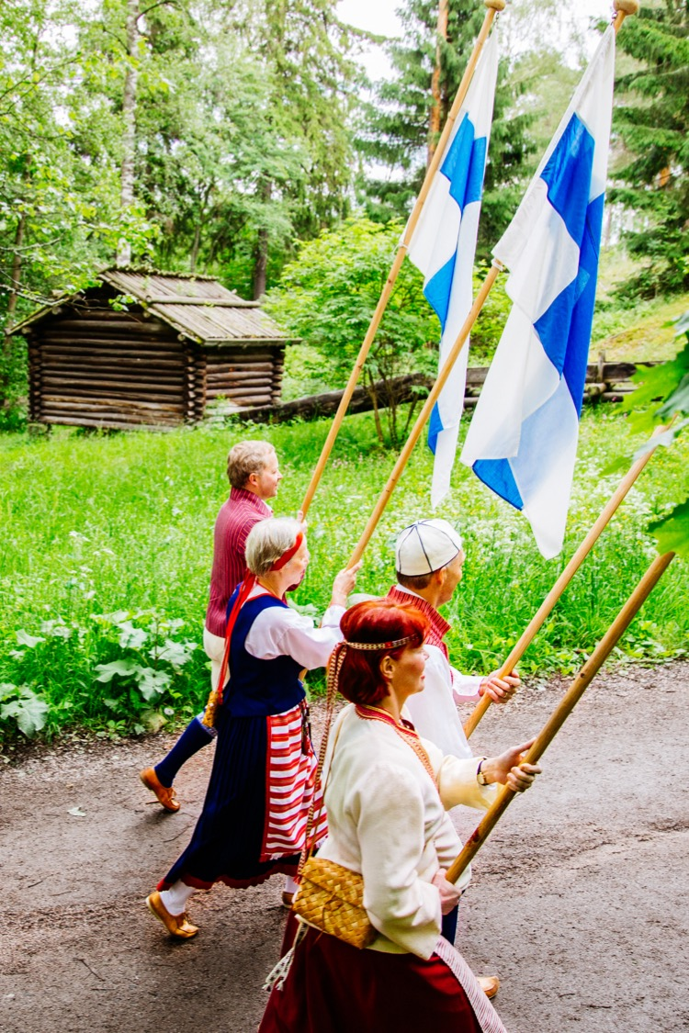
Finland is an active member of the Nordic, European and global families.
> Finland joins European Union in 1995.
> President Martti Ahtisaari wins Nobel Peace Prize in 2008.

Slide 19
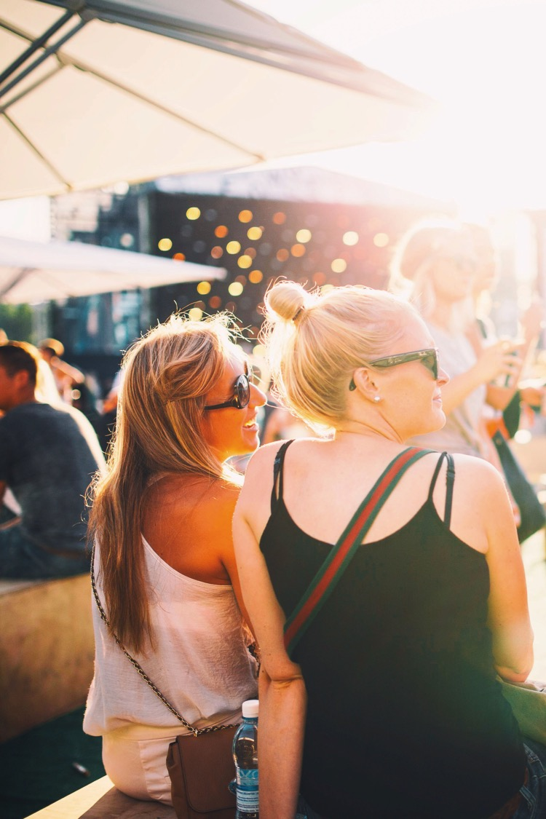
> 1st Quality of Life in
the EU.
> 5th World Happiness
Report.
All of this makes Finland a great place to live, visit or do business.

Slide 20
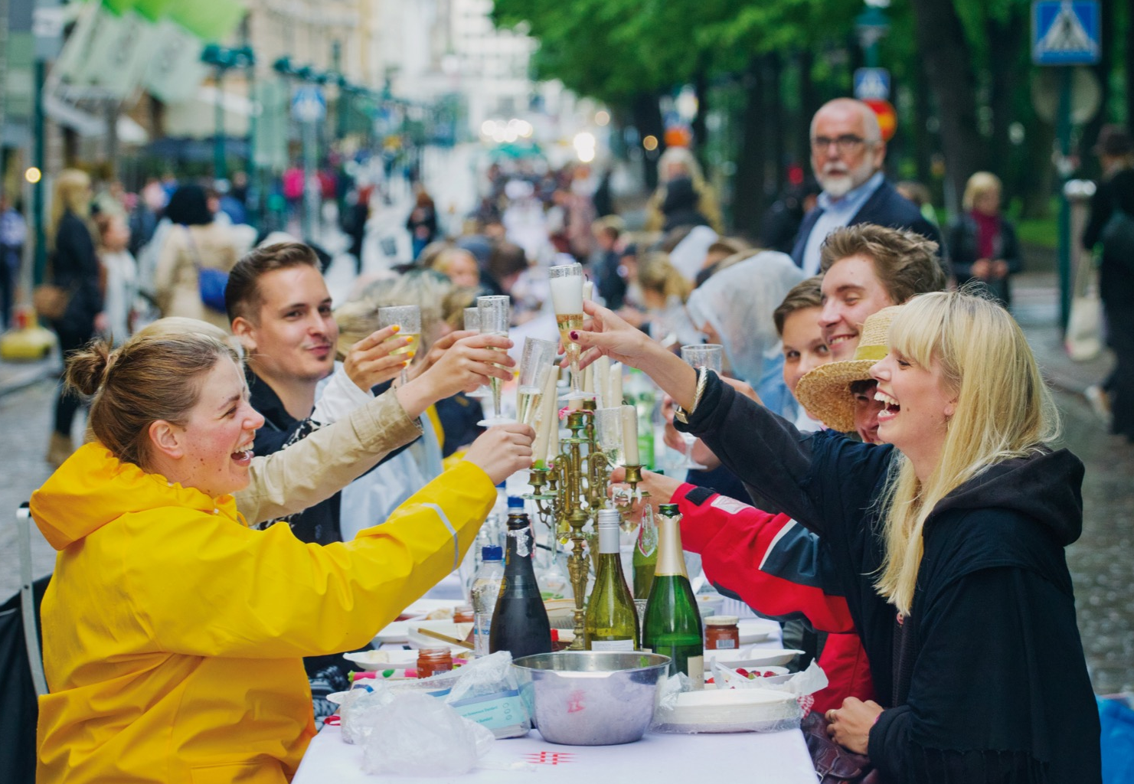
Join us in celebrating our first centenary.

