Slide 1
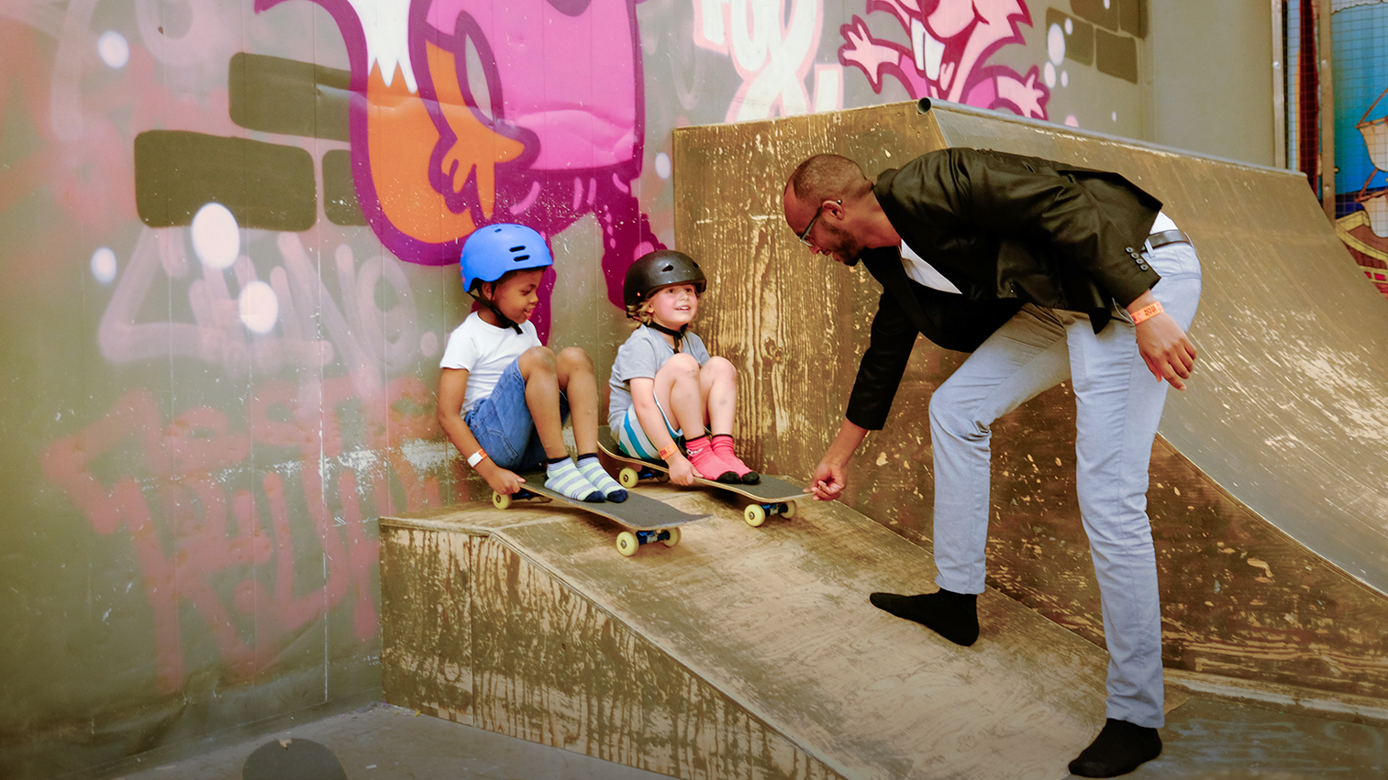
Finland, a cool Arctic country
Photo: Arctic Snow Hotel, Sinettä, Rovaniemi
Photo: Hannu Huhtamo, Ministry of Social Affairs and Health

Slide 2
To celebrate Finland’s 100 years of independence in 2017 the Government of Finland established the International Gender Equality Prize.
The prize is awarded biennially – the next time will be in 2019.
2
2

Slide 3
THE PURPOSE OF THE PRIZE
The primary goal of the International Gender Equality Prize is advancing gender equality across the world.
The recipient of the prize is given an opportunity to identify an issue or action that advances equality for allocation of the prize amount.

Slide 4
The award is apolitical, and is granted by the Prime Minister’s Office based on the recommendation of an independent prize committee.
Suggestions can be submitted on the website genderequalityprize.fi from October 25 to December 31, 2018.

Slide 5
PRIZE RECIPIENT & PROCESS
The prize will be awarded to a distinguished defender and builder of equality. The winner will identify a cause, an innovative endeavor or action to which the recipient grants the prize amount of the International Gender Equality Prize.
The prize recipient will be announced in autumn 2019.

Slide 6
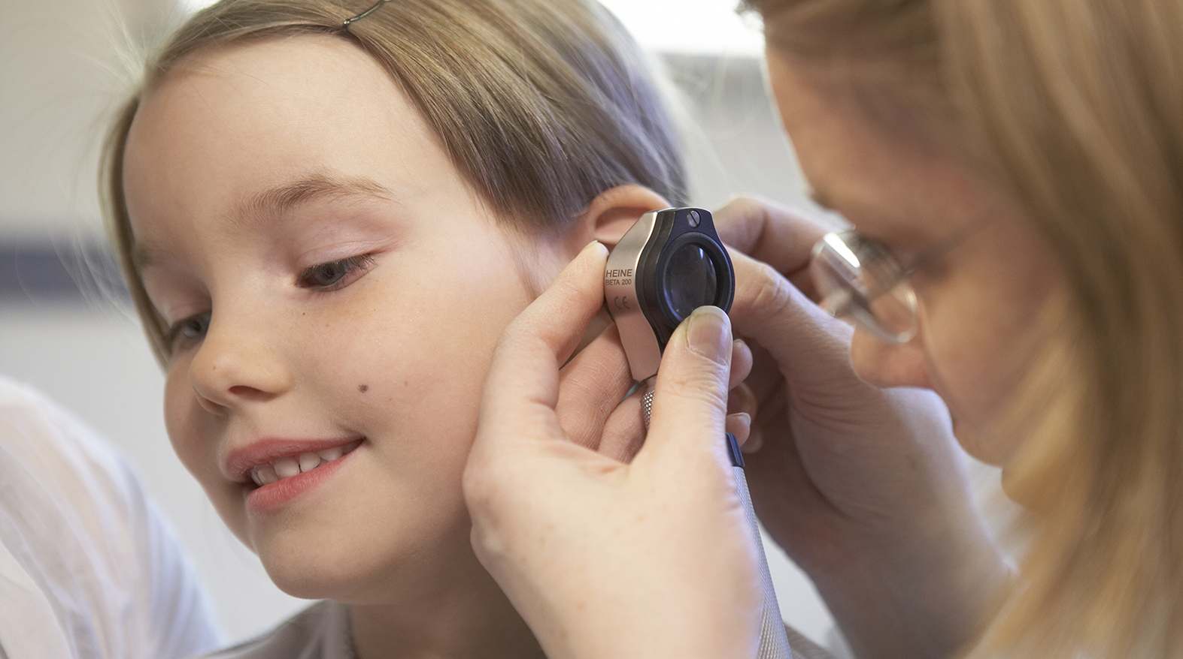
WHY FINLAND?
Photo: Plugi Oy

Slide 7
1. WHY FINLAND?
Finland was the first country to give full political rights to women in
1906.
Gender equality has been one of our fundamental values ever since.
Finland’s official girl power emoji
Illustration: ThisisFINLAND.fi

Slide 8
2. WHY FINLAND?
Finland’s successes and rapid development is in part based on our ability to value equality across gender roles and definitions.
Everyone had an equal opportunity and importance in our developing society — a truth and value that we still hold dear to and can be witnessed in Finland today.

Slide 9
3. WHY FINLAND?
Our growth from one of Europe’s poorest agricultural countries to the top of all financial, social and ecological ratings is based on equality.
Finland is among the best countries in the world to be a mother and a girl, and the best-performing country in the world when it comes to human capital potential. The entire talent of our small country — not only 50% of it — is fully utilized.

Slide 10
4. WHY FINLAND?
We believe that equality is possible in all societies. That is why Finland has for many years prioritized the role and rights of women and girls in its development cooperation.
10

Slide 11
5. WHY FINLAND?
Solutions to the problems in the world will not be found without equality and including women in decision-making.
Thanks to our world-class expertise, education system and research, Finland wants to find joyful and practical solutions to both local and global challenges related to gender equality.

Slide 12
SEND YOUR SUGGESTIONS
October 25 TO DECEMBER 31, 2018 >genderequalityprize.fi
Photo: Pia Inberg, Keksi

Slide 13
LEARN MORE ABOUT THE INTERNATIONAL Gender Equality Prize
#IGEP
genderequalityprize.fi

Slide 14
LEARN MORE ABOUT Equality in FINLAND
Minister for Family Affairs and Social Services (responsible for gender equality)
Ministry of Social Affairs and Health: Gender Equality Unit
Council for Gender Equality (TANE)
Ombudsman for Equality

Slide 15
LEARN MORE ABOUT Equality in FINLAND
National Discrimination and Equality Tribunal
Employment and Equality Committee in the Finnish Parliament
Minna – Centre for Gender Equality Information
Statistics Finland: Gender Equality

