Slide 2
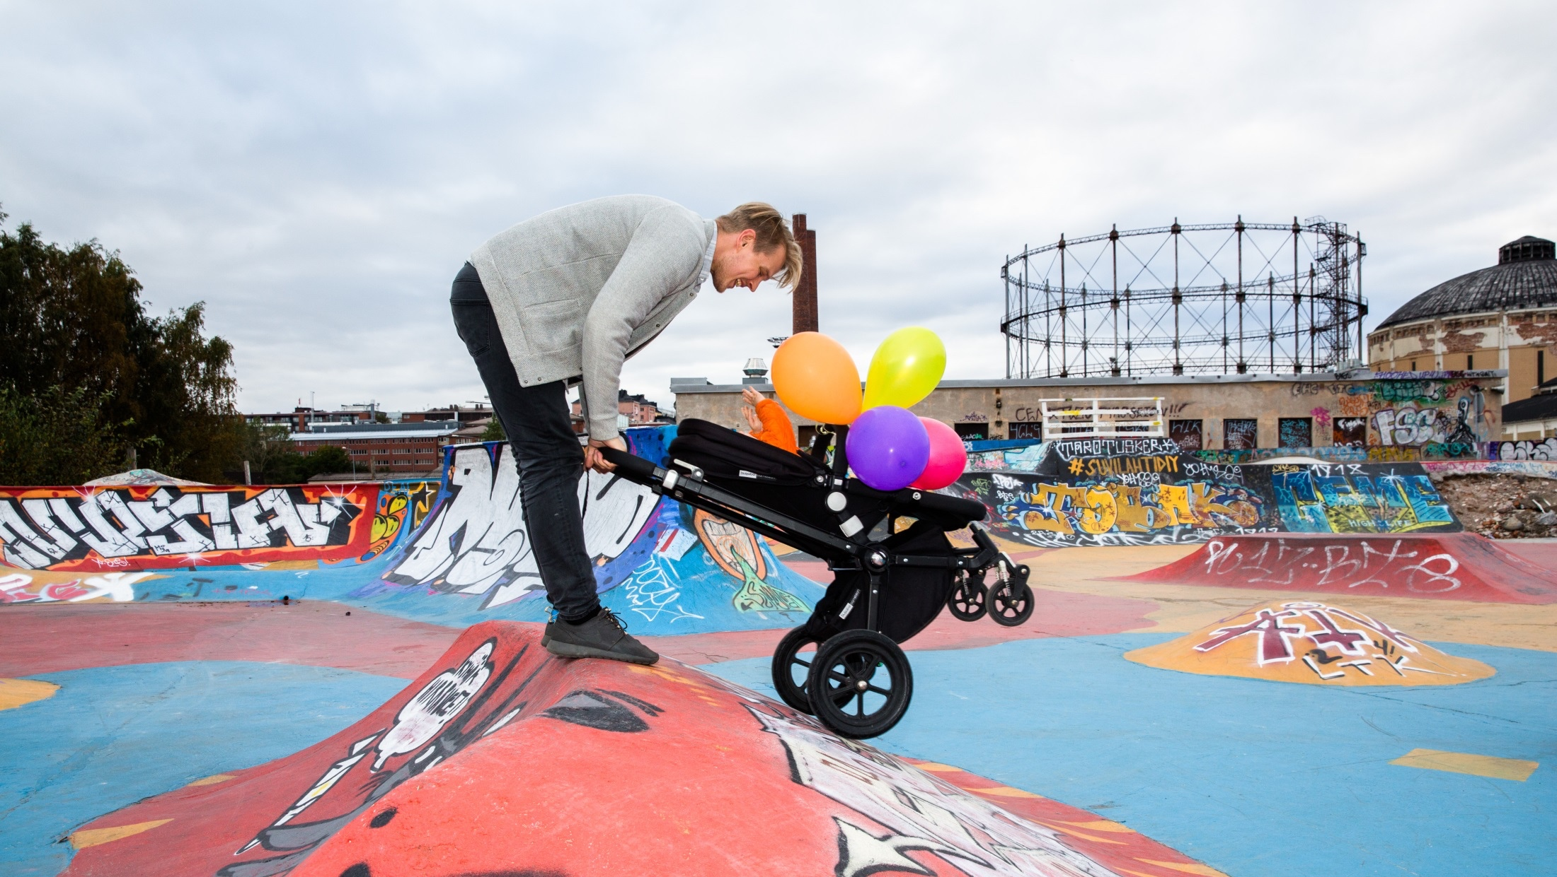
Work + LiVe in Finland

Slide 3
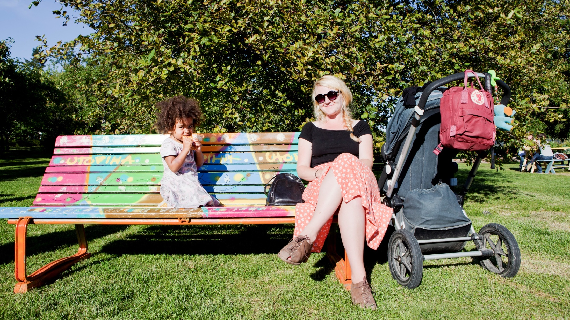
Balancing work with life is easy.
WORK + LIVE IN FINLAND / BALANCE
Notes:
FINLAND IMAGE BANK: Harvest Action & Family Market in Helsinki sadonkorjuu029.jpg MMM/ Mavi/ Heli Sorjonen

Slide 4
The 8-hour work day leaves plenty of time for family, friends and hobbies
1
ST
for good
working
hours
Finnish working hours are the most employee friendly, according to the European Company Survey.
Source: European Company Survey
WORK + LIVE IN FINLAND / BALANCE

Slide 5
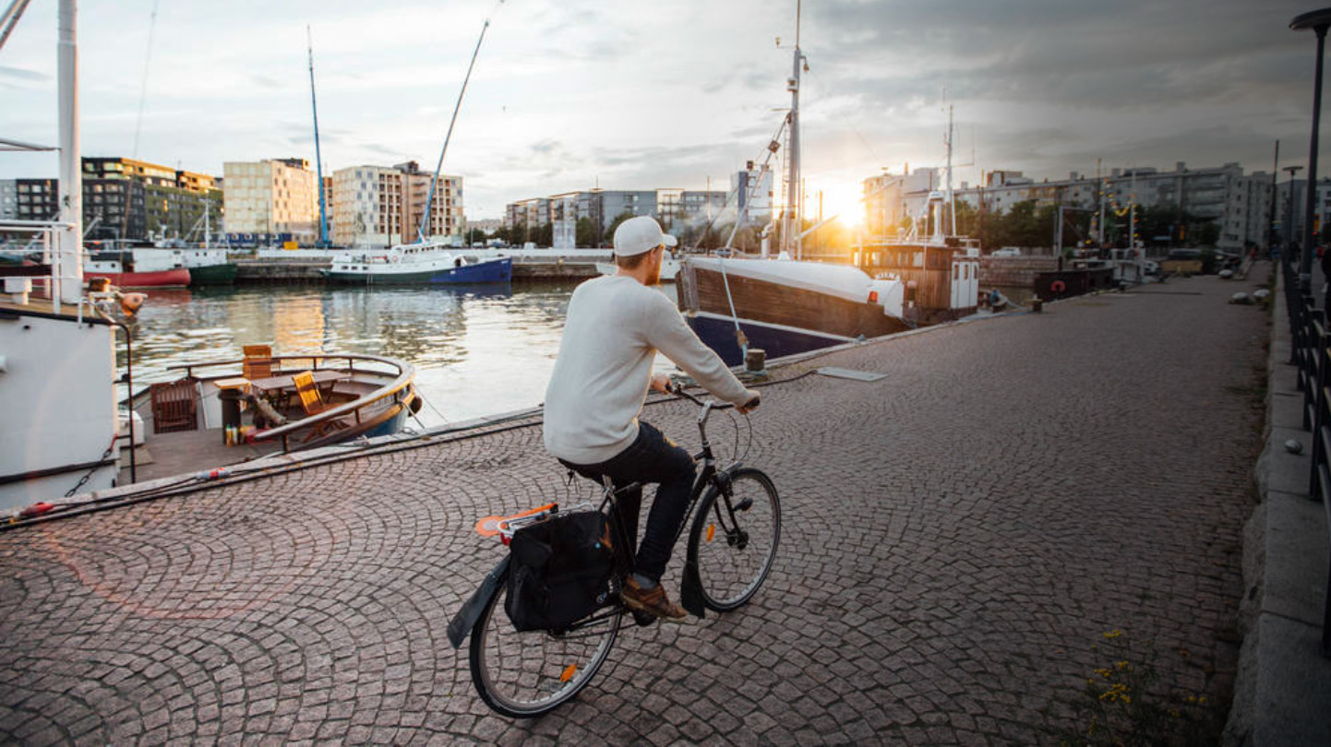
34 min
Average commute by public transport in the metropolitan area
WORK + LIVE IN FINLAND / BALANCE
Notes:
Julia Kivelä / Visit Finland Image Bank -- Finland_Helsinki_people_boats_web_by_JuliaKivela__MG_0747.jpg
Commuting is easy in Finland, with the average commute by public transport only taking 34 minutes in the metropolitan area.
Source: Statistics Finland

Slide 6
Everything just works. Even the bureaucracy
Example?
Helsinki is trialing a service
that would bring most services
needed by international newcomers
under one roof
WORK + LIVE IN FINLAND / BALANCE
Notes:
JULIA KIVELÄ / VISIT FINLAND IMAGE BANK: Finland_Helsinki_people_highres_byJuliaKivela__MG_4241.jpg

Slide 7
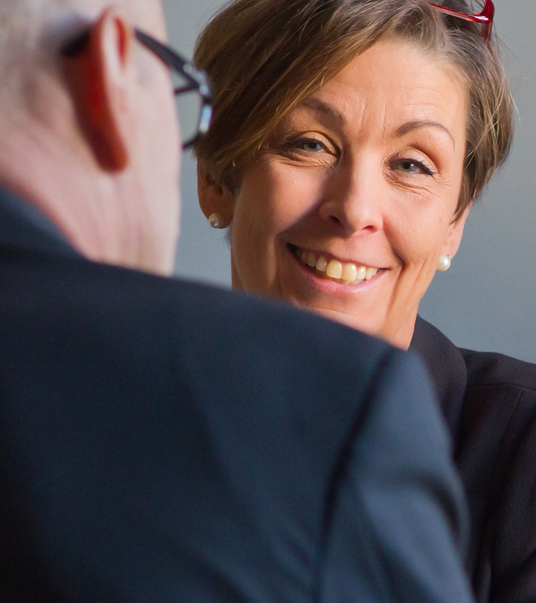
Women and men are truly equal – at home and at work
3
RD
Global
Gender
Gap Report
Finland is one of the best countries in the world for gender eguality, according to the World Economic Forum’s Global Gender Gap Report 2017.
Source: World Economic Forum
WORK + LIVE IN FINLAND / BALANCE

Slide 8
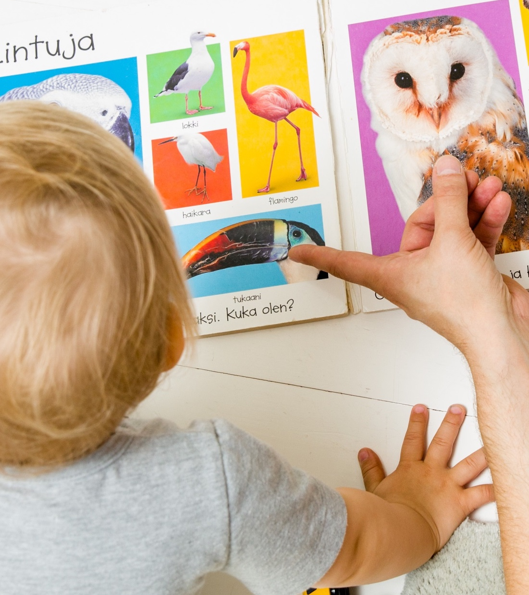
Dads in Finland spend more time with their kids than anywhere else
1
ST
For time dads spend with children
Finland is the only country in the developed world where dads spend more time with school-aged children than mothers.
Source: OECD
WORK + LIVE IN FINLAND / BALANCE
Notes:
Visit Finland Image Bank / Fishing_ Kuopio.jpg

Slide 9
Paid maternity, paternity and parental leave are guaranteed by law – and encouraged
80%
Of dads go on
paternity
leave
Men and women are entitled to paternity, maternity or parental leave, and expats can usually take the same leave.
Source: Kela
WORK + LIVE IN FINLAND / BALANCE
Notes:
Julia Kivelä / Visit Finland Image Bank -- Finland_Helsinki_people_boats_web_by_JuliaKivela__MG_0747.jpg
Commuting is easy in Finland, with the average commute by public transport only taking 34 minutes in the metropolitan area.
Source: Statistics Finland

Slide 10
Did we mention we’ve been voted the best country for expat families?
WORK + LIVE IN FINLAND / BALANCE
Notes:
Visit Finland Image Bank / G73487.jpg

Slide 11
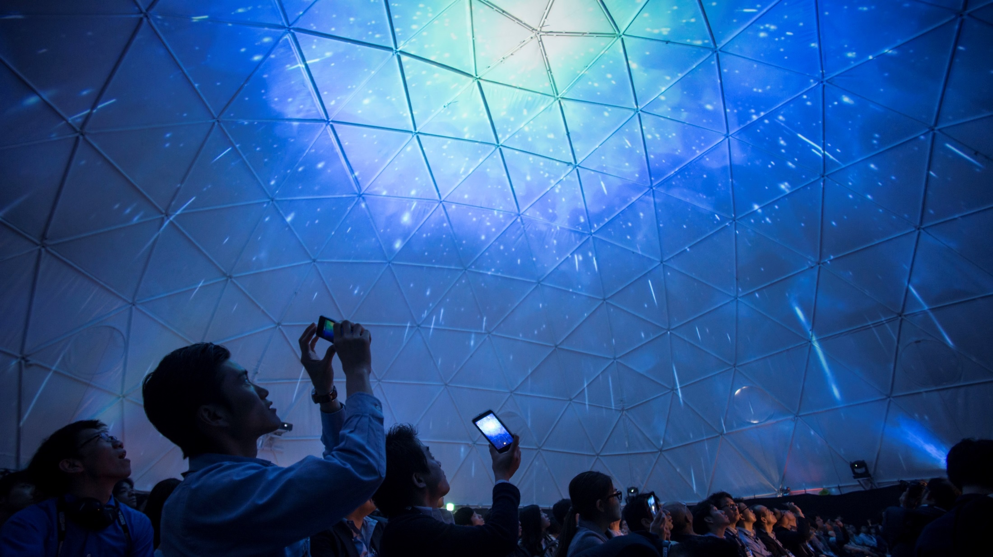
We’re the poster child for education – and innovation.
WORK + LIVE IN FINLAND / EDUCATION AND INNOVATION
Notes:
FINLAND IMAGE BANK: Slush Japan 2015 Slush_Japan_2015 (5).jpg Petri Artturi Asikainen/Team Finland/Finland Promotion Board

Slide 12
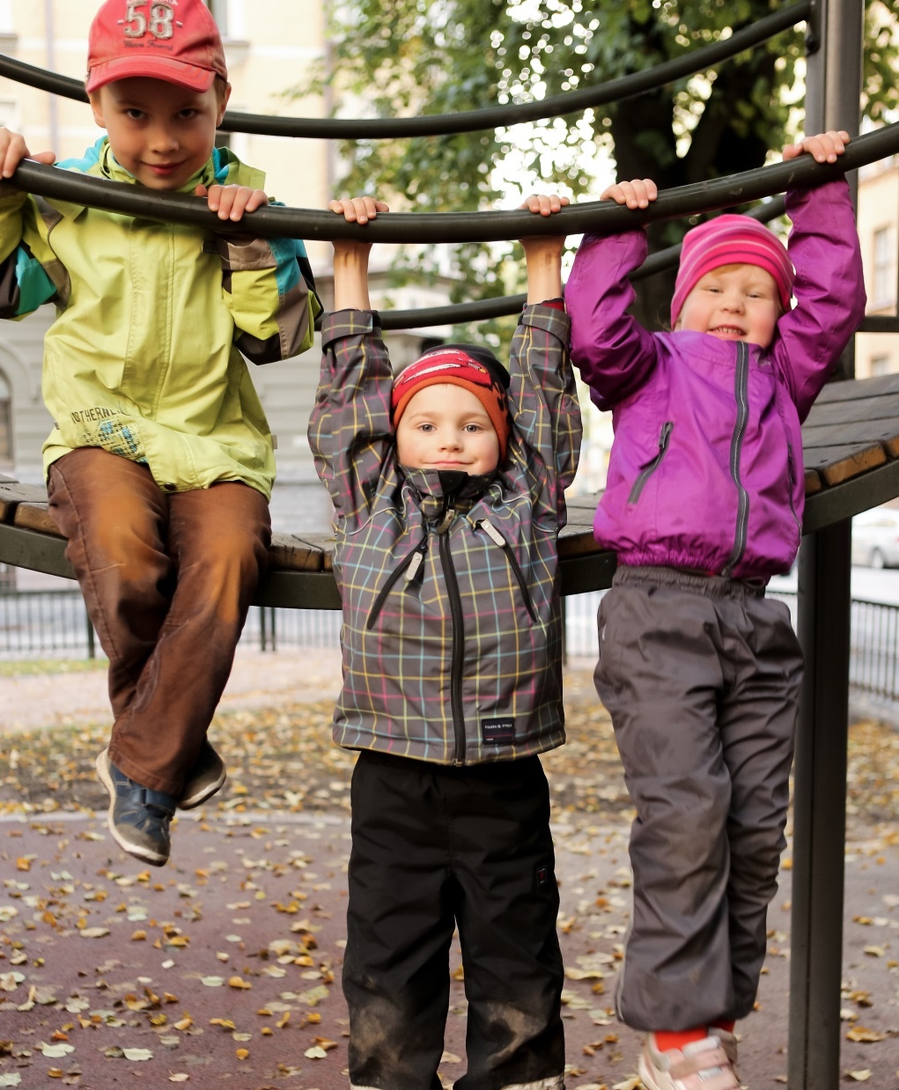
Our schools are some of the best in the world – and they’re free
WORK + LIVE IN FINLAND / EDUCATION AND INNOVATION

Slide 13
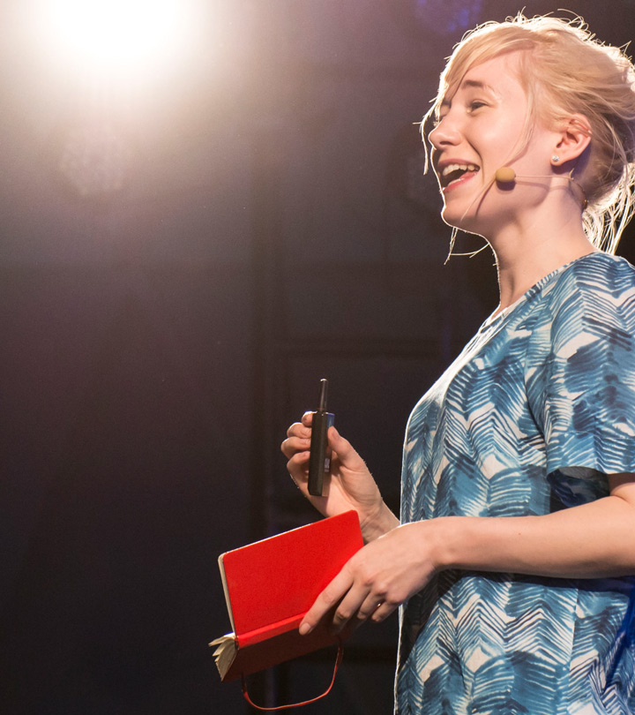
We also invest in lifelong learning
1
ST
For
skills development at work
According to the European Working Conditions Survey, Finns have the best opportunities in Europe to develop their skills at work.
Source: European Working Conditions Survey
WORK + LIVE IN FINLAND / EDUCATION AND INNOVATION
Notes:
Visit Finland Image Bank / Fishing_ Kuopio.jpg

Slide 14
University students and academics are encouraged to think outside the box – and solve global problems
Example?
Helsinki Challenge awards the most radical science-based solutions to the UN Sustainable Development Goals.
WORK + LIVE IN FINLAND / EDUCATION AND INNOVATION
Notes:
Harri Tarvainen / Visit Finland Image Bank –
HKI_8M0A5254.jpg

Slide 15
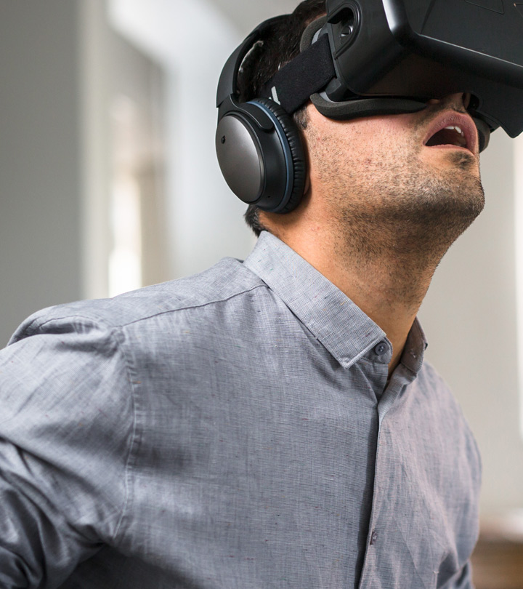
Cooperation between universities and businesses is seamless, creating a strong innovation ecosystem
1
ST
For
R&D personnel
Finland has most professionals working
in R&D in proportion
to population
Source: Bloomberg Innovative Countries 2015
WORK + LIVE IN FINLAND / EDUCATION AND INNOVATION
Notes:
Visit Finland Image Bank / Fishing_ Kuopio.jpg

Slide 16
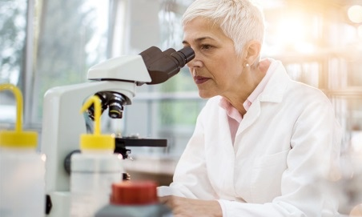
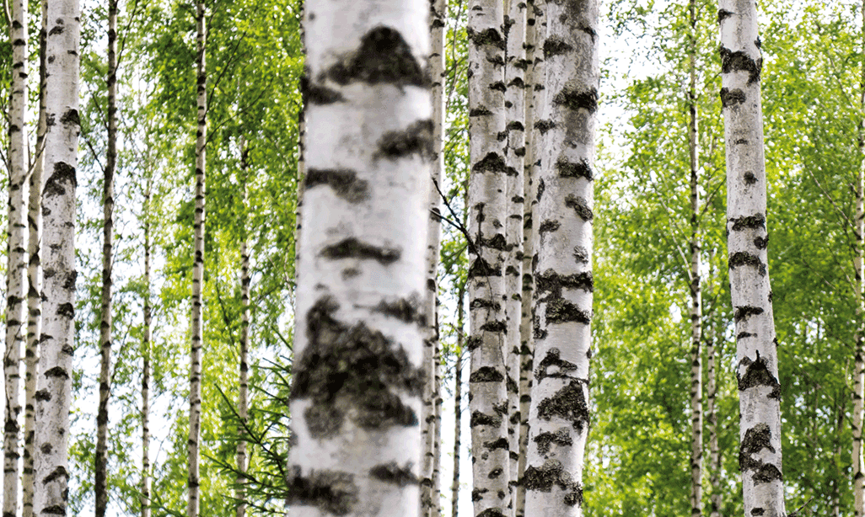
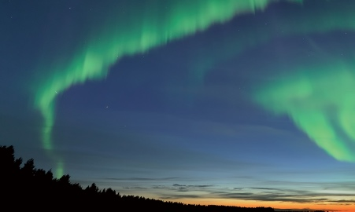
In fact, we’re leading the game in plenty of exciting fields
ICT & DIGITALIZATION
HEALTH & WELLBEING
CLEANTECH
BIOECONOMY
TRAVEL
WORK + LIVE IN FINLAND / EDUCATION AND INNOVATION

Slide 17
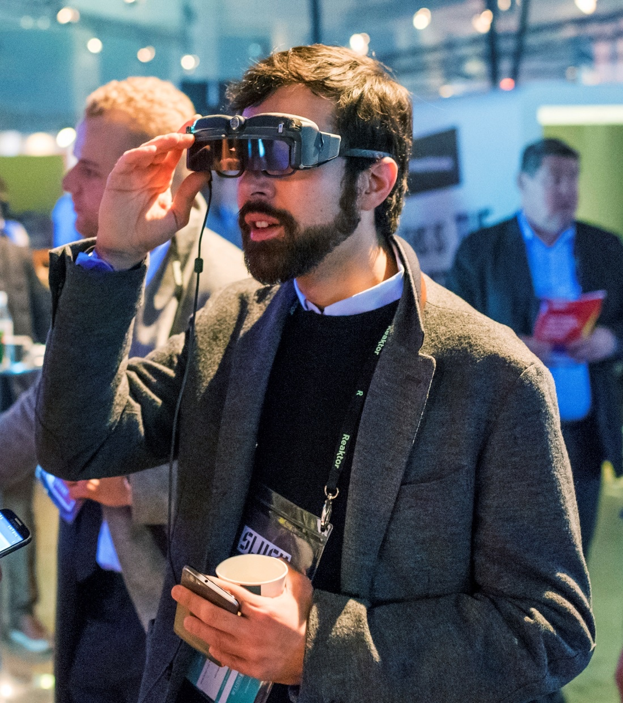
We’re even helping startup entrepreneurs to set up in Finland – by launching a startup visa
WORK + LIVE IN FINLAND / EDUCATION AND INNOVATION
Notes:
Mikael Ahlfors / Finland Image Bank --- MikaelAhlfors_Keksi_Slush2016-7570.jpg

Slide 18
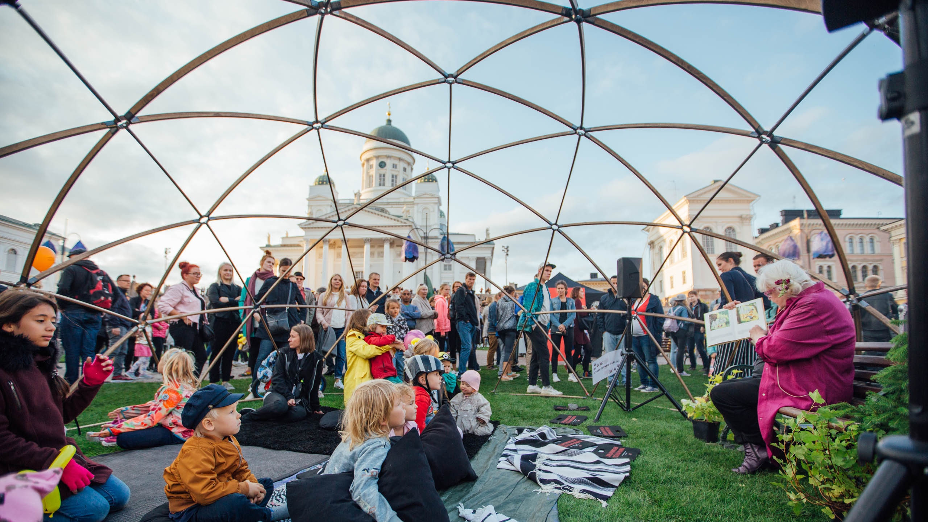
Nature or cities – we’ve got them both.
WORK + LIVE IN FINLAND / NATURE AND CITIES
Notes:
VISIT FINLAND IMAGE BANK: Finland_Helsinki_events_Juhlaviikot_TheNightOfArts_web_byJuliaKivela__MG_1317.jpg Julia Kivelä

Slide 19
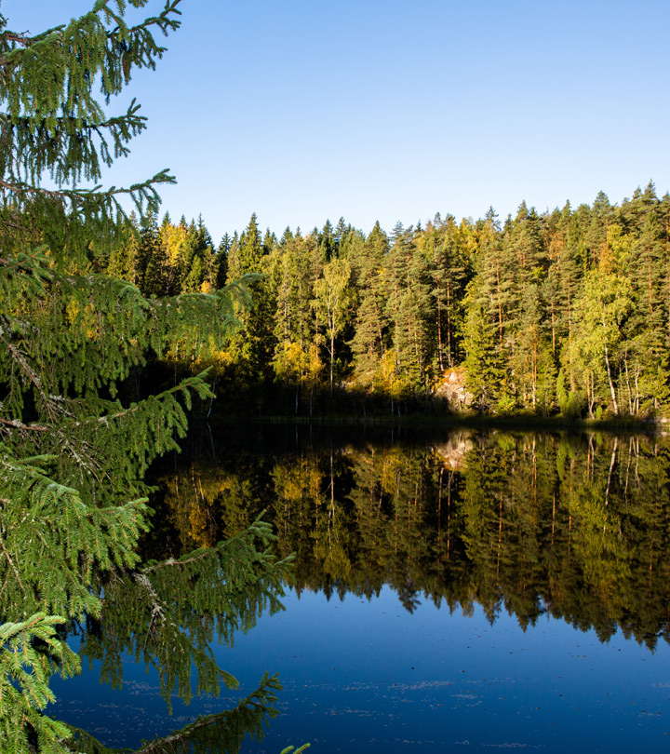
In Finland you’re always surrounded by nature
1
ST
GREENEST
COUNTRY
IN THE WORLD
According to the Environmental
Performance Index, Finland is
the greenest country in the
world. Finland’s top ranking is
mostly based on country’s
societal commitment to achieve
carbon-neutral society that
does not exceed nature’s
carrying capacity by 2050.
Source: Yale University
WORK + LIVE IN FINLAND / NATURE AND CITIES
Notes:
Visit Finland Image Bank / Fishing_ Kuopio.jpg

Slide 20
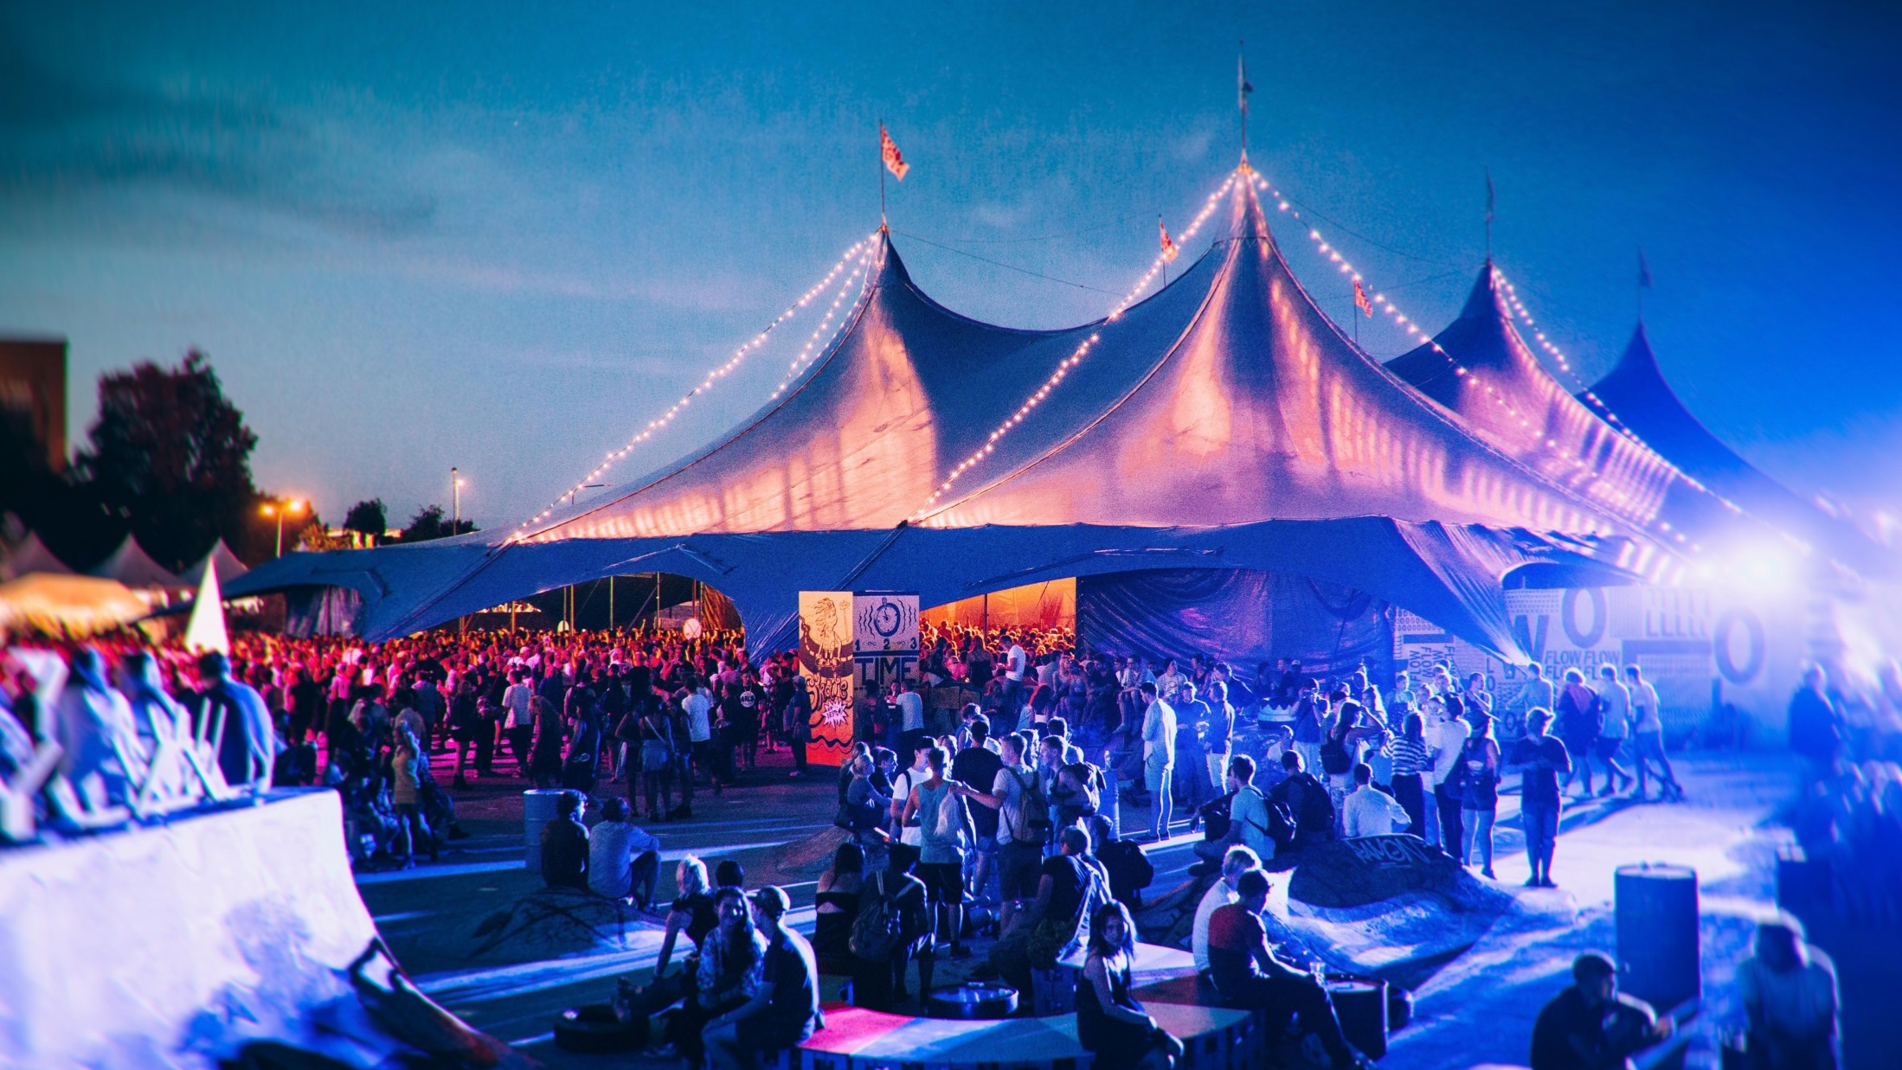
But we’ve got plenty of festivals too, if that’s your thing
WORK + LIVE IN FINLAND / NATURE AND CITIES
Notes:
Flow feelings by Jussi Hellstén 20140808_2240__MG_6986-Edit_4362.jpg Jussi Hellstén / Visit Helsinki

Slide 21
Everyone can build their city. Local communities create events, are involved in designing suburbs – and even set up their own sauna
Example? Restaurant Day grew from a grassroots movement, where ordinary people served up delicious dishes from pop-up stalls, to the world’s biggest food carnival. In 2016, there were more than 1200 pop-ups in 29 countries.
WORK + LIVE IN FINLAND / NATURE AND CITIES

Slide 22
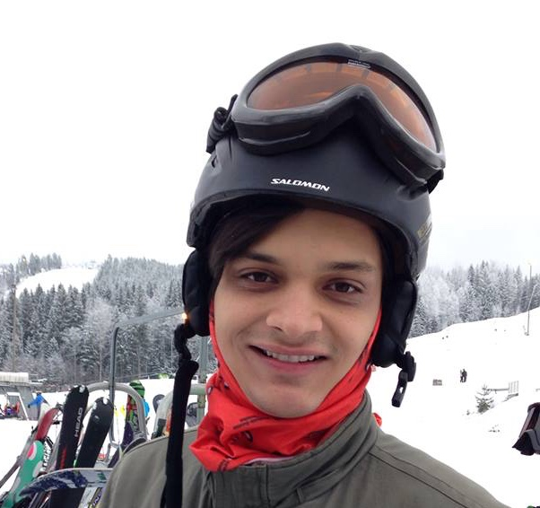
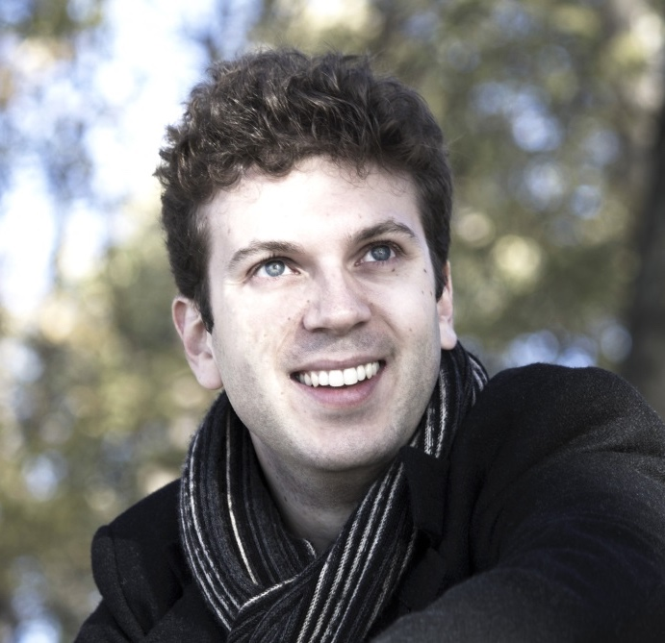
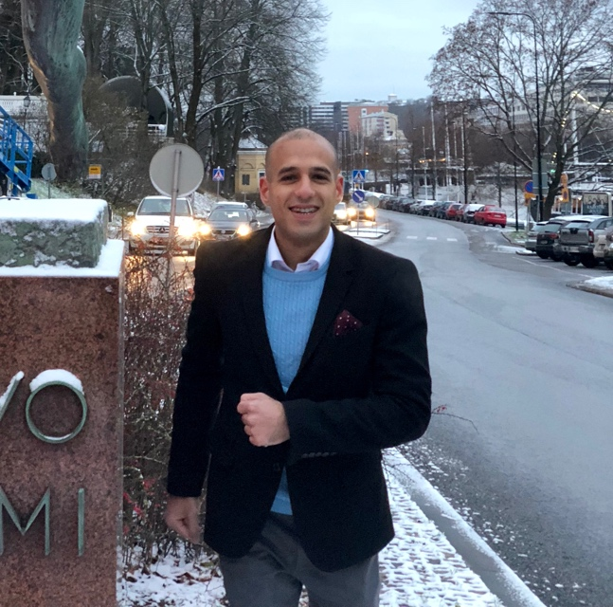
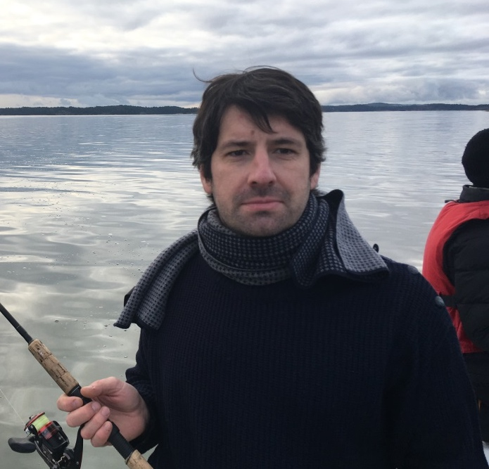
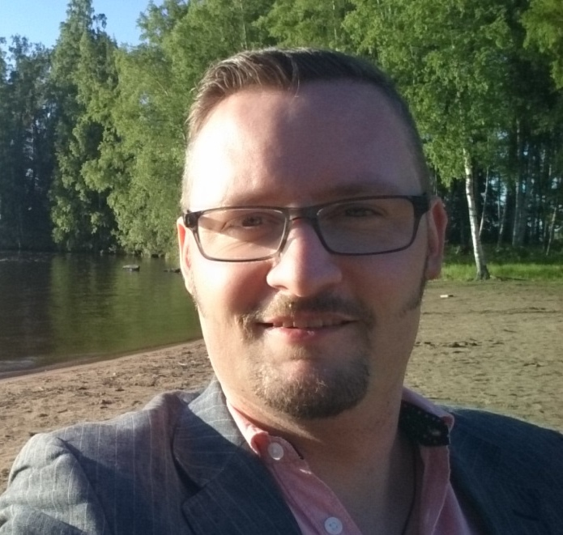
But don’t just take our word for it
WORK + LIVE IN FINLAND / TESTIMONIALS
Notes:
VISIT FINLAND IMAGE BANK: Finland_Helsinki_events_Juhlaviikot_TheNightOfArts_web_byJuliaKivela__MG_1317.jpg Julia Kivelä

Slide 23
“Turku has the perfect environment to help you develop and focus on your true talent.” Tarek, Egypt Dentist/Doctoral Candidate
WORK + LIVE IN FINLAND / TESTIMONIALS

Slide 24
“One of the most attractive attributes about Finland is the welfare system; and welfare is all about providing options not restricting opportunities.” Natalia, Mexico Co-founder and CEO, Deputy Councilor
WORK + LIVE IN FINLAND / TESTIMONIALS

Slide 25
“Everything started when I met a woman who soon became my wife – she happened to be a Finn. After living for two years in Brazil, we decided to move to Finland. Tampere is an incredible city, a vibrant environment full of interesting people, students and everything here seems to be different. The streets are safe at any time of the day.” Francisco, Brazil Student
WORK + LIVE IN FINLAND / TESTIMONIALS

Slide 26
“The best things about Finland for an expat are the many opportunities to pursue great ideas. I also think Finns and Finnish society are very accepting if you are a foreigner.” Miriam, Georgia Specialist
WORK + LIVE IN FINLAND / TESTIMONIALS

Slide 27
“I studied part of my undergraduate degree in Finland, just outside Hämeenlinna in 2004. During my studies I traveled all over Finland, from Kotka to Rovaniemi. I decided then that one day I would like to live in Finland.” Ashley, UK Landscape architect
WORK + LIVE IN FINLAND / TESTIMONIALS

Slide 28
“I like to compare Tampere to the first time I tried a Marianne mint. I thought it was just a standard mint, but then it burst in my mouth. That is how I like to see Tampere. It might look like any other city, but once you start paying more attention, you realize how great it is.” Pedro, Portugal Design and Research Engineer
WORK + LIVE IN FINLAND / TESTIMONIALS

Slide 29
“The main things that brought me to Finland were the country’s well-educated population, high level of security, lack of corruption, and smoothly working processes. I wanted to surround myself with highly educated individuals in an environment where things just work like they are supposed to.” Helin, Turkey Student
WORK + LIVE IN FINLAND / TESTIMONIALS

Slide 30
“I speak Finnish pretty well – every day.” David, Spain Researcher, CEO
WORK + LIVE IN FINLAND / TESTIMONIALS

Slide 31
Build a life around your career – in Finland.

