Slide 1


FINLAND –
TECHNOLOGY
SUPERPOWER

Slide 2
FINLAND –
GATEWAY BETWEEN
EAST AND WEST
Notes:
As the fastest route between Northern Europe and Asia, Helsinki Airport is an increasingly popular gateway also to the Far East.
The transfer times on Finnair flights between Europe and Asia are designed to suit business travellers.

Slide 3



Business opportunities in high tech and services
ICT and Digitalization
Travel &
Tourism
Bioeconomy
Cleantech
Health
Kick start your
bio-based business.
Greenest country
in the world.
A living lab
for global cures.
Brainpower for your next big thing.
Fast growing, safe and sustainable business environment
3

Slide 4
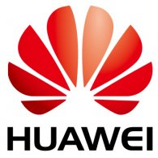

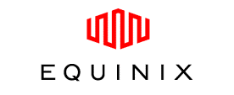
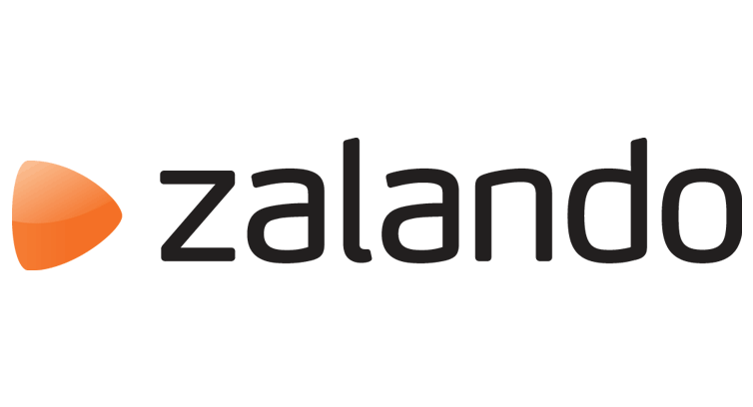
Finland accelerates business digitalization
Global giants look innovative solutions for their complex high tech needs in Finland.
Huawei’s R&D center has grown by tenfold in eight years
GE Health’s global wireless device centre of excellence is located in Finland.
Operating already six carrier-neutral data centres within the metropolitan area.
Online fashion retailer transforms into a mobile powerhouse by opening its tech office in Finland.
4

Slide 5
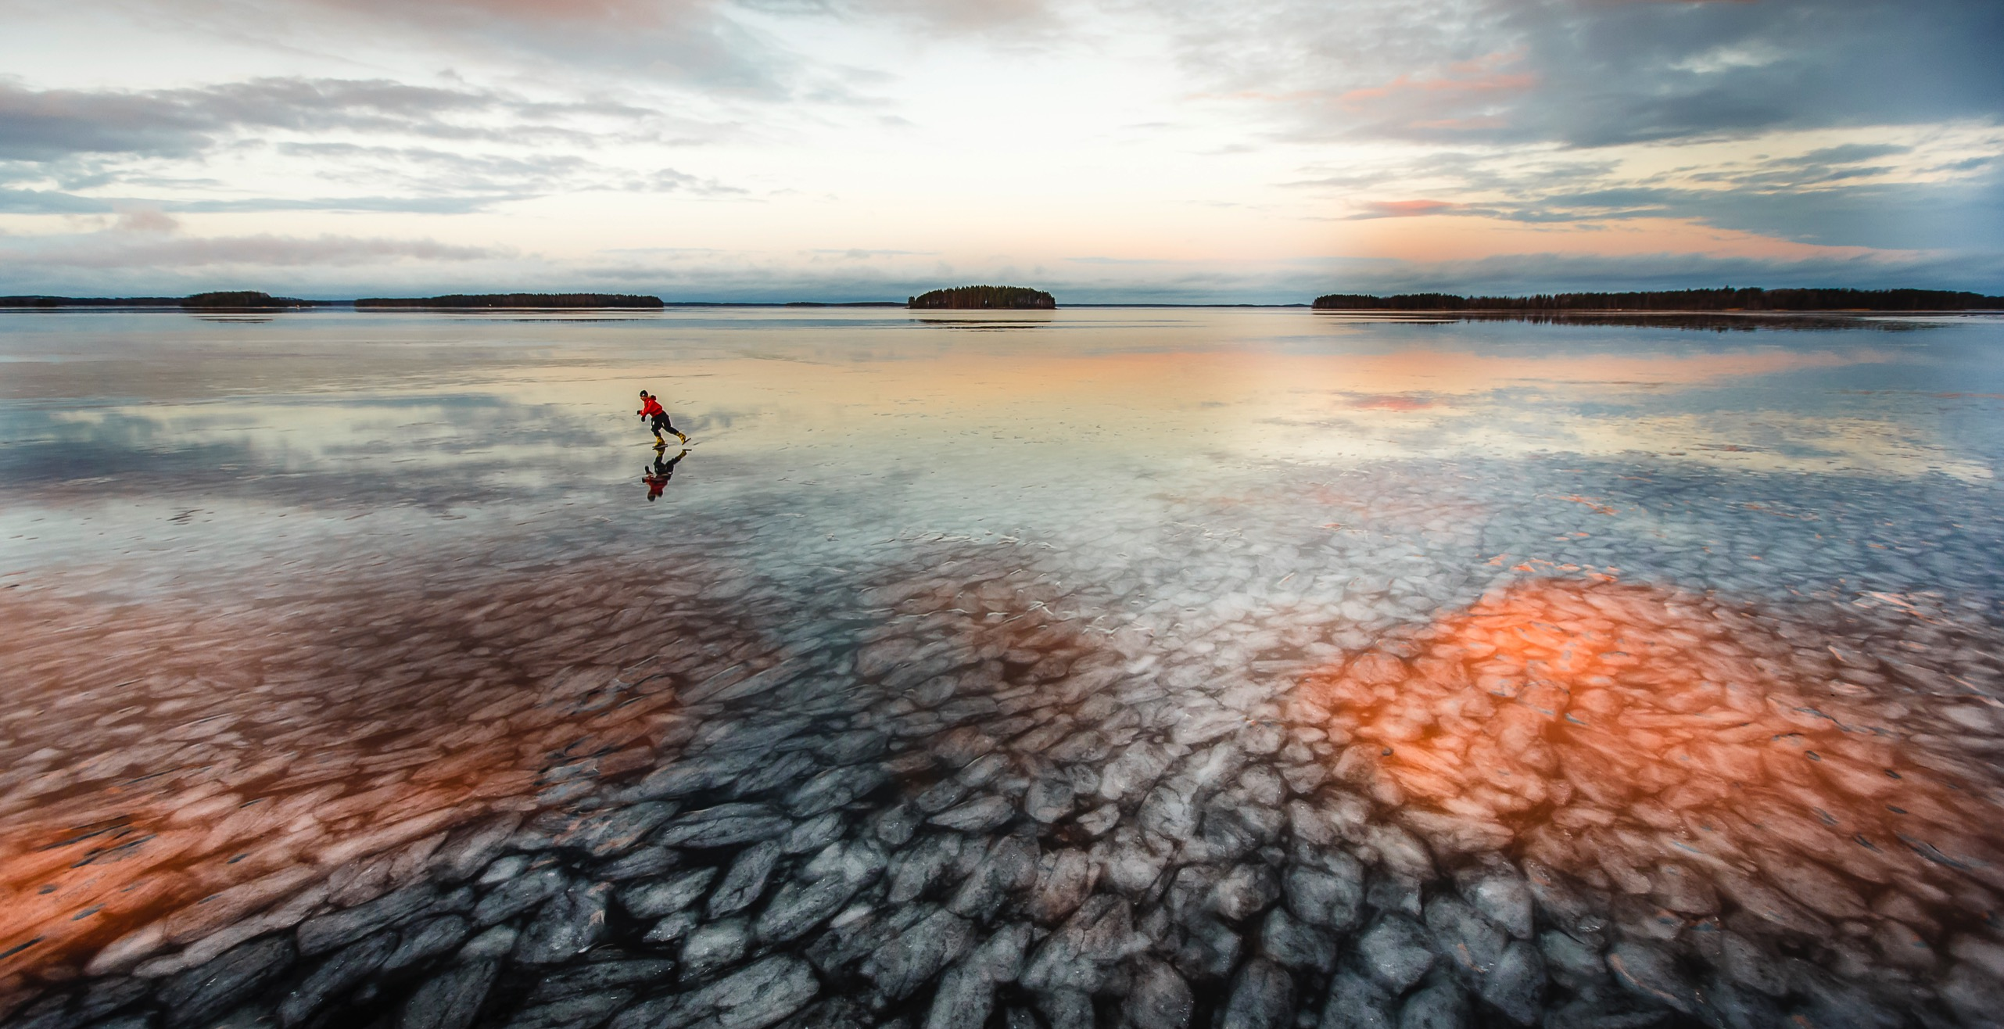
Facts about finland
5
Notes:
5th best in the world in English Proficiency Index for Companies
Source:Education First (EF) 2016

Slide 6
500 million consumers within easy reach
11.4.2018

Slide 7

WHY FINLAND
LOW
OPERATIONAL COSTS WITH
HIGLY RELIABLE INFRA
TOP QUALITY BUSINESS ENVIRONMENT
FAST START
FOR BUSINESS OPERATIONS
FASTEST
EUROPE-ASIA CONNECTIONS
VIBRANT
STARTUP
SCENE
THE MOST
STABLE
COUNTRY IN
THE WORLD
HIGH QUALITY
OF LIFE FOR EXPATS
COMPETENT PROFESSIONALS
CREATIVE SOLUTIONS
7
Notes:
Finnish business environment – efficient, stable, predictable
Supports the companies to have Fast and smooth set-up of business operations
Competitive environment for the companies in Finland through low operational costs.
And not the least, the high quality of life for expats, noted by the expats themselves
Top quality business environment
Fast start for business operations
Low operational cost and fast connections
High quality of life for Korean expats
COMPETENT PROFESSIONALS
Highly educated workforce
Efficient knowledge transfer between business and universities
CREATIVE SOLUTIONS
Unconventional solutions to conventional problems
One of the global innovation hotspots
STABLE SOCIETY
FINLAND HAS BEEN RANKED THE MOST STABLE COUNTRY IN THE WORLD FOR 7 YEARS IN A ROW.
(The Fund For Peace - Fragile States Index)
Effective social infrastructure and governance system
Country where everything works
FASTEST EUROPE-ASIA CONNECTIONS
Fastest air route between Asia and Northern Europe
Extensive logistics services to support
East-West trade

Slide 8

WHY FINLAND
THE BEST
university –
industry
research
collaboration
in the world *1
THE BEST
primary
education
in the world *2
THE
HAPPIEST
country in
the world *8
3RD BEST
economic environment for business growth in the world *5
THE BEST
destination
in eu for
international
business
expansion *3
3RD MOST
professionals working in
research and development, relative to the population *6
THE BEST
business
environment
in the world *1
THE BEST
in the
world in
innovation *9
THE MOST
stable
country
in the
world *4
5TH BEST
english skills among the
adults in
the world *7
1 Global Innovation Index 2016 / 2 World Economic Forum, The Global Competitiveness Report 2016-2017 / 3 FDI attractiveness scoreboard, Copenhagen Economics 2016
4 The Fund for Peace, Fragile States Index 2016 / 5 Grant Thornton, Global Dynamism Index 2015 / 6 Bloomberg, Bloomberg 2017 Innovation Index
7 Education First (EF), The world's largest ranking of countries by English skills / 8 UN 2018 World Happiness Report / 9 The Consumer Technology Association (CTA)™ 2018
8

Slide 9

Finland is a global leader in innovation talent
9
*World Economic Forum Global Competitiveness Report 2017-2018 / **The Consumer Technology Association (CTA)™ 2018
Notes:
When compared to other countries, Finland can be considered as the global leader in R&D and innovation talent
We can offer the best access to
R&D professionals
Collaboration between universitites and industry
latest technologies.
This can be also seen in the labor market
When looking at professionals working in R&D, the number per 1 million population is 7,482 in Finland compared to 3,979 in the U.S. (Lähde: http://www.bloomberg.com/graphics/2015-innovative-countries/)

Slide 10

Talent at reasonable cost
Labour costs (salary + additional costs) of a 100-employee software development centre
10

Slide 11
Finland offers very favorable
corporate taxation
Corporate tax rates 2018
11

Slide 12

Incentives and funding sources
R&D&I INCENTIVES
by
Business Finland
BUSINESS AID
from
ELY Centres
LOANS AND
GUARANTEES
by Finnvera
DEVELOPMENT
RESEARCH FUNDING
Academy of Finland
businessfinland.fi/en
ely-keskus.fi/en
finnvera.fi/en
aka.fi/en
COMPLIMENTARY ADVISOR SERVICES FOR COMPANY EXPANSIONS TO AND
FROM FINLAND
by Business Finland
TRAINING &
EMPLOYMENT
INCENTIVES
from ELY Centres
CAPITAL INVESTMENTS
from Finnish
Industry Investment
EU-funded
SUPPORT from
various sources
industryinvestment.com
businessfinland.fi/en
ely-keskus.fi/en
12
Notes:
Incentives and support for land & infra investments to companies operating in Finland is coordinated by the Centres of the Economic Development, Transport and the Environment (ELY Centres), whose 15 regional offices provide advisory, training and expert services and funding for investment and development projects. Foreign owned companies in Finland can beneﬁt from several different types of aid, mainly for Development areas 1 and 2 (please see Fig 2).
Capital investments from TESI. TESI (Finnish Industry Investment) is a 100% state owned equity investor. TESI’s mission is to invest in and develop Finland’s economic growth. It is an active minority owner who invest on the same terms as the private investors. Tesi’s share of the total investment is up to 50 %. Private investors’ share needs to be at least 50 %. Investment criteria are equal to private venture capital and private equity investors’ criteria. Tesi is an investor in major industrial companies in various segments.
Training & Employment services are offered by public service providers, such as ELY Centre’s. They offer a smooth, fast and free of charge services to cover employment and business services, such as recruitment, updating of staff skills, and training of new employees. The regional offices know the local labour force and the job market in the area. It is also free of charge to advertise open positions in ELY´s employment website, which is widely used by people living in Finland. ELY offers re-training of labor force to match with the requirements of the local companies and educates in the demand for specific skills in the area.
Direct support and funding for R&D and innovation is coordinated by Business Finland, Innovation funding for Technology and Innovation.BF funding is available for companies registered in Finland, irrespective of the beneficiary ownership. BF offers substantial incentives to support companies’ R&D activities, for example:
Grants for research and creation of new knowledge.BF grants are intended for research and development projects that generate new knowledge and competencies, but not a finished product or service at this stage. BF will pay the grant to the company in arrears, based on the reported actual costs. The BF grant accounts for 40% of total project costs at a maximum. Large companies must spend at least 40 % of total project costs on acquiring services from SMEs or research organisations, or the project must be carried out as a genuine joint project with SMEs and research groups.
Loan for development and piloting. Loan funding fromBF is advantageous for companies. At the moment, the interest rate is one per cent, and no collateral is required in most cases. If the project fails or its results cannot be commercially exploited, the loan may be partially converted into a grant. For large companies BF loan accounts for 50% of total project costs at a maximum. Large corporations must spend at least 15% of total project costs on acquiring services from SMEs or research organisations, or the project must be carried out as a genuine joint project with SMEs and research groups. As a rule, the loan period is seven or ten years, of which three or five years – even more if necessary – can be amortization-free. At the beginning of the project, 30% of the loan can be granted for the project in advance. The rest of the BF funding is paid on the basis of the actual costs.
Loans and guarantees from Finnvera. Finnvera strengthens the operating potential and competitiveness of enterprises in Finland by offering loans, domestic guarantees, export credit guarantees and other services associated with the financing of exports. The risks included in financing are shared between Finnvera and other providers of financing. Examples of services offered by Finnvera are
Finnvera can take part in financing arrangements for domestic investments that benefit exports. Eligible investments can include factory projects, project aiming at improving the level of processing or improving the yield, and projects involving logisctics and other areas of infrastructure development that helps to improve operating efficacy and competitiveness of exporting companies.
> Large corporations are eligible for receiving Finnvera’s export related domestic investments.
> General underwriting policy:
>
> * Maximum of 50% of the debt financing of the project
> * Pro-rata with other Senior Lendors
> * Maximum cover of 80% (state aid rule)
> * Repayment period max 8.5 years
>
> Finnvera’s export credit guarantees for domestic industrial investments can be obtained for investments in machinery and equipment that help to create new export business.

Slide 13

Business Finland research and development funding for companies
Business Finland funds companies’ projects that seek to increase their competitive advantage internationally.
BF requires that large companies buy services from SME’s and / or research organisations or implement the project as a joint project with them.
*The share of the bought services has to be at least 40 % of the project's overall costs.
**The share of the bought services has to be at least 15 % of the project's overall costs.
13

Slide 14
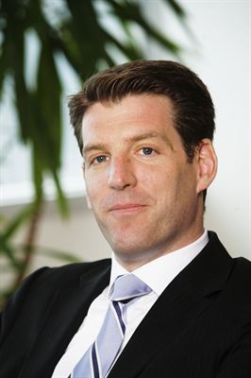
Case bayer
WHY BAYER CHOSE FINLAND FOR THEIR R&D AND MANUFACTURING SITE?
“We were impressed by the high level of talent we found in Finland.
There was a lot of talent for Bayer to choose from.”
”Finns say they are open to foreign investment and they really mean it,
and things can happen really quickly in Finland.”
”Doors to the decision-makers opened equally wide for Bayer as for local companies”
“The largest R&D unit is located in Germany, the second largest in the US,
and the third in China. Finland has the fourth largest unit, which is pretty remarkable, considering its size compared to other countries.”
Oliver Rittgen,
Head of Corporate Finance, Bayer AG, CEO of Bayer Nordic SE, 2011-2017

Slide 15

Finland Tops Family Life Index*
An impressive 72% of respondents living in Finland with their kids think that the education system is excellent, compared to a global average of 26%. Or as one of the respondents put it: “Finland is one of the best places on earth to raise kids”.
15
*Expat Insider, Family Life Index 2017
Notes:
in its fourth year, Expat Insider is one of the largest surveys worldwide offering an in-depth analysis of expat life across the globe. More than 12,500 respondents representing 166 nationalities and living in 188 countries or territories answered our questions, providing unique insights into what it means to be an expat in 2017.
In 2017, 45 countries are included in the Family Life Index. Each country has a minimum sample size of 40 respondents who are raising dependent children abroad. This index covers six different subcategories: availability of childcare & education, costs of childcare & education, quality of education, family well-being, childcare options, and options for children’s education.
NOTE: Finland won the Family Life Index also in 2016
Source: https://www.internations.org/expat-insider/2017/family-life-index-39189
An impressive 72% of respondents living in Finland with their kids think that the education system is excellent, compared to a global average of 26%. Only 56% say the same for runner-up, Singapore, putting Finland clearly in the lead. In fact, one respondent even deemed Finland “one of the best places on earth to raise kids”.

Slide 16
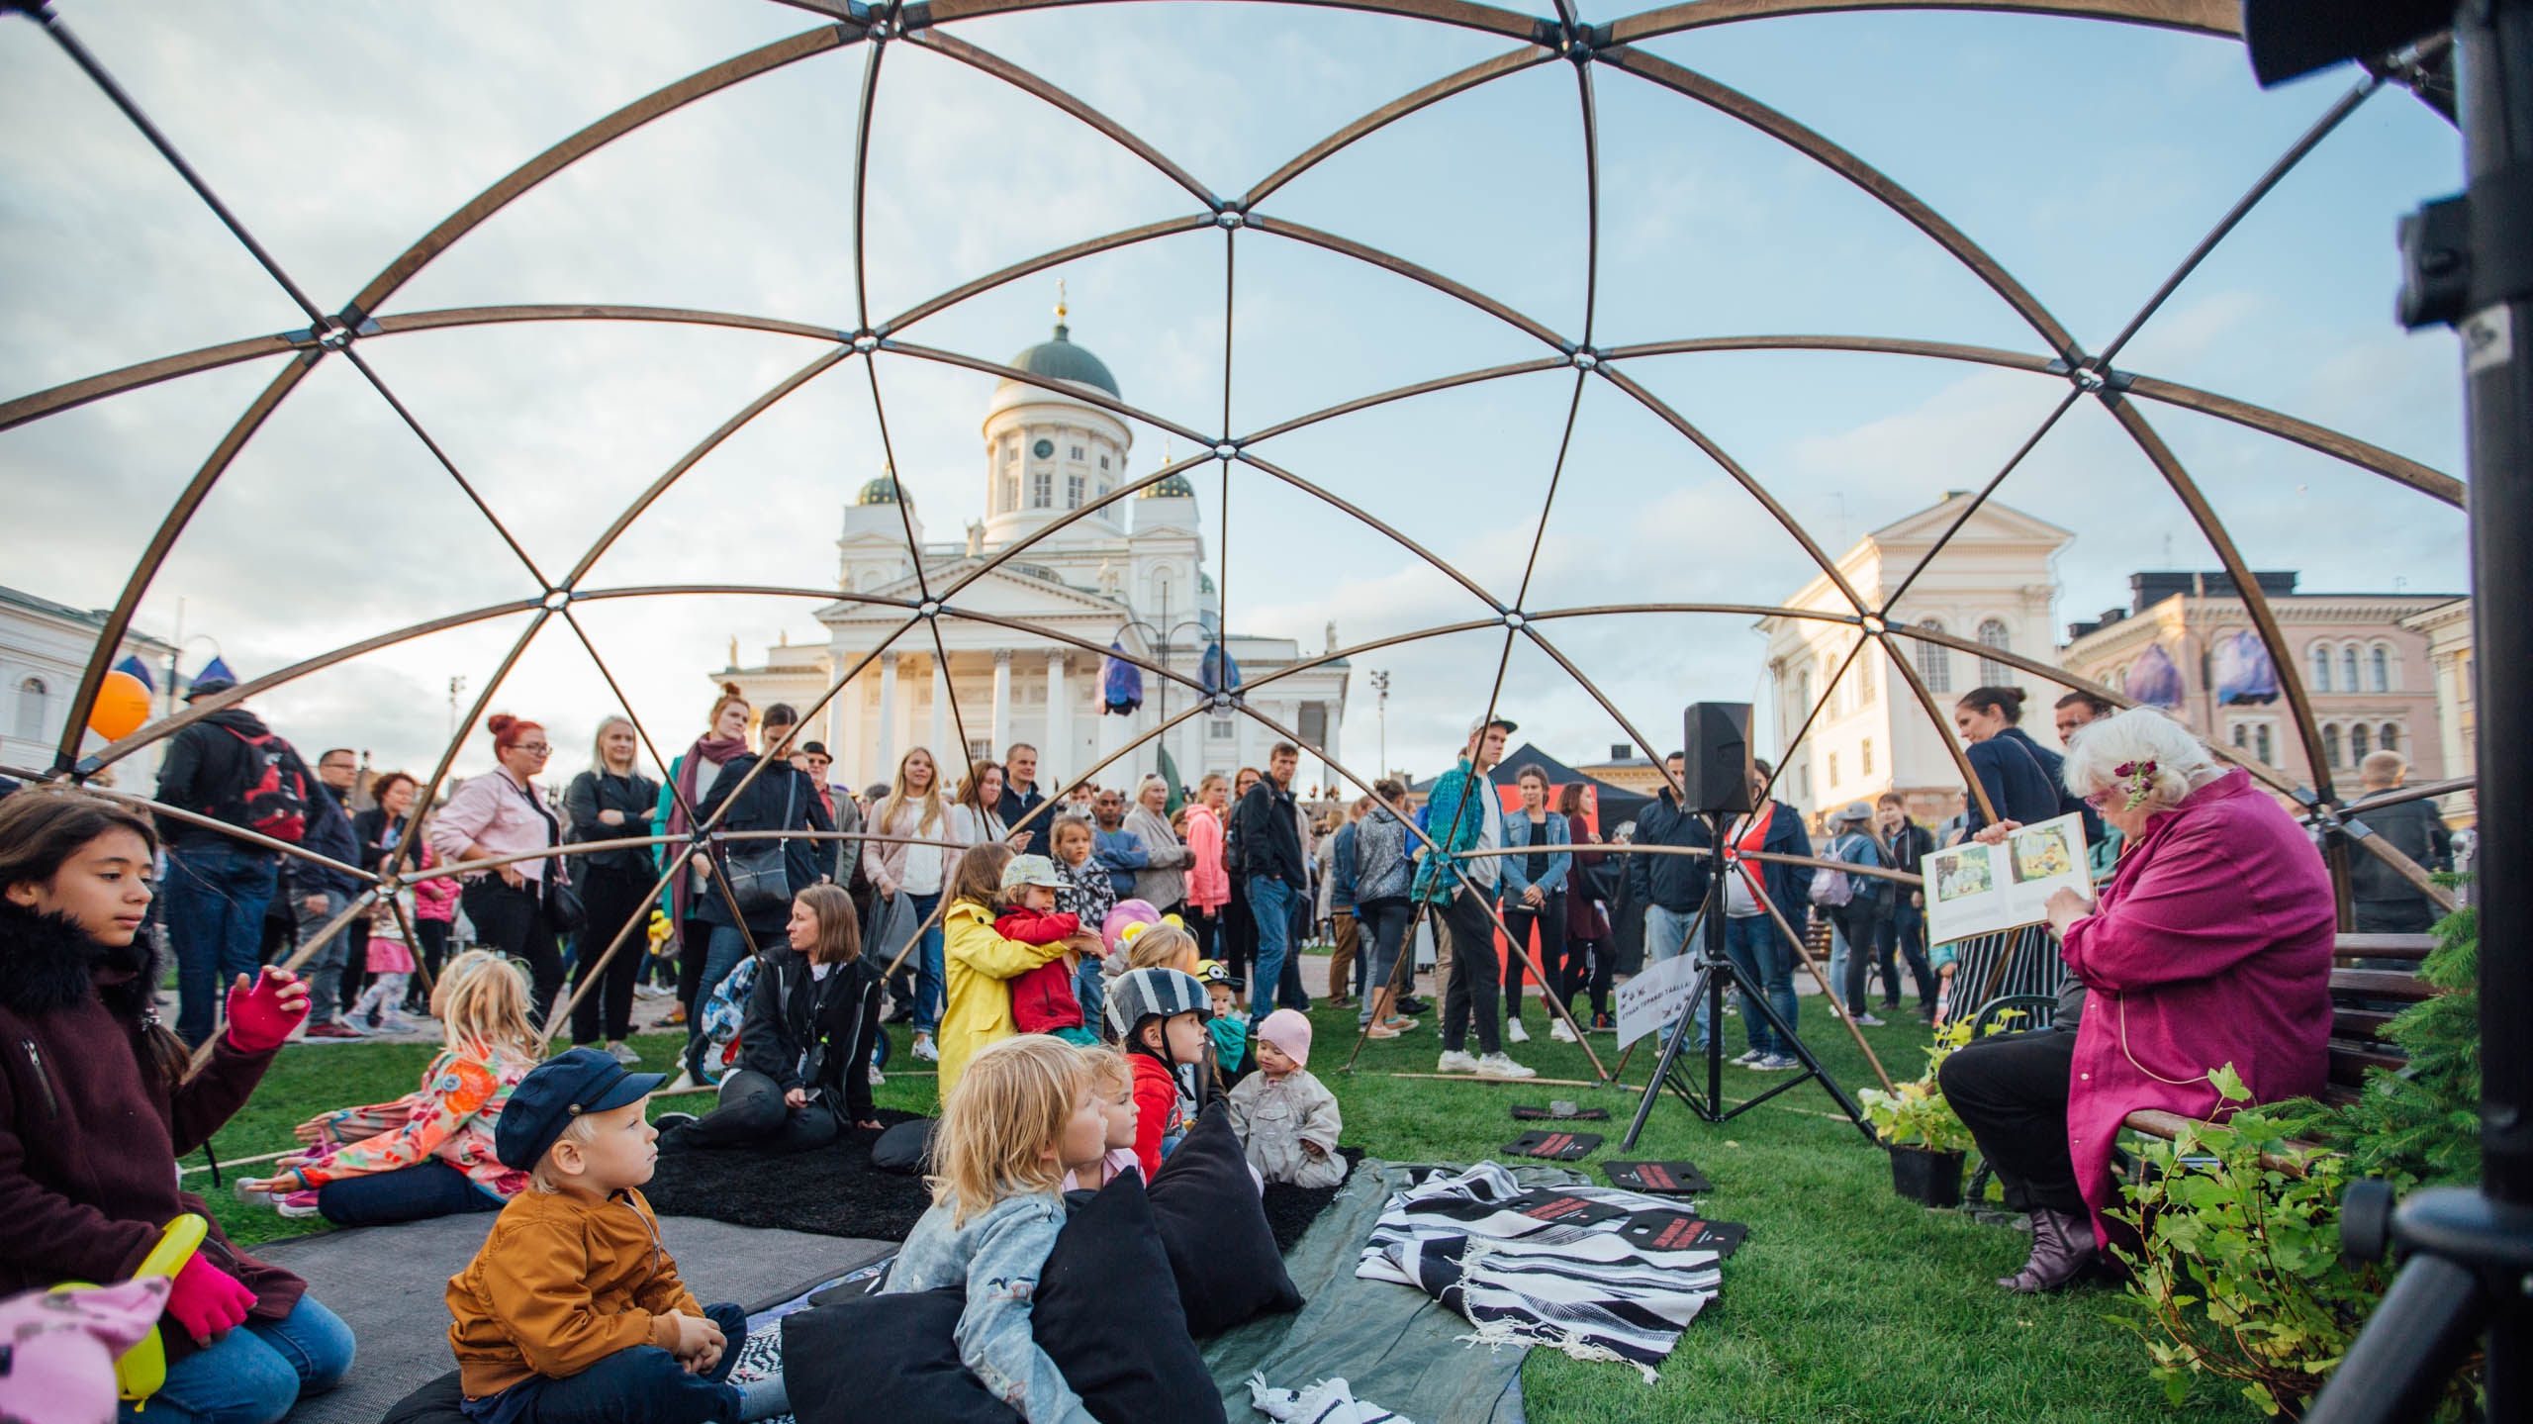
Nature or cities –
we’ve got them both.
16
Notes:
VISIT FINLAND IMAGE BANK: Finland_Helsinki_events_Juhlaviikot_TheNightOfArts_web_byJuliaKivela__MG_1317.jpg Julia Kivelä

Slide 17
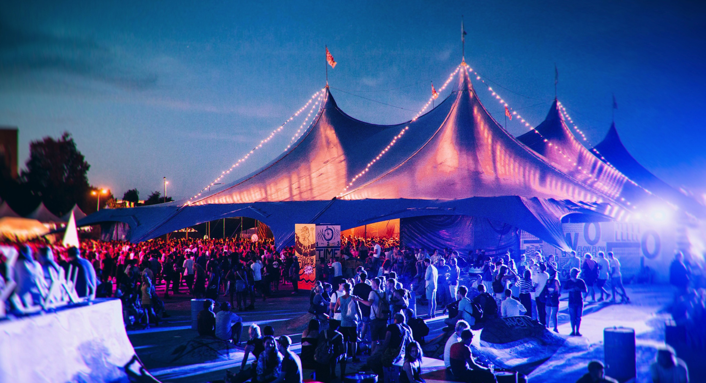
But we’ve got plenty
of festivals too,
if that’s your thing
17
Notes:
Flow feelings by Jussi Hellstén 20140808_2240__MG_6986-Edit_4362.jpg Jussi Hellstén / Visit Helsinki
In the summer time, there are many music and culture festivals every week, see list here: https://en.wikipedia.org/wiki/List_of_festivals_in_Finland
Some are international, e.g. Flow Festival has been awarded the Music & Media Finland Best Festival award four times in 2009, 2010, 2011 and 2013.
In 2013, Flow Festival was also nominated as "Best Medium-Sized Festival" at the European Festivals Awards (75,000 tickets sold in 2017)
https://www.flowfestival.com/en/75-000-visitors-enjoyed-flow-festival-this-weekend/

Slide 18

BUSINESS finland services for foreign companies
Data collection & analysis
Opportunity analysis
Guidance on entry alternatives
Networking
Location management
Setting up a business
Our comprehensive services are
confidential and complimentary

Slide 19
KIITOS
THANK YOU
11.4.2018

Slide 20
APPENDIX

Slide 21




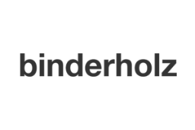

What our clients say
“The support we have received from Invest in Finland and Helsinki Business Hub has been essential for us. Their proactivity, efficiency and thorough knowledge of the market and business environment has helped us seize a great opportunity and tap into an extensive amount of market potential in an incredibly short time frame.”
Sevastos Kavanozis, Managing Director, Energy2Market
“From day one, we received tremendous support from Helsinki Business Hub and Finpro’s Invest in Finland. They helped us to recruit staff and find a spot-on location, and put us in contact with the relevant people.”
Mark Lamik, Head of Tech Expansion, Zalando
“We would like to express our gratitude to Finpro for having their great support to begin a new business in Finland. They introduced a good Finnish partner to us and we had their kind assistance for concluding the agreement between the Finnish partner company and Fujitsu.”
Shinji Yoshioka, Managing Director,
Fujitsu Greenhouse Technology Finland Ltd
“Every country should have a similar system where foreign investors can get assistance with even the most practical matters. I could say that Invest in Finland had a great influence on our decision to invest in a restaurant in Helsinki.”
Lalle Morberg, CEO, Hard Rock Café
“It helps a lot to have a partner on your side who knows the market and has access to the authorities and necessary key stakeholders.”
Hans Binder, Owner, Binderholz Group
“Invest in Finland has been an important partner for us for years.
They have helped us set up meetings with the authorities whenever needed, connect and network with the key players in the Finnish tech industry, and find the relevant information in every possible situation.”
Guoping Luo, Head of the Reliability Competence Center
at Huawei’s Finnish R&D center

Slide 22












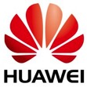

These Asian companies are already in Finland

Slide 23


















These European companies are already in Finland

Slide 24





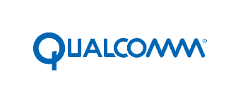







These AMERICAN companies are already in Finland
NEOLITICS

Slide 25
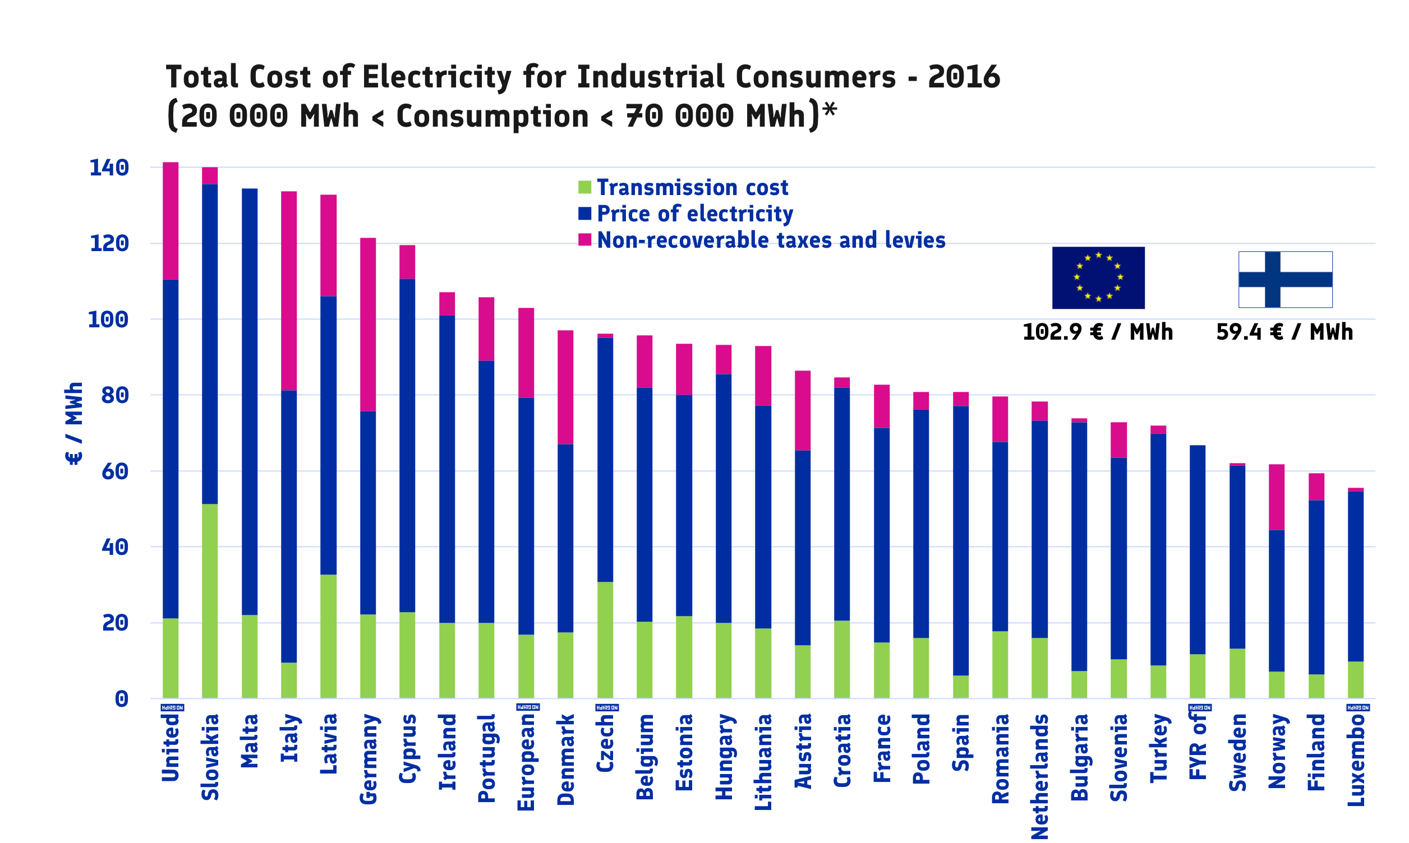
electricity
Energy prices and energy tax rate in Finland are remarkably low. Therefore, e.g. several data centres have chosen Finland for their investments. In addition, data centers benefit of the possibility to sell excess heat to energy network making it over 50 % cheaper to run a data center in the Finland rather than in Central Europe. Businesses profit also from Finland´s political, seismological and economic stability.
In terms of electricity supply, Finland outshines even the closest competitors.
In 2015, the transmission reliability of the national grid was as high as 99,9998 %, and the average duration of forced interruptions was only 2,1 minutes.
*Source: Eurostat - Statistical office of the European Union
Data extracted 24.10.2017
Notes:
Electricity. Energy prices and energy tax rate in Finland are remarkably low. Therefore, e.g. several data centres have chosen Finland for their investments. In addition, data centers benefit of the possibility to sell excess heat to energy network makes it 40-50 % cheaper to run a data center in the North than in Central Europe. Businesses profit also from Finland´s political, seismological and economic stability.
In terms of electricity supply, Finland outshines even the closest competitors. In 2015, the transmission reliability of the national grid was as high as 99,9998 %, and the average duration of forced interruptions was only 2,1 minutes.

