Slide 1
Talent boost
International talents boosting growth in Finland

Slide 2
Why talent matters
Photo: Keksi / Finland Image Bank

Slide 3
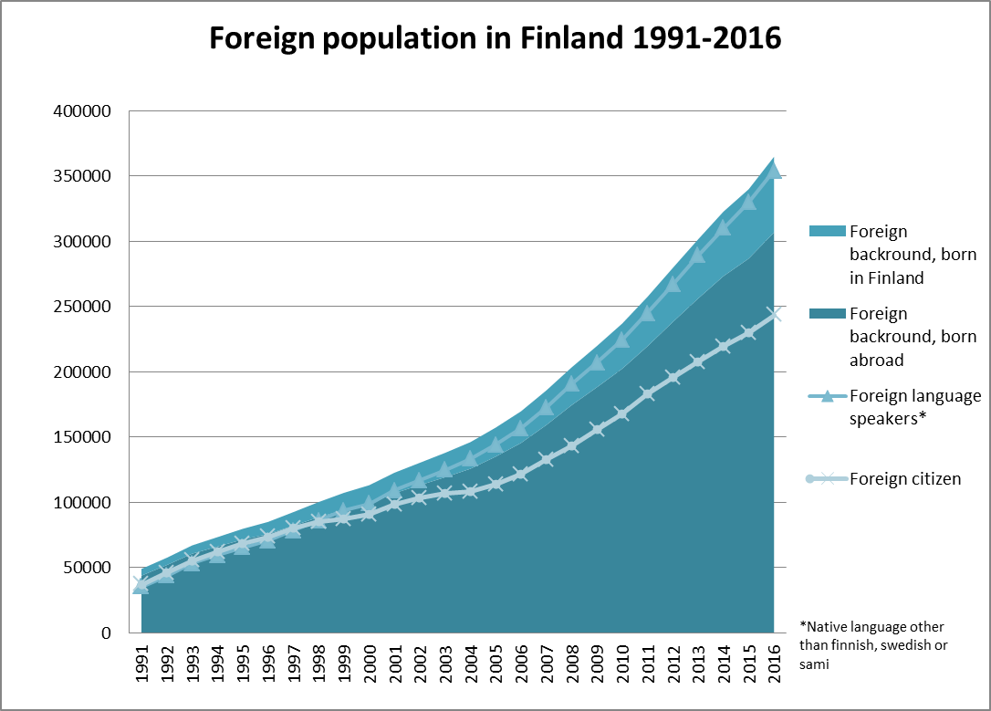
Finland is becoming more and more international
Work, family and studies are the most important reasons for coming to Finland. (Source: The Finnish Immigration Service, 2017)
Source: Statistics Finland/Kototietokanta
Notes:
Tarkista luvut!

Slide 4
International talents are vital for the growth of the Finnish economy
To become leaders in their fields, Finnish companies, universities and innovation actors must be able to attract the best talents from abroad.
The lack of talent is preventing the internationalisation and growth of companies.
The potential of international talents already in Finland is still partly untapped.
The success of our innovation ecosystem depends on the global networks.
Investments follow talents.

Slide 5
Who is an international talent?
A highly skilled immigrant or Finnish returnee with international experience, expertise and networks that can generate added value for Finnish industries.
For example, a foreign student, researcher, expatriate, returnee or spouse.

Slide 6
The global competition for international talents is becoming more and more intense. (Global talent competitiveness index)

Slide 7
Human capital propels growth
More than ever before, human capital is the one resource that can propel firms and economies to higher levels of productivity and competitiveness.
Globalisation has fostered a global competition for talent, as knowledge economies increasingly rely on highly-skilled workers.
Source: Europan Commission 2017: 10 trends shaping migration

Slide 8
Europe is an underachiever in the global competition for talent
Compared to similar economies like the US, Canada or Australia, Europe attracts a smaller share of highly-skilled migrants relative to the total global flow of highly-skilled migrants.
In 2013, the EU was home to only one in three high-skilled migrants, with 60% heading to North America.
Source: OECD, 2016 'Europe is underachieving in the global competition for talent'

Slide 9
Factors that attract talent
Primary drivers
Opportunity
Infrastructure
Other talented people
Wider environment
Fair social model
High quality of life
Tolerant and inclusive societies
Fifteen years ago, 80 percent of people said they chose the company before the city. Today, 64 percent choose the city before they choose the company or the job.
Charles Landry, Robert Bosch Academy
Source: European Political Strategy Centre, based on Migration Policy Institute, Talent in the 21st Century Economy, 2013

Slide 10
What Finland is doing about it
Photo: Riitta Supperi/Keksi/Finland Image Bank

Slide 11
We can learn from the best practices of other countries
Integration of international talent attraction and retention management in public services for companies, eg. Denmark.
Focused and people-centred country brand communications to attract talents, eg. New Zealand.
Connecting talent attraction and retention with investment promotion, eg. Denmark.
Service packages for start-ups, eg. Austria.

Slide 12
Finland’s strong points highlighted in the talent attraction communications
Balancing work with life is made easy.
The whole society is committed to equality.
Finland is the poster child for education.
Finland invests in knowledge.
We are leaders in innovation and our startup scene is world-known.
Nature is all around.
Everything just works – even the bureaucracy.

Slide 13
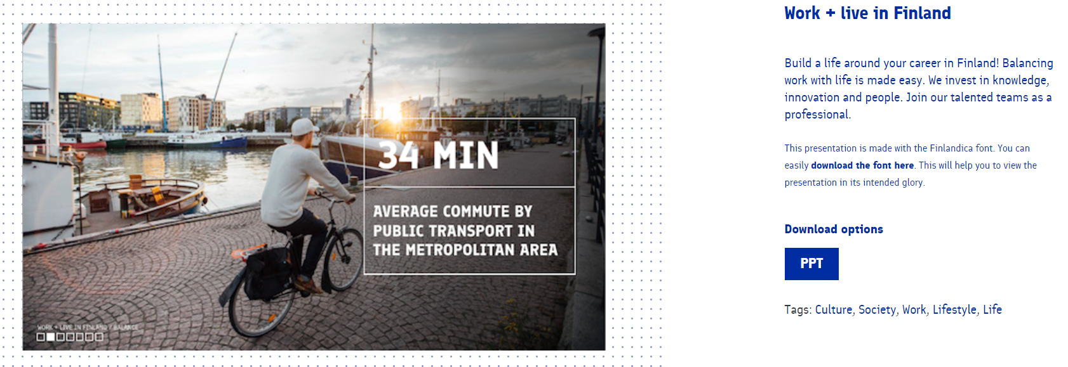
Work + live in Finland presentation at your disposal in Finland Toolbox
toolbox.finland.fi/presentations/life-society/work-live-finland/

Slide 14
Photos: Finland Image Bank

Slide 15
We also need to be able to retain them
Framework conditions:
Policies
Regulations
Economic situation
Political climate
Talent Attraction
Talent Reception
Talent Integration
Talent Reputation
Management
of ecosystem
Enablers:
Jobs
Quality of life
Culture & leisure
Accessibility
Place brand & marketing
Education & research
Clusters & networks
Copyright: Andersson, King-Grubert & van Hest, modified from Future Place Leadership

Slide 16
The Talent Boost programme answers to the need of a national strategy for international talent attraction and retention.

Slide 17
Talent Boost programme
In its 2017 mid-term policy review, Prime Minister Juha Sipilä’s Government decided to launch ‘Talent Boost – International talents boosting growth’, a joint cross-sectoral programme for the Government.
Until now, Finland has lacked a national programme or strategy for attracting and retaining international talents.

Slide 18
Talent Boost programme actors
Programme coordinated by the Ministry of Economic Affairs and Employment
On board:
Ministry for Foreign Affairs, Ministry of Education, Science and Culture, Ministry of Interior, Ministry of Finance and Prime Minister’s Office
the largest cities (Metropolitan area, Tampere and Turku)
Active dialogue between different stakeholders, such as business sector, universities, international talents and innovation actors.

Slide 19
Talent Boost programme targets
International talents consider Finland attractive.
The expertise of international talents accelerates growth and internationalisation of companies in Finland.
Finnish working life is inclusive for international talents.

Slide 20
In the pipeline
The Government will decide on the Talent Boost action plan in the beginning of 2018.
These measures are already under way:
International House Helsinki pilot
Startup residence permit launch
New workinfinland.fi website
Talent attraction as a lead theme of country branding
Pilot for attracting software developers

Slide 21
In the pipeline
Talent operations as part of Business Finland services
Talent Hub concept for the biggest growth centres to connect companies, international talents, universities & innovation platforms
International talents boosting growth projects launched around Finland
Annual Talent Boost Summit

Slide 22
What you can do

Slide 23
Make noice about Finland for talents
Share talent attraction materials from Finland Toolbox in your network
Use hashtag #workinfinland
Take part in the discussion with #TalentBoost

Slide 24
Learn more
tem.fi/talent-boost-en
Useful litterature and reports
Innovaatiotalouden maahanmuuttopolitiikka – Kansainvälinen muuttoliike, maahanmuuttajat ja innovaatiopolitiikka, Ministry of Economic Affairs and Employment 33/2015 (in Finnish)
Tools and Strategies for Innovative Talent Attraction and Retention, Tendensor 2014
Uutta osaamista report, Finnish National Agency for Education (1/2017) (in Finnish)
Notes:
Lisää lähteitä

