Slide 1
INNOVATIONS FOR A BETTER LIFE.
Call for 2020 Millennium Technology Prize Nominations 1 April–31 July, 2019
millenniumprize.fi

Slide 2
Millennium Technology Prize Finland's tribute to innovations for a better life
Awarded for groundbreaking technological innovations that benefit millions of people around the world by:
enhancing quality of life
promoting sustainable development and mitigation of climate change
generating applications with global commercial viability
creating new socio-economic value
stimulating further cutting-edge research and development in science and technology
Prize of €1M
established by the State of Finland, academic institutions and high-tech industries
awarded every other year since 2004
Presented by the President of the Republic of Finland

Slide 3
2020 Millennium Technology Prize Call for nominations 1 April–31 July 2019
Nominations across the world are invited from all fields of technology, excluding military technology. Special emphasis is placed on proposals related to:
energy and the environment
life sciences, including health and food
information and communications technology and smart systems
new materials, processes and manufacturing
Nominations are invited from organizations such as universities, research institutes, academies of science and technology, companies and industries
Process and schedule
1 April–31 July 2019: Call for 2020 Millennium Technology Prize nominations
August 2019–February 2020: Evaluation of the nominations
Spring 2020: Decision of the 2020 Millennium Technology Prize Winner(s)
26 May 2020: Announcement of the Winner(s) and Award Ceremony

Slide 4
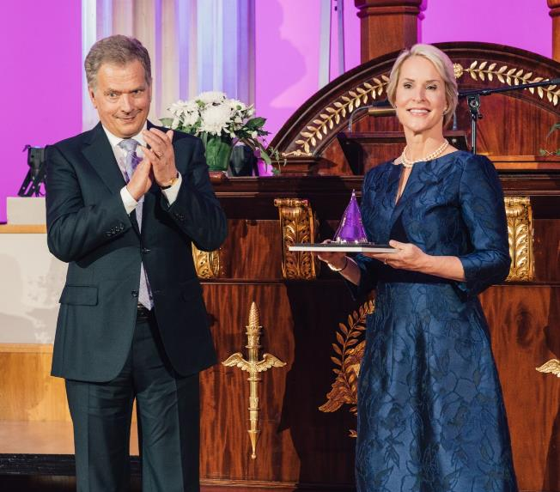
Three MTP Winners have received the Nobel Prize
Frances Arnold
2016 Millennium Technology Prize for directed evolution
2018 Nobel Prize in Chemistry
Shinya Yamanaka
2012 Millennium Technology Prize for ethical stem cells
2012 Nobel Prize in Medicine
Shuji Nakamura
2006 Millennium Technology Prize for Blue and white LEDs
2014 Nobel Prize in Physics
President of the Republic of Finland, Sauli Niinistö, presented the 2016 Millennium Technology Prize to Professor Frances Arnold in 2016 for her pioneering work on directed evolution.

Slide 8
Nominate your candidate
1 April–31 July 2019
millenniumprize.fi/cfn

