Slide 2
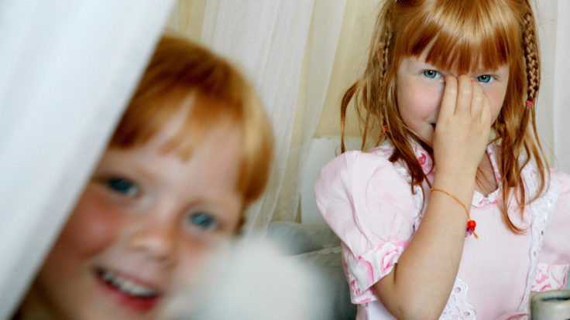

FINLAND:
THE HAPPIEST
COUNTRY IN
THE WORLD
Notes:
Visit Finland Image Bank / G73487.jpg

Slide 3

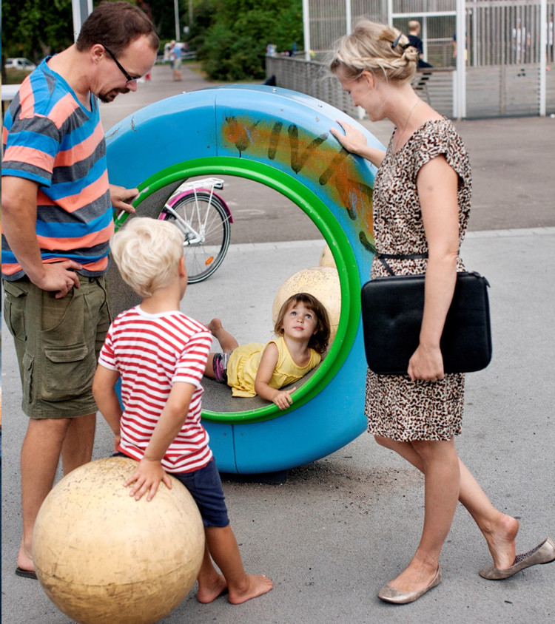

For the second year in a row, Finland ranks as the happiest country in the world in the UN World Happiness Report.
1
ST
HAPPIEST
COUNTRY
For the second year in a row, Finland is the happiest nation in the World Happiness Report, which ranks 156 countries by how happy their citizens perceive themselves to be.

Slide 4
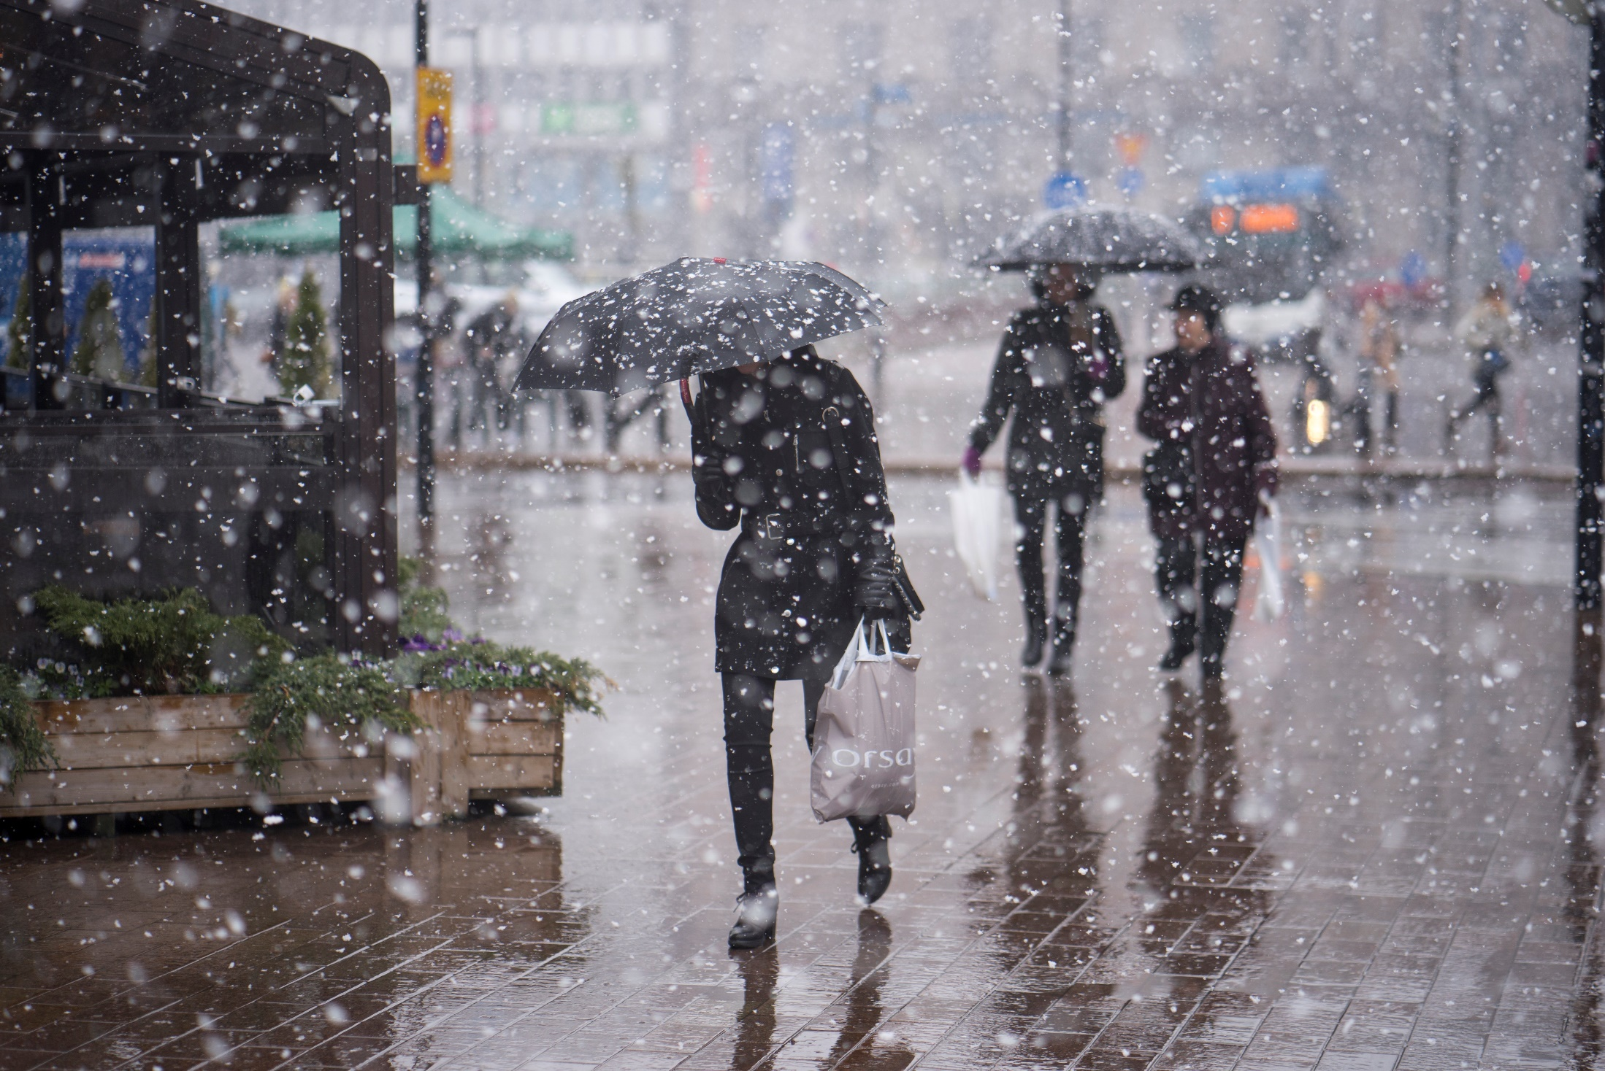

Some people are having trouble understanding this.
We cannot see why.*
*Literally. We really can’t see anything in this weather.

Slide 5
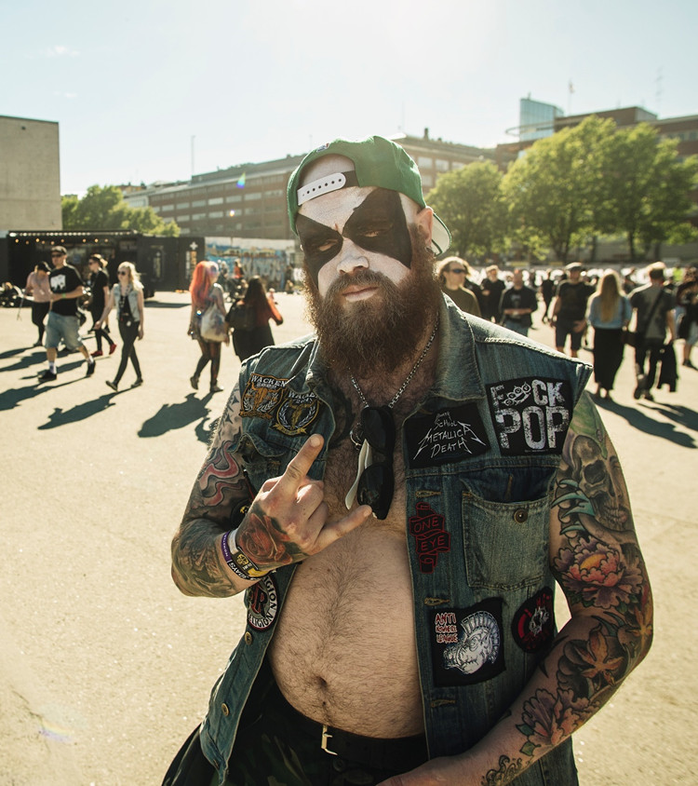
Joking aside, happiness does seem to come in many forms.
You don’t have to be all smiles to be happy.
Did you know?
According to studies, heavy metal fans are happier than people listening to other genres of music.
Notes:
https://www.tandfonline.com/doi/abs/10.1080/15298868.2015.1036918?journalCode=psai20#.VZoLPvlVhBc

Slide 6
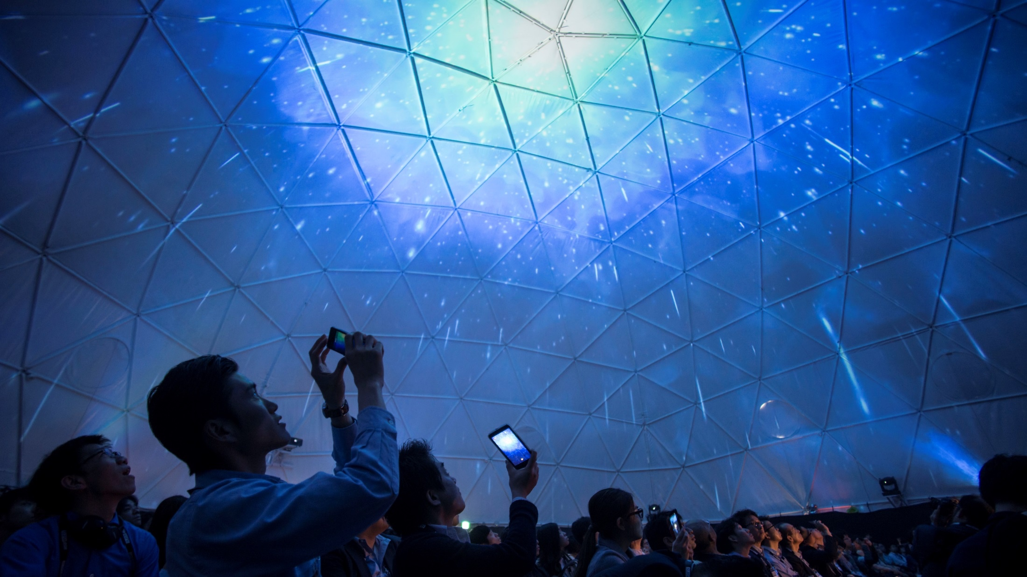
What is the World
Happiness Report?
The UN World Happiness Report ranks 156 countries by their happiness levels.
People in each country are asked to rate their life on a 10-step ladder from the best possible to the worst possible life for them.
Notes:
FINLAND IMAGE BANK: Slush Japan 2015 Slush_Japan_2015 (5).jpg Petri Artturi Asikainen/Team Finland/Finland Promotion Board

Slide 7
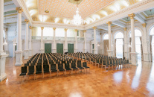
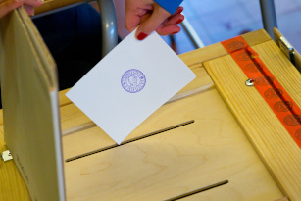
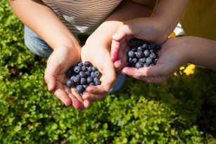
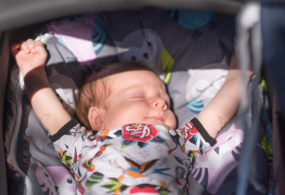
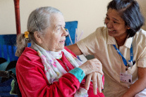


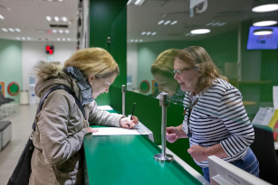
Although the World Happiness Report measures subjective happiness, the study also attempts to explain each country’s score by referring to a range of factors.
CONFIDENCE IN
GOVERNEMENT
QUALITY OF
DEMOCRACY
GDP
PER CAPITA
HEALTHY
LIFE EXPECTANCY
AVAILABLE
SOCIAL SUPPORT
FREEDOM TO
MAKE DECISIONS
GENEROSITY
IN SOCIETY
ABSENCE OF
CORRUPTION

Slide 8
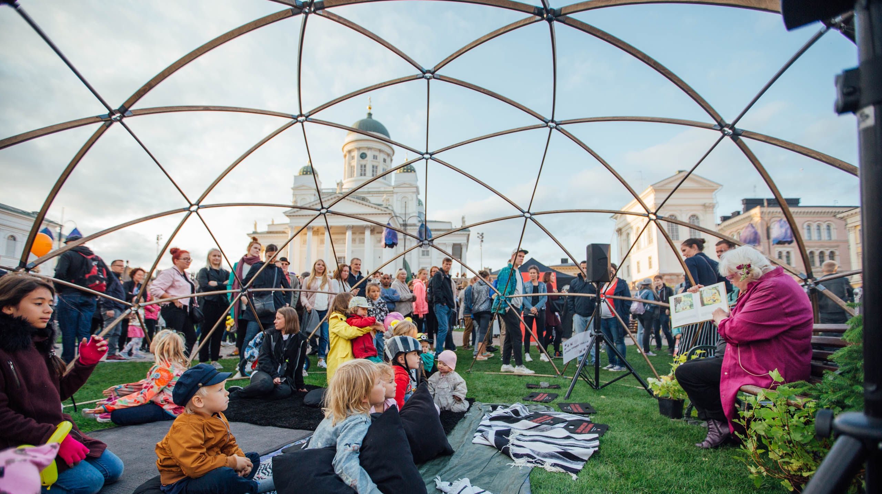
Why are Finns so happy?
Notes:
VISIT FINLAND IMAGE BANK: Finland_Helsinki_events_Juhlaviikot_TheNightOfArts_web_byJuliaKivela__MG_1317.jpg Julia Kivelä

Slide 9

Finland has the best governance in the world as measured by voter turnout, legislative independence and the number of women in Parliament.
Finland is also the most stable nation in the world.
1
ST
BEST
GOVERNANCE
IN THE
WORLD
Finland has the best governance in the world as measured by voter turnout, legislative independence and
the number of women in Parliament.
Source: The Legatum Prosperity Index 2017, Fund for Peace 2018
Notes:
Source: The Legatum Prosperity Index 2017 (Best Governance)
Source: Fund for Peace 2018 (Most stable nation)

Slide 10
In addition to the quality of governance and stability, Finland also ranks high in transparency of government practices, and has well-distributed political power.
It is easy to have confidence in government in Finland.
3
RD
MOST
TRANSPARENT
COUNTRY
Finland is the 3rd most transparent country in the world, with open business and government practices and well-distributed political power.
Source: U.S. News & World Report 2018, Transparency International 2018
Notes:
Source: U.S. News & World Report, Y&R’s BAV Group and Wharton School of the University of Pennsylvania 2018 (Transparent country)
Source: Transparency International 2018 (Corruption)

Slide 11

3
RD
LEAST
CORRUPT
COUNTRY
Finns can trust the system and each other.
Finland is one of the least corrupt countries in the world, and 85% of Finns agree or strongly agree that they can trust most of their fellow citizens. That is the highest percentage in the EU.
According to the Corruption Perceptions Index (CPI), Finland is one of the least corrupt countries in the world, right after Denmark and New Zealand.
Source: Transparency International 2018, Eurobarometer 471, 2018
Notes:
Source: Transparency International 2018 (Corruption)
Source: Eurobarometer 471 – April 2018 (Trust)

Slide 12
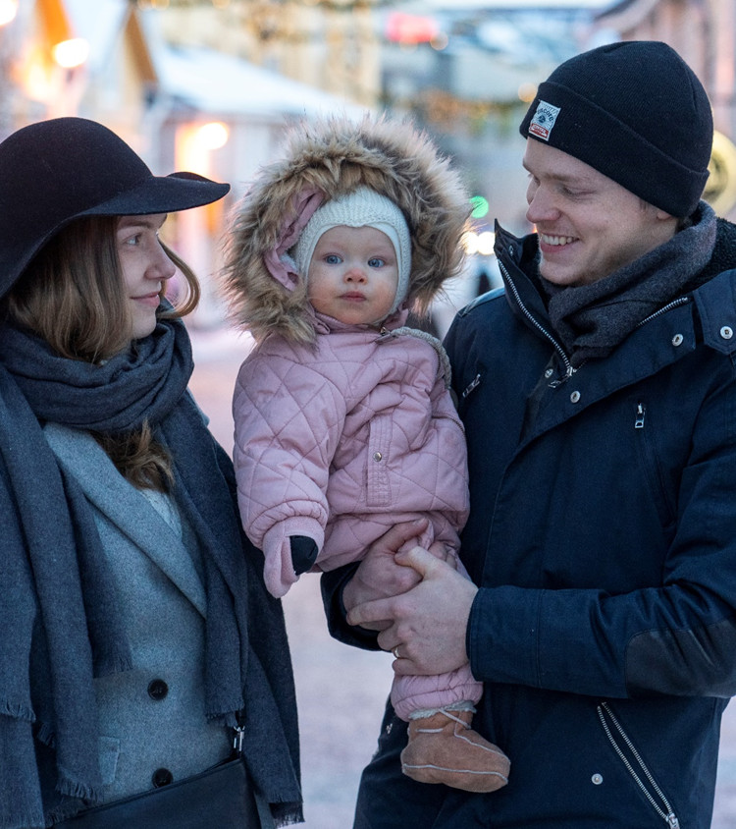

1
ST
MOST
POLITICAL AND civil
FREEDOM
Finns truly have the freedom to make decisions.
Finland ranks first among countries with the most political and civil freedom. Finns are also in the global top three when it comes to opportunities available to a nation’s citizens.
Finland ranks 1st among countries with the most political and civil freedom. The index uses indicators such as status of freedom, political rights and civil liberties.
Source: Freedom House 2018, The Legatum Prosperity Index 2018
Notes:
Source: Freedom House 2018 (Freedom)
Source: The Legatum Prosperity Index 2018 (Opportunities)

Slide 13
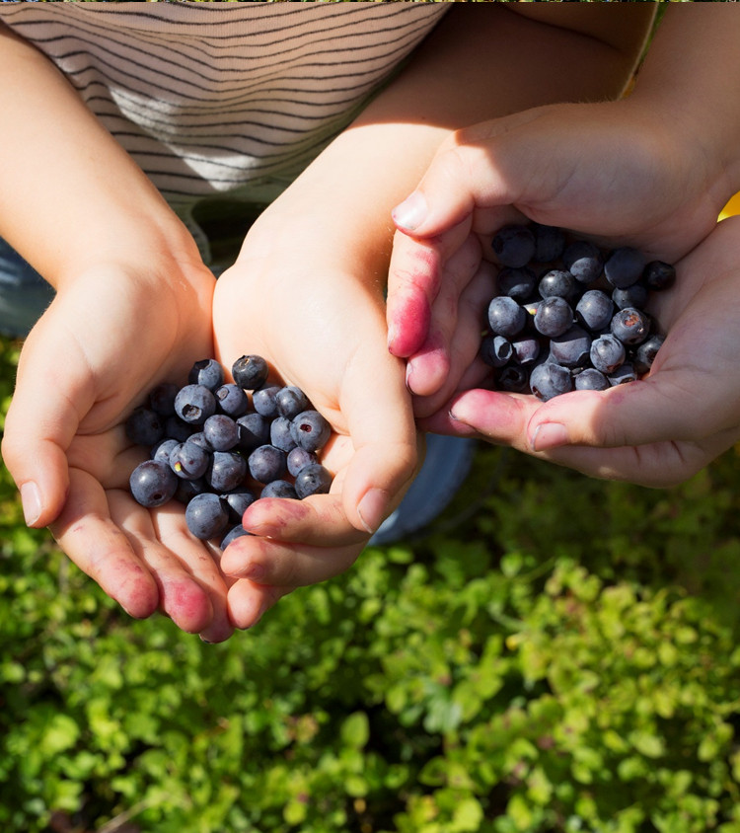
3
Wealth and wellbeing play a part in Finns’ happiness. Finland ranks high in prosperity when measuring economic growth, quality of life and other related categories.
Finland also comes out on top when ranked according to innovations and business environment.
RD
GLOBAL
PROSPERITY
Finland ranks third in the Global Prosperity Index, which measures wealth, economic growth, wellbeing, life opportunities and quality of life, among other things.
Source: The Legatum Prosperity Index 2018, Bloomberg Innovation Index 2019
Notes:
Source: The Legatum Prosperity Index 2018 (Global prosperity)
Source: Bloomberg Innovation Index 2019 and The Consumer Technology Association 2019 (Innovations)
Source: Global Innovation Index 2018 (Business environment)

Slide 14
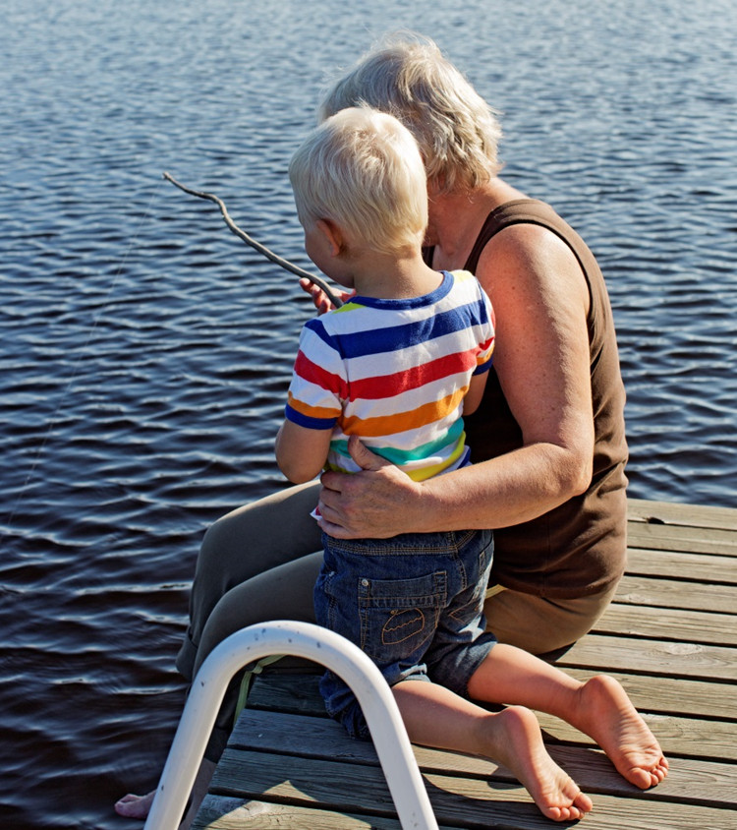

3
RD
MOST
SOCIALLY
JUST
Healthcare and income security are guaranteed for everyone in Finland.
This means a better chance at happiness for all. It is no coincidence that Finland ranks as one of the most socially just countries in the world.
Finland ranks as the 3rd most socially just country in the EU, measured according to poverty prevention, equitable education, labour market access, health and other factors.
Source: Bertelsmann Stiftung 2017
Notes:
Source: Bertelsmann Stiftung 2017 (Socially just)

Slide 15
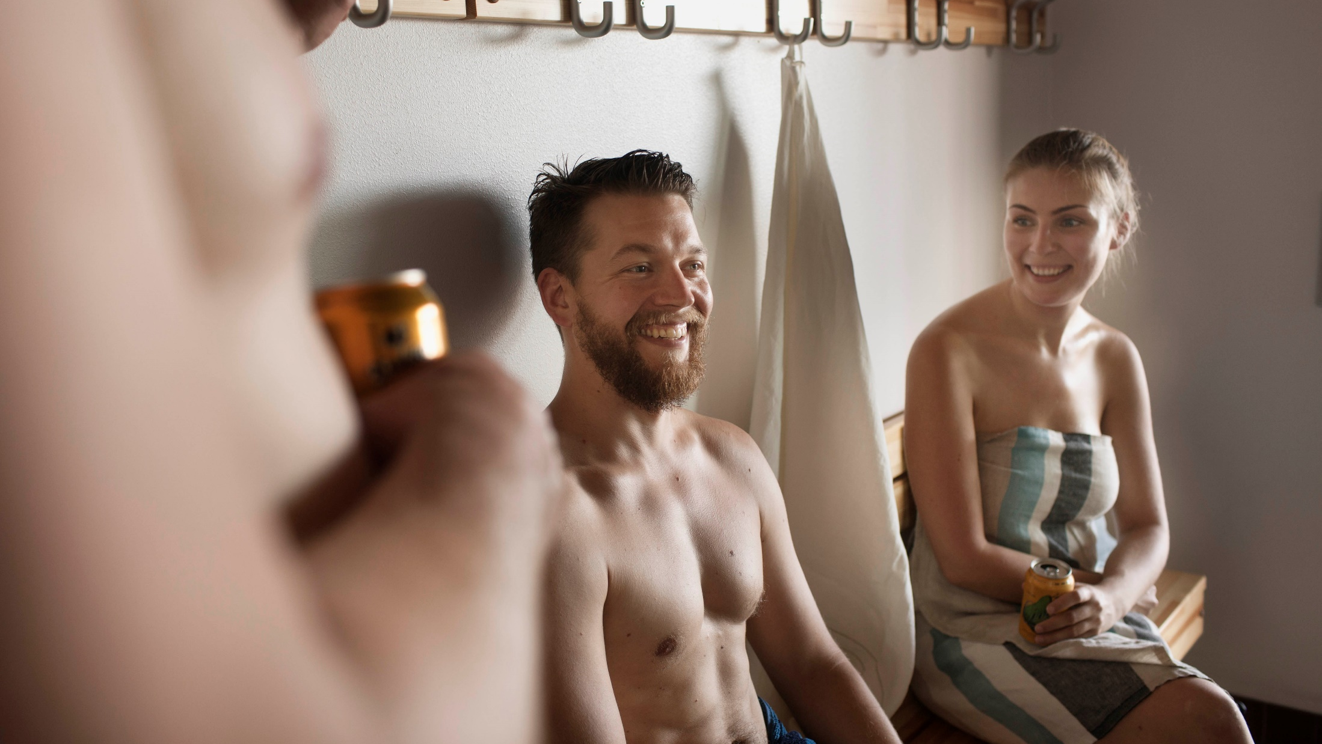
FINLAND IS ALSO
A HIGHLY EQUAL SOCIETY

Slide 16
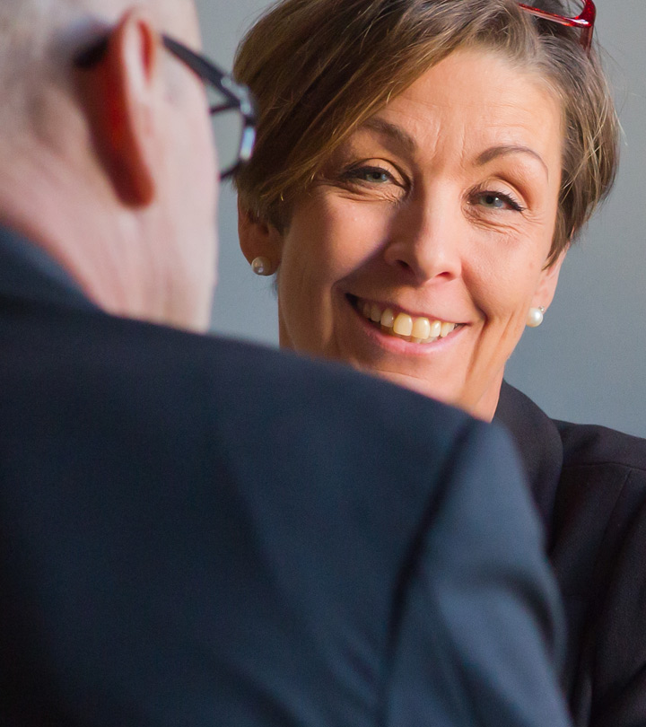

4
Gender equality is one of the core values of Finnish society.
Finland would not be one of the most advanced – and happiest – countries in the world had it not been for its strong commitment to equality.
th
Global
Gender
Gap Report
Finland is one of the best countries in the world for gender equality, according to the World Economic Forum’s Global Gender Gap Report 2018.
Source: Global Gender Gap Report 2018
Notes:
Source: Global Gender Gap Report 2018

Slide 17
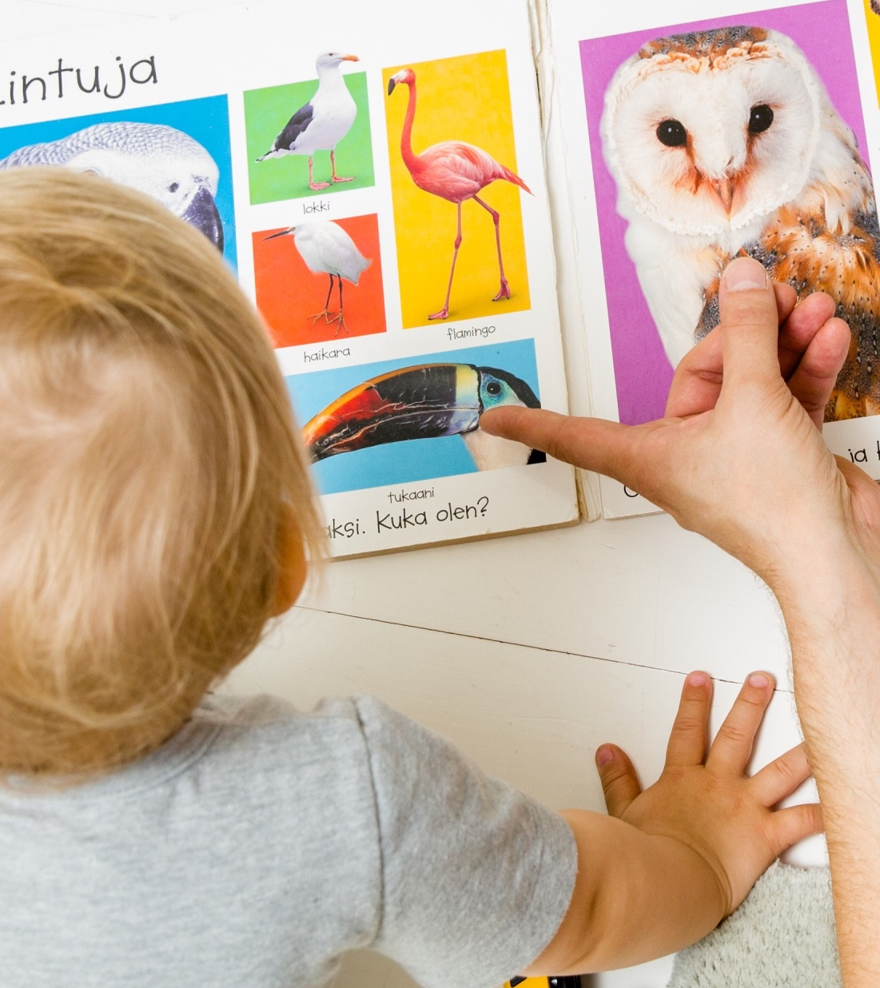

1
Women and men are equal – both at work and at home.
Finland is the only country in the developed world where fathers spend more time with school-aged children than mothers do.
Also, 80% of dads go on paid paternity leave.
ST
For time dads spend with children
Finland is the only country in the developed world
where dads spend
more time with
school-aged children than mothers do.
Source: OECD 2018
Notes:
Source: OECD 2018

Slide 18

Everyone gets an equal start in Finland.

Slide 19
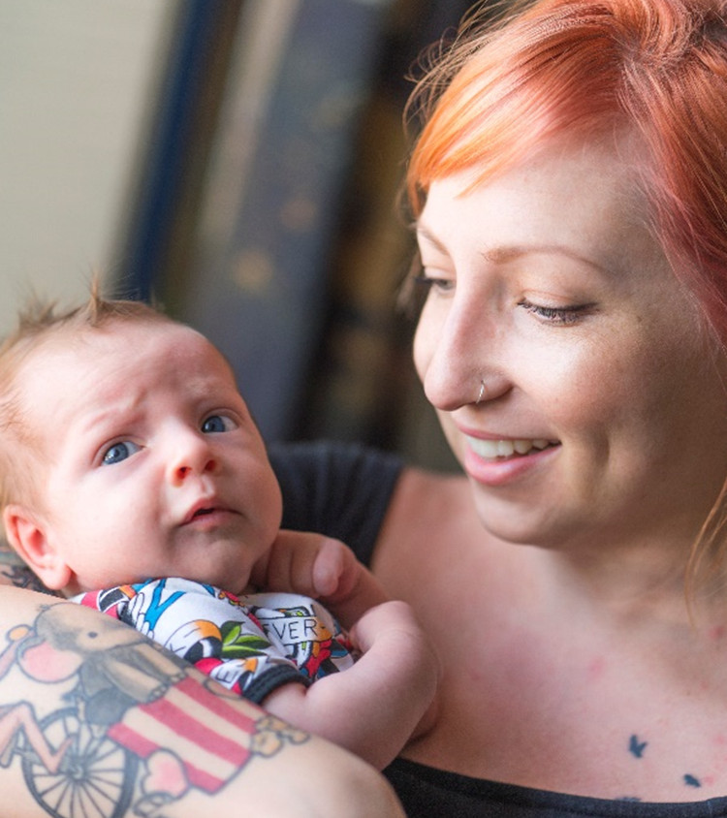

2
Finland is one of the fairest countries in the world for children.
To guarantee a more equal start to life, every Finnish child is welcomed into the world by a maternity package containing clothing and
baby-care products.
ND
FAIREST
COUNTRY FOR
CHILDREN
Finland ranks second when observing how fair a country is for all children and their wellbeing. Each country is ranked by inequality of income distribution; education; health; and life satisfaction.
Source: UNICEF 2016
Notes:
Source: UNICEF Office of Research 2016 (Fairest Country)

Slide 20
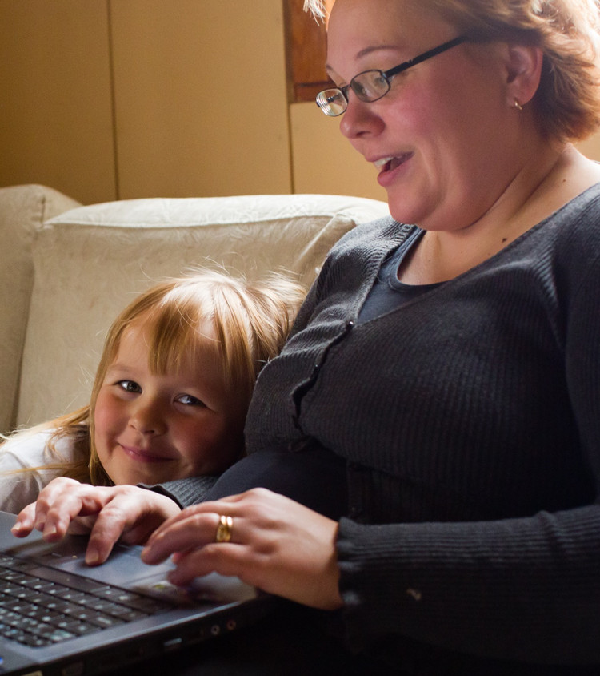
2
An equal start for everyone requires healthy and happy mothers. Finland offers free prenatal care for mothers and nearly a year of paid maternity leave when the child is born.
Affordable child care makes it easy for mothers to combine work and family life.
ND
BEST
COUNTRY TO
BE A MOTHER
UNICEF compiles statistics on the health of mothers and children and uses them to produce rankings showing where mothers fare best and where they face the greatest hardships.
Source: UNICEF 2016
Notes:
Source: UNICEF Office of Research 2015 State of The World’s Mothers Report

Slide 21
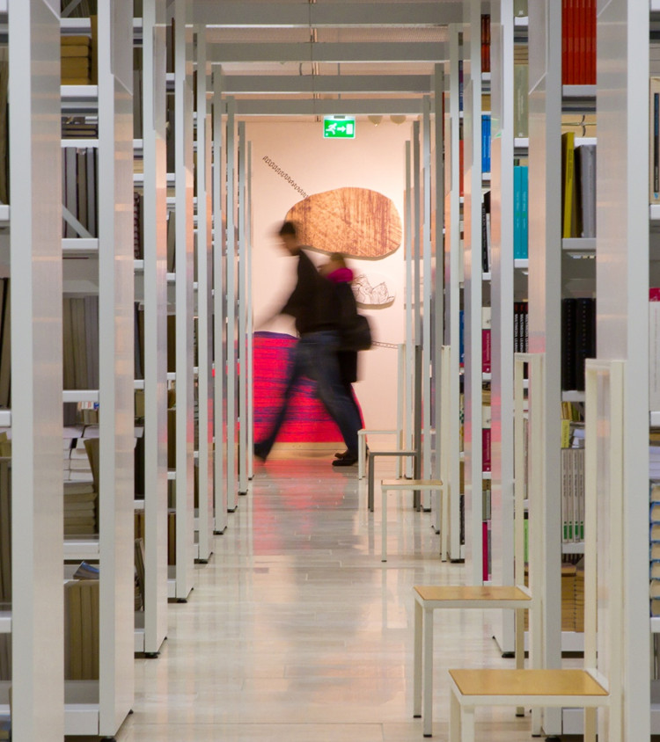

Equality also means equal access to education.
Education is free for everyone from preschool to higher education. This means that every Finn has a right to go to university tuition-free.
Everyone’s potential is utilised.
1
ST
EDUCATION
Finland ranks number one in education out of 149 countries. The Legatum Prosperity Index measures access to education; quality of education; and human capital.
Source: Legatum Prosperity Index 2018
Notes:
Source: The Legatum Prosperity Index 2018

Slide 22
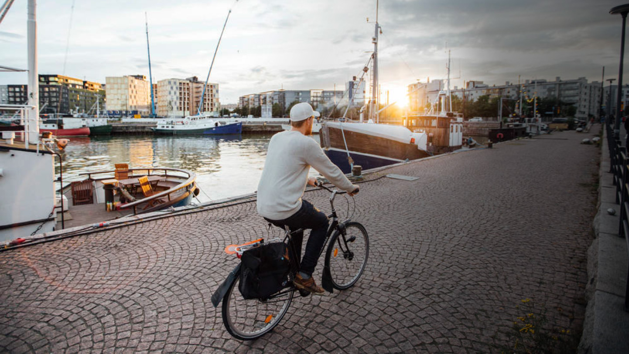
EVERYTHING
Just works
In Finland
Notes:
Julia Kivelä / Visit Finland Image Bank -- Finland_Helsinki_people_boats_web_by_JuliaKivela__MG_0747.jpg
Commuting is easy in Finland, with the average commute by public transport only taking 34 minutes in the metropolitan area.
Source: Statistics Finland

Slide 23
Finland:
The Happiest Country
in the World.*
*Can be very subtle or invisible to the naked eye.

