Slide 2
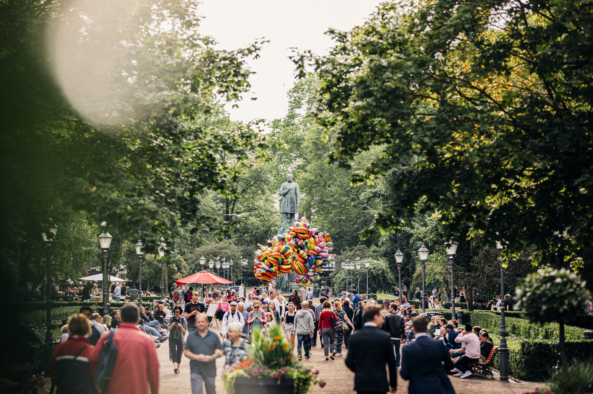

FINLAND:
The HAPPIEST COUNTRY
IN THE WORLD
Notes:
Photo: Jussi Hellstén / Visit Finland

Slide 3


1
ST
HAPPIEST
COUNTRY
Since 2018, the World Happiness Report has ranked Finland as the happiest country in the world.
The World Happiness Report
2018–2022
Notes:
Photo: Juulia Kivelä / Visit Finland

Slide 4
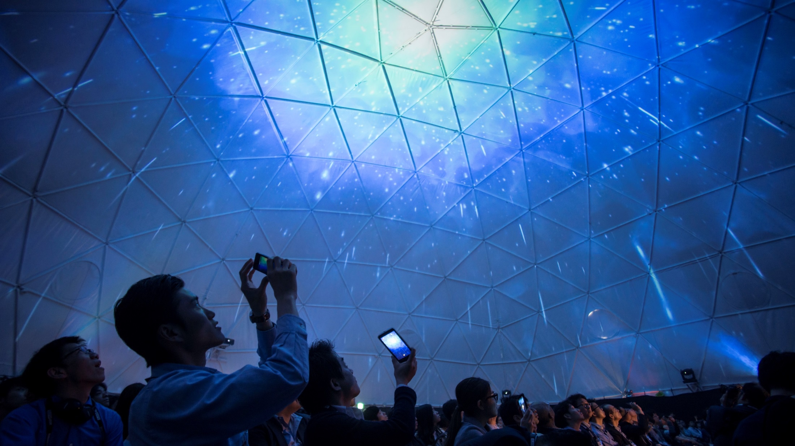

What is the World
Happiness Report?
The World Happiness Report ranks 156 countries by their happiness levels.
People in each country are asked to rate their life on a 10-step ladder from the best possible to the worst possible life for them.
Notes:
Photo: Petri Artturi Asikainen / Finland Image Bank

Slide 5
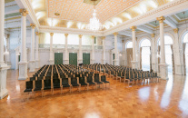
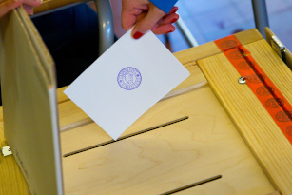
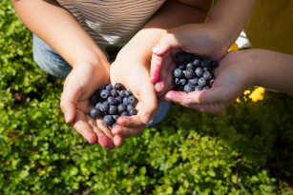
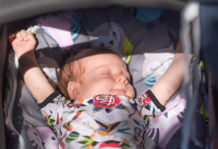
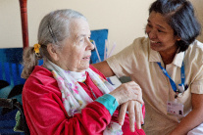


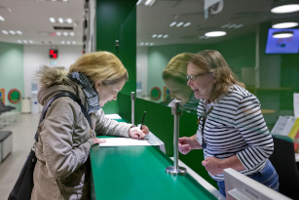
CONFIDENCE IN
GOVERNMENT
QUALITY OF
DEMOCRACY
Although the World Happiness Report measures subjective happiness, the study also attempts to explain each country’s score by referring to a range of underlying factors.
GDP
PER CAPITA
HEALTHY
LIFE EXPECTANCY
AVAILABLE
SOCIAL SUPPORT
FREEDOM TO
MAKE DECISIONS
GENEROSITY
IN SOCIETY
ABSENCE OF
CORRUPTION
Notes:
Photos:
Confidence in government: Jussi Hellstén/City of Helsinki
Quality of democracy: Riitta Supperi/Kuvatoimisto Keksi/Finland Image Bank
GPD per capita: Katri Lehtola/Kuvatoimisto Keksi/ Finland Image Bank
Healthy life expectancy: Pasi Markkanen/Finland Image Bank
Available social support: Riitta Supperi/Kuvatoimisto Keksi/Finland Image Bank
Freedom to make decisions: Pasi Markkanen/Finland Image Bank
Generosity in society: Pia Inberg/Kuvatoimisto Keksi/Finland Image Bank
Absence of corruption: Rami Salle/Finland Image Bank

Slide 6
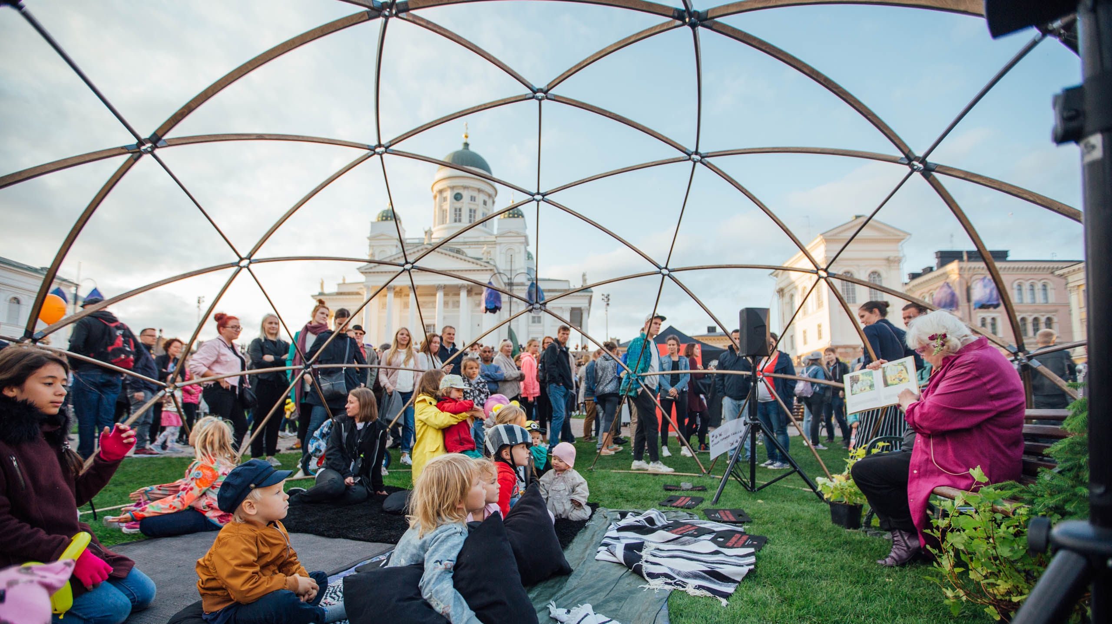
Why are Finns so happy?
Notes:
Photo: Julia Kivelä / Visit Finland

Slide 7
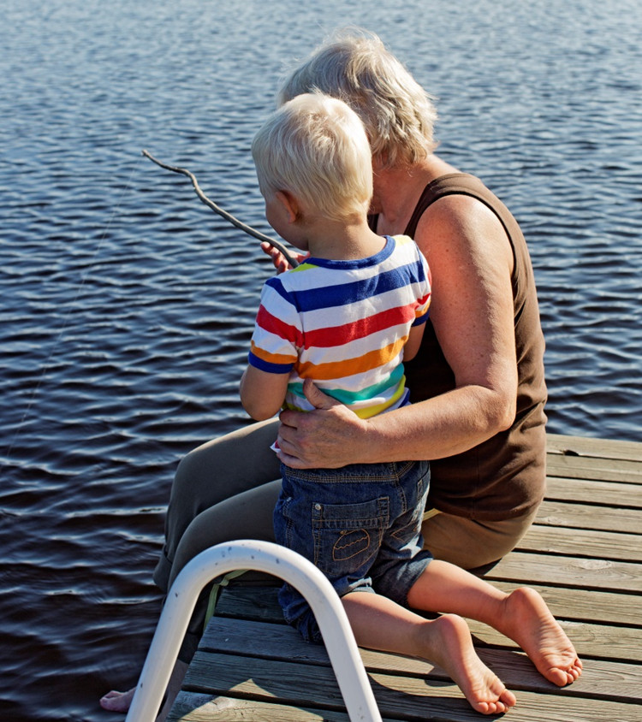

4
TH
MOST
SOCIALLY
JUST
Happiness starts with the basics: healthcare, poverty prevention and labour market access. In Finland, healthcare and income security are guaranteed to everyone.
Social Justice Index
2019
Notes:
Photo: Riitta Supperi / Kuvatoimisto Keksi / Finland Image Bank
Social justice refers to a political and philosophical theory that focuses on the concept of fairness in relations between individuals in society and equal access to wealth, opportunities, and social privileges.

Slide 8
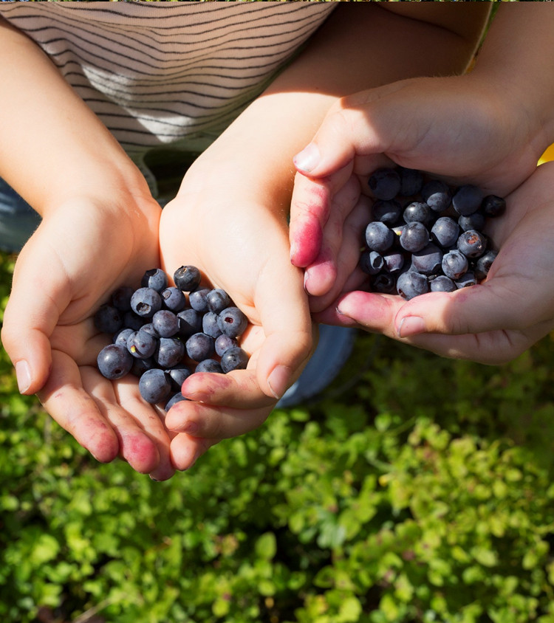
4
th
GLOBAL
PROSPERITY
Wealth also plays a part
in Finns’ happiness. However, according to the World Happiness Report, GDP per capita alone doesn’t explain happiness.
What explains it, then?
The Legatum Prosperity Index 2021
Notes:
Photo: Katri Lehtola / Kuvatoimisto Keksi / Finland Image Bank

Slide 9
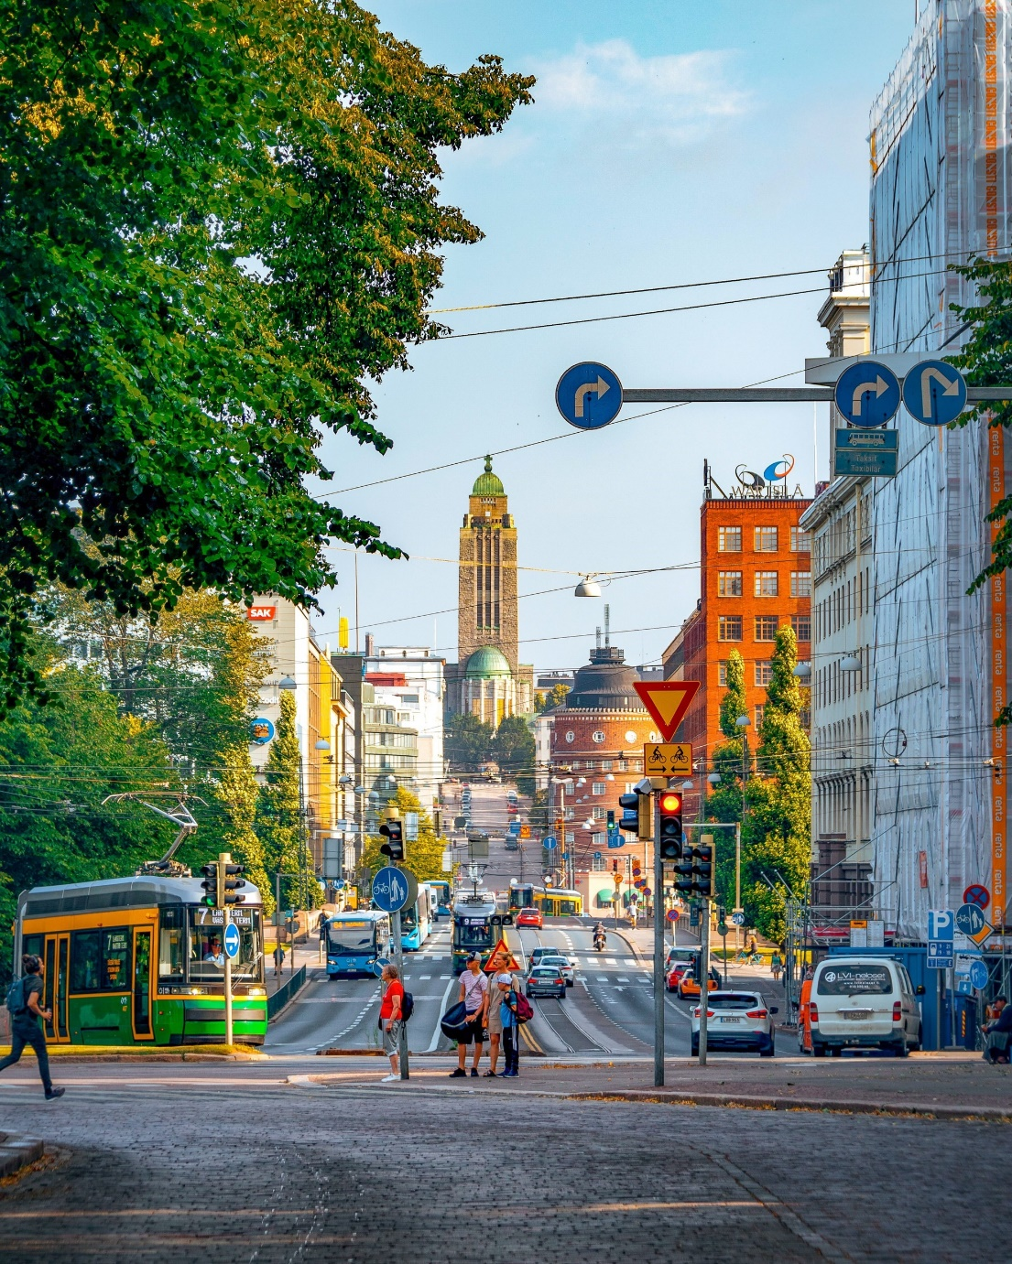
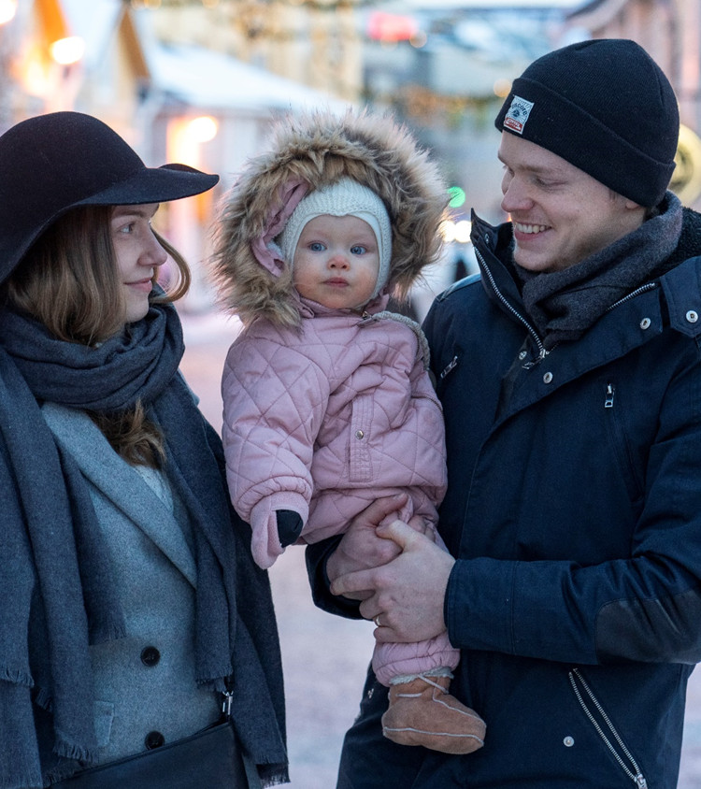
The secret is:
an infrastructure of happiness.
Finnish society is arranged in a way that allows for happiness.
Notes:
Photo: Omar El Mrabt / Helsinki Partners

Slide 10
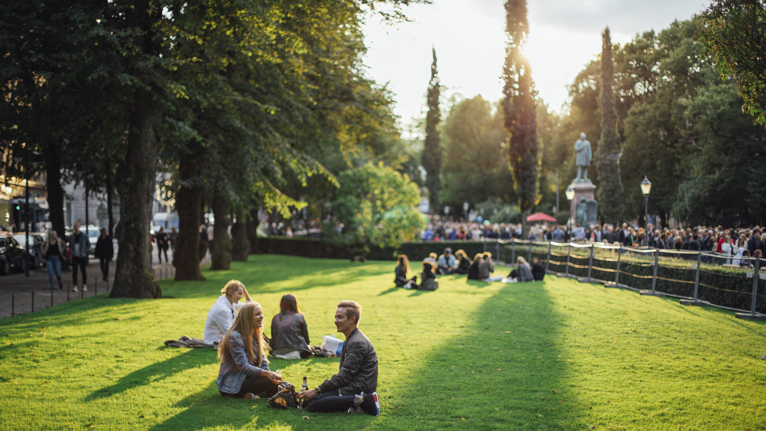
Let’s take a look.
Notes:
Photo: Julia Kivelä / Visit Finland

Slide 11
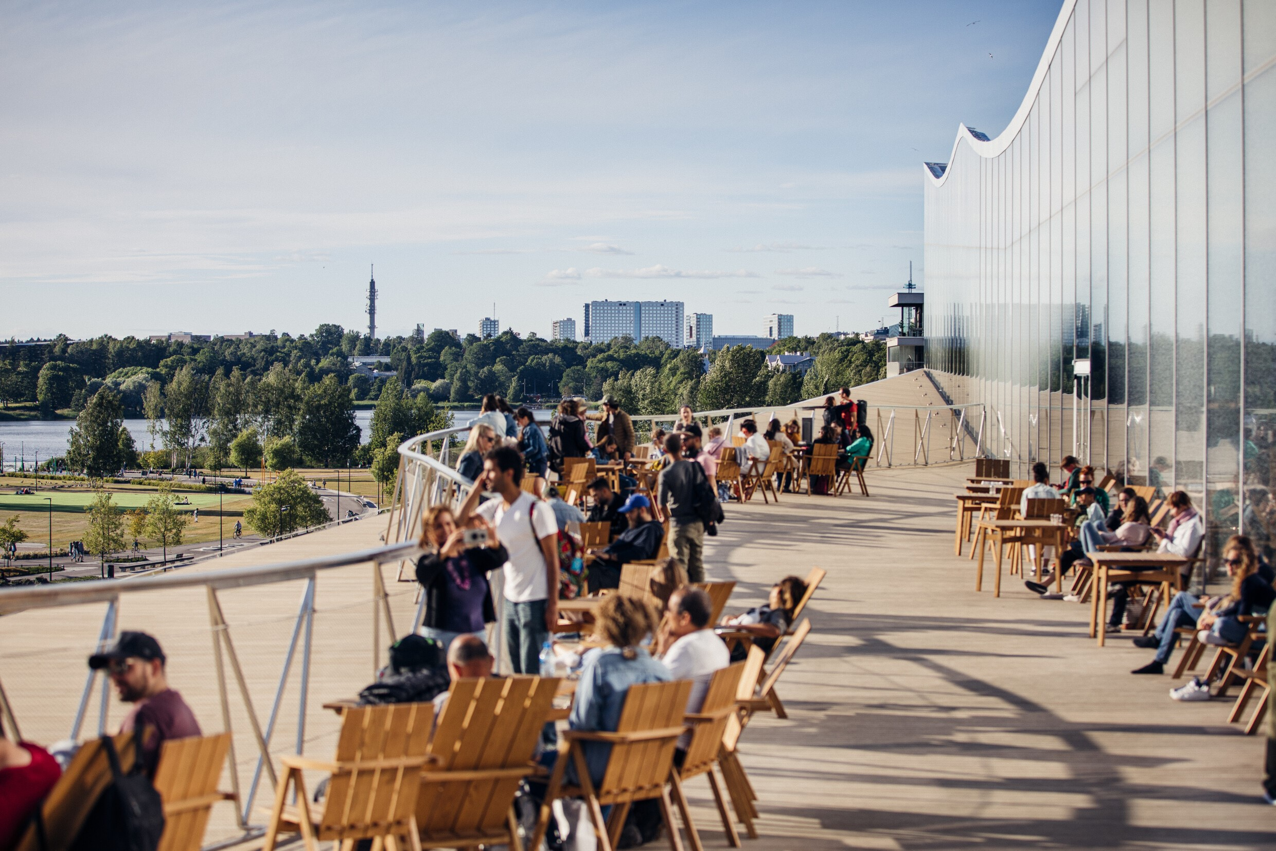
Good governance is at
the heart of happiness
Notes:
Photo: Jussi Hellstén / City of Helsinki

Slide 12
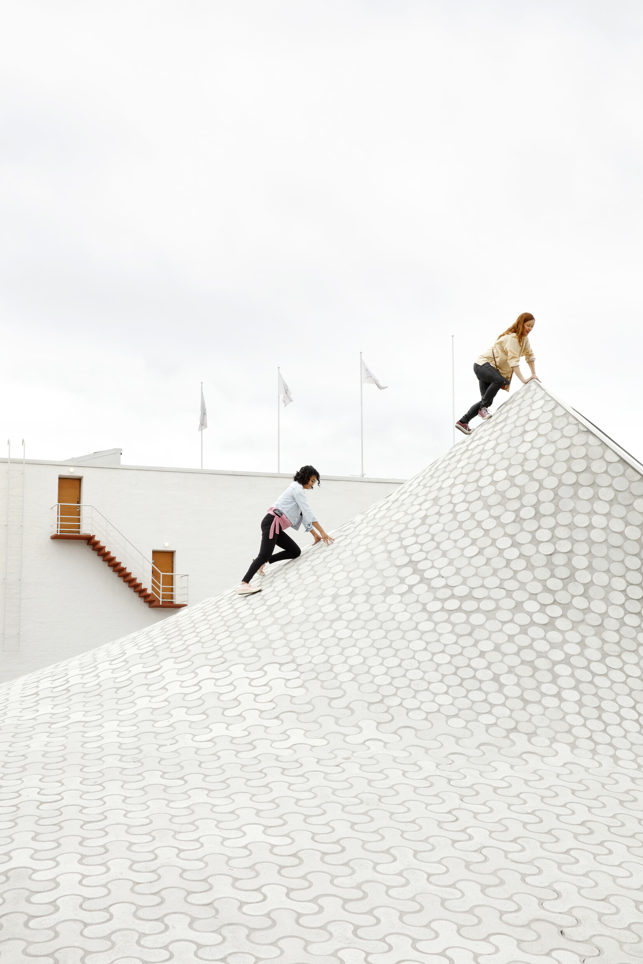
1
ST
BEST
GOVERNANCE
IN THE
WORLD
Finland has the best governance in the world as measured by voter turnout, legislative independence and the number of women in Parliament.
The Legatum Prosperity Index 2021
Notes:
Photo: Karoliina Bärlund / Helsinki Partners

Slide 13
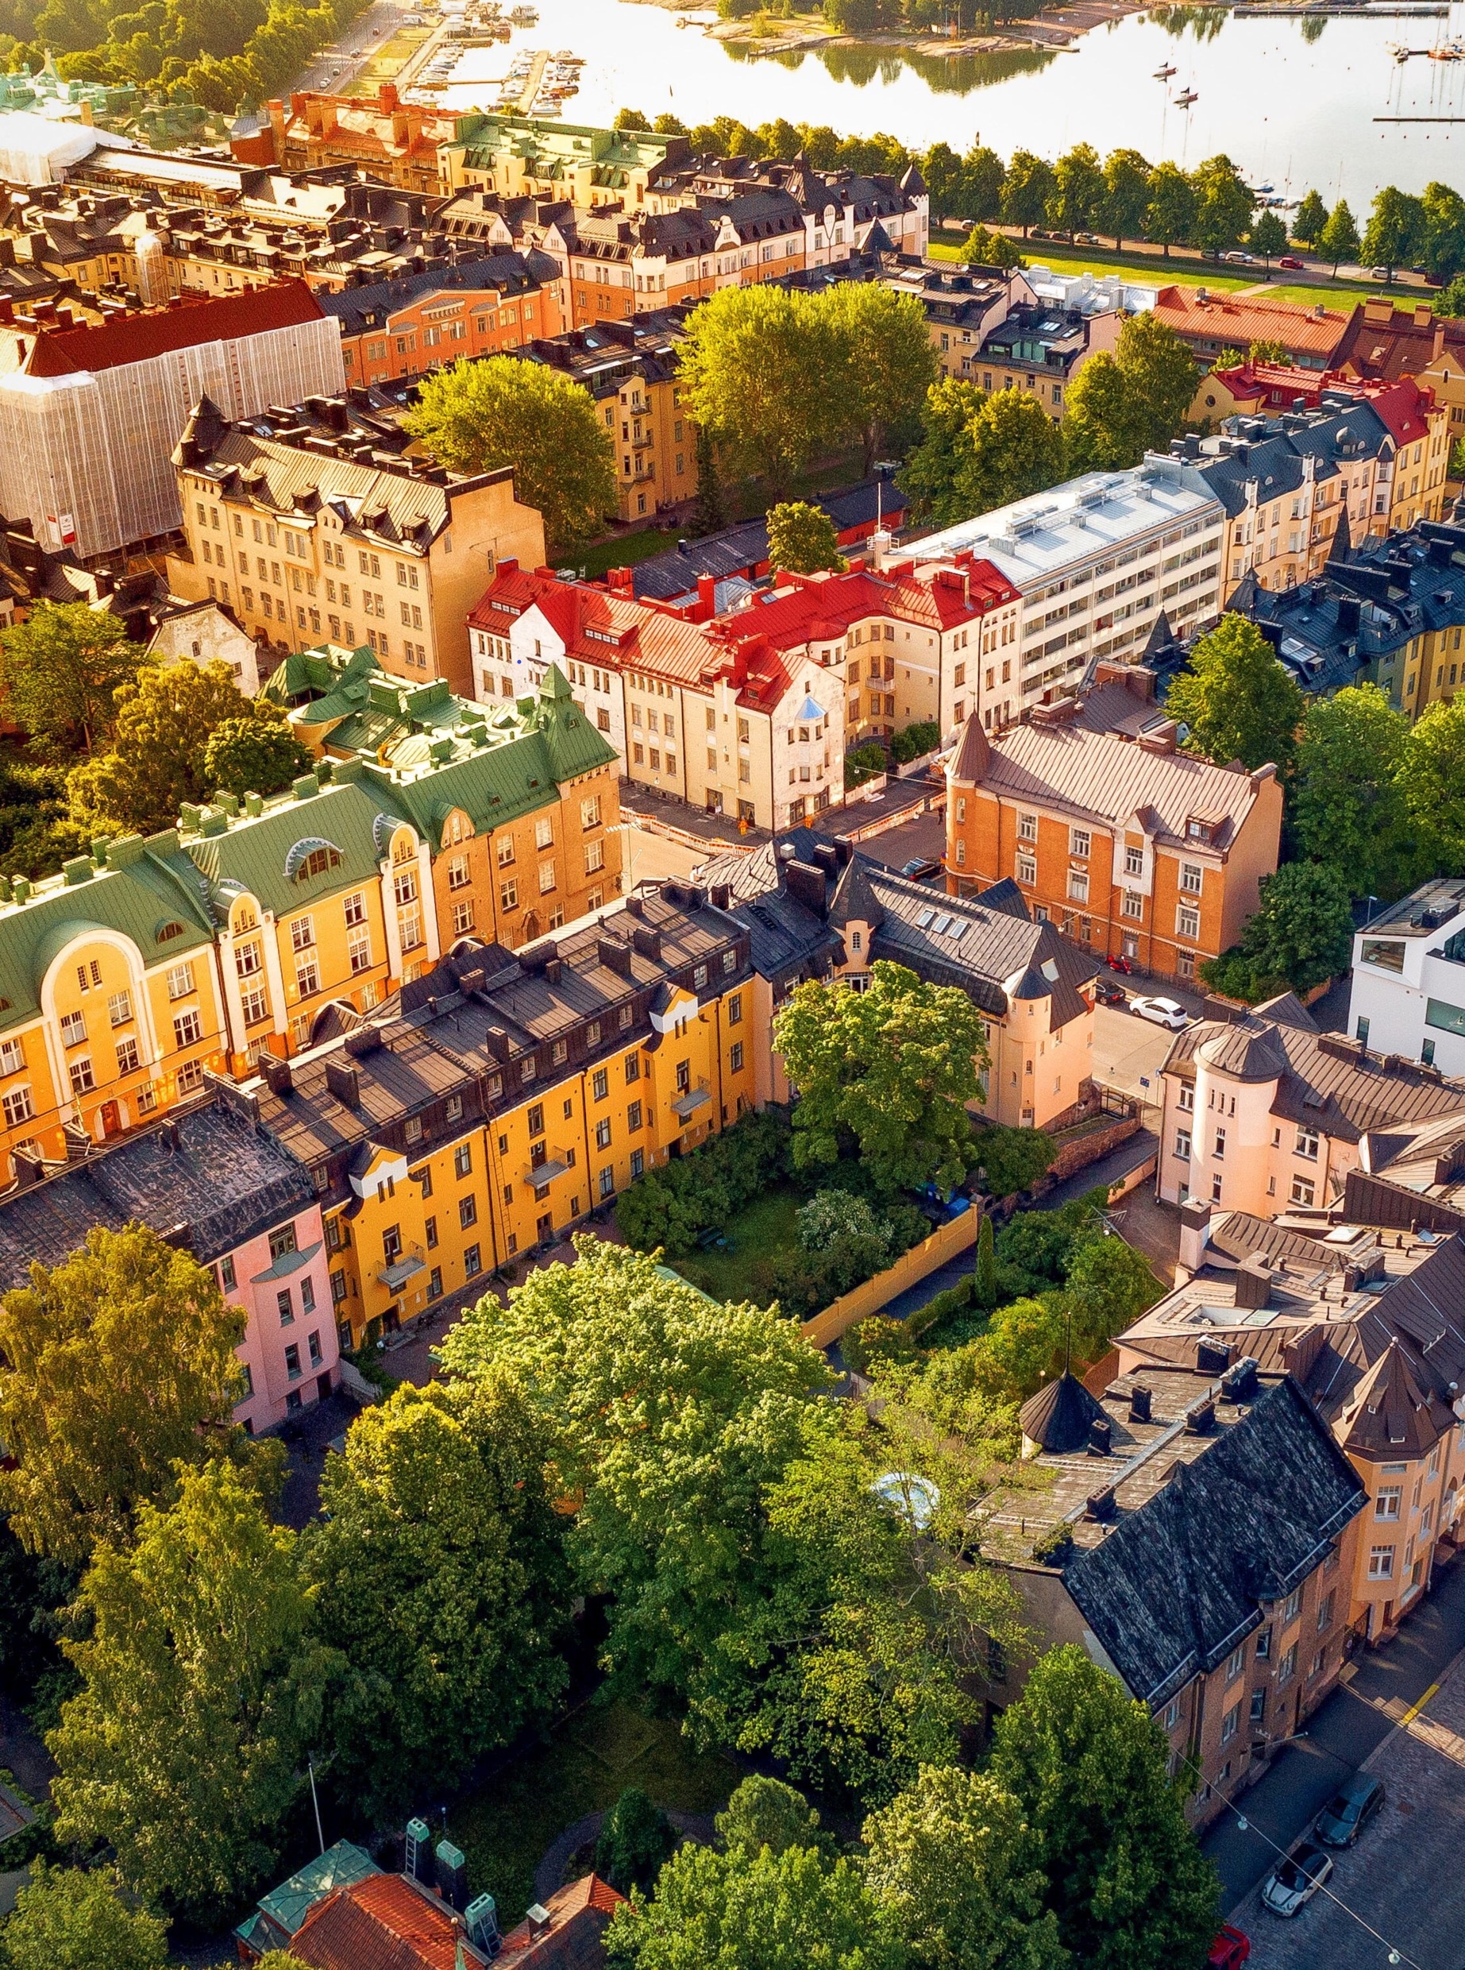

1
ST
MOST
STABLE
NATION
Finland is also very stable when measured by political, social, economic and cohesion indicators.
Fragile
States Index 2021
Notes:
Photo: Omar El Mrabt / Helsinki Partners

Slide 14

2
ND
press
freedom
The press is free in Finland. Press freedom entails media independence, pluralism, lack of self-censorship, transparency, good legislative framework and infrastructure.
Reporters
Without
Borders 2021
Notes:
Photo: Jules Hatfield & Christine Williams / Helsinki Partners

Slide 15
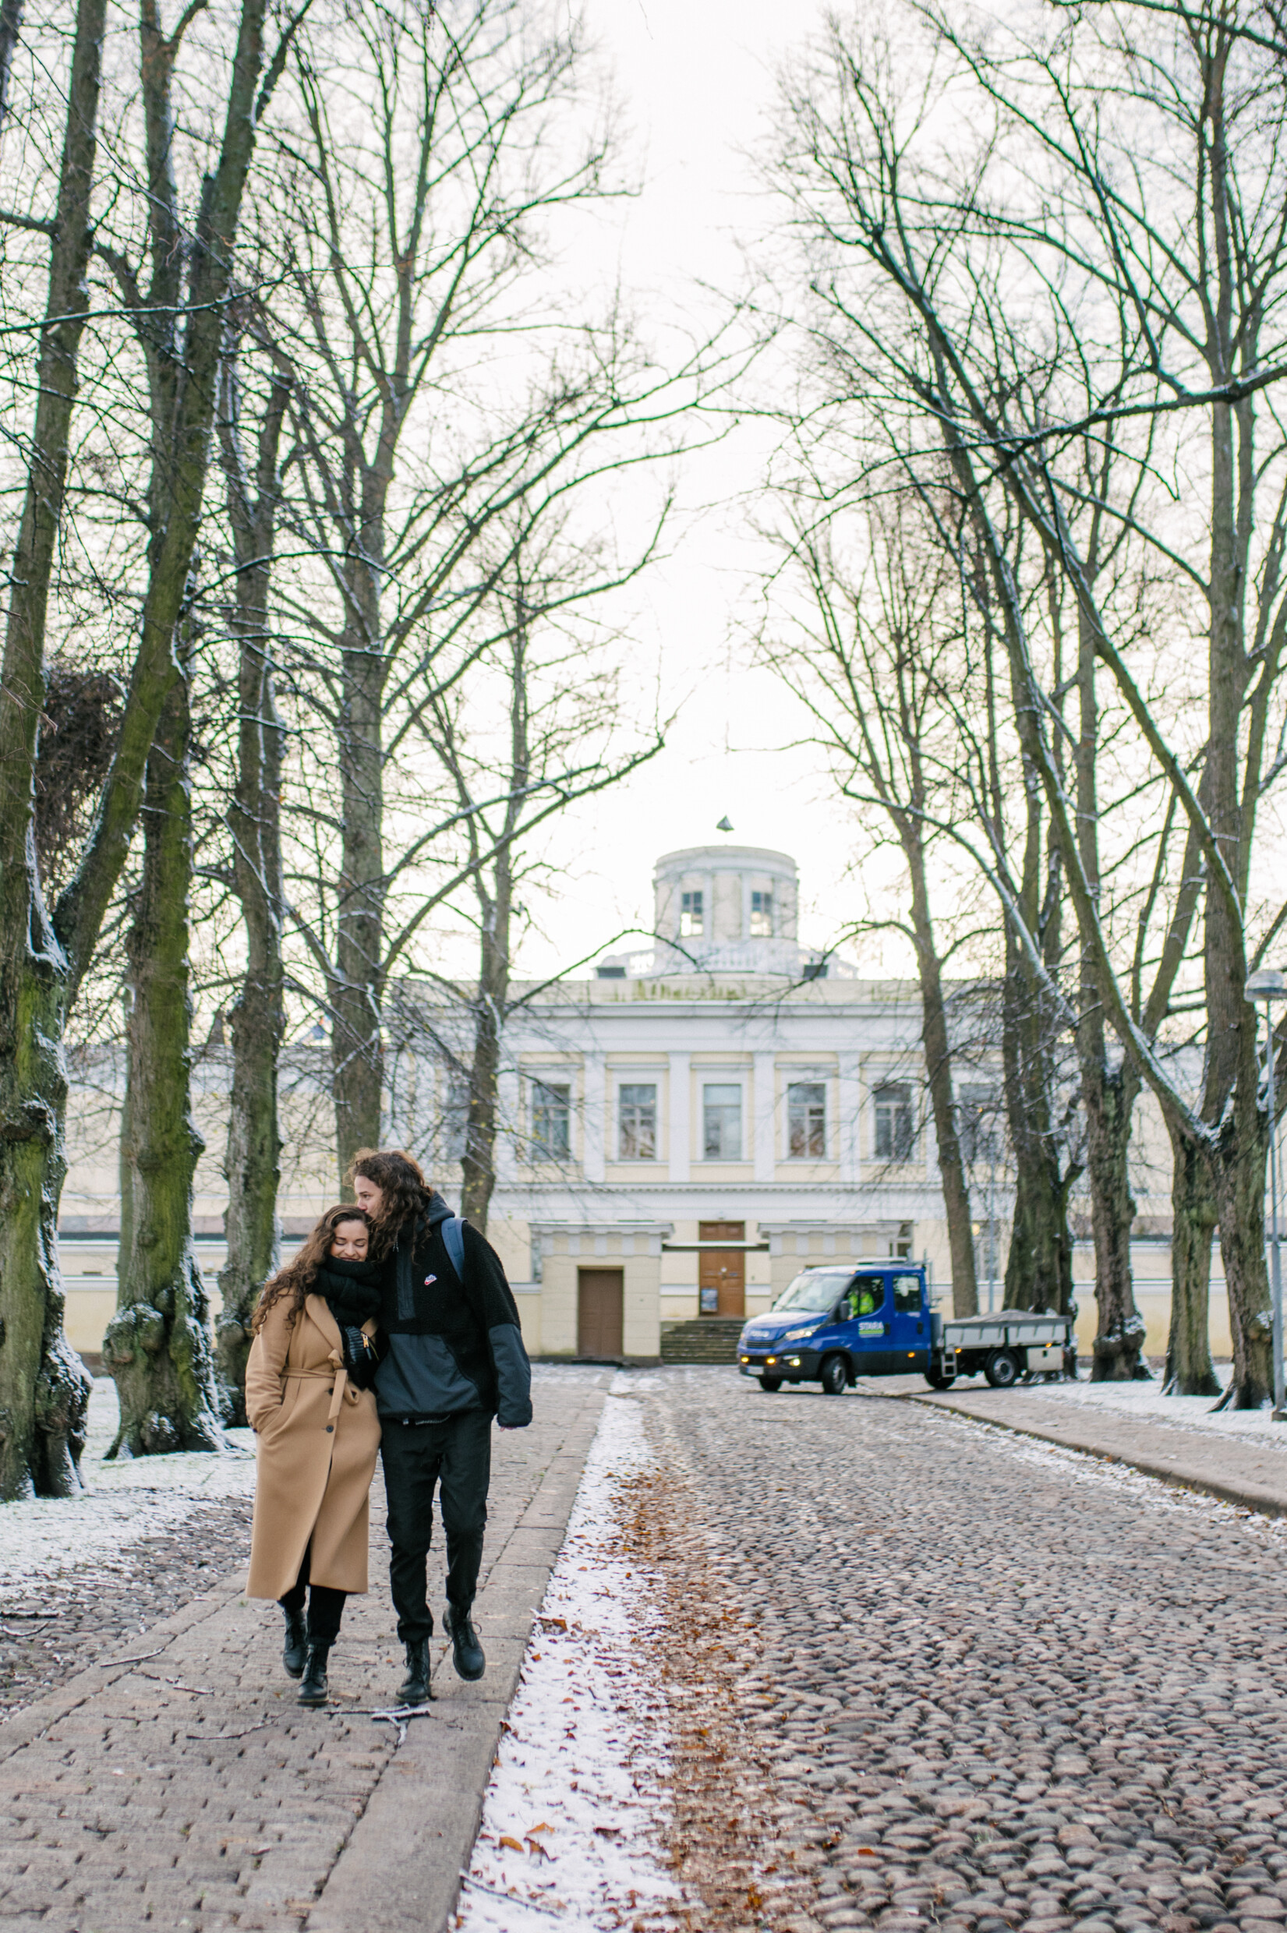
1
st
LEAST
CORRUPT
COUNTRY
And Finland measures the least amount of corruption in the world.
Corruption Perceptions Index 2021
Notes:
Photo: Shoot Hayley / City of Helsinki

Slide 16
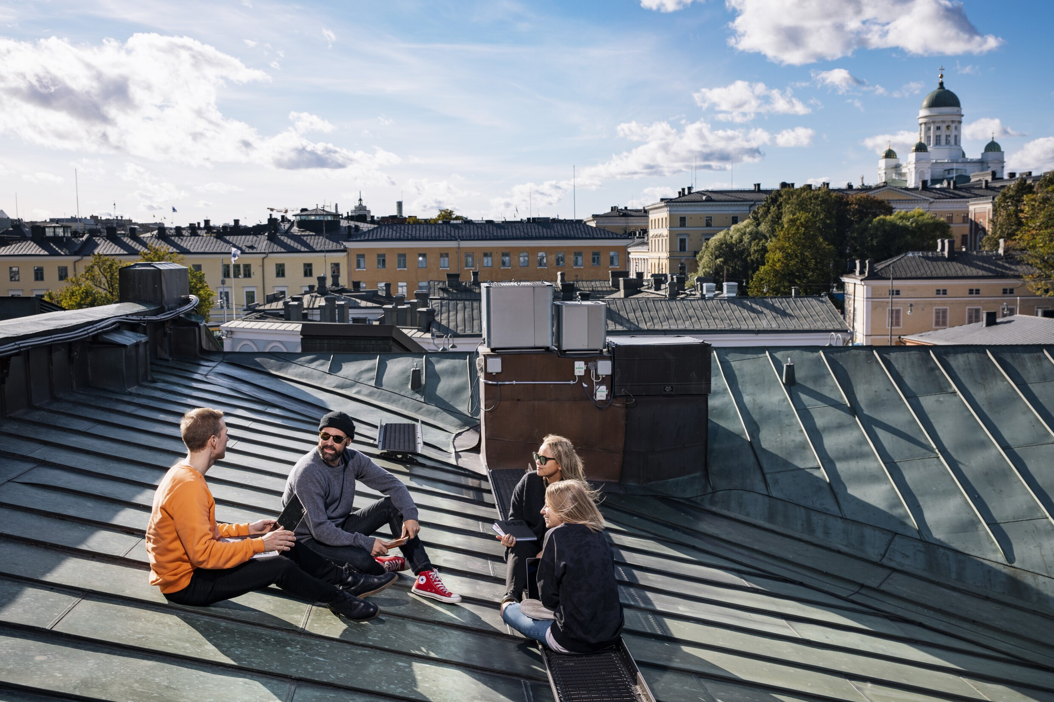
FINNS CAN TRUST THE SYSTEM AND EACH OTHER
Notes:
Photo: Jussi Hellstén / Helsinki Partners

Slide 17
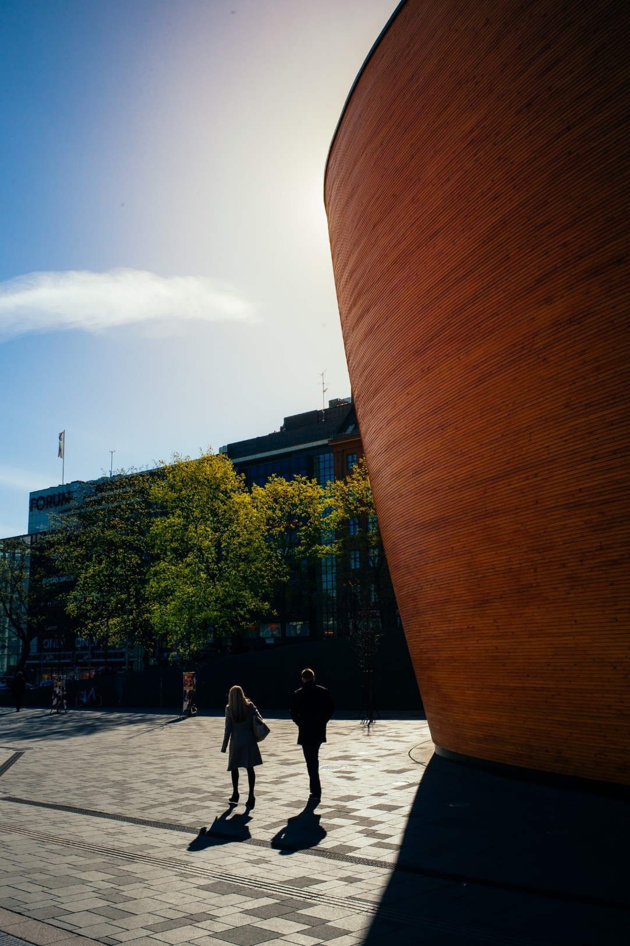
3
RD
TRUST IN INSTITUTIONS
Public institutions are trusted in Finland. People’s trust in institutions is a common indicator of public administrations’ performance.
Government
at a Glance 2021
Notes:
Photo: Jussi Hellstén / Helsinki Partners

Slide 18
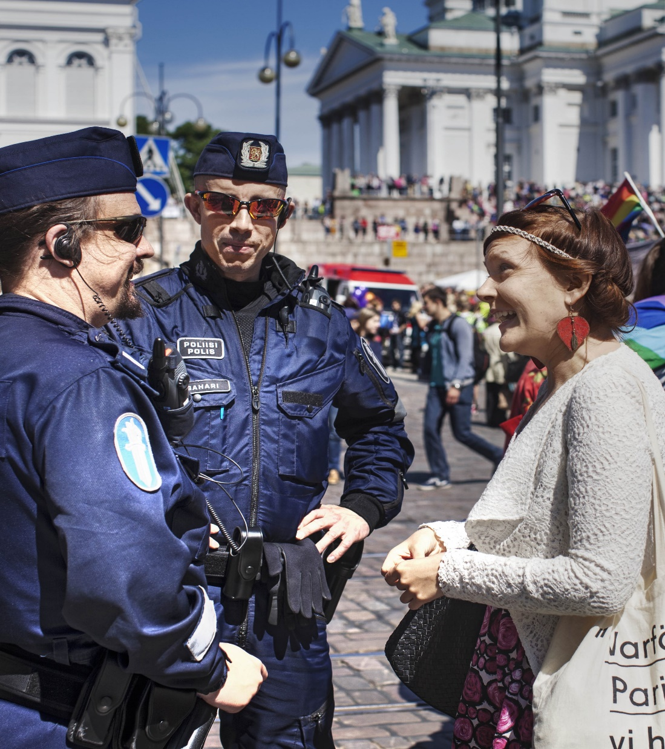

1
ST
TRUST IN
THE POLICE
The police are one of the most trusted institutions in Finland. More than 90% of Finns say they trust the police.
Government
at a Glance 2021
Notes:
Photo: Jukka Repo / Finland Image Bank
96% trust the army (2021)
https://www.oecd-ilibrary.org/governance/trust-in-government-the-civil-service-the-parliament-and-the-police-2018_c638e596-en

Slide 19
3
RD
SOCIAL CAPITAL
Trust in institutions is also a component of social capital. Other elements are high civic participation and strong personal and social relationships.
The Legatum Prosperity Index 2021
Notes:
Photo: Pasi Markkanen / Finland Image Bank

Slide 20
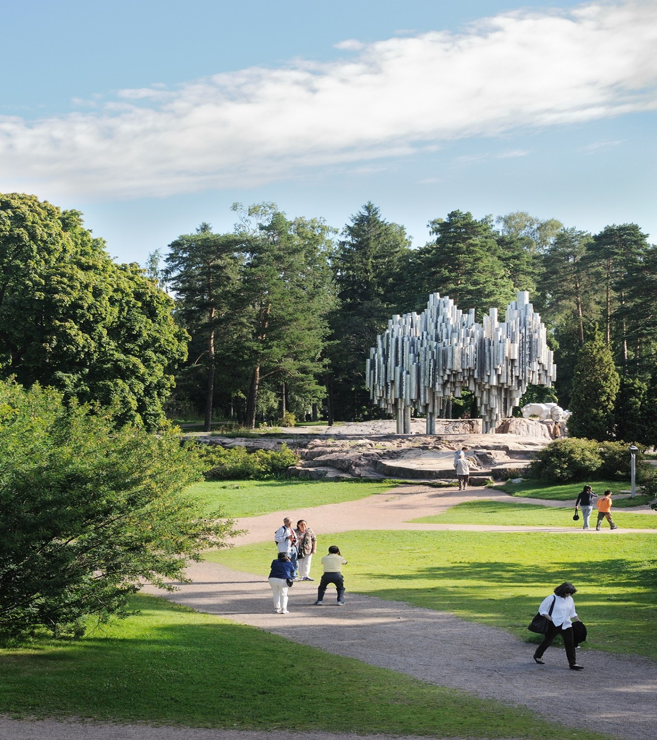

1
ST
TRUST IN
FELLOW
CITIZENS
85% of Finns agree or strongly agree that they can trust most of their fellow citizens. This is the highest percentage in Europe.
Eurobarometer 2018
Notes:
Photo: Paul Williams / Helsinki Partners

Slide 21
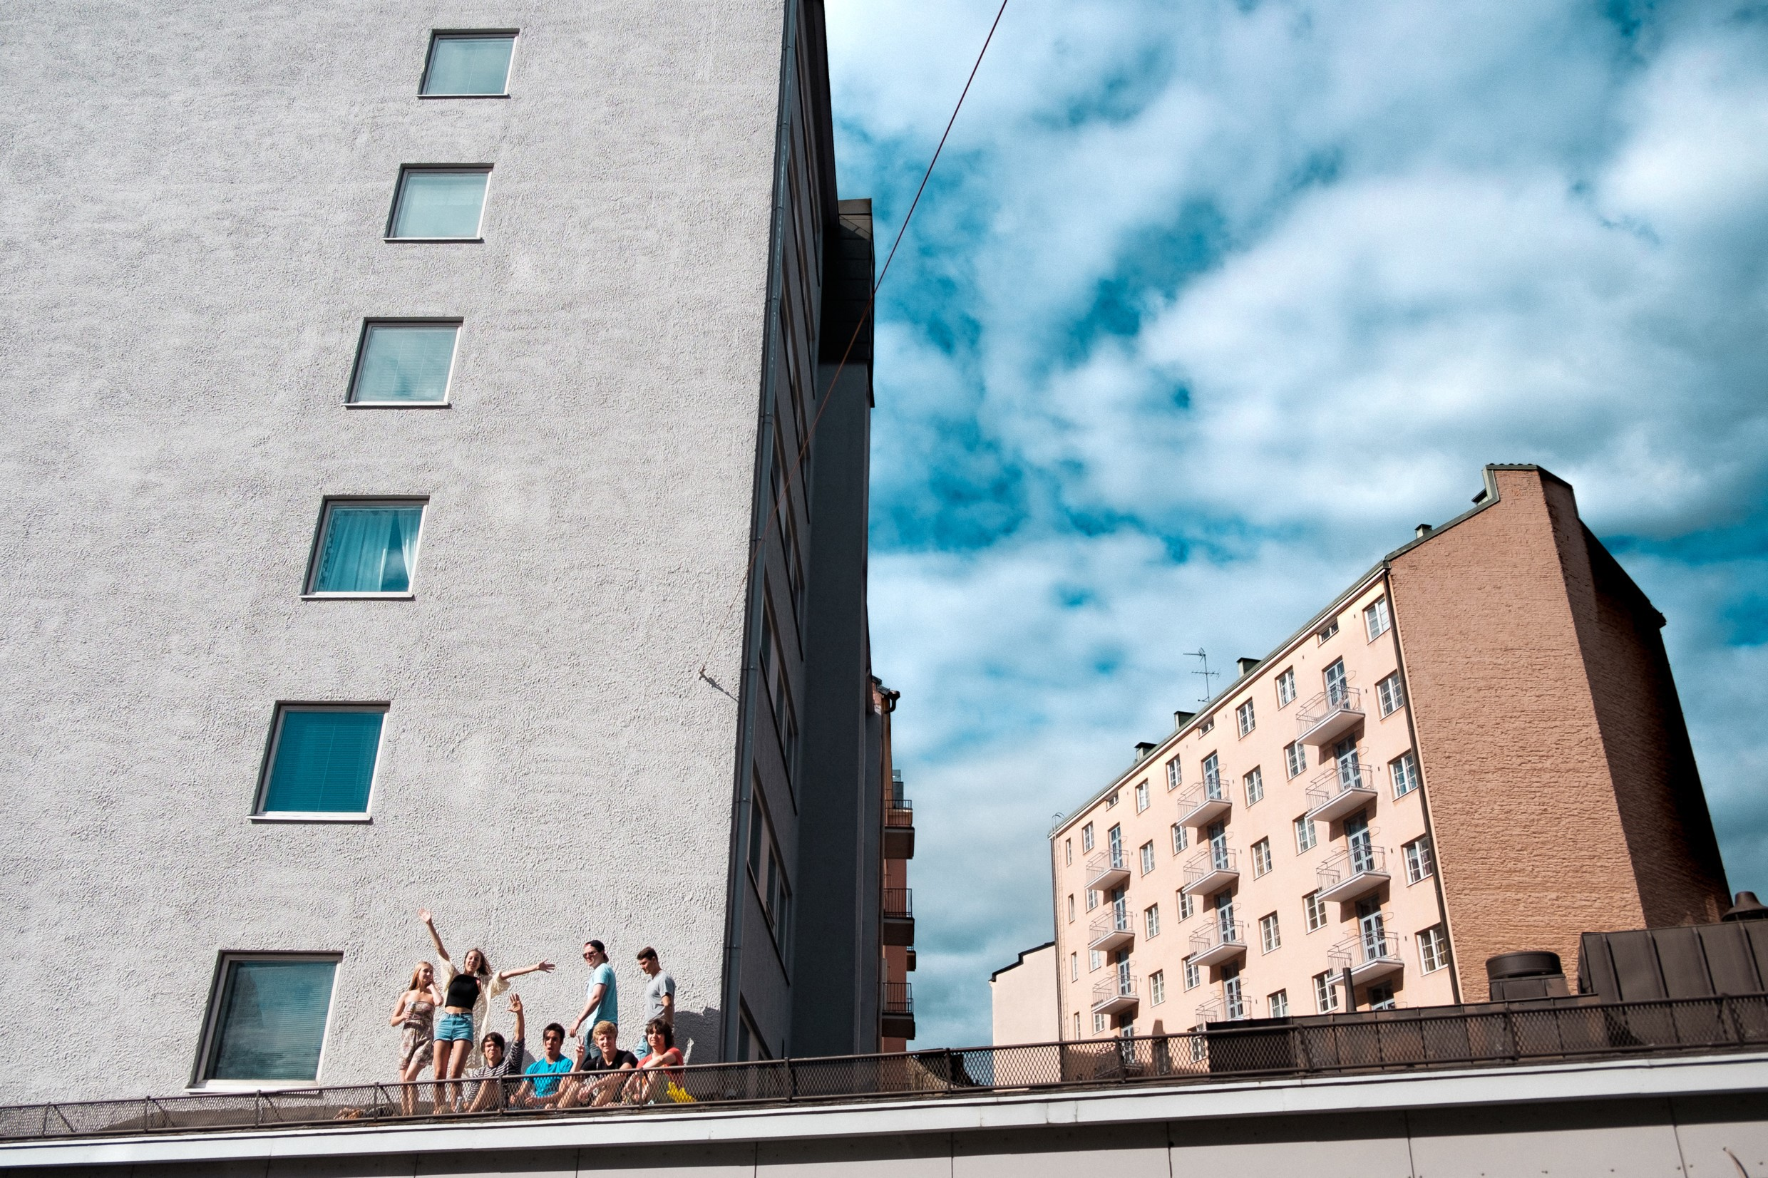
Trust comes easy when fairness is paired with equality
Notes:
Photo: Eetu Ahanen / Helsinki Partners

Slide 22
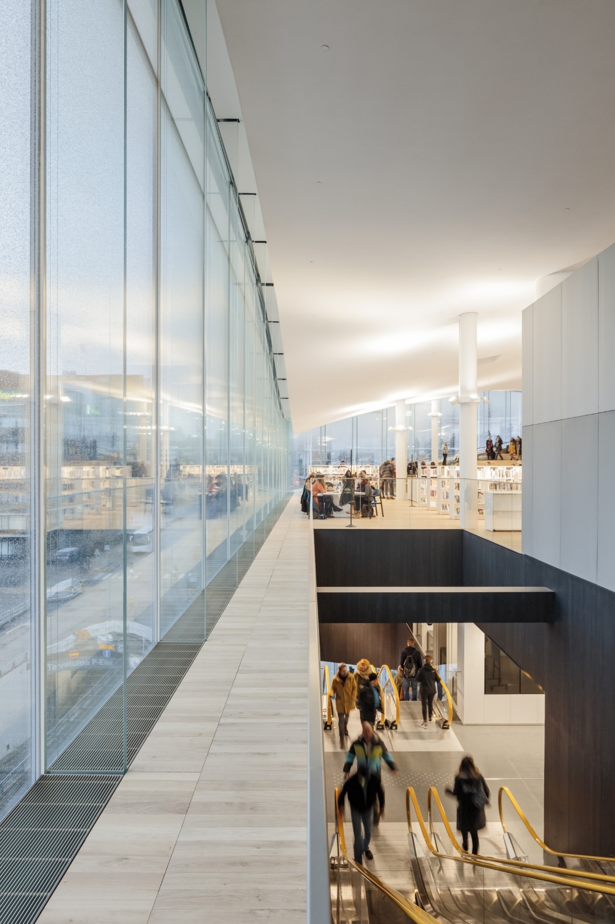
2
ND
MOST
INCLUSIVE
NATION
Finland places strong emphasis on social rights and equality. Basic welfare is a priority, as is equality of political power by gender, social group and socioeconomic position.
Social
Progress Index
2021
Notes:
Photo: Maija Astikainen / Helsinki Partners

Slide 23
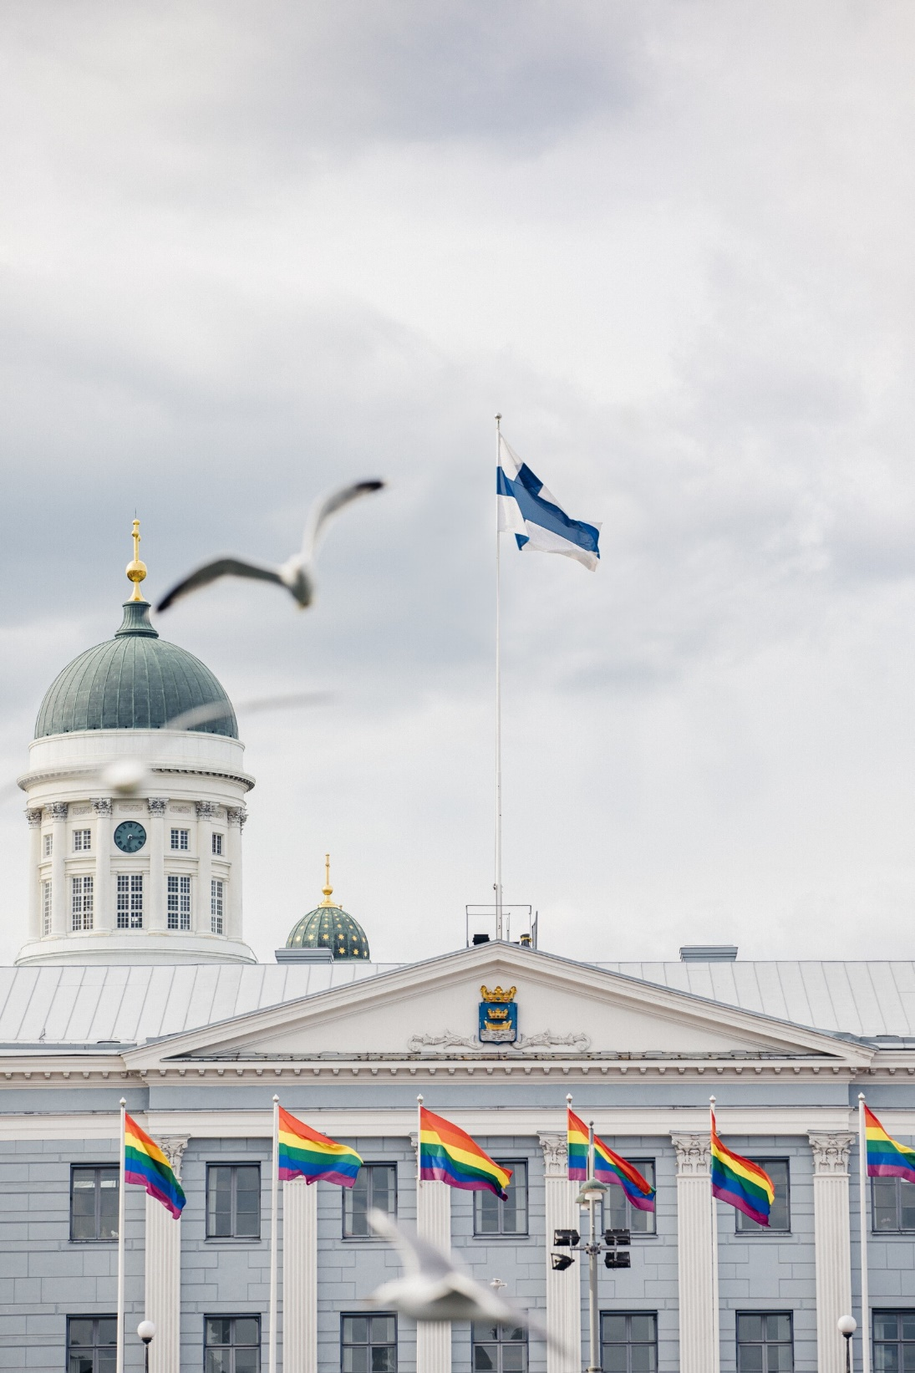
1
ST
MOST
INCLUSIVE
FOR MINORITIES
Inclusivity includes minorities, too. There is very little discrimination or violence against minorities, and a high acceptance of sexual minorities.
Social
Progress Index
2021
Notes:
Photo: Maija Astikainen / Helsinki Partners
https://www.socialprogress.org/?code=FIN&tab=2

Slide 24
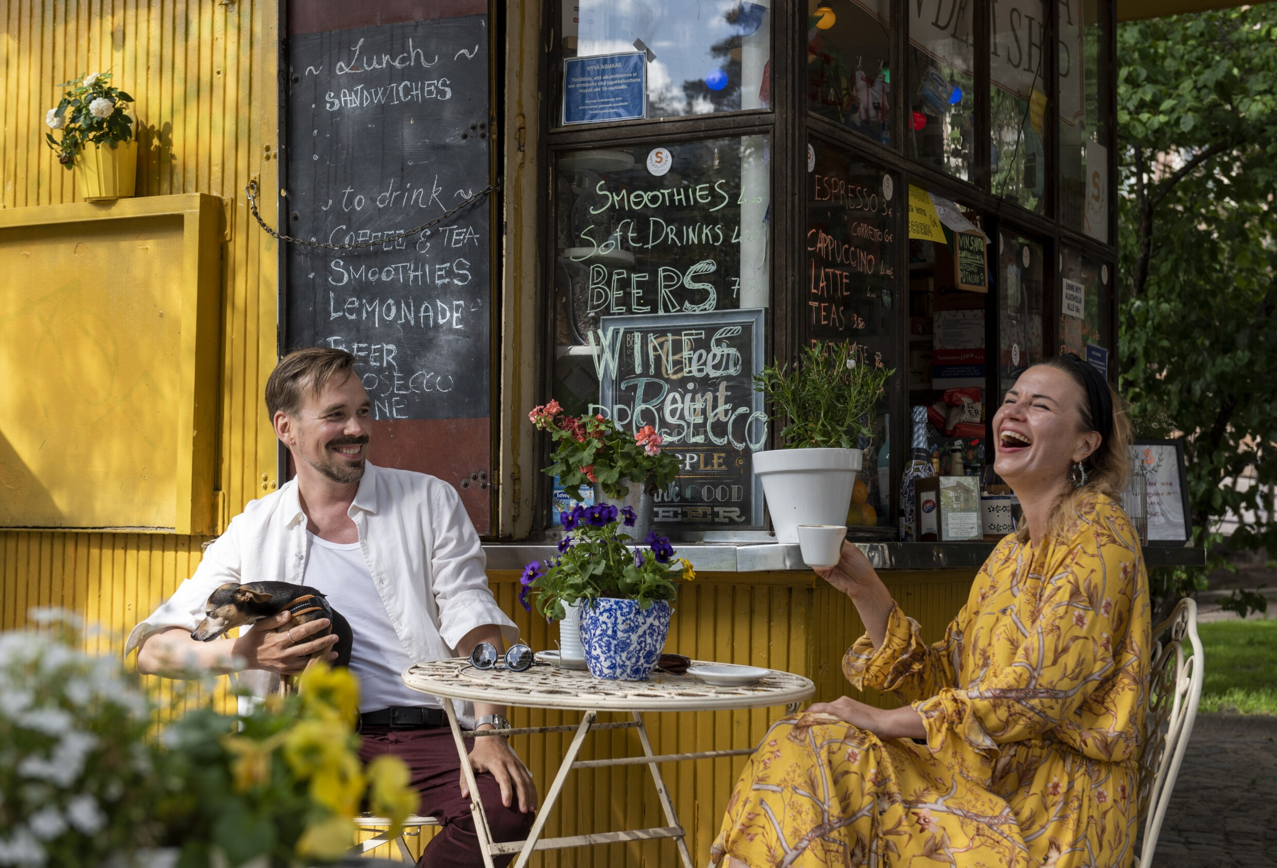
GENDER EQUALITY IS ONE OF THE CORE VALUES OF FINNISH SOCIETY
Notes:
Photo: Mikko Huotari / Visit Finland

Slide 25
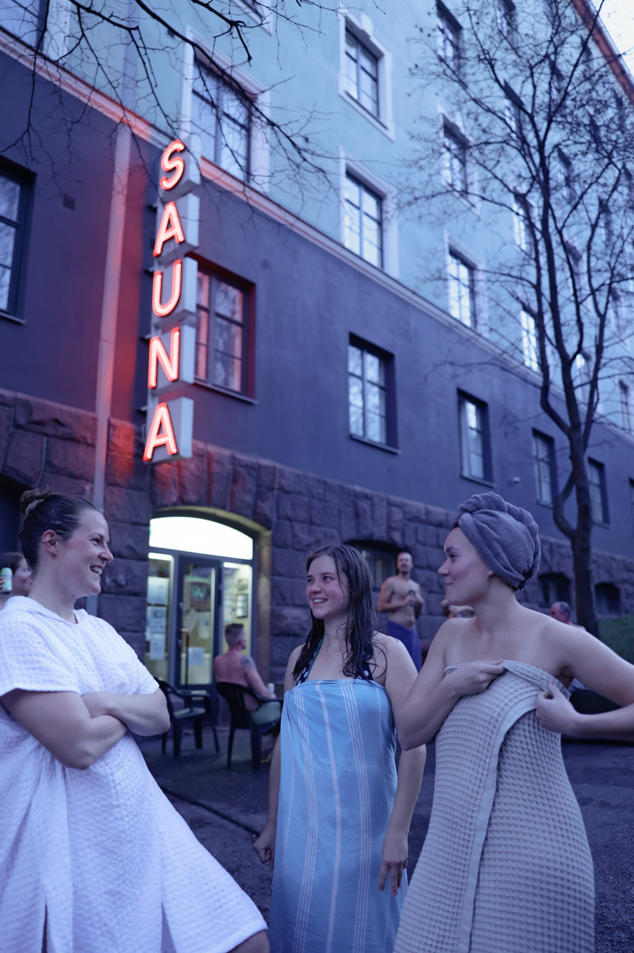

2
ND
GENDER
EQUALITY
Finland would not be the happiest country in the world had it not been for its strong commitment to equality.
Global Gender Gap Report 2021
Notes:
Photo: Maija Astikainen / Helsinki Partners

Slide 26
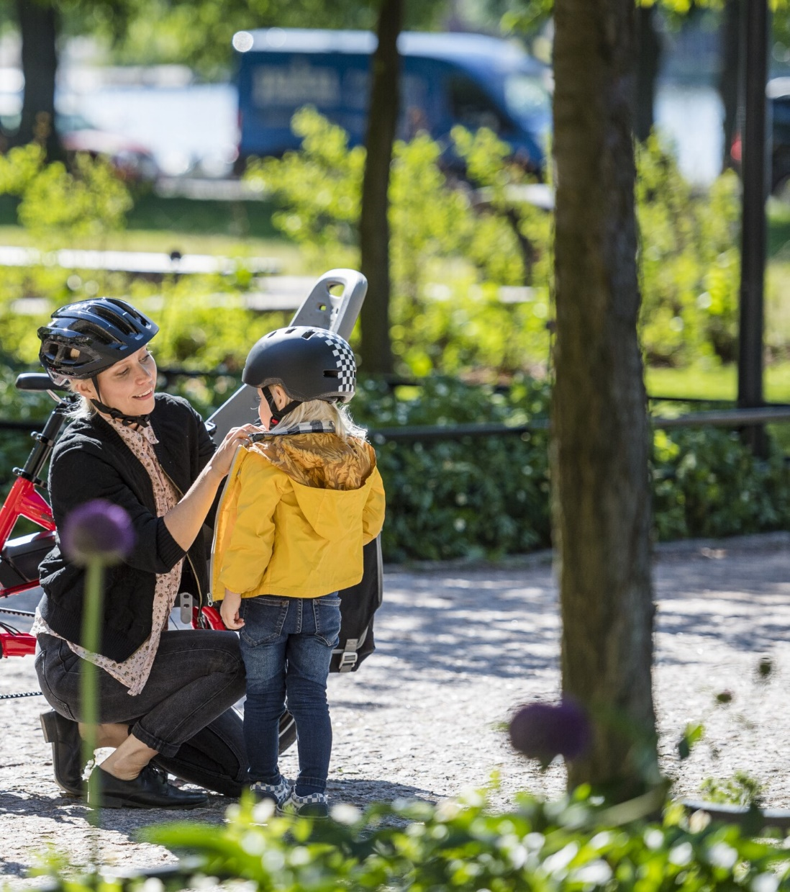
3
RD
BEST
COUNTRY FOR WORKING MOTHERS
Women make up 49% of the Finnish labour force.
Affordable child care and strong maternity rights make it easy for mothers to have a career in Finland.
The Economist Glass-Ceiling Index 2021
Notes:
Photo: Tern Bicycles

Slide 27
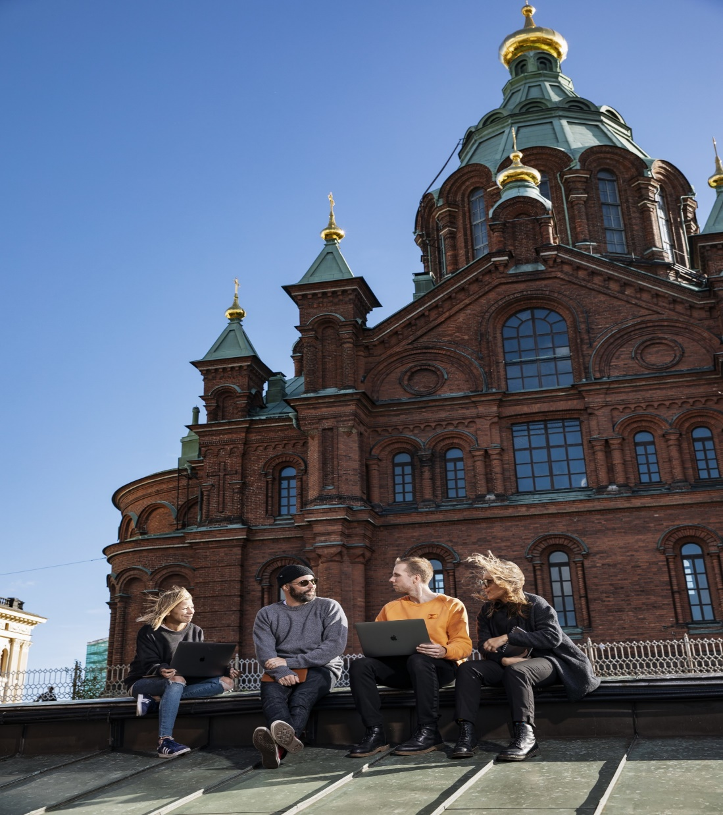

1
ST
WORK-LIFE
BALANCE
A working life that includes parental leave, flexible hours and remote work makes it easy for parents – and everyone else – to combine work with personal life.
Kisi Work–Life Balance Index 2021
Notes:
Photo: Jussi Hellstén / Helsinki Partners

Slide 28
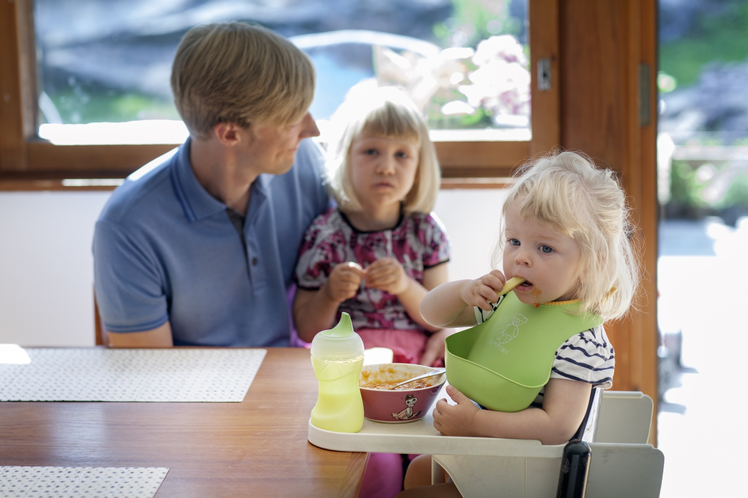
Women and men are equal – both at work and at home.
80% of Finnish dads
take paid parental leave.
Notes:
Photo: Jukka Rapo / Kuvatoimisto Keksi / Finland Image Bank

Slide 29

1
ST
For time dads spend with children
Finland is also the only country in the developed world where fathers spend more time with their school-aged children than mothers do.
The Pursuit of Gender Equality
2017 (OECD)
Notes:
Photo: Maija Astikainen / City of Helsinki

Slide 30

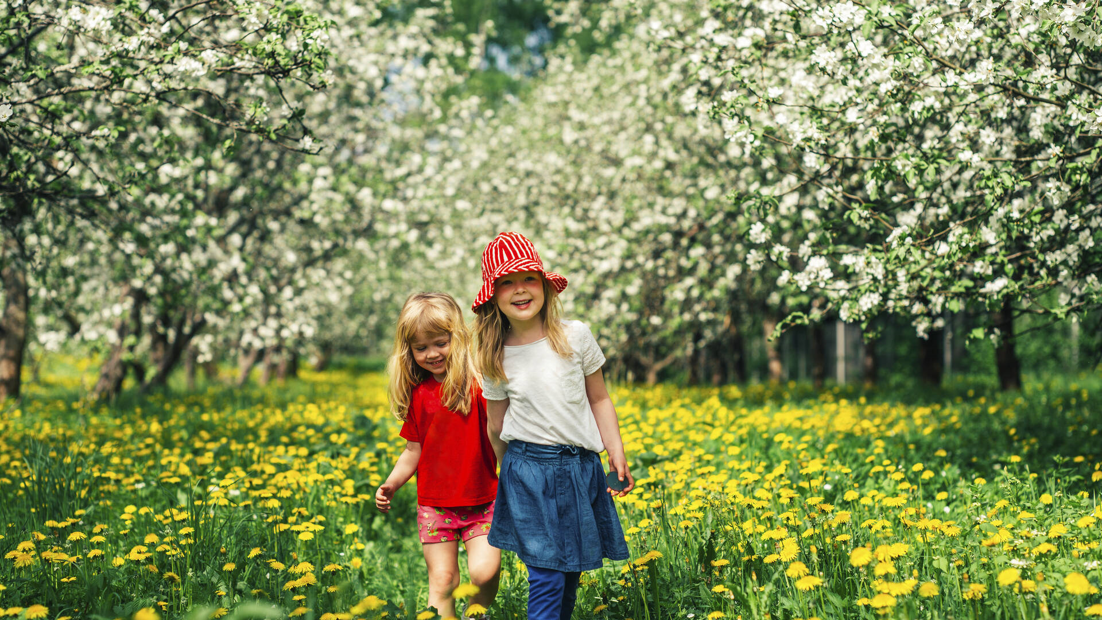
EVERYONE GETS AN
EQUAL START IN FINLAND
CLOSENESS TO
NATURE FOSTERS WELLBEING
Notes:
Photo: Pasi Markkanen / Finland Image Bank

Slide 31
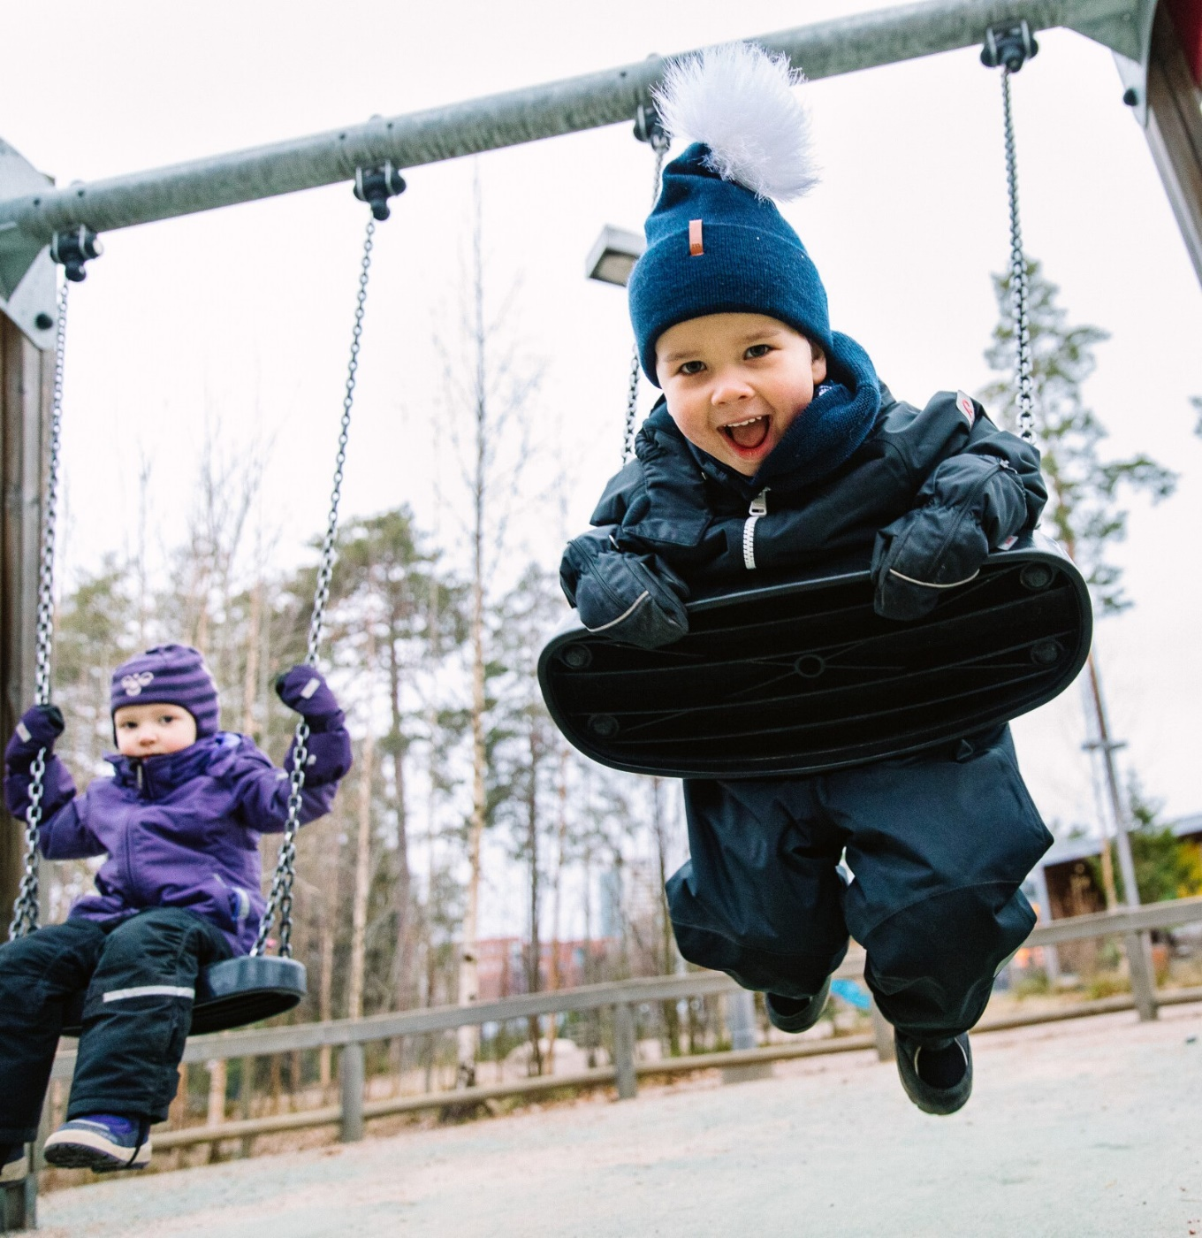
3
RD
CHILDREN’s
RIGHTS
Happiness starts at birth. Finland is committed to protecting, respecting and continually improving the rights of children.
KidsRights Index
2021
Notes:
Photo: Lauri Rotko / Helsinki Partners
LIFE • Under five mortality rate • Life expectancy at birth • Maternal mortality ratio
HEALTHCARE • % of under five year olds suffering from underweight • Immunization of one year old children • % of population using improved sanitation facilities (urban and rural) • % of population using improved drinking water sources (urban and rural)
EDUCATION • Expected years of schooling of girls • Expected years of schooling of boys • Gender inequality in expected years of schooling (absolute difference between girls and boys)
PROTECTION • Child labour • Adolescent birth rate • Birth registration
CHILD RIGHTS ENVIRONMENT • Non-discrimination • Best interests of the child • Enabling legislation • Best available budget • Respect for the views of the child/child participation • Collection and analysis of disaggregate data • State-civil society cooperation for child rights participation

Slide 32
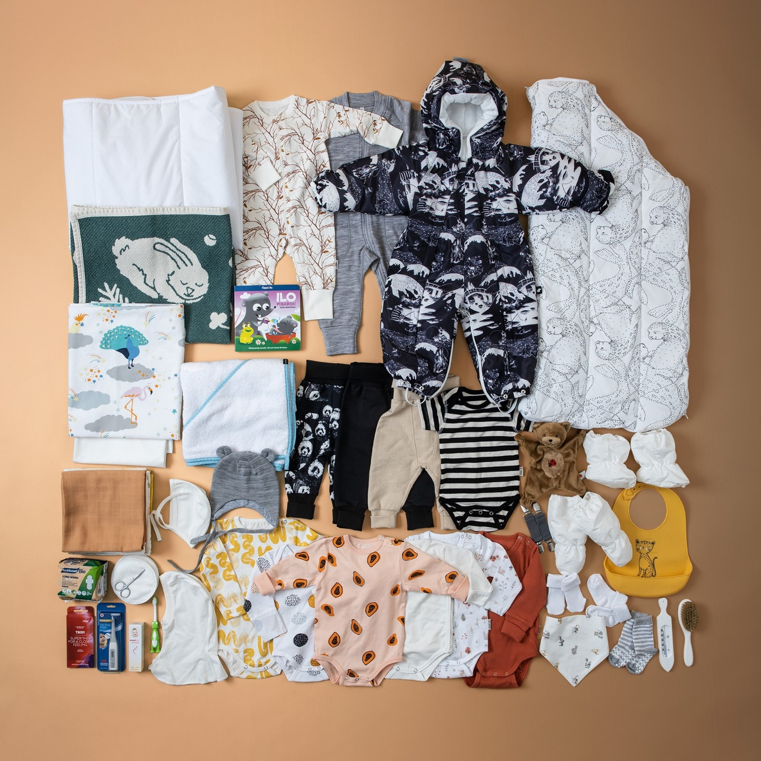
To guarantee a more equal start to life, every child in Finland is welcomed into the world with a maternity package containing clothing and baby-care products.
Notes:
Photo: Kela

Slide 33
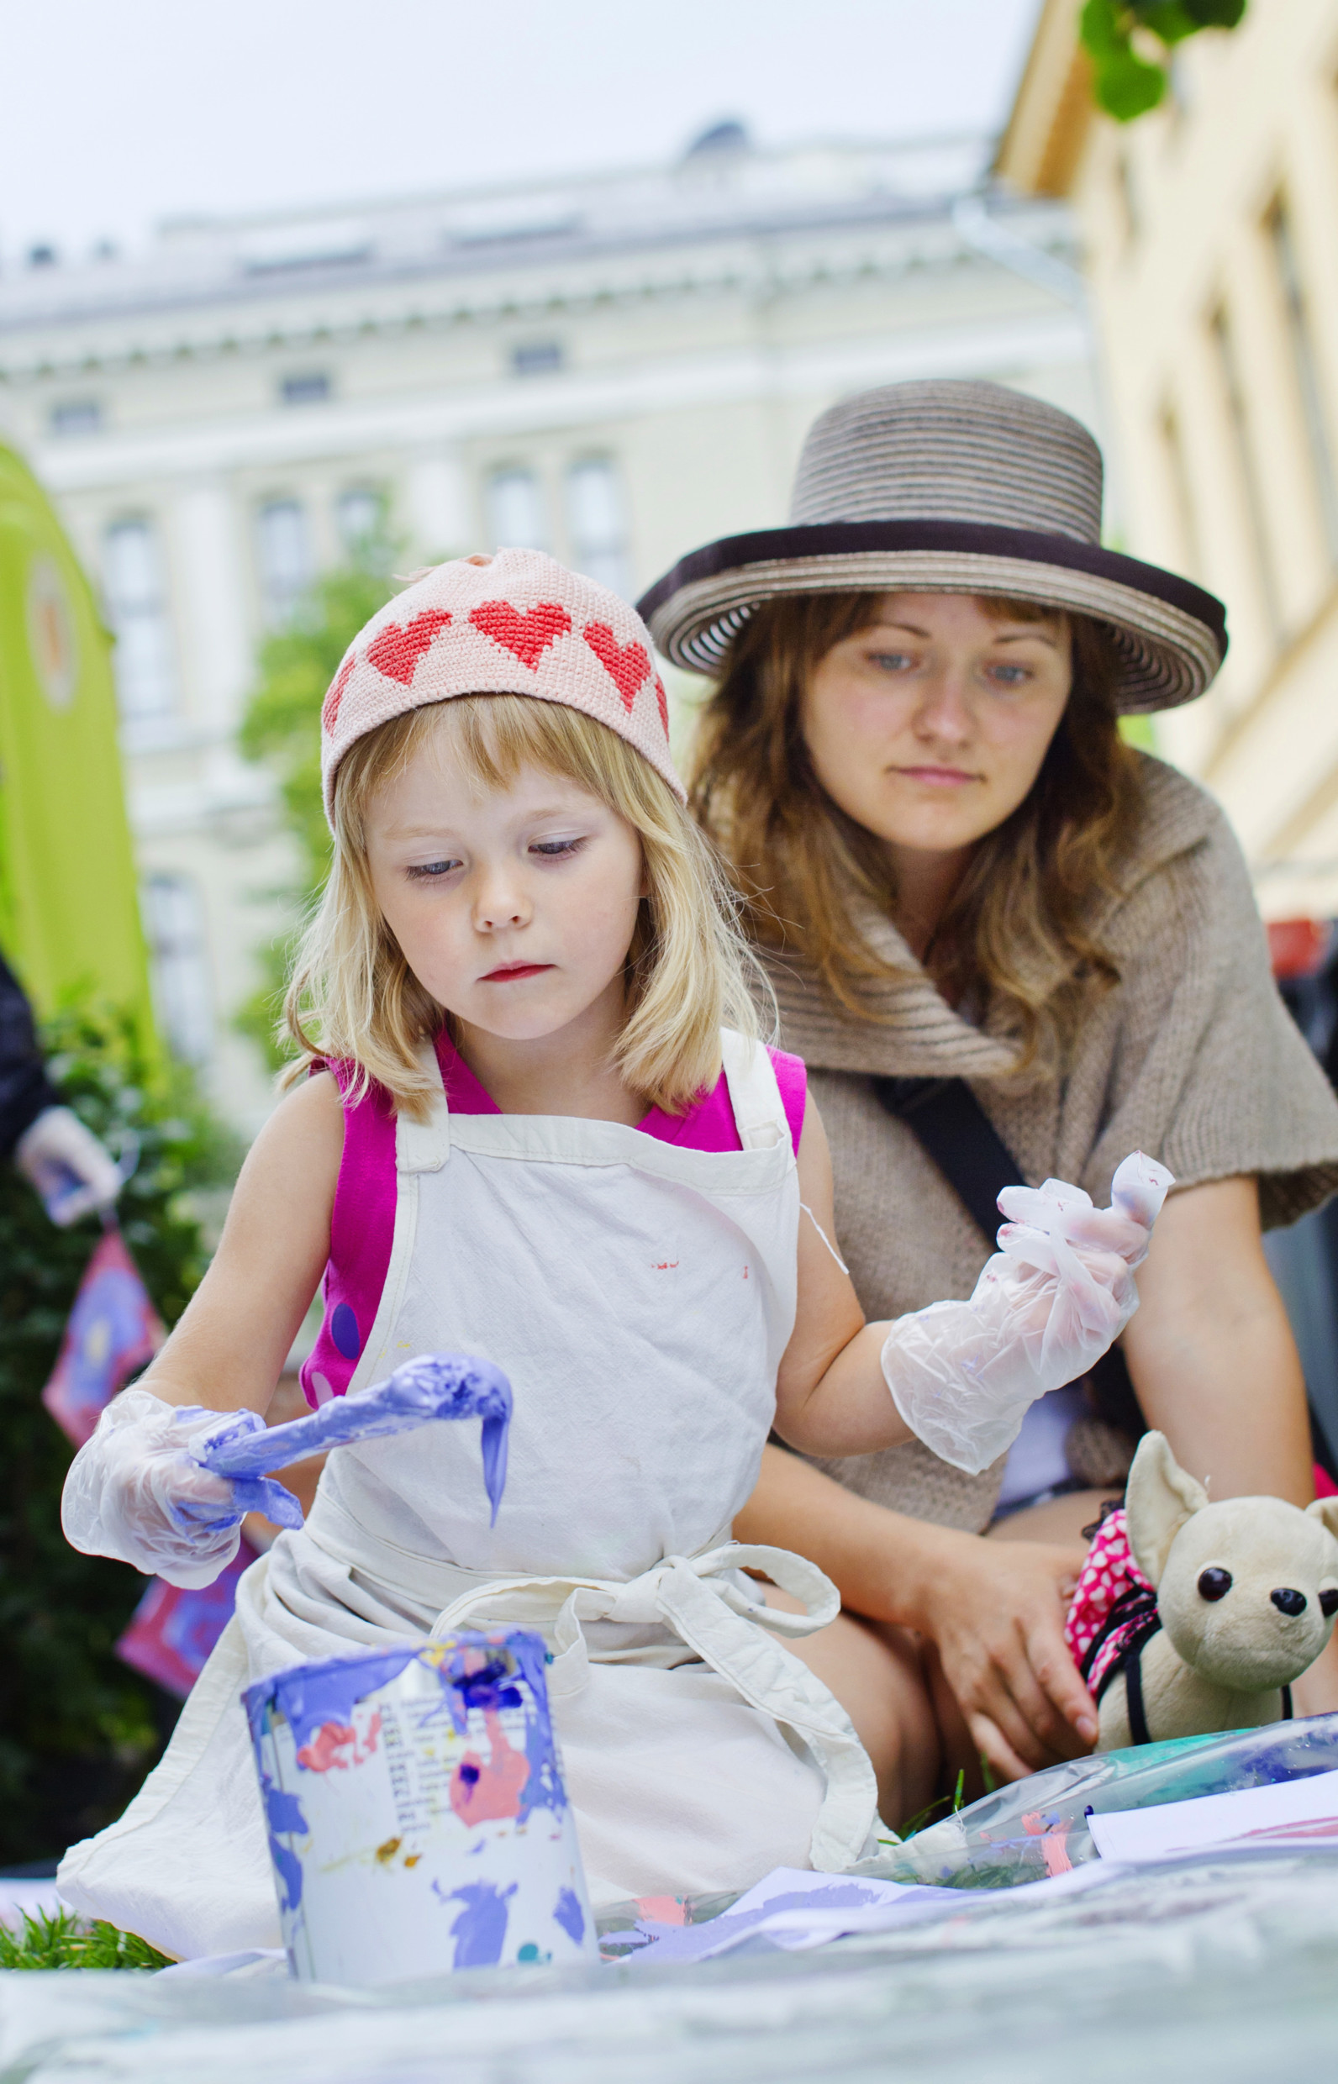
2
ND
BEST
COUNTRY TO
BE A MOTHER
An equal start for everyone requires healthy and happy mothers. Finland offers free prenatal care for mothers and nearly a year of paid parental leave when the child is born.
State of The World’s Mothers Report
2015 (UNICEF)
Notes:
Photo: Lauri Rotko / Helsinki Partners

Slide 34
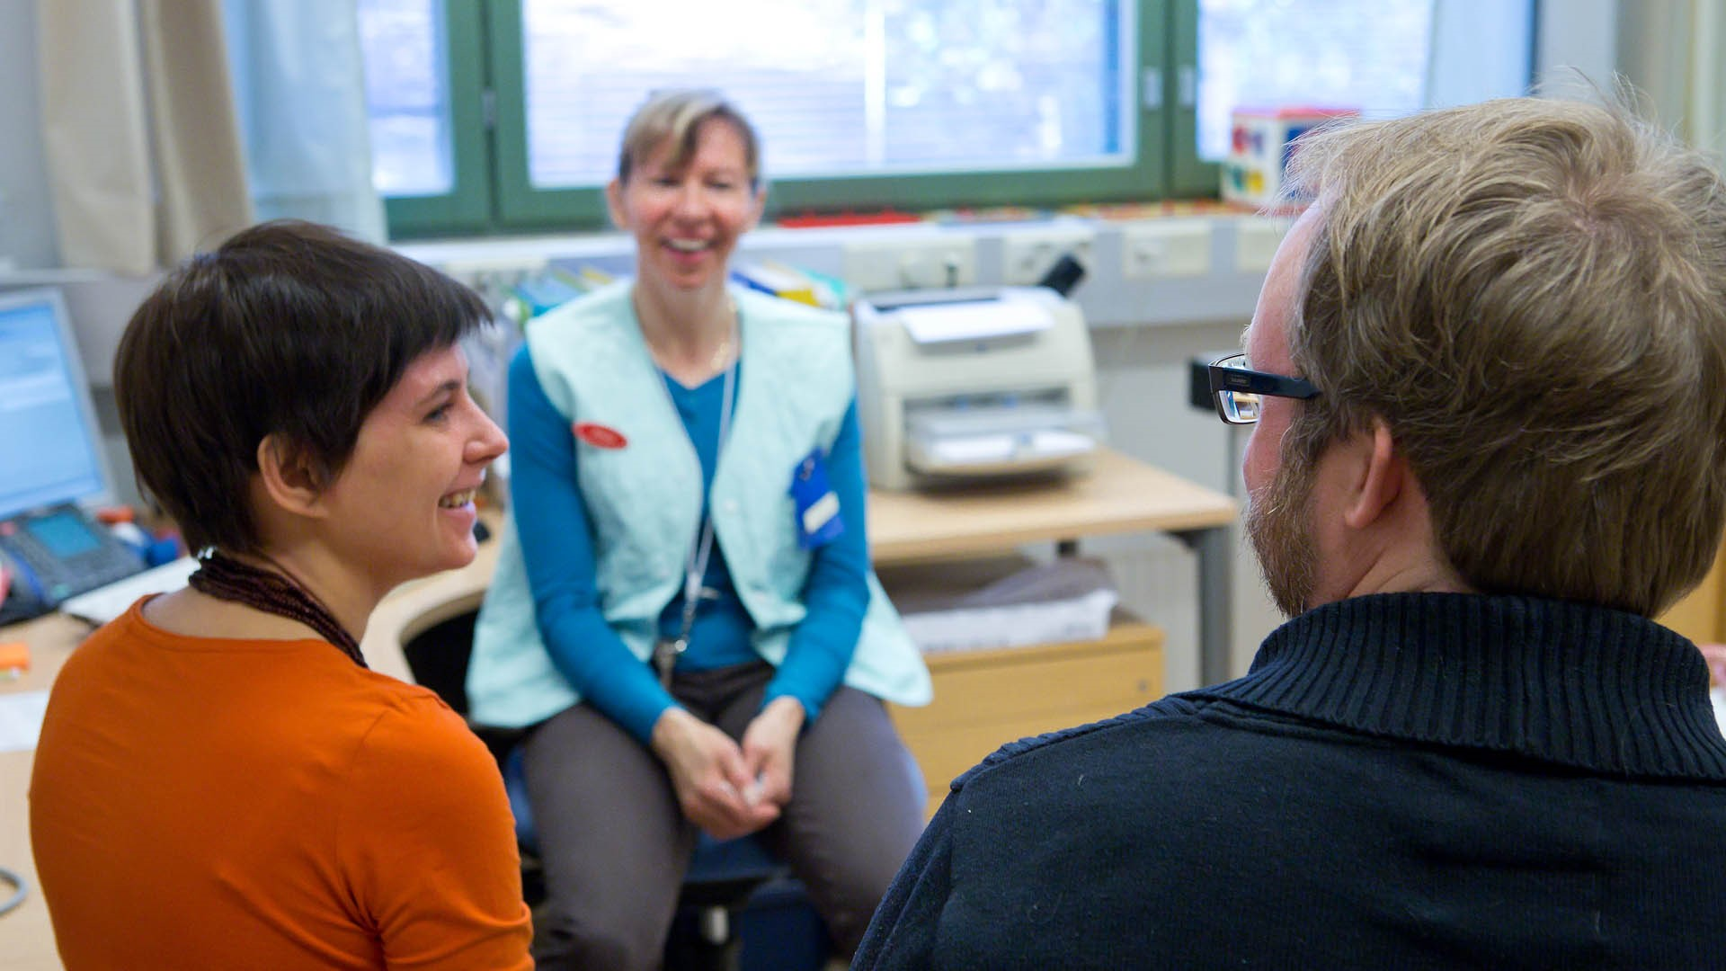
All children and their families are provided with healthcare and practical advice free of charge at neuvola, a national network of maternity and child health clinics.
Notes:
Photo: Riitta Supperi / Kuvatoimisto Keksi / Finland Image Bank

Slide 35
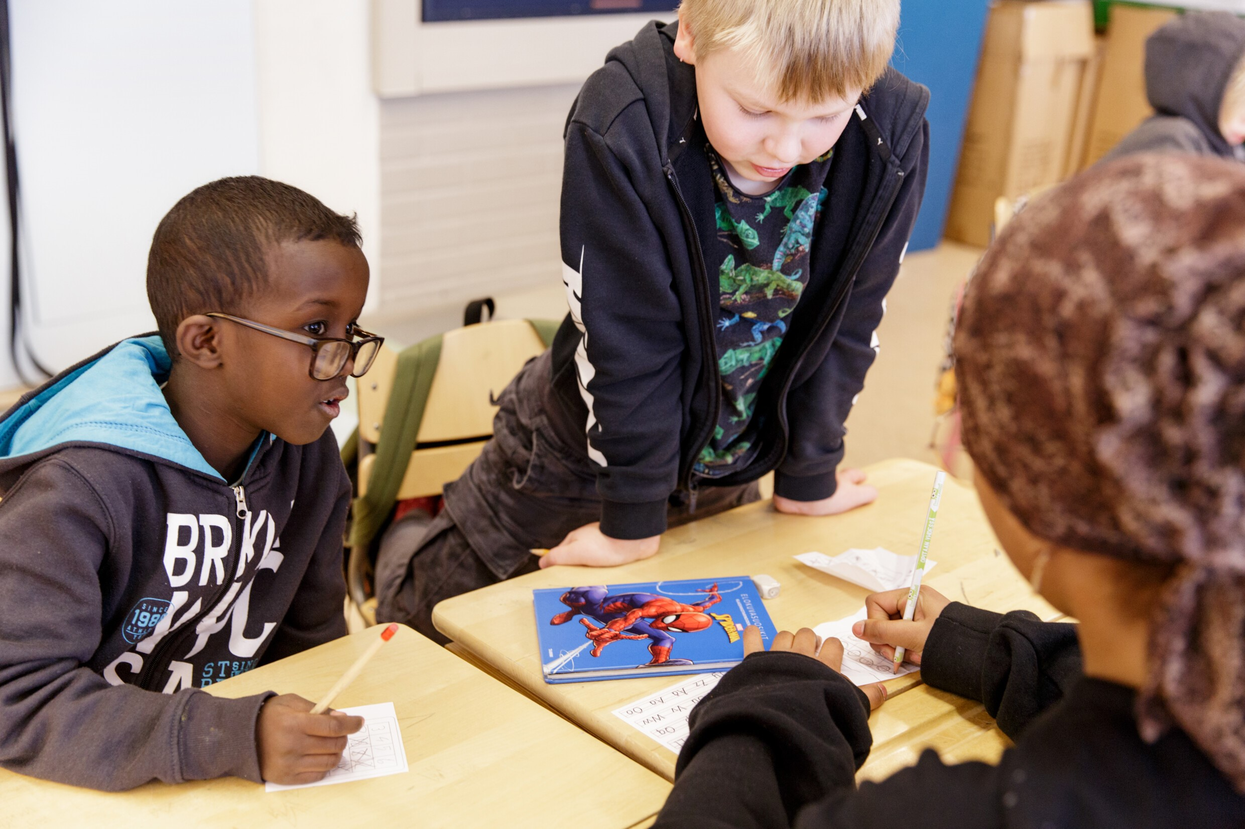
EVERYONE CAN REALISE THEIR POTENTIAL
Notes:
Photo: Maija Astikainen / City of Helsinki

Slide 36
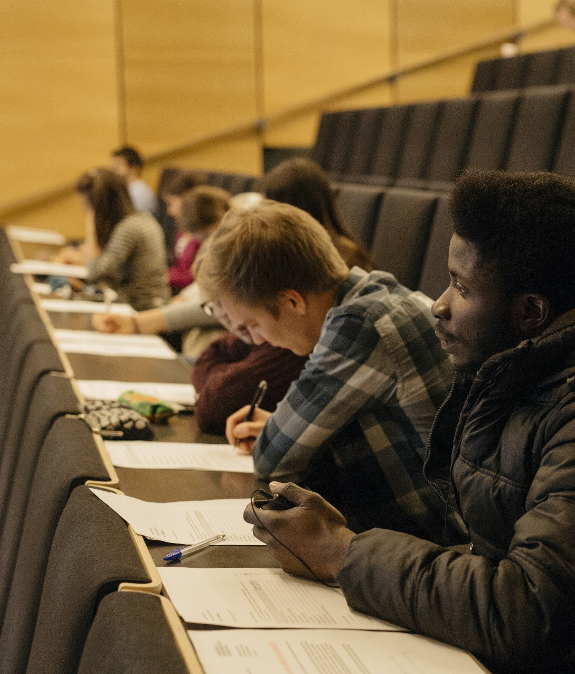

1
ST
EDUCATION
Equality also means equal access to education. Education is free for everyone from preschool to higher education. This means that everyone has the right to go attend university tuition-free.
OECD Better Life Index 2021
Notes:
Photo: Elina Manninen / Kuvatoimisto Keksi / Finland Image Bank

Slide 37
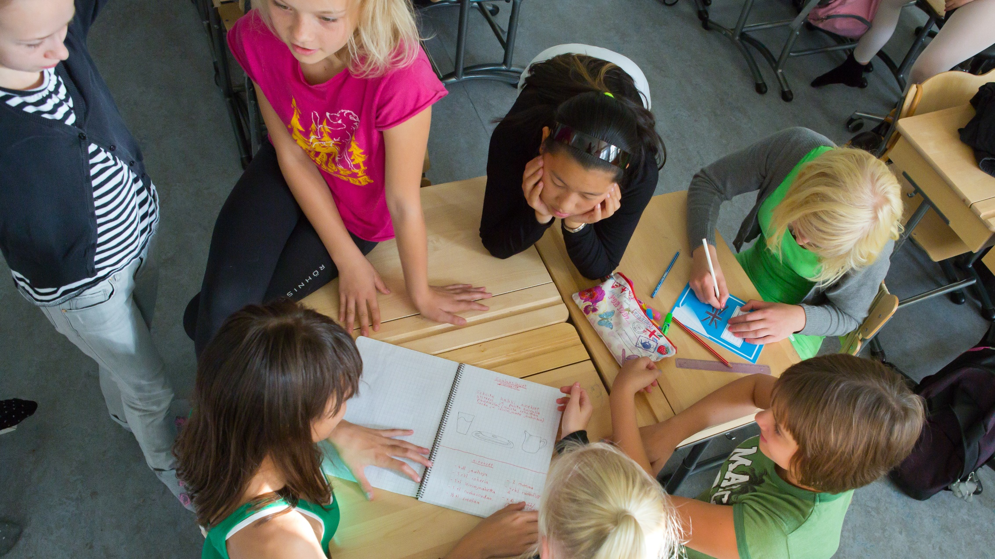
And Finns are happy studying, too. According to the OECD’s PISA study, Finland is the only nation where both students’ reading skills and their satisfaction with life are at a high level.
Notes:
Photo: Riitta Supperi / Kuvatoimisto Keksi / Finland Image Bank

Slide 38
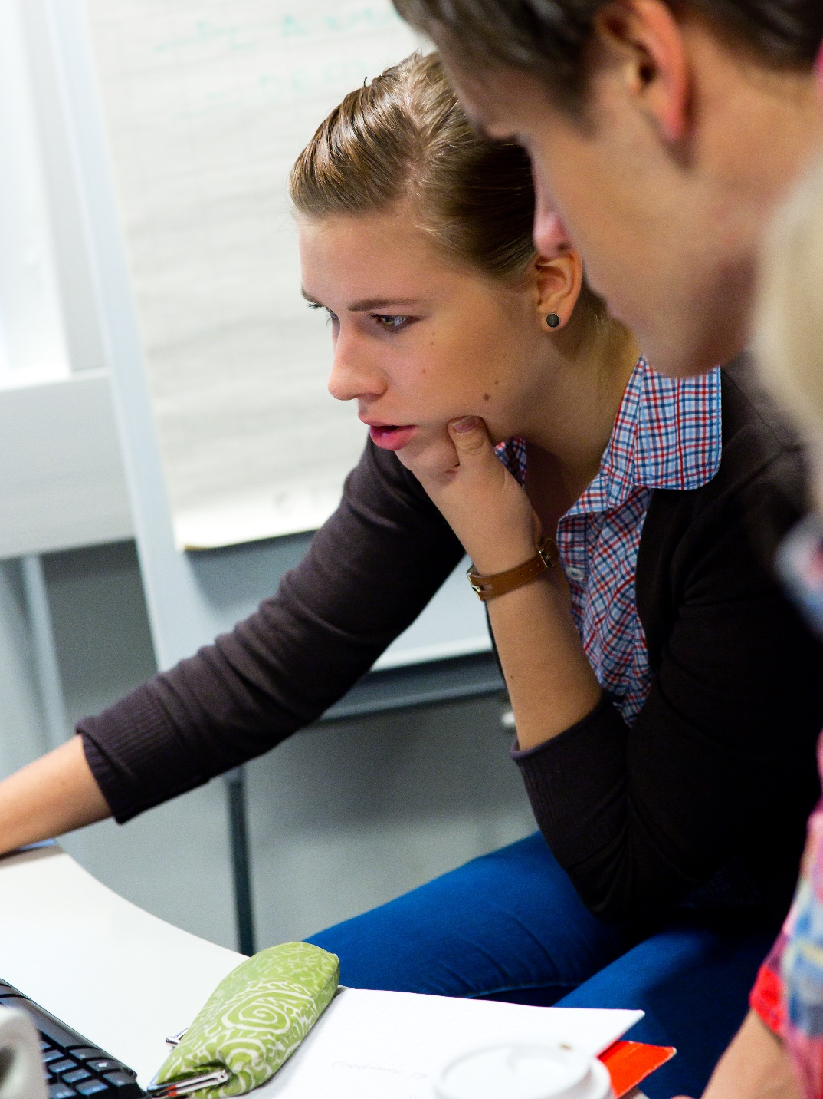
1
ST
SKILLS DEVELOPMENT AT WORK
In Finland, learning doesn’t end when you graduate. Finnish societal structures support lifelong learning and skills development at work.
European Skills Index Technical Report 2020
Notes:
Photo: Riitta Supperi / Kuvatoimisto Keksi / Finland Image Bank

Slide 39
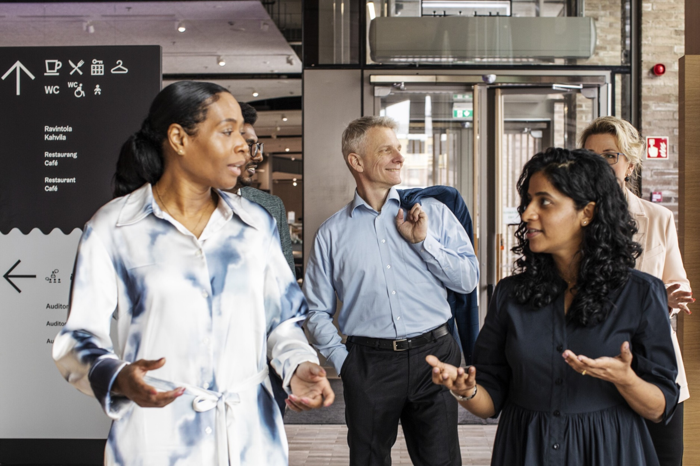
Trust, equality and low hierarchies are also staples of Finnish work culture. Employees’ opinions are taken into account, and instead of constant monitoring, people are trusted to do what everyone has decided.
Notes:
Photo: Matti Pyykkö / N2 Albiino / Helsinki Partners

Slide 40
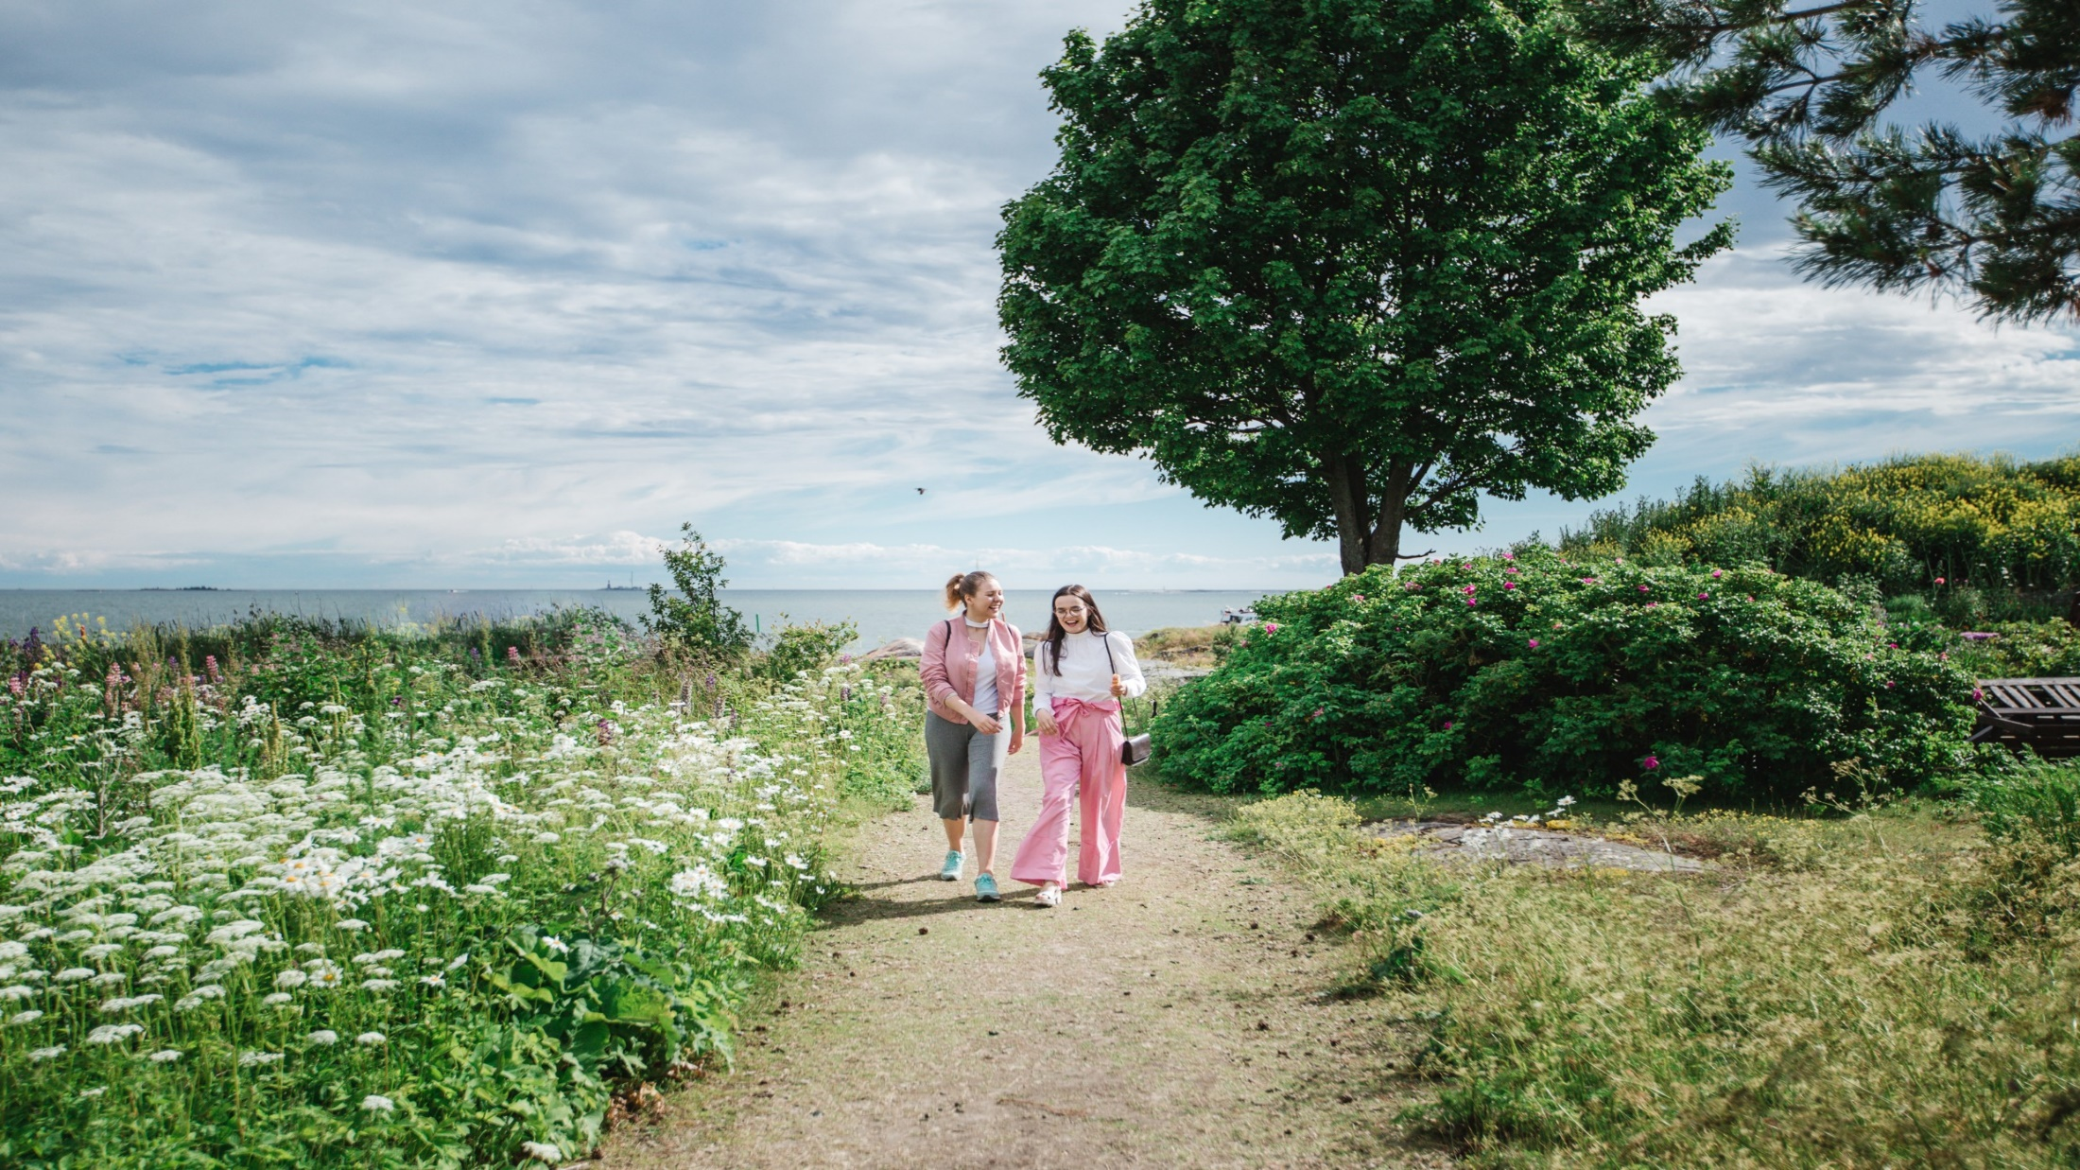
CLOSENESS TO
NATURE FOSTERS WELLBEING
Notes:
Photo: Julia Kivelä / Helsinki Partners

Slide 41
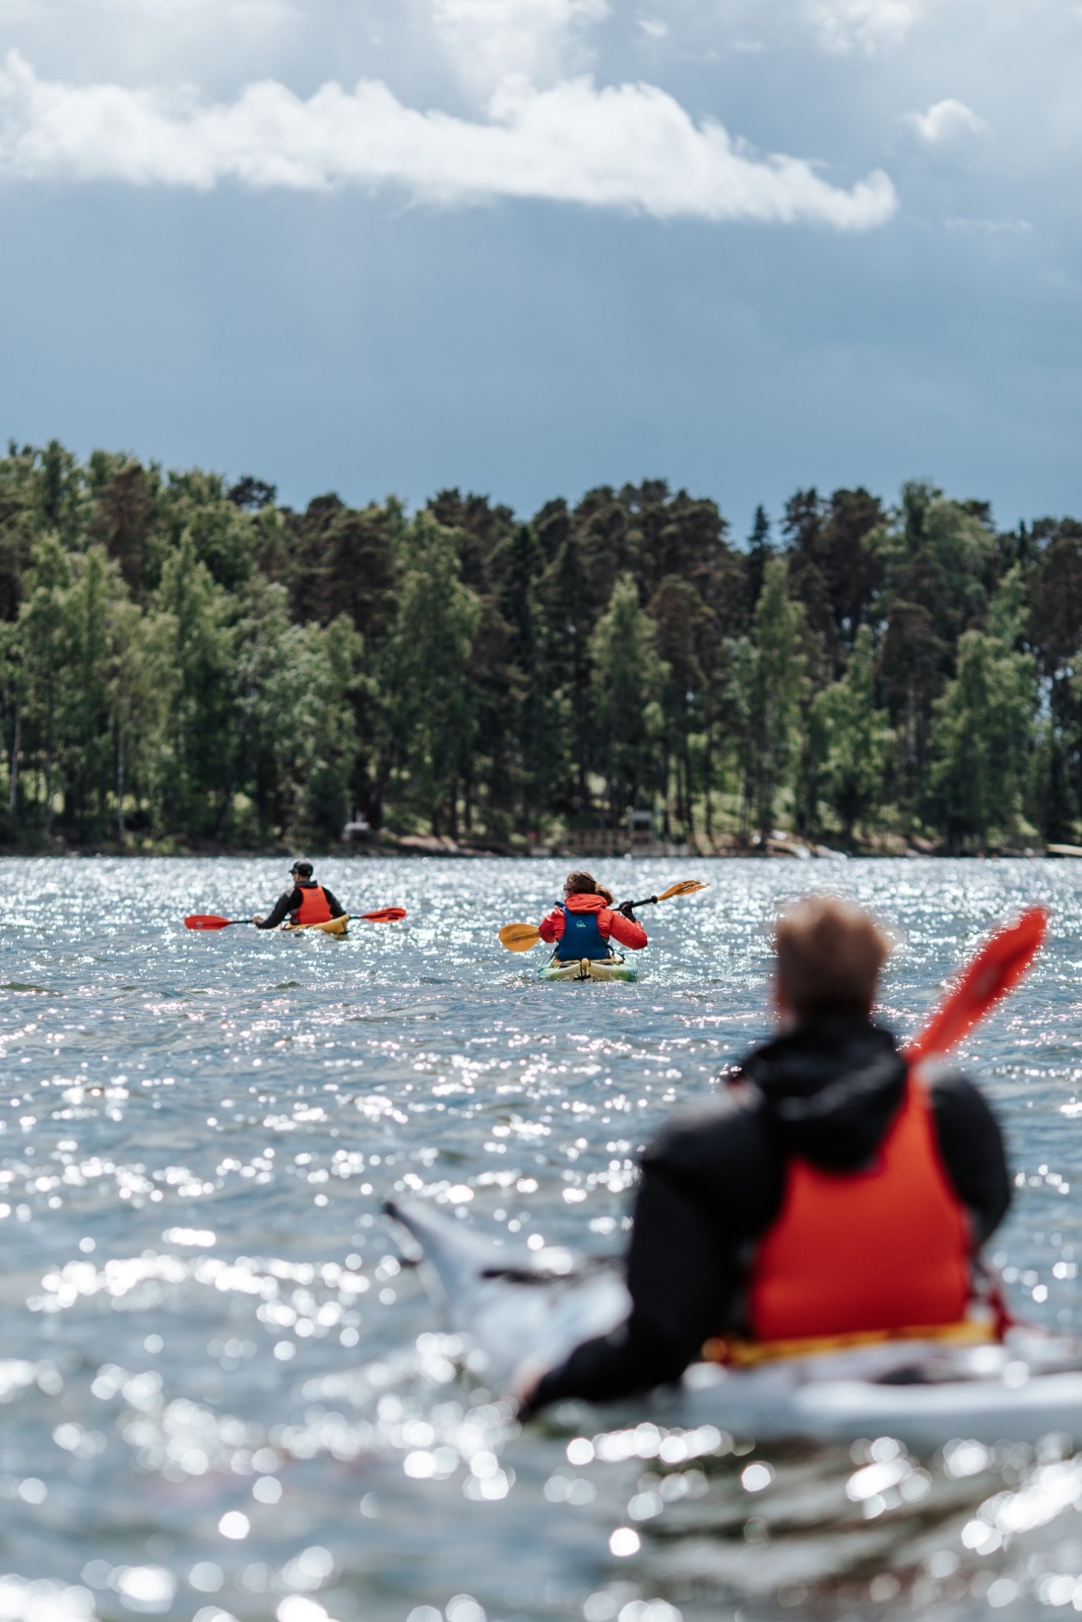

1
ST
CLEANEST COUNTRY
Clean water, unpolluted air and unspoiled nature greatly contribute to wellbeing and happiness.
Environmental Performance Index 2016
Notes:
Photo: Natura Viva

Slide 42

1
ST
CLOSENESS
TO NATURE
Nature is always close in Finland. Even if you live in a city, you are never more than a
10-minute walk from a park or forest.
How’s Life? 2020 (OECD)
Notes:
Photo: Jussi Hellstén / Helsinki Partners

Slide 43
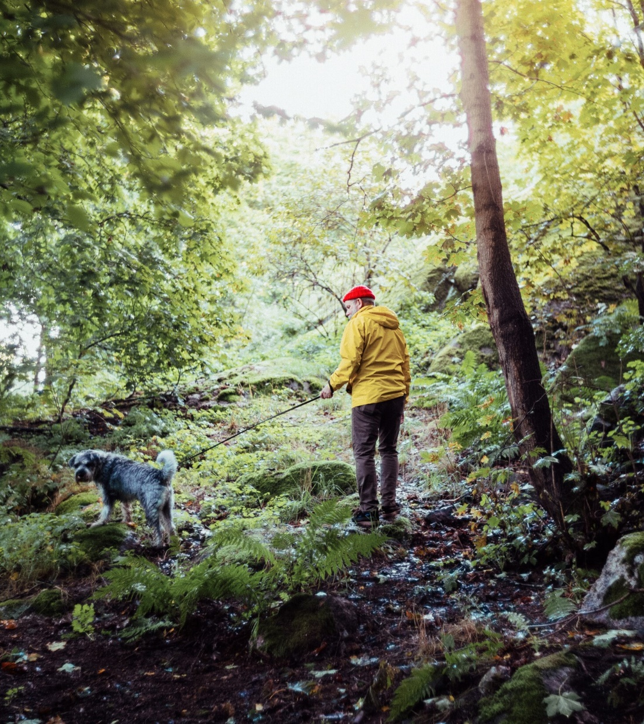

1
ST
MOST
FORESTED
IN EUROPE
Finns love the forest. More than 80% of Finns say the forest is important to them. Serenity, security, joy and energy are the words most associated with the woods.
Eurostat
2021
Notes:
Photo: Jussi Hellstén / Helsinki Partners

Slide 44
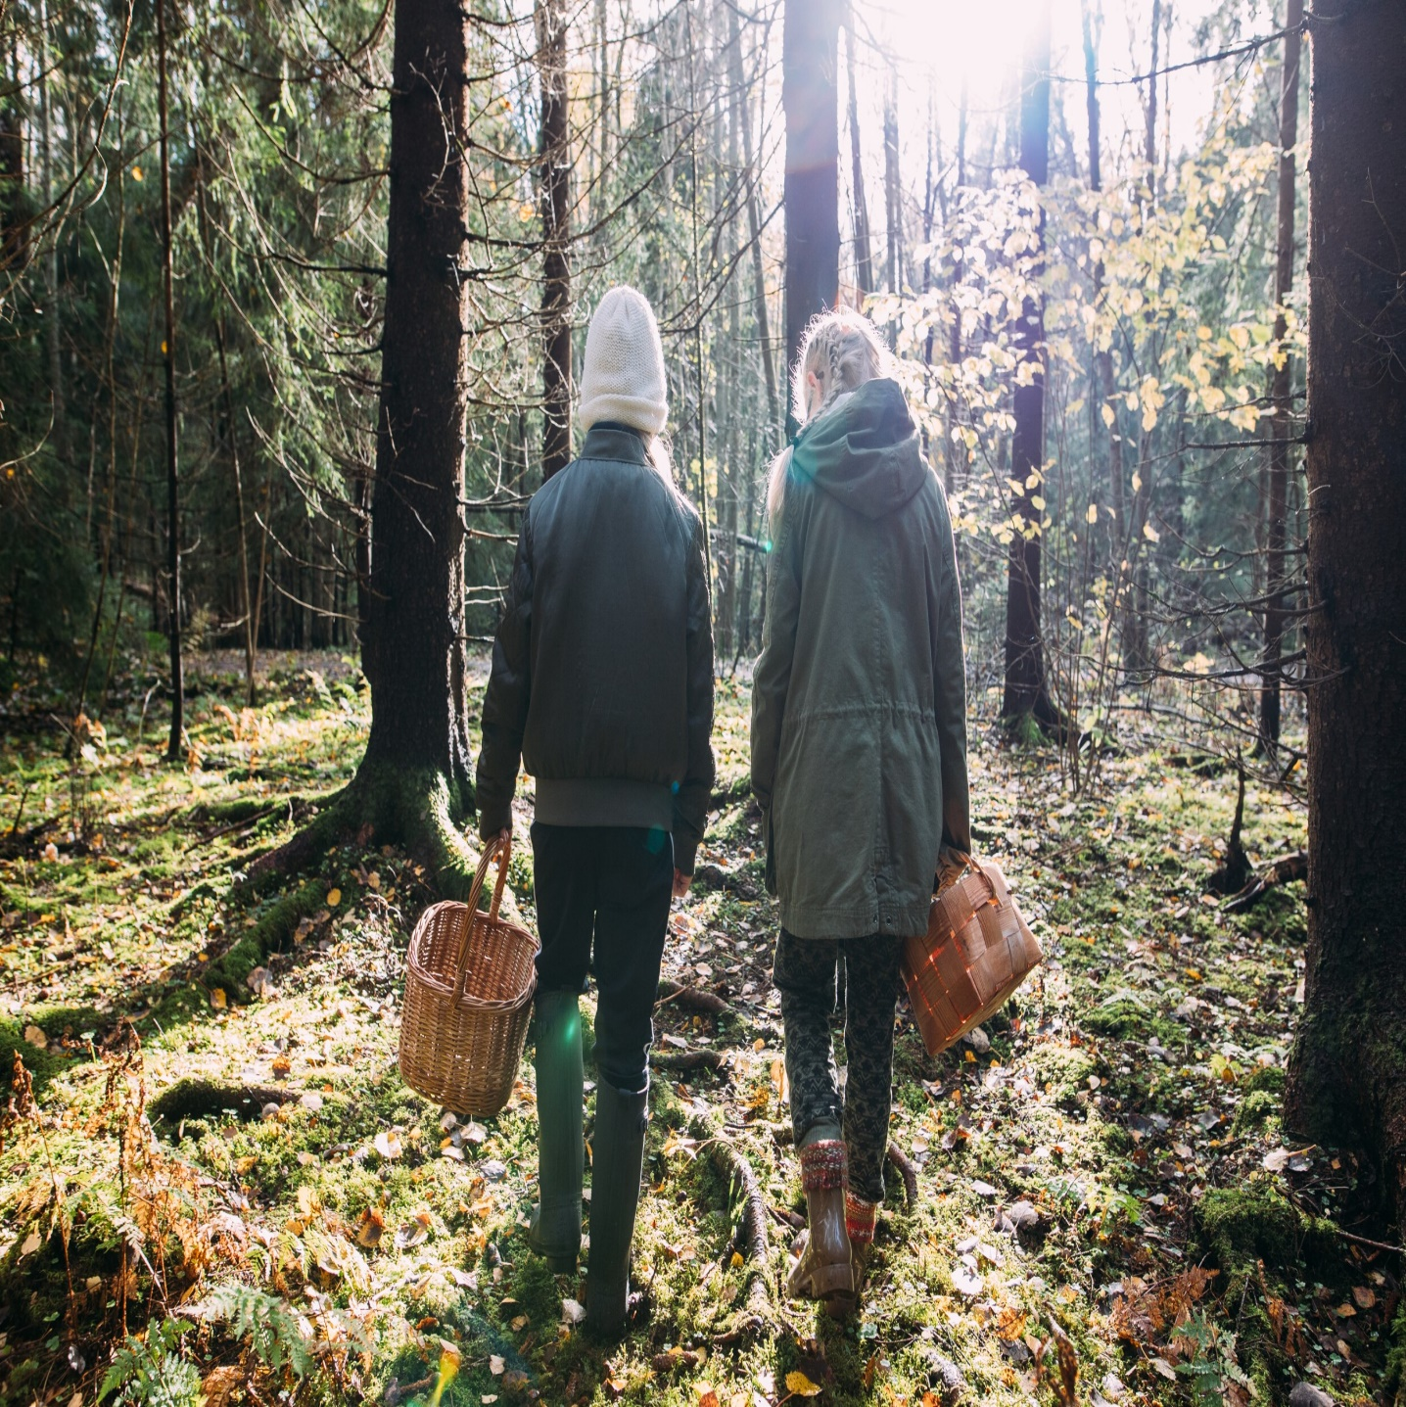
Two-thirds of Finnish forests are owned by ordinary families, but the concept of Every Person’s Right means that anyone may hike, camp, and gather mushrooms and berries in any forest, regardless of who owns it.
Notes:
Photo: Jussi Hellstén / City of Helsinki
https://toolbox.finland.fi/themes/nature-and-sustainable-development/finnish-nature-every-persons-right/

Slide 45
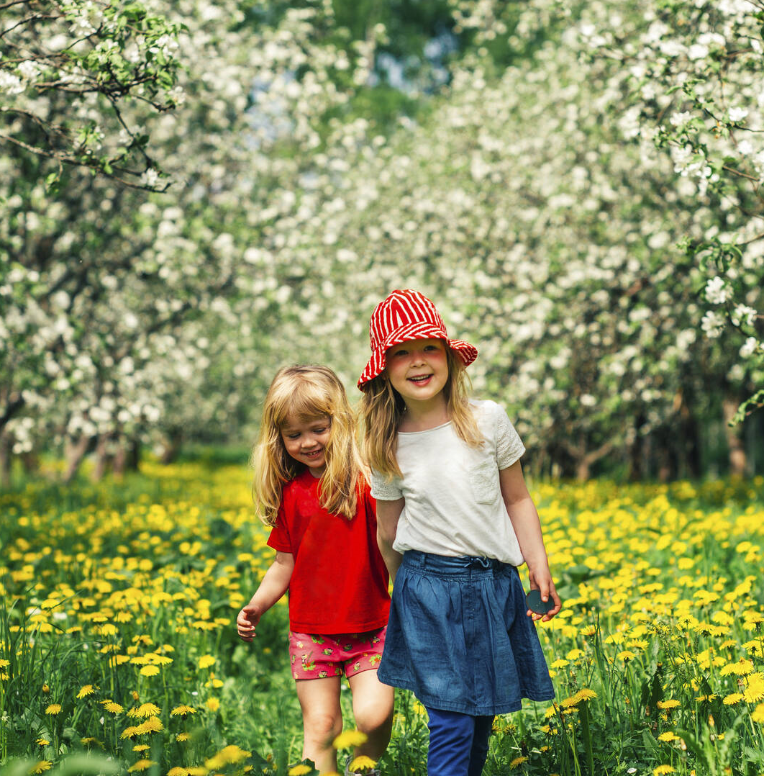
1
ST
SUSTAINABLE
DEVELOPMENT
To ensure future happiness, sustainable development needs to be a priority. This includes clean, affordable energy, responsible consumption and climate action.
Sustainable Development Report 2022
Notes:
Photo: Jussi Hellstén / Visit Finland

Slide 46
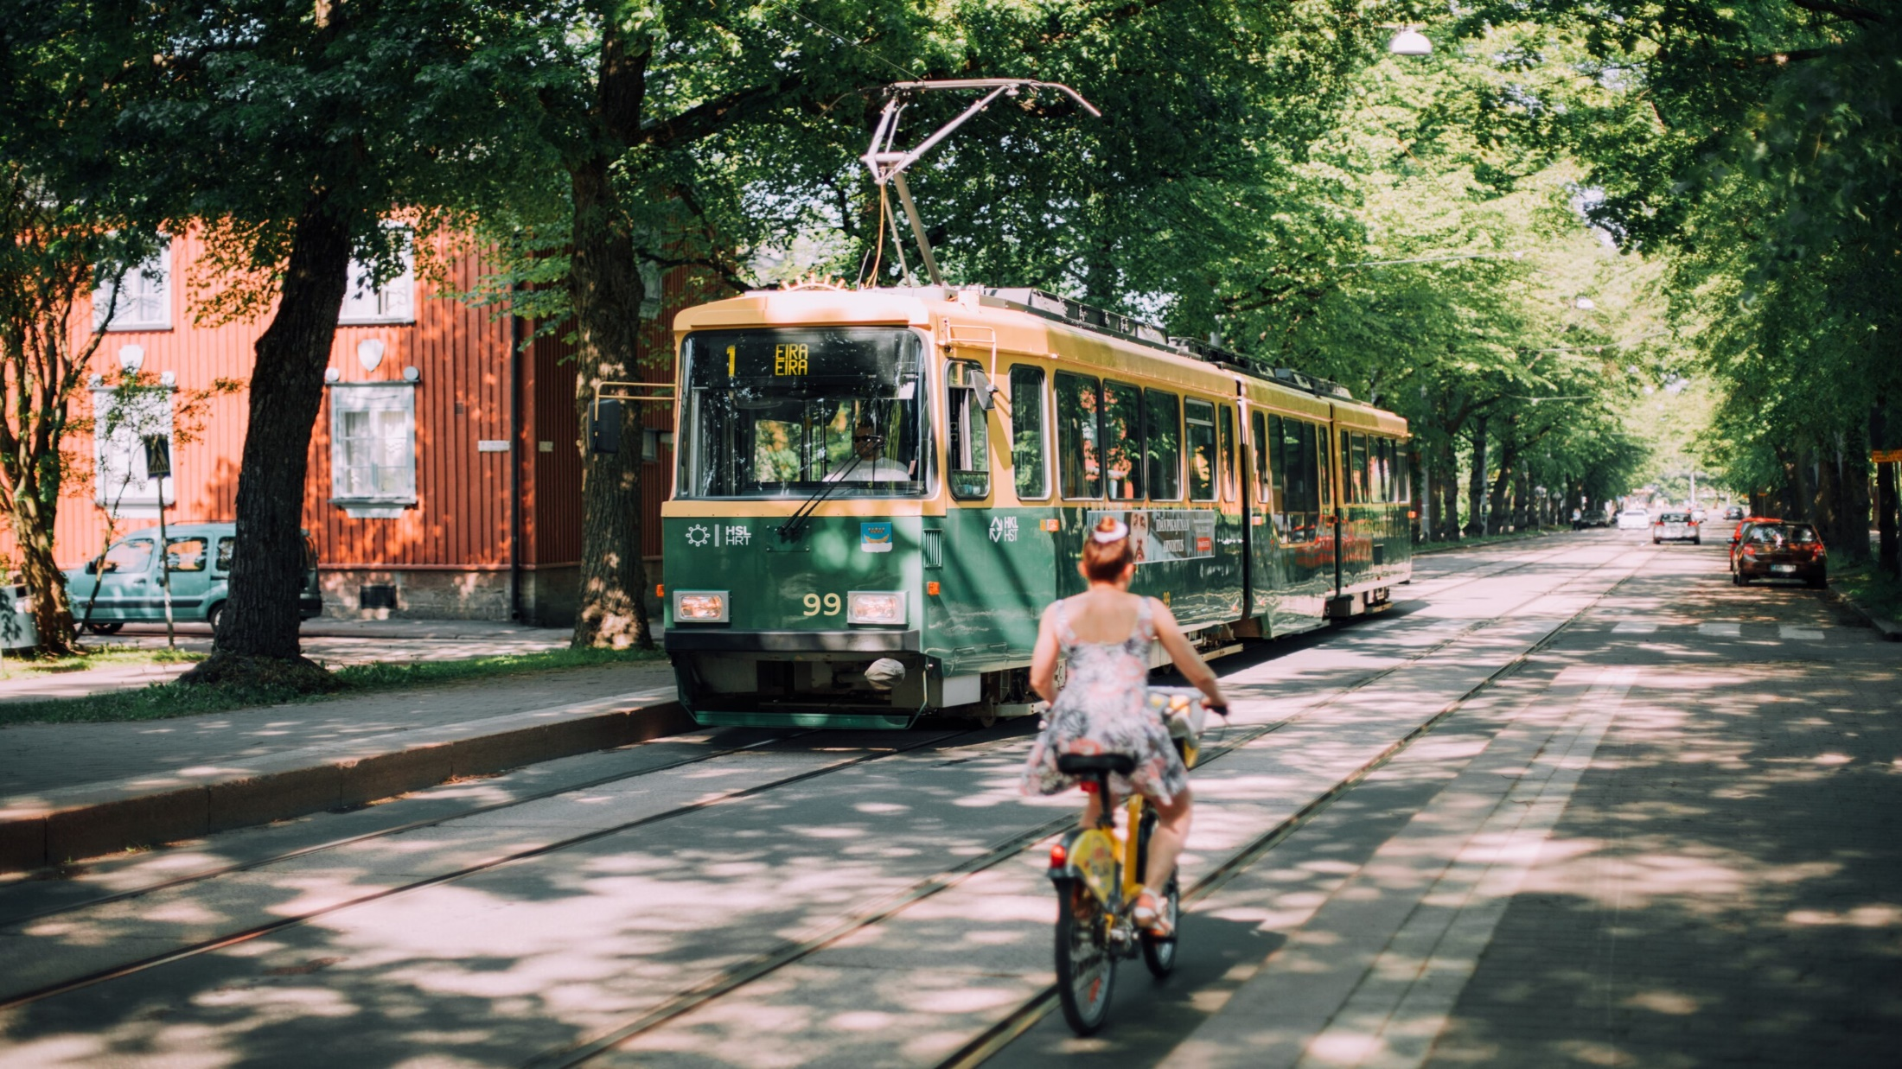
People in Finland
TRULY HAVE THE FREEDOM TO MAKE DECISIONS
Notes:
Photo: Juulia Kivelä / Visit Finland

Slide 47
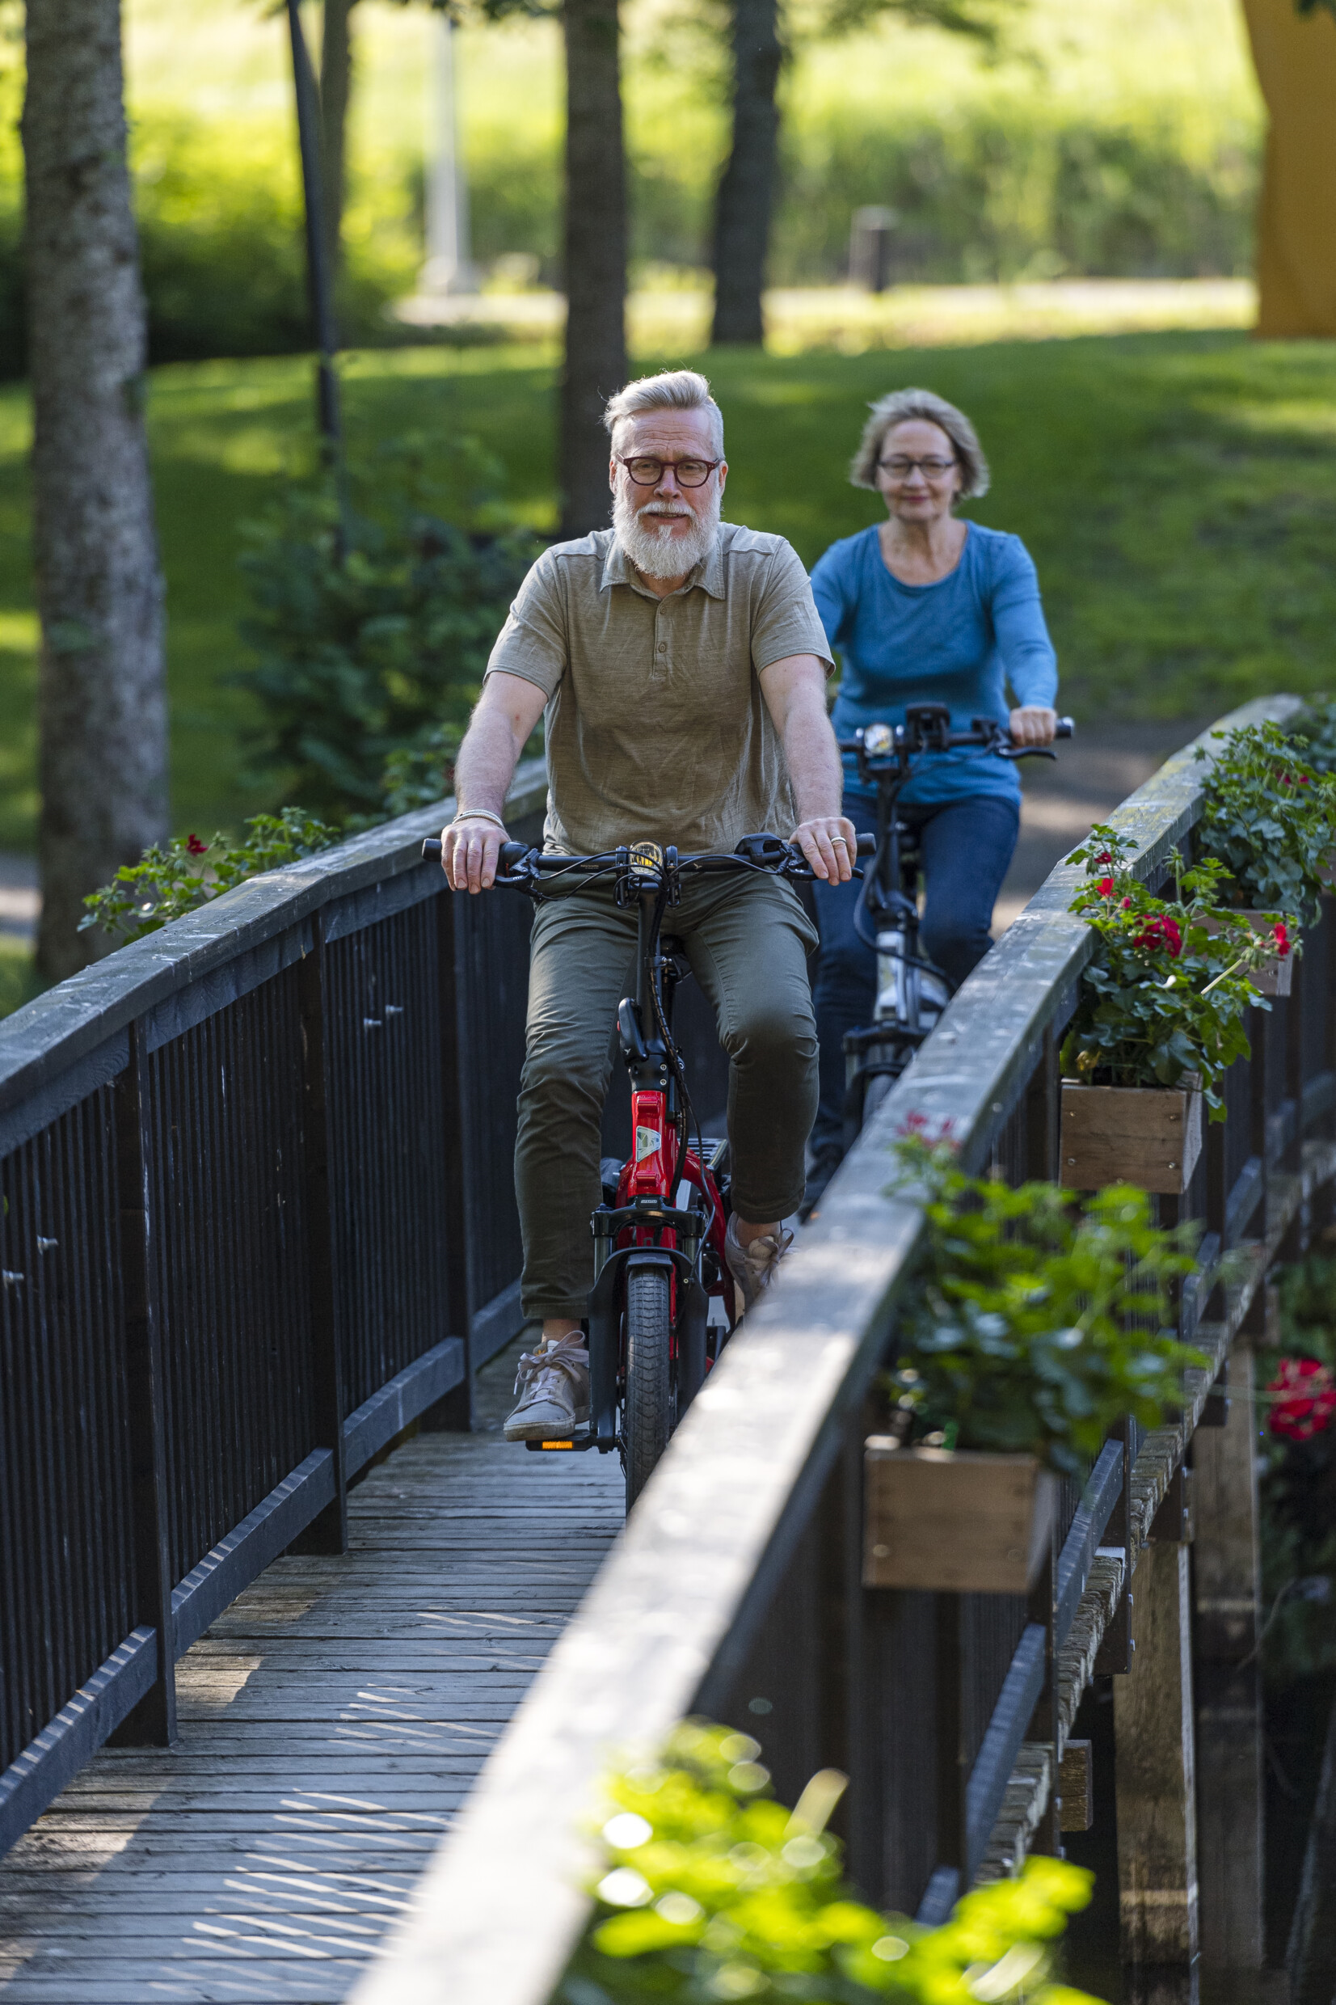

1
ST
MOST
POLITICAL AND civil
FREEDOM
Finland ranks first in political rights and civil liberties, while the Finnish infrastructure of happiness allows for even more comprehensive freedom.
Freedom
in the World 2022
Notes:
Photo: Tern Bicycles

Slide 48
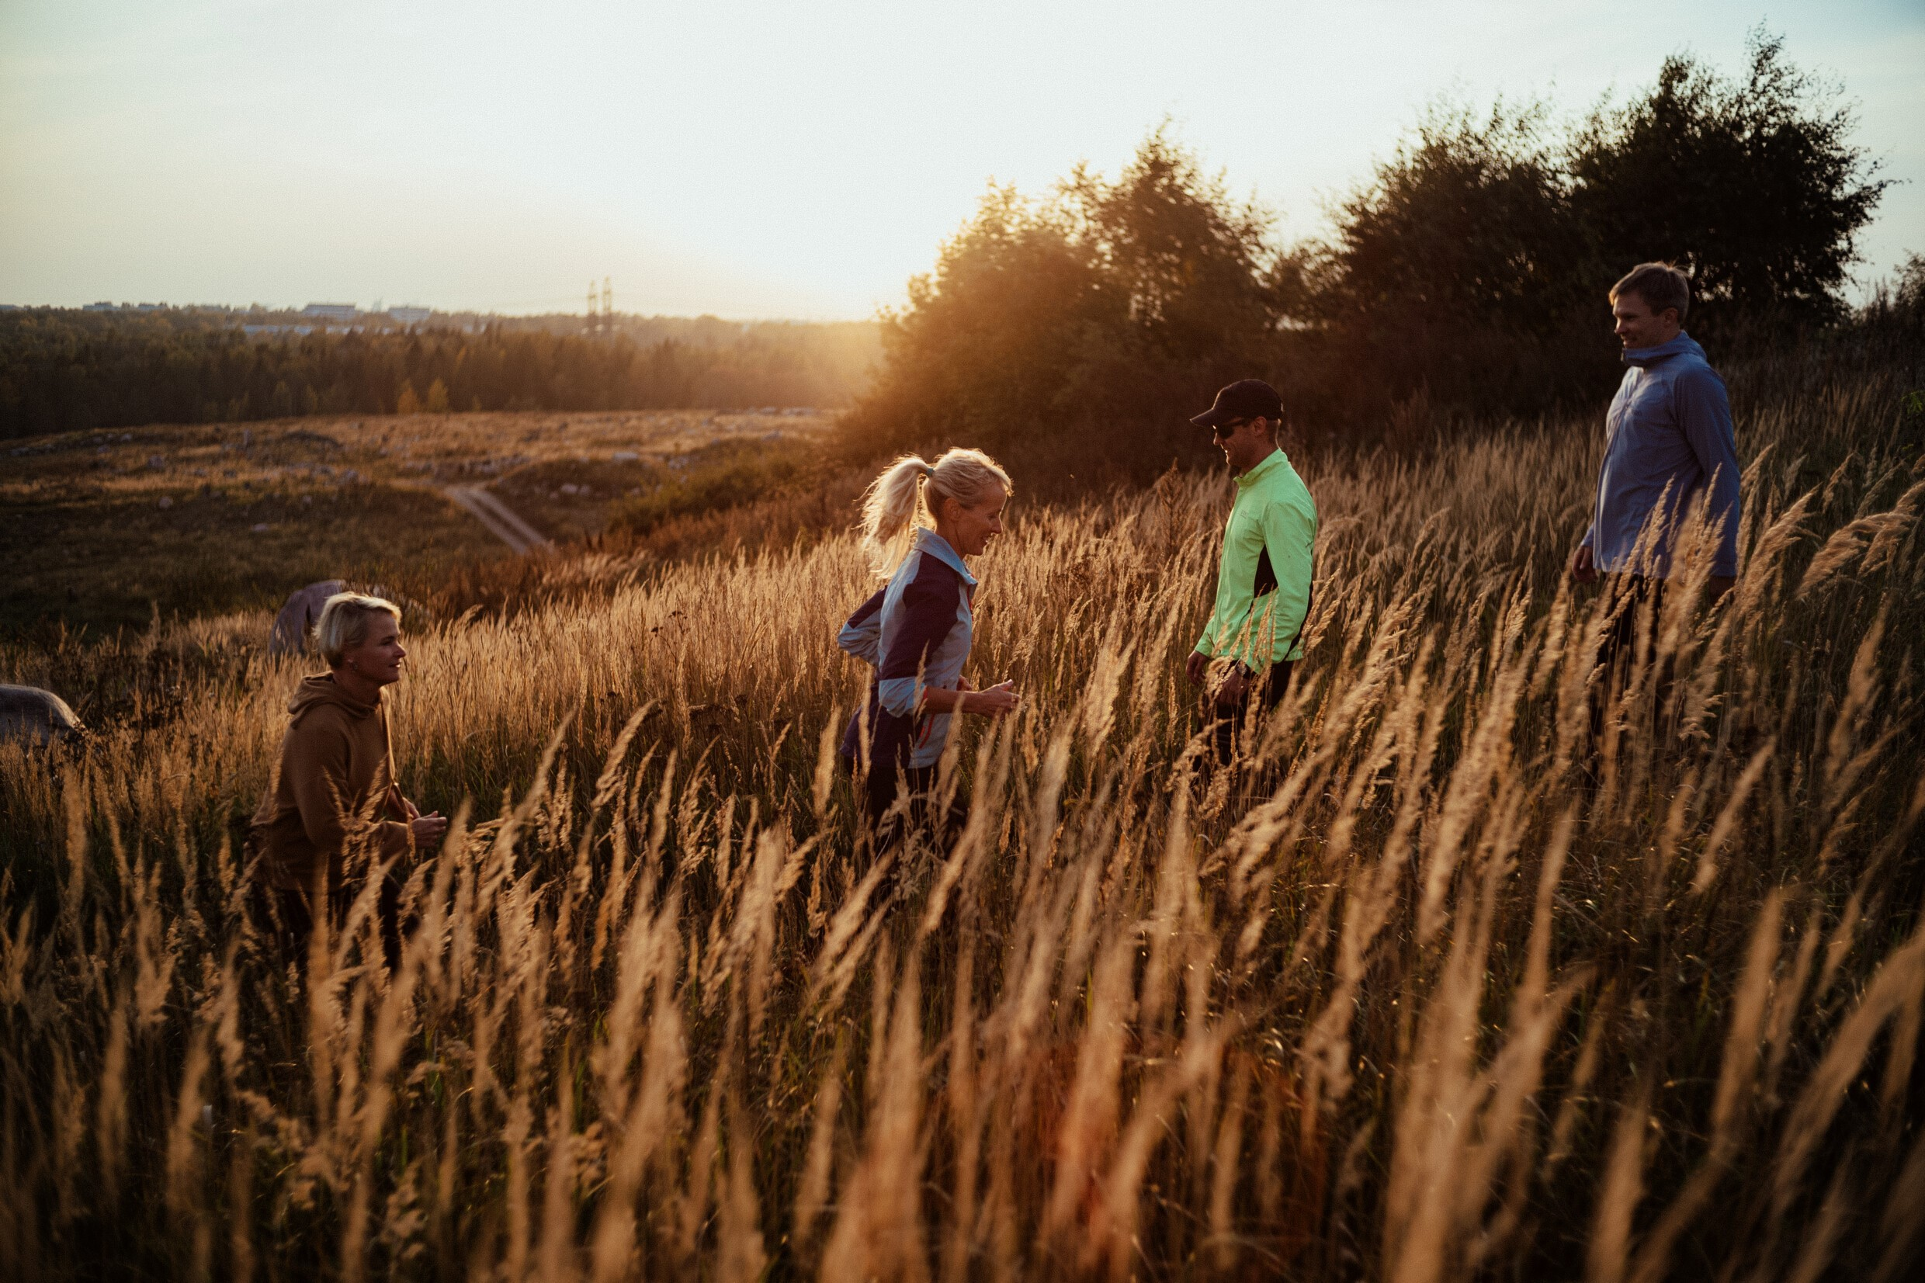
People in Finland are free to make mistakes. Poor life decisions or bad luck don’t necessarily mean falling too far behind, and people are free to explore and find their own path.
Notes:
Photo: Vesa Laitinen / City of Helsinki
Not hard to make ends meet: https://www.oecd-ilibrary.org/sites/9870c393-en/1/3/2/index.html?itemId=/content/publication/9870c393-en&_csp_=fab41822851fa020ad60bb57bb82180a&itemIGO=oecd&itemContentType=book#section-d1e5379

Slide 49
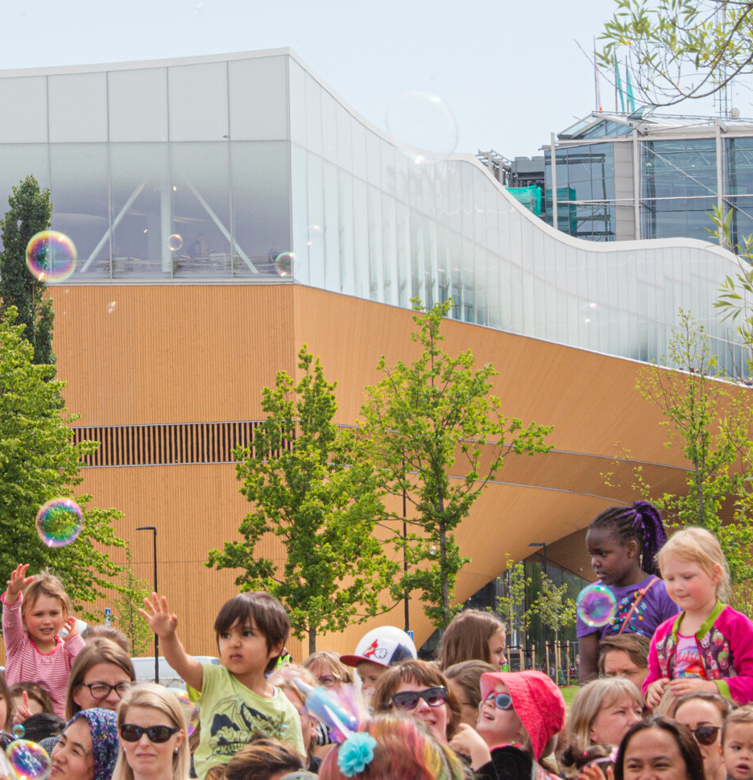
In a well-functioning, safe, fair, equal and ‘error-friendly’ society, people can worry less and concentrate on living their lives. People have the freedom to be happy.
Notes:
Photo: Vesa Laitinen / City of Helsinki

Slide 50
Finland:
The Happiest Country
in the World.

Slide 51
Extra slides for questions:

Slide 52
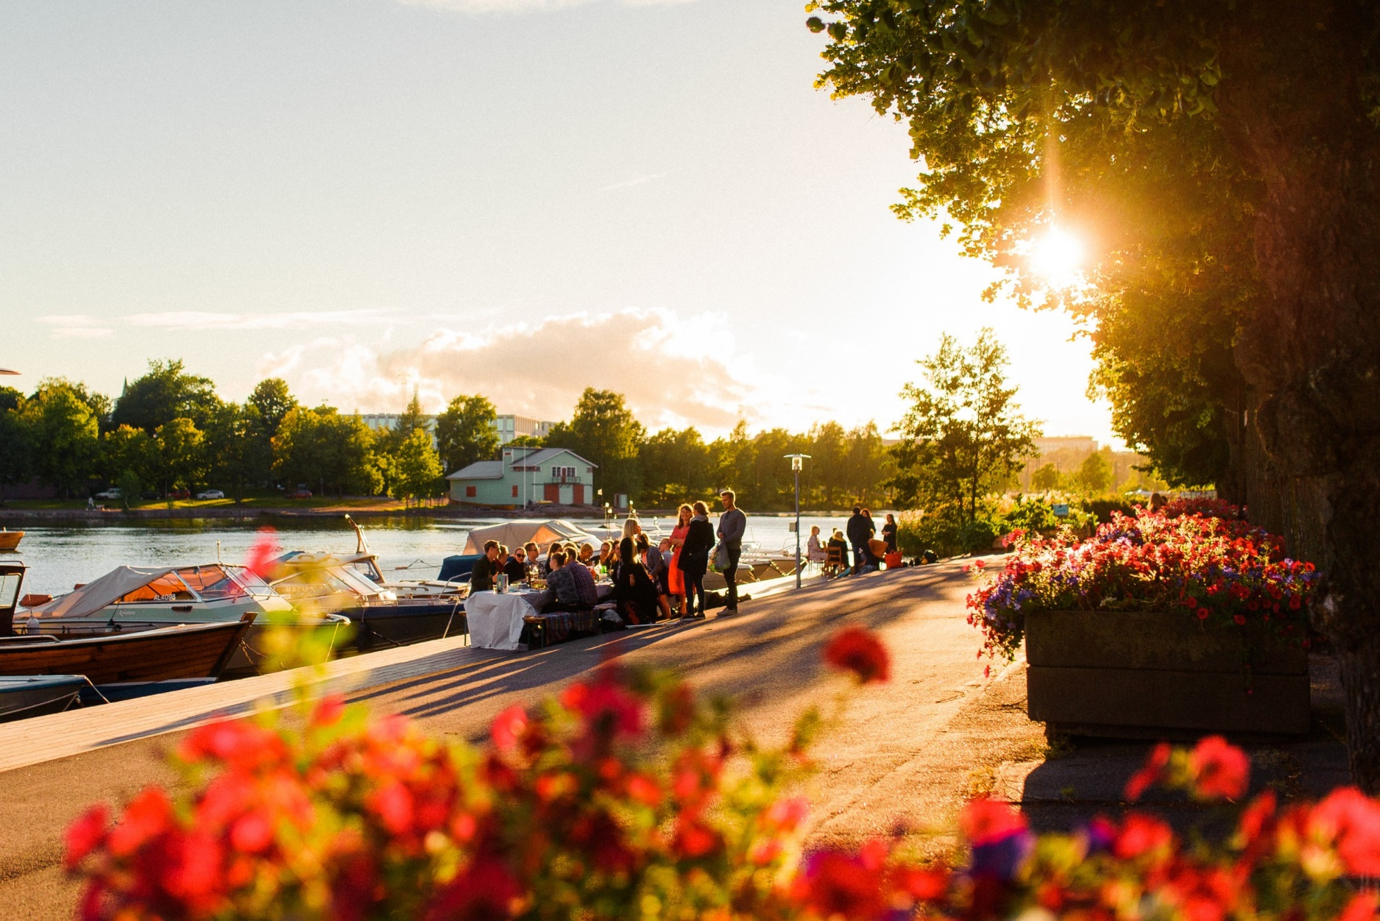
According to a survey commissioned by the Tax Administration in 2019, 80% of Finns are happy to pay their taxes, 96% believe paying taxes is an important civic duty and 98% believe taxes are important for maintaining Finland’s welfare state.
Notes:
Photo: Eetu Ahanen / Helsinki Partners
Tax article with examples at: https://finland.fi/life-society/facts-and-feelings-do-taxes-make-finnish-people-happy/

