Slide 2
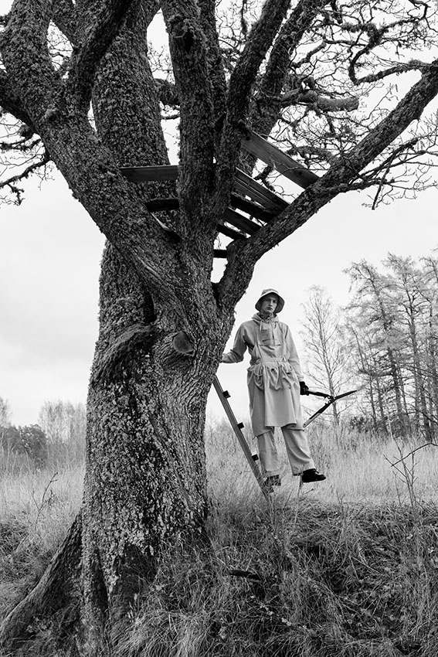
Fashion in finland
Fiskars by Maria Korkeila, photo by Chris Vidal

Slide 3
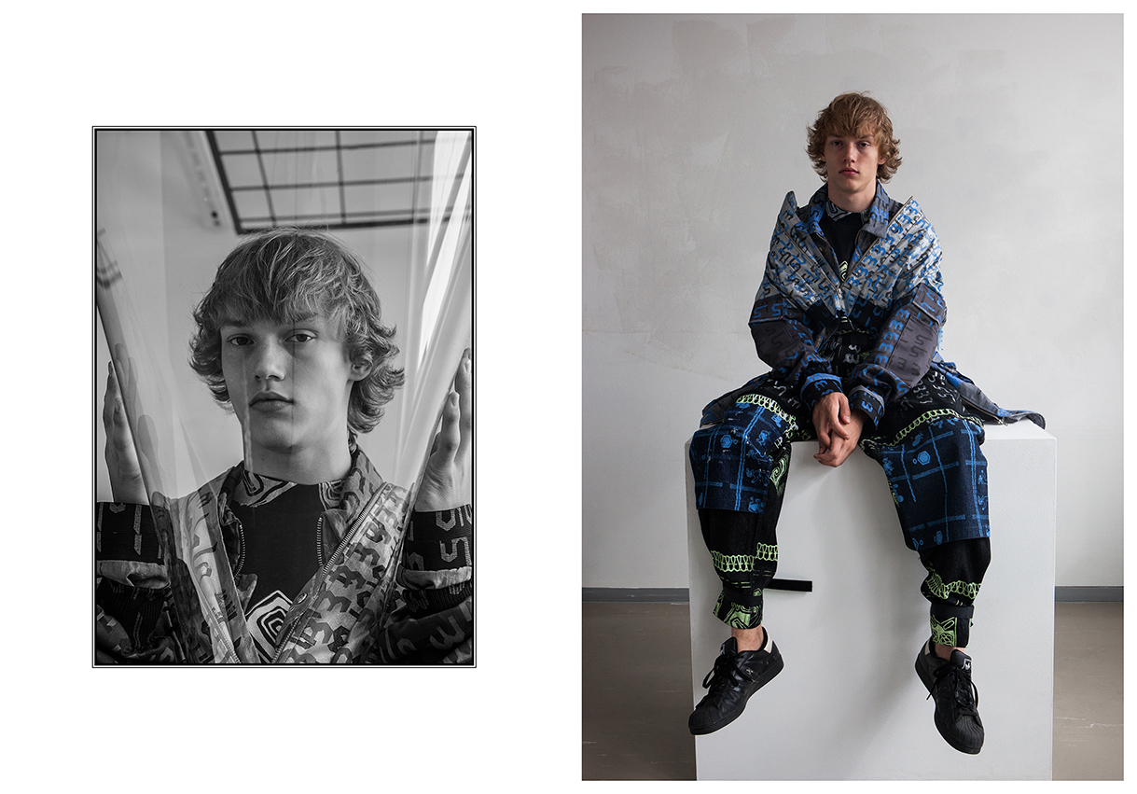
Finnish fashion
Männistö, photo by Chris Vidal

Slide 4
background
Modern Finnish fashion was born during the heyday of Finnish design and architecture in the 1950s. Today Finland is looking to the future with the fast development of new material innovations, award winning young designers and successful sustainable brands.
Notes:
Finland’s clothes industry continued to triumph in the 1970s and 80s. On the world stage, Finnish designers were known for their cold-season creations in particular. However, the industry faltered in the early 1990s as a result of the recession and the collapse in trade with the East. Unable to find jobs in Finland’s clothes industry, young designers set up their own companies. One of the resulting success stories was Ivana Helsinki, founded by Paola and Pirjo Suhonen in 1998. Other rising stars include Samu-Jussi Koski, Anna Ruohonen, and Tuomas and Anna Laitinen. Talented Finnish designers have also worked for a number of major foreign fashion houses.

Slide 5
Quality and sustainability
Finnish brands are designer driven – quality, sustainability and strong artistic vision are at the core of Finnish fashion.
During the past few years, Finnish designers and brands have been celebrated in all the important media from Vogue Italy to the New York Times.

Slide 6
Fashion heritage

Slide 7
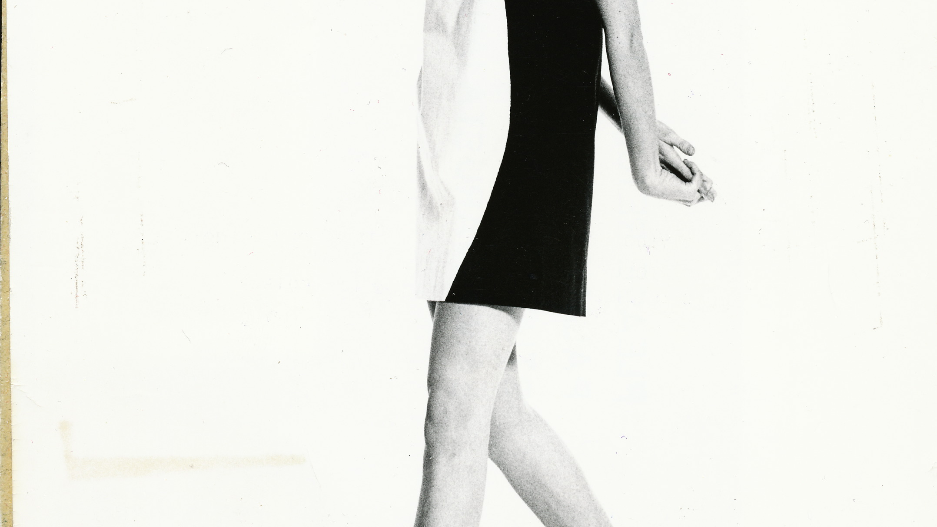
Fashion heritage

Slide 8
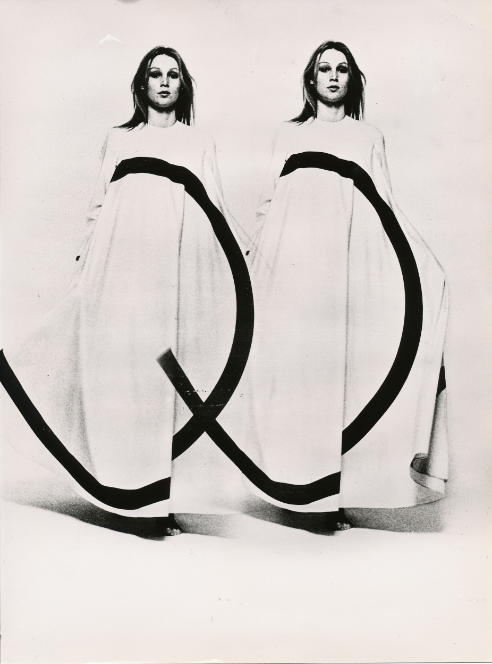
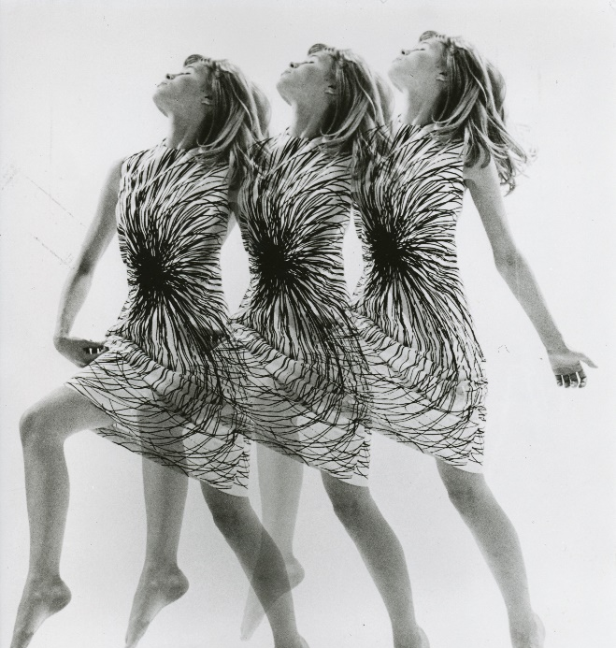
Vuokko Nurmesniemi

Slide 9
Vuokko Nurmesniem
Vuokko Nurmesniemi is the grand old master of Finnish fashion. She is best known for her designs for Marimekko in the 50s and 60s. She started her own label Vuokko in 1964.
Nurmesniemi´s design has been the inspiration for many current foreign fashion superstars and she is still designing and running her shop in Helsinki.

Slide 10
In the late 1960s Nurmesniemi became one of the first designers concerned about the environmental impact of the textile industry.
She received the Milan Triennial XIII grand prix and Lunning Prize for design in 1964, the Prince Eugen Medal in 1986 and the Kaj Franck Design Prize in 1997.

Slide 11

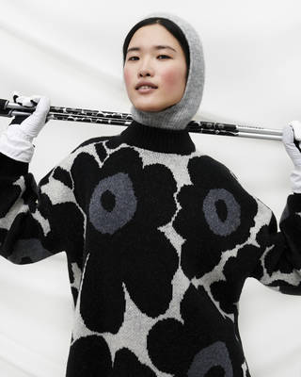
Marimekko

Slide 12
History of Marimekko
Marimekko is a Finnish lifestyle design house founded in 1951 with a mission to empower people to be happy as they are and to bring joy to their everyday lives with bold prints and colours.
In the 1950s Marimekko began making dresses with abstract prints and vibrant colours for women who are bold in expressing their personality through their choice of attire.
.

Slide 13
Marimekko
Marimekko is considered one of the first lifestyle brands in the world. Ready-to-wear clothes, bags and accessories, as well as home decor, are all a part of the expression of joyful living.
Marimekko became an international phenomenon at an early stage. Jacqueline Kennedy bought several Marimekko dresses in 1960. This hit the headlines around the world, helping the company to conquer foreign markets.

Slide 14
Some more Finnish heritage brands:
R-Collection
Nanso
Sasta
Vallila
Joutsen
Luhta
Reima

Slide 15
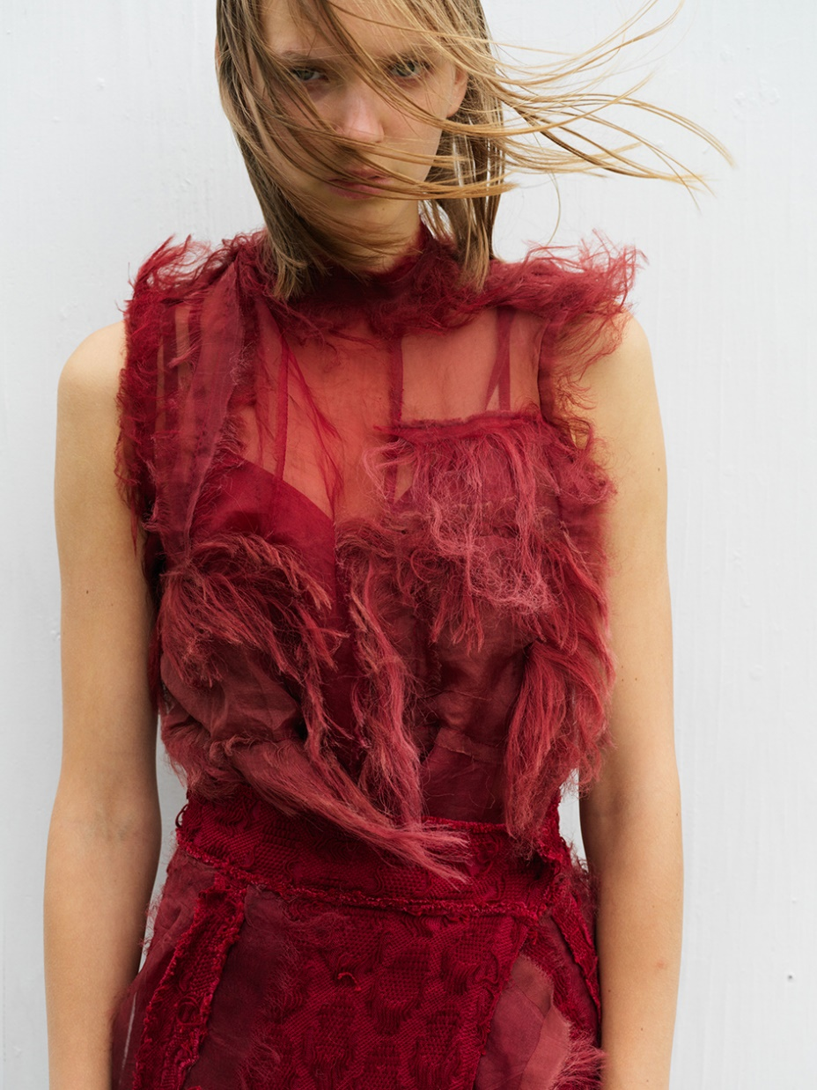
Talent and young designers
Anna Semi, Aalto Arts
Notes:
Finnish fashion is flourishing again and its future looks promising. Finnish fashion has become an international talking point. Many friends of fashion and press representatives are drawn to Finland in the spring for the Aalto University’s graduate show.

Slide 16
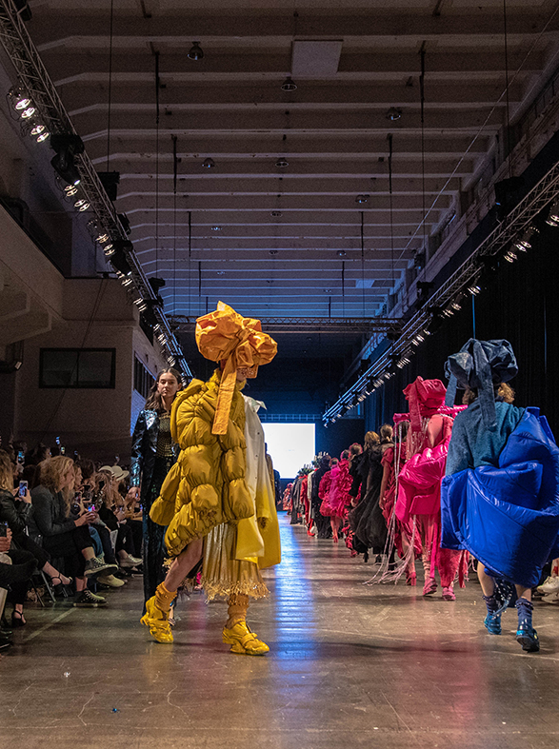
Aalto University
Young Finnish designers are known for their high-level, artistic designs that avoid the pitfalls of calculated commercialism.
Aalto University in Helsinki has become one of the hottest design schools in the international fashion scene. Headhunters, buyers and press representatives are drawn to Finland to see Aalto University’s graduate show.
Juslin Maunula,, photo by Osma Harvilahti

Slide 17
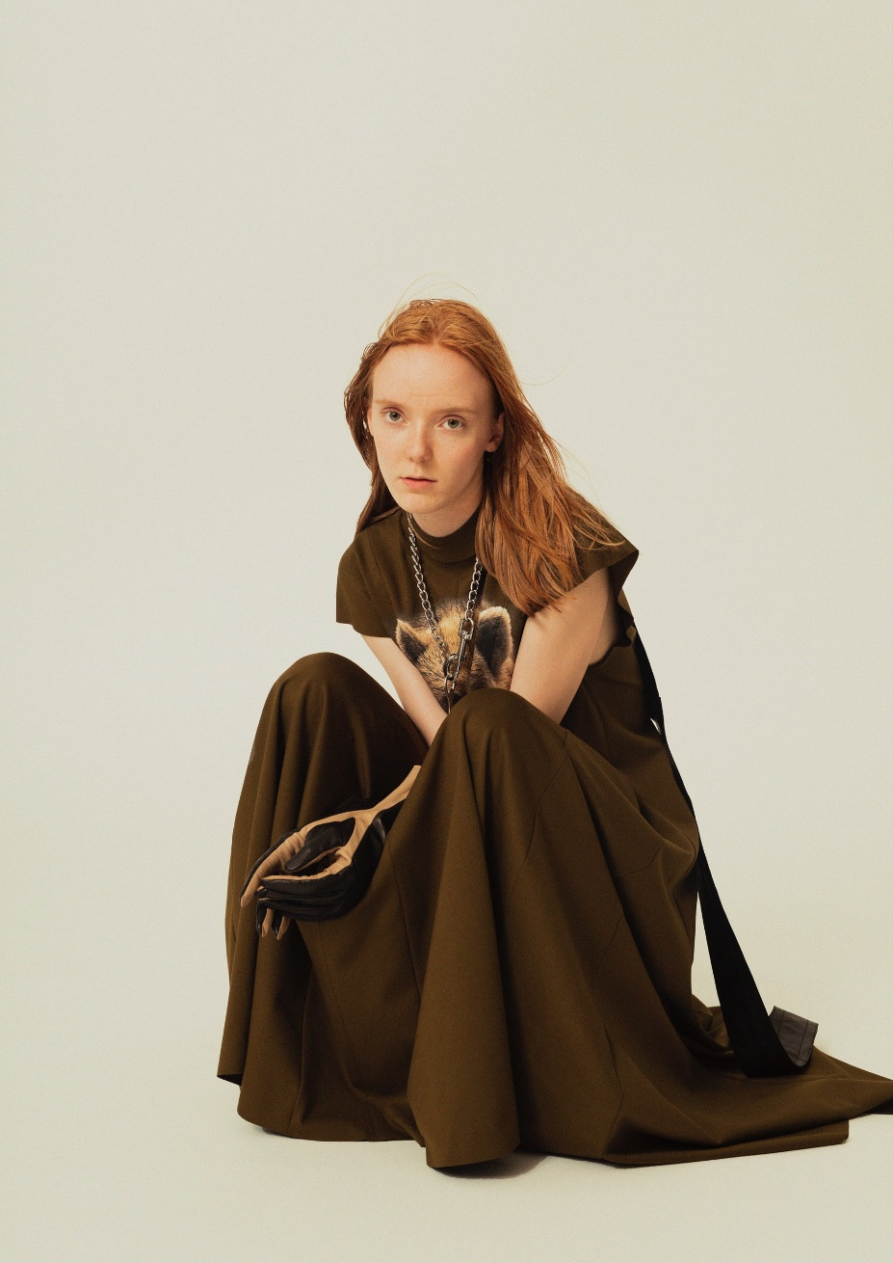
Aalto University’s success
Business of Fashion website ranked Aalto’s BA programme to be one of the best in the world.
Aalto’s students have enjoyed huge success at international design competitions such as the Hyères International Festival of Fashion in France and Designer´s Nest.
Emma Saarnio, photo: Chris Vidal
Notes:
In 2012, the undergraduates Siiri Raasakka, Tiia Sirén and Elina Laitinen won the main prize of the menswear collection. Satu Maaranen, who has since designed clothes for houses such as Marimekko, won the same prize in the following year. Three students from Aalto University were among the ten finalists in the 2015 Hyères competition.

Slide 18
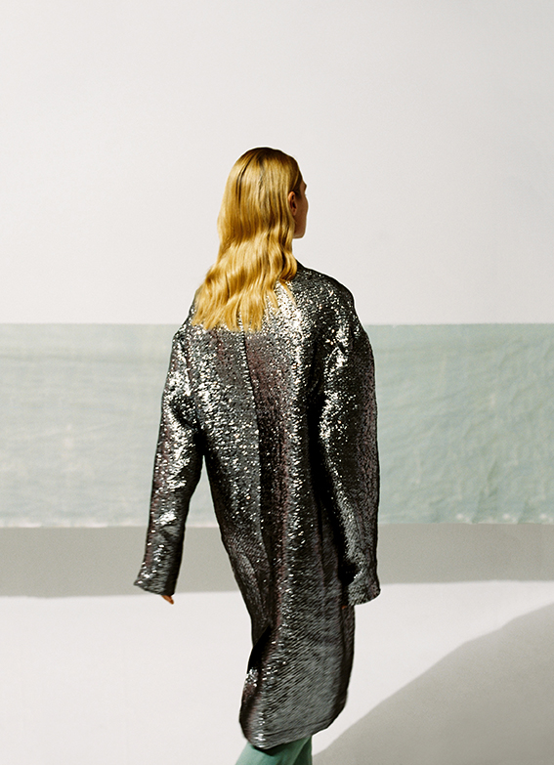
Finnish talents go international
This success has been noted, as many young Finnish talents have been recruited to international fashion houses such as Rick Owens, Balenciaga, Chanel, Diesel, Prada and Saint Laurent.
Many of the brands present their collections yearly at Paris Fashion Week, Milan Fashion Week or Pitti Uomo
Juslin Maunula, photo by Osma Harvilahti

Slide 19
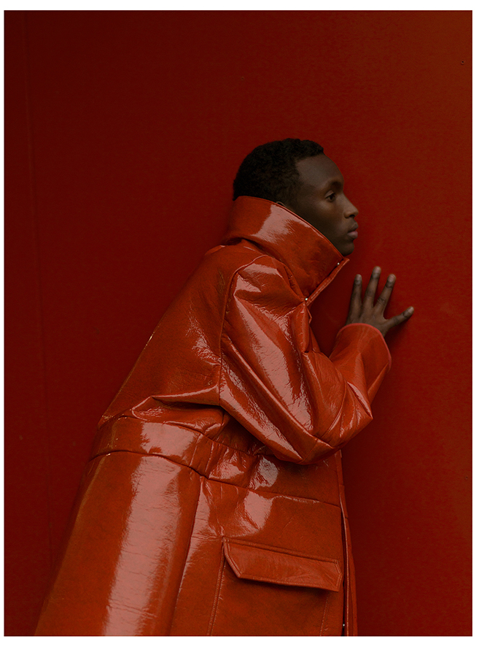
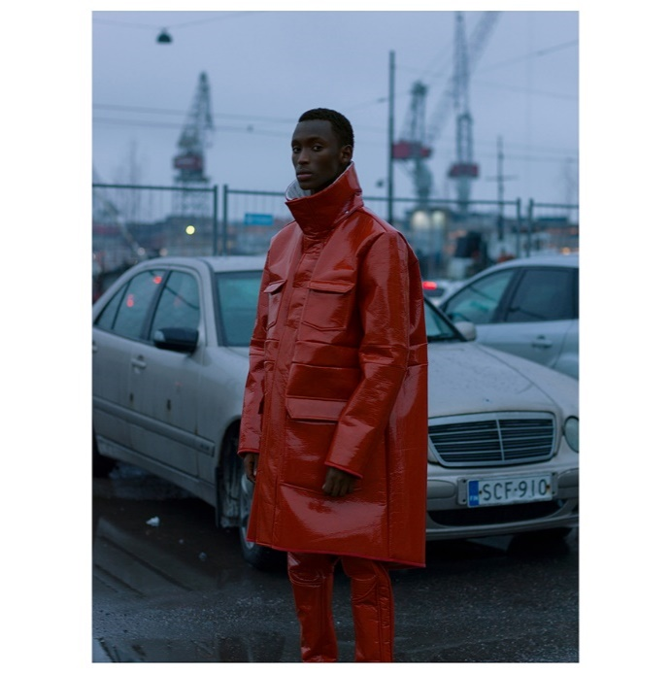
Rolf Ekroth
Rolf Ekroth, photo by Osma Harvilahti

Slide 20
Rolf Ekroth – rising star of Finnish Fashion
Rolf Ekroth graduated from Aalto University and is one of the rising stars of Finnish Fashion. The former professional poker player and social worker launched his own label in 2019 at Pitti Uomo.
Ekroth’s trademark of futuristic sportswear is inspired by anime and 1990s rap.
Ekroth was the winner of Designer´s Nest 2015 and a finalist of Hyères International Festival of Fashion 2016. In 2017 he designed a capsule collection for Galeries Lafayette.

Slide 21
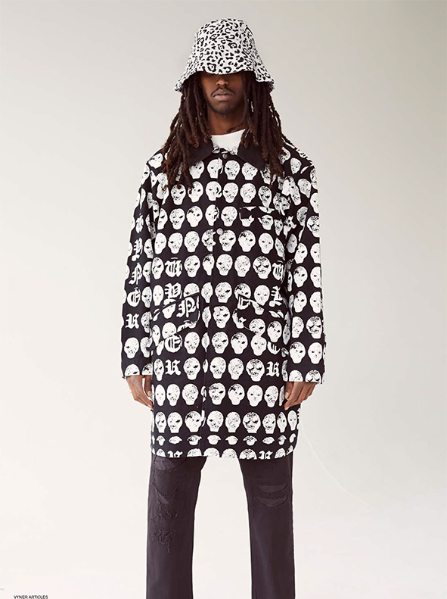
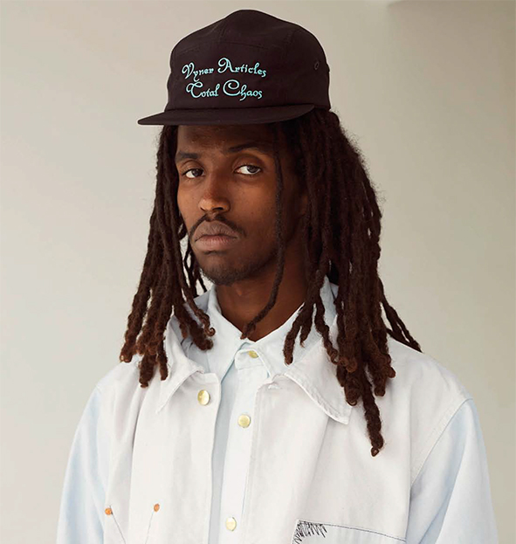
Vyner Articles

Slide 22
Heikki Salonen
Heikki Salonen launched his new namesake menswear line called Vyner Articles in 2018.
A graduate of London’s Royal College of Art, Salonen is one of Finland’s most successful designers in recent years. He previously worked at Erdem and as a design director of women´s wear at Diesel.
In 2008 Salonen launched his eponymous brand that quickly earned a cult reputation. In 2013 Salonen started as a head designer in a Parisian avant-garde brand owned by the OTB group.

Slide 23
Some more young designers and new brands to watch:
Some more young designers and new brands to watch:
Aalto University Fashion department graduates
Maria Korkeila
Emma Saarnio
Juslin Maunula
Sasu Kauppi
Ervin Latimer
Julia MännistöErvin Latimer
Julia Männistö

Slide 24
Finnish fashion in international media
New Finnish fashion can be spotted in fashion media such as Vogue Italy, Vogue USA, Dezed & Confused, Another Man, WWD, Le Figaro, South China Morning Post and ELLE Korea.

Slide 25
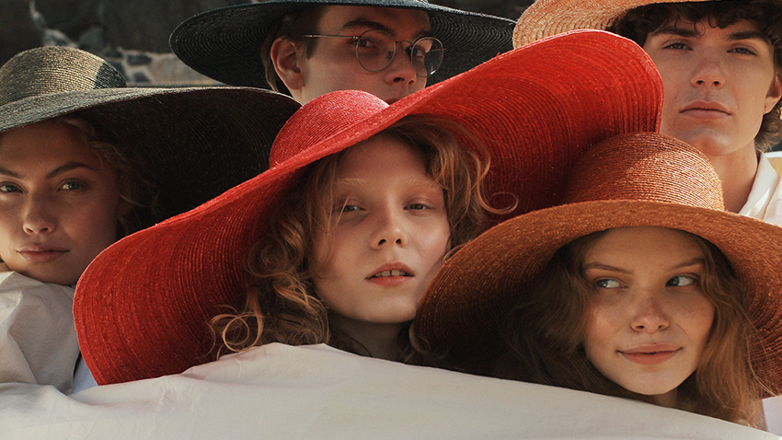
En Hats

Slide 26
Sustainability

Slide 27
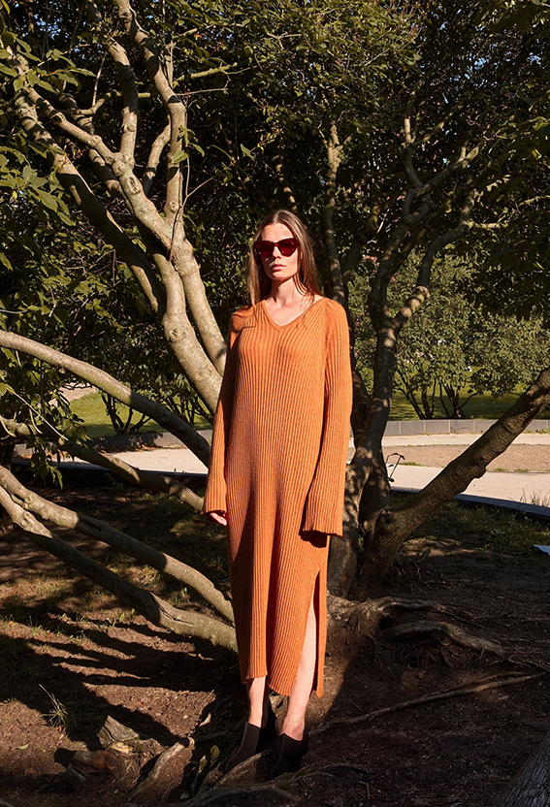
Unique design and quality
Unique design combined with good quality and sustainable production methods and materials have helped Finnish high fashion brands to achieve commercial success at home and overseas.
Arela

Slide 28
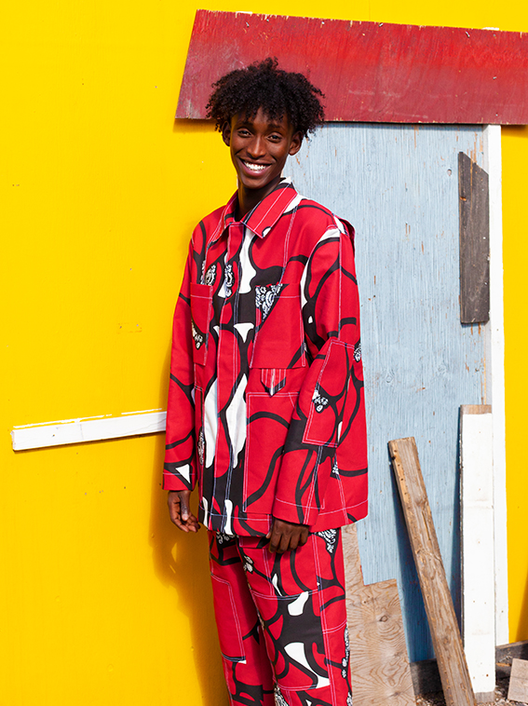
REPAIR & RENTAL SERVICES
Repair and rental services have become increasingly popular among fashion consumers in Finland.
The services enable responsible consumption and make Finnish fashion accessible to everyone.
Vallila x Ervin Latimer, photo by Chris Vidal

Slide 29
Second-cycle concepts
Many of the Finnish fashion brands run repair services and second-cycle concepts.
The brands repair or collect and reuse their own old collections.
Successful second-cycle services are available by brands such as Arela, Vallila and Marimekko.

Slide 30
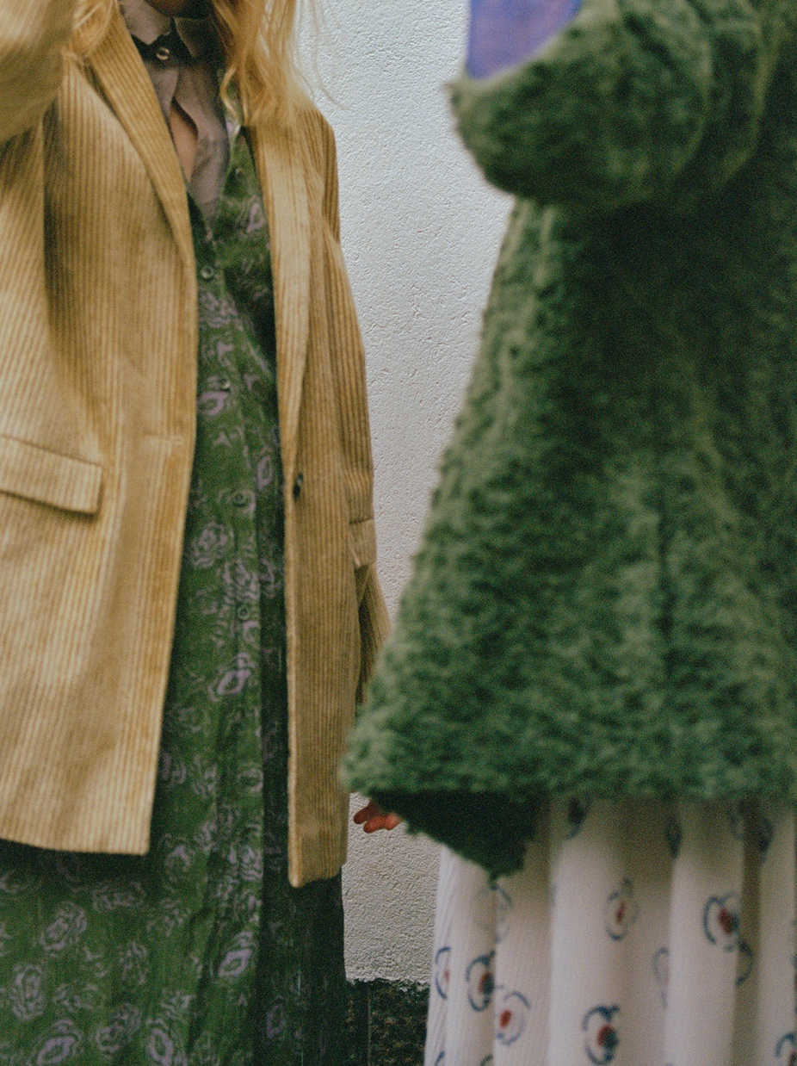
Renting clothes
The rental services enable recycling and serve consumers, for example, in the purchase of party clothes or business outfits.
Brands such as Samuji and Uhana run their own rental services. The Ateljé rents clothing from several brands and Curated sells well-selected second-hand products.
Samuji
Vallila x Ervin Latimer, photo by Chris Vidal

Slide 31
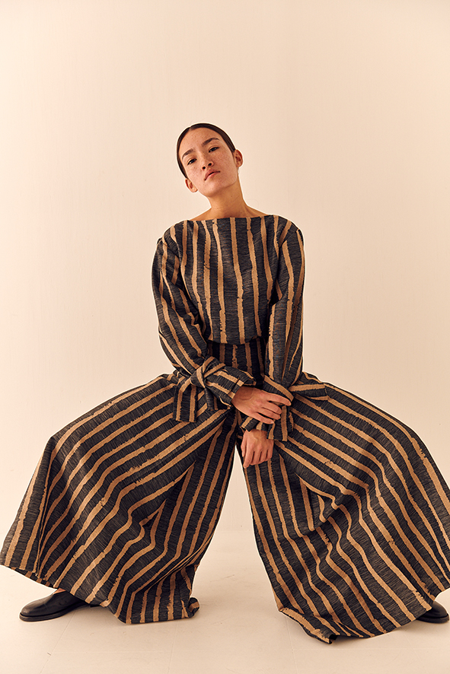
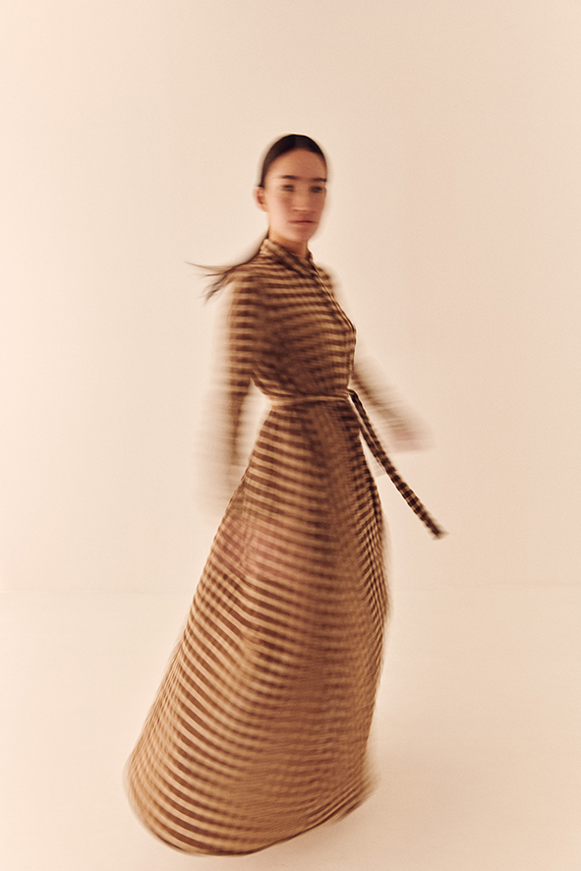
Samuji

Slide 32
Samuji
Samuji is a creative studio and design house founded in 2009. Samuji´s ambition is to produce sustainable and timeless design that serves a purpose yet carries a story.
All Samuji items are crafted out of quality materials from European and Japanese suppliers and produced in Europe by carefully selected manufacturers. Along with sourcing original and innovative fabrics, Samuji produces their own fabric.

Slide 33
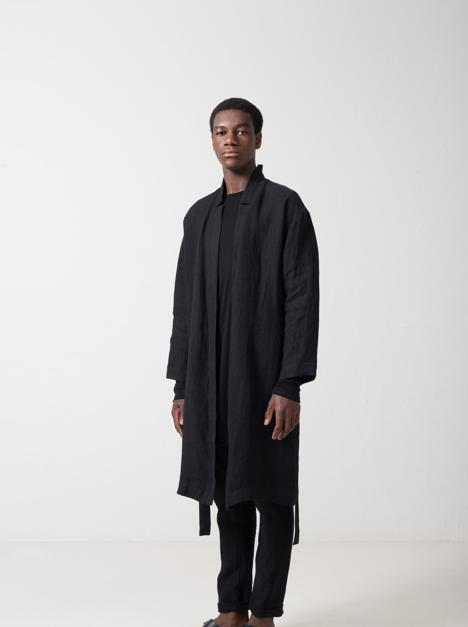
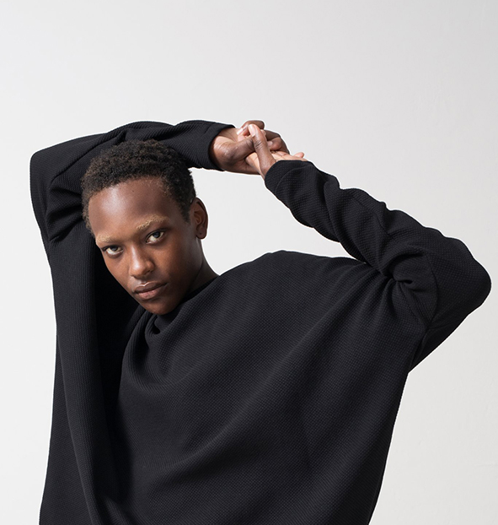
Nomen Nescio

Slide 34
Nomen Nescio
Nomen Nescio is a brand founded in 2012 by Timo and Niina Leskelä. It is known for its extreme simplicity and brutally Nordic aesthetics. The Helsinki-based brand features only black pieces.
The collection is made from sustainable materials sourced from responsible producers in Europe.
The collections are gender-neutral and feature few new styles every season which are added to the permanent collection. It is Finnish minimalism at its most fashionable.

Slide 35
Other brands
Some other brands to watch:
Arela
Terhi Pölkki
Halo
èN Hats
ONAR Studios
FRENN
Makia
R/H
Anna Ruohonen
Papu
Uhana Design

Slide 36
Sustainable innovations
Sustainability, long lasting quality and timeless design have been the key elements in Finnish fashion since the beginning. Today Finland is also known for material and technological innovations that will change the world. In Finland, sustainability always goes hand-in-hand with best design.

Slide 37
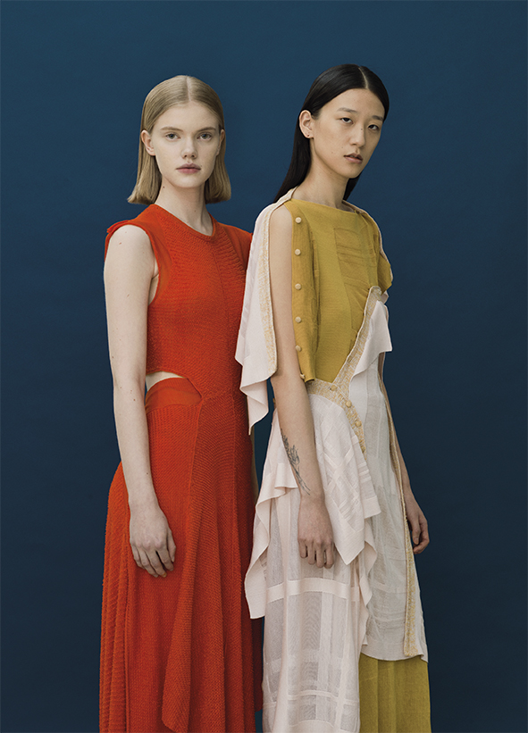
Sustainable innovations
Finnish textile and fashion business are gaining international recognition due to sustainable innovations.
Infinited Fiber has created a technology that allows textile waste to be used again and again, preserving 100 percent quality.
Spinnova represents an ecological innovation that turns wood or waste streams into textile fibre without harmful chemicals.
Ioncell

Slide 38
Innovations from textile waste
Pure Waste Textiles is making products from textile waste leftover from the clothing manufacturing process. One t-shirt made from their process saves 2,700 litres of water compared to using virgin cotton.
Ioncell uses a technology developed in Aalto University that turns used textiles, pulp or even old newspapers into new textile fibres sustainably and without harmful chemicals. The process converts cellulose into fibres which in turn can be made into long-lasting fabrics.

Slide 39
Fortum and Metsä
Fortum is doing research using wheat straw in production of sustainable textiles and the first tests look very promising. Fortum plans to establish sustainable fibre production in their future biorefineries that will use residual biomasses such as agricultural waste.
Metsä Spring has created a joint venture with Japanese Itochu Corporation in creating a textile fibre demo plant in Äänekoski. The plant will enable development of sustainable production technology to convert Metsä Fibre’s paper-grade pulp into textile fibres.

Slide 40
International collaboration

Slide 41
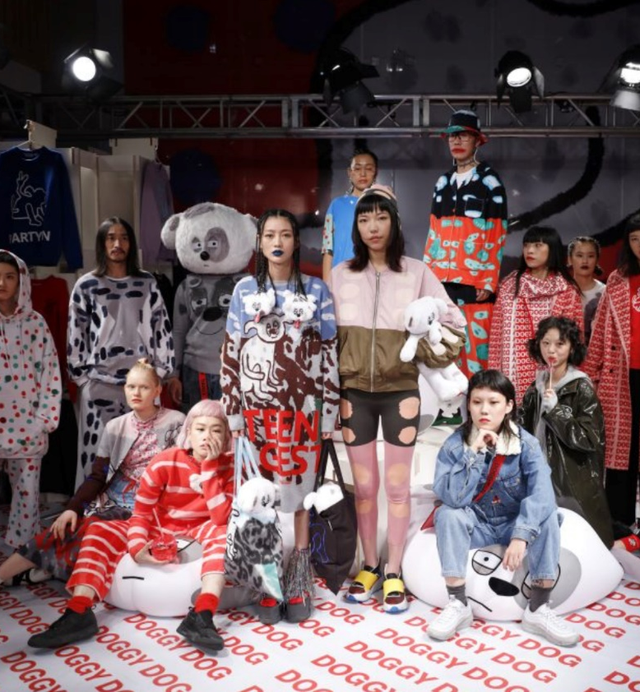
Daniel Palillo x ZucZug
INTERNATIONAL COLLABORATIONS
Design skills and international visibility have made Finnish designers wanted partners for collaboration projects with big international clients, especially in Asia.
Daniel Palillo x ZucZuq
Janine Rewell x Jorya
Marimekko x Uniqlo
Juslin Maunula x Peacebird
Jesse Auersalo x MM6

Slide 42
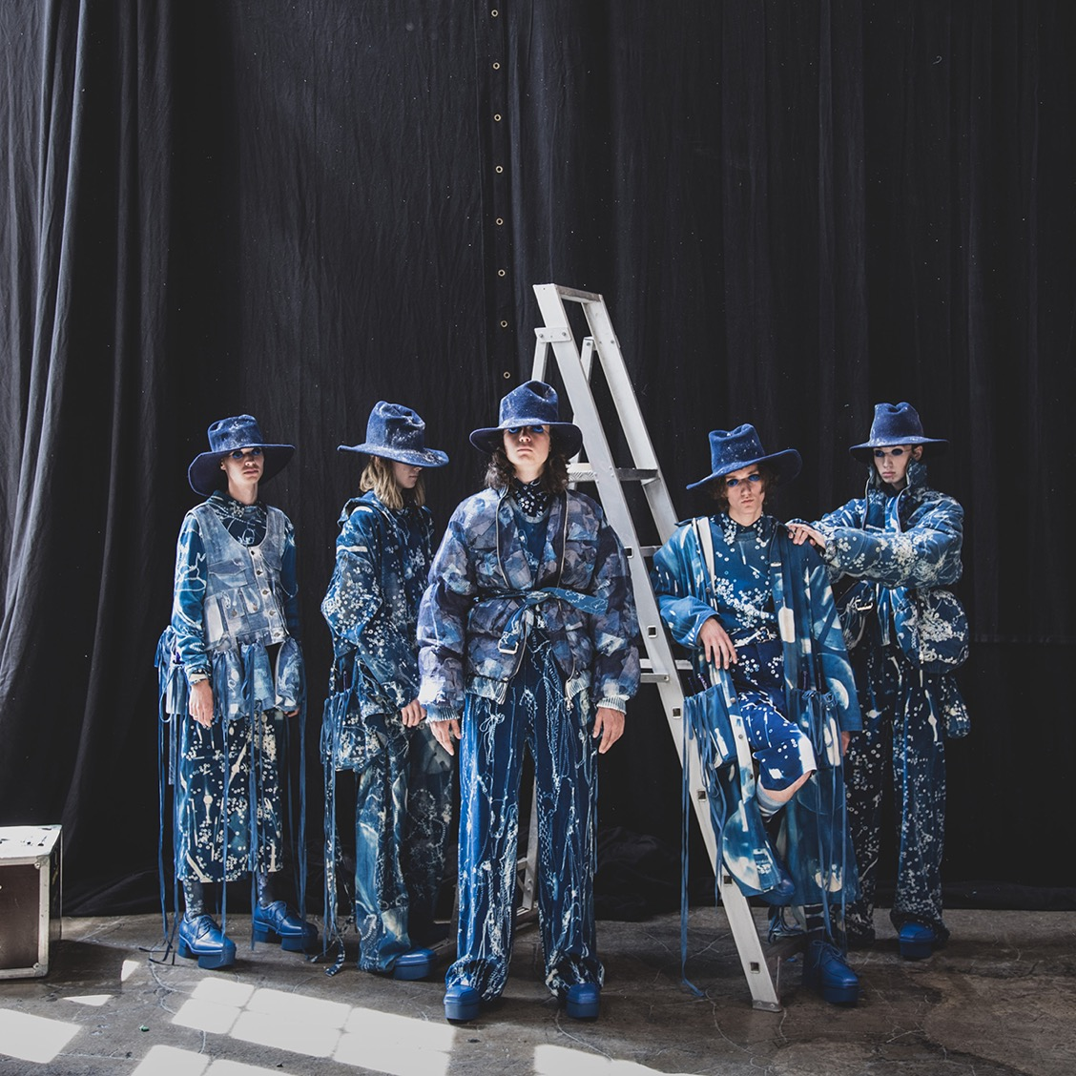
FASHION IN HELSINKI
www.fashioninhelsinki.com
Fashion in Helsinki has established itself as the leading international event for Finland’s fashion industry, with screenings, presentations, exhibitions and discussions. The main themes are responsibility and ethical consumption, creativity and young designers. The event is organised by Aalto University and Juni Communication.

Slide 43
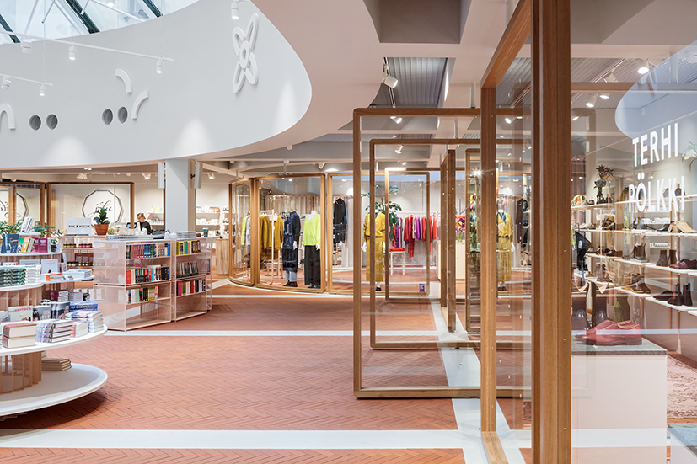
Finland has become a fashion destination with many new flagship stores and beautiful store concepts such as Metsä/Skogen, Kämp Garden and Nudge in Helsinki as well as Televisio Lifestyle Store and PUF in Turku.
Kämp Garden, photo by Tuomas Uusheimo

Slide 44
THE FUTURE OF FINNISH FASHION
We believe that fashion can make a difference. We have to continue to innovate in the field of sustainable textile production, and we need designers who strive to create fashion that is both beautiful and fair.

Slide 45
KIITOS!
THANK YOU!

