Slide 2
FINNISH MATERNITY AND CHILD HEALTH
CLINICS

Slide 3


Slide 4
Meeting societal challenges with innovative practices
Finland has long embraced social innovations as a way to improve the life of its citizens.
Perhaps the best-known examples are the innovative ways Finland has worked to improve mothers’ and children’s health.
Notes:
A social innovation is defined as a way to meet societal challenges with new and innovative social practices. As an open and forward-looking society, Finland has long embraced social innovations as a way to improve the life of its citizens. Perhaps the best-known examples are the innovative ways Finland has worked to improve mothers’ and children’s health

Slide 5

History of neuvola
Maternity and child health clinics, neuvola, were introduced in the 1920s.
The clinics were created to improve a nation’s health by focusing on its children.
Notes:
The maternity and child health clinics were invented in the 1920s by the internationally renowned pediatrician Dr. Arvo Ylppö, who believed that the best way to improve a nation’s health was to focus on its children. At a time when Finland was still poor and largely agricultural, he thought it was essential to improve health and wellbeing for children from all socio-economic backgrounds in every part of the country. The clinics offered a new kind of welfare service as they did not primarily aim to cure the ill but rather to prevent illnesses. They provided not only medical check-ups but also practical advice on health and childcare. And they were free for everyone. In 1944, a law was passed requiring every community in Finland to open a child health clinic.

Slide 6
Mission of the clinics
The clinics aim to provide comprehensive support to the whole family in order to give every child, regardless of their background, a healthy start in life by providing healthcare and practical advice.

Slide 7
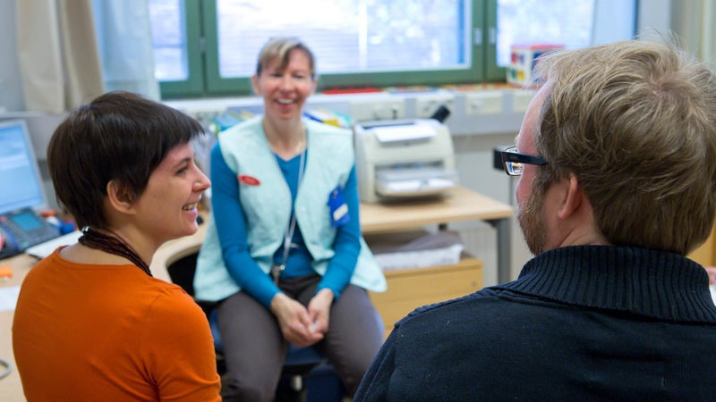
Maternity and child health clinics, neuvola, are a part of every Finn's life
Notes:
Maternity clinics are visited by 99.8% of families in Finland and child health clinics are visited by 99.5% of families. (The National Institute of Health and Welfare, THL, 2015)

Slide 8
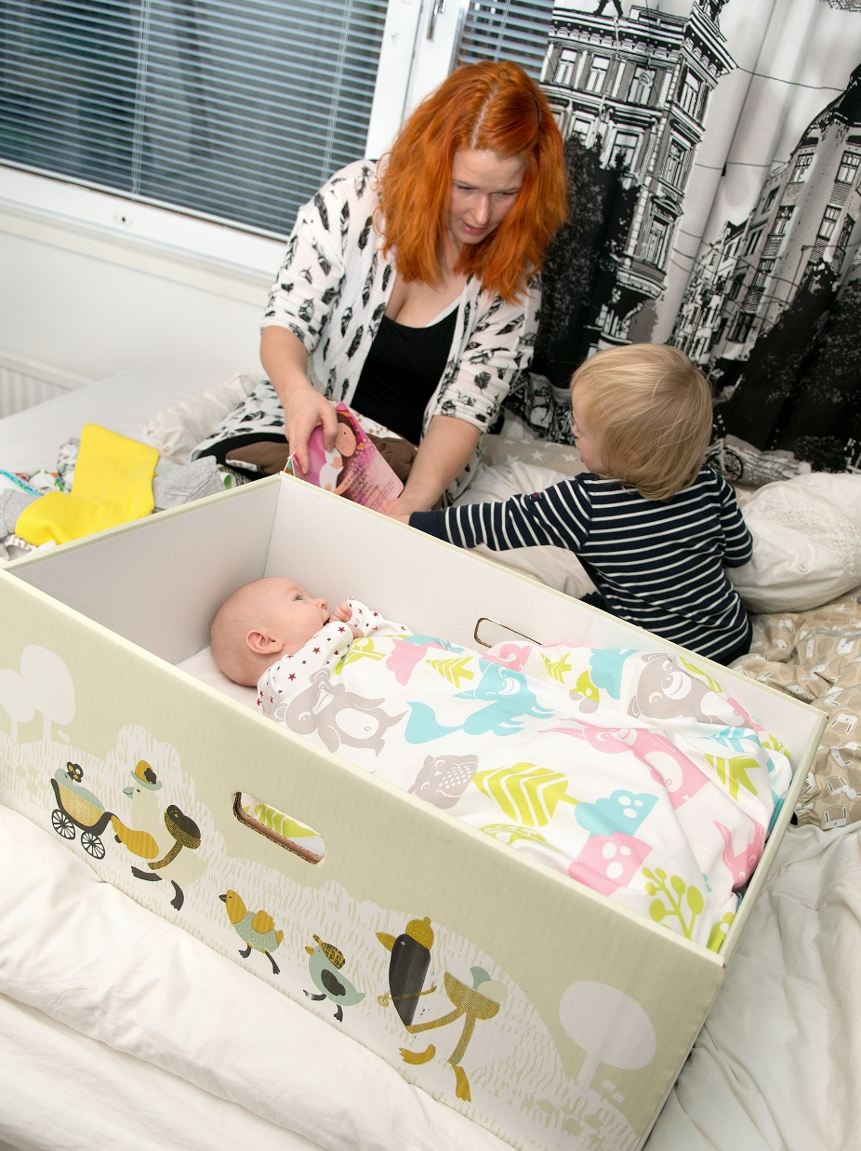
Maternity package
The maternity package – or “baby box” – is another Finnish social innovation. It provides mothers with items to make it easier to look after their baby, but it also seeks to promote health consciousness.
Notes:
Another social innovation designed to help children was introduced in 1938. The maternity package – or “baby box” – provided mothers with products and items making it easier to look after their baby, but it also sought to promote health consciousness. The box was available free of charge to pregnant women, but in order to get it, they had to visit a doctor or a clinic. Over the years, the contents of the maternity package have changed along with the times and the needs of the families. More than 95% of the mothers choose the baby box instead of an equivalent cash grant.

Slide 9


Slide 10
Timeline of maternity and child health clinics
1938
The maternity package – or “baby box” – was introduced
1944
The Act on Child Health Clinics was passed requiring every community in Finland to open a child health clinic
1920s
The first maternity and child health clinics were established
1949
A network of municipal maternity and child health clinics covers the whole country

Slide 11
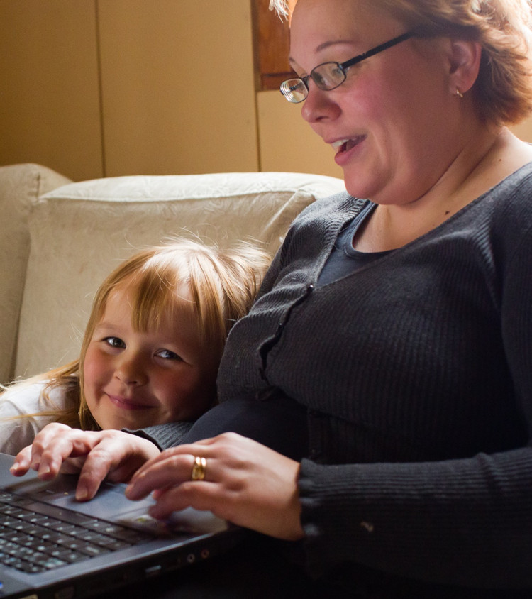
2
Improving health and equality
Since the 1920s, mothers’ and children’s health in Finland has improved dramatically.
Infant mortality in Finland is among the lowest in the world, and Finland consistently ranks at or near the top in rankings for the best place to be a mother.
ND
BEST
COUNTRY TO
BE A MOTHER
UNICEF compiles statistics on the health of mothers and children and uses them to produce rankings showing where mothers fare best and where they face the greatest hardships.
Notes:
Source: UNICEF Office of Research 2015 State of The World’s Mothers Report
Since the 1920s and the 1930s, mothers’ and children’s health in Finland has improved dramatically. Infant mortality in Finland is among the lowest in the world, and Finland consistently ranks at or near the top in rankings for the best place to be a mother. Studies also show that investments in mothers’ and children’s health have improved women’s position in the workplace and in business.

Slide 12
The goals and objectives of maternity and child health clinics
to promote the health and wellbeing of pregnant mothers and their families
to reduce health inequalities in society
to monitor and support healthy pregnancy and the growth and development of children
to identify any need for special support as early as possible
to provide support and assistance when needed

Slide 13
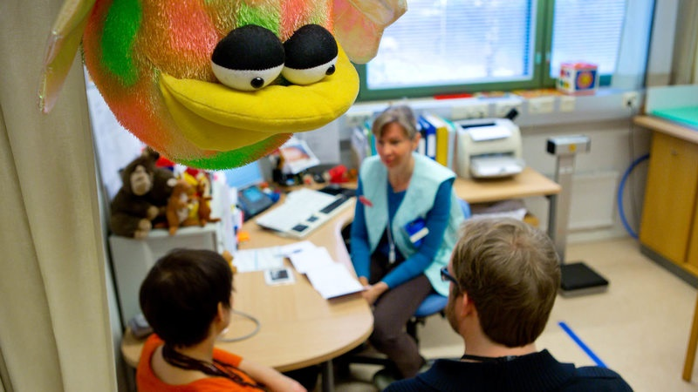
Notes:
The Ministry of Social Affairs and Health is responsible for guiding the development of maternity and child health clinics. Municipalities are in charge of the practical arrangement of services. The National Institute of Health and Welfare (THL) supports municipalities and monitors the implementation of the legislation.

Slide 14
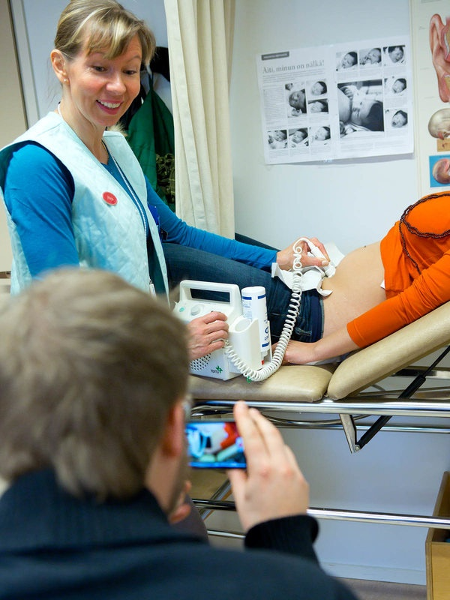
How do the clinics work?
Expectant mothers normally meet with a nurse or a doctor 11–15 times during pregnancy.
Attending a maternity clinic is one of the preconditions for eligibility for maternity benefit.
Notes:
Virtually all Finnish mothers and pre-school children from all backgrounds visit child health clinics.

Slide 15
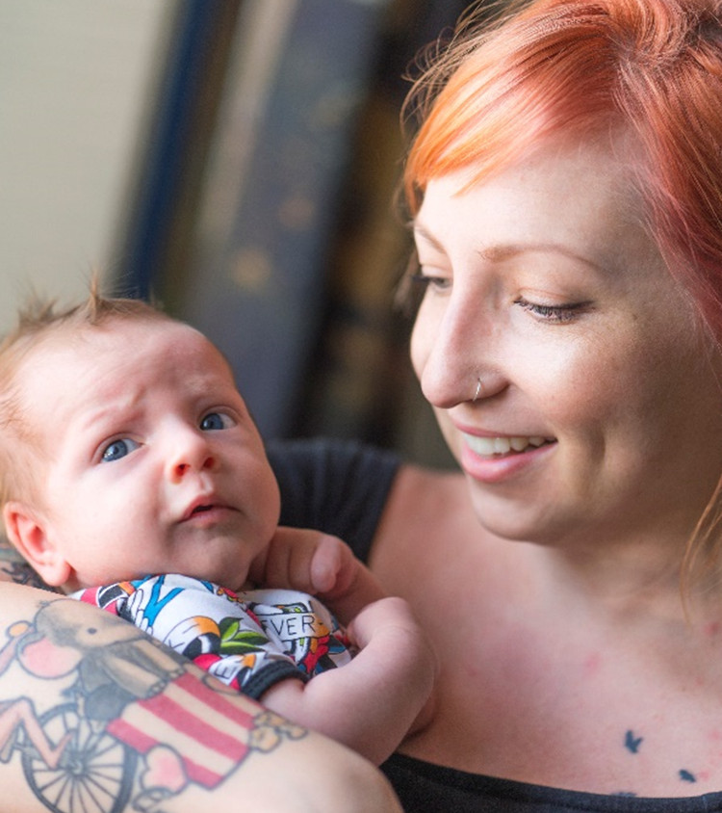
How do the clinics work?
Child health clinics assess the physical, mental and social condition of children under school age (0–7), provide vaccinations and support parents in providing secure, child-focused upbringing. Careful attention to the relationship of the parents also plays an important role in the work of the clinics.

Slide 16
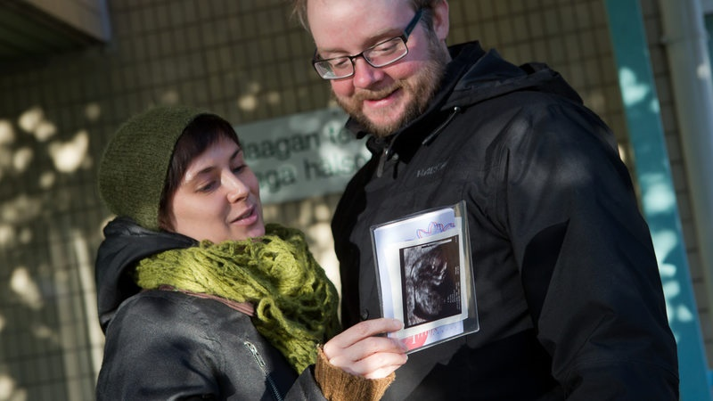
The services of the clinics are AVAILBALE AND free of charge for all Finnish residents
Notes:
The health care system is mostly funded by taxation levied by the state and the local authorities

Slide 17
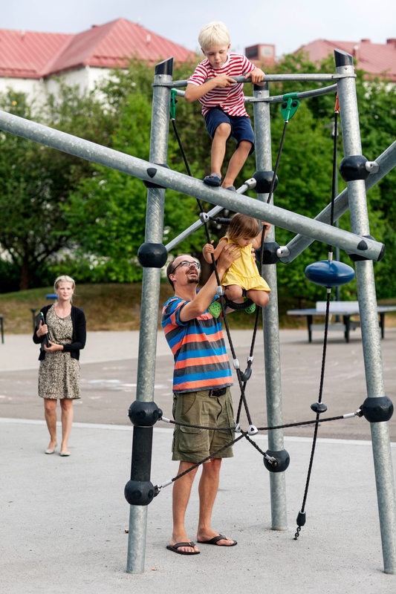
Supporting the whole family
The maternity and child health clinics have also changed with the times.
Instead of focusing purely on children and mothers and their physical health, the clinic network now aims to encourage good parenting with emphasis also on the role of fathers.
The basic idea is to provide comprehensive support to the whole family.
Notes:
A system originally devised for children now plays an important role in promoting lifelong health consciousness.

Slide 18

TODAY, Special emphasis is placed on the role of fathers and parental responsibility
Notes:
Source: Statistics Finland

Slide 19

Thank you

Slide 21


Slide 22
