Slide 2
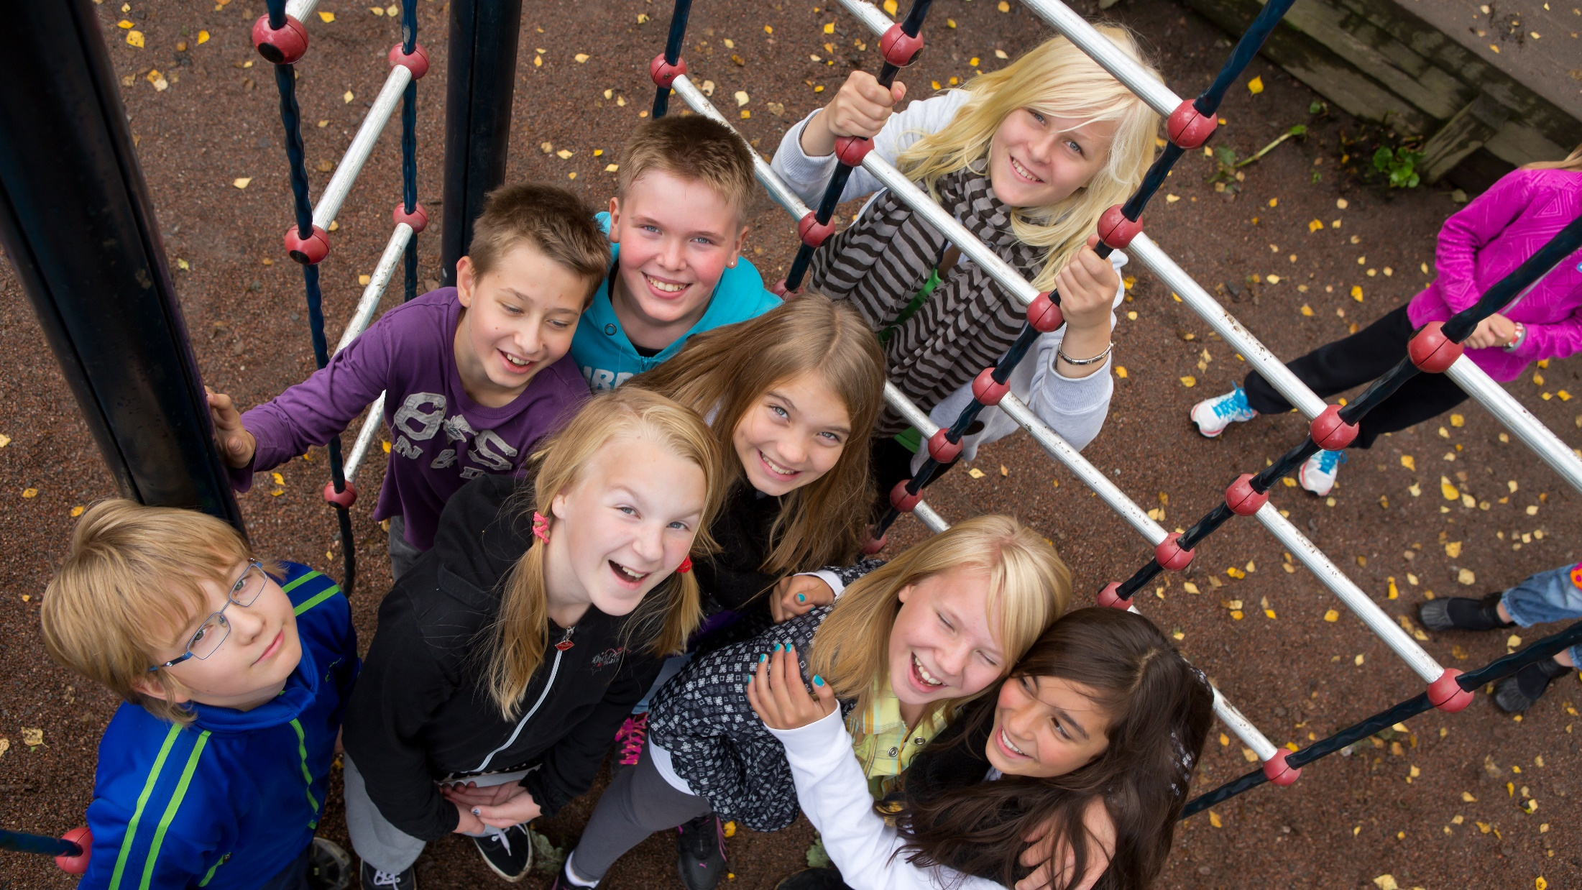
Future Skills

Slide 3
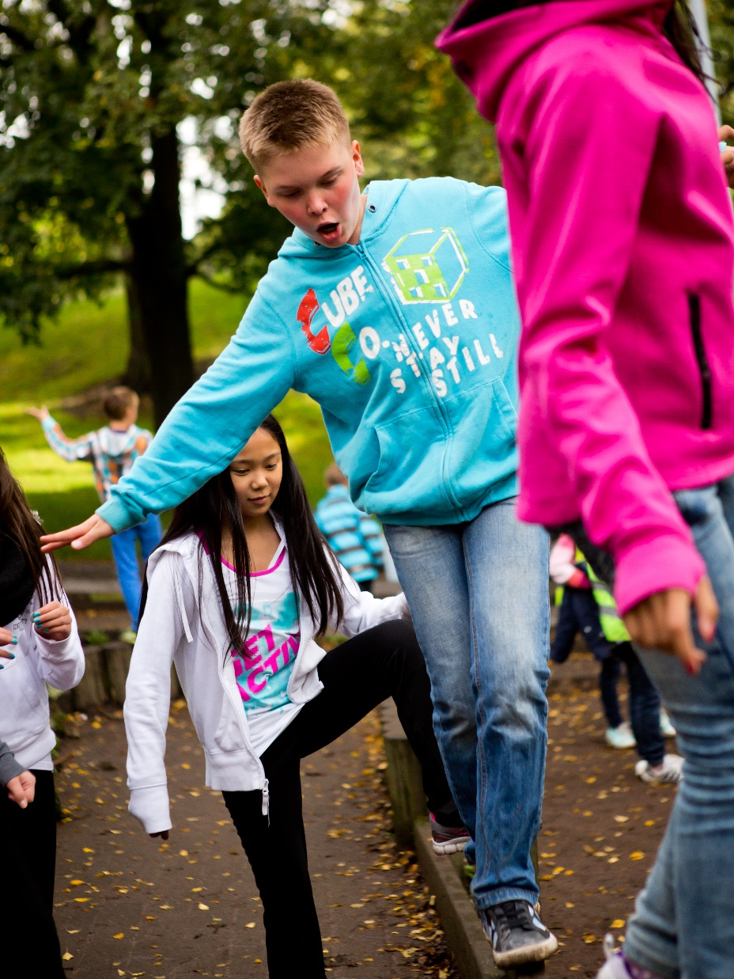
Equal education system
The Finnish education system has been built on the belief that a nation can only fulfill its human and economic potential if every citizen has the opportunity to fulfill his or her personal potential.
That has meant that education should be available to everyone regardless of their gender or socioeconomic background.

Slide 4
Equal education system
Today, the Finnish education system is world famous, and Finland consistently ranks at or near the top in international comparisons of students’ scholastic results.
Even more impressively, Finland - in three consecutive years ranked the happiest nation in the world – is one of the few countries in the world to combine high educational achievement with high life satisfaction.
Naturally, a highly educated and motivated workforce is also the backbone of the Finnish economy.

Slide 5
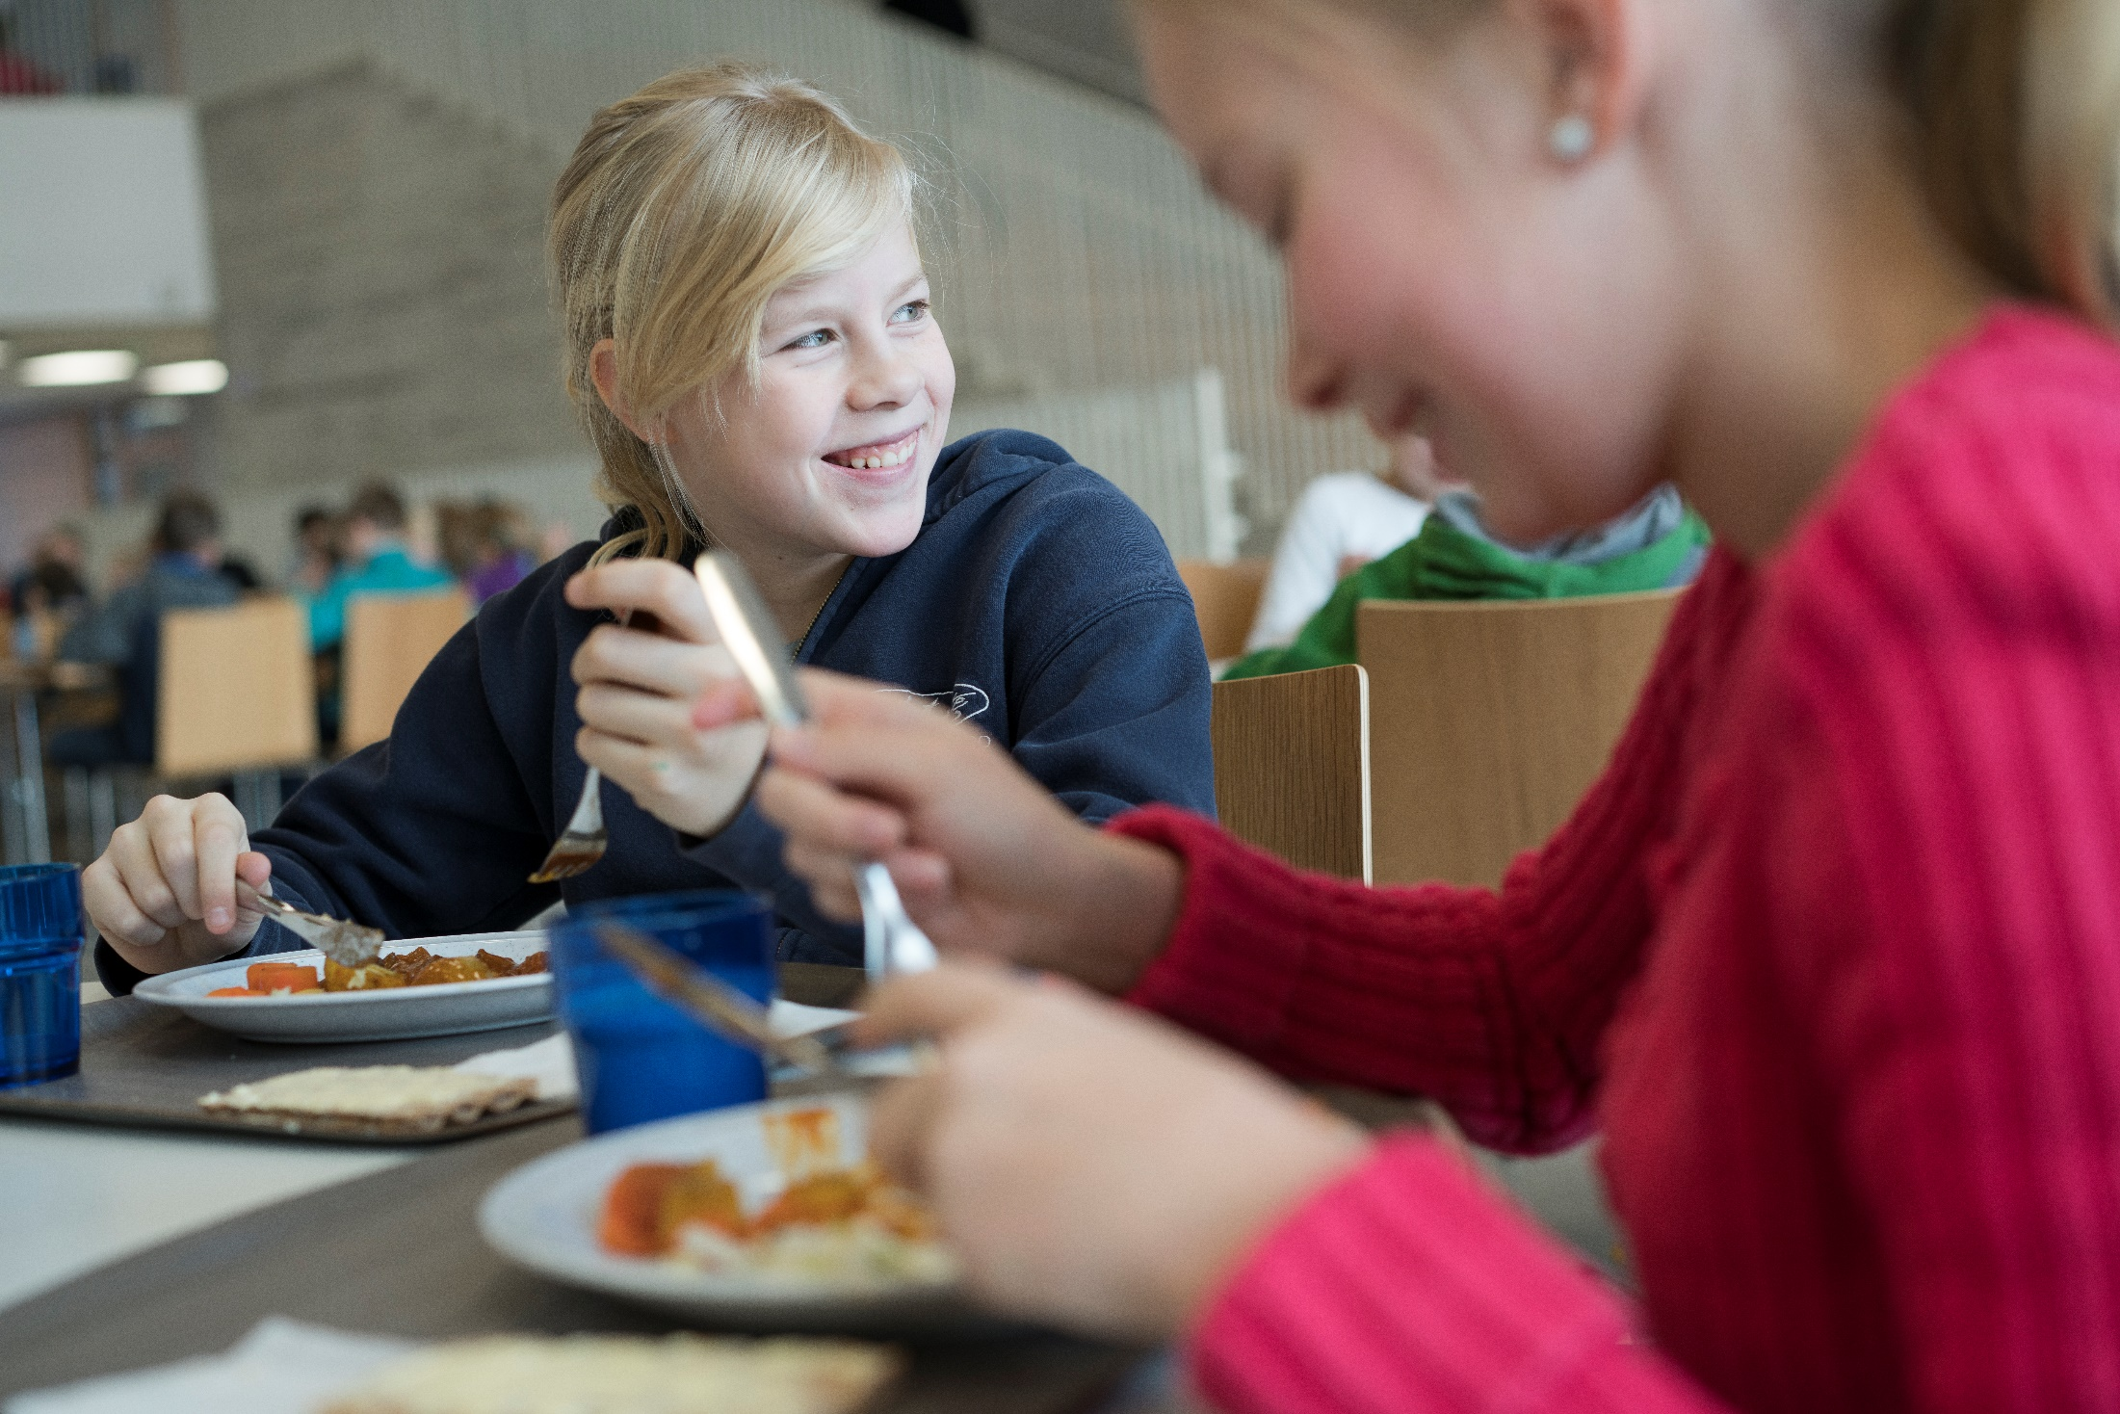

Slide 6
Finnish education has been ranked sixth best in the world.
(Legatum Prosperity Index, 2019)

Slide 7
Free education for all
All education from preschool to vocational colleges and universities is free of charge for Finnish and EU citizens.
Formal institutions of adult education as well as informal programs and online courses promote the increasingly important principle of lifelong learning.
In Finland enrolment in adult education ranks among the highest in the world. Some 85% of adult Finns have participated in adult education.

Slide 8
Teachers
Teachers are highly respected in Finland. All teachers are university-educated, and most of them hold a master’s degree.
Teachers also work independently and have significant autonomy to chose teaching methods, study materials and many other matters.

Slide 9
Student-centred approach
Finnish pupils spend less time in classrooms than most of their counterparts around the world.
In basic education, the average class size is 20 students, and a student-centred approach lies at the heart of learning.
While new technologies are actively used in the classroom, they are seen as a means rather than an end.
Notes:
Recently, a new approach of phenomenon-based learning has also been introduced.

Slide 10
Finland’s universities are considered the highest performing in the world when countries’ levels of economic development are taken into account
(Universitas 21, 2020)

Slide 11
Learning outcomes
An important result of this egalitarian approach to education is that regional and socioeconomic differences in learning outcomes are very modest.
The Finnish system is based on providing every child with a neighborhood school that is just as good as any other school in the country.
Notes:
Thanks to this policy and an emphasis on support to children with learning difficulties, Finnish education results are impressively equal.

Slide 12
PISA results
Finland has consistently placed near or at the top of the Programme for International Student Assessment (PISA), a comparison testing the skills and knowledge of 15-year-old students in different countries.
Finnish students also placed high in the assessment of life satisfaction, making Finland the only country in the PISA study combining high academic performance with high life satisfaction.
One of the factors behind Finland’s PISA results is the fact that low-achieving students perform better than in most other countries.
Notes:
In the 2018 PISA, Finnish students ranked second in reading, between 7th and 13th in mathematics, and third in science among OECD countries.

Slide 13
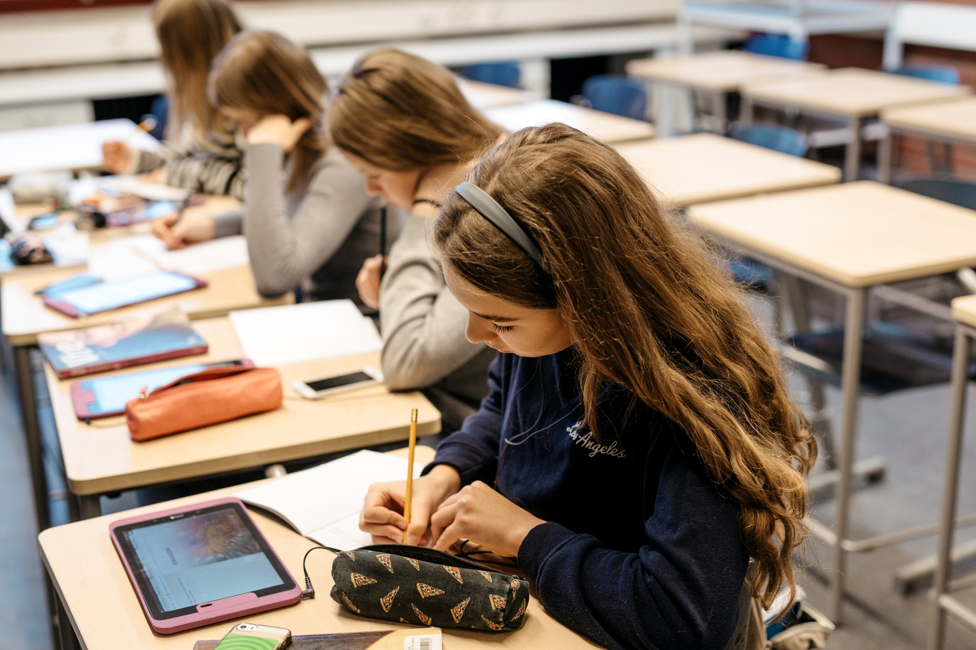

Slide 14
Way of teaching
Schooldays are relatively short, and there is no standardised testing.
Instead, Finnish schools focus on creating a motivating environment in the classroom, support for those who need it, and on a holistic perspective on children’s well-being.
Notes:
But as seriously as Finns take education, they are also serious about the joy of learning. Play and creativity are an especially important part of early childhood education, while music, arts and physical education continue to be a vital part of the curriculum in primary and secondary schools.
At upper secondary school the aim is to develop the pupils’ transversal competences. These contain skills in life management and responsible involvement, not only boosting lifelong learning but also helping pupils to grow into balanced, enlightened humans and citizens.

Slide 15
Investments in education
Finland is investing in its universities and other institutions of higher learning. Finland now aims to be an internationally attractive place to study, conduct research and invest.
By 2030, Finland plans to invest 4% of its GDP in Research and Development.
All this makes Finland uniquely positioned to adapt to a world transformed by digitalisation, automation, Artificial Intelligence and other new technologies, where traditional tasks and occupations will change or even disappear, and others emerge in their place.
Notes:
All this makes Finland uniquely positioned to adapt to a world transformed by digitalisation, automation, Artificial Intelligence and other new technologies, where traditional tasks and occupations will change or even disappear, and others emerge in their place.

Slide 16
New technologies
Finland's strengths lie in excellent, relatively equal learning outcomes, a high education level, a healthy work-life balance and flexibility of the education system, making it possible to rapidly adapt new technologies.
The Finnish system is also open to public-private partnerships as well as enterprise and research cooperation.
Notes:
Embedded in Finnish culture is an open-mindedness for science and technology and a broad commitment to knowledge-based growth and prosperity.

Slide 17
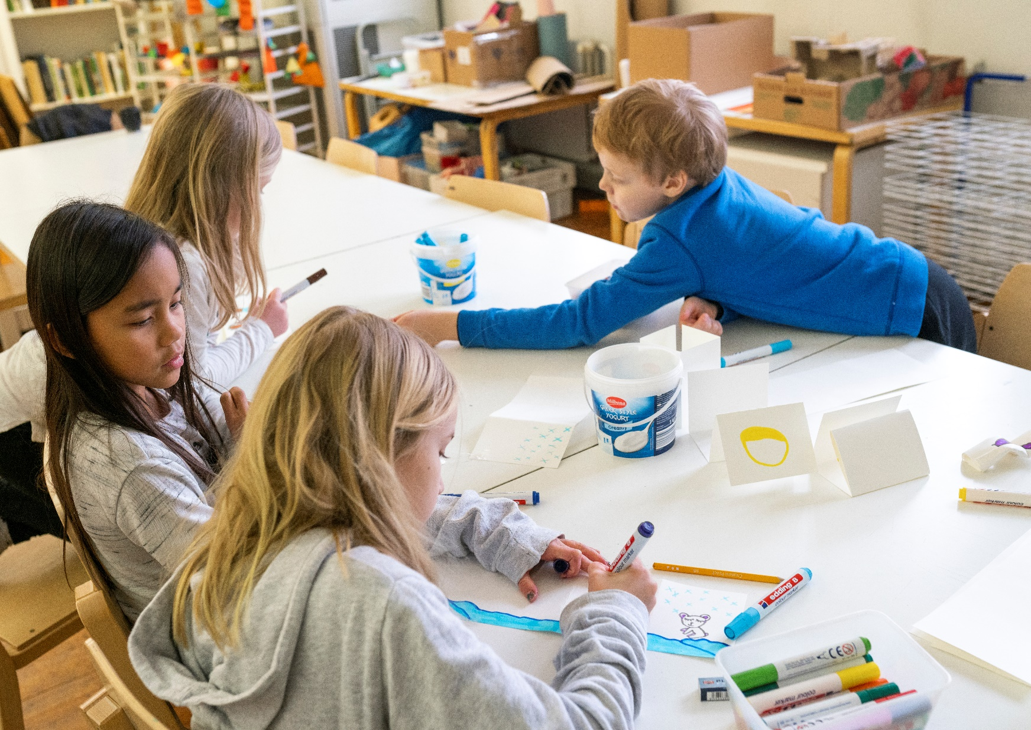
Notes:
In Finnish thinking, learning environments should encourage innovation, make room for creativity and allow the various abilities of individuals to flourish. That means equality, creativity and competitiveness are all very much intertwined.

Slide 18
Skills for the future
As the world changes, educational systems must evolve to keep up and continue to provide citizens with the skills needed in the future and to ensure future growth.
Just like in the 1800s, the best way to achieve sustainable economic growth and well-being in the future is to mobilise everyone’s competence and talents.
Continuous investment in education, research and lifelong learning is an investment in equal opportunities.

Slide 19
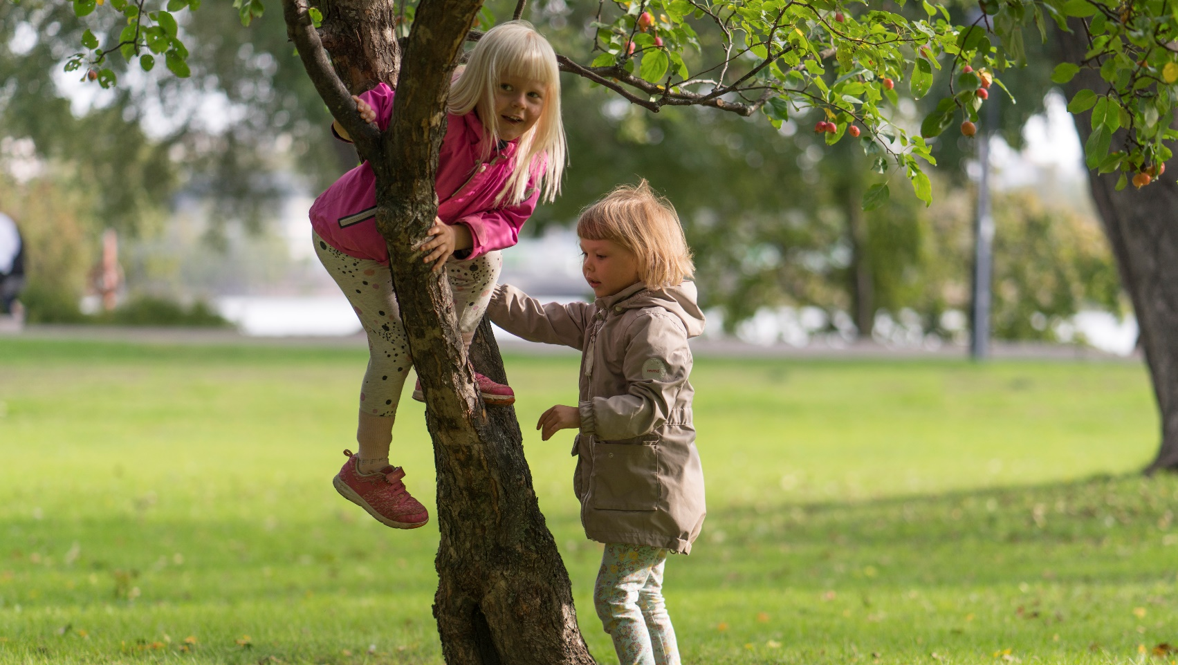
Thank you!

