Slide 1
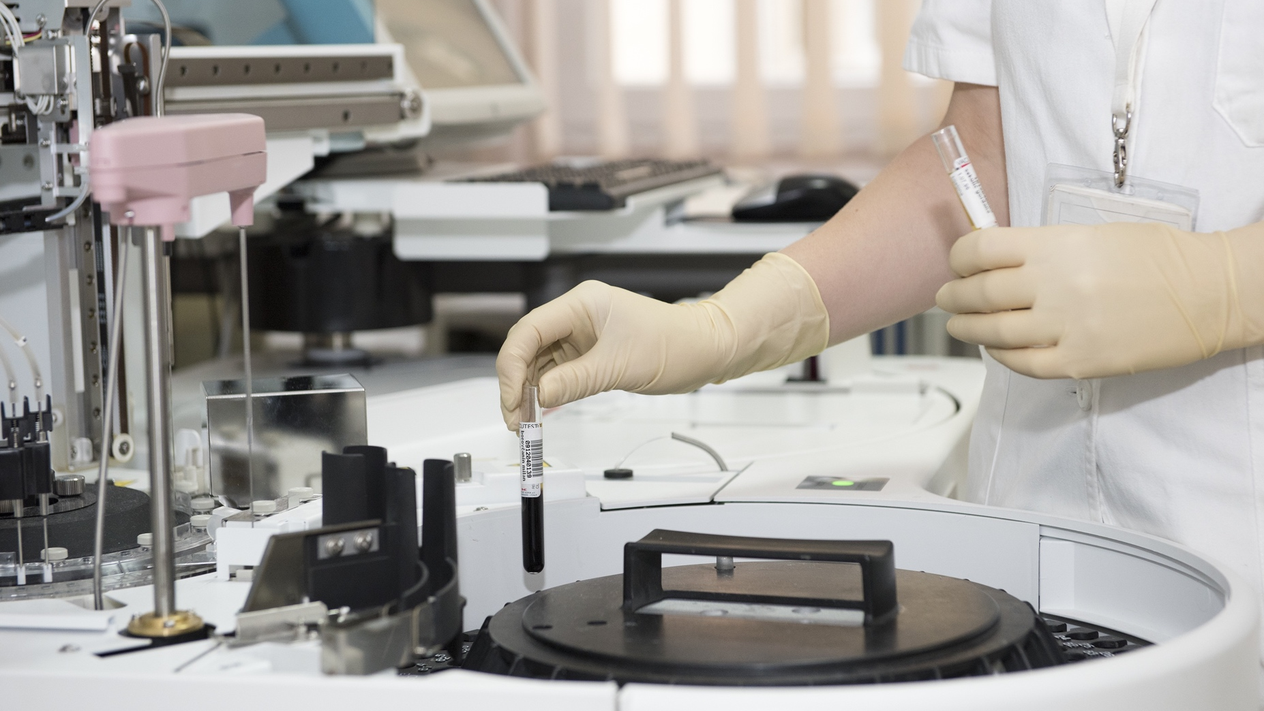
FINLAND’S
HEALTHCARE
SYSTEM

Slide 2
Finnish healthcare is state-of-the-art among the OECD countries.
The scope, accessibility and quality of health care services have been developed systematically over the last decades.
Reforming the structure and content of social welfare and healthcare services is one of the society’s most important goals in the coming years.

Slide 3
A SYSTEM THAT WAS CREATED TO COVER THE NEEDS OF EVERYONE

Slide 4
IN FINLAND, WORLD-CLASS HEALTH CARE IS AVAILABLE FOR ALL
The Finnish healthcare system provides comprehensive, high-quality healthcare ranging from primary to specialised medical care – and from care for newborns to services for the elderly.
Health promotion and disease prevention are the primary goals of Finnish health policy. The Finnish healthcare system is based on preventive health care and well-run, comprehensive health services.

Slide 5
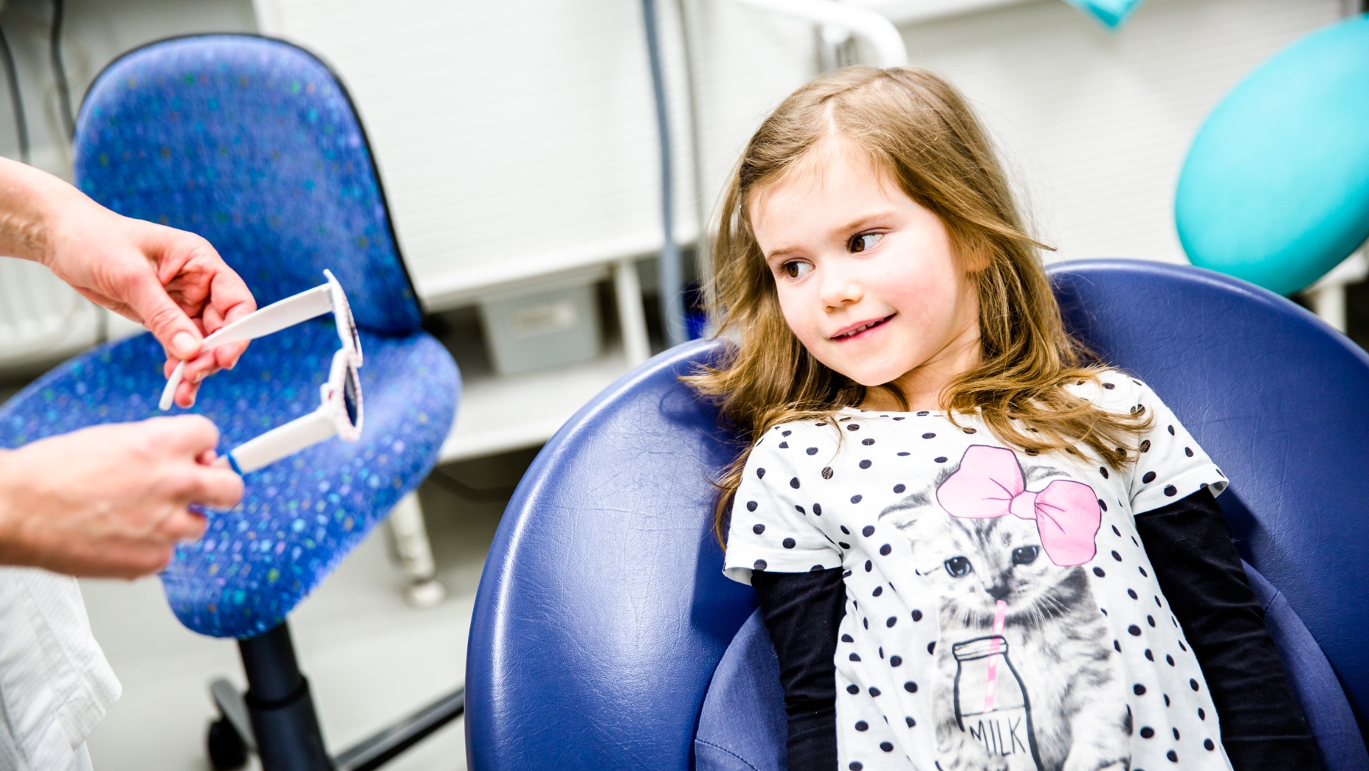

Slide 6
PUBLIC AND PRIVATE HEALTHCARE
Municipalities are responsible for organising and financing health care. A municipality can choose to organise healthcare services by providing them itself or in collaboration with other municipalities or purchasing services from organisations or from private companies.
Public healthcare is complemented by a number of private providers of specialised medical care, such as top-class specialists available to international patients travelling to receive care in Finland, or providers of state-of-the-art cancer treatment.

Slide 7
The life expectancy of newborn males in Finland is 79.2 years and, for newborn females, 84.5 years (2019).

Slide 8
EXAMPLES OF OUR PUBLIC HEALTH SERVICES
Health counselling, including health education, contraception advice, maternity and child welfare and medical examinations
Screening and vaccinations
Oral health services
School and student healthcare
Mental health services
Emergency treatment, emergency cases also handled by hospitals
Home care services
Public healthcare in Finland is not free, but charges are very low since the system is mainly tax-funded.

Slide 9
LIFE EXPECTANCY
Thanks to disease prevention and health promotion activities, life expectancy rates have risen markedly.
Combined with rapid access to life-saving care for cancer and acute cardiovascular diseases, these outreach policies have helped to ensure that Finnish people live longer than in the previous decades.
Notes:
Nationwide quality improvement programmes have hugely improved
patient outcomes in the case of chronic diseases such as asthma and diabetes.

Slide 10
PUBLIC HEALTH CARE MILESTONES
1922 - FIRST “NEUVOLA” CHILD HEALTH CLINIC IS ESTABLISHED
The first maternity and child health clinics were established in the 1920s thus contributing to the health and wellbeing of Finnish families. Maternity packages were distributed for the first time in 1938.
1972 - MUNICIPALITIES PROVIDE BASIC HEALTH CARE
As of 1972, municipalities have been obliged to provide basic health care. People residing permanently in Finland have the right to receive such healthcare their medical condition requires. Today, Finnish healthcare ranks among the best and most egalitarian in the world.

Slide 11
FINNISH PREVENTATIVE HEALTHCARE PROLONGS LIFE

Slide 12
WORLD-CLASS RESULTS
Finnish healthcare achieves world-class results in many areas, such as:
the effectiveness of specialised medical care
reducing cancer mortality
and screening and vaccination coverage.
Notes:
Nationwide quality improvement programmes have hugely improved
patient outcomes in the case of chronic diseases such as asthma and diabetes.

Slide 13
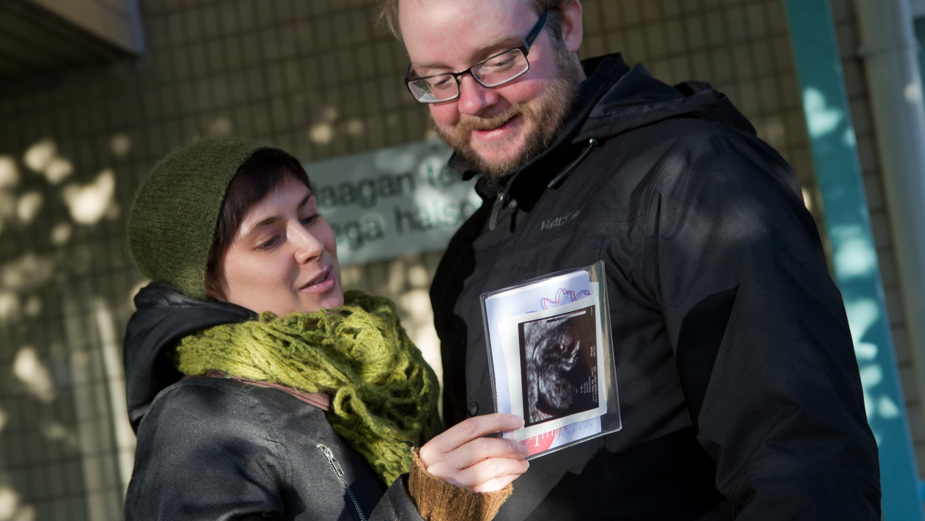
Notes:
Finnish healthcare achieves world-class results in many areas, such as: the effectiveness of specialised medical care, reducing cancer mortality and screening and vaccination coverage.

Slide 14
FACTS AND FIGURES
In 2019,
the life expectancy of newborn males in Finland was 79.2 years and, for newborn females, was 84.5 years.
the perinatal death rate was 3.9/1,000 children.
the overall fertility rate was 1.35.
vaccination coverage for small children was about 95 %.
In 2018,
Finnish healthcare spending amounted to EUR 21.1 billion or 9.0 per cent of gross domestic product and around EUR 3,829 per capita.

Slide 15
ONE OF THE BEST COUNTRIES IN THE WORLD FOR MOTHERS

Slide 16
THE BEST COUNTRY FOR MOTHERS
According to Save the Children’s annual State of the World’s Mothers’ report, Finland is one of the best countries in the world for mothers.
Save the Children states that Finland is a country, where maternal deaths affect less than one in 12,000 women, and the probability of a child dying before the age of five is one in 345.
.

Slide 17
The infant mortality rates have dropped from 95 per 1,000 children dying before the age of five in 1936, to just 3.9 by 2019.
Notes:
This tremendous performance is due to decades of systematic development of comprehensive coverage by child health clinics.

Slide 18
MATERNITY PACKAGE The maternity package – or “baby box” – was introduced in 1938. It provides mothers with products and items making it easier to look after their baby. More than 95% of the mothers choose the baby box instead of an equivalent cash grant.
Notes:
The state sends every expectant mother a maternity package which contains clothes and other necessities such as quilts, nappies, towels and clothing for new-borns.
In Finland, the package is viewed as a symbol of the country’s egalitarian culture and the belief that everyone is entitled to the best possible start in life.

Slide 19
FIND OUT MORE ABOUT FINNISH HEALTHCARE
www.stm.fi
www.thl.fi
www.finlandcare.com

Slide 20
Thank you!

