Slide 2
SMART ENERGY
Photo: Thomas Kast / Visit Finland
Notes:
Photo: Thomas Kast / Visit Finland

Slide 3
Finland - a leading country in smart energy
A combination of groundbreaking renewable energy technology, smart networks and automation has made Finnish smart energy solutions among the most advanced in the world.
Finland’s expertise in smart energy is based upon a variety of complimentary factors: a history of using renewable energy, strong support from society and public officials, rare natural resources, world-class research and an innovative private sector.
Notes:
The demand for energy is growing and the world needs new ways to produce, store, distribute and consume energy in efficient and sustainable ways.
According to Statistics Finland more district heat came from renewables (15.3 TWh) than fossil fuels (13.2 TWh) in 2019.
The smart energy sector is an important export industry, with one estimate placing it at 25-35% of total exports.
Eurostat says Finnish energy prices for non-households, including taxes, are the third lowest in the EU.

Slide 4
Developing smart energy
Finland has no usable old fossil energy deposits such as oil and coal. Because of this Finland has for decades focused on developing the energy it does have, such as renewable hydroelectric and wood-based bioenergy.
The harsh climate has forced Finland to develop efficiency solutions, such as district heating and smart grids. District heating takes “waste” heat from industry and uses it to heat homes.
The Finnish state has pledged €100 million to the Smart Energy Finland Program, while energy is key for the Finnish Innovation Fund Sitra.
Notes:
Finland’s total government-funded R&D leapt 58% from 2019 to 2020, according to Statistics Finland. The private sector has invested in software, AI and power-to-x, among other sectors.

Slide 5
Facts and stats:
Finland is a forerunner in the quest for carbon neutrality and smart energy. Already 40% of Finnish energy is produced from renewables. Finland has a goal of being coal-free in 2029.
The smart energy sector is an important export industry, with one estimate placing it at 25-35% of total exports.
Eurostat says Finnish energy prices for non-households, including taxes, are the third lowest in the EU.

Slide 6
Finland has focused on human resources and education, leading it to have one of the most highly-skilled workforces on the planet.
Notes:
Some of the main energy research groups are Aalto University, Lappeenranta University of Technology, the University of Vaasa and VTT Technical Research Centre of Finland. Sitra is a major energy think tank.
Photo: Business Finland mediabank

Slide 7
Renewable energy
According to the Finnish Ministry of Economic Affairs and Employment, 40% of Finnish energy comes from renewables.
Traditionally wood has been a major source of renewable energy in Finland, but currently the fastest growing energy source is wind power.
Wind power production is growing at a 24% annual rate, the fastest-growing energy source, according to Statistics Finland.
Notes:
The Finnish Wind Power Association says 18,500 MW of projects are currently under development, as of 2020.
One project, Arctic Energy Forerunners, is considering an ambitious plan to harvest wind energy above the Arctic circle and transmit it to southern Finland and into central Europe.

Slide 8
Finland’s energy grid is among the best in the word. In 2015, the transmission reliability of the national grid was as high as 99.9998%, and the average forced interruption was a little more than 1 minute.
Notes:
Power loss in the transmission and distribution grid is about 1.5% of total electricity consumption, the best in Europe, according to Fingrid.

Slide 9
Mobile communications and software skills
In the modern age of sustainability and renewability Finland has found its old skills in high demand. Finnish mobile communications and software skills are now required for Internet of Things (IoT) solutions and smart energy grids.
In the IoT, sensors are placed on equipment and relay information wirelessly. This information can warn operators if equipment is about to fail or help decide which power generation assets should be used in a flexible system, for example. This increases efficiency and reliability.

Slide 10
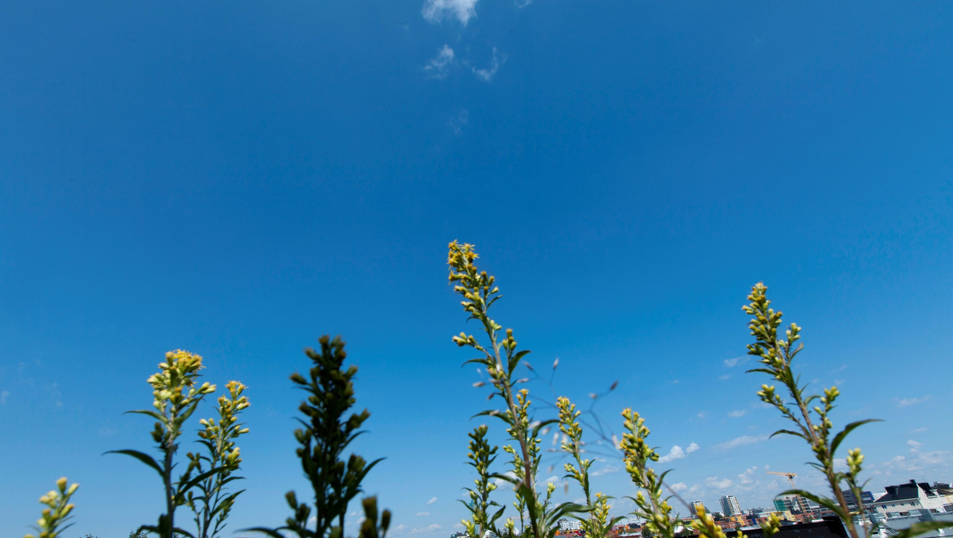
In 2020 the Environmental Performance Index ranked Finland the seventh cleanest country in the world and the first in air quality.
Notes:
Finland has also been ranked as the world’s happiest country by the UN’s World Happiness Report in 2020.
Photo: Business Finland mediabank

Slide 11
Power-to-X solutions
Power-to-X solutions, a way to convert and store energy, have drawn considerable attention. The problem with renewable solar and wind energy is that they do not produce power on demand, but only when the sun shines or wind blows.
Power-to-X seeks to solve this challenge by taking excess power and converting it to a fuel which can be accessed later on demand, such as methane or hydrogen. This technology is a main focus in the Smart Technology Hub in Vaasa.

Slide 12
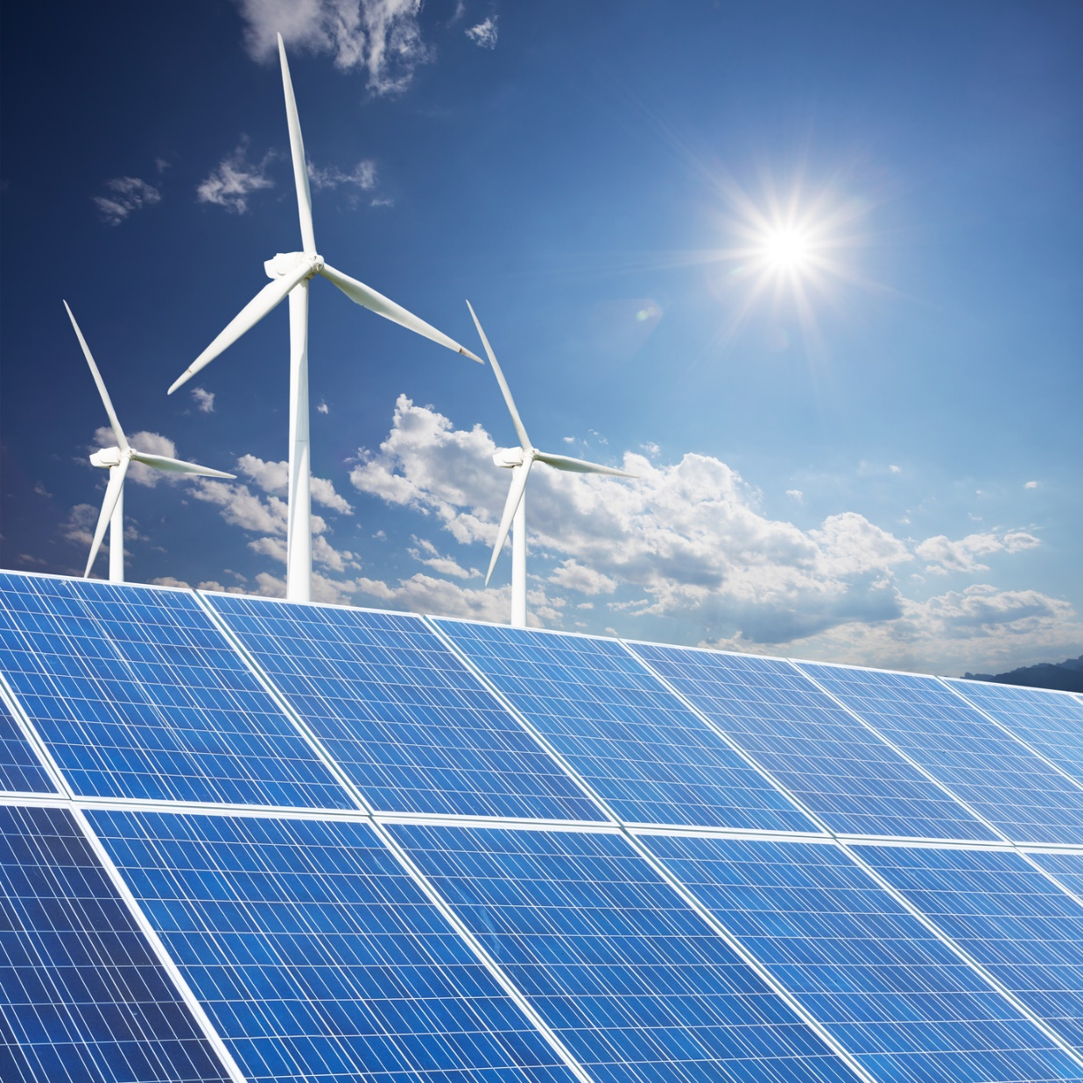
Renewable biofuels
The centuries-old forestry industry is rapidly developing renewable biofuels. The forestry industry is also innovative in circular solutions, such as using waste and side streams as sources of energy.
Renewable wood represents 28% of Finnish energy consumption, according to the National Resources Institute Finland.
Notes:
Photo: Business Finland mediabank

Slide 13
Learn more:
Business Finland Smart Energy Finland: The Smart Energy Finland Program brings together the services for technical development and exports.
VTT Smart City: A smart city is related to the smart energy sector, focusing on data, services, energy, housing and transport in urban environments.
Sitra: Energy: The Finnish Innovation Fund Sitra is a “think and do tank” which aims to improve Finland’s future.
VTT Smart Grids and Energy Systems: VTT puts together a wide range of solutions addressing the whole energy value chain, taking into account electricity, heating, cooling and fuels.

Slide 14
Thank you!

