Slide 2
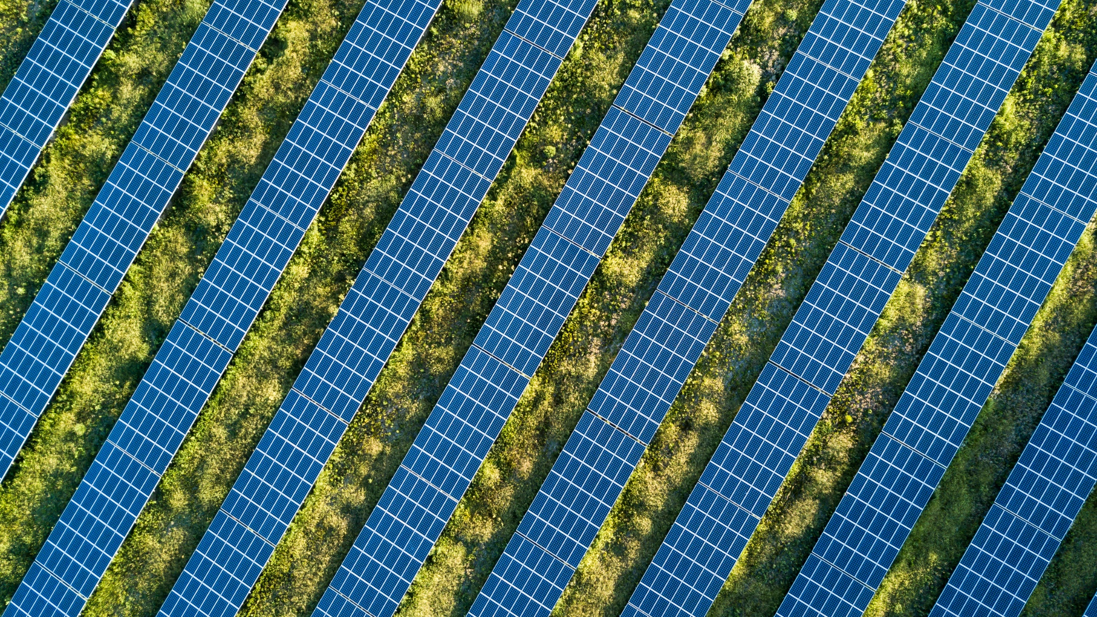
SUSTAINABLE GROWTH FROM THE BIOECONOMY
Photo: Business Finland

Slide 3
Bioeconomy is an economy that relies on renewable resources to produce food, energy, products and services.
A responsible bioeconomy will reduce our dependence on fossil-based natural resources, help prevent biodiversity loss and create new economic growth which is consistent with sustainable development.

Slide 4
Bioeconomy in Finland
In 2019, bioeconomy added 26 billion euros to the economy in Finland .
Over 300,000 persons are employed in the Finnish bioeconomy.
The bioeconomy makes up 13% of the Finnish economy.
Forestry is the largest bioeconomy sector (9 billion euros), followed by construction (4.6) and food (4.3).
Notes:
All stats are from Statistics Finland and the Natural Resources Institute Finland (Luke), unless stated otherwise.

Slide 5
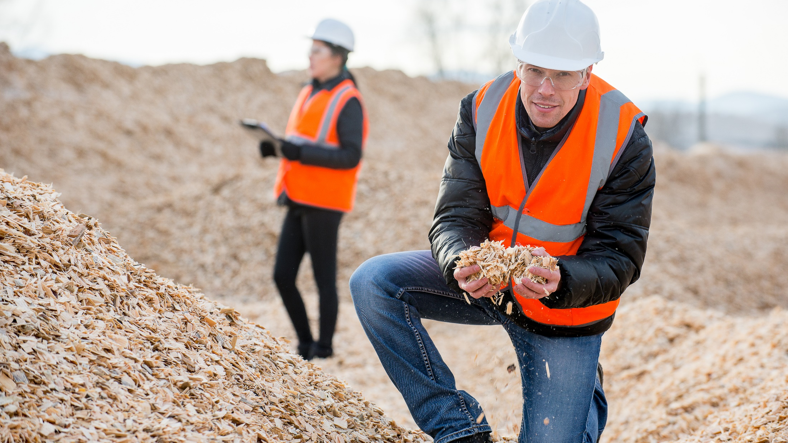
Photo: Business Finland

Slide 6
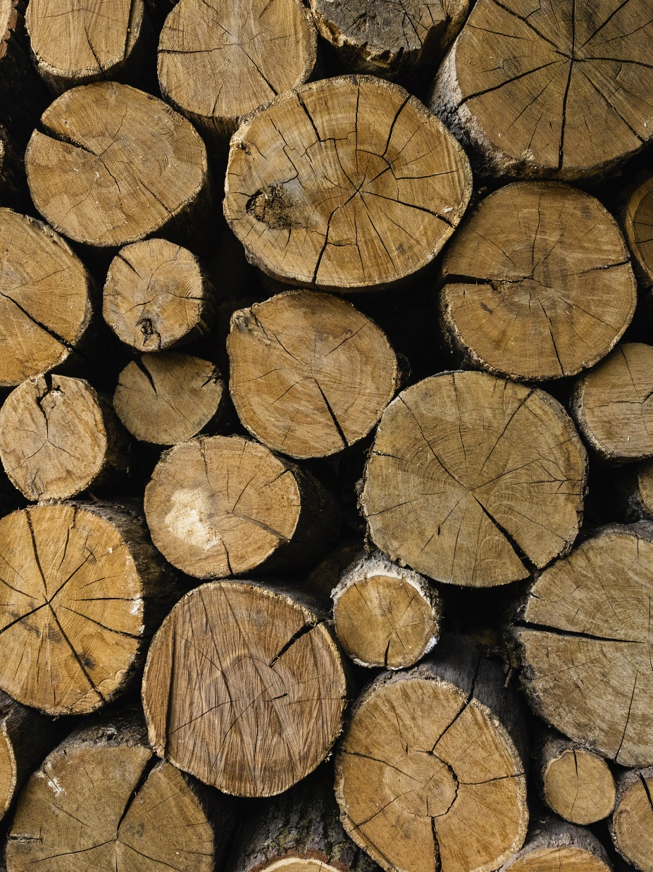
History
Finland has developed its bioeconomy for hundreds of years, in particular its forestry industry.
Finland manages its forests responsibly and sustainably. In fact, there is 50% more timber in Finland’s forests than 50 years ago, according to Forest Finland.
Photo: Business Finland

Slide 7
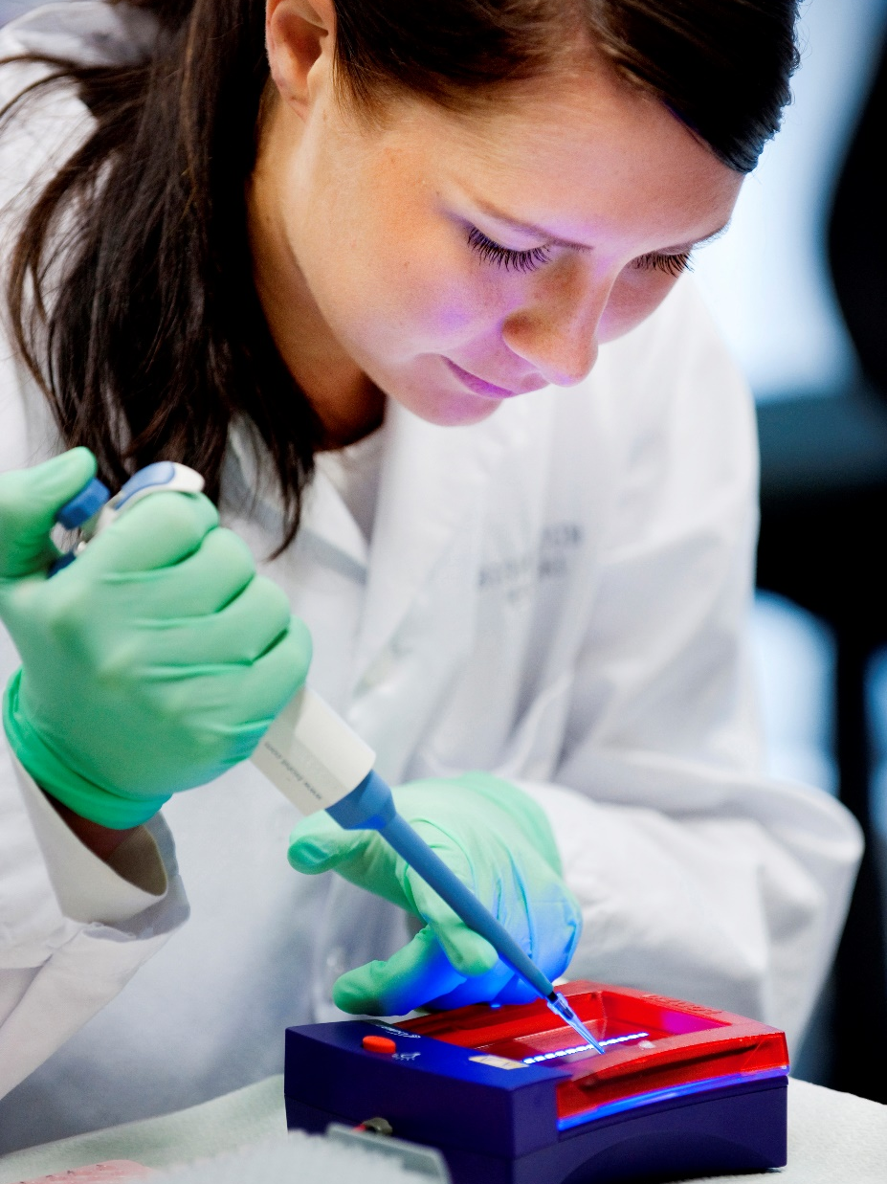
Research and education
A commitment to education and research has made Finland one of the best places in the world to develop bioeconomy solutions.
Other Finnish strengths, such as in software and mobile communications, are also critically important to the bioeconomy.
Photo: Business Finland

Slide 8
Forestry
About 78% of Finland is covered by forest. The forest industry generates about 20 billion euros in turnover and makes up 27% of Finland’s net exports.
  Long commercial experience and research in the entire forestry value chain has discovered how wood can replace many wasteful materials, such as oil and textiles.
Much of the technology that has been developed to transform wood-based cellulose can also be used with other biological resources, such as straw and crop residue from agriculture.
  This means solutions developed to be used on Nordic forests can even be used in countries which don’t have a forest industry.

Slide 9
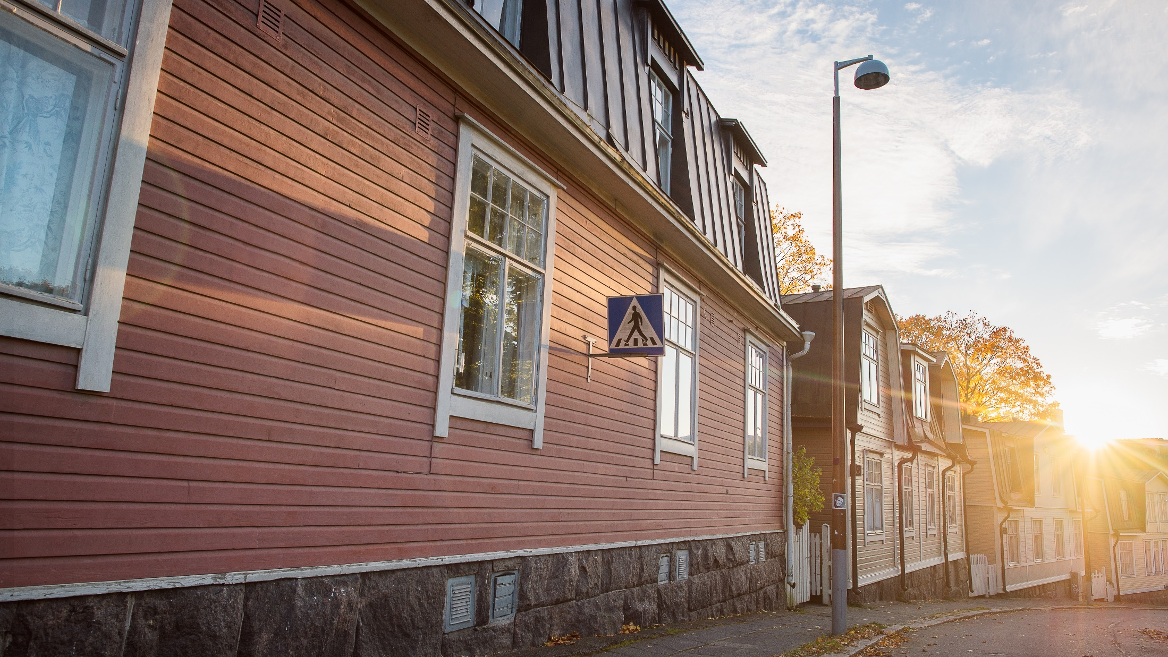
Finland is also a forerunner when it comes to using wood in construction. Public support and innovative private companies have used wood in surprising and intriguing places, such as urban locales and in infrastructure like bridges.
Photo: Aku Pöllänen

Slide 10
Wood as a material
Wood, as a versatile raw material, has received the most interest in Finland.
Oil can be replaced with wood in many products.
  Everything that can be made out of plastics can be made out of wood. Wood can be used in bioplastics, biochemicals, biofuels, textiles, pharmaceuticals, food additives and rubber.
Finnish companies have even made wooden sinks and wooden casts for broken bones. In many cases these wood-based products have superior characteristics than the old fossil-based products.

Slide 11
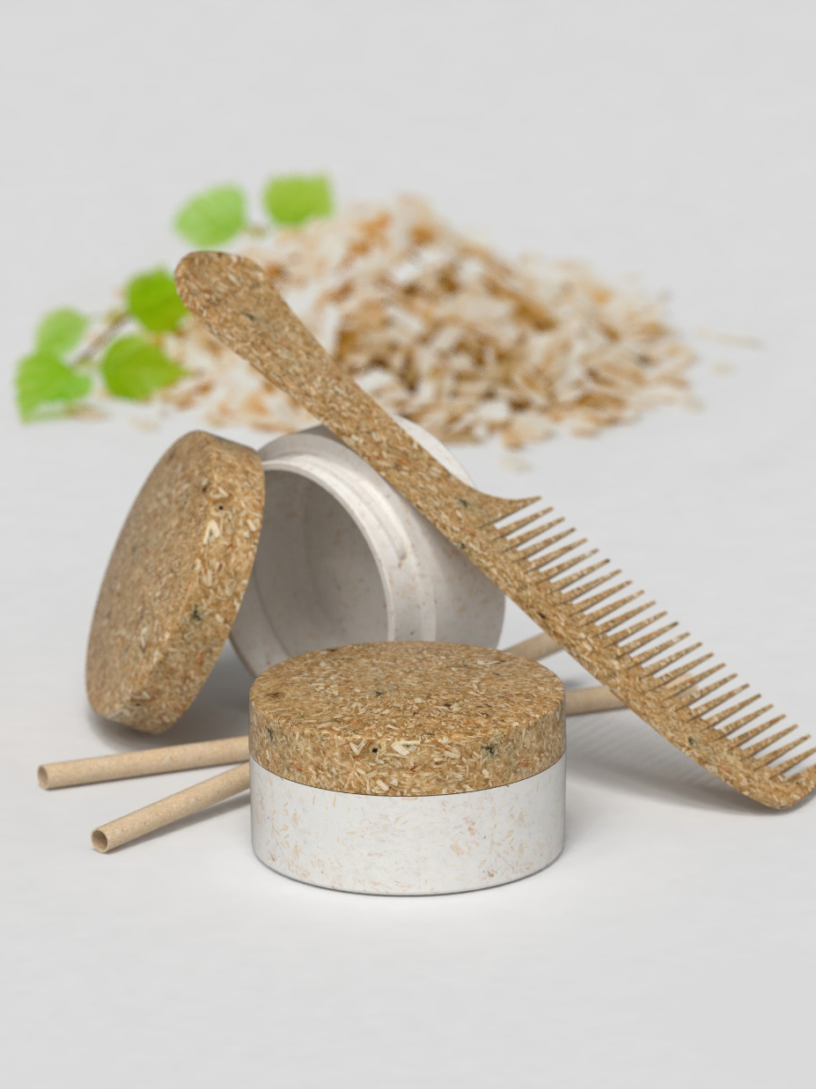
Packaging
Packaging is one of the most exciting sectors in the bioeconomy, thanks to the global awareness of plastic pollution.
Finland’s forestry companies have invested heavily into wood-based packaging, including bioplastics.
The sector also receives government support.
Photo: Sulapac

Slide 12
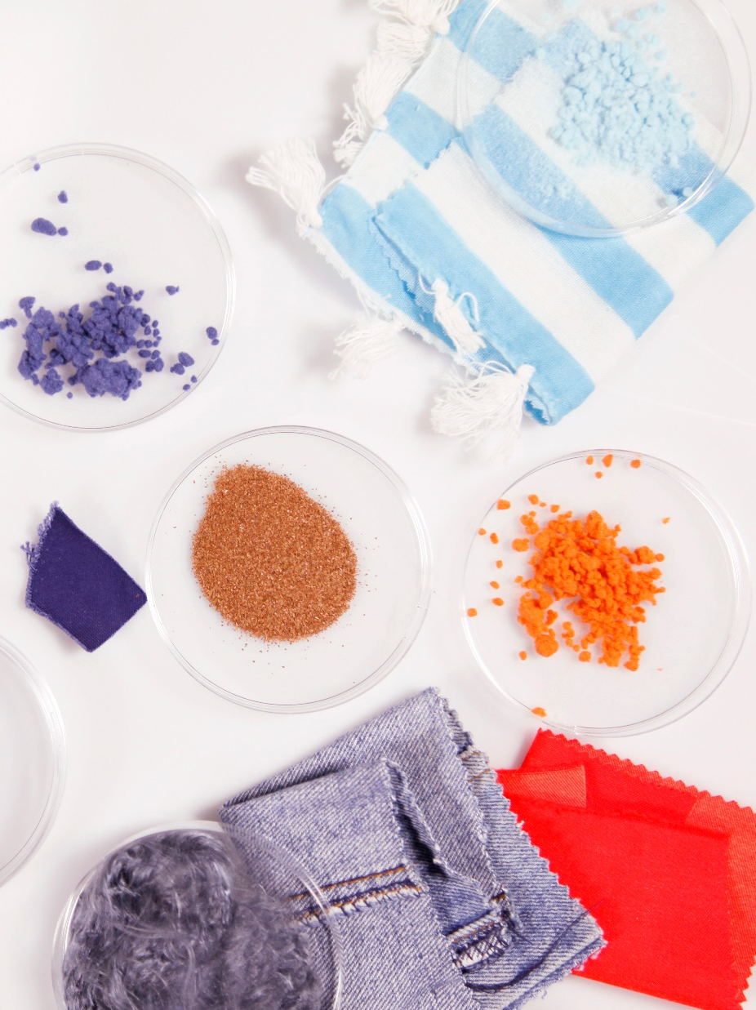
Textiles
There have been several promising developments in Finland to create textiles from a variety of raw materials, including wood.
Business Finland believes Finnish innovations could replace 1/3 of global cotton production.
Photo: Eeva Suorlahti/Ioncell

Slide 13
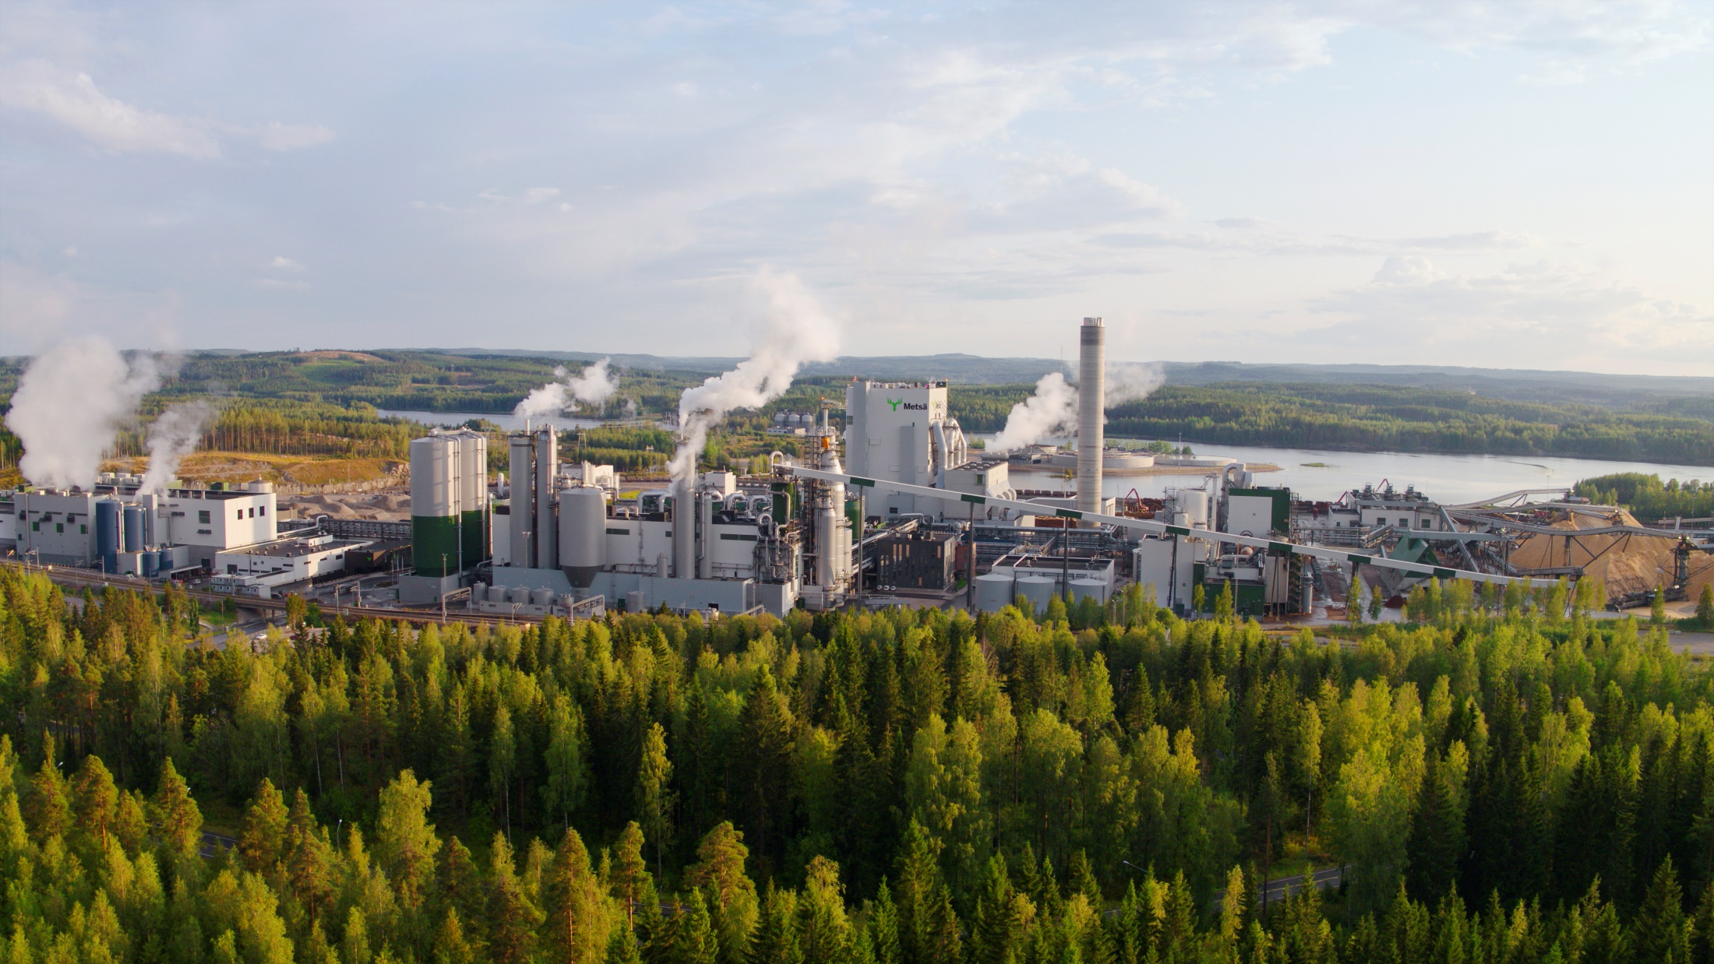
Metsä’s bioproduct mill in Äänekoski is the largest wood-processing plant in the Northern Hemisphere.
Photo: Metsä Group
Notes:
Metsä’s bioproduct mill in Äänekoski is the largest wood-processing plant in the Northern Hemisphere. The company says it has a capacity of 1.3 million tonnes of pulp annually and creates more than twice the amount of electricity it needs. In addition to traditional pulp products, the mill creates bioproducts like tall oil and biogas.

Slide 14
Investments
Bioeconomy services is one of the fastest growing sectors. Output grew 5.2% in 2019 while investments leaped 9.3% and the number employed climbed 2.8%.
Food attracted the most investments, 1.7 billion euros, in 2019. Forestry received 1.4 billion euros in investments while the energy sector received 949 million euros.
Over the long term the energy sector is seeing investments grow the fastest, at about 13% annually.

Slide 15
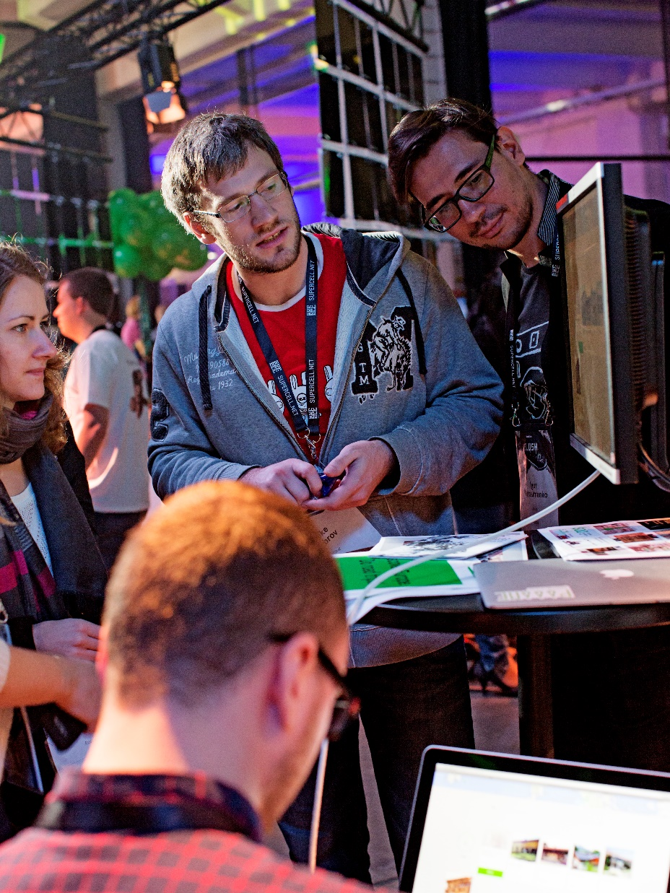
International partnerships
It is difficult for a country to develop a bioeconomy in isolation. It is faster and easier to nurture profitable international partnerships.
Many Finnish organisations have experience working with international partners. For example, Metsä partnered with the Japanese company Itochu to form an industrial scale pilot plant to produce textile fibres from wood.
Photo: Riitta Supperi/Keksi/Team Finland

Slide 16
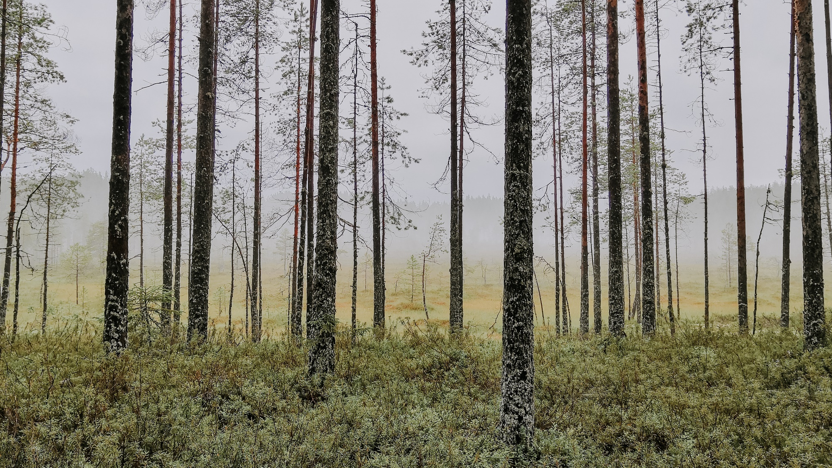
For every tree felled four new trees are planted, according to Forest Finland.
Photo: Julia Kivelä/Visit Finland

Slide 17
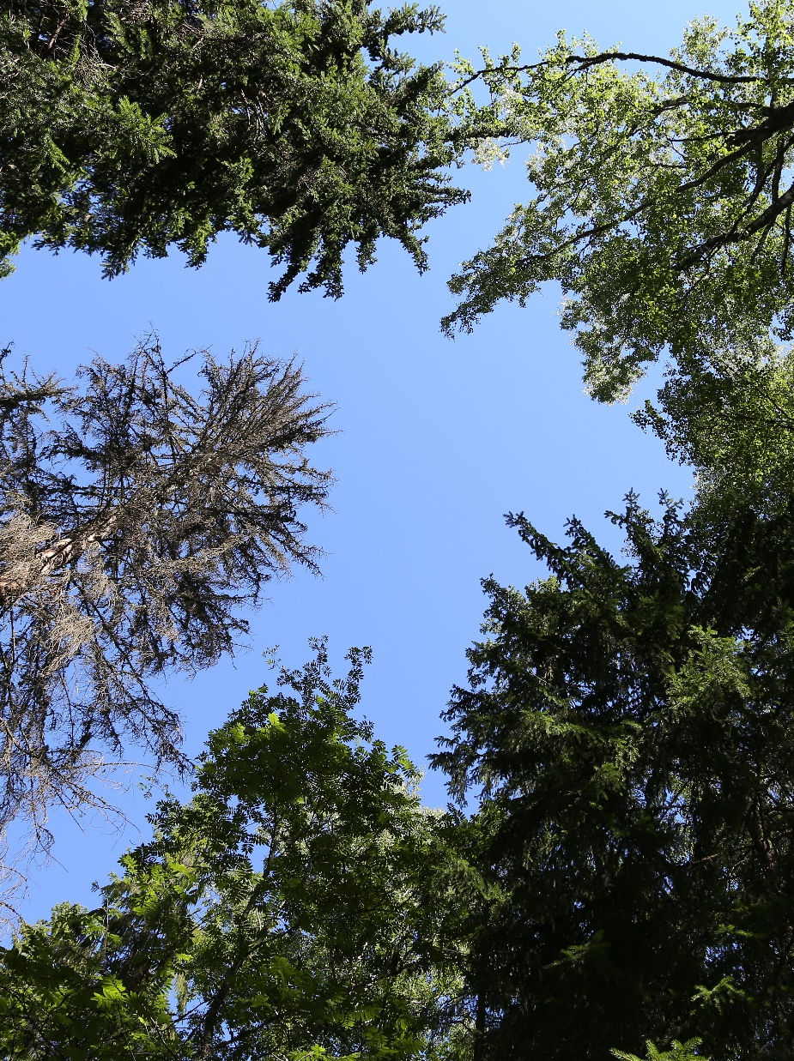
Policy support
The Finnish state has given strong, stable, long-term policy support to ensure the stable growth and development of the bioeconomy.
Finland’s 2025 vision is that sustainable solutions will form the basis of the country’s future welfare state and competitiveness.
Photo: Mohammed Alfaraj

Slide 18
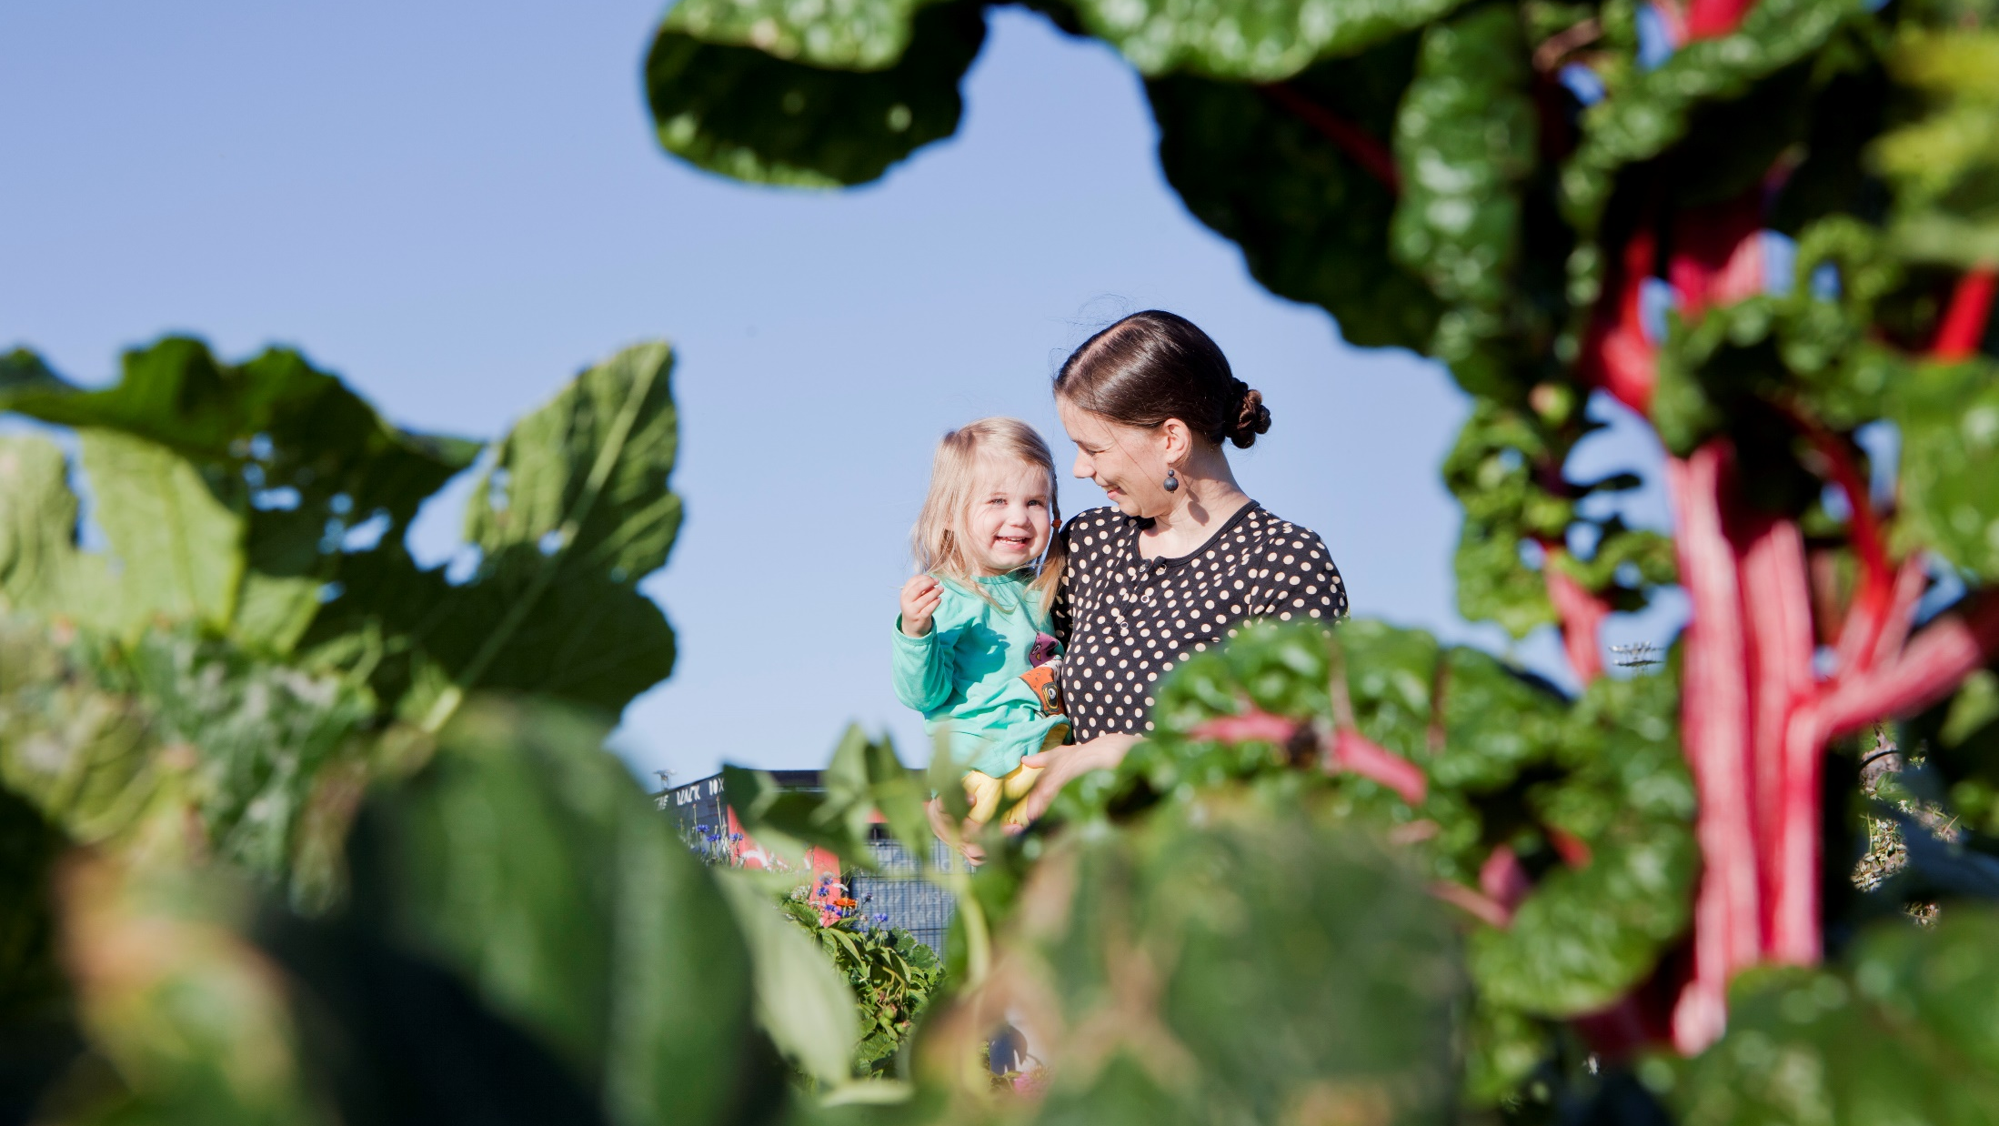
Thank you!
Photo: MMM/Mavi/Heli Sorjonen

