Slide 2
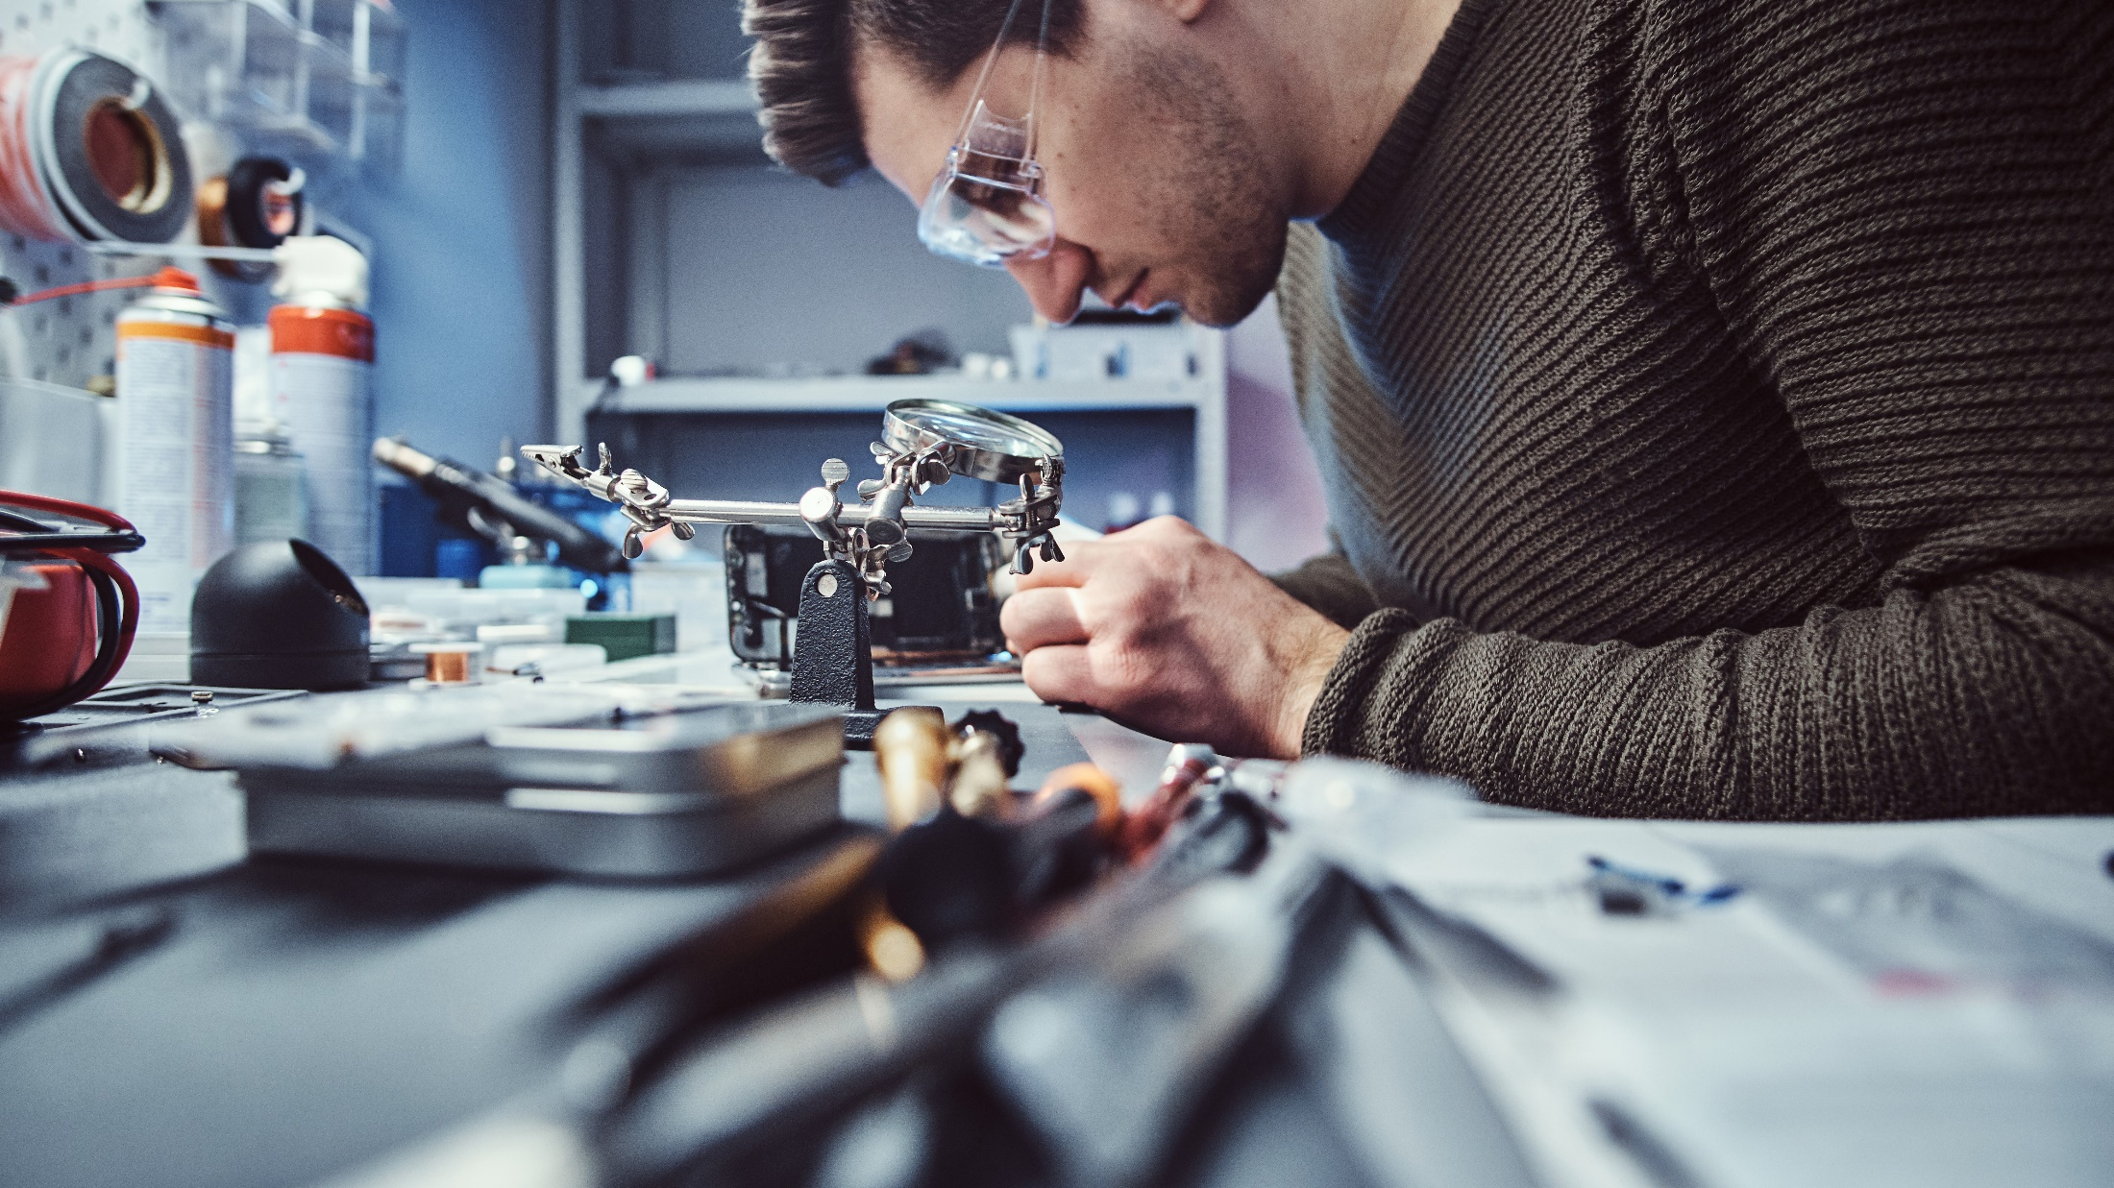
FINLAND - A GLOBAL FORERUNNER IN CIRCULAR ECONOMY
Photo: Business Finland

Slide 3
The key to solving the climate and biodiversity crises is to abandon the old, unsustainable “take-make-waste” linear economy. The alternative is circular: an economic system which continually reuses resources and where consumption is based on services.
Circular economy includes new business models, such as furniture as a service, and new products, like bioplastic. It involves new ways to consider an item’s life cycle, like building a product that is long-lasting and repairable.

Slide 4
Circular economy
The circular economy is expected to add about 3 billion euros to Finland’s national economy in added value potential by 2030, according to Sitra.
The main improvements are in machinery and equipment, forestry, food waste reduction, alternative real estate uses, nutrient recycling, private consumption and second hand trade.
In 2016 it was the first country in the world to have a roadmap to circularity. Many practical circular economy solutions have also been developed in Finland, making the country a global forerunner in circularity.
Notes:
Finland possesses circular strengths in materials, such as using waste streams from the forest industry or creating an ecosystem to recycle batteries.
Finland has technical know-how in circular solutions and is one of the world leaders in being awarded relevant patents.

Slide 5
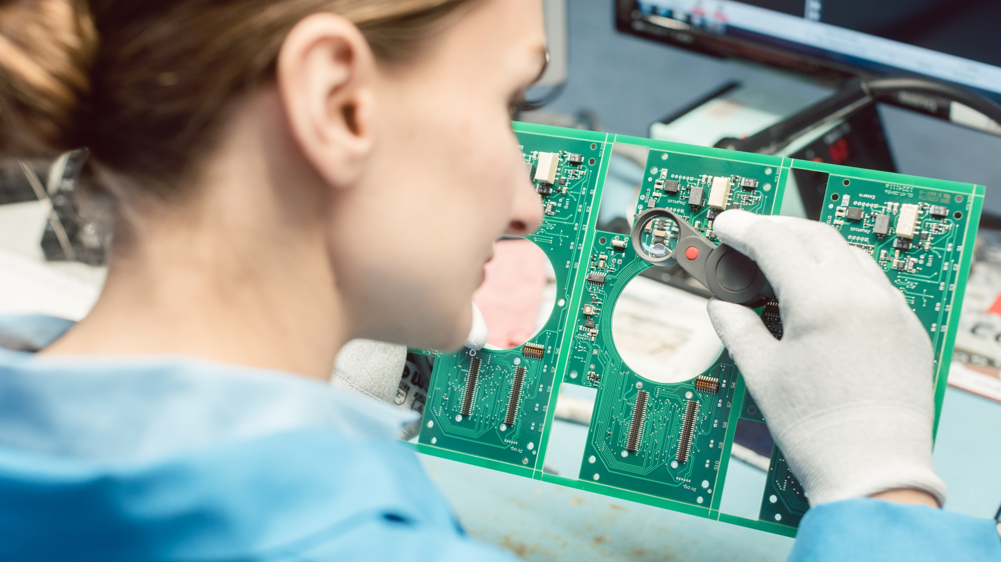
Photo: Business Finland

Slide 6
Finland is ranked 14th in the world for the number of patents issued related to recycling and secondary raw materials, one of the key circular economy indicators tracked by the EU.
Notes:
Finland has more patents than countries such as Sweden, Australia and Denmark, according to Eurostat, and was just barely eclipsed by the United Kingdom.

Slide 7
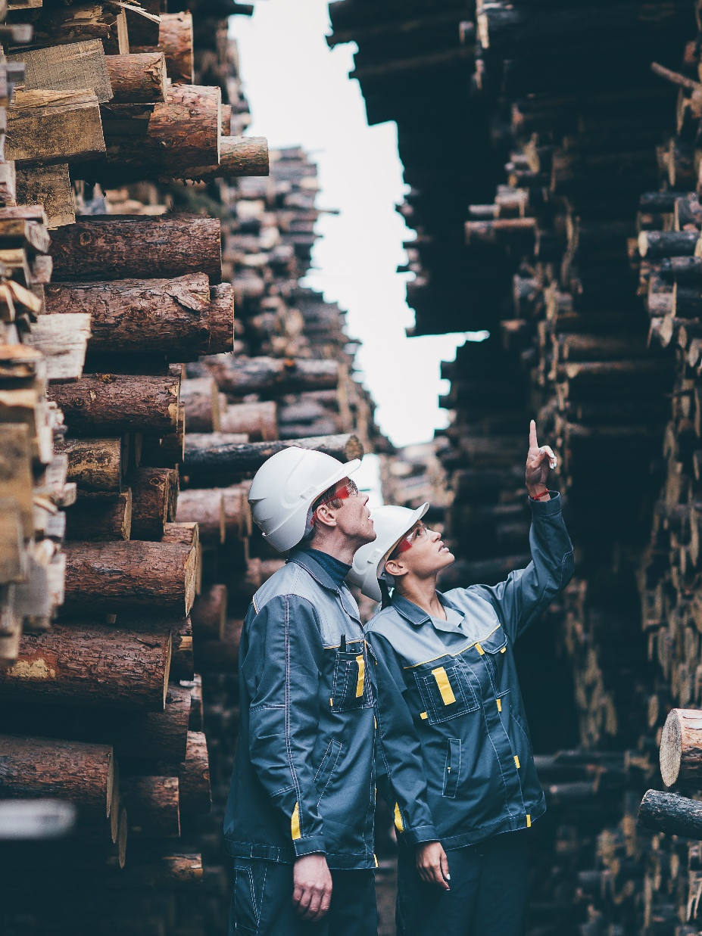
History
Finland has a history of developing circular solutions, even before the phrase “circular economy” was common.
The lack of fossil fuel deposits in Finland has also pushed society towards circular solutions, including developing renewable energy production and utilising waste streams as sources of energy.
Photo: Business Finland
Notes:
On the consumer side, a deposit scheme helped push the recycling of beverage containers to near 100%.
On the industrial side, companies strove to increase efficiency to succeed in global competition.
The big forestry companies have become so efficient using “waste” as a source of energy they actually produce more power than they consume. They have also found novel ways to create biofuels and biomaterials out of wood.

Slide 8
The Finnish people are conscientious about minimising waste. Eurostat says Finns waste 7.4% of their domestic material consumption, excluding major mineral waste. The EU average is 12.8%.

Slide 9
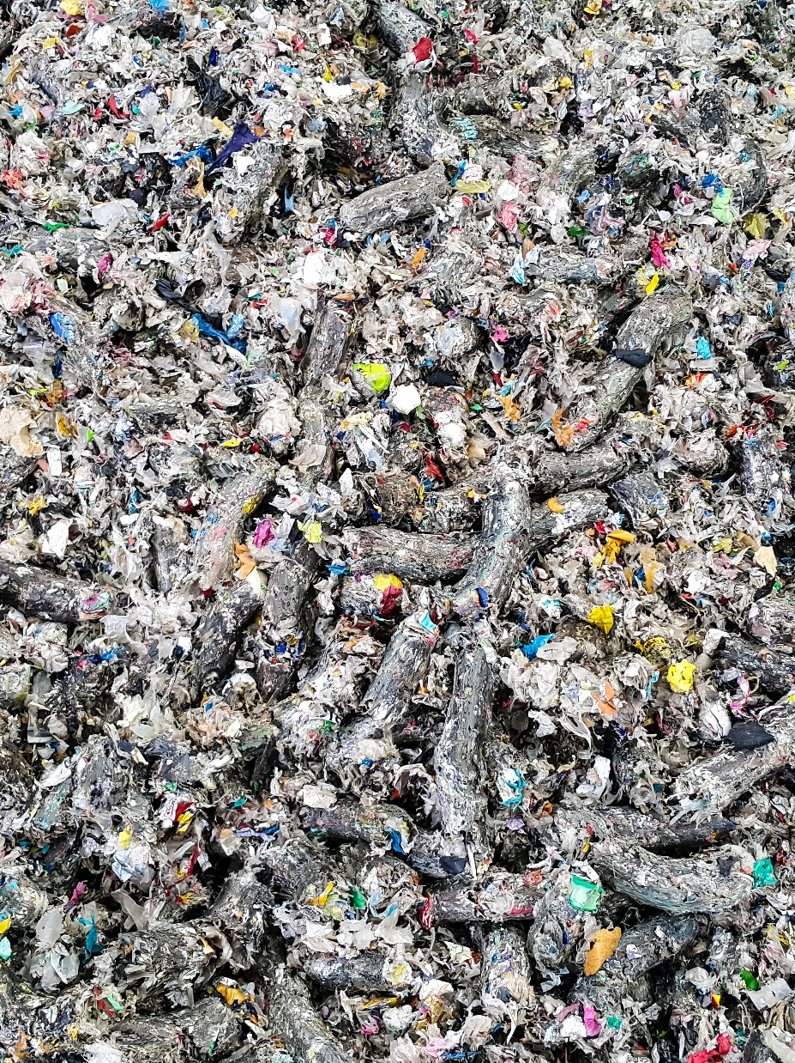
Finland taking action
In the 21st Century Finland seized the global momentum for sustainable solutions by championing the circular economy on the world stage.
  This includes creating the World Circular Economy Forum and promoting the circular economy in the EU.
When the COVID-19 crisis hit, Finland helped push circularity into the European Green Deal plan.
Photo: Emilia Kangasluoma/Team Finland
Photo: Business Finland

Slide 10
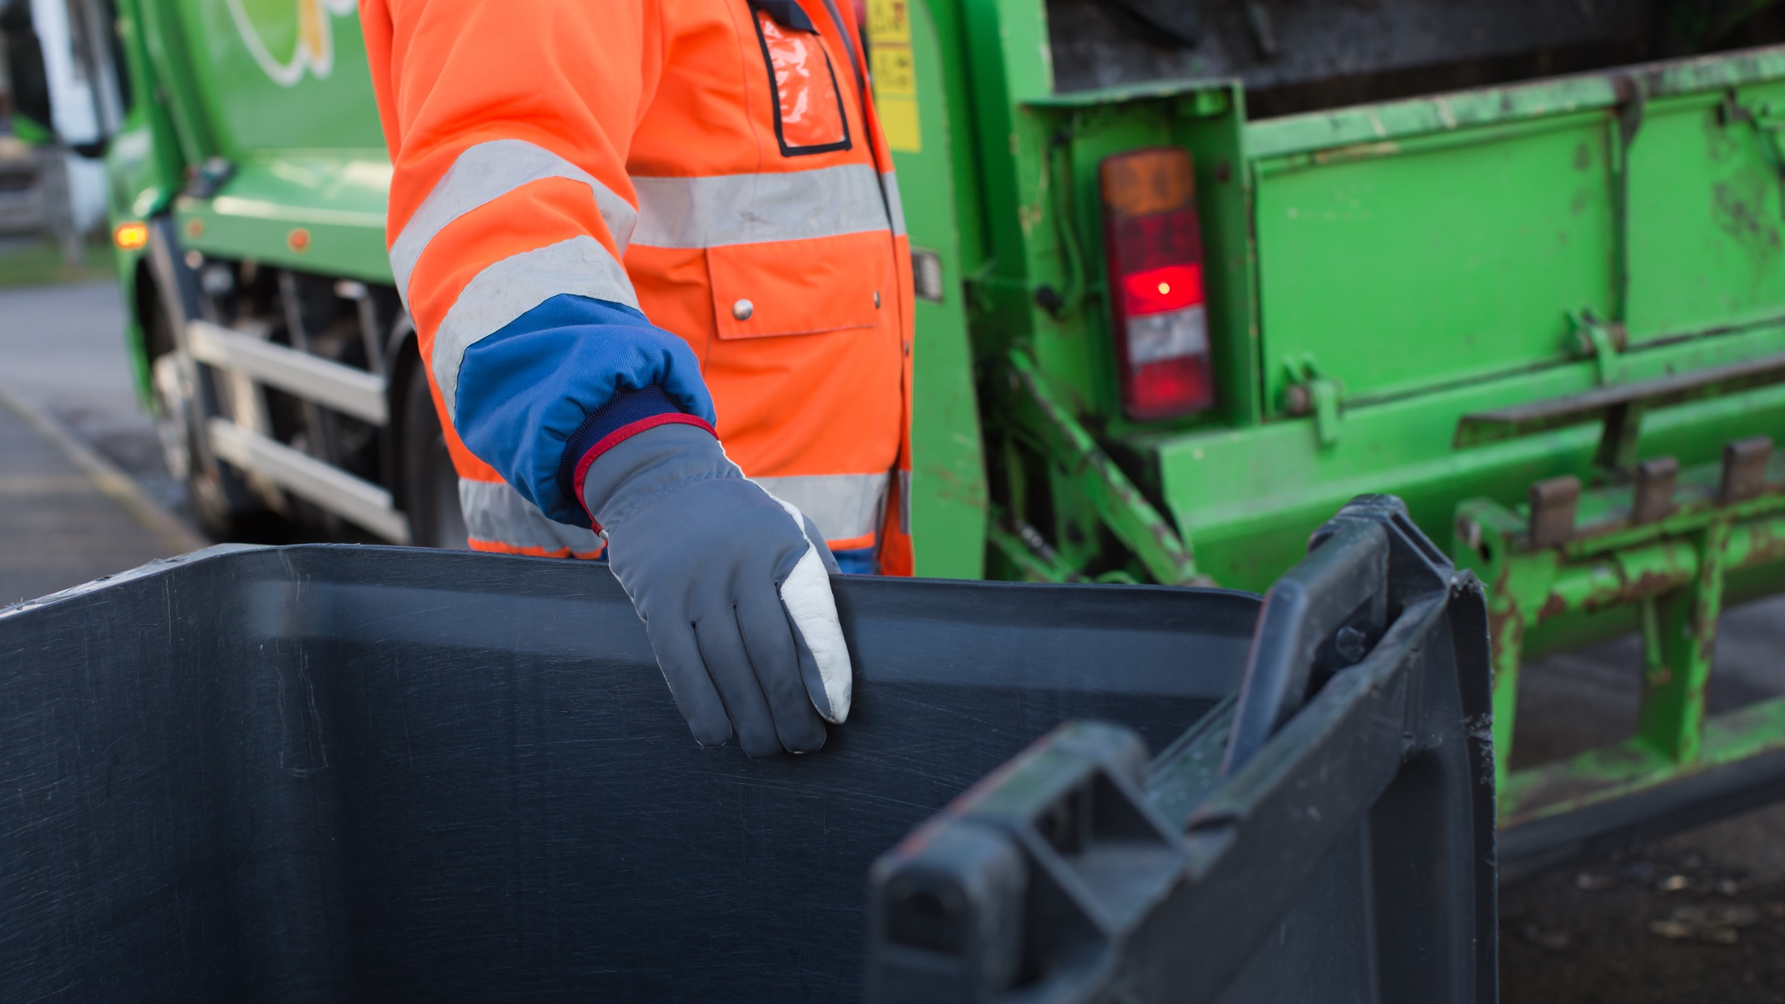
Photo: Riitta Supperi/Keksi/Team Finland

Slide 11
Investments in circular economy
Both public and private venture capitalists fund good ideas, and foreign investors also look to Finland for inspiring circular startups.
  The circular economy is expected to add about 3 billion euros to Finland’s national economy in added value potential by 2030, according to The Finnish Innovation Fund Sitra.
Private investments, jobs and gross value added related to the circular economy in Finland totalled almost 2 billion euros, according to Eurostat.

Slide 12
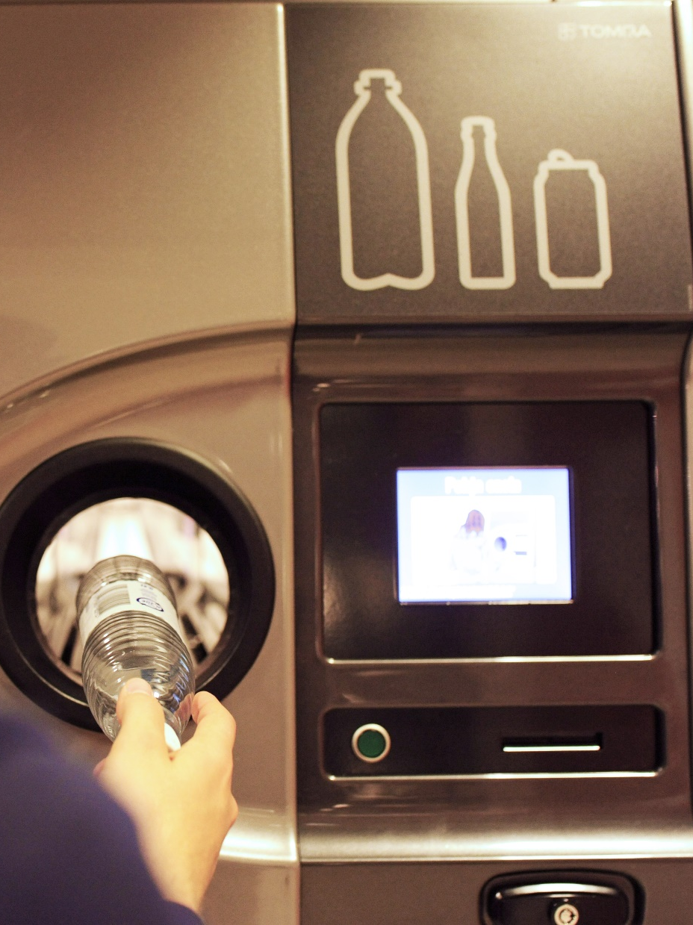
Deposit system
Thanks in part to a deposit system, Finland recycles 95% of cans, 90% of plastic beverage bottles and 87% of glass bottles, according to industry group Palpa.
These are some of the best rates in the world. For example, the Aluminum Association says the worldwide recycling rate for cans is only 49.8%.
Photo: Emilia Kangasluoma/Team Finland

Slide 13
Finland recycles 49.2% of its electronic waste, compared to an EU average of 34.8%, according to Eurostat.

Slide 14

Active participation
83% of Finns believe that Finland should take action to promote the circular economy, even if other countries are not doing so, according to a survey commissioned by Sitra.
Circular economy education has been embedded in all areas of society.
  In 2019 70,000 Finns studied the circular economy at all levels of education.
Photo: Katri Lehtola/Keksi

Slide 15
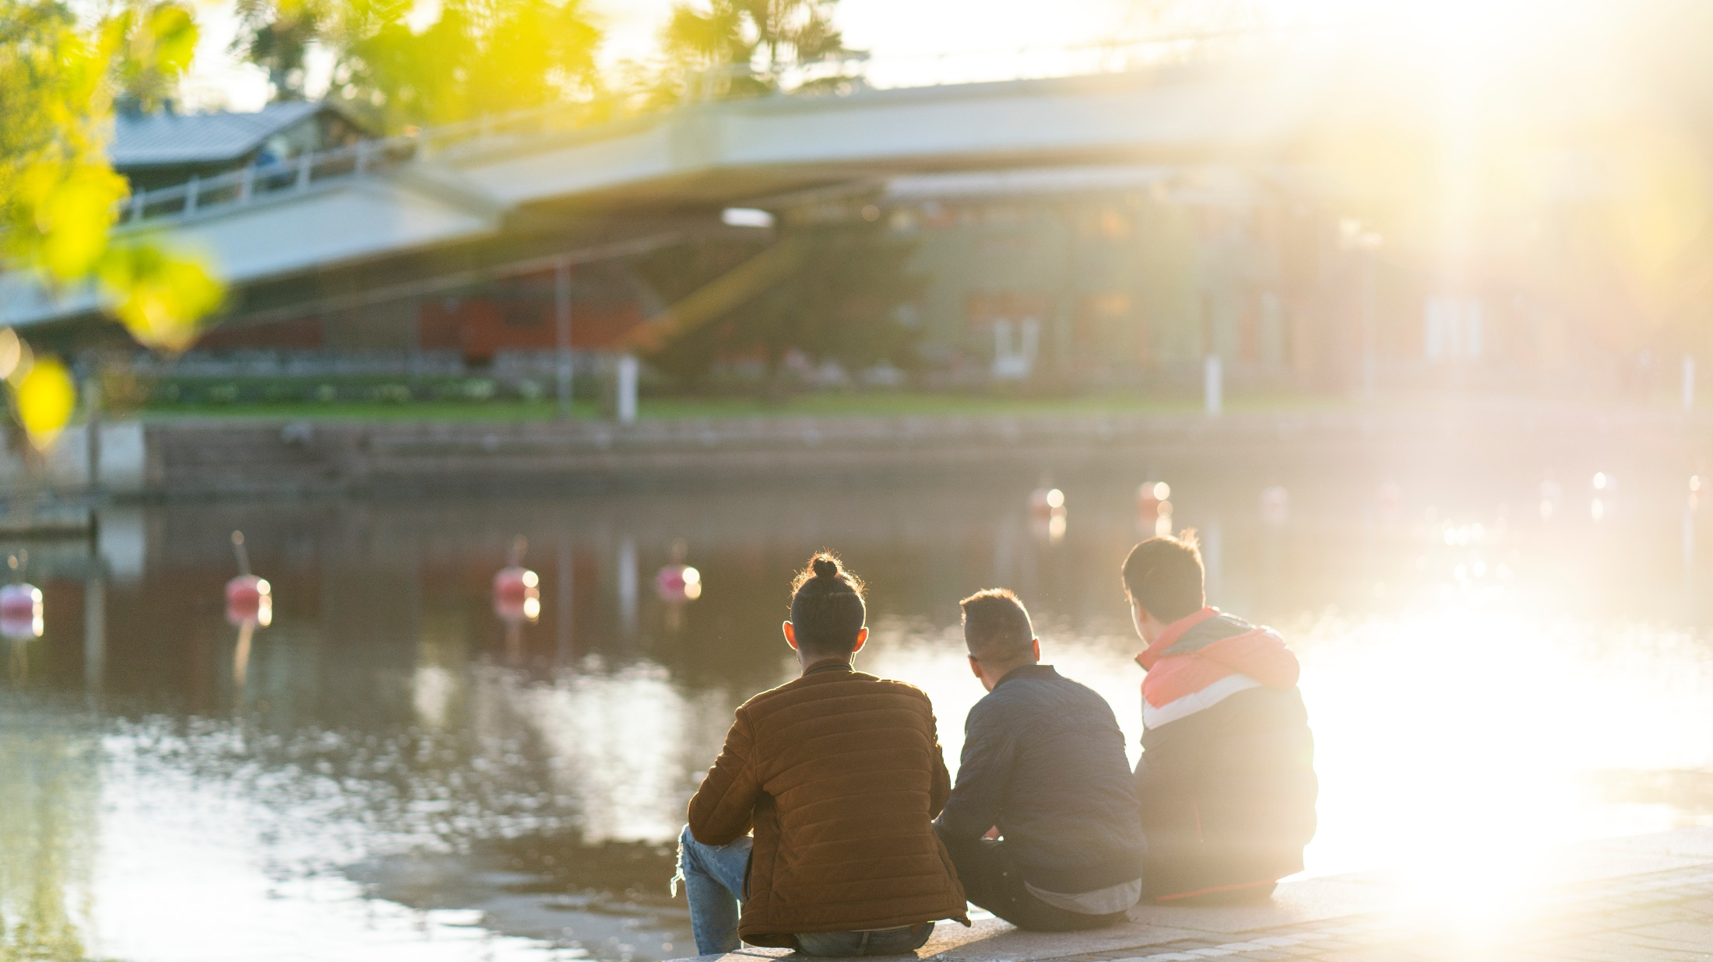
Thank you!
Photo: Pasi Markkanen

Slide 16
Thank you

