Slide 2
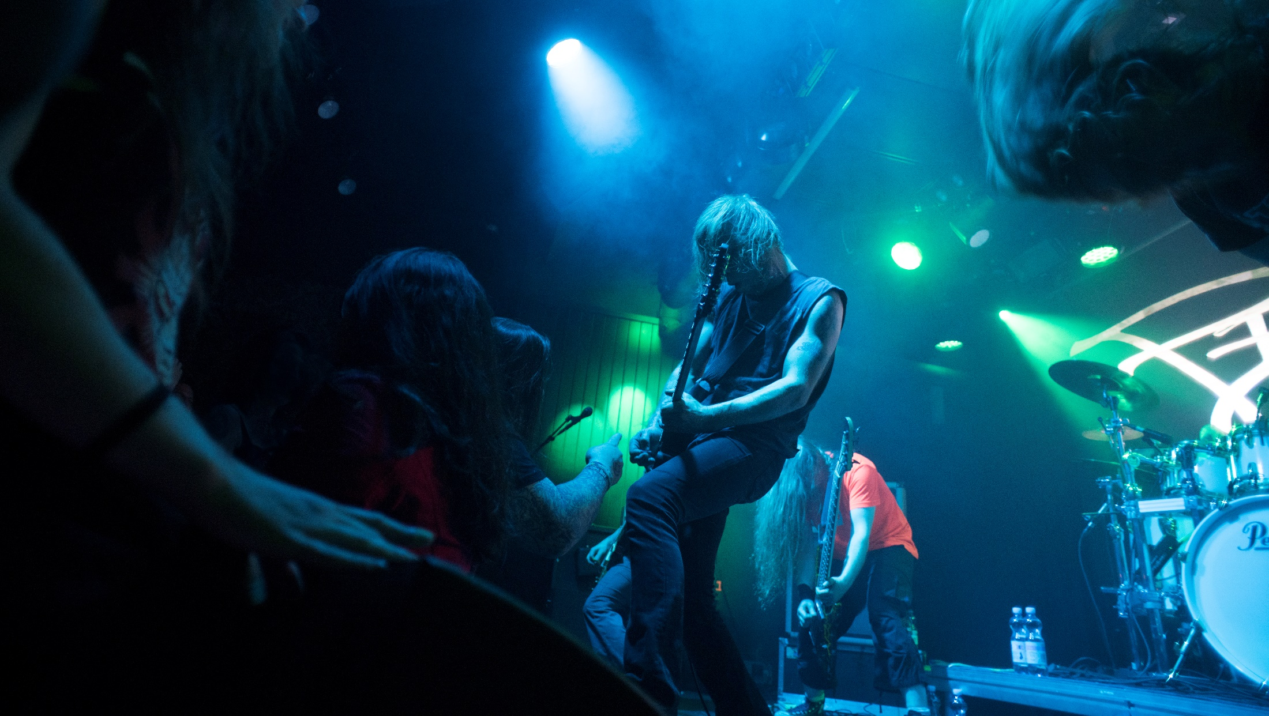
YES, THERE ARE FAMOUS FINNS

Slide 3
JEAN SIBELIUS (1865–1957)
Jean Sibelius is Finland’s national composer.
He composed most of his works during the five decades between the early 1880s and the late 1920s. His national romantic music played a key role in the formation of Finland's national identity. They include the most frequently recorded violin concerto of the 1900s. Sibelius’ music is still topical today. Since the mid-1990s, his symphonies have been performed as a full symphony cycle in concert halls in London, Helsinki, Tokyo and Vienna.
Photo credit: Sibelius150

Slide 4
“Music begins where the possibilities of language end.”
Jean Sibelius

Slide 5
OSMO VÄNSKÄ (1953–)
Osmo Vänskä is an internationally acclaimed Finnish conductor, clarinettist and composer.
Vänskä has been the Music Director of the Minnesota Orchestra since 2003 and he works as the Music Director of the Seoul Philharmonic Orchestra since 2020. In 2014 Vänskä, together with the Minnesota Orchestra, won a Grammy for best orchestral performance for the album of Sibelius' Symphonies Nos. 1 and 4.
Photo credit: Lisa-Marie Mazzucco/ Minnesota Orchestra

Slide 6
“The old way of thinking is that the players are only playing and not using their brain for anything else... If I have one brain and we have 70 players in the orchestra, 71 brains are much more than one, right?”
Osmo Vänskä

Slide 7
ESA-PEKKA SALONEN (1958–)
Conductor Esa-Pekka Salonen achieved his international breakthrough in 1983, when he was invited to conduct a London Philharmonic Orchestra performance of Gustav Mahler’s third symphony.
Since then, he has been the Music Director and Principal Conductor at the Los Angeles Philharmonic and Principal Conductor with the London Philharmonic Orchestra. He became the Marie-Josée Kravis Composer-in-Residence of the New York Philharmonic in early 2015, a three-year appointment.
Photo credit: Minna Hatinen/
Finnish National Opera and Ballet
Notes:
www.esapekkasalonen.com

Slide 8
ALMA (1996–)
Alma, real name Alma-Sofia Miettinen (1996–), is a Finnish singer-songwriter.
She is currently one of the most internationally successful Finnish artists and is known for her hits "Karma" and "Chasing Highs". She has collaborated with numerous well-known artists, including Miley Cyrus and Ariana Grande.
Photo credit: Antti Aimo-Koivisto/ Lehtikuva
Notes:
https://www.cyberalma.com/

Slide 9
SUSANNA MÄLKKI (1969–)
Finnish Susanna Mälkki (1969–) is currently one of the most famous female conductors in the world.
Mälkki was the musical director of the Paris Ensemble InterContemporain from 2006 to 2013 and is currently the chief conductor of the Helsinki Orchestra and the Principal Guest Conductor of the Los Angeles Philharmonic.
Photo credit: Jiyang Chen/
Finnish National Opera and Ballet
Notes:
https://susannamalkki.com/

Slide 10
KAIJA SAARIAHO (1952-)
Kaija Anneli Saariaho (1952-) is one of the most well-known Finnish contemporary composers.
For example, she has composed vocal music, four operas, chamber music and great works for symphony orchestra. Saariaho's works have received a lot of media attention. For example, The New York Times described Saariaho's first opera, Far Love, as a “poetic masterpiece”.
Photo credit:© Maarit Kytöharju
Notes:
http://saariaho.org/

Slide 11
VILLE VALO (1976–)
Ville Valo is a Finnish singer and songwriter, who is best known as the leading figure of the love metal band HIM.
Valo has also been titled as the best metal singer in the world many times. HIM was the first Finnish band to succeed in the United States with their gold album Dark Light, with over 500,000 copies sold in the United States alone. Since HIM dissolved, Valo toured in 2019 with the Finnish schlager and rock'n'roll band Agents.
Photo credit: Vesa Moilanen/Lehtikuva
Notes:
By 2015 more than eight million copies of HIM albums have been sold worldwide.

Slide 12
ARMI RATIA (1912–1979)
Armi Ratia was a textile artist and the founder of the well-known textile and clothing company Marimekko.
Ratia has been described as a strong-willed woman with a strong vision and an exceptional ability to read the time. In the 1960s Jacqueline Kennedy, the spouse of the future President of the United States, fell in love with Marimekko's outfits during her husband's election campaign, raising Marimekko’s profile.
Photo credit: Pertti Jenytin
Notes:
https://kansallisbiografia.fi/english/person/1581

Slide 13
“I only want people together so they can get to know each other and gain something from one another.”
Armi Ratia

Slide 14
EERO AARNIO (1932–)
Eero Aarnio a Finnish designer, is one of the great influencers of modern furniture design.
Aarnio is known for his futuristic chairs made of fiberglass, of which the Ball Chair in particular is also known internationally. His products have been featured in music videos and films and his work can be found in the Museum of Modern Art in New York and the Victoria and Albert Museum in London, to name a few.
Photo credit: Pekka Sakki/Lehtikuva
Notes:
https://www.designeeroaarnio.com/
https://toolbox.finland.fi/arts-design/meet-eero-aarnio/

Slide 15
ALVAR AALTO (1898–1976)
Alvar Aalto is Finland’s best-known architect and a key international figure in architectural modernism.
Alvar Aalto understood the building as a whole, including furniture and lighting. During his career, Aalto designed a lot of furniture that combined practicality and aesthetics. He designed Finnish buildings such as the Paimio sanatorium, Finlandia Hall and the main building of the Helsinki University of Technology.
Notes:
Well-known Aalto buildings abroad include the Maison Louis Carré in France, the Nordic House in Iceland and the Opera House in Essen, Germany.
www.alvaraalto.fi

Slide 16
“Human life is a combination of tragedy and comedy. The shapes and designs that surround us are the music accompanying this tragedy and this comedy.”
Alvar Aalto

Slide 17
AINO AALTO (1894–1949)
Aino Aalto (1894–1949) is a well-known Finnish architect and designer.
Aino Aalto started working in Alvar Aalto's office in 1924 and in the same year Aino and Alvar Aalto got married. Aino worked closely with her husband, but she is also known for her own individual contributions to modern Finnish design. Aino Aalto is known, for example, for the Bölgeblick glass series she designed, which was awarded a gold medal at the Milan Triennial in 1936.

Slide 18
KAJ FRANCK (1911–1989)
The design of Finnish household dishes has been hugely influenced by Kaj Franck (1911–1989).
Franck, who designed functional utensils for daily use from both ceramic and glass, sought to dramatically modernise consumer goods to fit in with contemporary needs and trends. This included a turn away from ornament and decoration. His best-known homeware items are the Kilta and Teema dishes.
Photo credit: Iittala
Notes:
http://franck.kokoelma.fi

Slide 19
“Doesn't ‘beautiful’ ultimately mean necessary, functional, justified, right?”
Kaj Franck

Slide 20
EERO SAARINEN (1910–1961)
Eero Saarinen was born in Finland but forged a career as an architect in the United States.
He started out by engaging in design together with his father, Eliel Saarinen. Eero Saarinen’s career in architecture lasted only ten years, but he was highly productive. His breakthrough came in 1949 when he won a competition in St Louis for the 200-metre high St Louis Arch. Other major works included the TWA terminal in New York and the Milwaukee War Memorial Center.
Photo credit: Balthazar Korab
Notes:
Saarinen is also known for his furniture made of pressed veneer and plastic.
www.eerosaarinen.net

Slide 21
HELENE SCHJERFBECK (1862–1946)
Helena Sofia (Helene) Schjerfbeck (1862–1946) was a Finnish-Swedish painter.
She is one of Finland's most respected modernist visual artists. During her lifetime, she made many well-known works, including oil paintings, watercolours, drawings, lithographs as well as textile designs. Schjerfbeck's best-known works include Wounded Warrior in the Snow (1880), At the Door of Linköping Jail in 1600 (1882) and The Convalescent (1888).

Slide 22
TOUKO LAAKSONEN (1920–1991)
Touko Valio Laaksonen, better known as Tom of Finland, was a Finnish homoerotic visual artist and cartoonist whose production had a significant impact on the gay culture of the late 20th century.
Tom of Finland is one of the most internationally known Finnish visual artists and his works are still popular around the world. Laaksonen spent a lot of time in Los Angeles in the 1980s, where he could freely impress himself and his homoerotic art could succeed.
Photo credit: Phillip Stuart
Notes:
https://www.tomoffinland.org/

Slide 23
"To me, a fully dressed man is more erotic than a naked one."
Touko Valio Laaksonen

Slide 24
TOVE JANSSON (1914–2001)
Swedish-speaking Finn Tove Jansson is best known as the creator of the Moomin books and the lovable, round characters of the same name.
She is the most translated of Finnish authors – her Moomin books appear in almost 50 languages. However, Jansson’s artistic output was highly diverse and included illustration, visual art and political caricatures. Many of Jansson’s paintings consist of landscapes, interiors and various compositions.
Photo credit:© Moomin Characters™
Notes:
www.tovejansson.com

Slide 25
“Someone who eats pancakes and jam can’t be so awfully dangerous. You can talk to him.”
Finn Family Moomintroll

Slide 26
SOFI OKSANEN (1977–)
Sofi Oksanen is the most awarded contemporary Finnish author.
Her works have been published in over 50 languages. Her most well-known novel, Purge (Puhdistus), has sold more than a million copies worldwide. Purge is one of the best-known and most praised Finnish contemporary books. Sofi Oksanen has a unique way of telling stories which have a strong link to history.
Photo credit: Heikki Saukkomaa/Lehtikuva
Notes:
http://www.sofioksanen.fi/

Slide 27
“She found it hard to believe that there would be any bold moves, because too many people had dirty flour in their bags, and people with filthy fingers are hardly enthusiastic about digging up the past.”
Sofi Oksanen, Purge

Slide 28
MINNA CANTH (1844–1897)
Minna Canth (1844–1897) was a Finnish writer, businesswoman and social influencer, best known for her work on advocating for women's rights.
Through her work Canth promoted the status of women, among other things, by improving girls' educational opportunities. Minna Canth has her own flag day in Finland, Equality Day, on 19 March.
Photo credit: Barsokevitsch Victor (1894), Museovirasto
Notes:
https://kansallisbiografia.fi/english/person/2816

Slide 29
"The issue of women is not just a question of women but a question of humanity."
Minna Canth

Slide 30
TARJA HALONEN (1943–)
Tarja Halonen is Finland's first female president and an eager advocate for equality.
After her term as President Halonen has worked in sustainable development both in Finland and internationally. Currently Halonen is involved in numerous organisations and networks in Finland and abroad. For example, she has close contacts with the UN and is a member of the Council of Women World Leaders.
Photo credit: © Tasavallan presidentin kanslia
Notes:
During her career Halonen has paid a lot of attention to human rights, democracy and civil society.
https://presidenthalonen.fi/

Slide 31
"When women participate in working life and do so to the same extent, with the same career goals as men, it becomes even more important to reconcile family and working life."
Tarja Halonen

Slide 32
MARTTI AHTISAARI (1937–)
Finnish President and diplomat Martti Ahtisaari (1937–) is known for his work as the leader of difficult international peace processes.
In 2008 Ahtisaari was the first Finn to receive the Nobel Peace Prize "for his important efforts, on several continents and over more than three decades, to resolve international conflicts". In addition to this, he has been awarded the UNESCO Peace Prize and the Geuzenpenning Medal.
Photo credit: Tomas Whitehouse/CMI
Notes:
https://kansallisbiografia.fi/english/person/634

Slide 33
KIMI RÄIKKÖNEN (1979–)
Kimi Räikkönen is a Finnish racer and Formula 1 world champion.
Räikkönen is the most successful Finnish Formula 1 driver ever in terms of wins, podium places, fastest laps and World Championship points. Räikkönen won the 2007 Formula 1 World Championship driving for Scuderia Ferrari. Räikkönen is known for his funny, laconic quotes and he is called “the Iceman” in F1 circles to describe his cool and calm nature.
Photo credit: James Moy/Lehtikuva

Slide 34
TOMMI MÄKINEN (1964–)
Tommi Antero Mäkinen is a Finnish racing executive and a former driver.
Currently Mäkinen is a Motorsport Advisor to Toyota, for whom he helped build the Toyota Gazoo Racing team. Mäkinen is one of the most successful World Rally Championship drivers of all time, ranking fifth in wins (24) and third in Championships (4). Mäkinen is considered by some to be the best Finnish rally driver of all time.
Photo credit: Heikki Saukkomaa/Lehtikuva

Slide 35
LAURI MARKKANEN (1997-)
Lauri Elias Markkanen (1997-) is a Finnish basketball player who plays for the Chicago Bulls in the National Basketball Association (NBA).
During his debut NBA season at the Bulls Markkanen broke several records, such as being the fastest player to reach100 three-point goals in the series’ history. Markkanen has made a positive contribution to the popularity of basketball among young people in Finland and the basketball schools bearing his name are constantly full.
Photo credit: Timo Jaakonaho/Lehtikuva

Slide 36
EVA WAHLSTRÖM (1980–)
Finland's most internationally successful boxer, Eva Wahlström, is a former WBC female world champion.
Eva Wahlström won the World Boxing Championship in 2015 and successfully defended her title several times. Wahlström is a polymath and in addition to boxing, she has participated in TV series, written two books, held her own art exhibition and studied interior architecture.
Photo credit: Andrew Couldridge/Lehtikuva

Slide 37
AKI KAURISMÄKI (1957–)
Aki Kaurismäki (1957–), the only Finn to win the Grand Prix at Cannes (for The Man Without a Past), is a highly individual film director.
Other well-known movies Kaurismäki directed include Drifting Clouds (1996), Le Havre (2011) and The Other Side of Hope (2017). His films are minimalistic and he has his own recognisable style. Kaurismäki is widely considered as Finland's best-known film director.
Photo credit: Odd Andersen/Lehtikuva
Notes:
Kaurismäki was also one of the founders of the Sodankylä Film Festival in 1986.
www.kansallisbiografia.fi/english/?id=4955

Slide 38
JASPER PÄÄKKÖNEN (1980–)
Jasper Pääkkönen is many things - an actor, fly fisherman, environmentalist and entrepreneur.
He is most well-known internationally for his acting roles in Spike Lee's BlacKkKlansman and the TV series “Vikings”. The Löyly Restaurant in Helsinki, which he co-founded, has been named one of the World's 100 Greatest Places by Time Magazine. Pääkkönen is also known for his work on the protection of the endangered fish species of Finland.
Photo credit: Mikko Stig/Lehtikuva
Notes:
https://www.imdb.com/name/nm0701747/

Slide 39
LINUS TORVALDS (1969–)
Linus Torvalds is a Finnish-American IT expert, programmer and hacker.
At the beginning of the 1990s Torvalds developed his own version of the Unix operating system. Freely downloadable from the internet, Linux soon gathered millions of users and a worldwide developer community. In 2012, Torvalds was declared as the winner of Millennium Technology Prize, along with Shinya Yamanaka. The prize is often described as technology's equivalent of the Nobel Prize.
Photo credit: Kimmo Mäntylä/Lehtikuva
Notes:
Torvalds, who lives in Portland in the USA, is still the project coordinator of Linux.

Slide 40
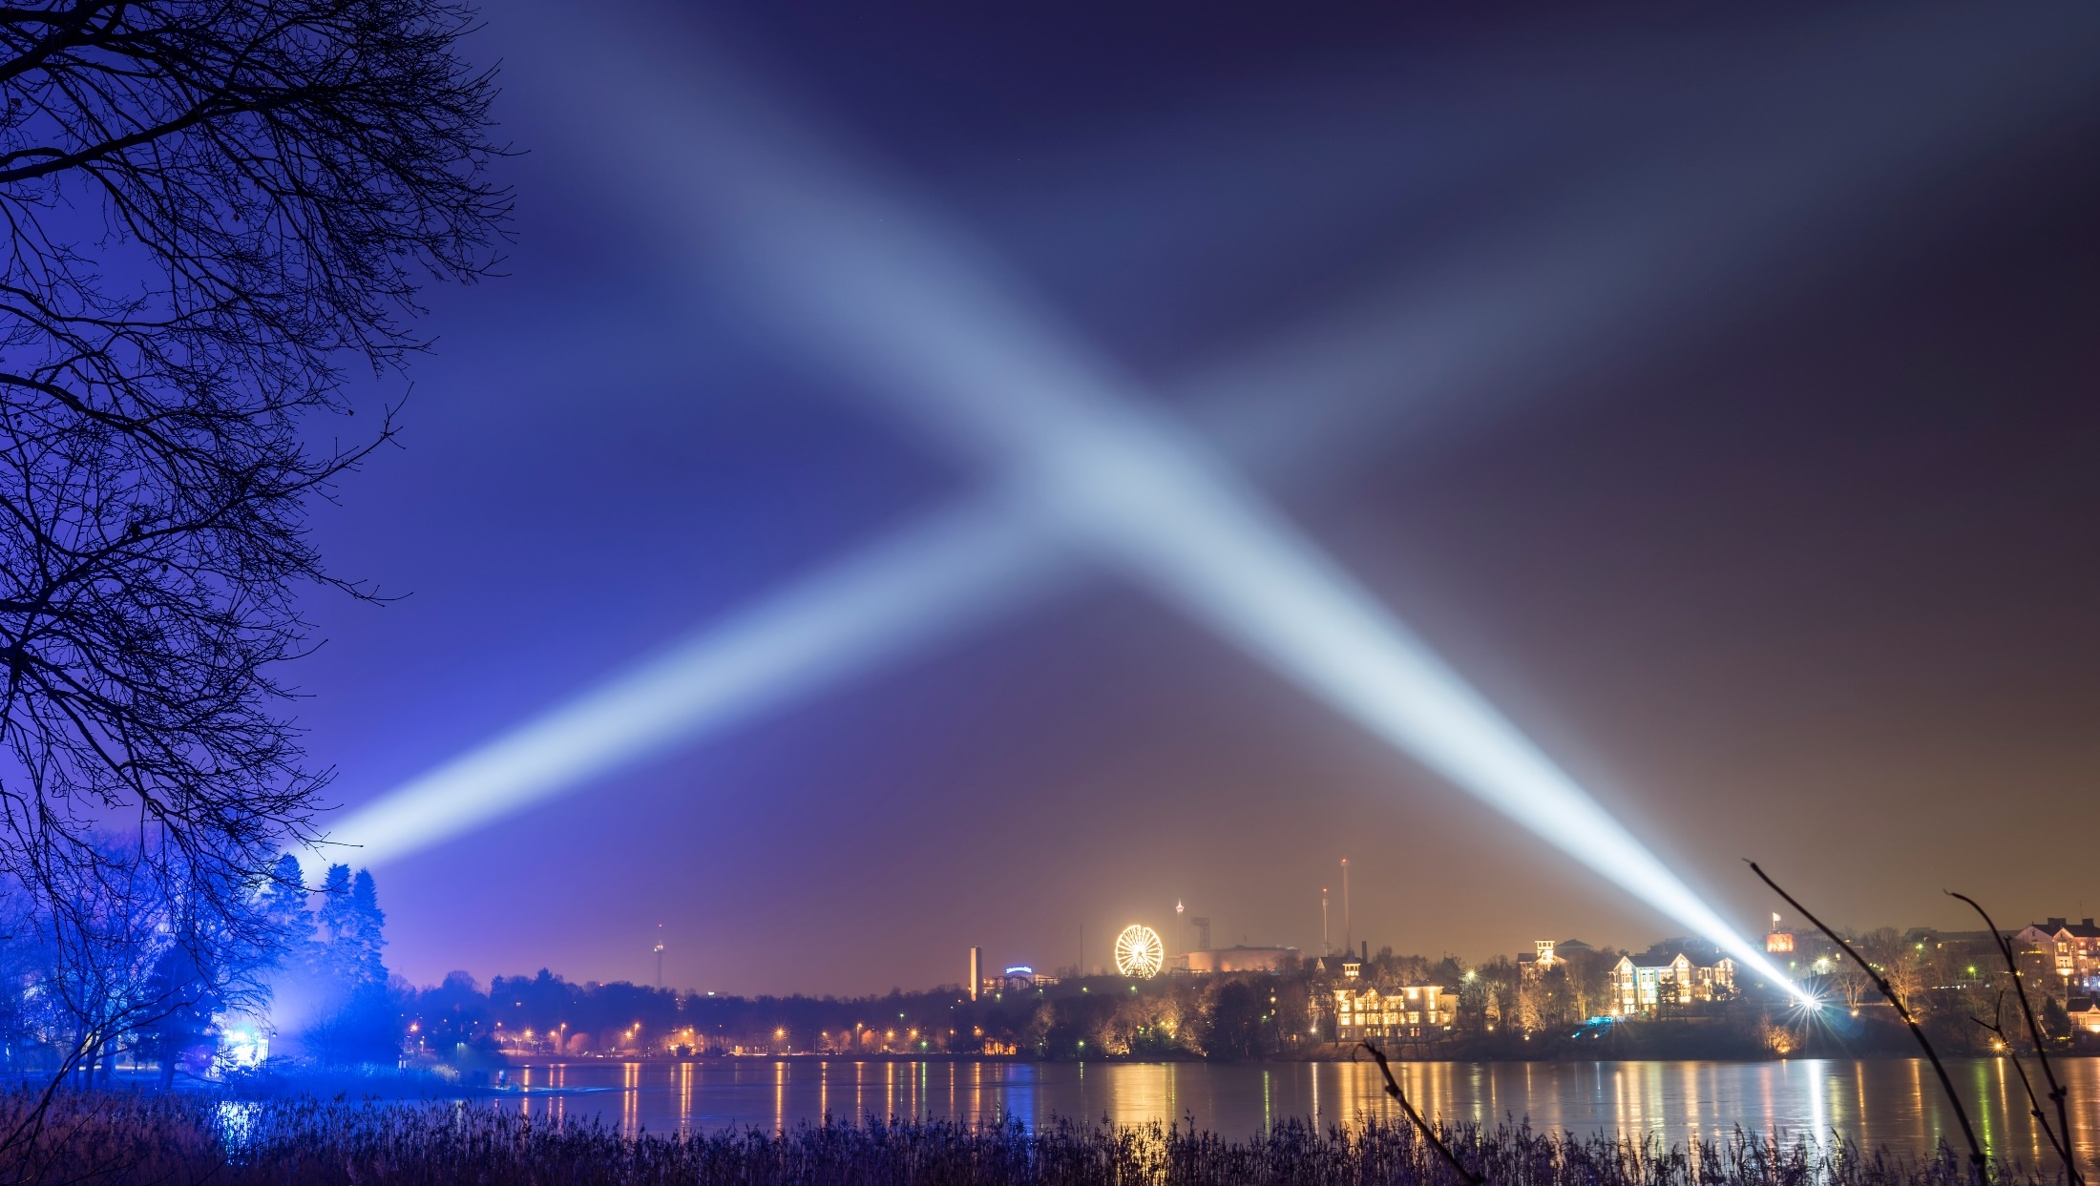
Thank you!

