Slide 2
Finland as a global leader of digitaliZation
Notes:
Photo: Business Finland

Slide 3
Digitalization - the next great industrial revolution
Digitalization, sometimes called digital transformation, is the use of digital technologies to modify or create new organizational processes, culture, business models and experiences.
Digitalization can help companies be more profitable at lower costs, while it can help public institutions improve services at lower costs.
Efficiency is a key benefit, but digitalization can also boost innovation and creativity.

Slide 4
Finland ranks #1 in availability of latest technologies.
(WEF Global Competitiveness Report 2017–2018)
Photo: Sakari Piippo/Finland Image Bank
Notes:
Photo: Sakari Piippo/Finland Image Bank

Slide 5
Finland - the most digitalized country in Europe
Digital skills are the greatest relative strength of Finland. In particular, Finland has a very high share of ICT specialists, while also scoring well in basic skills and STEM graduation rates. (Digital Economy and Society Index).
Today Finland is the most digitalized country in Europe, according to the European Commission’s Digital Economy and Society Index (DESI).
Finland has strengths also in other sectors, such as the IoT, cyber security, big data and AI.
Notes:
Today Finland is the most digitalized country in Europe, according to the European Commission’s Digital Economy and Society Index (DESI). It measures connectivity, human capital, the use of the internet, integration of digital technologies and digital public services. While the EU’s average is about 52 / 100, Finland’s is about 72 / 100.

Slide 6
Finland holds the #1 rank in university-industry collaboration.
(EU/Impact Assessment)
Photo: Emilia Riitta Supperi/Keksi/Team Finland
Notes:
Photo: Riitta Supperi/Keksi/Team Finland

Slide 7
History about digitalization in Finland
Finland’s journey began back in the 1950s when universities and the military acquired computers.
The history of Nokia is one reason why Finland is a global forerunner in digitalization today. In the 1990s public decision makers enacted rules to encourage digitalization, while educational institutions prioritized the skills needed for a global digital company.
Nokia is the 3rd largest 5G network provider in the world with a 22% market share, according to TrendForce (2020).
Notes:
Linux, the open source operating system, has deep Finnish roots. The inventor, Linus Torvalds, is a Finn living in the US.

Slide 8
Finland’s online public services was ranked 2nd in Europe and 6th in the world.
UN E-Government Survey (2018)
Photo: Mikael Ahlfors

Slide 9
Digital public sector
Finland’s online public services was ranked 2nd in Europe and 6th in the world in the UN E-Government Survey (2018).
The public sector are early adopters of new digital technologies. For example, Finland has implemented the Aurora AI program, which uses machine learning to improve public services. Finland’s public services are becoming primarily digital, although citizens are not forced to use digital channels.
Some examples of Finland’s online public services are pre-completed tax returns, tax cards, student applications, drug prescriptions and personal health records.

Slide 10
Embracing open data
Finland is ranked 5th in the world in the Global Open Data Index (2020).
Finland has embraced the idea of open source and open data. An example is Avoindata, a service for open data and interoperability standards and guidelines.
Photo: Emilia Hoisko/Visit Finland
Notes:
The central government has opened environmental data and topographic data, while cities and municipalities have opened public transport data.
Photo: Emilia Hoisko/Visit Finland

Slide 11
Cyber security
Finland is the #1 innovator in cyber security capabilities, according to the EU/Impact Assessment.
Finland is not afraid to answer the big questions, such as how to have open data while protecting user privacy. For example, Finland has been a leader in building international technical and ethical standards.
Finland is also the home to the European Centre of Excellence for Countering Hybrid Threats.

Slide 12
Internet of Things
The Internet of Things (IoT) is also a thriving sector in Finland.
Some major companies use the IoT for their own solutions, such as elevator manufacturer KONE, while others develop IoT products and services for others.
Photo: Business Finland

Slide 13
Finland has a very high share of ICT specialists, while also scoring well in basic skills and STEM graduation rates.
(Digital Economy and Society Index)
Photo: Business Finland

Slide 14
International co-operation
Finland has a talented ICT workforce. Not only does Finland produce excellent homegrown talent, it also attracts international talent. For example, many ICT companies use English as their company language because of the high percentage of immigrant experts.
International partners are welcomed by Finland. On the government level, Finland has ICT partnerships with the Nordic countries, Estonia, International Council for Information Technology in Government Administration, EU and OECD.

Slide 15
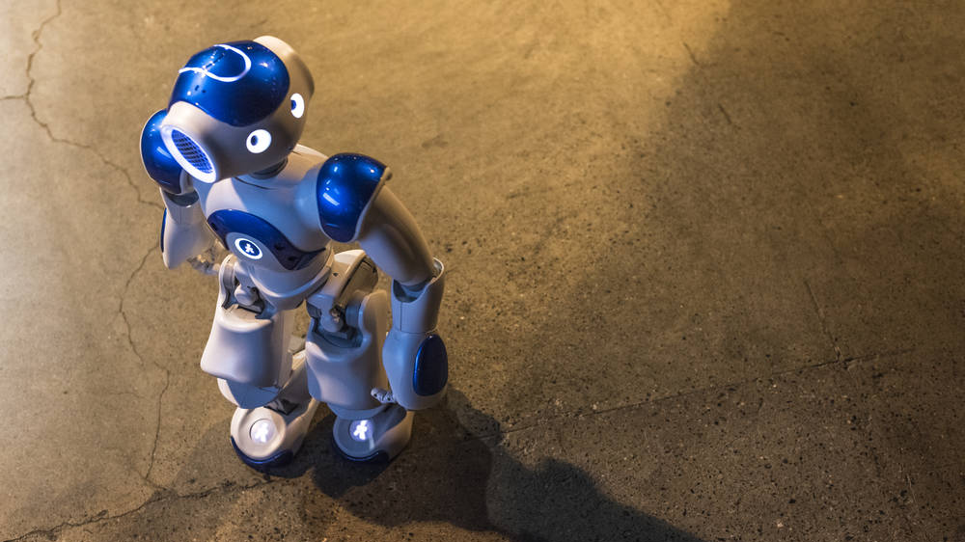
Thank you!
Photo: Mikael Ahlfors
Notes:
Photo: Mikael Ahlfors

