Slide 2
Finland as a global pioneer of smart health
Photo: Eeva Anundi/Business Finland
Notes:
Photo: Eeva Anundi/Business Finland

Slide 3
Smart health
The developed world has a significant demographic challenge. People are living longer and need more healthcare services. However, the population is aging and the proportion of workers is falling, putting stress on budgets.
Smart health is the solution. It is tools and services which use technology to efficiently provide better healthcare services to more people at a more reasonable cost.
Notes:
The benefits of smart health solutions are to cure afflictions more effectively, to care for patients more efficiently and to prevent illnesses more frequently.

Slide 4
Finland is the most prepared European country for the digital, personalised future of health.
(European Personalised Healthcare Index 2020)
Photo: Sakari Piippo

Slide 5
Finland as a global pioneer of smart health
Finland is a global pioneer in smart health. Finland has an extremely efficient healthcare system and invests in new solutions that solve current and future healthcare needs.
Finnish strengths are diverse, ranging from AI and sensors to mobile communications and new business models.
An added benefit of smart health solutions is that it typically generates highly skilled jobs.

Slide 6
Finland has the #1 availability of scientists, engineers and latest technologies.
(World Economic Forum’s global competitiveness report 2017-2020)
Photo: Business Finland Mediabank
Notes:
Photo: Business Finland Mediabank

Slide 7
THERE ARE 400 HEALTH TECHNOLOGY COMPANIES IN FINLAND
They employ 10,000 professionals and have a revenue of 3 billion euros.
Source: Business Finland

Slide 8
Cost effective healthcare system
The healthcare and welfare service sector in Finland includes 19,000 companies, 67,000 workers and 5.5 billion euros in revenue.
The Health Care Index 2020 ranks the Finnish healthcare system as 10th best in the world. Good results with modest investments means Finland’s system is cost-effective.
Finns are very satisfied with their healthcare system. Surveys from the European Commission and Alma Media over the past two decades have found satisfaction rates around 80-90%. The EU average is about 71%.
Notes:
Finland spends 9.2% of GDP on health expenditures, slightly more than the OECD average of 8.8%, according to the OECD.
Approximately 99% of Finns say they would take part in medical research, according to Business Finland.

Slide 9
Government support
The Finnish government fully supports the development of the smart health sector, providing funds, favorable rules, advice and encouragement.
The Finnish government is investing in centers of excellence, including cancer treatment, drug development, neuroscience and genome research.
Finland has a corporate tax rate of only 20%, one of the lowest rates in Europe.
Photo: Business Finland

Slide 10
Easily accessible medical records
FinBioBank connects all six university hospital biobanks and two national biobanks. It is available for public and corporate R&D if the application receives ethical approval.
Findata is the national “one stop shop” for health and social data. It is a single point of contact as a data permit authority and service operator.
All medical records in Finland are in electronic format and digitally accessible, providing real-world data that allows ideas to be turned into concrete solutions.

Slide 11
THERE ARE 260 HEALTH IT
COMPANIES IN FINLAND
They have a combined revenue of 5 billion euros.
Source: Business Finland

Slide 12
Using patient data safely
A unique Finnish strength is how it safely uses patient data. It has developed an innovative system to meet strict data protection requirements while allowing data to be used for research, statistics and healthcare development.
The Biobank law enables a faster drug discovery and clinical trails by granting access to data and specimens.
Photo: Business Finland
Notes:
Finland has proactively addressed these legal and ethical issues to spur responsible development. The Biobank law enables a faster drug discovery and clinical trails by granting access to data and specimens. The Act on the Secondary Use of Health and Social Data grants improved access to data while protecting patients’ personal information.

Slide 13
International environment
The Finnish healthcare system is not isolated; it is international. Healthcare institutions and companies are eager to work with international partners to jointly develop new smart health solutions.
Major global healthcare companies have chosen to work in Finland, including Bayer, Santen, Perkin Elmer, GE Healthcare, Philips Healthcare and Thermo Fischer Scientific.
For example, Bayer has an R&D and manufacturing unit in Turku. GE Healthcare uses Finland as their base for wearable technology development and have developed a connected health ecosystem.

Slide 14
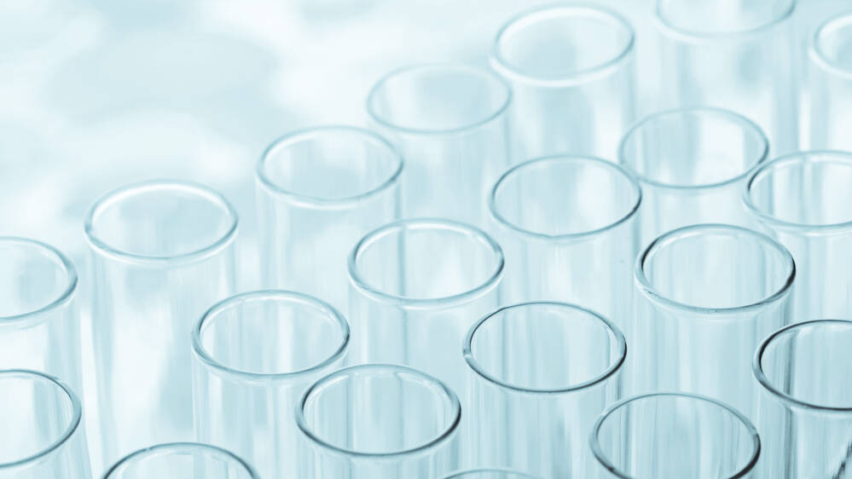
Thank you!
Photo: Business Finland

