Slide 1
Climate matters – reaching common goals to secure a better future

Slide 2
Background: Read before use
To introduce Finland’s story as a climate actor and to support climate communications, we have produced a climate narrative, supported by case examples. You will find them in this presentation. On section header slides you will find key messages of our climate story. Each of these slides contains also a short index of following case examples. The case examples describe what has been and will be done to achieve Finland’s climate goals. Navigate through the case examples by using the index on the next slides. You can cascade the case examples by clicking any of the seven sub-headings listed in the left hand sidebar. Please contact VIE-50@formin.fi for further details on how to use this document.
Notes:
NB! Read this slide before using the presentation.

Slide 3
Index: Navigating through the case examples
Bringing science and decision-making together
Education and a strong nature relationship
In Finland, everyone does their share for climate
The Martha organisation offers knowledge to live a more climate-friendly life
Climate Barometer measures Finns’s attitude to climate policies
The Sustainable Lifestyle Service engages citizens to take climate action
Agenda 2030 brings young people to the centre of sustainable development policy
Universities use climate learning as a tool to build societal competencies
Participation of ordinary people strengthens the Climate Change Act
The Finnish National Agency for Education strives for the inclusion of climate responsibility in teaching
Finland is a land of forests
Hinku network aims for a stronger economy through local climate action
Profitable climate change mitigation: The story of Ii
The CitiCAP app promotes sustainable mobility through citizen engagement in Lahti
Government aid for substituting oil heating with sustainable solutions
Reducing emissions throughout the whole life cycle of buildings
Low-carbon roadmaps for Finnish industries
Voluntary agreements help to fulfil Finland’s energy efficiency obligations
First country in the world to introduce a carbon tax
World’s 1st circular economy road map
Working towards climate neutrality by 2035
The Finnish Climate Change Panel facilitates dialogue between science and policy-making
Interaction with researchers improves the knowledge base of policy-making

Slide 4
Index: Navigating through the case examples
Adaptable solutions for tackling climate change
Global co-creation and collaboration
The common path towards a more sustainable world
The World Circular Economy Forum brings together business leaders, policymakers and experts
Helping to build climate resilient society in Vietnam
Gender equality in the face of climate change
International collaboration in the Turku region for resource wisdom
Finland prompts the Climate Coalition
Green to Scale – Scaling up existing solutions
Active team player in the UN the EU
Technological innovation leads Wärtsilä’s customers towards decarbonisation
Processing plant enables recycling of discharged textiles
Reducing the energy use of peat by at least half by 2030
Climate-friendly cultivation and management methods in peatlands with the help of SOMPA
Ban of coal in energy production by 2029
Integrating the adaptation and mitigation of climate change to the Nature Conservation act
Helsinki Energy Challenge calls for ideas to decarbonise city heating
Helsinki’s energy company Helen uses abandoned oil caverns to reduce carbon dioxide emissions
Infinited Fiber regenerates high-quality textile fibers from textile waste
Solar Foods produces food from CO2 and electricity
Energy research projects find alternative solutions
Carbon Action By Baltic Sea Action Group

Slide 5
Climate matters – reaching common goals to secure a better future
One country working alone cannot tackle the climate and environmental problems we face today. That is why Finland is committed to solving environmental issues swiftly, practically and together with others. We believe that technological and social innovations are the key to finding solutions that work inside and outside of Finland. Rather than being afraid of challenges, we meet the ambitious global and national climate targets with action and cooperation.
Legislation and research form the basis of our climate goals, but in order to meet them, we need to do much more. Everybody needs to contribute to the change, which is why climate education is now an integral part of the curriculum in Finnish schools.
A lot of climate work is also being done at the regional level. Some municipalities have set themselves climate goals even more ambitious than the national ones, and there are networks for bringing together municipalities, businesses, citizens and experts to create and carry out solutions to reduce greenhouse gas emissions.

Slide 6
Bringing science and decision-making together
Finnish environmental legislation has a strong research underpinning and we believe in collaborating across sectoral and disciplinary boundaries. In 1990 Finland was the first country in the world to introduce a carbon tax based on the carbon content of fossil fuels as an instrument for climate mitigation.
Finland’s Climate Act (2015) sets target to cut emissions 80% by 2050 on 1990 levels and promotes transparency in climate policy. It requires each future government to set out climate policies towards the long-term goal and monitor the results. Finland was also the first country to publish a national Climate Change Adaptation Strategy in 2005 and a roadmap to a circular economy in 2016.
Though much has already been done, there is a lot more to do. According to prime minister Sanna Marin’s Government Programme in 2019 Finland will be climate neutral by 2035, and the world’s first fossil-free welfare society. The Climate Act is currently being amended and updated in a way that the target of climate neutrality by 2035 can be achieved.
See the case examples →
First country in the world to introduce a carbon tax
World’s 1st circular economy road map
Working towards climate neutrality by 2035
The Finnish Climate Change Panel facilitates dialogue between science and policy-making
Interaction with researchers improves the knowledge base of policy-making

Slide 7
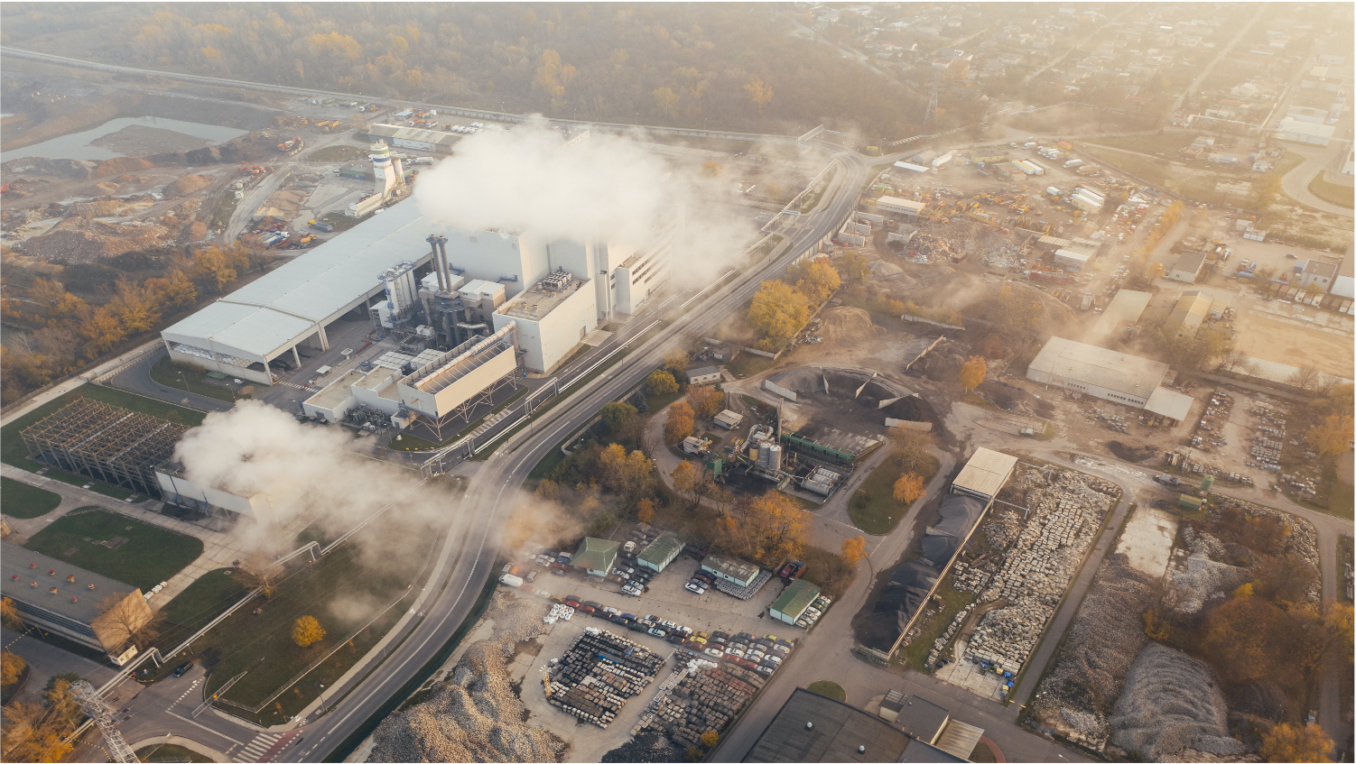
The CO₂ tax
CASE EXAMPLE
Notes:
CO2 tax: Outi Honkatukia, Senior Environmental Adviser at Ministry of the Environment outi.honkatukia@ym.fi, +358 29 525 0272

Slide 8
First country in the world to introduce a carbon tax
Finland was the first country in the world to introduce a carbon dioxide (CO₂) tax based on the carbon content of fossil fuels in 1990. Carbon taxes are considered to be one of the key economic instruments for addressing global climate change.
Energy taxation is at the core of Finland’s energy and climate policy. It takes into account the energy content, carbon dioxide emissions, local emissions and the sulphur content of fuels. The overall tax rates are driven primarily by energy content and Co₂.
Finland continues to reform its energy taxation to better support a swift transition away from fossil fuels. This means continuing to increase taxes on fossil fuels and reforming industries’ energy taxation. The basic idea behind the carbon tax is to make commodities with heavy emissions more expensive in relation to low emissions alternatives. It is how manufacturing and consumption are guided towards a more sustainable direction.
The rate of carbon taxation is proportional to the greenhouse gas emissions of the commodity.
Energy taxes are levied on electricity, coal, natural gas, peat, tall oil and liquid fuels.
Major changes to the structure of energy taxation were introduced in 2011 and, for example, the taxation of energy commodities was tightened.
Notes:
CO2 tax: Outi Honkatukia, Senior Environmental Adviser at Ministry of the Environment outi.honkatukia@ym.fi, +358 29 525 0272

Slide 9
CIRCULAR ECONOMY ROAD MAP
CASE EXAMPLE
Notes:
Sitra circular economy road map: Tuuli Hietaniemi specialist, climate solutions at Sitra, tuuli.hietaniemi@sitra.fi +358 (294) 618 411 & Mari Pantsar: Director, Carbon-neutral circular economy at Sitra, mari.pantsar@sitra.fi +358 (294) 618 210

Slide 10
World’s 1st circular economy road map
Under the leadership of the Finnish Innovation Fund Sitra, Finland was the first country in the world to create a national roadmap to a circular economy.
A circular economy road map is a tool for change: it helps define required steps and compiles key stakeholders’ views on the essential changes and actions required for the circular economy. It is a document that includes a vision as well as goals and tangible actions designed to accelerate a country’s transition towards a circular economy.
Sitra has advanced the actualisation of the circular economy roadmap by starting over 70 projects with partners to achieve change. In addition, instructions have been made available as to how maps can be created in other countries.
A circular economy is an increasingly efficient economy that questions the meaning of ownership. Instead of producing and accumulating large amounts of goods, consumption in a circular economy is based on the use of services: sharing, renting and recycling. In order to implement the transition to a circular economy, what is a suitable starting point?
A circular economy provides solutions to the biggest challenges the world is facing: overconsumption of natural resources, climate change and biodiversity loss.
The initial circular economy road map from 2016 was updated in 2019 to reflect the current ambition level. Its vision is for Finland to be a carbon-neutral circular economy by 2025.
The roadmap was drawn up in collaboration with stakeholders representing different sectors of society.
Sitra has compiled a guide based on Finland’s road map process. The guide includes tools and inspiration for countries that want to move towards a circular economy.
Notes:
Sitra circular economy road map: Tuuli Hietaniemi specialist, climate solutions at Sitra, tuuli.hietaniemi@sitra.fi +358 (294) 618 411 & Mari Pantsar: Director, Carbon-neutral circular economy at Sitra, mari.pantsar@sitra.fi +358 (294) 618 210

Slide 11
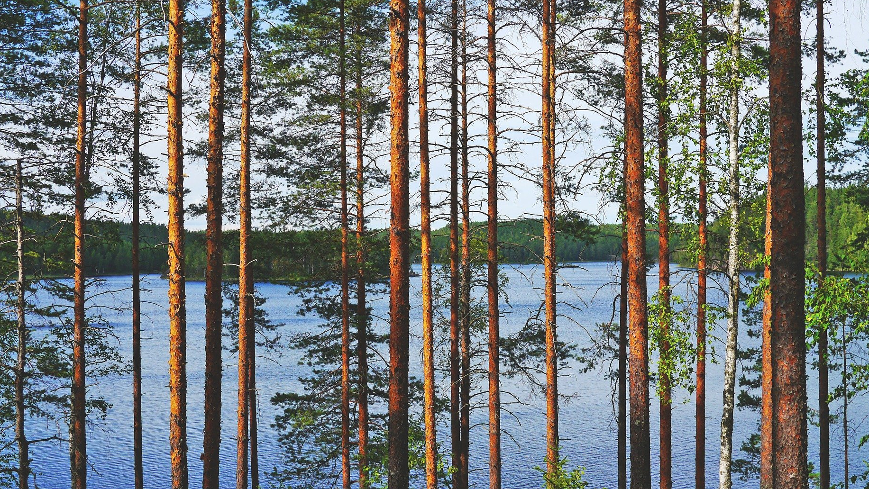
The aim to be the world’s first fossil-free welfare society
CASE EXAMPLE
Notes:
2035 tavoite: Outi Honkatukia, Senior Environmental Adviser at Ministry of the Environment outi.honkatukia@ym.fi, +358 29 525 0272

Slide 12
Working towards climate neutrality by 2035
According to Prime Minister Sanna Marin’s 2019 Government program, Finland is striving to be carbon-neutral by 2035, and the world’s first fossil-free welfare society.
This requires fast emissions reductions in all sectors and the strengthening of carbon sinks. Finland can reach this through a just, inclusive and green transition by advocating for a more ambitious EU climate policy. The Ministry of the Environment is updating the Climate Act, with an intermediate emission reduction target for 2030, to ensure that Finland will reach climate neutrality by 2035.
The Ministry commits to going beyond its ambitious climate neutrality goal and reaching negative emissions soon after 2035. The means to achieve the target include new decisions on climate policy and nearly emissions-free electricity and heat production by the end of the 2030s, as well as reducing the carbon footprint of construction, promoting a circular economy, and a climate-friendly food policy.
In taxation, the focus will shift to gather even more taxes from environmentally harmful activities. The decline in biodiversity will be halted by reforming the nature conservation legislation, increasing the funding for the protection of biodiversity and promoting a sustainable use of natural resources.
Climate change, loss of biodiversity and overconsumption are different aspects of the same sustainability crisis.
Climate neutrality by 2035 means Finland produces carbon emissions at the same rate carbon sinks sequester carbon. Most EU countries aim for climate neutrality by 2050.
The work is led and guided by a ministerial working group chaired by Minister of the Environment and Climate Change.
Notes:
2035 tavoite: Outi Honkatukia, Senior Environmental Adviser at Ministry of the Environment outi.honkatukia@ym.fi, +358 29 525 0272

Slide 13
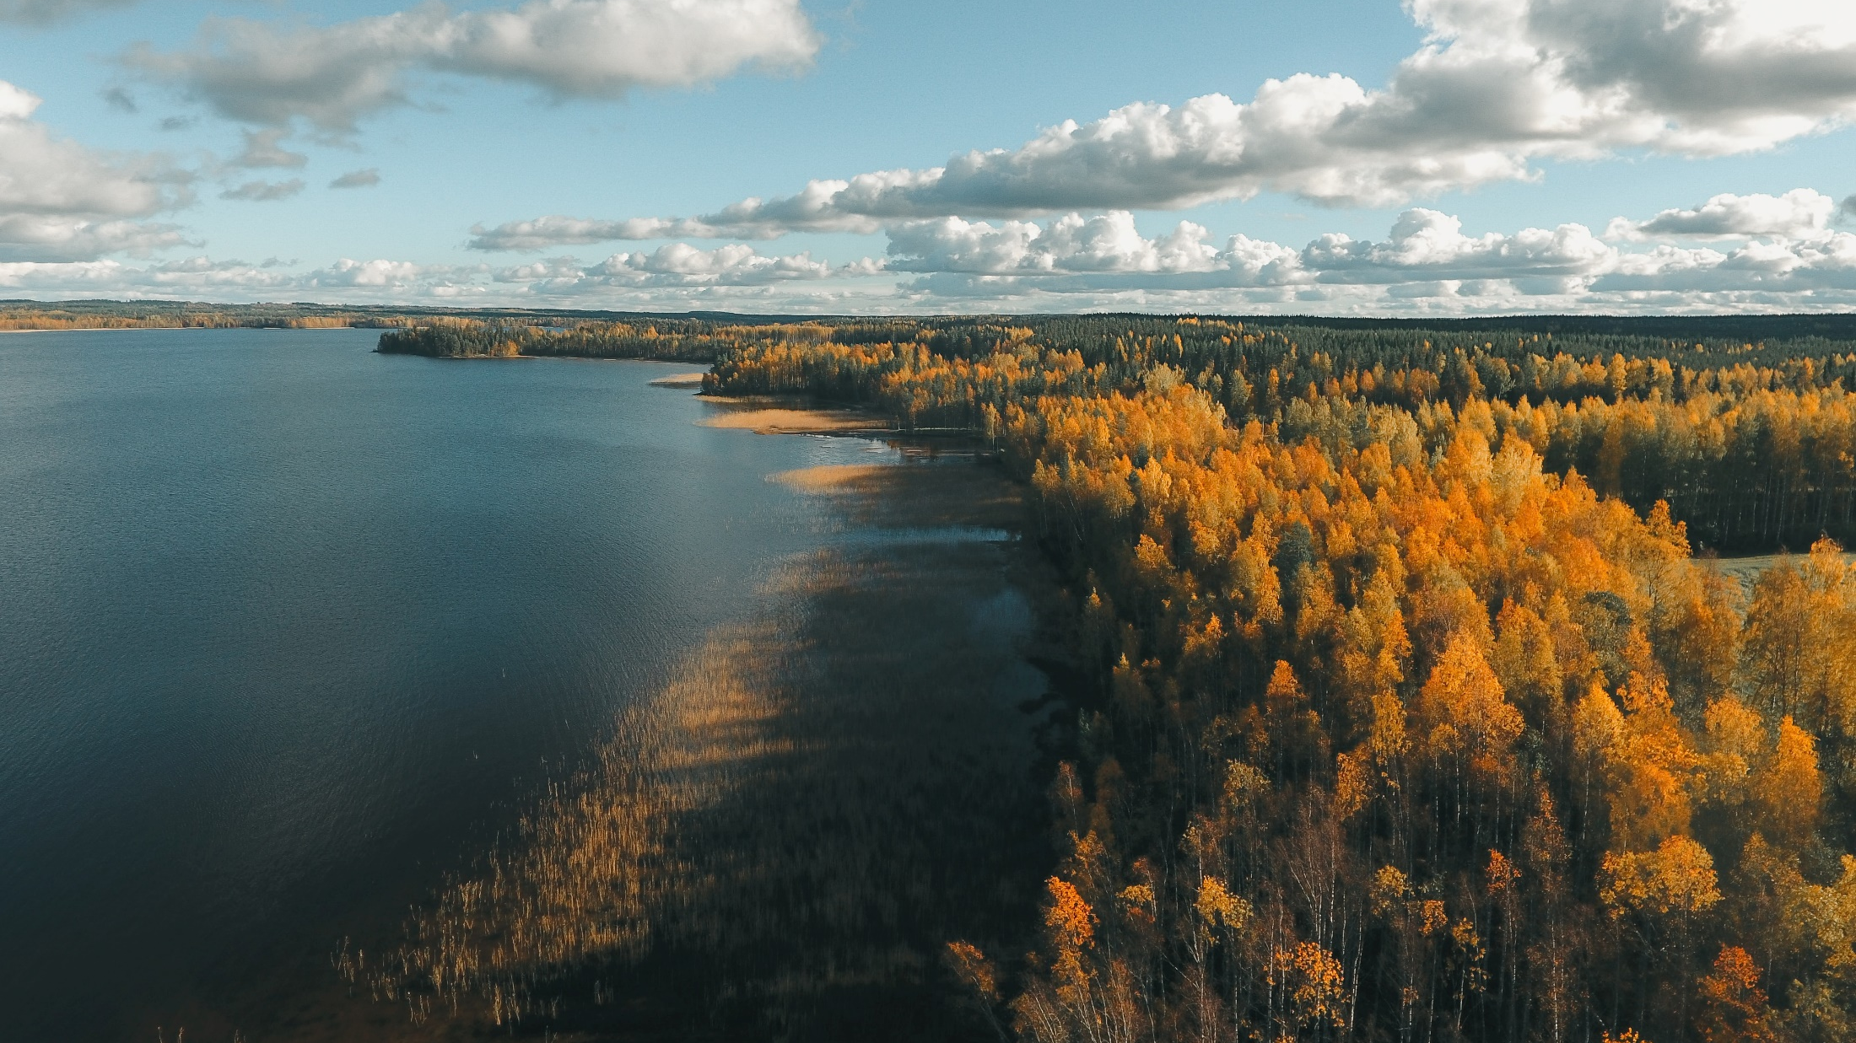
Bringing science and decision-making together
CASE EXAMPLE
Notes:
Finnish Climate Change Panel: Yhteyshenkilö: Heta-Elena Heiskanen, Senior specialist at the Ministry of Environment heta-elena.heiskanen@ym.fi +358 295 250 380

Slide 14
The Finnish Climate Change Panel facilitates dialogue between science and policy-making
The Finnish Climate Change Panel provides independent, scientific and researched information regarding climate change.
The Panel is an independent and interdisciplinary scientific body that promotes dialogue between science and policy-making by providing scientific advice. The work of the Climate Change Panel is based on the Climate Change Act, which entered into force in 2015. The Panel is tasked with assessing the coherence of climate policy and the sufficiency of the implemented measures to answer to the challenges of climate change. For example, the Panel has produced an emissions reduction path report which demonstrates the sufficiency of Finland’s climate actions and several reports concerning consumer perspectives on climate policy, the social acceptability of climate action, electric vehicles and water management.
In addition to the reports the Panel has created an online app comparing the life cycle emissions and cost of cars powered by petrol, diesel, electric and natural gas or biogas. The Panel also issues statements on proposed legislation which affects climate change mitigation or adaptation.
The work of the Finnish Climate Change Panel is based on the Climate Change Act, which entered into force in 2015.
The Panel’s members represent different branches of science from educational sciences to atmospheric sciences.
The current Panel has 15 members and is chaired by Markku Ollikainen, Professor Emeritus of Environmental and Resource Economics at the University of Helsinki.
Notes:
Finnish Climate Change Panel: Yhteyshenkilö: Heta-Elena Heiskanen, Senior specialist at the Ministry of Environment heta-elena.heiskanen@ym.fi +358 295 250 380

Slide 15
Developing INTERACTION BETWEEN RESEARCHERS AND POLICY-MAKERS
CASE EXAMPLE
Notes:
Tiede & päätöksenteko: Heta-Elena Heiskanen, Senior specialist at the Ministry of Environment heta-elena.heiskanen@ym.fi +358 295 250 380

Slide 16
Interaction with researchers improves the knowledge base of policy-making
New methods of giving science advice deepen the cooperation between policymakers and researchers. These include forming scientific task groups to support the drafting of legislation as well as national strategies, to name but a few. Civil servants act in advisory boards and use policy briefs.
New methods have been piloted in the context of circular economy, biodiversity and climate change in the Ministry of the Environment. The cooperation ensures a sufficient knowledge base for policy making, which correlates with the new requirement of preparing a climate change impact assessment on every law.
Close and continued cooperation with researchers conducting these assessments for the Climate Change Act ensures policies support the resolution of complex environmental challenges.
The Ministry of the Environment works in active cooperation with universities and scientists. Research projects and teaching cooperation is being developed to better include climate science and circular economy.
A group of scientists assigned by the Ministry focused on the climate impacts of the new Nature Protection Act and conducted workshops with civil servants.
The Climate University group develops climate education for higher education institutions. Civil servants participate in the workshops by giving presentations about topical issues in climate policy.
The Design for Government course at Aalto University is a 6-month course, where students solve real policy issues that support the Ministry’s work.
Notes:
Tiede & päätöksenteko: Heta-Elena Heiskanen, Senior specialist at the Ministry of Environment heta-elena.heiskanen@ym.fi +358 295 250 380

Slide 17
Education and a strong nature relationship
See the case examples →
Participation to solving matters for common good is deep-rooted in the Finnish culture. According to a survey conducted in 2019, four out of five Finns consider that urgent action is needed to mitigate climate change. We also wish to have solutions to climate crisis at the heart of policy-making.
Finns want to participate in protecting the environment. Climate change education is part of Finnish curriculum from kindergarten to university.
Participation is the core element of law drafting process as well. During the renewal of the national Climate Act over 2500 people told us what “the perfect climate act” should consist of.
Finnish people have a strong nature relationship, because nature has always been accessible to us. Finland is the most forested country in Europe and four out of five Finns say nature is very important to them.
The Martha organisation offers knowledge to live a more climate-friendly life
Climate Barometer measures Finns’s attitude to climate policies
The Sustainable Lifestyle Service engages citizens to take climate action
Agenda 2030 brings young people to the centre of sustainable development policy
Universities use climate learning as a tool to build societal competencies
Participation of ordinary people strengthens the Climate Change Act
The Finnish National Agency for Education strives for the inclusion of climate responsibility in teaching
Finland is a land of forests

Slide 18
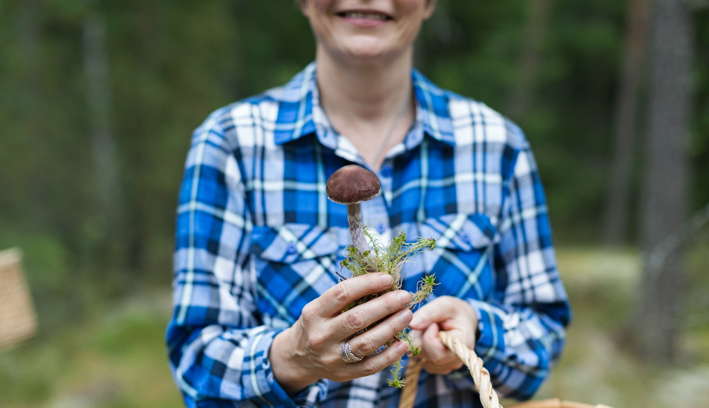
CLIMATE-FRIENDLY EVERYDAY LIVES
CASE EXAMPLE
Notes:
Martat: Yhteyshenkilö: Salka Orivuori, development director at the Martat Organization salka.orivuori@martat.fi, 050 5474751

Slide 19
The Martha Organization offers knowledge to live a more climate-friendly life
The Martha Organization’s mission is to promote good and sustainable everyday lives by giving advice on, for example, climate friendly food choices and recipes, how to avoid food waste, how to save energy and improve energy effectiveness, how to reduce and sort waste, and how to consume more sustainably.
The organisation, founded in 1899, has long-standing traditions in advising about household chores, but it has been able to also tackle modern challenges. It offers knowledge and skills to live a more climate friendly life through counselling, courses, communication and advocacy. In addition, the Sustainable Everyday web page provides information on the effects of everyday choices and solutions which have positive influence on the environment.
Changing daily routines can have a significant impact on the environment. Households create 66% of Finland’s consumption-based greenhouse gas emissions. The emissions are the result of everyday life: housing, food, transportation, services and goods.
The Martha Organization is a home economics organisation that promotes well-being and quality of life at home.
The Martha Organization has 43,000 members and operates all across Finland.
The organisation promotes the idea that climate friendly choices are likely to be better for your health, wellbeing and household economy.
Notes:
Martat: Yhteyshenkilö: Salka Orivuori, development director at the Martat Organization salka.orivuori@martat.fi, 050 5474751

Slide 20
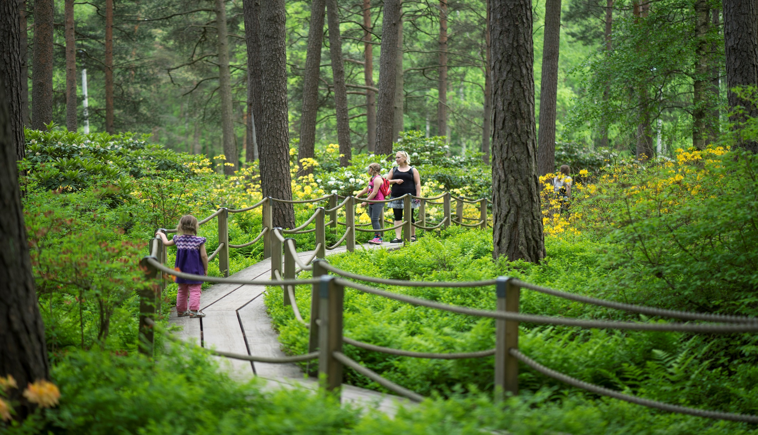
Finns want ambitious climate policies
CASE EXAMPLE
Notes:
Climate Barometer 2019: Yhteyshenkilö: Riikka Lamminmäki, communication manager at the ministry of enviroment riikka.lamminmaki@ym.fi, 0295250343

Slide 21
Climate Barometer measures Finns’ attitudes to climate policies
The Climate Barometer survey shows that four out of five Finns consider that urgent action is necessary to slow down climate change.
Growing numbers of Finns say they have changed their own behaviour to mitigate climate change. More than half of the barometer’s participants answered that they have decreased their electricity consumption and nearly half claimed they have reduced their purchases of goods. The Climate Barometer survey is conducted every four years to find out what Finns think about climate change and climate policy. In 2019, a total of 1,013 people aged 15–74 from different parts of Finland participated in the survey. According to the results, Finns believe solutions to the climate crisis should be at the centre of policy-making.
The barometer is commissioned by the Steering Group for Central Government Climate Communications.
76% of Finns think that the impacts of climate change in other parts of the world are a security threat to Finland.
80% believe new expertise and technical solutions that mitigate climate change may create new jobs and improve Finland’s competitiveness.
Ambitious climate policy is supported, in particular, among women, the young and highly educated.
Notes:
Climate Barometer 2019: Yhteyshenkilö: Riikka Lamminmäki, communication manager at the ministry of enviroment riikka.lamminmaki@ym.fi, 0295250343

Slide 22
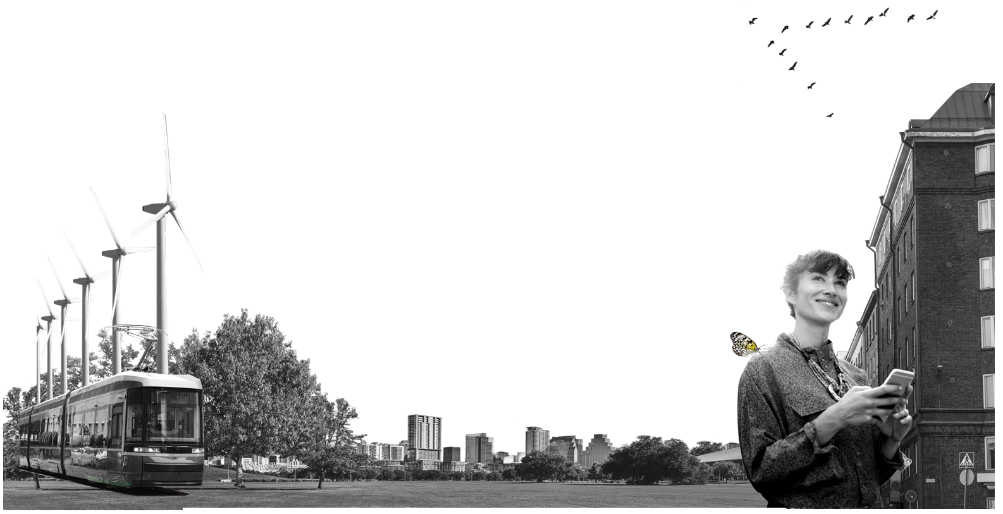
SUSTAINABLE LIFESTYLE COMMITMENTS
CASE EXAMPLE
Notes:
Sitra sustainable lifestyle service: Tuuli Hietaniemi specialist, climate solutions at Sitra, tuuli.hietaniemi@sitra.fi +358 (294) 618 411 & Emma Hietaniemi, specialist at Sitra emma.hietaniemi@sitra.fi, +358 (294) 618 483

Slide 23
Sustainable Lifestyle Service engages citizens to take climate action
The Sustainable Lifestyle Service developed by the Finnish Innovation Fund Sitra and the Prime Minister’s office enables Finns to pursue a more sustainable everyday life.
Users can first calculate their personal carbon footprint with a Lifestyle test and then generate a personal Sustainable Lifestyle plan to reduce their carbon footprint by choosing suitable actions from a list of smart choices. Most greenhouse gas emissions are created through choices of how individuals live, travel, eat and consume. Each individual plan made through the Sustainable Lifestyle Service contributes to the national emissions reduction target and takes into consideration all attempts at lowering emissions.
Simultaneously, these plans deliver important signals as to which emission reduction measures are easy to perform and in which actions the support of the rest of society is necessary – because everyone can find their own way to live a more sustainable life.
The Lifestyle test has been taken over a million times. In a country of 5.5 million people, that is a fair amount.
On average, citizens are ready to cut approximately 30% of their carbon footprint over the first year of their plan.
Citizens have committed to actions which would reduce emissions by 5,098 t CO₂e (11/2020).
Notes:
Sitra sustainable lifestyle service: Tuuli Hietaniemi specialist, climate solutions at Sitra, tuuli.hietaniemi@sitra.fi +358 (294) 618 411 & Emma Hietaniemi, specialist at Sitra emma.hietaniemi@sitra.fi, +358 (294) 618 483

Slide 24
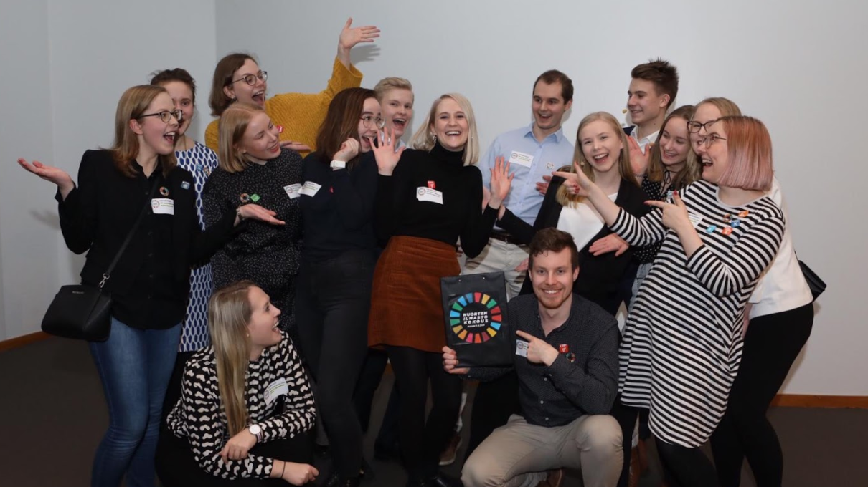
Changemakers for sustainable development
CASE EXAMPLE
Notes:
Nuorten Agenda2030: Heta-Elena Heiskanen, Senior specialist at the Ministry of Environment heta-elena.heiskanen@ym.fi +358 295 250 380 & Riina Pursiainen project coordinator at prime minister’s office riina.pursiainen@vnk.fi, 0295160577

Slide 25
Agenda 2030 brings young people to the centre of sustainable development policy
The Agenda 2030 Youth Group’s mission is to increase young people’s involvement in implementing sustainable development policies in Finland.
The group, established in 2017, has two main purposes: to spur on the Finnish National Commission on Sustainable Development in its work while making young people's voices heard in sustainable development policy processes and public debate, and to inform other young people of the Sustainable Development Goals and themes in various networks, such as schools and leisurely activities. From the start, the group has focused on climate action. The first Youth Climate summit was organised in 2018 with over 500 young people from all over Finland. In 2020, the group maintained focus on the new Climate Law and how it will establish youth participation in its follow up mechanism.
The group does both grassroots work and spars decision-makers on sustainable development themes. Members have had access to official processes through the group. For example, in events organised by the committee of sustainable development, chaired by the Prime Minister, the group always has an important role: often the opening statement or comment. In addition, the group has prepared their own version of the Climate Law, which has been presented to the Ministry of the Environment.
Each group holds the position for 1.5 years at a time. In 2020, the group had 14 members ranging from 16 to 29 years of age.
Each group decides what they want to focus on during their term. In 2020, the group chose to focus on the Climate Law process and education.
Notes:
Nuorten Agenda2030: Heta-Elena Heiskanen, Senior specialist at the Ministry of Environment heta-elena.heiskanen@ym.fi +358 295 250 380 & Riina Pursiainen project coordinator at prime minister’s office riina.pursiainen@vnk, 0295160577

Slide 26
EDUCATION for a sustainable future
CASE EXAMPLE
Notes:
Climate University: Yhteyshenkilö: Heta-Elena Heiskanen, Senior specialist at the Ministry of Environment heta-elena.heiskanen@ym.fi +358 295 250 380 & Laura Riuttunen, postdoctoral researcher at University of helsinki laura.riuttunen@helsinki.fi, 0294151663

Slide 27
Universities use climate learning as a tool to build societal competencies
Climate University is a network of 11 Finnish universities and several high schools which are developing joint methods to teach climate change and sustainability.
So far, the network has established nine open online courses as well as training and networking events for higher education teachers. The courses are organised in Finnish and English and the course materials are open to everyone. However, academic credits are only available to those who participate in a course offered by a college or university, or open university. All Climate University course materials will be free in order to build the capabilities of the society. The purpose of Climate University collaboration is to create multidisciplinary digital learning solutions for the education of sustainability challenges, and to form a collegial network of teachers to support the teaching of climate change and sustainability in university education.
Examples of courses offered in English include a Circular.now online course on the basics of circular economy, Climate.now course on the basics of climate change and Sustainable.now – a course piecing together the challenges of climate change and sustainability. The project is funded by the Ministry of Education and Culture and the Finnish Innovation Fund Sitra.
The Climate University has been a network of universities, schools and businesses since 2017.
Climate University provides 9 online courses on climate change and sustainability.
Climate University also provides education for higher education teachers.
Notes:
Climate University: Yhteyshenkilö: Heta-Elena Heiskanen, Senior specialist at the Ministry of Environment heta-elena.heiskanen@ym.fi +358 295 250 380 & Laura Riuttunen, postdoctoral researcher at University of helsinki laura.riuttunen@helsinki.fi, 0294151663

Slide 28
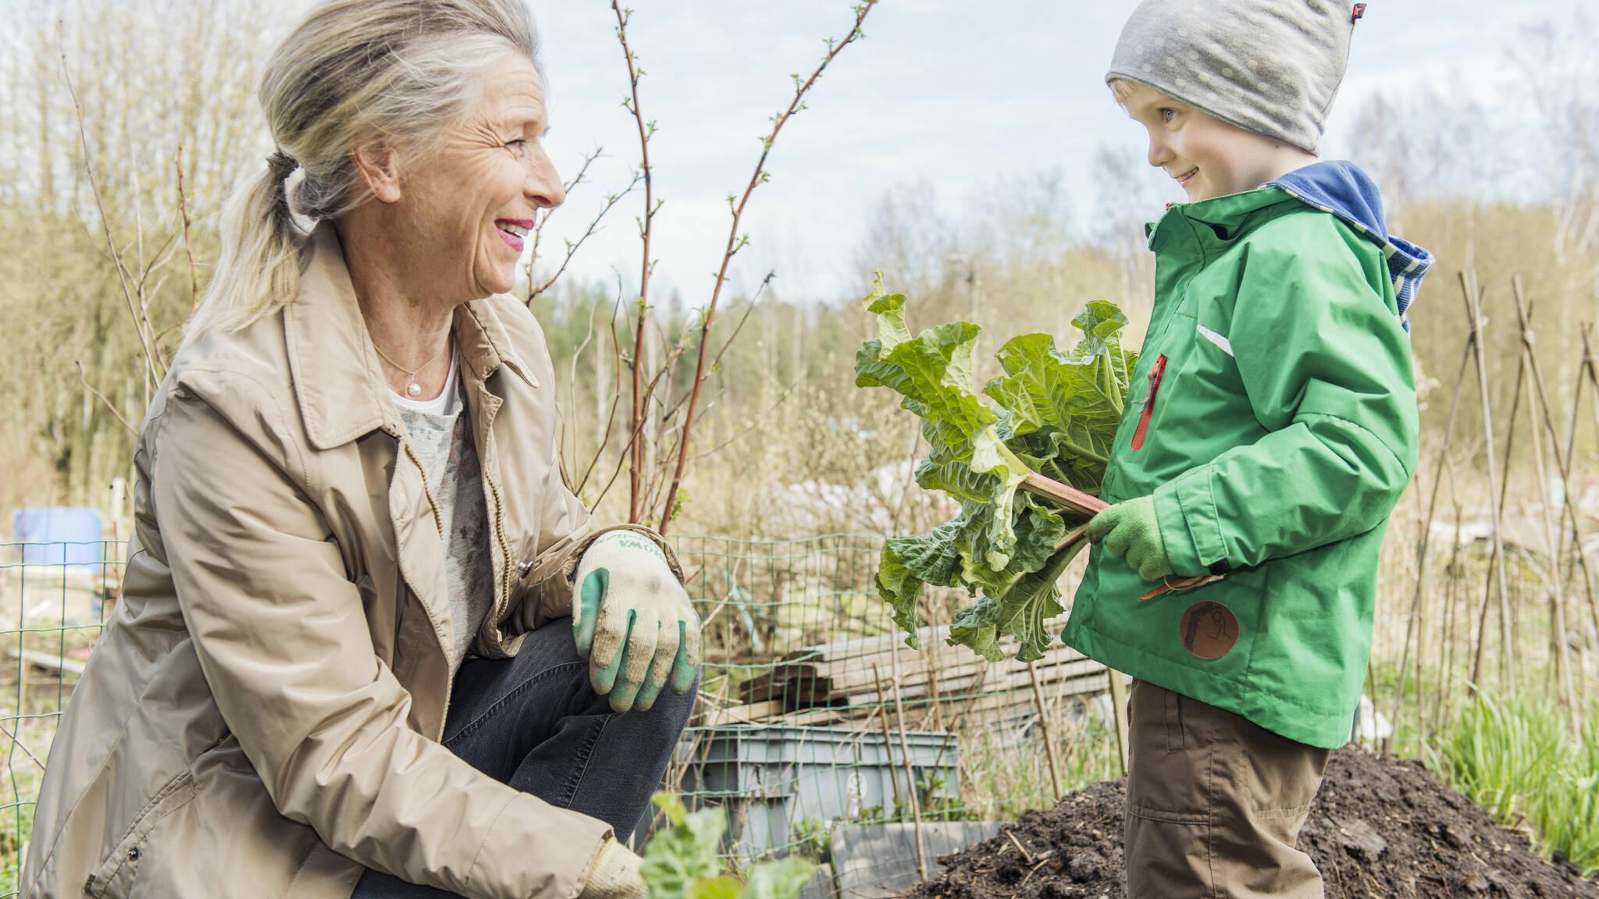
STRONGER CLIMATE CHANGE LEGISLATION IN COOPERATION WITH THE PEOPLE
CASE EXAMPLE
Notes:
Finland’s Climate Change Act: Heta-Elena Heiskanen, Senior specialist at the Ministry of Environment heta-elena.heiskanen@ym.fi +358 295 250 380

Slide 29
Participation of ordinary people strengthens the Climate Change Act
Finland is renewing its Climate Change Act together with its citizens. The reform began with extensive public hearings in the fall of 2019. The main objective of these hearings was to give all of the citizens a chance to participate and tell what a just transition would look like to them.
The content of the law will impact all Finns both now and in the distant future which is why ordinary people have been widely involved in the reform through processes such as small-scale social media surveys and a more extensive online survey that was open to everyone and brought in about 2,500 responses. The majority of responses were given in the role of a citizen. Methods of participation have included online questionnaires, live events and web-based workshops.
All in all, there have been over 3,000 participants during consultations of the reform, including a roundtable of ministers and young people as well as a discussion on climate change mitigation through legislative means as part of the “Children take over the Government” event. The chance to participate strengthens the acceptability of the law and also provides valuable information to the civil servants drafting it.
Finland’s Climate Change Act was enacted in 2015. It includes a climate change planning system, an annual reporting mechanism to Parliament and the Climate Change Panel, a group of top scientific advisors.
The reformed Climate Change Act is planned to be ready in 2021.
The new Climate Change Act will include the target year of 2035 for climate neutrality and it will have a broader scope: climate impacts of land use will also be included.
Notes:
Finland’s Climate Change Act: Heta-Elena Heiskanen, Senior specialist at the Ministry of Environment heta-elena.heiskanen@ym.fi +358 295 250 380

Slide 30
climate responsibility EDUCATION
CASE EXAMPLE
Notes:
OPH (opetussunnitelma laaja-alainen osaaminen/ilmastokoulutus): Anne Liimatainen counsellor of education, anne.liimatainen@oph.fi & Hanna Pohjonen Senior Ministerial Adviser, Department for Higher Education puh. 029 533 1801, hanna.pohjonen@oph.fi

Slide 31
The Finnish National Agency for Education strives for the inclusion of climate responsibility in education
The Finnish national core curricula aim to teach everyone the basics of climate responsibility.
The Finnish National Agency for Education supports teaching skills that are essential to build a sustainable future for the climate through the national core curricula. The learning objectives help students understand why human activity has to be reconciled with the capacity of natural environments as well as the sustainable use of limited natural resources.
Students learn appreciation for the diversity of nature, circular economy and sustainable consumerism, as well as research-based climate action. One of the objectives of the national core curricula is that the operational cultures of learning communities support sustainable development by sharing and spreading best practices related to climate responsibility. Climate responsibility covers the aspects of climate change mitigation and adaptation.
The aim of the core curricula is for students to familiarise themselves with research evidence and practices associated with climate change mitigation and safeguarding biodiversity.
The core curricula help students understand why human activity has to be reconciled with the capacity of natural environments as well as the sustainable use of limited natural resources.
Through the core curricula students can reflect on their observations from the perspective of civic engagement, striving to identify structures that enable or prevent different communities from taking sustainable action.
Notes:
OPH (opetussunnitelma laaja-alainen osaaminen/ilmastokoulutus): Anne Liimatainen counsellor of education, anne.liimatainen@oph.fi & Hanna Pohjonen Senior Ministerial Adviser, Department for Higher Education puh. 029 533 1801, hanna.pohjonen@oph.fi

Slide 32
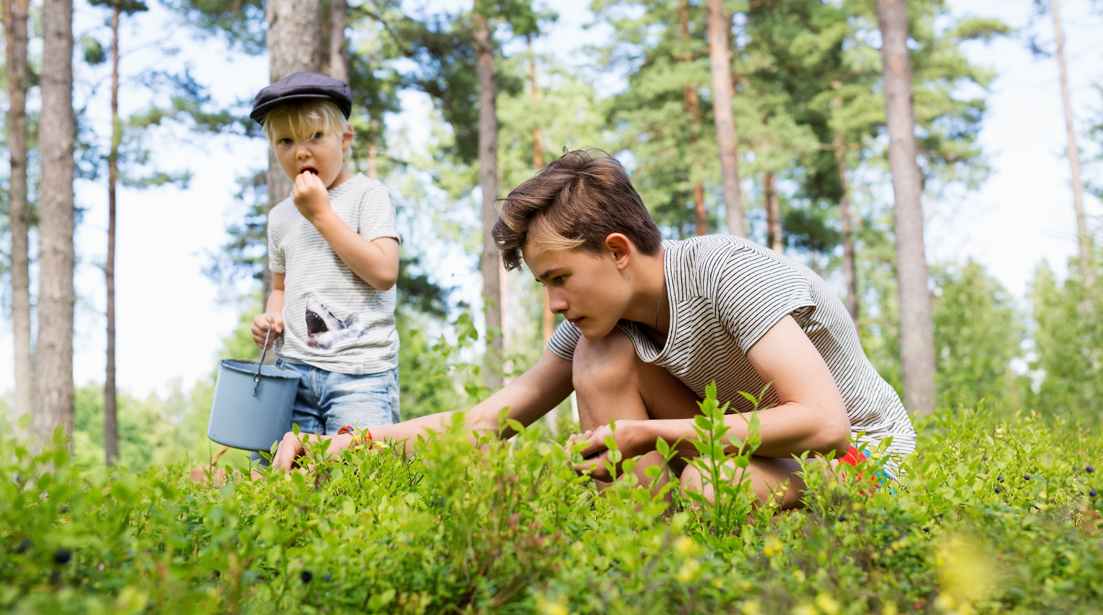
Finland is a land of forests
Notes:
Nature Conservation act: Riitta Rönn, legislation at the Ministry of Enviroment riitta.ronn@ym.fi +358 295250255

Slide 33
Finnish people value forests and benefit from them sustainably
With more than 70% of its area covered by trees, Finland is Europe’s most forested country. Finnish people have an individual connection to forests; more than 80% of Finnish people say the forest is important to them.
60 % of Finnish forests are owned by ordinary families and there are around 400,000 family-owned forest estates – with a medium size of slightly over 30 hectares. A desire to preserve nature also figures strongly in Finnish people’s relationship to the forest. Around 12% of Finnish forest is protected, mostly in Northern Finland.
The Finnish concept of Everyman’s Right means that anybody may hike, camp, and gather mushrooms and berries in any forest, regardless of who owns it.
Finland is a world leader in sustainable forest management and with a 20% share the forest industry is Finland’s main export sector. In Finland, commercial forestry takes into account biodiversity and carbon sinks. The forest industry actively searches for new products based on wood material.
Finland is the most forested country in Europe. Forests account for as much as three quarters of Finland’s surface.
60 % of Finnish forests are owned by ordinary families, and 15% of Finns own forest.
With a 20% share the forest industry is Finland’s main export sector. Finland is the world leader in forest technology and research.

Slide 34
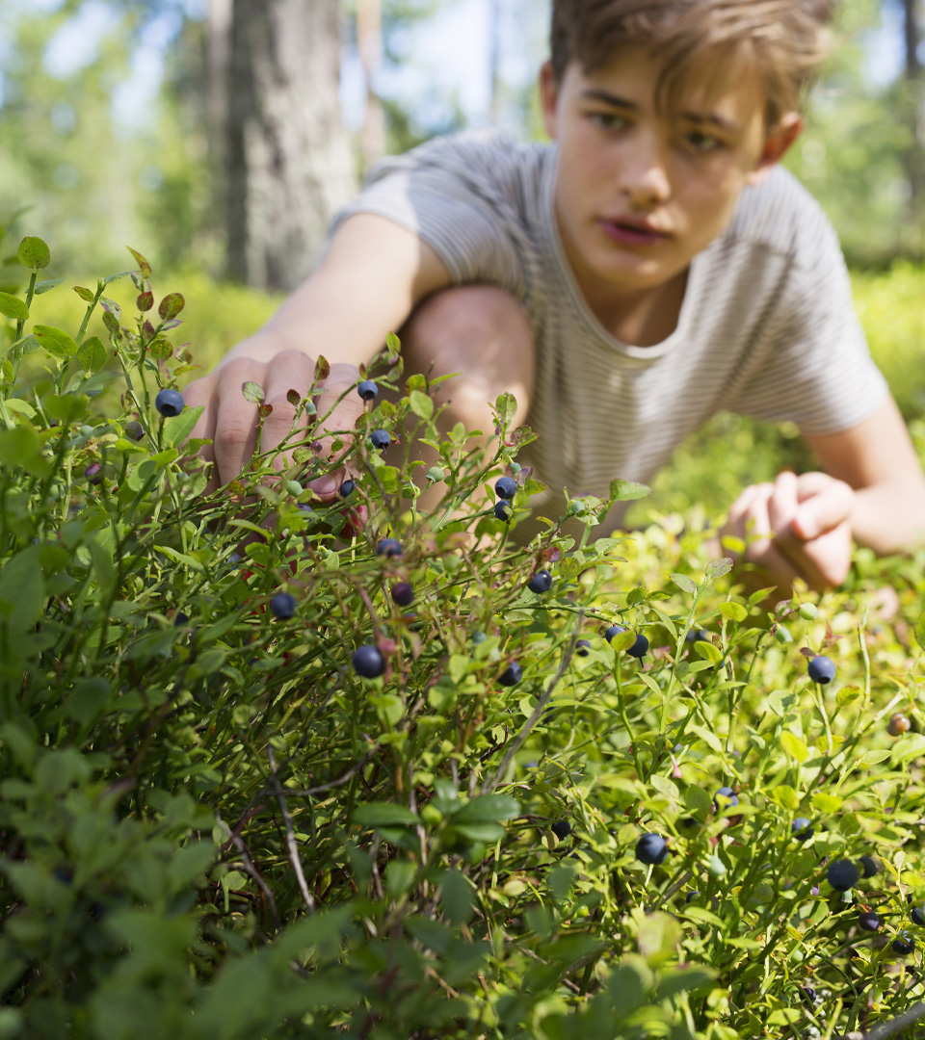
In Finland, everyone does their share for climate
See the case examples →
Legislation and solutions developed together by the private and public sectors have always played a central role in Finland in solving environmental problems. The same ability to collaborate across interest groups and sector boundaries is now being harnessed again.
Businesses are striving towards a structural change to ensure a more sustainable future. Roadmaps have been prepared for four energy-intensive industries and nine other sectors, aiming at significant reductions in greenhouse gas emissions by 2035. These roadmaps will be one of the cornerstones of the government’s climate policy.
Almost half of the Finns live in municipalities that aim to be carbon-neutral already by 2030. Finnish cities and municipalities have developed active networks nationally and internationally to share best practices.
Hinku network aims for a stronger economy through local climate action
Profitable climate change mitigation: The story of Ii
The CitiCAP app promotes sustainable mobility through citizen engagement in Lahti
Government aid for substituting oil heating with sustainable solutions
Reducing emissions throughout the whole life cycle of buildings
Low-carbon roadmaps for Finnish industries
Voluntary agreements help to fulfil Finland’s energy efficiency obligations

Slide 35
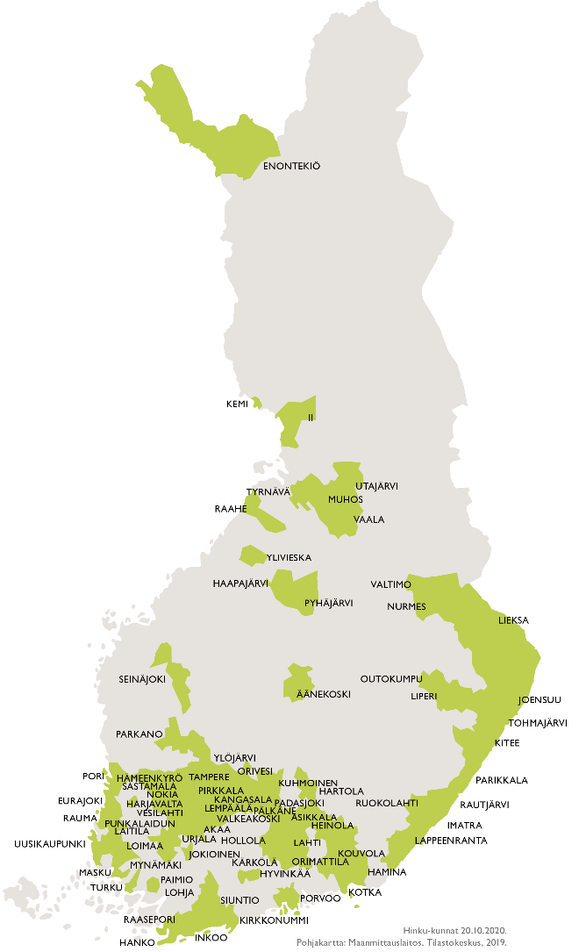
Working together towards Carbon Neutrality
CASE EXAMPLE
Notes:
Hinku: Yhteyshenkilö: Ulla Ala-Ketola, Communications speacialist at Syke ulla.ala-ketola@syke.fi, +358 (0)50 465 5883

Slide 36
Hinku network aims for a stronger economy through local climate action
The Towards Carbon Neutral Municipalities (Hinku) network brings together municipalities, businesses, citizens and experts to create and carry out solutions that reduce greenhouse gas emissions.
Over 70 Hinku municipalities and 5 Hinku regions are working together to reach their ambitious goal of reducing their greenhouse gas emissions by 80% from 2007 levels by 2030. Hinku aims to reach targets much sooner than required by the EU.
Hinku facilitates the spreading of best practices and knowledge. The focus is on local climate action to yield a stronger economy, social welfare and new business opportunities. Hinku’s overall emissions have decreased 25% by 2018, and the top five municipalities have each managed to reduce their emissions by 40–60%. The Hinku network was initiated in 2008 and it is coordinated by the Finnish Environment Institute SYKE, which together with other expert organisations provides support, tools and services, like science-based emission calculations for member municipalities.
Climate action based on cooperation between municipalities, businesses, experts and citizens.
Local action, national impact: municipalities spread best practices, knowledge and experiences.
The Finnish Environment Institute provides science-based emissions calculation services and other tools.
Notes:
Hinku: Yhteyshenkilö: Ulla Ala-Ketola, Communications speacialist at Syke ulla.ala-ketola@syke.fi, +358 (0)50 465 5883

Slide 37
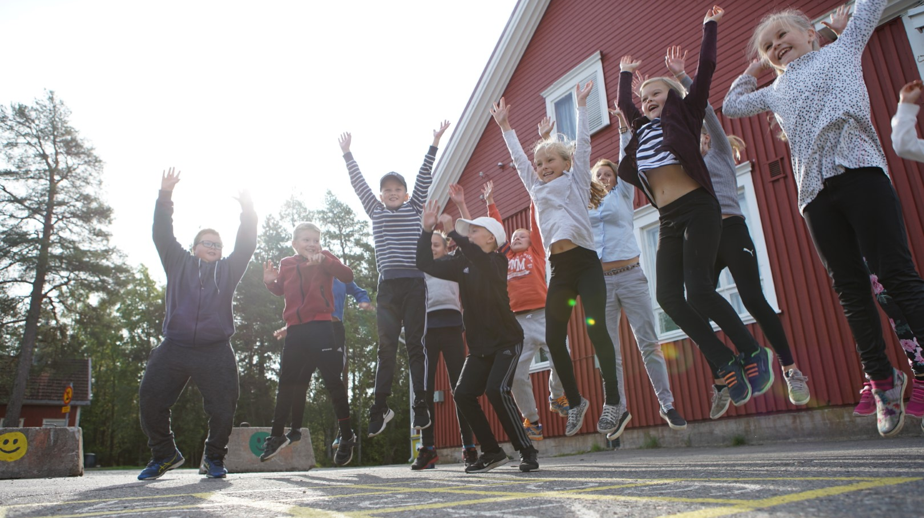
GREEN GROWTH FOR CITIES
CASE EXAMPLE
Notes:
Ii: Yhteyshenkilö: Leena Vuotovesi CEO at Micropolis Leena.vuotovesi@micropolis.fi, 0407514318

Slide 38
Profitable climate change mitigation: The story of Ii
With a population of less than 10,000, the northern town of Ii now generates a profit of half a million euros a year after investing heavily in geothermal, solar and wind energy projects since 2012.
The municipality of Ii has stopped using fossil fuels and their target is to reduce carbon emissions by 80%, and to do it 30 years ahead of the EU's target and faster then any other community in Finland. Ii also wants to be the world’s first zero-waste community.
Since investing in renewable energy and ceasing the use of fossil fuels, the municipality presently produces ten times more clean energy than it consumes. Ii’s strategy is built on sustainable development, and the climate actions are part of the municipality’s official budget and financial statement. Due to profit generated through climate actions, Ii has been able to cut city taxation by 1.5 percentage points.
Ii has also invested in climate education. In schools and nurseries children are taught climate actions are a part of their everyday life. By learning that climate actions are possible and profitable they acknowledge there are tools to undertake climate change. This is climate hope.
Due to profit generated through climate actions, Ii has been able to cut city taxation by 1.5 percentage points.
Ii has received green investments that amount to 200 million euro.
Ii annually organises the national Climate Festival IlmastoAreena in order to tackle climate change.
Notes:
Ii: Yhteyshenkilö: Leena Vuotovesi CEO at Micropolis Leena.vuotovesi@micropolis.fi, 0407514318

Slide 39
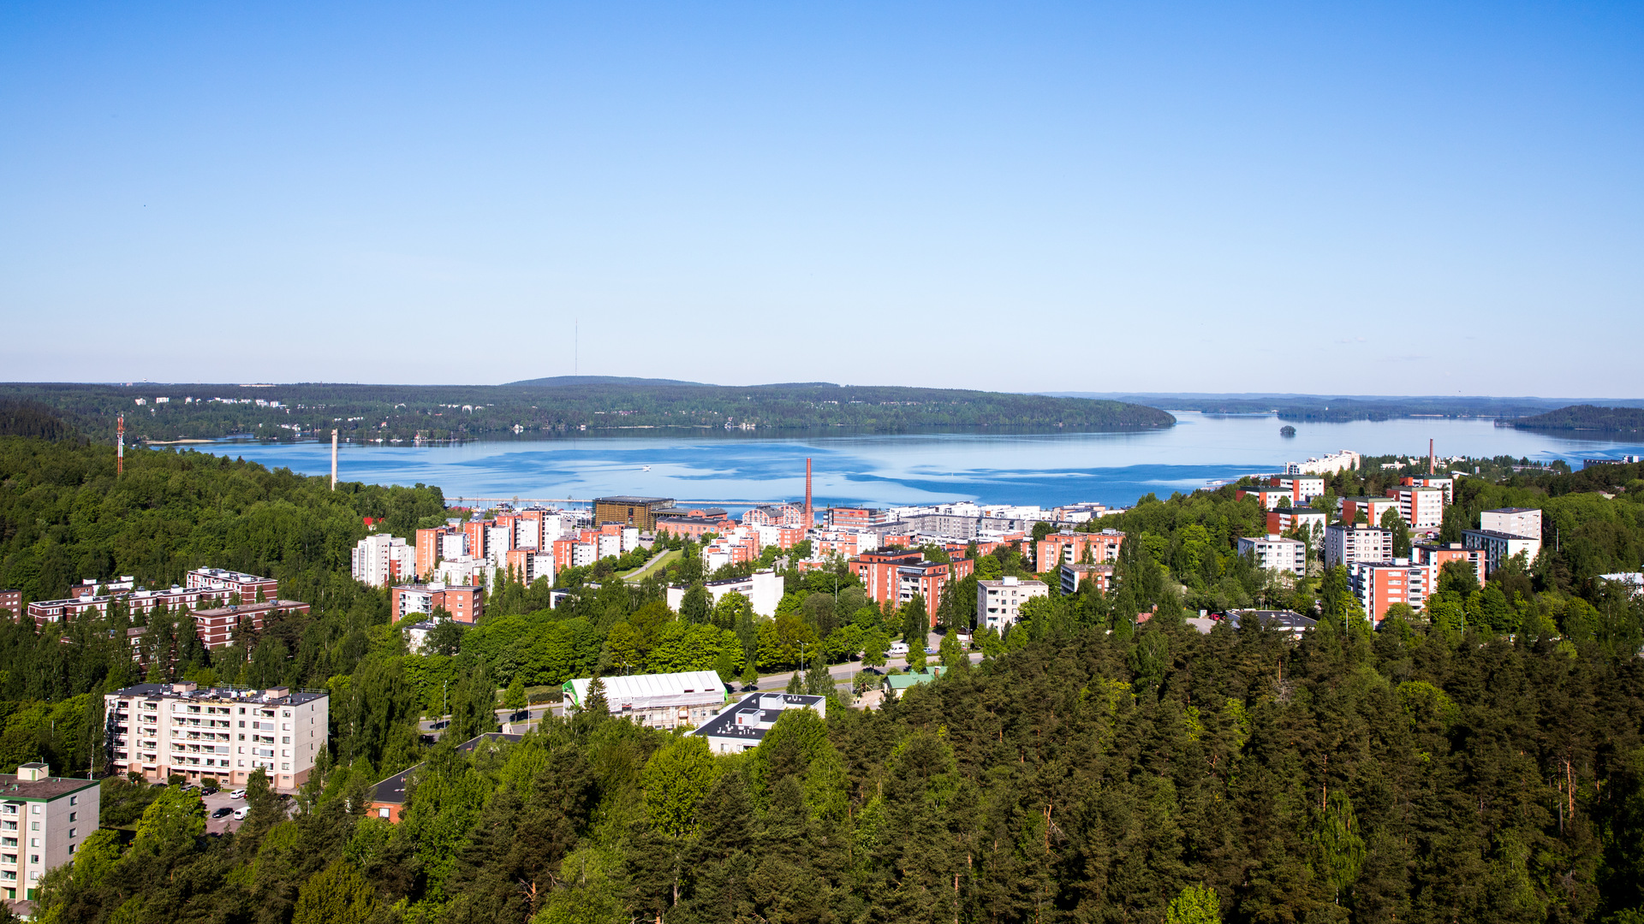
Personal carbon trading
CASE EXAMPLE
Notes:
Lahti/CitiCAP: Yhteyshenkilöt: Anna Huttunen, project manager at the city of Lahti Anna.Huttunen@lahti.fi, 0444826176

Slide 40
The CitiCAP app promotes sustainable mobility through citizen engagement in Lahti
The main goal of the CitiCAP project is to decrease emissions generated from traffic. The citizens of Lahti (the European Green Capital of 2021) are given the chance to participate in reducing CO2 emissions through a specifically designed app. They are rewarded for climate-friendly mobility choices.
The app tracks the person’s mobility, calculates the CO2 emissions generated and uses the information to set a weekly goal for mobility emissions. The project has developed a model for personal carbon trading regarding mobility. The app enables real-time tracking and the visualisation of one’s mobility carbon footprint. It rewards citizens for their emission reductions, such as with discounts for local products.
The project is engaging citizens in climate change mitigation by sharing knowledge with other cities in order to encourage them to start developing their own personal carbon trading (PCT) pilots. A PCT pilot opens up a discussion about personal carbon trading as a part of the solution in tackling climate change. Further research is still necessary, and the feasibility of personal carbon trading is yet to go through critical evaluation in a wider, scaled-up context. The project is funded by the EU.
The first city in the world to pilot an application that utilises the personal carbon trading (PCT) logic.
The CitiCAP application engages citizens and positively encourages them to make a change in their mobility behavior.
Notes:
Lahti/CitiCAP: Yhteyshenkilöt: Anna Huttunen, project manager at the city of Lahti Anna.Huttunen@lahti.fi, 0444826176

Slide 41
Sustainable heating solutions – transition with government aid
CASE EXAMPLE
Notes:
Valtion tuki öljylämmityksestä luopuville: Liisa Kemppainen, communications specialist at Ministry of the Environment Liisa.Kemppainen@ym.fi viestintäasiantuntija, +358 295 250 124 & Pekka Kalliomäki, Senior technical adviser at Finnish Ministry of the Environment pekka.kalliomaki@ym.fi +358 295 250 114

Slide 42
Government aid for substituting oil heating with sustainable solutions
Since the autumn of 2020 the Finnish government has provided aid to municipalities and the owners of small residential buildings for renovations in which oil heating is substituted with more sustainable solutions.
Finland is to discontinue the use of fossil oil for heating purposes by the beginning of 2030. The public sector will lead by example by transitioning to a more sustainable heating solution before 2024.
For small residential buildings, the target is to complete 10,000 oil heating renovations with 30 million euros of aid in 2020. In addition to this, 15 million euros of funds will go to oil heating renovations in municipalities.
Supplemental funds for the heating renovations have already been applied to the government’s upcoming budget.
Buildings and construction produce a third of Finland’s climate emissions. In order to achieve the objective of a climate neutral Finland by 2035, emissions related to construction and living have to be reduced. The planned heating renovation of 10,000 small residential buildings would reduce the collective carbon emissions of the effort-sharing sector by 56 kilotons in a year. The renovations would also create 1,500 person-years of employment to Finland.
The owners of small residential buildings will receive either 2,500 or 4,000 euros depending on the chosen substitute heating solution. Municipalities will be compensated for 20–25% of the cost of renovation.
The heating renovations are considered to be sustainable recovery: they create work and reduce emissions.
The project has been a great success. After three months, the amount of applications is approximately 8,000.
Notes:
Valtion tuki öljylämmityksestä luopuville: Liisa Kemppainen, communications specialist at Ministry of the Environment Liisa.Kemppainen@ym.fi viestintäasiantuntija, +358 295 250 124 & Pekka Kalliomäki, Senior technical adviser at Finnish Ministry of the Environment pekka.kalliomaki@ym.fi +358 295 250 114

Slide 43
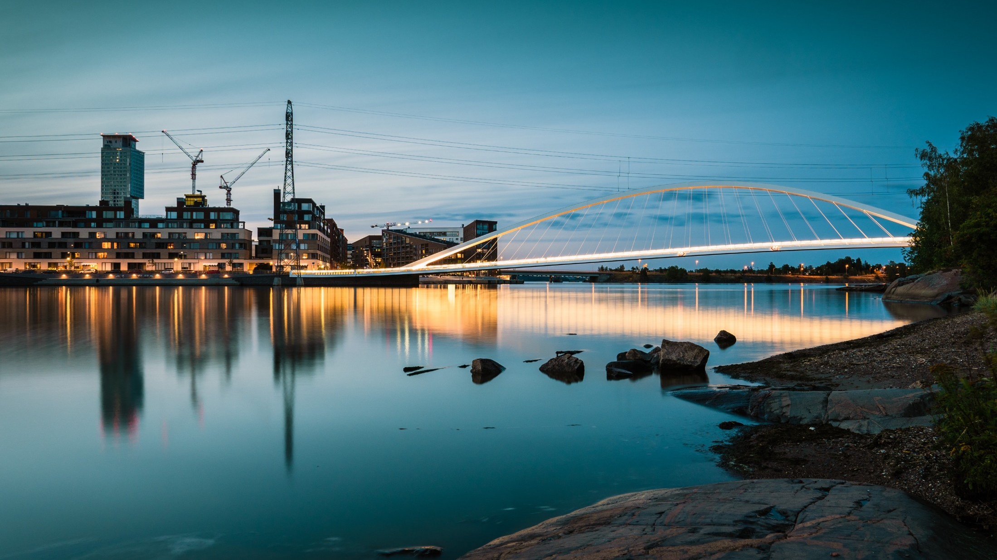
Finland in the forefront of low-carbon construction
CASE EXAMPLE
Notes:
Low-carbon construction: Matti Kuittinen, Senior Specialist at the Ministry of Enviroment Matti.Kuittinen@ym.fi, +358 2 951 50268 & Harri Hakaste, architecht at Ministry of the Environment harri.hakaste@ym.fi, +358 295 250 074

Slide 44
Reducing emissions throughout the whole life cycle of buildings
Finland is making great efforts towards low-carbon construction. The target is to find ways to reduce the emissions related to the whole life cycle of a building: from choosing the construction materials, the construction, the use of the building, its maintenance and repairs, and eventually demolition and waste management.
Carbon footprint limits to new buildings will be introduced in Finland before 2025. For enabling the calculation of carbon footprints in a consistent manner, an assessment method has been developed and an open database of the average greenhouse gas emissions of construction products and processes will be made available. Carbon footprinting of buildings has already been piloted in multiple projects. For example, the carbon footprints of all 33 houses presented in Finland´s annual housing fair were calculated in the summer of 2020.
Due to the regeneration of building stock at the pace of 1% per year, life cycle thinking and carbon footprint assessment have been expanded to repair and refurbishment projects as well. Finland’s aim is to renovate the existing building stock to a highly energy efficient and low-carbon condition by 2050.
Buildings and construction produce about a third of Finland's greenhouse gas emissions. In order to reach Finland’s target of becoming climate neutral by 2035 it is essential that these emissions be reduced. Sustainable buildings make a good place to live while keeping the cost of living moderate.
Circular economy and low carbon construction go hand in hand. In an ideal situation, buildings would be designed to be easily modified and disassembled, and their components reused and recycled. Buildings that are waiting to be demolished should be seen as material banks instead of waste.
Digitalisation is of key importance for meeting the goals of circular economy in construction. Finland is preparing regulation and instructions for automating life cycle assessments and material declarations of buildings with the help of their “digital twins”.
Notes:
Low-carbon construction: Matti Kuittinen, Senior Specialist at the Ministry of Enviroment Matti.Kuittinen@ym.fi, +358 2 951 50268 & Harri Hakaste, architecht at Ministry of the Environment harri.hakaste@ym.fi, +358 295 250 074

Slide 45
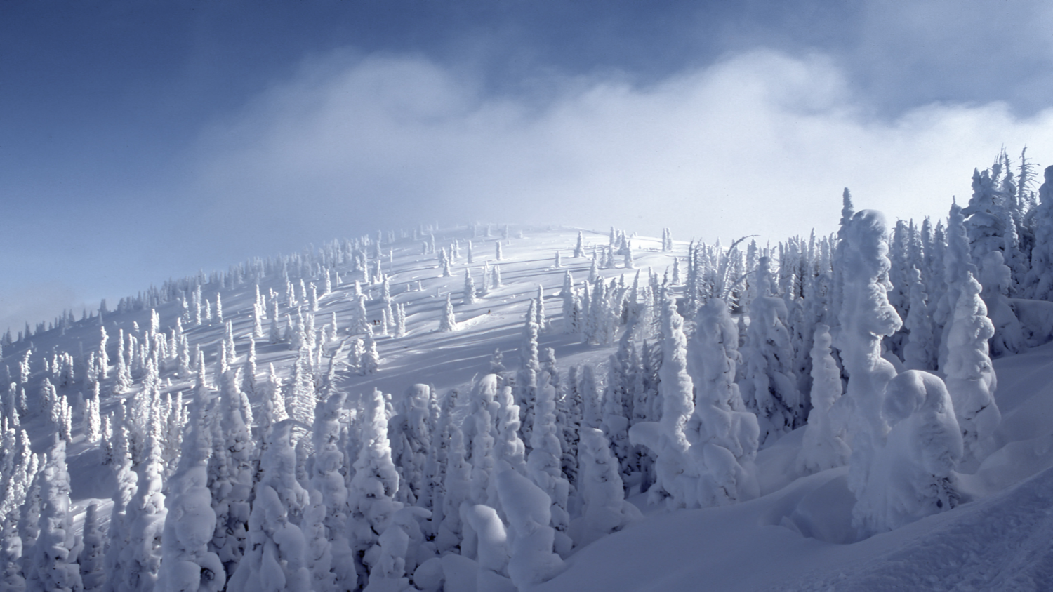
reduction of greenhouse gas emissions
CASE EXAMPLE
Notes:
(TEM) Finland’s low-carbon roadmaps: Mauri Vieru communications specialist at Ministry of Economic Affairs and Employment puh. 029 506 3577 mauri.vieru@tem.fi Katja Keckman communications specialist at Ministry of the Economic Affairs and Employment of Finland puh. 029 504 7106 katja.keckman@tem.fi

Slide 46
Low-carbon roadmaps for Finnish industries
The sectoral low-carbon roadmaps’ purpose is to provide a more accurate picture of the scale, costs and conditions of the measures needed to transform into a climate neutral Finland by 2035. The preparation of sectoral roadmaps was included in the Government Programme in 2019. A total of 13 sectors, such as the energy, chemical, forestry and technology industries, prepared their roadmaps by the summer of 2020.
The roadmaps show that a climate neutral Finland in 2035 is achievable for many industry sectors with existing or upcoming technologies. The roadmaps reveal the potential for significant reductions in greenhouse gas emissions. For example, industrial emissions could be reduced by more than 10 MB by 2035 from 2015 levels. The roadmaps offered a new perspective on responding to the climate challenge, produced a great deal of new information and increased the commitment of sectors and companies to climate work.
Success will be determined by how well the measures highlighted in the roadmaps can be transformed into concrete investments and new practices. Clean and climate neutral solutions offer great opportunities for new business ventures and can be a significant competitive factor in the future.
Roadmaps show electrification, clean energy and RDI investments play key roles on the sectoral roads to climate neutral Finland in 2035.
The carbon handprint – the positive climate impact – of current and upcoming solutions is considerable.
The impact of individual investments on emissions development is significant and therefore emissions reductions are often not linear but happen step by step.
Notes:
(TEM) Finland’s low-carbon roadmaps: Mauri Vieru communications specialist at Ministry of the Environment puh. 029 506 3577 mauri.vieru@tem.fi Katja Keckman communications specialist at Ministry of the Economic Affairs and Employment of Finland puh. 029 504 7106 katja.keckman@tem.fi

Slide 47
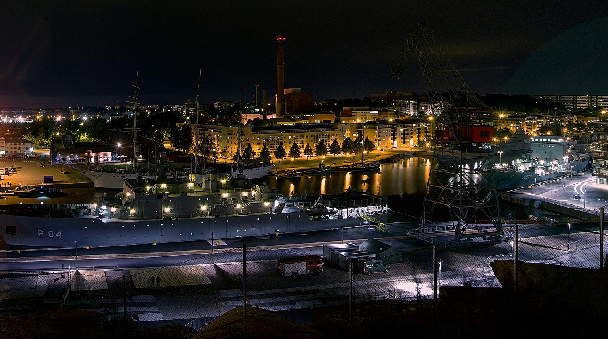
The Finnish way to promote energy savings
CASE EXAMPLE
Notes:
TEM energy-effiency: Mauri Vieru communications specialist at Ministry of the Environment puh. 029 506 3577 mauri.vieru@tem.fi Katja Keckman communications specialist at Ministry of the Economic Affairs and Employment of Finland puh. 029 504 7106 katja.keckman@tem.fi

Slide 48
Voluntary agreements help to fulfil Finland’s energy efficiency obligations
Voluntary energy efficiency agreements is an approach the Finnish government and industry sectors have jointly chosen to fulfil Finland’s international energy efficiency obligations, without the need for new regulations and mandatory procedures.
The agreements cover more than 60% of Finland's total energy use. More than 550 companies and over 100 municipalities have committed to the energy efficiency objectives set in these agreements for the period 2017–2025.
During 2008–2016 participants decreased Finland’s annual energy consumption by almost 16 TWh. They reduced CO2 emissions by 4.7 million tonnes a year. At the same time the Government granted 105 million euros for energy audits and energy efficiency investments. Participants invested over 1.3 billion euros in energy efficiency measures during 2008-2016. The energy efficiency agreements for 2017–2025 concern several sectors: industry, energy, services, property and buildings, municipalities and oil-heated real estate. Action plans have been created for a number of industrial branches such as food and drink, chemicals, technology, wood products, energy production, energy services, motor trades and repairs, commerce and hospitality. Finland reports to the EU on the progress of its energy savings measures.
An efficient use of energy is a responsible activity and one of the key ways to mitigate climate change.
Voluntary energy efficiency agreements guide companies and organisations in improving their energy efficiency.
EU directive sets a common EU energy efficiency target of 32.5% by 2030. In addition, a binding annual 0.8% energy saving obligation has been laid down for the member states.
Notes:
TEM energy-effiency: Mauri Vieru communications specialist at Ministry of the Environment puh. 029 506 3577 mauri.vieru@tem.fi Katja Keckman communications specialist at Ministry of the Economic Affairs and Employment of Finland puh. 029 504 7106 katja.keckman@tem.fi

Slide 49
Adaptable solutions for tackling climate change
See the case examples →
Helsinki Energy Challenge calls for ideas to decarbonise city heating
Helsinki’s energy company Helen uses abandoned oil caverns to reduce carbon dioxide emissions
Infinited Fiber regenerates high-quality textile fibers from textile waste
Solar Foods produces food from CO2 and electricity
Sustainable and renewable energy
Carbon Action By Baltic Sea Action Group
Education, technology, science and innovation are our allies in finding comprehensive solutions in tackling climate change.
Ambitious political goals accelerate the process. We believe individual ingenuity should be magnified
with government research funding. Our mission is to develop solutions that work on a global scale.

Slide 50
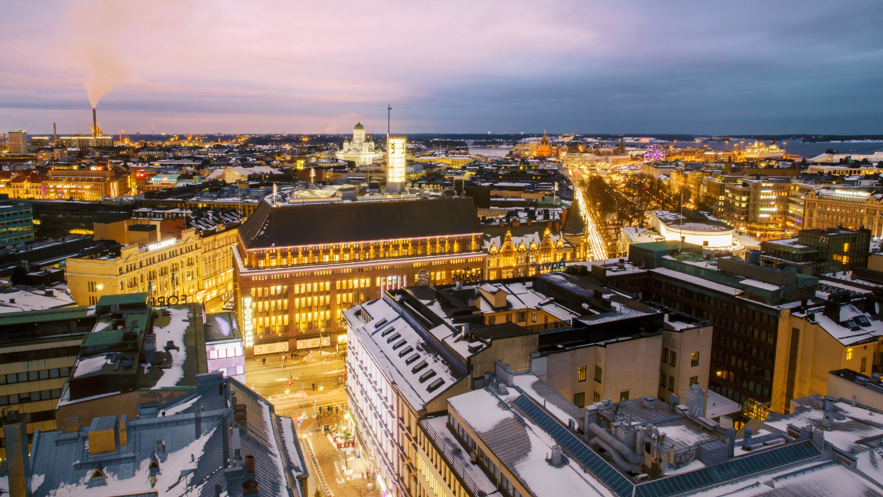
Helsinki as the testbed for future-proof heating solutions
CASE EXAMPLE
Notes:
Helsinki Energy Challenge: Laura Uuttu-Deschryvere, project director at Helsinki Energy Challenge laura.uuttu-deschryvere@hel.fi

Slide 51
Helsinki Energy Challenge calls for ideas to decarbonise city heating
The Helsinki Energy Challenge is a global competition to answer the question: How can we decarbonise the heating of Helsinki, using as little biomass as possible? The main requirement is that the proposed solution should significantly contribute to stopping the use of coal by 2029 and speed up the City of Helsinki’s journey to carbon-neutrality. The Helsinki Energy Challenge is an ongoing global one-million-euro challenge. Over 250 challenge entries have been received, out of which 10 teams have been selected to continue to the co-creation phase. The winner will be announced in March 2021. The challenge aims to find solutions for the City of Helsinki but also for other cities around the globe: Helsinki can be viewed as a testbed where future-proof urban heating solutions are created. Helsinki is committed to sharing the results and solutions with other cities around the world.
The climate crisis is the most crucial challenge of our time, and cities have a key role in driving the shift to a low-carbon economy. Helsinki is one of the leading cities in the transition towards a sustainable future, with a goal of becoming carbon-neutral by 2035.
However, currently more than half of the city’s heat is produced with coal. In order to achieve carbon-neutrality, new and radical solutions are necessary to meet Helsinki’s heat demand. The heat demand in Helsinki is significant due to the cold climate but fluctuates widely due to weather variability. The high volume but rapidly changing heat demand means that it has been challenging to find a replacement for fossil fuels.
To fight climate change, sustainable heating solutions are needed in cities all over the world. Heating needs to be taken further: not just beyond coal, but also beyond burning biomass.
Helsinki wants to find long-term sustainable solutions to heat the city in the future and to act as a platform for new and innovative solutions that can also benefit other cities around the world.
Shortlisted teams will work to develop and finetune their proposals during the co-creation phase, which includes webinars, teams’ individual work and an intensive 3-day virtual bootcamp.
Notes:
Helsinki Energy Challenge: Laura Uuttu-Deschryvere, project director at Helsinki Energy Challenge laura.uuttu-deschryvere@hel.fi

Slide 52
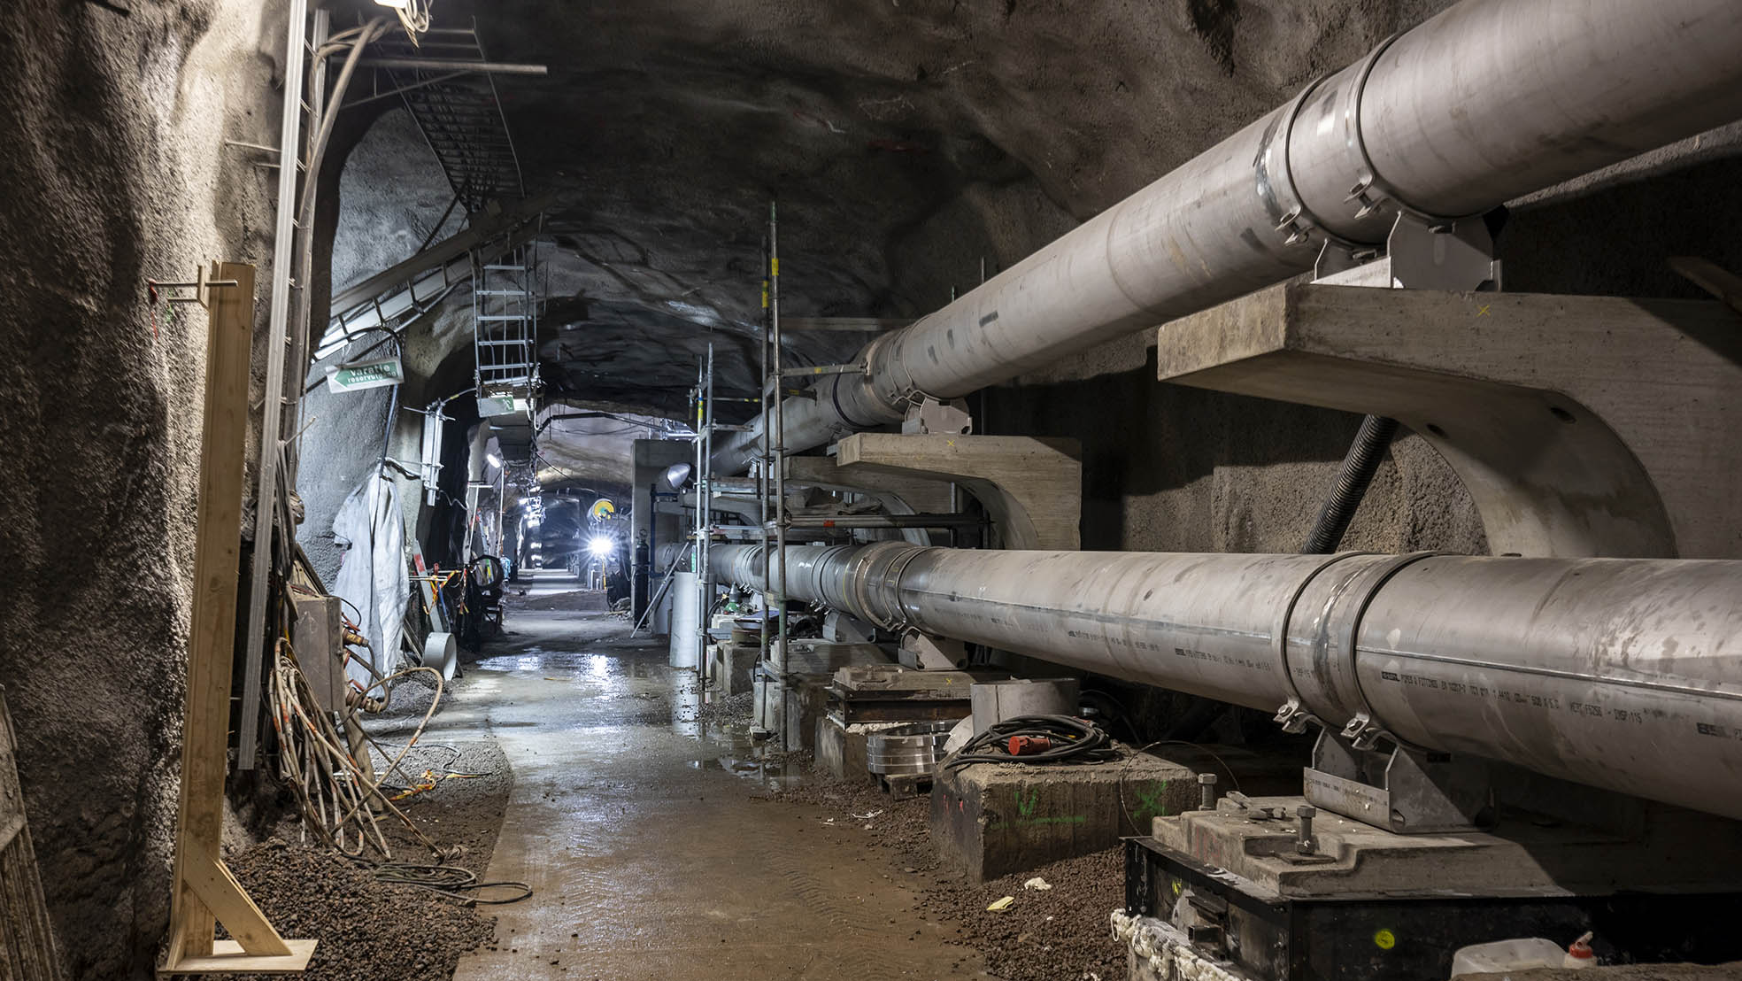
FINLAND’S LARGEST THERMAL CAVERN TO STORE DISTRICT HEAT
CASE EXAMPLE
Notes:
Helen: Seija Uusitalo, head of communications at Helen seija.uusitalo@helen.fi 050 558 8619

Slide 53
Helen uses abandoned oil caverns to reduce carbon dioxide emissions
The energy company Helen, owned by the city of Helsinki, has built Finland's largest district heat storage facility in two decommissioned oil caverns. The heat storage facility will reduce the use of fossil fuels.
The caverns, located in Mustikkamaa, Helsinki, were formerly used for storing oil but have been empty since 1999. They will be filled with water to serve district heating network customers by balancing consumption peaks throughout the year.
The system makes it possible to convert heat from wastewater and properties into district heating and store it in the water. of thermal caverns and release it for use if necessary. The heat does The heat will not escape on its own, as the tens of meters of bedrock act as excellent insulation. The storing of heat improves the efficiency of the energy system and reduces the use of fossil fuels. The thermal caverns will reduce Helen’s carbon dioxide emissions by approximately 21,000 tonnes annually.
The caverns are a part of a sustainable future where not only ingredients are recycled but also energy. Helen’s goal is to be climate neutral by 2035, and underground thermal caverns are an important step on this path. The heat storage will be ready for production by the summer of 2021.
The caverns have such a large capacity that filling them with an ordinary kitchen tap water would take more than 50 years. The heat contained in the water corresponds to the heating of 25,000 one-bedroom apartments all year round.
Helen has numerous projects for carbon neutral production such as the large heating and cooling plant under Sörnäinen as well as the heat pump being built in Vuosaari which utilises heat from sea water.
Finland’s largest heat storage has been built into old oil caverns. The heat storage will be ready for production by the summer of 2021.
Notes:
Helen: Seija Uusitalo, head of communications at Helen seija.uusitalo@helen.fi 050 558 8619

Slide 54
From rags to new robes – Circularity in textiles is InfiniteD
CASE EXAMPLE
Notes:
Infinited Fiber: Yhteyshenkilö: Paula Bergqvist, Senior Specialist Communications at VTT
paula.bergqvist@vtt.fi, +358505665160 & Laura Vinha, PR & Communications manager, laura.vinha@infinitedfiber.com

Slide 55
Infinited Fiber Company regenerates high-quality textile fibres from textile waste
Infinited Fiber Company’s technology regenerates textile waste into new, high-quality textile fibres that look and feel like cotton, and have unique properties that make them ideal for clothing, bedsheets or even baby wipes.
Nothing new needs to be grown when we use what’s already been made. That’s the philosophy that underlies Infinited’s technology, which can turn any cellulose-rich waste – including old clothes, used cardboard, and rice or wheat straw – into versatile new fibres for the textile and the nonwovens industries. In addition to offering a solution for eliminating multiple waste streams, the technology uses only a fraction of the water needed to grow conventional cotton. The fibres are biodegradable and contain no microplastics, and textiles made with them can be recycled together with other fabrics.
It is estimated that a truckload of textile waste is landfilled or burned every second, with valuable resources turned into pollution. Simultaneously, as problems related to conventional cotton farming, viscose production and petroleum-based textiles like polyester become more evident, the demand for sustainable, bio-based textiles is growing. Global fashion and nonwoven brands have validated and endorsed the technology, and the first commercial garments made with the fibre will be available in 2021. Commercial-scale production is expected to begin in late 2023.
For Infinited Fiber Company, textile waste is not a problem but a valuable raw material to be regenerated into high-quality fibres.
Biodegradable, microplastic-free and validated by global fashion brands, textiles made with Infinited Fiber are the circular and more sustainable alternative to virgin cotton.
Infinited Fiber Company’s patented cellulose carbamate fibre technology is based on research by the VTT Technical Research Centre of Finland.
Notes:
Infinited Fiber: Yhteyshenkilö: Paula Bergqvist, Senior Specialist Communications at VTT
paula.bergqvist@vtt.fi, +358505665160 & Laura Vinha, PR & Communications manager, laura.vinha@infinitedfiber.com

Slide 56
FOOD OUT OF THIN AIR
CASE EXAMPLE
Notes:
Solar Foods:
Yhteyshenkilö: Paula Bergqvist, Senior Specialist Communications at VTT
paula.bergqvist@vtt.fi, +358505665160

Slide 57
Solar Foods produces food from CO2 and electricity
Solar Foods produces an entirely new kind of natural protein, Solein®, by using CO2 and electricity as its primary raw materials. Based on natural fermentation, this process revolutionises food production, as the production of Solein is non-dependent on the weather, climate, or agriculture.
Solein can be produced even in the toughest of environmental conditions, e.g. the desert, the Arctic, or possibly even in space. The production process of Solein does not involve irrigation, pesticides, fertilizers applied on open land or animals, and this makes Solein the world’s most sustainable protein.
As a new sustainable and natural protein, Solein also provides exciting opportunities for entirely new foods of tomorrow. So far, Solar Foods has already developed over 20 different kinds of food products that utilise Solein. The company aims to start the commercial production of Solein in early 2023. Solar Foods estimates the production to start from 5 up to 50 million meals a year.
Instead of causing CO2 emissions, Solar Foods’ bioprocess captures carbon dioxide and uses renewable electricity.
Solar Foods works in collaboration with the ESA to develop food production for a Mars mission.
Solar Foods’ technology is based on research by VTT Technical Research Centre of Finland and LUT University.
Notes:
Solar Foods:
Yhteyshenkilö: Paula Bergqvist, Senior Specialist Communications at VTT
paula.bergqvist@vtt.fi, +358505665160

Slide 58
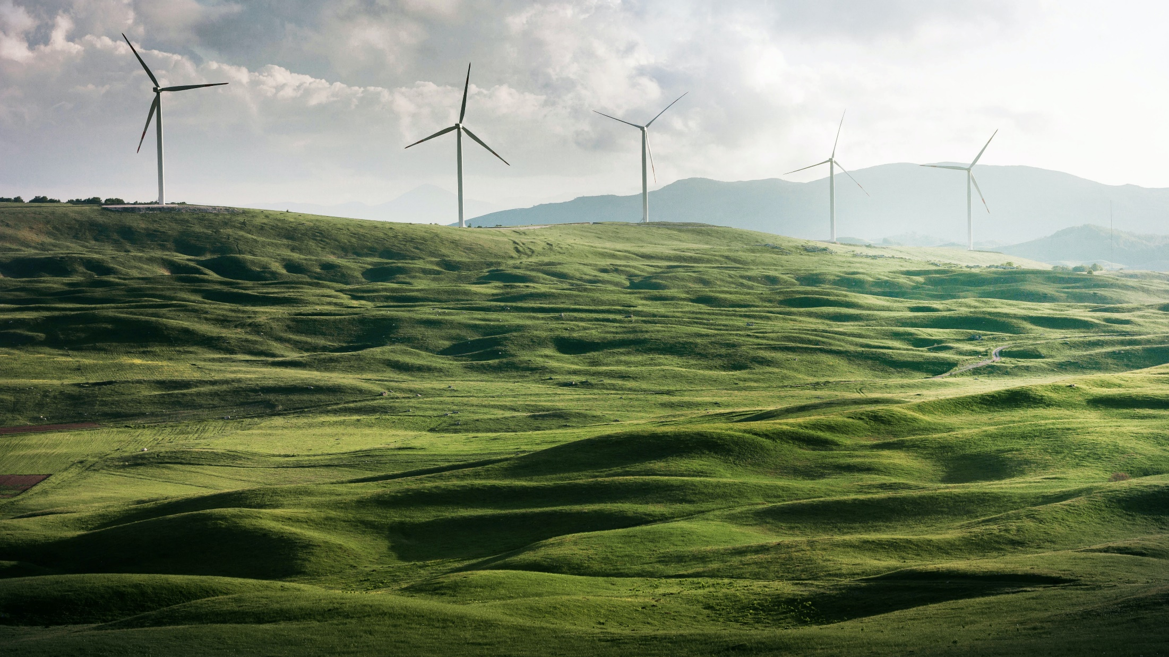
Sustainable and renewable energy
CASE EXAMPLE
Notes:
STE’s energy projects Päivi Tikka, Director, Division of Strategic Research at Academy of Finland paivi.tikka@aka.fi, +358295335007

Slide 59
Energy research projects find alternative solutions
Three projects research changes in global energy and map out ways in which Finland can benefit from the technologies surrounding energy. The focus is to find alternative solutions through which more sustainable energy can be utilised more widely and cost efficiently.
The energy projects funded by the Strategic Research Council (SRC) have connected stakeholders from businesses, authorities and civil society to explore new solutions and to identify pathways of change at the local, national and international level.
The transition calls for a combination of low emission production technologies and energy efficiency to reach ambitious national and international climate targets.
The energy transition is knowledge-intensive. The projects have explored the role of industrial scale heat pumps and novel ICT-solutions, business opportunities, as well as experiments and pilots. The transition will change the way in which we view energy and its role in society. Ultimately, it will lead to a radical cut in greenhouse gas emissions.
SET’s main area of research is the global turning point of energy and its effects on the Finnish economy. http://smartenergytransition.fi/en/front-page/
The EL-TRAN Consortium Works to rethink the totality of the electric energy system. https://el-tran.fi/in-english/
BCDC Energy research project seeks solutions for using solar and wind power as extensively and cost effectively as possible. http://www.bcdcenergia.fi/en/
Notes:
STE’s energy projects Päivi Tikka, Director, Division of Strategic Research at Academy of Finland paivi.tikka@aka.fi, +358295335007

Slide 60
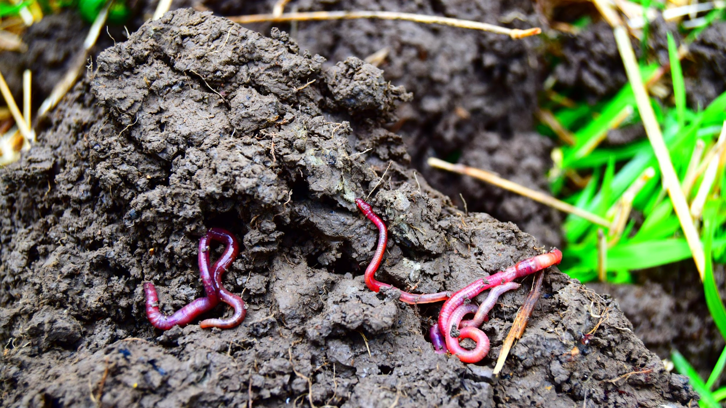
Advancing Carbon Farming
CASE EXAMPLE
Notes:
BSAG/Carbon action: Yhteishenkilö: Pieta Jarva, communication manager at Baltic sea action group pieta.jarva@bsag.fi, +358 50 338 1096

Slide 61
Carbon Action by Baltic Sea Action Group
The Carbon Action Platform speeds up the transformation from destructive agricultural practices to regenerative carbon farming practices.
This pilot platform speeds up the transformation to regenerative farming practices that build soil, isolate carbon, nurture biodiversity, keep nutrients away from water bodies – and enhance the profitability of the farm. The new practices will establish more resilient soil for future food production in the changing climate.
All together 100 pilot Carbon Farms test practices and collect experiences. Companies also provide carbon farming training for their contract farmers.
Regenerative agriculture enhances soil health by restoring carbon content, which in turn, improves productivity. Added benefits include increased biodiversity, ecosystem resilience, water filtration and nutrient retention.
One field hectacre can sequester 200-1000 kgs of carbon annually. Increasing carbon sinks is essential in mitigating climate change because agriculture accounts for 39% of Europe’s land coverage and 10% of current EU greenhouse gas emissions. Fields can be turned from carbon emitters into carbon sinks. Carbon Action is a pilot assembled by the Baltic Sea Action Group (BSAG) and launched in 2017 with funding from the Finnish Innovation Fund Sitra. It is now a platform with many actors and funders.
There is more carbon in soil than in the atmosphere and plant biomasses combined. Agricultural soil has great potential to mitigate climate change by storing carbon.
At the Paris Climate Conference in 2015, Finland signed the 4/1000 Initiative. It aims to increase the amount of carbon sinks in farmland to secure food production and curb climate change.
Notes:
BSAG/Carbon action: Yhteishenkilö: Pieta Jarva, communication manager at Baltic sea action group pieta.jarva@bsag.fi, +358 50 338 1096

Slide 62
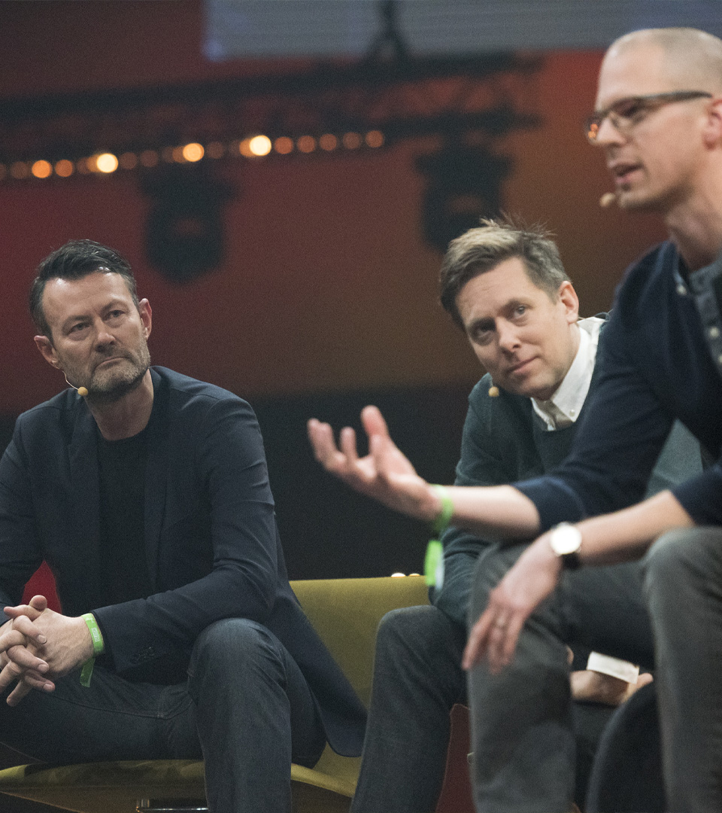
Global co-creation and collaboration
See the case examples →
The World Circular Economy Forum brings together business leaders, policymakers and experts
Helping to build climate resilient society in Vietnam
Gender equality in the face of climate change
International collaboration in the Turku region for resource wisdom
Finland prompts the Climate Coalition
Green to Scale – Scaling up existing solutions
Active team player in the UN the EU
Technological innovation leads Wärtsilä’s customers towards decarbonisation
With ambitious targets, it is important to be realistic: environmental issues know no boundaries. We are only 5.5 million people, but we are in no way separate from the 7.8 billion others on this planet.
To achieve change on a global scale, we need to network, find partners and embrace a systemic approach globally. Only together can we see the big picture. We are ready to share our know-how and lessons learned and join forces to change the future.

Slide 63
The World Circular Economy Forum
CASE EXAMPLE
Notes:
Sitra WCEF: Tuuli Hietaniemi specialist, climate solutions at Sitra, tuuli.hietaniemi@sitra.fi +358 (294) 618 411

Slide 64
The World Circular Economy Forum brings together business leaders, policymakers and experts
The World Circular Economy Forum (WCEF) brings together over 4,000 business leaders, policymakers and experts from around the world to present the world’s best circular economy solutions.
WCEF is a global initiative of the Finnish Innovation Fund Sitra and the country of Finland. It examines how businesses can seize new opportunities and gain a competitive advantage through circular economy solutions, and how a circular economy contributes to achieving the UN’s Sustainable Development Goals.
Sitra works with partners to lead the way in the transition to a fair and competitive carbon-neutral circular economy – a new kind of society in which individuals’ everyday lives and well-being are no longer based on excessive consumption and fossil fuel use. By adopting circular solutions it is possible to fight climate change and the nature crisis.
Sitra works with international partners to scale up the transition to a circular economy.
WCEF is a global initiative of the Finnish Innovation Fund Sitra and the country of Finland.
Notes:
Sitra WCEF: Tuuli Hietaniemi specialist, climate solutions at Sitra, tuuli.hietaniemi@sitra.fi +358 (294) 618 411

Slide 65
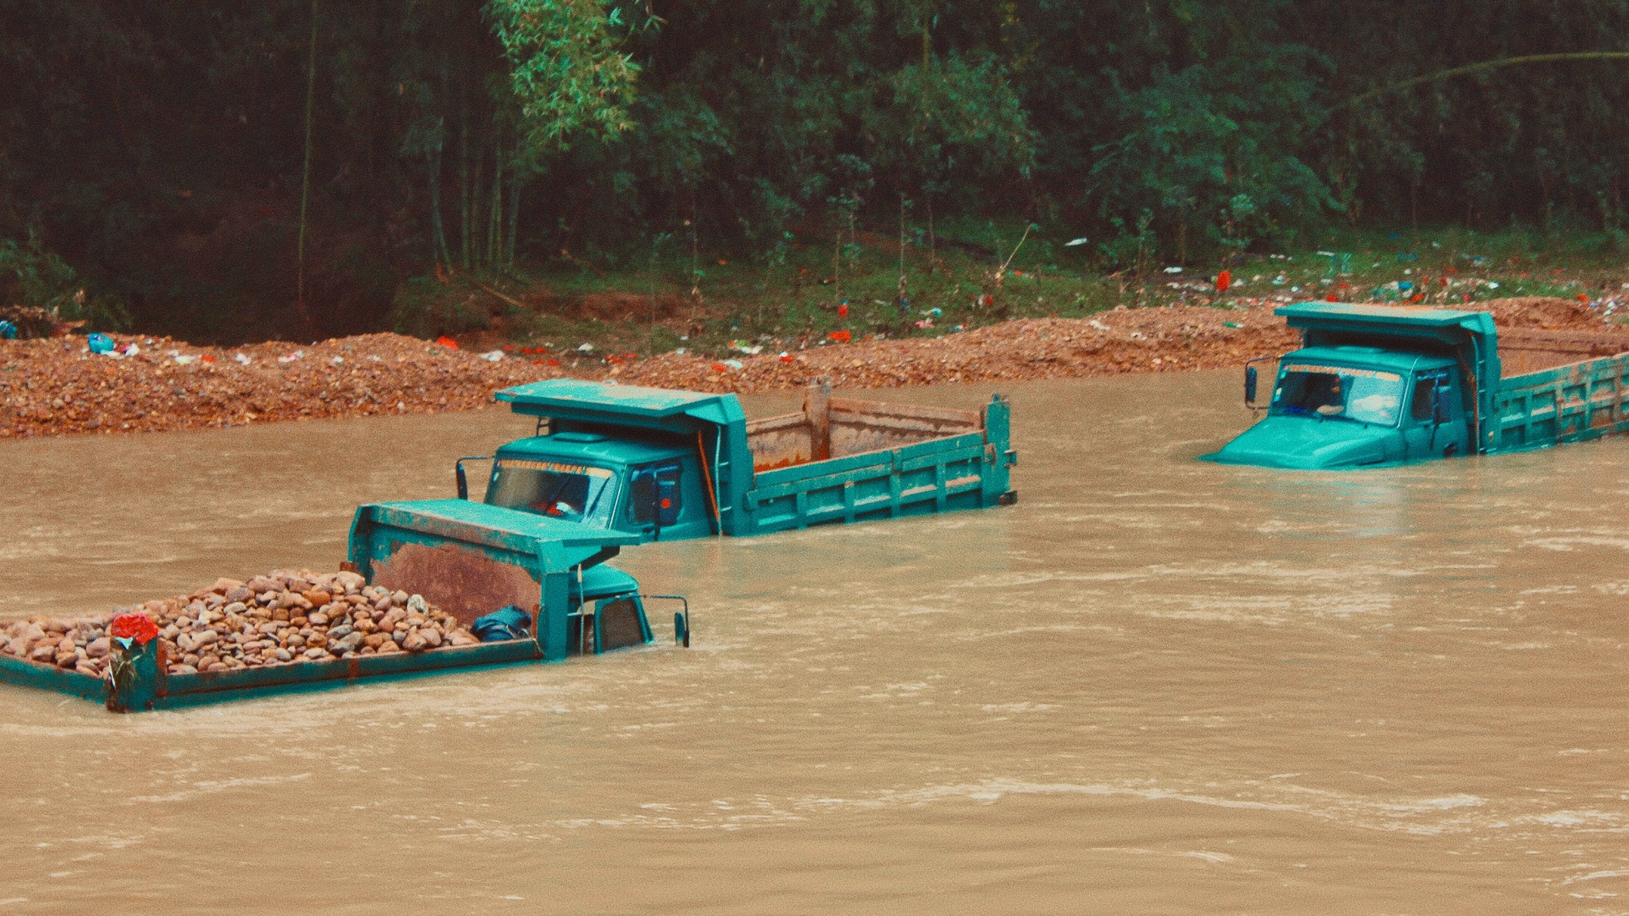
HELPING TO BUILD SOCIETIES’ RESILIENCE TO climate CHANGE
CASE EXAMPLE
Notes:
Ilmatieteenlaitos: Yhteyshenkilö: Eija Palosuo, Communications official multilateral cooperation at Ministry of Foreing eija.palosuo@formin.fi, +358295351961

Slide 66
Helping to build a climate- resilient society in Vietnam
The Finnish Meteorological Institute (FMI) has implemented several development projects to provide better services for the safety of Vietnamese society.
FMI has helped to build the capacity of the Vietnam National Meteorological and Hydrological Administration (VNMHA) with Finnish development funding.
Since the beginning of the cooperation, the biggest single task has been to modernise the whole operational system. The Concessional Credit program (2017–2020), together with the Finnish private company Vaisala, improved institutional capacity of the VNMHA for weather observations and early warning services. Modern dissemination channels and improved cooperation have generated outstanding results in climate change adaptation in Vietnam.
Vietnam is considered to face one of the most severe effects of the changing climate. The country’s weather extremes have included droughts, storms and typhoons, which have had an adverse impact on the Vietnamese society and economy. The observation system allows for a better basis to detect severe weather phenomena.
FMI has implemented development projects for improving the climate resilience of over 100 countries worldwide.
FMI-built forecast and early-warning production system SmartMet is in use in 30 countries worldwide to improve the preparedness and safety of people during natural hazards.
According to the World Meteorological Organization (WMO), FMI is the second largest provider of development projects in its field.
Notes:
Ilmatieteenlaitos: Yhteyshenkilö: Eija Palosuo, Communications official multilateral cooperation at Ministry of Foreing eija.palosuo@formin.fi, +358295351961

Slide 67
CLIMATE CHANGE IS A CHALLENGE FOR HUMAN RIGHTS
CASE EXAMPLE
Notes:
Human rights: Eija Limnell, Desk Officer human rights issues in the UN at Ministry of Foreign Affairs of Finland eija.limnell@formin.fi , +358 295 350 358 & Liina Älli, Adviser on Development Policy at Ministry of Foreign Affairs of Finland +358 295 350 230 iina.alli@formin.fi, & Eeva-Maria Mikkonen-Jeanneret Adviser on Development Policy at Ministry of Foreign Affairs of Finland Eeva-Maria.Mikkonen-Jeanneret@formin.fi +358 295 351 707

Slide 68
Gender equality in the face of climate change
Finland promotes gender equality in climate action through development cooperation.
A weak economic position complicates the preparedness of climate change, but poverty is very gendered: 70% of the world’s poor are women. Climate change affects women and men differently and can thus exacerbate inequality between genders.
Finland has supported the inclusion of the gender perspective in climate work since 2008 aiming, for example, to strengthen women’s role in international climate policy and the mainstreaming of gender equality. This has been done through supporting a project by the Global Gender and Climate Alliance (GGCA). Through the years 2008-2016 Finland gave the project 8.9 million euros in aid.
Finland supports a common project between the UN’s environmental program UNEP, UN Women and UN Peacebuilding Support Office to create methods to take gender equality into account in natural resource management and peacebuilding situations.
According to the UN’s Food and Agricultural Organization 70% of the world’s poor are women. Climate change can exacerbate inequality between genders.
Finland has supported the inclusion of the gender perspective in climate work since 2008.
Safeguarding the participation of women and girls in the mitigation and adaptation processes is efficient. Women and girls need to become actors of change.
Notes:
Human rights: Eija Limnell, Desk Officer human rights issues in the UN at Ministry of Foreign Affairs of Finland eija.limnell@formin.fi , +358 295 350 358 & Liina Älli, Adviser on Development Policy at Ministry of Foreign Affairs of Finland +358 295 350 230 iina.alli@formin.fi, & Eeva-Maria Mikkonen-Jeanneret Adviser on Development Policy at Ministry of Foreign Affairs of Finland Eeva-Maria.Mikkonen-Jeanneret@formin.fi +358 295 351 707

Slide 69
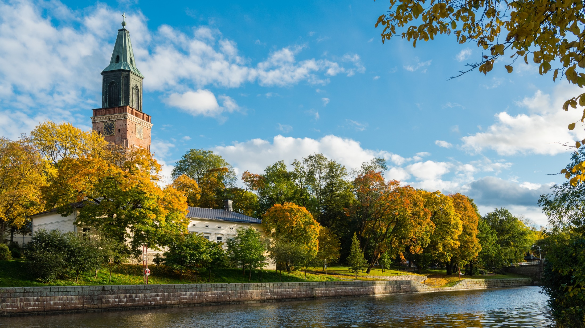
Circular Turku Shares best practices
CASE EXAMPLE
Notes:
Turku: Risto Veivo,
Climate Director (acting) at city of Turku
risto.veivo@turku.fi
+358 50 5590 417
& Lotte Suveri, project specialist at city of Turku
lotte.suveri@turku.fi
050 559 0582

Slide 70
International collaboration in the Turku region for resource wisdom
The city of Turku aims to be a carbon neutral area by 2029 and to reach resource wisdom by 2040 – meaning no waste, no emissions and sustainable use of natural resources. The city is sharing best practices and creating solutions with domestic and international partners.
The transition to a circular economy is at the core of Turku's Climate Policy to achieve positive impacts on the environment, economy and well-being. A circular climate policy also addresses the indirect emissions embedded in products and materials along their entire life-cycle and connects different sectors in circular solutions. For example, the Kakola wastewater treatment plant, operating underground downtown, captures heat from waste water for district heating and cooling. The plant produces ten times more energy than it consumes. In collaboration with other circular economy operators, Turku is preparing a Resource Wisdom roadmap with the support of the Finnish Innovation Fund Sitra to speed up the entire area’s transition towards a circular economy. ICLEI (Local Governments for Sustainability) is contributing to the process as a partner and helps to make the roadmap an internationally scalable model.
Turku is already sharing its best practices nationally and, for example, with Japanese and European cities. Turku is creating circular economy solutions with local stakeholders such as universities, companies and organisations. Partner cities can benefit from Turku's experience, in particular, in stakeholder collaboration at an early stage and in determining how to encourage citizens to take climate action.
The European Commission chose Turku as the best medium-sized climate city in 2020 (CoM Climate Award). Turku has already halved GHG emissions from the 1990 level.
Turku University’s Futures Research Center states that the Turku area already contains 700 circular economy agents, 270 of which are companies.
There are several circular economy hot-spots in the Turku area, such as Smart Chemistry Park which focuses on industrial symbiosis, and "Topinpuisto" where materials circulate and new sustainable businesses are created.
Notes:
Turku: Risto Veivo,
Climate Director (acting) at city of Turku
risto.veivo@turku.fi
+358 50 5590 417
& Lotte Suveri, project specialist at city of Turku
lotte.suveri@turku.fi
050 559 0582

Slide 71
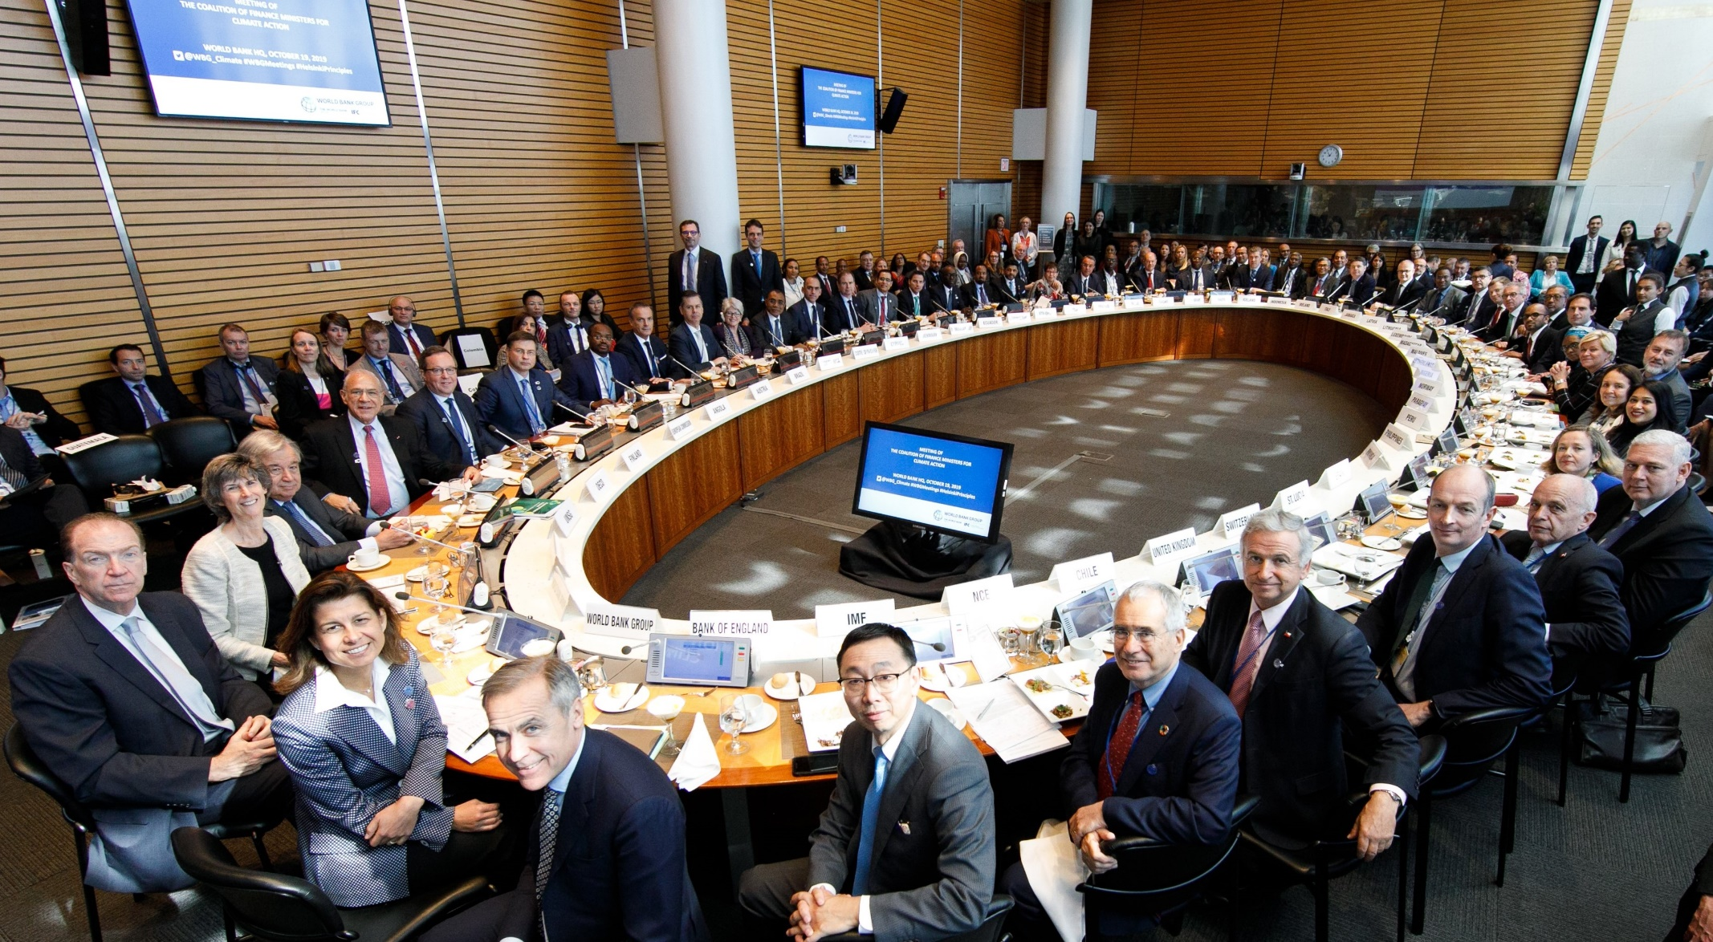
Finance Ministers hold the keys to unlocking climate action
CASE EXAMPLE
Notes:
Finance minister coalition Outi Honkatukia, Senior Environmental Adviser at Ministry of the Environment outi.honkatukia@ym.fi, +358 29 525 0272

Slide 72
Finland prompts the Climate Coalition
The Coalition of Finance Ministers for Climate Action is helping countries mobilise and align the finances needed to implement national climate action plans.
The Coalition was launched in 2019 on Finland’s initiative and its main task is to establish best practices such as climate budgeting and strategies for green investment and procurement, as well as to factor climate risks and vulnerabilities into members’ economic planning.
Finance ministers have a clear understanding of the risks posed by climate change, but they also recognise how taking action could unlock trillions in investment opportunities and create millions of jobs by 2030. Finance ministers from 50 countries have signed the “Helsinki Principles”, which include aligning policies and practices with the Paris Agreement commitments:
sharing experiences and expertise with each other in order to provide mutual encouragement and promote collective understanding of policies and practices for climate action
working towards measures that result in effective carbon pricing
taking climate change into account in macroeconomic policy, fiscal planning, budgeting, public investment management and procurement practices
mobilising private sources of climate finance by facilitating investments and the development of a financial sector which supports climate mitigation and adaptation
engaging actively in the domestic preparation and implementation of Nationally Determined Contributions submitted under the Paris Agreement.
The Coalition was launched in Washington DC in April 2019 on Finland’s initiative.
The Coalition has more than 50 member countries, each committed to the Helsinki Principles.
The Coalition brings together fiscal and economic policymakers to lead the global climate response and secure a just transition towards low carbon resilient development.
Notes:
Finance minister coalition Outi Honkatukia, Senior Environmental Adviser at Ministry of the Environment outi.honkatukia@ym.fi, +358 29 525 0272

Slide 73
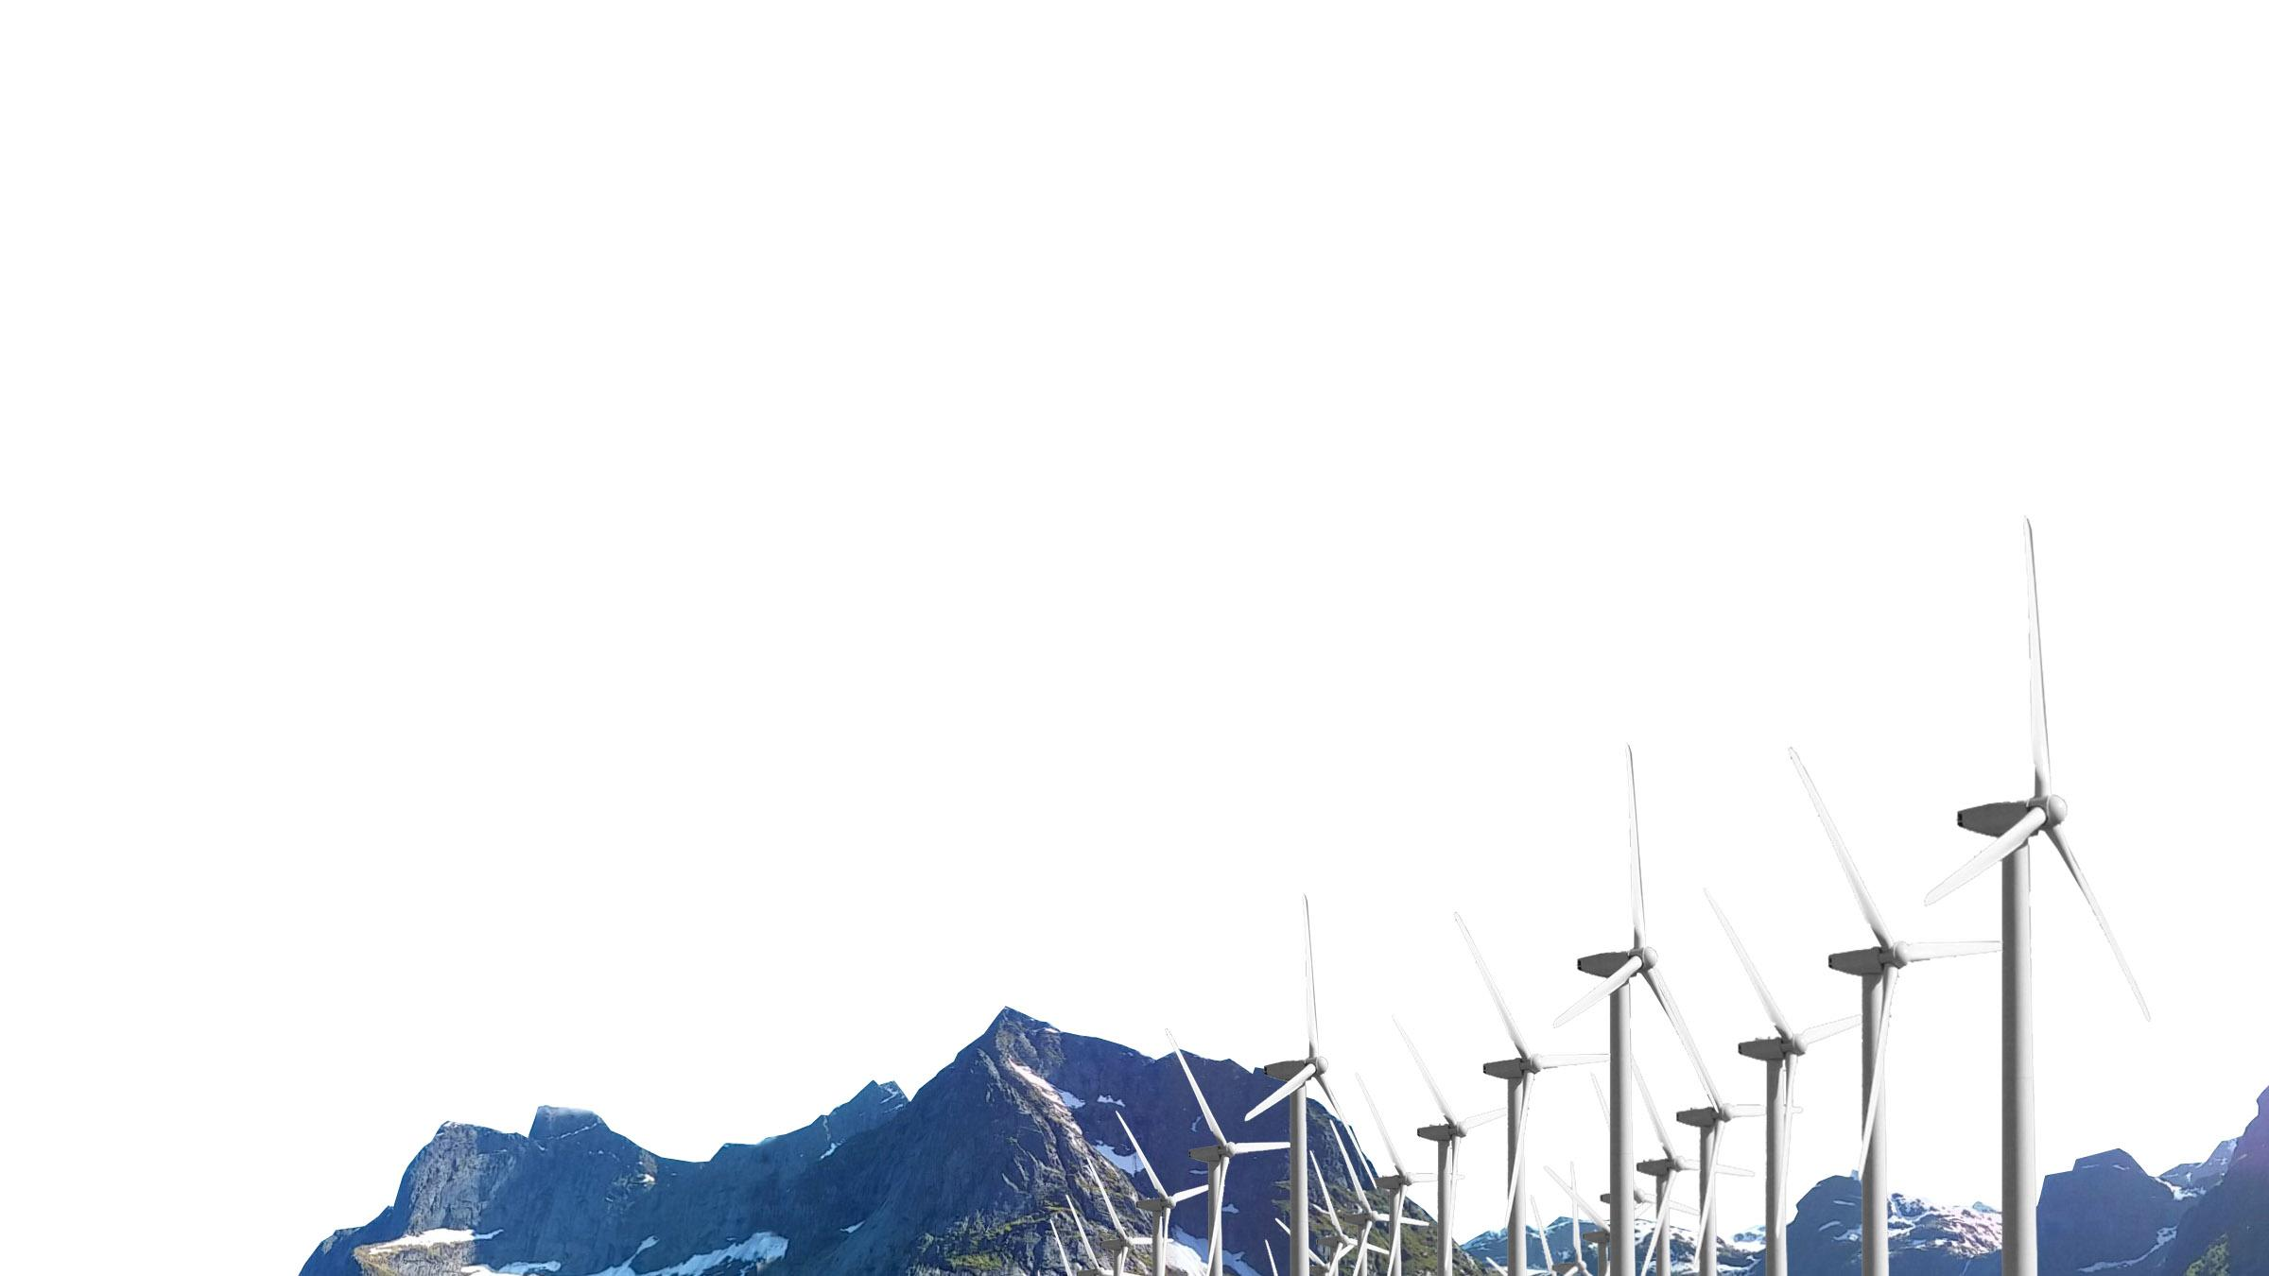
Scaling up proven climate solutions
CASE EXAMPLE
Notes:
Sitra Green to Scale: Tuuli Hietaniemi specialist, climate solutions at Sitra, tuuli.hietaniemi@sitra.fi +358 (294) 618 411

Slide 74
Green to Scale – Scaling up existing solutions
Existing solutions from sectors such as energy, buildings, waste and transportation can uncover a vast emissions reduction potential both globally and in specific countries. Since 2015 the Green to Scale project has published a series of reports on the topic.
How far could we go simply by scaling up already proven low-carbon solutions? The Finnish Innovation Fund Sitra has collaborated with the Nordic Council of Ministers, distinguished research institutions and think tanks to answer this simple question.
Reducing emissions does not necessarily come at a high cost or require new technologies. By scaling up and better implementing existing low-carbon solutions it is possible to tackle the global climate crisis, reduce emissions and achieve other environmental, economic and social benefits.
A Nordic study states the world’s emissions could be reduced 4 Gt by 2030 by implementing 15 climate solutions created in the Nordic countries. On top of direct emissions reductions, the widespread application of these 15 solutions also bring forth other significant benefits, such as improved air and water purity, increased number of local jobs and better biodiversity.
Scaling up just 17 existing climate solutions globally could cut global emissions by 25% by 2030.
By using the aforementioned solutions, countries all over the world could reduce global emissions by 4 Gt – as much as the EU produces annually.
Cities are able to adopt solutions that have already been applied in Nordic cities and communities – and achieve benefits for the people and the environment.
Notes:
Sitra Green to Scale: Tuuli Hietaniemi specialist, climate solutions at Sitra, tuuli.hietaniemi@sitra.fi +358 (294) 618 411

Slide 75
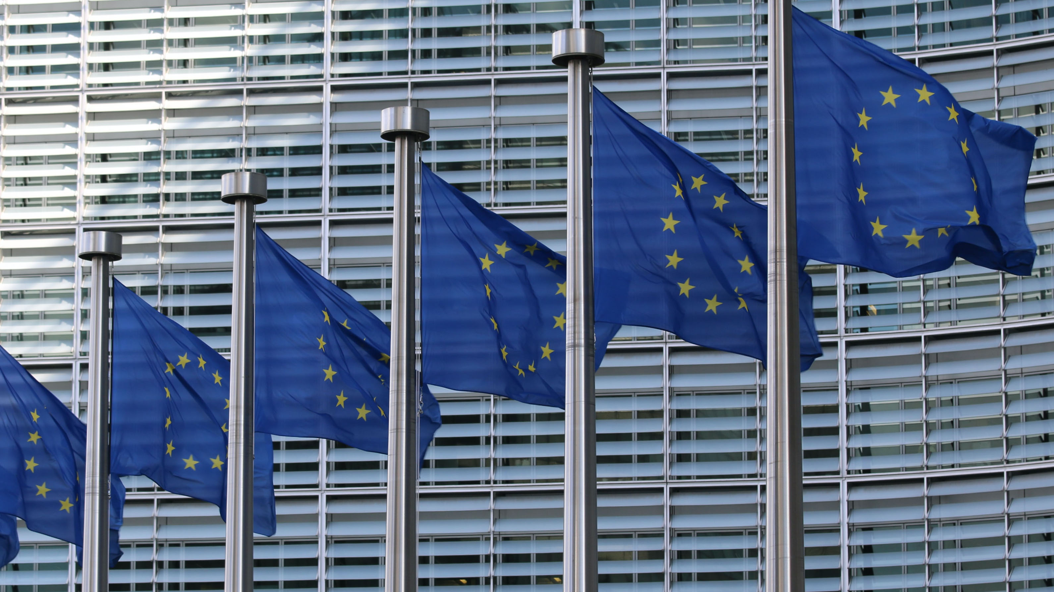
Finland influences climate policy in the EU and the UN
CASE EXAMPLE
Notes:
YK&EU yhteistyö: Outi Honkatukia, Senior Environmental Adviser at Ministry of the Environment outi.honkatukia@ym.fi, +358 29 525 0272

Slide 76
Active team player in the UN and EU
Finland strongly supports the EU’s plan to become the world’s first climate neutral continent by 2050. Finland’s 2035 climate neutrality target and ambitious climate policies provide a solid basis for an exceptionally high international profile.
Finland actively advocates ambitious EU-wide climate policy instruments, including the EU emissions trading scheme. The EU’s common emission reduction target for the emissions trading sector is 43%. The emissions trading system covers aviation, large industrial plants and the production of electricity and district heat.
Current ministers, officials and experts have various high profile roles in the UN climate negotiations and EU working groups. As the co-chair of the Coalition of the Finance Ministers for Climate Action, Finland commits to improve efforts that accelerate climate action by bringing together fiscal and economic policymakers. Finland is also committed to scale up climate finance as a part of its development finance, taking account of its contribution based on the Paris Agreement.
Finland is committed to share experiences and solutions to facilitate transition in other countries.
The country aims to direct half of the international climate funds towards climate change adaptation in developing countries.
Finland, together with other Nordic countries, is recapitalising the Nordic Development Fund, which has a strong climate mandate.
Notes:
YK&EU yhteistyö: Outi Honkatukia, Senior Environmental Adviser at Ministry of the Environment outi.honkatukia@ym.fi, +358 29 525 0272

Slide 77
towards sustainable operations and decarbonisation
CASE EXAMPLE
Notes:
Wärtsilä sustainable operations: Atte Palomäki, Communications manager at Wärtsilä, atte.palomaki@wartsila.com, 0107095599

Slide 78
Technological innovation leads Wärtsilä’s customers towards decarbonisation
Technological innovation and upgrading existing installations allow Wärtsilä’s customers to take steps towards sustainable operations and decarbonisation.
Wärtsilä provides customers and partners with decision making support based on global real-time data analytics, advanced diagnostics and artificial intelligence combined with human expertise. This allows for customers to optimise their operations and make adjustments in real time to ensure that their ships and power plants always operate with optimal fuel efficiency, leaving a smaller environmental footprint.
Currently, there are 700 vessels and 250 power plants supported by Wärtsilä Lifecycle Solutions agreements globally. Their efficient installations utilise lifecycle data and remote support, minimising fuel consumption and reducing emissions. The lifecycle of installed Wärtsilä technology often spans decades, and thus upgrade packages pave the way for significant reductions of greenhouse gas emissions, and even switching to synthetic and biofuels.
Optimisation and modernisation solutions have a significant impact on fuel efficiency and environmental footprints.
Currently, there are 700 vessels and 250 power plants supported by Wärtsilä Lifecycle Solutions agreements globally.
Wärtsilä supports its customers through partnerships by guaranteeing performance that is based on shared efficiency targets.
Notes:
Wärtsilä sustainable operations: Atte Palomäki, Communications manager at Wärtsilä, atte.palomaki@wartsila.com, 0107095599

Slide 79
The common path towards a more sustainable world
See the case examples →
Processing plant enables recycling of discharged textiles
Reducing the energy use of peat by at least half by 2030
Climate-friendly cultivation and management methods in peatlands with the help of SOMPA
Ban of coal in energy production by 2029
Integrating the adaptation and mitigation of climate change to the Nature Conservation act
As we in Finland continue to focus on climate and the environment, we will discover new innovations, turn them into practical solutions and learn good practices.
If we can multiply the impact of those discoveries with other countries, the journey will lead us towards a more sustainable world. Climate matters. By reaching common goals we can secure a better future.

Slide 80
TOWARDS CIRCULARITY OF TEXTILES
CASE EXAMPLE
Notes:
Recycling of discharged textiles: Sini Immonen, Circular Economy specialist at South-West Finland’s waste management Sini.Immonen@lsjh.fi, 040 867 0139

Slide 81
Processing plant enables recycling of discharged textiles
Southwest Finland’s waste management company and the recycling firm Rester are working together to refine end-of-life textiles into raw materials so that industry will be able to use the recycled fibers in new products.
In Paimio, Finland, two companies are building processing plants, one for post-consumer textiles from households and one for pre-consumer textiles from the B2B sector. Finland could be one of the European textile recycling hubs (ReHub). The textile industry is one of the most polluting industries in the world. Fast fashion and low quality raw-materials have made the industry produce huge amounts of clothes. Approximately 26 kilograms of textiles per capita are thrown out every year – and that is only within the EU. In Finland, the yearly figure is around 70,000 – 100,000 tonnes of discarded textiles. The whole system of textiles needs to be changed from a linear to circular model.
The production and consumption of textiles causes significant environmental, climate and social impacts due to the use of water, land, pesticides and chemicals, as well as the emission of greenhouse gases and pollutants. By replacing primary raw materials with recycled components and by keeping once-produced materials in the economy as long as possible, we have the opportunity to affect the huge global system and value chains. The recycling of textiles helps tackle the EU´s Green Deal targets and brings the national circular economy program into action.
A national model for collecting and sorting will be built together with municipal waste management companies and other textile collectors.
Discarded textiles undergo high-quality processing. The capacity will be scaled up to match national volume needs and possibly also for the Baltic Sea region.
Development throughout the value chain brings new business opportunities and employment in Finland.
Notes:
Recycling of discharged textiles: Sini Immonen, Circular Economy specialist at South-West Finland’s waste management Sini.Immonen@lsjh.fi, 040 867 0139

Slide 82
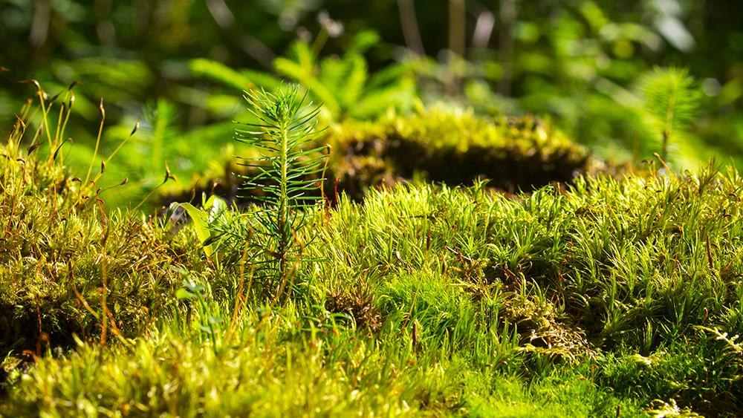
Reducing PEAT AS A SOURCE OF ENERGY in a just and fair manner
CASE EXAMPLE
Notes:
Reducing the energy use of peat: Outi Honkatukia, Senior Environmental Adviser at Ministry of the Environment outi.honkatukia@ym.fi, +358 29 525 0272

Slide 83
Reducing the energy use of peat by at least half by 2030
Sanna Marin’s Government (2019-) has committed to halving Finland's peat energy output by 2030. A broad working group has assessed ways to compensate regional economies and employment in regions where a decrease in the energy use of peat has significant impacts.
Finns have traditionally used peat to produce heat and electricity, and reducing the use of peat has environmental, economic and social consequences. Currently, peat provides around 4% of Finland's annual energy production, but it also accounts for 11–12% of emissions – a figure which is larger than the total emissions from passenger vehicles.
A broad working group examined ways to ensure the changes resulting from the reduction of peat as an energy source take place in a fair and just way, both regionally and socially, and that the changes do not jeopardise the security of electricity and heat supply in Finland, including during emergencies.
The working group also examined potential alternatives to energy use from new, innovative ways of using peat for higher value-added products. Work on the just transition is conducted in an open and transparent manner, including public consultations to hear the citizens’ views.
The Finnish Government has appointed two working groups to ensure a fair and just transition of the climate measures: The Climate Policy Round Table and a broad working group.
The Climate Policy Round Table increases the acceptability of climate policy and creates a common understanding of climate policy choices.
Notes:
Reducing the energy use of peat: Outi Honkatukia, Senior Environmental Adviser at Ministry of the Environment outi.honkatukia@ym.fi, +358 29 525 0272

Slide 84
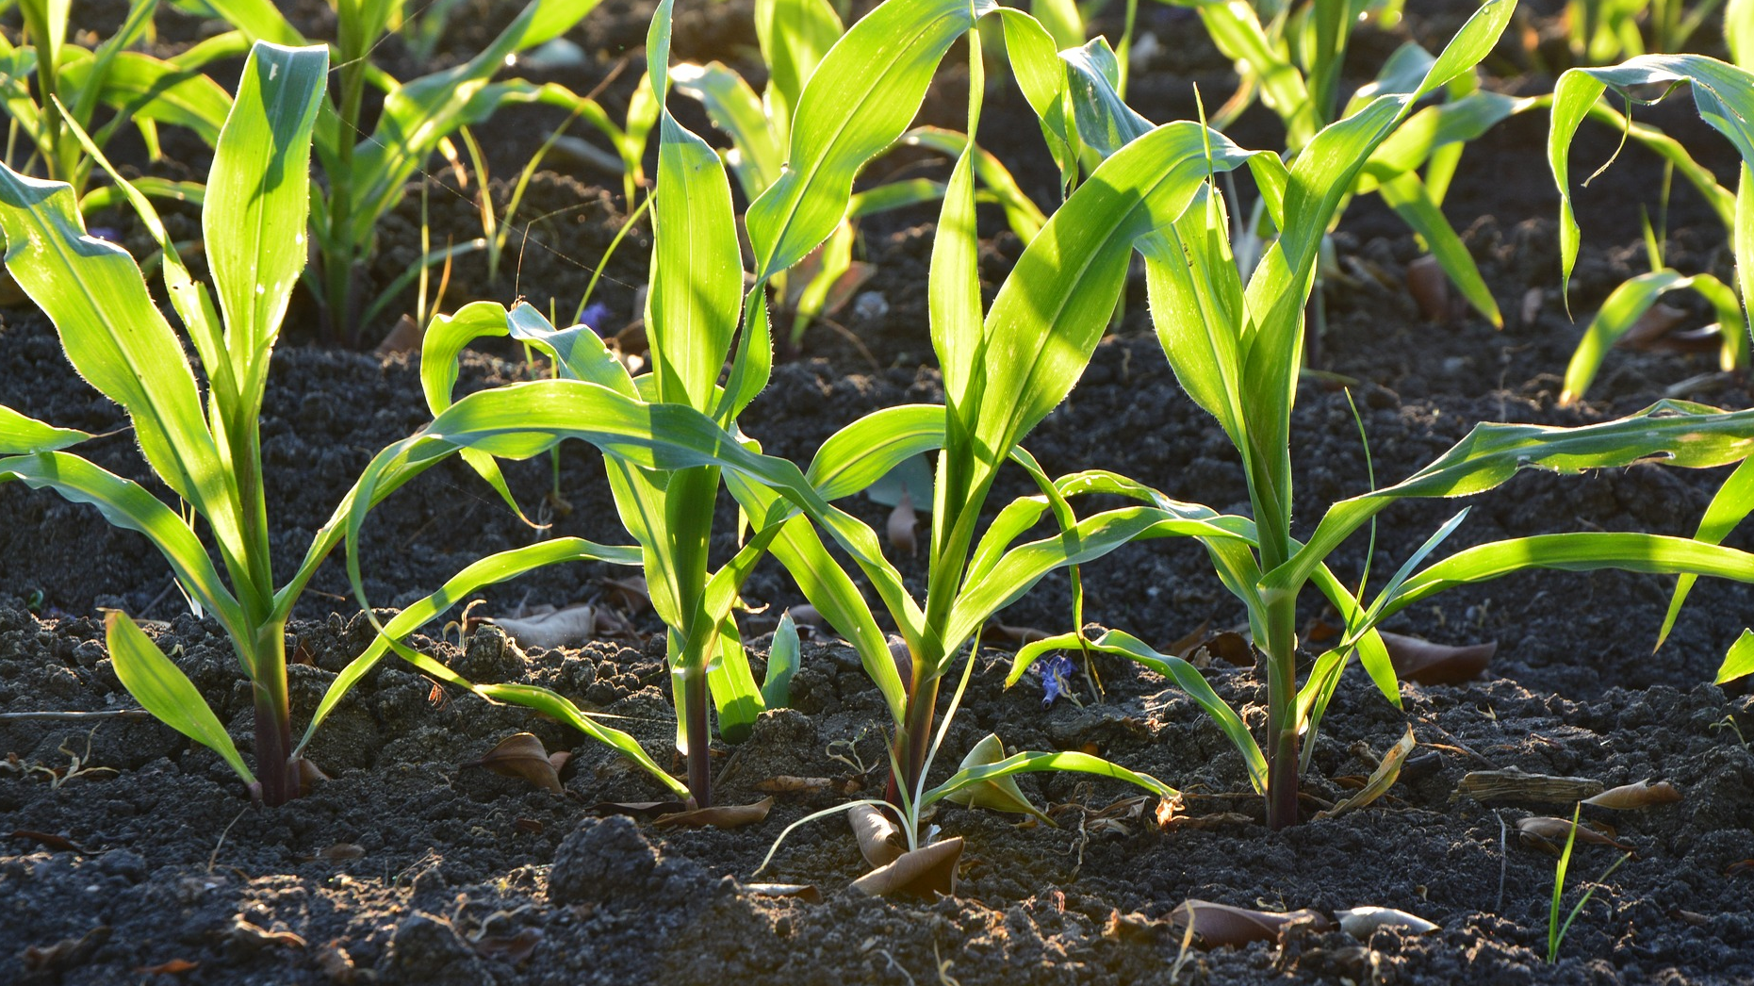
REDUCING EMISSIONS WITH BETTER SOIL MANAGEMENT PRACTICES
CASE EXAMPLE
Notes:
STE Sompa: Päivi Tikka, Director, Division of Strategic Research at Academy of Finland paivi.tikka@aka.fi, +358295335007

Slide 85
Climate-friendly cultivation and management methods in peatlands with the help of SOMPA
The research project Novel soil management practices – key for sustainable bioeconomy and climate change mitigation (SOMPA) will develop ecologically and economically sound methods to manage organic soil fields and forests while simultaneously mitigating climate change. The SOMPA research group will produce new scientific information on the formation of methane and carbon dioxide emissions in peatlands and on cost-efficient and ecologically sustainable means to mitigate the emissions.
It will provide methods that encourage landowners to apply the optimal mitigation measures in practice. The adoption of climate-smart management practises in peatlands will significantly decrease emissions and help societies to achieve their climate targets.
Peat soil of croplands and forests is currently a large emission source in Finland. However, emissions of peat soil can be reduced by improving practices, both in Finland and globally.
In forested peatlands, continuous growth of forests is a promising approach that is both economical and climate-smart. In croplands, the use of paludiculture – meaning the use of wet agriculture and forestry on peatlands – can be encouraged. The method refers to the productive land use of wet peatlands so that subsidence is stopped and emissions are minimised, along with cultivating crops that are adapted to high water levels.
The project is financed by the Strategic Research Council which funds high-quality research with great societal relevance.
Strategic Research seeks to find concrete solutions to grand challenges that require multidisciplinary approaches and communication – such as climate change.
The scientific consortium consists of the Natural Resources Institute Finland, the Finnish Environment Institute, the University of Eastern Finland, the University of Helsinki and Tyrsky Consulting.
Notes:
STE Sompa: Päivi Tikka, Director, Division of Strategic Research at Academy of Finland paivi.tikka@aka.fi, +358295335007

Slide 86
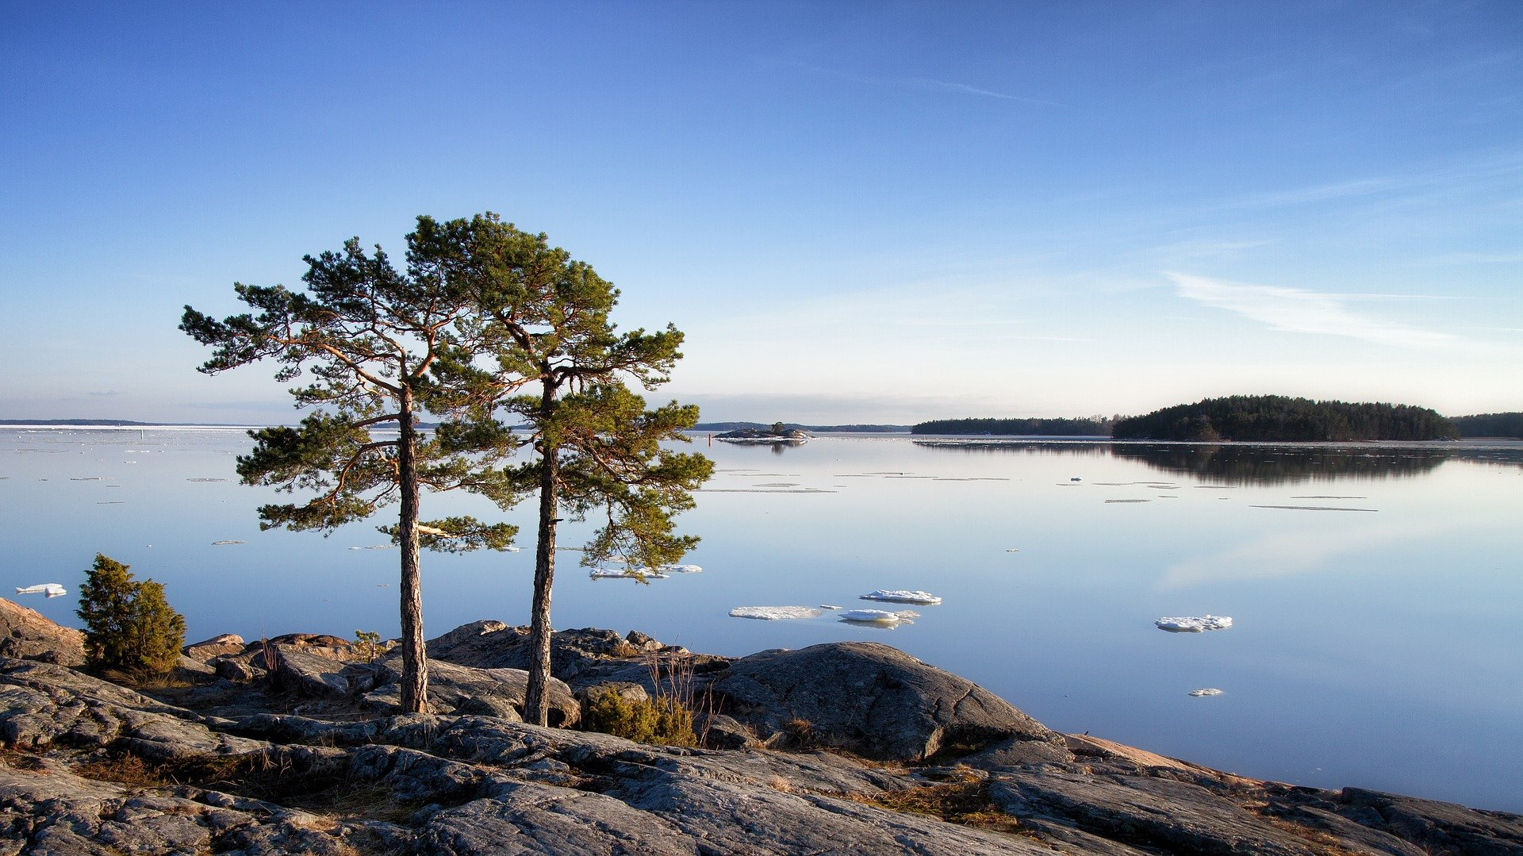
COAL WILL BE HISTORY IN ENERGY PRODUCTION BY 2029
CASE EXAMPLE
Notes:
Ban of coal in energy production: Mauri Vieru communications specialist at Ministry of the Environment puh. 029 506 3577 mauri.vieru@tem.fi Katja Keckman communications specialist at Ministry of the Economic Affairs and Employment of Finland puh. 029 504 7106 katja.keckman@tem.fi

Slide 87
Ban of coal in energy production by 2029
Among the first countries in the world, Finland is committed to phasing out coal in energy production by 2029.
The law banning the use of coal came into force in the spring of 2019. The coal ban will promote a low-carbon energy system, drive the use of renewable energy sources, and ensure a healthy living environment.
Finland’s far-reaching energy policy aims to phase out the use of fossil fuels in energy generation and move towards an emission-free energy system. Coal will be the first fossil energy source to be phased out. While nearly 80% of electricity production in Finland is already emission-free, only 36% of district heating uses renewable energy sources (year 2018).
In March 2020, Prime Minister Sanna Marin’s Government issued a decree on investment aid for projects accelerating the replacement of coal in energy production. The decree will encourage companies and communities, including municipalities, to voluntarily move away from coal energy by the end of 2025. A total of 90 million euros has been reserved for this investment aid. The supported projects involve using non-combustion-based technologies in district heat generation.
First supported projects will involve combining a large-scale air-to-water heat pump with district heat generation and the utilisation of waste heat in district heat generation.
The coal ban and investment aid supports climate neutrality target, as 40% of Finland´s emissions of district heat generation come from coal and 12% of the total greenhouse gas emissions from the energy sector are caused by coal.
The Powering Past Coal alliance was founded in Bonn 2017 at the COP 23. Finland was one founder among 20 other countries.
Notes:
Ban of coal in energy production: Mauri Vieru communications specialist at Ministry of the Environment puh. 029 506 3577 mauri.vieru@tem.fi Katja Keckman communications specialist at Ministry of the Economic Affairs and Employment of Finland puh. 029 504 7106 katja.keckman@tem.fi

Slide 88
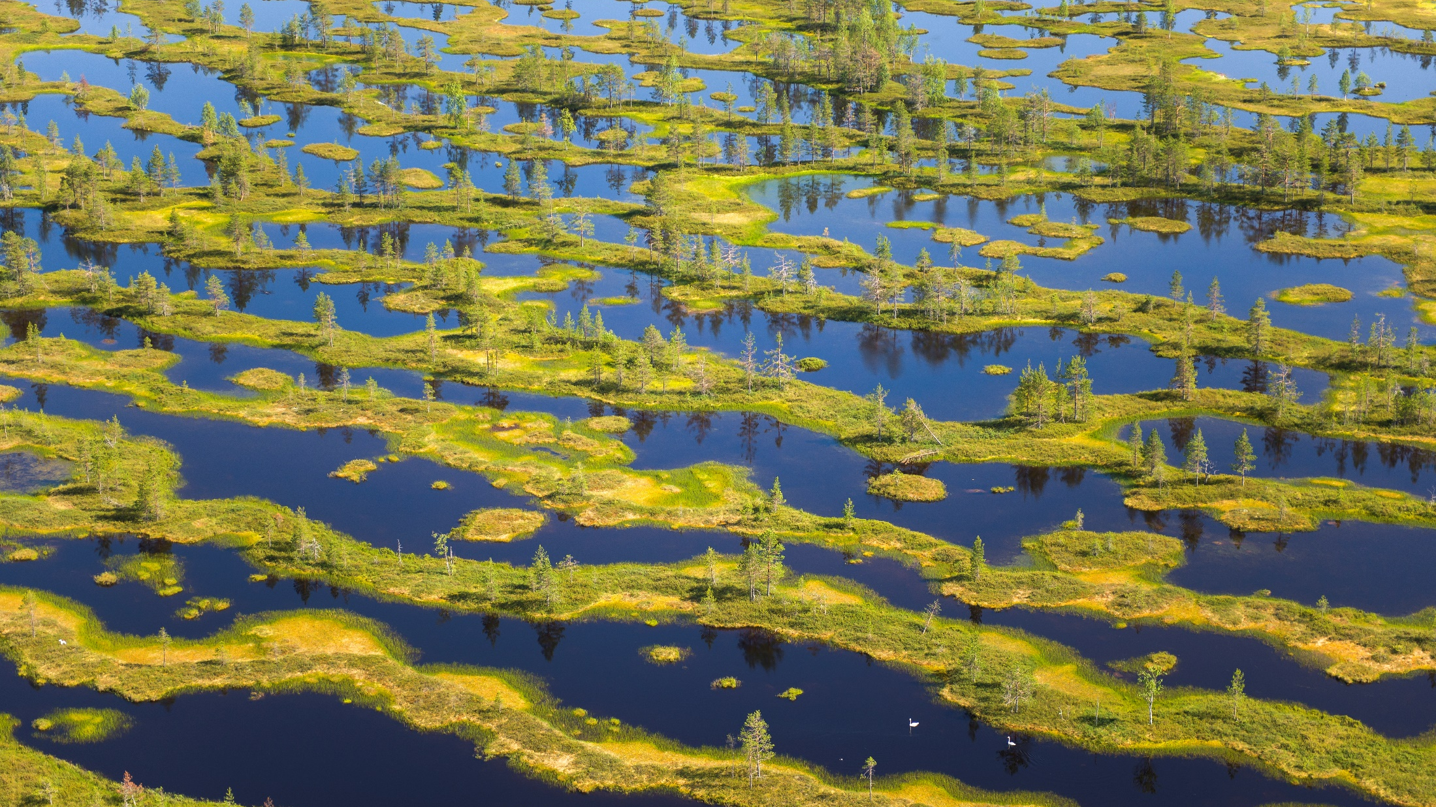
Acknowledging climate issues in LEGISLATION
Notes:
Nature Conservation act: Riitta Rönn, legislation at the Ministry of Enviroment riitta.ronn@ym.fi +358 295250255

Slide 89
Integrating the adaptation and mitigation of climate change to the Nature Conservation act
The Nature Conservation Act is one of the key instruments in the efforts to ensure the biodiversity of Finland’s natural environment. The adaptation and mitigation of climate change will be integrated into the Nature Conservation Act, to an applicable extent.
The effects of climate change could be added to the legal framework of the nature conservation areas and protective habitats as a legally binding criteria. This will strengthen the normative weight of climate change in the decision-making processes concerning the Nature Conservation Act.
Climate change is an imminent threat for biological diversity, but the current Finnish Nature Conservation Act does not recognise its significance. The renewal of the Act, which is under preparation, will change this.
Effective legal framework is necessary in order to tackle both climate change and the loss of biological diversity.
Climate change and the loss of biological diversity are severe, interrelated and complex issues.
An effective legal framework is necessary in order to tackle both climate change and the loss of biological diversity.
The renewal of the Nature Conservation Act takes the impacts of climate change into consideration.
Notes:
Nature Conservation act: Riitta Rönn, legislation at the Ministry of Enviroment riitta.ronn@ym.fi +358 295250255

