Slide 2
Pure food from Finland
Photo: Elina Manninen/Keksit
Notes:
Photo: Elina Manninen / Keksit

Slide 3
The world needs another agricultural revolution. We need healthier and safer food which is produced sustainably. Finland is in an excellent position to help propel this revolution because safe and sustainable food is already the national philosophy.

Slide 4
Long winters create a unique industry
Finland has long winters, a pristine environment and a short, intense growing period. These conditions result in the dense and unique taste of Finnish food, as well as the domestic industry’s focus on quality instead of quantity.
Milk makes up 24.4% of the total output of the Finnish agricultural sector, according to Statistics Finland. Milk is followed by vegetables and horticulture products (12%), grains (10.5%), cattle (9.5%) and pork (6.6%).
Notes:
Finland is also an attractive place to develop energy efficient and automated vertical farming because of the long, dark and cold winters.

Slide 5
Finland has the purest water on Earth.
Source: Unicef
Photo: Elina Manninen/Visit Finland
Notes:
Many of Finland’s beverages take advantage of the climate, clean environment and latitude. The pure spring water goes into gins and vodkas, rye goes into whiskies, and berries are popular for juices and liquors.

Slide 6
Finnish strengths in food industry
Finland is an attractive place to develop energy efficient and automated vertical farming because of the long, dark and cold winters. Such solutions are economically viable in Finland before they are profitable in sunnier countries.
Finland also has strengths in agricultural machinery, including everything from tractors to robot milking machines. The three main segments include agricultural equipment, solutions for livestock, and forest and utility machinery.
Notes:
Finland’s first commercial vertical farm, Robbes Lilla Trädgård, had an international collaboration with Fujitsu and was able to increase closed loop crop productivity by 40%.

Slide 7
Finland has the world’s largest harvesting area for wild organic products, 11.6 million hectares, which represents 30% of the total area in the world where such products can be collected.
Source: Natural Resources Institute Finland (LUKE)
Photo: Elina Manninen / Keksit

Slide 8
Excellent food safety
Finland takes food safety seriously. Finnish food is known for its purity throughout the food chain, its hygiene, traceability and accountability, which are among the best in the world.
Finland has a unique salmonella control program which requires all forms of salmonella to be monitored throughout the production chain.*
Finnish poultry farms have been antibiotic-free since 2009 and the quantity of antibiotics administered to livestock is among the lowest in Europe, according to the Natural Research Institute. Animal welfare is strictly controlled by the authorities in each municipality.
Notes:
* Other countries typically only focus on a few different types.

Slide 9
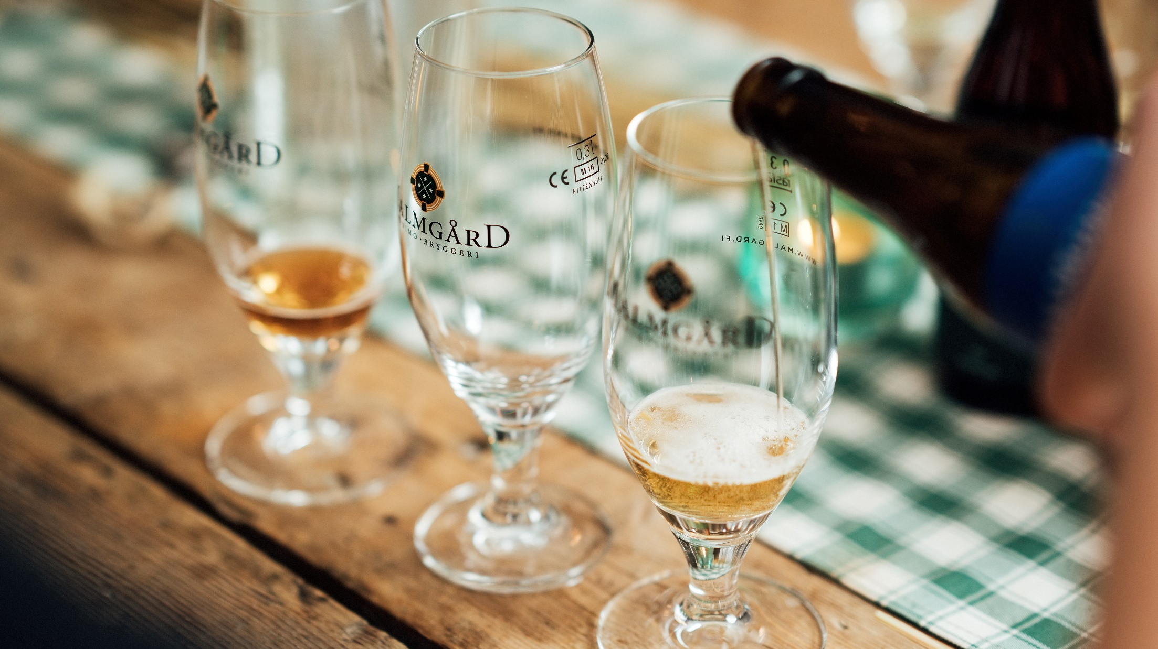
Many of Finland’s beverages take advantage of the climate, clean environment and latitude. The pure spring water goes into gins and vodkas, rye goes into whiskies, and berries are popular for juices and liquors.
Photo: Ilona Savola/Visit Finland

Slide 10
Food innovations from Finland
Finland is a significant innovator and producer of functional, gluten- and lactose-free foods.
Finns consume one of the highest amounts of milk per capita in the world (about 130 litres per person per year). But almost 1/5 of Finns are lactose intolerant. That is one of the reasons for the long tradition of making special food products.
Finland is a forerunner in functional food research, development and product innovations, like Xylitol birch sugar, Lactobacillus GG, Benecol cholesterol lowering ingredient and plant-based protein products such as pulled oats, rapeseed proteins and products made of Nordic Fava beans.

Slide 11
Finland has the cleanest air in the world.
Source: World Health Organization
Photo: Katri Lehtola/Kuvatoimisto Keksi

Slide 12
Investments in food innovations
Finland is among the highest investors to food sector R&D, measured as a percentage of industry turnover. As a result of this Finnish food and beverage companies are constantly introducing new innovative products to domestic and international markets.
Finland is a small country and is actively searching for international food and beverage partners.
Finnish agrotechnology innovations include machinery, tractors, robotics and IoT (Internet of Things) solutions.

Slide 13
Finland is the #1 country in oat research and innovations.
Source: Business Finland
Photo: Business Finland

Slide 14
Finnish oat expertise
Oats have become an area of Finnish expertise. Oats are becoming more popular, thanks to their nutrition, versatility and ability to be used in special diets such as gluten-free foods or meat substitutes.
Finland produces 13% of European oats and is the 2nd largest oat exporter, according to the Finnish Oat Association.
Rye and malt are two grains which grow well in Finland’s Nordic environment and are becoming more popular around the world.

Slide 15
Finnish superfood
Superfoods like berries and oats are significant Finnish agricultural products and have received major research and development.
Many wild berries are exported just as they are, but Finland is also skilled at developing berry-based products such as powders, dried berries, liquors, snacks and even beauty products.
Photo: Julia Kivelä/Lakeland Finland
Photo:
Notes:
More than 50 varieties of berries grow naturally in Finland. 37 are edible and 12 are farmed commercially.
Photo: Julia Kivelä/Lakeland Finland

Slide 16
The Every Person’s Right says anyone can fish and pick berries and mushrooms, even on private property, as long as you don’t disturb others.
Photo: Julia Kivelä/Visit Finland
Notes:
Finns love collecting the bounties of nature so much the right to do so is actually enshrined in law.

Slide 17
Food export and international partners
Finnish authorities want to promote the export of Finnish food, so the government has invested systematically in order to help our international food and beverages business.
Finland wants to work with international partners to develop sustainable food solutions for our world.
Food and beverage exports from Finland jumped 13% in 2019, according to Business Finland. The biggest increases were in China (+82%), Germany (+30%), South Korea (+29%) and Sweden (+16%).
Notes:
As a small country Finland looks abroad for their markets, both for agricultural produce as well as know-how and agrotechnology.

Slide 18
Thank you!
Photo: Elina Manninen / Keksit

