Slide 2
Finland - the best place in the world to develop games

Slide 3
The global games industry is tough. You need experience, talent, bravery, resources and institutional support to succeed – all of which you can find in Finland.
Finland has decades of experience developing globally successful and ground-breaking games.

Slide 4
Finnish game industry
Finnish authorities have supported the game industry for decades. Public innovation and funding groups support gaming, as do universities, trade groups and industry associations.
Games education is an established and respected field in Finland. It is offered in adult education centers, vocational colleges, universities of applied sciences and universities.
Some Finnish companies are also experts at “gamification”, or bringing game design or principals into non-game contexts.

Slide 5
Games education
Education doesn’t end with graduation: Finnish educational institutions also offer lifelong learning for the necessary creative and technical skills to create games.
The Finnish game industry does not only focus on entertainment. It also develops “serious games”, or games for a purpose other than entertainment, such as education or training.
In recent years a thriving Education Technology (EdTech) sector has developed, merging Finnish software and education strengths.

Slide 6
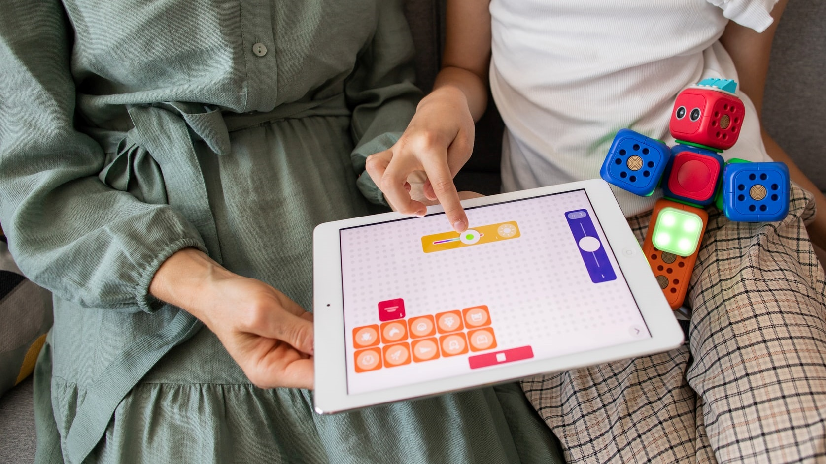
Many of the educational technology solutions have been developed together with Finnish teachers, and tested in Finnish schools.
Photo: Robo Wunderkind/Unsplash

Slide 7
Vibrant gaming community
The industry and gaming community has also supported its own growth, for example through events and industry camaraderie.
For example, the Slush startup and technology event is organized by university students.
The Assembly demoscene and gaming event began in 1992 and is still held twice a year.
The community has helped several generations of Finnish games professionals.

Slide 8
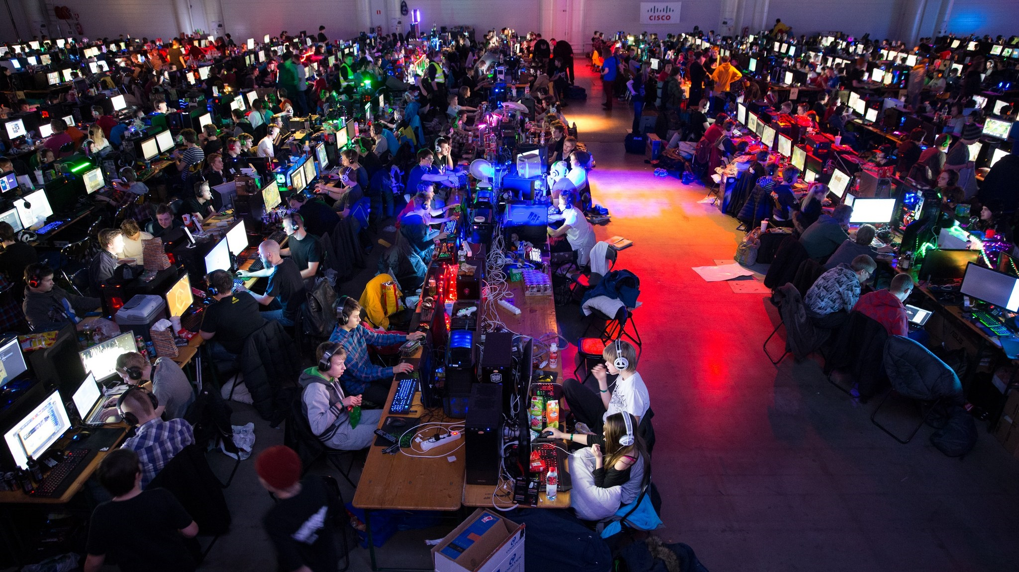
Assembly is also one of the major Finnish esports events.
Photo: Aleksi Kinnunen/ASSEMBLY Organizing
Notes:
Esports is a form of sport competition using video games.

Slide 9
History of Finnish game industry
Finns have been interested in computer games for almost as long as there have been computer games. In the early 1950s the mathematical strategy game Nim was used by computer scientists as demonstration tools. Finnish researchers had their version in 1954.
The first commercial computer game officially developed in Finland was chess, developed in 1979.
The first globally distributed commercial Finnish game was a space-based shoot’em-up launched in 1986.
Notes:
In 1966 the Finnish military started to use computer war games for training and simulation purposes.

Slide 10
Nokia – a Finnish trailblazer
Nokia deserves credit for much of Finland’s current success in games. Nokia developed their first computer in 1971-1972. As Nokia mobile phones exploded in global popularity they encouraged mobile gaming experiments.
In 1997 Nokia released the now-iconic mobile game Snake. In 2003 Nokia began selling the N-Gage, a device which combined the features of a mobile phone and a handheld game system.
In the late 2000s when Nokia exited the mobile device market, some of their international talent moved to the games industry.

Slide 11
In 2019 the turnover for the Finnish games industry was about 2.2 billion euros, up 4.7% from 2018.
Photo: Florian Olivo/Unsplash

Slide 12
Finnish success stories
The new Millennium saw the release of two groundbreaking Finnish games: the social networking game Habbo Hotel by Sulake in 2000 and the third-person shooter Max Payne by Remedy Entertainment in 2001.
In 2009 the mobile game came of age with Rovio’s release of Angry Birds, the most successful Finnish game franchise to date. Angry Birds has expanded to movies, toys, music and even drinks.
Supercell was founded in 2010 and released the mobile games Hay Day and Clash of Clans a few years later. By 2016 Supercell was valued at over 10 billion USD, making it the most valuable Finnish games company.
Notes:
Rovio, the maker of the Angry Birds franchise, say they have had over 4 billion downloads of their games.

Slide 13
20 new game companies were founded in 2018 and 10 were founded in 2019.
Photo: Sakari Piippo

Slide 14
At the end of 2018 Finland had over 220 game development studios.
Source: Neogames
Photo: Fredrick Tendong/Unsplash

Slide 15
International gaming industry
The Finnish gaming industry is very international. About 27% of employees were foreign in 2018, and between 2016 and 2018 the number of foreign employees grew 75%, according to Neogames.
The Finnish games industry is both local and international. Major global companies and investors have set up shops in Finland. Still, the sector keeps a distinctly Finnish flavor.
Major international games giants like AMD, Nvidia, EA, Ubisoft, Unity and Zynga have a presence in Finland.

Slide 16
Thank you!
Photo: Israel Andrade/Unsplash

