Slide 2
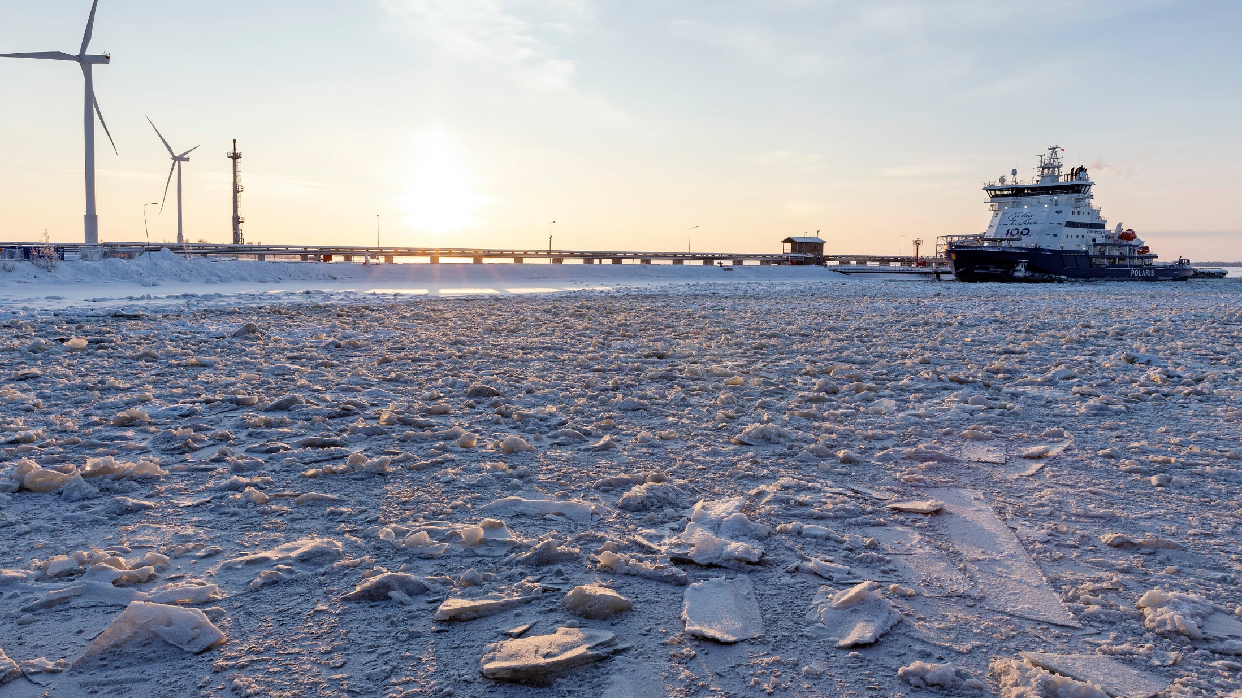
ARCTIC KNOW-HOW AND SMART MOBILITY IN FINLAND
Photo: Visit Finland Imagebank

Slide 3
The transportation of goods and people is critical to how our modern society functions, yet our old methods are unsustainable. We need new, cleaner and smarter transportation solutions. Smart mobility can reduce emissions, save time and improve safety. The combination of maritime experience, enabling technology and Arctic know-how has made Finland one of the most innovative places for smart mobility solutions in the world.
Notes:
One definition of smart mobility cited by the EU is using digital technologies to make transport and mobility smarter, safer and greener.

Slide 4
Smart mobility in Finland
Finland is a Nordic country with cold-weather expertise. This includes developing icebreakers, polar shipbuilding, ice technology and fleet operation, oil spill cleaning in ice and autonomous vehicles in snow.
Finland has strengths in enabling technology, such as mobile communications, sensors, data analytics and AI. These help to enable smart mobility solutions.

Slide 5
The government supports development
In 2018 Finland introduced new transport rules to encourage the development of a smart mobility ecosystem. This included deregulation, tax incentives and data-sharing mandates for public entities.
Many smart mobility solutions involve sharing, such as vehicle or ride sharing. Finland changed rules to allow innovation in these areas. Now there are city bike, electric scooter, car and ride sharing companies in the country.

Slide 6
Helsinki is one of the best prepared cities for new mobility.
Source: Future Mobility Competitiveness Index (2019)
Photo: Aku Pöllänen

Slide 7
Innovations for smart mobility
One of the first wide scale applications of the Mobility-as-a-Service (MaaS) concept happened in Helsinki. MaaS is a service which allows a traveler to plan, book and pay for multiple types of mobility services at once. For example, it could include a bike to the metro station, a metro ride, and a taxi to your final destination.
Connectivity and the Internet of Things (IoT) is required for most smart mobility applications. Finland has many experts in necessary infrastructure, such as communications technology, sensors and data analysis.
Notes:
With MaaS the customer pays for mobility, not for a bus ticket or car, for example. MaaS allows a traveler to plan, book and pay for multiple types of mobility services at once.

Slide 8
Autonomous vehicles and winter testing
With everything in a car becoming digitalized and connected, automotive industry is looking for new innovative solutions and technologies, providing the needed edge for tomorrow's vehicles.
Finland has taken a pole position in Europe for autonomous vehicle and winter testing. Many global companies have chosen Finland as the place to test self-driving cars in ice and snow and develop solutions for their cold weather use.

Slide 9
Lapland provides excellent winter testing environment for automated vehicles. Arctic vehicle testing has been a growing industry and has been one of Lapland's core businesses for decades.
Photo: Juha Kauppinen/Lapin materiaalipankki
Notes:
Read more about winter testing: https://www.lapland.fi/business/lapland-is-the-worlds-best-winter-testing-environment-for-automated-driving-and-vehicles/

Slide 10
Autonomous vehicles
Finland’s expertise in autonomous vehicles extends to the air and sea: Finnish companies provide innovative solutions to autonomous unmanned aerial vehicles and ships.
There are 1,142 automotive and transport technology companies in Finland according to Helsinki Business Hub.
Photo: FABULOS project
Notes:
FABULOS’ Helsinki Pilot tested robot buses in Helsinki in 2020. Read more: https://fabulos.eu/helsinki-pilot/

Slide 11
Maritime expertise
Finland is developing the world’s first autonomous maritime ecosystem One Sea in collaboration with both Finnish and international companies The ecosystem should be operational by 2025.
Finland has some of the world’s top ship designers, builders and outfitters. For example, the Oasis of the Seas, which was the largest cruise ship in the world when launched, was built in Finland and is powered by engines from the Finnish company Wärtsilä.
Notes:
Finland has a long history of developing maritime solutions. Today, there are 3,000 maritime companies, according to the Ministry of Economic Affairs and Employment.

Slide 12
Finland has built more polar class icebreakers than any other country.
Source: Business Finland
Photo: Visit Finland

Slide 13
Sustainable maritime solutions
Increasing efficiency is one way smart solutions increase sustainability.
As an example, the Finnish maritime company Wärtsilä has developed route optimization technology which helps ships use the prevailing weather to assist their journey. This reduces fuel usage and emissions.
Wärtsilä has also developed innovative zero-emission maritime solutions. The company has designed and equipped two battery-powered ferries for Norway.

Slide 14
Finland is ranked the #1 country in building the most energy-efficient cruise vessels and is the #1 country in polar shipbuilding, design and fleet operation.
Source: The Ministry of Economic Affairs and Employment (2019)
Photo: Visit Finland Imagebank

Slide 15
Achieving sustainability goals together
Finland works bilaterally and multilaterally on achieving a sustainable future for the Arctic. Finland is a member of the Arctic Council, the Barents Euro-Arctic Council and many related UN sub-organizations.
Finland can bring valuable know-how to partnerships in the mobility sectors and wishes to work with international co-creators.
Photo: Visit Finland Imagebank

Slide 16
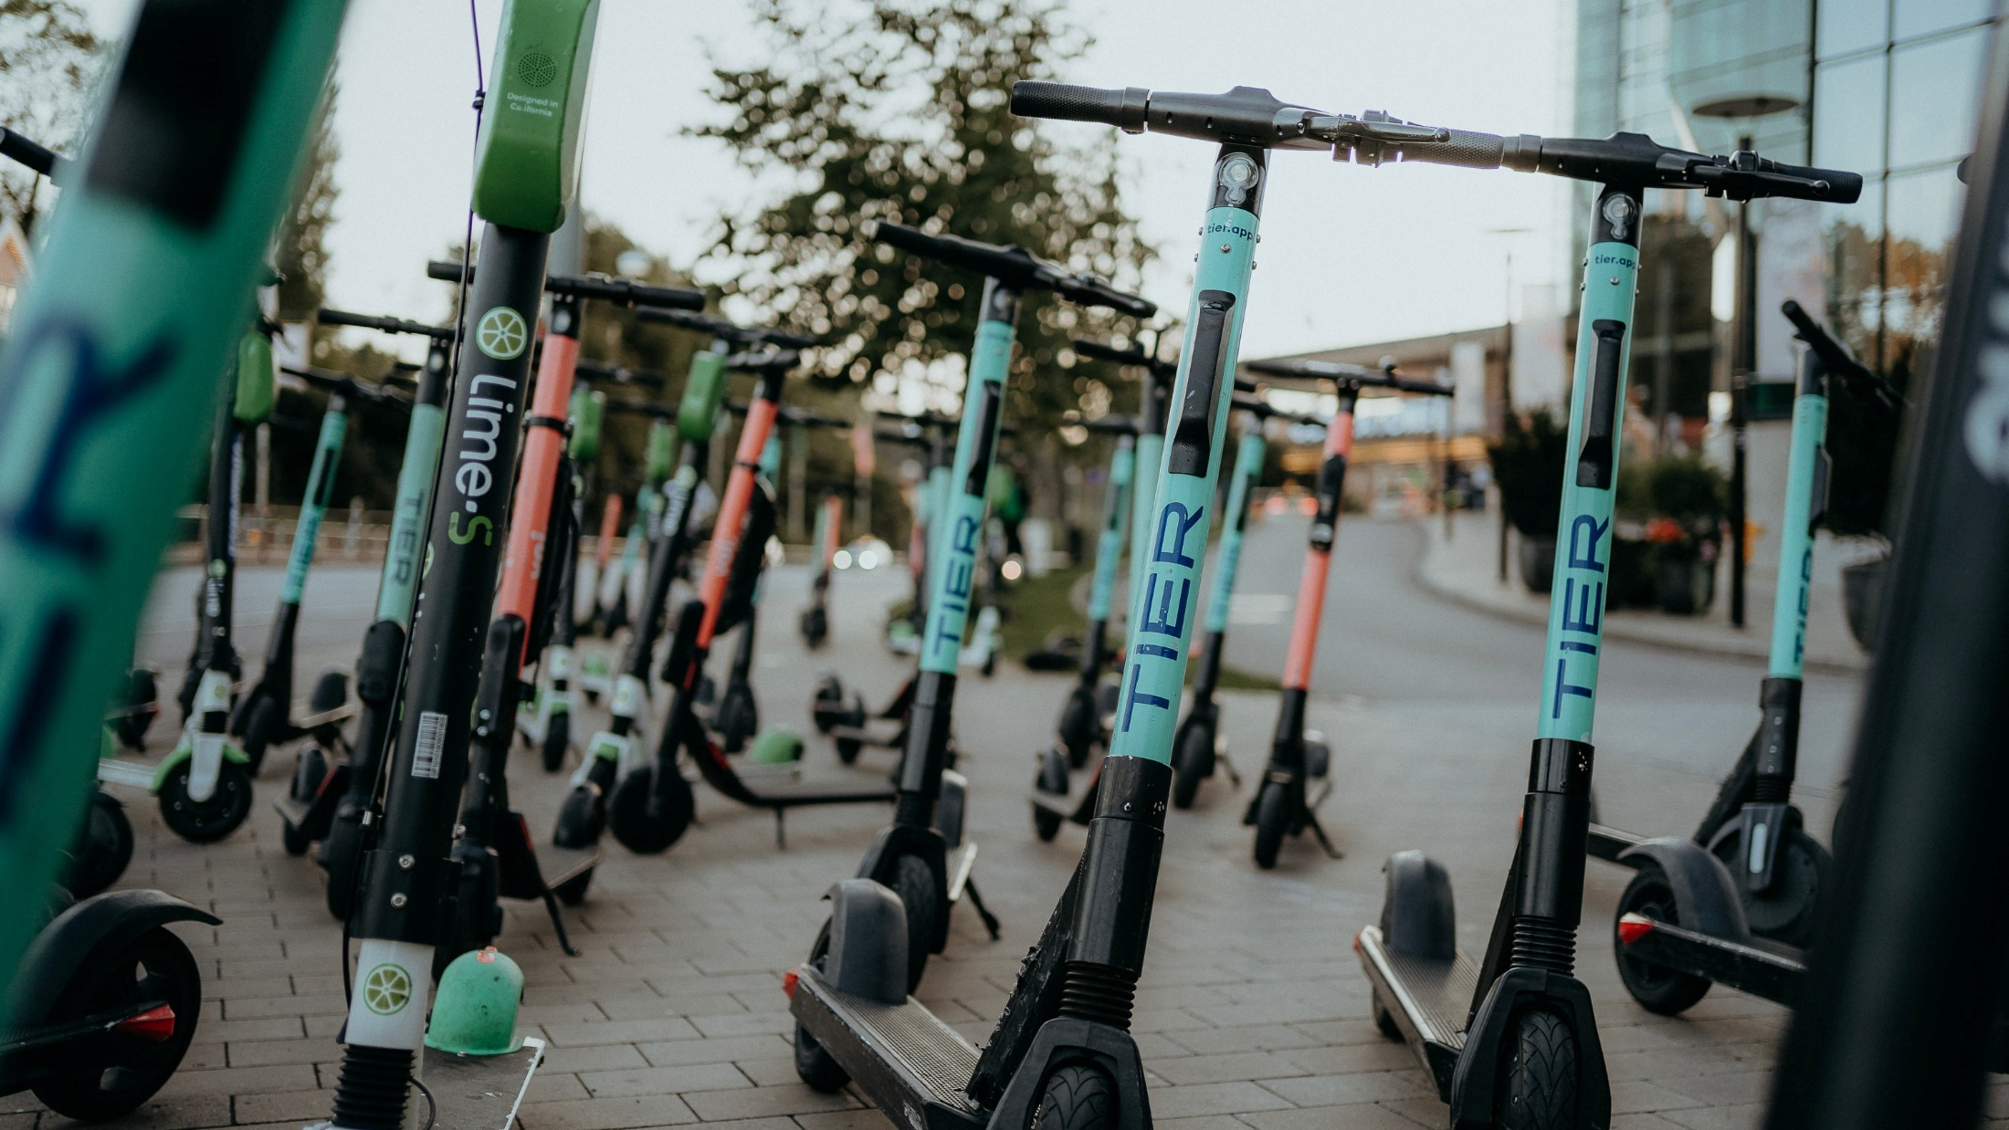
Thank you!
Photo: Jonas Jacobsson/Unsplash

