Slide 2
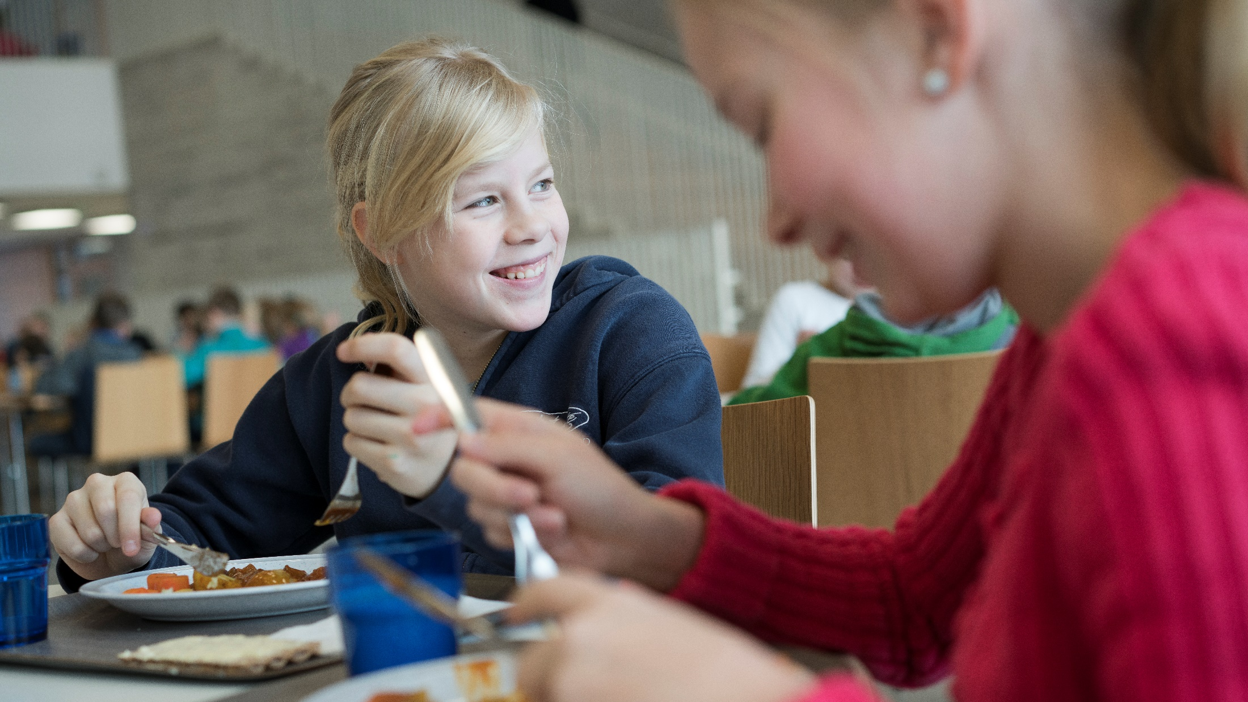
School food – building Finnish equality since the 1940s
Notes:
Photo: Riku Isohella

Slide 3
Free meals for all
In Finland, free-of-charge school meals have been provided since the 1940s, with the aim of supporting children’s learning, nutrition, and health.
All pupils in Finland from pre-primary to upper secondary schools get a free-of-charge, nutritious meal each school day.
The Finnish school feeding system promotes equal opportunities and education for all. The system is a Finnish social innovation, which plays an essential role in the educational system of the country.

Slide 4
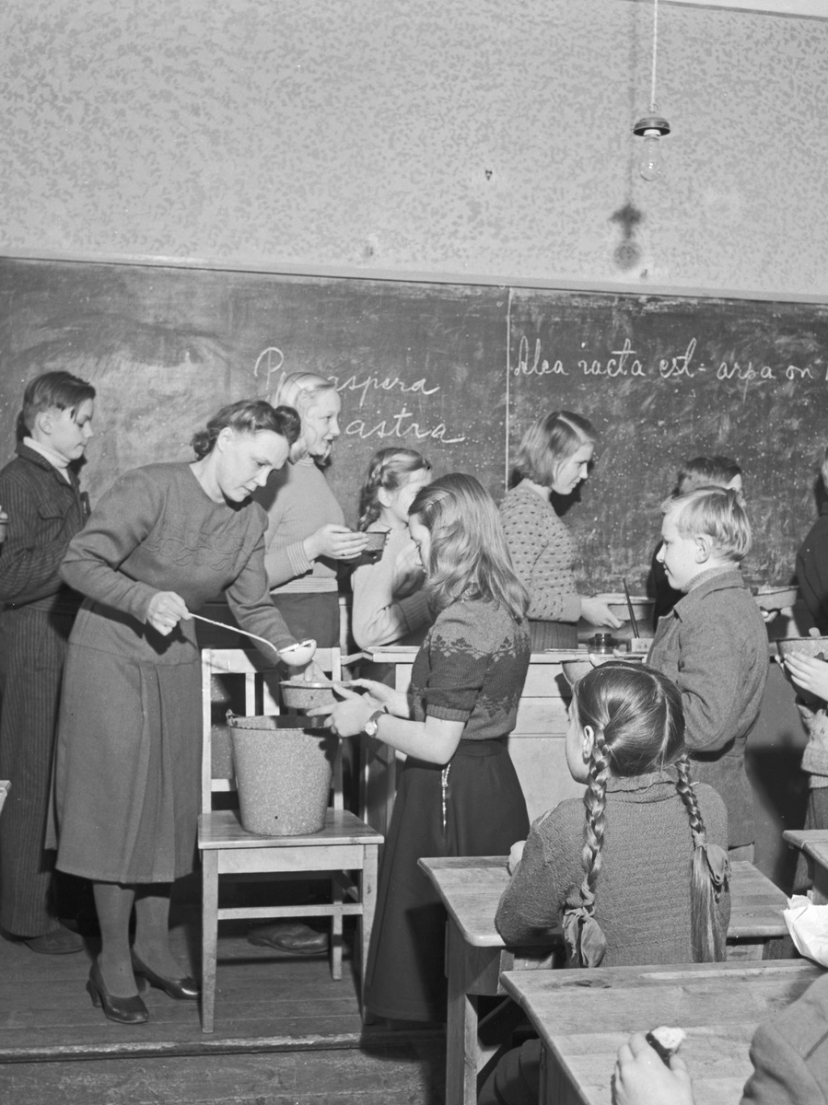
History of Finnish school meals I
The school feeding system was originally introduced in the 1920’s, but free-of-charge school meals for all children began in the 1940s.
With a history of over 70 years, Finland has the world’s longest-running free-of-charge school feeding system.
Notes:
Photo: Pekka Kyytinen /Finnish Heritage Agency – Musketti: Ethnographic Picture Collection

Slide 5
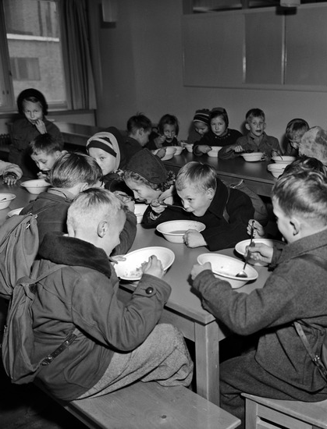
History of Finnish school meals II
When first introduced, the aim of the free school meals was to level out social differences.
As hungry children are not able to focus on learning, school feeding was seen as an important step towards educational equality.
Notes:
Photo: Helsinki City Museum

Slide 6
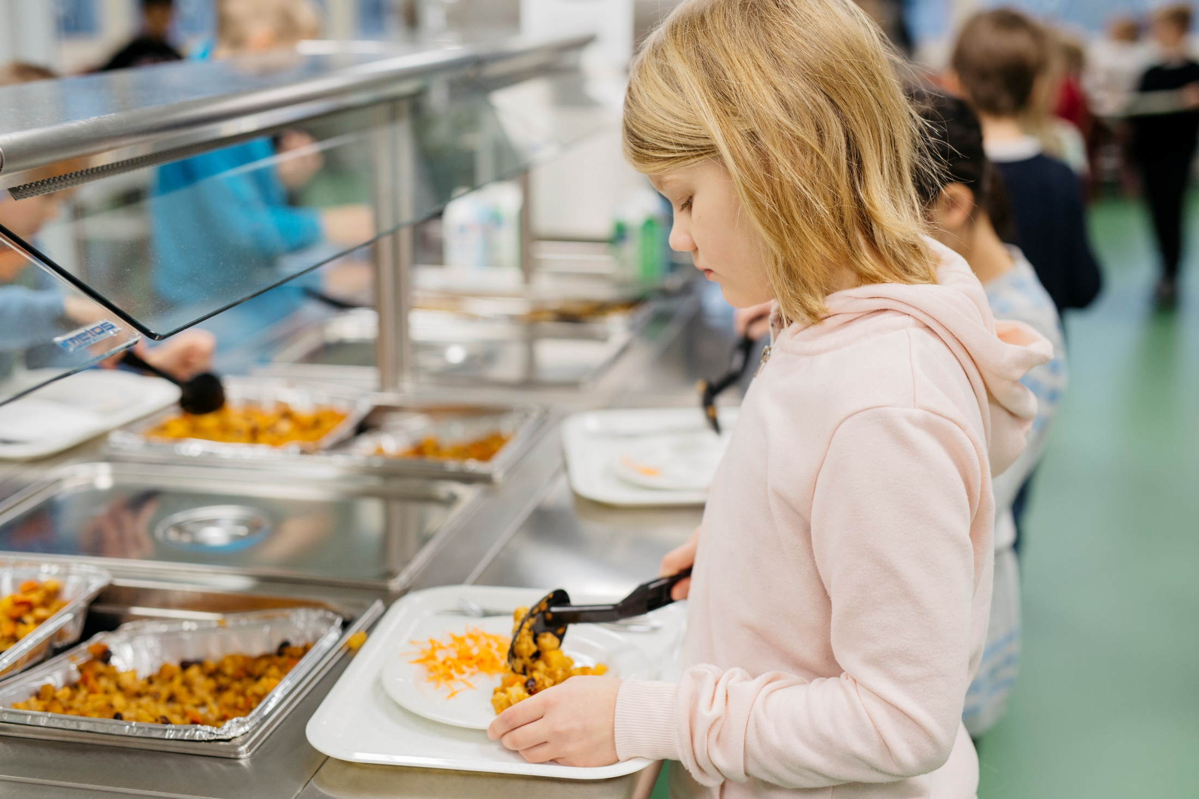
School meals are an investment in equality and the future. They build equality between children from different backgrounds, strengthening equal opportunity.
.
Notes:
Photo: Elina Manninen/Keksi

Slide 7
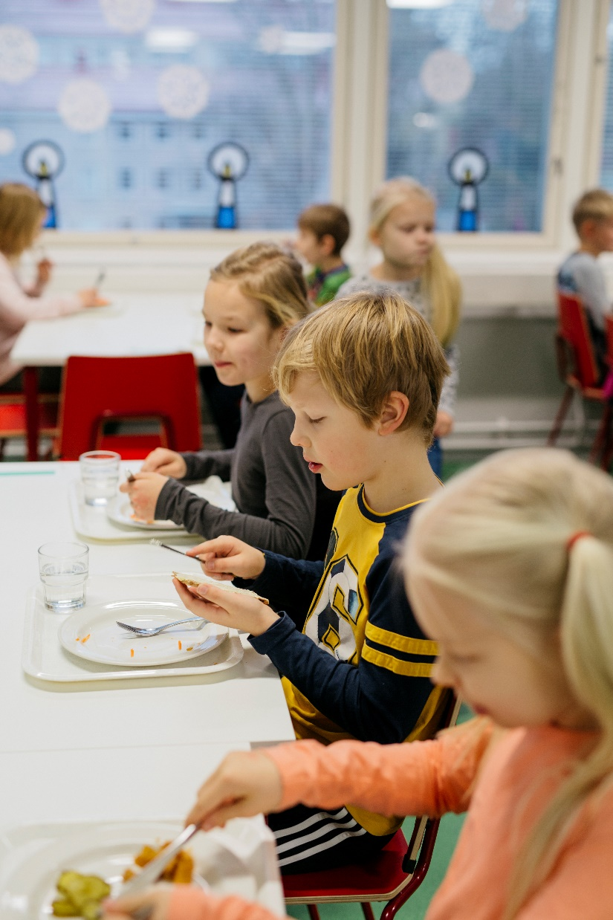
Educational status
Since 2004, school meals have been part of the national school core curriculum, giving them an educational status.
Pupils learn food-related skills and knowledge, such as awareness of healthy diets, other food cultures, and food’s environmental impact.
Notes:
Photo: Elina Manninen / Keksi

Slide 8
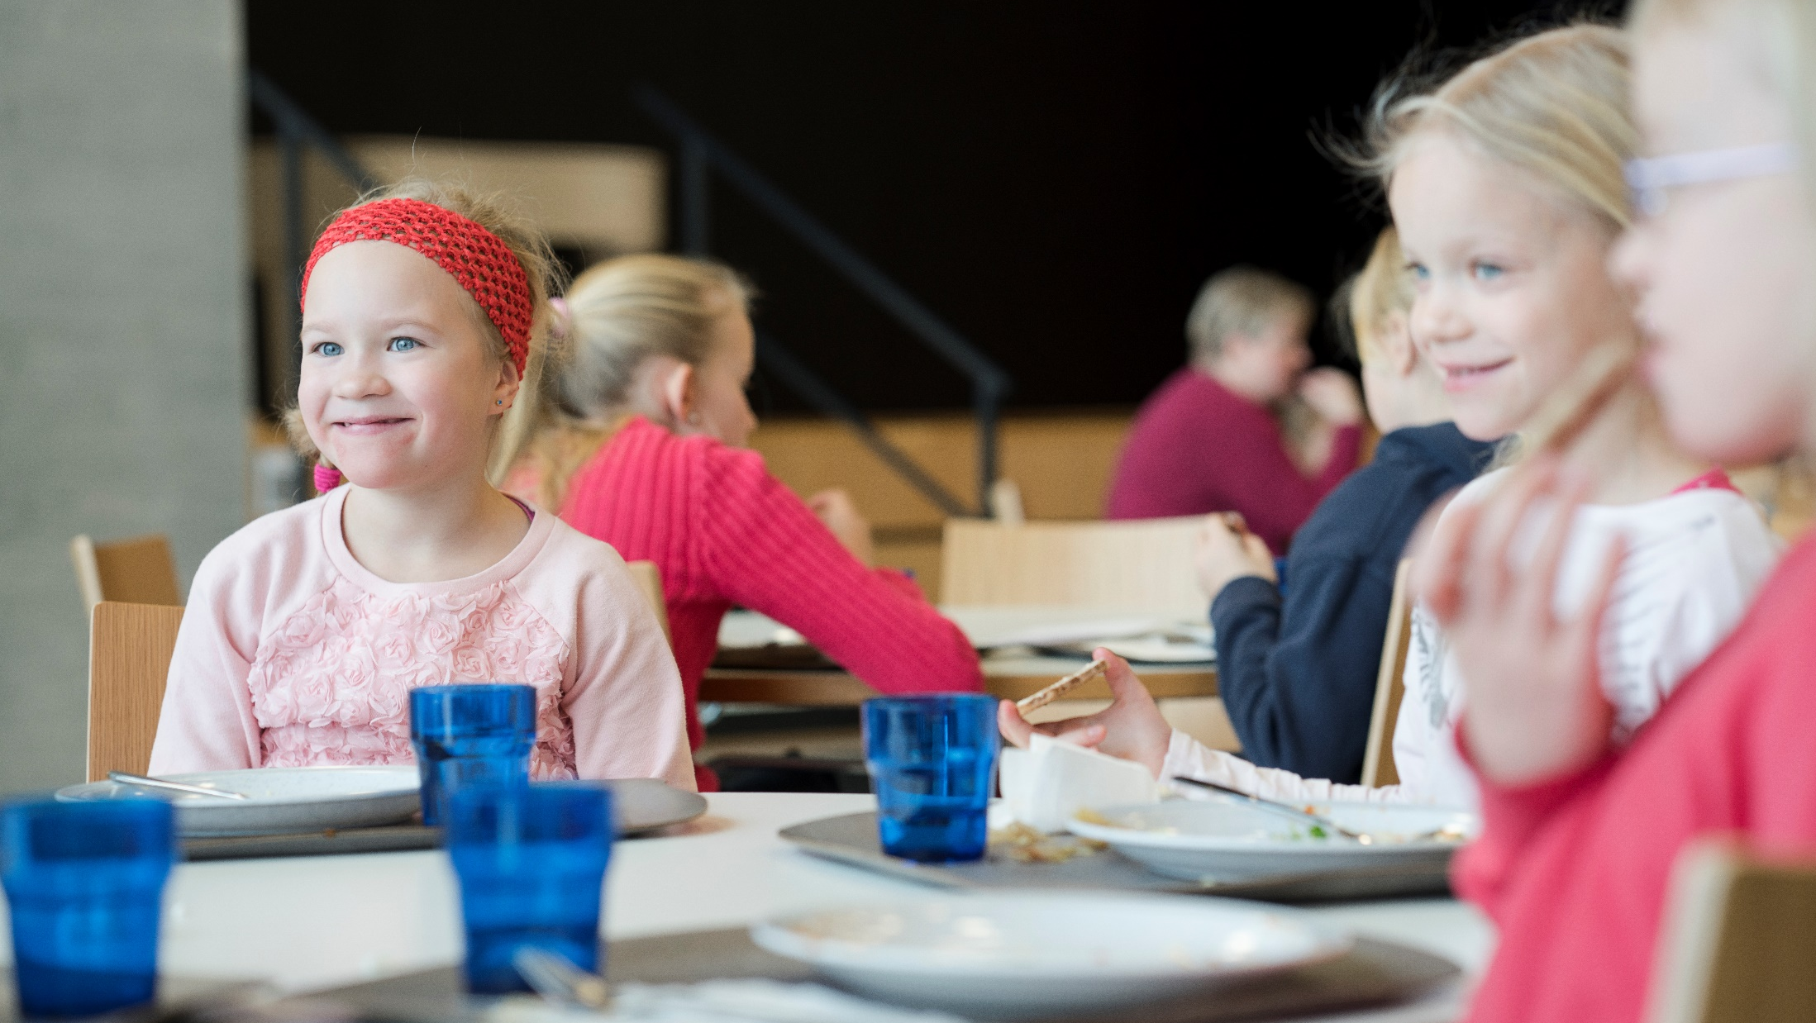
A good lunch is more than nutrition.
It is something that gives pleasure, relaxes, maintains the ability to work, and helps children grow into healthy adults.
Notes:
Credit: Riku Isohella

Slide 9
Also supporting gender equality
School meals also make it easier for parents to work outside the home, supporting gender equality, female workforce participation, and thus economic growth.
Notes:
Photo: Riitta Supperi / Keksi

Slide 10
A joint effort
The scheme is based on cooperation and trust: ministries and agencies provide funding, municipalities take care of practical arrangements, and pupils are encouraged to participate in the planning and evaluation of the school meals.
Notes:
Photo: Riitta Supperi / Keksi

Slide 11
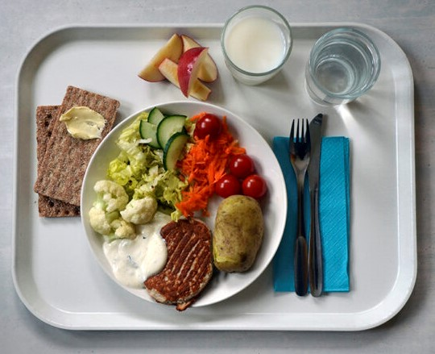
What goes on the plate?
Finnish school meals often include potatoes or rice, a source of protein, and half a plate of salad, served with rye crisp bread and a glass of milk.
Schools are encouraged to serve a vegetarian meal to all pupils one day a week and to have two alternative foods on display each day.
Notes:
Photo: Ulla-Maija Hänninen

