Slide 1

SCHOOL MEALS: THE FINNISH EXPERIENCE
Notes:
1

Slide 2
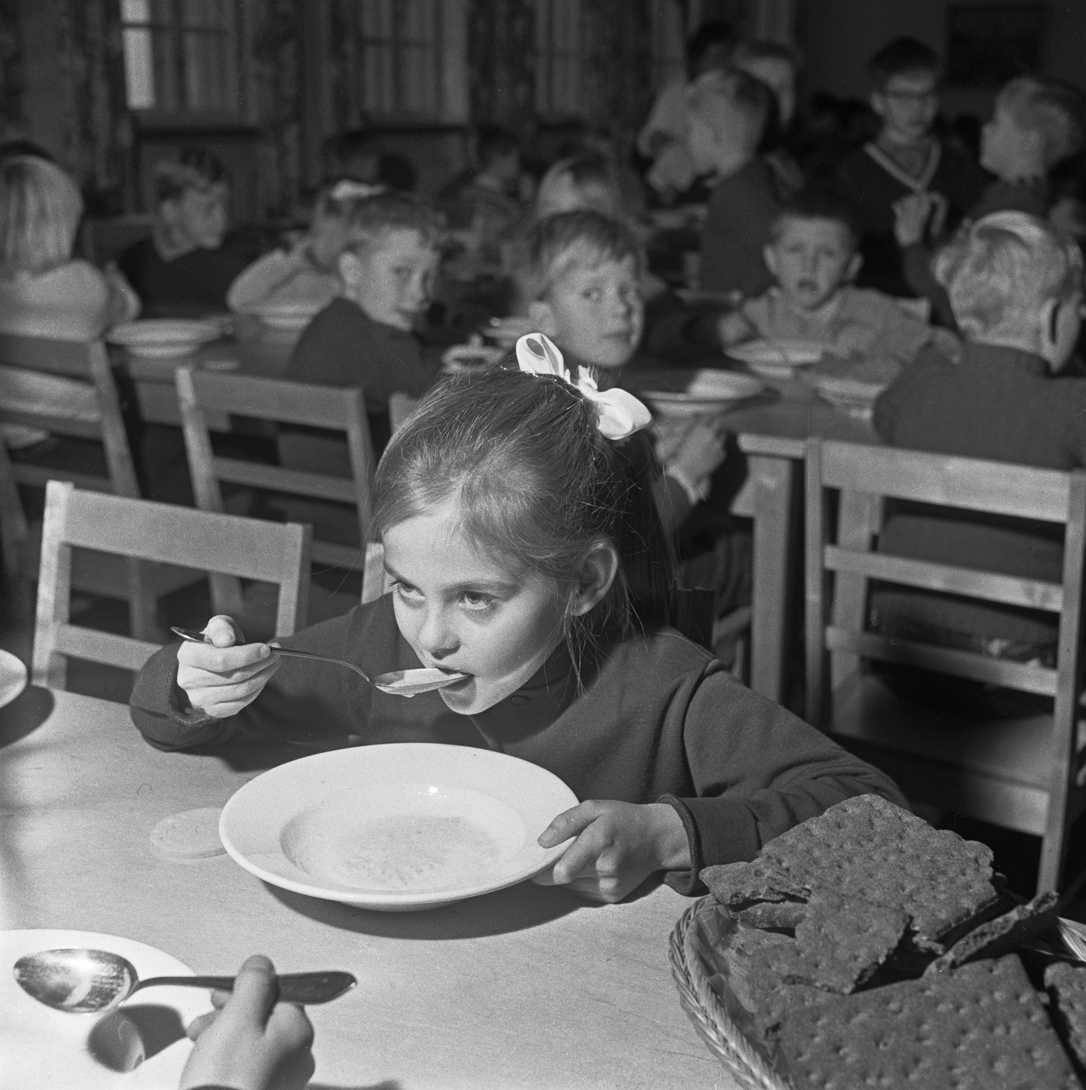
1
The role of school meals
in the development of Finnish society
Cover photo: Riku Isohella / Velhot Photography
Photo: Bror Brandt / Finnish Heritage Agency
Notes:
2

Slide 3
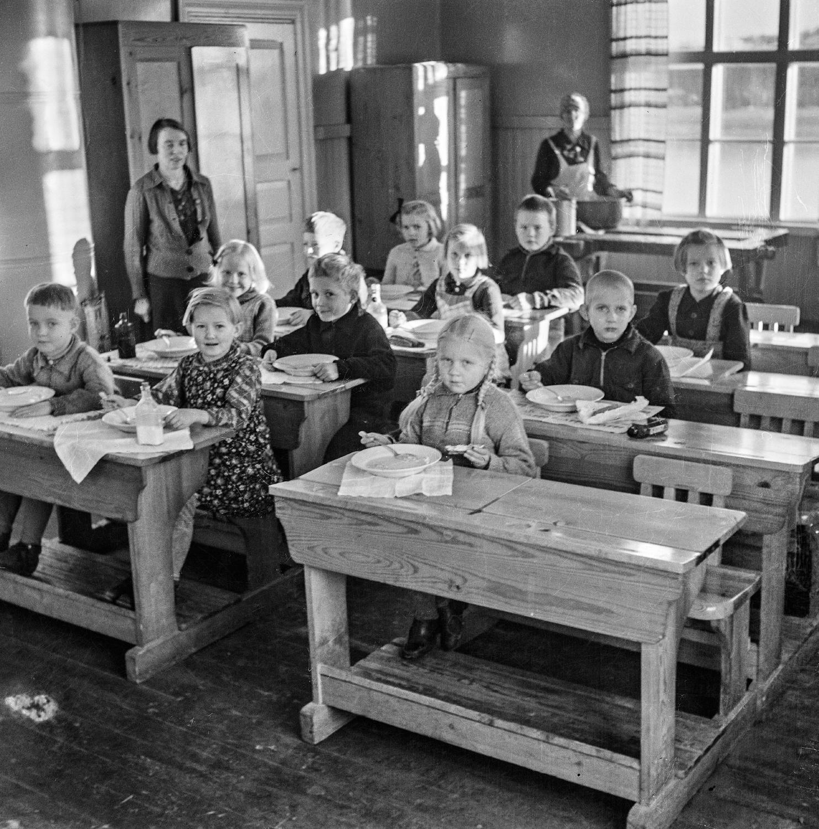
1
1
Free school meals have been provided by law to all pupils since the 1940s.
Initially, school meals served to address post-war poverty and malnutrition. They also facilitated children’s equal access to education and improved their cognitive development.
School meals aim to support children’s learning, nutrition, and health.
The school meal system is an important part of Finland’s education success story.
.
Photo: Antti Pänkäläinen / Museum of Central Finland
Notes:
3

Slide 4

Free meals for all build equity between children from different backgrounds, strengthening equal opportunities.
School meals support equality among parents by facilitating working outside the home and enhancing gender parity, female workforce participation and economic growth.
Photo: Riitta Supperi, Keksi / Finland Image Bank
Notes:
4

Slide 5

Educational aspects
of Finnish school meals
Photo: Sakari Piippo / Finland Image Bank
Notes:
5

Slide 6

Food education teaches healthy and sustainable everyday food choices. It is a tool to promote physical and social wellbeing.
Home economics classes for all students play a key role in empowering children with practical skills.
The Finnish school meals program emphasizes links to local food systems, healthy diets, and environmental sustainability.
Photo: Vesa Laitinen / Helsinki Partners
Notes:
6

Slide 7

Educational strategies
Photo: Maija Astikainen / Helsinki Partners
Notes:
7

Slide 8

Municipalities are responsible for providing school meals.
Legislation sets out the basic rules, implementation can be decided locally.
The food is prepared by public or private catering companies contracted by the municipality. Canteen staff can also be hired by each school.
School meals provide an opportunity to source local products and promote local food culture and heritage.
Photo: Elina Manninen, Keksi / Finland Image Bank
Notes:
8

Slide 9

School menus are aligned
with nutritional recommendations and students’ preferences
Photo: Riitta Supperi, Keksi / Finland Image Bank
Notes:
9

Slide 10

Menus are designed to follow national nutritional recommendations.
Meals must meet the quality criteria defined in legislation, the national core curriculum, local curricula and national guidelines.
In some municipalities, students actively participate in menu development. Feedback is collected from students and staff.
Vegetarian options are available daily.
Photo: Sakari Röyskö / City of Helsinki
Notes:
10

Slide 11

Benefits of school meals acknowledged
Photo: Maija Astikainen / Helsinki Partners
Notes:
11

Slide 12

Effectiveness is measured in improved health and learning capacity.
The benefits of school meals and their links to education and learning outcomes are widely acknowledged.
Photo: Vesa Laitinen / Helsinki Partners
Notes:
12

Slide 13

Cooperation is key
Photo: Jussi Hellsten / Helsinki Partners
Notes:
13

Slide 14

Throughout the system, cooperation and trust between the authorities, municipalities and schools create the basis for a successful school meal program.
Various institutional bodies deal with school nutrition and health with wide participation from ministries, agencies and the civil society.
A national school meals network brings together all actors to secure seamless flow of information and knowledge.
Photo: Vesa Laitinen / Helsinki Partners
Notes:
14

Slide 15

The School Meals Coalition
The School Meals Coalition aims ensure that every child can receive a healthy, nutritious meal in school by 2030.
Established by Finland and France in 2021, in collaboration with the World Food Programme (WFP).
Currently co-chaired by Finland, France and Brazil.
The coalition has 112 member countries and over 150 partners. More than 60 countries have established national commitments for school meals development.
Photo: Jussi Hellsten / Helsinki Partners
Notes:
15

Slide 16

The coalition promotes research, sustainable financing, data and monitoring development, co-operation of cities through its initiatives and consortiums.
The latest initiative is the School Meals Accelerator which offers targeted technical assistance to countries that have made significant commitments to scale up their programs.
Photo: Jussi Hellsten / Helsinki Partners
Notes:
16

Slide 17
Making happiness happen.
FINLAND
Notes:
17

