Slide 2
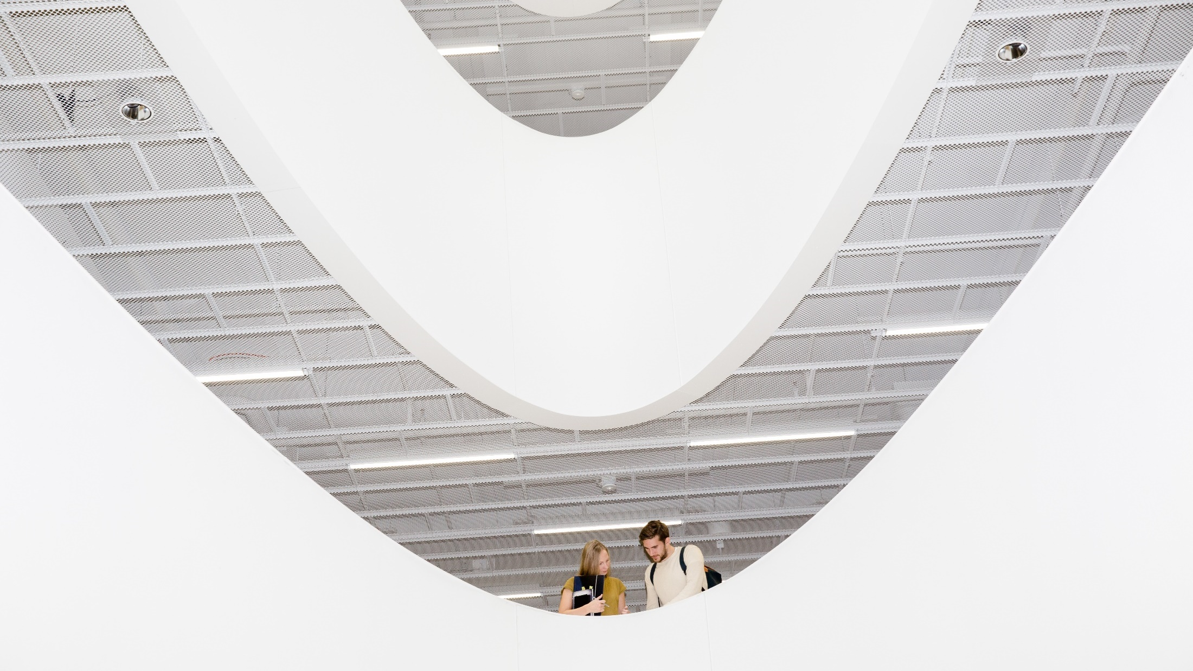
The FINNISH education system & EDUCATION SERVICES and solutions
Photo: Sakari Piippo
Notes:
Photo: Sakari Piippo

Slide 3
Education is the key to evolve and adapt in the changing world. Education helps us meet the requirements of future jobs and improves our standard of living while mitigating climate change.
The system in one country cannot be copied, but good practices can be adapted to another when co-creation takes place. People, new knowledge, digital technologies, learning philosophies, flexible structures, and processes can cross borders.
Finland has great strengths and proven track record in education, which can be shared with other countries.
Notes:
OECD (2019), “Preparing for the changing nature of work in the digital era”, OECD Going Digital Policy Note, OECD, Paris,
www.oecd.org/going-digital/changing-nature-of-work-in-the-digital-era.pdf

Slide 4
FINLAND HAS ONE OF THE BEST PERFORMING EDUCATION SYSTEMS IN THE WORLD
#1
MEDIA LITERACY INDEX
(OSIS 2023)
#1
PROFICIENCY IN NUMERACY AND LITERACY AMONG ADULTS
(PIAAC 2023)
#1
ADAPTIVE PROBLEM SOLVING AMONG ADULTS
(PIAAC 2023)
#1
THE HAPPIEST COUNTRY IN THE WORLD
(World Happiness Report 2026)
Notes:
Sources:
#1 MEDIA LITERACY INDEX: https://osis.bg/?p=4450&lang=en
#1 PROFICIENCY IN LITERACY AMONG ADULTS: https://www.oecd.org/en/about/programmes/piaac.html#publications
#1 PROFICIENCY IN NUMERACY AMONG ADULTS: https://www.oecd.org/en/about/programmes/piaac.html#publications
#1 THE HAPPIEST COUNTRY IN THE WORLD: World Happiness Report 2025 https://data.worldhappiness.report/table

Slide 5
THE FINNISH EDUCATION SYSTEM IN A NUTSHELL

Slide 6

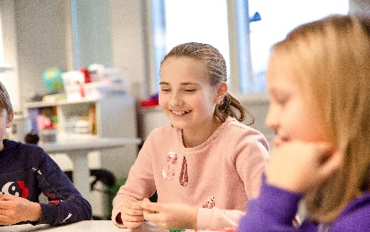
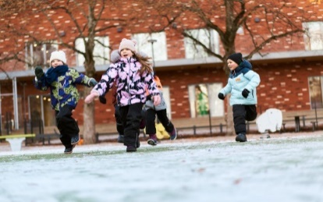
Finnish education is characterized by…
Joy of learning and the importance of student wellbeing - no one is left behind
Flexible system with no dead ends, lifelong learning
Critical thinking, creativity, and innovation play an important role
Low hierarchies, local autonomy, a strong culture of mutual trust
World-class media education and literacy
Free at all levels from pre-primary onward; modest fees for early childhood care
Long-term commitment to equality
Highly trained and respected teachers
No ranking of schools, students or teachers
Notes:
Tämä kopioitu toisesta esityksestä – pitäisi ehkä integroida tähän esitykseen visuaalisesti ja muutenkin paremmin, mutta ehdotuksena.
Tekstin erottuminen vaaleimman sinisten laatikoiden osalta, ei riittävä kontrasti saavutettavuuden kannalta.
Spiikkejä:
Schools have a great deal of autonomy. The national core curriculum is localized, and there is a high level of trust between all key education actors.
Teachers are professionals of learning. They can for example decide how they teach and what learning materials and resources they use.
Finnish children begin pre-primary education at the age of six, spend less time in the classroom and have less homework than kids in many other countries, but still have good learning outcomes.
Playing, gameful learning and physical activity promote the joy of learning, and pupils’ active role in learning increases motivation and capabilities for creative thinking.

Slide 7
Education for all
The development of the whole education system takes time. During the first years of the 20th century, only a third of children in rural areas went to school.
The 1921 act on compulsory education started the path towards a modern education system based on the philosophy of education for all. School meals have been free for all students, nationwide, in basic education since 1948.
Today, education from pre-primary to higher education is free of charge for Finns and citizens from EU/ETA countries. Early childhood education and care is heavily subsidized.

Slide 8
History
1943
Law on free-of-charge school meals. All pupils have been served free school lunch during each school day since 1948.
1973
Act on Children’s Day Care. Local authorities are obliged to organize public day care, which allows both parents to participate in working life.
1921
Compulsory School Attendance Act. Municipalities are obliged to provide six years of compulsory education to all children aged 7 to 13.
1972
School reform. New comprehensive school system with 9 grades guarantees same opportunities for good quality education in a school nearest to you.

Slide 9
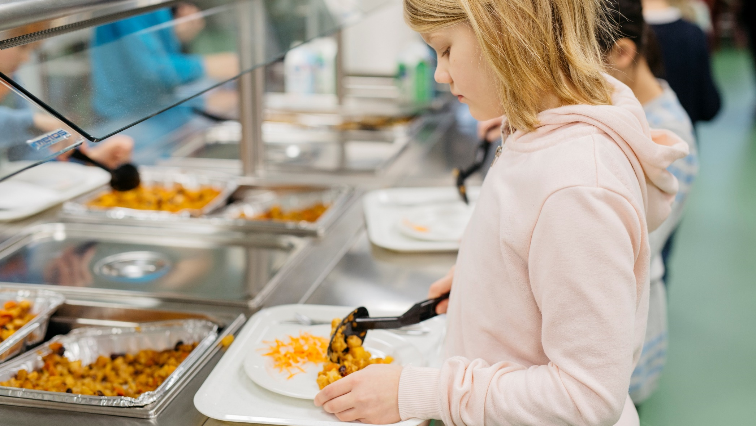
School meals work as an equalizer between children from different backgrounds, strengthen equal opportunity and most importantly, promote learning.
Photo: Elina Manninen/Keksi
Notes:
All pupils in Finland from pre-primary to upper secondary schools get a free-of-charge, nutritious school meal each day. In higher education, students get a meal subsidy.

Slide 10
History
1994, 2004, 2014
The national core curriculum and the education system have been reformed several times
1994
Requirement of master's level education for all basic education teachers
1985
Shift from a unified curriculum to a national core curriculum with local adaptations
1990s
Strong decentralization of education system. Abolishment of School inspectorate system, School books no longer centrally approved.
1996
Introduction of the dual model in higher education: academic universities & universities of applied sciences.

Slide 11
History
2018
Reform of secondary vocational education to introduce competence-based qualifications and a close co-operation with workplaces
2010
Introduction of the principal of inclusion in Finnish schools
1995
First ‘e-Learning strategy’: Education,
Training and Research in the Information Society (1995-2000)
2015
Pre-primary education compulsory for all 6-year-olds
2021
Extension in compulsory education. The minimum school leaving age raised from 16 to 18 years.

Slide 12
The Finnish education system today
Secondary education
16-19-year-olds
Matriculation examination in general upper secondary schools
Tertiary education
Appr. 3+2 years
Bachelor’s and Master’s degrees at Universities
Doctoral degrees and licentiate degrees in Universities
Basic education
0-5-year-olds
Early childhood education and care
6-year-olds
Compulsory pre-primary education
7–16-year-olds
Basic education in comprehensive schools
16-19-year-olds
Vocational qualifications in vocational institutions (incl. adult learners)
Appr. 3+2 years
Bachelor’s and Master’s degrees at Universities of Applied Sciences
Notes:
Tämän visuaalinen ilme paremmaksi! Toimisiko valkoinen pohja ja siniset laatikot? The Finnish education system today consists of early childhood education and care, one-year pre-primary education, nine-year basic education, upper secondary (general or vocational) and higher education.
Additionally, lifelong/continuous learning is emphasized and adult education is available at all levels of education and in non-formal education. It is no coincidence that in Finland enrolment in adult education ranks among the highest in the world together with other Nordic countries.

Slide 13
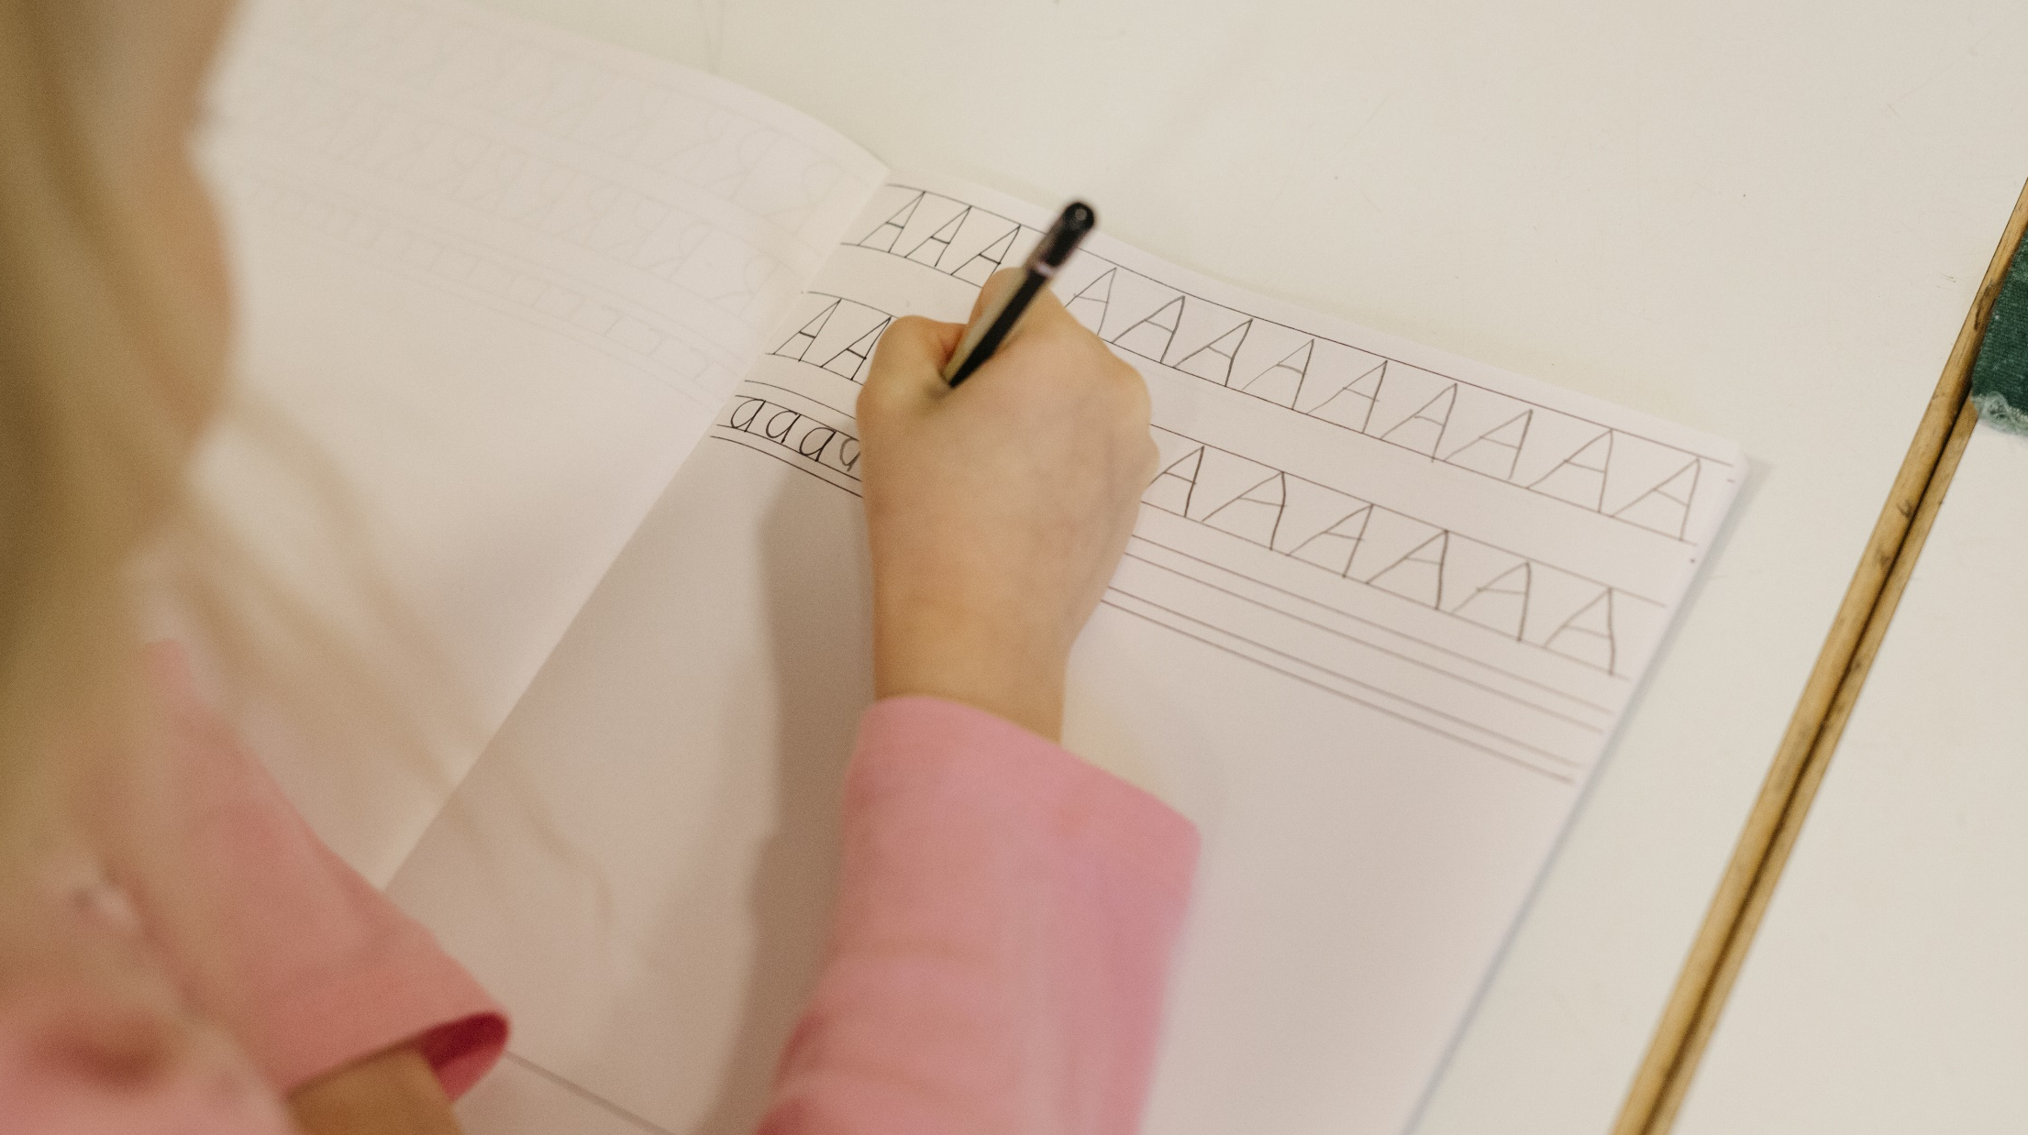
All children are entitled to support for learning. Pupils with learning difficulties generally study in the same schools and classrooms as the others
Photo: Elina Manninen/ Keksi/ Finland Promotion Board
Notes:
Tähän taustalle joku kiva kuva + teksti boksiin

Slide 14
Teachers in Finland
Teachers are valued in Finnish society. Teaching is a popular profession and universities can select the most motivated and talented applicants.
Both class teachers and subject teachers are highly trained (with a university Master’s degree), and their research-based training includes pedagogical studies as well as teaching practice.
As a result, teachers are autonomous professionals with the expertise and ability to develop their own work. They are trusted, enjoy wide autonomy and have flexibility in their work.
Teachers also actively participate in developing education and educational solutions as well as learning materials.
Notes:
- lisäys maisterintutkinnosta tähän diaan
- tähän myös tietoa opettajien palkoista, jos tulee kysymys niin on vastaus heti saatavilla + tietoja siitä, mitä eri koulutusasteiden opettajilta vaaditaan
+ . + ei raportointivelvollisuutta

Slide 15
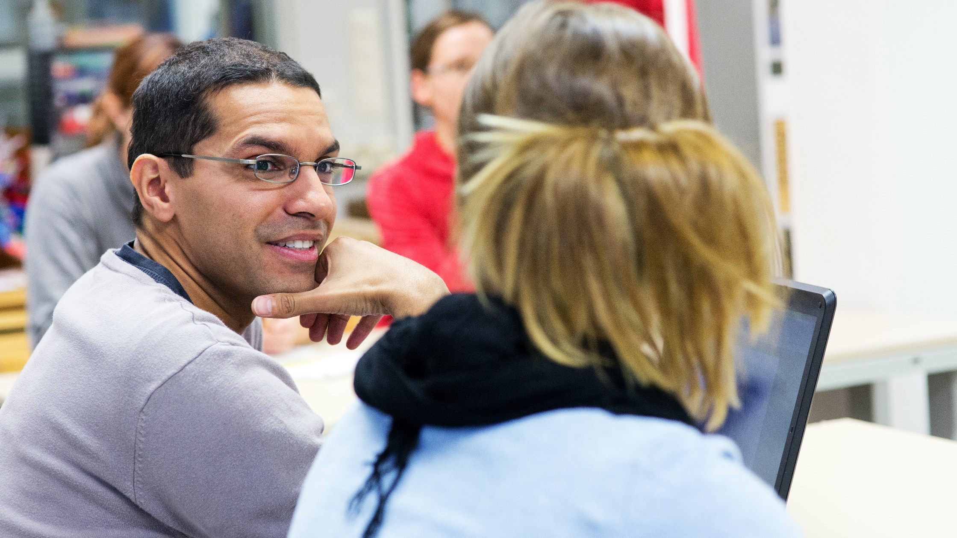
Finnish teachers develop and update their competences by taking part in regular in-service training, all throughout their teaching careers.
Photo: Riitta Supperi/Keksi/Finland Promotion Board

Slide 16
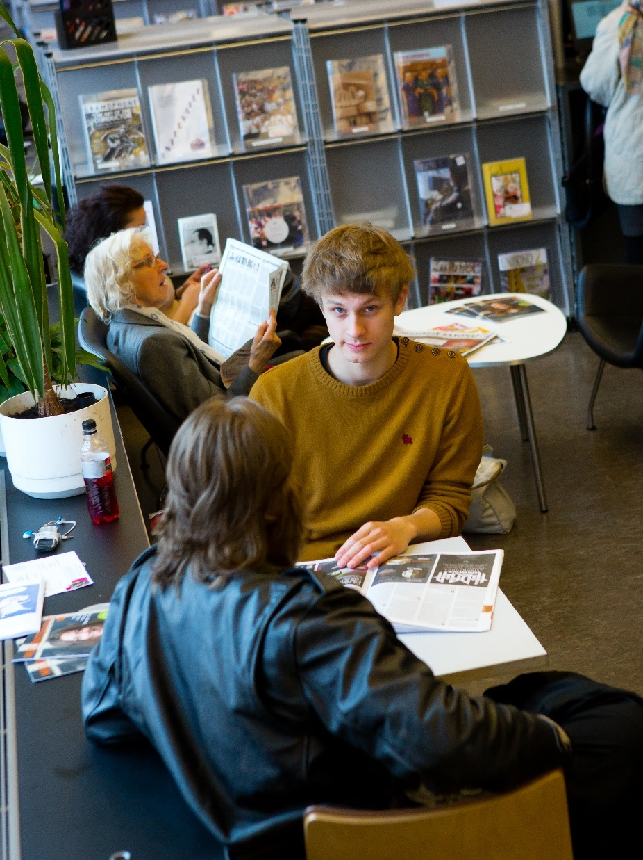
Lifelong learning
Annually 1,1 million citizens take part in courses offered by adult education centres, folk high schools, learning centres, sports training centres and summer universities. Courses are nearly free of charge.
The aim of liberal adult education is to promote social cohesion, equality and active citizenship.
Photo:
Photo:
Photo: Riitta Supperi/Keksi/Team Finland
Notes:
Photo: Riitta Supperi/Keksi/Team Finland
Source: Tilastokeskus: https://pxdata.stat.fi/PxWeb/pxweb/en/StatFin/StatFin__oaiop/statfin_oaiop_pxt_12yh.px/table/tableViewLayout1/

Slide 17
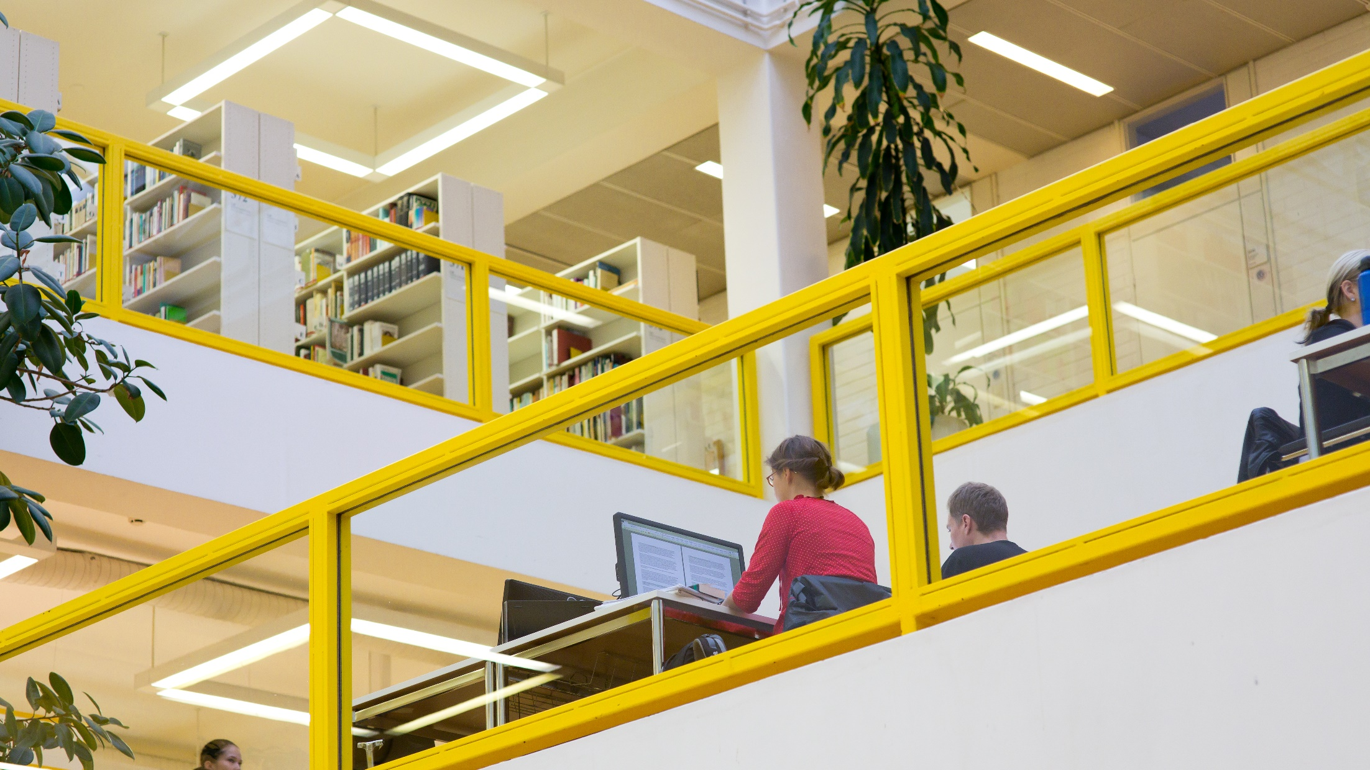
76.4% of adult Finns participated in informal learning during the past year, compared to the EU average of 64.2%.
Source: Eurostat (2022)
Photo: Riitta Supperi/Keksi/Team Finland
Notes:
Tähän tarkemmin tilaston vuosiluku ja lähde

Slide 18
Creativity and problem-solving
At the end of the 20th Century Finland’s economy started focusing on technology industries, R&D, information and knowledge.
New partnerships developed between tertiary education and industry, while primary and secondary education also evolved to promote creativity, problem-solving, teamwork and other working life skills.
The national core curricula emphasize transversal competences, such as media literacy, while still keeping traditional school subjects.
Finnish students have high scores in creative thinking, with particularly good performance in the collaborative solving of social problems.
Notes:
Experts have helped travel companies to develop comprehensive study tours.

Slide 19
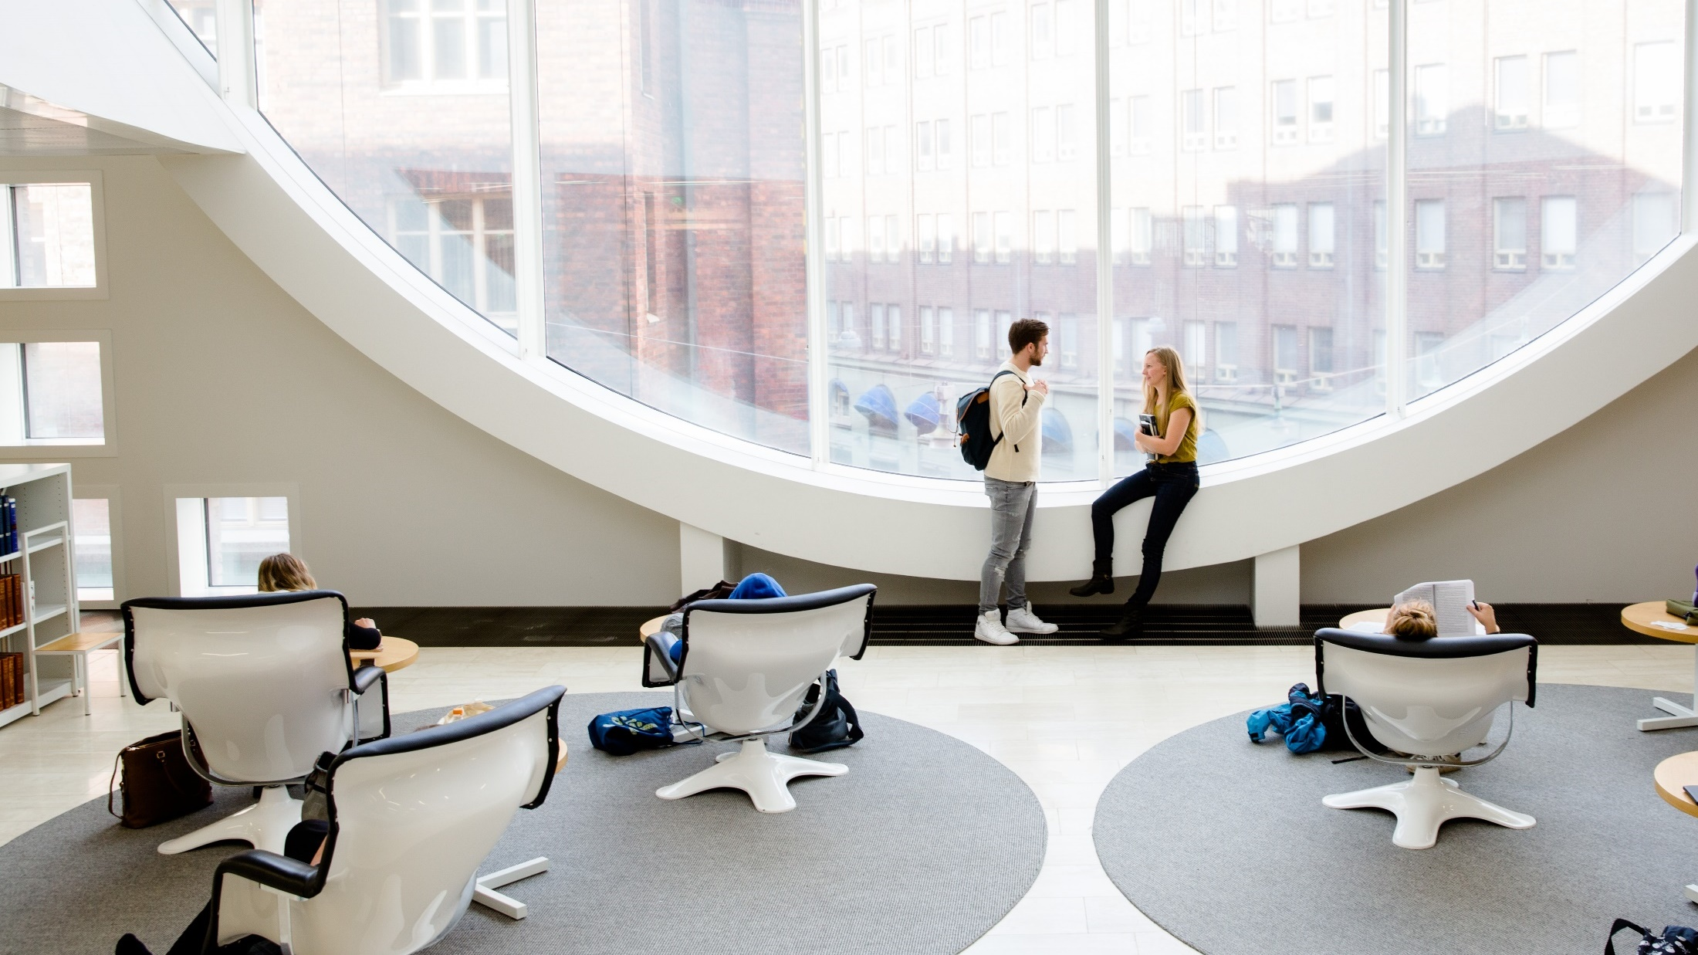
Collectively, Finnish universities feature in the top third of the QS World University Rankings (2026)
Photo: Sakari Piippo
Notes:
Education at a Glance 2019 (OECD): https://www.oecd-ilibrary.org/sites/f8d7880d-en/index.html?itemId=/content/publication/f8d7880d-en

Slide 20
Worldwide recognition
In the 2000s, Finland’s education system began to receive worldwide attention thanks to high international rankings in education. Finland was able to achieve these results while spending only slightly more money per student than the OECD average.
Finland has stood out for success in combining excellent academic results with a high level of student satisfaction. Well-being is a key consideration in Finnish education.
In the OECD’s Programme for the International Assessment of Adult Competencies (PIAAC), the so called “Adult PISA”, Finland ranks first in all three domains; literacy, numeracy and adaptive problem-solving.
Notes:
Kakkospallon lähde PISA, mutta ei haluta erikseen nostaa

Slide 21
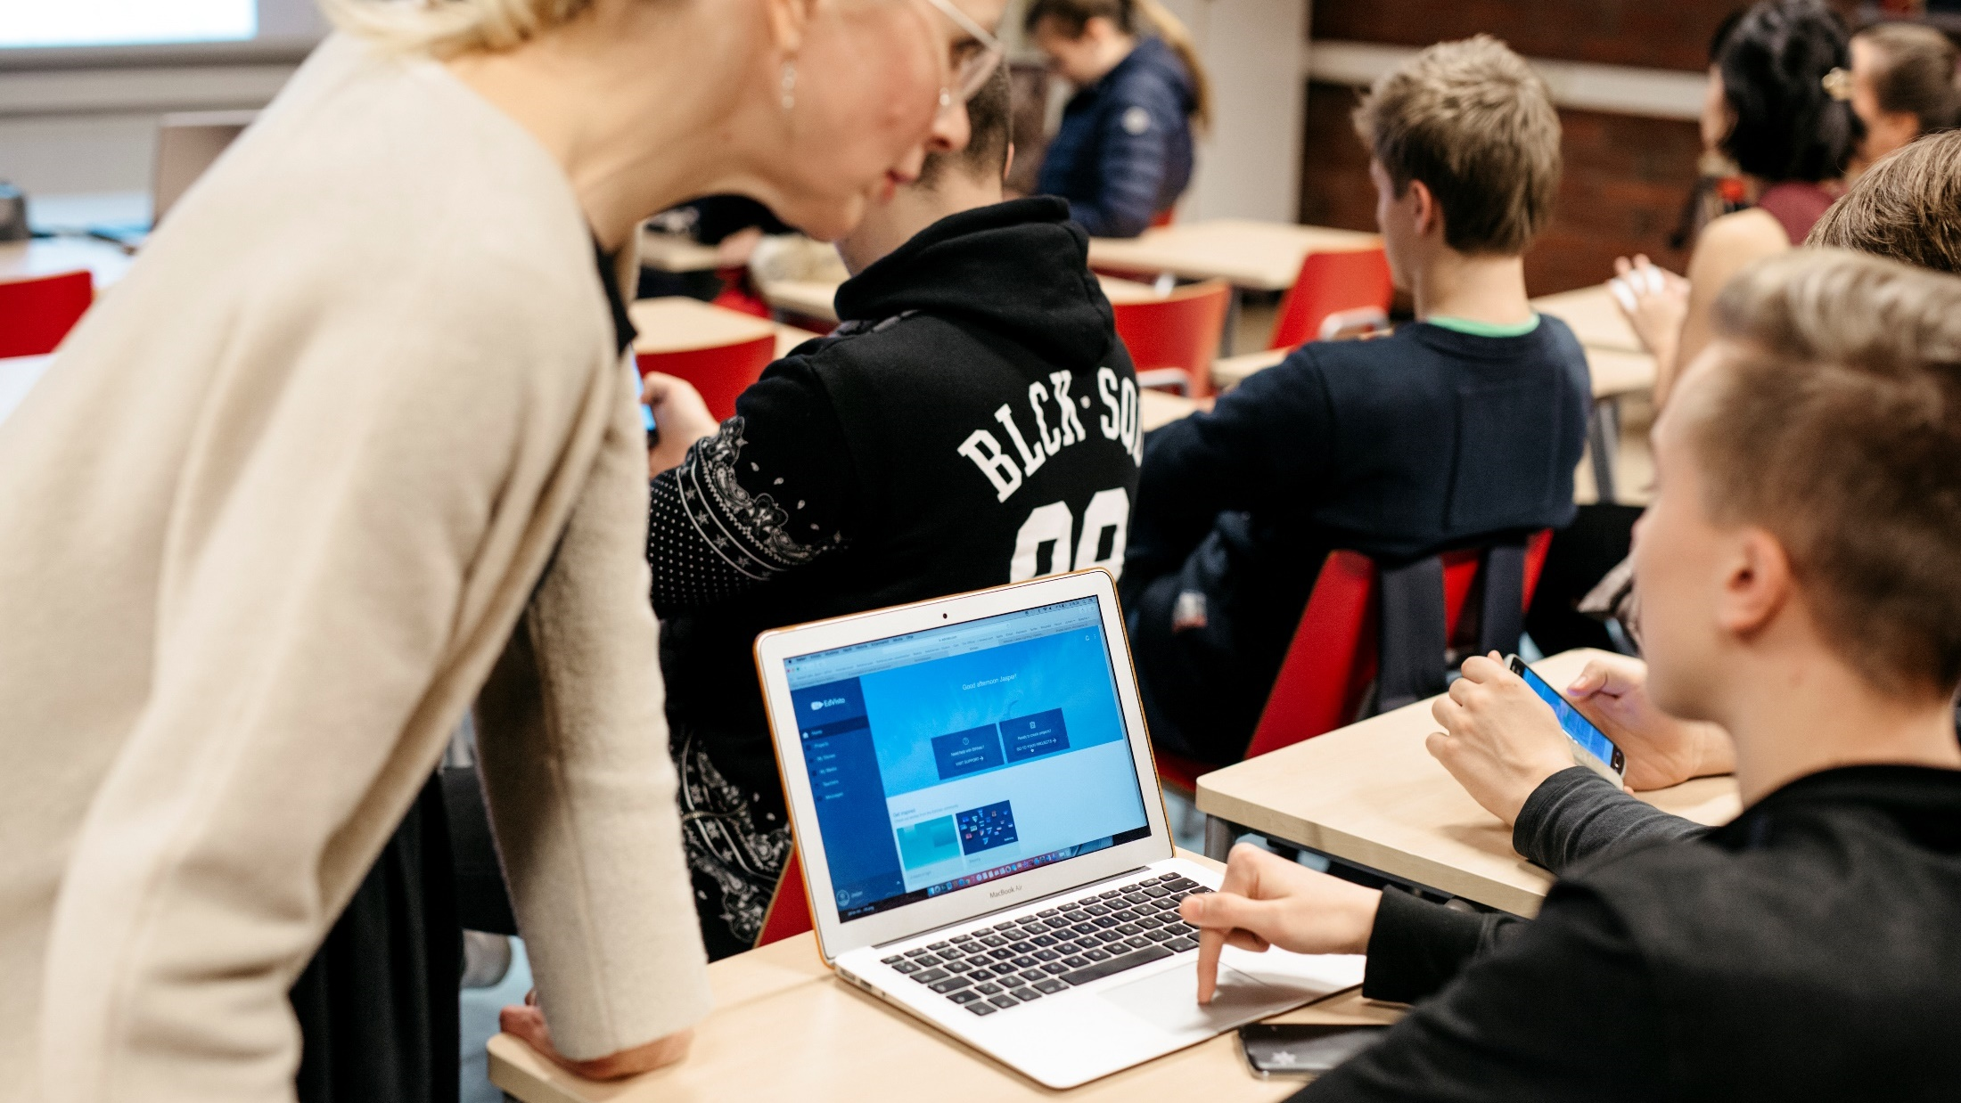
In Finnish education, technology is seen as a tool that supports learning, rather than as an end in and of itself
Photo: Velhot Photography Oy/ Riku Isohella

Slide 22
Digital competences in Education
In Finland, digital technologies or ICT is not generally taught as a separate subject in either primary or secondary education. The national core curricula for basic education includes digital skills and multi-literacy skills as transversal competences. They are integrated in the teaching of all subjects.
It is important that new technologies are used in a pedagogically meaningful way. Technologies for learning must be easy and reliable to use. All children and young people have the right to digital competence.
Finnish schools have digital tutor teachers and mentors as well as other peer support mechanisms for using digital tools and services.

Slide 23
Education Technology
In recent years a thriving Education Technology (EdTech) sector has developed, merging Finnish software and education strengths.
Finland has a strong digital sector and a booming gaming industry. This all has helped to create favorable conditions for developing cutting-edge digital learning solutions, that make learning fun, engaging and personal.
Many of the educational technology solutions have been developed together with Finnish teachers, and tested in Finnish schools.

Slide 24
THE BEST PRACTICES FROM FINLAND’S EDUCATION SYSTEM CAN BE ADAPTED

Slide 25

Continuous development
Photo: Jeswin Thomas/Unsplash
The reforming of the education system in Finland continues today.
Finnish education institutions and companies are eager to work with international partners in education, share what they know and collaborate for new innovations in learning.
Notes:
Photo: Jeswin Thomas/Unsplash

Slide 26
Education Finland
Education Finland is a governmental cluster programme supporting education institutions and companies in their growth on the international market.
Its 120+ member companies have a wide variety of services in education, representing some of the most innovative solutions:
Degree programmes: higher education and VET
Educational services: teacher training, pedagogical and vocational programs, consultancy services
Educational and learning products: programs, applications, learning platforms, educational content and materials
Learning environments.
Notes:
Source: https://www.educationfinland.fi/members

Slide 27
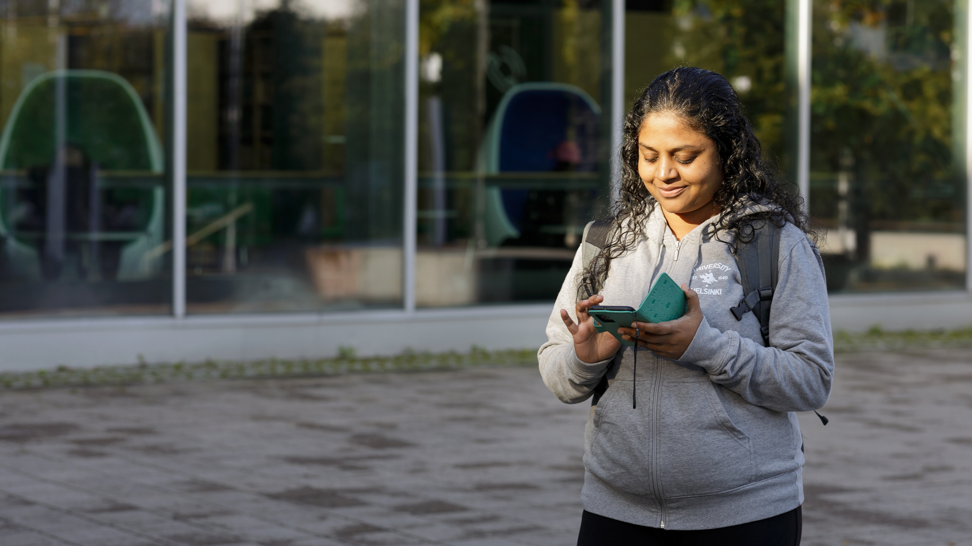
There are more than 600 English-taught degree programs in 13 universities and 22 universities of applied sciences. Source: Studyinfo.fi
Photo: Keksi / Suvi-Tuuli Kankaanpää
Notes:
Source: https://opintopolku.fi/konfo/en/haku?koulutustyyppi=amk-alempi,amk-ylempi,kandi,kandi-ja-maisteri,maisteri&opetuskieli=oppilaitoksenopetuskieli_4&order=desc&size=20&sort=score

Slide 28
Higher Education
Universities and universities of applied sciences have extensive autonomy and freedom of education and research.
They promote competitiveness, well-being, education and learning as well as sustainable development.
The Finnish Higher Education system has been ranked by Universitas21 among the Top 10 in the world.
International students particularly appreciate Finland’s study facilities like well-equipped libraries and campuses, IT services and support services.
Affordable student housing is offered to international students.

Slide 29

INTERNATIONAL STUDENTS
LOVE TO
Follow the student ambassadors on IG:
sif.ambassadors
Notes:
Jotakin student ambassadoreista tähän, esim. linkki? + visu vanha

Slide 30
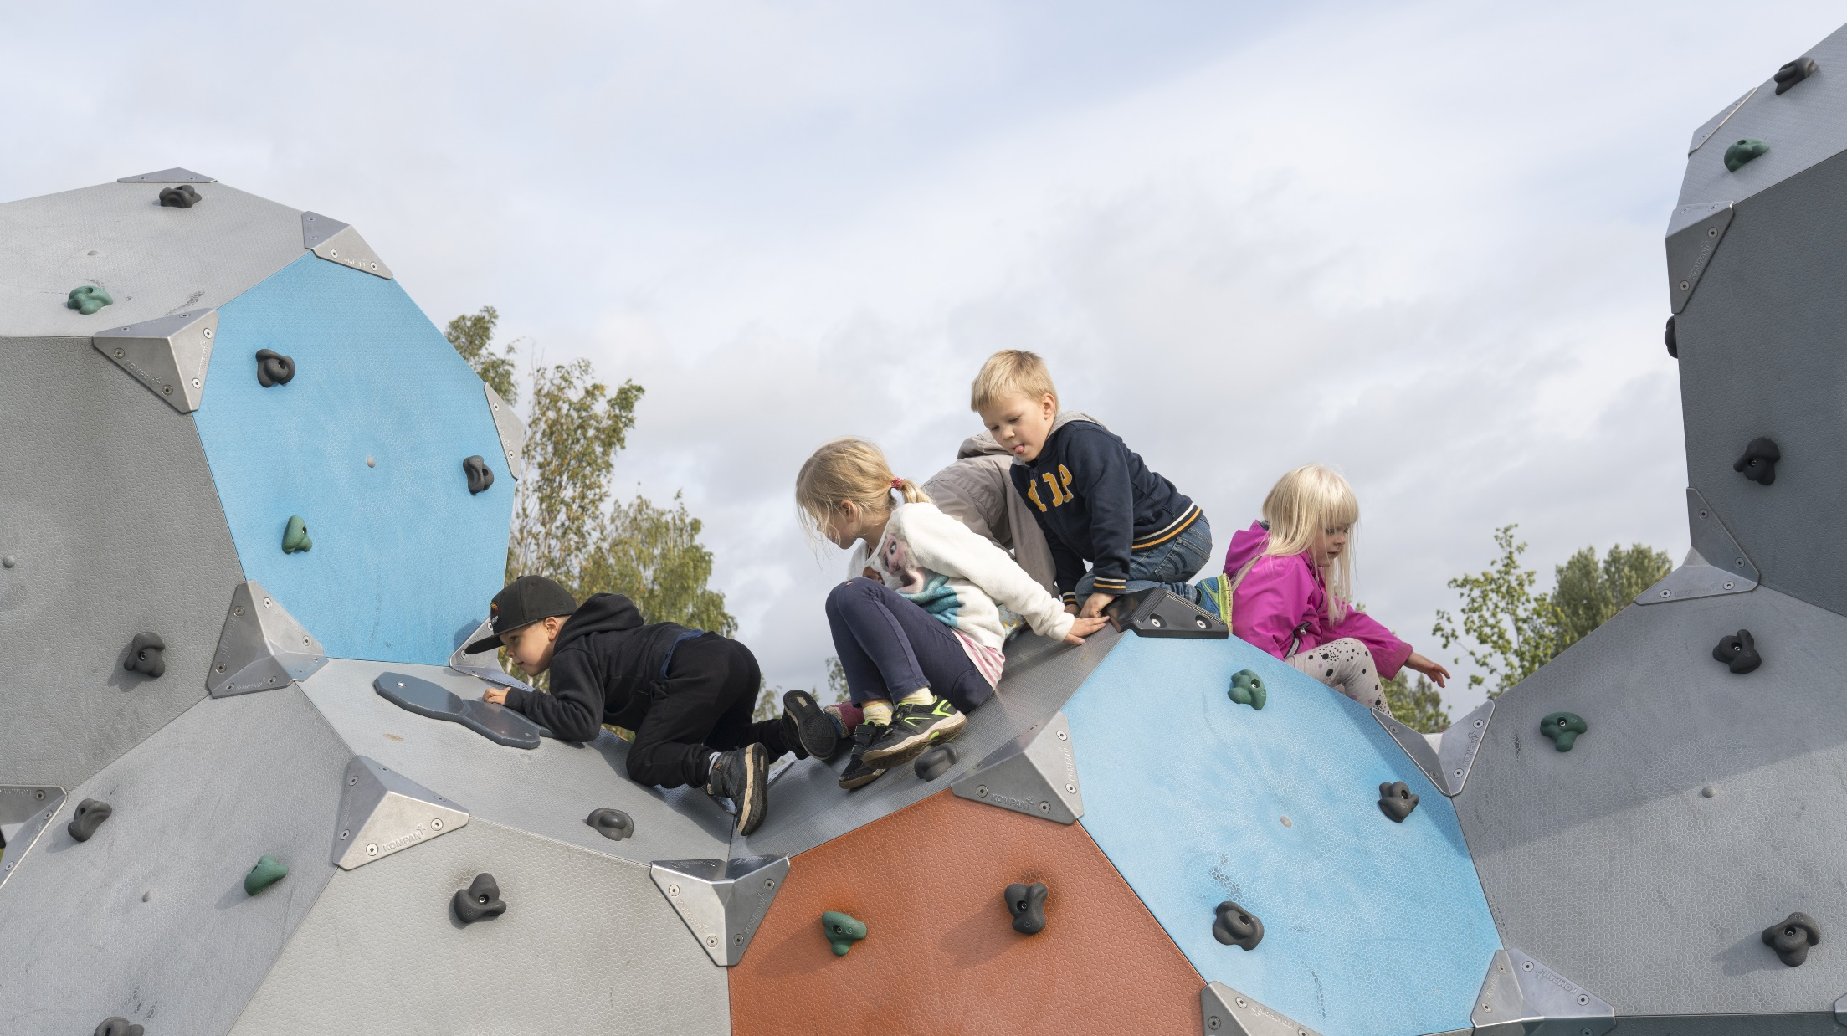
Thank you!
Photo: Pasi Markkanen/ Finland Promotion Board

