Slide 2
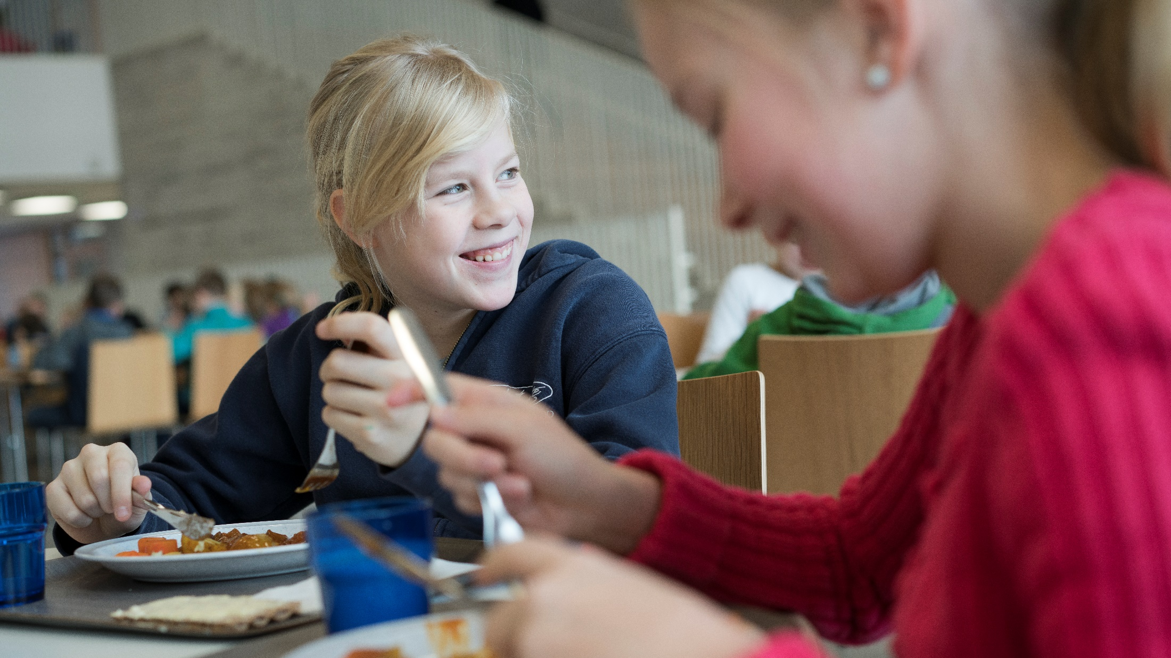
School food – building finnish equality since the 1940s

Slide 3
Free meals for all
In Finland, free-of-charge school meals have been provided since the 1940s, with the aim of supporting children’s learning, nutrition, and health.
All pupils in Finland from pre-primary to upper secondary schools get a free-of-charge, nutritious meal each school day.
The Finnish school feeding system promotes equal opportunities and education for all. The system is a Finnish social innovation, which plays an essential role in the educational system of the country.

Slide 4
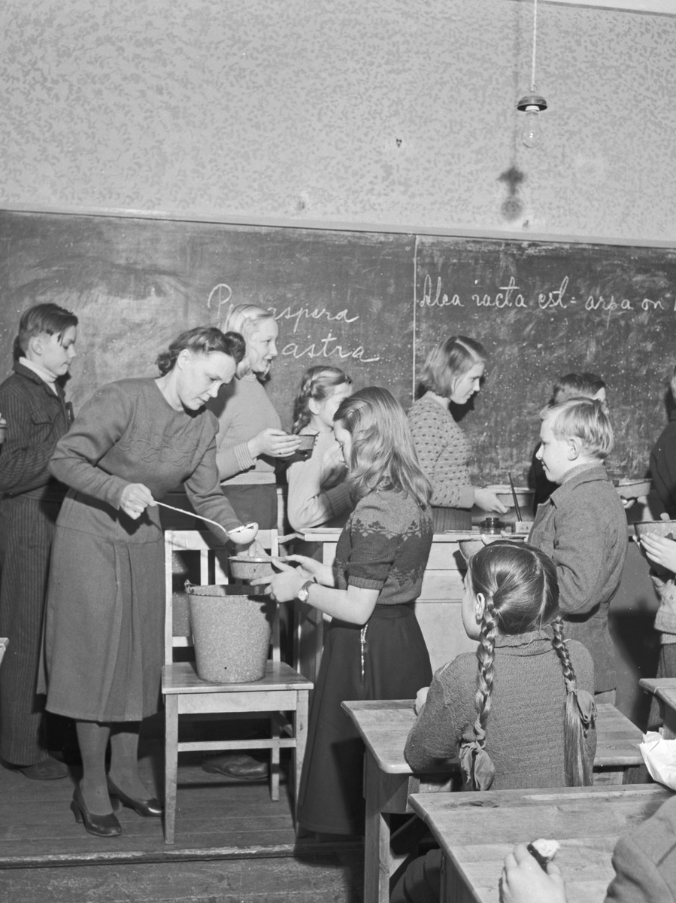
History of Finnish school meals
The school feeding system was originally introduced in the 1920’s, but free-of-charge school meals for all children began in the 1940s.
With a history of over 70 years, Finland has the world’s longest-running free-of-charge school feeding system.
Photo: Pekka Kyytinen /Finnish Heritage Agency – Musketti: Ethnographic Picture Collection

Slide 5
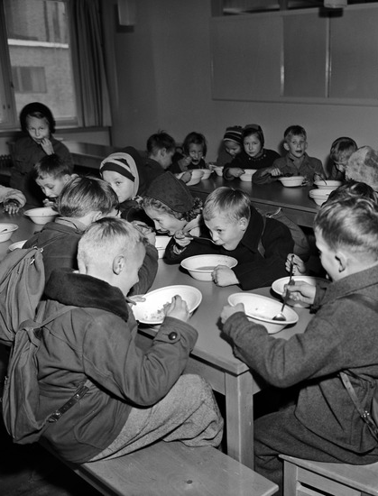
History
When first introduced, the aim of the free school meals was to level out social differences.
As hungry children are not able to focus on learning, school feeding was seen as an important step towards educational equality.
Photo: Helsinki City Museum

Slide 6
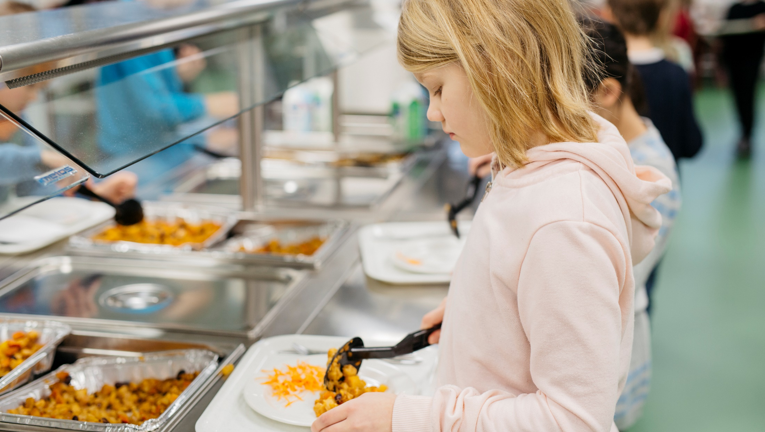
Photo: Elina Manninen/Keksi

Slide 7
Equal opportunities for all children
Finland has invested in human capital and equal opportunities for all children by providing access to free education and free school meals. This has been one of the key factors in strengthening economic growth and transforming Finland into a knowledge-based society.
The benefits of school-time feeding and its links to education and learning is widely acknowledged. School meals support children’s learning outcomes, nutrition, and health.

Slide 8
School meals are an investment in equality and the future. They build equality between children from different backgrounds, strengthening equal opportunity.

Slide 9
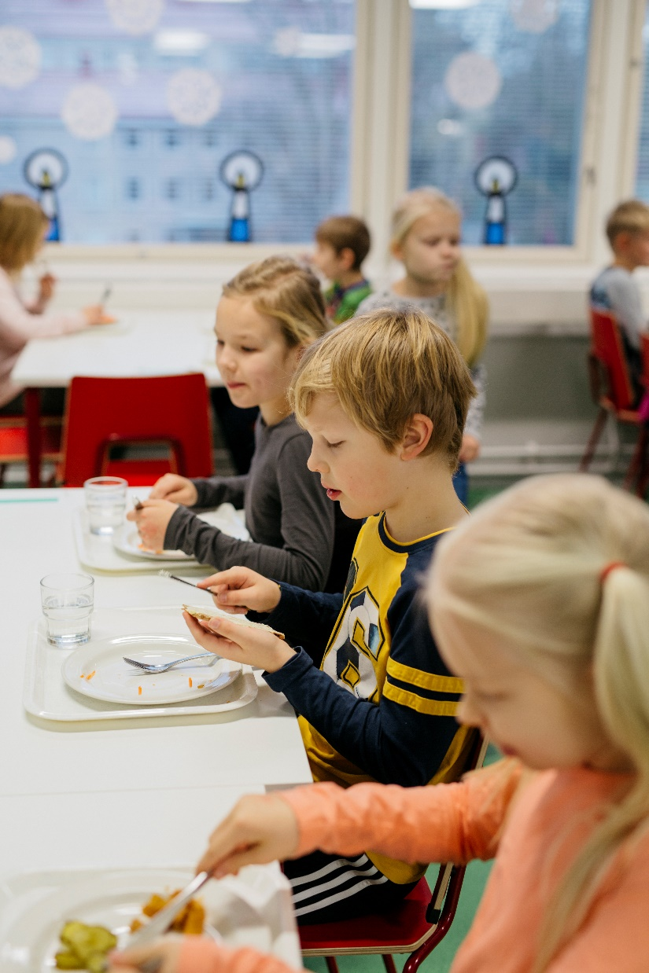
School meals as part of education
Since 2004, school meals have been part of the national school core curriculum, giving them an educational status.
School meals not only provide the pupils with a nutritious meal on school days. They also teach them food-related skills and knowledge, such as awareness of healthy diets, other food cultures and food’s environmental impact.

Slide 10
An investment in equality and the future
School meals make it easier for parents to work outside home, supporting gender equality, female workforce participation, and thus economic growth.
All children regardless of their background receive a nutritious meal once a day supporting their health and learning.
The school meals also provide an opportunity to source and promote local products and local food culture.

Slide 11
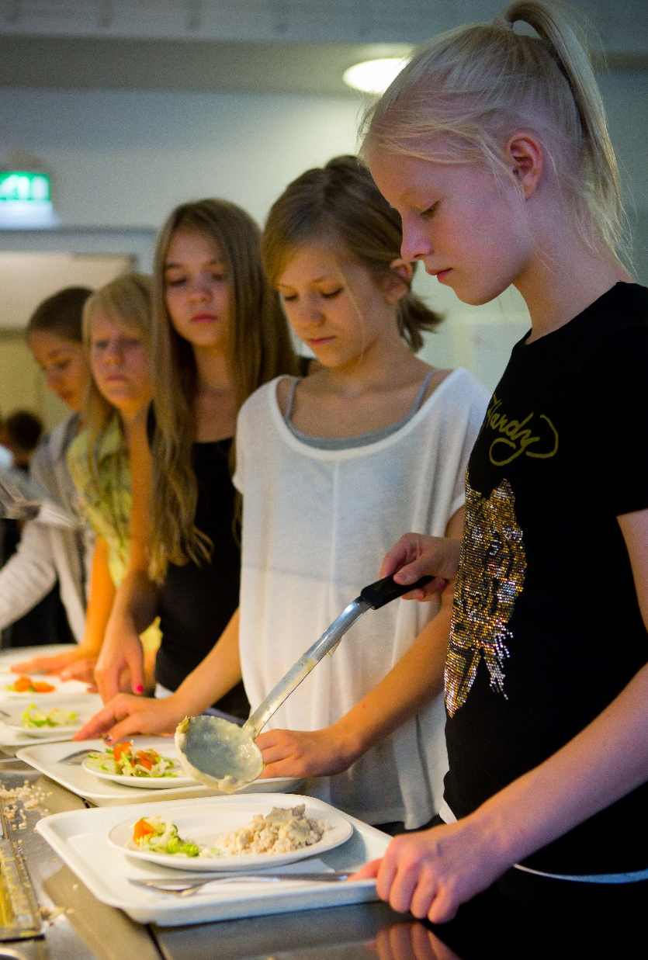
Scheme built on cooperation and trust
The scheme is based on cooperation and trust: ministries and agencies provide funding, municipalities take care of practical arrangements, and pupils are encouraged to participate in the planning and evaluation of the meals.
Budgets for education are decided locally, so financial allocation to school feeding depends on local political decision-making by municipal councils.

Slide 12
2.8€
The national average cost of a single school meal
The meal should
cover about
30%
of the pupils’ daily need of energy
Notes:
The national average cost of a single school meal includes food personnel costs, equipment and transport.

Slide 13
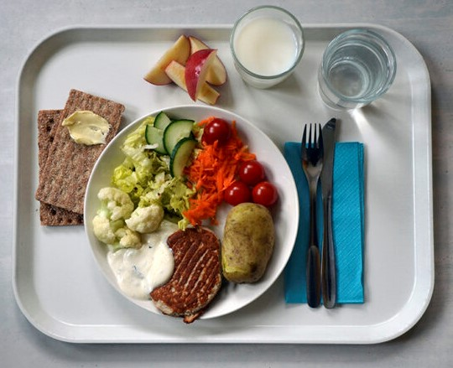
What goes on the plate?
Finnish school meals often include potatoes or rice, a source of protein, and half a plate of salad, served with rye crisp bread and a glass of milk
Schools are encouraged to serve a vegetarian meal to all pupils one day a week, and to have two alternative foods on display each day.
Photo: Ulla-Maija Hänninen

Slide 14
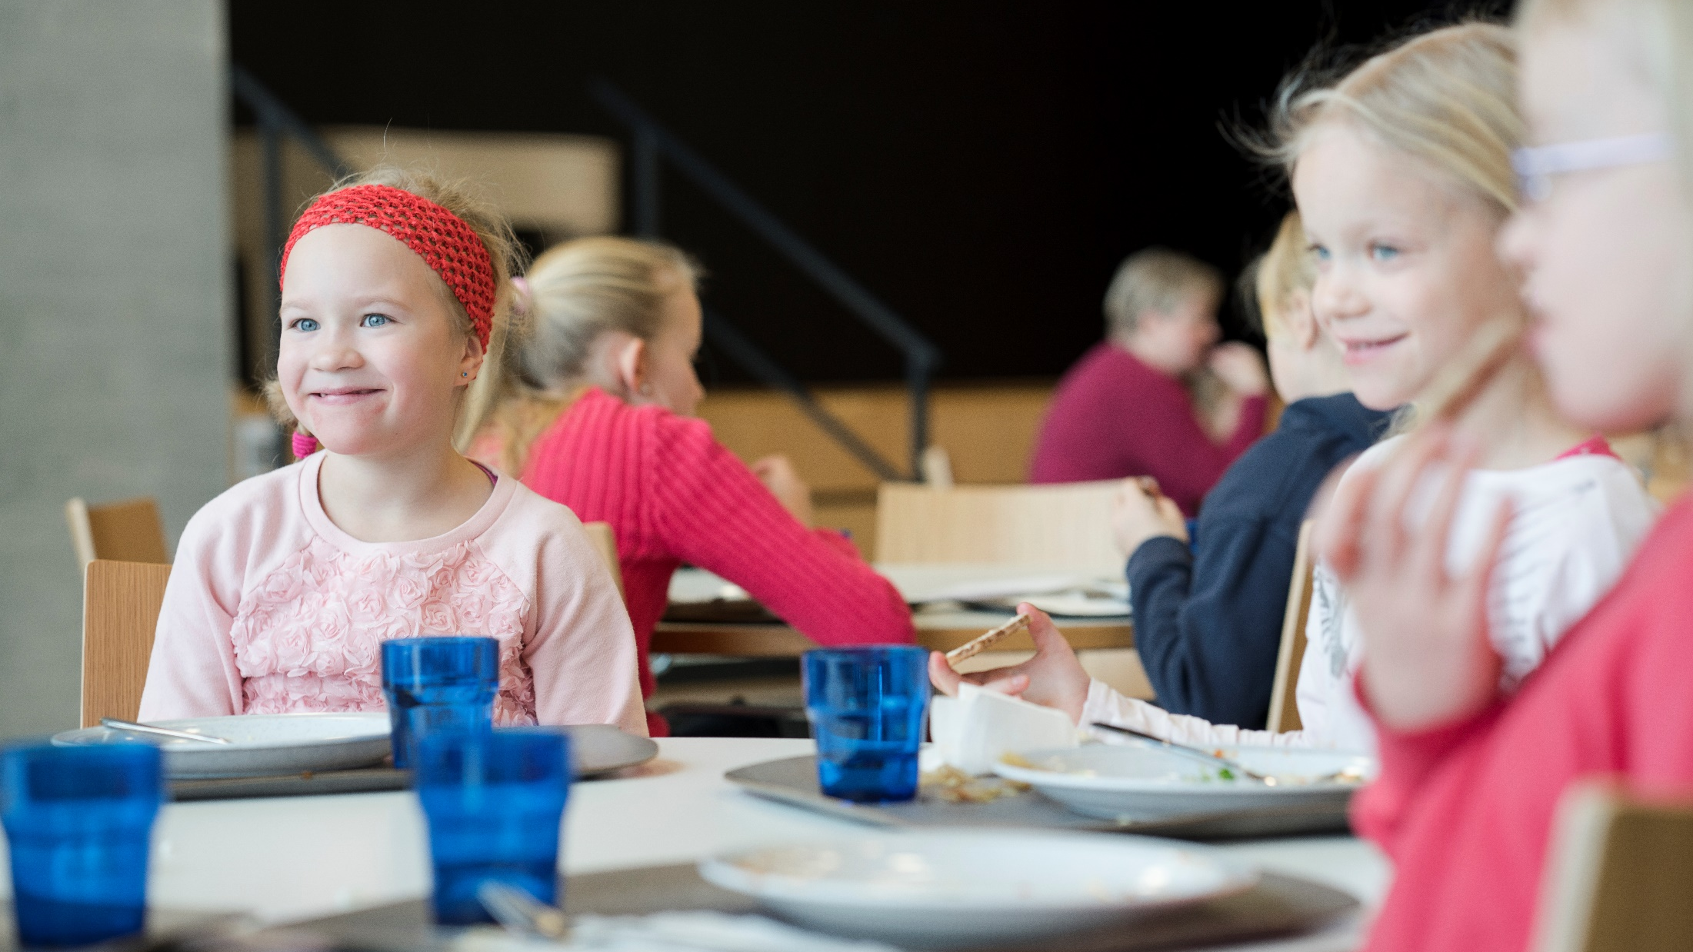
Thank you!
Photo: Riku Isohella/Velhot Photography

