Slide 2
CLIMATE MATTERS – finland takes climate action

Slide 3
One country working alone cannot tackle the climate and environmental problems we face today. That is why Finland is committed to solving environmental issues swiftly, practically and together with others.
We believe that technological and social innovations are the key to finding solutions that work inside and outside of Finland. Rather than being afraid of challenges, we meet the ambitious global and national climate targets with action and cooperation.
Legislation and research form the basis of our ambitious climate goals, but in order to meet them we need to do much more. Everybody needs to contribute to the change, which is why climate education is now an integral part of the curriculum in Finnish schools.

Slide 4
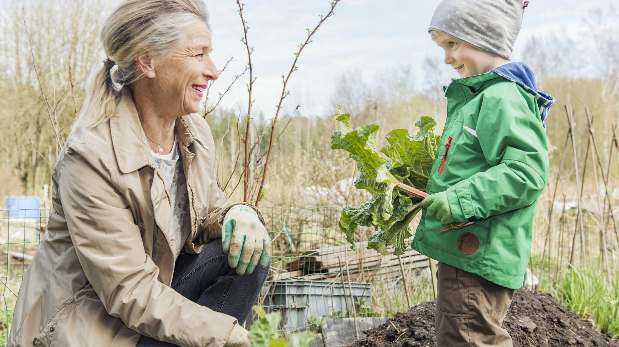
Education and a strong nature relationship

Slide 5
Finns support ambitious climate policies and participate in solving problems
Four out of five Finns consider that urgent action is needed to mitigate climate change. People in Finland believe that solutions to the climate crisis should be at the heart of policy-making.
Participation in solving matters for the common good, volunteering and working together are deep-rooted in the Finnish culture.
Participation is the core element of the law drafting process as well. During the renewal of the national Climate Act over 2,500 people told the Government what “the perfect climate act” should consist of.

Slide 6
teaching climate responsibility
CASE EXAMPLE
Climate change education is part of the Finnish curriculum from kindergarten to university. The aim of the core curricula is for students to familiarise themselves with research evidence and practices associated with mitigating climate change and safeguarding biodiversity.

Slide 7
Climate change education forms the base for climate responsibility
The Finnish national core curricula aim to teach everyone the basics of climate responsibility. The aim of the core curricula is for students to familiarise themselves with research evidence and practices associated with mitigating climate change and safeguarding biodiversity.
The Finnish National Agency for Education supports teaching skills that are essential to build a sustainable future for the climate.
The learning objectives help students understand why human activity has to be reconciled with the capacity of natural environments as well as the sustainable use of limited natural resources.

Slide 8
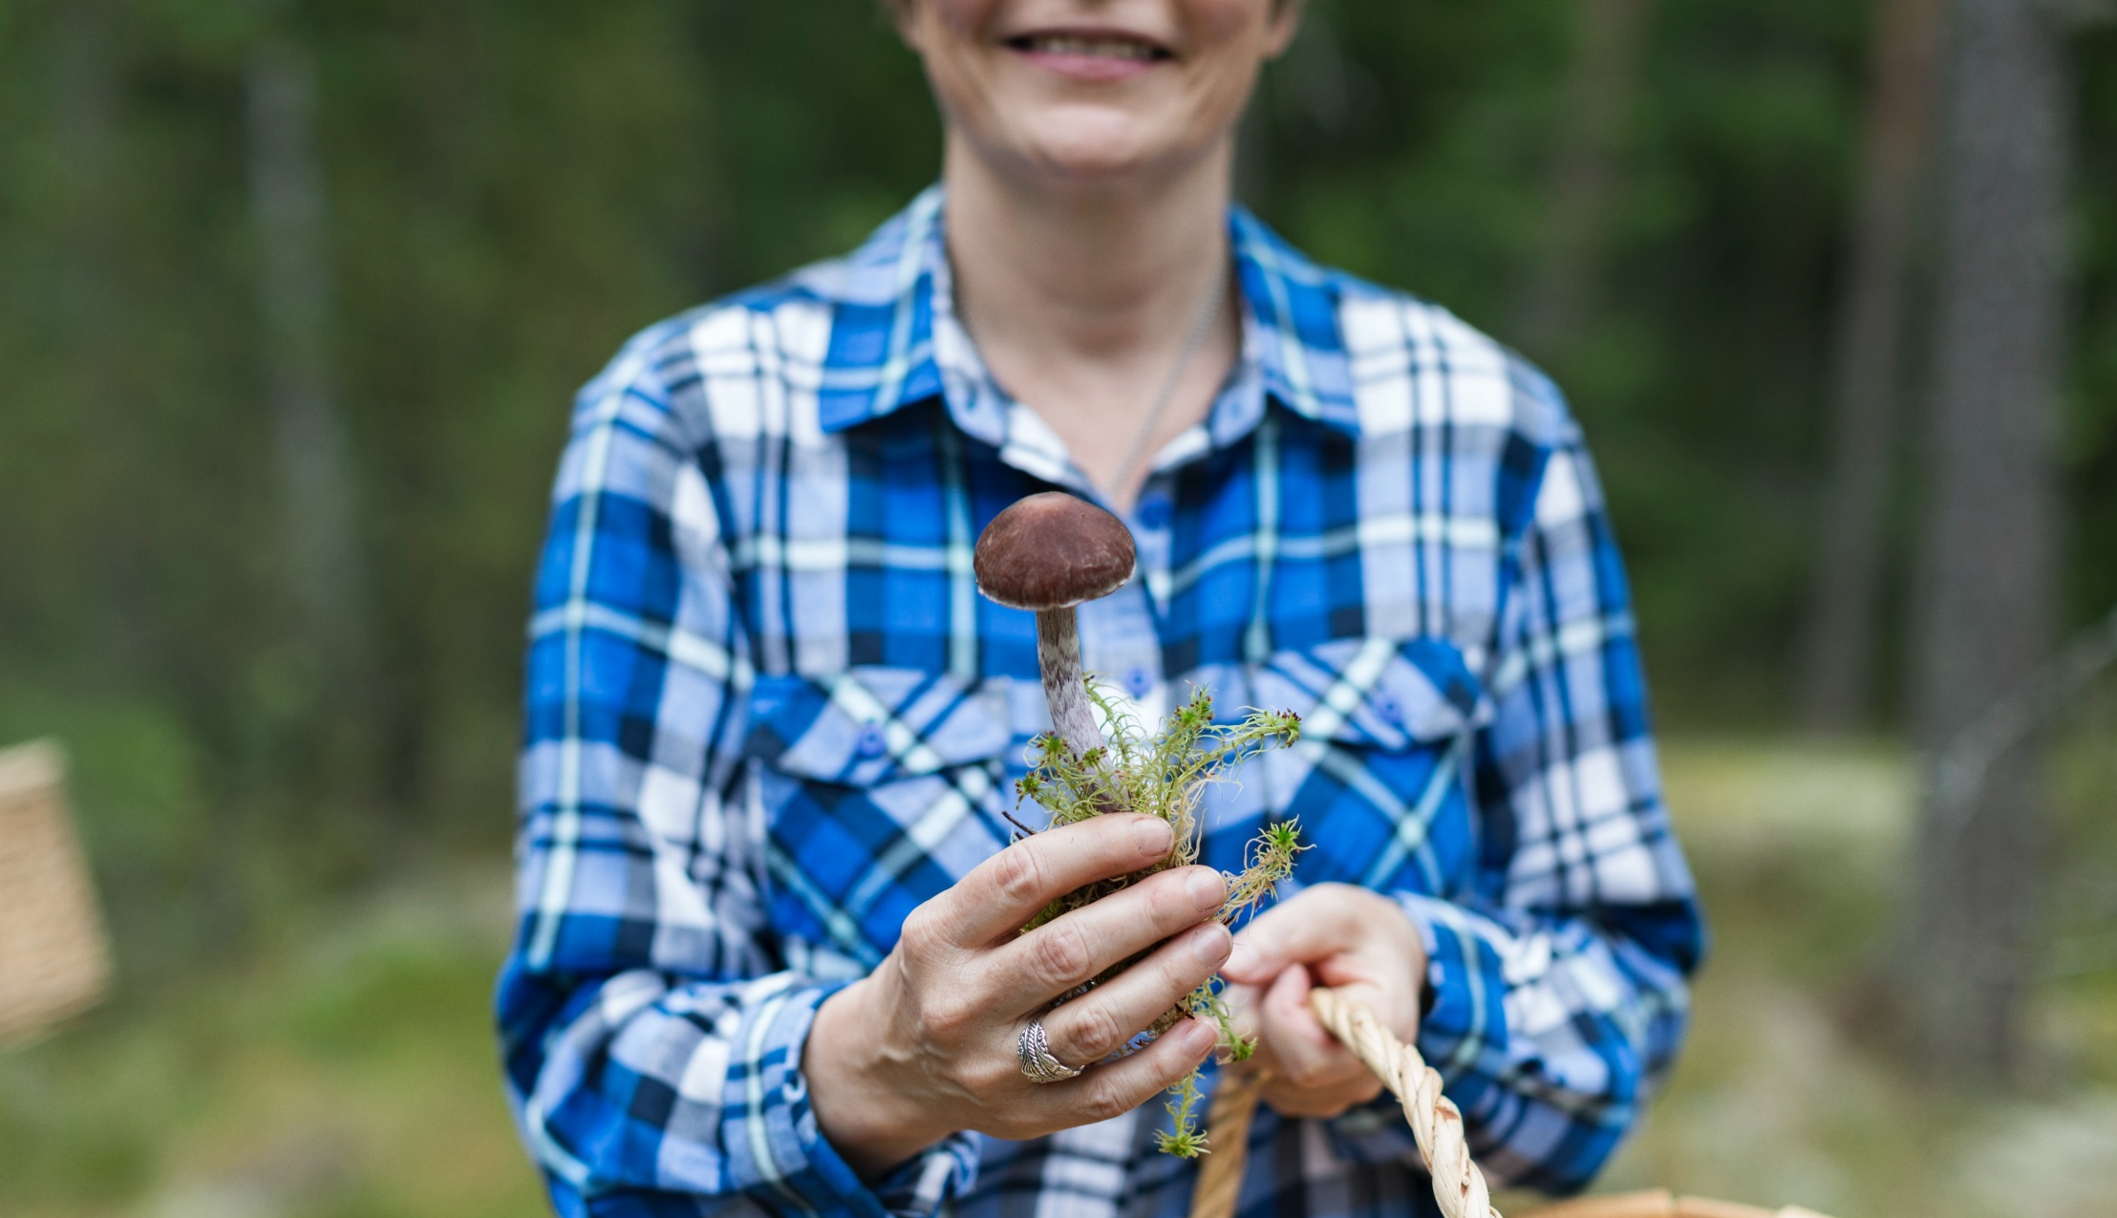
CASE EXAMPLE
The Martha Organization
The Martha Organization’s mission is to promote good and sustainable everyday lives by giving home economics advice. This includes, for example, climate friendly food choices and recipes, how to avoid food waste, how to save energy and improve energy effectiveness, how to reduce and sort waste, and how to consume more sustainably. Volunteers across Finland carry out the work.
The Martha Organization is a home economics organisation that promotes well-being and quality of life at home.
The organisation promotes the idea that climate friendly choices are likely to be better for your health, wellbeing and household economy.

Slide 9
strong nature relationship
Finnish people have a strong relationship with nature, because nature has always been accessible to us. Finnish people have an individual connection to forests; more than 80% of Finnish people say the forest is important to them.
Photo: Marjaana Tasala / Visit Finland
Notes:
Nature has also successfully established a foothold in towns and cities and almost all urban residential areas lie within a short walk of natural forests criss-crossedby footpaths, cycle paths and skiing trails. Many towns also have waterside locations enabling residents to go swimming in both summer and winter.
Photo: Marjaana Tasala / Visit Finland

Slide 10
Forests are always accessible in Finland
Finland is the most forested country in Europe. Four out of five Finns say nature is very important to them.
About 75% of Finland is covered by trees and a further 10% by lakes and rivers, which means that even the most urban Finn is never far from nature.
Finland is a world leader in sustainable forest management. In Finland, commercial forestry always takes into account biodiversity and carbon sinks.
Access to nature is guaranteed by the Finnish concept of Every Person’s Right. It states that anyone may hike, camp and gather mushrooms and berries in any forest, regardless of who owns it.

Slide 11
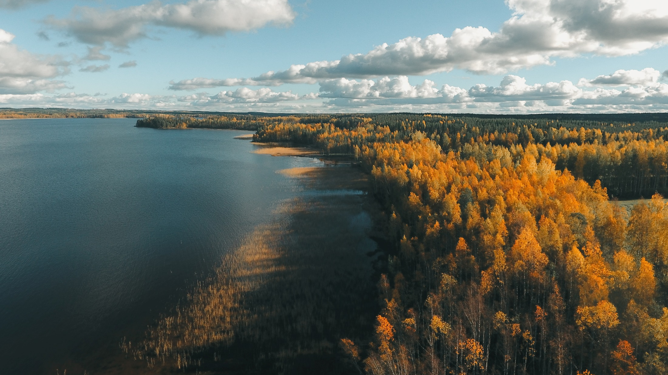
Bringing science and decision-making together

Slide 12
Decision-making based on science and collaboration
Finnish environmental legislation has a strong research underpinning and we believe in collaborating across sectoral and disciplinary boundaries.
Finland’s Climate Act (2015) sets the target to cut emissions 80% by 2050 from 1990 levels and promotes transparency in climate policy.
We require each future government to set out climate policies towards the long-term goal and monitor the results.
Finland was also the first country to publish a national Climate Change Adaptation Strategy in 2005 and a roadmap to a circular economy in 2016.

Slide 13
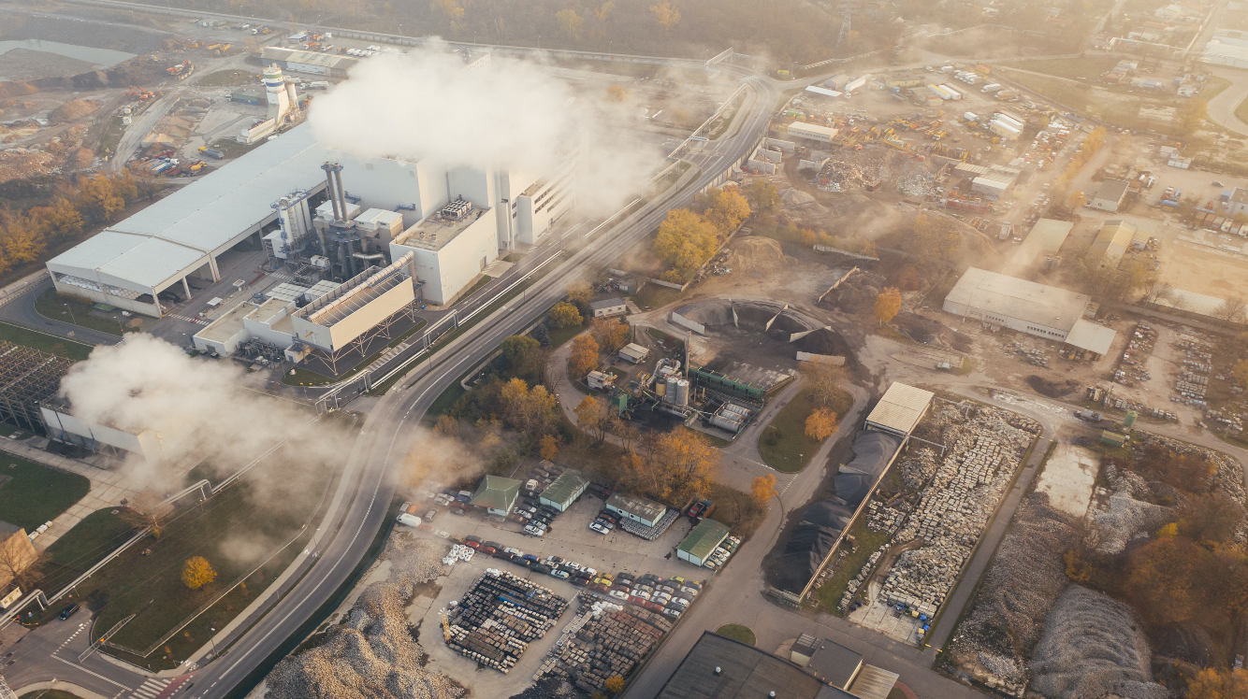
The CO₂ tax
CASE EXAMPLE
Finland was the first country in the world to introduce a carbon dioxide (CO2) tax based on the carbon content of fossil fuels in 1990. The basic idea behind the carbon tax is to make commodities with heavy emissions more expensive in relation to low emission alternatives.

Slide 14
Policymakers and researchers work together
Finland deepens the cooperation between policymakers and researchers by forming scientific task groups to support the drafting of legislation as well as national strategies. Civil servants act in advisory boards and use policy briefs.
This method is piloted in the context of circular economy, biodiversity and climate change. The cooperation ensures a sufficient knowledge base for policy making, which correlates with the new requirement of preparing a climate change impact assessment on every law.

Slide 15
World’s 1st circular economy road map
CASE EXAMPLE
Under the leadership of the Finnish Innovation Fund Sitra, Finland was the first country in the world to create a national roadmap to a circular economy. Sitra has advanced the actualisation of the circular economy roadmap by starting over 70 projects with partners to make a positive change.

Slide 16
Finnish Climate Change Panel weighs in on all legislation
The Finnish Climate Change Panel provides independent, scientific and researched information regarding climate change.
The Panel is an independent and interdisciplinary scientific body that promotes dialogue between science and policy-making by providing scientific advice.
The Panel is tasked with assessing the coherence of climate policy and the sufficiency of the implemented measures to answer the challenges of climate change. The Panel also issues statements on proposed legislation which affects climate change mitigation or adaptation.
Notes:
In addition to the reports the Panel has created an online app comparing the life cycle emissions and cost of cars powered by petrol, diesel, electric and natural gas or biogas.

Slide 17
CASE EXAMPLE
From rags to new robes –
Circularity in textiles is InfiniteD
Infinited Fiber Company’s technology regenerates textile waste into new, high-quality textile fibres that look and feel like cotton, and have unique properties that make them ideal for clothing, bedsheets or even baby wipes. Biodegradable, microplastic-free and validated by global fashion brands, textiles made with Infinited Fiber are the circular and more sustainable alternative to virgin cotton.
For Infinited Fiber Company, textile waste is not a problem but a valuable raw material to be regenerated into high-quality fibres.
Infinited Fiber Company’s patented cellulose carbamate fibre technology is based on research by the VTT Technical Research Centre of Finland.

Slide 18
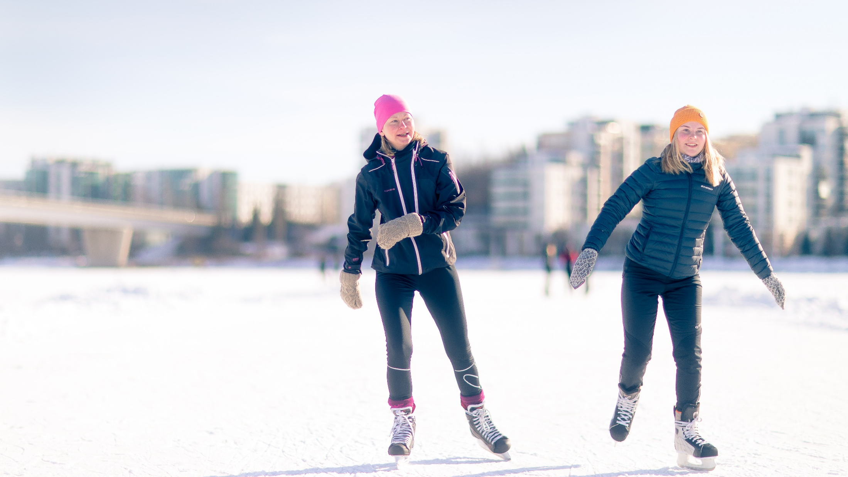
In Finland, everyone does their share for THE climate

Slide 19
Driving change together
Legislation and solutions developed together by the private and public sectors continue to play a central role in Finland in solving environmental problems.
Businesses are striving towards a structural change to ensure a more sustainable future. Roadmaps have been prepared for four energy-intensive industries and nine other sectors, aiming at significant reductions in greenhouse gas emissions by 2035. These roadmaps will be one of the cornerstones of the government’s climate policy.
Many municipalities and cities have set even more ambitious climate goals than the national ones and are sharing their best practices.

Slide 20
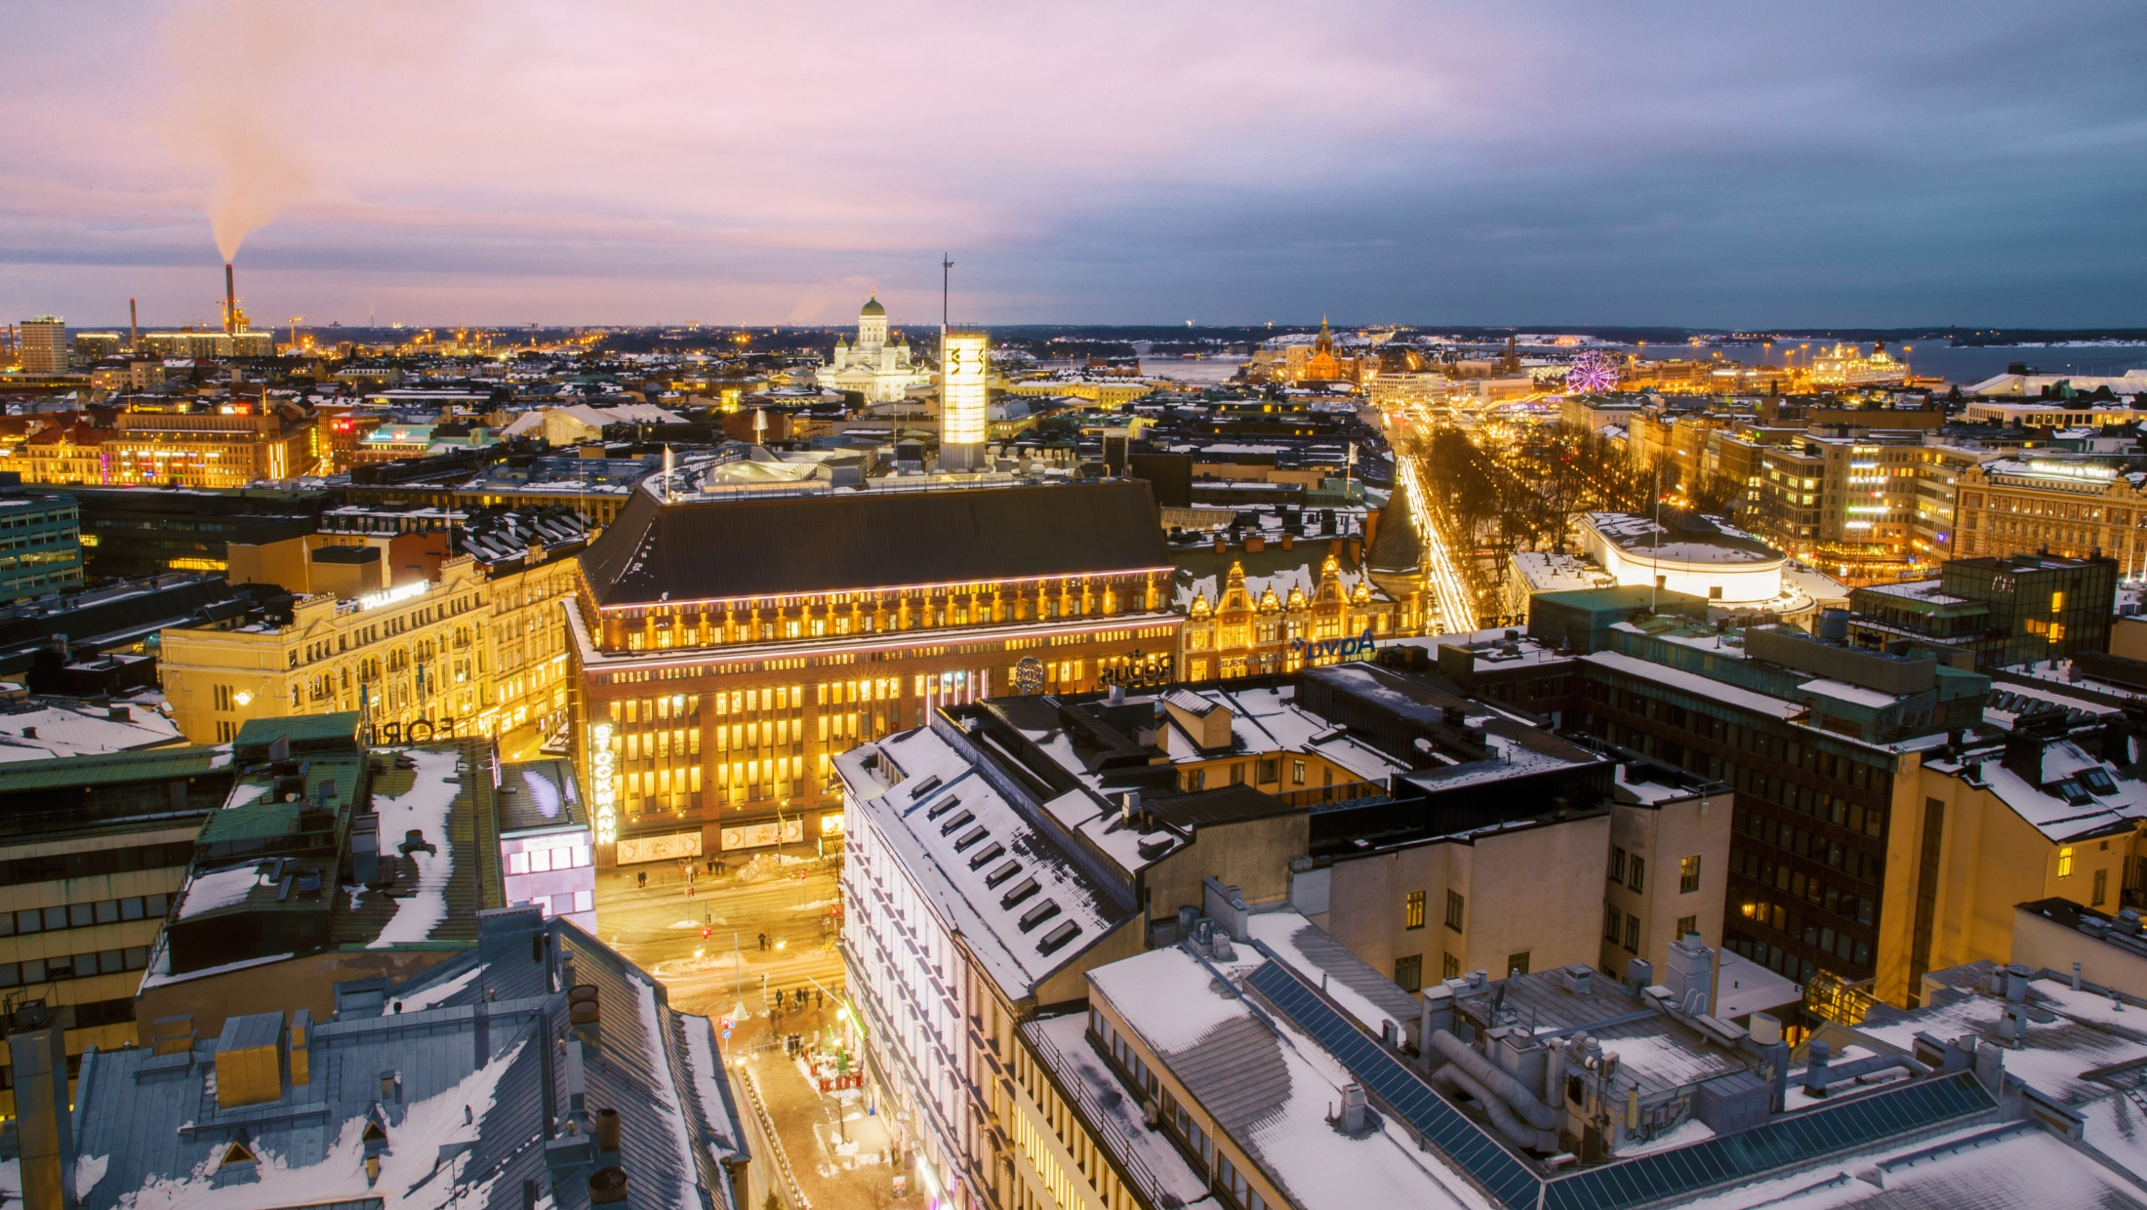
CASE EXAMPLE
Helsinki as the testbed for future-proof heating solutions
The Helsinki Energy Challenge is a global competition to answer the question: how can we decarbonise the heating of Helsinki, using as little biomass as possible? The main requirement is that the proposed solution should significantly contribute to stopping the use of coal by 2029 and speed up the City of Helsinki’s journey to carbon-neutrality.
Helsinki is one of the leading cities in the transition towards a sustainable future, with a goal of becoming carbon-neutral by 2035.
Helsinki wants to find long-term sustainable solutions to heat the city in the future and to act as a platform for new and innovative solutions that can also benefit other cities around the world.
Notes:
The challenge aims to find solutions for the City of Helsinki but also for other cities around the globe: Helsinki can be viewed as a testbed where future-proof urban heating solutions are created. Helsinki is committed to sharing the results and solutions with other cities around the world.

Slide 21
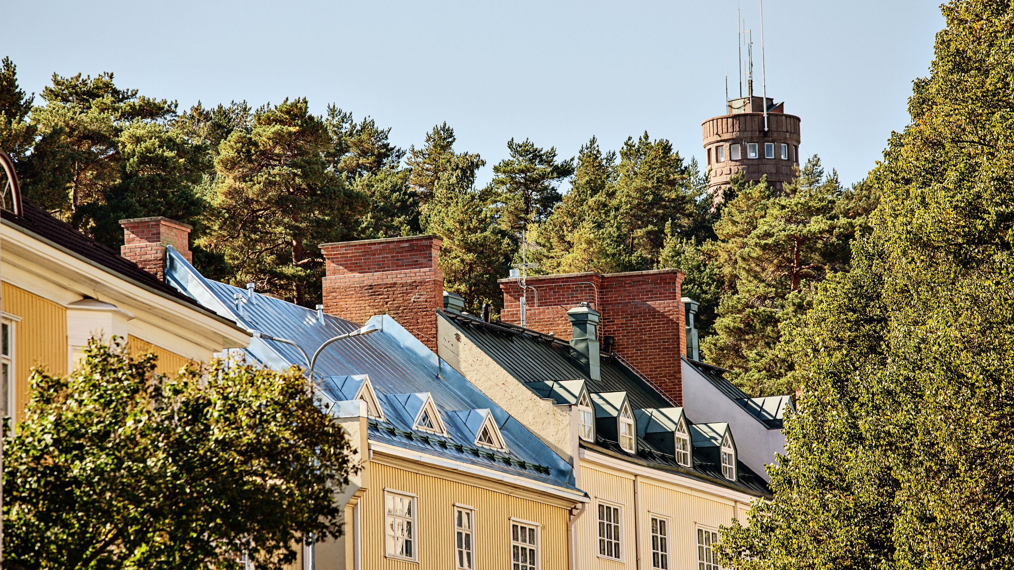
Ambitious regional climate work
A lot of climate work is being done at the regional level. Almost half of Finns live in municipalities that aim to be carbon-neutral already by 2030. Finnish cities and municipalities have developed active national and international networks to share best practices.
Photo: Krista Keltanen/Visit Finland
Notes:
Photo: Krista Keltanen/Visit Finland

Slide 22
Hinku network aims for a stronger economy through local climate action
The Towards Carbon Neutral Municipalities (Hinku) network brings together municipalities, businesses, citizens and experts to create and carry out solutions that reduce greenhouse gas emissions.
Over 70 Hinku municipalities and 5 Hinku regions are working together to reach their ambitious goal of reducing their greenhouse gas emissions by 80% from 2007 levels by 2030. Hinku aims to reach targets much sooner than required by the EU.
Hinku facilitates the sharing of best practices and knowledge. The focus is on local climate action to yield a stronger economy, social wellbeing and new business opportunities.
Notes:
Hinku’s overall emissions have decreased 25% by 2018, and the top five municipalities have each managed to reduce their emissions by 40–60%.

Slide 23
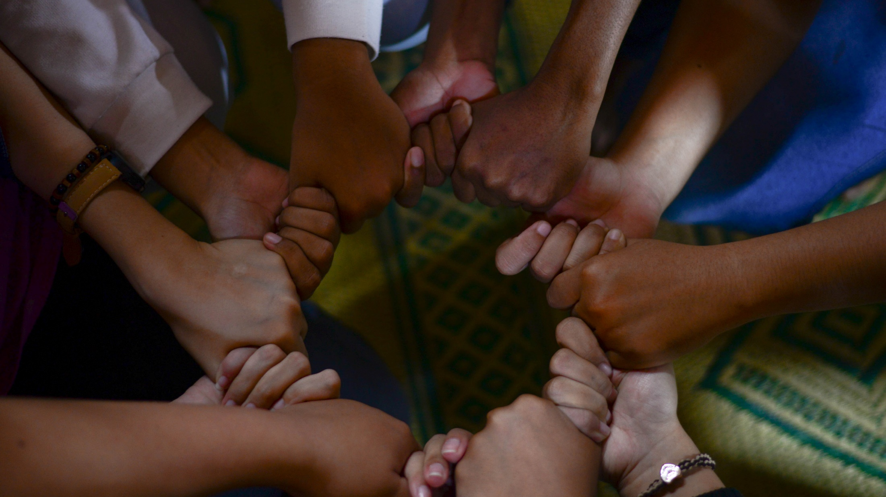
A common path towards a more sustainable world

Slide 24
Finland seeks global co-creation and collaboration
Since environmental issues know no boundaries, to achieve change on a global scale we need to network, find partners and embrace a systemic approach globally. Finland shares know-how and lessons learned to change the future.
Finland continues to focus on the climate and environment, discovering new innovations, turning them into practical solutions and learning good practices. These can be amplified and multiplied across the world.

Slide 25
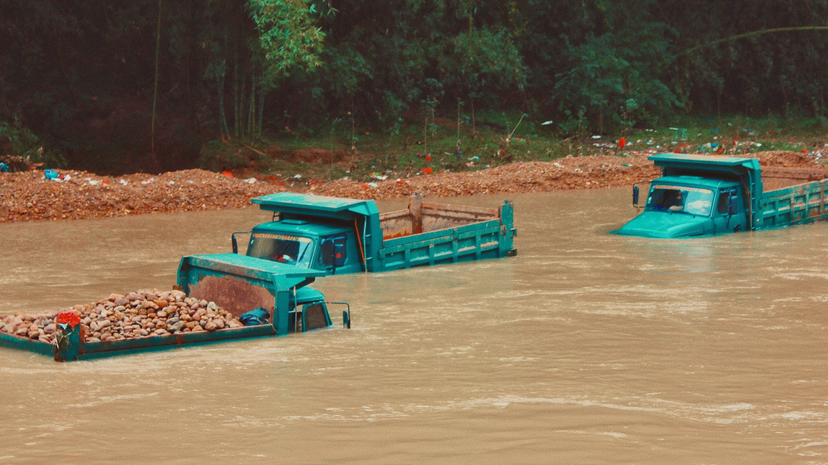
CASE EXAMPLE
Helping to build a climate- resilient society in Vietnam
The Finnish Meteorological Institute (FMI) has implemented several development projects to provide better services for the safety of Vietnamese society. The biggest single task has been to modernise the whole operational system. The Concessional Credit program (2017–2020), together with the Finnish private company Vaisala, improved the institutional capacity of the Vietnamese organisation for weather observations and early warning services.
FMI has implemented development projects for improving the climate resilience of over 100 countries worldwide.
According to the World Meteorological Organization (WMO), FMI is the second largest provider of development projects in its field.

Slide 26
Ambitious national climate targets lead the way for international cooperation
Finland has some of the most ambitious goals to mitigate climate change.
Among the first countries in the world, Finland is committed to phasing out coal in energy production by 2029.
The coal ban will promote a low-carbon energy system, drive the use of renewable energy sources, and ensure a healthy living environment.
Sanna Marin’s Government (2019-) has committed to halving Finland's peat energy output by 2030.

Slide 27
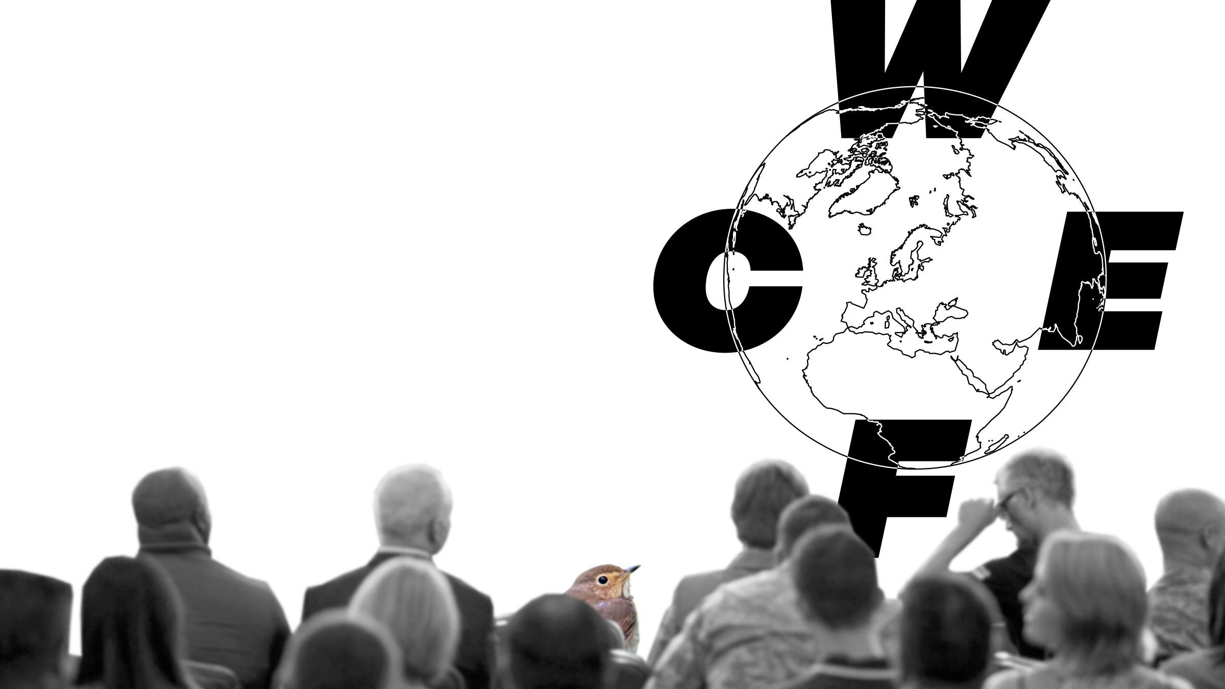
The World Circular Economy Forum
CASE EXAMPLE
The World Circular Economy Forum (WCEF), a global initiative of the Finnish Innovation Fund Sitra and the country of Finland, brings together over 4,000 business leaders, policymakers and experts from around the world to present the best circular economy solutions.

Slide 28
Active team player in the UN and EU
Finland strongly supports the EU’s plan to become the world’s first climate neutral continent by 2050. Finland’s 2035 climate neutrality target and ambitious climate policies provide a basis for a high international profile.
Finland actively advocates ambitious EU-wide climate policy instruments, including the EU emissions trading scheme. The EU’s common emission reduction target for the emissions trading sector is 43%.
The emissions trading system covers aviation, large industrial plants and the production of electricity and district heat.

Slide 29
CASE EXAMPLE
innovations for a better world
Food out of thin air
Solar Foods produces an entirely new kind of natural protein, Solein, by using CO2 and electricity as its primary raw materials. Based on natural fermentation, this process can revolutionise global food production, as the production of Solein is not dependent on the weather, climate or agriculture. The production process of Solein does not involve irrigation, pesticides, fertilizers applied on open land, or animals, and makes Solein the world’s most sustainable protein.
Instead of causing CO2 emissions, Solar Foods’ bioprocess captures carbon dioxide and uses renewable electricity.
Solar Foods worked in collaboration with the ESA to develop food production for a Mars mission.
Solar Foods’ technology is based on research by VTT Technical Research Centre of Finland and LUT University.

Slide 30
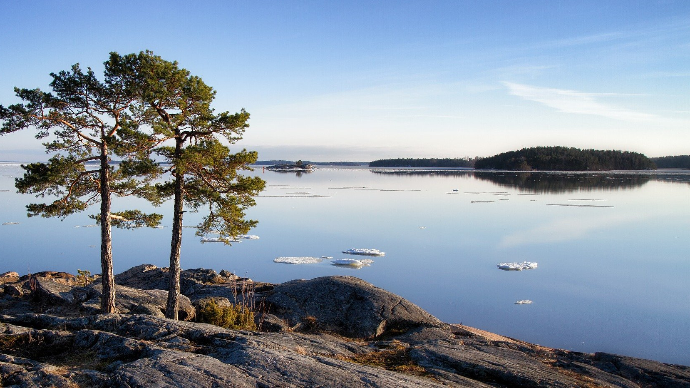
Thank you!

