Slide 1
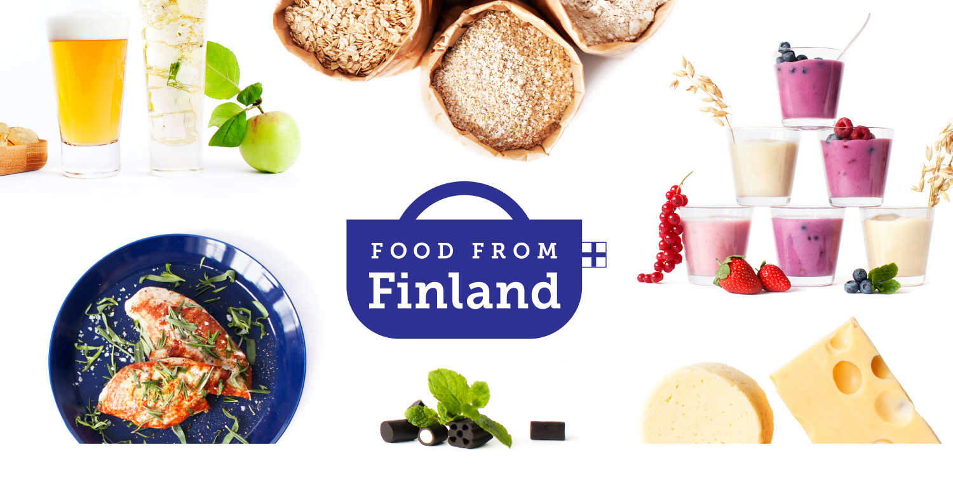
Finnish Food Offering:
Meat Products

Slide 2
Meat and Poaltry Products

Slide 3
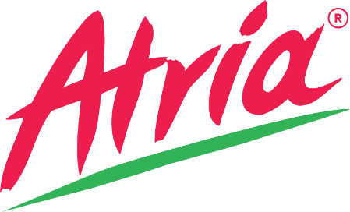
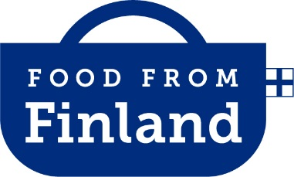
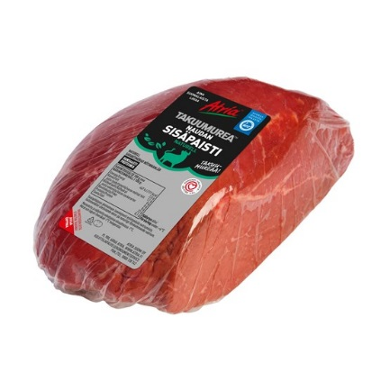
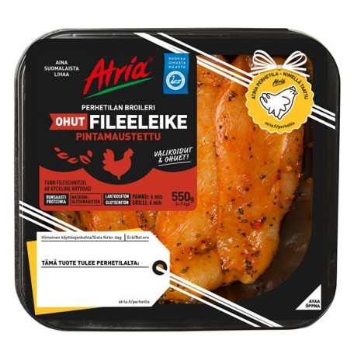
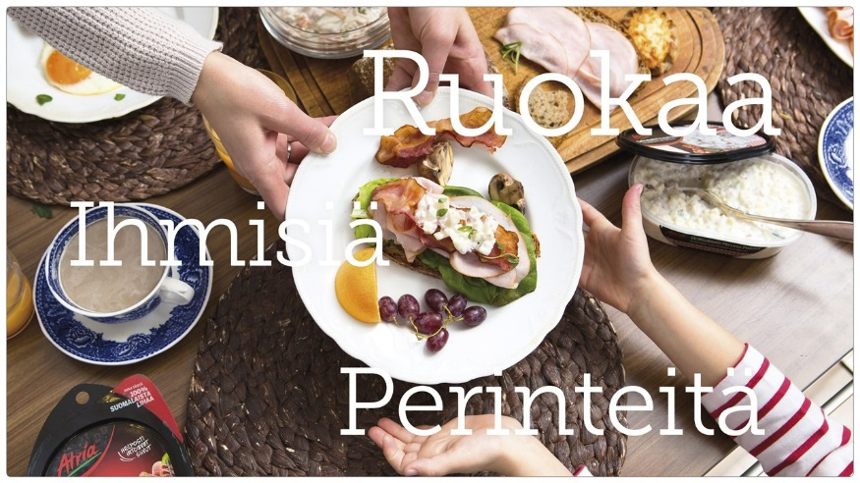
Oat
SINCE
EMPLOYEES
SIZE
HEADQUARTER
http://atria.fi/
1903
4270
Large
Kuopio
Atria is a growing Finnish food company with an international presence. Its success is built on three pillars: food, people and traditions. Atria is one of the leading food companies in the Nordic countries, Russia and the Baltic region, with experience stretching over 110 years.
Atria’s net sales in 2015 exceeds EUR 1.3 billion, and it employed an average of 4,270 personnel. The Group is divided into four business areas: Atria Finland, Atria Scandinavia, Atria Russia and Atria Baltic.
Atria’s customer groups are consumer goods retailers, Food Service customers and the food industry. Atria also has a Fast Food concept based on its own brands. Atria’s roots go back to 1903, when its oldest shareholding co-operative was founded. Atria Plc is listed on Nasdaq Helsinki.
PRODUCTS 1. Beef, pork, poultry; processed food products, sausages, hams, ready-made meals
SPECIALITY
One of the biggest livestock companies in the Nordic region with

Slide 4
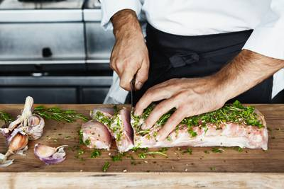
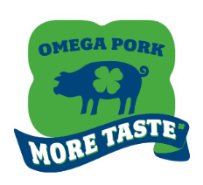
Oat
SINCE
EMPLOYEES
SIZE
HEADQUARTER
www.hkscan.com/en/frontpage
1913
7700
Large
Turku
HKScan is the leading meat and food company in Nordic region. Established by Finnish farmers in 1913, it has grown into a multinational company with net sales of EUR 2.0 billion and with almost 7700 employees. Our customers are the retail, food service, industrial and export sectors, and our home markets comprise of Finland, Sweden, Denmark and the Baltics. We also export our high quality Nordic products close to 50 countries worldwide. HKScan focuses on producing value added products from Nordic poultry, pork, beef and our core business principle is consumer and customer satisfaction, which calls for high quality of products, innovations and services at every stage of the value chain.
HKScan´s pork meat with Omega3 is a unique and innovative concept developed together with Finnish universities and farmers. The main essence of the innovation is that Omega pigs are fed on Finnish and Swedish domestic feed containing rapeseed flower oil, which changes the fat compositions of meat. The saturated fat is partly replaced by unsaturated fat; compared to conventional pork, the amount of saturated fat has been decreased to the level recommended by dietary recommendations.
PRODUCTS 1. Nordic Poultry, Pork and Beef; processed meats
SPECIALITY
Leading meat and food company in the Nordic region. Omega-3 premium pork meat a unique product.

Slide 5
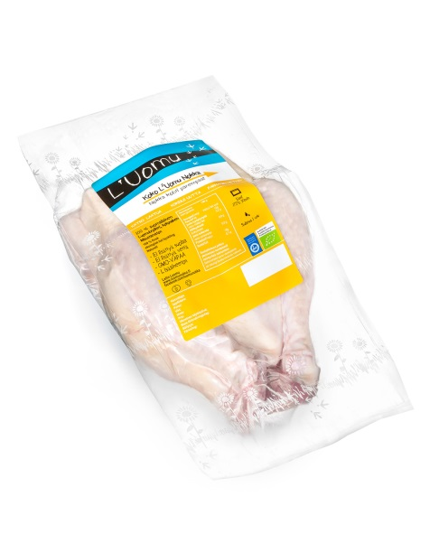
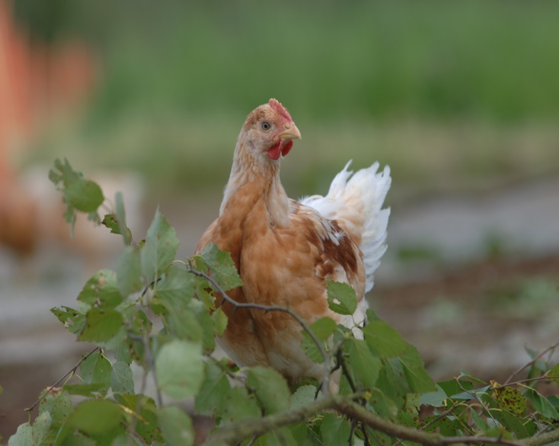
Oat
SINCE
EMPLOYEES
SIZE
HEADQUARTER
www.luomunokka.fi
2014
< 25
Small
Vantaa
L’Uomu Nokka organic broilers are Hubbard CY, an organic breed that is able and allowed to move around freely. Nokka broilers are raised on Finnish organic farms on Finnish organic feed. They enjoy plenty of daylight and fresh air as they run around in a garden, digging and socialising. Finnish nature, with its expansive coniferous forests, thousands of lakes and variance in daylight between the seasons, gives Finnish organic broiler a distinctive clean taste. Finnish food safety is world class.
L’Uomu Nokka broiler pieces are hand-cut, which means that they have a distinct look with a bit of personality, like a chicken that spends much of its life at a garden party. The meat is packaged with the skin on and, in many cases, the bone in, as they provide additional flavour for your meals. All this makes for broiler meat that is fit to grace the finest of meals. L’Uomu Nokka is real food with a flavour of “arctic taste, midnight sun and clean waters”
PRODUCTS 1. Organic broilers
SPECIALITY
Organic broiler breed raised in Finnish organic farms in a free environment

Slide 6
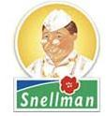
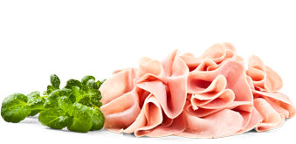
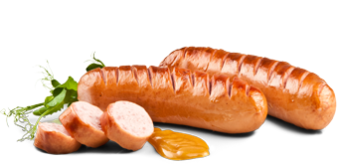
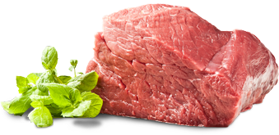
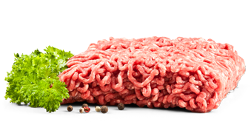
Oat
SINCE
EMPLOYEES
SIZE
HEADQUARTER
www.snellman.fi/old/en
1951
< 900
Large
Pietarsaari
Oy Snellman Ab is a family company in Jakobstad which has been producing top quality meat and pork products for 60 years. Business activities comprise procurement, slaughtering, cutting, meat processing and pork production. Liver products, sliced luncheon meat and Finnish consumer pre-packed meat are Mr Snellman's most popular product categories. Mr Snellman has witnessed the rise and fall of different consumer trends in 60 years of business activity. However, he intends to maintain a qualitative mindset.
The company functions include procurement, abattoir, cutting and processing of meat and sliced products. Sliced products and liver products are the leading products of the company. Snellman Ltd can also offer tasty convenience foods such as soups and meat with gravy. The company manufactures products also for export.
PRODUCTS 1. Meat products; minced meat, steaks, fillets, casseroles, sausages, cold cuts, liver products
SPECIALITY
Meat and pork products with over 60 years of expertise

Slide 7
Lisää Savuhovi

Slide 8
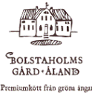
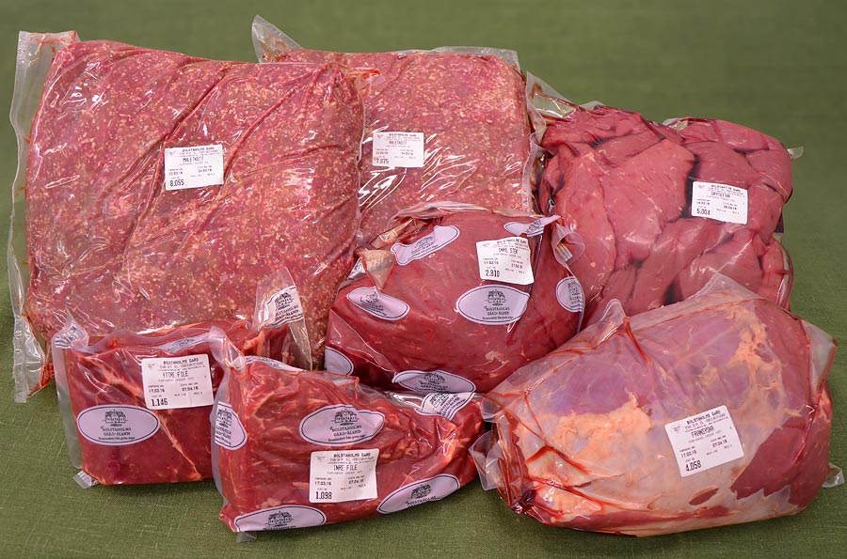
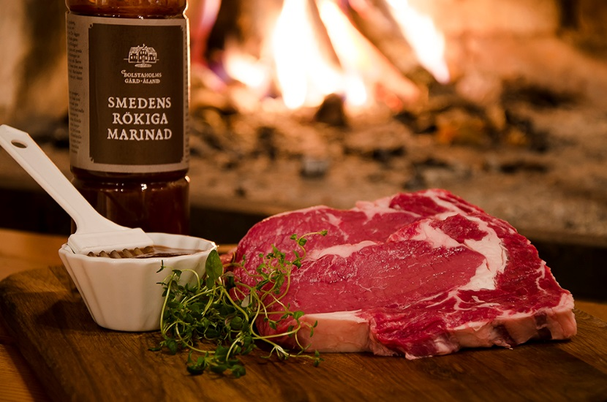
Oat
SINCE
EMPLOYEES
SIZE
HEADQUARTER
www.bolstaholm.ax/
< 50
Small
Åland
Our beef cattle are of the breed charolais. It is a race that is born to give the best possible meat: tender, juicy and aromatic.
Our cows are fed on GM-free animal feed which we ourselves grow, and summertime animals out to pasture with their calves. At the same time, the absent sly and shrubs from 41 hectares of grassland.
They live in other words shoes made for thousands of years, before the industrial meat factories. They keep the provinces open, live good lives and their meat is – thanks to the natural grass diet — rich in omega-3 and other utilities.
Our meat comes from respectfully treated animals, is locally produced – and much, much better.
PRODUCTS 1. Beef products, sausages, marinades
SPECIALITY
The largest Åland beef company, speciality omega-3 richness

Slide 9
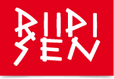
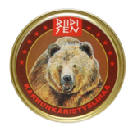
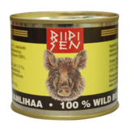
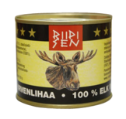
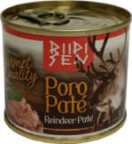
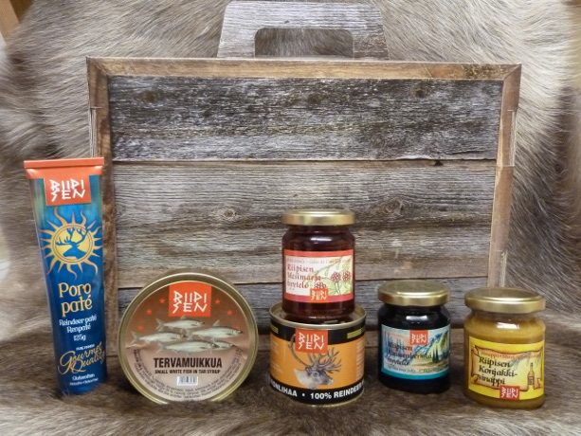
Oat
SINCE
EMPLOYEES
SIZE
HEADQUARTER
www.riipisen.fi/en/
1996
< 15
Small
Kuusamo
Riipisen Riistaherkut is a company located in Kuusamo, northern Finland.
They produce various canned meat products, berry jellies and teas, as well as other nature food products. Their local shop also includes a restaurant, a knife & kuksa shop, as well as a design shop.
PRODUCTS 1. Berry jellies, berry teas, syrups, mustards
2. Canned meat & fish products (reindeer, elk, bear, wild boar, fish)
SPECIALITY
Canned meat and berry products from the Finnish wilderness

Slide 10
EU Recommendation on Company Size
Company sizes in the list according to EU recommendation

