Slide 1
FINNISH
Teachers
Superheroes of the happiest country in the world

Slide 3
In Finland, we place great value on education.
We understand that a good teacher is
the very core of successful learning.
This exhibition features eight Finnish
teachers from different parts of the country.
Photographer: MINNA KURJENLUOMA

Slide 5
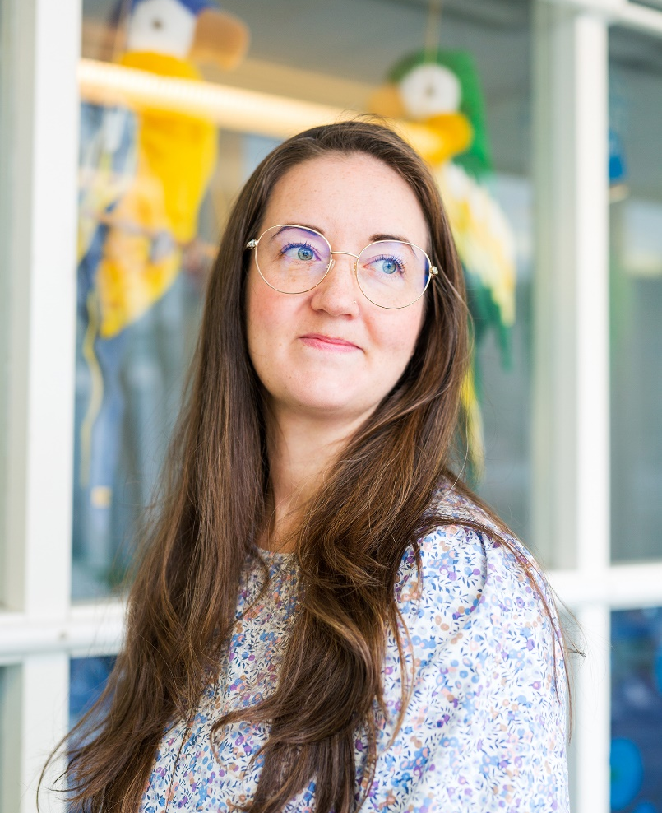
“
Every situation or moment offers a chance to learn something. My education gave me the skills to see these moments and use them as learning opportunities.
HANNA AHVONEN
Pre-primary education teacher, Helsinki

Slide 6
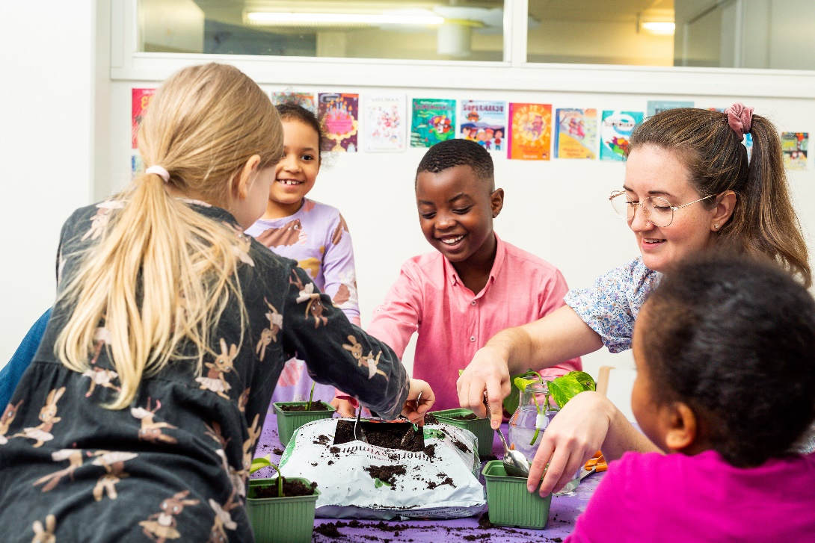
“
Every situation or moment offers a chance to learn something. My education gave me the skills to see these moments and use them as learning opportunities.
HANNA AHVONEN
Pre-primary education teacher, Helsinki

Slide 7
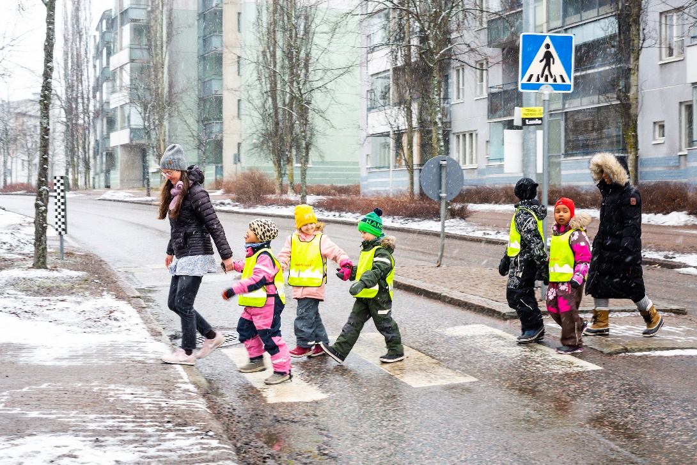
“
Every situation or moment offers a chance to learn something. My education gave me the skills to see these moments and use them as learning opportunities.
HANNA AHVONEN
Pre-primary education teacher, Helsinki

Slide 8
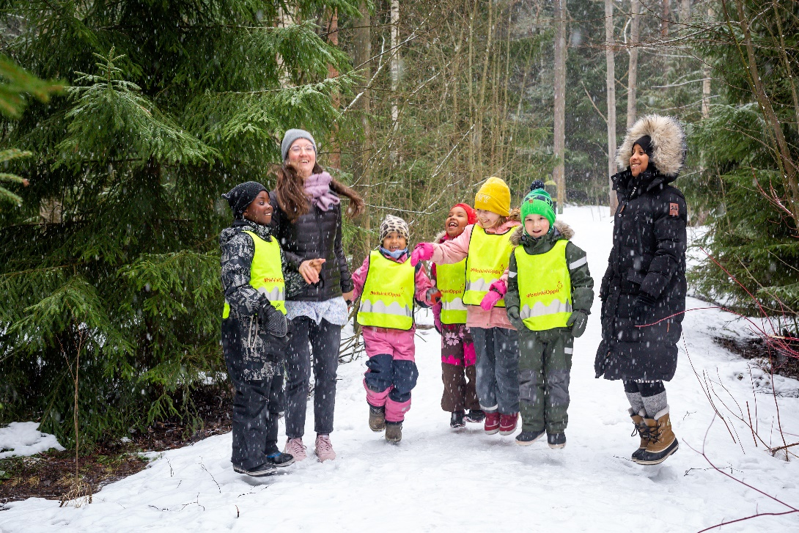
“
Every situation or moment offers a chance to learn something. My education gave me the skills to see these moments and use them as learning opportunities.
HANNA AHVONEN
Pre-primary education teacher, Helsinki

Slide 10
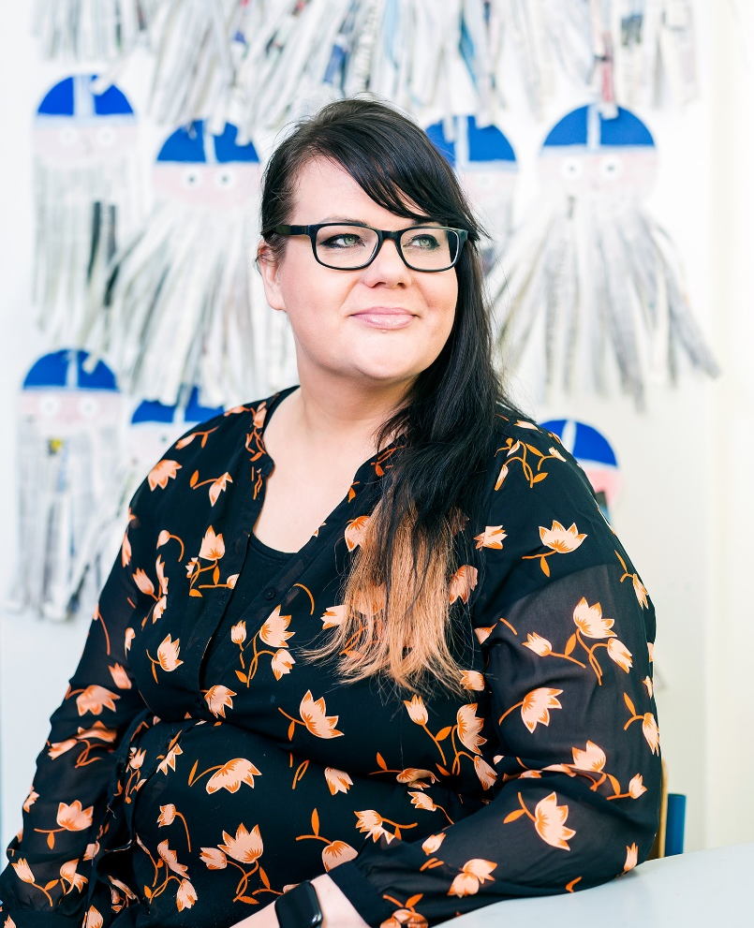
“
You don’t have to be scary. You can do more with a smile than an angry face.
JOHANNA HEIKKILÄ
Principal, Hyvinkää

Slide 11
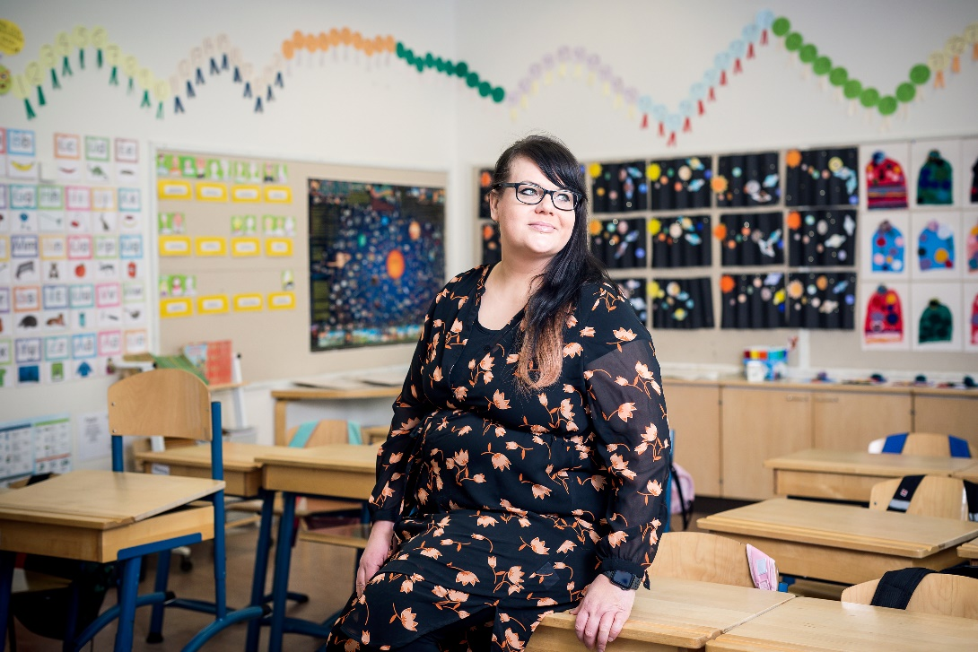
“
You don’t have to be scary. You can do more with a smile than an angry face.
JOHANNA HEIKKILÄ
Principal, Hyvinkää

Slide 12
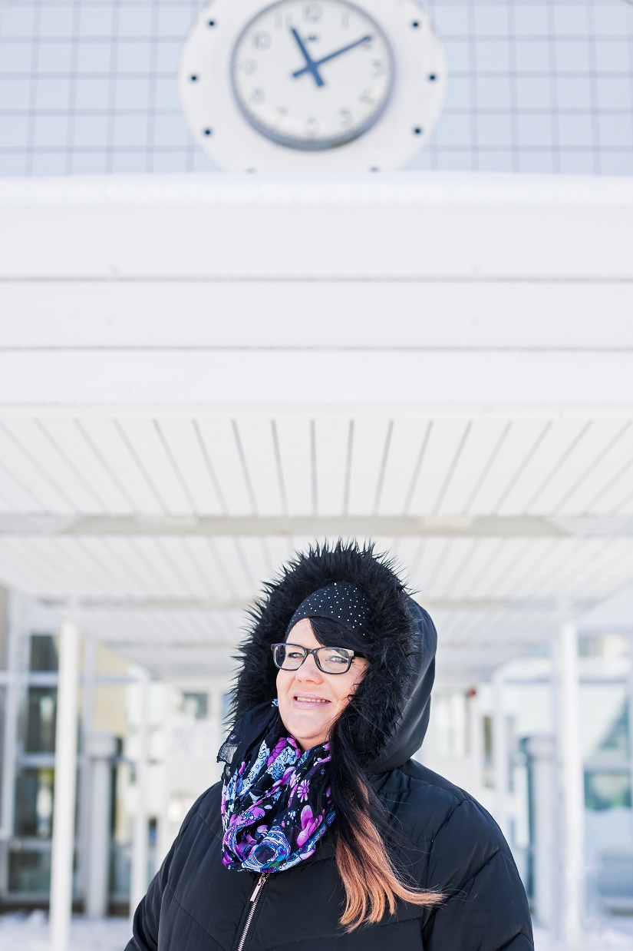
“
You don’t have to be scary. You can do more with a smile than an angry face.
JOHANNA HEIKKILÄ
Principal, Hyvinkää

Slide 14
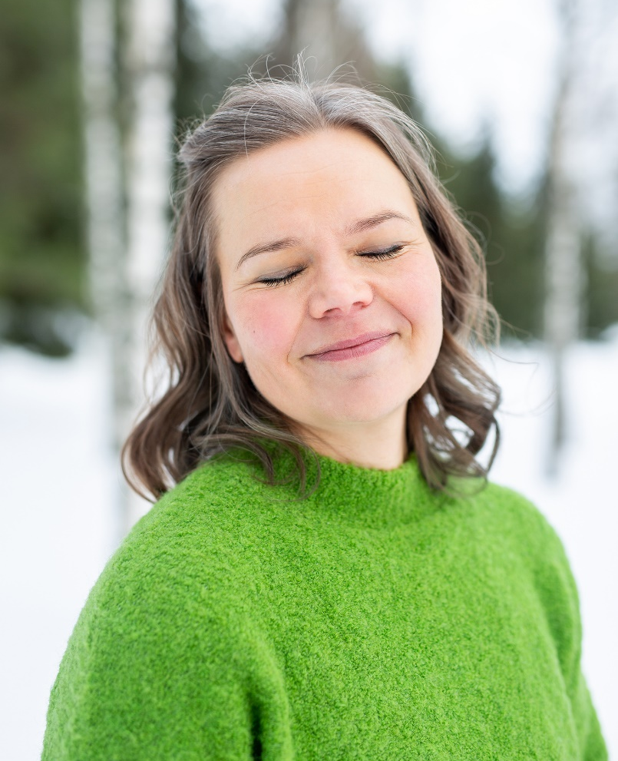
“
My focus in teaching is always practical. I find it's more important that you can play or sing than that you know some musical notation.
MINNA MOUHU
Music teacher, Sipoo

Slide 15
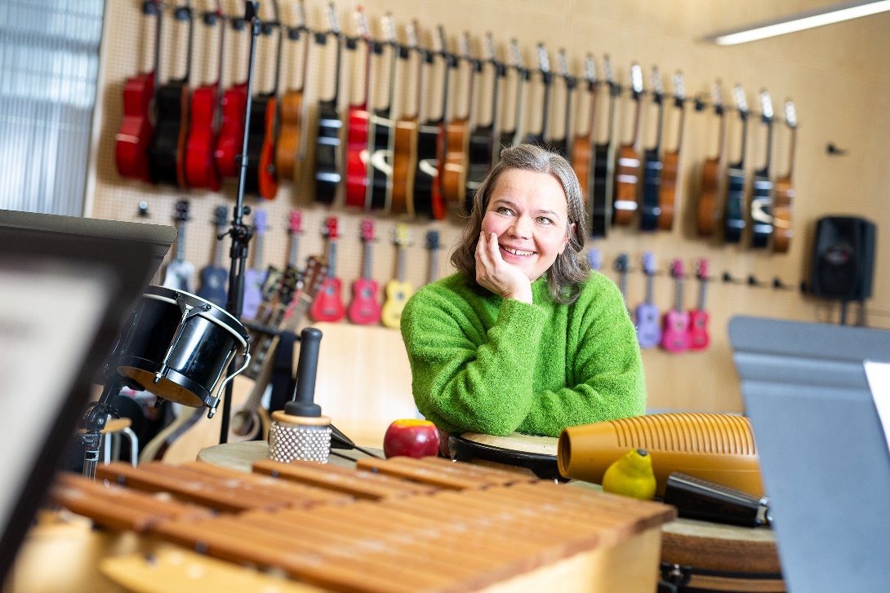
“
My focus in teaching is always practical. I find it's more important that you can play or sing than that you know some musical notation.
MINNA MOUHU
Music teacher, Sipoo

Slide 16
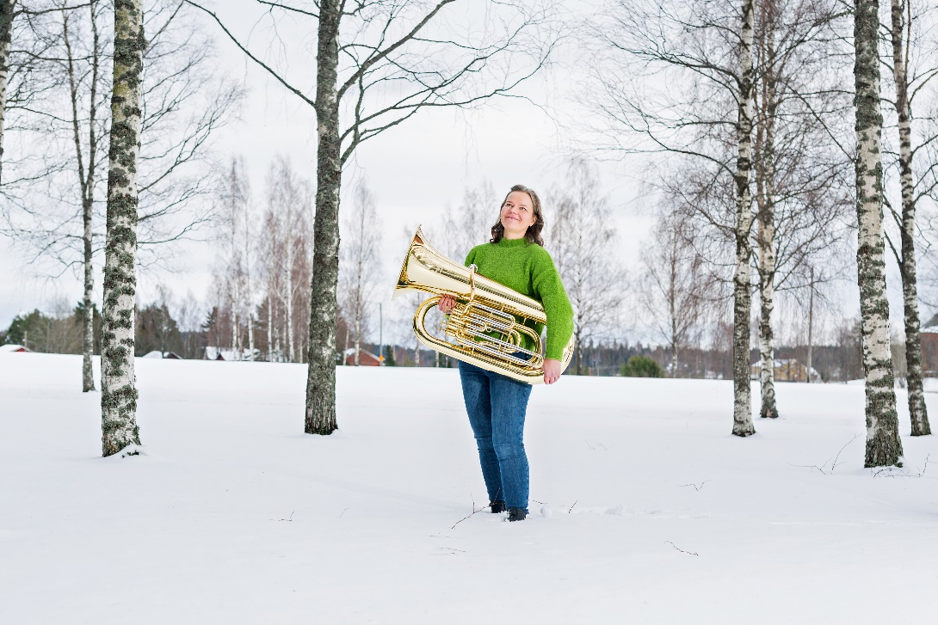
“
My focus in teaching is always practical. I find it's more important that you can play or sing than that you know some musical notation.
MINNA MOUHU
Music teacher, Sipoo

Slide 18
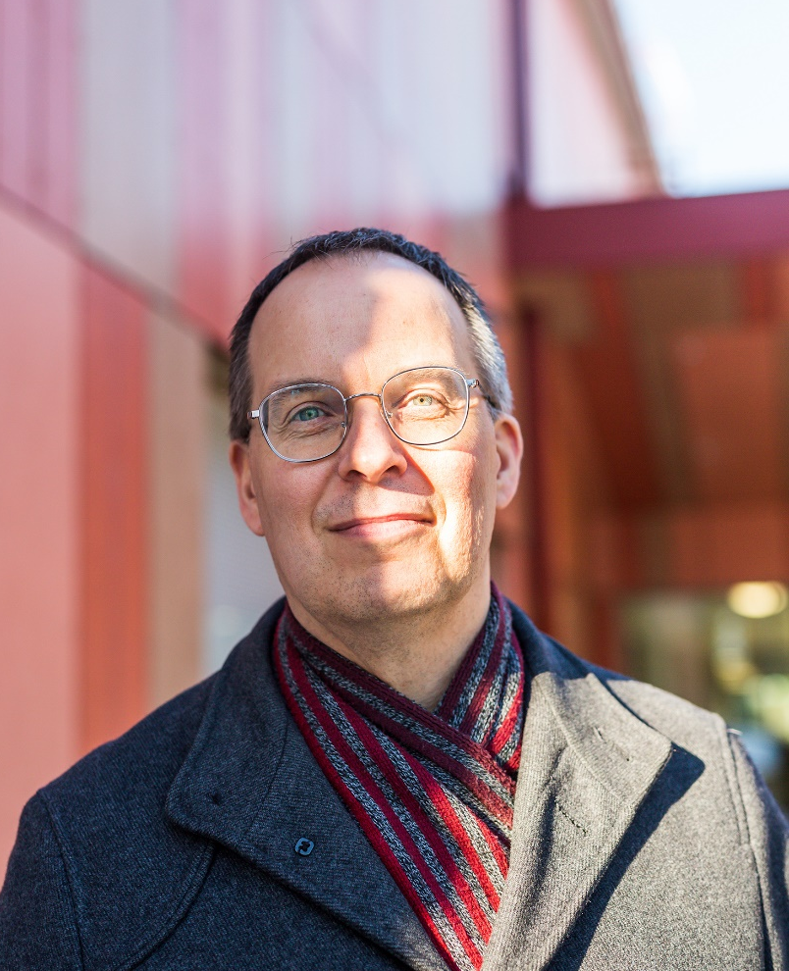
“
I am very happy every day. I come to school with joy every day! Always! Wow! This is my life; this is good for me.
DICK KULLBERG
Teacher in lower secondary, Porvoo

Slide 19
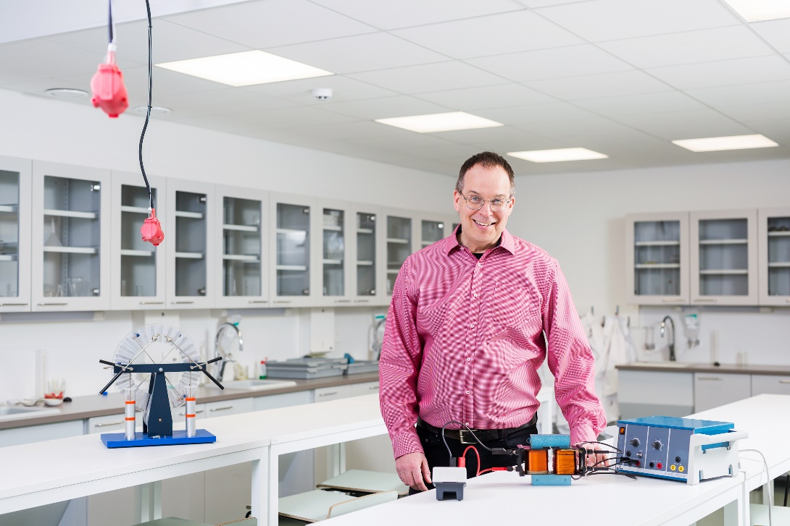
“
I am very happy every day. I come to school with joy every day! Always! Wow! This is my life; this is good for me.
DICK KULLBERG
Teacher in lower secondary, Porvoo

Slide 20
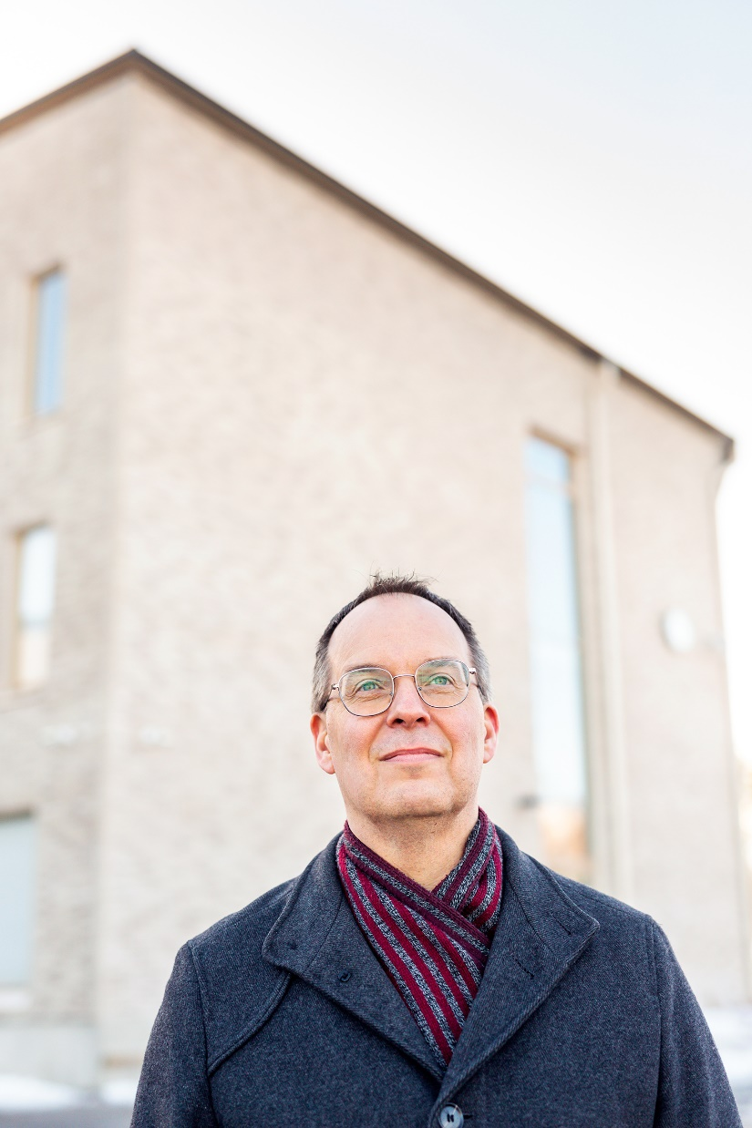
“
I am very happy every day. I come to school with joy every day! Always! Wow! This is my life; this is good for me.
DICK KULLBERG
Teacher in lower secondary, Porvoo

Slide 22
“
I think it’s super important that we find the strengths in each and every pupil, in each and every kid.
MAIJA SNECK
Primary school teacher, Lahti

Slide 23
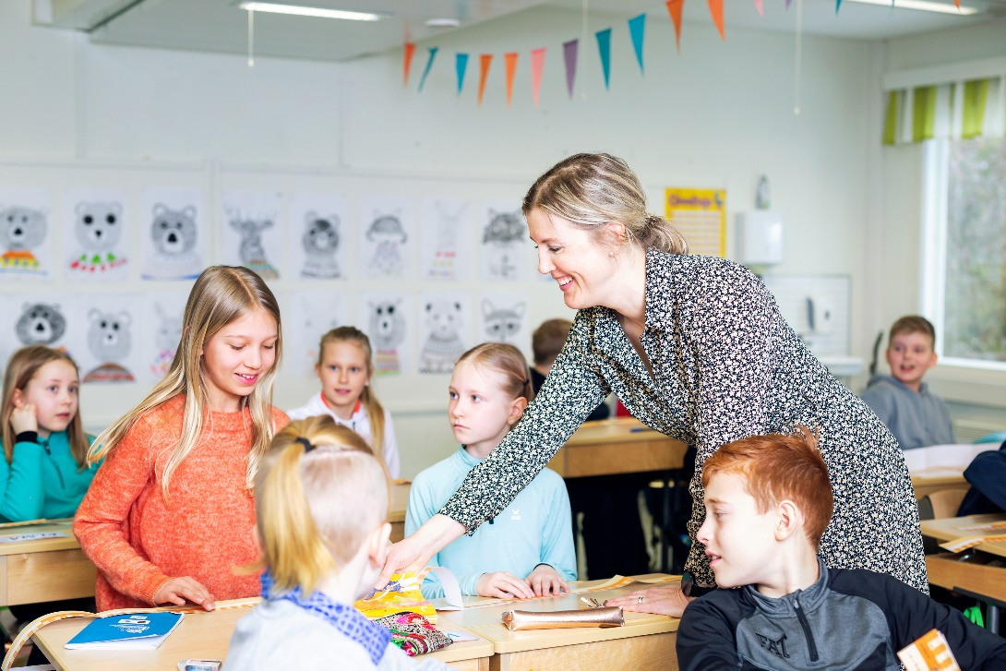
“
I think it’s super important that we find the strengths in each and every pupil, in each and every kid.
MAIJA SNECK
Primary school teacher, Lahti

Slide 24
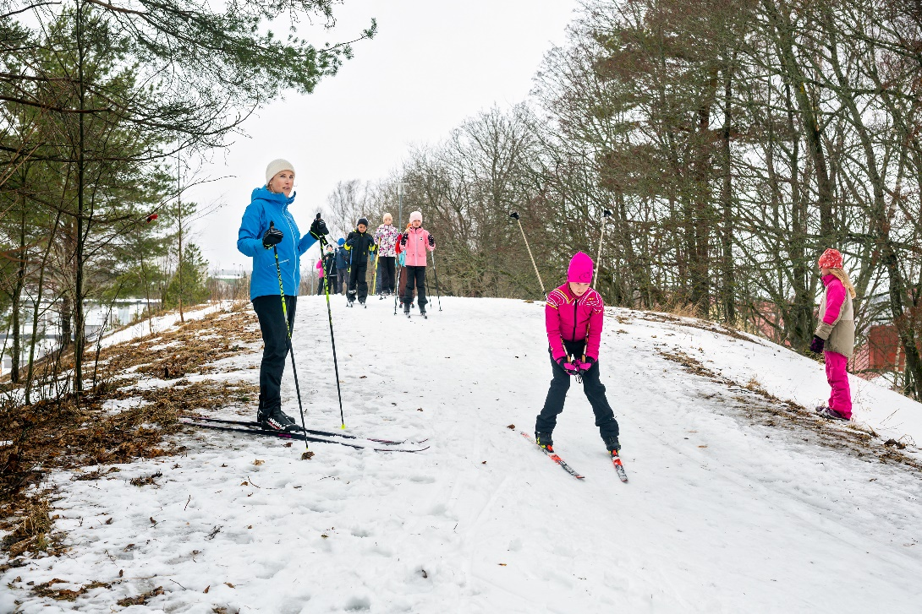
“
I think it’s super important that we find the strengths in each and every pupil, in each and every kid.
MAIJA SNECK
Primary school teacher, Lahti

Slide 25
“
I think it’s super important that we find the strengths in each and every pupil, in each and every kid.
MAIJA SNECK
Primary school teacher, Lahti

Slide 26
“
I think it’s super important that we find the strengths in each and every pupil, in each and every kid.
MAIJA SNECK
Primary school teacher, Lahti

Slide 28
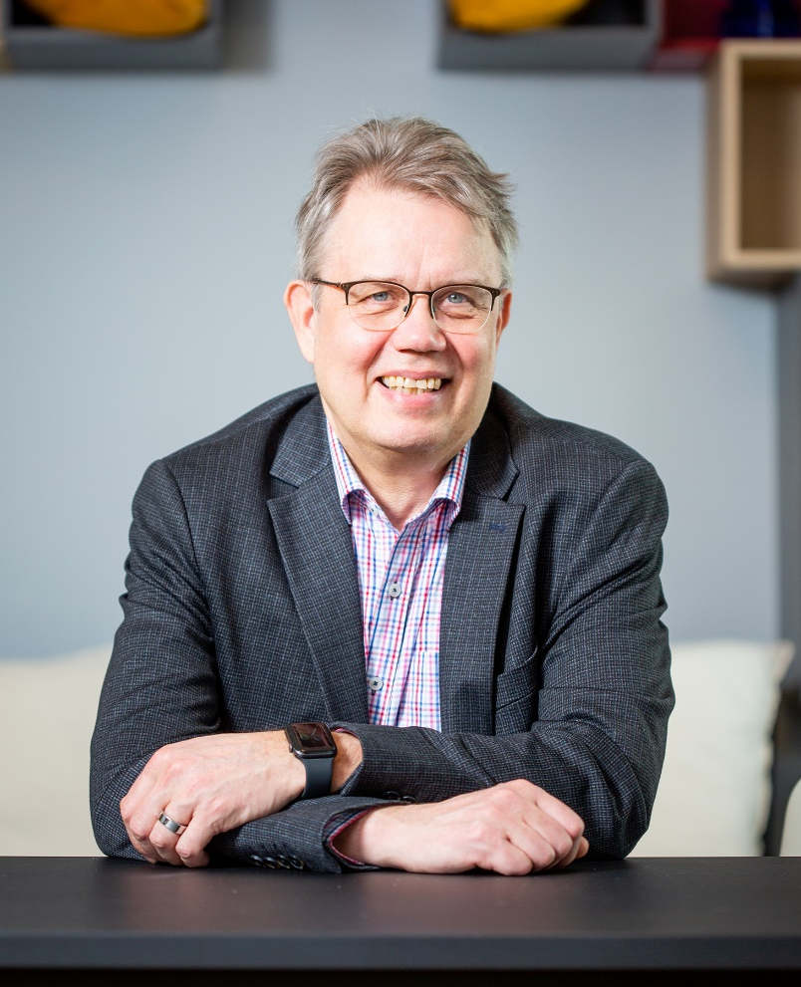
“
I am a mental health nurse and I am also a social psychologist. I think they make quite a perfect mix to teach.
PETRI KAROSKOSKI
Teacher in adult education, Tampere

Slide 29
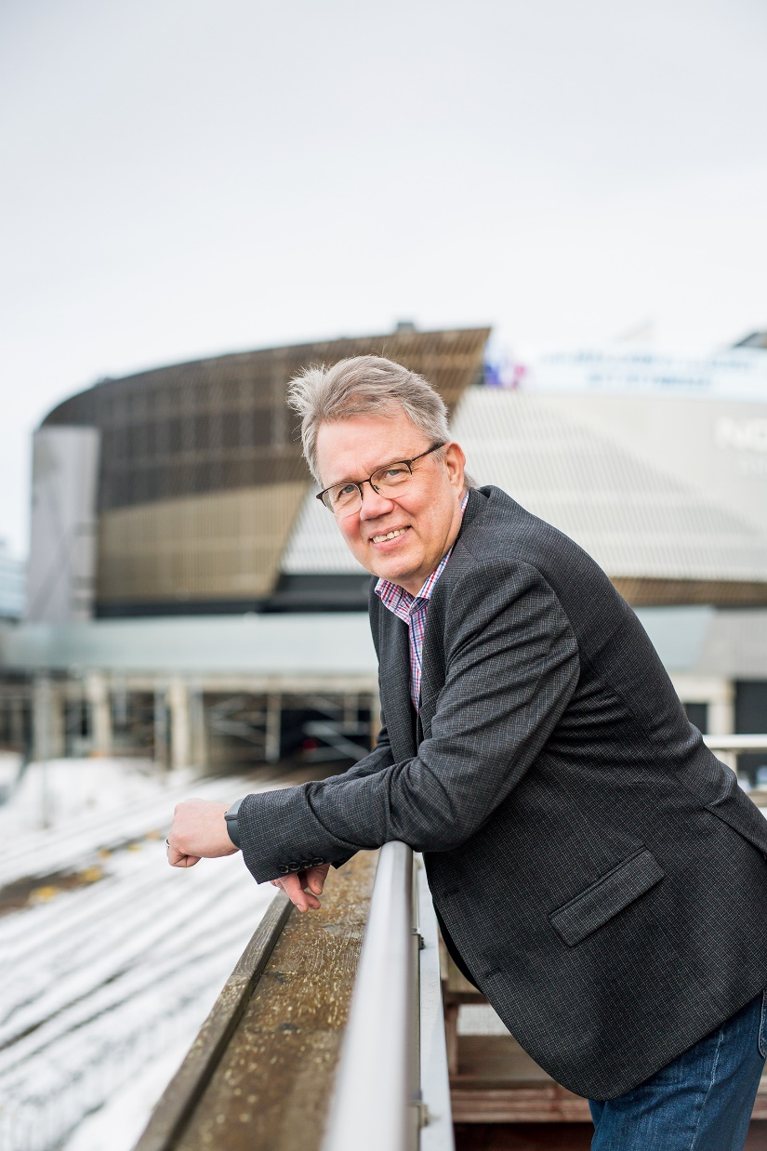
“
I am a mental health nurse and I am also a social psychologist. I think they make quite a perfect mix to teach.
PETRI KAROSKOSKI
Teacher in adult education, Tampere

Slide 30
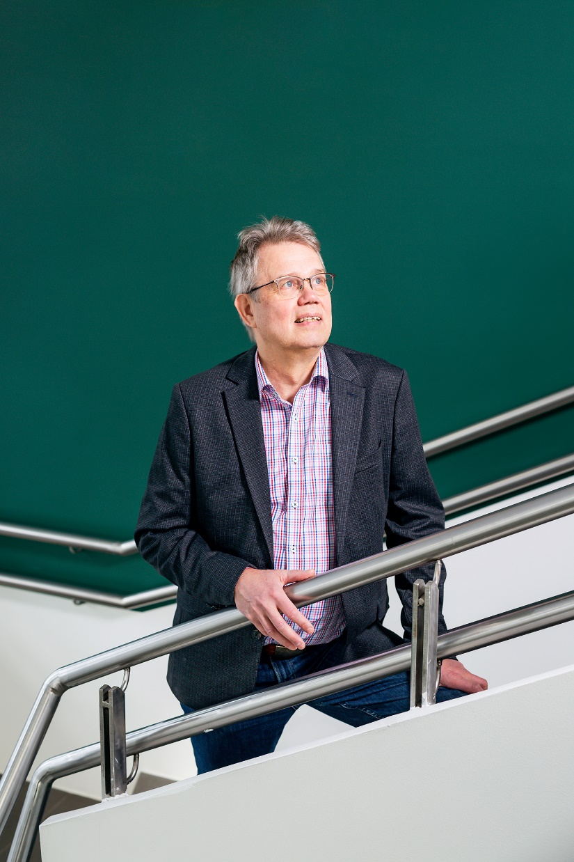
“
I am a mental health nurse and I am also a social psychologist. I think they make quite a perfect mix to teach.
PETRI KAROSKOSKI
Teacher in adult education, Tampere

Slide 32
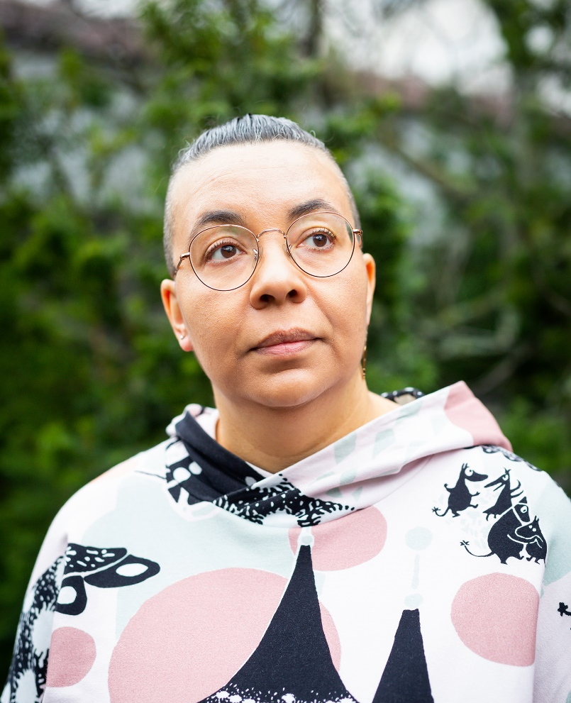
“
Learning should be comfortable and motivating. Only then you can get good results. And one of the main tasks of the teacher is to make learning fun.
ELLA JÄRVINEN Language and special needs teacher, Espoo

Slide 33
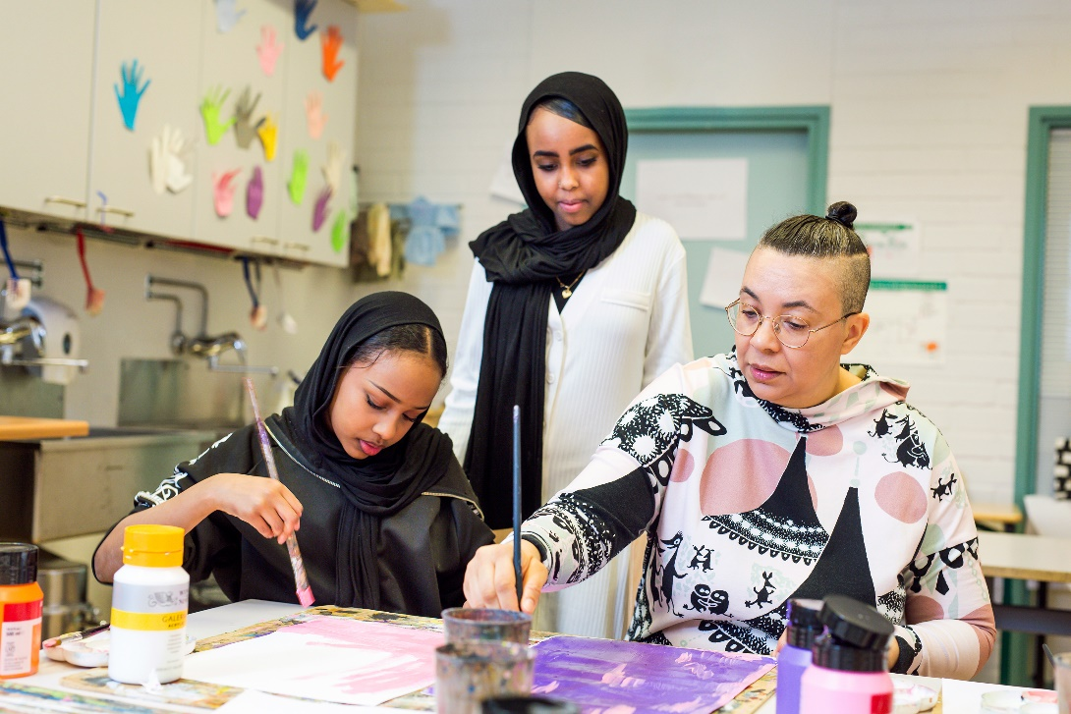
“
Learning should be comfortable and motivating. Only then you can get good results. And one of the main tasks of the teacher is to make learning fun.
ELLA JÄRVINEN Language and special needs teacher, Espoo

Slide 34
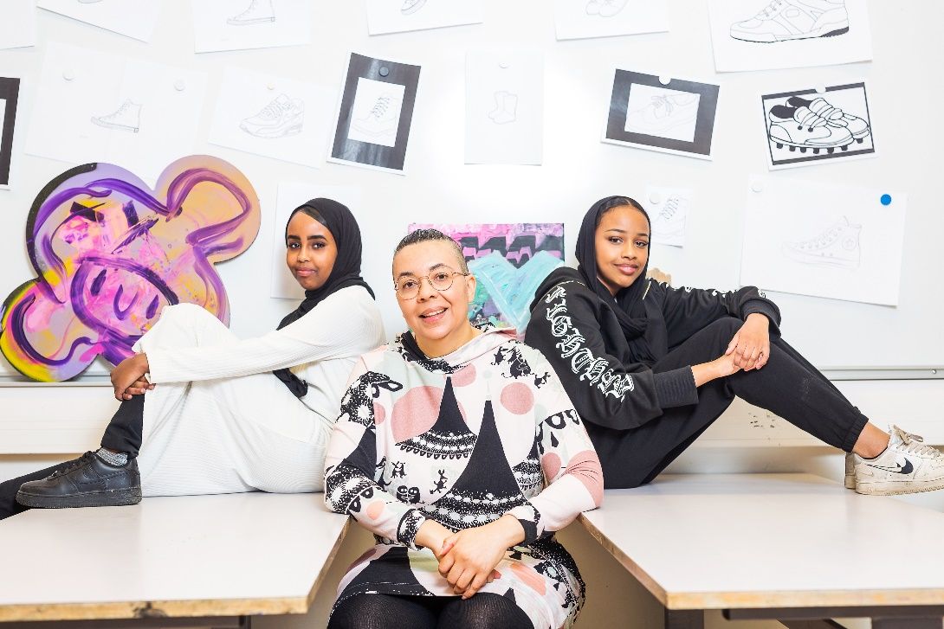
“
Learning should be comfortable and motivating. Only then you can get good results. And one of the main tasks of the teacher is to make learning fun.
ELLA JÄRVINEN Language and special needs teacher, Espoo

Slide 36
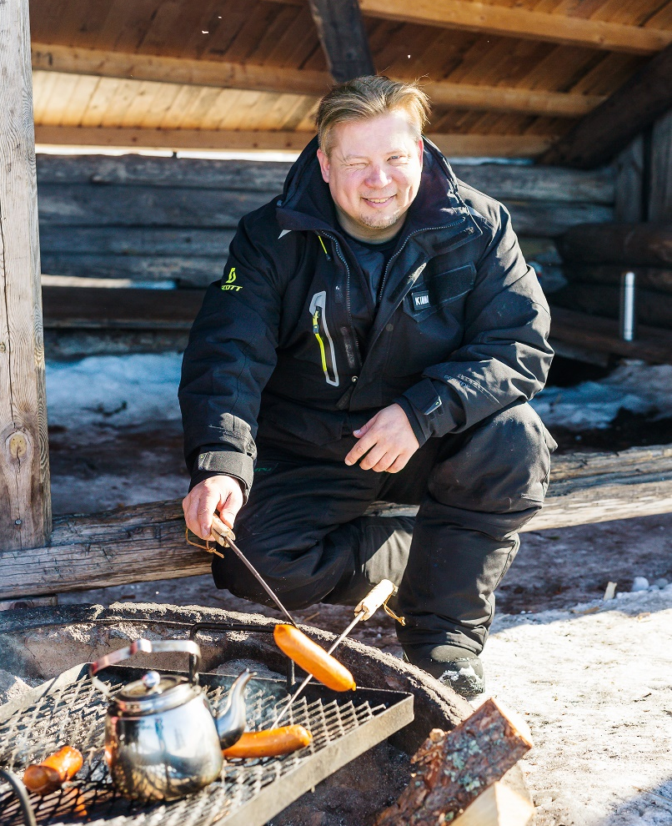
“
I teach about nature and tourism. Life is very different here because we have so much snow. We have huskies and reindeer and use snowmobiles.
KIMMO SIURUAINEN Teacher in vocational education, Rovaniemi

Slide 37
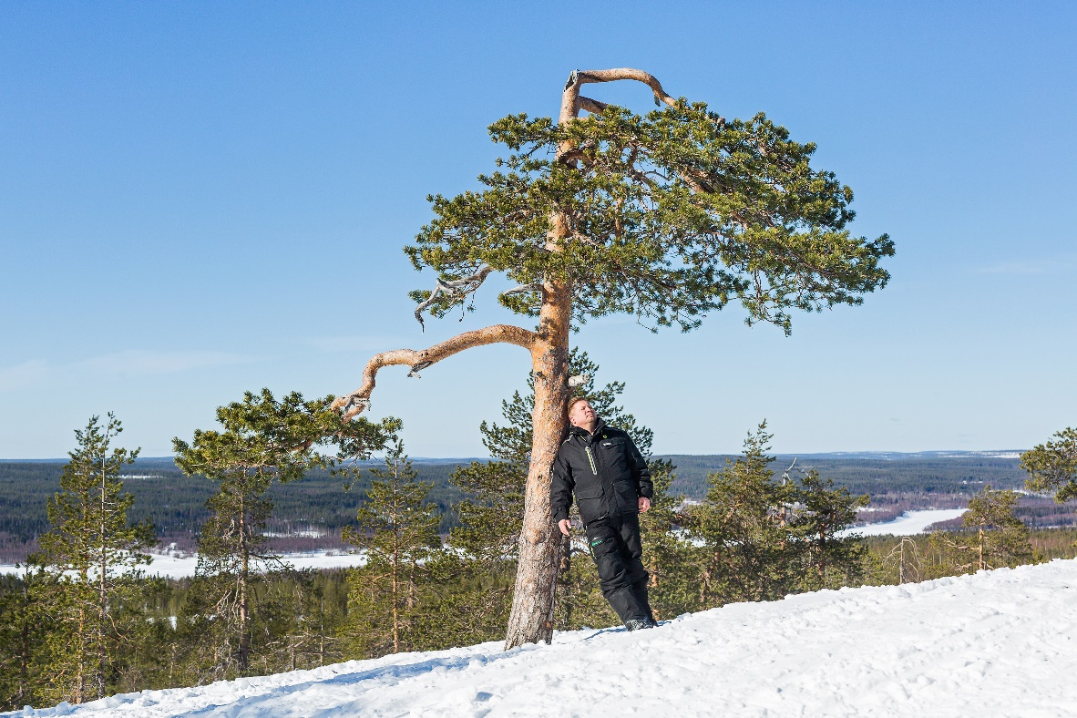
“
I teach about nature and tourism. Life is very different here because we have so much snow. We have huskies and reindeer and use snowmobiles.
KIMMO SIURUAINEN Teacher in vocational education, Rovaniemi

Slide 38
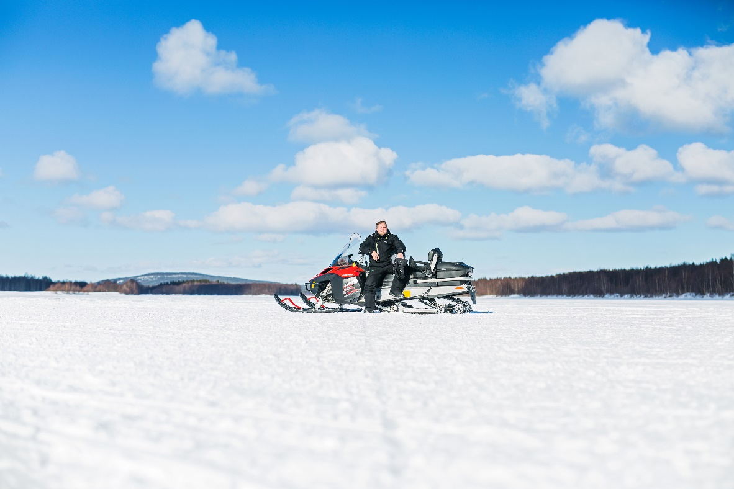
“
I teach about nature and tourism. Life is very different here because we have so much snow. We have huskies and reindeer and use snowmobiles.
KIMMO SIURUAINEN Teacher in vocational education, Rovaniemi

Slide 39
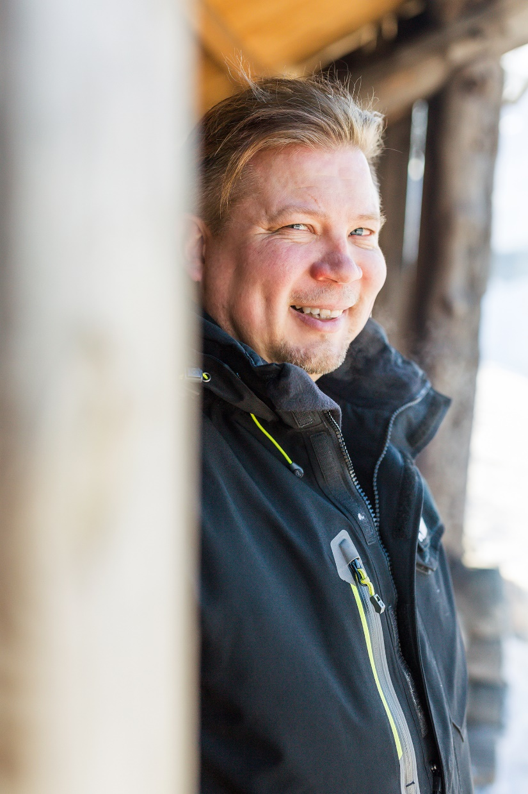
“
I teach about nature and tourism. Life is very different here because we have so much snow. We have huskies and reindeer and use snowmobiles.
KIMMO SIURUAINEN Teacher in vocational education, Rovaniemi

Slide 40
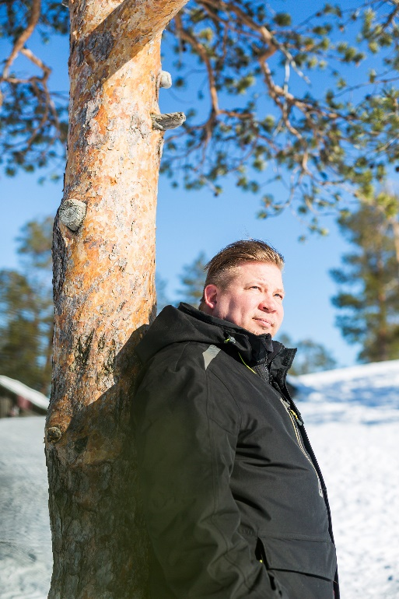
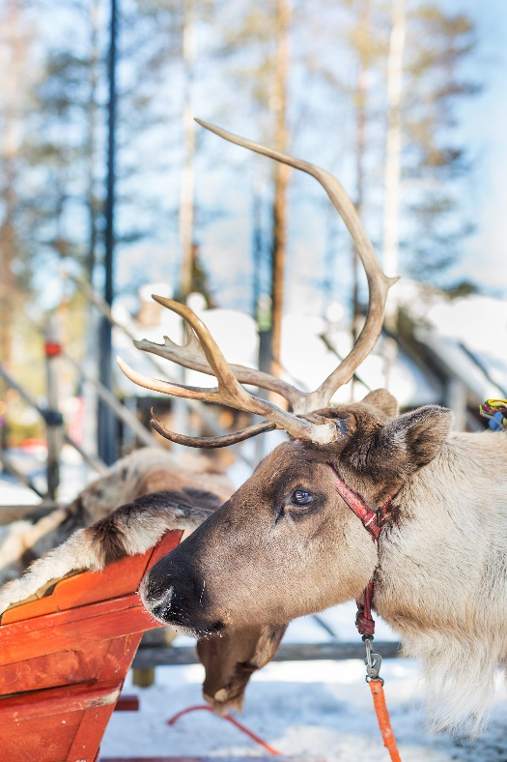
“
I teach about nature and tourism. Life is very different here because we have so much snow. We have huskies and reindeer and use snowmobiles.
KIMMO SIURUAINEN Teacher in vocational education, Rovaniemi

