Slide 1
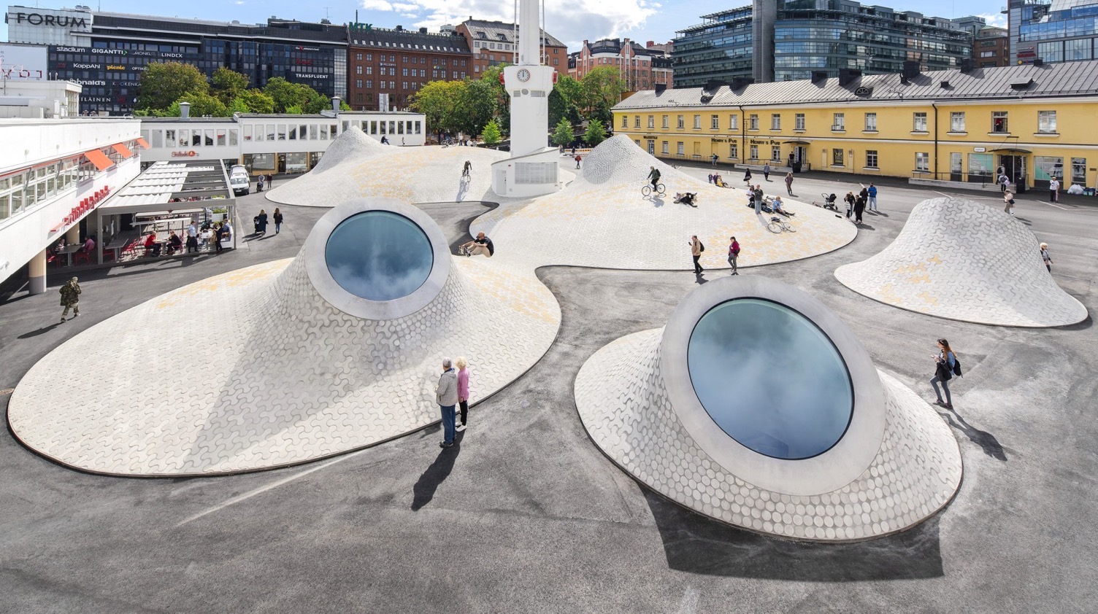
10 WINDOWS INTO
FINNISH ARCHITECTURE
Amos Rex Art Museum by JKMM Architects, Helsinki 2018. Photo: Mika Huisman / JKMM
Notes:
Architecture is an excellent perspective to look into what Finland is about: architecture always reflects the values of the society it was created for.
Here are 10 facts you should know about Finnish architecture.
The opening image combines neo-classical architecture from the time before Finland's independence, stream-lined modernism of the young independent state, and contemporary architecture reflecting the values of today

Slide 2
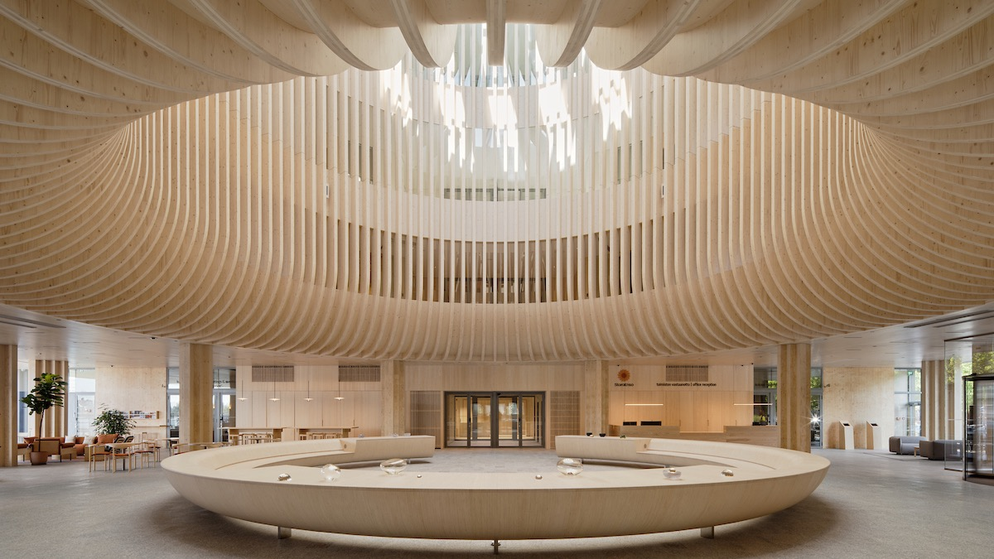
1/10
Reshaping wood
runs in our roots.
Laituri Office and Commercial Building by Anttinen Oiva Architects, Helsinki 2024. Photo: Tuomas Uusheimo / AOA
Notes:
The first – and maybe obvious – fact about Finland is that our traditional construction material is wood; but we do know how to work it even today.
The forestry company Stora Enso Headquarters and a seaside hotel are located in this amazing and awarded wood-framed building.

Slide 3
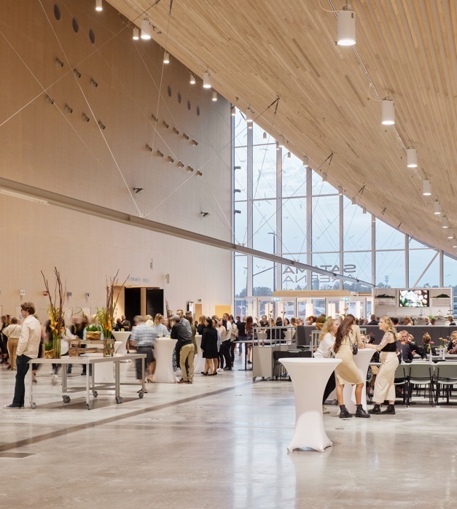
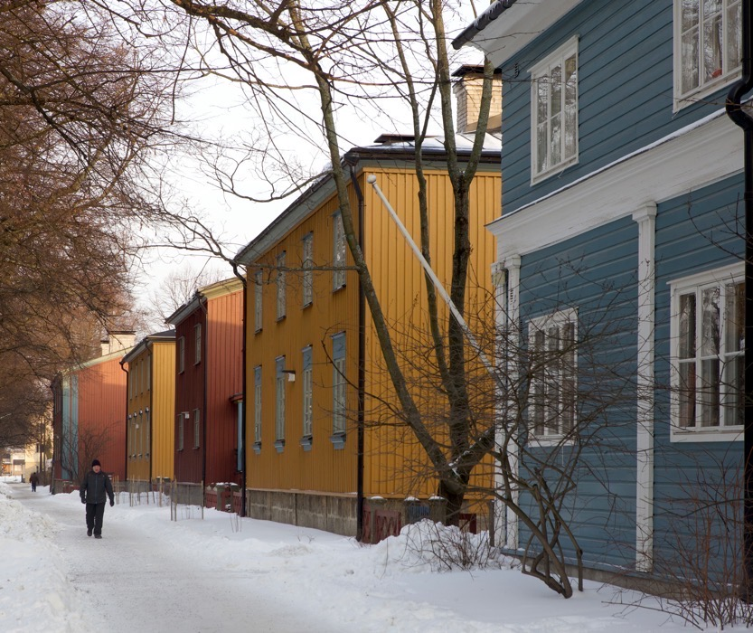
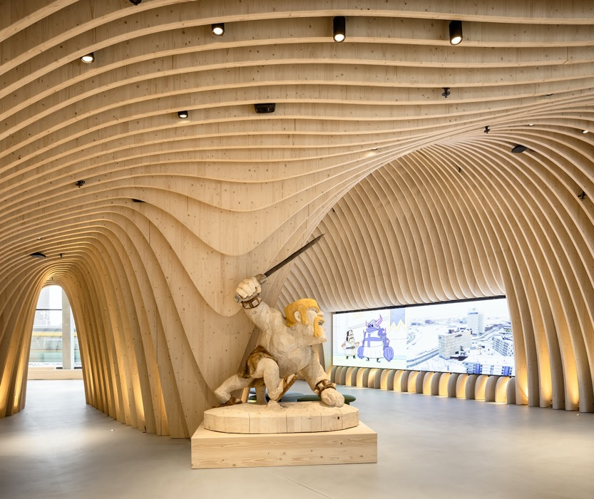
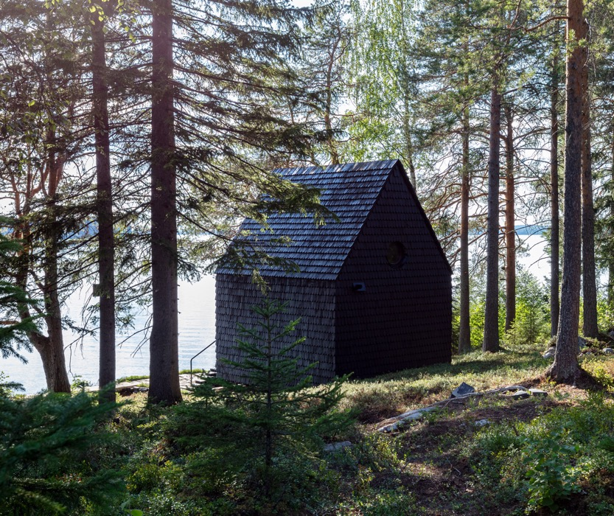
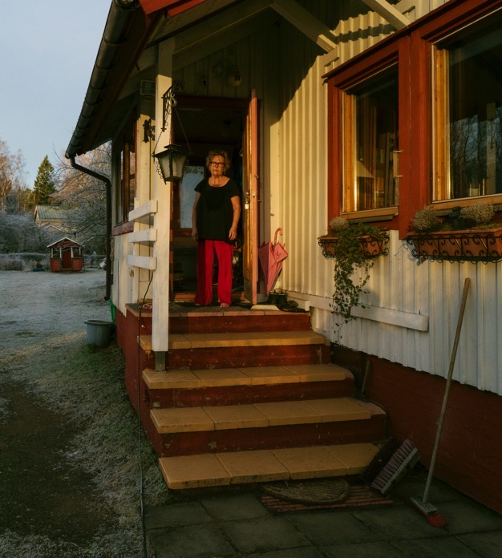
Reshaping wood runs in our roots.
10 WINDOWS INTO FINNISH ARCHITECTURE
1
2
3
4
5
6
7
8
9
10
Filmmaker’s Hut by Pirinen & Salo Architects, Iisalmi 2020. Photo: Marc Goodwin / Pirinen & Salo
Event Centre Satama by ALA Architects, Kotka 2023. Photo: Tuomas Uusheimo / ALA
Pohjolankatu Street from the 1920s in Puukäpylä, Helsinki. Photo: Nea Ilmevalta / Archinfo
Wood City by Anttinen Oiva Architects, Helsinki 2020. Photo: Tuomas Uusheimo / AOA
78 %
of the Finnish territory
is covered by forests.
No wonder we know
wood inside out.
Puutalo Oy House from the 1940s in Marttila, Helsinki. Photo: Juuso Westerlund / New Standards
Notes:
Finland has urbanised fairly late.
In 1950 most Finns still lived in the countryside whereas in 1970 more than half already lived in towns.
Still, today, 78 % of the Finnish territory is covered by forests, so it's no wonder wood has been a natural material for houses.
Finland was a pioneer in industrialising timber house production:
(right) the Käpylä district of Helsinki, built in the 1920s for working class people to improve their living conditions; here the houses were produced semi-industrially;
(left) an example of war-time endeavours to rapidly house war refugees by creating innovations in industrially produced timber houses. Marttila in Helsinki is just one of many similar neighbourhoods in Finland.
Puutalo Oy – Timber Houses Ltd. then became the world's largest export venture of timber houses – the story was exhibited in the 2021 Venice architecture Biennale.
Today, wood is also used in large-scale urban complexes, such as the event centre in Kotka, eastern Finland, and the gaming company Supercell's headquarters in Helsinki.

Slide 4
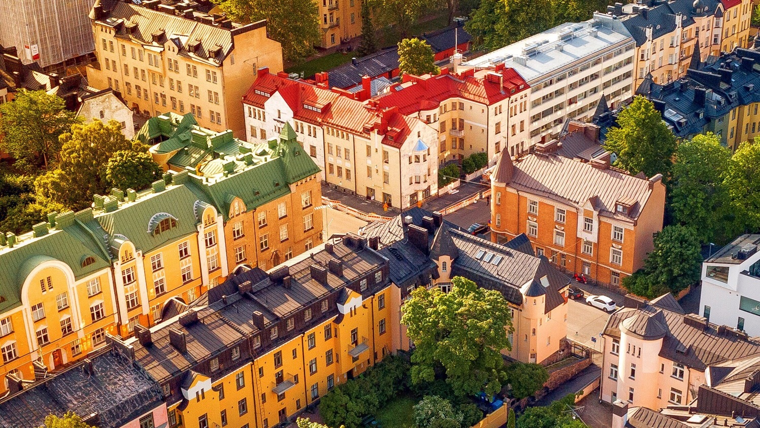
2/10
Helsinki is the blooming
Art Nouveau capital of
Northern Europe.
Aerial view of the Eira district. Photo: Omar El Mrabt / City of Helsinki
Notes:
One thing you may not have known: Helsinki is home to Northern Europe’s largest concentration of Art Nouveau architecture.
The monumental centre of Helsinki was built in the Neo-Classical “Empire” style in the first half of the 19th century, but some neighbourhoods are predominantly Art Nouveau or Jugenstil.

Slide 5
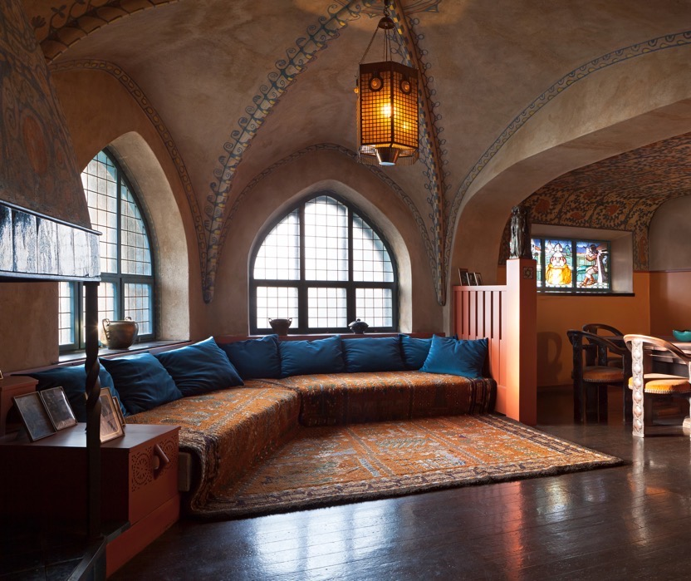
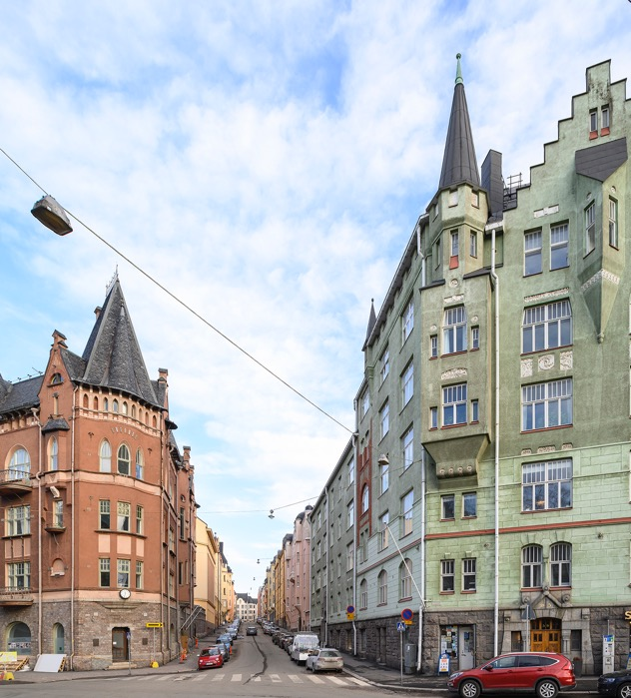
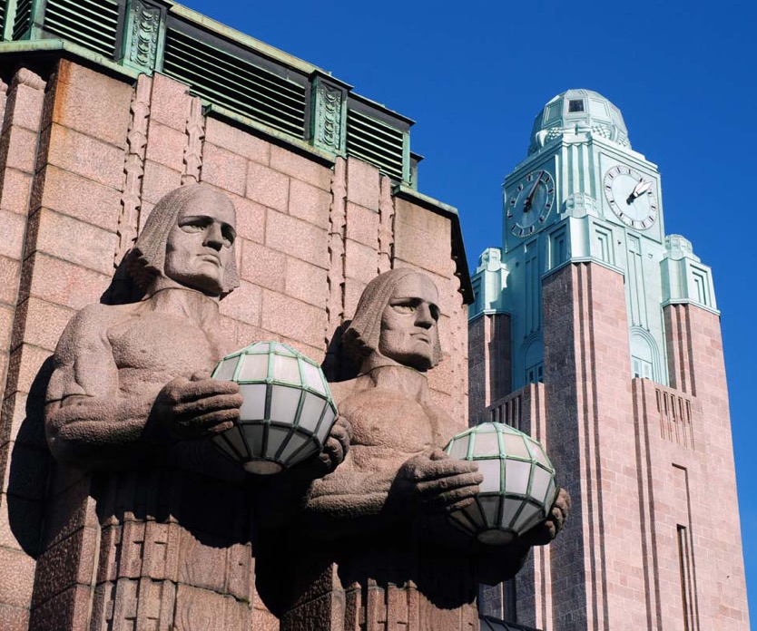
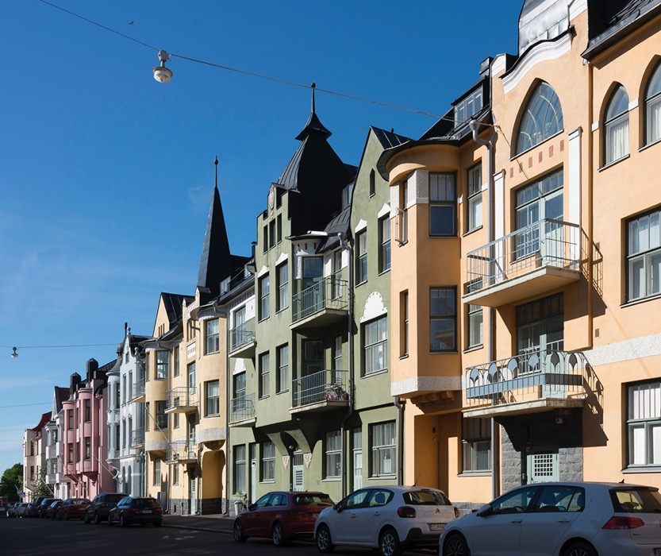
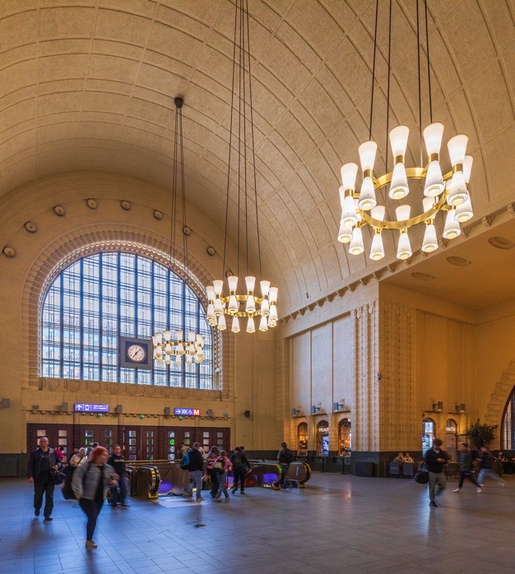
Helsinki is the blooming Art Nouveau capital of Northern Europe.
10 WINDOWS INTO FINNISH ARCHITECTURE
1
2
3
4
5
6
7
8
9
10
Huvilakatu Street in the Eira district, Helsinki. Photo: Matti Similä / Helsinki City Museum
Helsinki Railway Station by Eliel Saarinen, 1919. Photo: Soile Laaksonen / VR Group
Luotsikatu Street in the Katajanokka district, Helsinki. Photo: Yehia Eweis / Helsinki City Museum
Hvitträsk, Saarinen’s home studio, Kirkkonummi 1903. Photo: Ilari Järvinen / National Heritage Agency
And since we like to do things a bit differently,
the Finnish interpretation of Art Nouveau is known as National Romanticism.
One of its biggest names was
Eliel Saarinen
Helsinki Railway Station with Paavo Tynell light fixtures.
Photo: Simo Räsänen / Wikimedia Commons
Notes:
The Finnish interpretation of Art Nouveau is called National Romanticism. It prevailed a fairly short period but the style was a powerful expression of what was seen as Finnish – at the time, in the turn of the 20th century, Finland was part of the Russian Empire and strongly moving towards independence, which was reflected in all arts, including architecture.
The greatest master of the National Romantic era was Eliel Saarinen (1873–1950), who then became the internationally best-known Finnish architect of the time: he worked the second half of his career in the United States and had a great influence also on American architecture. [His son, architect Eero Saarinen, is one of the biggest names of American Modernism with works such as the Gateway Arch in St. Louis.]
(right) The home and studio of Saarinen by a lake in Kirkkonummi is a total work of art [Eero Saarinen was born here], today a museum.
(left) Helsinki Railway Station has been called the world's most beautiful train station. Entrance hall with Paavo Tynell lamps that are today coveted by design collectors all over the world.
Some street views in Art Nouveau or Jugendstil districts in Helsinki: Katajanokka and Eira.

Slide 6
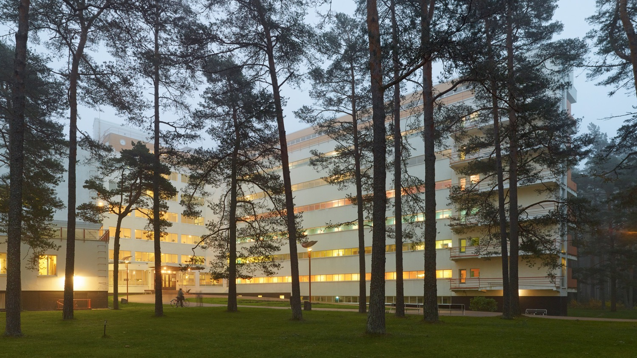
3/10
Finland is a landmark of
world-class modernism.
Paimio Sanatorium by Alvar and Aino Aalto, 1933. Photo: Tuomas Uusheimo
Notes:
What Finnish architecture is probably the best known for, is Modernism.
E.g. the Paimio tuberculosis sanatorium from the 1930s was widely published internationally and a paragon to many architects all over the world.
The Sanatorium was designed by the great architect Alvar Aalto and his office.

Slide 7
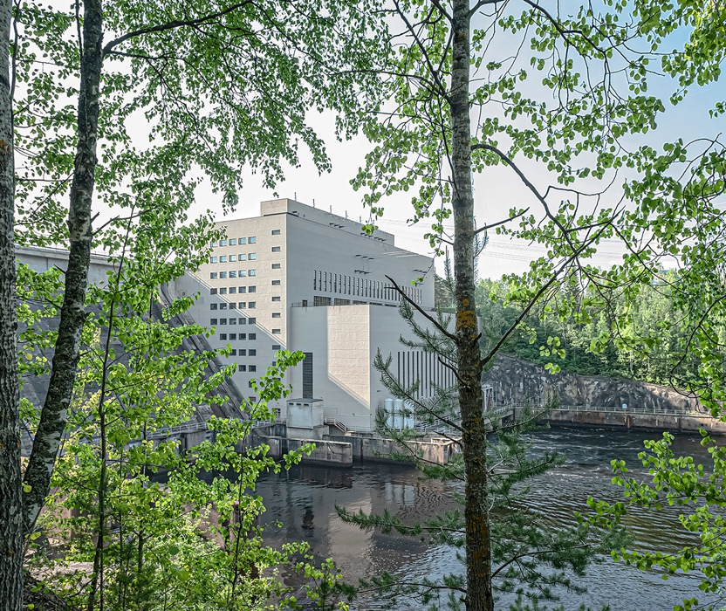
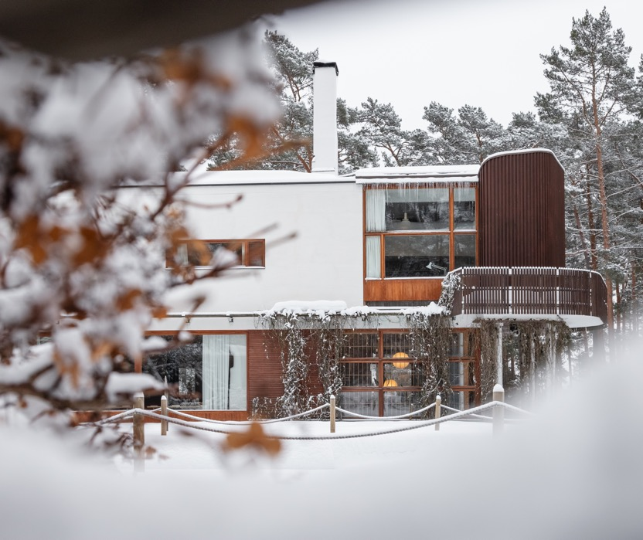
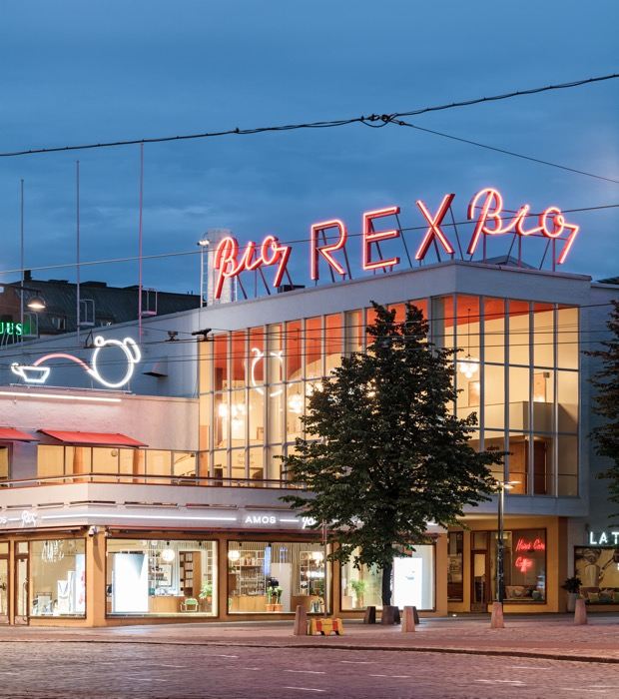
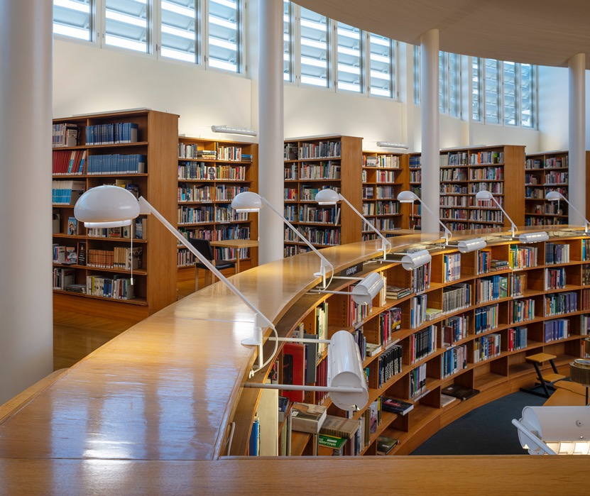
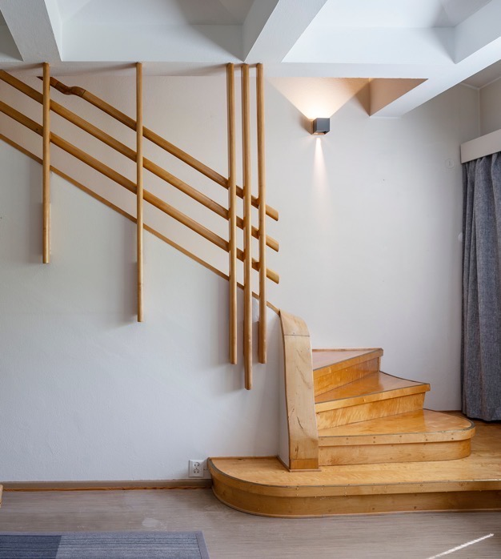
Finland is a landmark of world-class modernism.
10 WINDOWS INTO FINNISH ARCHITECTURE
1
2
3
4
5
6
7
8
9
10
Pyhäkoski Hydropower Plant by Aarne Ervi, Muhos 1951. Photo: Pekka Elomaa / Council of Oulu Region
Villa Mairea by Alvar and Aino Aalto, Noormarkku, Pori 1939. Photo: Jarno Kylmänen / Mairea Foundation
Lasipalatsi by Kokko, Revell & Riihimäki, Helsinki 1935.
Photo: Tuomas Uusheimo / City of Helsinki
Seinäjoki Library by Alvar Aalto, 1965. Restoration Architects Mustonen, 2015. Photo: Maija Holma / Alvar Aalto Foundation
Alvar Aalto
is one of the best-known Finns worldwide. He was an architect, a designer, and a giant of the Modernist scene.
"Form must have a content, and that content
must be linked with nature."
Mäkelä House by the Aalto office, Sunila, Kotka 1937.
Photo: Maija Holma / Alvar Aalto Foundation
Notes:
In 2025, Finland nominated a series of 13 Aalto sites for the Unesco World Heritage List.
Villa Mairea, a private home for an industrial tycoon and patron of arts near the west coast of Finland, is one of the 13 sites...
...as well as these two, a rowhouse for the employees of a forestry company in Sunila, eastern Finland, and a public library in Seinäjoki. [These are examples of features characteristic of Aalto's architecture: the use of indirect natural light, warm atmosphere created by wooden elements, and attention to detail.]
Of course, Aalto was not the only great Finnish architect of the Modernistic era – there were many others, such as Viljo Revell, designer of the Toronto City Hall, who was only a student in the 1930s when he and his student colleagues designed the Functionalistic Glass Palace building in Helsinki originally meant to be a temporary structure but today home to Amos Rex Art Museum. (right) Aarne Ervi was another big name of Modernism, and among libraries and other public buildings, he designed a series of handsome hydropower plants in northern Finland.

Slide 8
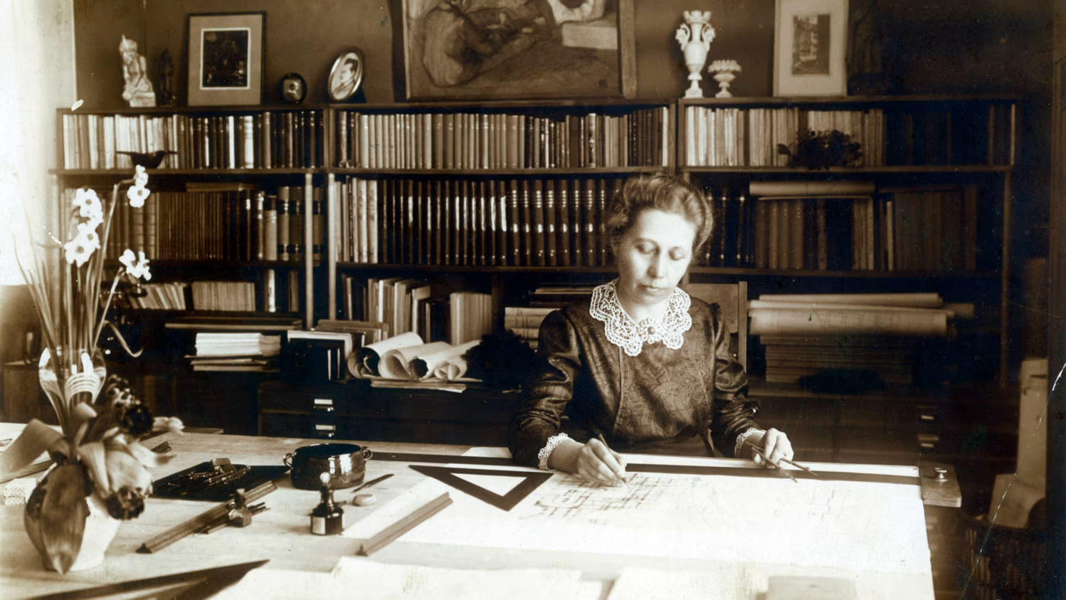
4/10
And can you guess the first
country to allow women to
graduate as architects?
Architect Wivi Lönn (1872–1966) was the first Finnish woman to start her own architectural practice.
Photo: Wilhelm Lönn / Museum of Central Finland
Notes:
Finland is world leader in gender equality and women’s rights – Finland was the first country in Europe and third in the world [1st New Zealand, 2nd Australia] to grant women the right to vote, in 1906.
Similarly in architecture, Finland was a paragon: the first country to allow women to graduate as architects.

Slide 9
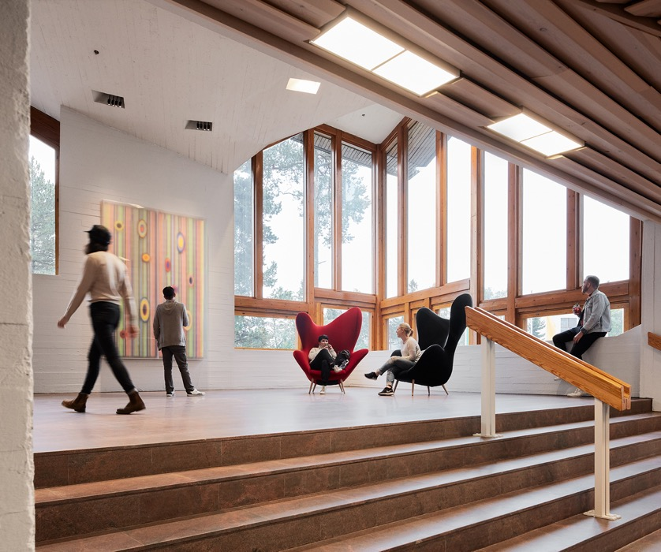
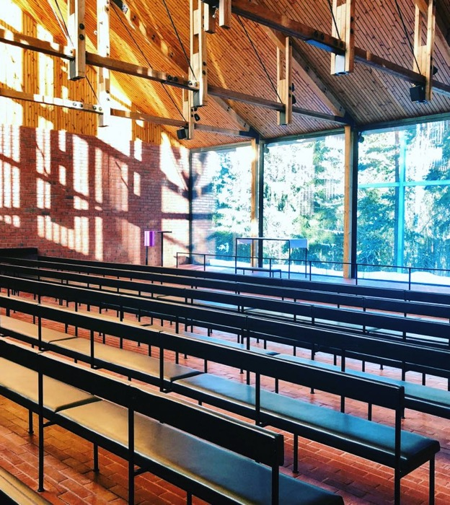
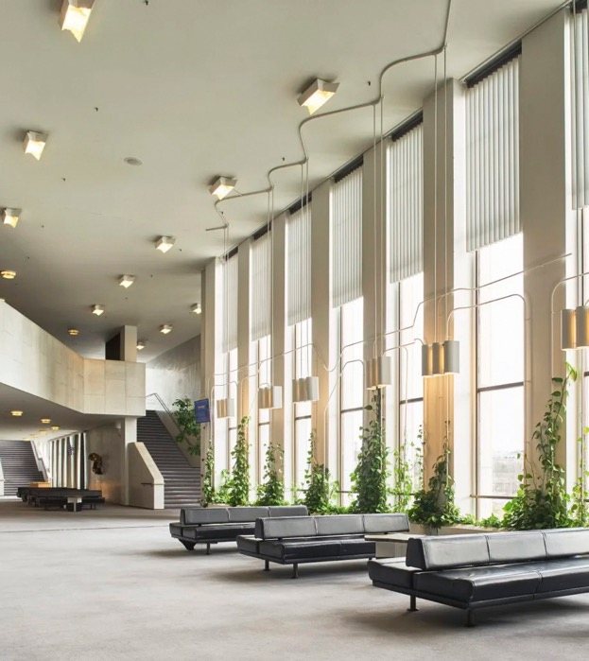
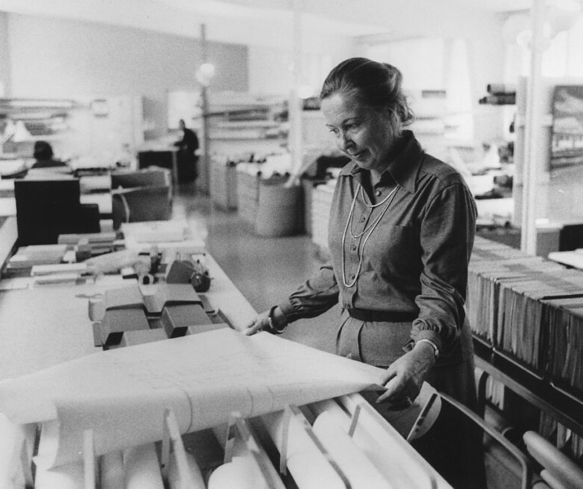
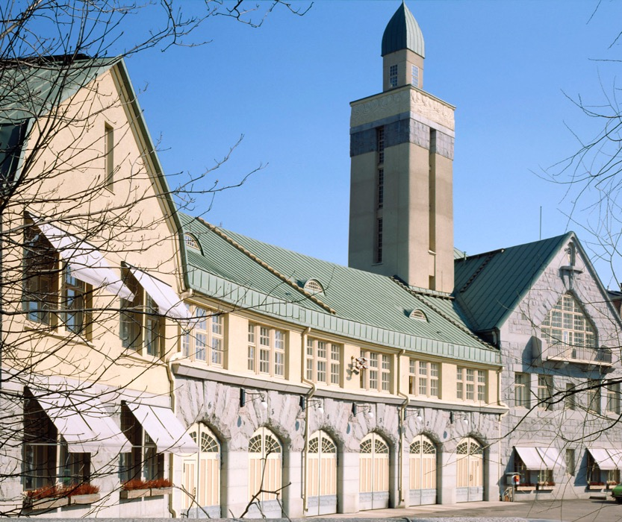
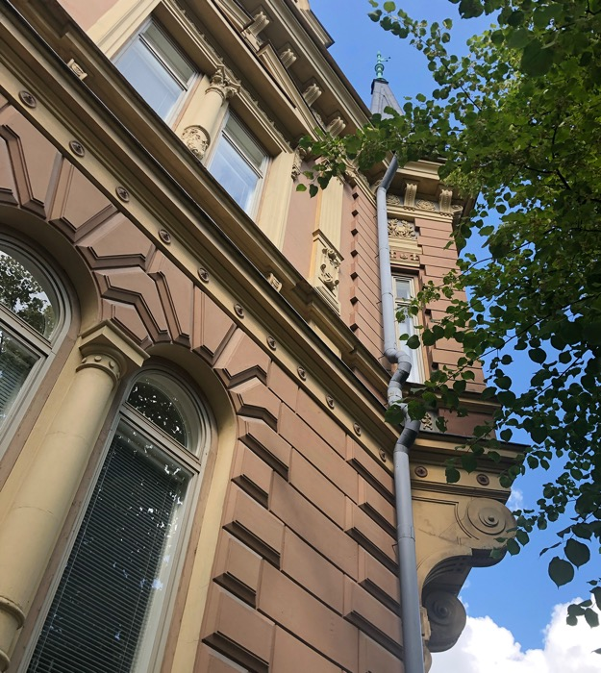
And can you guess the first country to allow women to graduate as architects?
10 WINDOWS INTO FINNISH ARCHITECTURE
1
2
3
4
5
6
7
8
9
10
Finlandia Hall by Alvar and Elissa Aalto, Helsinki 1971. Photo: Finlandia Hall
Tampere Central Fire Station by Wivi Lönn, 1908. Photo: Kari Hakli / Architecture & Design Museum Helsinki
Otaniemi Chapel by Kaija and Heikki Siren, Espoo 1958. Photo: Archinfo
Elissa Aalto at the Aalto office in the 1970s. Photo: Stig Bergström / Alvar Aalto Foundation
Dipoli by Raili and Reima Pietilä, Espoo 1966. Renovation by ALA Architects, 2017. Photo: Tuomas Uusheimo / ALA
1890
was the year when
the first woman graduated
as an architect.
In Finland—where else.
Today, three out of four students in Finnish schools of architecture are women.
House Newander (Signe Castle) by Signe Hornborg, Pori 1892. Photo: Miina Jutila / Archinfo
Notes:
The first woman architect was Signe Hornborg, who graduated Helsinki University of Technology in 1890, and soon after her, Wivi Lönn who was the first to work independently through her own firm.
The number of women in architecture is still growing: in the early 2010s, half of the students of architecture were women; today, the ratio is 3 out of 4.
(left) A residential building (1892) by Hornborg in Pori, western Finland, and (right) one of Wivi Lönn’s key works, the Central Fire Station in Tampere (1908).
Many of Finland’s renowned male architects had a joint office with their architect wives, who were equal, although less known partners, such as Aino Aalto, Elissa Aalto, Raili Pietilä and Kaija Siren.
Although there are less well-known women architects than men, today, all-female firms are nothing out of the ordinary.

Slide 10
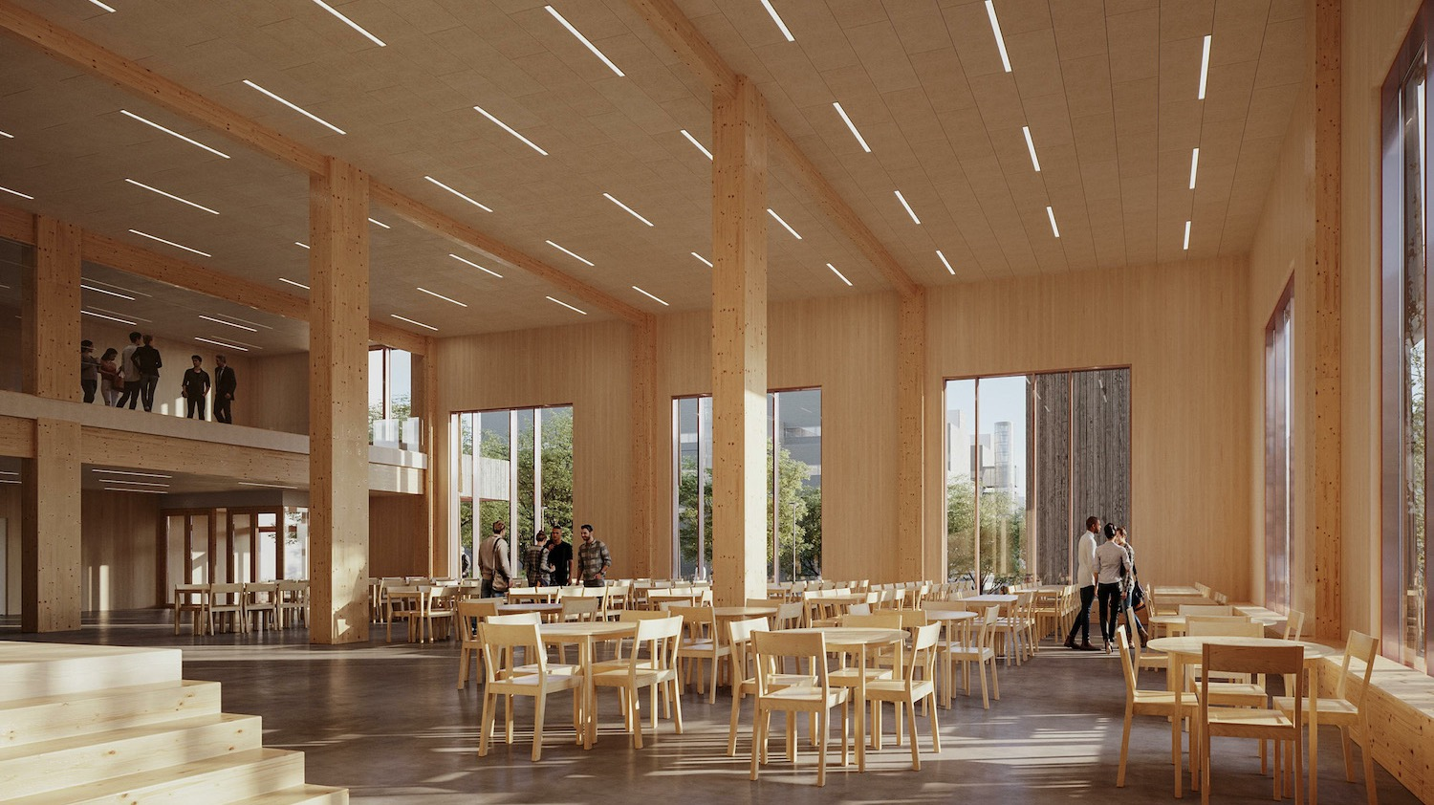
5/10
Our top ranking in education
inspires high-class school design.
Helsinki Upper Secondary School of Natural Sciences by AFKS Architects, 2023. Image: Olli Raila / AFKS
Notes:
As our 5th fact we present the celebrated Finnish school system. Architecture creates the setting for great educational results, and we put much effort into creating comfortable and well-functioning school facilities.

Slide 11
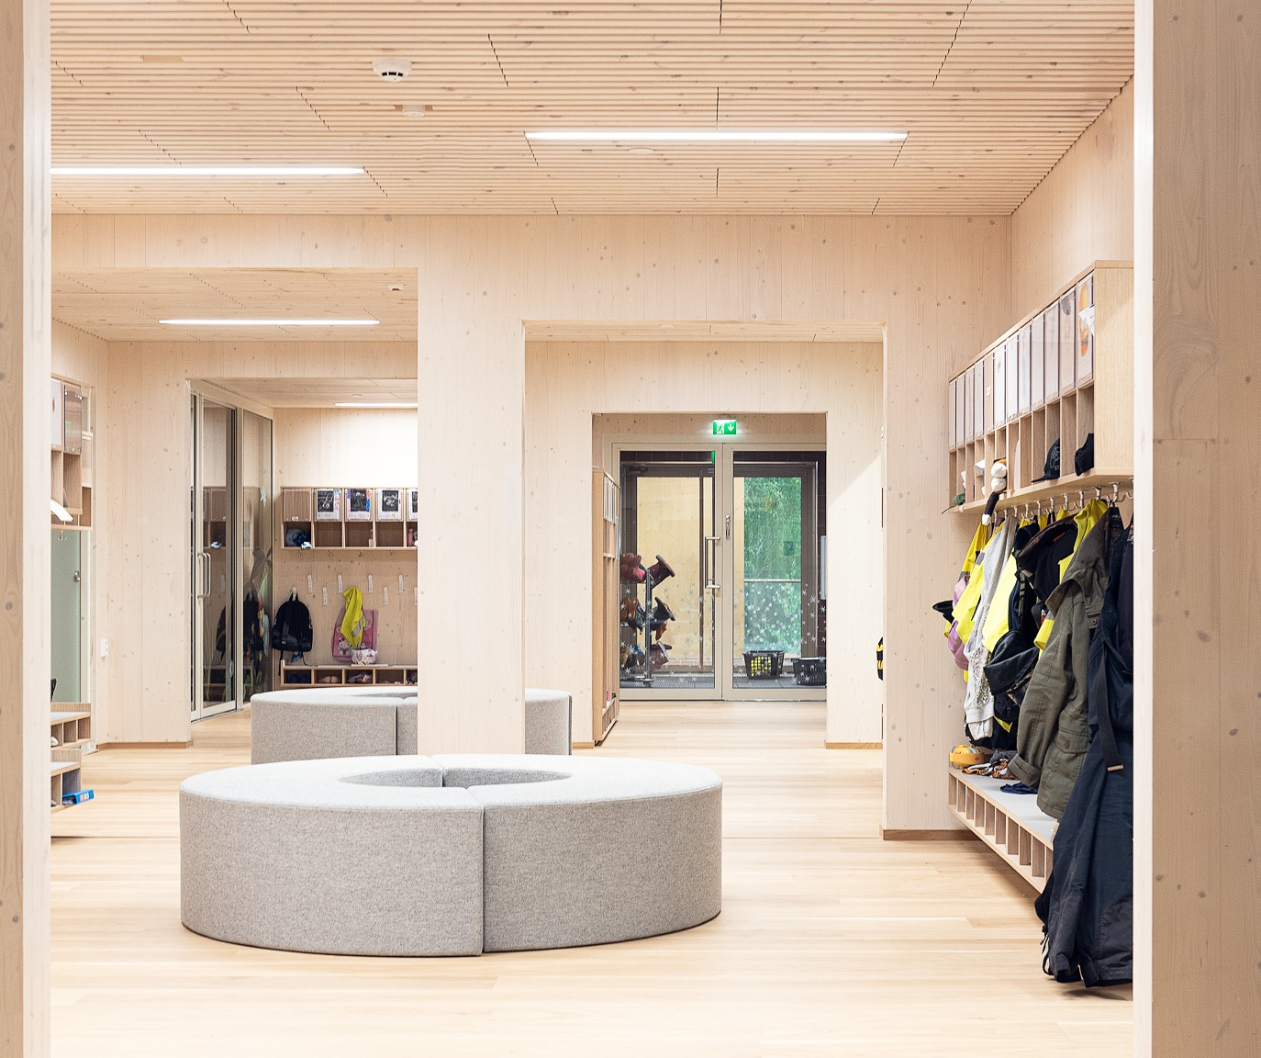
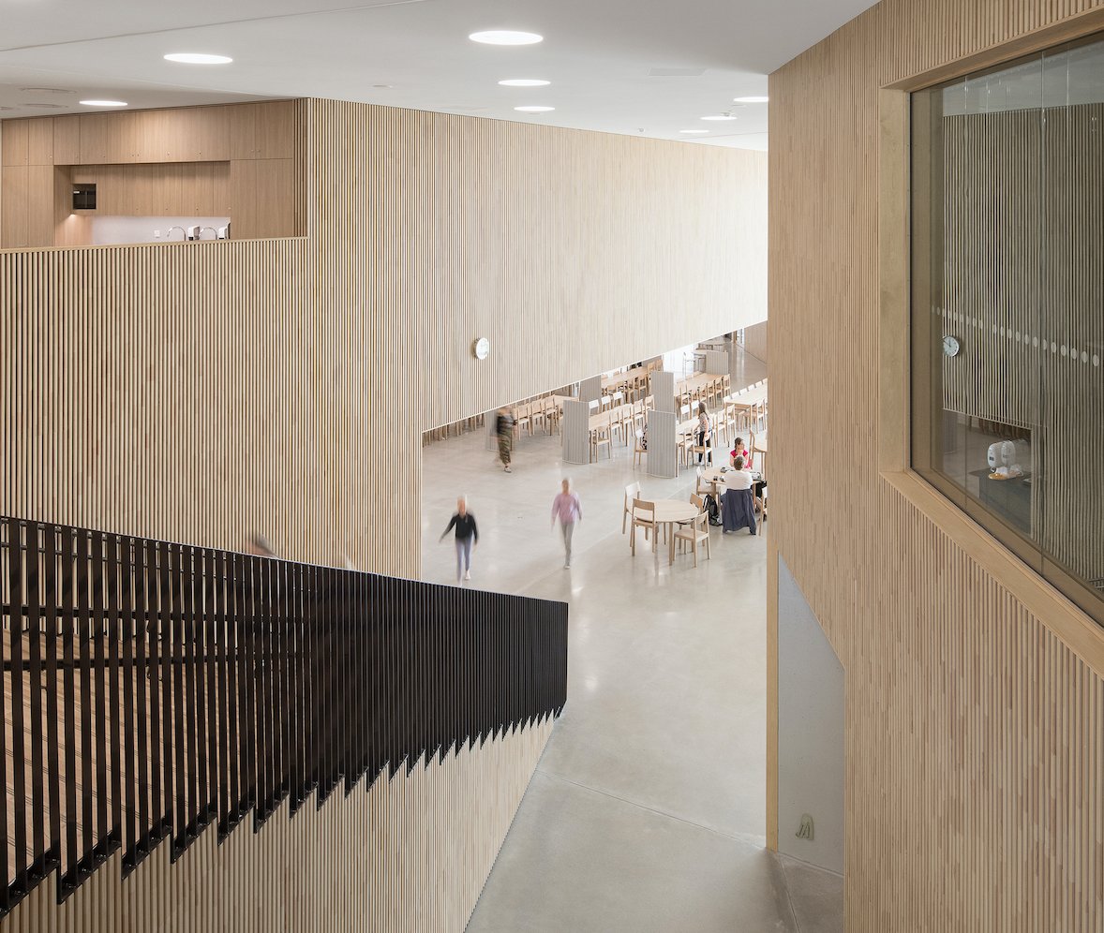
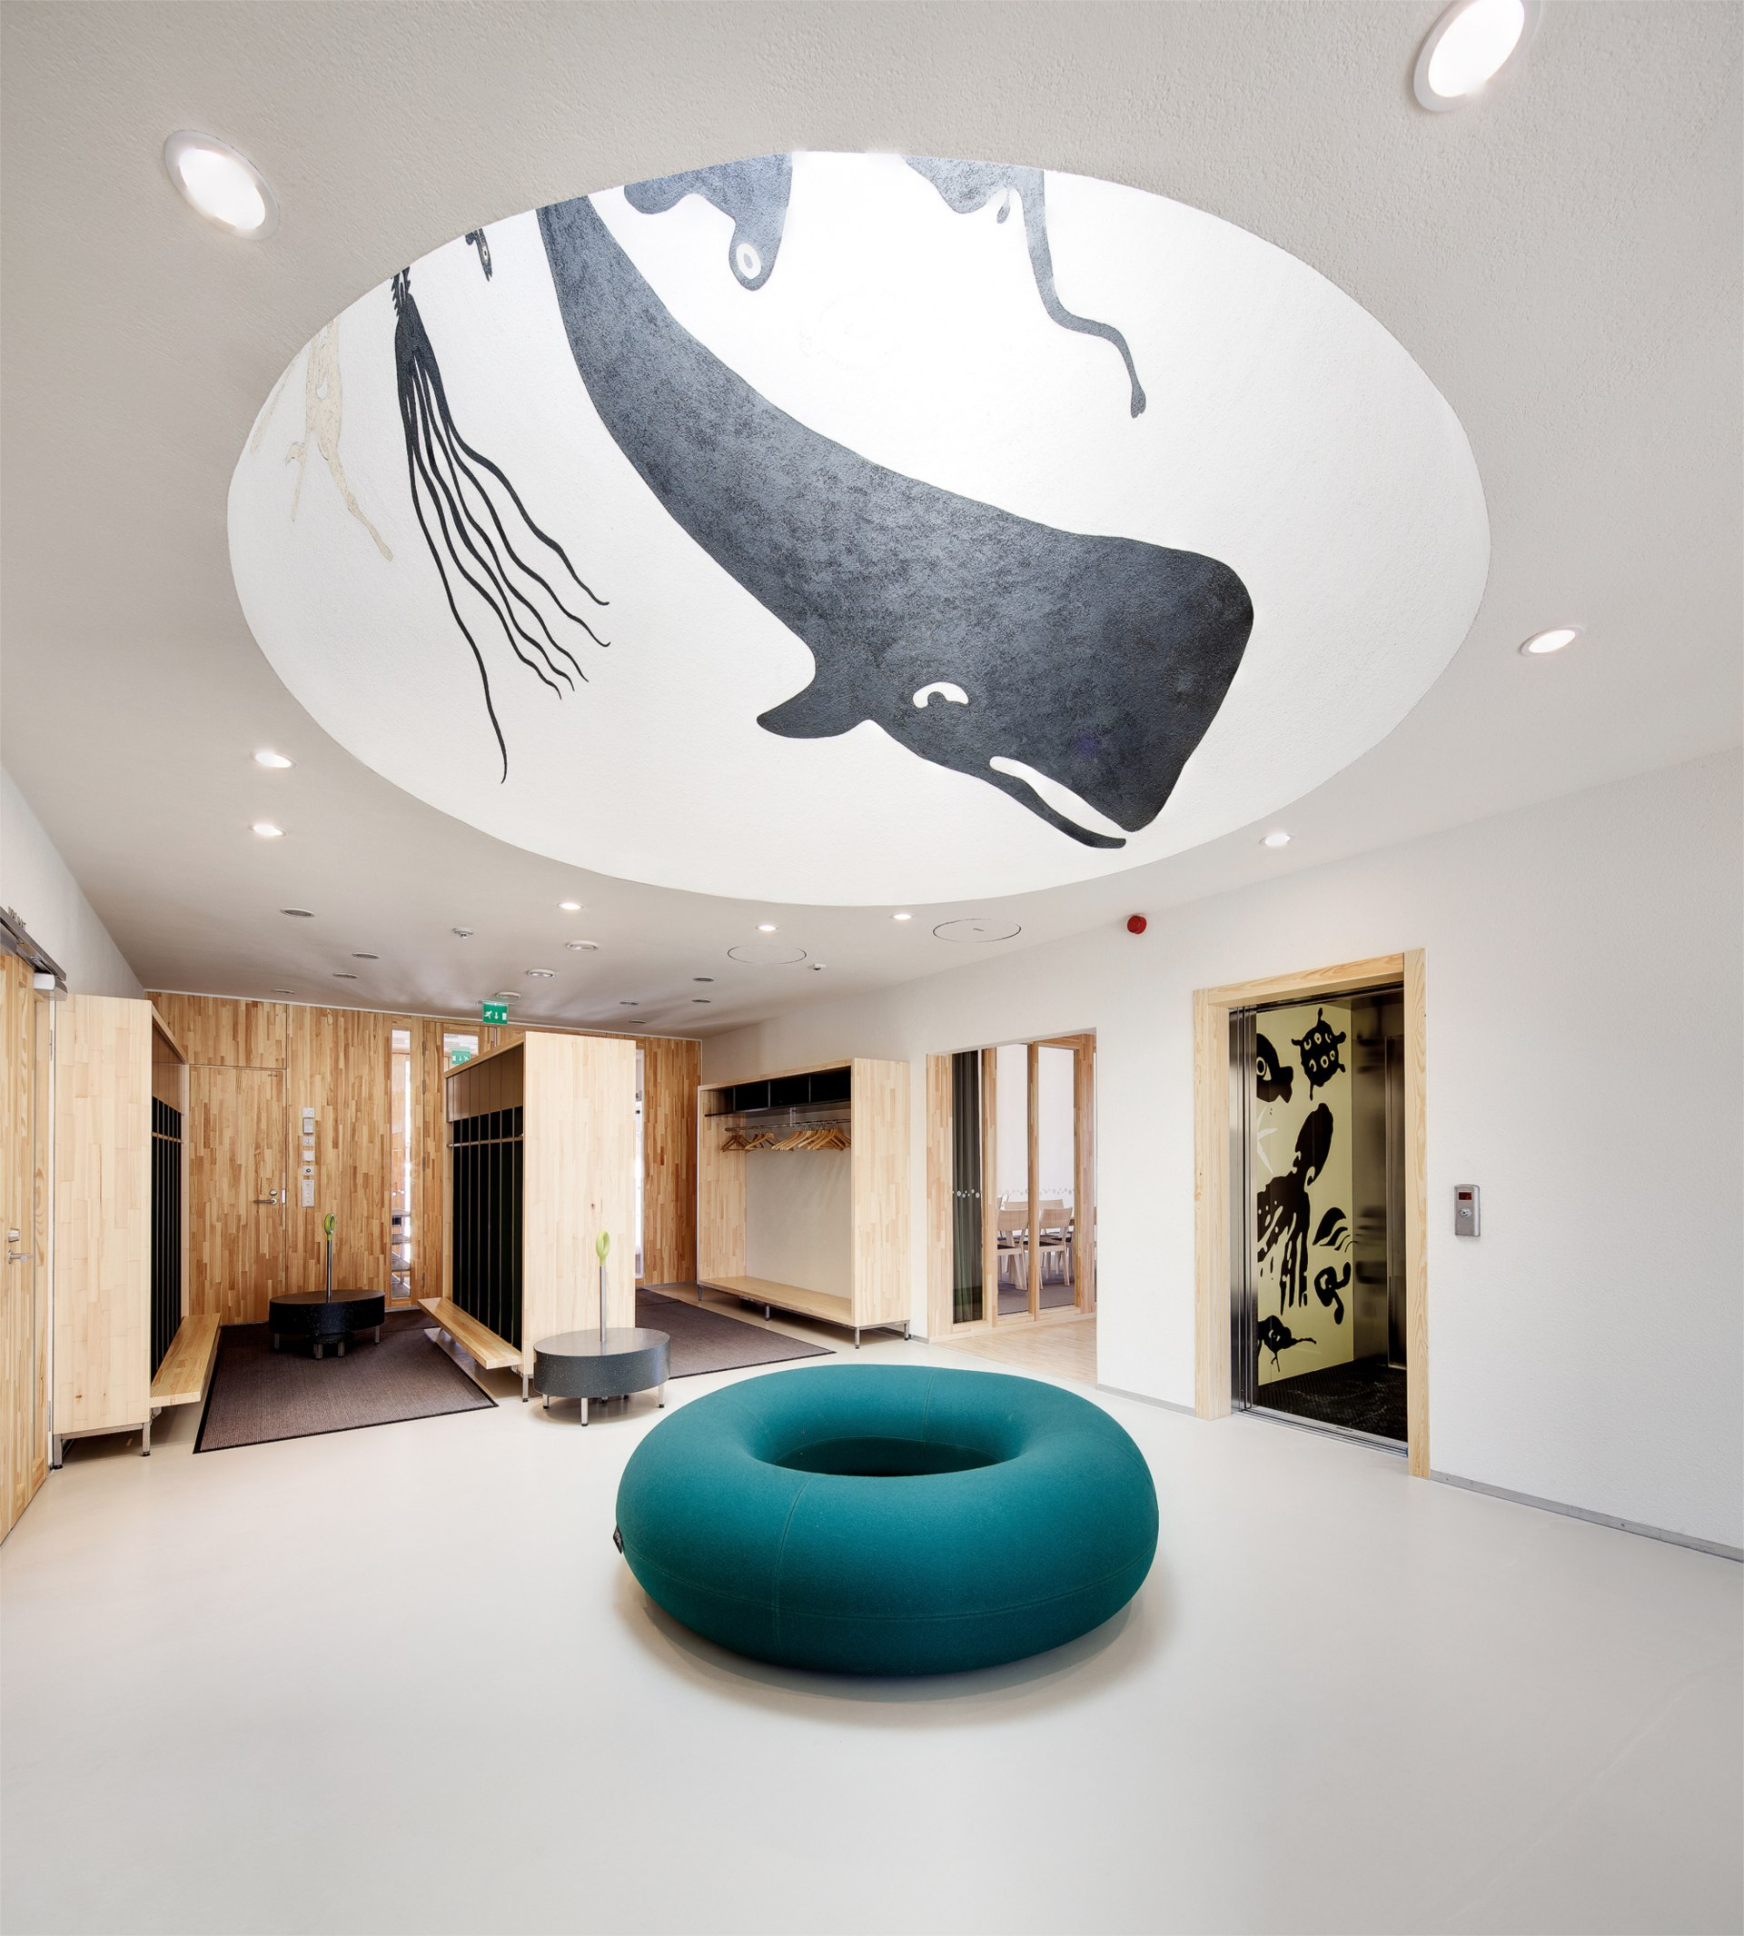
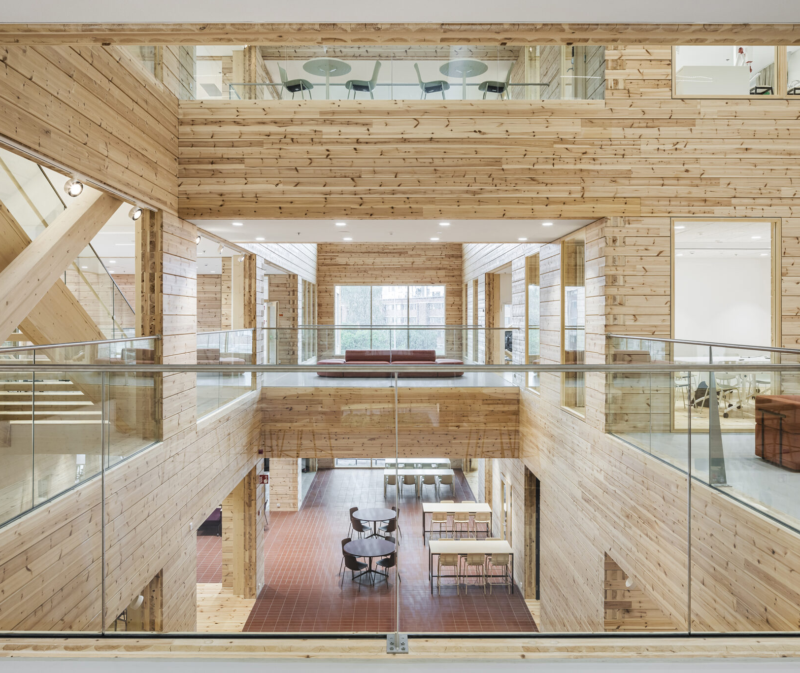
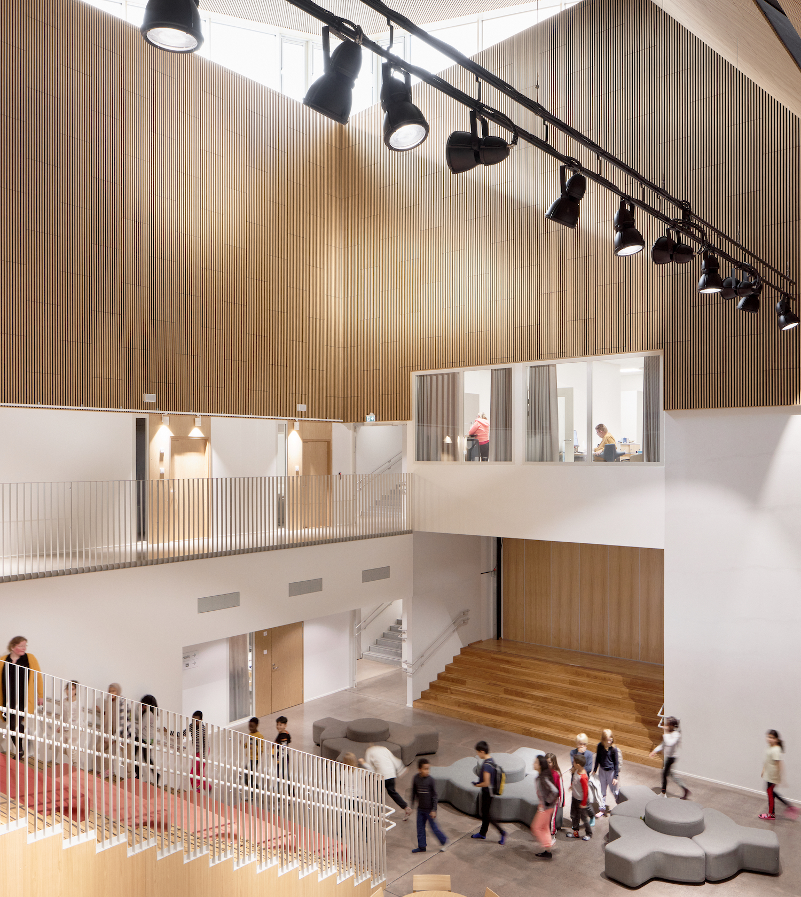
Our top ranking in education inspires high-class school design.
10 WINDOWS INTO FINNISH ARCHITECTURE
1
2
3
4
5
6
7
8
9
10
Lamminrahka School by Verstas Architects, Kangasala 2023. Photo: Niclas Mäkelä / Verstas
Saunalahti Daycare Centre by JKMM Architects, Espoo 2011. Photo: Mika Huisman / JKMM
Tuusula High School and Cultural Centre by AOR Architects, 2022. Photo: Anders Portman / AOR
Martta Wendelin Daycare Centre by AFKS Architects, Tuusula 2022. Photo: Hannu Rytky / AFKS
New schools are often
built of wood.
It creates a calm atmosphere and an inspiring space that nurtures growth.
Puotila Primary School by Verstas Architects, Helsinki 2022.
Photo: Tuomas Uusheimo / Verstas
Notes:
In the 2000s, schools are often built of wood. It creates a calm atmosphere and a great acoustic environment.
The best architectural firms are commissioned to design our schools. (right) The high school and community centre Monio in Tuusula (2023) is one of the biggest log buildings in Finland.
Public art also has its place in the design of new kinderkartens and schools, as stated in the Percent for Art principle adopted in Finland since a long time. [The principle means that one percent of the construction budget is reserved to public art.]

Slide 12
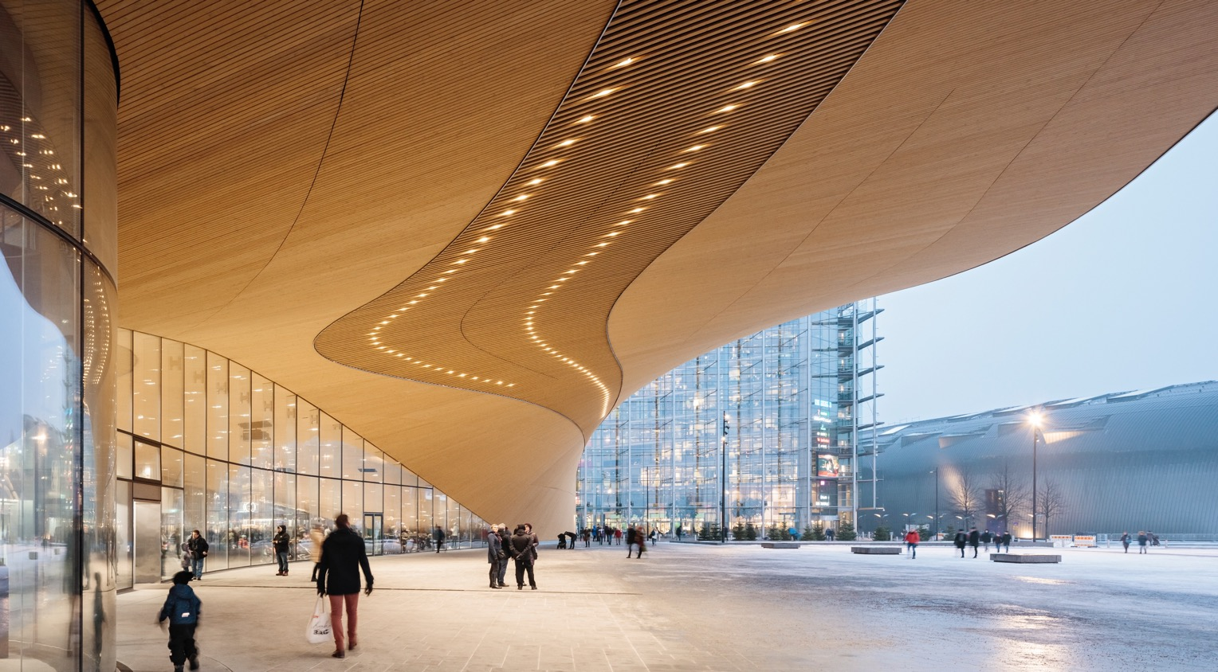
6/10
Our public library institution
is an important building block
of democratic education.
And it shows.
Helsinki Central Library Oodi by ALA Architects, 2018. Photo: Tuomas Uusheimo / City of Helsinki
Notes:
Since the 19th century, Finland’s public library institution has provided free culture and education to all, despite their background or social status. And we are very proud of it. This is reflected in our handsome library architecture.

Slide 13
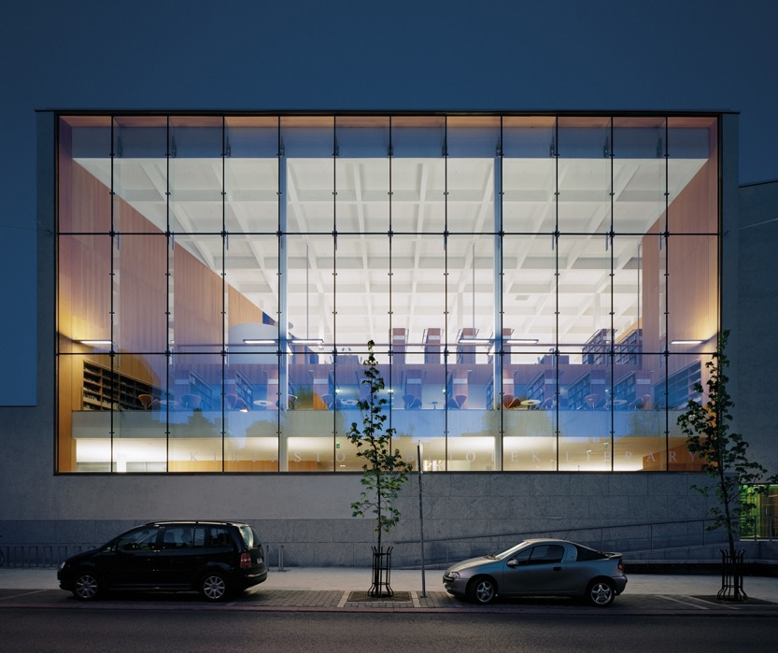
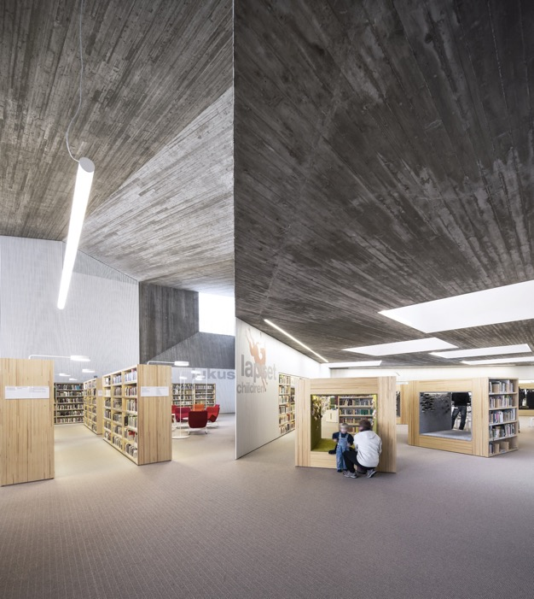
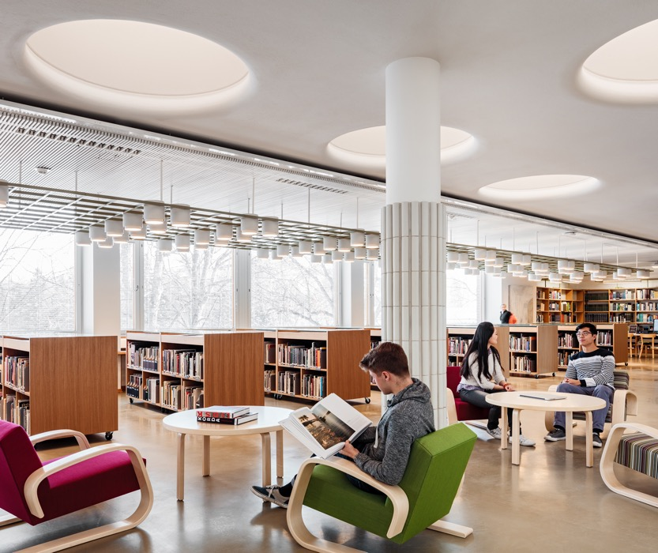
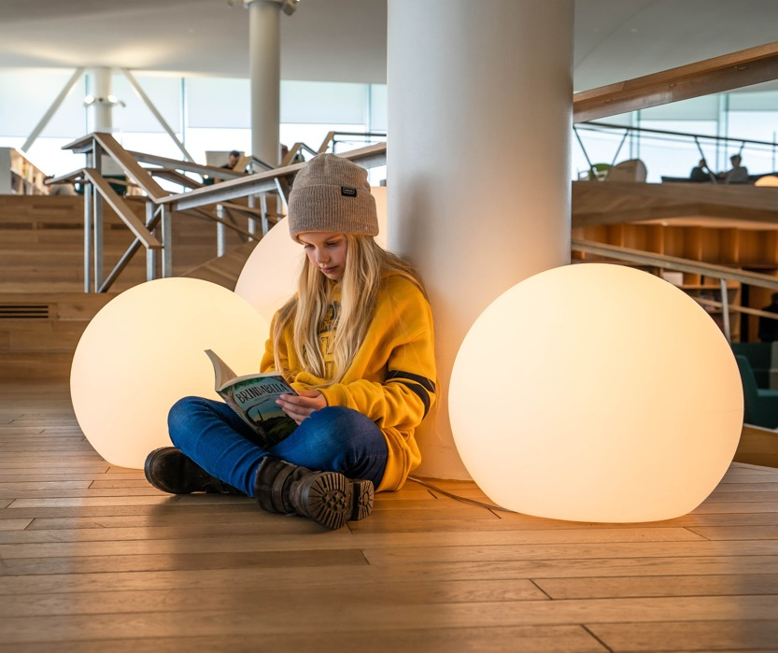
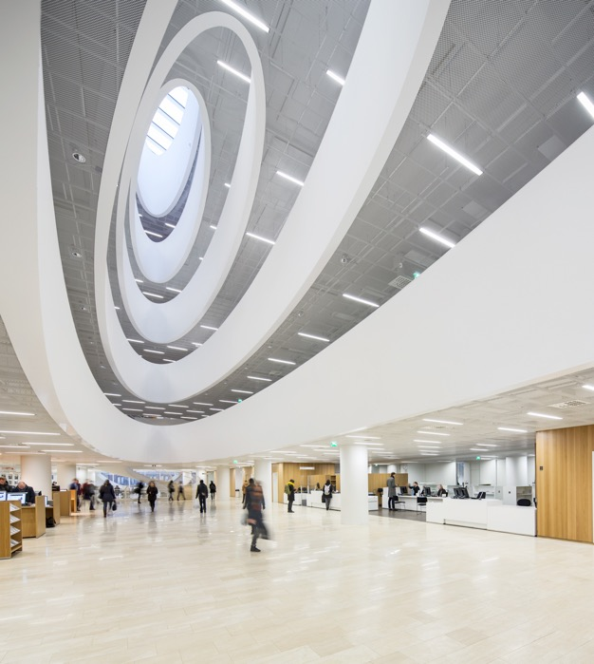
Our public library institution is an important building block of democratic education.
10 WINDOWS INTO FINNISH ARCHITECTURE
1
2
3
4
5
6
7
8
9
10
Turku Main Library by JKMM Architects, 2007. Photo: Michael Pelmutter / JKMM
Helsinki Central Library Oodi by ALA Architects, 2018. Photo: Laura Dove / City of Helsinki
Seinäjoki Main Library by JKMM Architects, 2012. Photo: Tuomas Uusheimo / JKMM
Aalto University Library by Alvar and Elissa Aalto, Espoo 1970. Renovation by NRT and JKMM Architects, 2016. Photo: Tuomas Uusheimo
Oodi
– Helsinki Central Library is the flagship of future libraries.
It's a space for community, connection, and creativity.
Helsinki University Main Library by Anttinen Oiva Architects, 2012. Photo: Mika Huisman / AOA
Notes:
Helsinki Central Library Oodi is the flagship of future libraries. Opened in 2018 in the centre of the country’s capital city, next to the railway station and opposite to the Parliament House, it is a place to concentrate on books but also for activities such as 3D printing, sowing clothes and making music. It’s a space for community, connection, and creativity – and a tourist attraction.
We love our libraries: The library is Finland's most used cultural service. Also university libraries are open for all.
A library is often the central public building of a city or a town, as are these examples from Seinäjoki and Turku in western Finland, both designed by Finland's most awarded contemporary architectural firm JKMM.

Slide 14
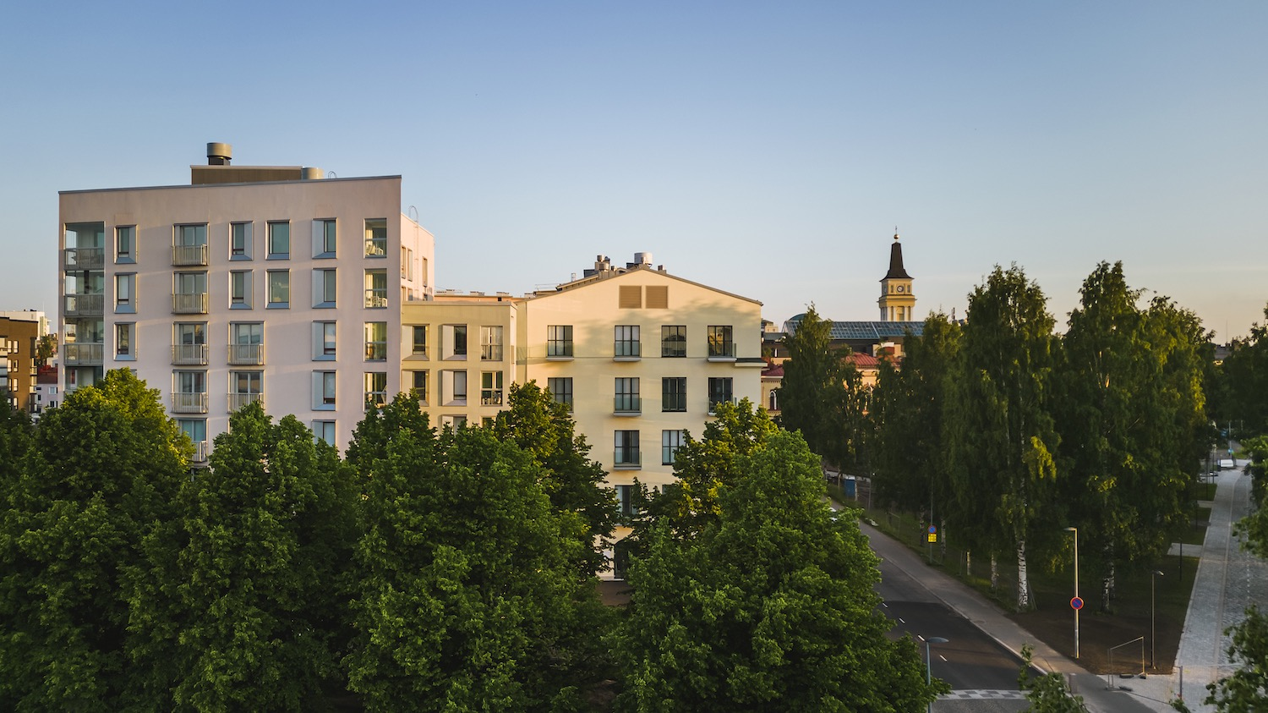
7/10
Simple, functional elegance is our home.
Literally.
Valjaskortteli Housing Block by LUO Architects, Oulu 2022. Photo: Anders Portman / LUO
Notes:
Finland is a rather scarcely populated country, yet the average household size in Finland (1.9 rooms per person) is smaller than the average in Europe (2.3). However, the quality of our dwellings is high: e.g. the share of people unable to keep their home adequately warm is the second lowest in Finland – despite our northern climate.
Here in the picture a contemporary block of flats in Oulu, not far from the Arctic circle.

Slide 15
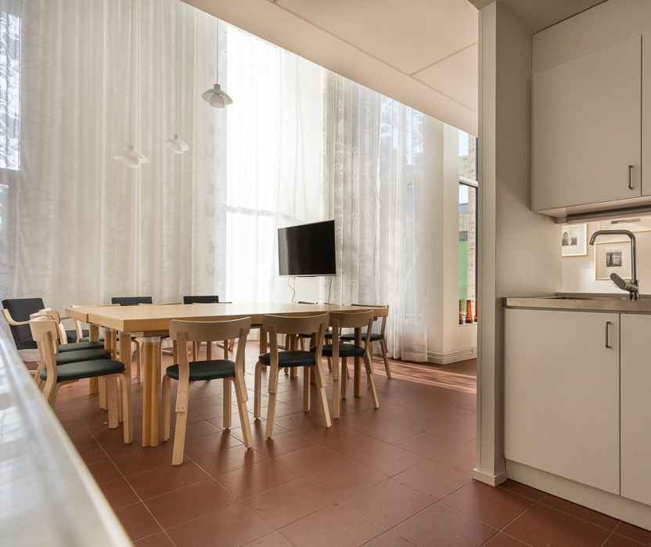
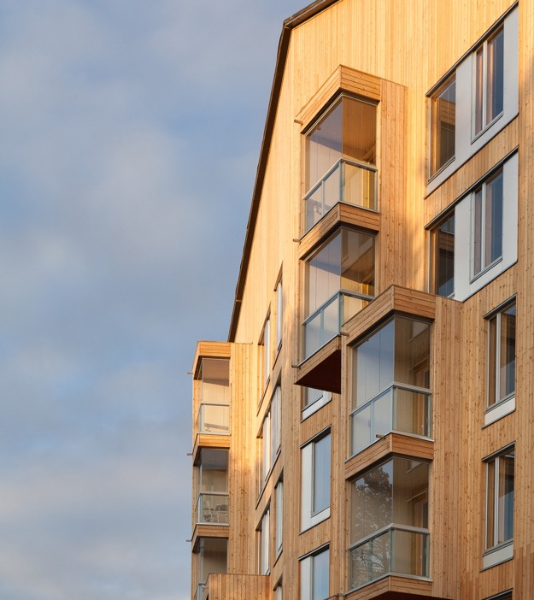
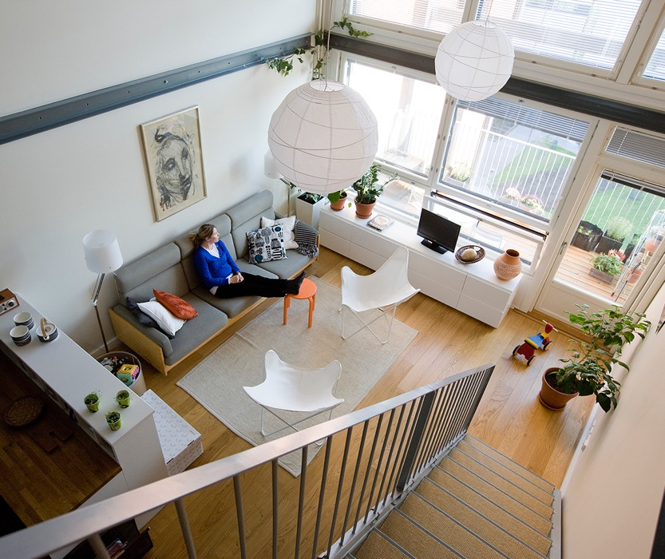
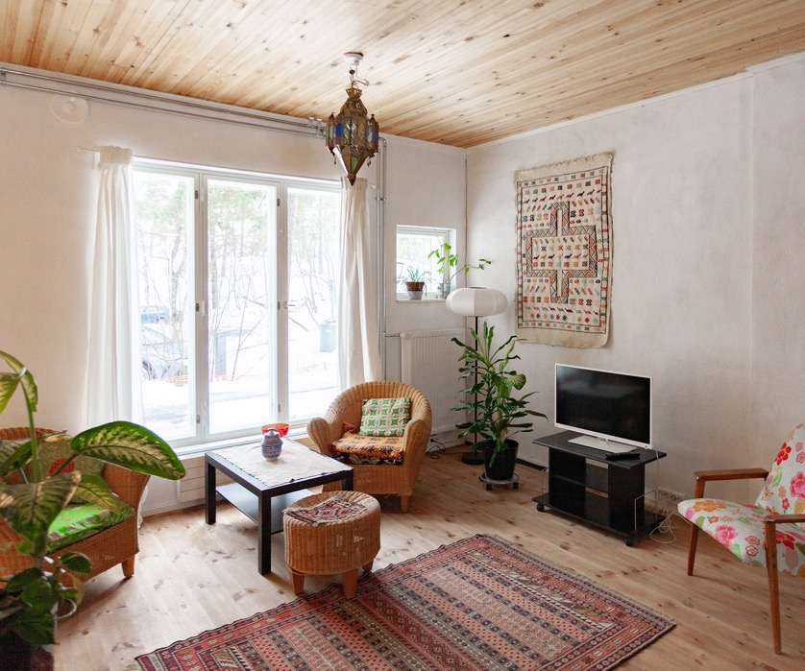
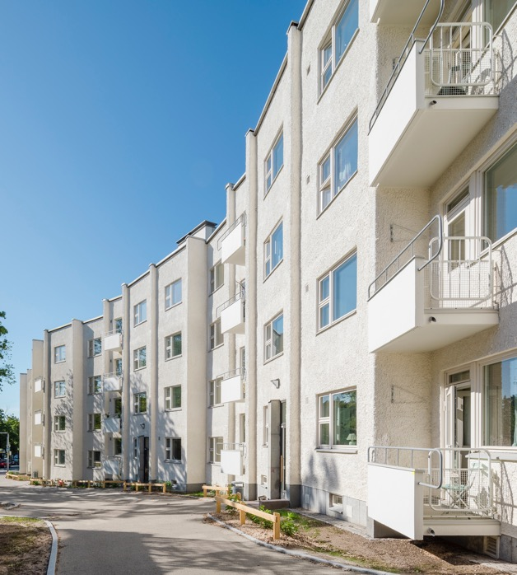
Simple, functional elegance is our home. Literally.
10 WINDOWS INTO FINNISH ARCHITECTURE
1
2
3
4
5
6
7
8
9
10
Kipparintalo Housing for young people with special needs by Juha Leiviskä and Kati Murtola, Helsinki 2015.
Photo: Arno de la Chapelle
Puukuokka Housing by OOPEAA, Jyväskylä 2015. Photo: Mikko Auerniitty / OOPEAA
Tila Loft Housing by Pia Ilonen, Helsinki 2011. Photo: Stefan Bremer / ILO
Huopalahti Residential Barracks by Livady Architects, Helsinki 2024. Photo: Livady
48% of Finns
live in apartment blocks.
Housing is designed with plenty of shared spaces
for all residents—including, of course, saunas.
Serpentine House by Yrjö Lindegren, Helsinki 1951. Renovation by Mona Schalin, 2018.
Photo: Kuvio
Notes:
A growing number of Finns live in blocks of flats, today 48 %.
Almost half of Finnish households comprise only one person and only 20% of households have more than two members. This is why communal spaces in housing blocks are important.
Some 70% of Finns live in their own homes and 30% rent. The construction of privately owned houses can also be state-subsidised, which doesn’t mean poor quality. The Serpentine House, built in 1951, is a protected building and was awarded the Finlandia Prize for Architecture for its renovation and restoration in 2019. (right) A house for young people with special needs can be designed by a celebrated architect, as is the case in the Juha Leiviskä-designed Kipparintalo building.
Wood and other traditional building materials and methods combined with today's knowhow are becoming more and more attractive also in housing design.

Slide 16
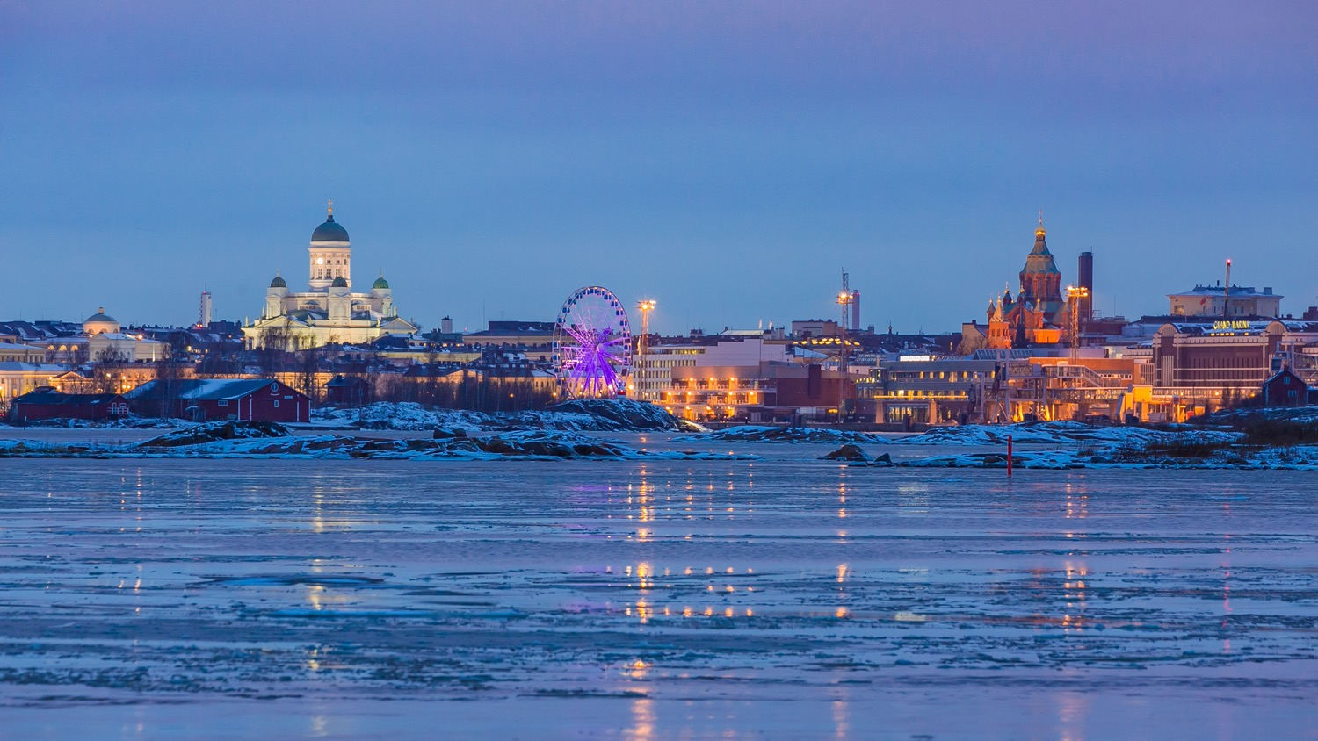
8/10
We open doors to new ideas and talents
through architectural competitions.
The new Architecture and Design Museum will open in Helsinki’s South Harbour in 2030.
Photo: Alex Bao / City of Helsinki
Notes:
Finland is a world leader in open, anonymous architectural competitions.
The competition for Finland's new museum of architecture and design, running in 2024–2025, attracted 623 proposals from all over the world. The new museum is estimated to open in Helsinki's South Harbour in 2030 – this is the view from its site.

Slide 17
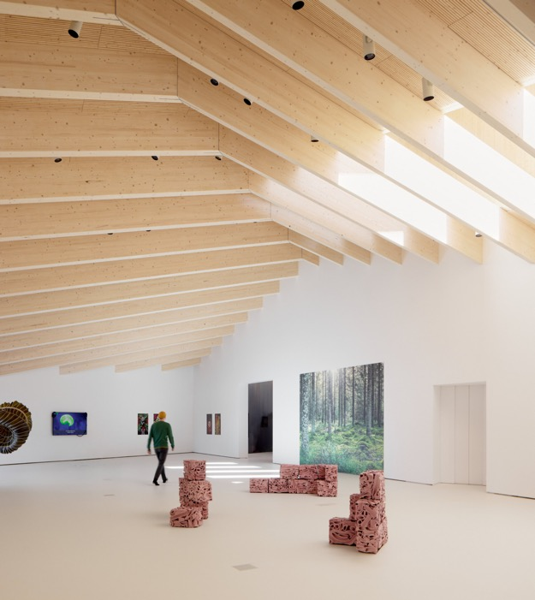
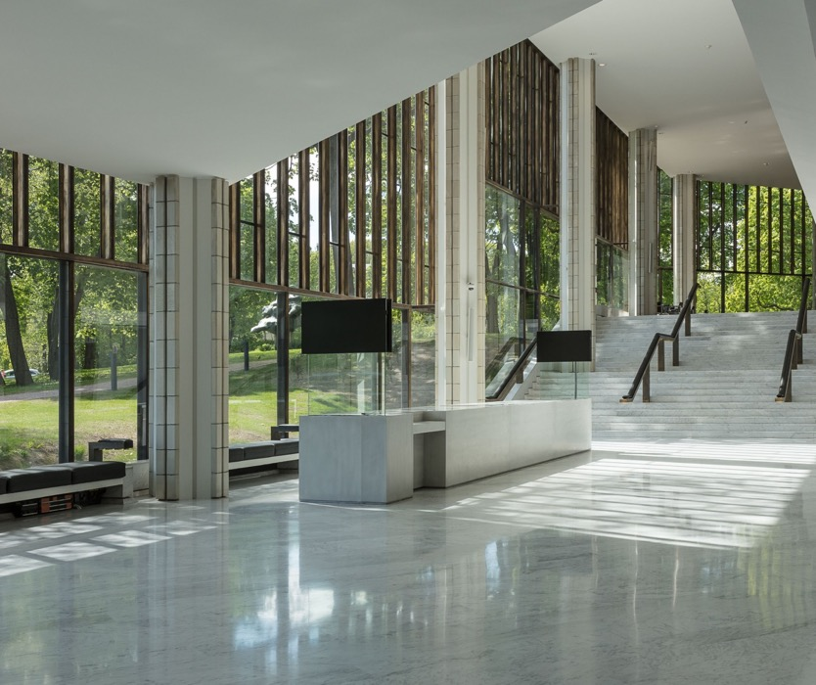
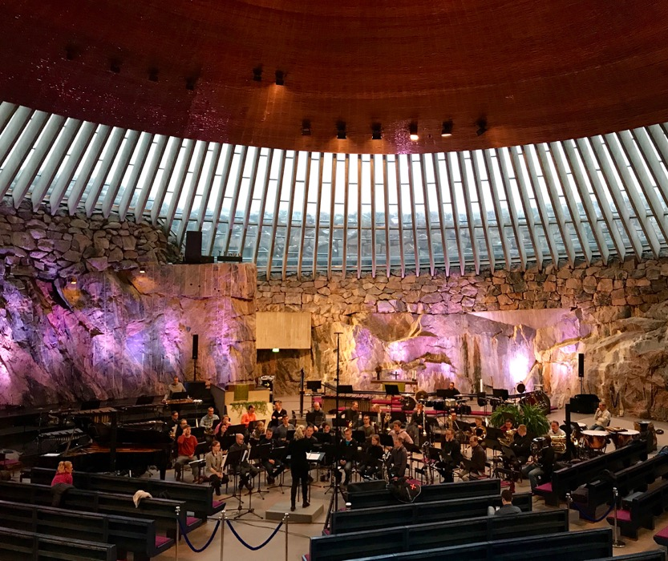
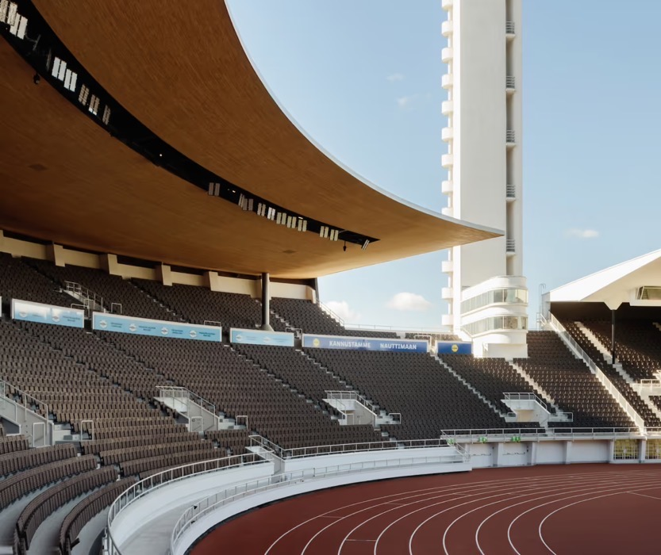
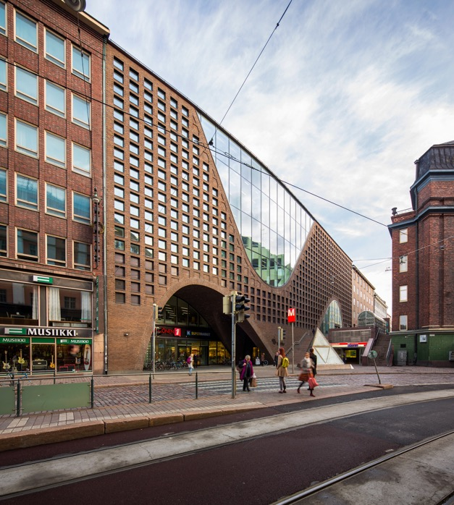
We open doors to new ideas and talents through architectural competitions.
10 WINDOWS INTO FINNISH ARCHITECTURE
1
2
3
4
5
6
7
8
9
10
Olympic Stadium by Yrjö Lindegren and Toivo Jäntti, Helsinki 1938. Renovation by K2S & NRT Architects, 2020.
Photo: Tuomas Uusheimo / K2S
Chappe Art Museum by JKMM Architects, Tammisaari 2023. Photo: Tuomas Uusheimo / JKMM
Helsinki City Theatre by Timo Penttilä & Kari Virta, 1960. Renovation by LPR Architects, 2017. Photo: Arno de la Chapelle
Temppeliaukio Church (Rock Church) by Timo & Tuomo Suomalainen, Helsinki 1969. Photo: Helsinki Partners
We have a
vibrant
150-year history
of architectural competitions.
Most of our
landmark buildings
result from competitions, allowing young talents to rise and make their mark.
Helsinki University Main Library Kaisa by Anttinen Oiva Architects, 2012.
Photo: Mika Huisman / AOA
Notes:
The vibrant history of architectural competitions in Finland spans 150 years.
Many young talents have kicked off their career by winning an anonymous competition, and most of our landmark buildings result from competitions.
Here are some: the Helsinki University Main Library, Kaisa, marked the breakthrough of the young architects Selina Anttinen and Vesa Oiva, and Timo Penttilä was only 29 years old when he won the competition for the Helsinki City Theatre.
(right) The famous Rock Church was designed by the architect brothers Timo and Tuomo Suomalainen, one of whom was still a student at the time of the competition. (left) The designers of Chappe Art Museum in Tammisaari, JKMM Architects, have a record-breaking number of winning entries in architectural competitions.

Slide 18

9/10
Nature is always our
next-door neighbour.
Lammassaari Boardwalk by Studio Puisto Architects and Nomaji Landscape Architects, Helsinki 2018. Photo: Mika Huisman / Puisto
Notes:
This maybe comes as no surprise: Us Finns, we do have a special connection with nature. But designing in nature requires a delicate balance between man-made and leaving nature as it is.

Slide 19





Nature is always our next-door neighbour.
10 WINDOWS INTO FINNISH ARCHITECTURE
1
2
3
4
5
6
7
8
9
10
Rautulampi Wilderness Huts by Manu Humppi in Urho Kekkonen National Park, the Municipality of Sodankylä 2021. Photo: Manu Humppi
Kirkkokivi Wooden Shelter by Malin Moisio, Tampere 2018. Photo: Julia Kivelä
Majamaja by Pekka Littow, Helsinki 2021. Photo: Nicole Bittger / City of helsinki
Space of Mind by Studio Puisto Architects, 2020. Photo: Archmospheres / Puisto
Nature is an integral part
of the Finnish way of life.
While we value all modern comforts in our homes,
we are happy to live close to nature at our cottages.
Filmmaker’s Hut by Pirinen & Salo, Iisalmi 2020. Photo: Arcmospheres / Pirinen & Salo
Notes:
Nature is an integral part of the Finnish way of life.
There are more than 0.5 million summer cottages in Finland – in a country of 5.5 million inhabitants!
Some holiday homes are fully equipped and winter-proof, but most cottages are without contemporary comforts such as running water, flushing toilets, or even electricity. When we are in nature, we are in nature.
At summer cottages we like peace and quiet, a simple life in harmony with nature. These are mini-dwellings, one by a lake in central-northern Finland and one by the sea in the Helsinki archipelago. [On the previous slide, the mini-cottage concept, Space of Mind.]
Finland also offers wonderful opportunities to be in nature without having your own cottage. The so-called Everyman’s Right enables us to walk and pick berries or mushrooms freely almost anywhere. There are plenty of structures for hikers, such as shelters for cooking and even huts for overnighting – free of charge.

Slide 20

10/10
Our love for saunas
burns bright.
Public sauna on Lonna Island by OOPEAA, Helsinki 2017. Photo: Julia Kivelä / City of Helsinki
Notes:
Last but not least: We love the sauna! Did you know that it's a Finnish word?
And what could be better than dip in the cold sea after a good "löyly" – that's the steam when you throw water on the burning-hot stones of the stove.
This public sauna built of logs is on an island just off the coast from Helsinki centre.

Slide 21





Our love for saunas burns bright.
10 WINDOWS INTO FINNISH ARCHITECTURE
1
2
3
4
5
6
7
8
9
10
Löyly Public Sauna and Restaurant by Avanto Architects, Helsinki 2016. Photo: Anders Portman / Kuvatoimisto Kuvio Oy
Löyly Public Sauna and Restaurant by Avanto Architects, Helsinki 2016. Photo: Kuvatoimisto Kuvio / Avanto
Lonna Sauna by OOPEAA, Helsinki 2017. Photo: Julia Kivelä / City of Helsinki
Sauna by Mattila & Merz, Fiskars 2017. Photo: Mattila & Merz
Public or private
our warm affection for saunas is undeniable.
It’s a space for both connection and
personal reflection.
Kotiharju Sauna in Kallio district, Helsinki. Photo: Maija Astikainen / City of Helsinki
Notes:
Be it public or a private, sauna is both a physical and a spiritual experience – a space for both connection and personal reflection. Architecture plays a big part in creating the right kind of atmosphere.
Urban public saunas in particular in working-class neighbourhoods were places for a thorough weekly scrubbing and bathing. One of the oldest still-functioning urban saunas in Helsinki on the left. In the 2010s, the urban public sauna experienced a revival in Finland, with new, beautifully designed sauna and restaurant complexes built by the sea- or lakeside. (right) The Löyly Public Sauna in Helsinki is a cool place to spend the evening with friends, and it has been widely published in international media outlets...
...but (right) it also treats the visitor to a real and genuine sauna experience; (left) one that you can also experience in a private, hand-crafted sauna such as this one in the village of Fiskars – or at any summer cottage in the midst of Finnish nature.

Slide 22
11/10
11/10
An extra skylight
with views to
common ground.
An extra skylight
with views to
common ground.

Slide 23
An extra skylight with views to common ground.
10 WINDOWS INTO FINNISH ARCHITECTURE
1
2
3
4
5
6
7
8
9
10
11
Photo: xxx
Any note
can be written here.
This is a place for
more detailed information.
You can use this page to highlight connections between Finnish architecture and your country, shared projects, or even interesting upcoming events.
Notes:
Tähän osioon voi koota vastaanottajan ja tilanteen mukaan personoitavia asioita, toki arkkitehtuurikulman huomioiden.

Slide 24

The end.
The beginning.
Perhaps we should build the next chapter together?
Notes:
More about Finnish Architecture:
finnisharchitecture.fi

