Slide 1


10 PIECES OF
FINNISH MUSIC
Photo: Julius Töyrylä / Music Finland

Slide 2

1/10
A minor language,
a major love
Photo: Julius Töyrylä / Music Finland

Slide 3
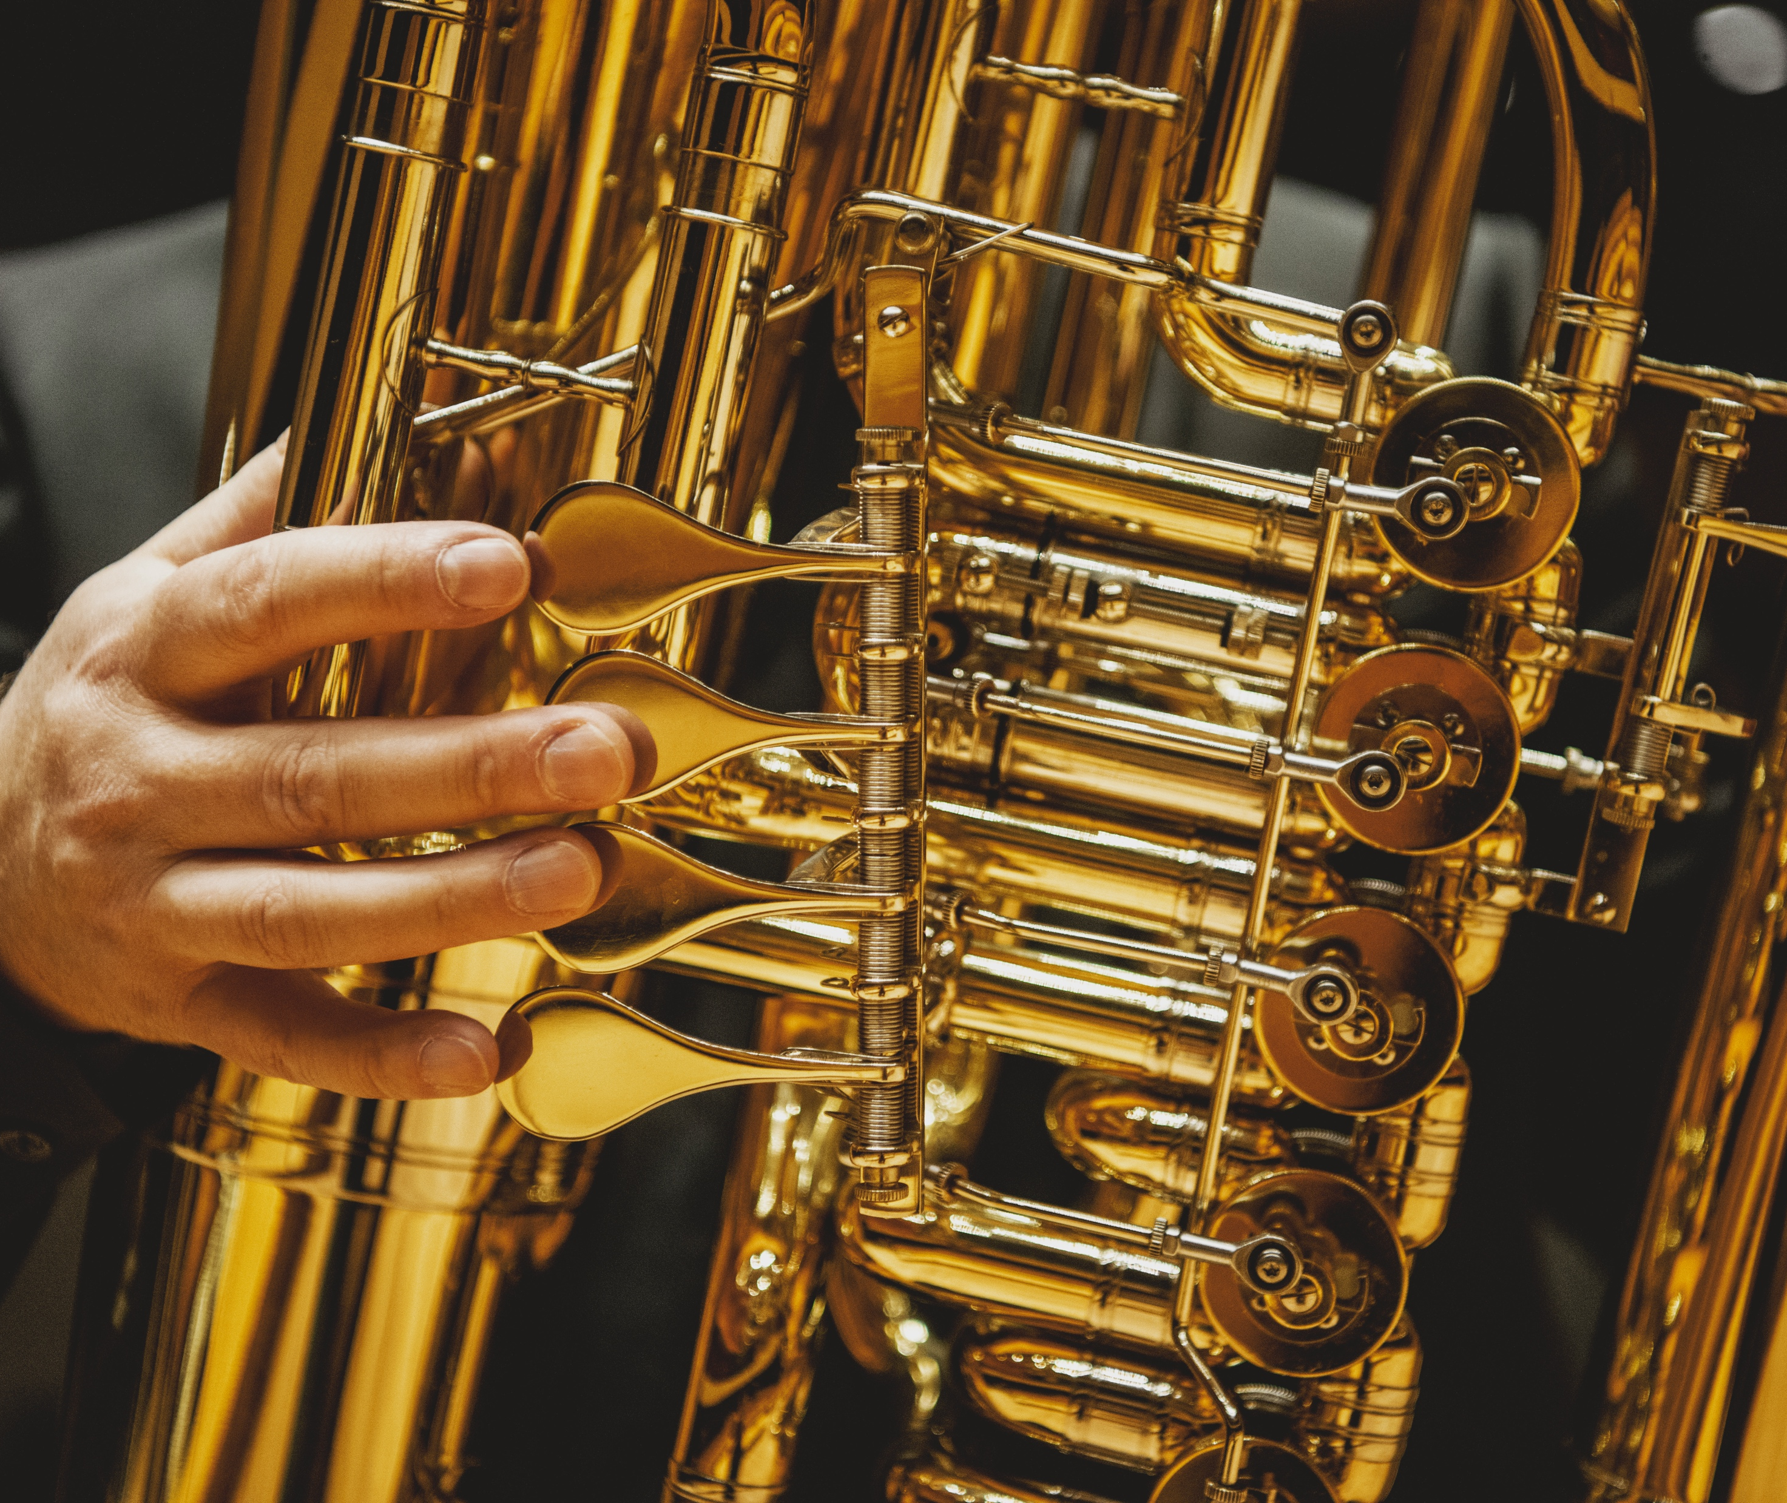
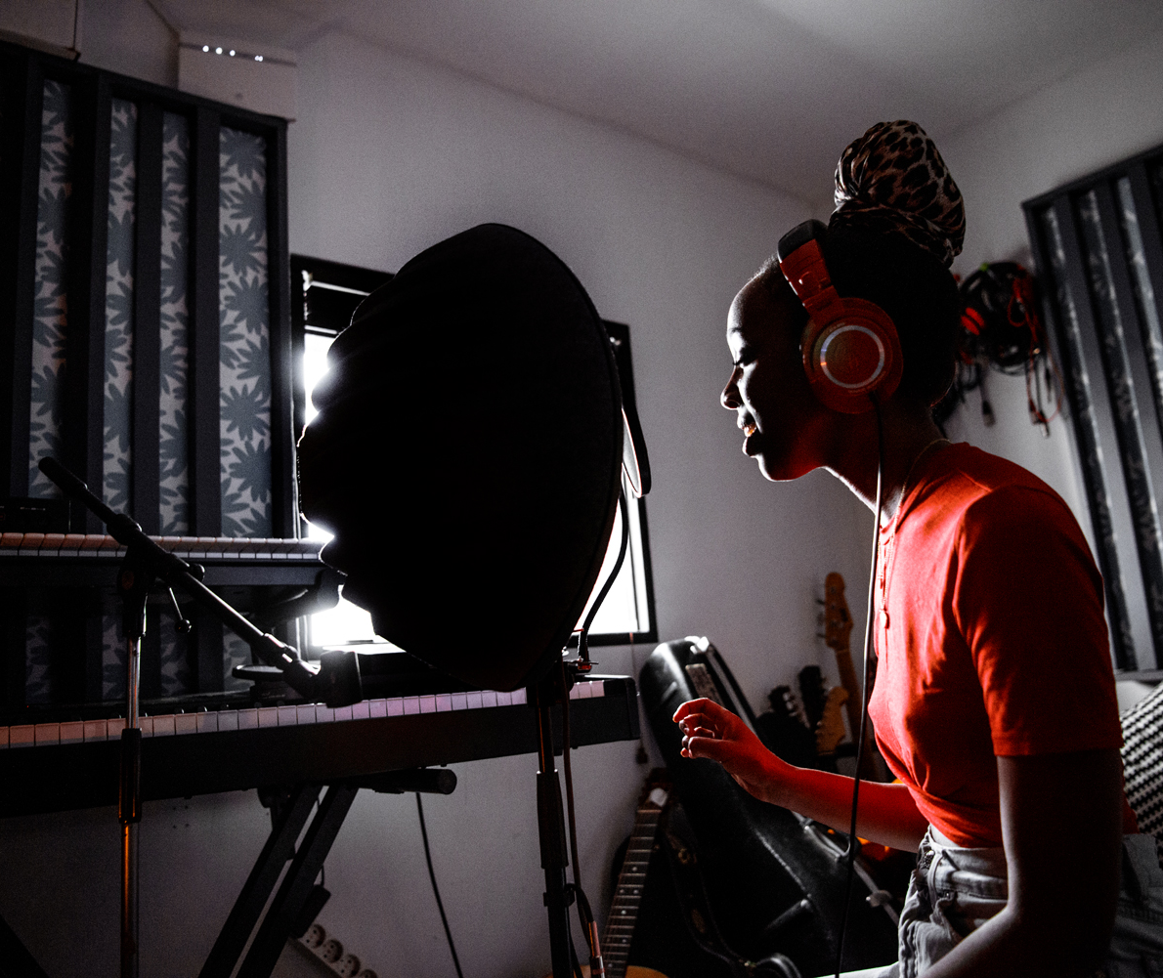
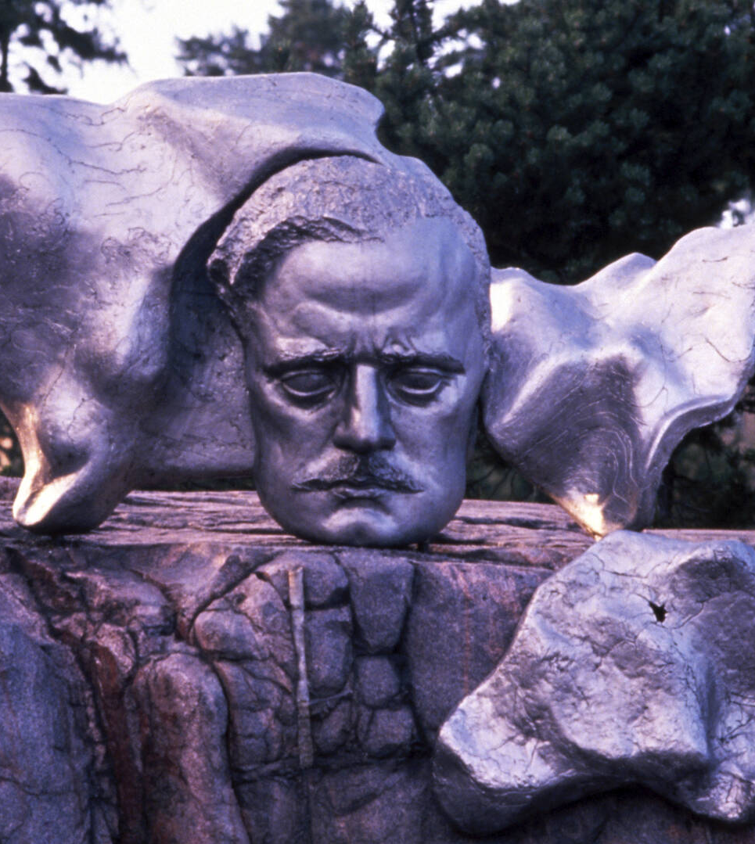
A minor language, a major love
10 PIECES OF FINNISH MUSIC
1
2
3
4
5
6
7
8
9
10
Our own musical language
Finns love Finnish music, but it also resonates internationally – our distinct pop and iskelmä give foreigners a chance to visit our inner landscape.
Photo: Julius Töyrylä / Music Finland
Photo: Julius Töyrylä / Music Finland
Sibelius Statue
Photo: Business Finland
Notes:
Finns have a deep and diverse relationship with music. It’s reflected in the wide range of musical styles, the strong culture of amateur music-making, and the high standard of professional musicianship found throughout the country.
Music has also played a key role in shaping Finland’s national identity. When Finland gained independence, music and the arts played a central role in expressing a sense of nationhood. Composer Jean Sibelius became a national icon by writing music inspired by themes close to the hearts of Finns, such as our national epic, Kalevala, and the Finnish landscape.
To this day, Finns have a strong preference for music in their native language. For example, 21% say their favorite genre is Finnish-language pop. Traditional genres like iskelmä (schlager) and Finnish tango have remained enduring favorites across generations.
Finnish music also resonates internationally, helping shape how the world sees Finland and sparking curiosity about our culture and creativity.

Slide 4
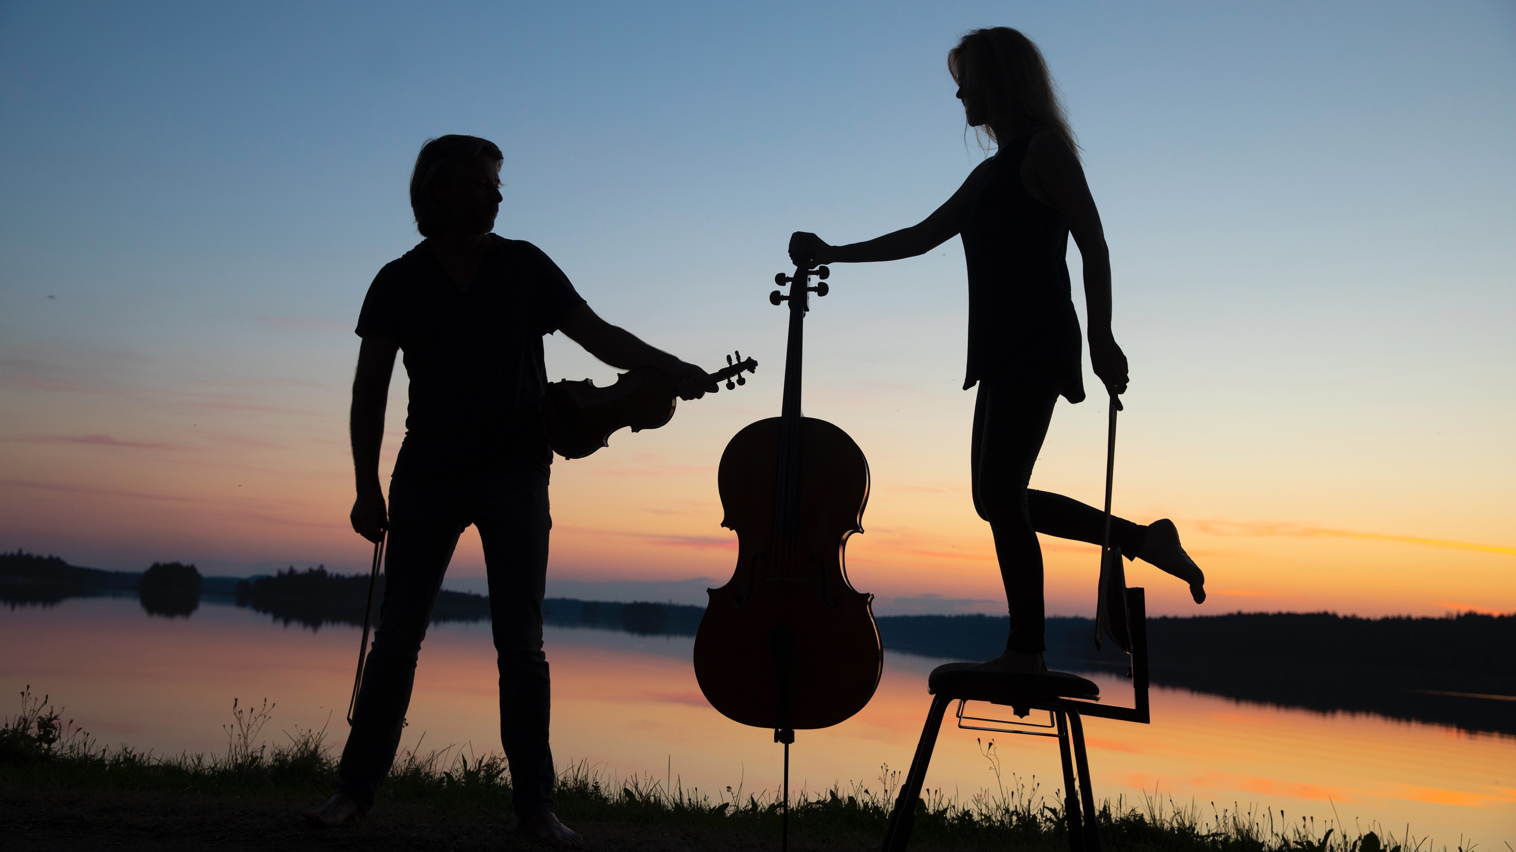
2/10
From Sibelius to Saariaho
Kuhmo Chamber Music Festival
Photo: Stefan Bremer / Business Finland

Slide 5
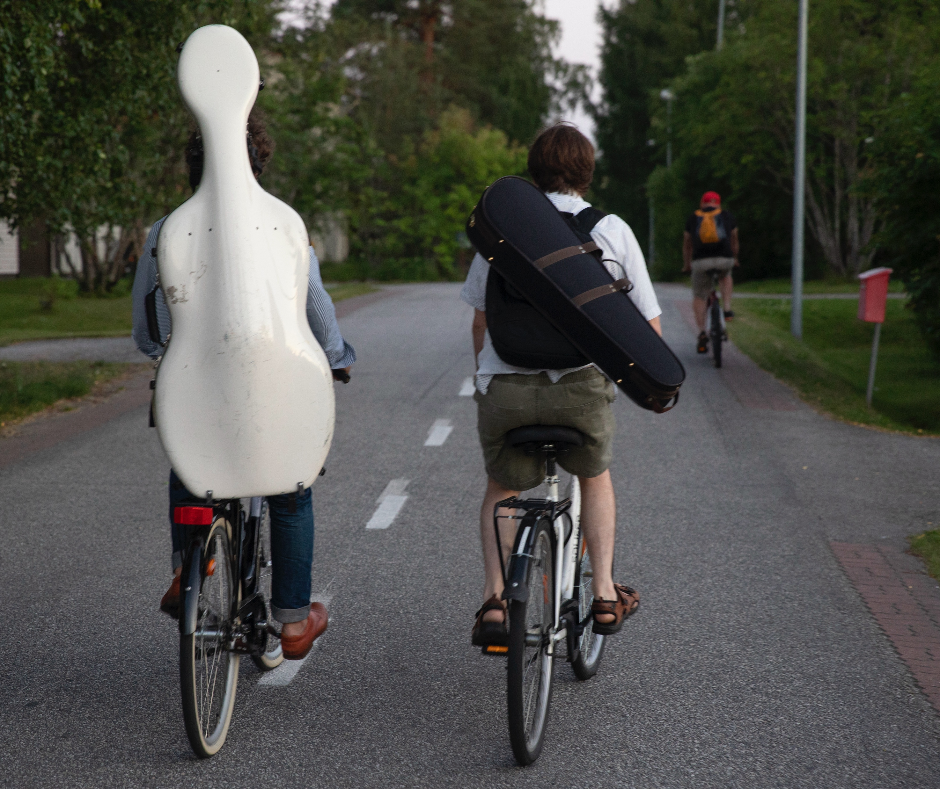
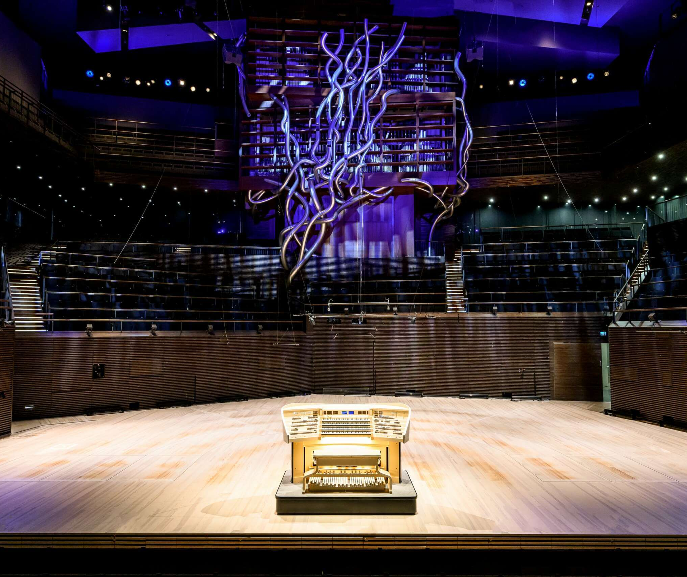
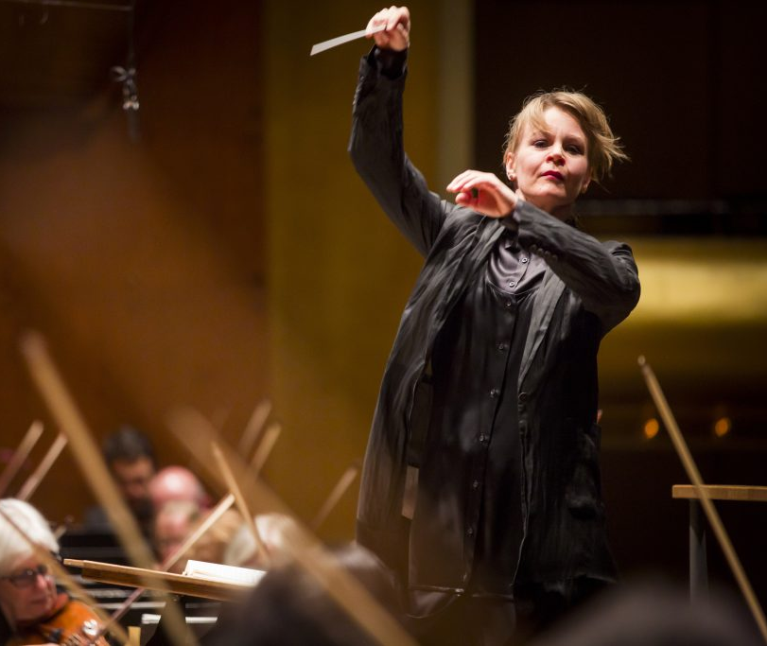

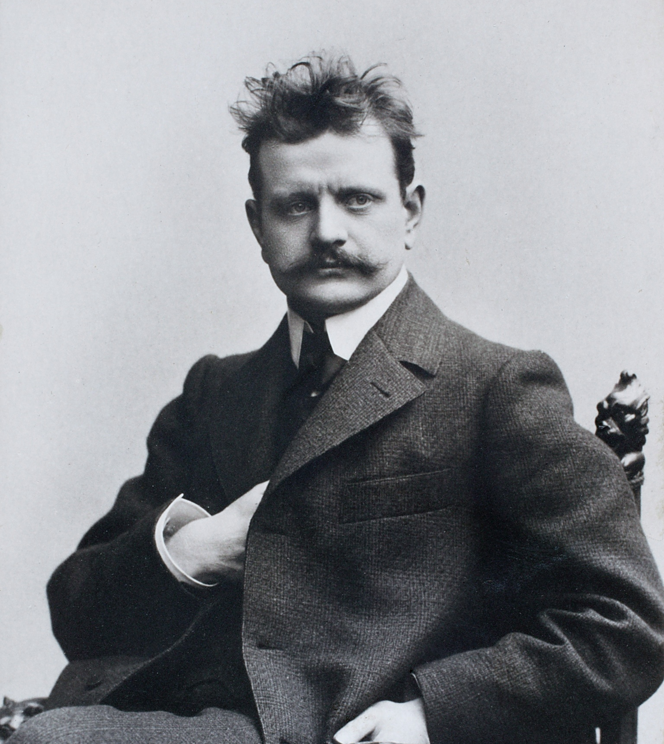
From Sibelius to Saariaho
10 PIECES OF FINNISH MUSIC
1
2
3
4
5
6
7
8
9
10
Truly
classical
Finland is known for world-renowned conductors and composers.
Musiikkitalon urut
Photo: Sakari Röyskö / Musiikkitalo
Kuhmo Chamber Music Festival
Photo: Stefan Bremer / Business Finland
Susanna Mälkki conducting.
Photo: Chris Lee
Esa-Pekka Salonen
Photo: Minna Hatinen
Jean Sibelius
Photo: Business Finland
Notes:
Finland is a country bigger than its size in classical music. Jean Sibelius is the most internationally known and performed Finnish composer. Thanks to his heritage, Finland is a well-known and esteemed country in classical music. Today, Finnish conductors and composers are among the world's classical music superstars, performing regularly in international concert halls with top orchestras.
Finland has a diverse and vibrant orchestral scene: every major city is home to a symphony or chamber orchestra, all supported by public funding. Among the most well-known Finnish orchestras are the Finnish Radio Symphony Orchestra (RSO) and the Helsinki Philharmonic Orchestra (HKO). The Finnish National Opera and Ballet plays an important role in our cultural life. Its repertoire includes both international classics and new Finnish works.
Composers: Kaija Saariaho, Magnus Lindberg, Einojuhani Rautavaara, Outi Tarkiainen
Conductors: Esa-Pekka Salonen, Klaus Mäkelä, Susanna Mälkki, Dalia Stasevska

Slide 6

3/10
Metal is in our nature
Battle Beast
Photo: Petri Artturi Asikainen / Music Finland

Slide 7
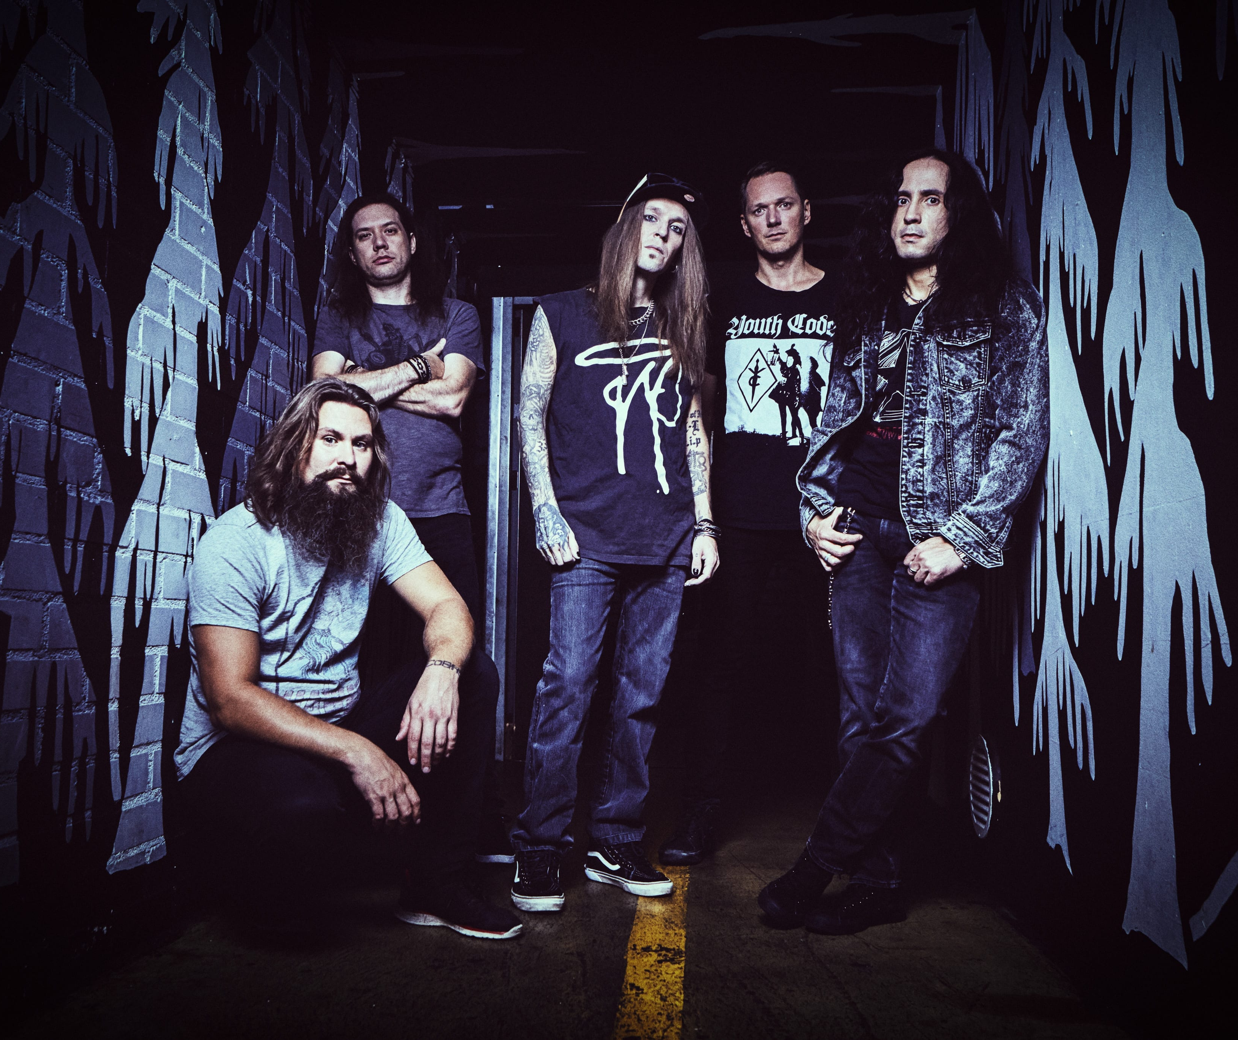
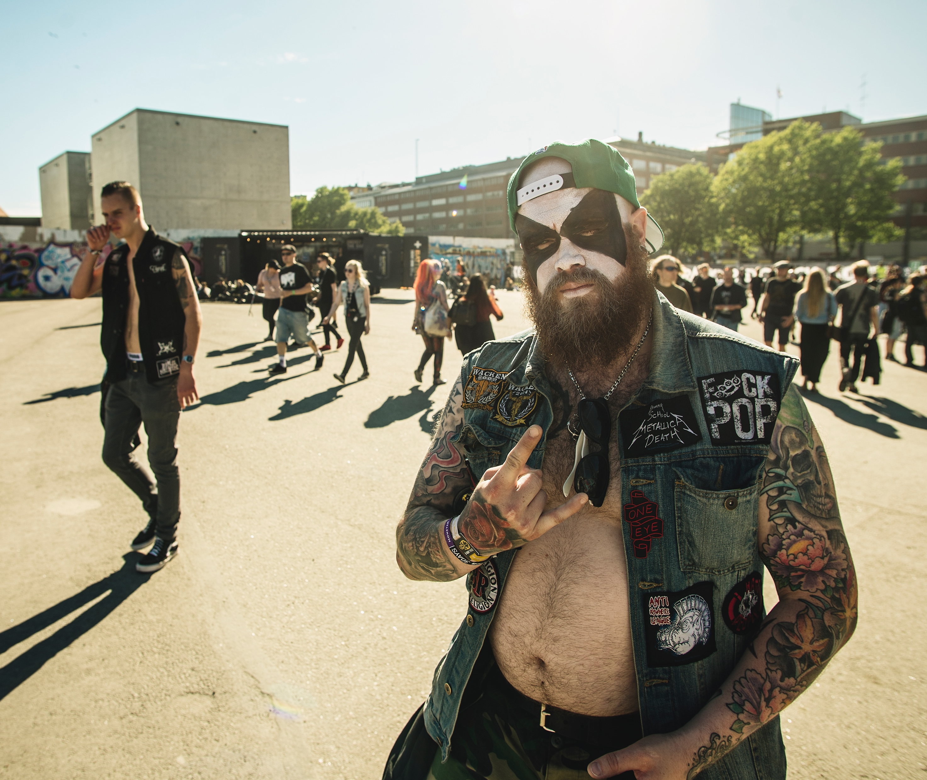
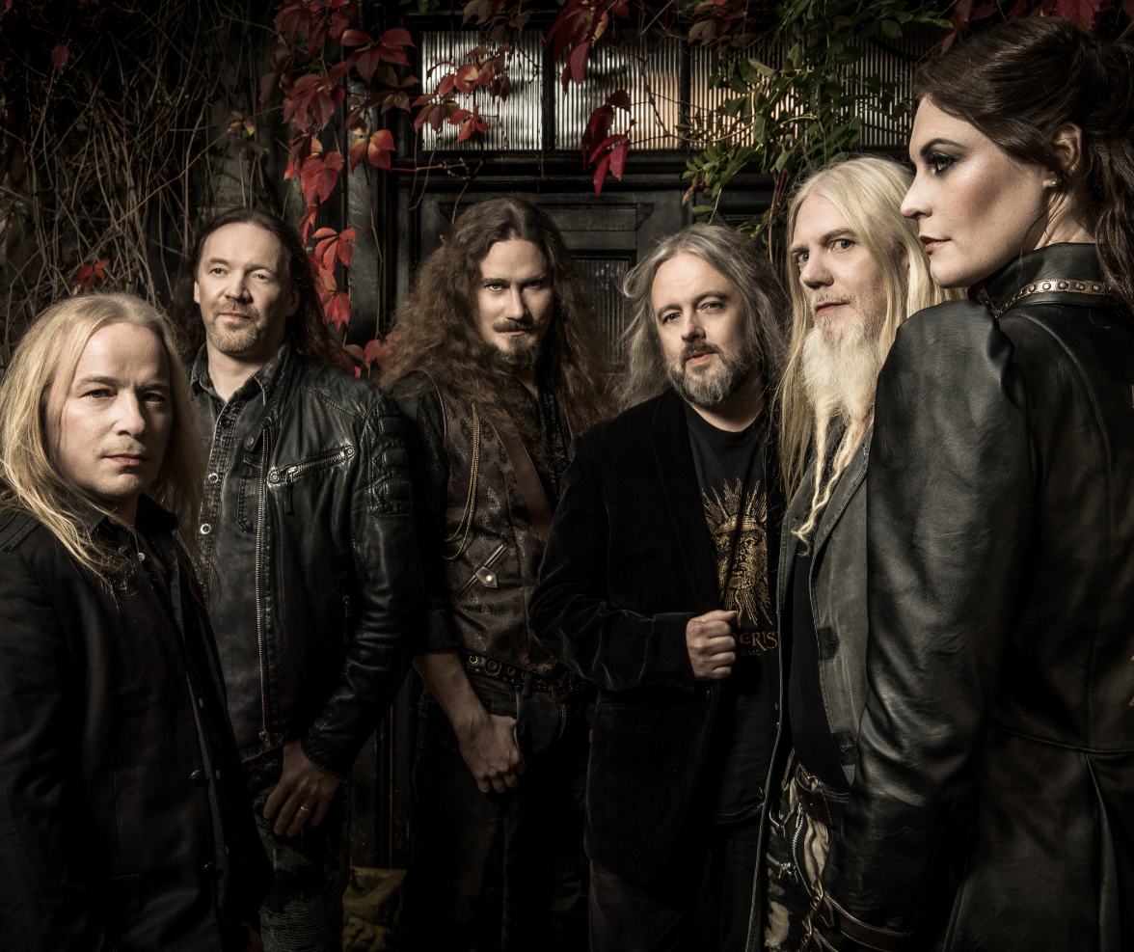
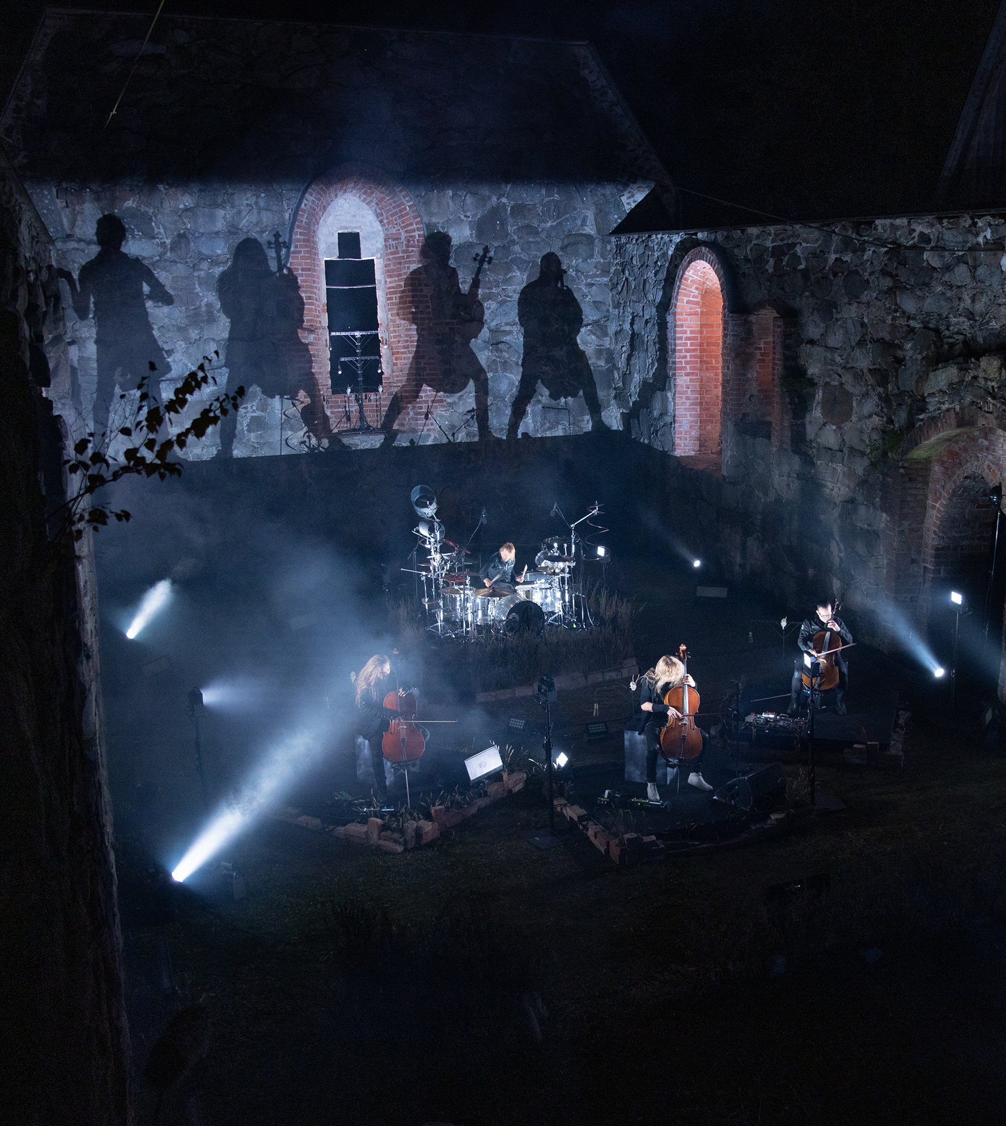

Metal is in our nature
10 PIECES OF FINNISH MUSIC
1
2
3
4
5
6
7
8
9
10
Finland has the highest number of metal bands per capita in the world
The dark atmosphere reflects our country’s natural landscape and climate.
Capital of Metal –dude
Photo: The Ministry for Foreign Affairs of Finland
Nightwish (promo picture)
Apocalyptica
Photo:
Children of Bodom (promo picture)
VV aka Ville Valo at Tuska
Photo: Jesse Kämäräinen / Business Finland
Notes:
The international breakthrough of Finnish metal began in the late 1990s and continues to this day. Heavy music has become a cornerstone of Finland’s music exports, with Finnish metal bands touring consistently around the world, year after year.
Finnish heavy music is characterized by its melancholy and darkness—qualities frequently associated with the country’s cold climate and vast, forested landscapes. Finnish metal bands are also widely recognized for their high level of technical skill. Equally important is Finland’s production expertise.
For the past few decades, metal music has been one of the main contributors to Finland’s global image—second only, perhaps, to Nokia. Finnish metal has sparked international interest in the Finnish language and culture, with some universities even studying it as a phenomenon.
Finland holds the official title of having world’s highest number of metal bands per capita—53.2 bands per 100,000 inhabitants. This widely acknowledged fact has even been referenced in a speech by President Barack Obama.
Bands: Nightwish, Amorphis, Children of Bodom, HIM, Apocalyptica, Stratovarius, and Battle Beast.

Slide 8
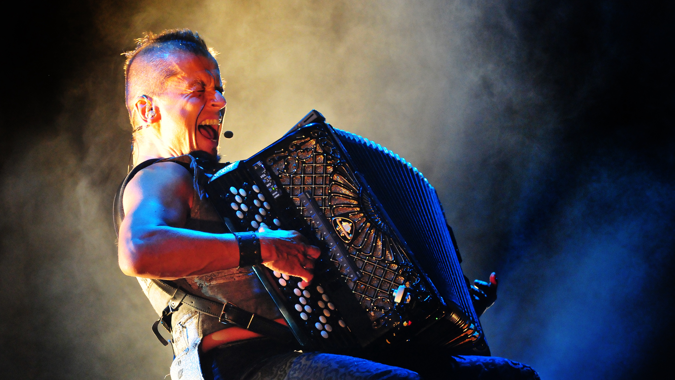
4/10
Folk keeping up
with the times
Kimmo Pohjonen
Photo: Edigio Santos

Slide 9


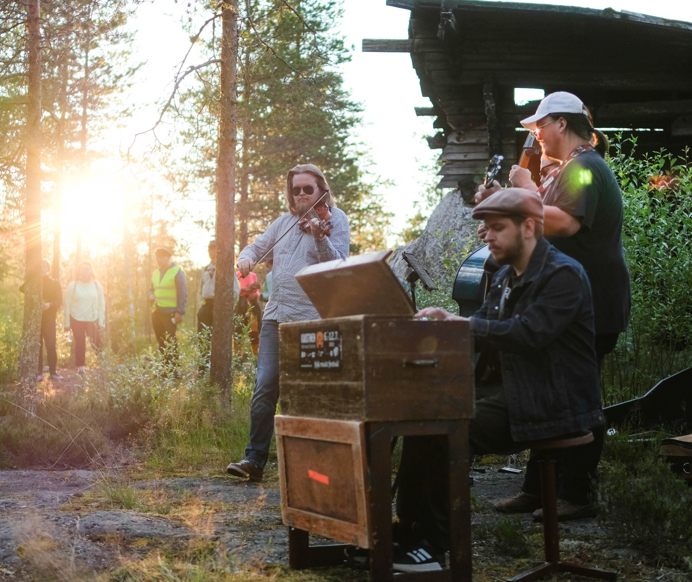

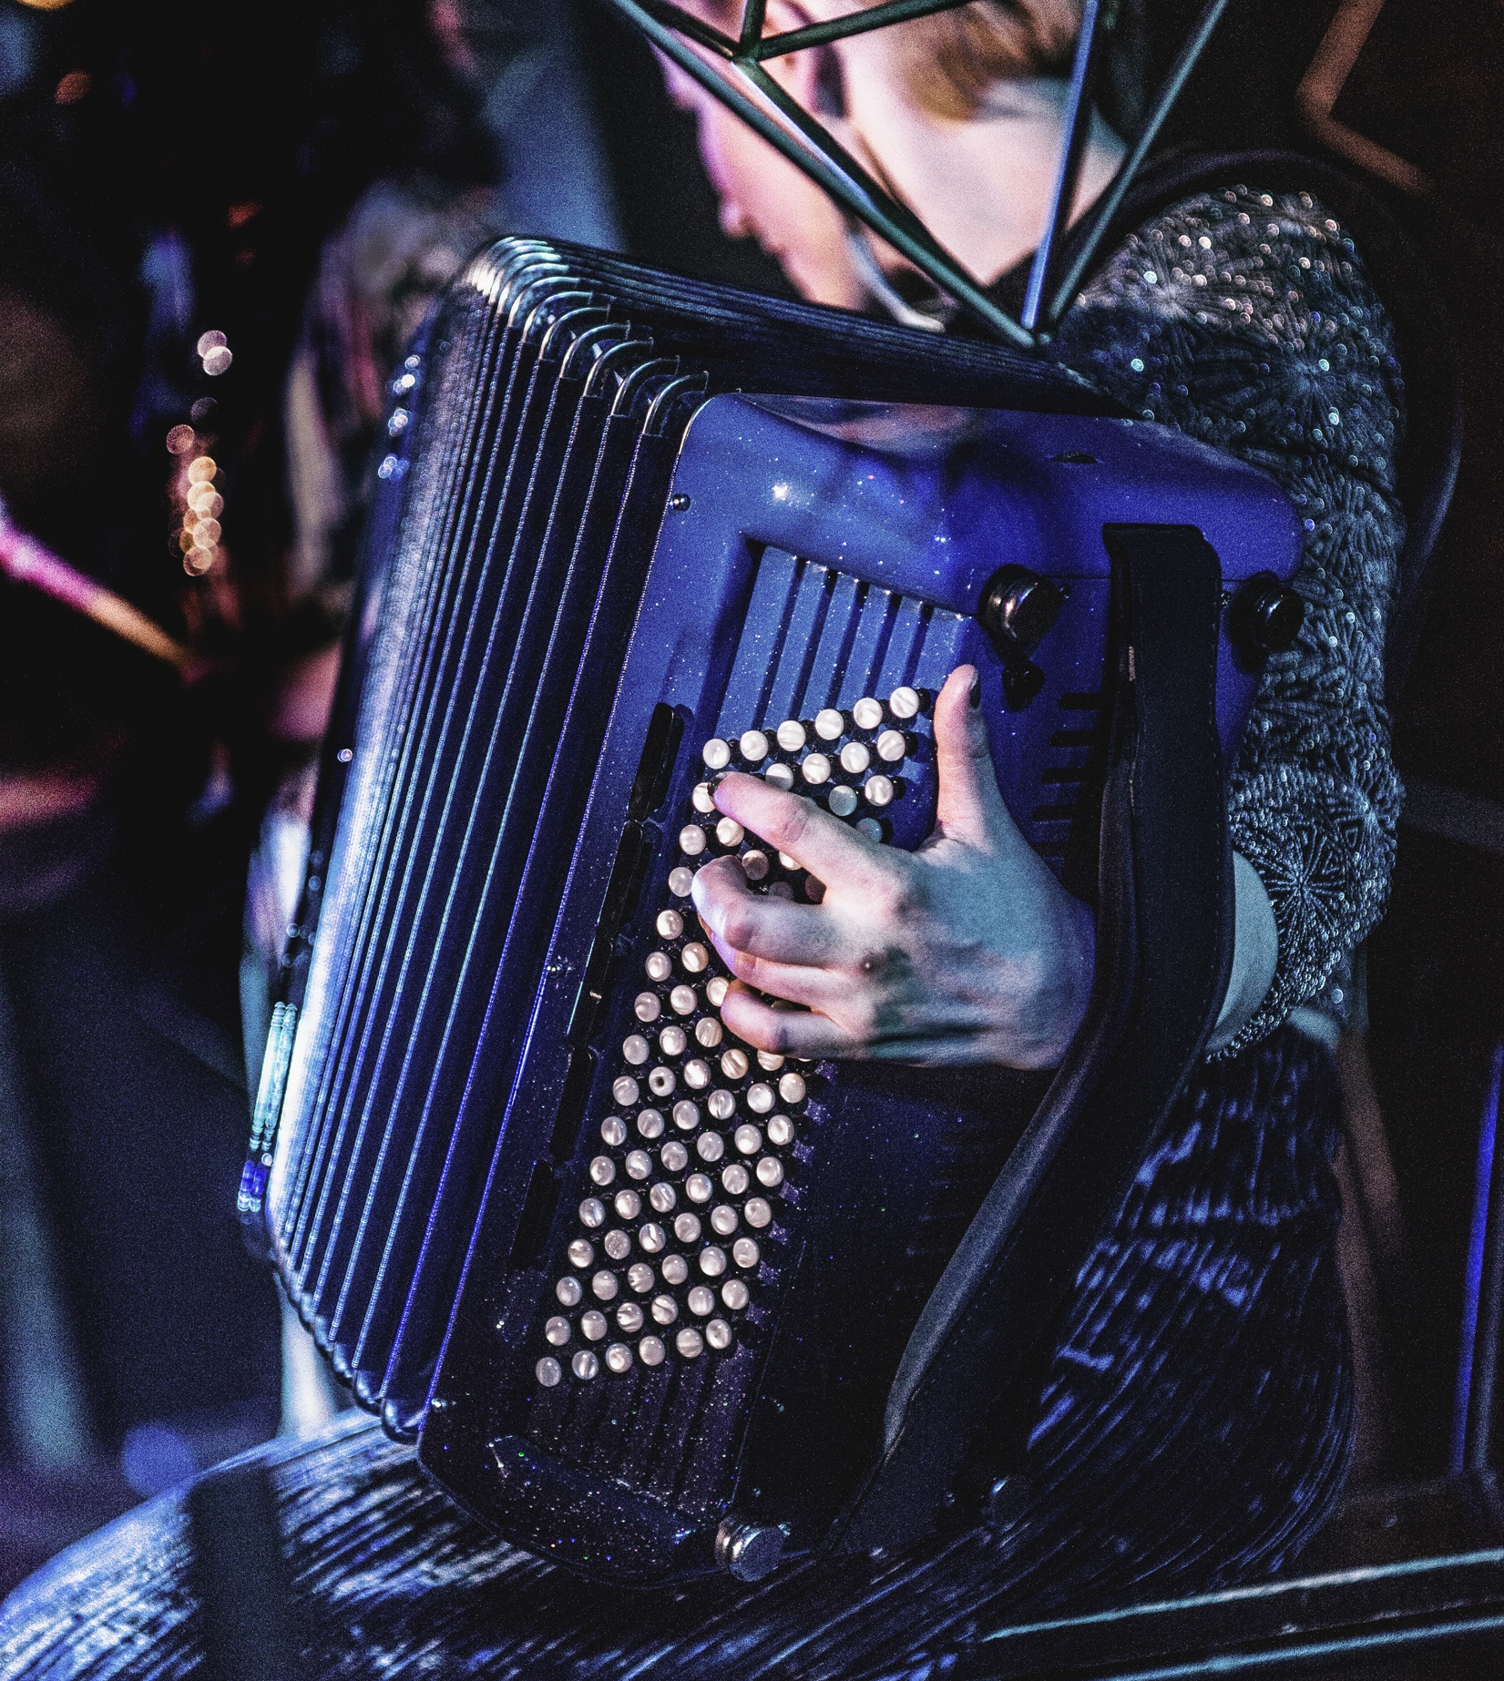
Folk keeping up with the times
10 PIECES OF FINNISH MUSIC
1
2
3
4
5
6
7
8
9
10
Young musicians respect and reinvent folk traditions
– especially at the small town of Kaustinen, home to UNESCO listed fiddling tradition and one of Europe’s most important folk music festivals.
Yövaellus at Kaustinen Folk Music Festival
Photo: Krista Järvelä
Maija Kauhanen at Kaustinen Folk Music Festival
Photo: Krista Järvelä
Suistamon Sähkö
Photo: Julius Töyrylä
Värttinä (promo picture)
Hahmot ja muut
Photo: Julius Töyrylä
Notes:
Folklore is thriving and remains relevant. There are many different styles in folk music ranging from northern Sámi music to the western violin and the eastern singing tradition.
Young enthusiasts are keeping the legacy alive. The small town of Kaustinen is famous for its folk music festival, fiddle playing tradition and the children’s folk music group “Näppärit”. According to the Näppäri ideology making music should be a natural part of everyone’s life. It is worth mentioning that the Kaustinen folk fiddling tradition was added to the UNESCO Intangible Cultural Heritage of Humanity list in 2021.
Combining styles is characteristic of contemporary Finnish folk music.
Traditional instruments such as the kantele, jouhikko (bowed lyre), and violin are combined with e.g. electronic music. Many Finnish contemporary folk musicians have gained international recognition and regularly tour the world.
Well-known folk tunes: Ievan polkka, Letkis
Artists: Värttinä, Kimmo Pohjonen, JPP, Maija Kauhanen, Piirpauke, and Frigg

Slide 10
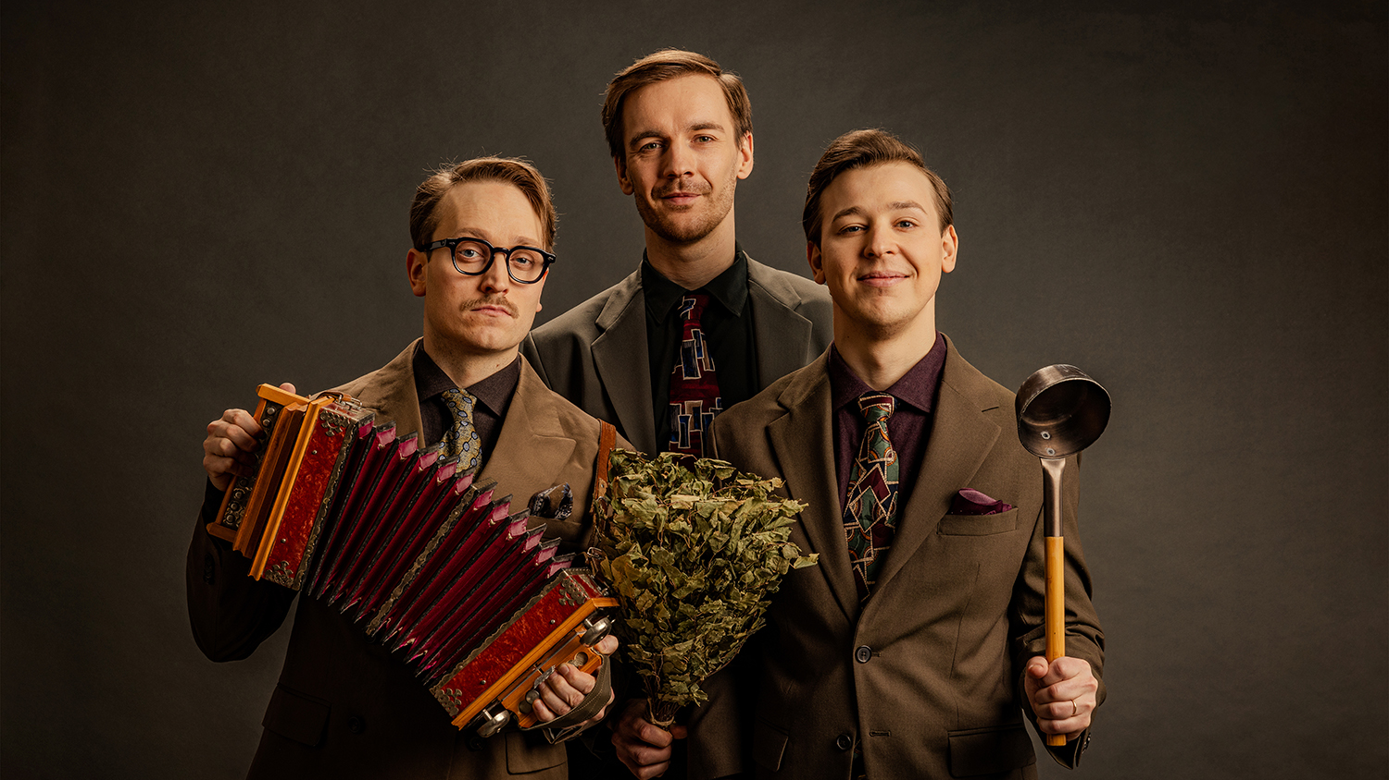
5/10
Wonderfully weird
KAJ
Photo: Erik Åhman / Warner Music Finland

Slide 11
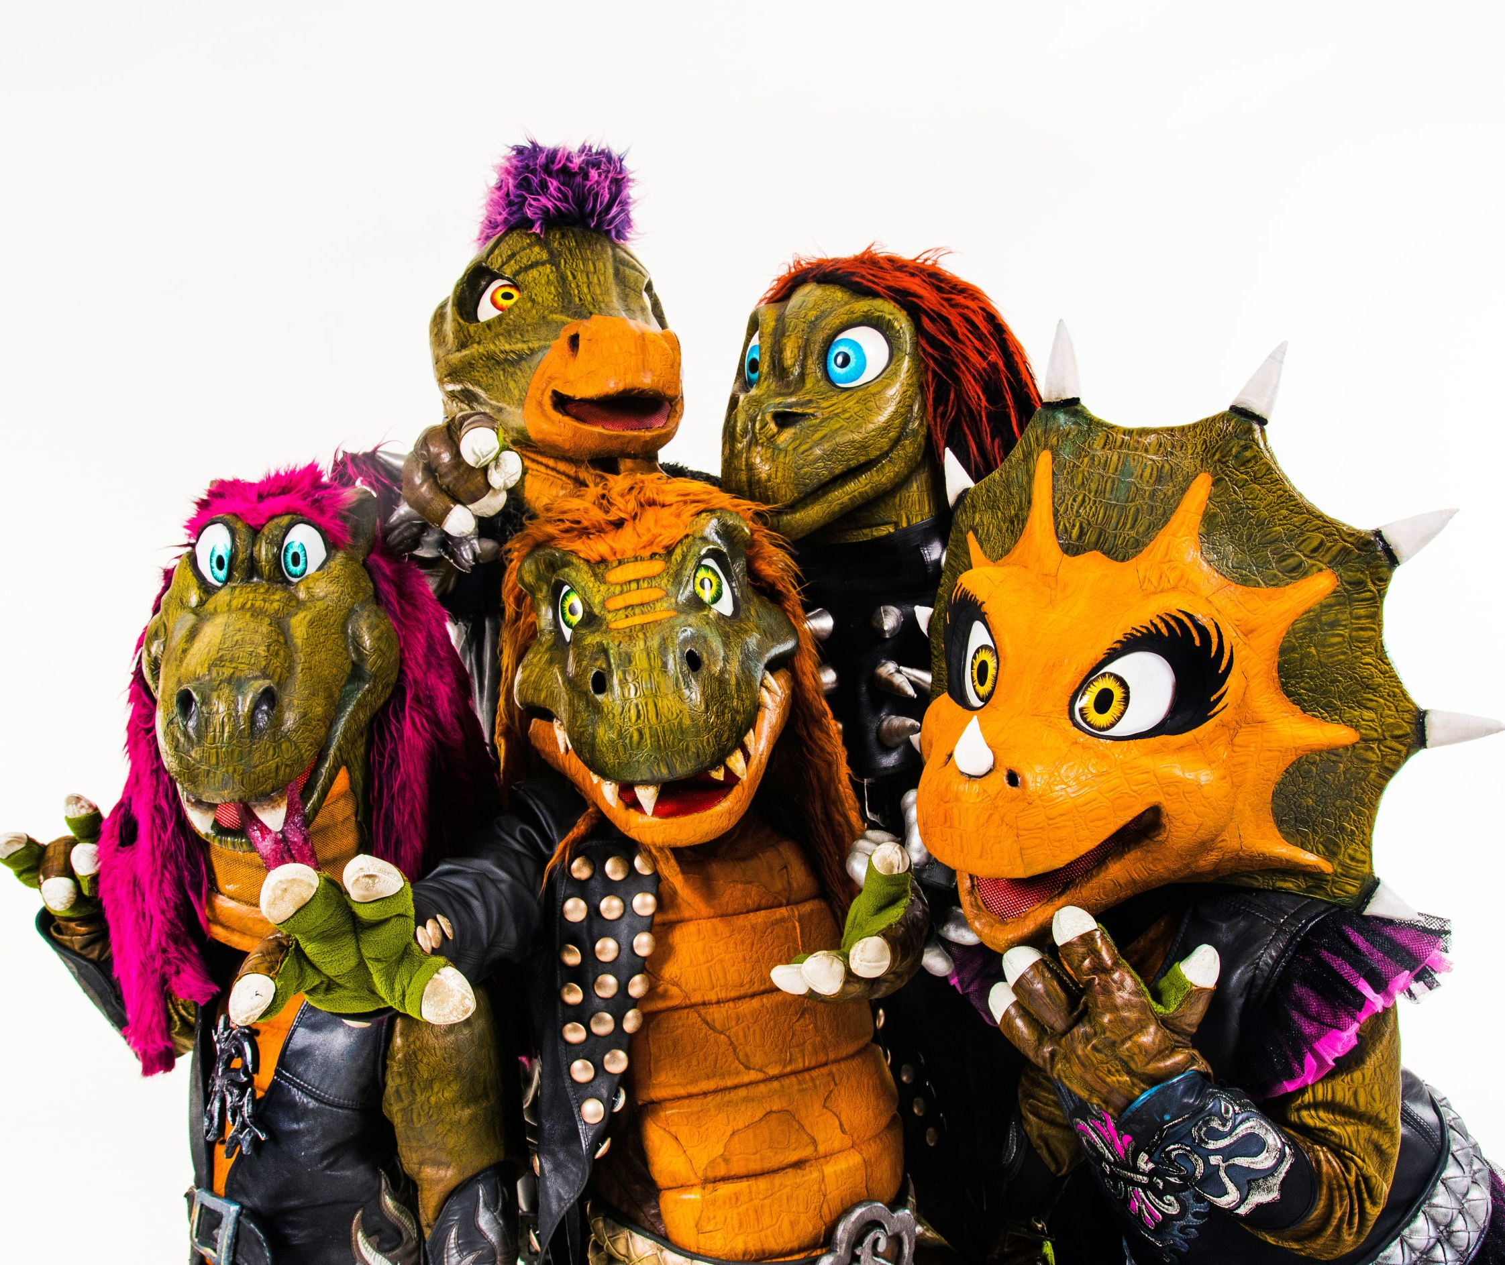

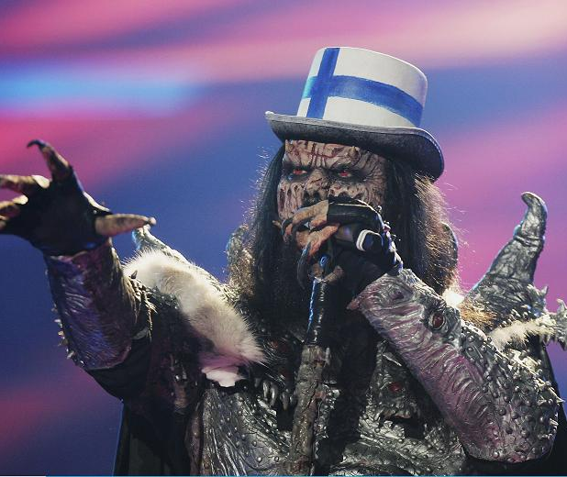
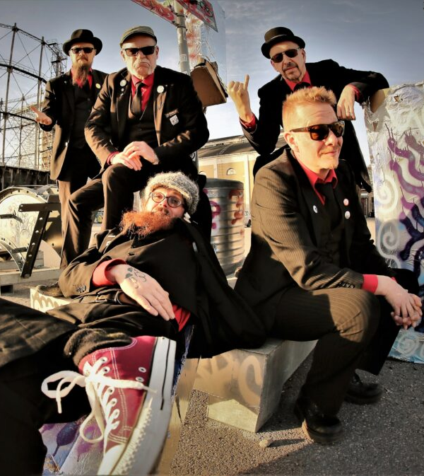
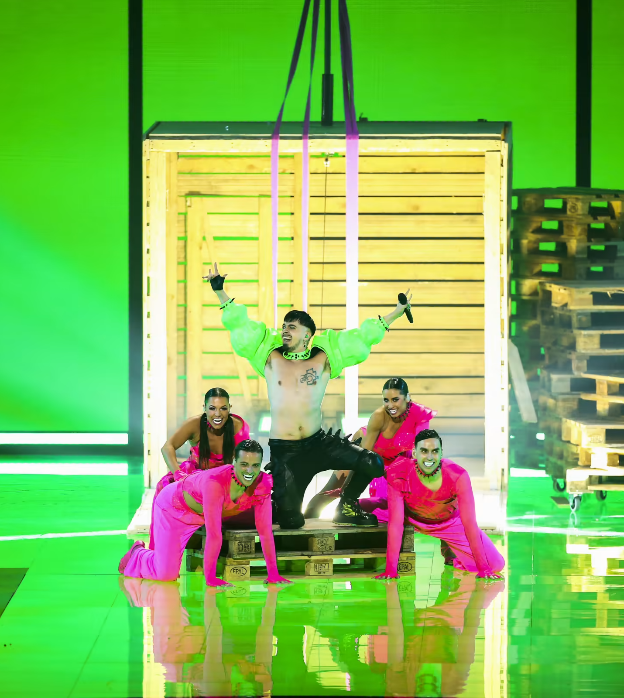
Wonderfully weird
10 PIECES OF FINNISH MUSIC
1
2
3
4
5
6
7
8
9
10
Lordi,
Windows95Man, Käärijä…
Many memorable acts have captured global attention with their bold style.
Lordi
Photo: Yle
Heavysaurus
Photo: Sony Music
Windows95Man
Photo: All Day Agency
Eläkeläiset
Photo: Stupido Records
Käärijä
Photo: Adam Vaughan / EPA
Notes:
Finnish artists often stand out internationally thanks to their unique and unconventional style. People sometimes talk about “Finnish madness,” but in the world of pop music, Finland is often remembered for being quirky and weird, which tends to leave a lasting impression.
Finland is, for example, the only country to have won the Eurovision Song Contest with a monster-costumed metal band—Lordi. Another well-known export, Heavysaurus, performs heavy metal for children while dressed as dinosaurs, while dj/artist Windows95Man has charmed the world with his 90s haircut and tiny denim shorts. Rapper Käärijä’s style may be too peculiar to even describe!
A few examples of these distinctive acts include: Lordi, Käärijä, Hevisaurus, Windows95Man, Eläkeläiset, and KAJ.

Slide 12
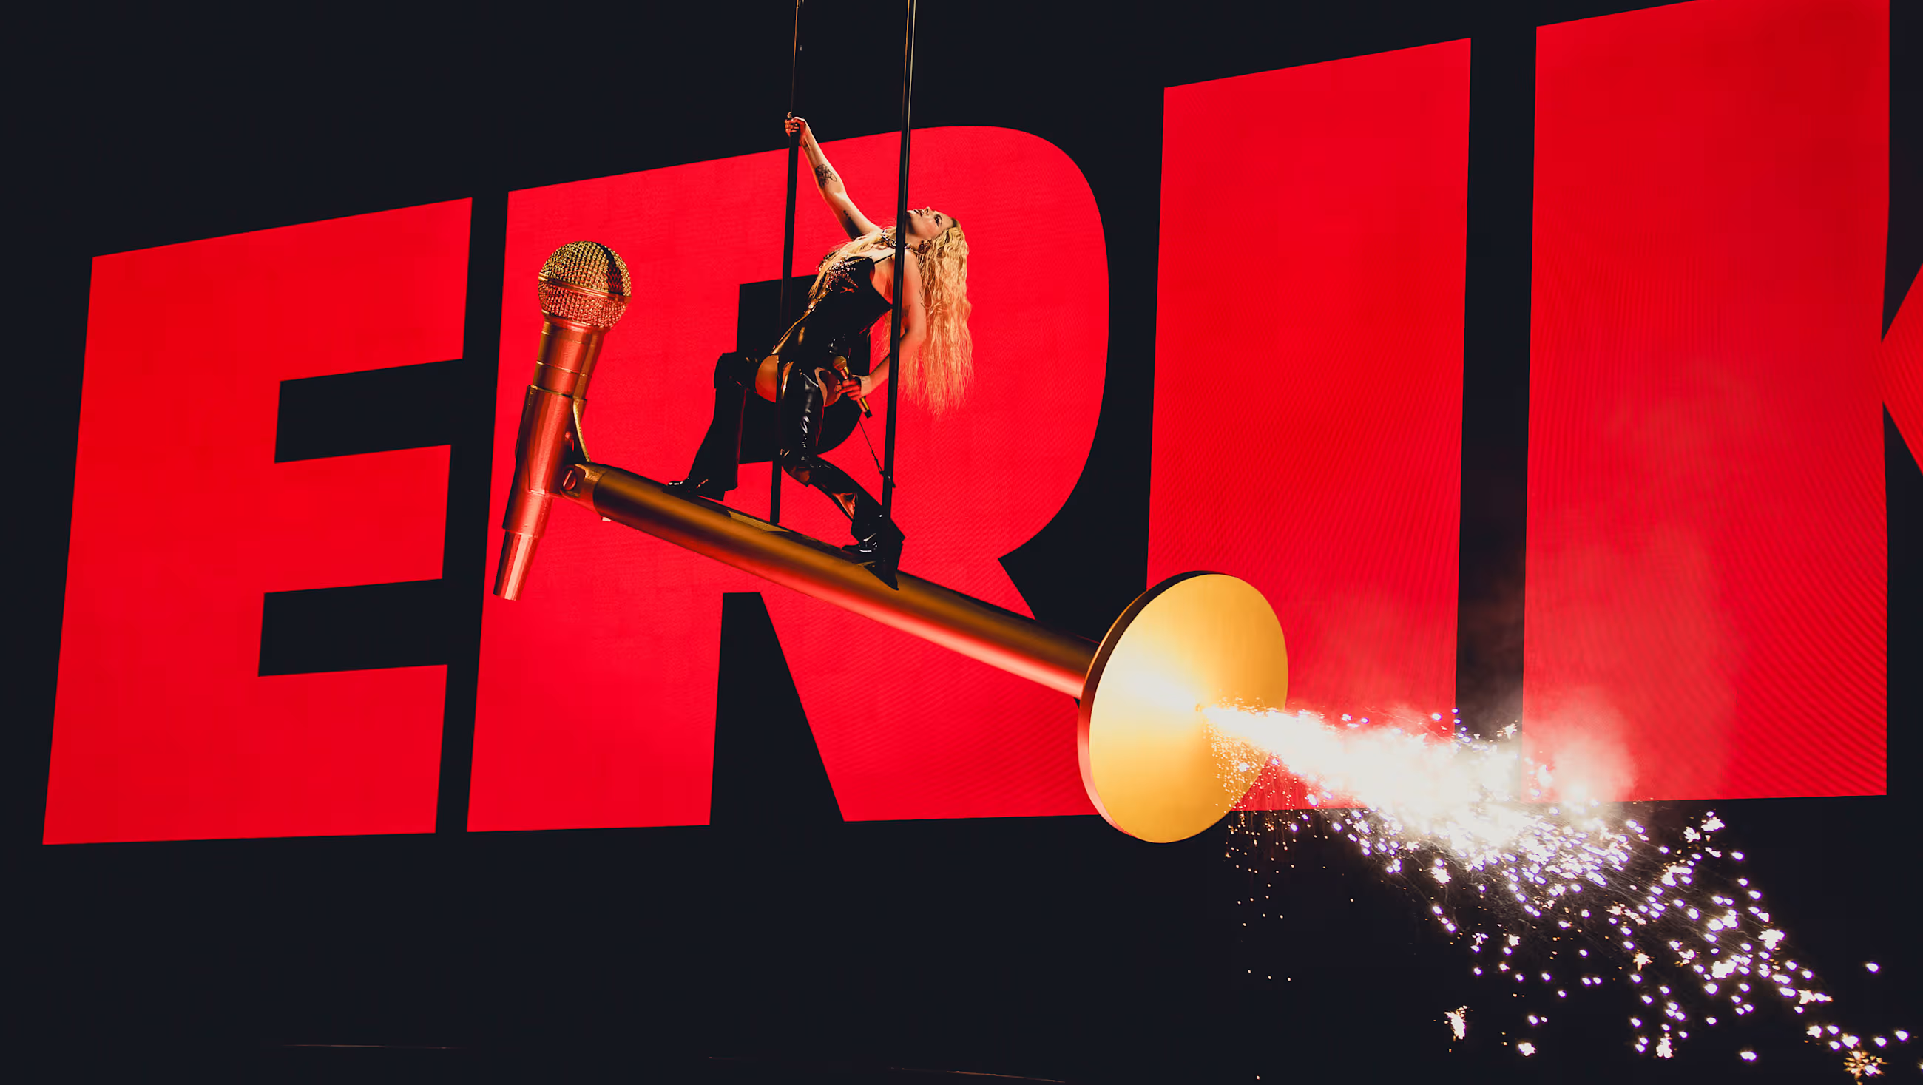
6/10
Sandstorm the gates
Erika Vikman
Photo: Miikka Varila

Slide 13



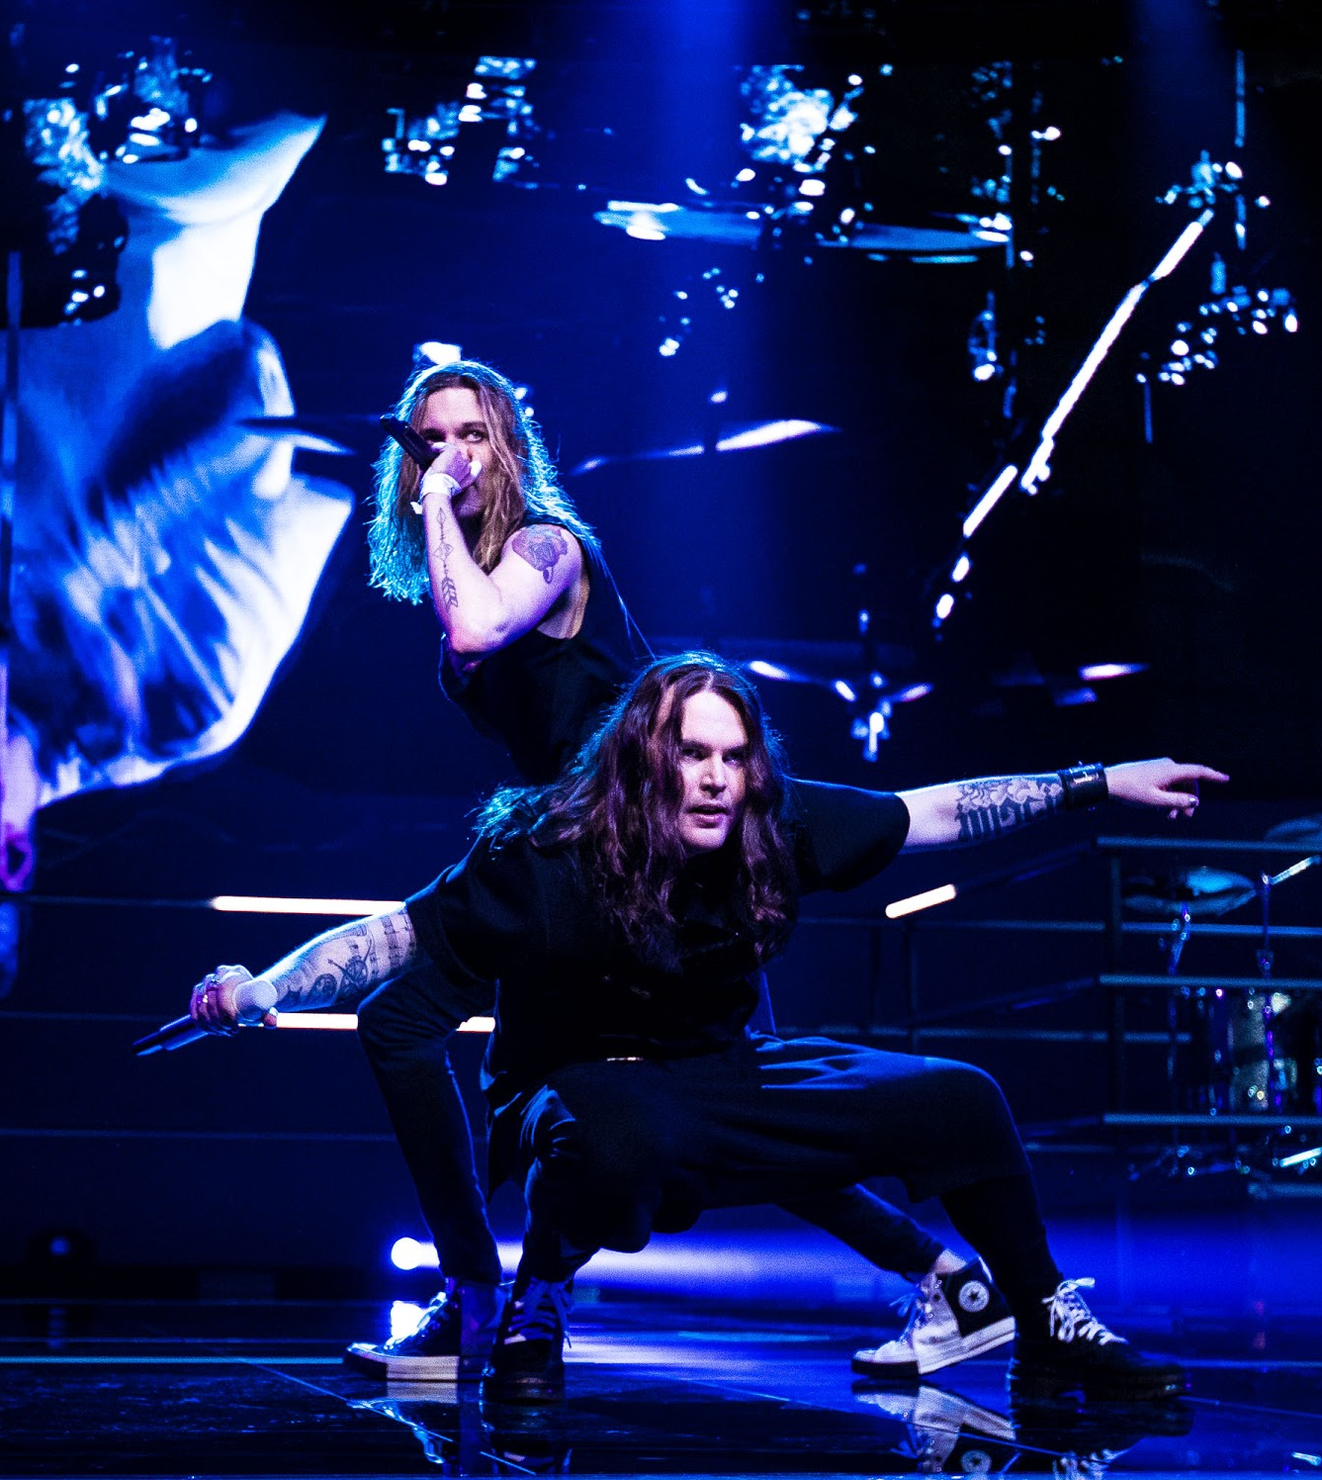
Sandstorm the gates
10 PIECES OF FINNISH MUSIC
1
2
3
4
5
6
7
8
9
10
The global breakthrough of Finnish pop music was led by Darude, HIM, and The Rasmus.
Now performers like ALMA and Sunrise Avenue are continuing the world conquest.
Samu Haber from Sunrise Avenue
Photo: Comusic Management
The Rasmus
Photo: Miikka Varila / Yle
Alma
Photo: Viivi Huuska
Blind Channel
Photo: Miikka Varila / Yle
Notes:
In the early 2000s, Finnish pop music broke through internationally for the first time, thanks to hits like "Sandstorm" by Darude, "Freestyler" by Bomfunk MC’s, "Join Me" by HIM, and "In the Shadows" by The Rasmus.
Over the past decade, some of the biggest Finnish pop successes have included Käärijä’s "Cha Cha Cha", ALMA’s "Chasing Highs", Sunrise Avenue’s "Hollywood Hills", as well as rising artists like Blind Channel.
In addition, Finnish pop songwriters and producers, such as ALMA, Teemu Brunila and MD$, are making hits for international pop stars (i.e. Kylie Minogue, Miley Cyrus) year after year. Finland also has a vibrant and independent electronic music scene, with a wide range of self-driven producers and DJs making their mark globally.

Slide 14

7/10
It’s summer, it’s party
Pori Jazz
Photo: Julius Töyrylä / Music Finland

Slide 15


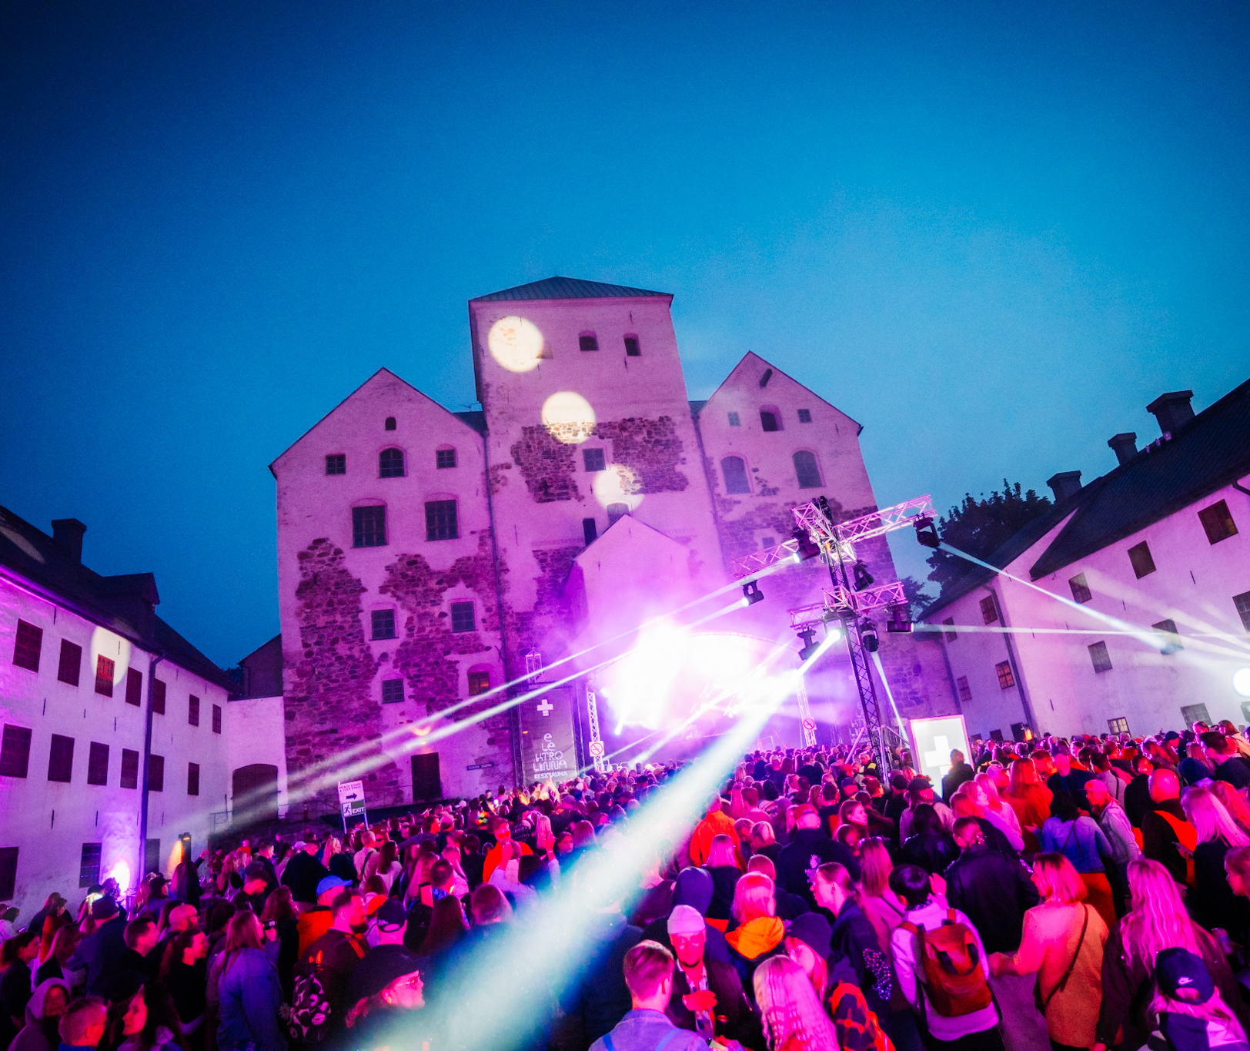


It’s summer, it’s party
10 PIECES OF FINNISH MUSIC
1
2
3
4
5
6
7
8
9
10
From intimate art events to major Midsummer gatherings
Festivals are a key part of Finnish summer culture.
Ruisrock
Photo: Riikka Vaahtera
Tuska 2023
Photo: Miika Storm / Business Finland
Elektrolinna, Kesärauha
Photo: Jussi Virkkumaa
H2Ö festival
Photo: Sami Heiskanen
Tikkurila Festival
Photo: Jaakko Meyn
Notes:
Finland is well known for its summer festivals, with hundreds taking place every year. They’re held all over the country—even in the smallest towns—and cover every musical genre imaginable, from non-commercial art events to large-scale Midsummer celebrations for the whole nation.
For Finns, festivals are about more than just music. People come together to enjoy the summer, spend time with others, and soak in the atmosphere. These days, festivals are a full-on experience and an essential part of the Finnish summer.
Some well-known festivals include: Flow Festival, Tuska, Helsinki Festival, Ruisrock, Kuhmo Chamber Music Festival, Kaustinen Folk Music Festival, and Pori Jazz.

Slide 16
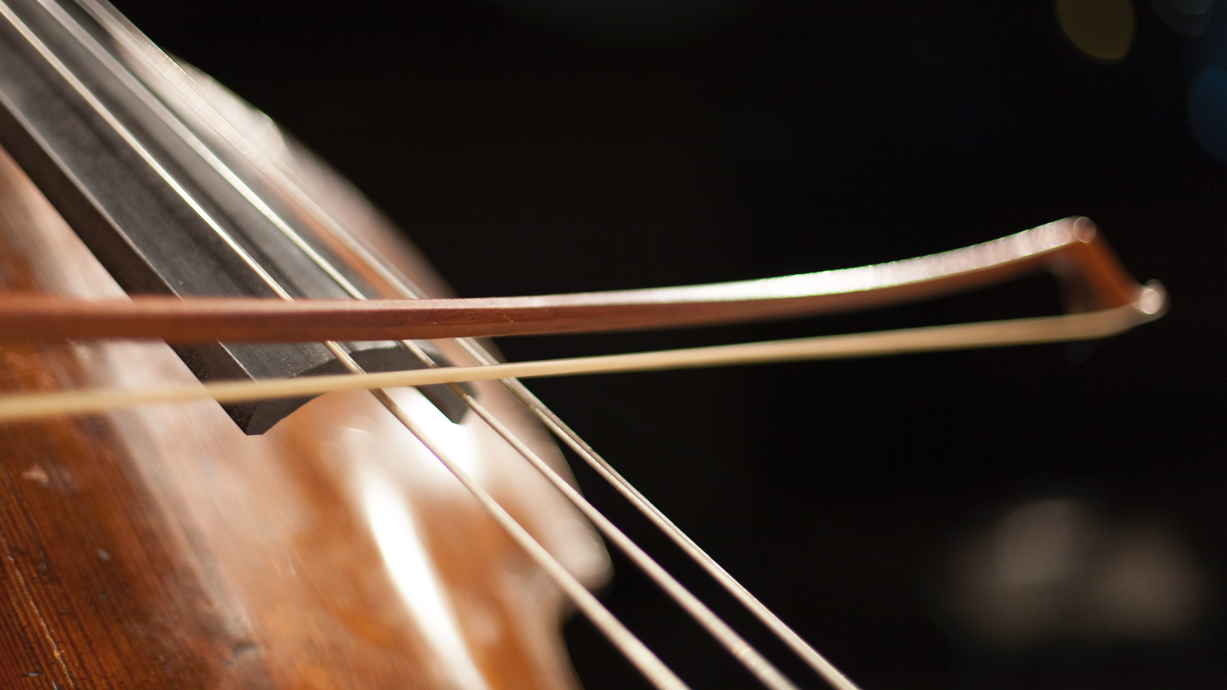
8/10
A sound music
education system
Photo: Katri Naukkarinen / Music Finland

Slide 17
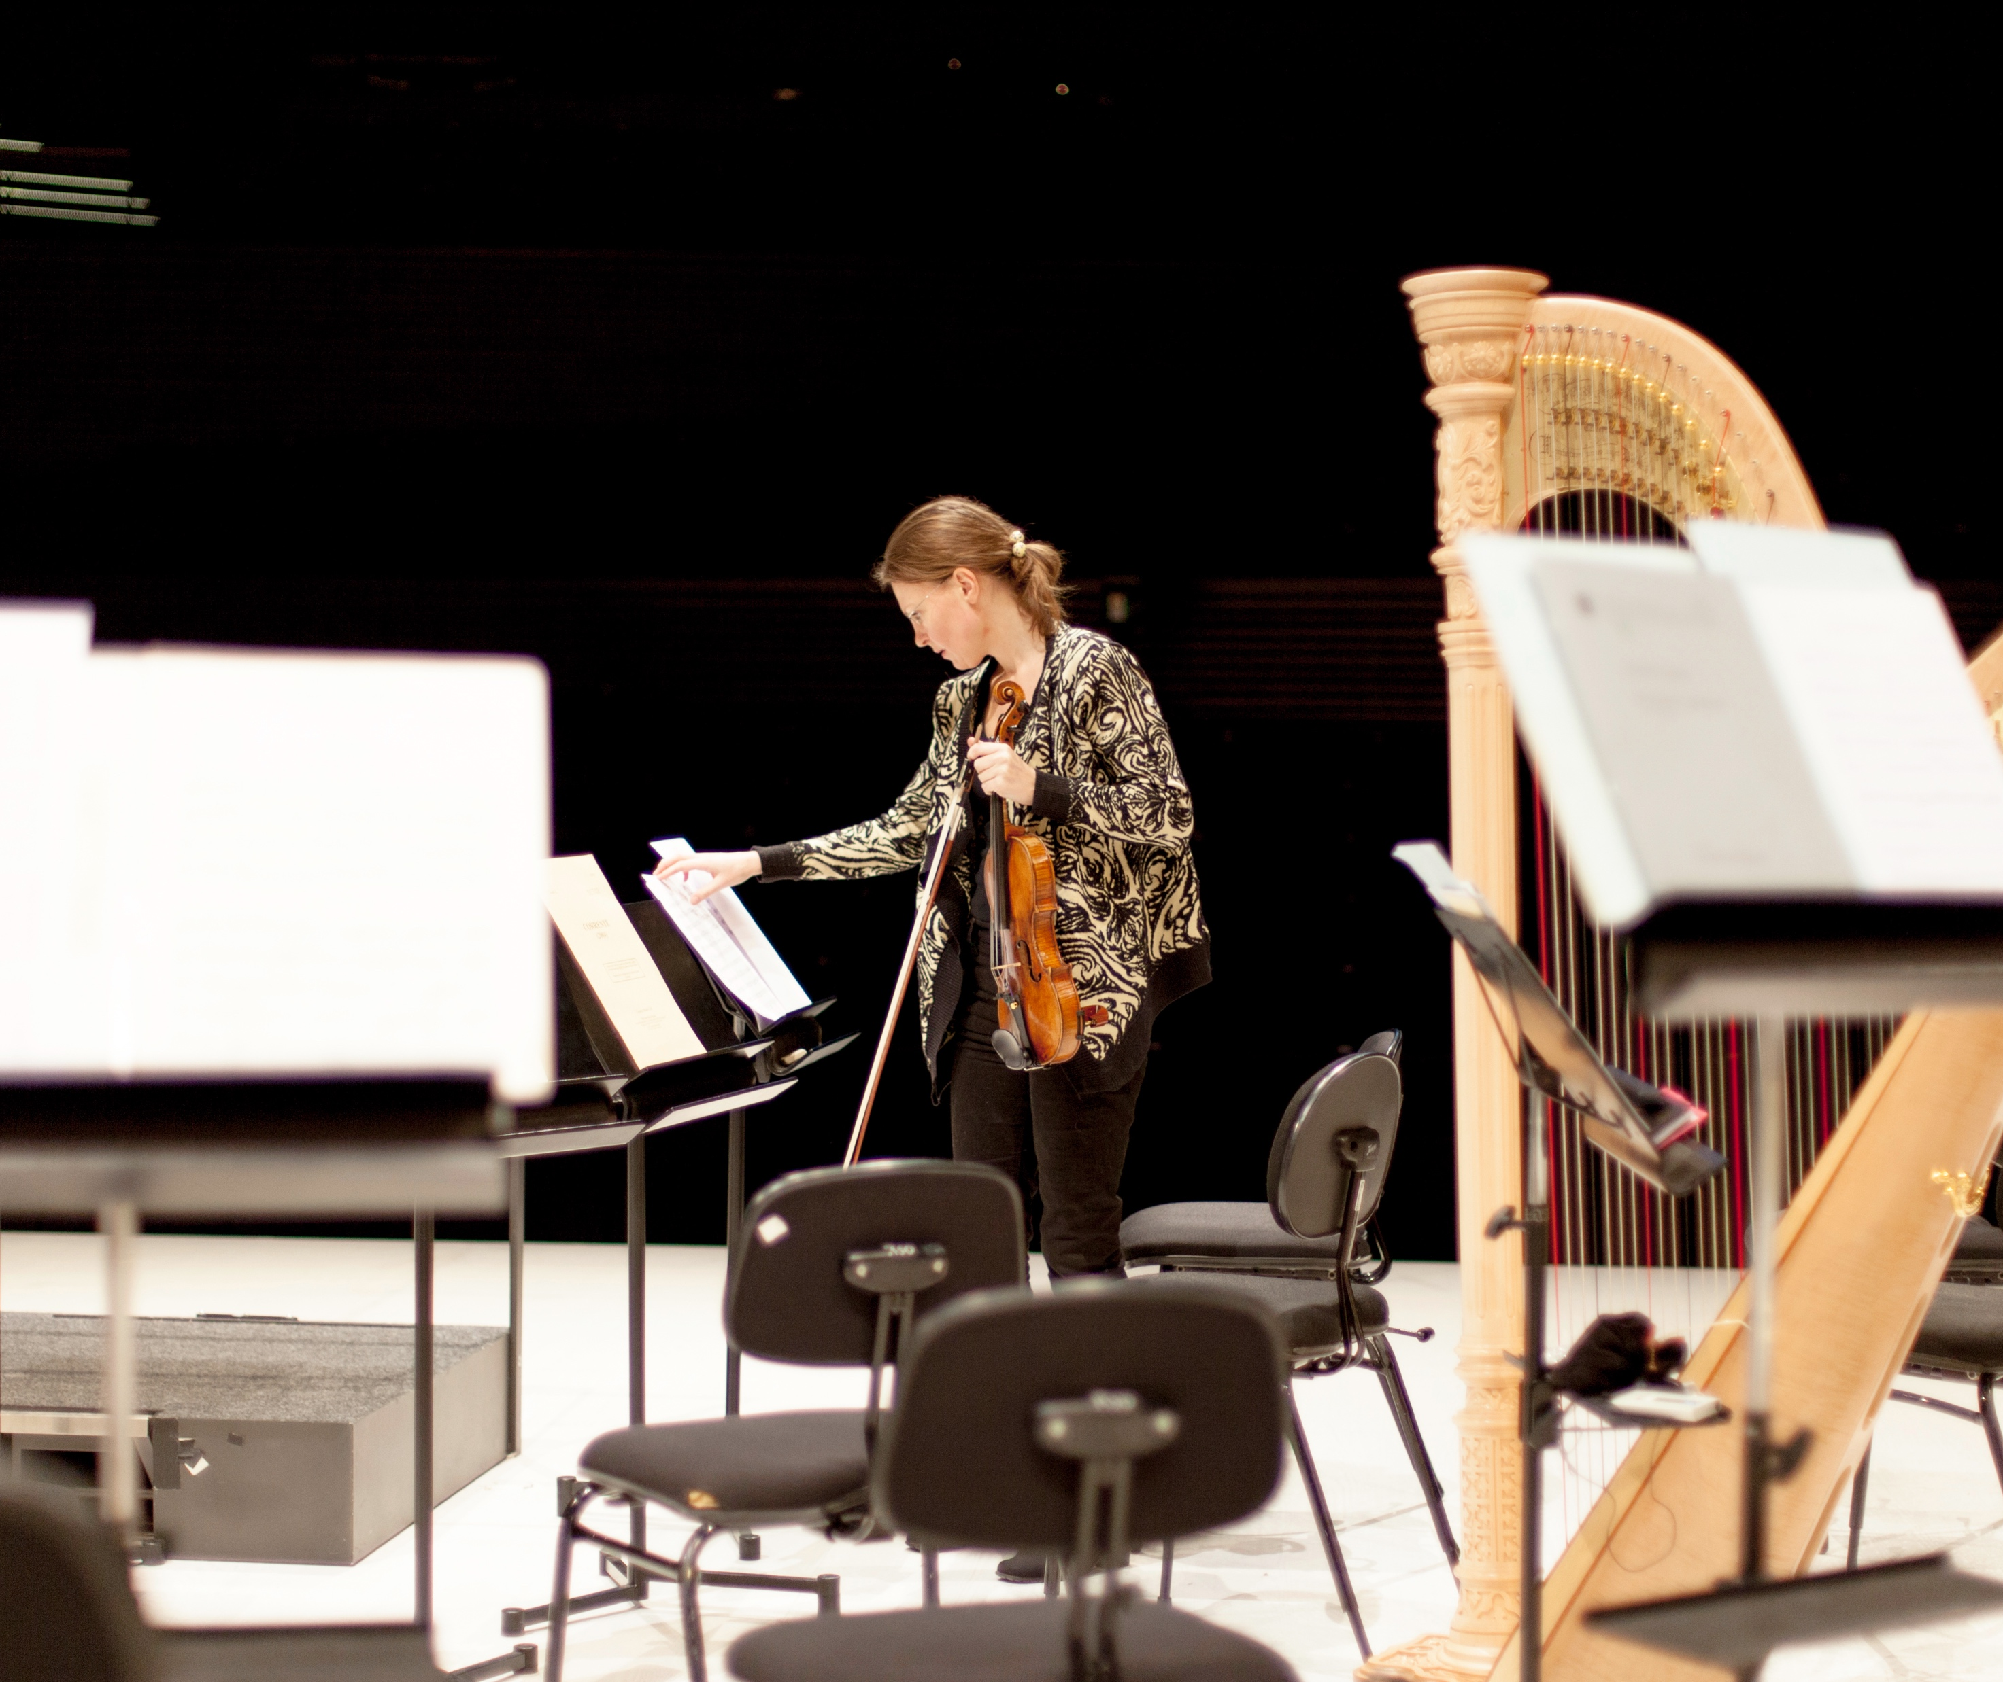
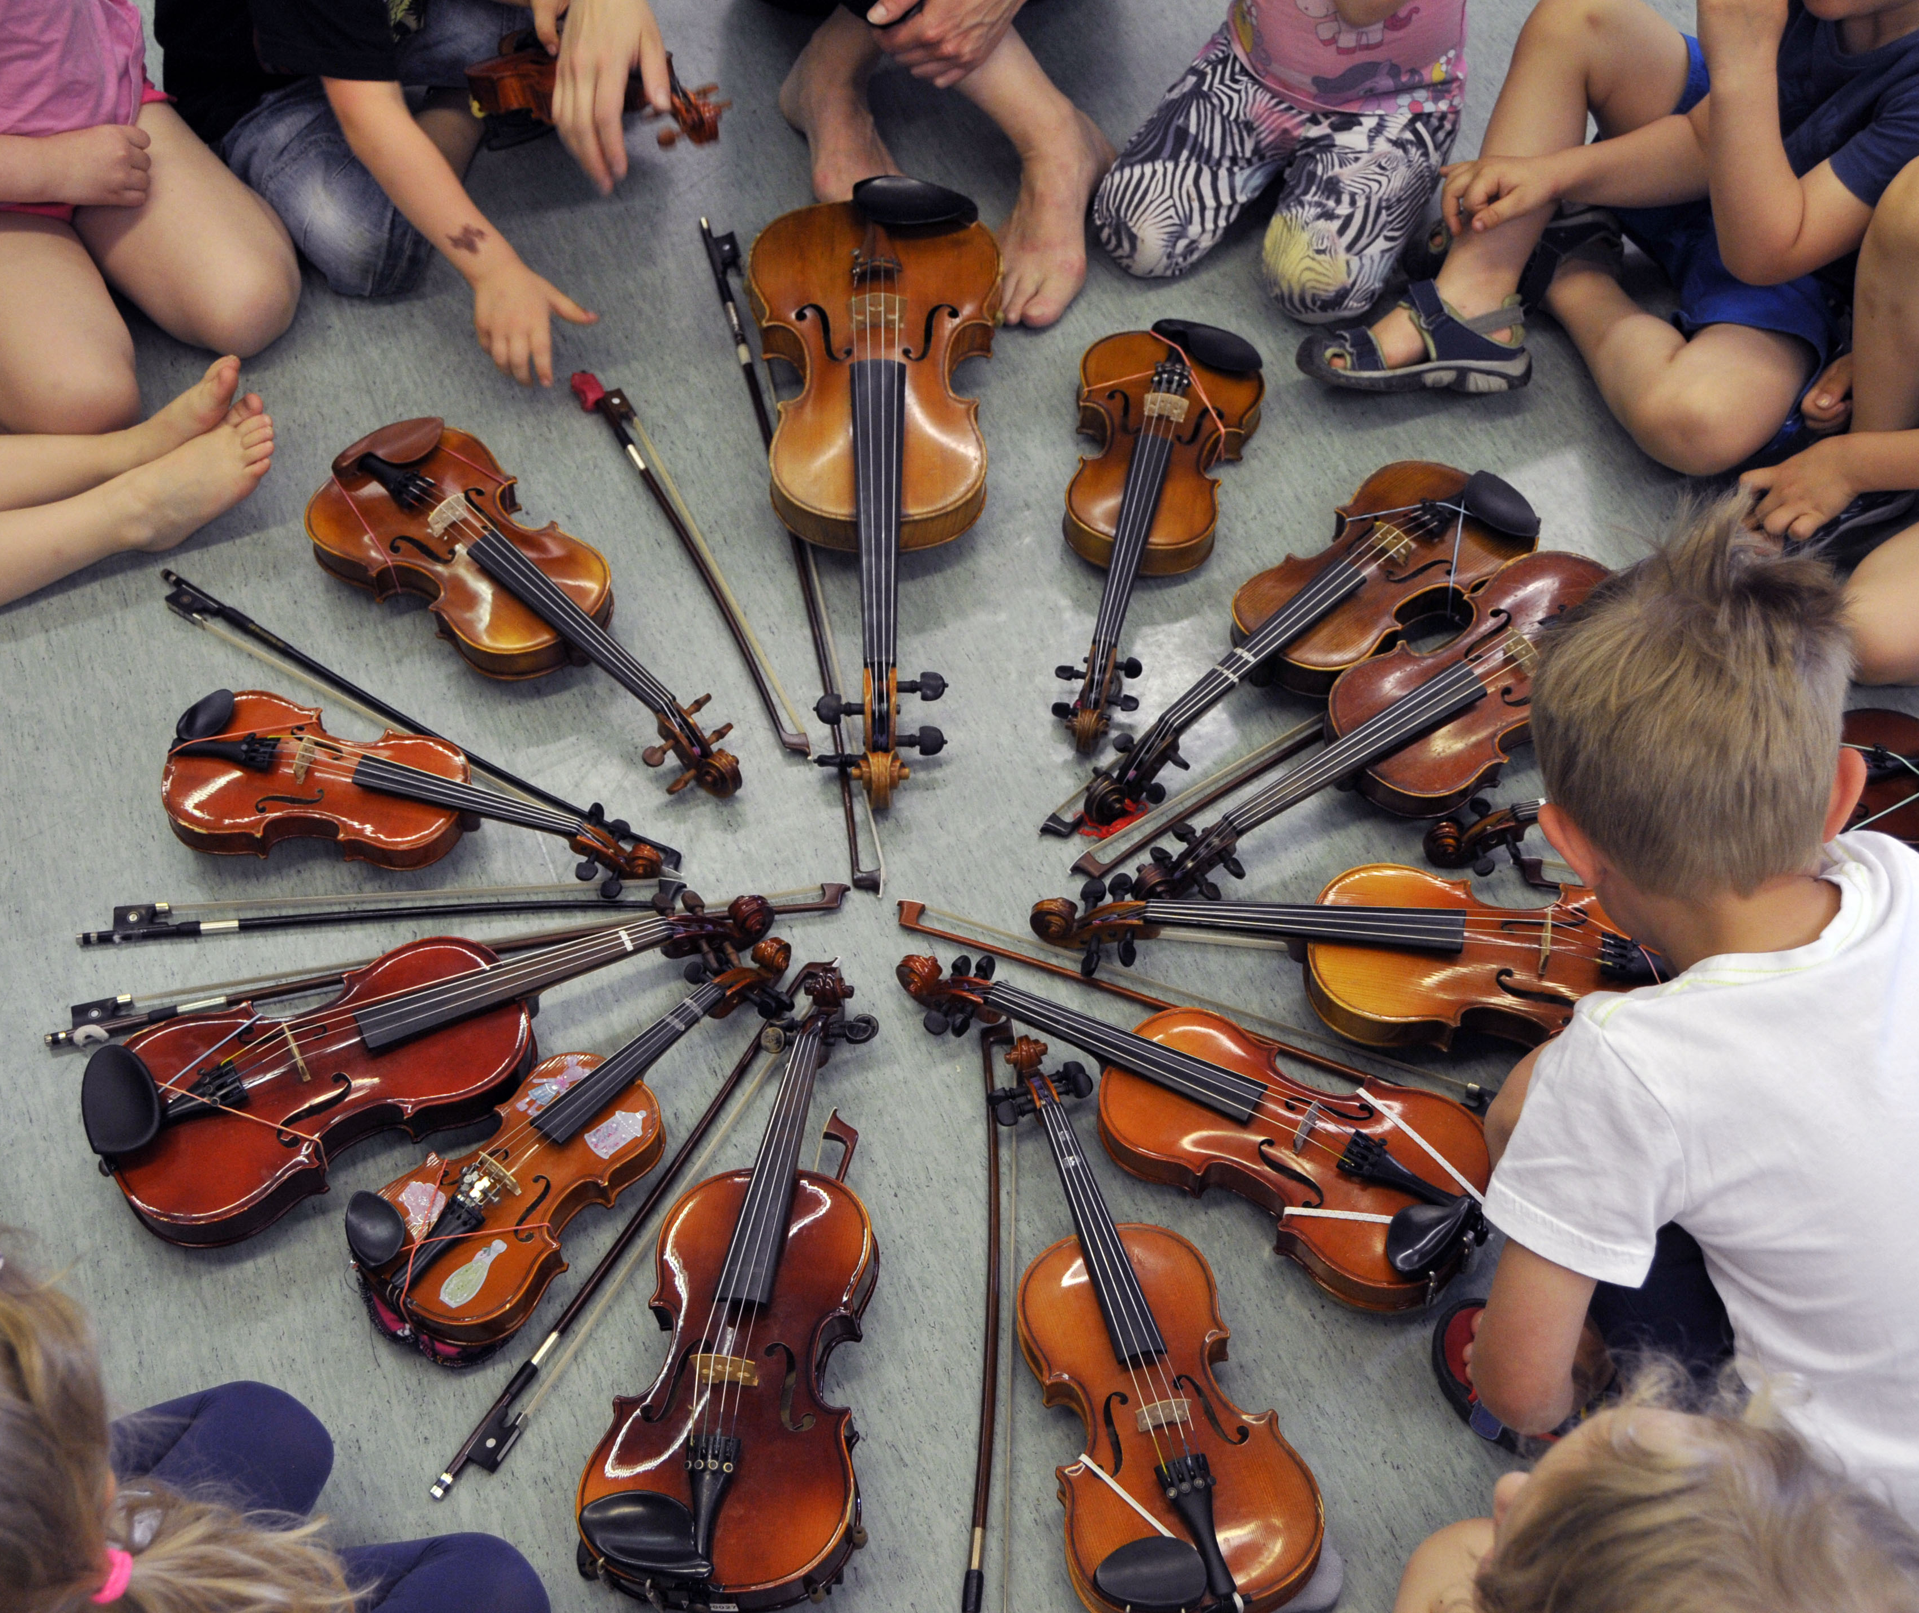
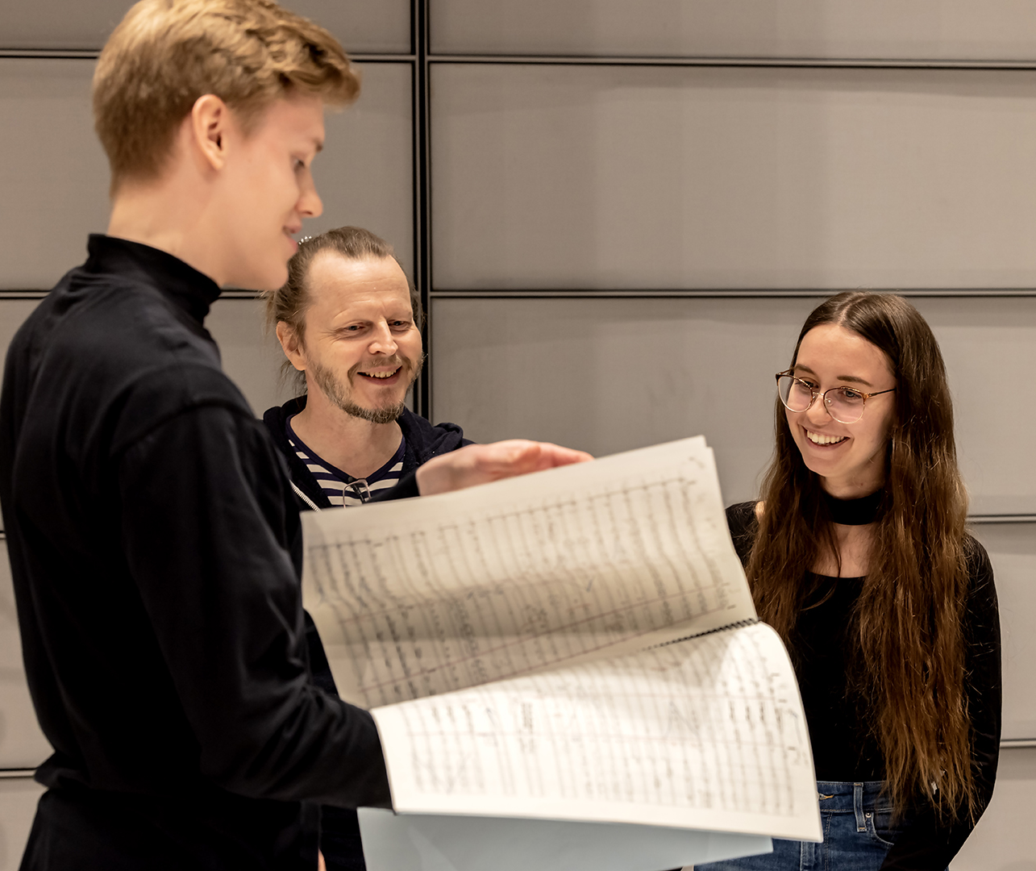
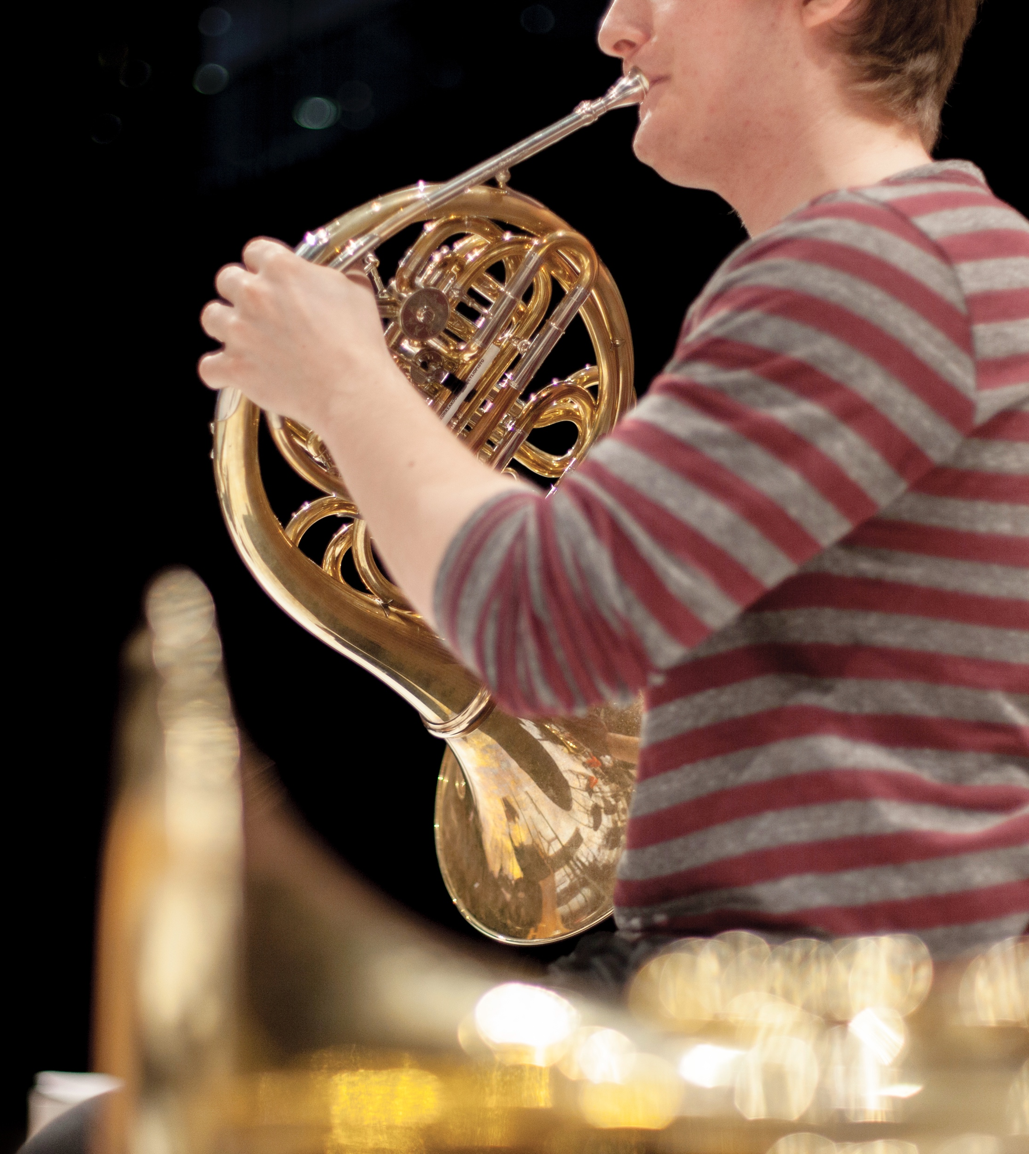
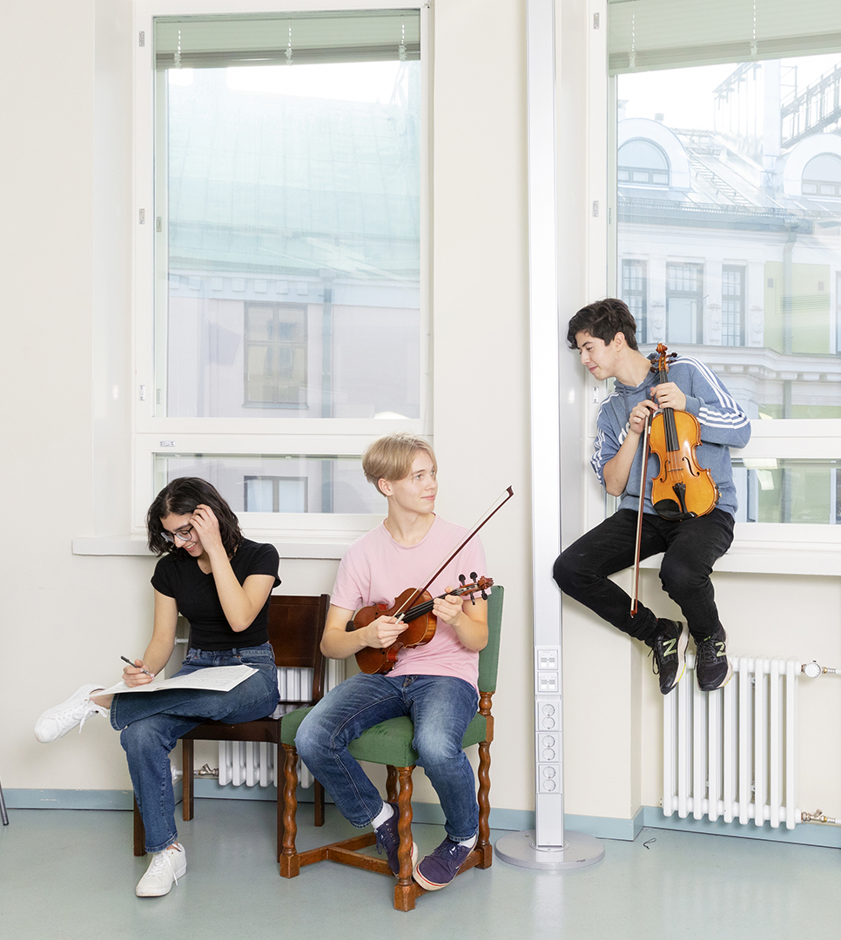
A sound music education system
10 PIECES OF FINNISH MUSIC
1
2
3
4
5
6
7
8
9
10
Key factor in our musical miracle
High-quality instruction is accessible at all levels, from early childhood to advanced professional training.
Photo: Maija Voutilainen / Kaustinen Folk Music Festival
Photo: Minna Hatinen / Taideyliopisto
Photo: Katri Naukkarinen / Music Finland
Photo: Katri Naukkarinen / Music Finland
Photo: Wilma Hurskainen / Taideyliopisto
Notes:
People often ask: What’s the secret behind the so-called "Finnish musical miracle"? The answer lies in Finland’s exceptional music education system, often considered one of the best in the world.
This state-supported system was established in the 1970s, and over the decades, it has grown into a comprehensive, nationwide network. It covers every stage of music education, from early childhood music play schools to advanced professional education.
But it’s more than just a talent pipeline. The system is built on the principles of accessibility and equality. Regardless of background or income, children in Finland have the opportunity to study music, to make it their profession, or simply for the joy of it.
This broad access doesn’t just produce world-class musicians; it also cultivates a society that deeply values and supports music. In other words, Finland’s music education doesn’t just shape artists, but it also shapes audiences.

Slide 18
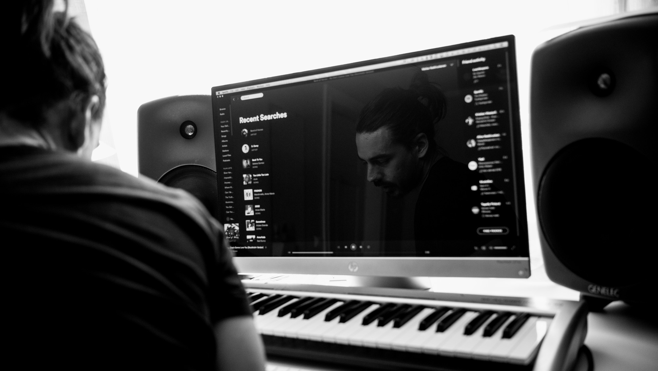
9/10
Finland is a leading player
in music technology
Photo: Julius Töyrylä / Music Finland

Slide 19
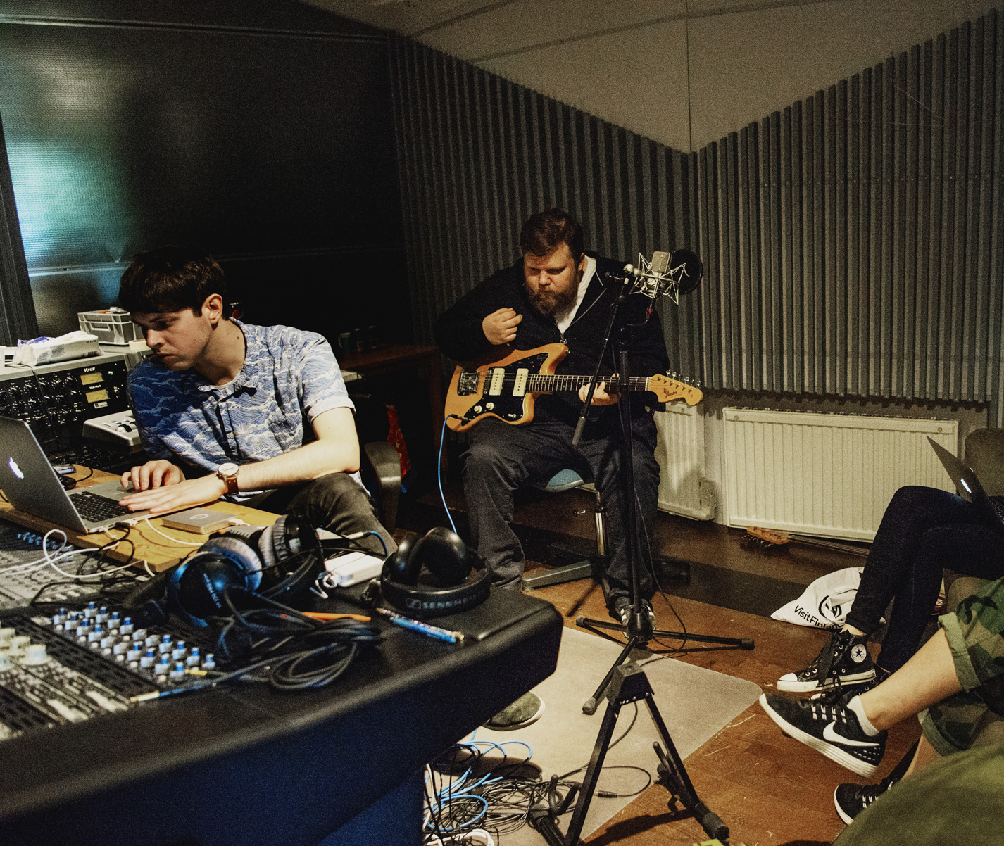

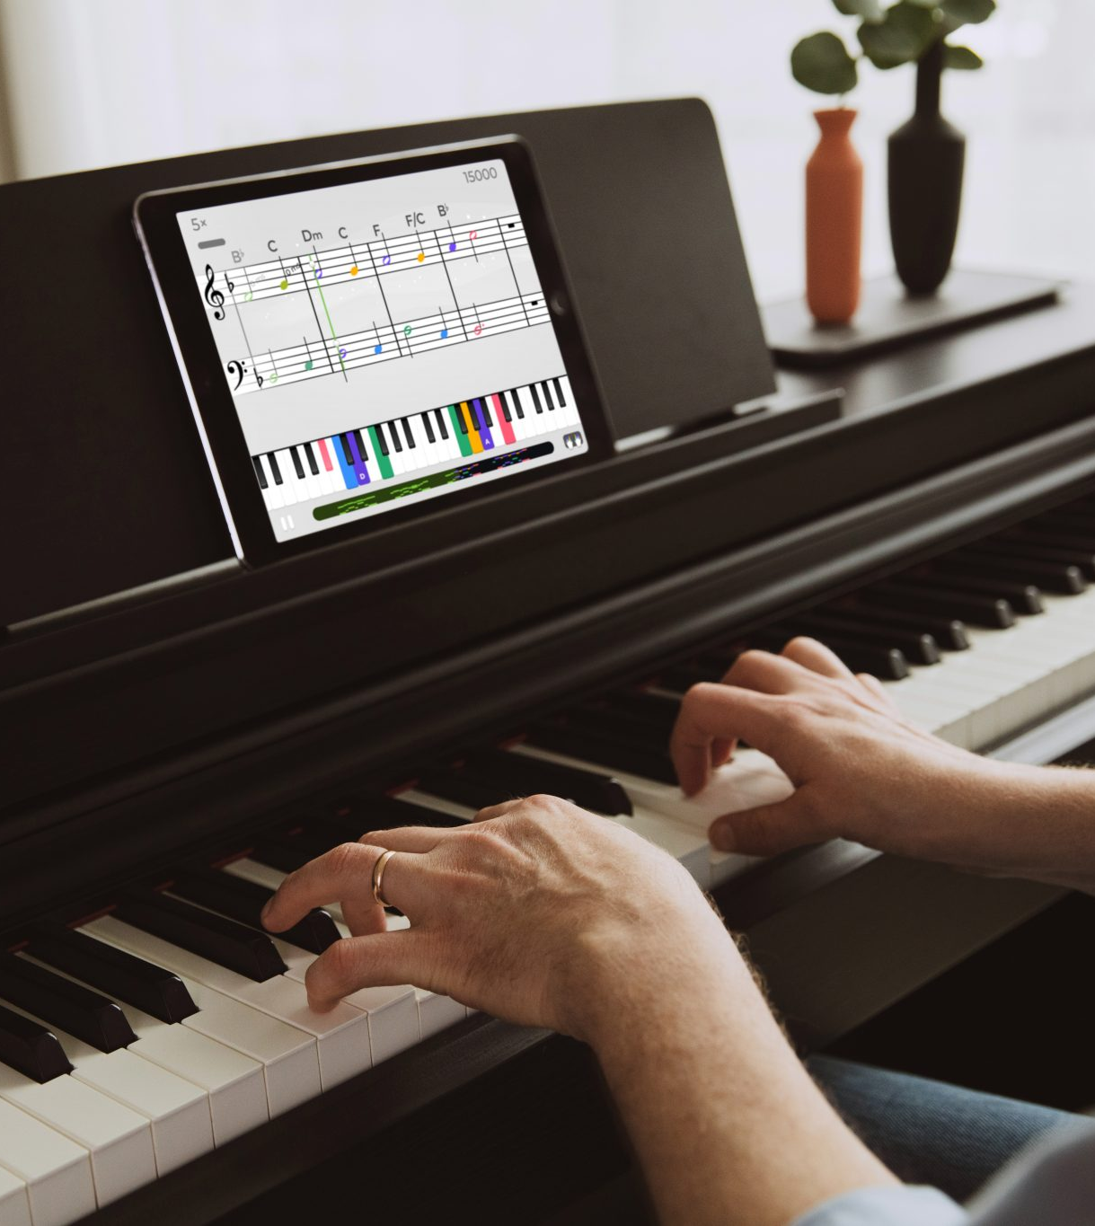
Finland is a leading player in music technology
10 PIECES OF FINNISH MUSIC
1
2
3
4
5
6
7
8
9
10
Technical brilliance
Combining engineering excellence with musical heritage produces globally recognised cutting-edge tools and software.
Photo: Singa
Photo: Julius Töyrylä / Music Finland
Photo: Yousician
Notes:
Finland is also a hub for cutting-edge music technology, both in hardware and software.
The best-known example is Genelec, which originally focused on professional studio monitors. The company has earned a global reputation for top-tier sound quality, trusted by hi-fi enthusiasts around the world.
Finnish companies are making their mark across the music tech spectrum, from digital effects and audio software to innovative tools for music learning. This blend of engineering expertise and a deep-rooted music culture makes Finland a fertile ground for high-quality, forward-thinking music technology.
Companies include: Genelec (speakers), Amphion (speakers), Singa (karaoke), Yousician (learning), Neural DSP (digital instrument effects), Oeksound (professional studio software)

Slide 20
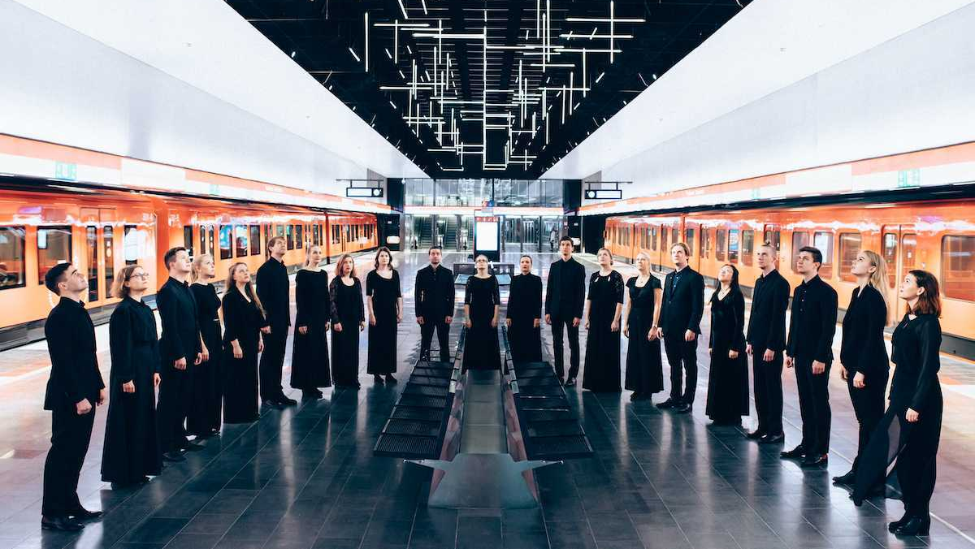
10/10
Finland’s Choirs Hit
All the Right Notes
Emo Ensemble
Photo: Aleksi Kallioja

Slide 21
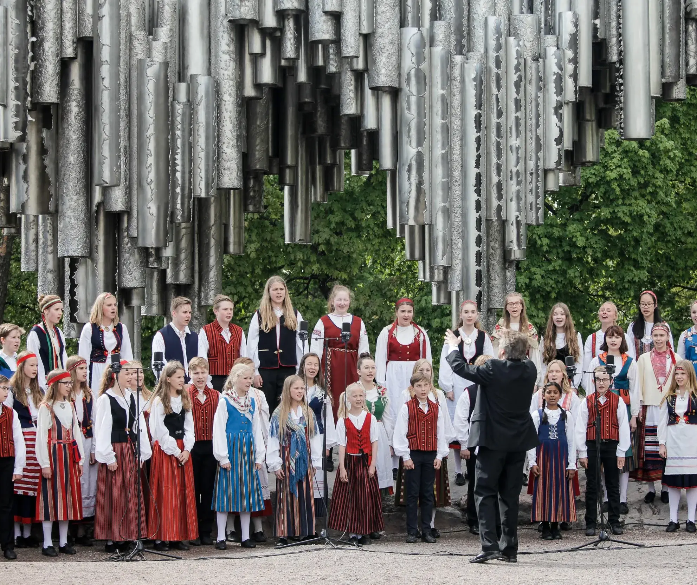

Finland’s choirs hit all the right notes
10 PIECES OF FINNISH MUSIC
1
2
3
4
5
6
7
8
9
10
Singing in a choir is part of the Finn experience
We have choirs for grade schoolers and university students, amateurs and professionals – choirs have united us since the 19th century, when they played a major role in the development of our national identity.
Photo: Singa
Tapiolan Kuoro
Mieskuoro Huutajat
Photo: Vesa Ranta
Notes:
Finland has thousands of choirs of all kinds — from children’s and youth choirs to student, church, chamber, and professional ensembles. Singing in a choir is both a hobby and a key part of Finnish cultural life.
Choral singing played a major role in shaping Finnish national identity during the 19th century. University choirs, such as the YL Male Voice Choir, helped promote Finnish-language music and nationalism.
Finnish choirs are known for their musical precision and expressive sound. Composers like Jean Sibelius, Einojuhani Rautavaara, and Jaakko Mäntyjärvi have made Finnish choral music internationally respected.
Choir singing in Finland fosters a strong sense of community and well-being. There are both elite competition choirs and easy-access community choirs, allowing everyone to participate regardless of skill level.)

Slide 22
11/10
11/10
An extra skylight
with views to
common ground.
Epilogue

Slide 23
Epilogue
10 PIECES OF FINNISH MUSIC
1
2
3
4
5
6
7
8
9
10
Photo: xxx
Any note
can be written here.
This is a place for
more detailed information.
You can use this page to highlight connections between Finnish cinema and your country, shared projects, or even interesting upcoming events.
Notes:
Tähän osioon voi koota vastaanottajan ja tilanteen mukaan personoitavia asioita, toki elokuvakulman huomioiden.

Slide 24
Did we strike a chord?
Let’s come up with the next arrangement together.

