Slide 1
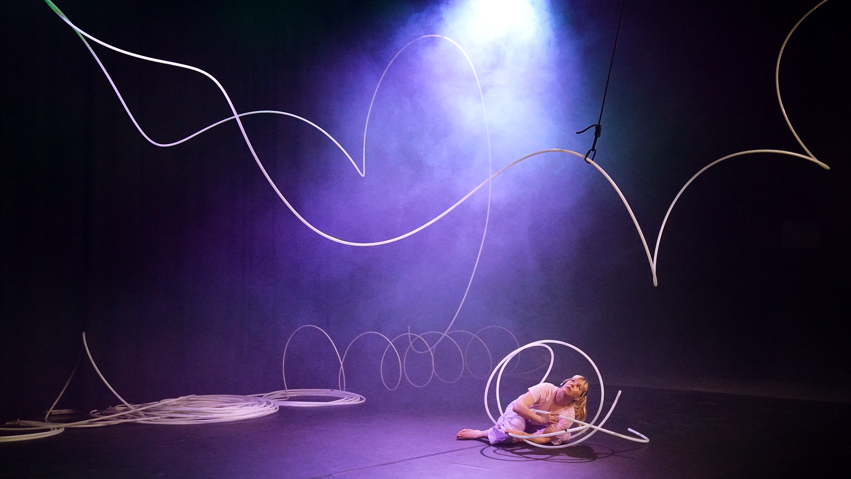

SEVEN PEEKS AT FINNISH CIRCUS
Recover Laboratory: <3 Smaller than three, 2024.
Photo: Sofi Häkkinen

Slide 2
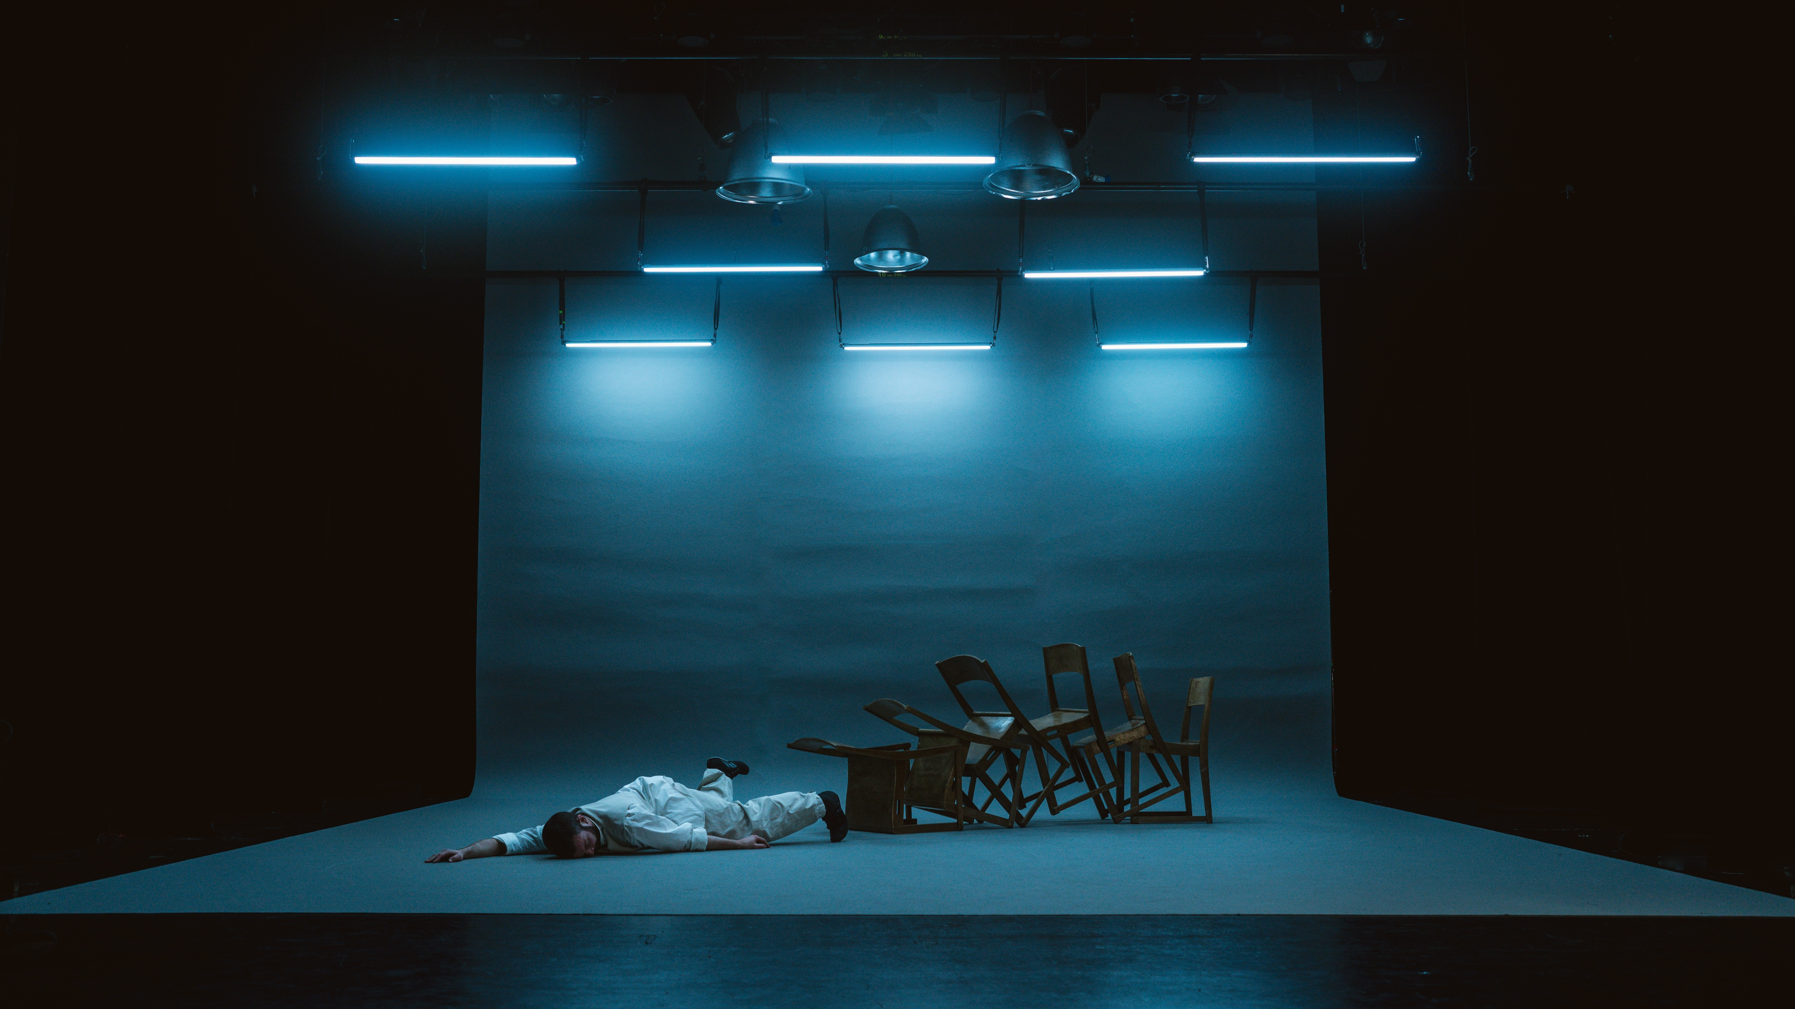
1/7
Finnish contemporary circus
boldly crosses boundaries.
WHS / Kalle Nio & Fernando Melo: Tempo, 2025.
Photo: Kalle Nio
Notes:
Kuvaa klikkaamalla pääsee videointiin esityksestä.
Contemporary Finnish circus is known for its fearless, boundary-breaking spirit. Artists are not afraid to blend disciplines or invent their own. Rather than staying within the traditions of circus or performing arts, they cross into visual arts, choreography, installation and sound-based work. The results are often surprising, provocative and emotionally resonant. Performances may explore abstraction, absurdity or strong conceptual ideas, but remain rooted in physical skill and presence.
This bold and experimental character is visible in the works of companies like Company Portmanteau, Nuua and WHS. Kalle Nio, for example, combines stage magic and visual art into captivating illusions that challenge perception, while Recover Laboratory draws from installation and sound art to create immersive, multisensory environments. Lighting and sound are treated as equal artistic tools alongside movement and object manipulation.
This approach appeals to audiences looking for something fresh, thought-provoking and different. Finnish contemporary circus connects with its time, reflecting a culture that values authenticity, risk-taking and artistic independence. While some pieces are poetic and abstract, others are raw and funny.

Slide 3
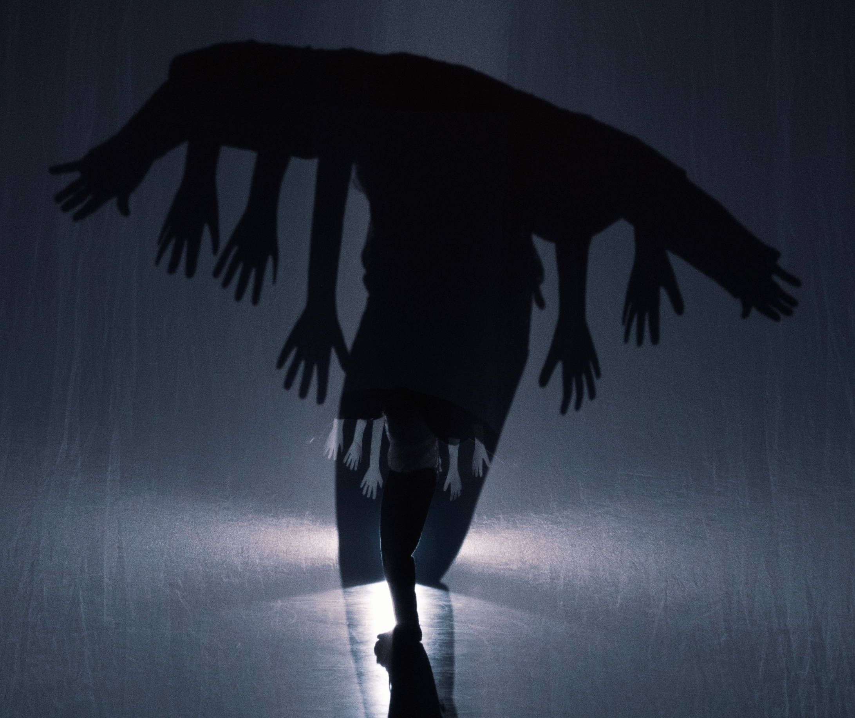
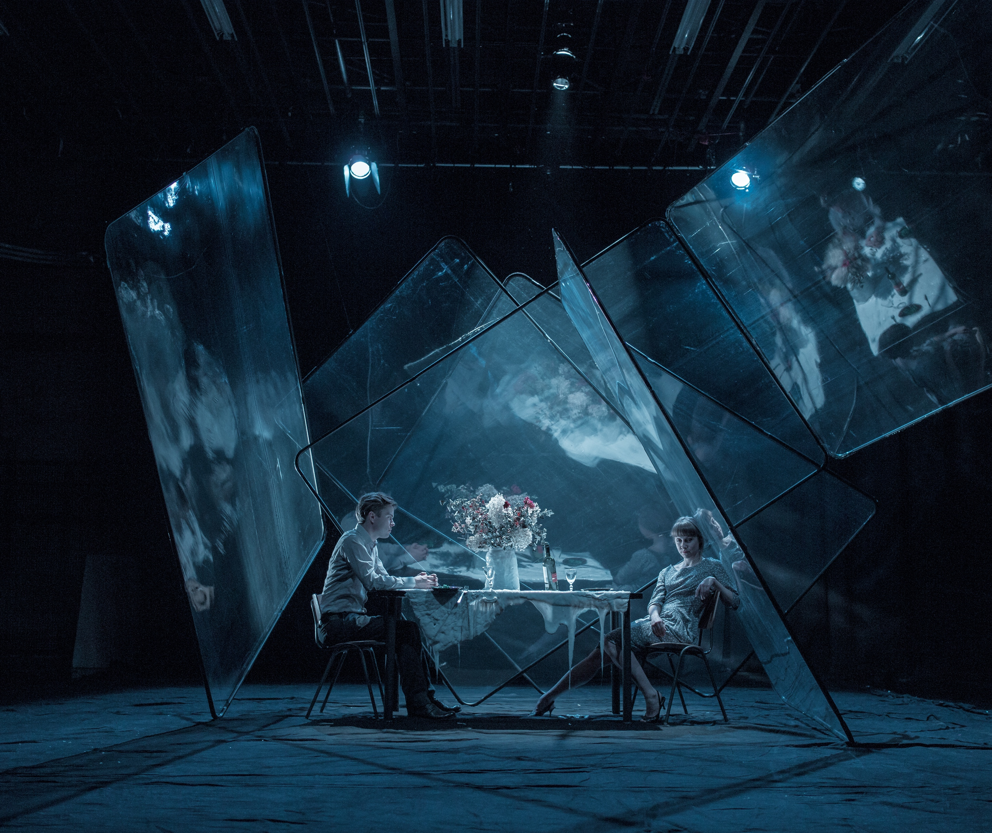
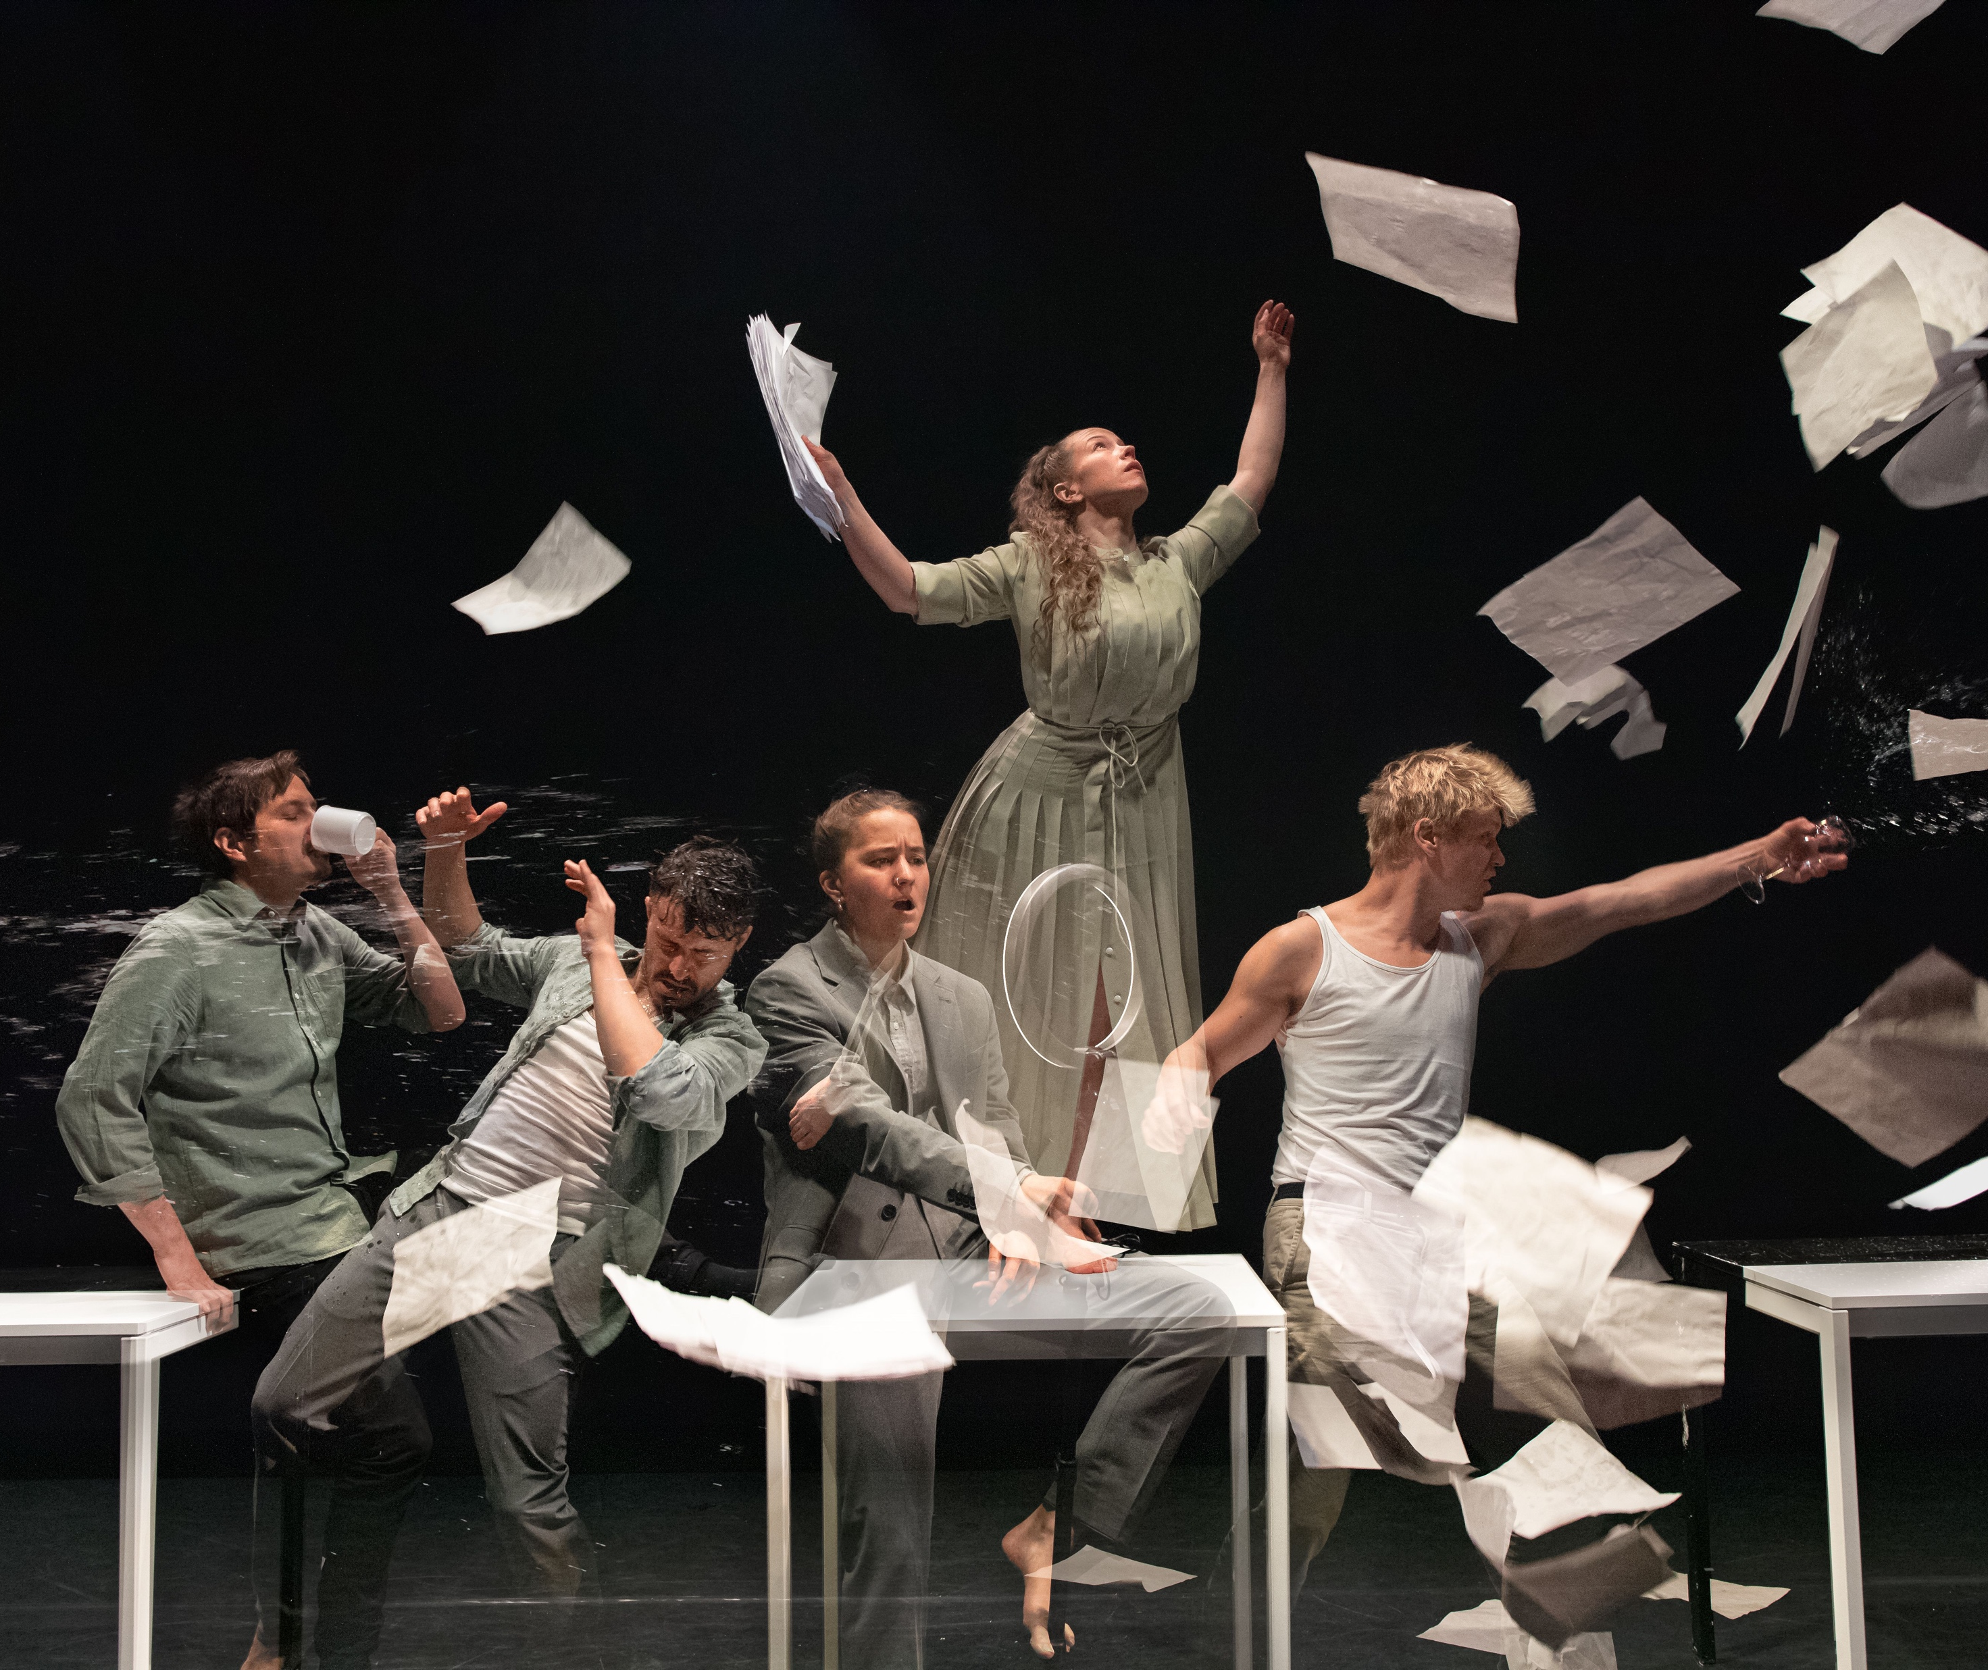
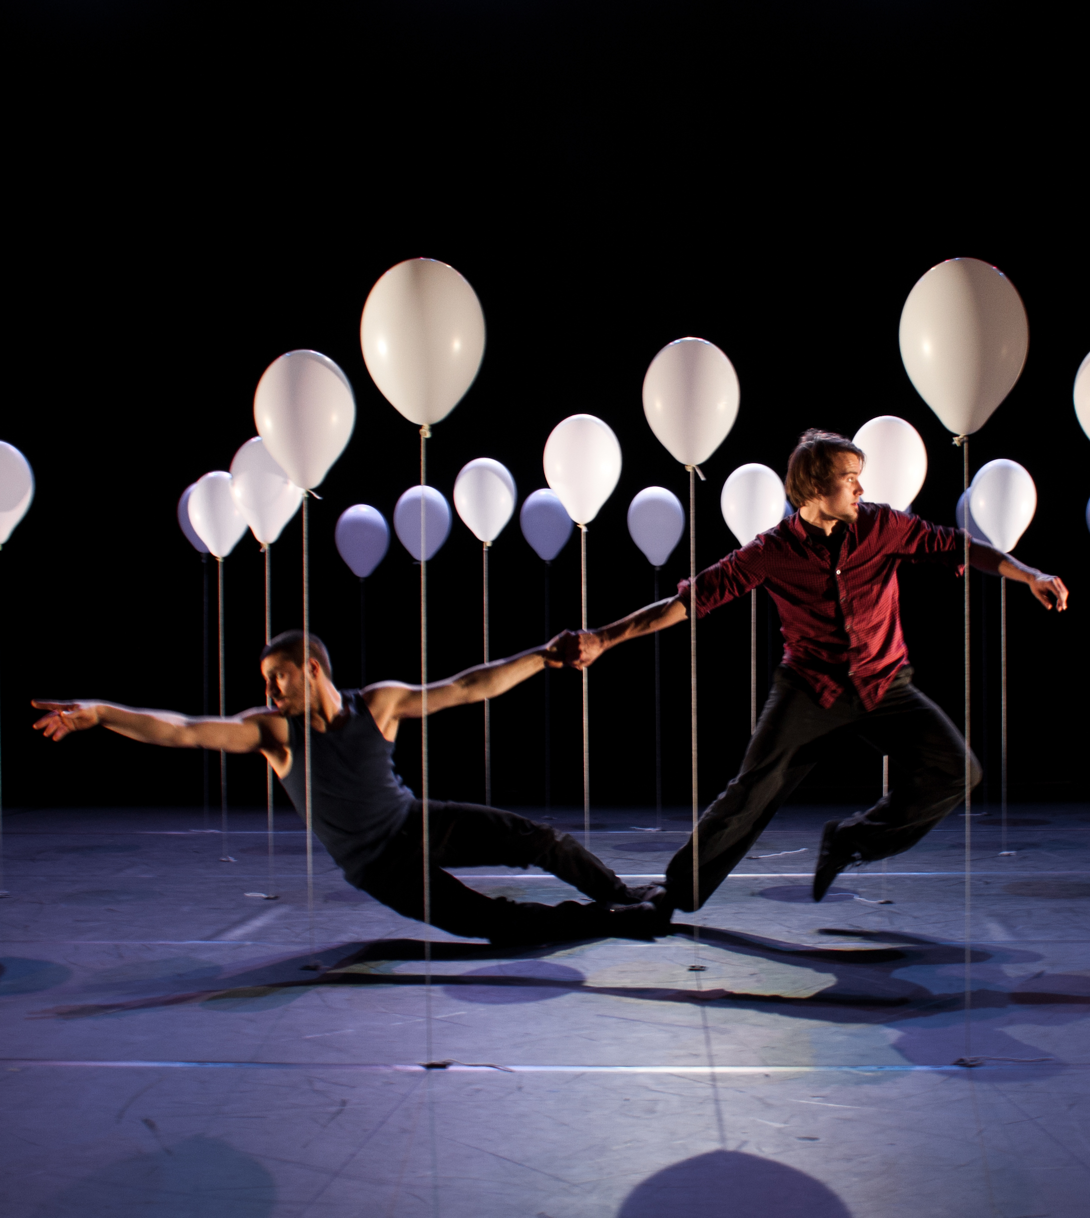
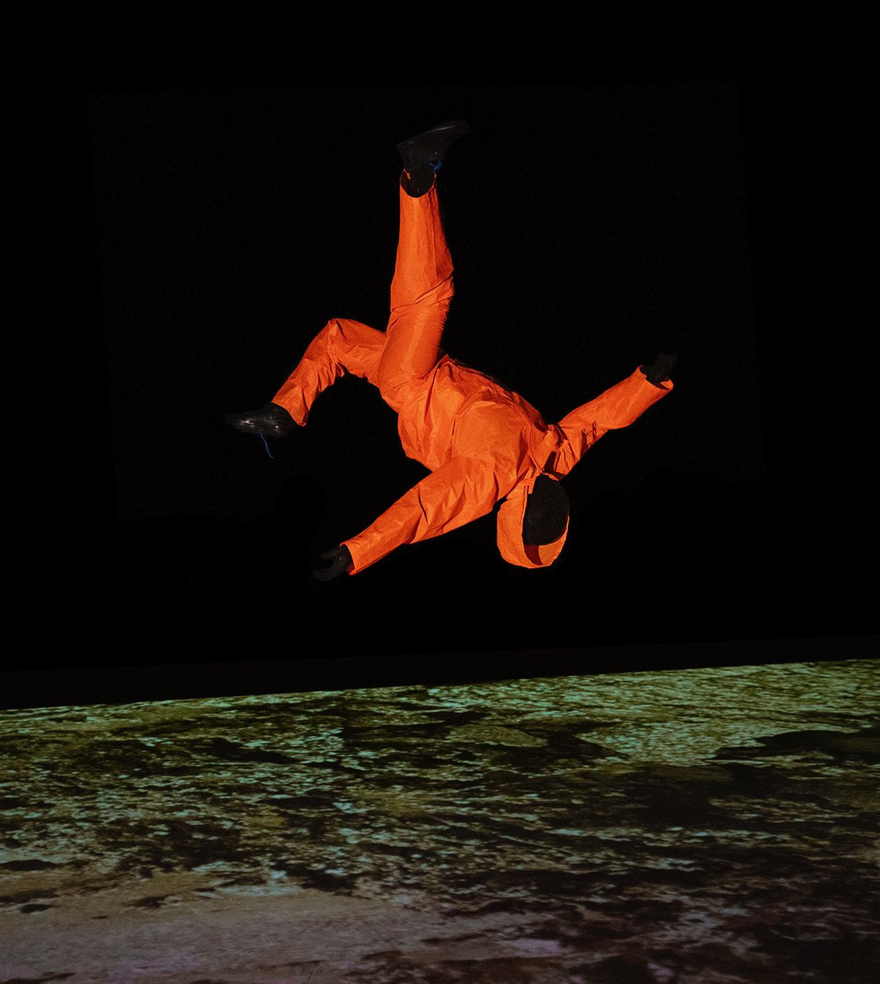
Finnish contemporary circus boldly crosses boundaries.
SEVEN PEEKS AT FINNISH CIRCUS
1
2
3
4
5
6
7
It is exceptional to blend this much visual arts, dance, and experimental sound and light design into circus.
The result? Surprising, uncompromising and genre-defying.
Agit-Cirk / Sakari Männistö: Hypnos, 2025.
Photo: Amber Hunt
Company Portmanteau: PERTO, 2021.
Photo: Luis Sartori do Vale
WHS / Kalle Nio: Lähtö / Départ, 2013–19.
Photo: Tom Hakala
Nuua Company: Lento, 2013.
Photo: Luis Sartori do Vale
Vilus.art: Life After, 2022.
Photo: Miia Autio
Notes:
Contemporary Finnish circus is known for its fearless, boundary-breaking spirit. Artists are not afraid to blend disciplines or invent their own. Rather than staying within the traditions of circus or performing arts, they cross into visual arts, choreography, installation and sound-based work. The results are often surprising, provocative and emotionally resonant. Performances may explore abstraction, absurdity or strong conceptual ideas, but remain rooted in physical skill and presence.
This bold and experimental character is visible in the works of companies like Company Portmanteau, Nuua and WHS. Kalle Nio, for example, combines stage magic and visual art into captivating illusions that challenge perception, while Recover Laboratory draws from installation and sound art to create immersive, multisensory environments. Lighting and sound are treated as equal artistic tools alongside movement and object manipulation.
This approach appeals to audiences looking for something fresh, thought-provoking and different. Finnish contemporary circus connects with its time, reflecting a culture that values authenticity, risk-taking and artistic independence. While some pieces are poetic and abstract, others are raw and funny.

Slide 4
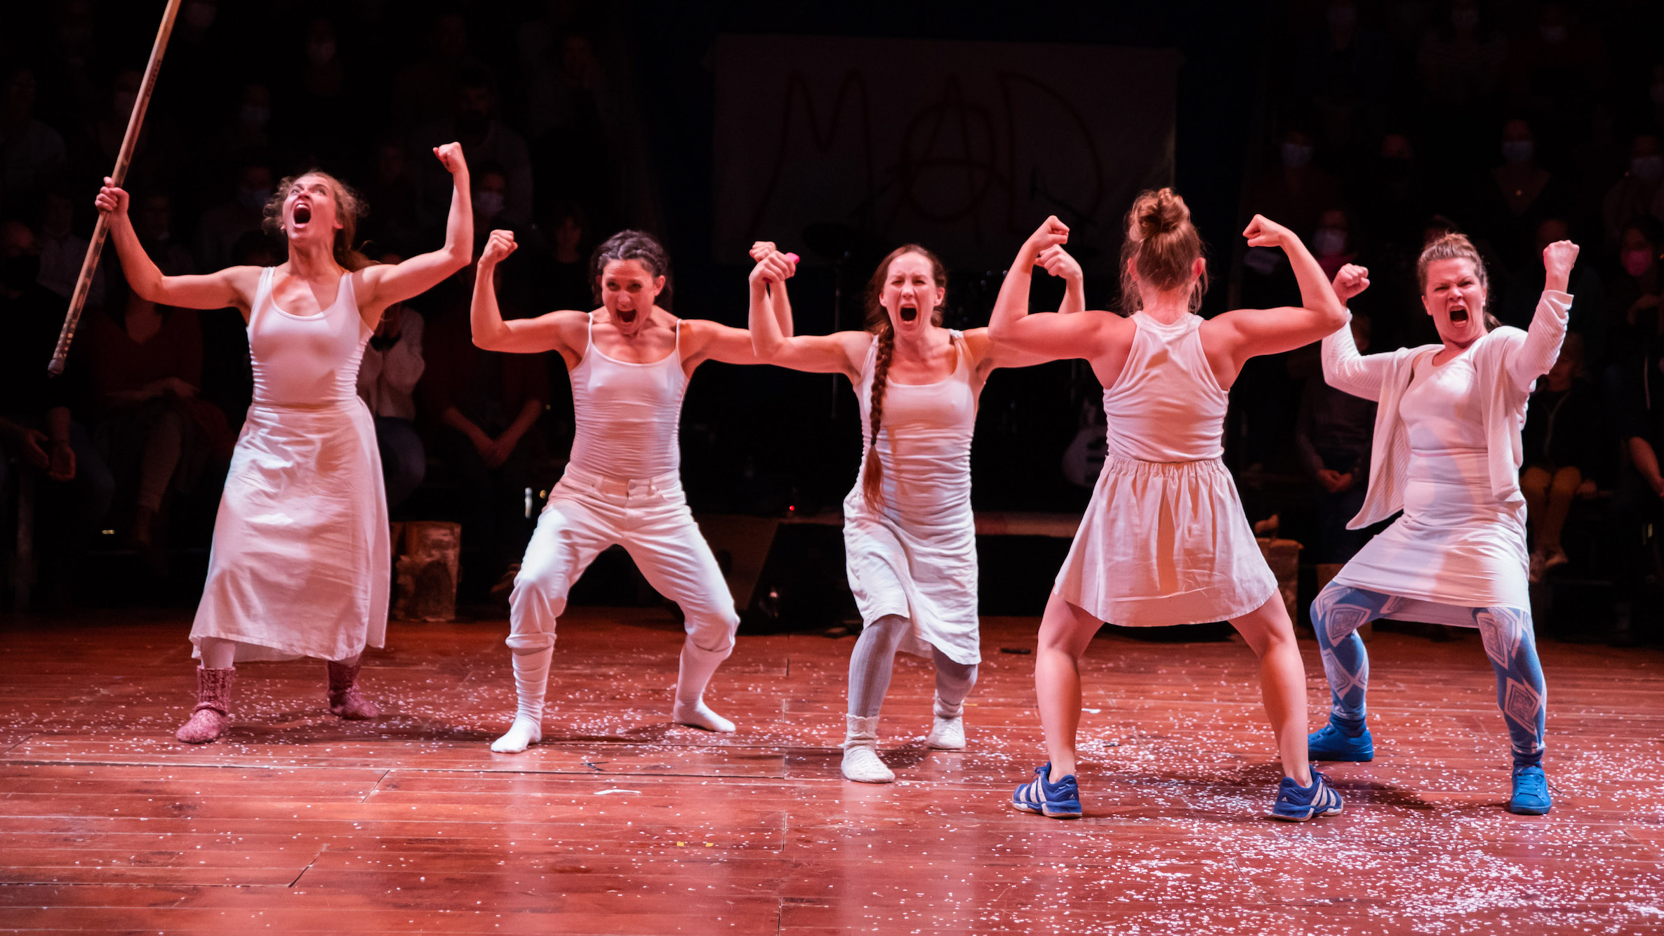
2/7
Women have a strong presence
on stage – and behind it.
Collectif MAD: Mad in Finland, 2012–.
Photo: Sebastien Armengol
Notes:
In Finland, women are not just present in the circus field – they shape it. Finnish circus artists often break away from traditional gender roles, stepping into powerful, independent positions both on and off stage. Chopping firewood on stage might be seen as shocking in Paris, but in Finland, as artist Sanja Kosonen puts it, it’s just a natural part of life – regardless of gender.
This pragmatic, hands-on attitude is deeply rooted in Finnish culture. Women are doers. In circus, that means they lead projects, take creative risks and bring bold visions to life. Groups like Mad in Finland, an all-female ensemble working internationally, showcase exceptional physical and comedic skills. Recover Laboratory in Helsinki infuses its work with feminist, queer and body-positive perspectives, challenging audiences to rethink who belongs on stage and how bodies can be seen.
The feminist clowning festival Red Pearl, organised in Helsinki, is another example of how circus can be a space for reimagining identities and questioning norms.
In Finnish circus, the female body is not ornamental or passive – it’s expressive, political, strong and complex. This presence is felt in the performances, institutions and innovations that define the scene.

Slide 5
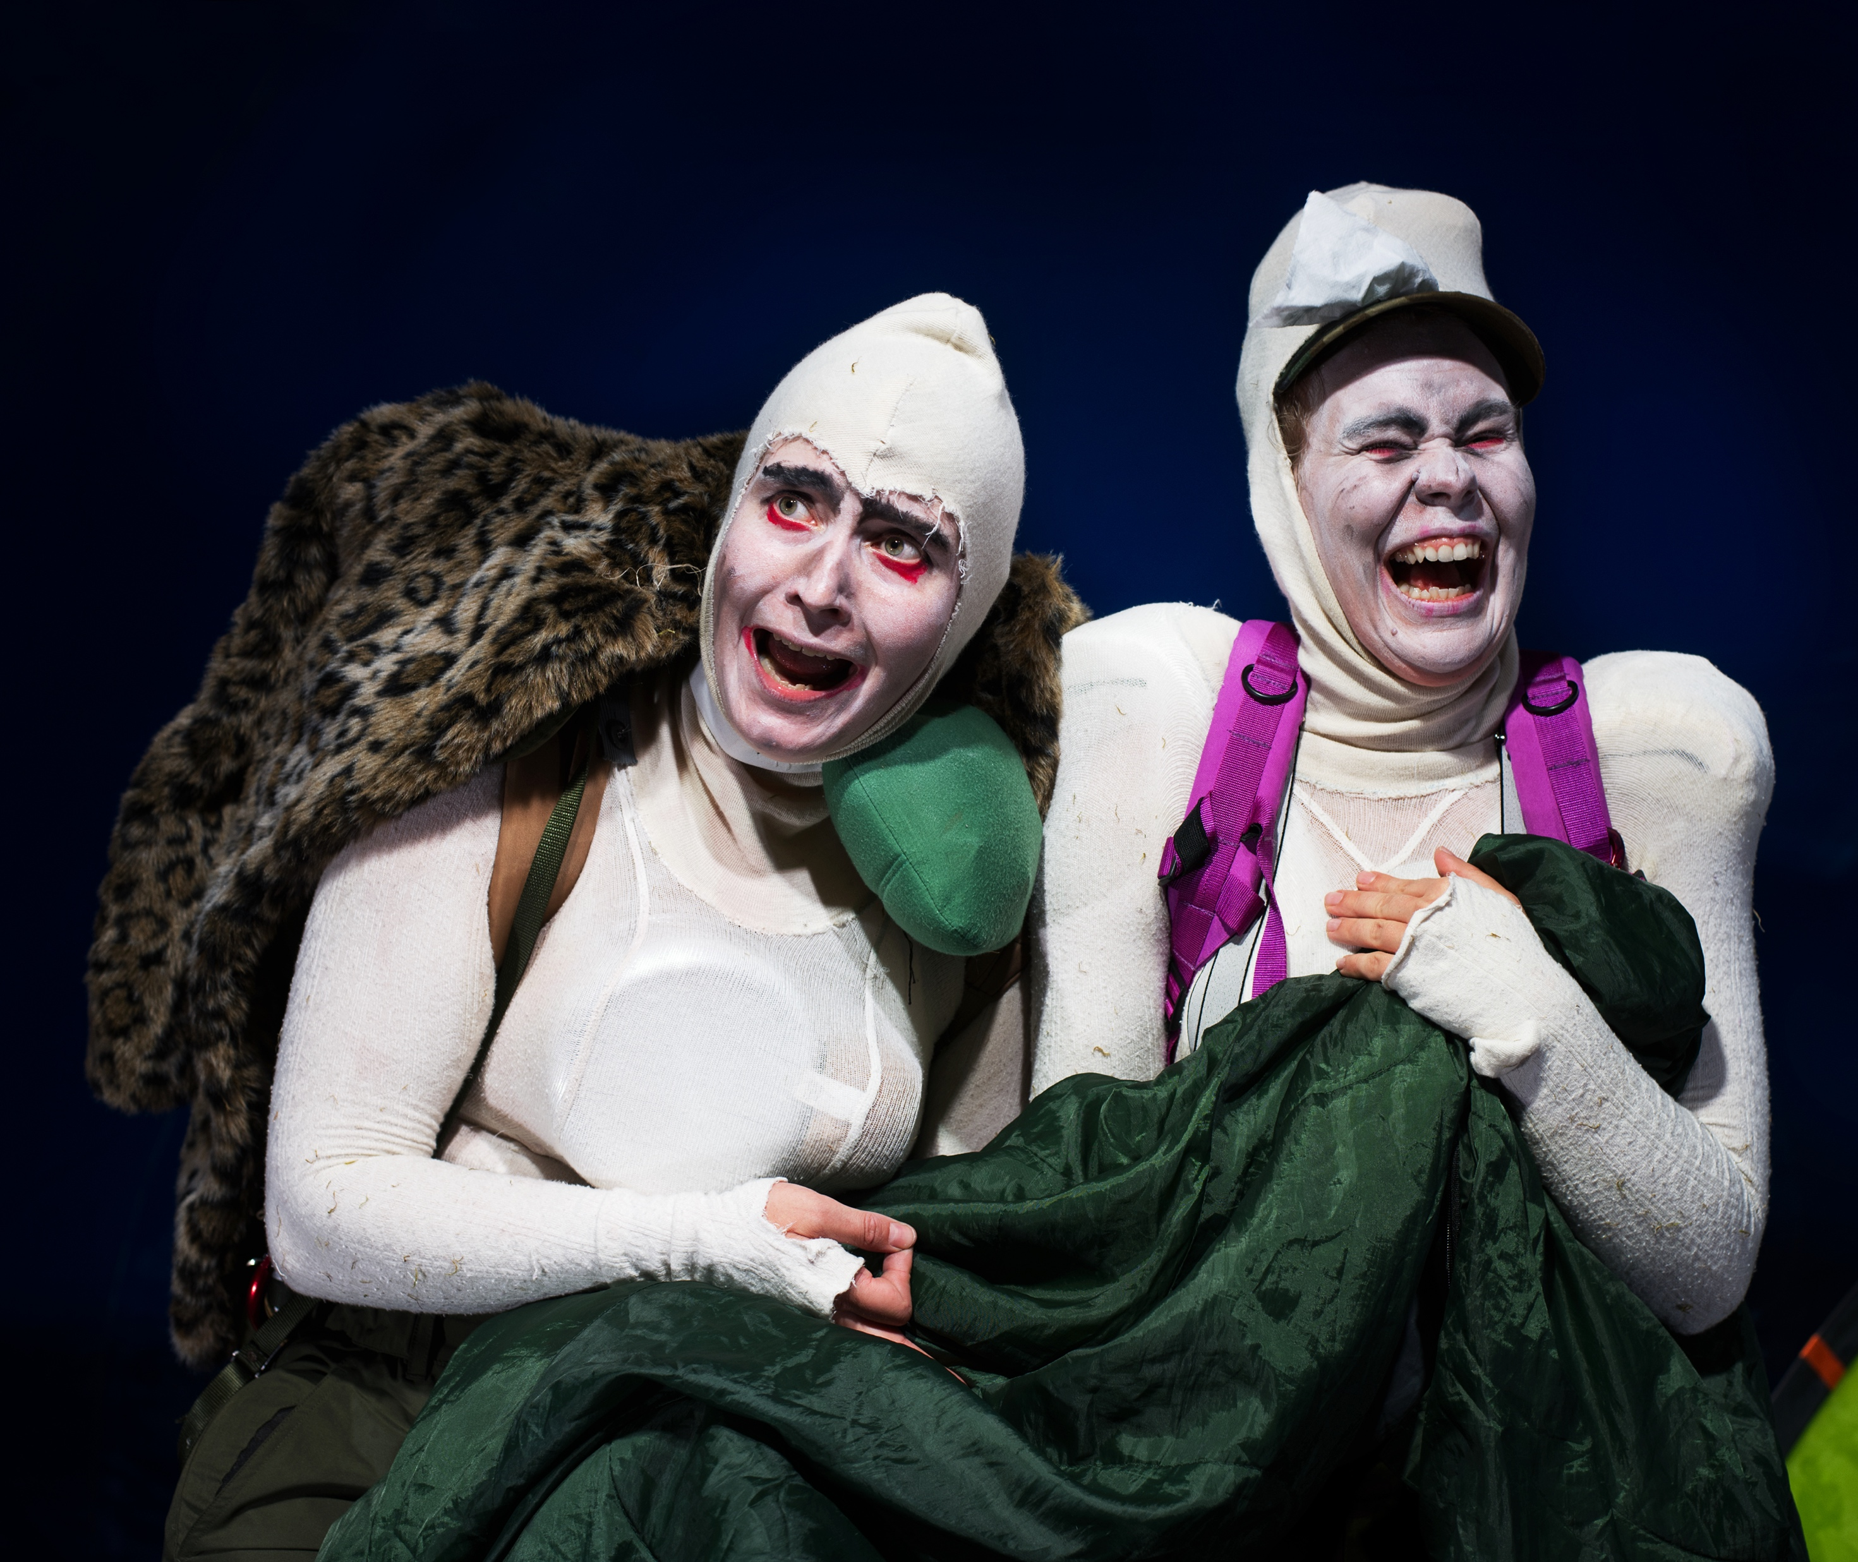
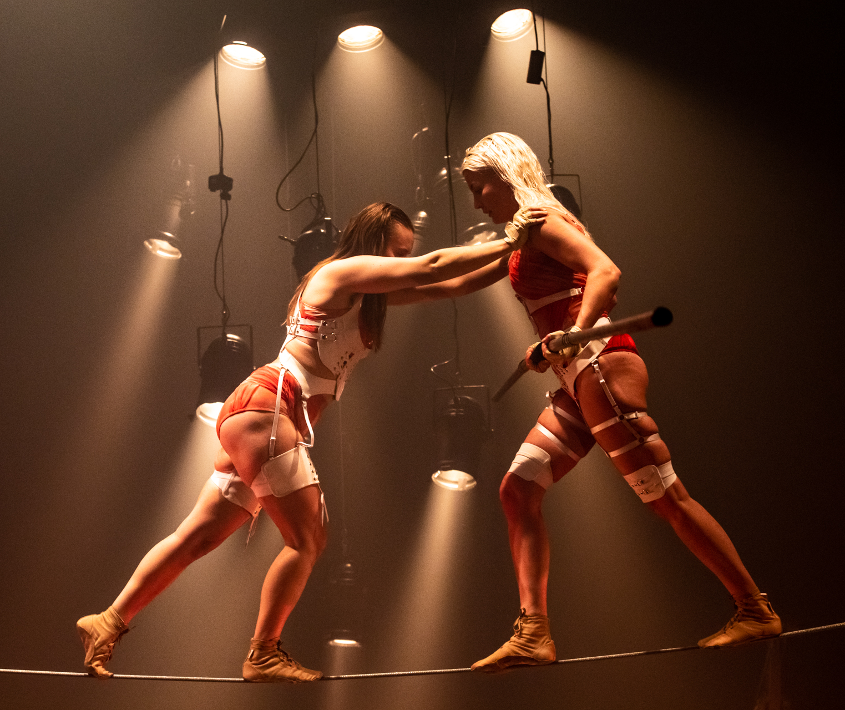
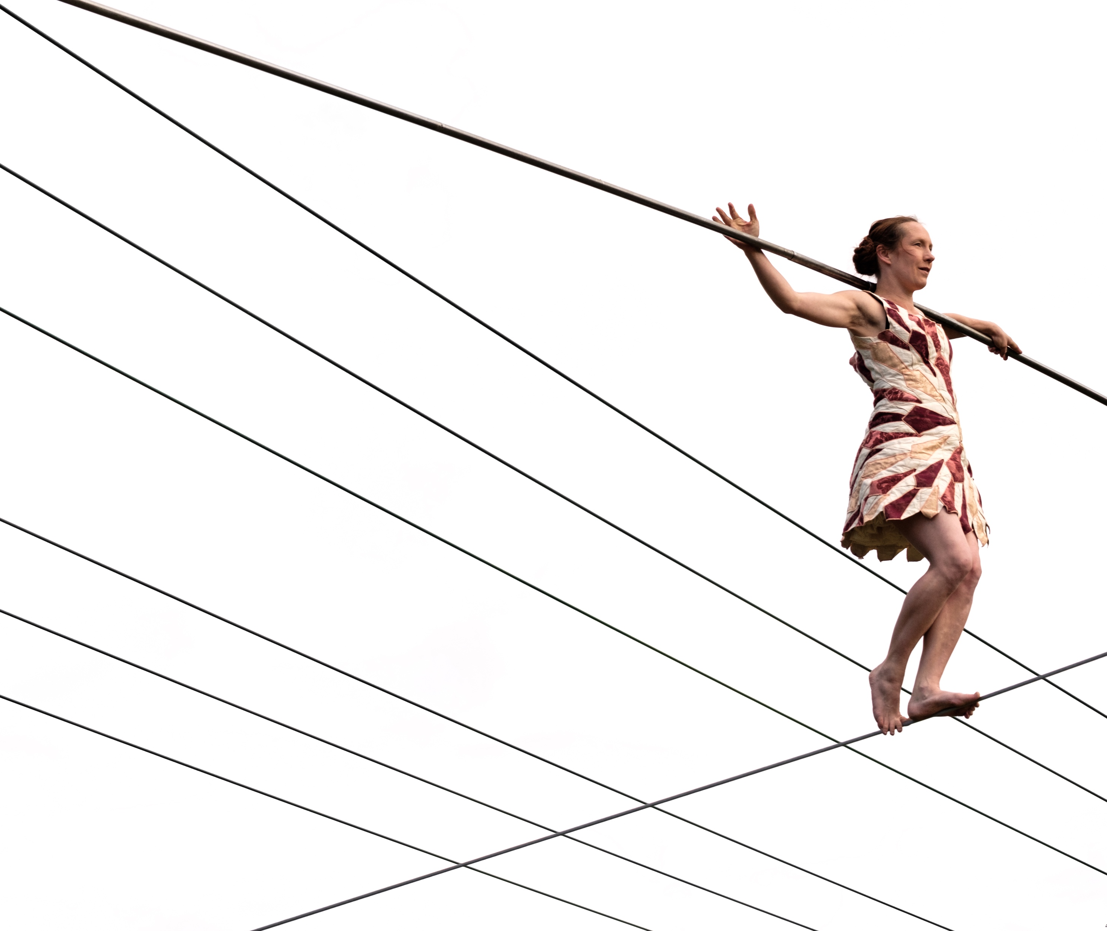
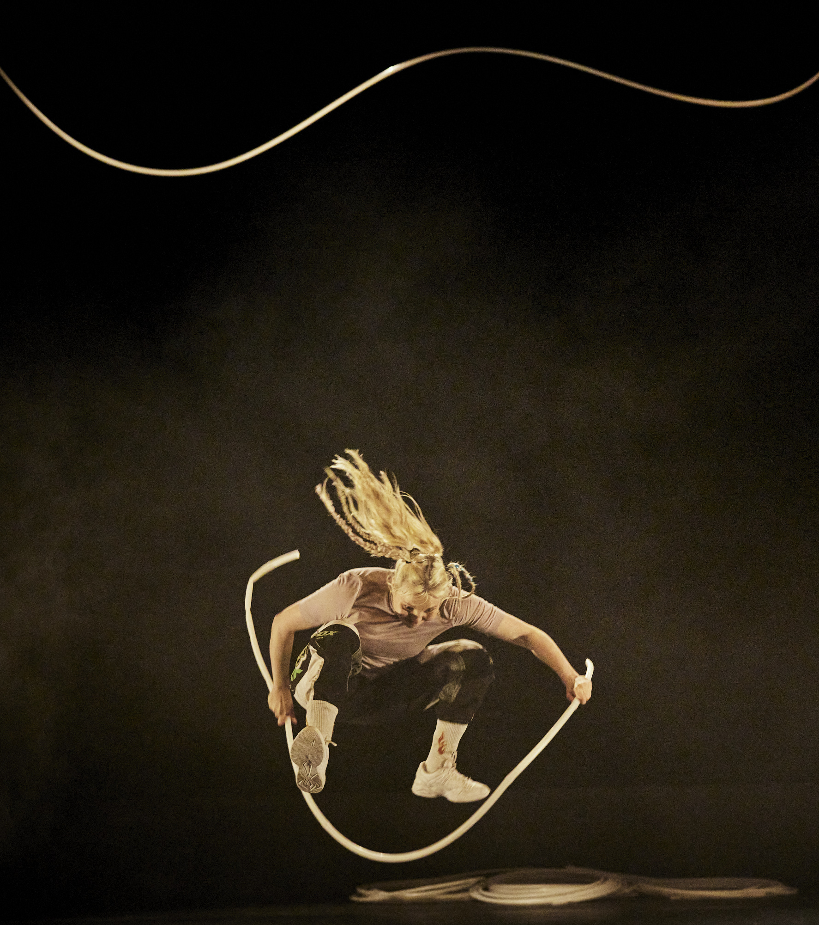
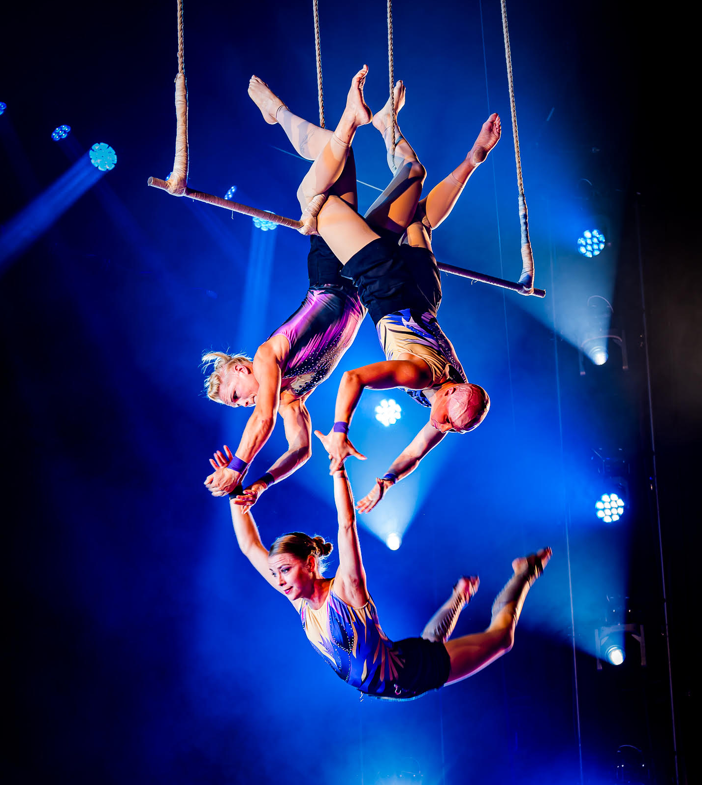
Women have a strong presence on stage – and behind it.
SEVEN PEEKS AT FINNISH CIRCUS
1
2
3
4
5
6
7
In Finnish circus, women are not just decorations on display.
Here, women often take part in the heavy lifting behind the scenes: directing, building, hauling, and fundraising.
Kallo Collective & Theatre Metamorfoosi: In to the Wild, 2023.
Photo: Majo Kurki
Lumo Company: Fineline, 2023.
Photo: Mikki Kunttu
Sanja Kosonen: Lähde, 2018–.
Photo: Luis Sartori do Vale
Recover Laboratory: <3 Smaller than three.
Photo: Christophe Raynauddelage, CircusNext 2023
Wise Fools: Blue.
Photo: Gaby Merz.
Notes:
In Finland, women are not just present in the circus field – they shape it. Finnish circus artists often break away from traditional gender roles, stepping into powerful, independent positions both on and off stage. Chopping firewood on stage might be seen as shocking in Paris, but in Finland, as artist Sanja Kosonen puts it, it’s just a natural part of life – regardless of gender.
This pragmatic, hands-on attitude is deeply rooted in Finnish culture. Women are doers. In circus, that means they lead projects, take creative risks and bring bold visions to life. Groups like Mad in Finland, an all-female ensemble working internationally, showcase exceptional physical and comedic skills. Recover Laboratory in Helsinki infuses its work with feminist, queer and body-positive perspectives, challenging audiences to rethink who belongs on stage and how bodies can be seen.
The feminist clowning festival Red Pearl, organised in Helsinki, is another example of how circus can be a space for reimagining identities and questioning norms.
In Finnish circus, the female body is not ornamental or passive – it’s expressive, political, strong and complex. This presence is felt in the performances, institutions and innovations that define the scene.

Slide 6
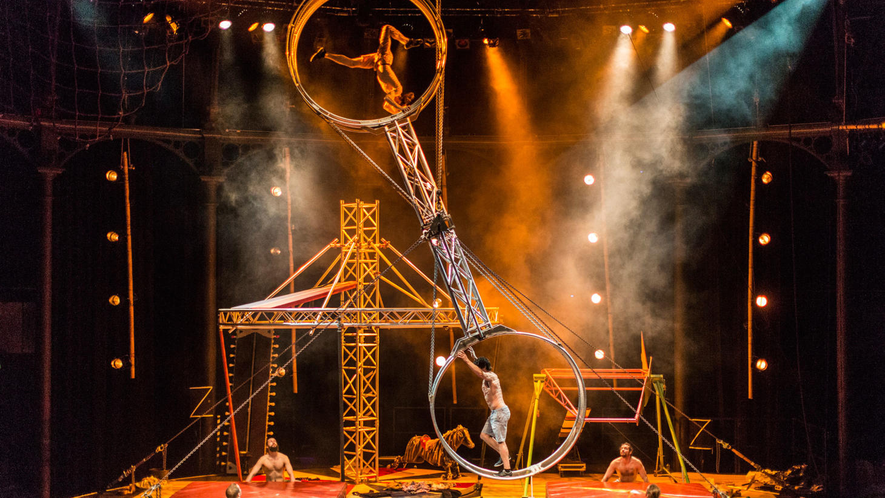
3/7
It’s a strange world with wild humour
and fearless risk-taking.
Race Horse Company: Super Sunday, 2014–2019.
Photo: David Levene
Notes:
There’s something delightfully wild in Finnish circus: a raw physicality, a love of the ridiculous and a taste for danger. Companies like Race Horse Company mix acrobatics with anarchic humour and have thrilled audiences around the world.
Being geographically on the edge seems to grant freedom from convention, fostering a highly original aesthetic. Artists develop their own tools and ways of moving, not bound by tradition.
This creates a physical language that’s blunt, funny and unmistakably Finnish. It’s not always polished, but it’s always alive – and it connects with audiences everywhere.

Slide 7
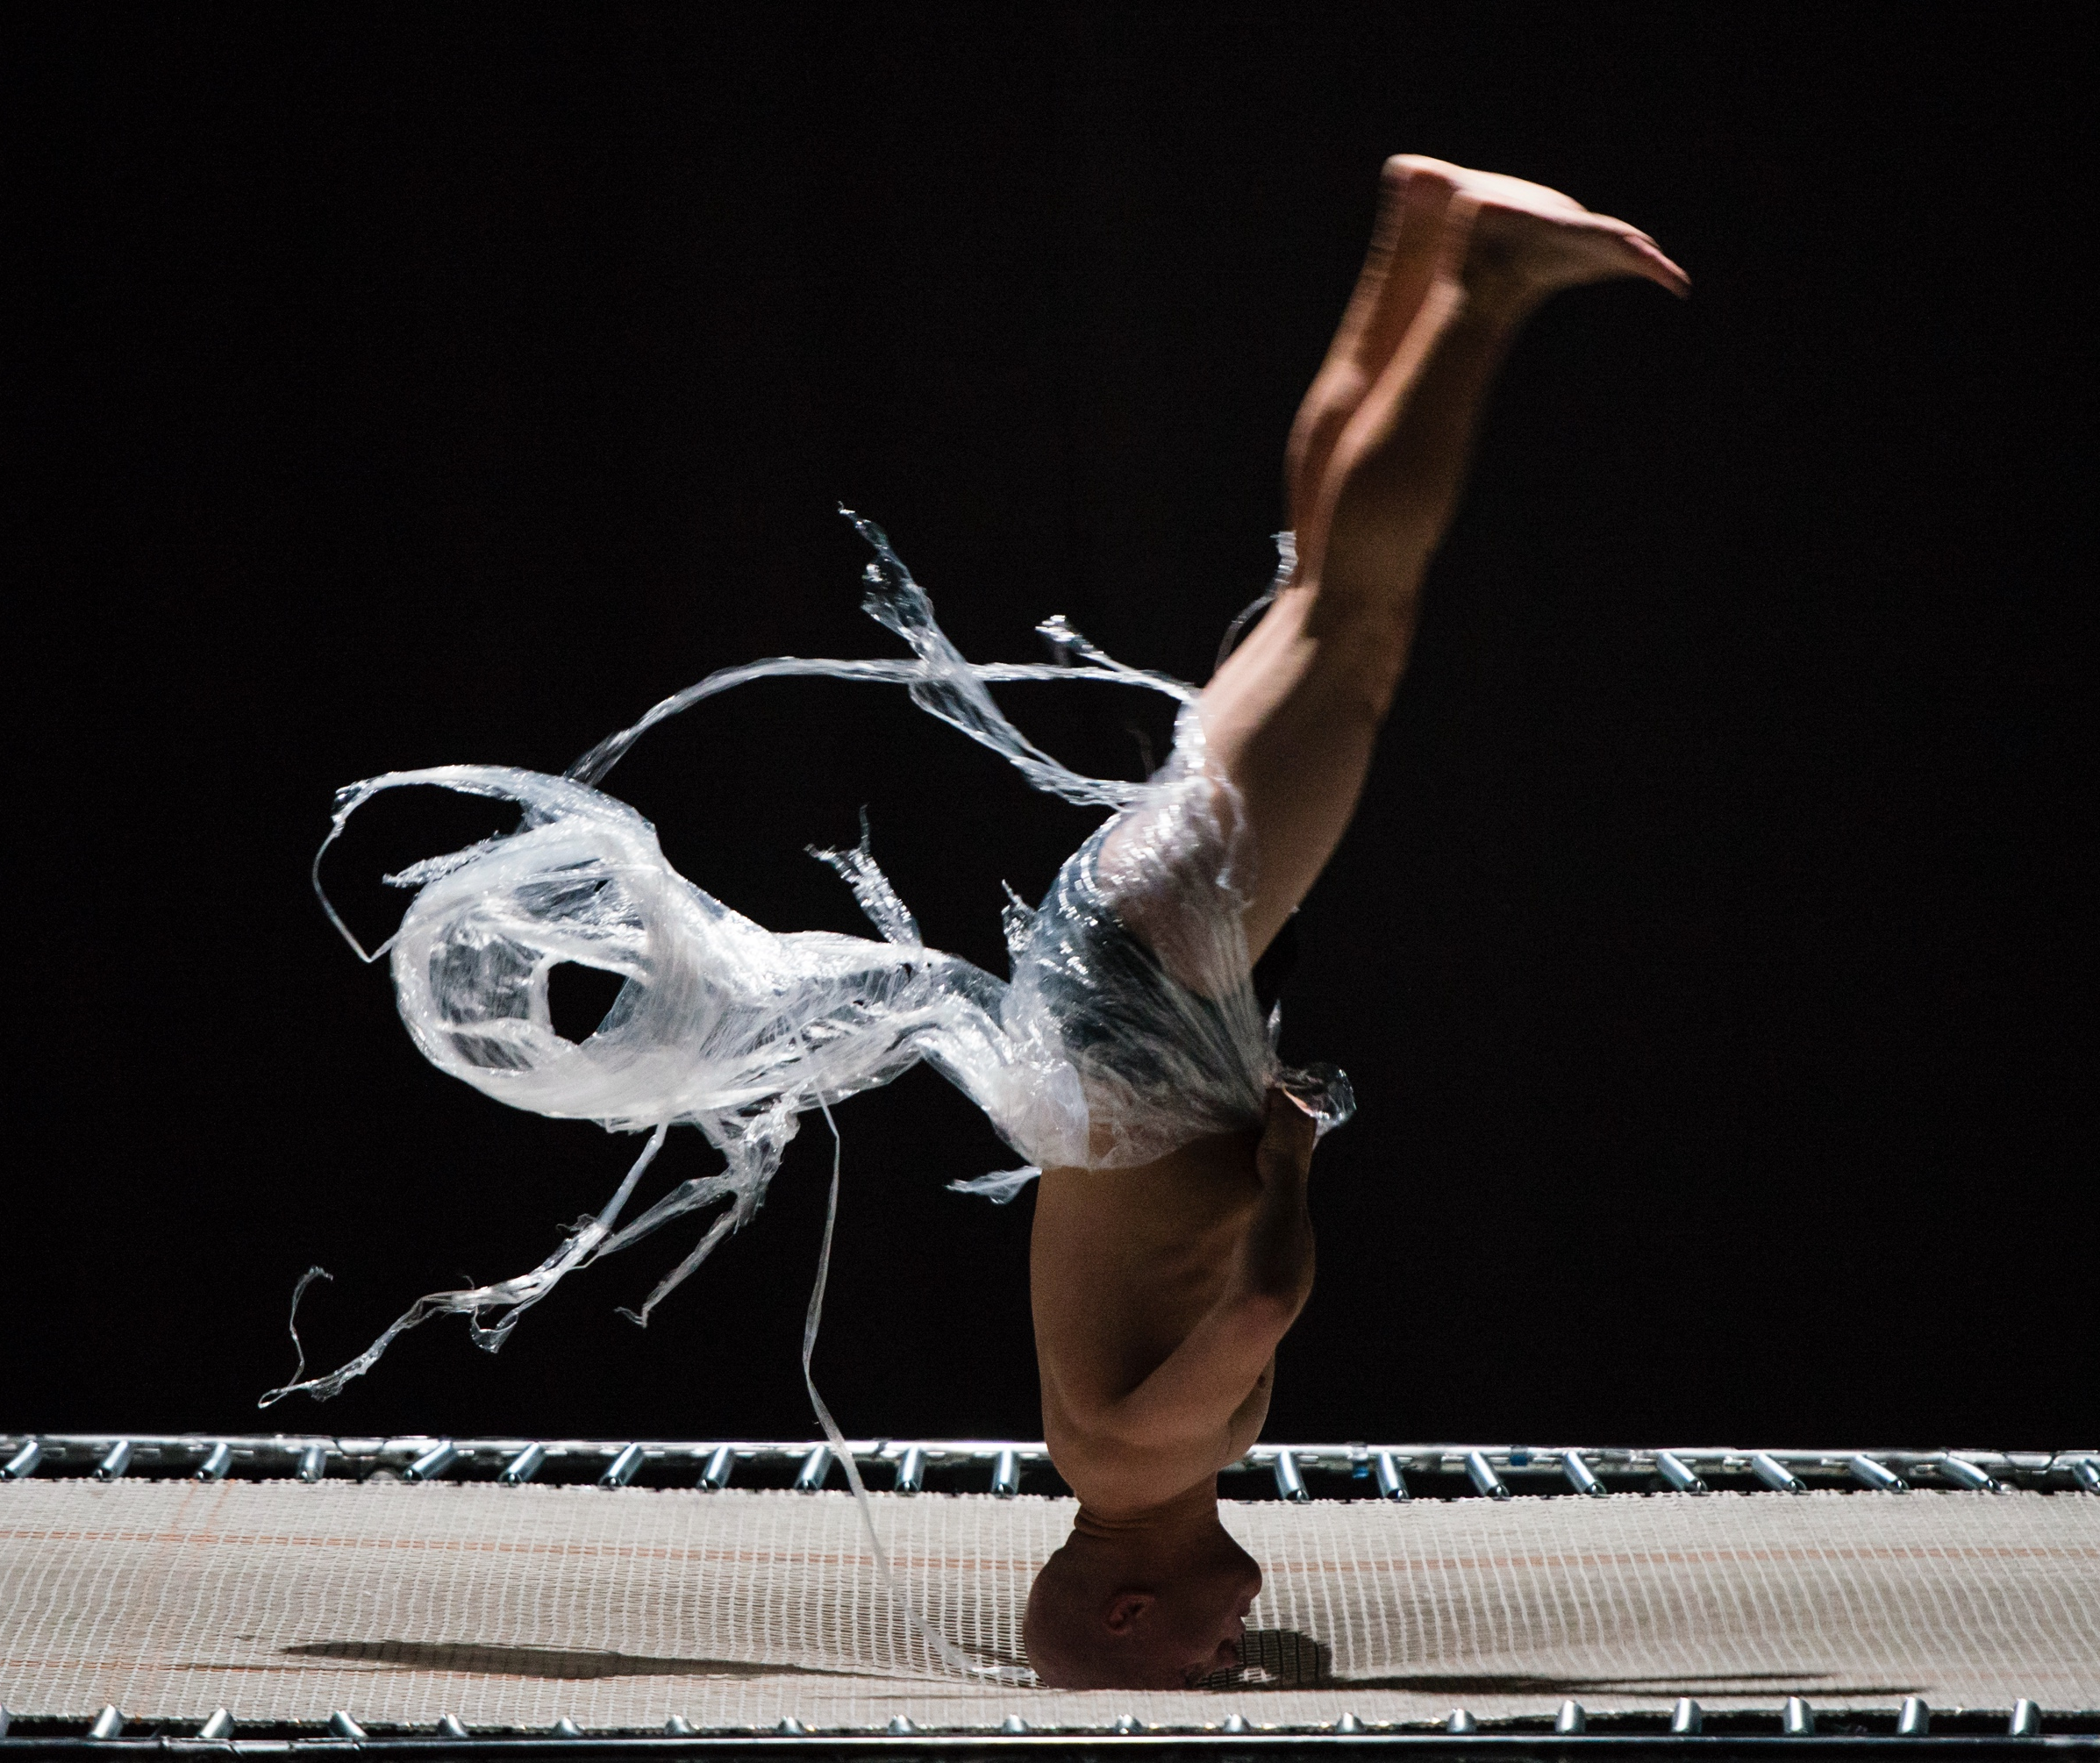
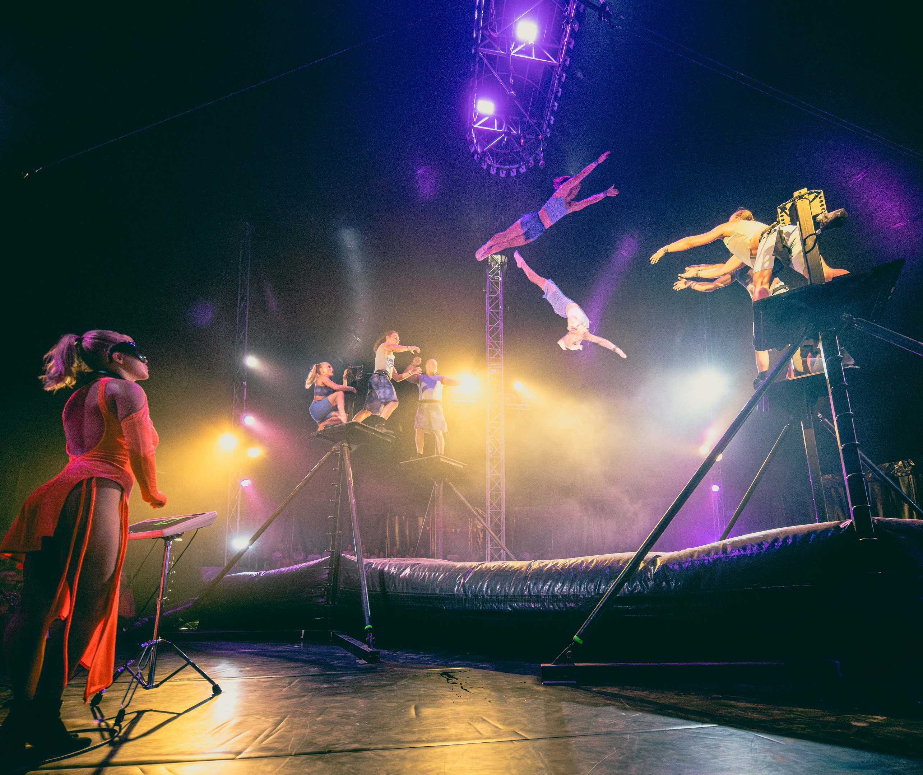
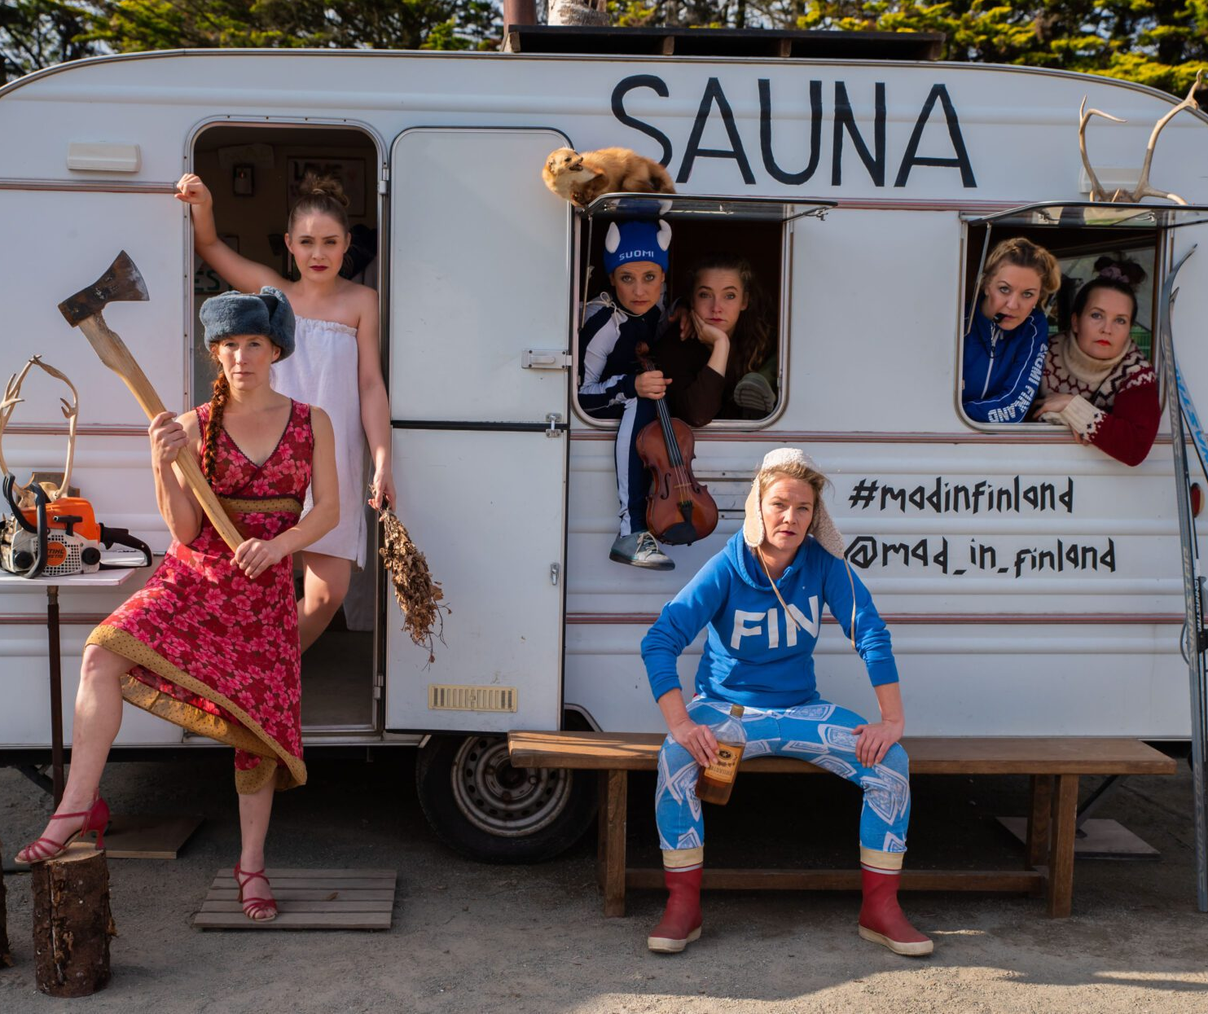
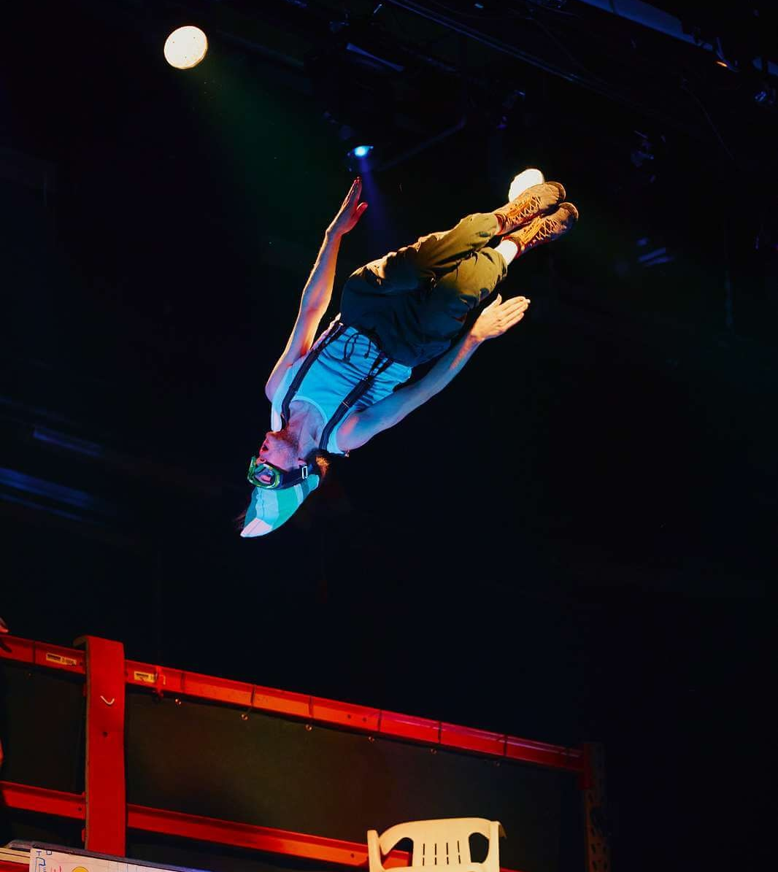
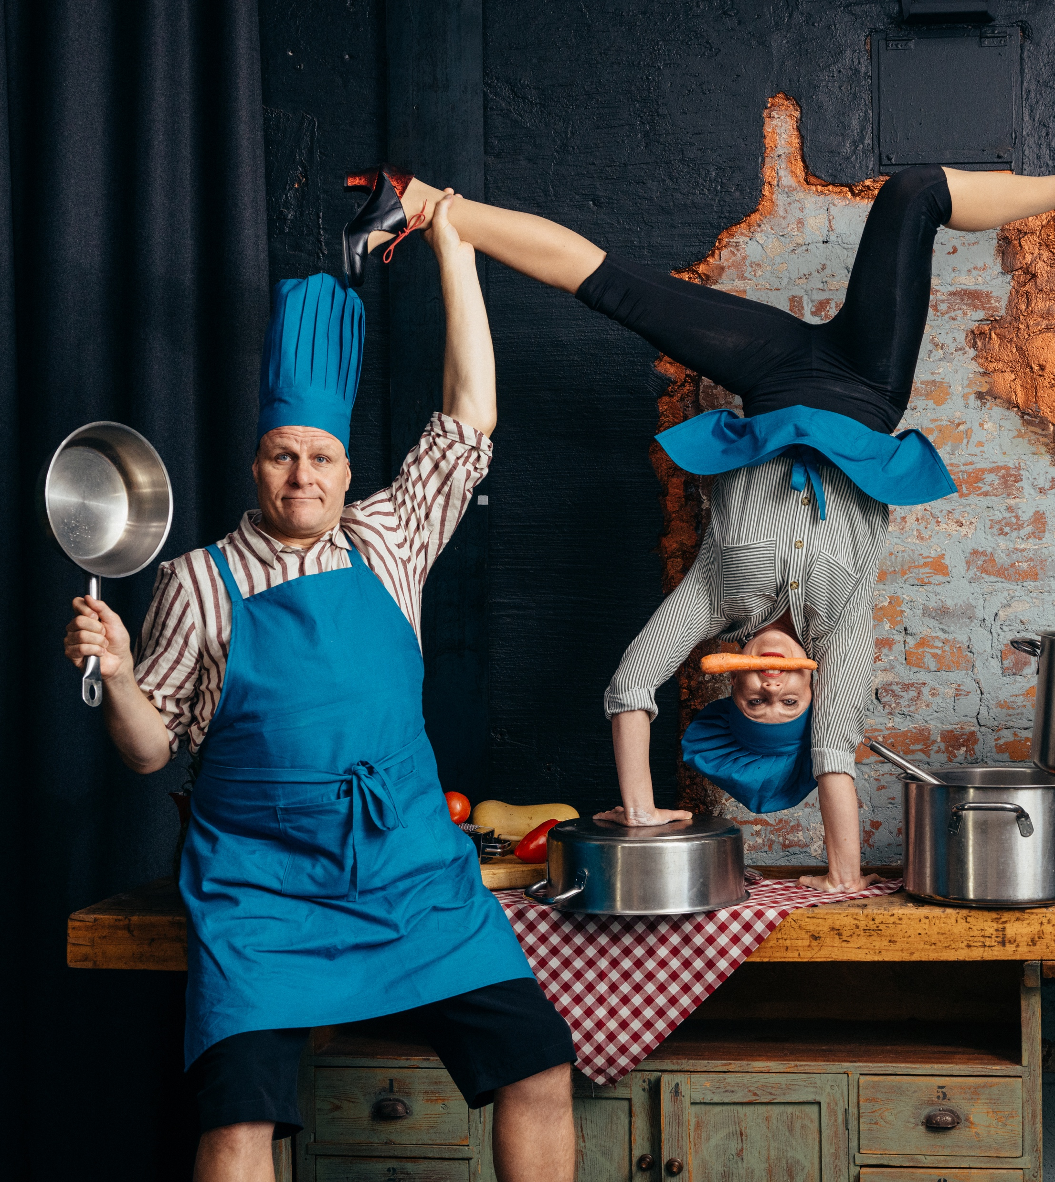
It’s a strange world with wild humour and fearless risk-taking.
SEVEN PEEKS AT FINNISH CIRCUS
1
2
3
4
5
6
7
There is a certain madness to our methods
Finnish circus doesn’t just make you laugh – it makes you gasp with daring, absurd, and downright crazy stunts.
Collectif MAD: Mad in Finland, 2012–.
Photo: Sebastien Armengol
Arctic Ensemble: Ensembled, 2024.
Photo: Mikko Pirinen
Race Horse Company: O’DD, 2020–2024.
Photo: Petter Hellman
Race Horse Company: Tattarmossen Experience, 2023.
Photo: Minja Kaukoniemi
Kate & Pasi: Kulinaarikaaos, 2025.
Photo: Kai Kuusisto
Notes:
There’s something delightfully wild in Finnish circus: a raw physicality, a love of the ridiculous and a taste for danger. Companies like Race Horse Company mix acrobatics with anarchic humour and have thrilled audiences around the world.
Being geographically on the edge seems to grant freedom from convention, fostering a highly original aesthetic. Artists develop their own tools and ways of moving, not bound by tradition.
This creates a physical language that’s blunt, funny and unmistakably Finnish. It’s not always polished, but it’s always alive – and it connects with audiences everywhere.

Slide 8
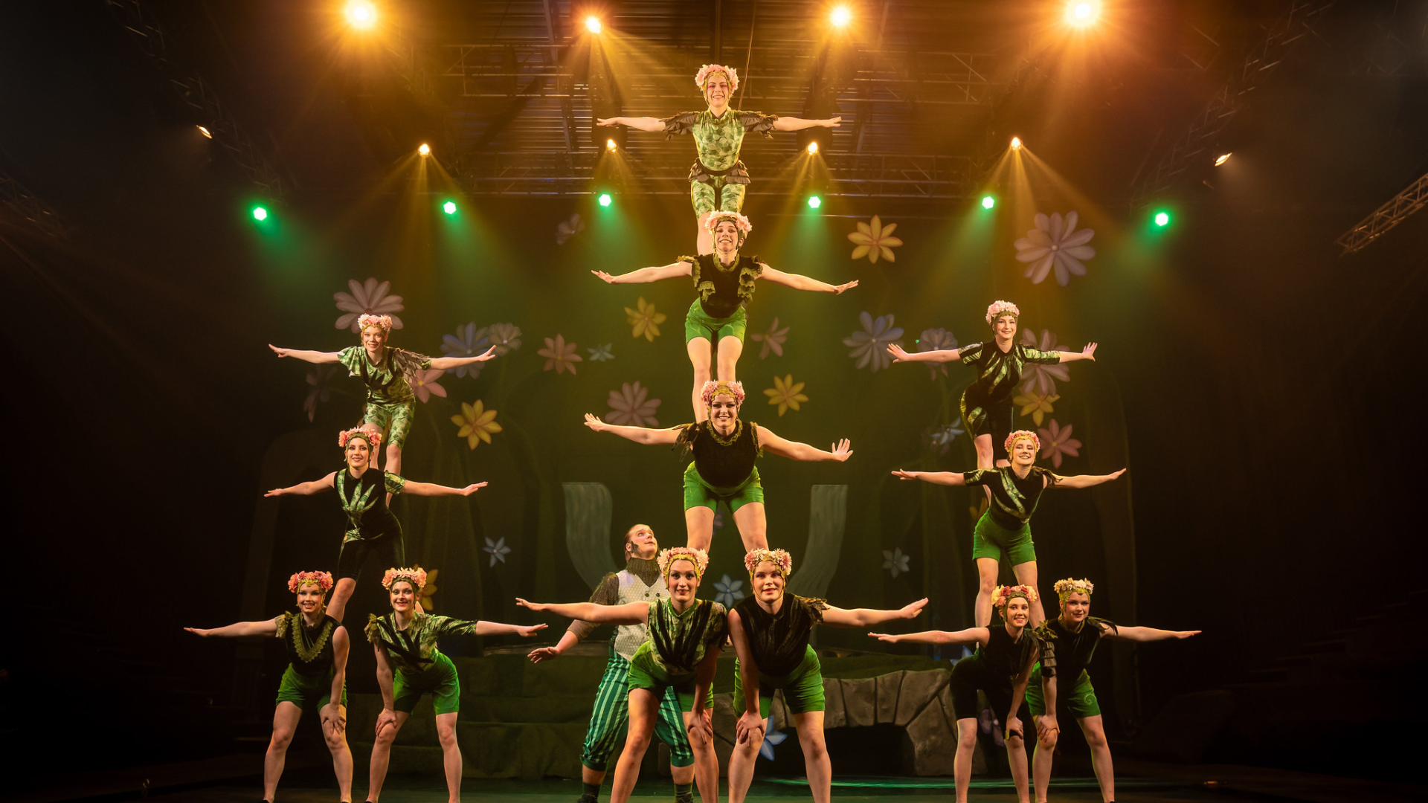
4/7
It’s not just entertainment.
It’s part of growing up.
Sorin Sirkus: Christmas Show Verda, 2024.
Photo: Kristian Wanvik
Notes:
In Finland, circus is not just entertainment. It’s part of growing up. There are nearly 50 youth circus schools nationwide, from southern cities to the far north in Lapland. Children can begin their circus journey as babies and continue through structured training as part of the official basic arts education system.
The presence of local youth circuses means that children and teens can develop physical skills, confidence and creativity in supportive environments. Sorin Sirkus in Tampere is a notable example – its alumni include several internationally recognised performers.
But despite the wide reach of youth circus, professional training in Finland is available in only two institutions. As a result, many aspiring circus artists pursue further education in countries like France, Belgium, Sweden or Canada. This creates strong global connections and helps keep Finnish circus internationally engaged and evolving.

Slide 9
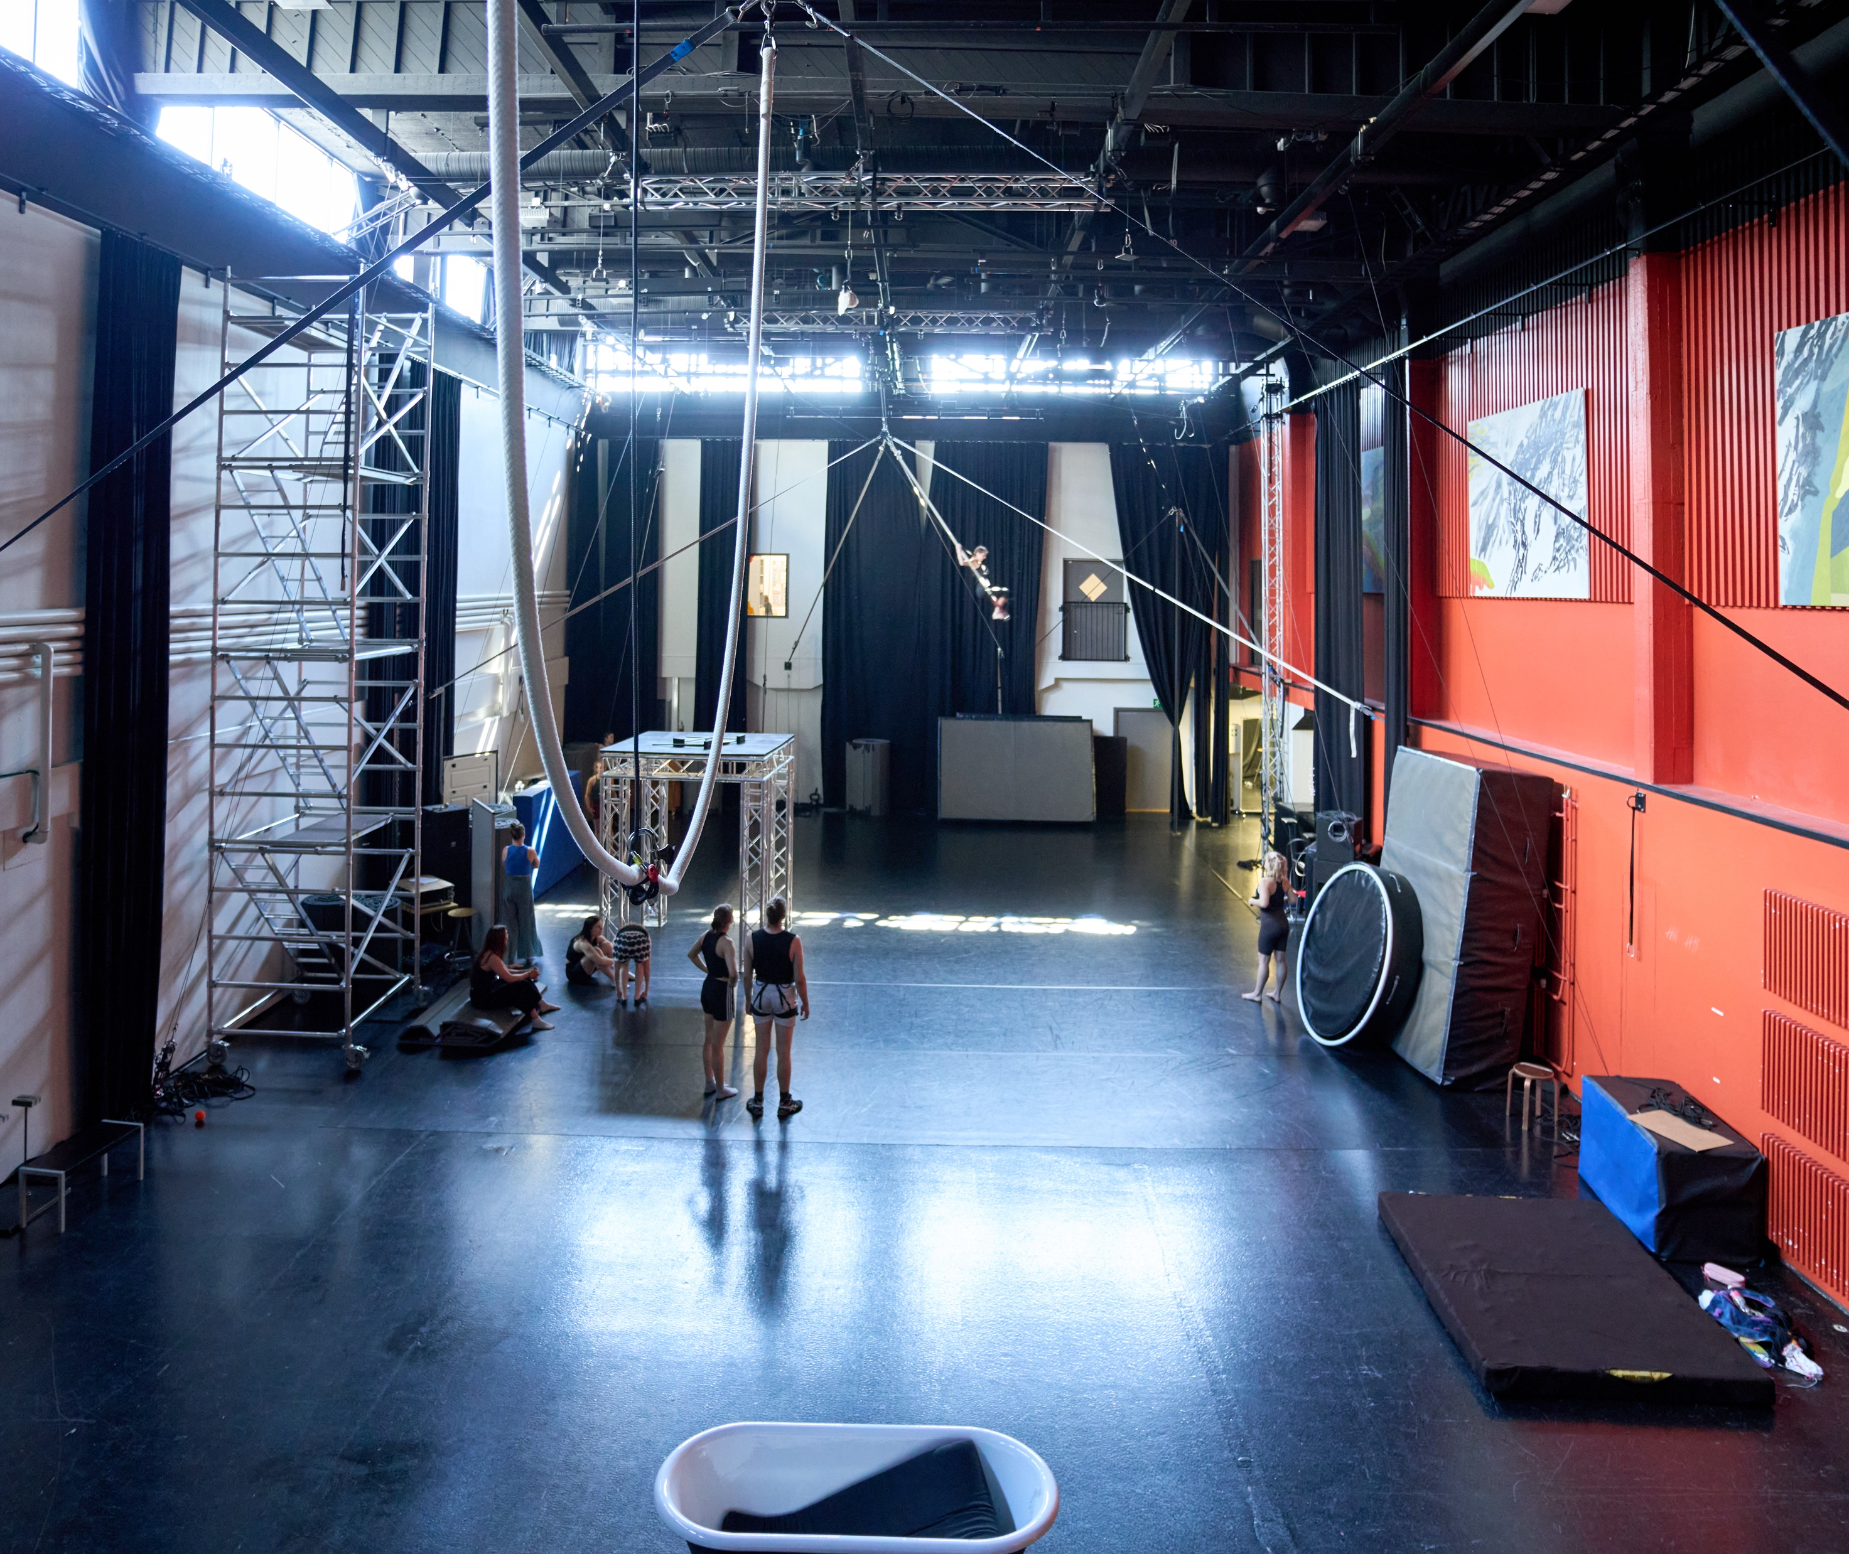
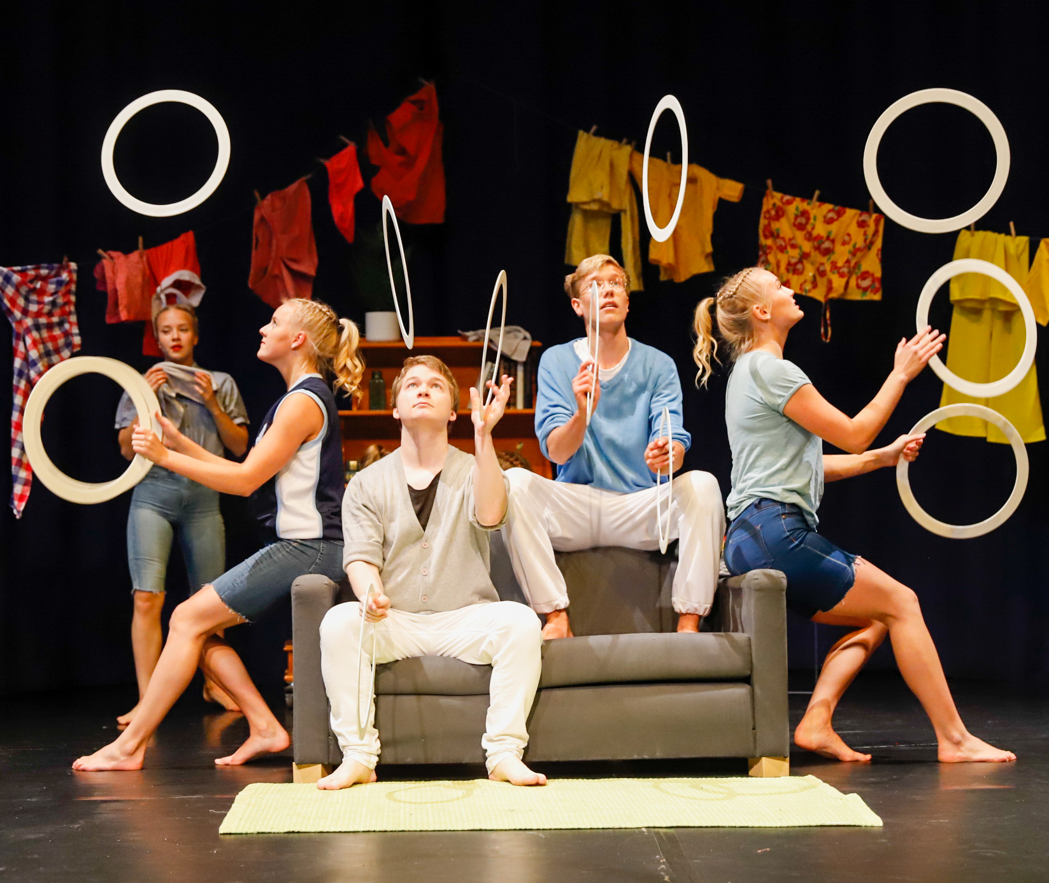
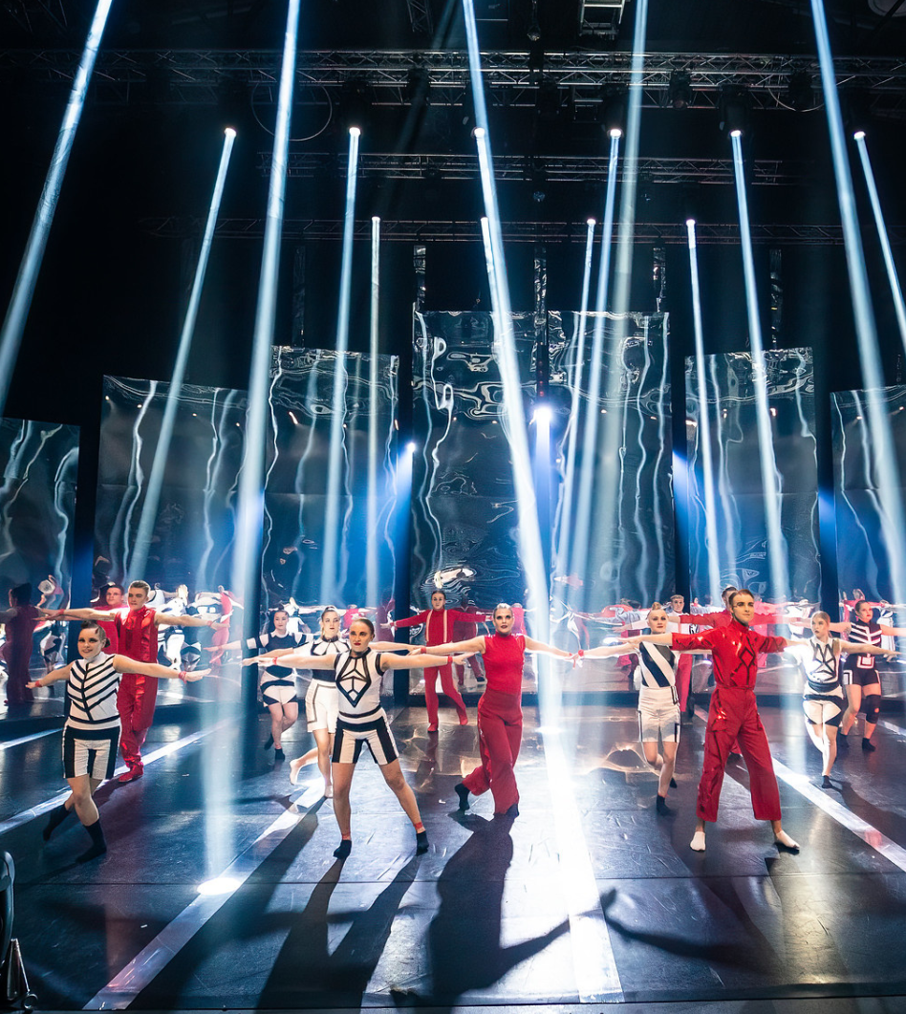
It’s not just entertainment. It’s part of growing up.
SEVEN PEEKS AT FINNISH CIRCUS
1
2
3
4
5
6
7
Circus is part of
our art education program.
Meaning all children around the country get to practice and study it – even in remote Lapland.
SaSak circus hall at Salpaus Further Education in Lahti.
Photo: Viestimaakarit Oy
Linnanmäki Youth Circus.
Photo: Mika Kukkonen
Sorin Sirkus: Christmas show Kaila, 2023.
Photo: Kristian Wanvik
Notes:
In Finland, circus is not just entertainment. It’s part of growing up. There are nearly 50 youth circus schools nationwide, from southern cities to the far north in Lapland. Children can begin their circus journey as babies and continue training in the art education program that follows a national curriculum outside of the regular school system.
The presence of local youth circuses means that children and teens can develop physical skills, confidence and creativity in supportive environments. Sorin Sirkus in Tampere is a notable example – its alumni include several internationally recognised performers.
But despite the wide reach of youth circus, professional training in Finland is available in only two institutions. As a result, many aspiring circus artists pursue further education in countries like France, Belgium, Sweden or Canada. This creates strong global connections and helps keep Finnish circus internationally engaged and evolving.

Slide 10
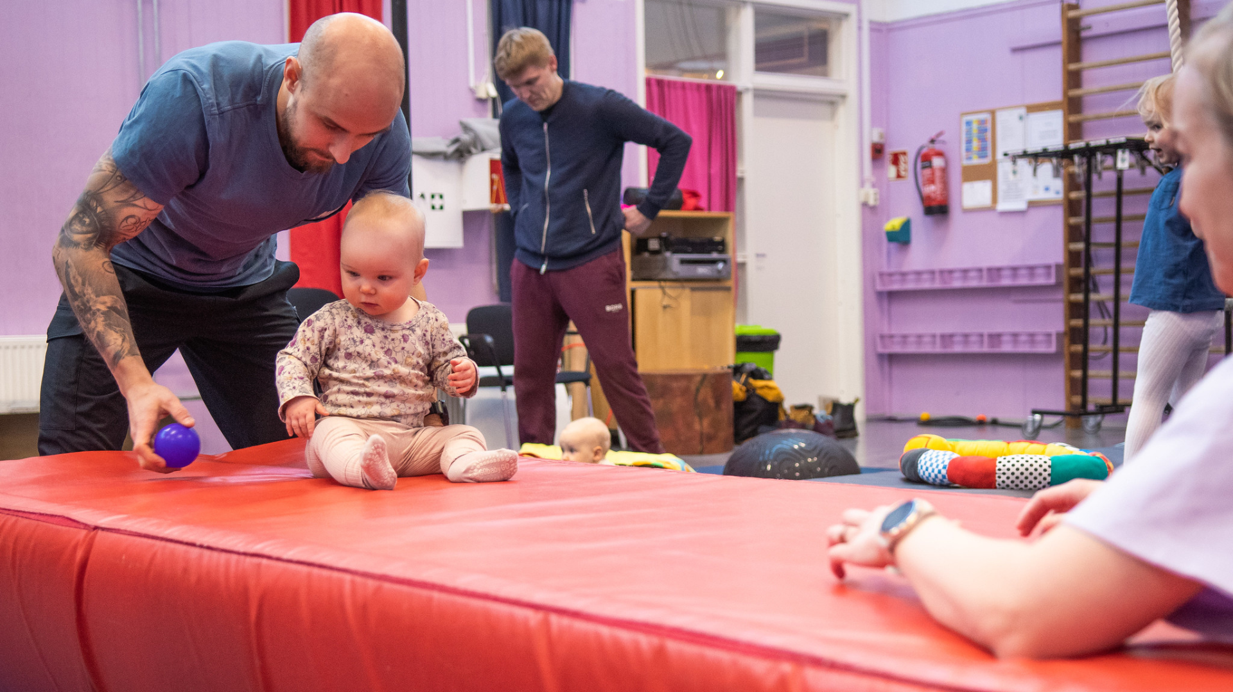
5/7
In Social Circus, every body
plays an important role
Baby circus at Sorin Sirkus.
Photo: Aleksanteri Mikkola
Notes:
Social circus in Finland is about much more than learning tricks or improving technical skills. It focuses on people, connection and healing. Through creative movement, group trust and playful challenges, participants gain confidence, emotional strength and a sense of belonging.
Social circus is used in many contexts where people face difficulties: in prisons, shelters, with at-risk youth and in rehabilitation programmes. It provides a safe space for expression and connection, helping individuals rediscover their strengths and creativity. The performances or activities don’t have to be polished or public – the process itself is valuable.
Circus brings people together across social divides. It requires no shared language or background, and everyone can find a role regardless of age, ability or experience. Because of this, it can genuinely bridge societal gaps and foster empathy. The joy of shared laughter and physical play has real power to heal and unite.
Finland has become internationally known for integrating circus into work that supports well-being, inclusion and community building.

Slide 11
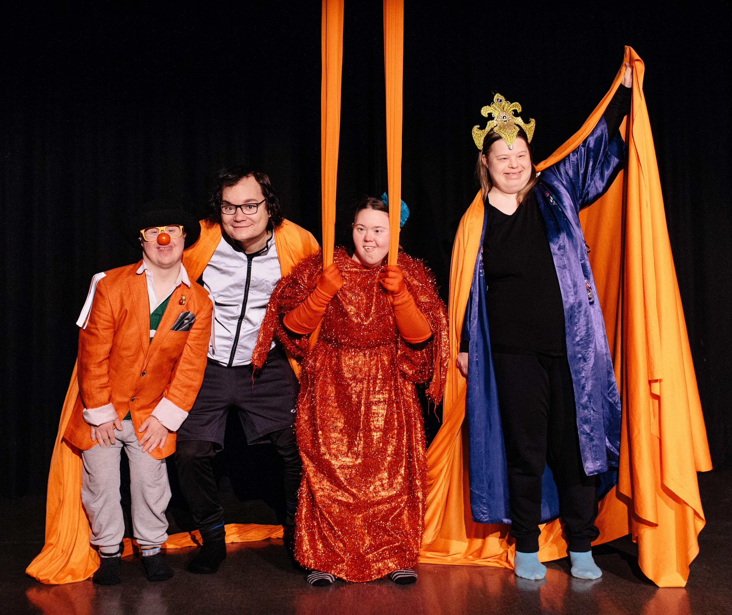
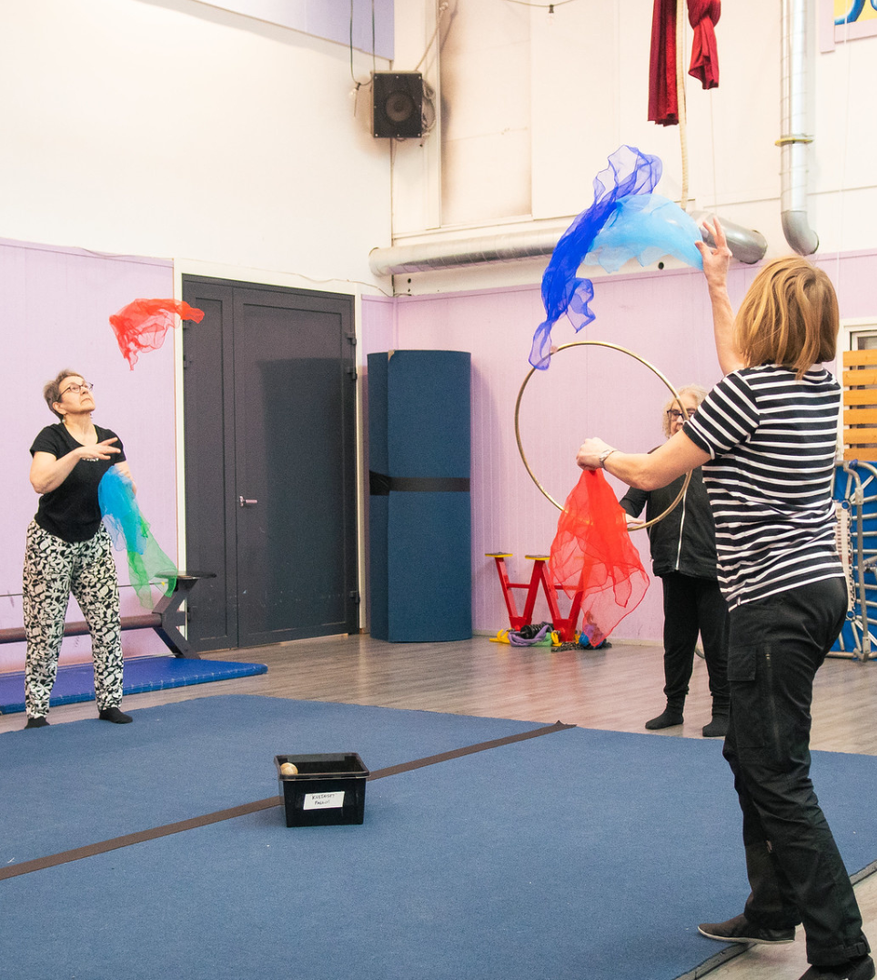
In Social Circus, every body plays an important role
SEVEN PEEKS AT FINNISH CIRCUS
1
2
3
4
5
6
7
Social Circus promotes equality and personal growth rather than professional performance
Finland is a leading country of using social circus in social and health services.
Narri Circus & Theatre.
Photo: Sara Hornig / Sirkus Magenta
Social circus activities at Sorin Sirkus.
Photo: Aleksanteri Mikkola
Notes:
Social circus in Finland is about much more than learning tricks or improving technical skills. It focuses on people, connection and healing. Through creative movement, group trust and playful challenges, participants gain confidence, emotional strength and a sense of belonging.
Social circus is used in many contexts where people face difficulties: in prisons, shelters, with at-risk youth and in rehabilitation programmes. It provides a safe space for expression and connection, helping individuals rediscover their strengths and creativity. The performances or activities don’t have to be polished or public – the process itself is valuable.
Circus brings people together across social divides. It requires no shared language or background, and everyone can find a role regardless of age, ability or experience. Because of this, it can genuinely bridge societal gaps and foster empathy. The joy of shared laughter and physical play has real power to heal and unite.
Finland has become internationally known for integrating circus into work that supports well-being, inclusion and community building.

Slide 12
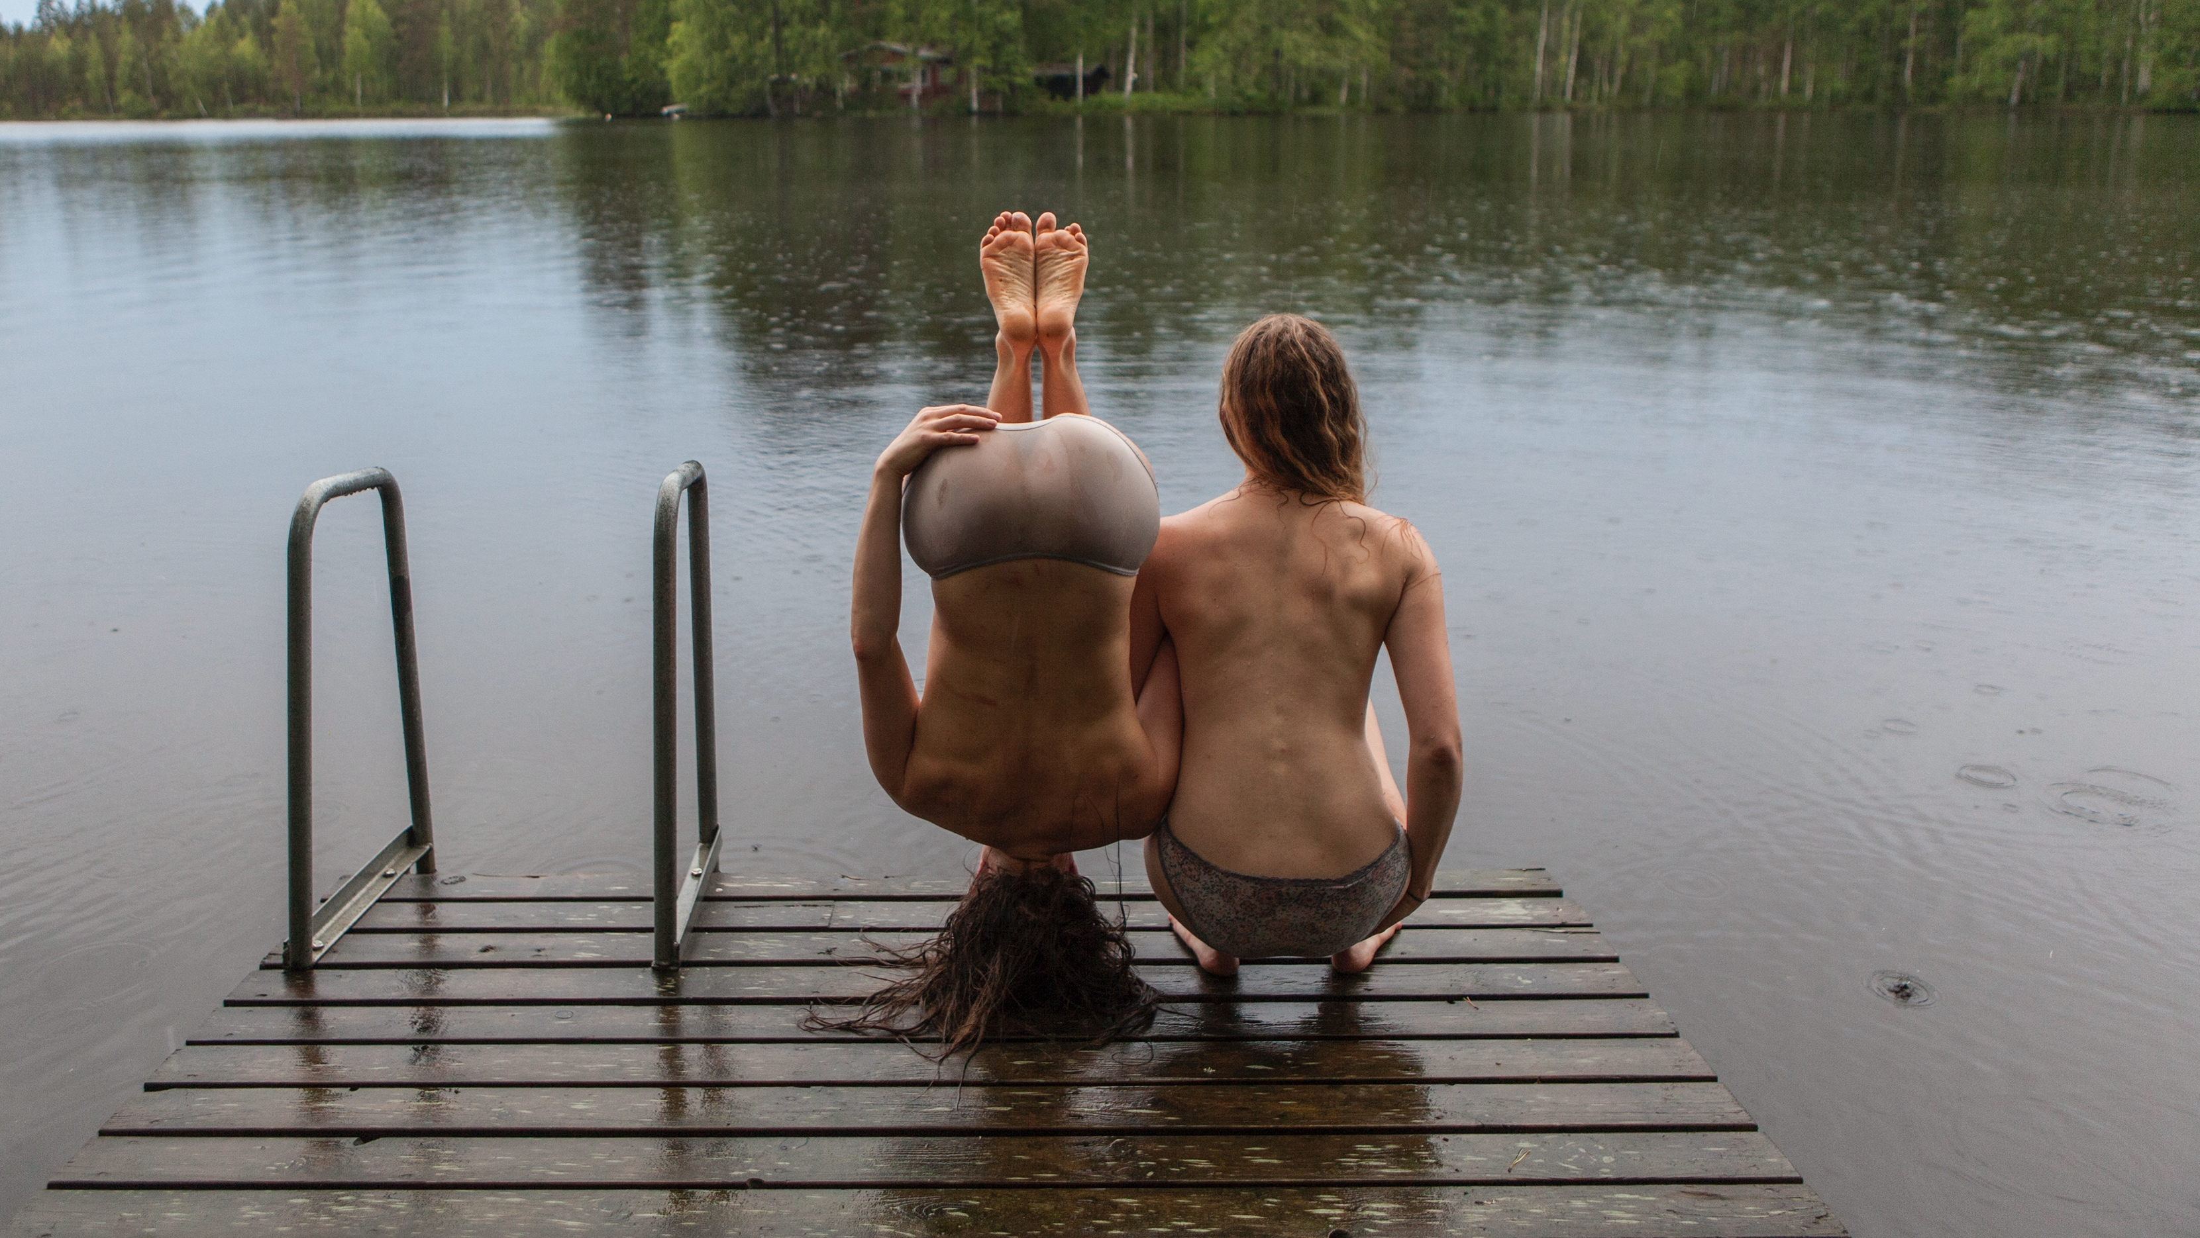
6/7
Nature plays a role
in Finnish circus.
Metsä – The Forest Project by Sade Kamppila
and Viivi Roiha, Uukuniemi 2015.
Photo: Ben Hopper
Notes:
Finland’s natural environment deeply influences its circus. The vast landscapes, long horizons and silence of sparsely populated areas offer a powerful contrast to urban chaos – and space for slow, intuitive artistic processes. The strong seasonal shifts, from dark winter to endless summer light, influence both the content and rhythm of artistic work.
Circus performances in Finland often take place in nature or are inspired by it – not only visually but also in terms of atmosphere and philosophy. Nature is not just a backdrop but a collaborator: its unpredictability, raw beauty and stillness become part of the work.
The Silence Festival, a small circus and music festival held in a village in Lapland, is one example of how deeply this connection runs. Removed from the buzz of urban centres, Finnish and international artists in remote areas are free to work without the expectations of mainstream trends. This distance gives space for personal expression, experimentation and originality – elements that are central to the identity of Finnish circus.

Slide 13
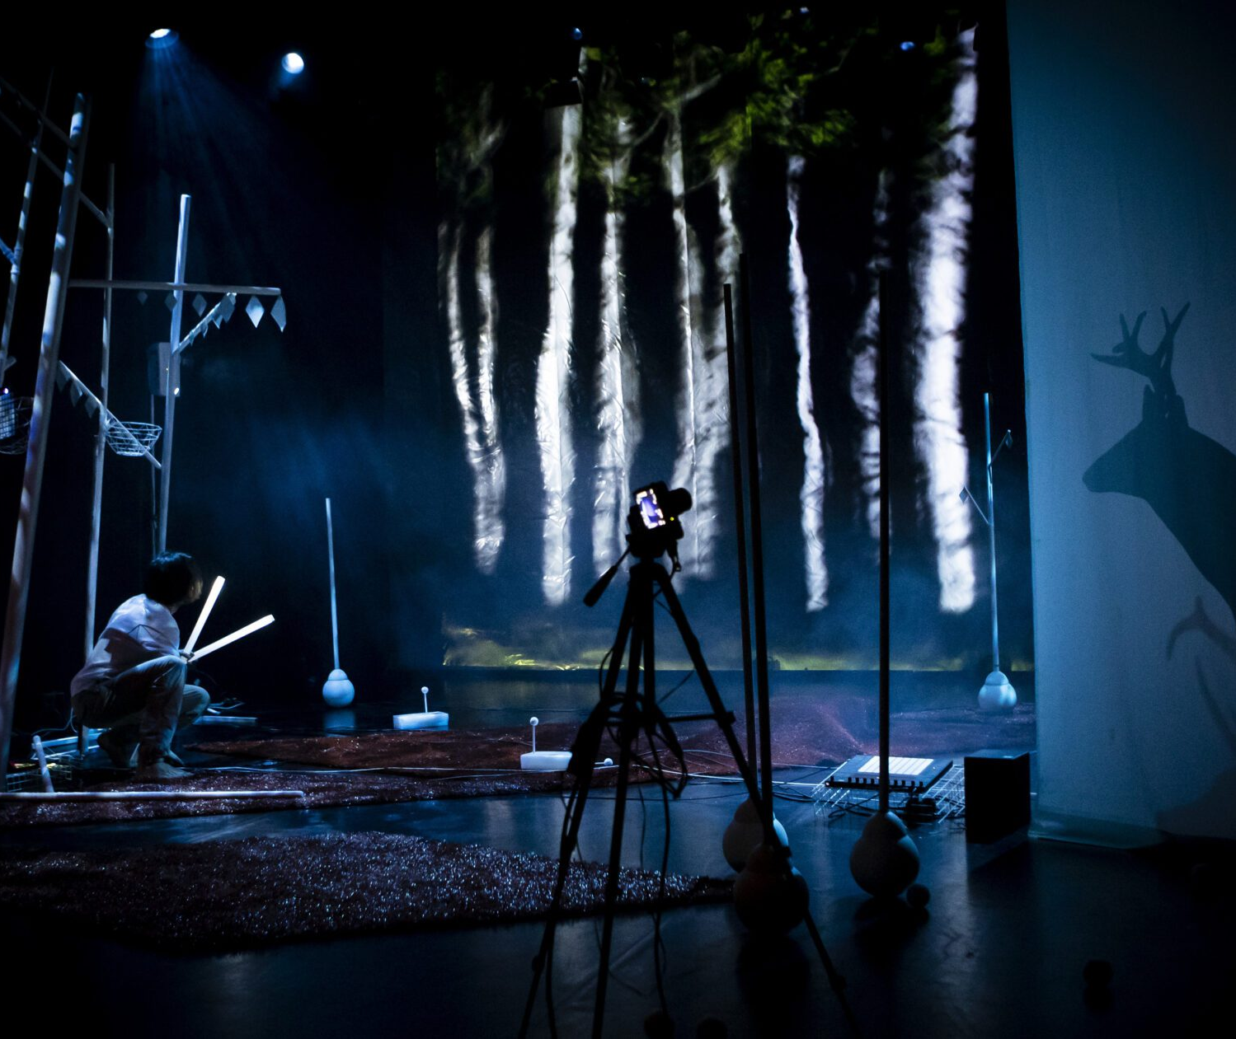
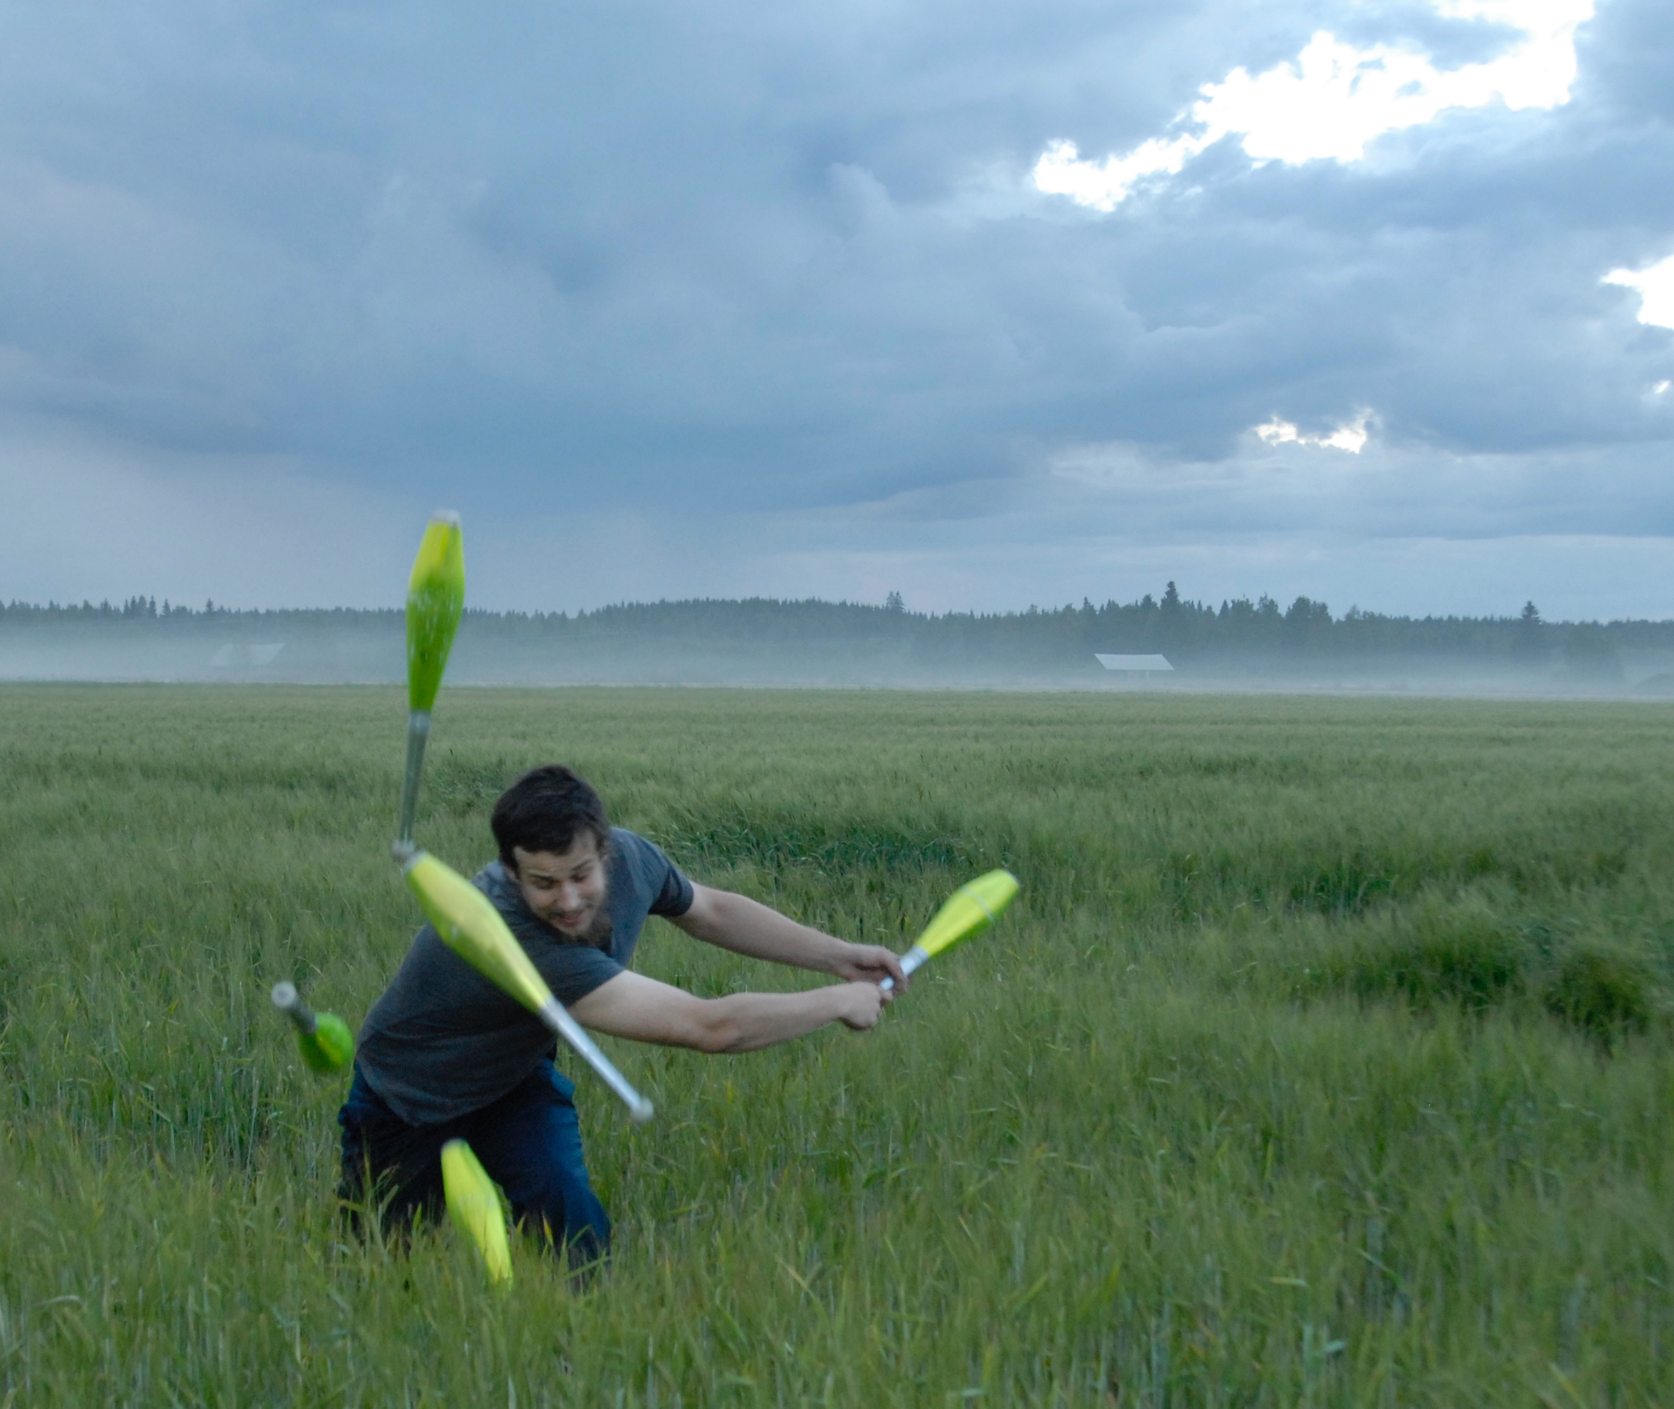
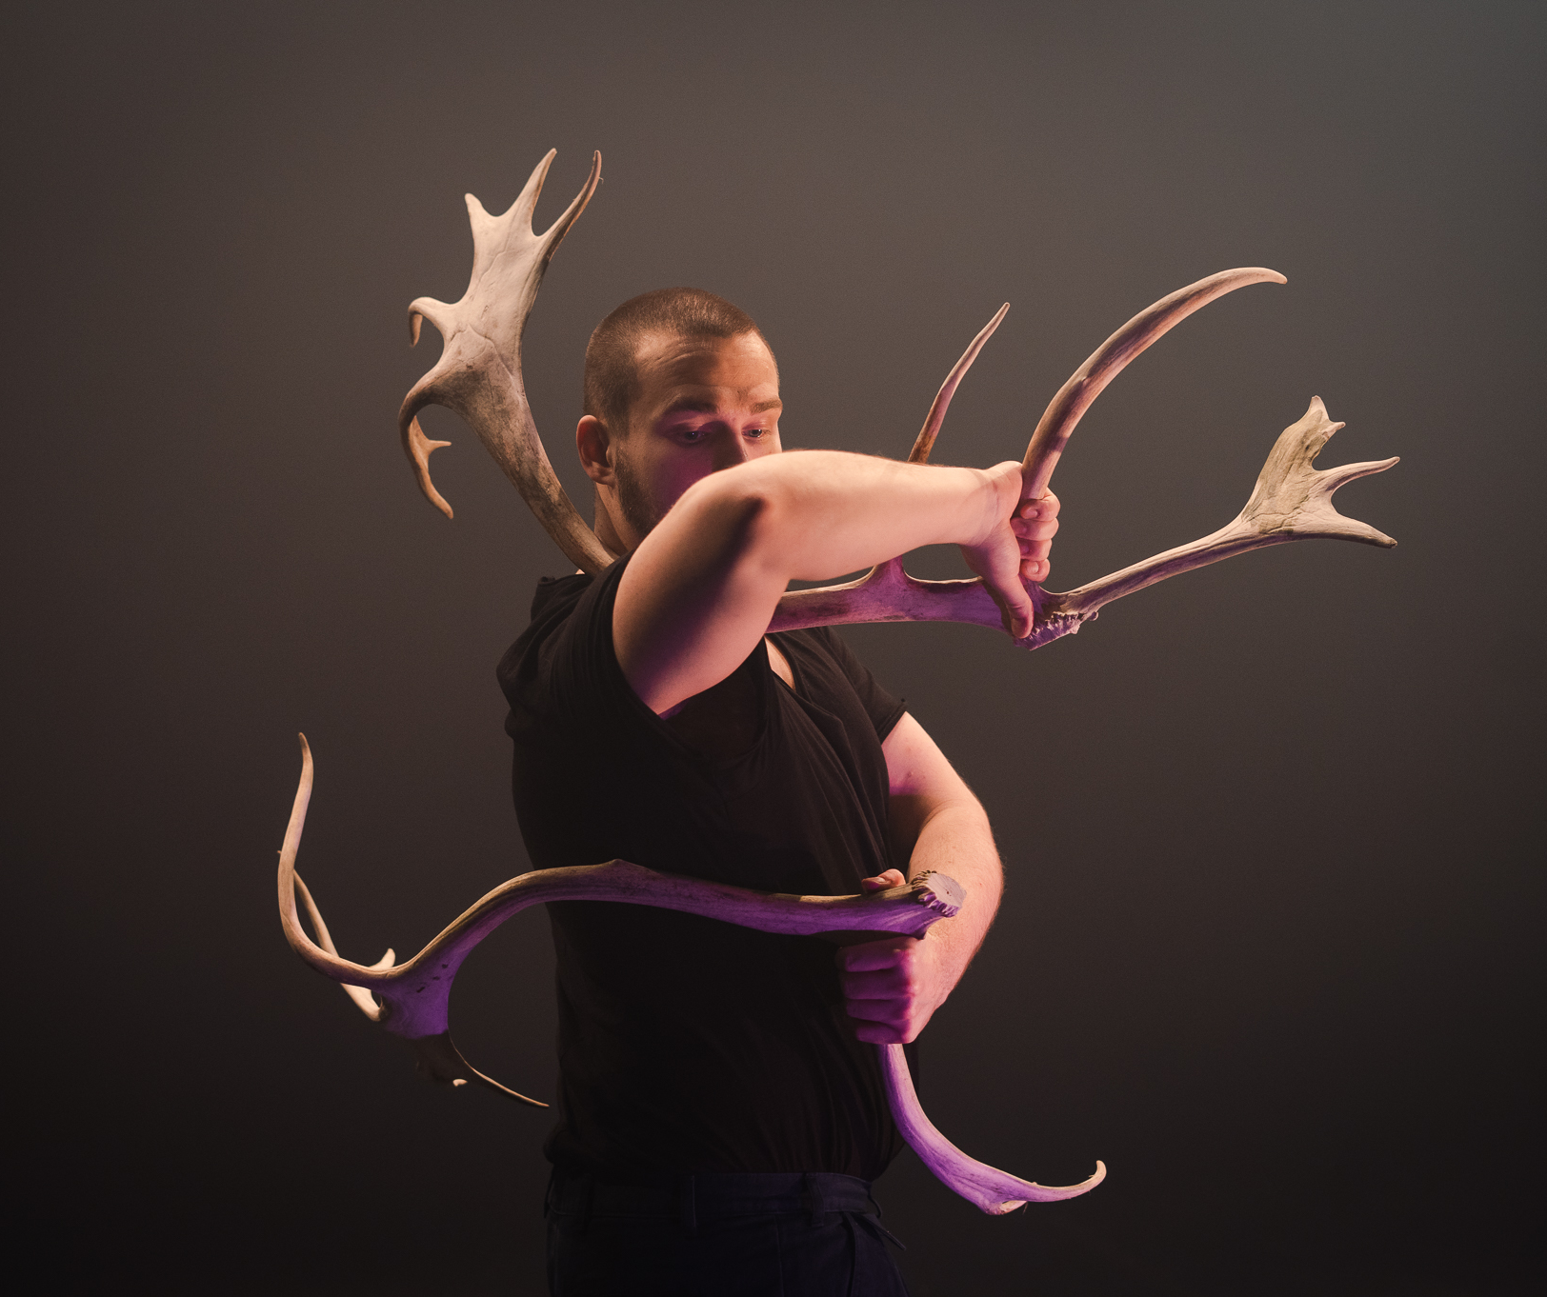
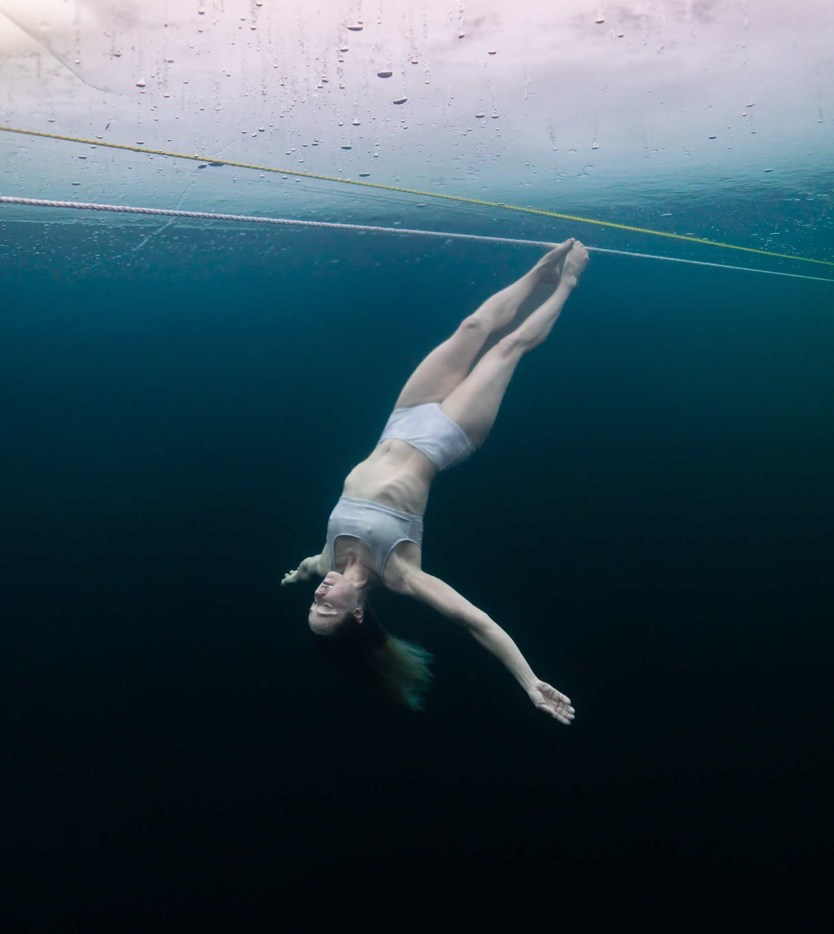
Nature plays a role in Finnish circus.
SEVEN PEEKS AT FINNISH CIRCUS
1
2
3
4
5
6
7
Things are
getting wild
In Finnish circus, nature often is a part of the performance – and sometimes the performance itself becomes part of the surrounding nature!
Juggler Sakari Männistö, 2007.
Photo: Joonas Martikainen
Juggler Aleksi Niittyvuopio / Discoporo collective, 2022.
Photo: Laura Manninen
Blind Gut Company / Tuomas Vuorinen: Maannos, 2022.
Photo: Rauli Katajavuori
Underwater Aerialist Salla Hakanpää, 2024.
Photo: Tommi Pasanen
Notes:
Finland’s natural environment deeply influences its circus. The vast landscapes, long horizons and silence of sparsely populated areas offer a powerful contrast to urban chaos – and space for slow, intuitive artistic processes. The strong seasonal shifts, from dark winter to endless summer light, influence both the content and rhythm of artistic work.
Circus performances in Finland often take place in nature or are inspired by it – not only visually but also in terms of atmosphere and philosophy. Nature is not just a backdrop but a collaborator: its unpredictability, raw beauty and stillness become part of the work.
The Silence Festival, a small circus and music festival held in a village in Lapland, is one example of how deeply this connection runs. Removed from the buzz of urban centres, Finnish and international artists in remote areas are free to work without the expectations of mainstream trends. This distance gives space for personal expression, experimentation and originality – elements that are central to the identity of Finnish circus.

Slide 14
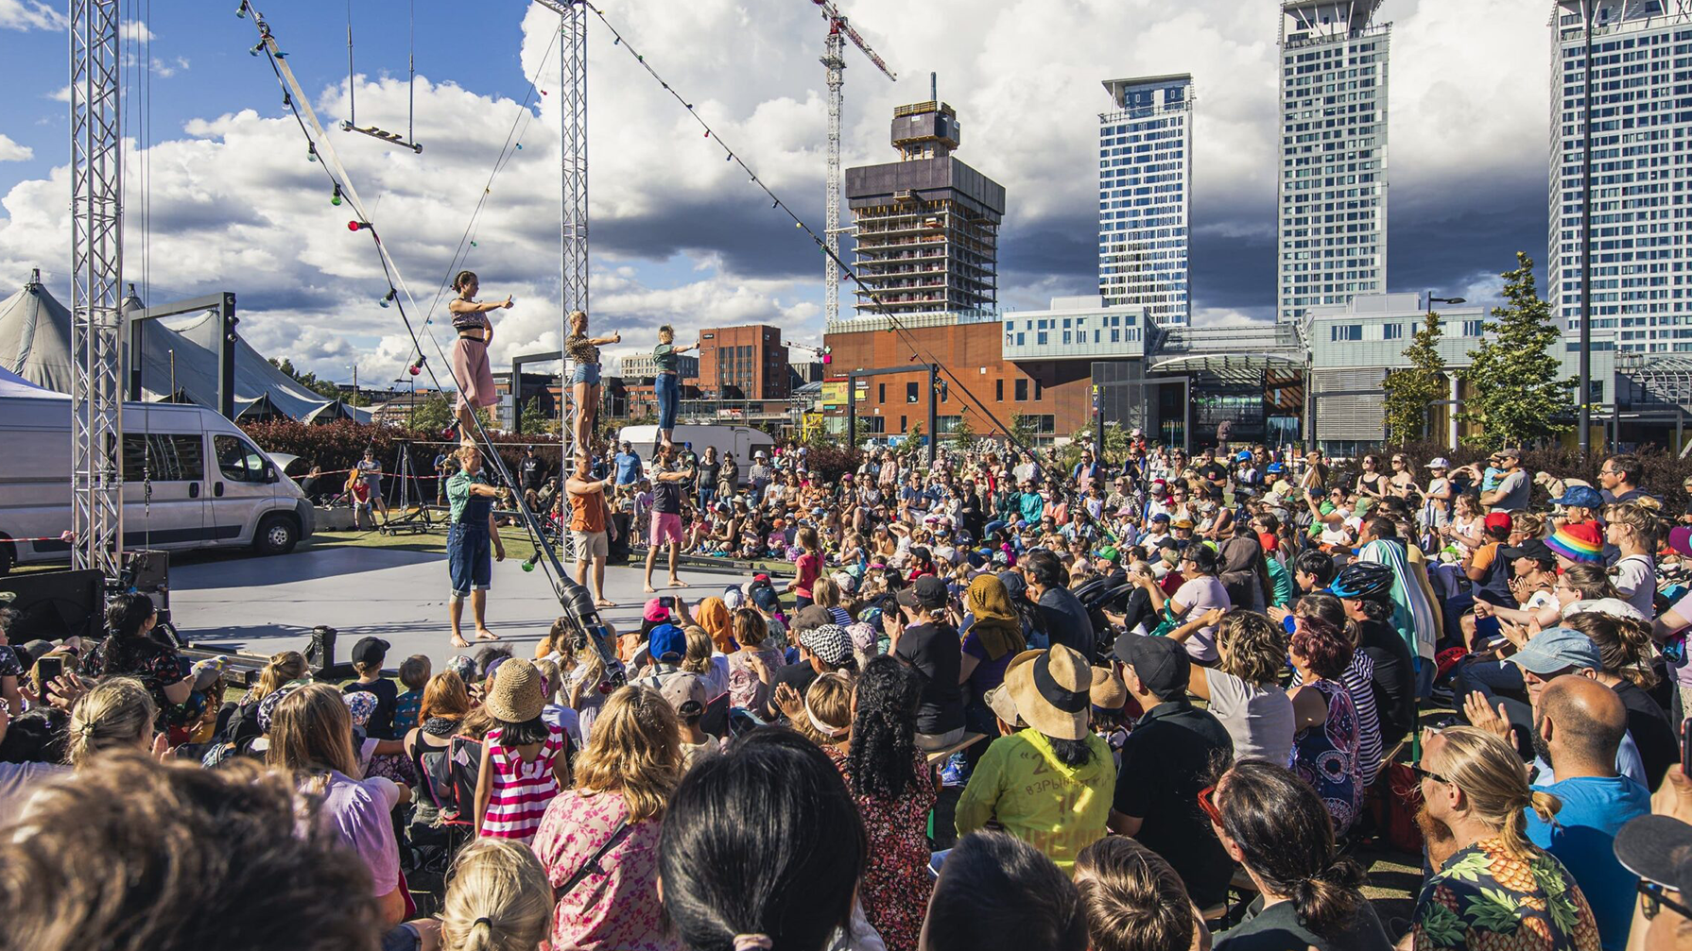
7/7
The final act
Arctic Ensemble: Kick Start, 2020–2024.
Photo: Mikko Pirinen
Notes:
Circus is officially recognised and supported as an art form in Finland. Since 2009, companies have been eligible for public funding through the state, and circus artists can apply for grants like artists in other fields. Circus has also been included in Finland’s national list of intangible cultural heritage – a strong signal of its cultural value.
More than 30 professional contemporary circus companies operate in Finland today. Cirko – Center for New Circus, based in Helsinki, is a key artistic hub for contemporary circus in Finland. Among the most prominent are also the visual and physical theatre WHS, Circo Aereo, Arctic Ensemble, Flow Circus in Oulu and Hurjaruuth. Many Finnish artists have also trained abroad – in France, Belgium, Sweden or Canada – and later formed companies with their international peers in Europe and Scandinavia.
Finland’s circus ecosystem is actively supported by Circus & Dance Info Finland, an expert organisation that promotes Finnish artists and companies both domestically and internationally. It collects statistics, publishes news and updates, advocates and participates in international networks. Despite its relatively small scale, the Finnish circus field is vibrant, well-organised and deeply connected to the world.

Slide 15
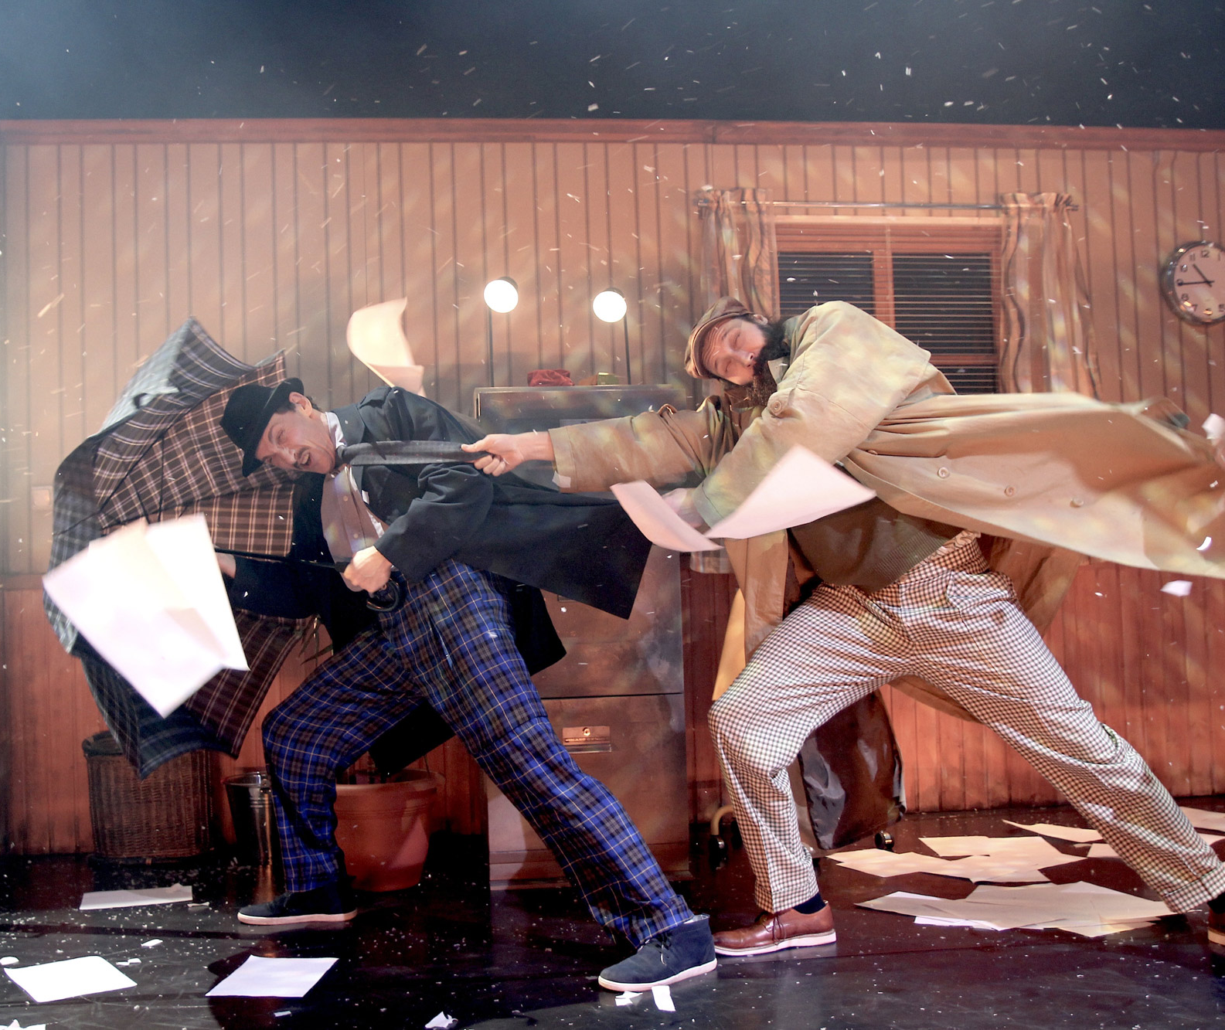
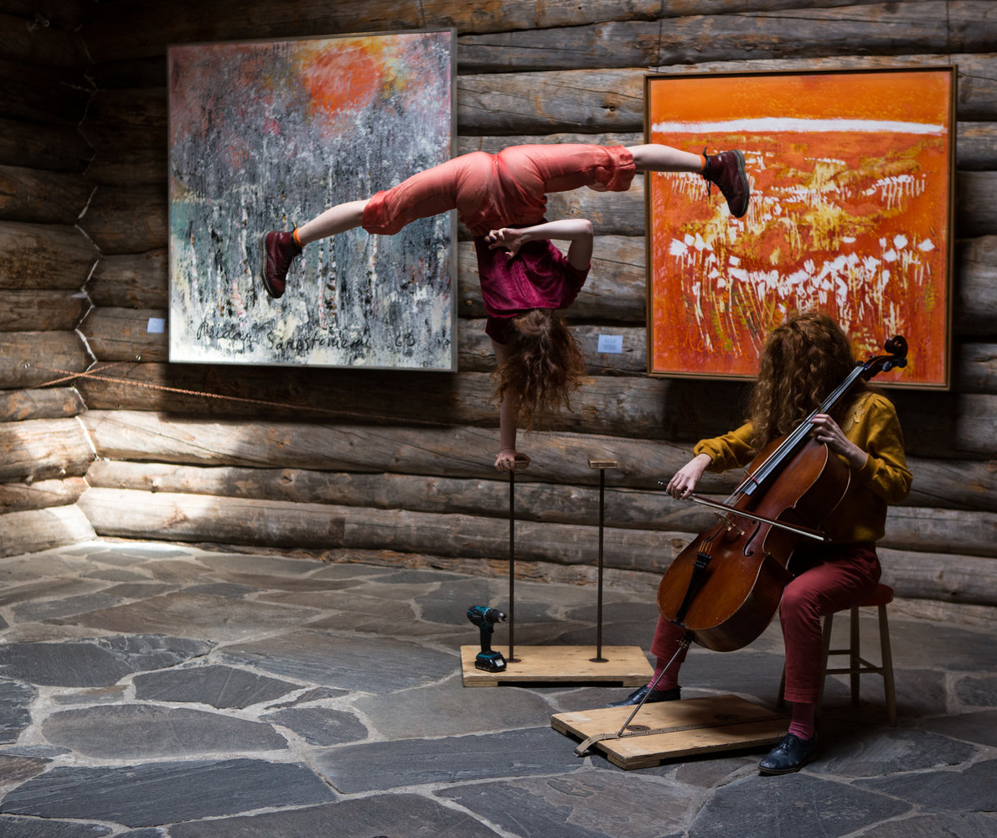
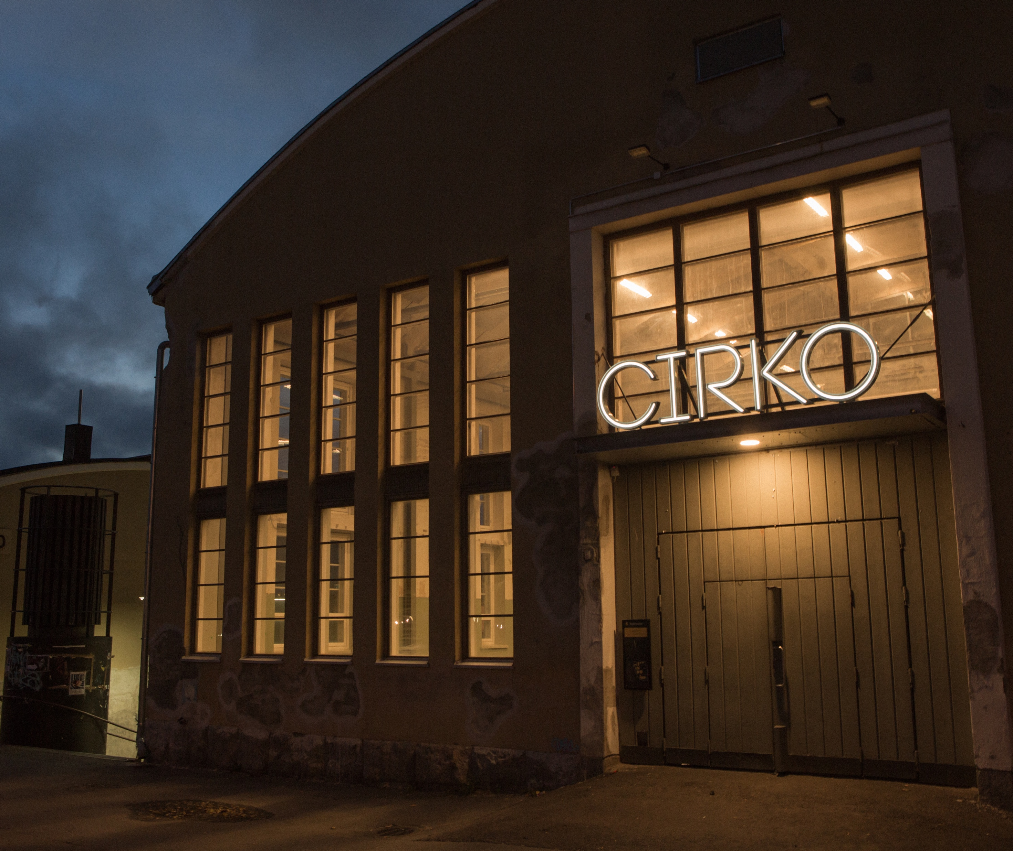
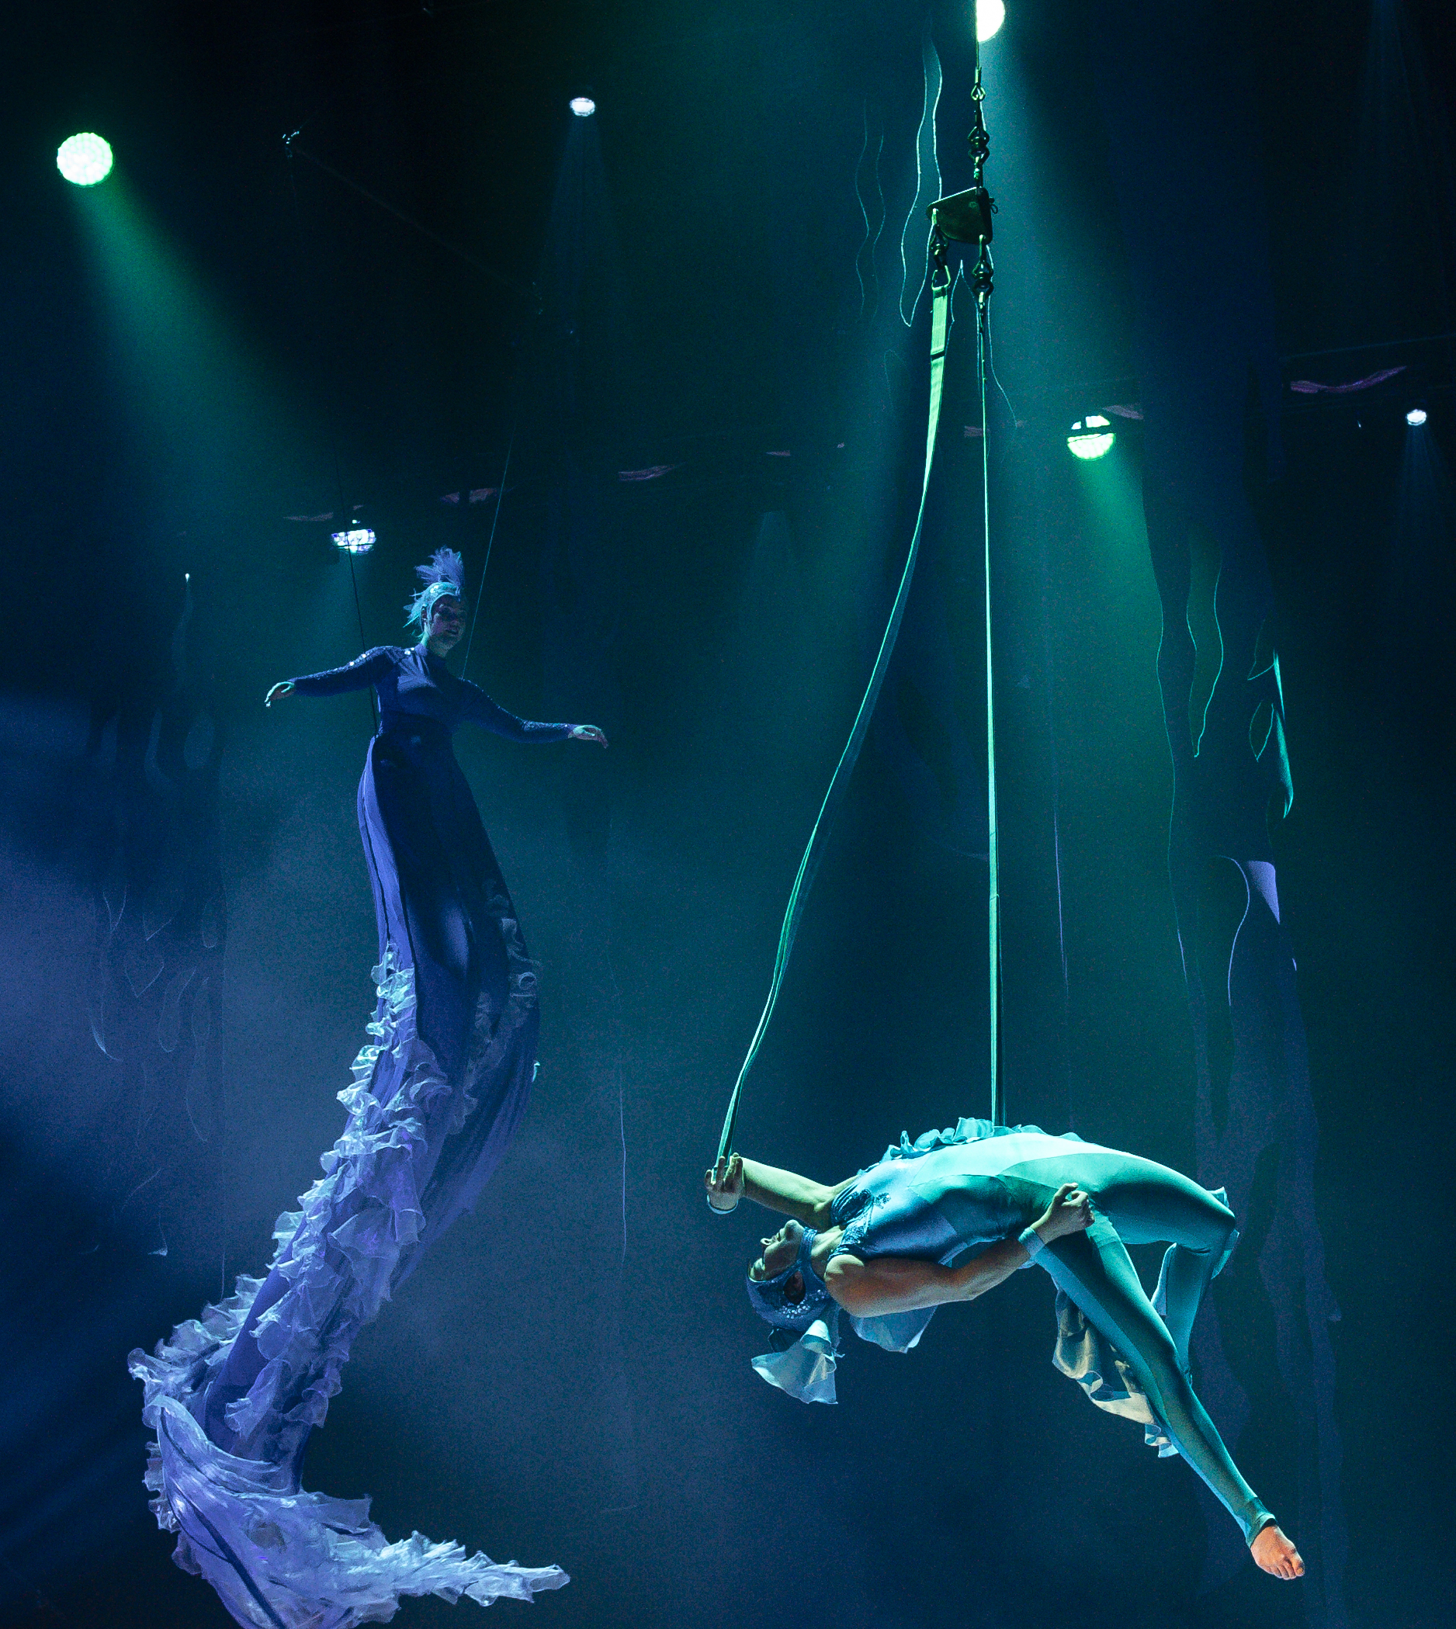
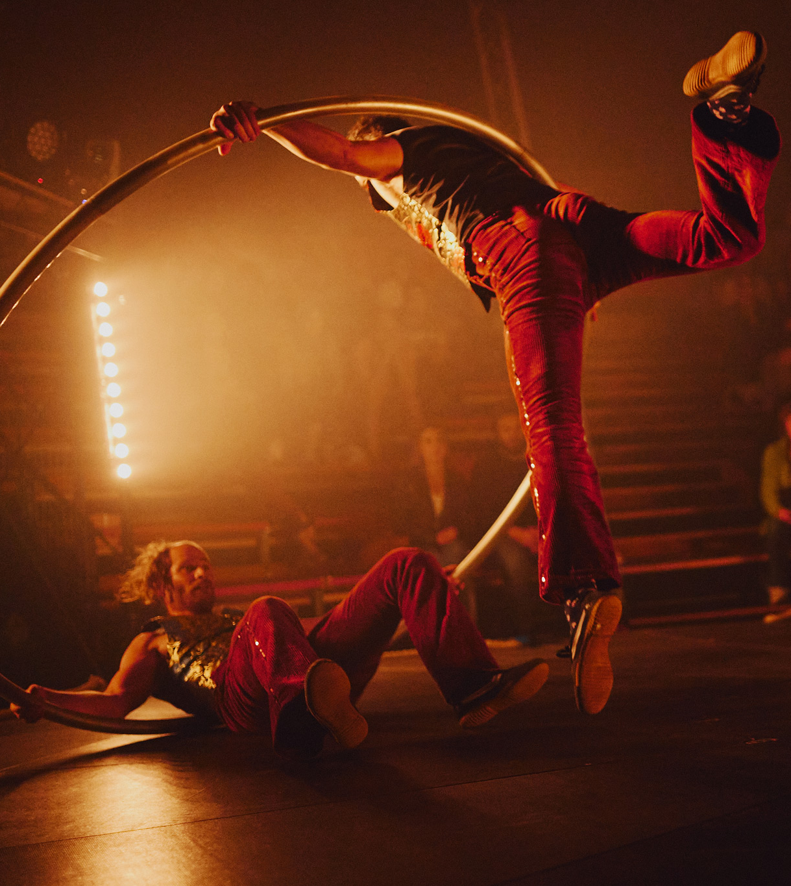
The final act
SEVEN PEEKS AT FINNISH CIRCUS
1
2
3
4
5
6
7
In Finland, circus receives public funding.
We are also one of the very few countries where circus is included in the national inventory of intangible cultural heritage.
Circo Aereo & Race Horse Company: Detectives, 2024.
Photo: Juho Rahijärvi
Cirko – Center for New Circus in Helsinki.
Photo: Jouni Ihalainen.
Hiljaisuus Seasons of Silence / Imogen Huzel & Anni Elif Egecioglu, 2018.
Photo: Jouni Ihalainen
Dance Theatre Hurjaruuth: Winter Circus Fantasia, 2024.
Photo: Uupi Tirronen
Sirkus Aikamoinen & Circus I love you: I love You Two, 2023.
Photo: Minja Kaukoniemi
Notes:
Circus is officially recognised and supported as an art form in Finland. Since 2009, companies have been eligible for public funding through the state, and circus artists can apply for grants like artists in other fields. Circus has also been included in Finland’s national list of intangible cultural heritage – a strong signal of its cultural value.
More than 30 professional contemporary circus companies operate in Finland today. Cirko – Center for New Circus, based in Helsinki, is a key artistic hub for contemporary circus in Finland. Among the most prominent are also the visual and physical theatre WHS, Circo Aereo, Arctic Ensemble, Flow Circus in Oulu and Hurjaruuth. Many Finnish artists have also trained abroad – in France, Belgium, Sweden or Canada – and later formed companies with their international peers in Europe and Scandinavia.
Finland’s circus ecosystem is actively supported by Circus & Dance Info Finland, an expert organisation that promotes Finnish artists and companies both domestically and internationally. It collects statistics, publishes news and updates, advocates and participates in international networks. Despite its relatively small scale, the Finnish circus field is vibrant, well-organised and deeply connected to the world.

Slide 16
11/10
8/7
An extra skylight
with views to
common ground.
Encore

Slide 17
Encore
SEVEN PEEKS AT FINNISH CIRCUS
1
2
3
4
5
6
7
8
Any note
can be written here.
This is a place for
more detailed information. You can use this page to highlight connections between Finnish circus and your country, shared projects, or even interesting upcoming events.
Photo: xxx
Notes:
Tähän osioon voi koota vastaanottajan ja tilanteen mukaan personoitavia asioita, toki sirkuskulman huomioiden.

Slide 18
The show is over. Let’s create more magic together.

